Slide 1
Ion-beam implantation to simulate radiation damage in novel metallic systems for nuclear fusion applications
Particle Accelerator and Beams Conference 2024
S. F. Yeates¹, A. Gandy², C. Hofer³, R. Goodall¹
1 - The University of Sheffield
2 - UKAEA
3 - The University of Oxford

Slide 2
Contents
Challenges for fusion materials
Compositionally complex alloy design approach
Alloy characterisation
Implantation
Post-Implantation characterisation
Conclusions

Slide 3
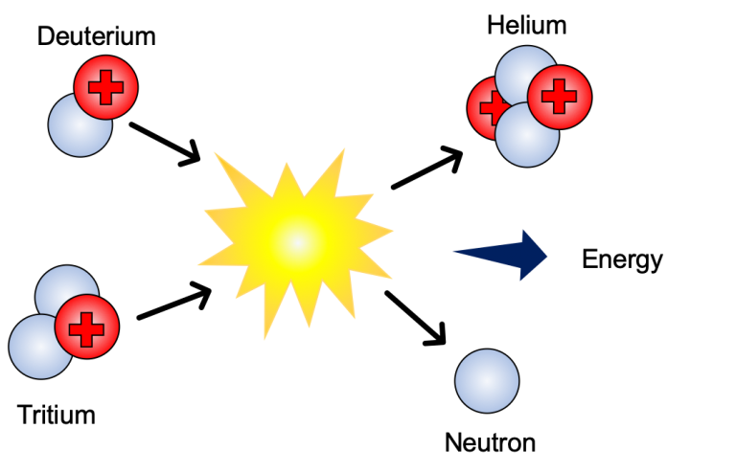
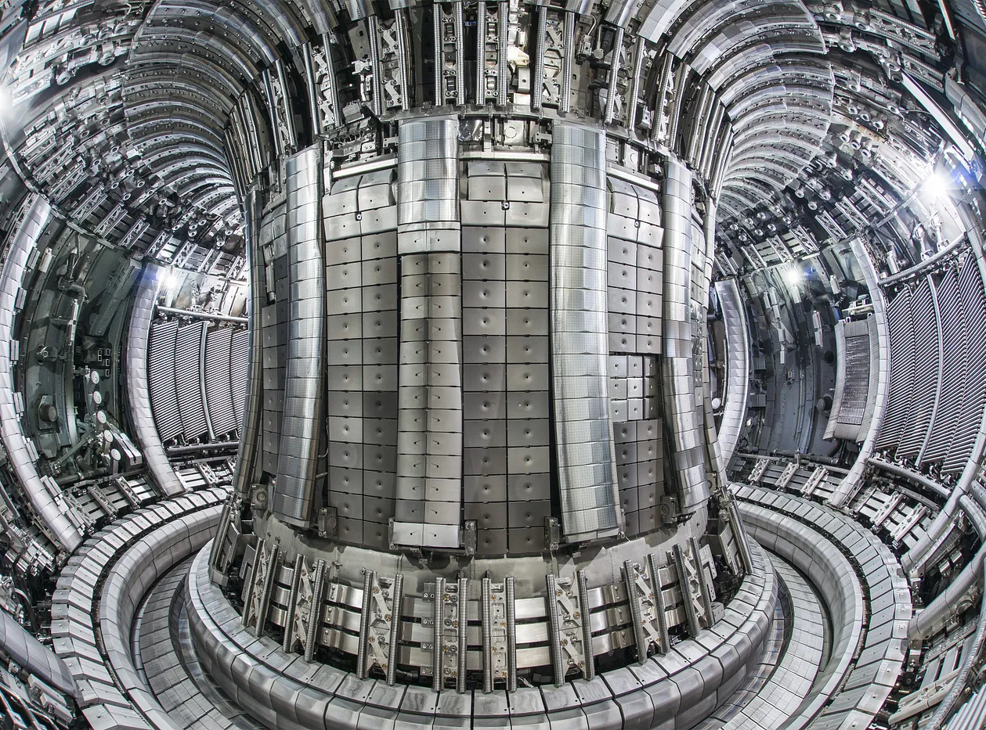

Fusion Plasma Facing Components
Deuterium-Tritium – From – Pegasus-III
Joint European Tokamak– From - UKAEA
Operating Conditions
  High 14.1 MeV neutrons
    Ballistic damage
    Transmutation products
  High temperatures
  Thermal cycling & fatigue
  Plasma erosion
  Tritium absorption
Material Shopping List
  High melting temperature
  Phase stability
  Irradiation damage resistance
  Minimal production of long-lived radioactive waste
From - Energy Institute - Statistical Review of World Energy

Slide 4
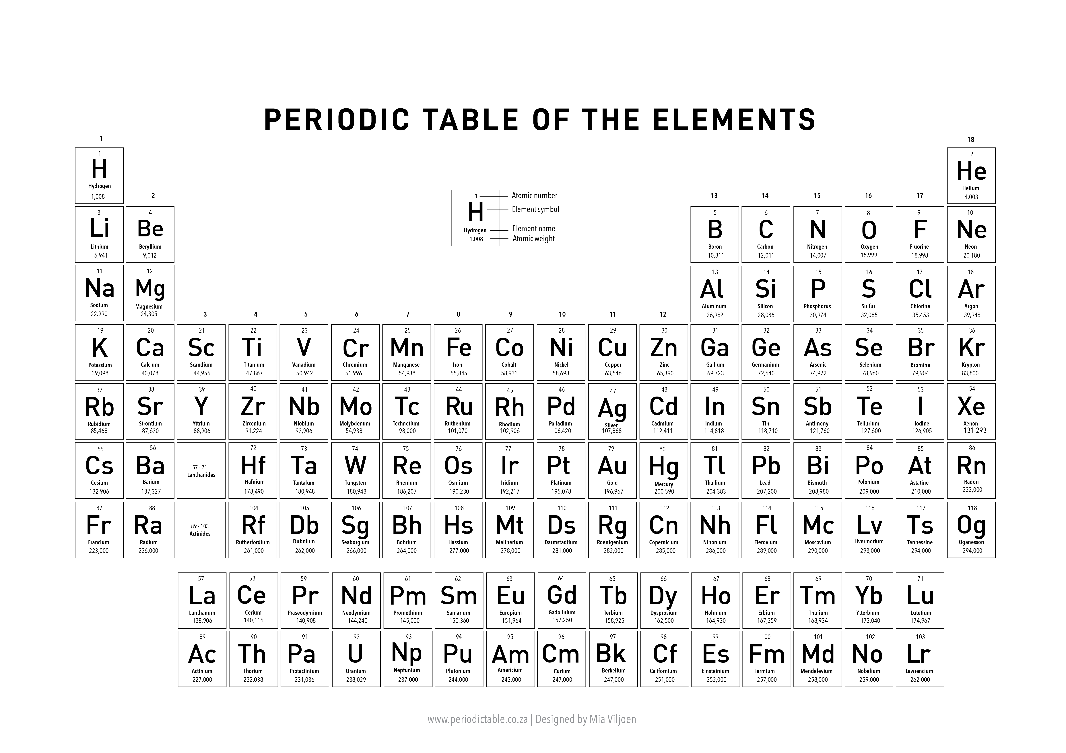
Compositionally Complex Alloy Design Approach

Slide 5
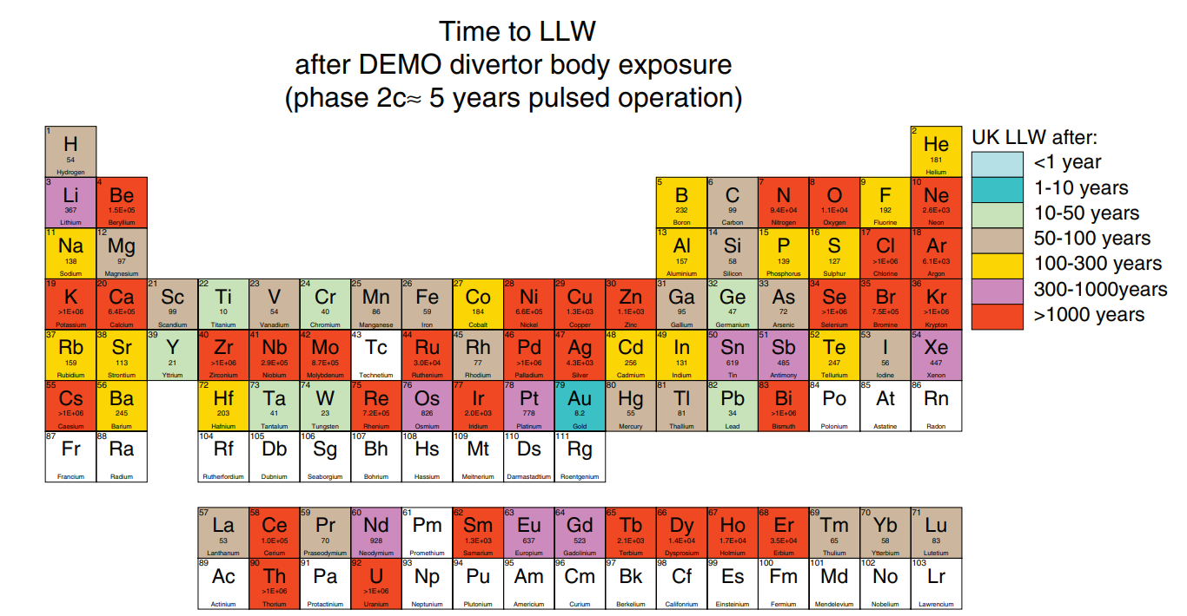
CCAs for Fusion
From - ”Waste implications from minor impurities in European DEMO materials”, Gilbert et al, 2019

Slide 6
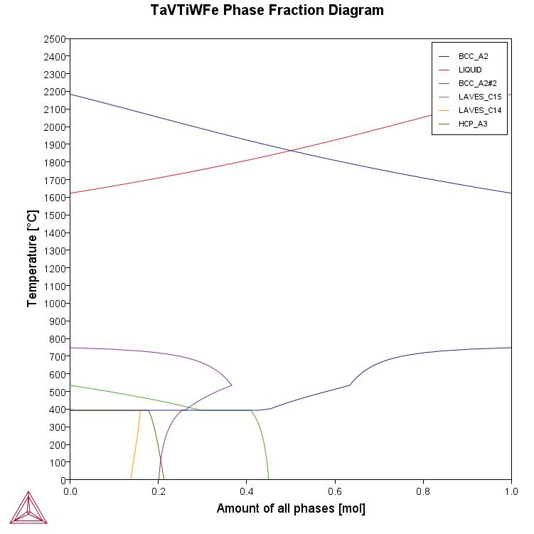
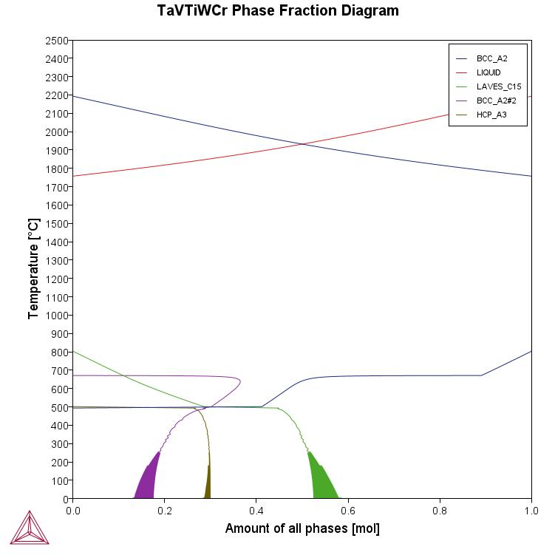
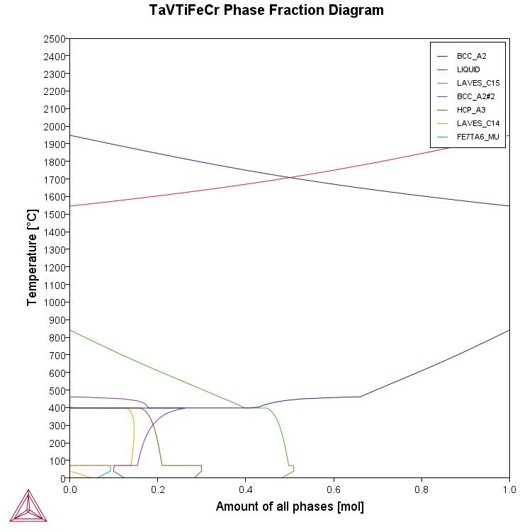
CCA Compositions
Ta₃₀V₃₀Ti₃₀W₅Fe₅
Ta₃₀V₃₀Ti₃₀W₅Cr₅
Ta₃₀V₃₀Ti₃₀Fe₅Cr₅

Slide 7
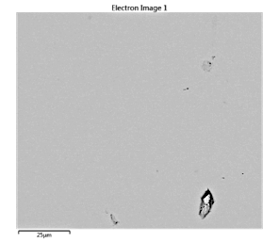
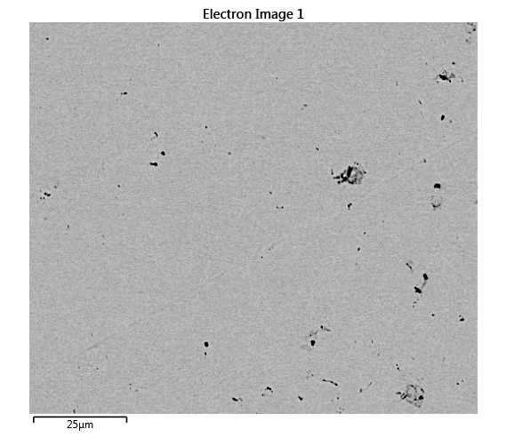
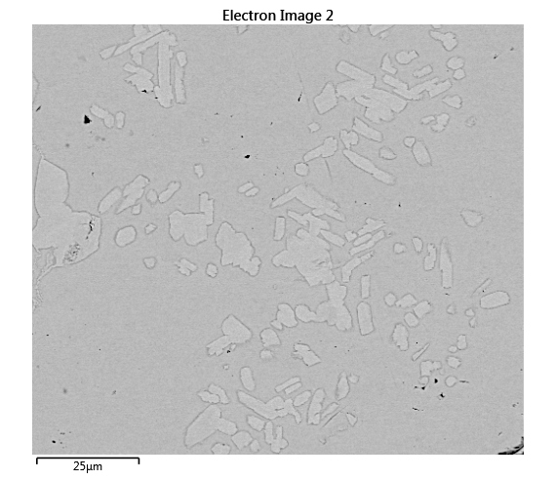
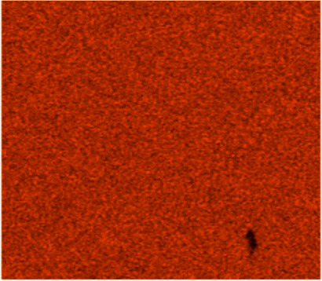
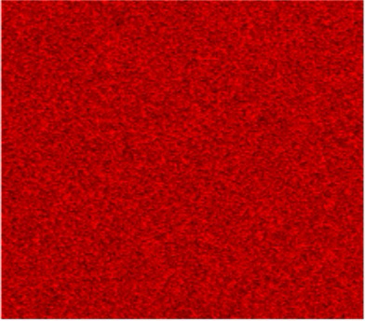
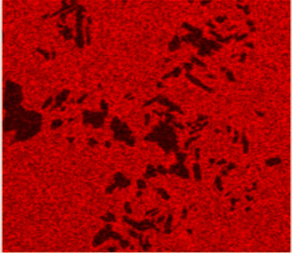
Homogenised Alloy Characterisation
Ta₃₀V₃₀Ti₃₀W₅Fe₅
Ta₃₀V₃₀Ti₃₀W₅Cr₅
Ta₃₀V₃₀Ti₃₀Fe₅Cr₅
Ti
Ti
Ti

Slide 8
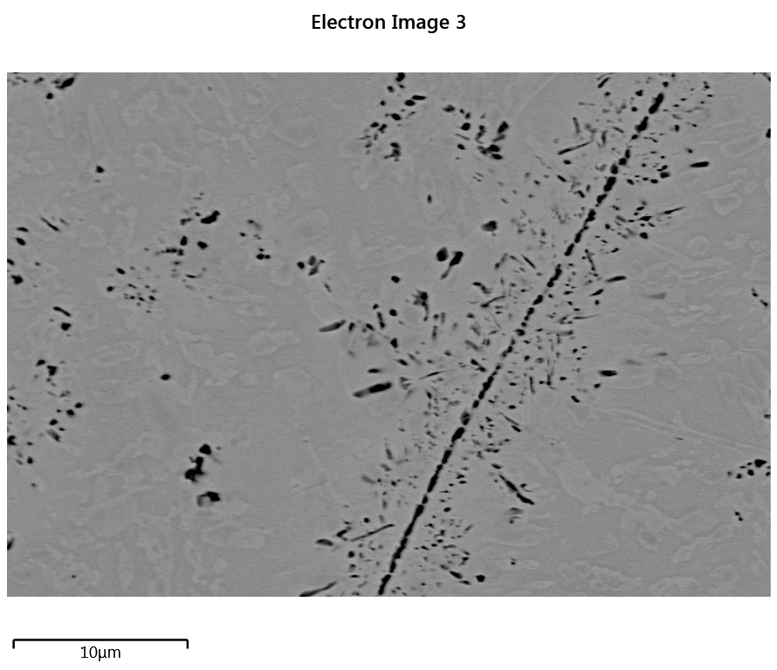
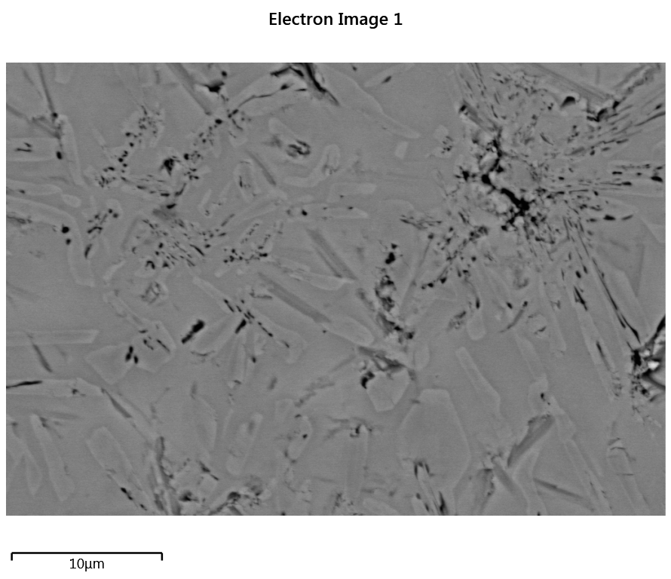
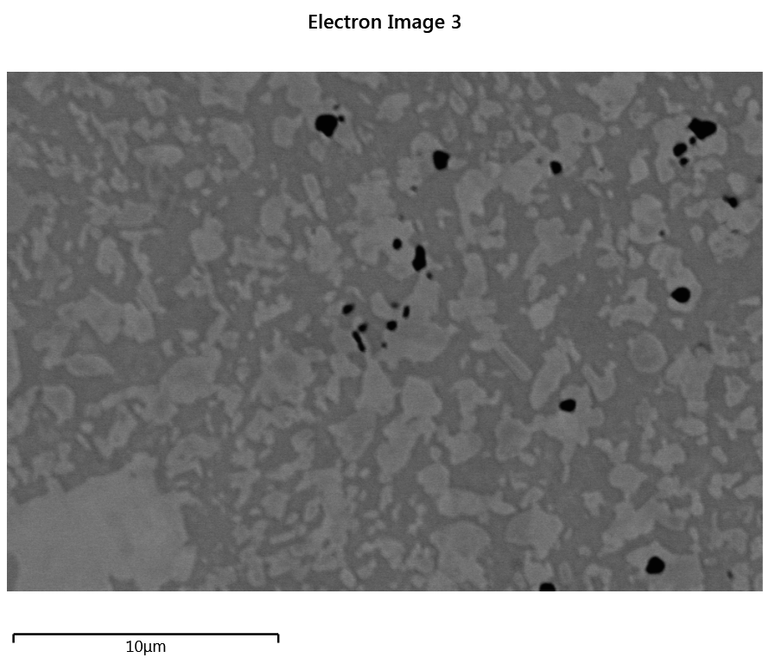
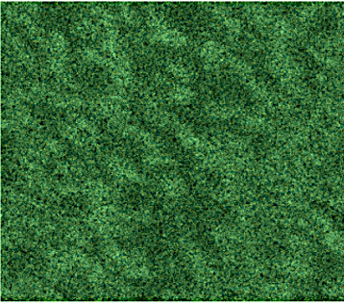
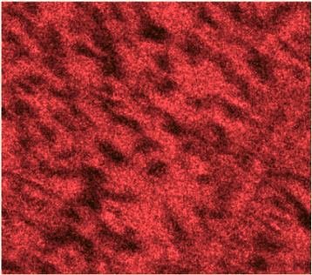
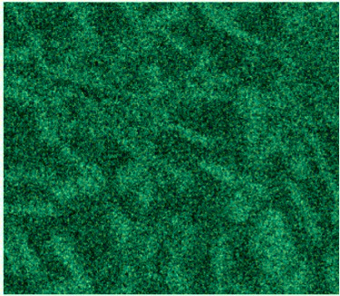
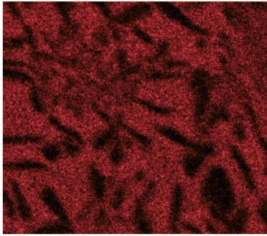
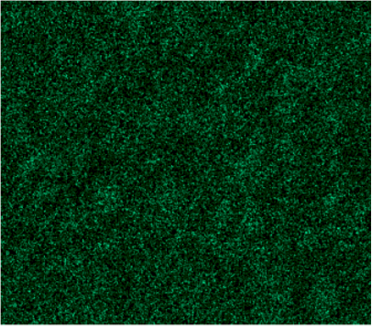
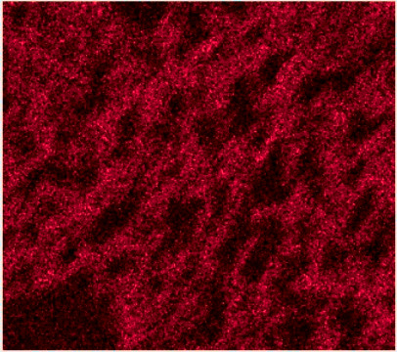
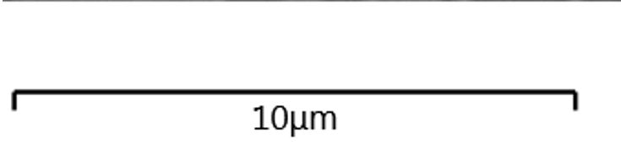
Aged Alloy Characterisation
Ta₃₀V₃₀Ti₃₀W₅Fe₅
Ta₃₀V₃₀Ti₃₀W₅Cr₅
Ta₃₀V₃₀Ti₃₀Fe₅Cr₅
V
V
Ti
V
Ti
V
Ti
V

Slide 9
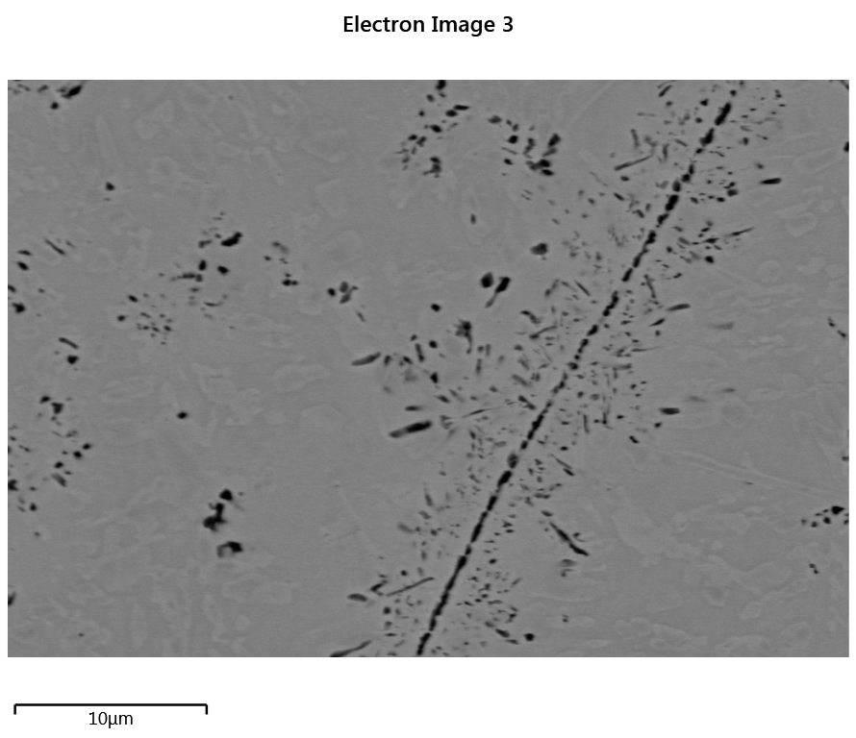
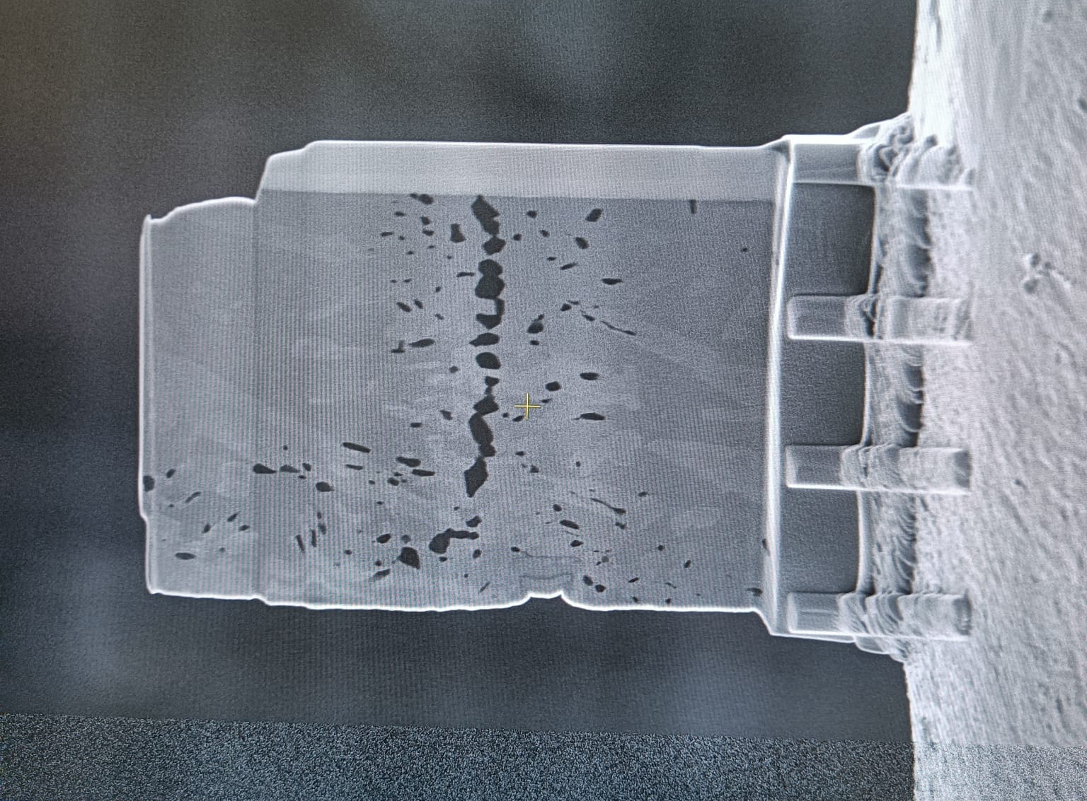
Aged Alloy Characterisation
C15 Laves
BCC A2
Ti-CON
Ta₃₀V₃₀Ti₃₀W₅Fe₅
FIB Lamellar of Ta₃₀V₃₀Ti₃₀W₅Fe₅
Ta₃₀V₃₀Ti₃₀W₅Cr₅

Slide 10
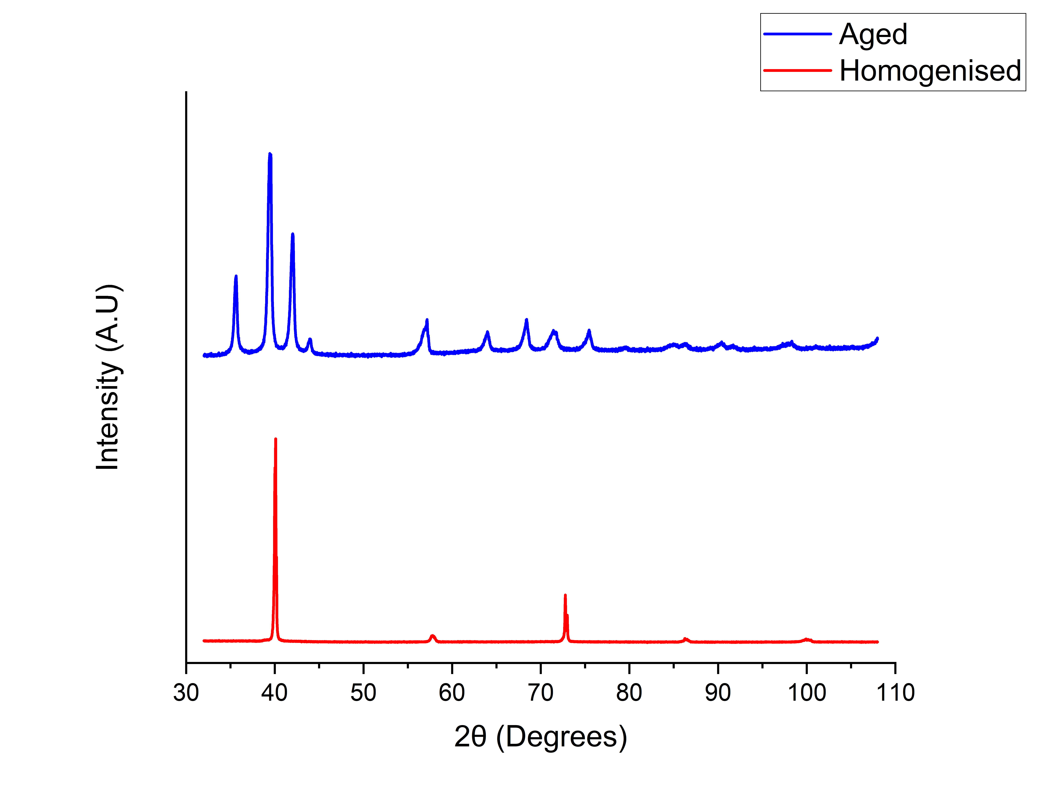
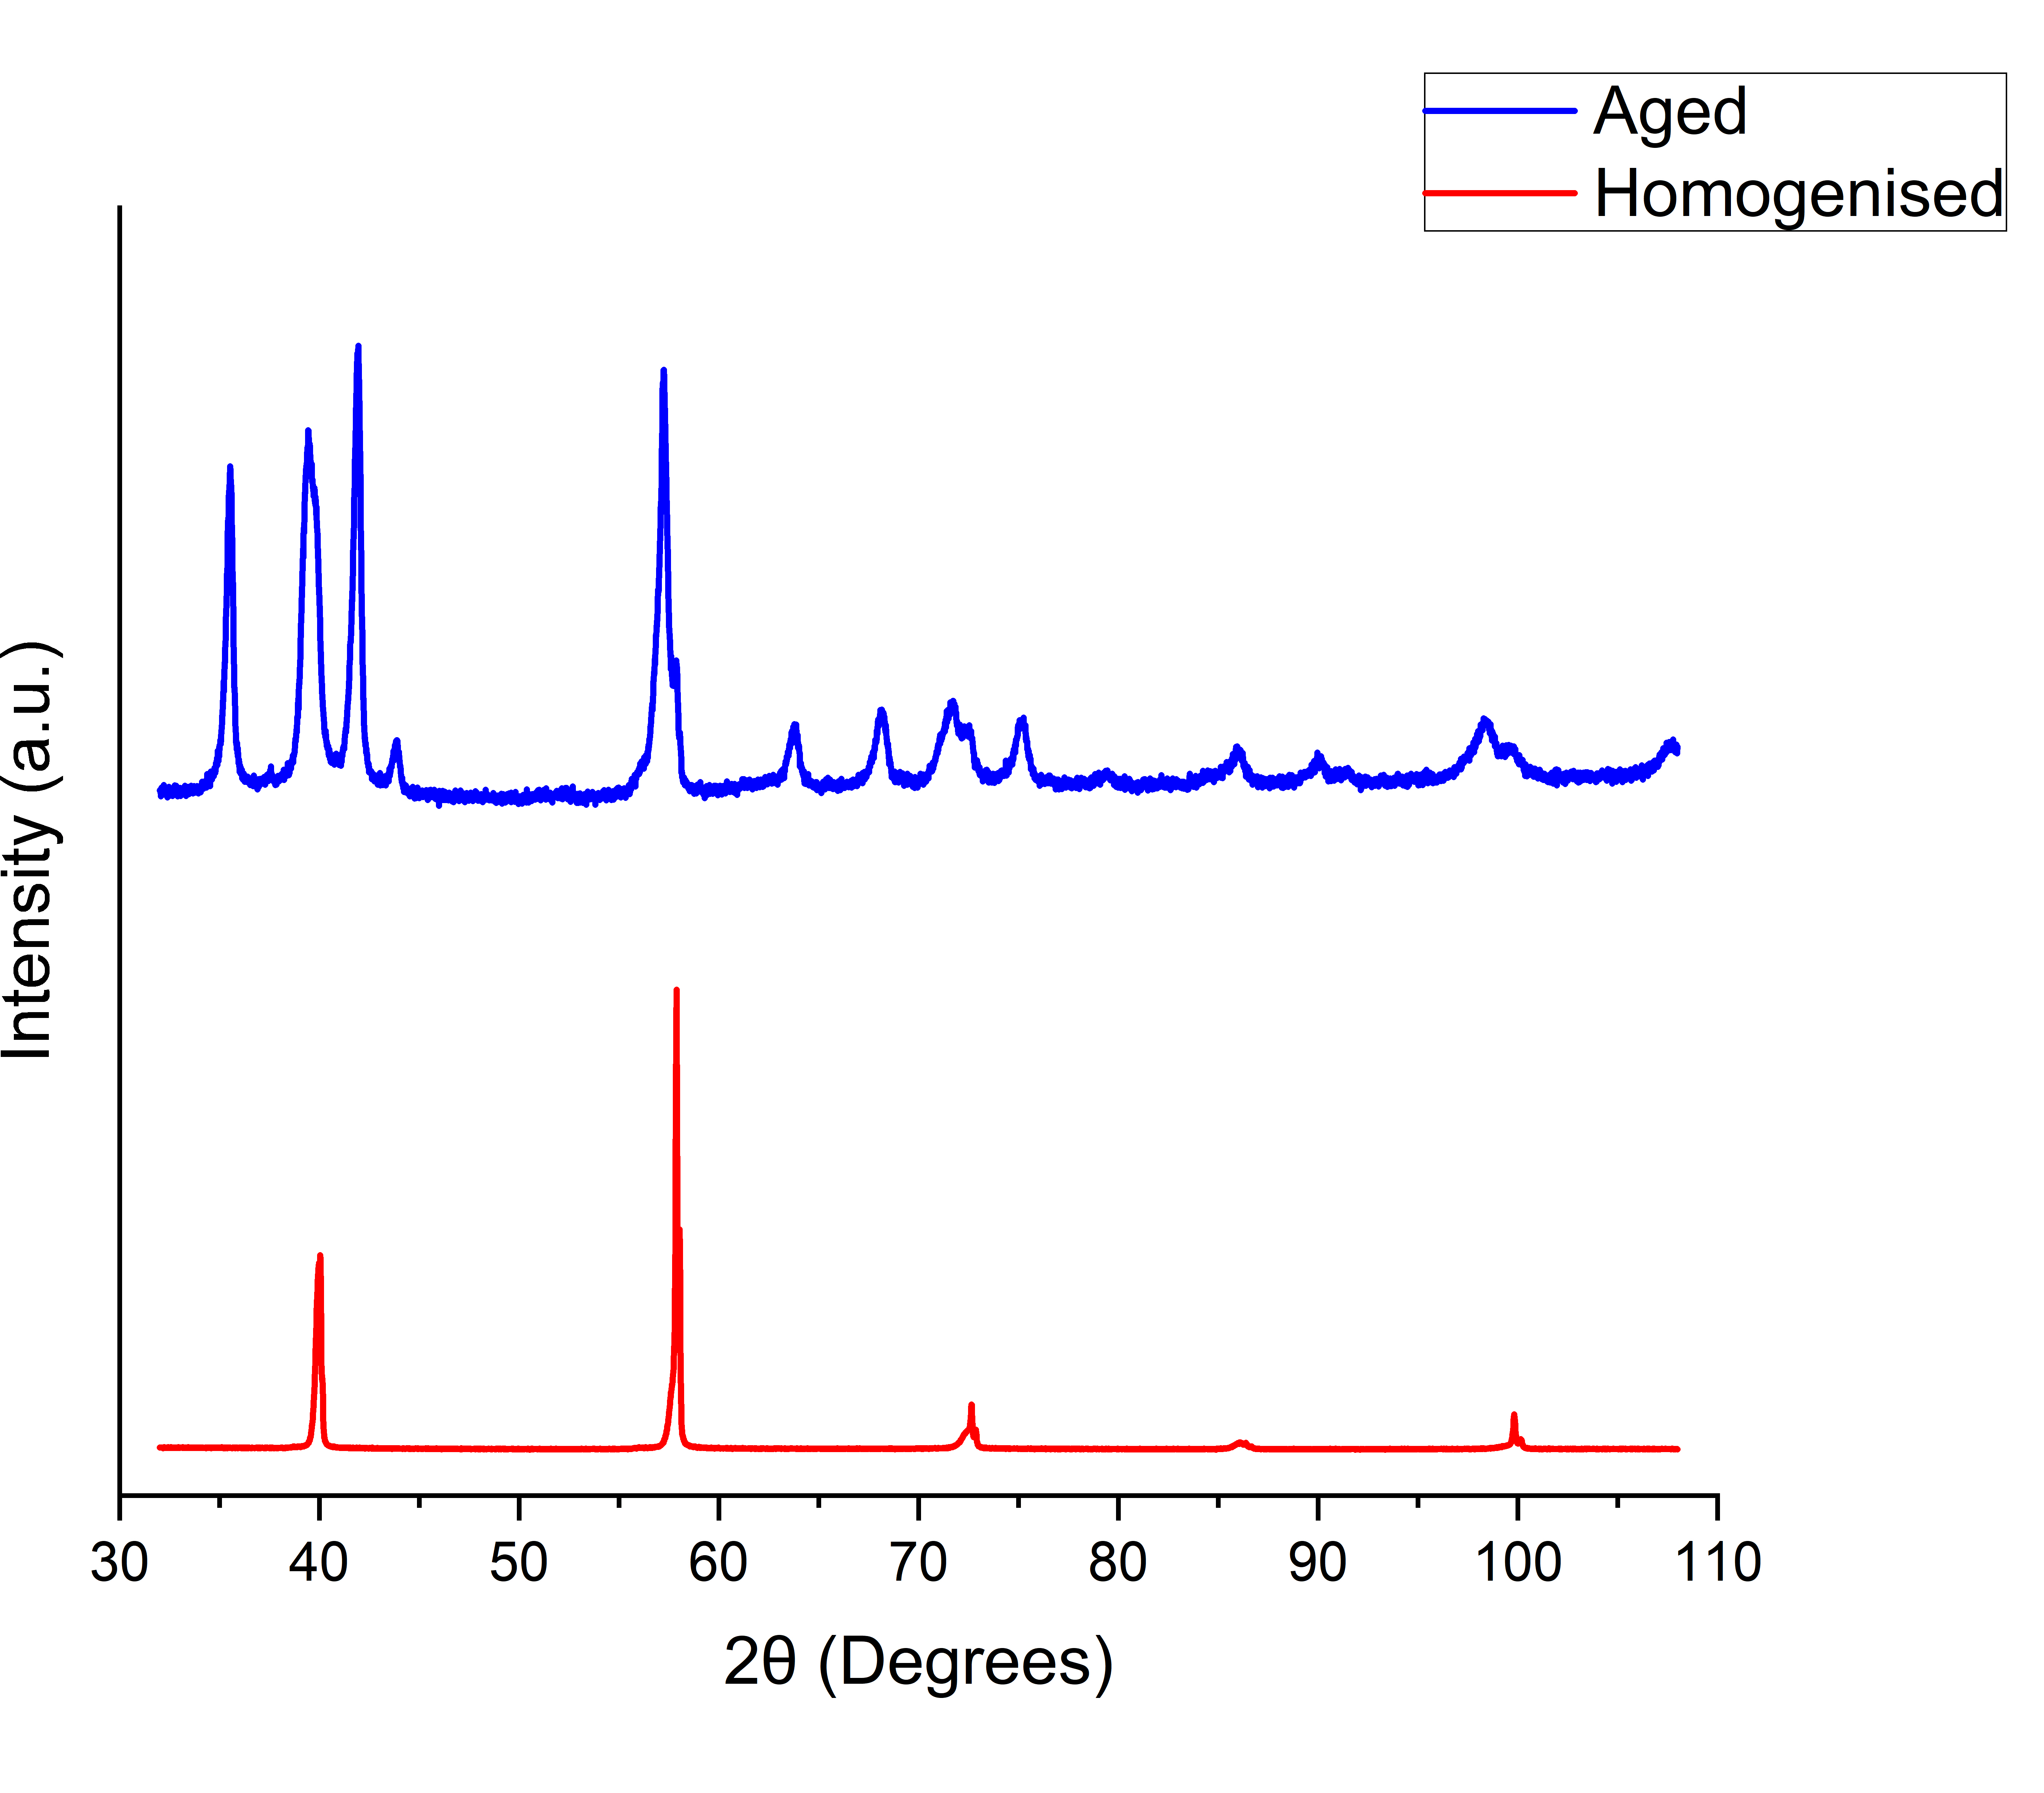
Alloy Characterisation
C15 Laves
C15 Laves
BCC
BCC
Ta₃₀V₃₀Ti₃₀W₅Fe₅ XRD Data
Ta₃₀V₃₀Ti₃₀W₅Cr₅ XRD Data

Slide 11
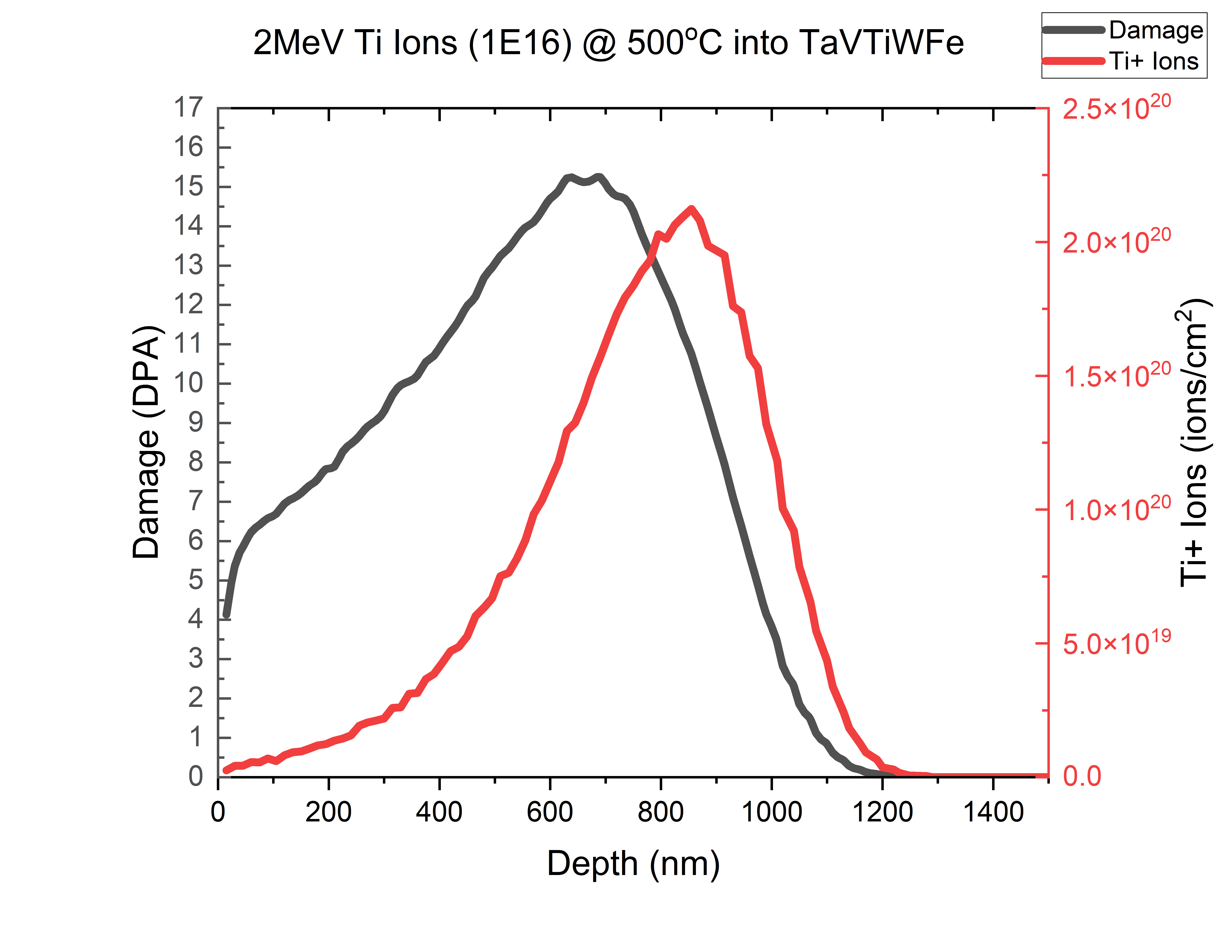
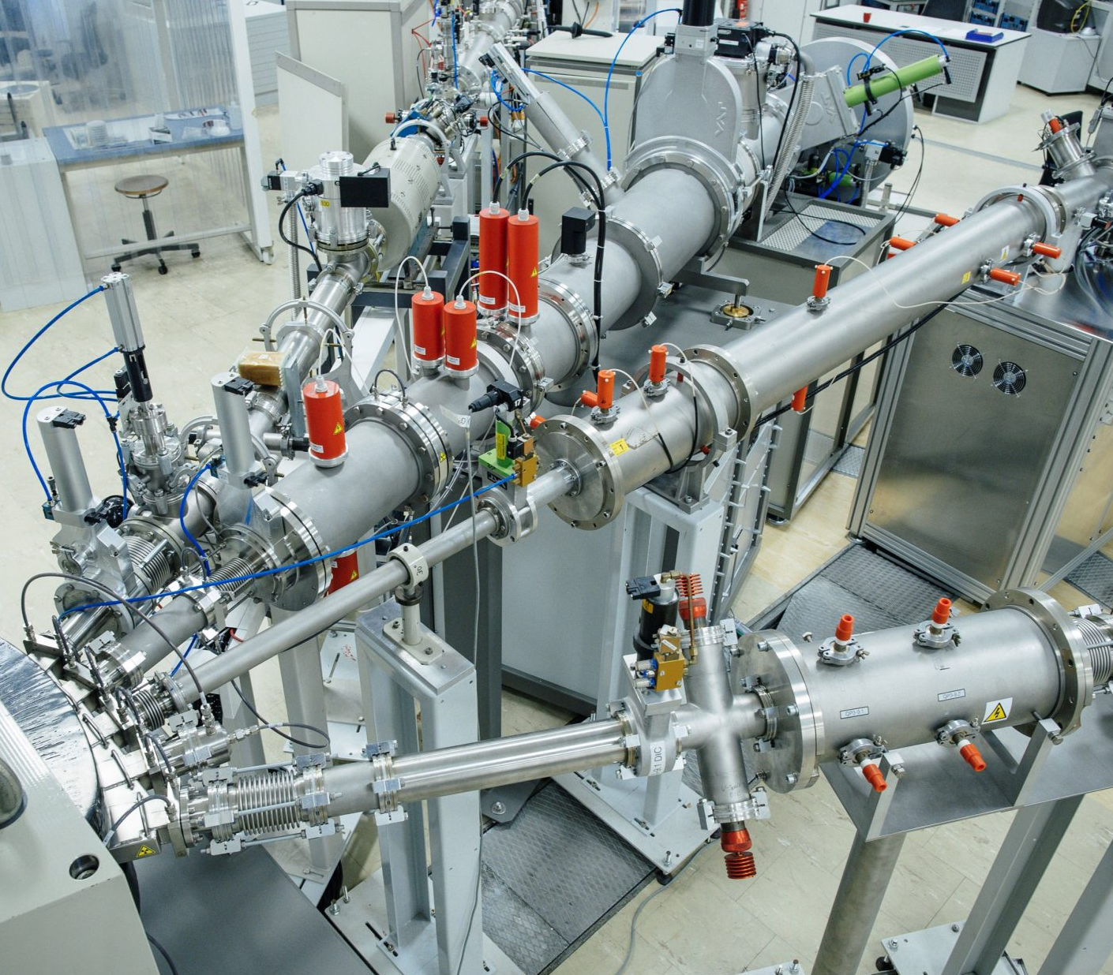
Ti Ion Implantation
Element | Displacement Energy /eV (ASTM E521 2016)
Ta | 90
V | 40
Ti | 30
W | 90
Fe | 40
Ta₃₀V₃₀Ti₃₀W₅Fe₅ | -WFe
Peak Damage/ dpa | 15.25
Mean Projected Range/ nm | 749
From - Helmholtz-Zentrum Dresden-Rossendorf e.V.

Slide 12
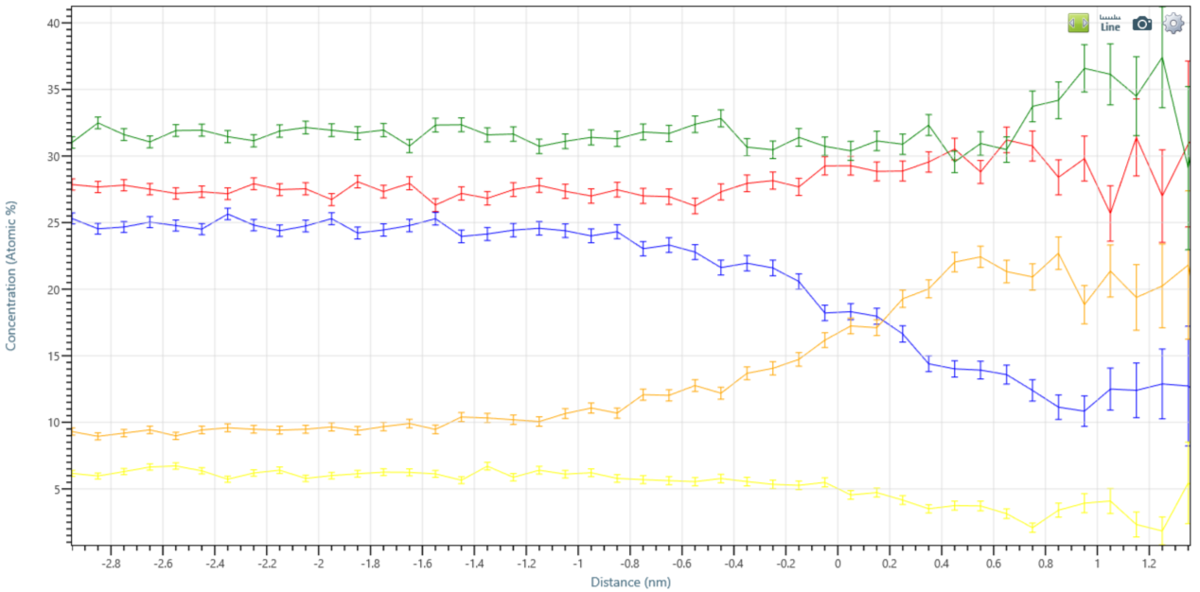
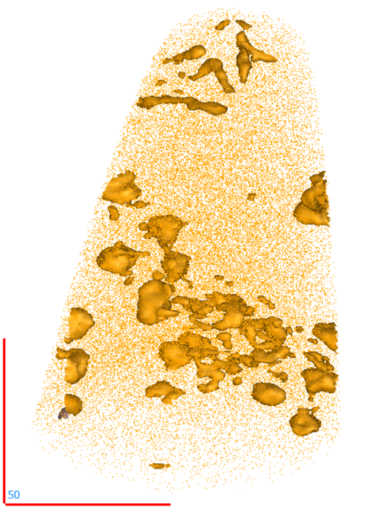
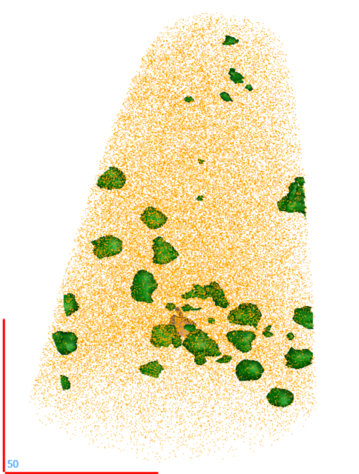
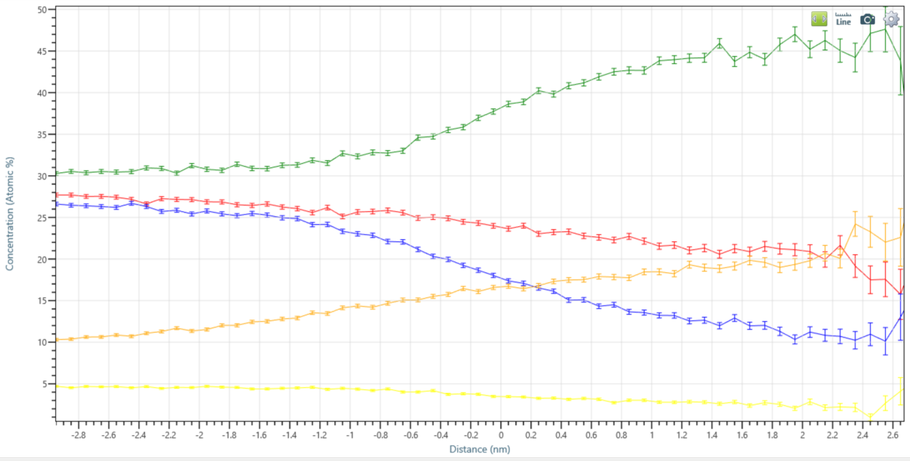
Homogenised Atom Probe Tomography
Ta
V
Ti
W
Fe
C
N
O
>15 at% Fe
>37 at% V
Dislocation lines
Linescan of dislocation line
Dislocation
loops
Implanted Homogenised Ta₃₀V₃₀Ti₃₀W₅Fe₅ - 660nm below surface
Linescan of dislocation loop
Notes:
C4_M21: 660 nm - 19.5 m

Slide 13
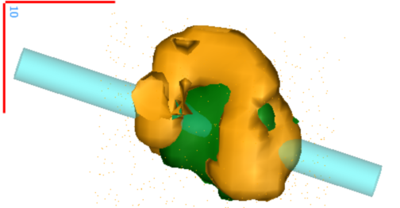
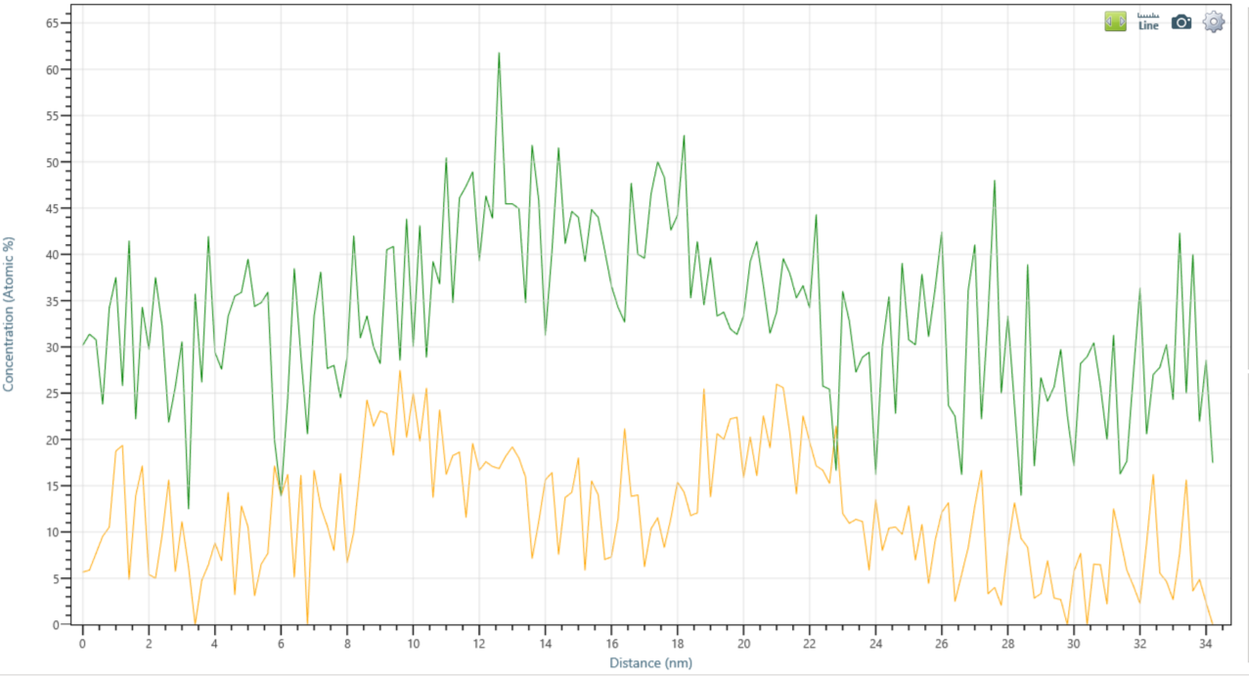
Homogenised Atom Probe Tomography
>15 at% Fe
>15 at% Fe
>37 at% V
>37 at% V
Dislocation lines
Isosurface of Fe/V cluster
V cluster
Dislocation
loops
Implanted Homogenised Ta₃₀V₃₀Ti₃₀W₅Fe₅ - 660nm below surface
Line scan of of Fe/V cluster
Notes:
C4_M21: 660 nm - 19.5 m

Slide 14
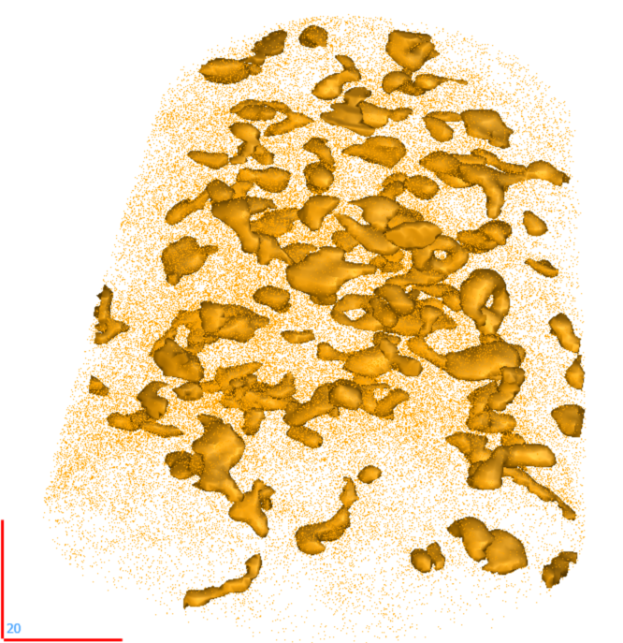
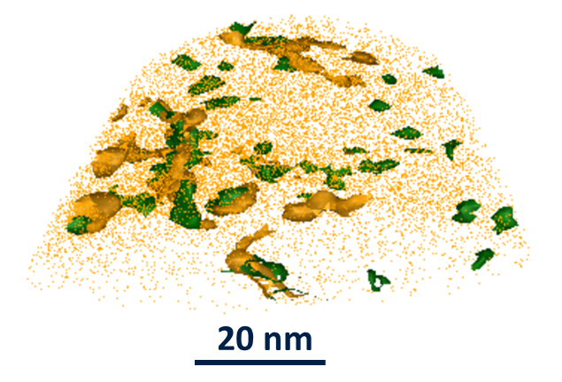
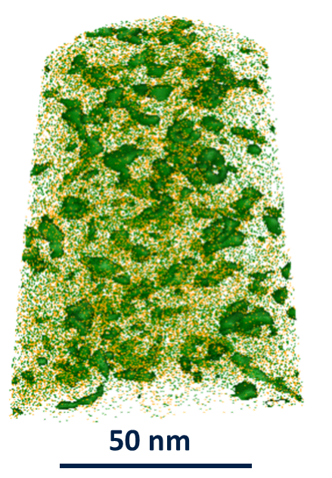
Aged Atom Probe Tomography
>33 at% Fe+V
C15 Laves – 650 nm
Matrix – 300 nm
Dislocation loops
>17 at% Fe
>33 at% V+Fe
>52 at% V
Implanted aged Ta₃₀V₃₀Ti₃₀W₅Fe₅
Dislocation lines
 | Matrix |  |  | C15 Laves
 | Bulk | Cluster | Increase | Bulk | Cluster | Increase
V | 19 at% | 49 at% | 105 % | 47 at% | 60 at% | 33 %
Fe | 2 at% | 5 at% | 150 % | 12 at% | 18 at% | 50 %
Implanted matrix phase of aged Ta₃₀V₃₀Ti₃₀W₅Fe₅ - 300 nm below surface

Slide 15
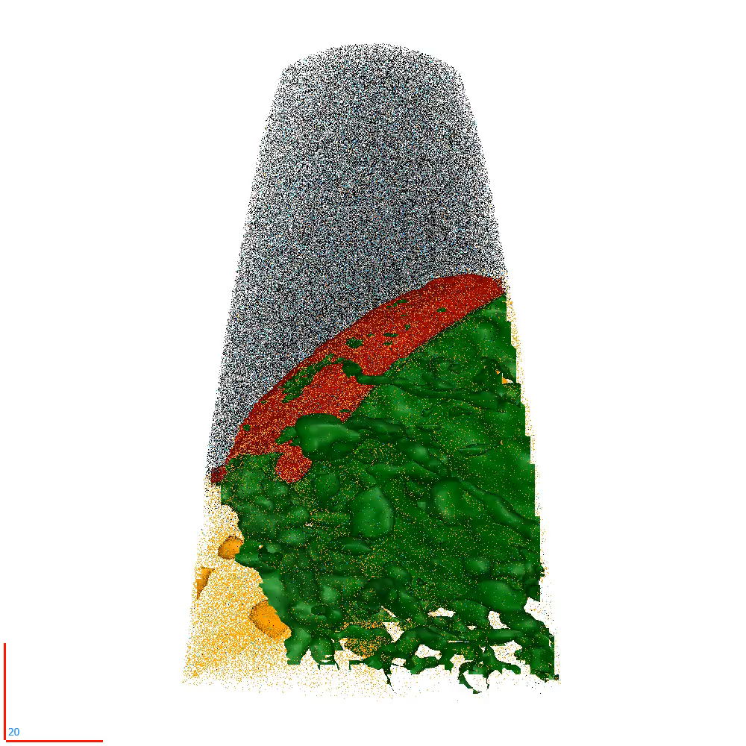
Multi-phase Boundaries
70 at% Ti+C+N+O
27 at% V
20 at% Fe
TiCON
Ti | 67.6 at%
N | 18.3 at%
C | 8.6 at%
O | 3.6 at%
C15 Laves Phase
Ta | 27.3 at%
V | 44.6 at%
Ti | 14.4 at%
W | 4.0 at%
Fe | 9.2 at%
Matrix | Concentration
Ta | 28.5 at%
V | 18.8 at%
Ti | 43.3 at%
W | 7.5 at%
Fe | 0.7 at%
Implanted aged Ta₃₀V₃₀Ti₃₀W₅Fe₅ - 210 nm below surface

Slide 16
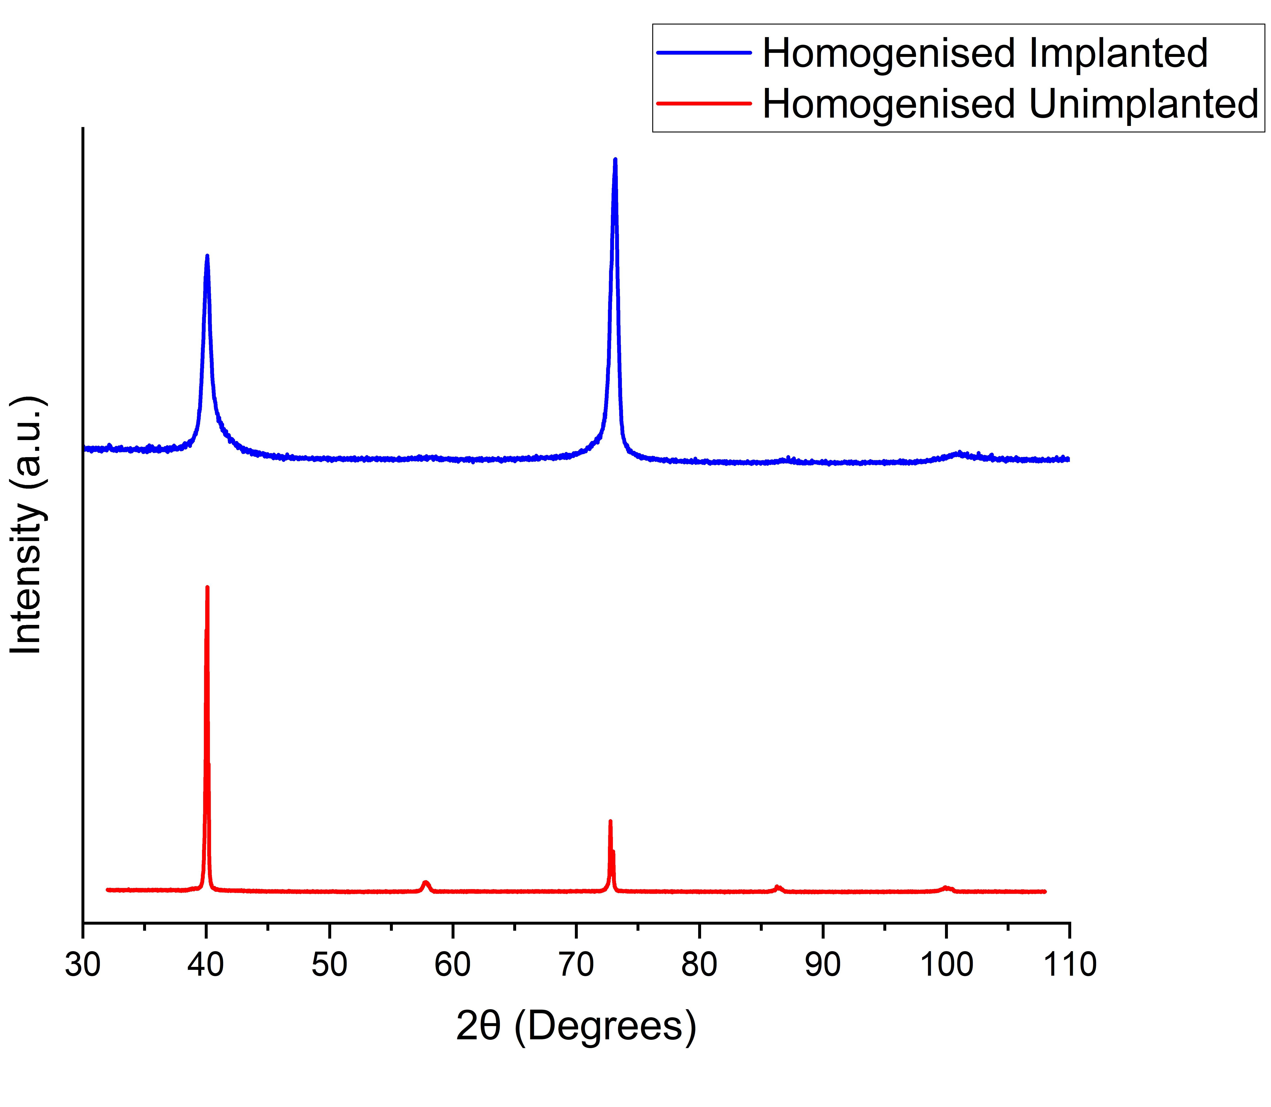
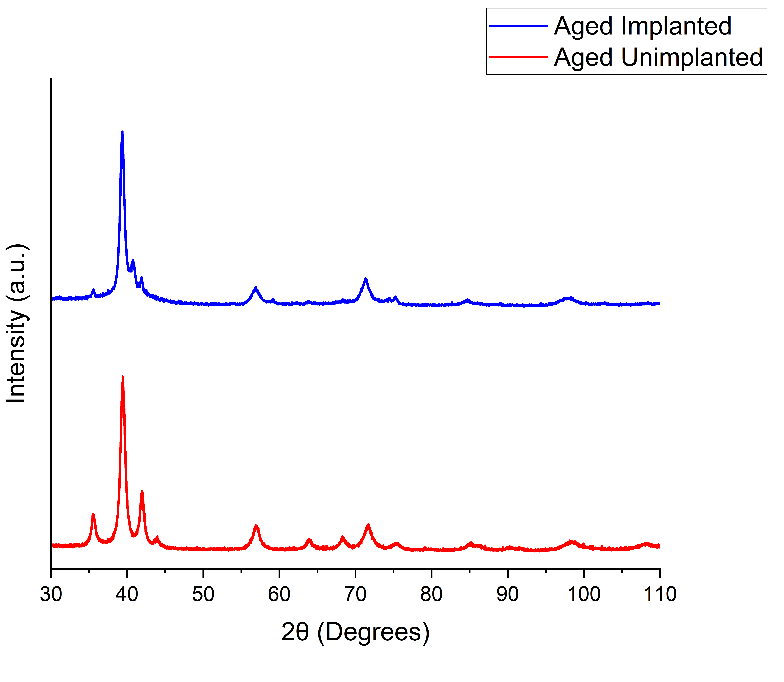
Phase Structure Changes
BCC
C15 Laves
BCC
GI-XRD Implanted Homogenised Ta₃₀V₃₀Ti₃₀W₅Fe₅
GI-XRD Implanted Aged Ta₃₀V₃₀Ti₃₀W₅Fe₅

Slide 17
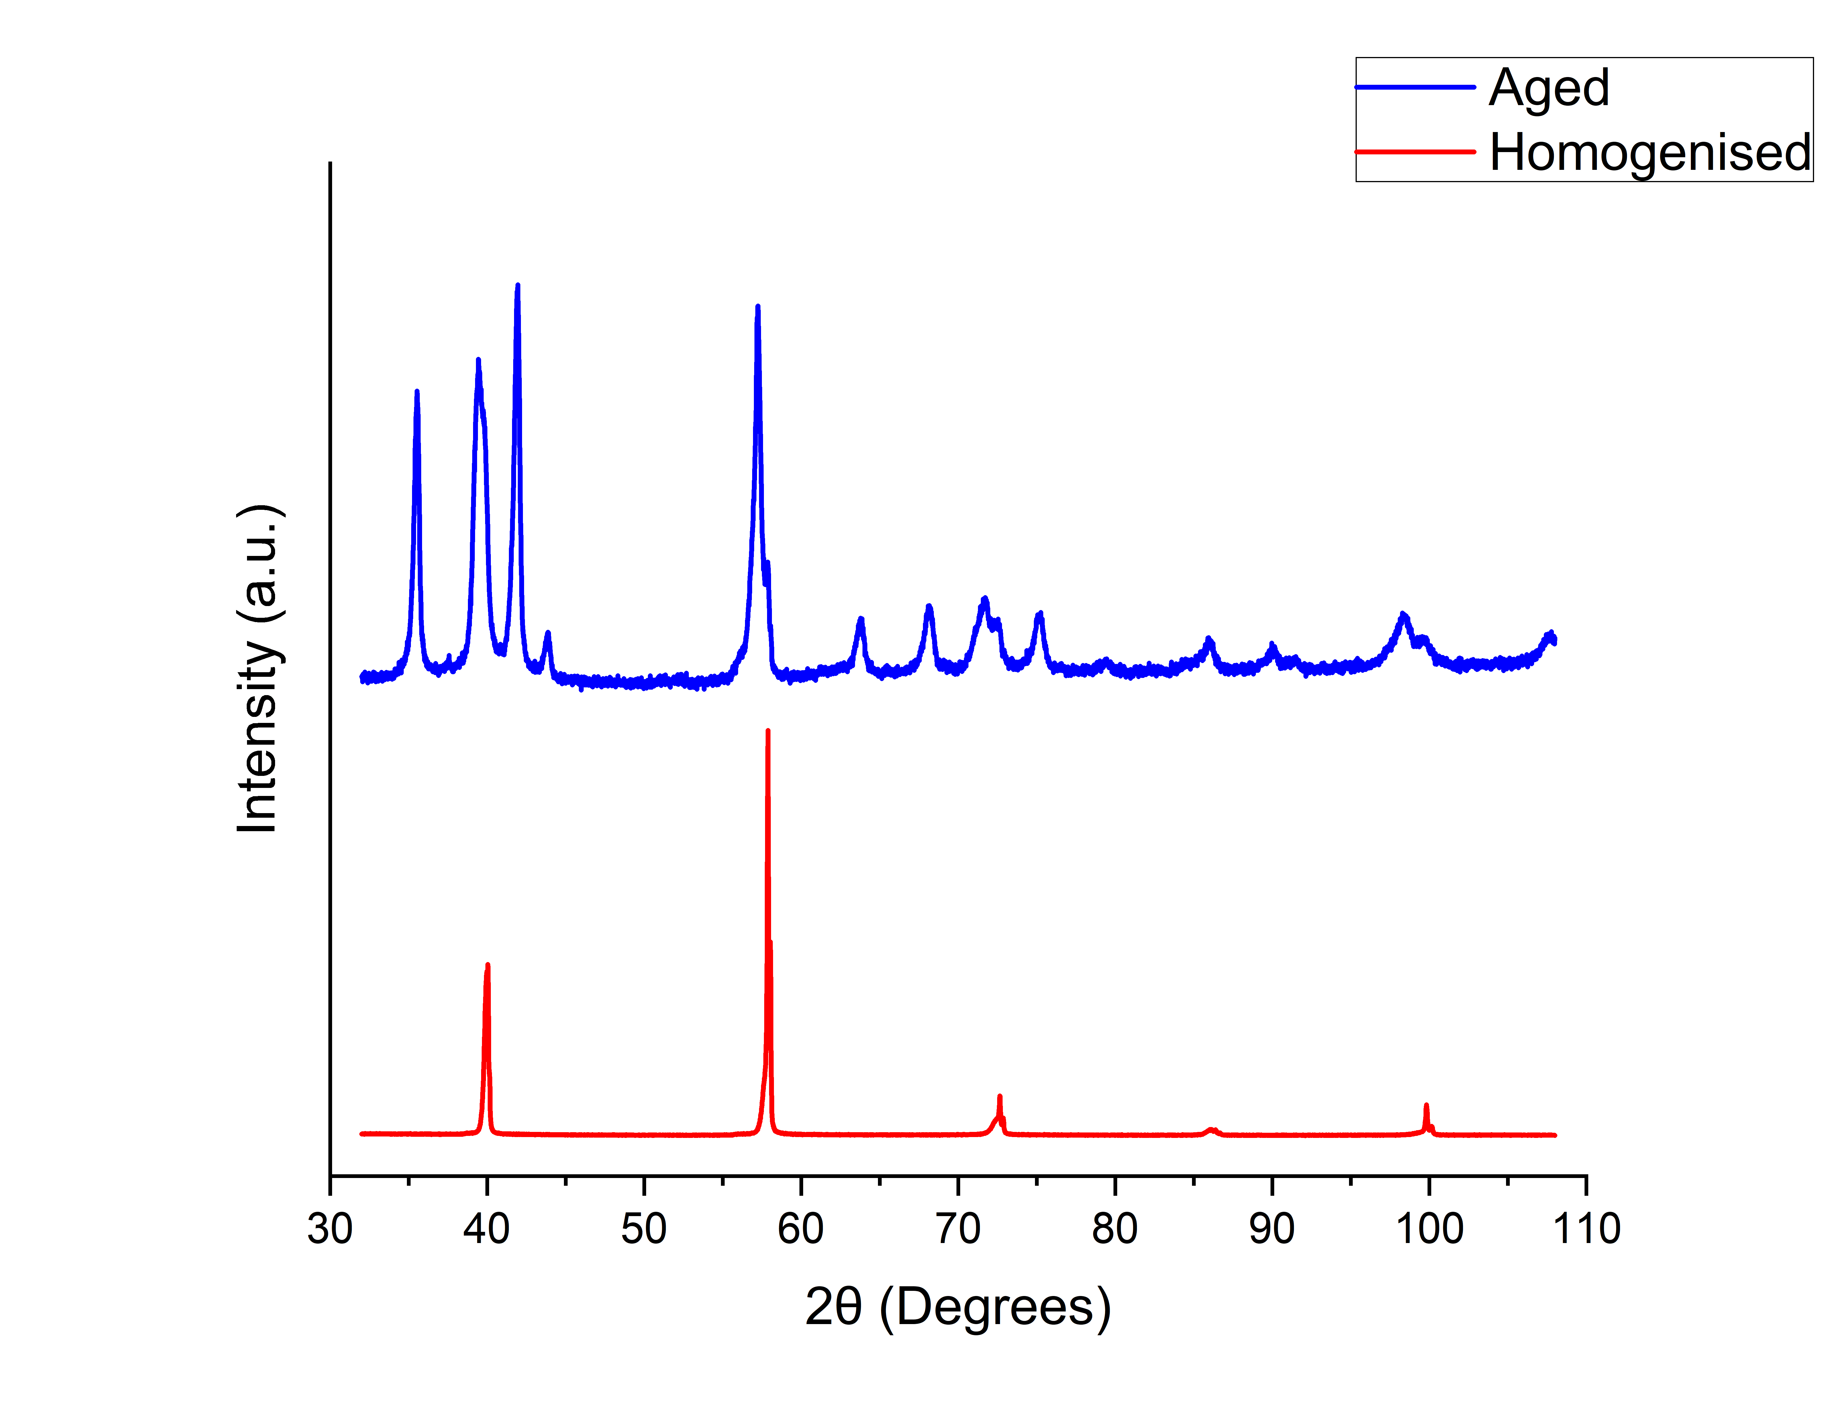
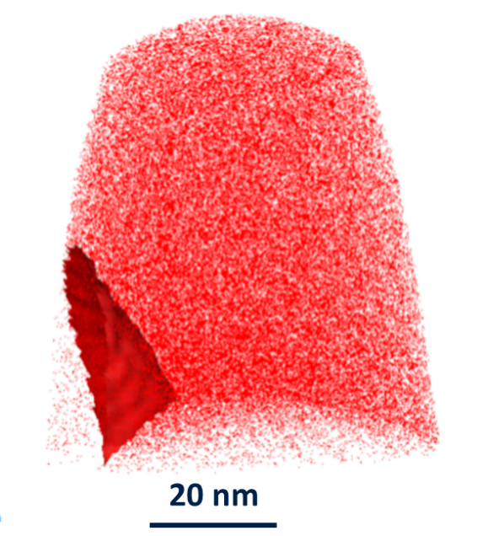
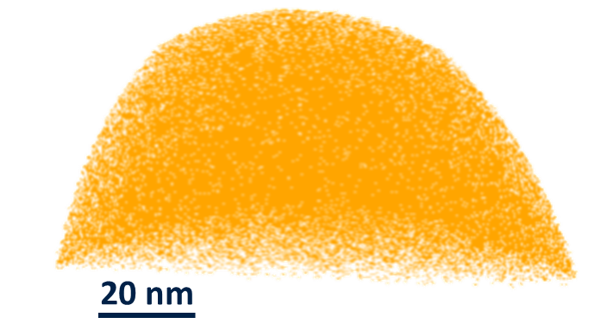
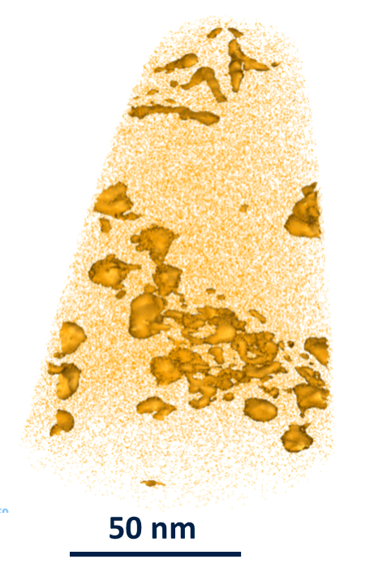
Conclusions
Ion implantation used to produce ballistic damage in Ta₃₀V₃₀Ti₃₀W₅Fe₅
Ballistic damage drives elemental segregation
Dislocation species demonstrate different segregation behaviors
Bulk phase stability suggested up to 15.3 dpa
Homogenised
Aged

Slide 18




Acknowledgements
Any Questions?

Slide 19
Alloy Characterisation
(110)
(211)
(211)
(220)
(310)
(110)
(211)
(211)
(220)
(310)
Ta₃₀V₃₀Ti₃₀W₅Fe₅ XRD Data
Ta₃₀V₃₀Ti₃₀W₅Cr₅ XRD Data
Notes:
Need to add reflection markers to indicate phases and plane families

Slide 20
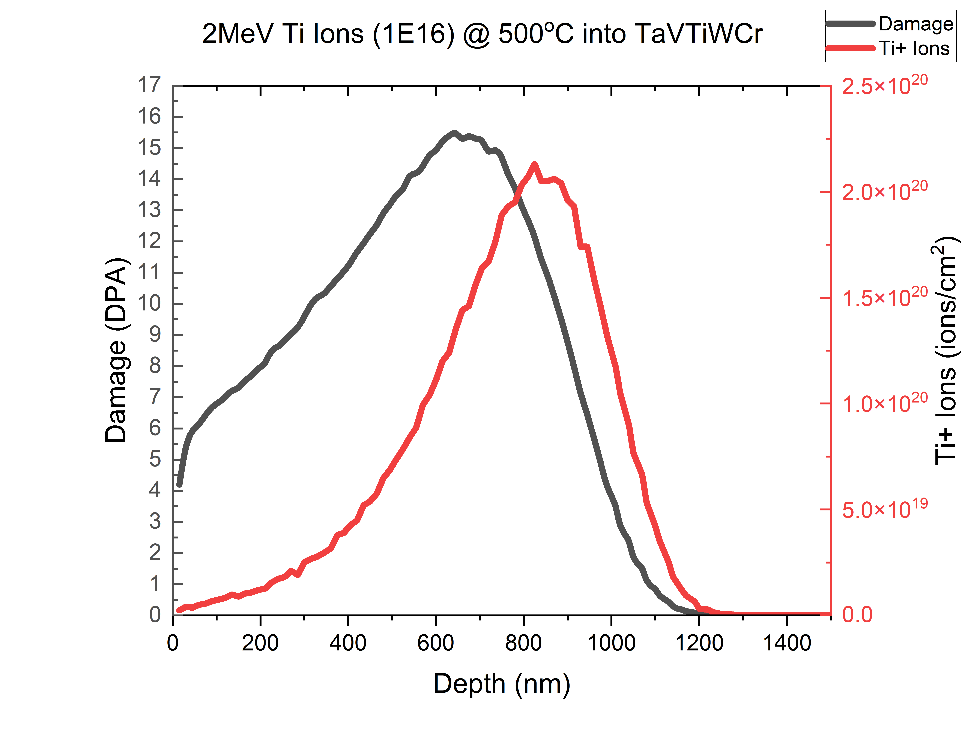
Ti Ion Implantation
Element | Displacement Energy /eV (Ref)
Ta | 90
V | 40
Ti | 30
W | 90
Cr | 28
 | -WCr
Peak Damage/ dpa | 15.3
Mean Projected Range/ nm | 746
From - Helmholtz-Zentrum Dresden-Rossendorf e.V.

Slide 21
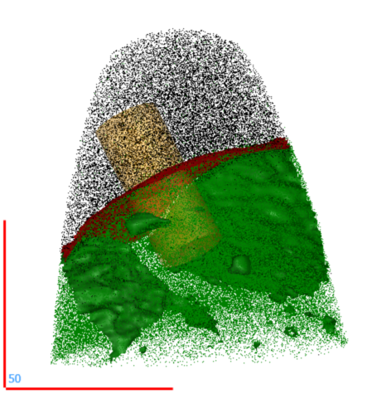
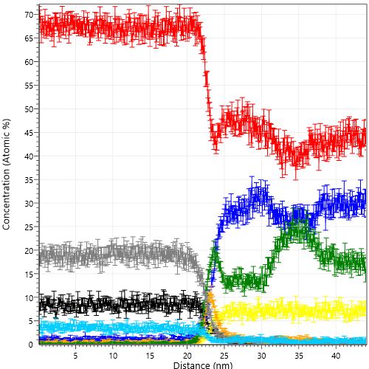
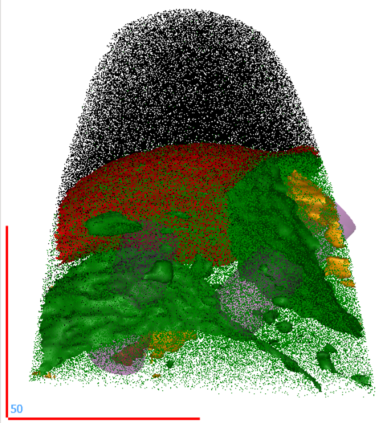
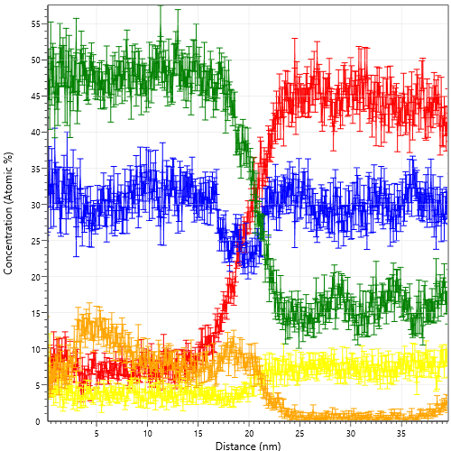


Multi-phase Boundaries
Ta
V
Ti
W
Fe
C
N
O
Matrix
Matrix
Ti₃(N,C,O)
Laves Phase
Laves Phase
Ti₃(N,C,O)

Slide 22
Compositionally Complex Alloy Design Approach

Slide 23
Compositionally Complex Alloy Design Approach

Slide 24
Compositionally Complex Alloy Design Approach
Notes:
We then remove very expensive or non-metallic elements and we end up with…
Rhenium cost - $2000 per kg
Scandium cost – 500000 per kg

Slide 25

Homogenised Atomic Probe Microscopy
500 nm

