Slide 1





Relativistic Ultrafast Electron Diffraction and Imaging
Tim Noakes
(on behalf of the RUEDI team)
https://ruedi.uk/

Slide 2
Contents
Introduction to RUEDI:
  RUEDI project
  Science case
  MeV UED and UEM background
RUEDI Design:
  Design evolution
  Ultrafast diffraction beamline
  Imaging / electron microscopy
  Laser pumps
  Environmental sustainability
  Digital
Summary

Slide 3
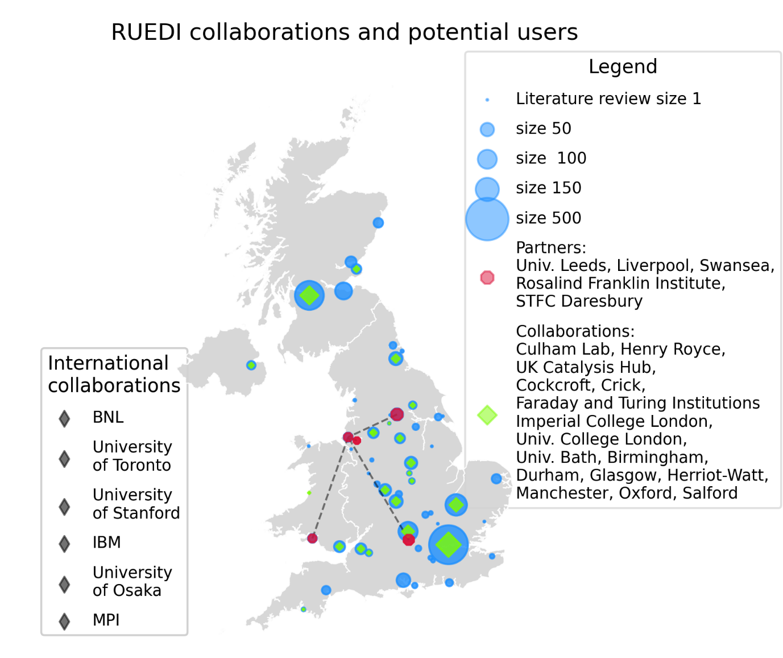

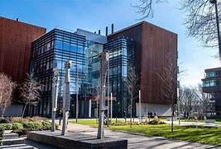
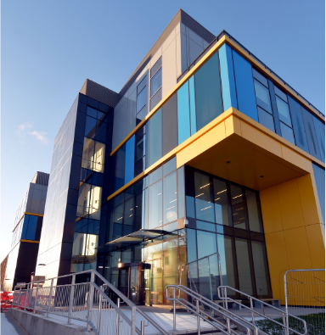
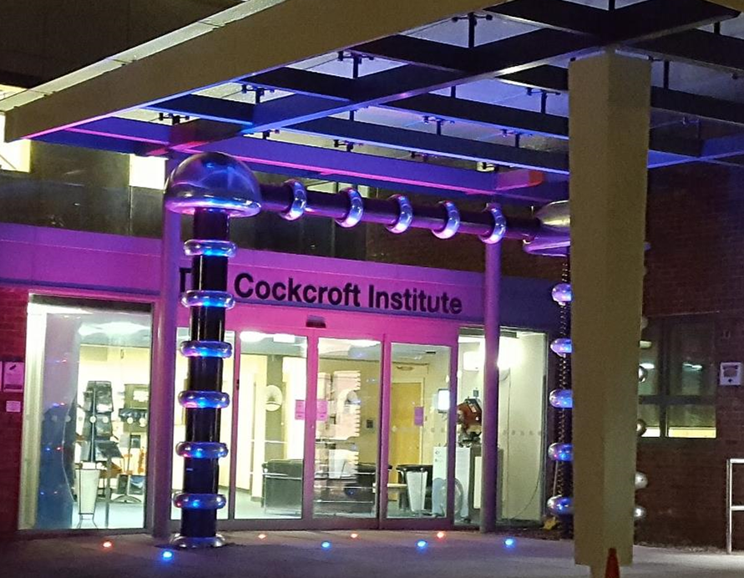


The RUEDI Project
Lead institute (University of Liverpool – Prof. Nigel Browning)
And main partners: (RFI – Prof. Angus Kirkland)
Daresbury Laboratory
The Materials Innovation Factory
Harwell Campus Hub
Cockcroft Institute
Other science theme leads:
UK Infrastructure Fund:

Slide 4

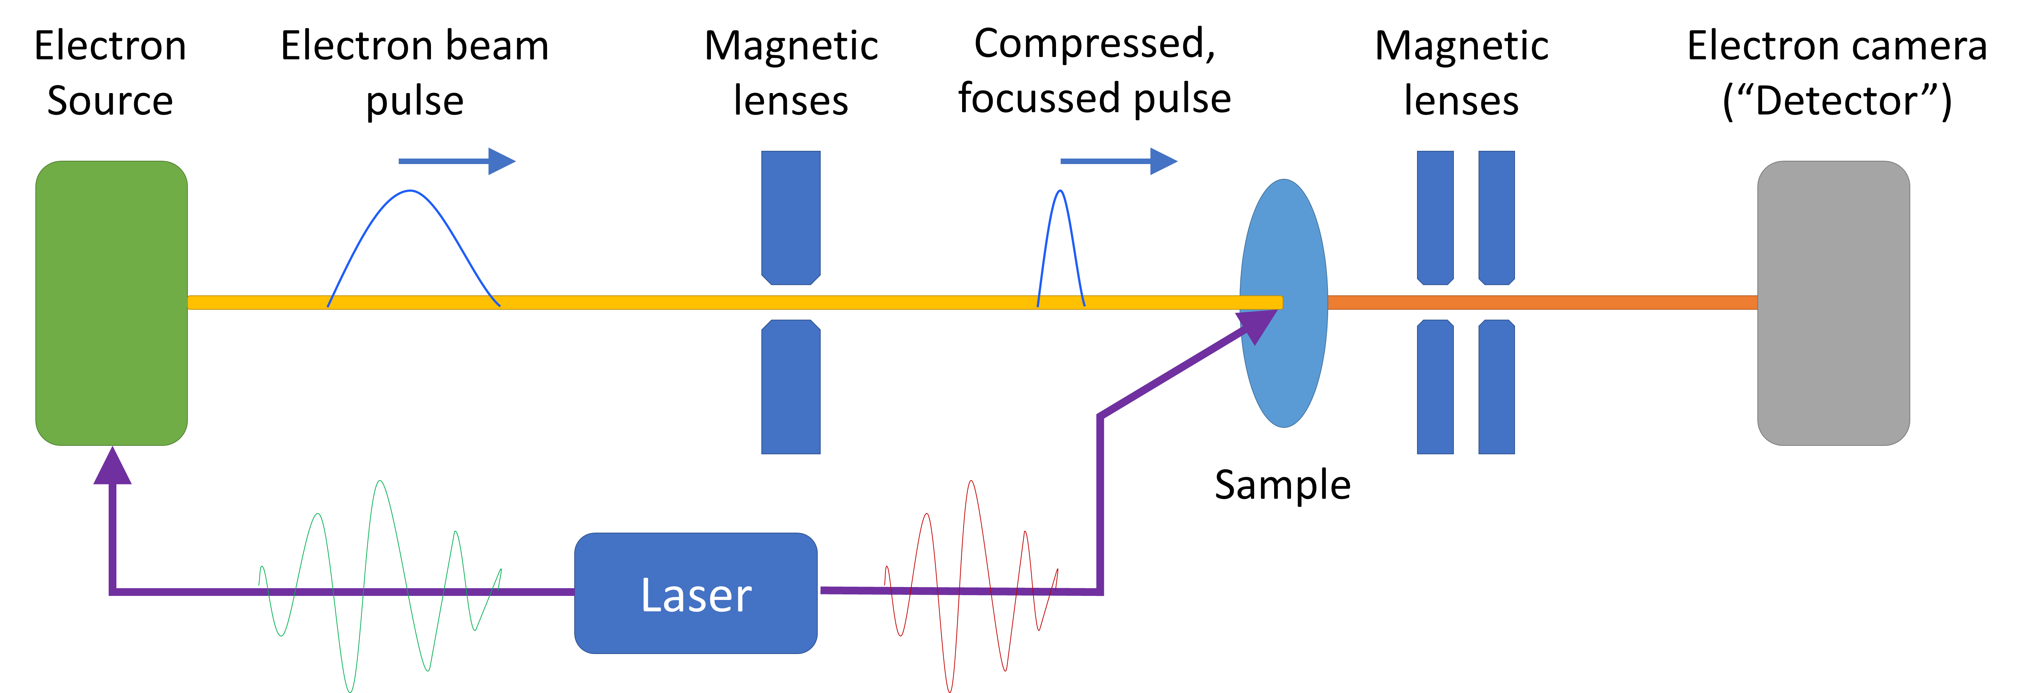
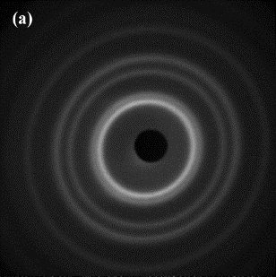
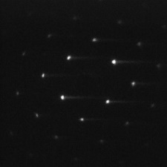
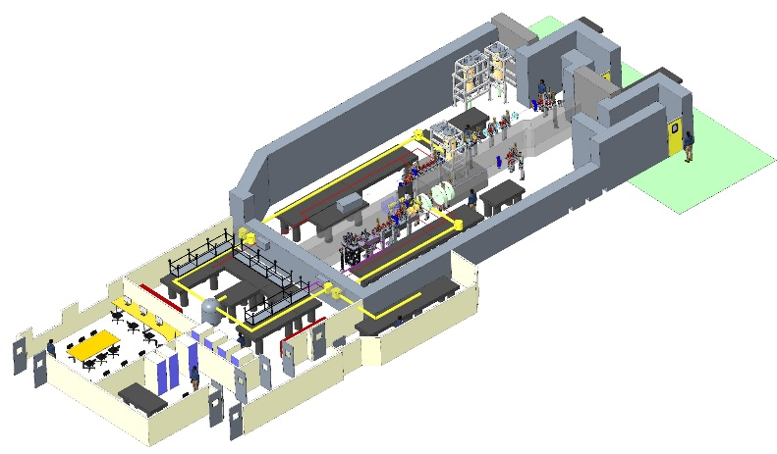
The RUEDI Facility Proposal
Proposal for a new UK National User Facility
Relativistic Ultrafast Electron Diffraction & Imaging (RUEDI)
MeV UED and UEM
Time-resolved pump-probe experiments in both real and reciprocal space
With a large variety of pumps and sample environments
To enable a large range of science
Pumps:
  Wide variety of laser wavelengths, THz, TW, keV ion source
Environments:
  Solid, liquid cells, liquid/gas jets, plasmas, cryogenic (down to mK level)

Slide 5
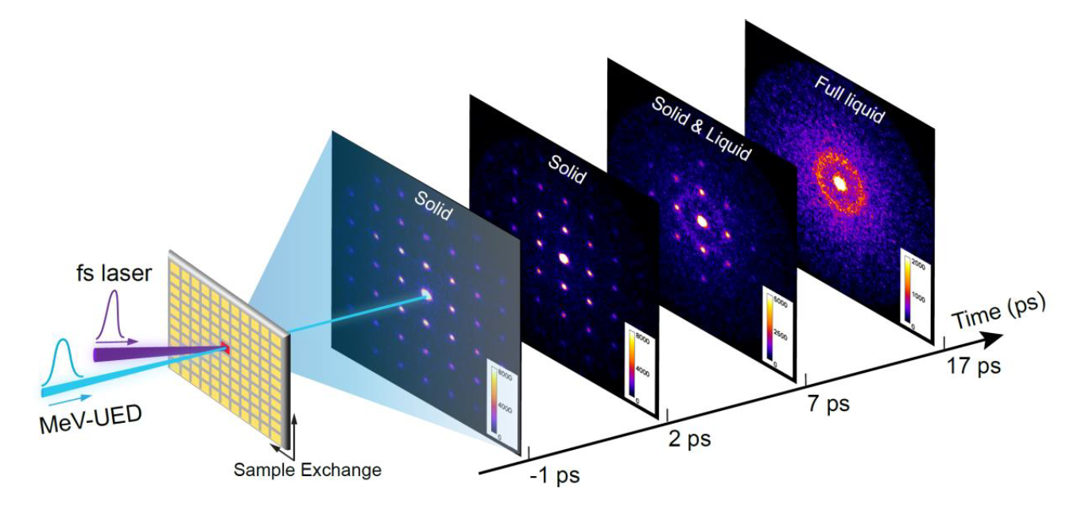
Pump-probe experiments
In RUEDI experiments some change is affected by an external stimulus (e.g. laser pump)
Sample then probed by electron beam
Variable delay between pump and probe to observe the process in real time
  Diffraction – provides structural information
  Imaging – Microscope ‘pictures’ of the sample
“the equivalent of watching a whole game of football rather than just checking the final score”

Slide 6
Enabling Science
Mostly Imaging
Biosciences
Town hall meetings held throughout 2022
Identified experiments, electron parameters, pump sources and sample environments
  Photosynthesis & energy transfer
  Cardiac disease related dynamics
  Virology & infection
  Biological self-assembly/toxicity
Mostly Diffraction
Materials in Extremes
Dynamics of Chemical Change
  Astrophysics & warm dense matter
  Advanced manufacturing
  Nuclear fission/fusion/space
  Response to shocks
  Chemical complexity across scales
  Hydrogen bonding
  Pulse radiolysis
  Heterogenous catalysis
Energy Generation,
Conversion & Storage
Quantum Materials & Processes
  Ultrafast low-energy optical switching
  Magnetic textures & skyrmions
  Topological superconductors
  Thermoelectric energy harvesting
  Photocatalysis & induced electro-chemistry
  Defect kinetics in solar cells
  Ion solvation kinetics in batteries
  Kinetics of glasses

Slide 7
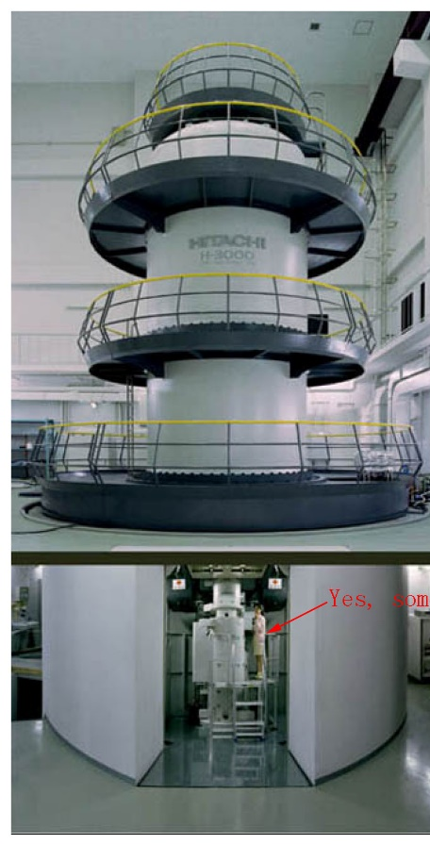
Existing Instruments
Ultrafast Diffraction
  Probes structure of materials
  Based on similar accelerator and laser technology to CLARA and X-FELs
  Other existing MeV instruments around the world – SLAC/KAERI(Korea)/DESY/Shanghai etc
Imaging/Microscopy
  Directly view materials nm-scale
  Commercial systems at keV level
  Static (DC) MeV machines – only a few, decades old
  Higher energy means thicker, more realistic samples
    Eg/ live cells in liquid instead of frozen
    Solid-liquid interface in batteries
  No other MeV time-resolved machine worldwide
Osaka 3 MeV TEM
SLAC MeV UED facility

Slide 8
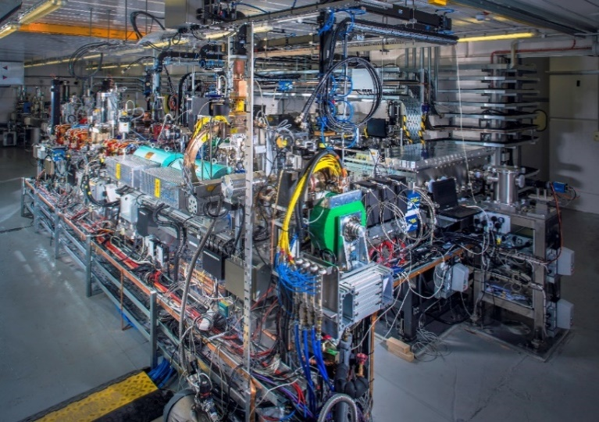
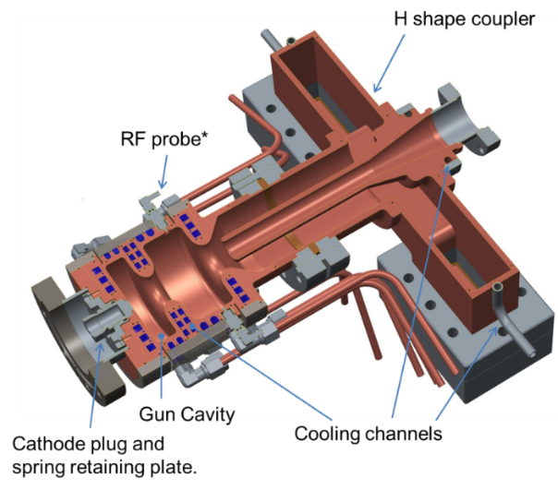
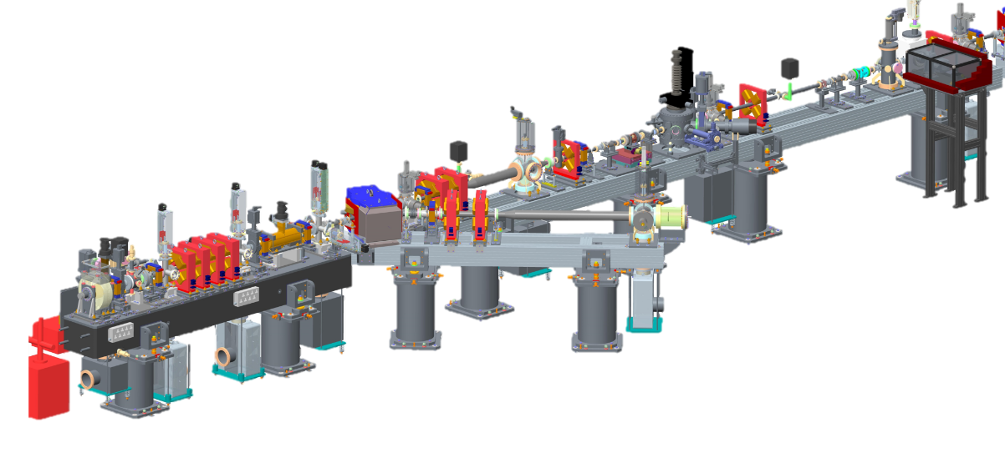
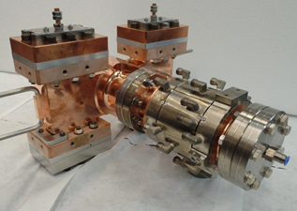
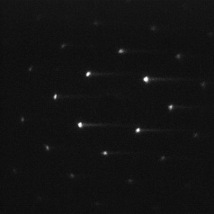
Leveraging ASTeC Experience
Design, build, and operation of particle accelerator facilities
Femtosecond photoinjector development
MeV UED Experience
Proof-of principle static MeV electron diffraction on VELA

Slide 9
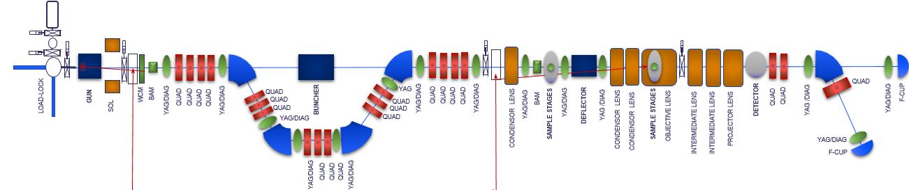
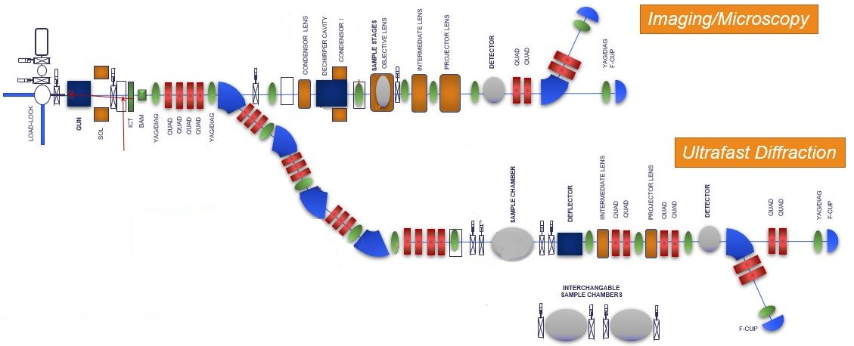
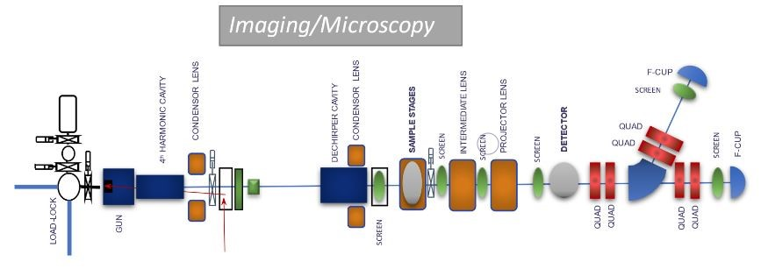
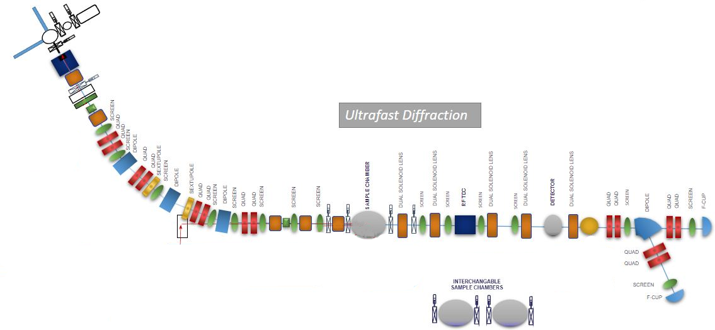
Instrument Design - Evolution
Initial concept – single beamline for both imaging and diffraction
Need for different sample stages and environments as well as different beam parameters – one and a half beamline design
Remove constraints of one beamline on the other to improve performance – current two beam line design
Laser and RF infrastructure still shared!

Slide 10
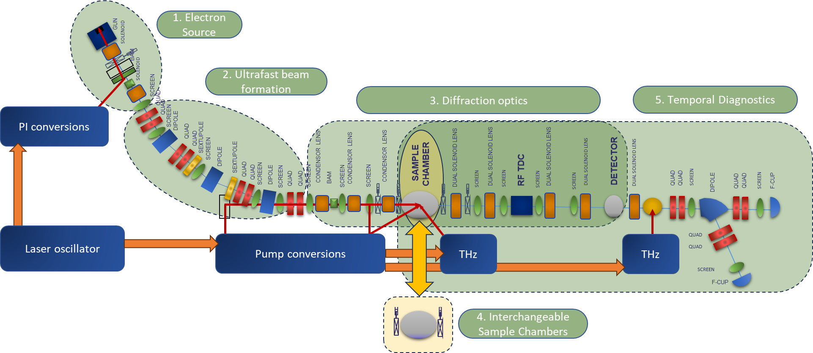
Ultrafast Diffraction Line
S-band RF gun
  Creates high brightness, short pulse beams
Magnetic arc
  Simultaneous bunch compression and jitter suppression
Optics
  Focus and magnification onto detector
4. Chambers
  Solid, liquid and gas samples
  mK low temperature chamber
5. Temporal diagnostics
  Time of arrival
  RF and THz streaking for bunch length
  Energy spectrometer
  fs-scale

Slide 11
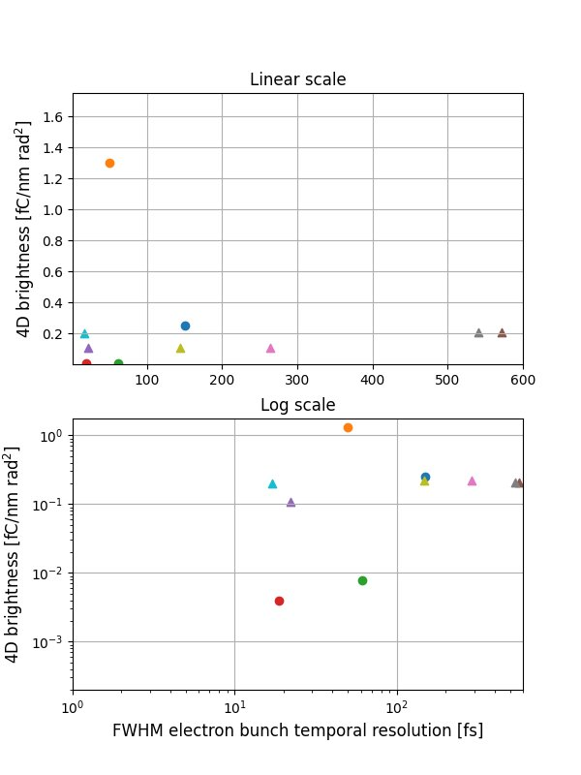
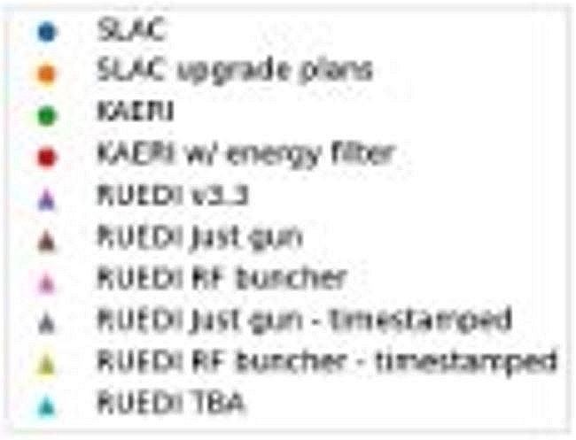
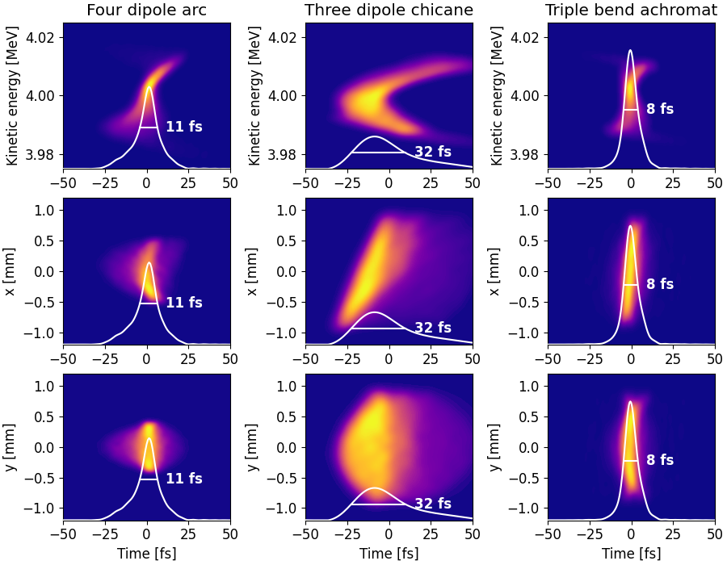
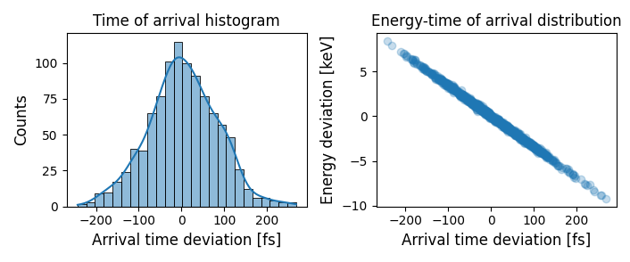
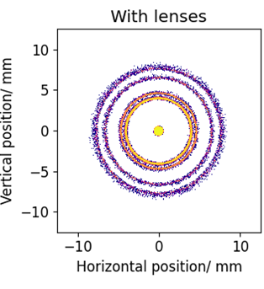
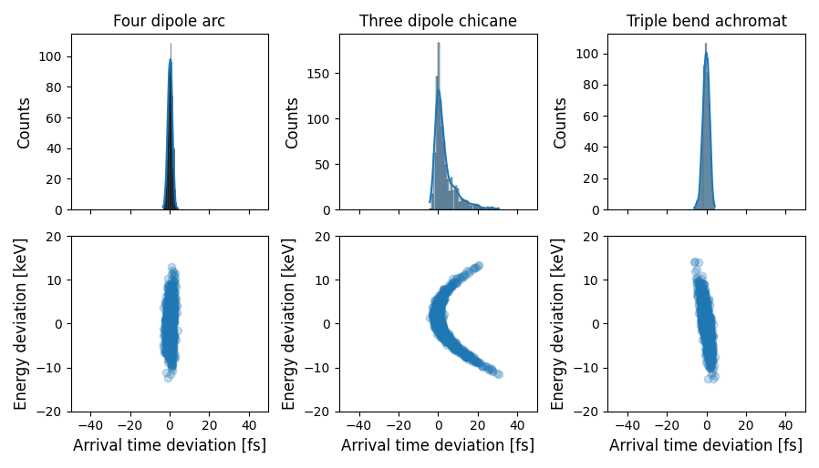
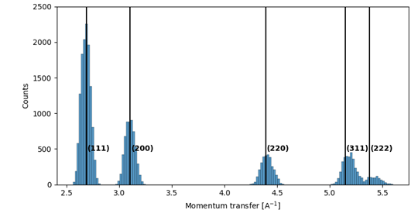
Diffraction Line
SLAC MeV UED
SLAC upgrade plans
KAERI
KAERI w/energy filter
RUEDI v3.3
RUEDI just gun
RUEDI RF buncher
RUEDI just gun – timestamped
RUEDI RF buncher – timestamped
RUEDI TBA
Current design
Current design suggests
  8 fs FWHM timing resolution
  Excellent transverse resolution for diffraction pattern (related to 4D brightness)
World-leading performance!
Jitter suppression
(note different scales!)
For more information on diffraction line see Ben Hounsell’s talk!

Slide 12
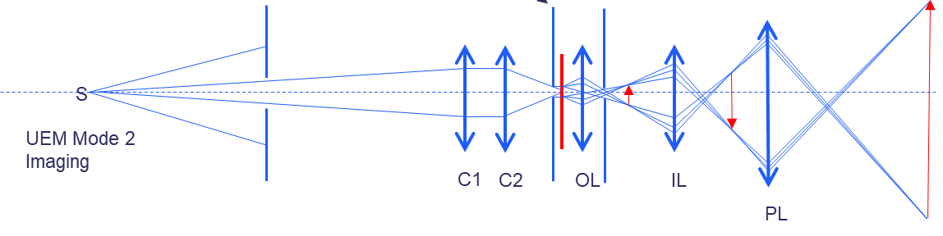
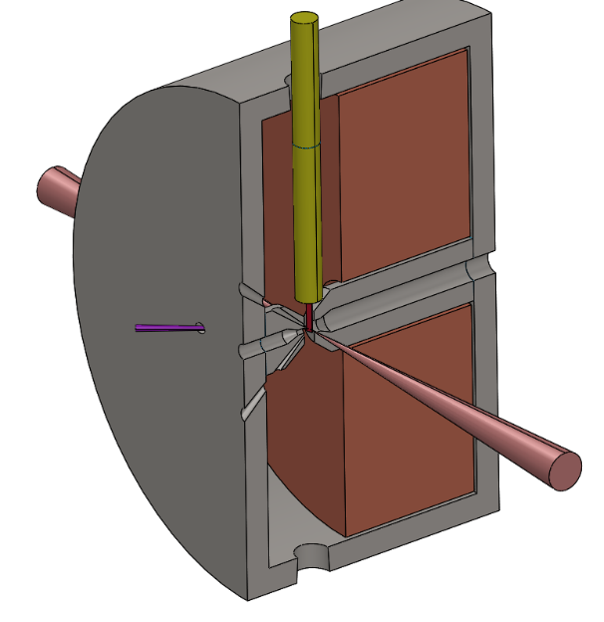
Imaging Beamline
Objective lens
The key to the whole system
Sample stage loading
e-beam
DETECTOR
yoke
coils
pump laser entry
Electrons from source
e-beam
Objective lens
pump laser entry
pump laser entry
Detector
16-64 MP
Single electron sensitive
Imaging lens system
Series of magnetic lenses
Aiming for ~9000x magnification
Samples inserted into middle
Multiple pump laser entry ports
Compatible with commercial TEM sample stages (enabling experiments in solid, liquid, cryogenic, heating etc)
Energy limited by objective lens to ~ 2 MeV
  Aberrations from quadrupole options too high (limits lateral resolution)
Need large number of electrons (10⁸ for single-shot images, less with compressive sensing?)
  (compared to 10⁶ for diffraction)

Slide 13
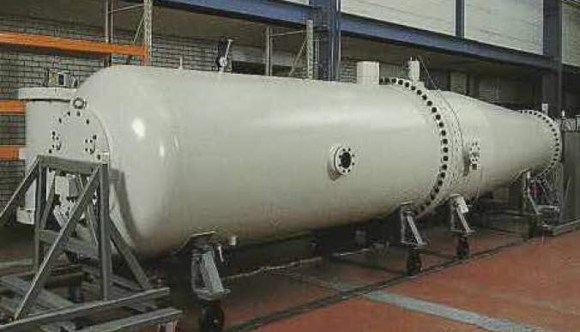
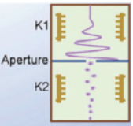
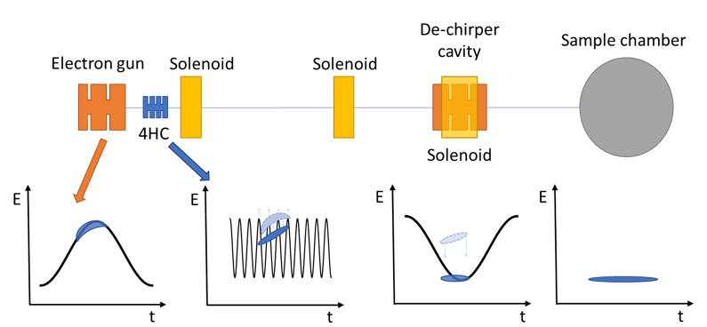
Imaging Line – 2 options
Pulse length determines temporal resolution
∆E/E (and lens aberrations) limit imaging resolution
DC source + fast RF chopper:
  ∆E/E between 3 x 10⁻⁵ and 1 x 10⁻⁶
  10 to 200 ps pulses
  Maximum 10⁴ electrons per pulse (enables stroboscopic use)
  Bunch trains for ‘single shot’ (10s of µs resolution only)
3 RF cavity beam delivery:
  ∆E/E between 3 x 10⁻⁴ and 3 x 10⁻⁵
  Bunch lengths between 0.5 and 12 ps
  10⁶ to 10⁷ electrons per pulse (single-shot may be possible)
  S-band gun (high brightness beam)
  4HC (lossless monochromation)
  S-band DCP (decelerate/dechirp)
For more information on imaging line see Alex Bainbridge’s poster!

Slide 14
Laser Systems
Common Oscillator
Ultrafast Diffraction Beamline
Imaging/Microscopy Beamline
Amplification
(32 mJ, 35 fs)
Amplification
(17mJ, 80 fs)
Electron Source
THz Generation
TW Amplifier
Sample Pump Conversions
Electron Source
Harmonic Generation
OPA
Sample Pump Conversions
Harmonic Generation
OPA
HCF
HHG

Slide 15
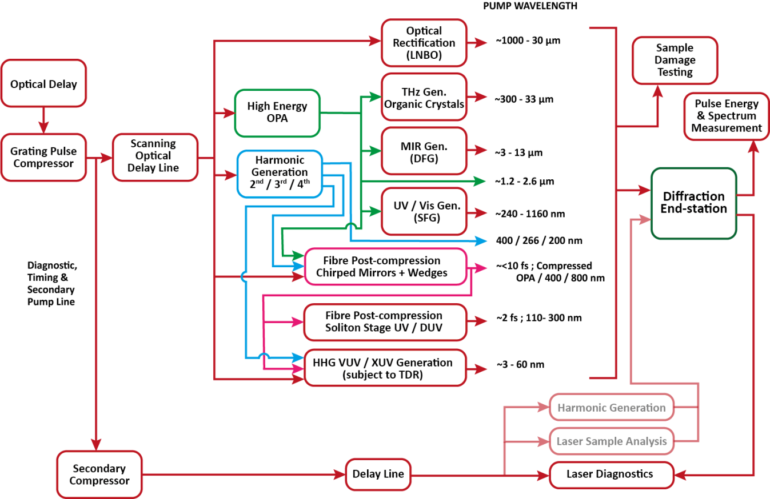
Laser systems
Proposed experiments demand a wide range of pump lasers
Both wavelength and pulse length variation required
Significantly broaden the range of science that can be achieved
  contribute to the unique capabilities of the instrument/s

Slide 16
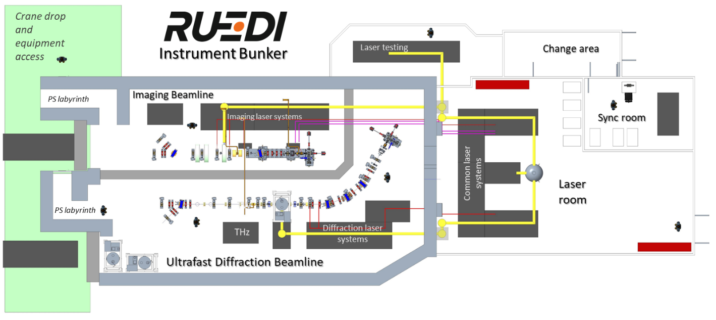

Proposed Layout

Slide 17
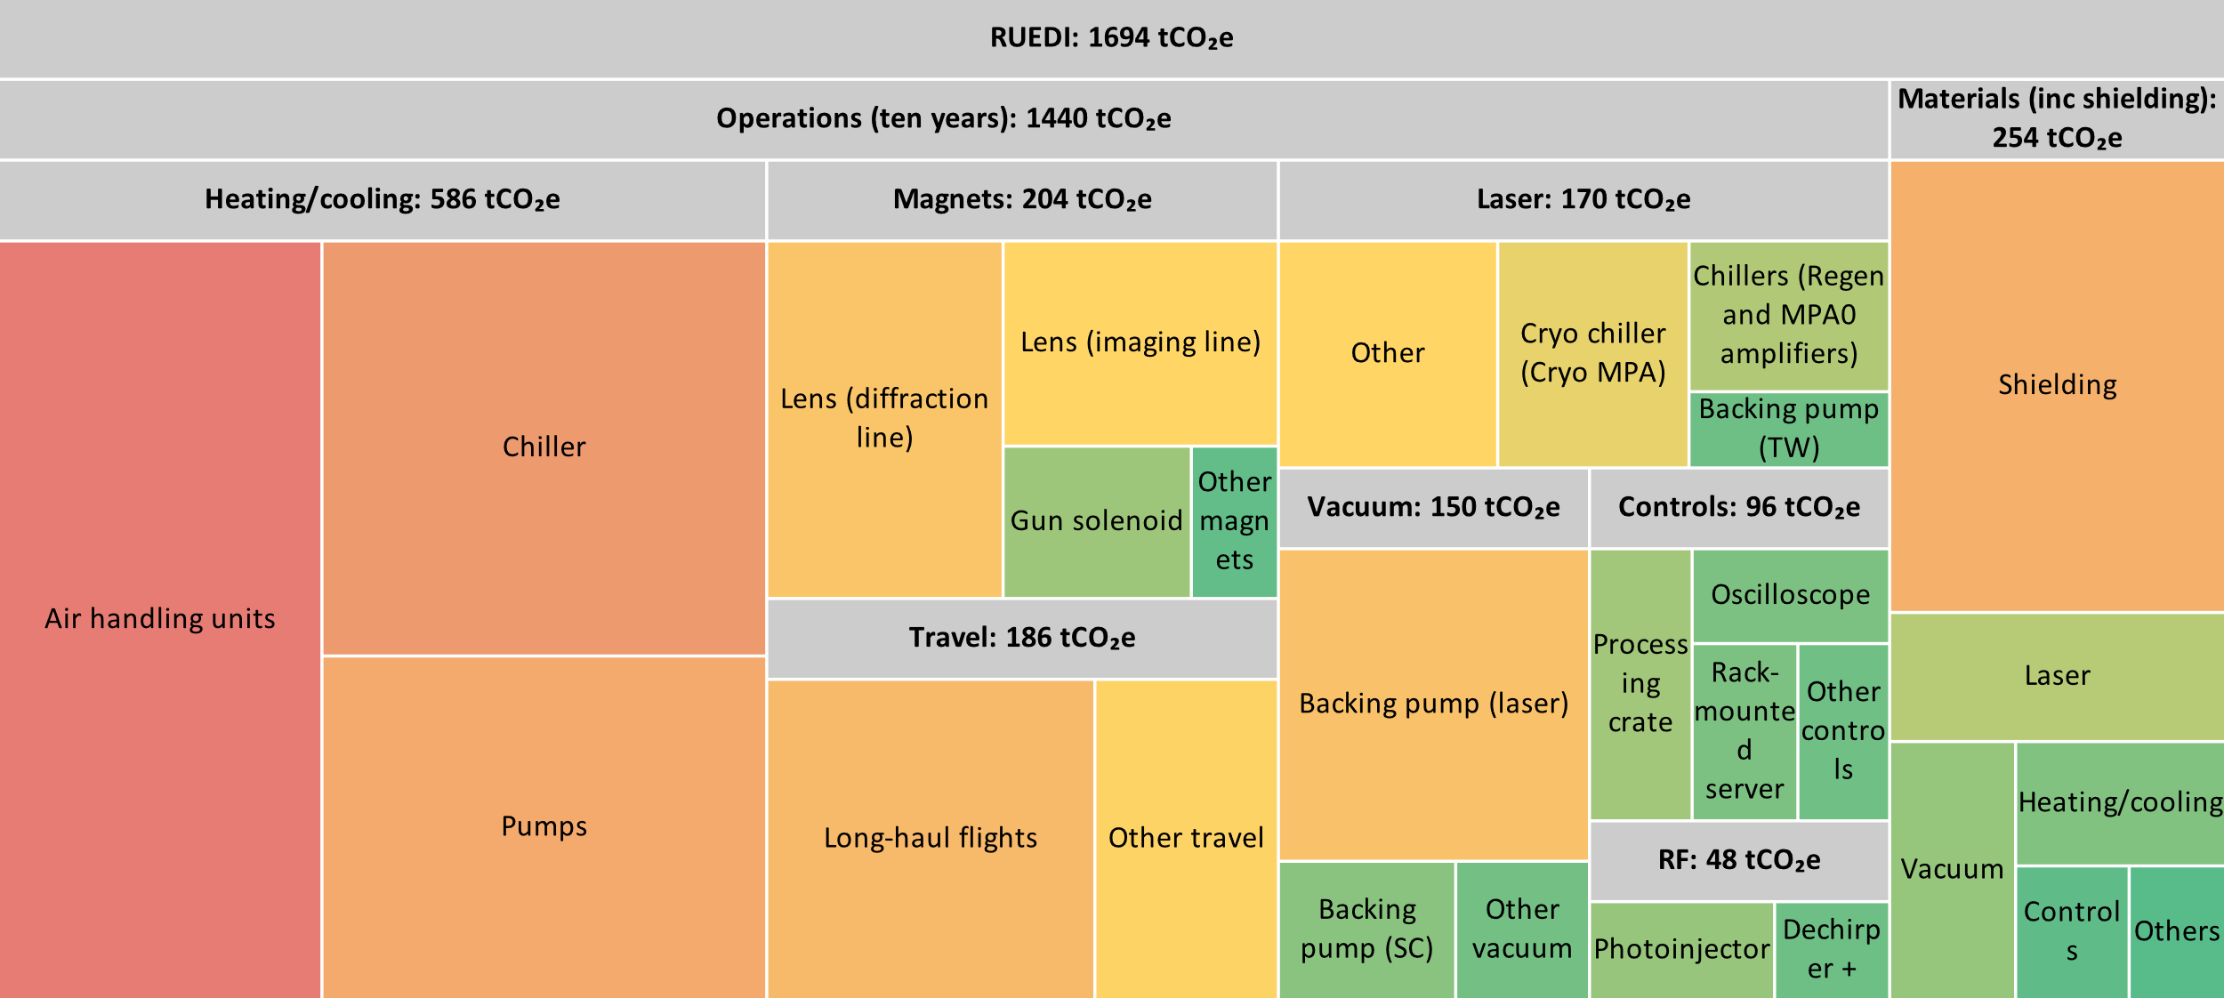
Environmental Sustainability
RUEDI will be the first accelerator designed by ASTeC to fully take sustainability into account
More in Ben Shepherd’s talk later today!

Slide 18
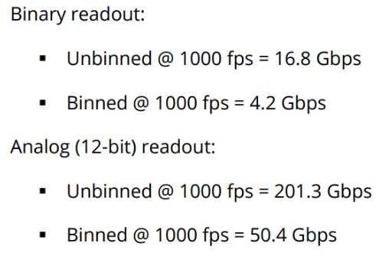
Digital + Data
Digital Twin
  Building on CLARA virtual machine
  Simulate full user experiments
AI/Machine Learning integral part of microscope/imaging
  Reduces number of electrons needed to create single-shot imaging
  Compressive sensing/inpainting/dictionary learning
Data challenges
  1 kHz rep rate!
  16-64 MP detector

Slide 19
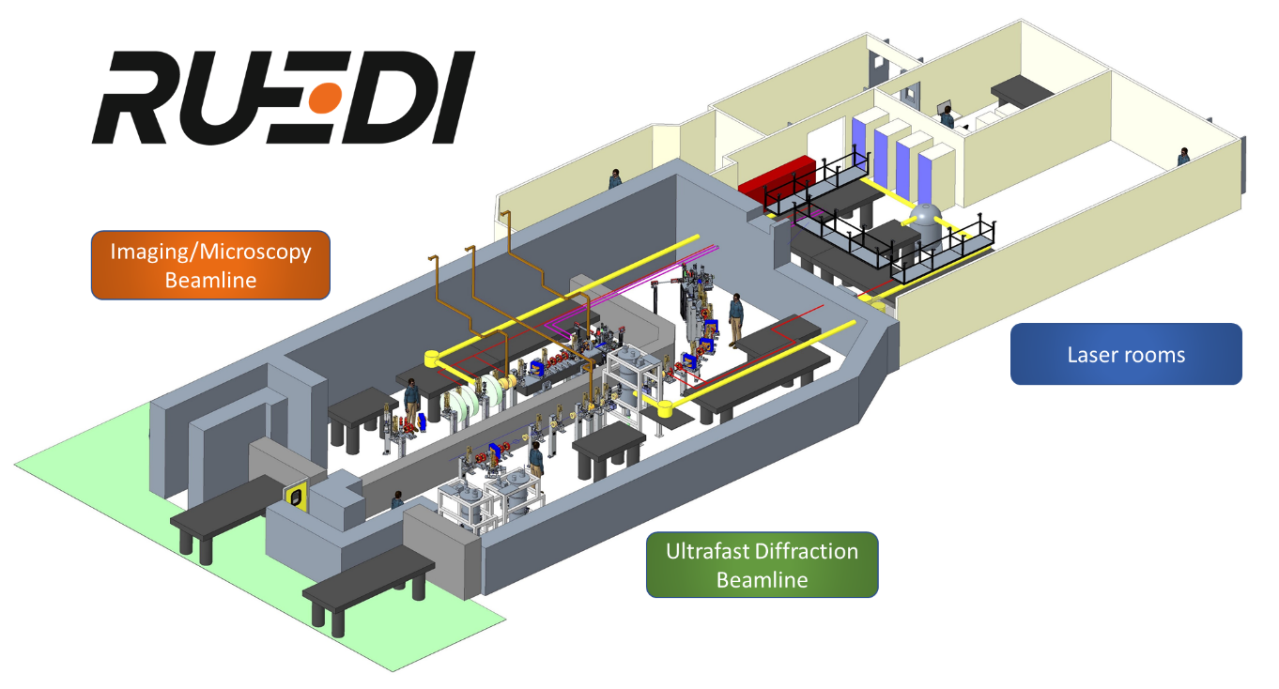
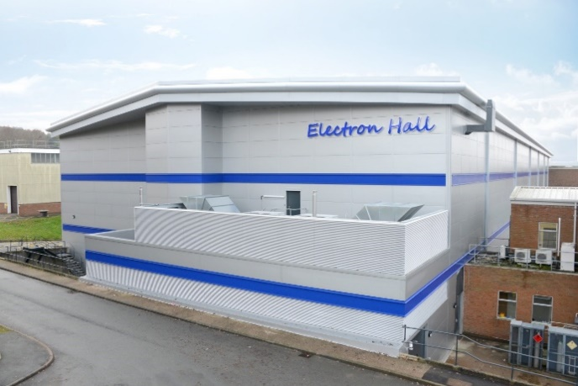

Project status
Technical design report completed at end of March 2024
Full project approval announced on 27 March 2024
https://www.ukri.org/news/major-research-and-innovation-infrastructure-investment-announced/
£124.4 million from UKRI Infrastructure Fund from ~2026
  Subject to full business case approval
Bunkers
To be sited at Daresbury Laboratory in the Electron Hall, next to CLARA
CLARA

Slide 20
Timeline
TODAY
2018
2025
2026
2027
2028
2029
2030
2031
2019
2020
2021
2022
2024
2023
Initial funding
Capital funding
Ops
Bridging funding
Initial bid
Infrastructure Fund Bid
Bid
Science case
Funding decision!
CDR
TDR
Final design
Construction
Commissioning
Users
Assume 5-year operation cycles after commissioning
Capital for upgrades on same timescales
At least two 5-year cycles guaranteed!

Slide 21
Summary
RUEDI project has received full project approval (£124 M from UKRI Infrastructure Fund)
Design work is underway
  Diffraction line will have excellent 4D brightness (diffraction pattern resolution) and world-leading temporal resolution
  Imaging line still requires more work to deliver single-shot imaging with sub-nm imaging resolution (design choices to be made)
  Large suite of laser pump sources planned to facilitate diverse science case
  Environmental sustainability will be key factor in design choices made
Construction due to commence in 2026, commissioning from 2028 and full user programme from 2030
For further information
  Ben Shepherd’s talk on sustainability
  Ben Hounsell’s talk on diffraction line
  Alex Bainbridge’s poster on imaging line
  Suzanna Percival’s poster on the diffraction beamline electron source

Slide 22
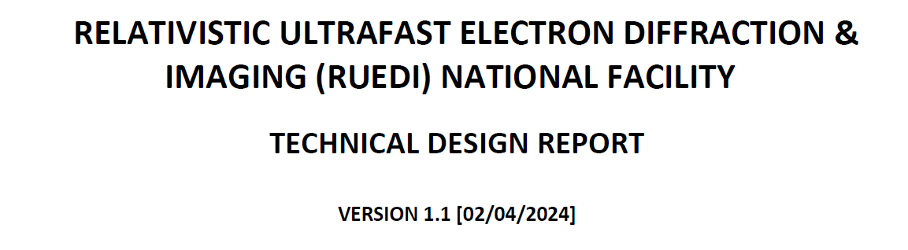
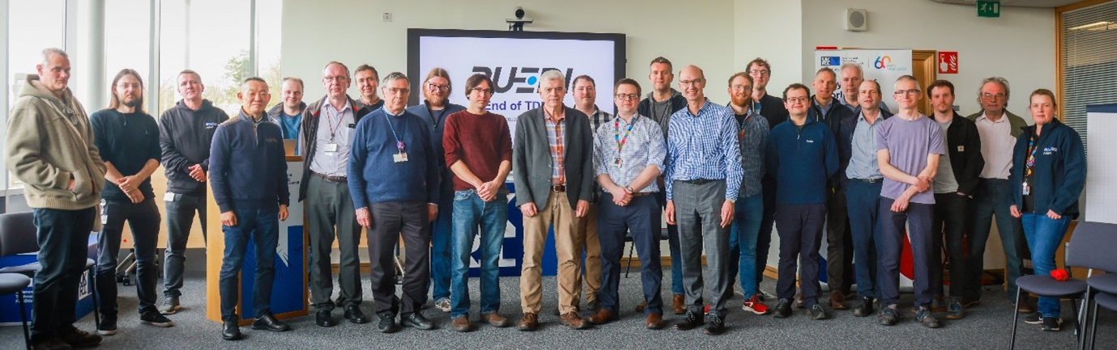
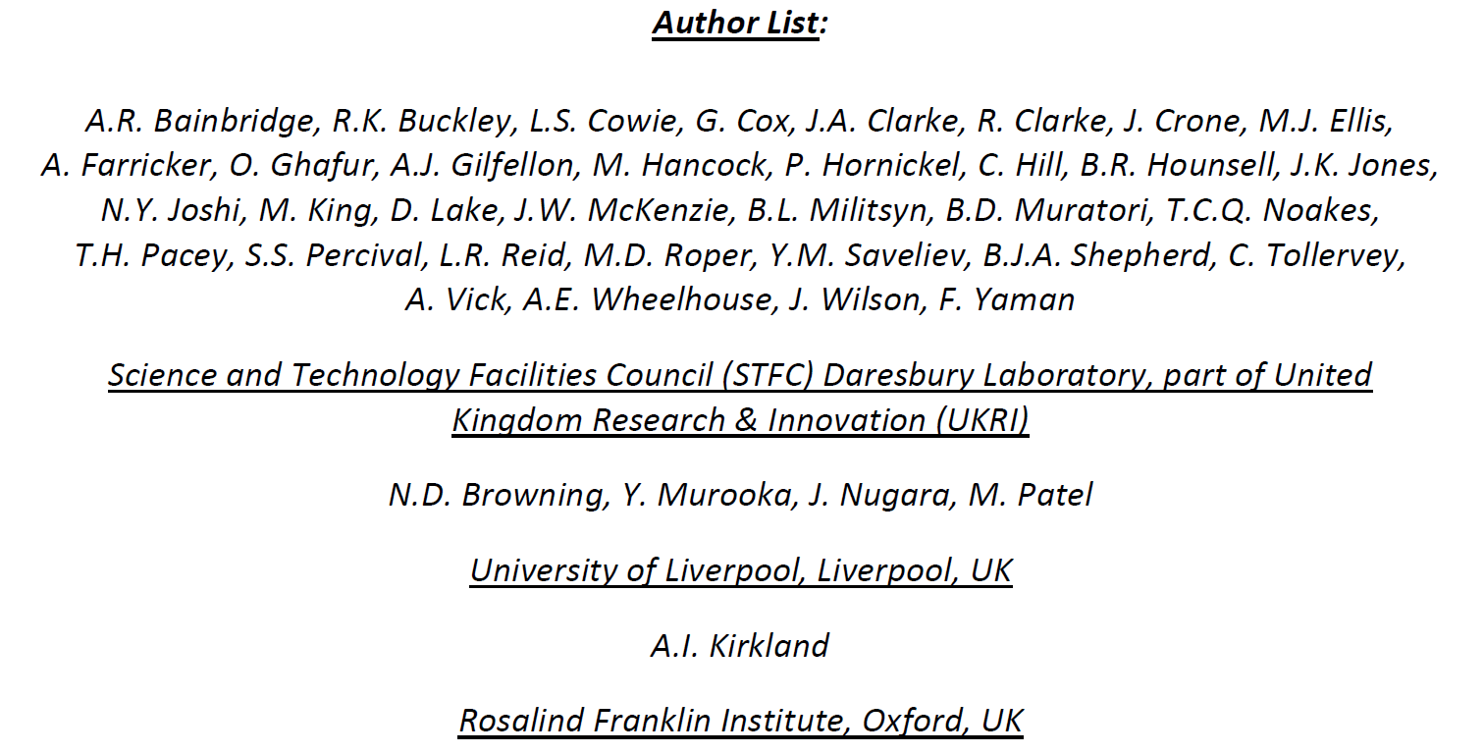
Acknowledgements
Thanks to the TDR team!

