Slide 1
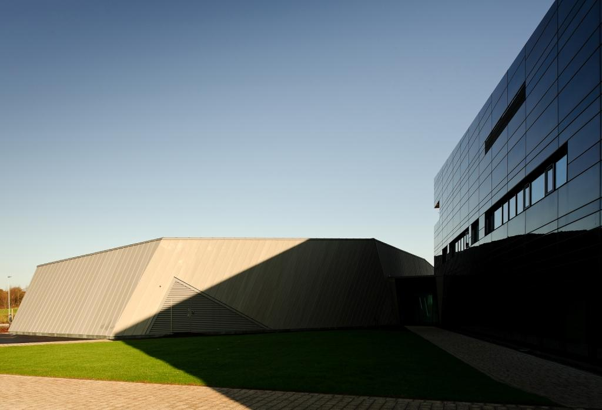




Applications of ion accelerators & the
Dalton Cumbrian Facility
Andy Smith, Samir Shubeita, Mel O’Leary, Aidan Milston (University of Manchester)

Slide 2
Outline
The nuclear problem(s)
Role of radiation testing
Types of radiation
Radiation facilities at DCF
Some examples
Future plans

Slide 3
The nuclear Problem(s)

Slide 4
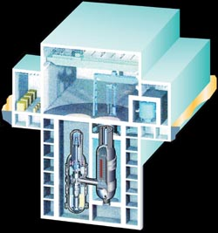
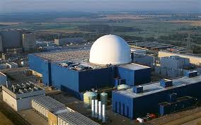
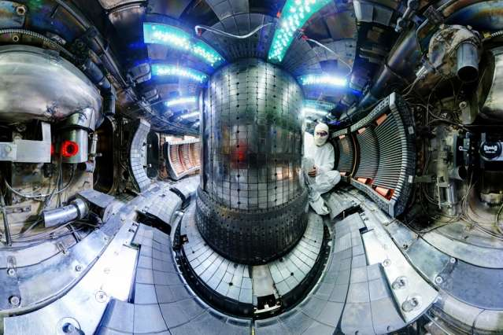
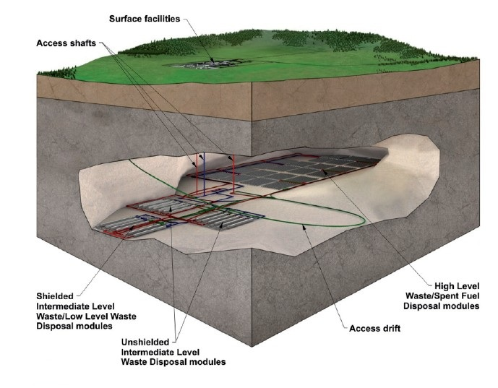
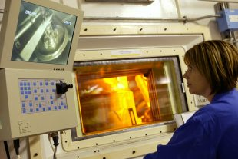
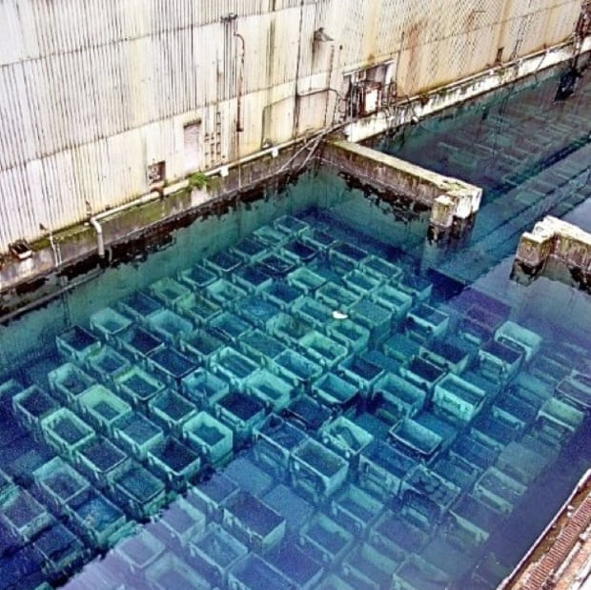
Problems for the full fuel cycle
Next
Generation
Power
Production
Power production
Extending life of
Existing plant
Gen IV
New materials
for new plant
Geological
disposal
Fusion
Safe
disposal
Fuels and reprocessing

Slide 5
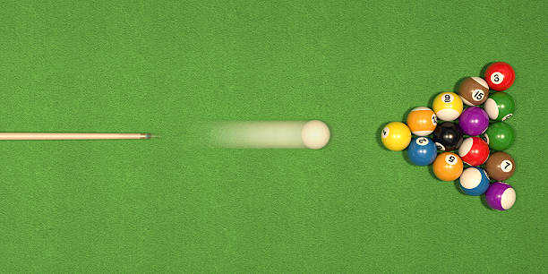
Effects of types of Radiation
Photons & electrons
Ions and particles
Ionisation
  Electronic bond breaking
  Changes to chemistry
Ionisation
  Electronic bond breaking
Particles also have mass and hence KE
  Dislodge atoms from their normal lattice positions

Slide 6
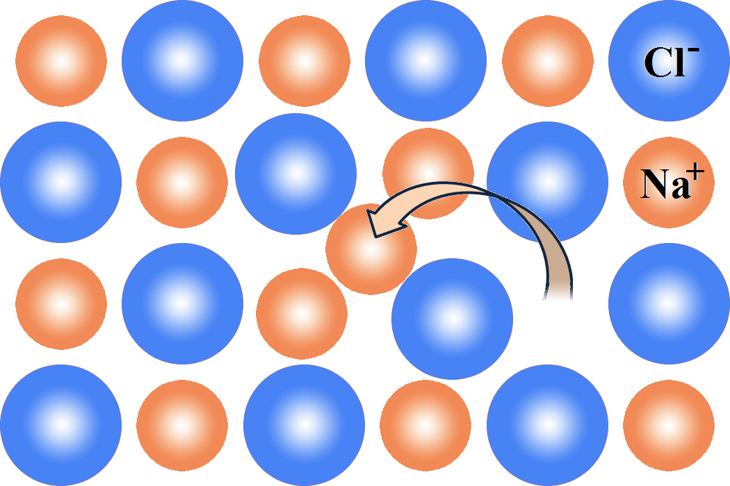
Frenkel defects
Incoming ion dislodges target atom to form a Frenkel defect
Atoms can exchange to from a Frenkel pair
These form local lattice distortions
Sufficient dislocations can migrate and coalesce to from defects in the structure
Leading to work hardening, swelling, embrittlement and other structural failures.
Measure of damage is dpa – displacements per atom
ion
Cation dislocation in
NaCl crystal (Wikipedia)

Slide 7
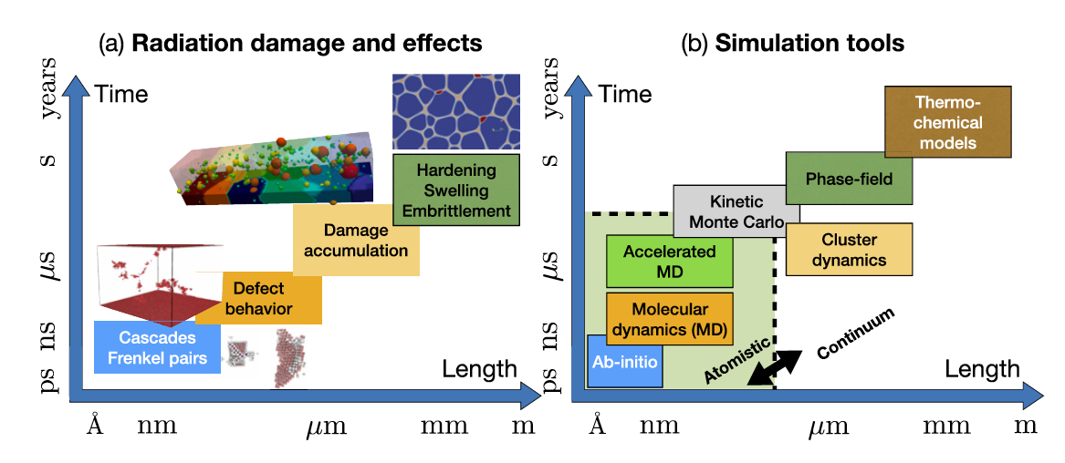
Propagation of damage
C.S. Deo et al. Modelling Simul. Mater. Sci. Eng. 30 (2022) 023001 (22pp)
Damage accumulates over time and over a range of length scales
Macroscopic property changes & crystal amorphisation can be attributed to ballistic effects
Use of intense ion beams to accumulate a lot of damage in a short time

Slide 8
Linear Energy Transfer (LET)
Energy loss per unit of travel (keV/μm)
Can be equated to the Stopping Power
Linked to Relative Biological Effectiveness (RBE)
For low LET, LET = RBE
For higher LET, LET <> RBE
Gammas, X-rays & electrons are low LET, ions have high LET

Slide 9
Choice of ions ?
Majority of particle damage in nuclear reactors (fission of fusion) is caused by neutrons
Neutrons are difficult to accelerate, focus or bend
Charged particles are much more compliant
Protons – ‘same’ mass as a neutron
Helium ions = alpha particles
Heavy ions (Z > 2) do much more damage
  Chemically neutral, self ion or fission product

Slide 10
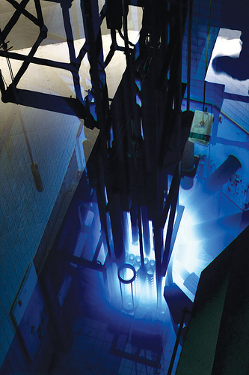
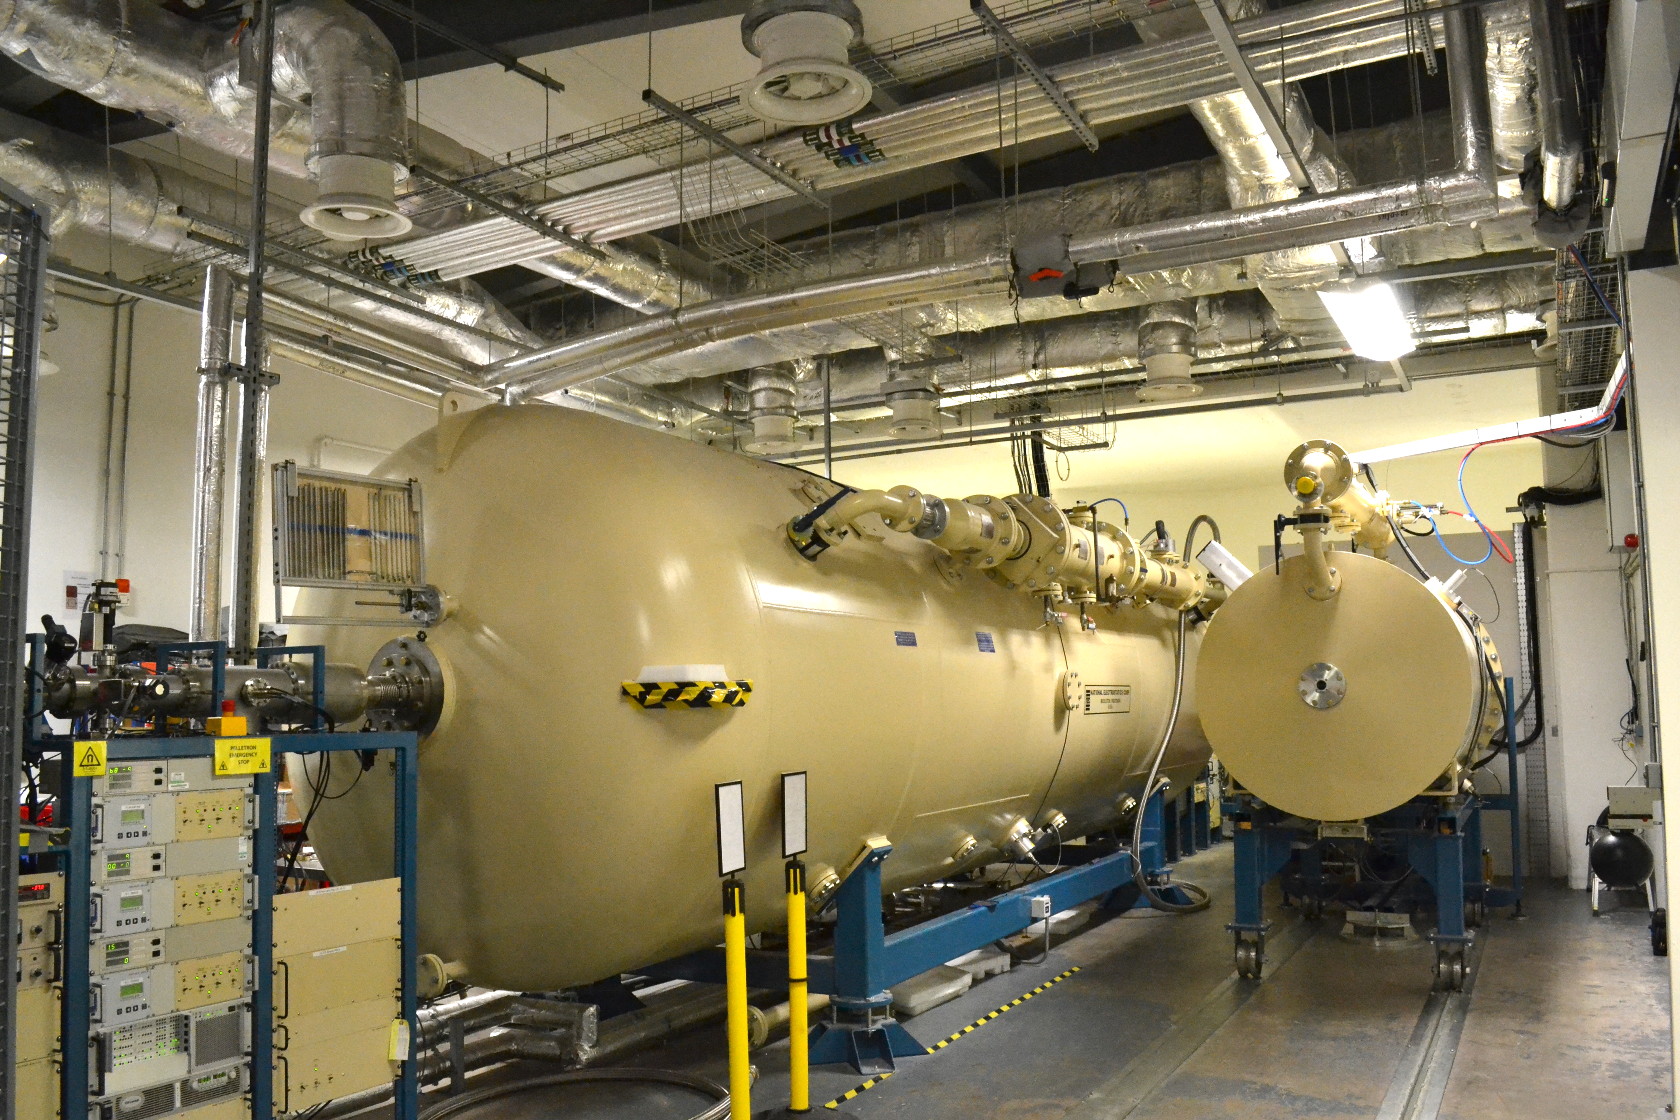
Particle sources
Ion beam accelerator
Test reactor
Relatively cheap to buy and run
Dose accumulated in minutes – days
Samples not necessarily activated
Adaptable – fluences, ion species, ion energies, sample environments
‘Gold standard’ source of neutrons
Expensive to run
Long time to accumulate dose (months – years)
Activated samples

Slide 11
DCF Radiation FAcilities

Slide 12
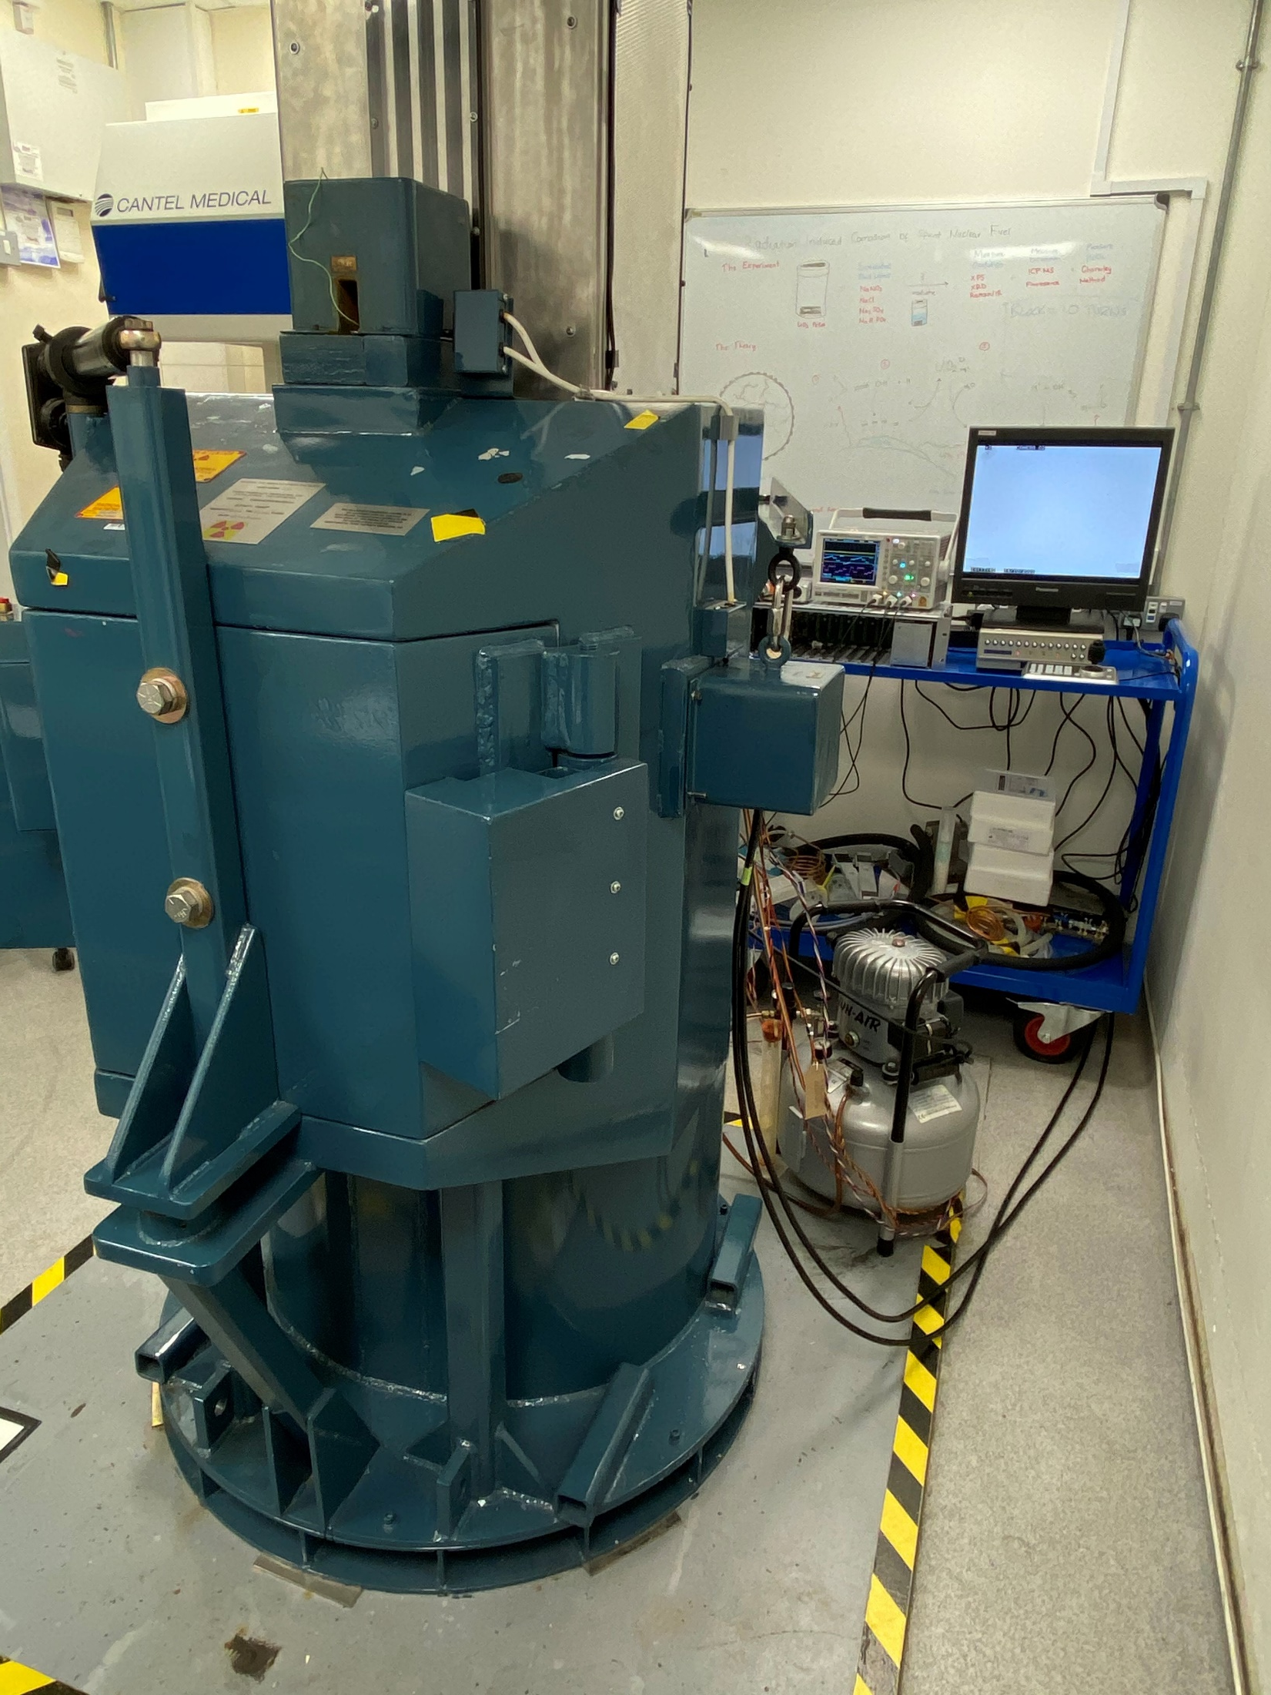
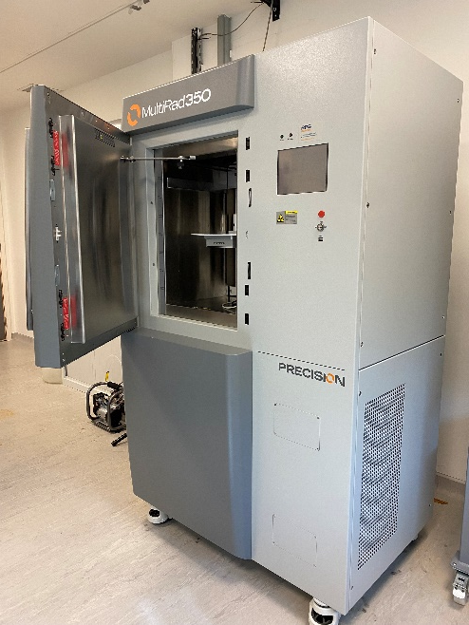
Gamma & X-ray irradiation
High Dose Rate ⁶⁰Co Gamma Irradiator
    Wide range of absorbed dose rates (30 kGy/hr down to 100 Gy/hr)
    10 litre sample chamber incorporating three turntables & two access ports for connection to external experimental rigs
X-Ray Irradiator
Up to 350 kV
Up to 40 Gy/min
Turntable & access port

Slide 13
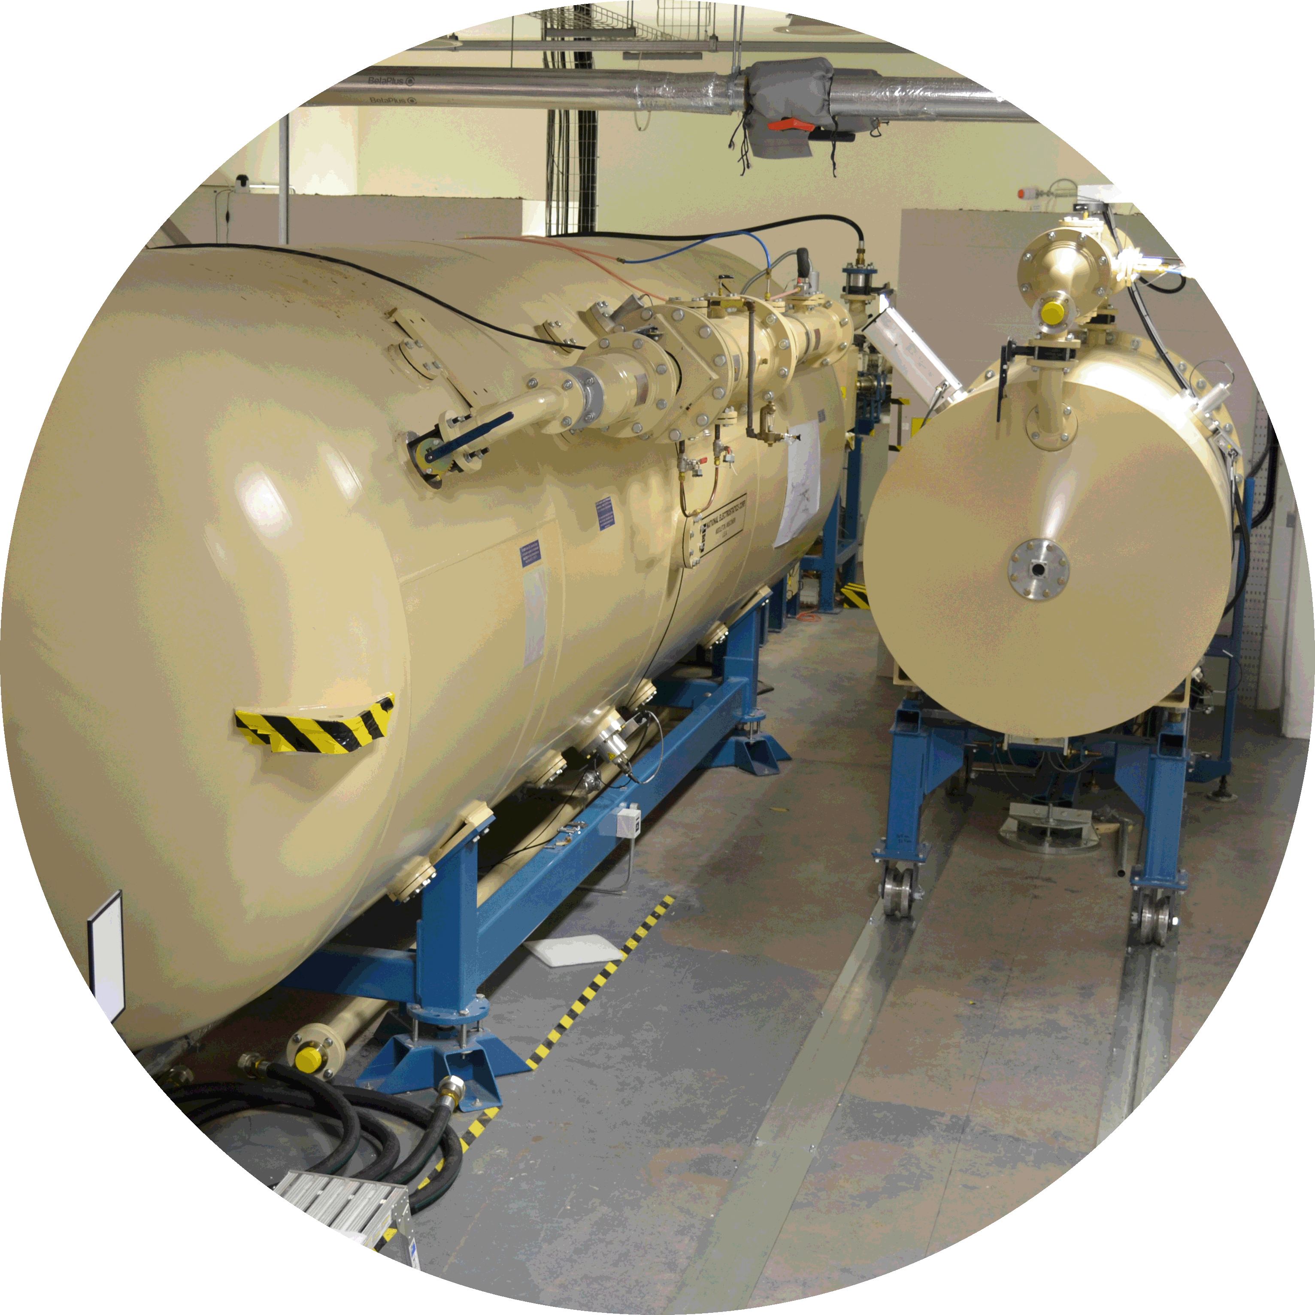
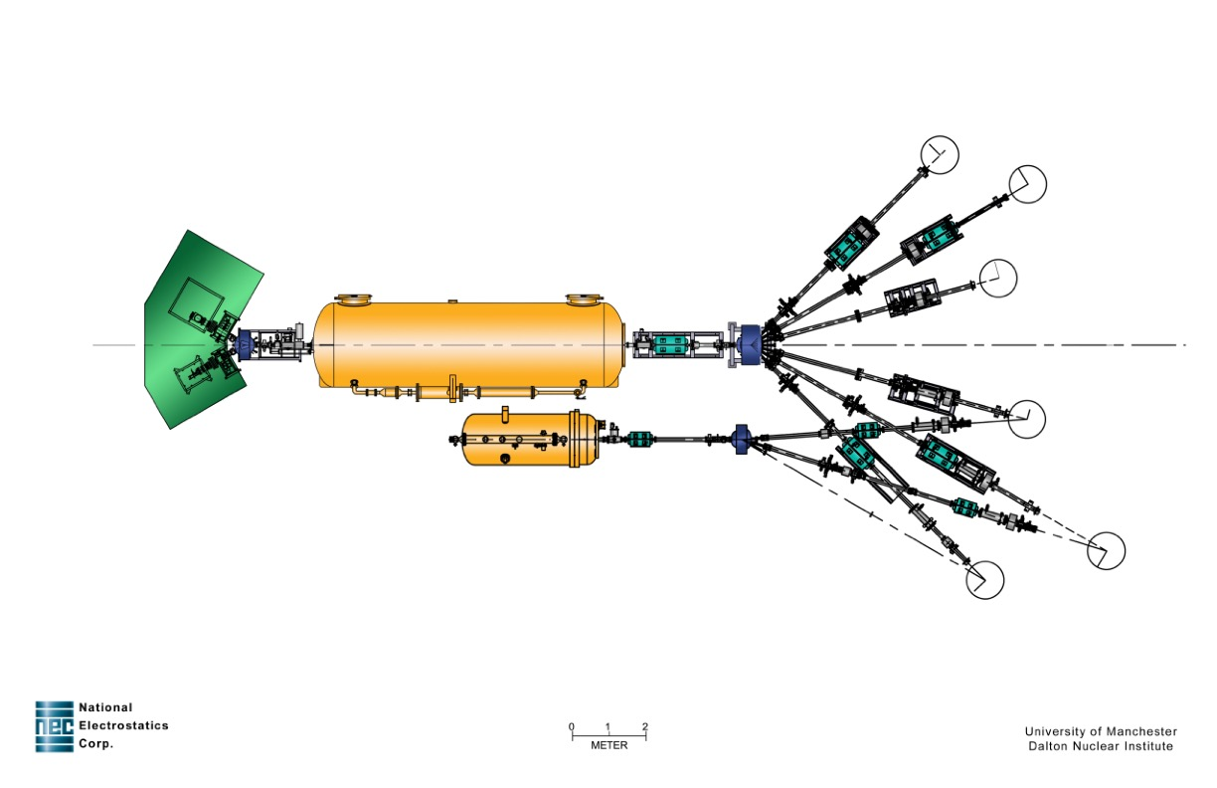
Ion Beam Accelerators
Commercial NEC Pelletron
5MV Tandem
  Proton, alpha, deuterium Torvis
  20 cathode heavy ion SNICS
2.5MV Single
  Proton, alpha, (Ar, Kr, Xe) RF source

Slide 14
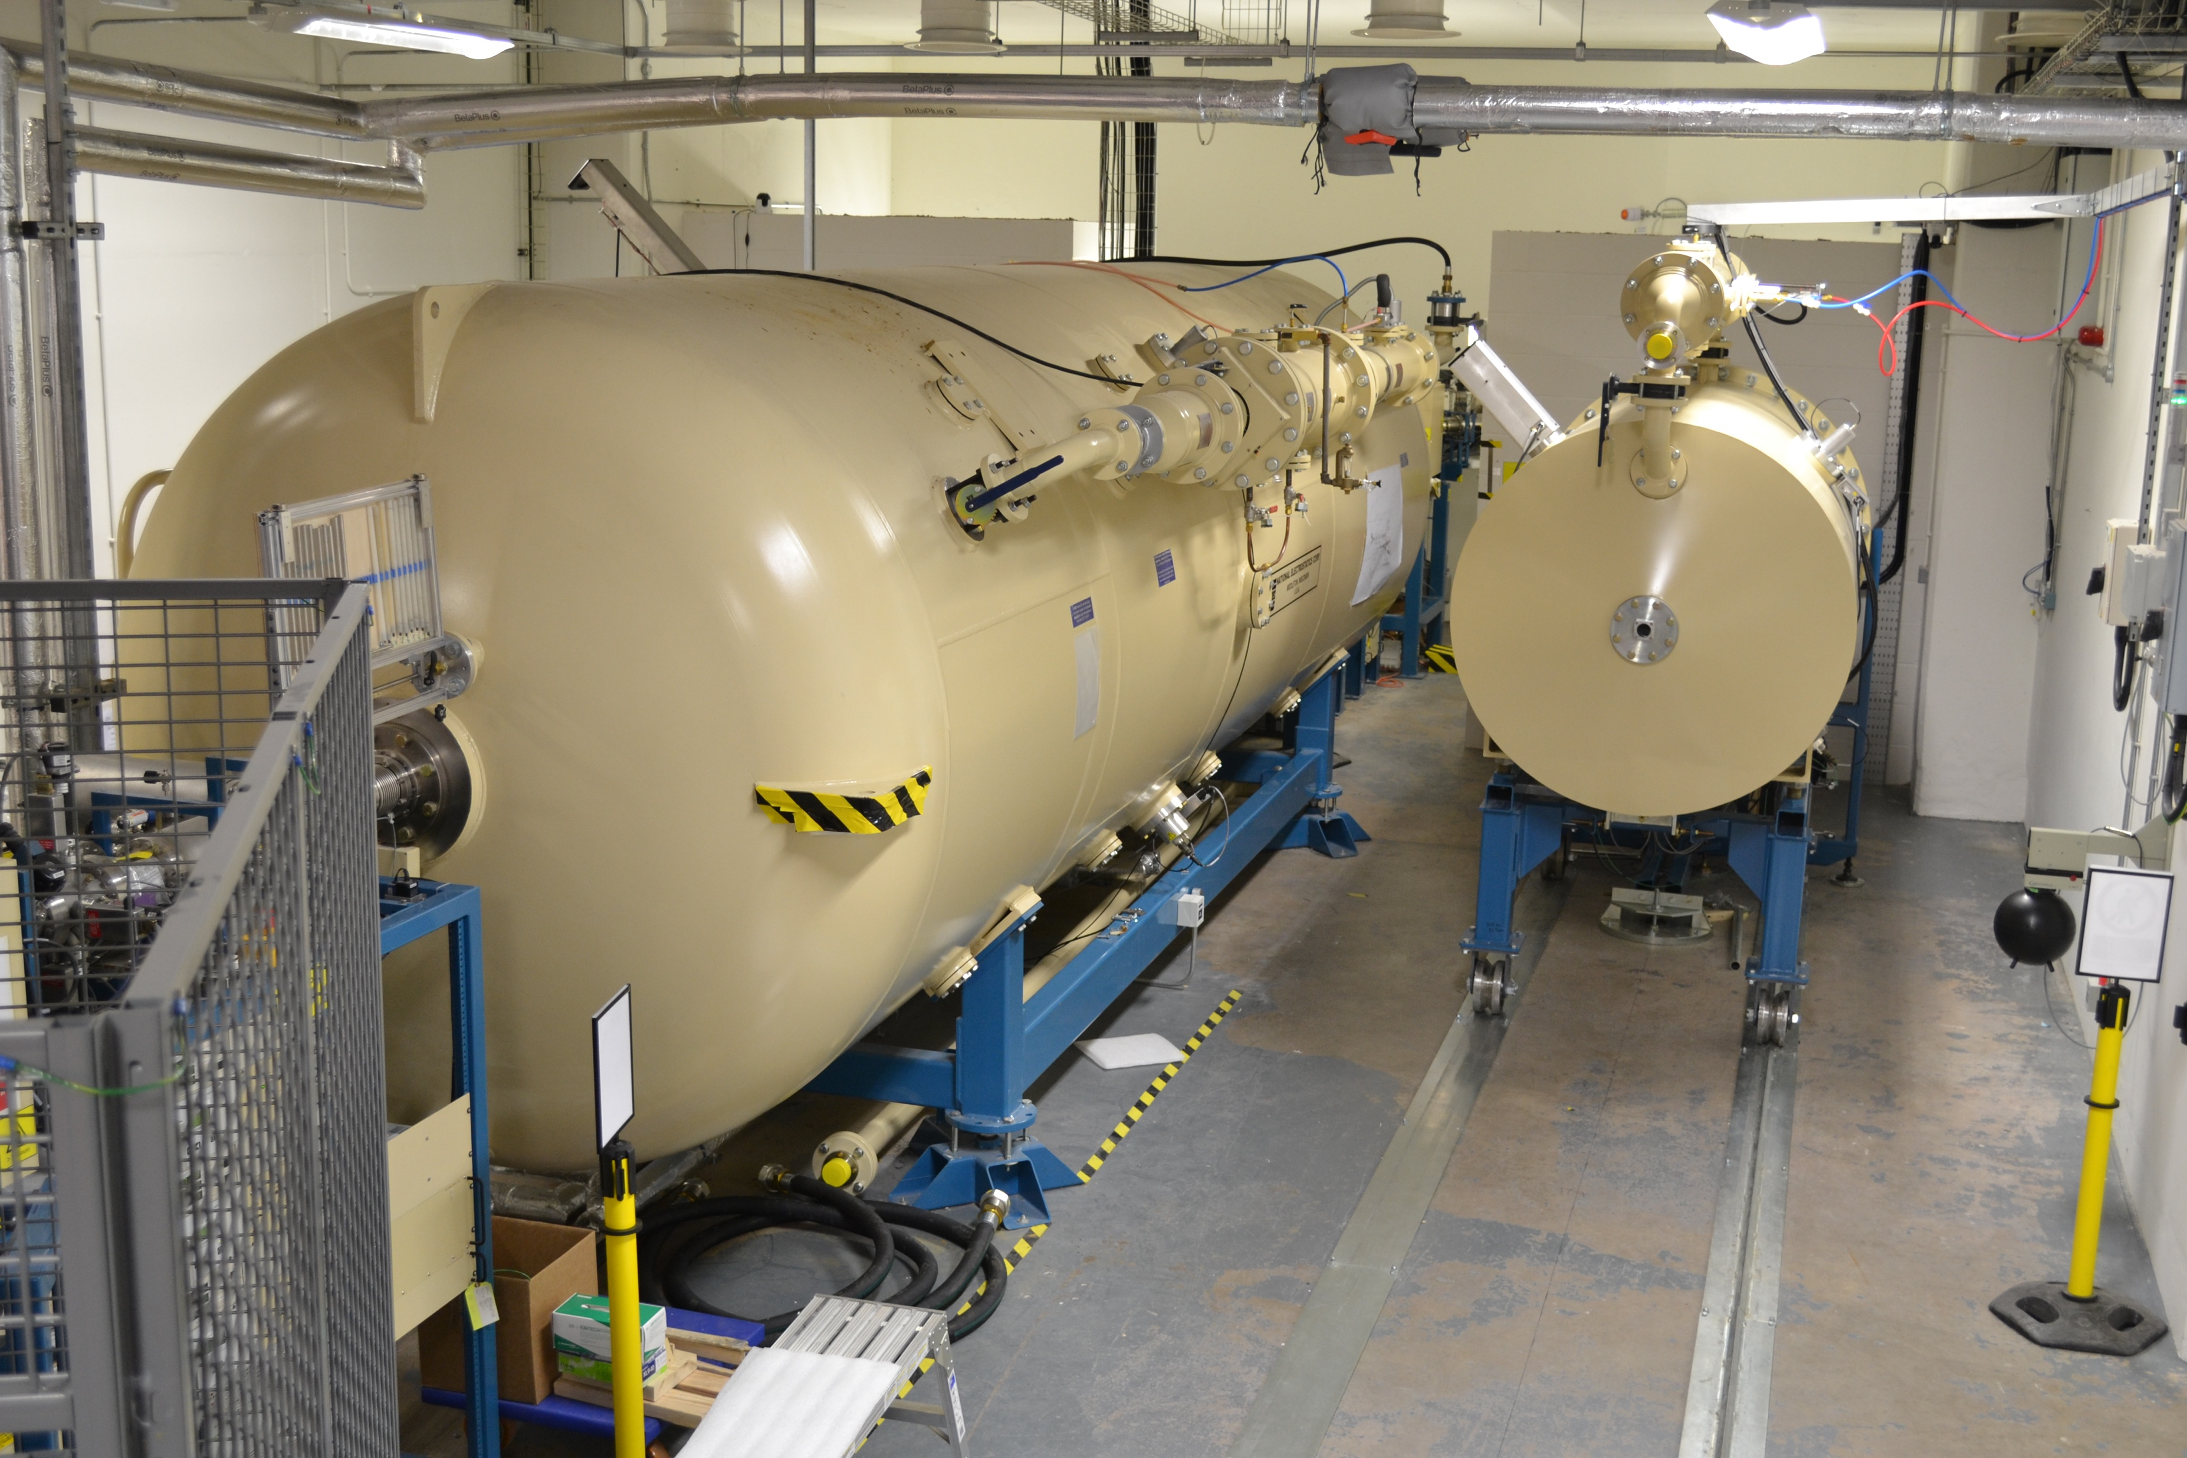
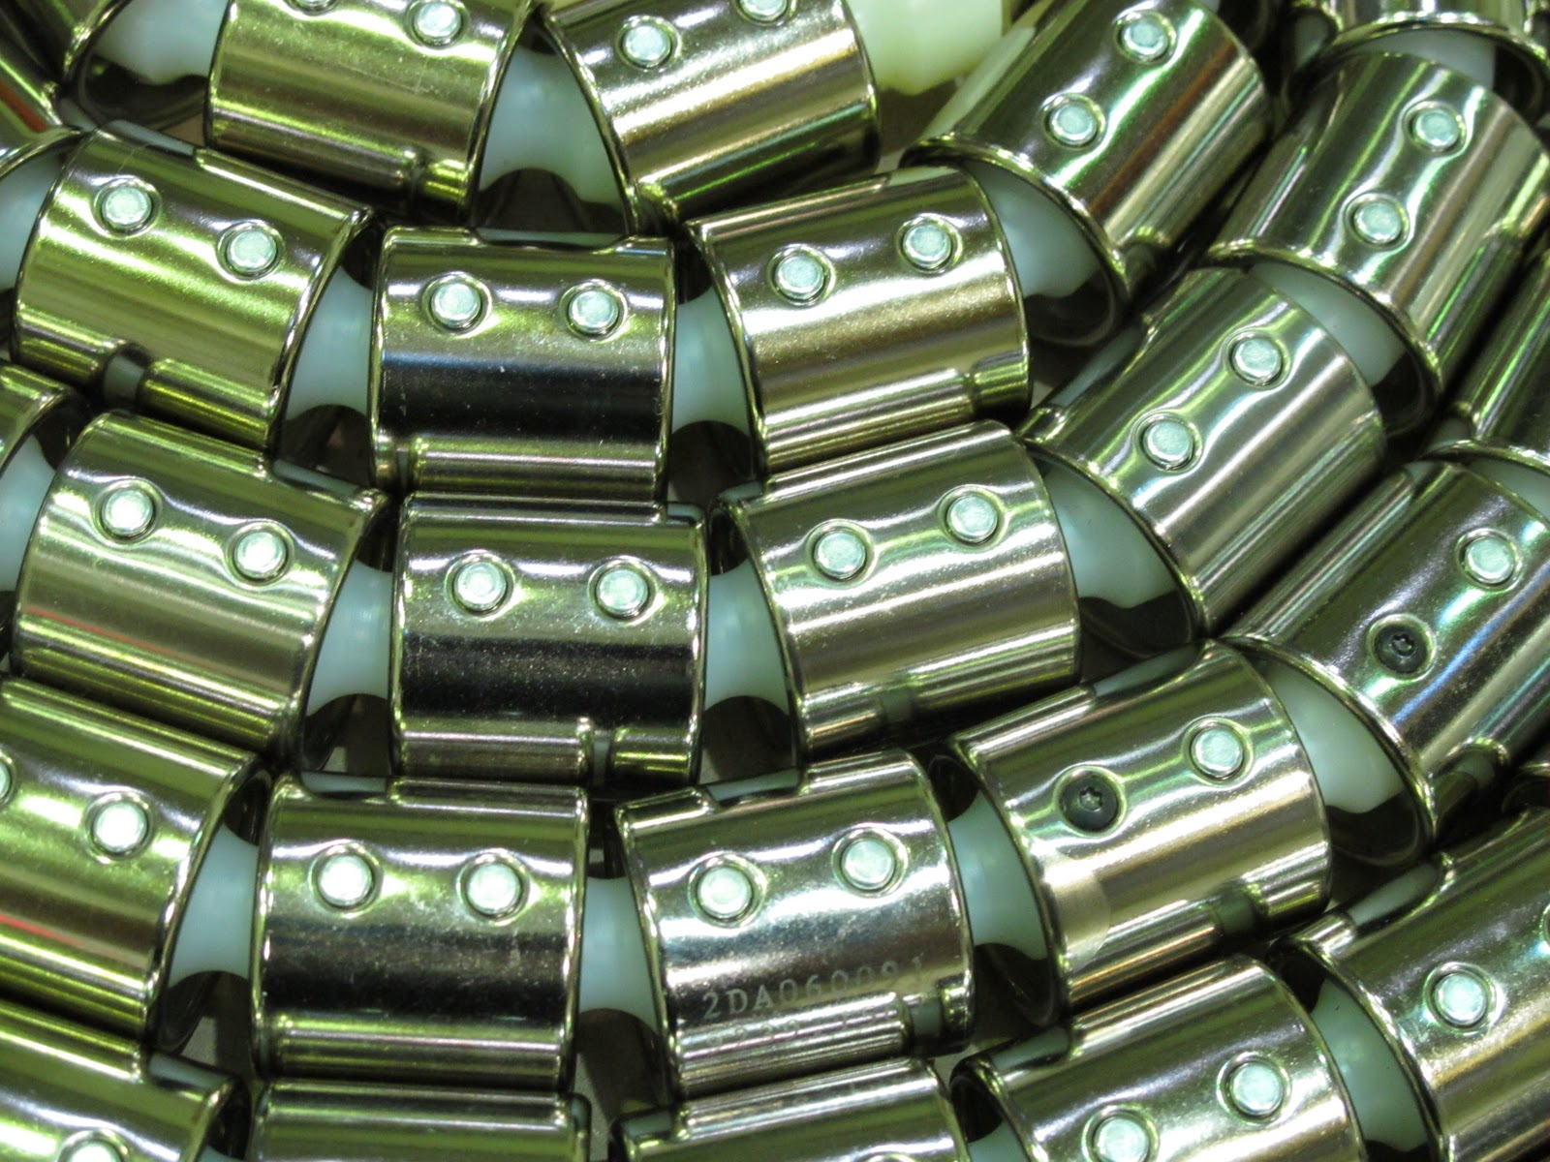
Pelletron Accelerators
Electrostatic
Simple & robust
Charging chains, charge a central terminal to high voltage
Primarily dc beams only
5 MV tandem & 2.5 MV single-ended

Slide 15
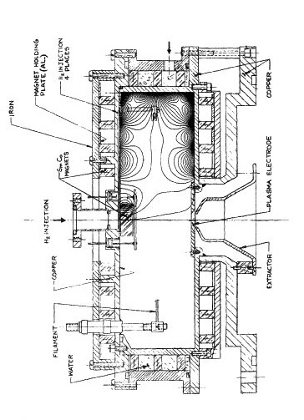
Ion Sources (1)
TORVIS
(TORoidal Volume Ion Source)
Hot filament source
  Negative ion source
  High current H/He
K.Prelec (1990) Rev.Sci.Instrum. 61 pp.415–418

Slide 16
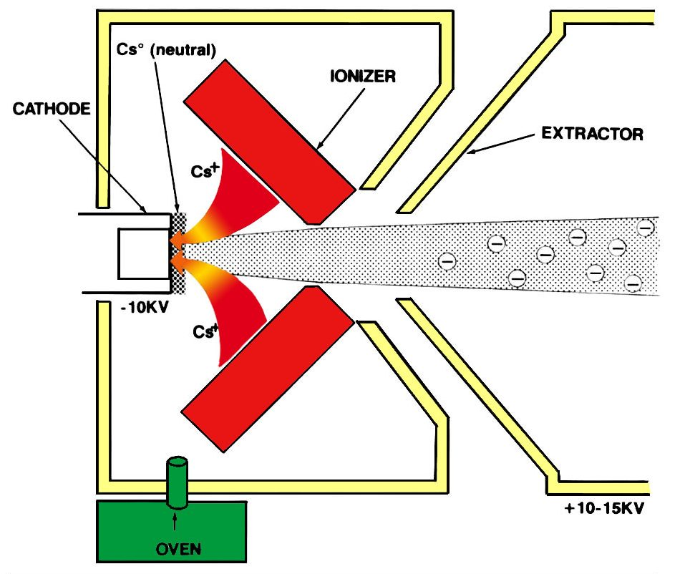
Ion Sources (2)
SNICS
(Source of Negative Ions by Caesium Sputtering)
Cs sputtered solid cathode
  Negative ion source
  20 cathode wheel
  ‘large’ (6mm Φ) cathodes for long life
  ’Heavy’ ion source (most of the periodic table)
R.Middleton (1983) Nucl.Instrum.Meth. 214 pp.139–150
R.Middleton (1994) Nucl.Instrum.Meth. B93 pp.39–51

Slide 17
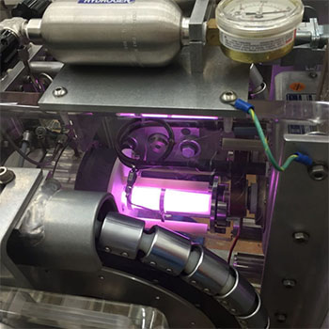
Ion Sources (3)
RF plasma
RF discharge source
  Positive ion source
  4 source bottles
  H/He (also Ar, Kr, Xe)
  High current (~100μA H⁺)

Slide 18
Example CASE Study

Slide 19
Glass composite nuclear waste forms (Tamás Zagyva)
Encapsulation of high level active waste from nuclear fuel reprocessing in borosilicate glass
Waste stream contains Mo rich solids
Vitrification of Mo-rich waste streams is a significant challenge
Low solubility in the glass leads to molybdate crystalline phases (often water soluble)
New Ca/Zn borosilicate glass for high Mo waste streams promoting formation of powellite (CaMoO4) crystals
Radiation tolerance testing using high-Z ions (Ni & Au) to simulate accumulate the ballistic effects of α-recoil.

Slide 20
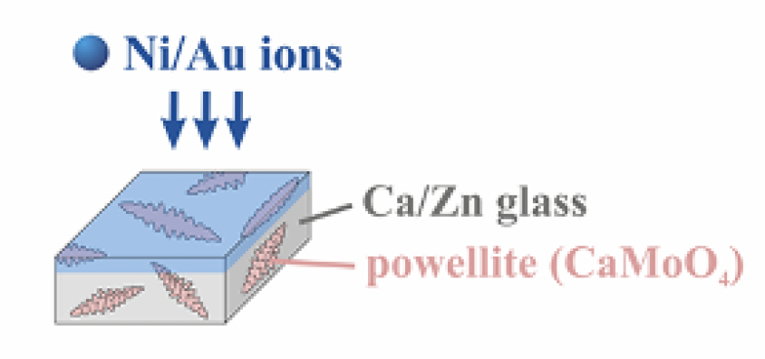
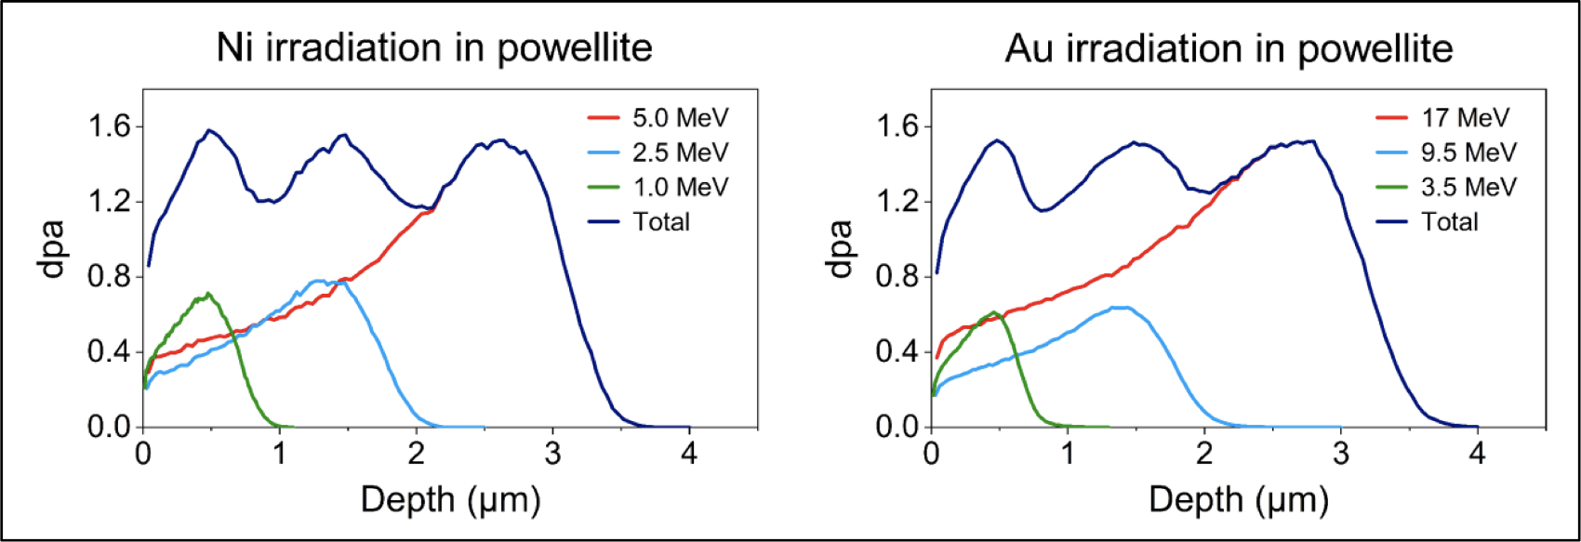
Accelerated damage rate using heavy ions
‘Low’ energy heavy ions to simulate ballistic damage from recoil alpha particles from decay mechanism in highly radioactive high level nuclear waste
T. Zagyva et al J.Nucl.Mat. 585 pp.154635 (2023)

Slide 21
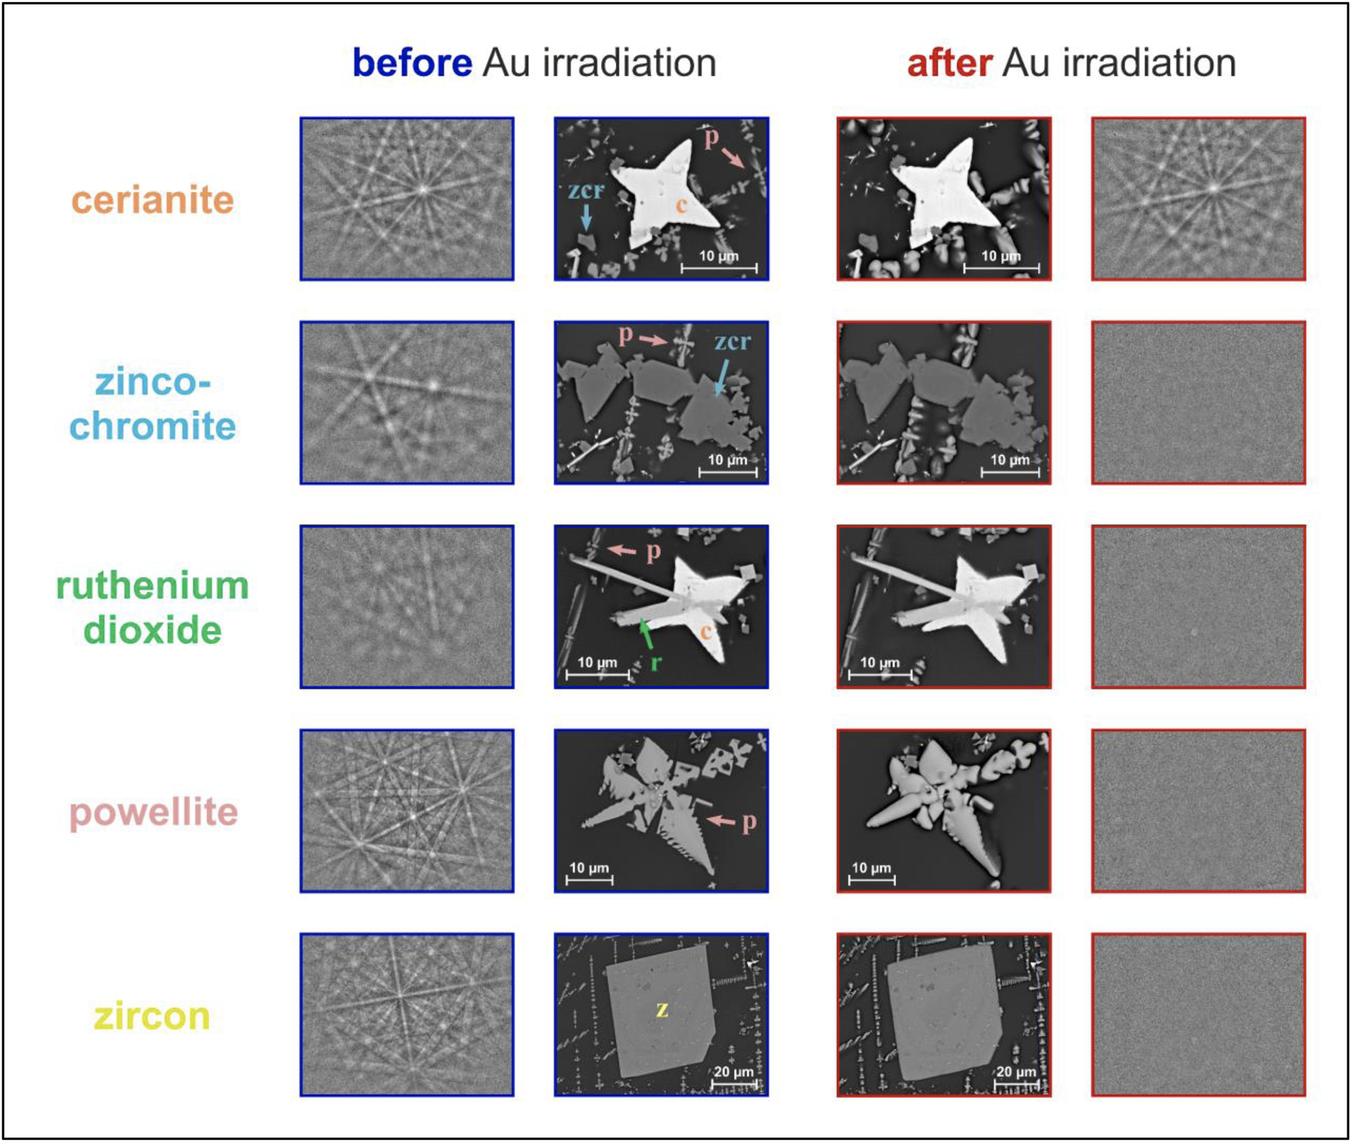
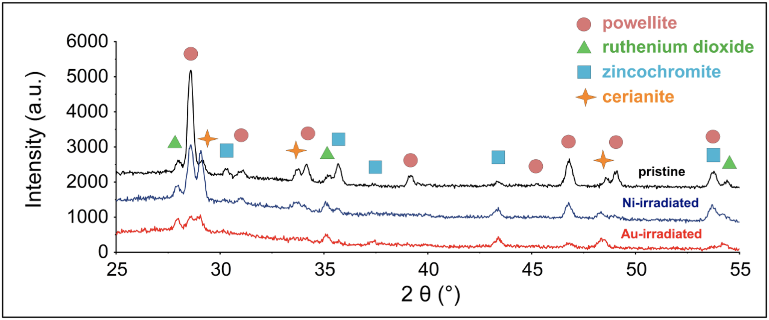
Heavy ions → Crystal amorphisation
T. Zagyva et al J.Nucl.Mat. 585 pp.154635 (2023)

Slide 22
Conclusions
Powellite & zircon crystals less radiation tolerant than previously thought
Previous low dose studies may be below threshold for damage to appear
Earlier studies using very high energy ions (100 MeV) may be misleading due to annealing effects
Radiation induced swelling could be significant and lead to microcrack formation in the HLW glass composite material.
T. Zagyva et al J.Nucl.Mat. 585 pp.154635 (2023)

Slide 23
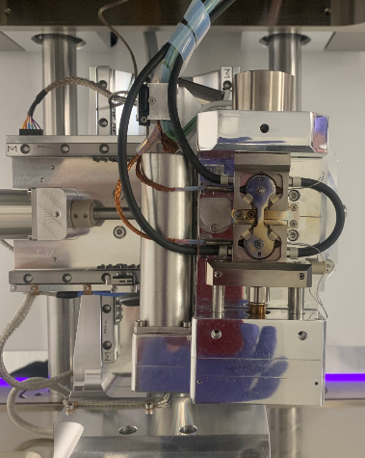
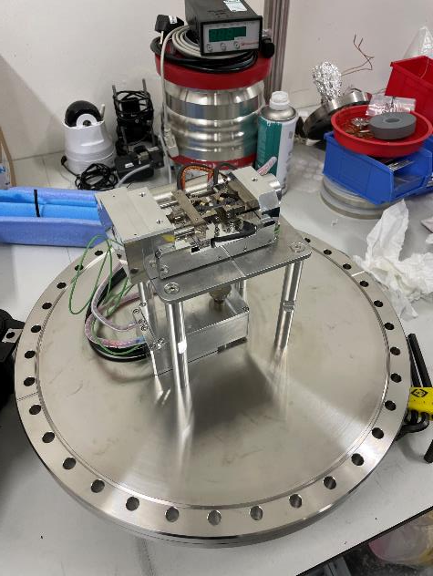
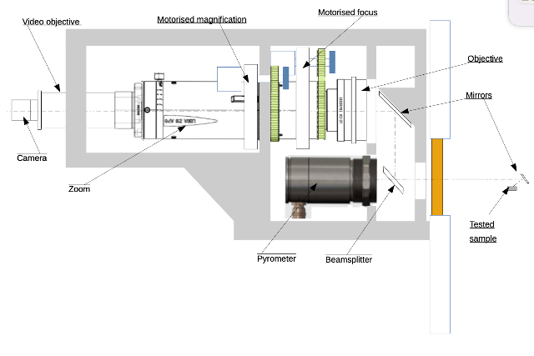
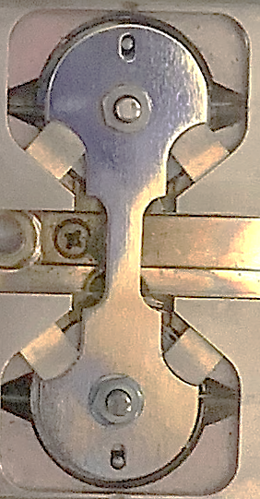
In-situ tensile test stage
Collaboration between University of Manchester & UKAEA
To perform synergistic irradiation thermo-mechanical testing
NewTec MT1000 adapted loading rig
Optical microscope and pyrometer system
Sample design and loading

Slide 24
New Applications of ion beams for DCF

Slide 25
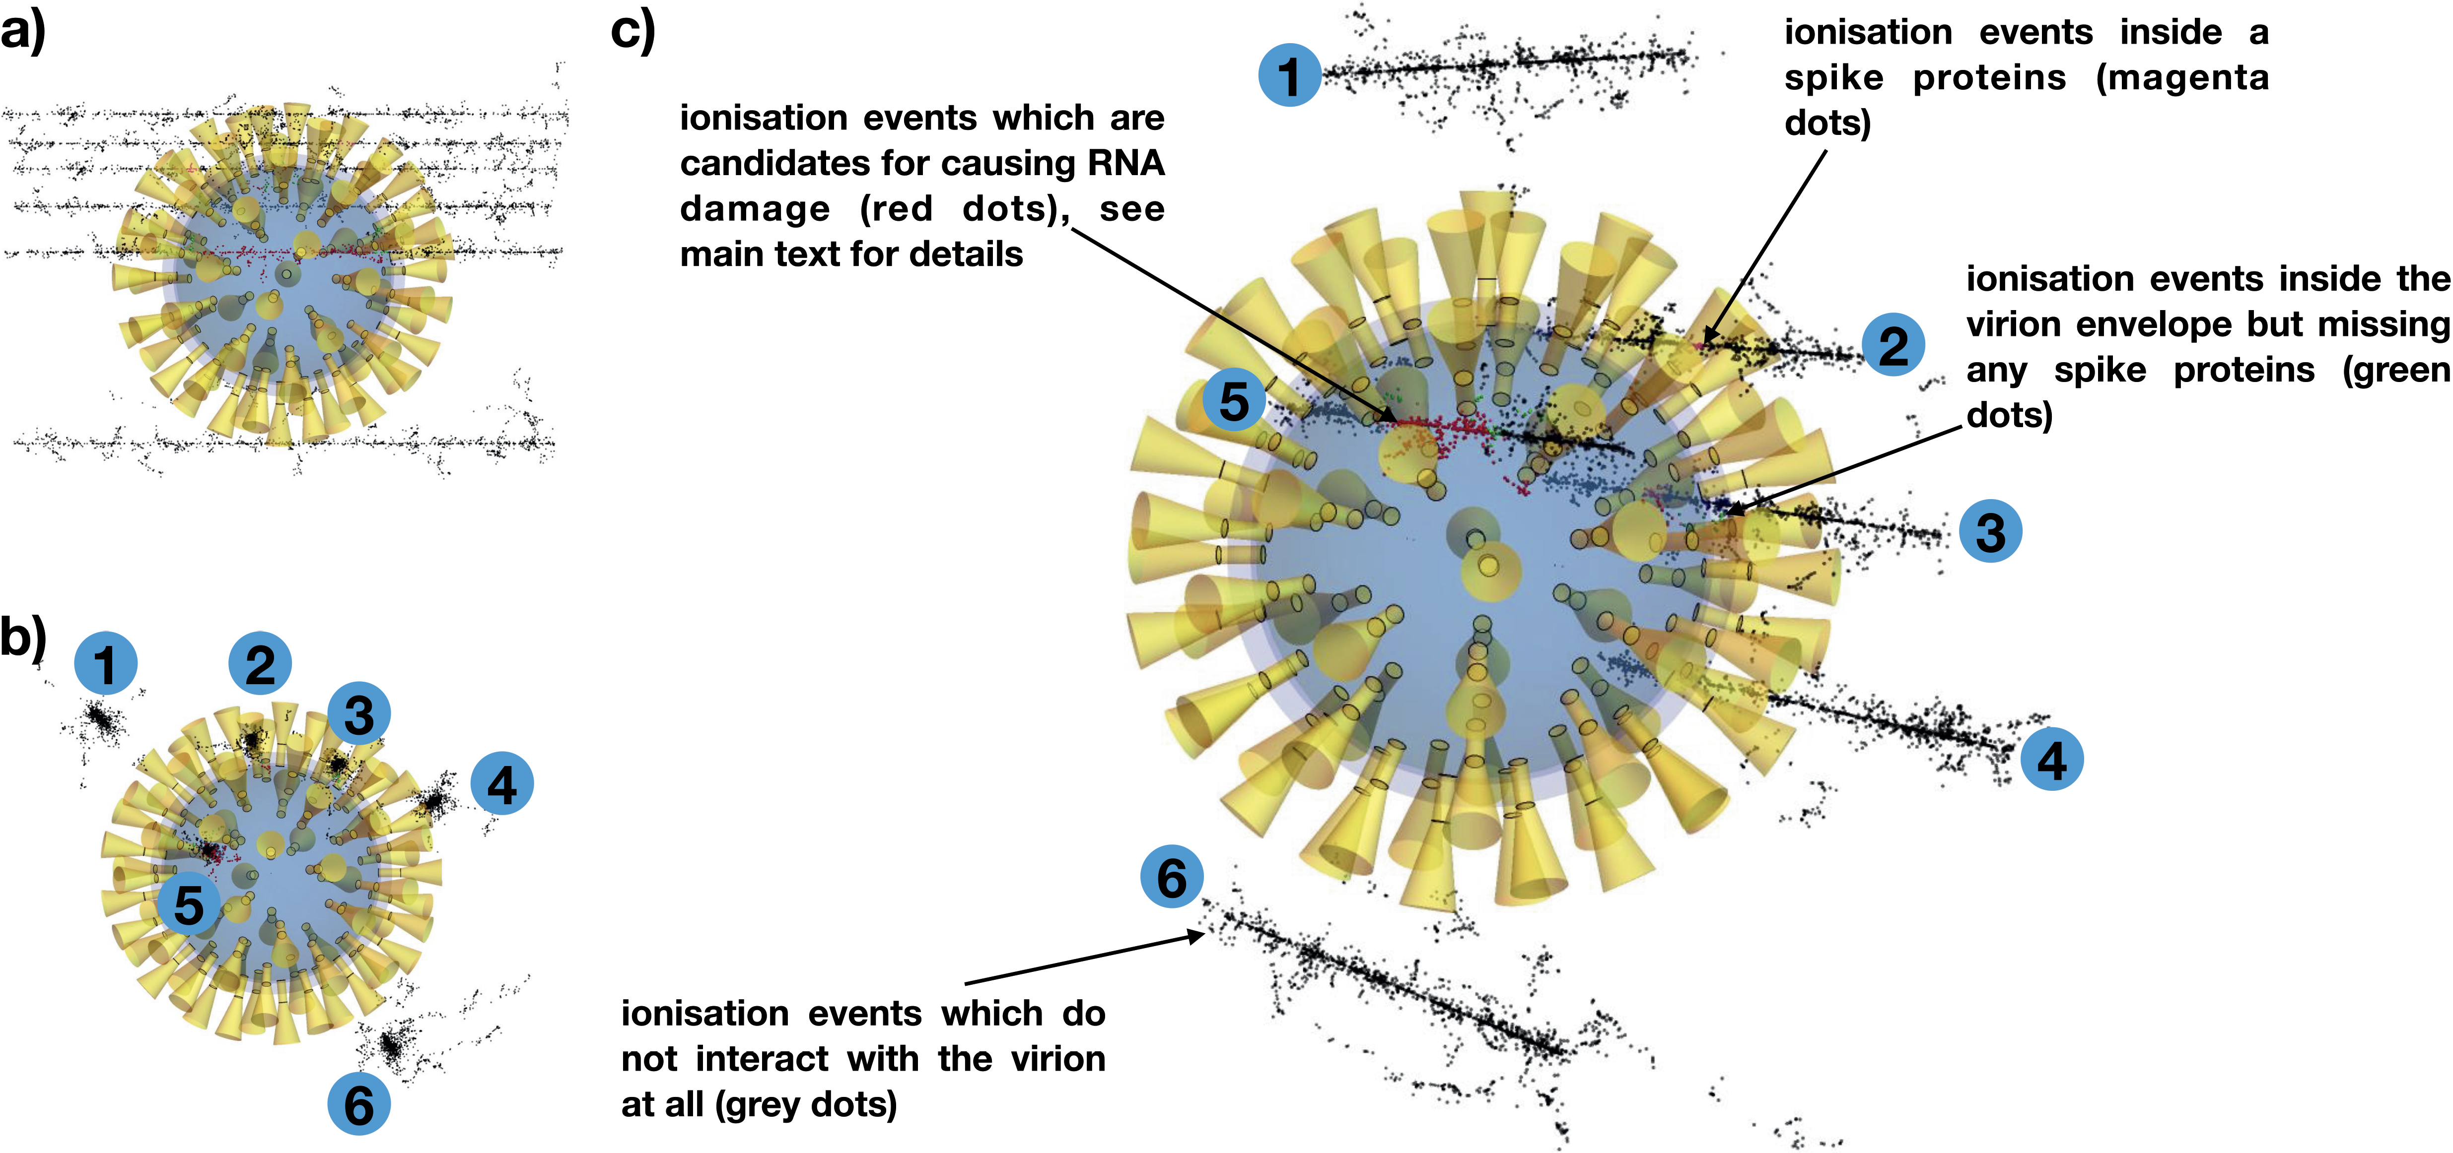
Virus in-activation by ions
Use the high LET of ions to break RNA strands in virus particles
  Without seriously damaging the spike proteins
B. Villagomez-Bernabe, S.W. Chan, J. A. Coulter, A.M. Roseman, F.J. Currell
Rad.Research 198 pp.68–80 (2022)

Slide 26

New radio-medicines
Transmutation of materials to create new radionuclides for medicine
New radio-isotopes – not in the current radio-medicine ‘tool box’
For treatment & For diagnosis (scanners)
  Transform nuclear waste into something useful
  DCF has funded (DESNZ) project to develop a capability

Slide 27
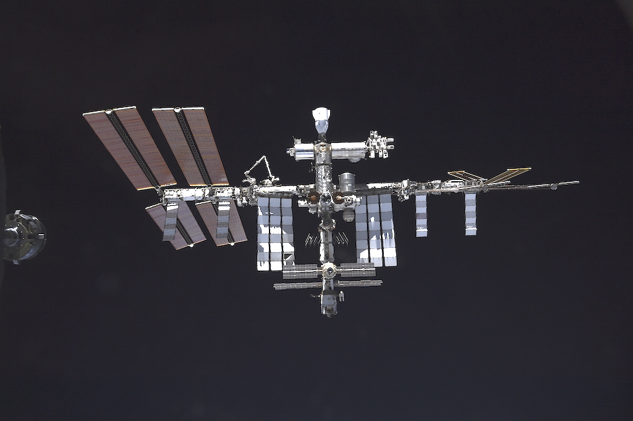
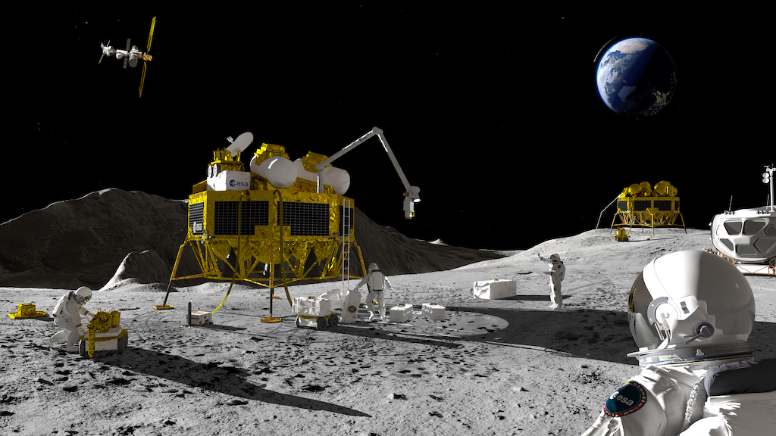
Into Space
Astrochemistry changes in inter-planetary space
Radiation damage to space-craft
  new materials (e.g. thin film solar panels)
Humanity’s return to the moon
  (and then to Mars)

Slide 28
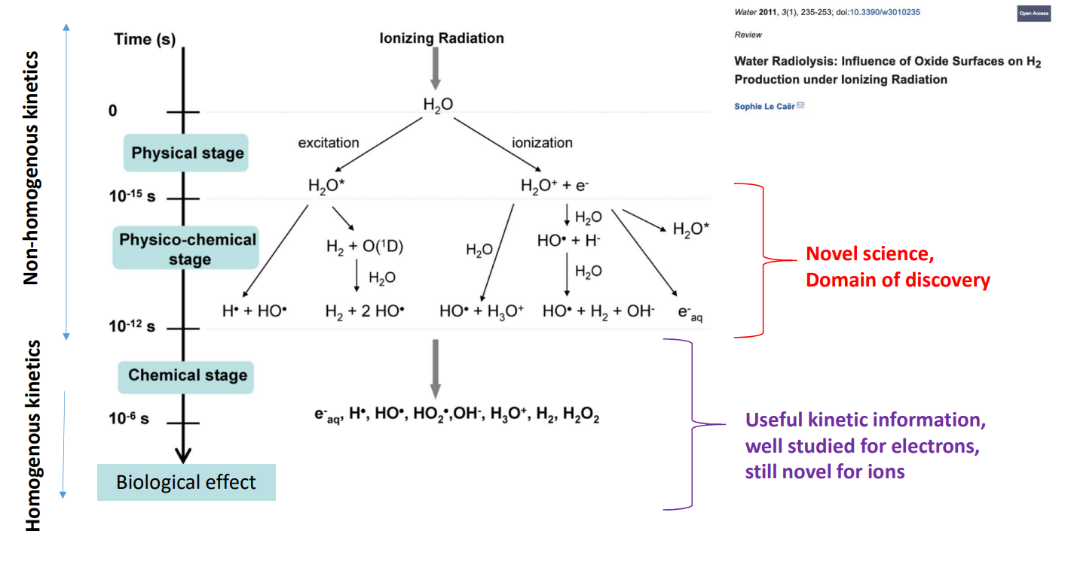
Ultra-fast kinetics

Slide 29
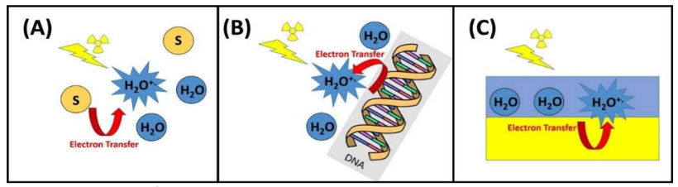
Ultra-fast processes in radiation chemistry
Radiolysed water can form radical cations that engage in electron transfer
    Highly concentrated solutions in which the water radical cation can oxidise solute molecules directly – e.g. spent nuclear fuel processing (purex)
    Highly structured water layers formed in contact with biomolecules e.g. DNA – cancer therapy
    Water/solid interfaces – safe nuclear waste storage, Pu stewardship, corrosion in reactors & storage ponds.
How to generate ultra-short ion pulses ?

Slide 30

Acknowledgements
Ion Accelerator Team – Samir Shubeita, Mel O’Leary, Aidan Milston + 1 other
Fred Currell + Rob Jones
DCF Admin team
Staff & students @ DCF
Funding agencies : Henry Royce Institute, UK National Ion Beam Centre, NNUF & others

Slide 31
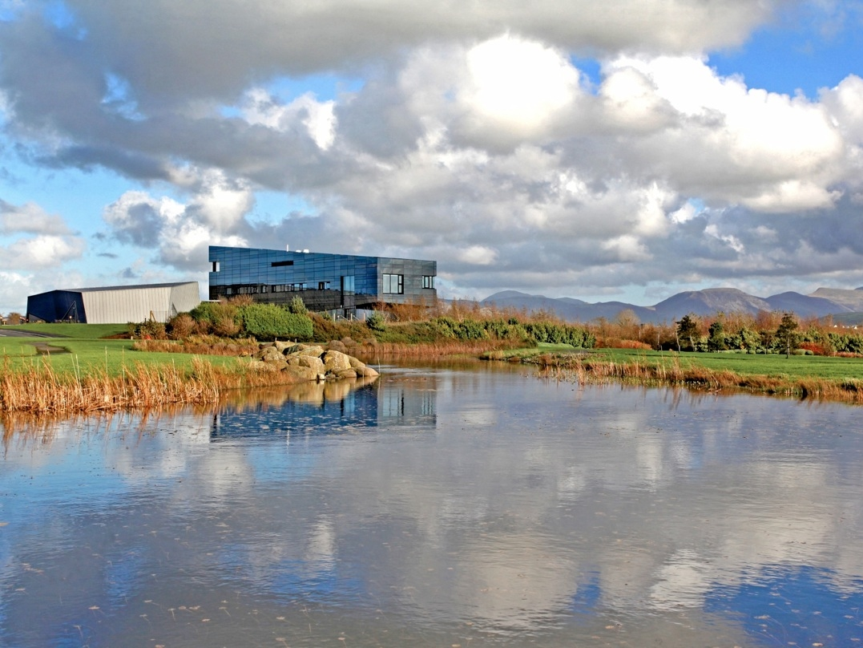
Thank You!
Andy.smith@manchester.ac.uk
www.dalton.manchester.ac.uk

