Slide 1



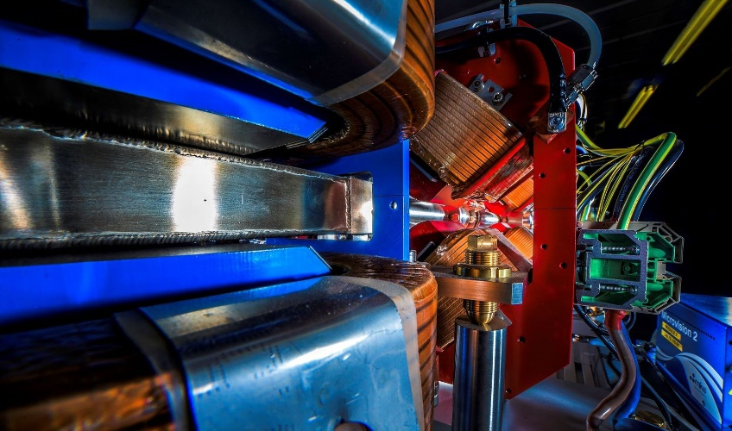
Making a brighter future through advanced accelerators
UK National Accelerator Facilities Landscape
Deepa Angal-Kalinin
ASTeC, STFC Daresbury Laboratory and The Cockcroft Institute
PAB Conference, 11th -12th June 2024, Workington

Slide 2

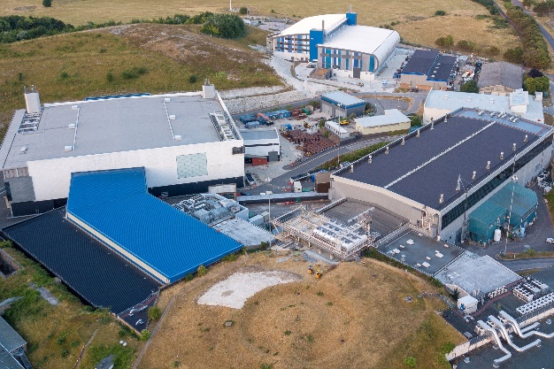
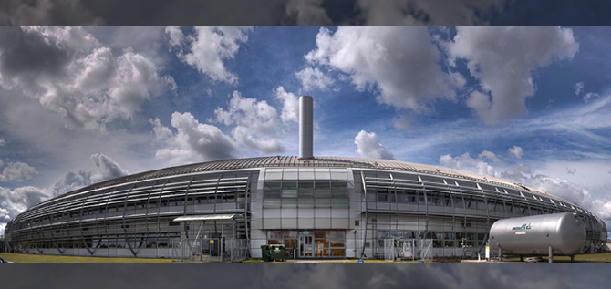
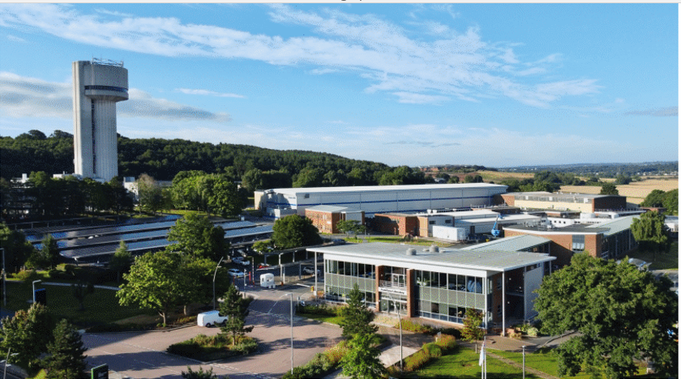
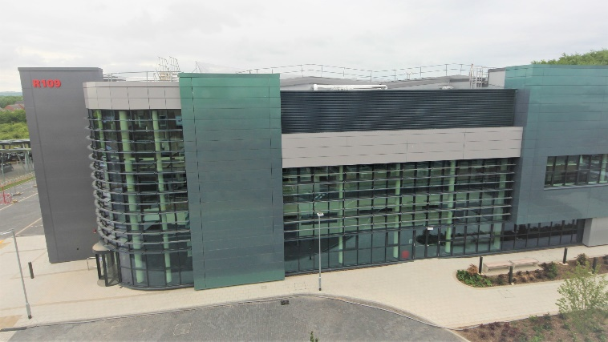
Outline
UK National Accelerator Facilities
Infrastructure opportunities
Status of new national projects

Slide 3
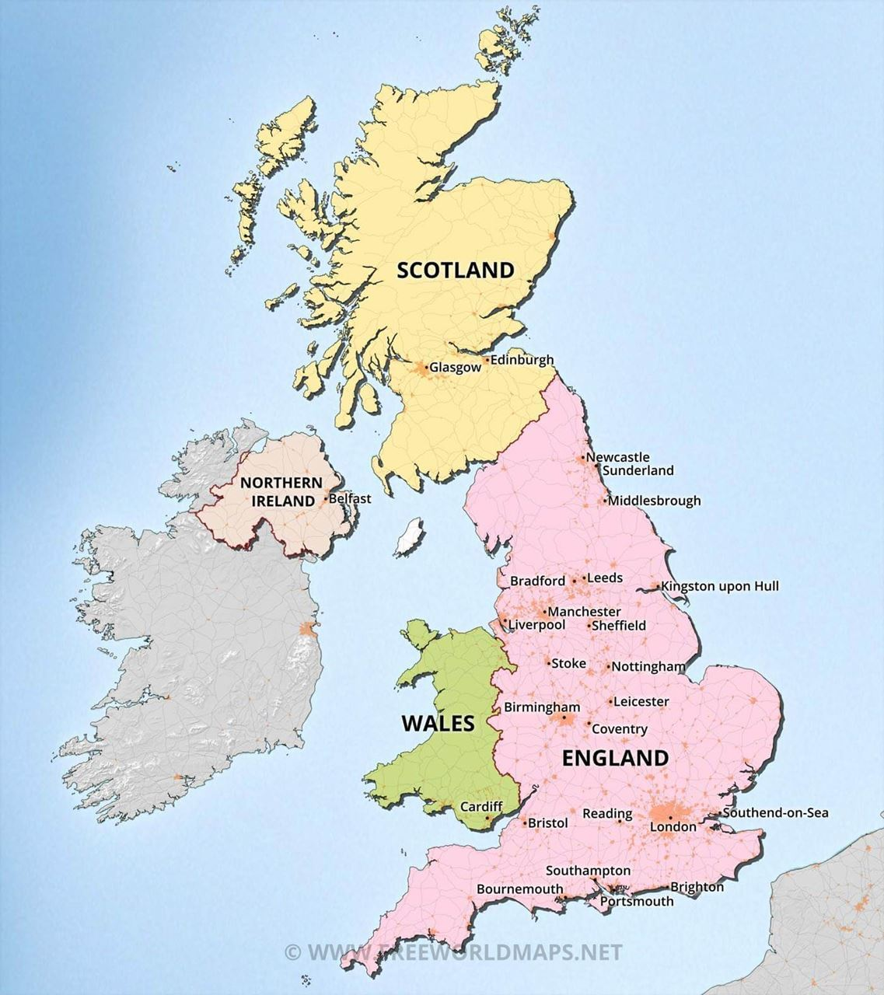








UK National Accelerator Facilities
ISIS: 800 MeV protons, 50 Hz generating neutrons and muons
(Operational 1984 – Present)
ISIS II upgrade
CLARA: 50 MeV e-, 10 Hz
(operational 2018 – 2023)
CLARA: 250 MeV e-, 100 Hz
RUEDI: 1-4 MeV e- diffraction & imaging,100 Hz (1KHz)
EPAC: 1 PW, 10 Hz ; LWFA
ITRF/
ITRF/LhARA: protons (15-127 MeV)/ions (5-34 MeV/u)
Diamond: 3 GeV e- storage ring, 32 beamlines
(Operational 2007 – Present)
Diamond-II: 3.5 GeV, 35 (37) beamlines
Planned upgrades/ future projects
UK XFEL : Conceptual Design & Options Analysis

Slide 4
UK Infrastructure Funds
A prioritisation process for identified infrastructure opportunities has now been running for three years
Two types of proposal can receive funding:
  Full project – requesting the funds for the full project
  Preliminary Activity – requesting funds for some up-front activity (typically a design study) with the expectation of later being resubmitted as a Full Project request
Current status:
  ISIS-II (preliminary activity)
  RUEDI (full project funding approved, business case submission 2024, construction starts 2026 )
  Diamond-II (full project funding approved, project completion March 2030)
  Ion Therapy Research Facility (preliminary activity)
  UK XFEL (preliminary activity)
The EPAC was funded prior to this process (different route) and is under construction at RAL
CLARA, built in phases at DL also funded separately to this process.

Slide 5
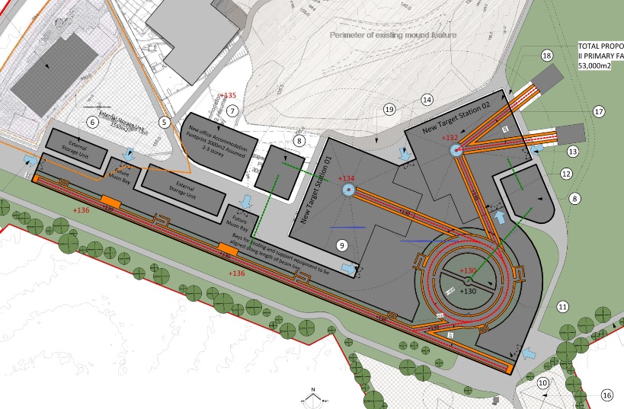
ISIS -II
Phase 1
Phase 2
Phase 3
    Favoured option is a new, stand-alone facility.
    MW-class is expected, but dependent on target technology.
    Two target stations from day one.
  Accelerator options:
2019
2021
2028
2032
2040
Feasibility, design studies and R&D
Integrated facility technical design
ISIS-II construction
                Low energy linac with rapid cycling synchrotron to bunch compress and accelerate up to 1.2 GeV.
                Low energy linac with fixed-field alternating-gradient accelerator to bunch compress and accelerate up to 1.2 GeV.
                Full energy linac with accumulator ring to bunch compress at 1.2 GeV.
ISIS upgrade talk by Billy Kyle next!
Similar scale facility to ESS or SNS
Courtesy of John Thomason

Slide 6
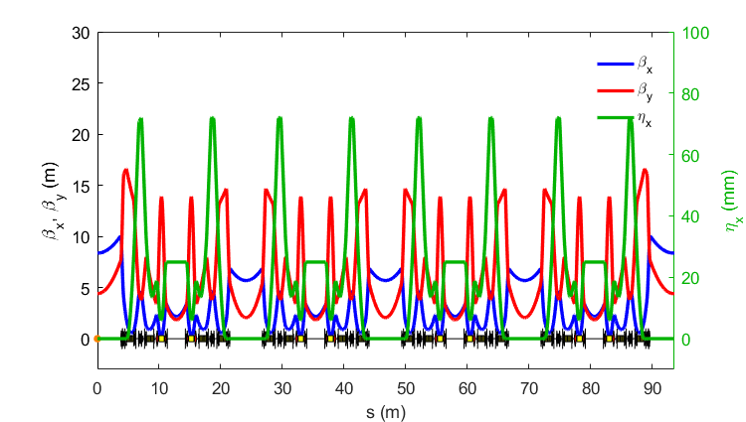
Diamond II - Objectives
Objective #1: Optimise the science enabled at Diamond
Objective #2: Maximise the impact it has for researchers both in universities and in industry
New Modified Hybrid 6-Bend Achromat (M-H6BA) storage ring
  Lower emittance (x~20) to increase brightness and coherence
  Double number of straight sections to increase capacity
Raise energy from 3 GeV to 3.5 GeV to increase flux and brightness above 10 keV
Upgrade insertion devices, new flagship beamlines
Improved data handling/computation, automation, ...
Technical Design Report published in October 2022:
https://www.diamond.ac.uk/Home/News/LatestNews/2022/14-10-22.html
1 super-period of M-H6BA
 | Bare lattice | With IDs
Average ε_{x}* | 163 pm.rad | 120 pm.rad
Average σ_{E}* | 0.095 % | 0.109 %
Average σ_{L}* (RMS) | 49.1 ps | 48.1ps
Total Lifetime* | 7.0 ± 0.2 | 7.0 ± 0.3
Courtesy of Ian Martin & Richard Walker

Slide 7
1. Diamond-II Project
WBS 1.1 Machine
WBS 1.2 Beamlines
WBS 1.3 Core Software, Controls & Computing
WBS 1.4 Buildings & Infrastructure
WBS 1.5 Project Management
Diamond II - Top-Level Work Breakdown Structure
A major upgrade of the machine, replacing most of the Booster synchrotron and Storage Ring.
A boost in data handing and analysis hardware & software, to manage the increased data rates.
Enhanced Project Management processes.
A new Diamond Extension Building for Diamond-II assembly work, as well as several other on- and off-site storage buildings.
3 new ‘flagship’ beamlines + significant upgrades to many existing beamlines.
Courtesy of Ian Martin & Richard Walker

Slide 8
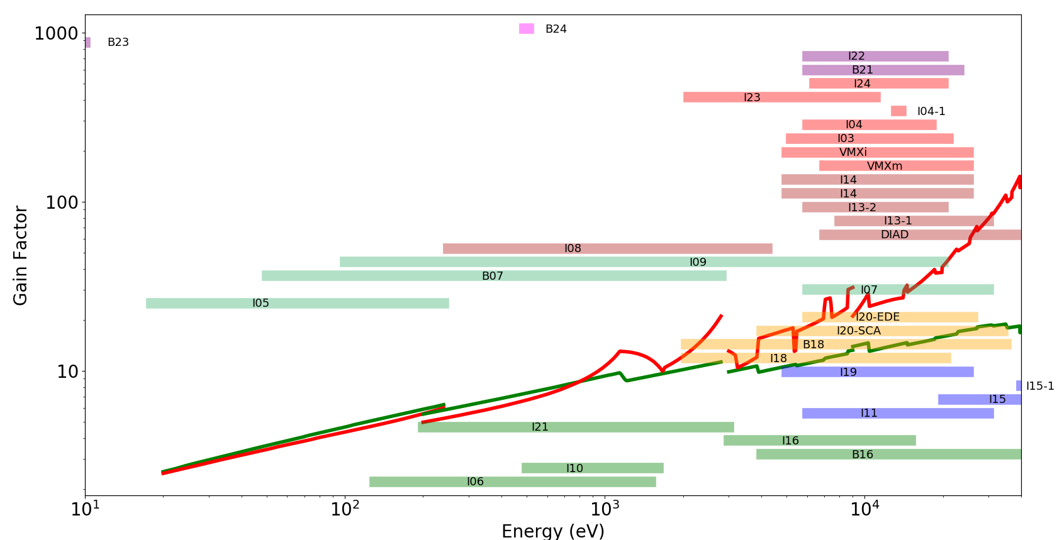
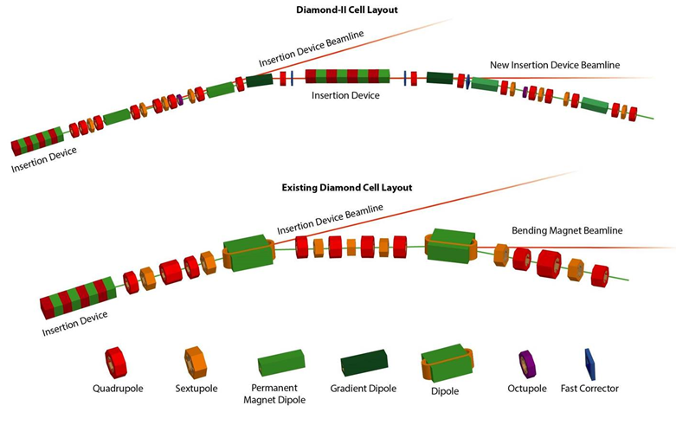
Diamond II – Layout & Brightness
Diamond-II 6BA lattice
3.5 GeV 161 pm
Diamond DBA lattice
3.0 GeV
118 pm
 | emittance (no IDs) | Ratio | emittance (IDs+IBS+3HC) | Ratio
Diamond | 2.7 nm | 16.8 | 3.1 nm | 22.3
Diamond-II | 161 pm |  | 139 pm
Courtesy of Ian Martin & Richard Walker

Slide 9
Diamond II – Project Status & Key Milestones
Project Status
Tendering for major components underway:
Solid-state amplifiers for normal conducting RF cavities (ITT Aug ’23, contract placed Nov ’23)
Storage ring quadrupole magnets (ITT Jan ’24, contract placed Mar ’24)
Superconducting 3rd harmonic RF cavity (ITT Feb ’24 , contract placed May ’24)
Storage ring sextupole magnets (ITT Mar ’24 , contract placed May ’24)
Booster magnet power supplies (ITT Mar ’24)
Booster girder assemblies (ITT Apr ’24)
Transverse gradient (DQ) electromagnet dipoles (ITT June ’24)
Major items in next few months:
Permanent magnet blocks and shunts for storage ring longitudinal gradient (DL) dipoles
Main RF cavities
Hybrid permanent magnet undulators
Copper and stainless-steel girder vacuum vessels (NEG coated)
Key Milestones
Project approval and first Calls For Tender – Jul. 2023
Completion of Diamond Extension Building – Feb. 2025
Start of the Diamond-II shutdown (the 18-month “dark period”) – Dec. 2027
Start of storage ring commissioning – Dec. 2028
Start of regular beamline X-ray commissioning – Jun. 2029
First phase of operational beamlines – Sep. 2029
First User on a flagship beamline – Jan. 2030
Diamond-II Project completed – Mar. 2030
Courtesy of Ian Martin & Richard Walker

Slide 10


Extreme Photonics Applications Centre (EPAC)
Centre for applications of laser-driven plasma sources in industry, medicine, security etc.
New building housing a PW laser system operating at 10 Hz with two independent experimental areas.
Focus on developing LWFA driven beams at 10 Hz: up to 10 GeV electron beams, x-rays.
Improved capability for studies of fundamental science using laser-driven secondary sources.
£100M investment (UKRI & MOD)
~ £6M p.a. expected operational cost
Installation underway
Operational in 2026
Courtesy of Dan Symes

Slide 11
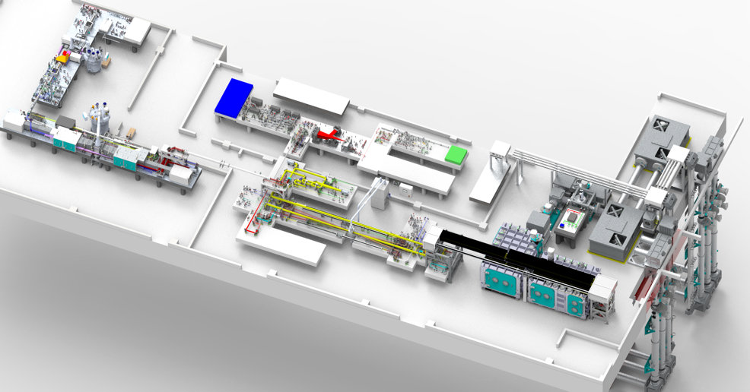
EPAC Laser System
EPAC specification
1PW@10Hz
Output Energy 30 J
Pulse duration ≤ 30 fs Repetition rate 10 Hz, 1 Hz, Shot on Demand
EPAC Front End
Beam transport
DPPLS Pump
Pump for Ti:Sa is CLF developed 100J DiPOLE system.
Additional space for future laser and experimental areas (eg. a 100Hz system under development)
Green conversion
Ti:Sa High Energy Amplifier
Compressor & diagnostics
EPAC Front End
10 Hz TiSa Amplifier
Compressor
Beam propagation
Experimental Areas
EPAC pump
2 W Conversion
Courtesy of Dan Symes

Slide 12
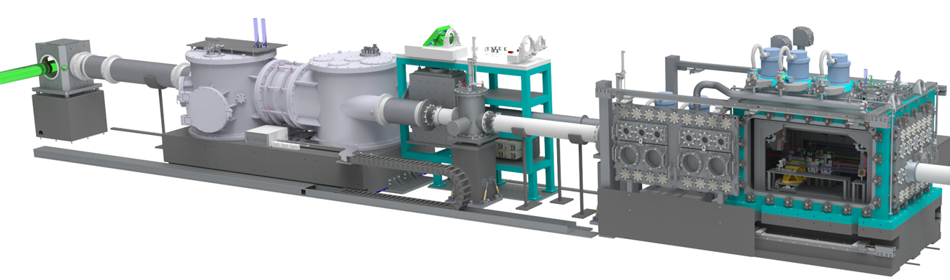
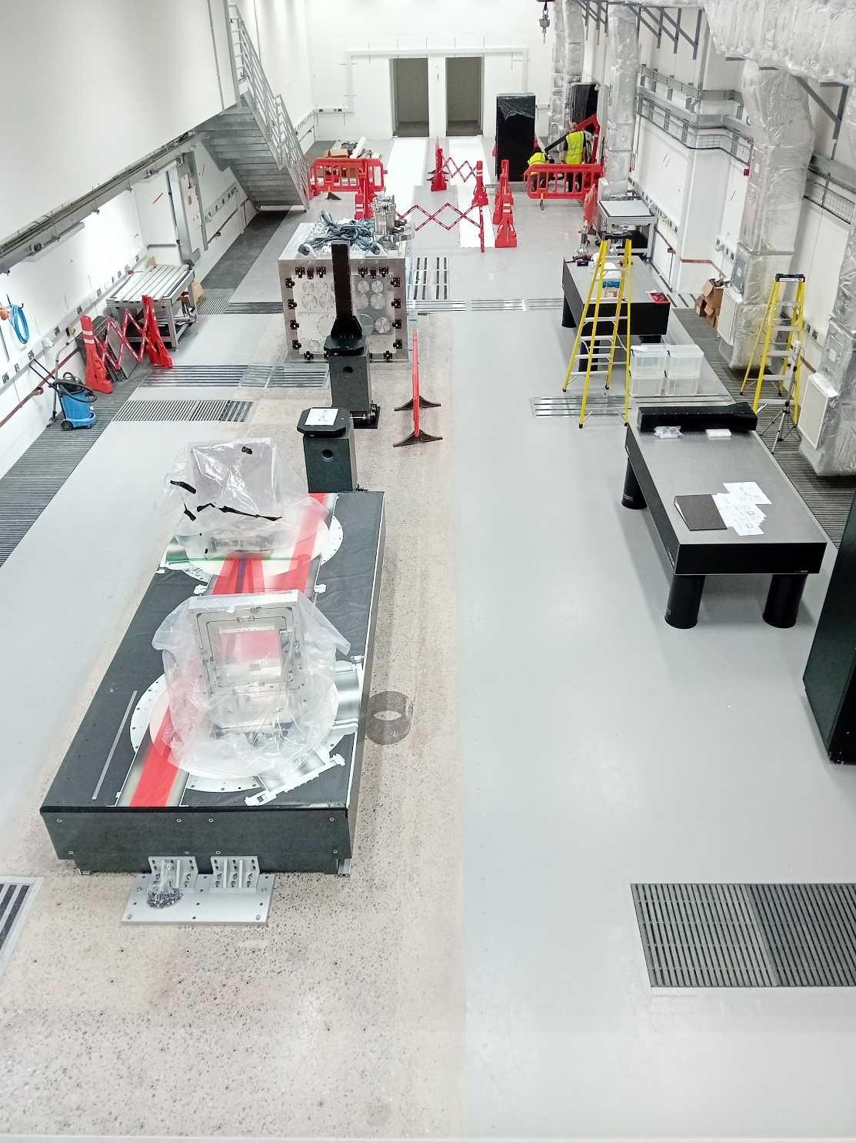
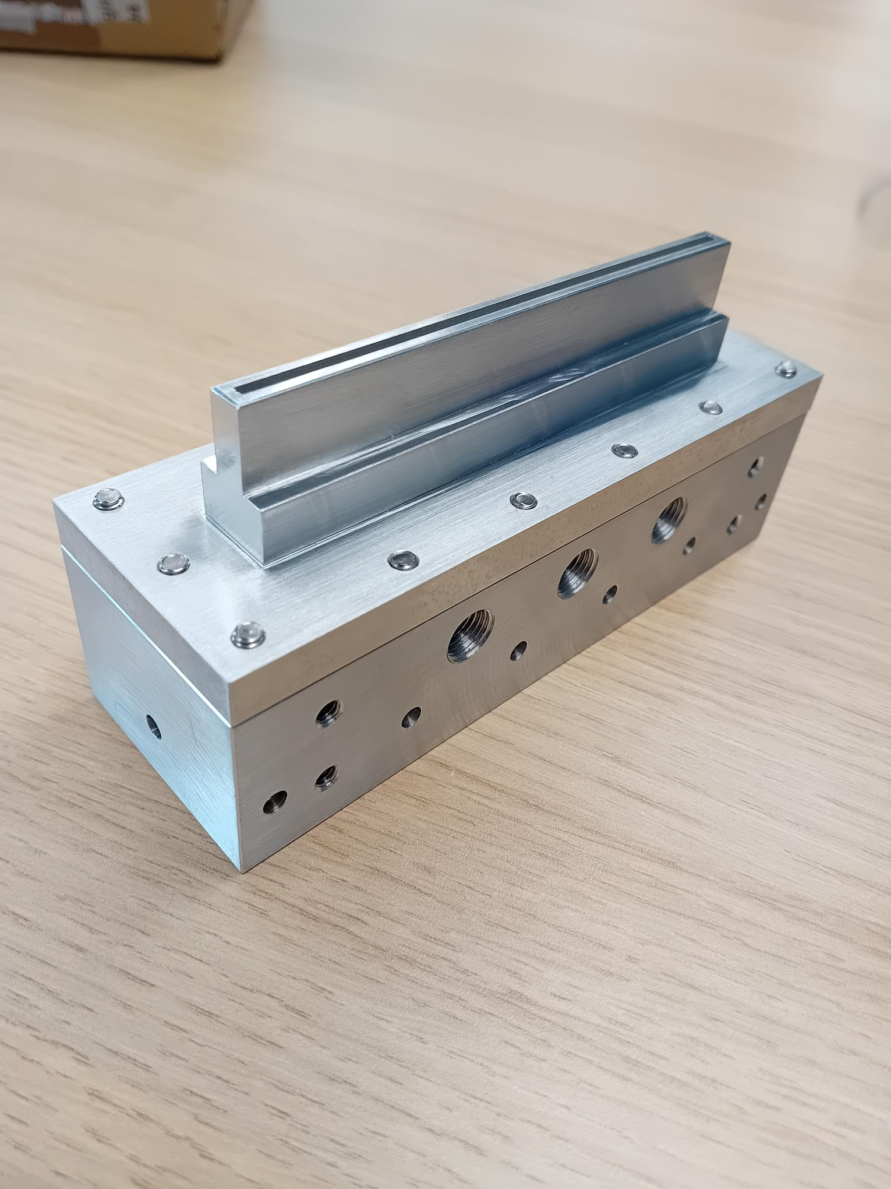
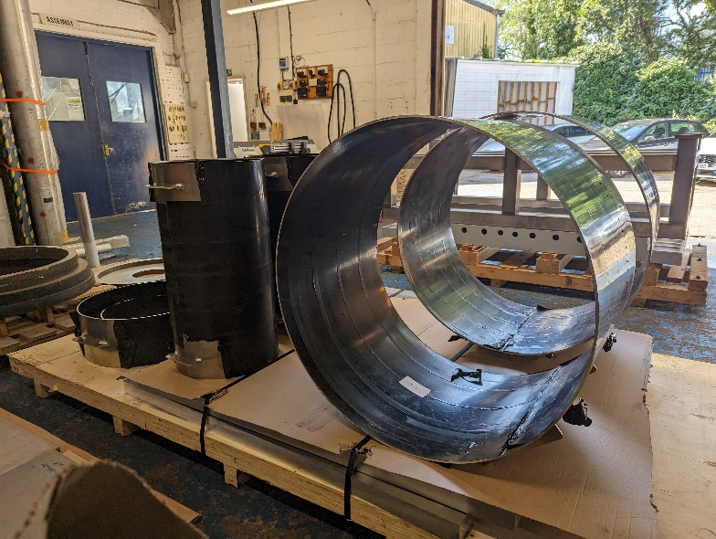
EPAC EA1
Turning chamber
Beam focusing
Interaction chamber
Off-axis parabola: focal length 6 m (f / 27) – 14.5 m (f / 65)
Adaptive optic for focal spot control
20 x 9 m area for flexible applications beamlines
Focusing chamber in manufacture with HiVac , expected delivery by summer 2024
Precision engineered slot nozzles for gas jet targets
EA1: the optic mounts for adaptive optic and parabola, and the target chamber.
Courtesy of Dan Symes

Slide 13

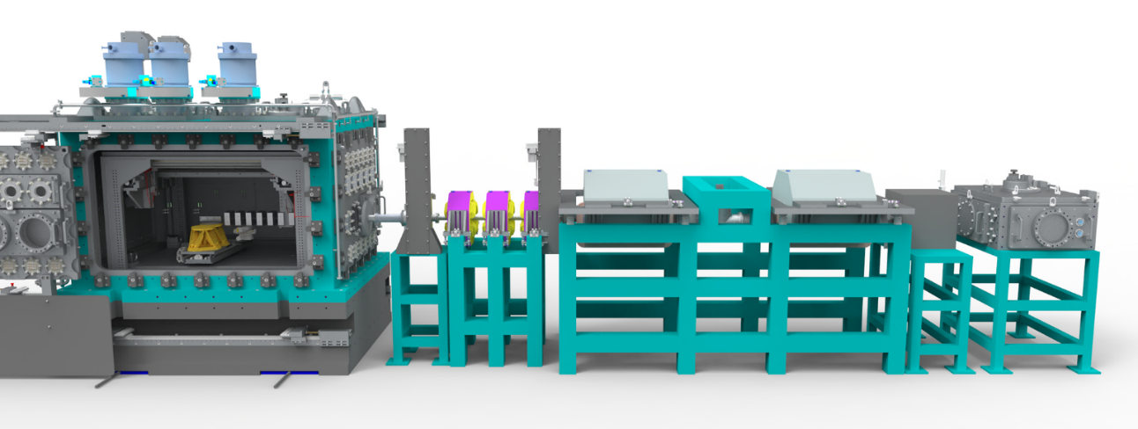
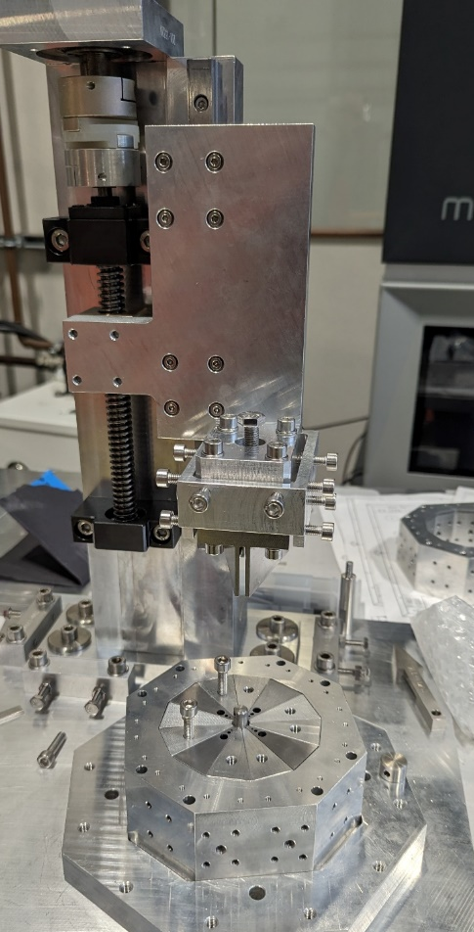
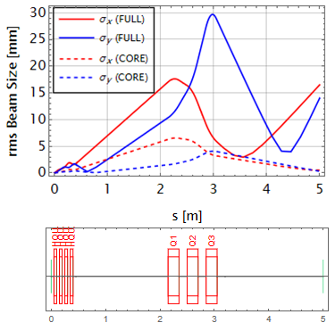
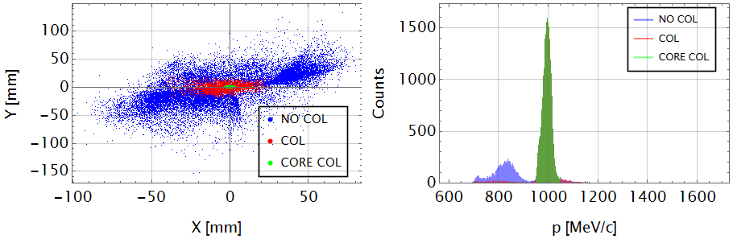
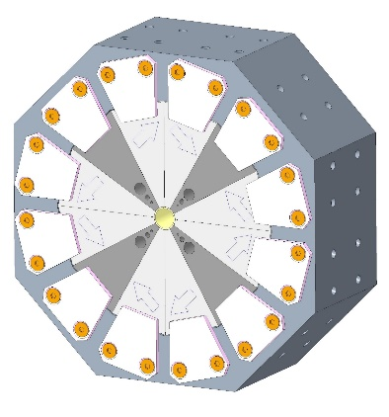
EPAC – Electron Beam Line Design
Start-to-end simulations
FBPIC simulation output fed into beamline tracking code
The core of the electron beam at 1 GeV forms a < 1 mm spot at 5 m
Spectrometer dipoles – tender progressing
Permanent magnet quadrupoles used for beam capture at LWFA exit
In-vacuum & low maintenance
Design & assembly at STFC-DL
Modular assemblies for 100 MeV, 1 GeV, 5 GeV
Plasma mirrors and beam diagnostics inserted between PMQs
Four Halbach quads have been designed and being built at DL (~500T/m)

Slide 14
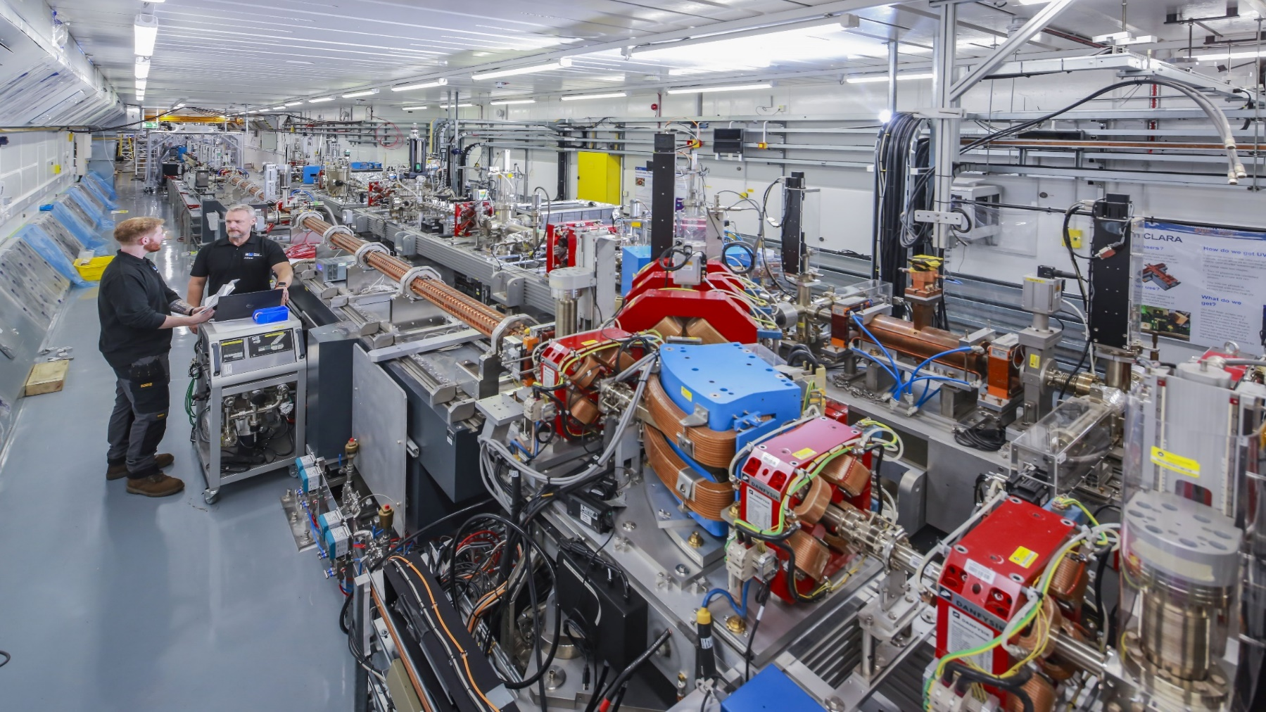
Compact Linear Accelerator for Research & Applications
CLARA is a 250 MeV ultra-bright electron beam test facility under construction at STFC Daresbury Laboratory.
Built in phases, first phase of CLARA provided 35 MeV ultrabright electron beam at 10 Hz to number of novel applications.
Phase 2 installation is nearly complete. This will deliver 250 MeV ultrabright electron bunches at 100 Hz and 120 TW laser at 5 Hz for novel user experiments.
Conceived to test advanced Free Electron laser schemes, it has since become a unique facility for user-led experiments in a wide range of disciplines.

Slide 15
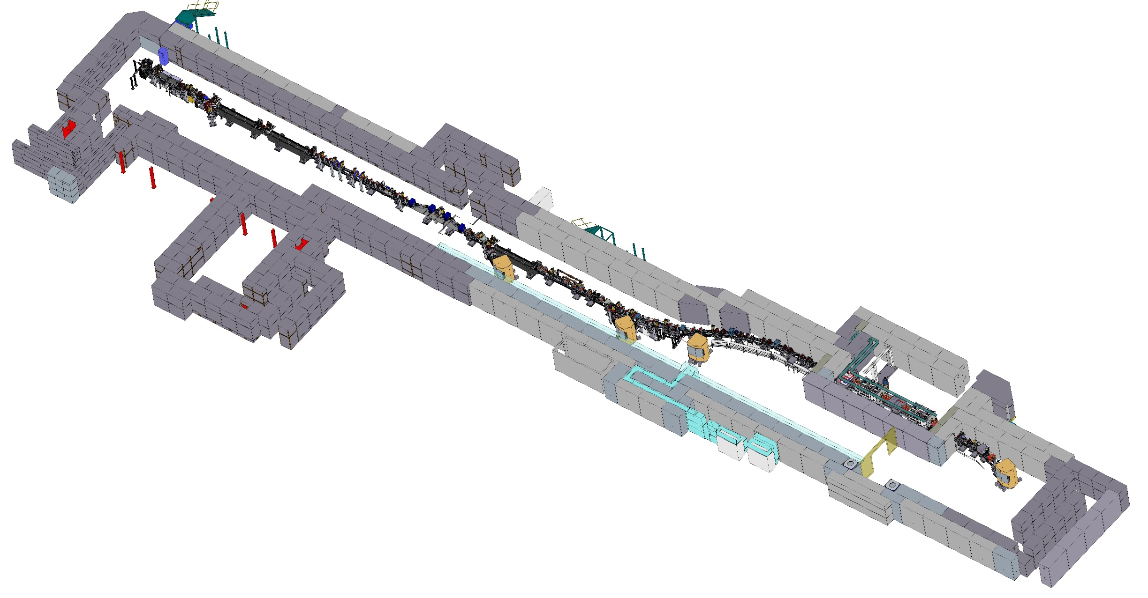
CLARA Overview
RF Photoinjector (S band)
3 Linacs (S band)
Linearizing Cavity (X band)
Magnetic Bunch Compressor
1 Linac (S band)
Transverse Deflecting Cavity (S band)
FEBE Beamline
FEBE User Hutch
~95m
Straight Ahead Space for 100nm FEL
No-FEL dump line
FEBE Laser on Roof

Slide 16
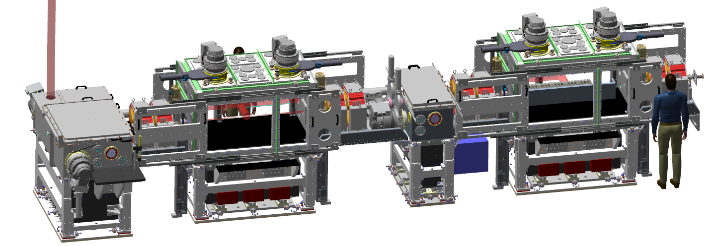
FEBE Experimental Hutch
Two chambers: possible route to ‘interaction’ and ‘characterisation’ experiments with novel components.
  Offered parameters to evolve
  ‘Day 1’ → Nominal → R&D
Laser from roof
Parameter | High charge | Low charge
Energy [MeV] | 250 | 250
Charge [pC] | 250 | 5
RMS t [fs] | 100 (50) | 50 (≤50)
σ_{E}/E [%] | <5 (1) | <1 (<1)
RMS x [µm] | 100 (50) | 20 (1)
RMS y [µm] | 100 (50) | 20 (1)
ε_{N} x @ 250 MeV [µm] | 5 (<5) | 2 (1)
ε_{N} y @ 250 MeV [µm] | 5 (<1) | 2 (<1)
250 MeV
FEL ready e- beam
FEC1
Primary IP
~1.5m length
FEC2
Flexible array of diagnostics
FEBE design details: E Sneddon et al, PRAB, 27, 041602 (2024)
To be confirmed through measurement using appropriate diagnostics (and R&D)
CLARA talk by Deepa Angal-Kalinin

Slide 17




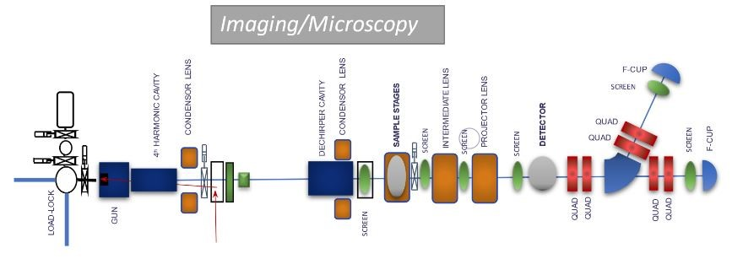
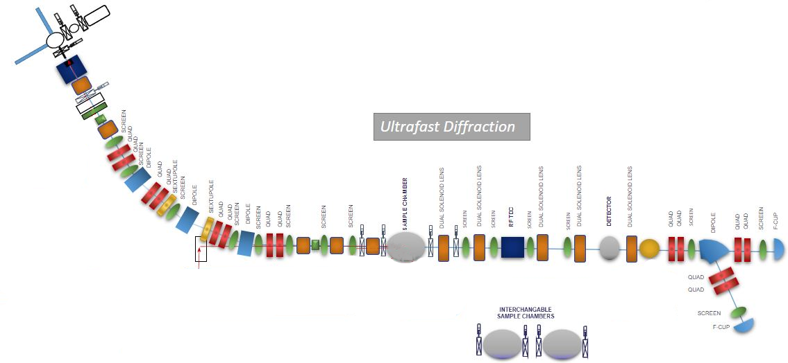

RUEDI
Daresbury Laboratory
Relativistic Ultrafast Electron Diffraction & Imaging
A new UK National User Facility at Daresbury Laboratory. £124.4 million from the UKRI Infrastructure Fund approved.
Time-resolved pump-probe experiments in both real and reciprocal space
With a large variety of pumps and sample environments to enable a large range of science
UEM
ps scale
200 fC – 20 pC
Stroboscopic + Single-shot
UED
10-100s fs scale
Up to 400 fC
Stroboscopic + Single-shot
RUEDI talks by Tim Noakes & Ben Hounsell

Slide 18
ITRF /
Collaboration
Ion Therapy Research Facility
A medium-scale facility to enable user research programme to study radiobiology and cancer treatments with ions in the UK
Multi-ion delivery p/He/C/N,O…
Depth suitable for in-vitro and in-vivo studies – not patient treatment!
High dose rate, suitable for FLASH >40 Gy/s
Comparison of two technology choices (risk, cost, timescales):
  Conventional ion source/synchrotron. Understood, lower intensity
  Very high dose rate plasma/FFAG. Several novel technologies require demonstrations

Slide 19
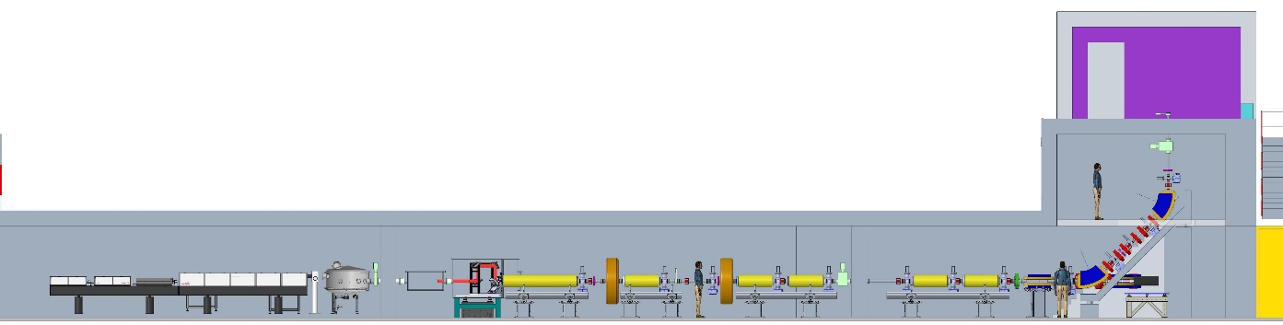
ITRF /
Collaboration
ITRF Status
Significant physics/component design and engineering detailing
18-month design review last month: https://indico.stfc.ac.uk/event/986/
Experimental campaign at Strathclyde has resolved many source issues
No Stage 1 showstoppers – plasma-based approach selected
Bridging funding beyond Oct 24 :
To establish baseline demonstration of Stage 1 output and user experiments
Further de-risk source/capture/Stage 2 FFA to enable full project bid
6-month review
Re-examine baseline
12-month review
Progress major work, outline
engineering assessment
18-month review
Establish CDR design, engineering integration
24 months
CDR
Oct 24
IF PA1 (CDR), Oct 22 - Oct 24
In-vitro exptl. station
Target and source
Stage 1 line

Slide 20

xfel.ac.uk
UK XFEL – Conceptual Design & Options Analysis
The three years CDOA project formally started on 1st October 2022. The Year 1 activities are largely complete – the activities in second year making good progress.
Year 1
Project launch event January 2023
Initial conceptual design and layout
Preliminary engagement with overseas XFEL facilities
Survey of the science team, workshops and town halls meetings begin
Year 2
Developing the concepts
R&D targeting gaps in key physics and technology areas
Collaborative activities and working groups with overseas XFEL facilities
Workshops and town hall meetings continue
Year 3
Summary of R&D activities
Preferred options identified, socio-economic analysis
Revision to science case published
CDOA phase completed September 2025
UK XFEL talk by Dave Dunning

Slide 21
xfel.ac.uk
UK XFEL
Our focus to date has been on some of the most challenging and fundamental features
- Transform limited operation across entire X-ray range (approx. 100 as – 100 fs and 50 eV to 20 keV)
- High efficiency facility with a step change in the simultaneous operation of multiple end stations
- Evenly spaced, high-rep rate pulses to match samples & detectors (~ 100 kHz per FEL, with flexibility)
- Improved synchronisation/timing data with external lasers to < 1 fs
- Widely separated multiple colour X-rays to at least one end-station (e.g. SXR+ HXR)
Full array of synchronised sources:
XUV-THz, e-beams, high power & high energy lasers at high rep-rate
Minimise the carbon footprint and energy consumption for both operation and build.
Also significant interest in:
High pulse energy (>>1 mJ)
High photon energy (> 20 keV)
In some cases with less demand for high rep rate

Slide 22
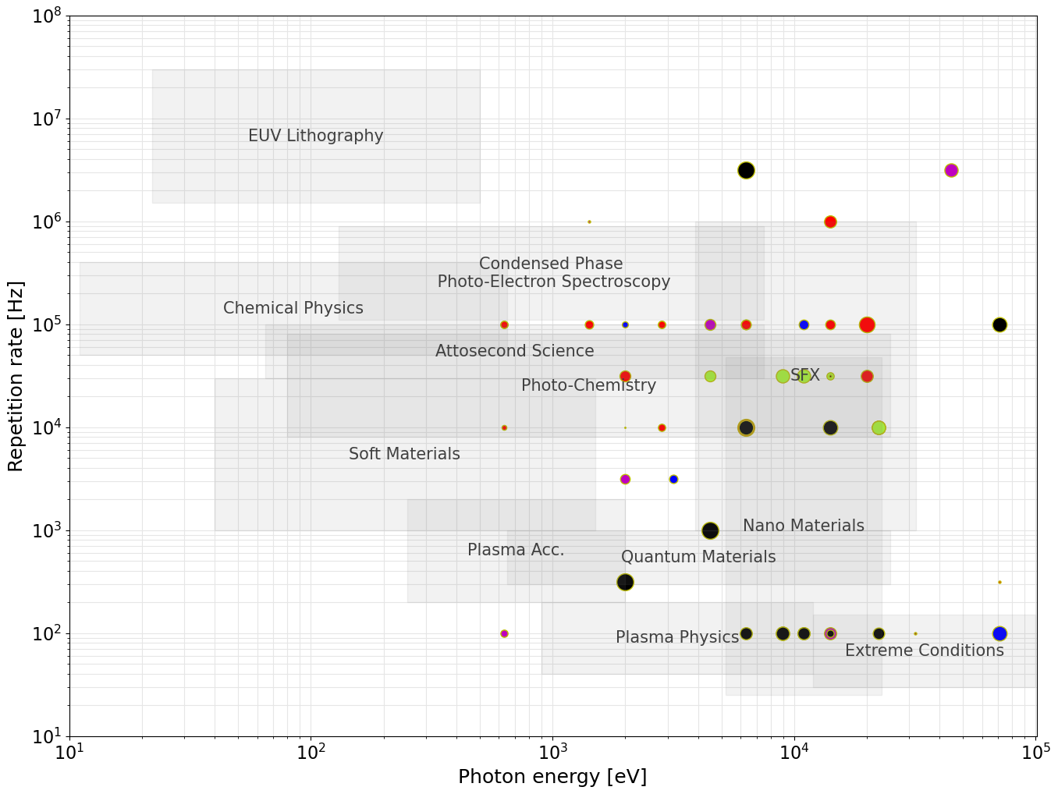

Acceleration Technology:
UK XFEL – User Requirements from the Science Case & Survey
Evenly spaced, high-rep rate pulses
ERLs
Max. photon energy strongly influences the required electron beam energy
Repetition rate largely dictates the type of acceleration technology
Requirements suggest
~8 GeV superconducting RF linac
SRF
(CW)
Preliminary focus for
UK-based option:
~8 GeV SRF CW
SRF
(Pulsed)
HRR NC
NC
~1-1.5 GeV
22
Electron Beam Energy:
~2-3 GeV
~6-8 GeV
≥10 GeV

Slide 23
xfel.ac.uk
UK XFEL – Facility Concept
A step change in the simultaneous operation of multiple end stations
Potential for e-beam experimental areas
FELs independently tuneable in terms of photon energy, pulse duration etc.
Kicker magnets to split MHz bunches at ~100 kHz.
Electron bunch properties tailored per FEL after kicker
FEL-6
FEL-5
FEL-4
Multiple end stations per FEL
FEL-3
FEL-2
Possible energy boost for higher photon energy in FEL-1
FEL-1
~ 100 kHz Kicker Magnet
UK XFEL talk by Dave Dunning

Slide 24
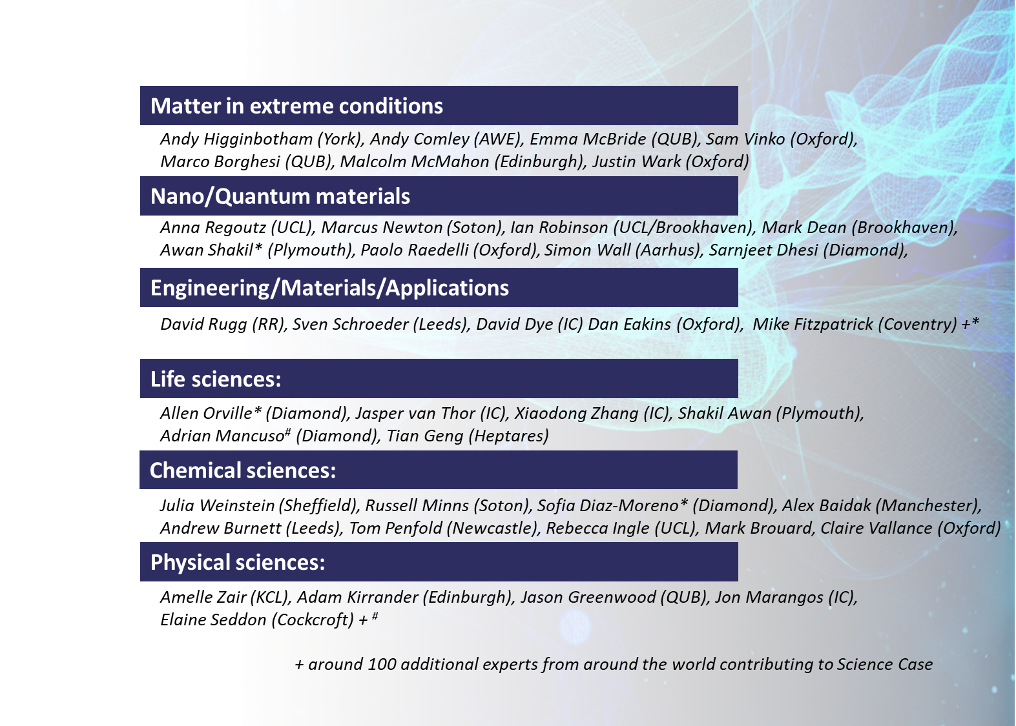

xfel.ac.uk
UK XFEL
Expert Science Team
Opportunities to engage (Townhall Meetings)

Slide 25
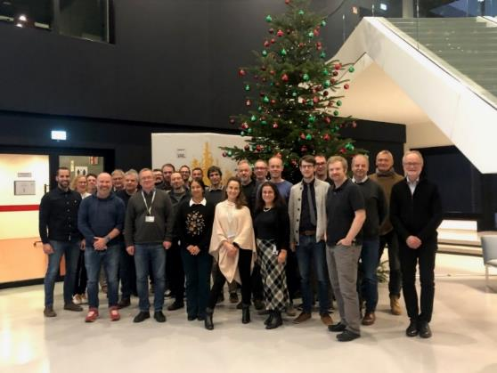
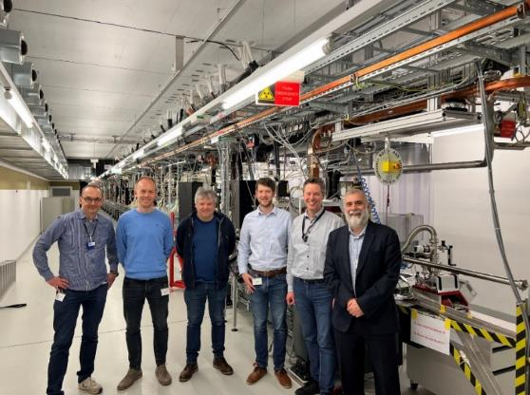
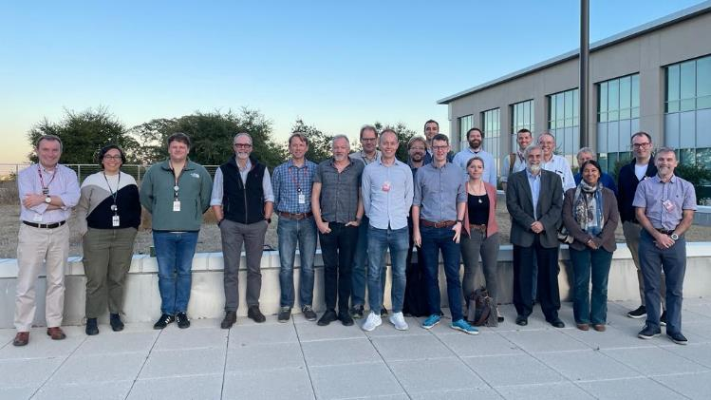
xfel.ac.uk
UK XFEL – Engagement & Communications
  Wider Stakeholder Engagement
  Eu-XFEL visits + regular collaboration seminars
  SwissFEL visit + continuing engagement
  LCLS-II visit + engagement
  Multiple Conferences attended
  Science team meets monthly
    Facility Design Team presents updates at this meeting
  International Advisory Board meetings:
  (11th Dec 23, 1st May 24, 10th Dec 24)

Slide 26
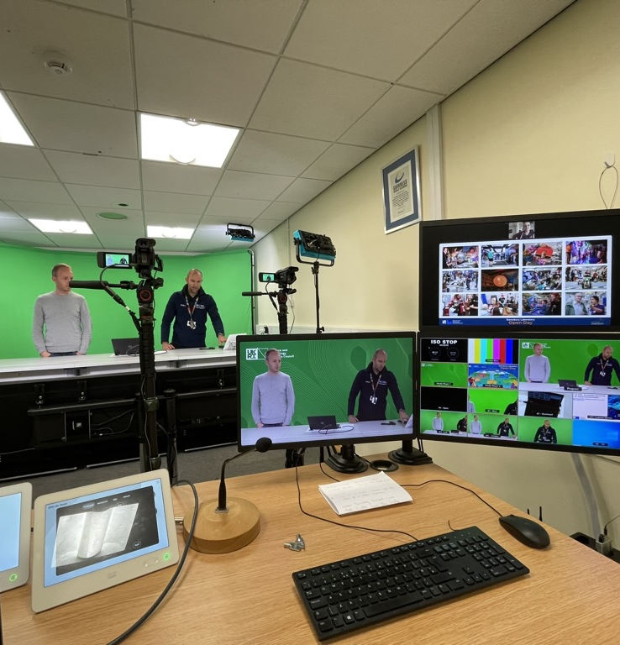
xfel.ac.uk
UK XFEL – Communications
  Website refreshed, and updated – xfel.ac.uk
  Community slides updated for use by anyone
  Social media presence via twitter and linkedin
  Two blogs written for Medium [1] [2]
  Update in FELs of Europe Newsletter
  Videos produced for YouTube
  Mailing list now over 360 people
  Engaging with the likes of IoP and TEDx for public talks and engagement

Slide 27
Summary
This decade promises to be a very busy one for UK national accelerator infrastructure!
  Diamond-II is fully on track to deliver the upgrade, with dark period starting from December 2027 & project completion by March 2030.
  ITRF, UK XFEL and ISIS-II have multi-year technical design and prototyping phases ahead of them, after the current concept design activities
  RUEDI is now ready to move to full construction and has received funding approval.
  CLARA will be available to users in 2025
  EPAC will be operational in 2026.

Slide 28







Science and Technology Facilities Council
@STFC_matters
Science and Technology Facilities Council
Notes:
The abstract pattern can be removed or repositioned if required. Be careful to ‘Send to Back’ so that it does not obscure any important information.

