Slide 1


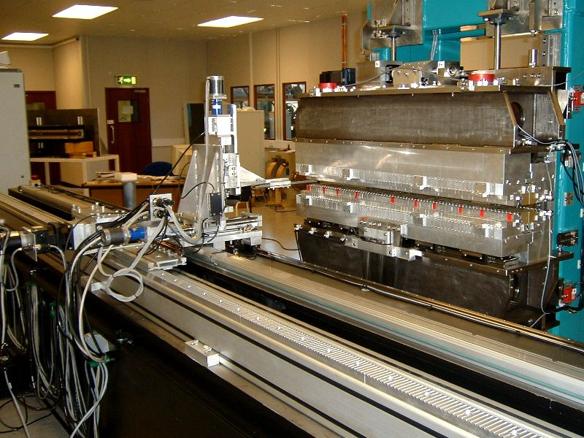

Making a brighter future through advanced accelerators
Prize Talk
Jim Clarke
STFC Daresbury Laboratory
PAB Conference June 2024

Slide 2
The Brief…
“Traditionally we do not impose any real constraint on the topic or content of the talk, save that it should be suitable to entertain a room full of accelerator scientists for about an hour, including time for any questions or discussion.”

Slide 3
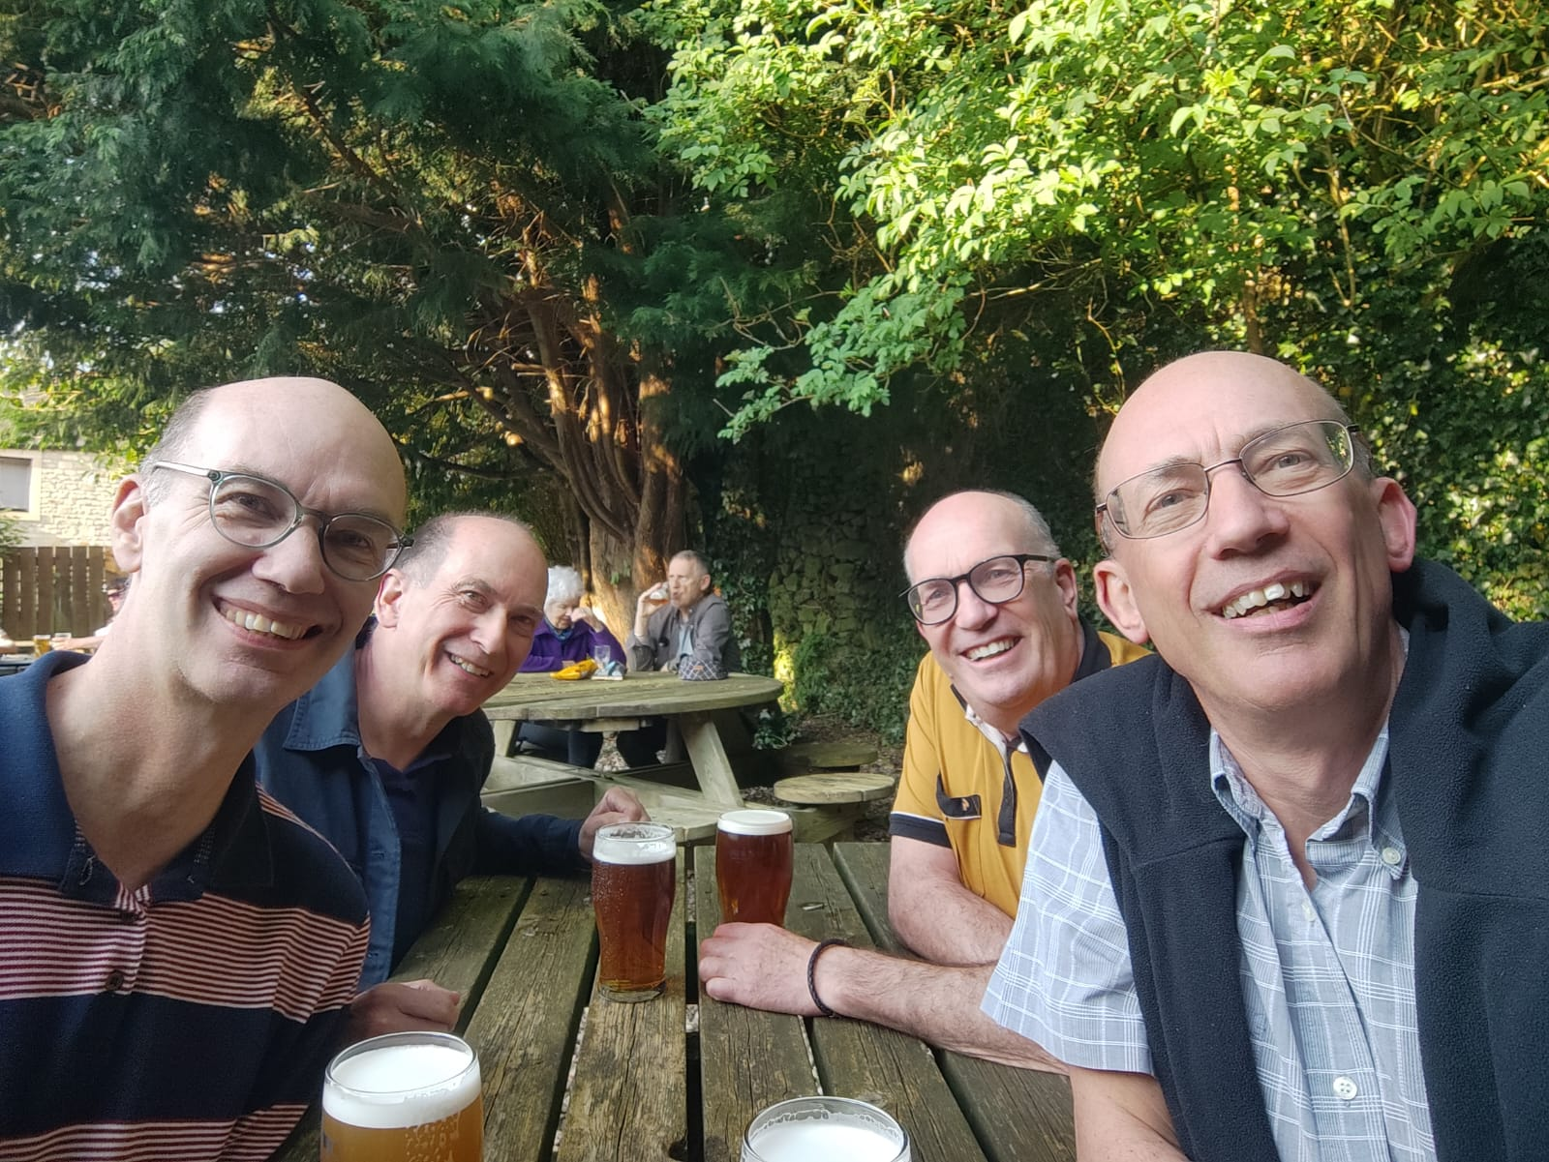
My Brother Reads The Guardian…
Or how I ended up at Daresbury …

Slide 4
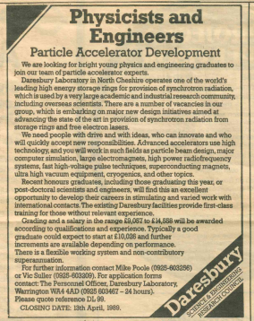
The Job Advert
“…our group … is embarking on major new design initiatives … state of the art … storage rings and free electron lasers”
“Advanced accelerators use high technology …particle beam design, major computer simulation, large electromagnets, high power RF systems, high-voltage pulse techniques, superconducting magnets, ultra high vacuum equipment, and other topics.”
“So, have you applied for that job I sent you then?”

Slide 5
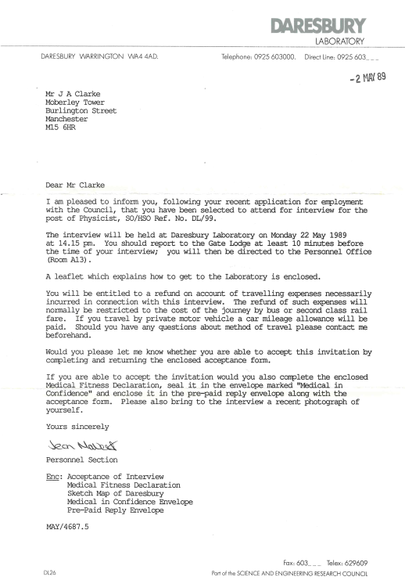
The Interview
Travelling from Manchester the train was late…
I received a warm welcome from the admin team - “We don’t pay taxis!”

Slide 6

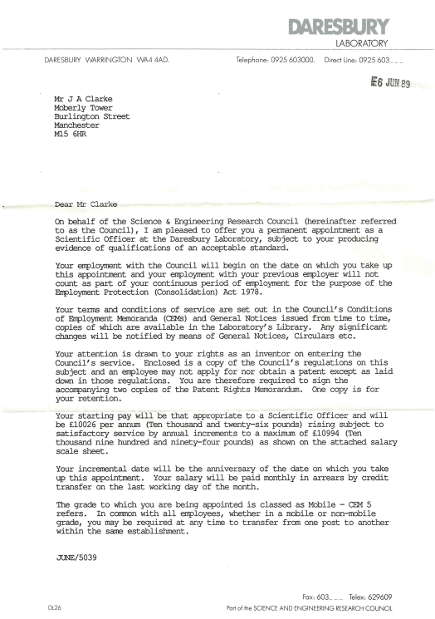
The Offer
Scientific Officer at a salary of £10,026
When I received the offer I visited Daresbury again to learn a bit more about what the job actually was!
Q “Can I do a PhD here?”
A “No, it’s not possible to do a PhD in accelerators in the UK unfortunately”
I was very unsure so said to myself I would give it two years…

Slide 7
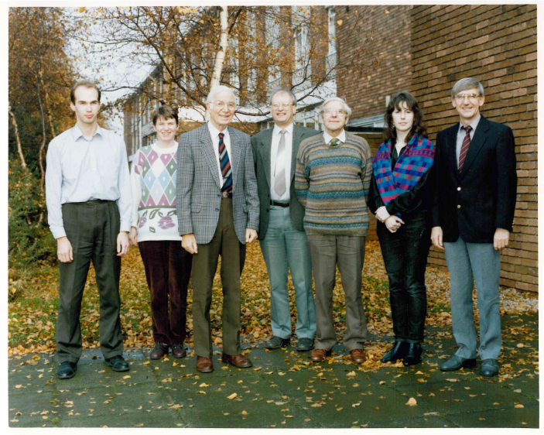
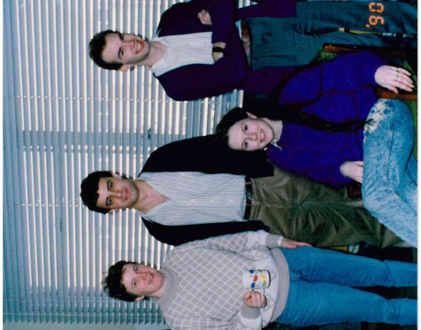
The Group
I joined the Accelerator Physics Group which sat within Synchrotron Radiation Department (the SRS user facility), Mike Poole was Group Leader and Vic Suller was Accelerator Division Head
The AP group (plus Mike Poole) in 1990
The AP group and Vic Suller in 1993 when John Lawson visited

Slide 8
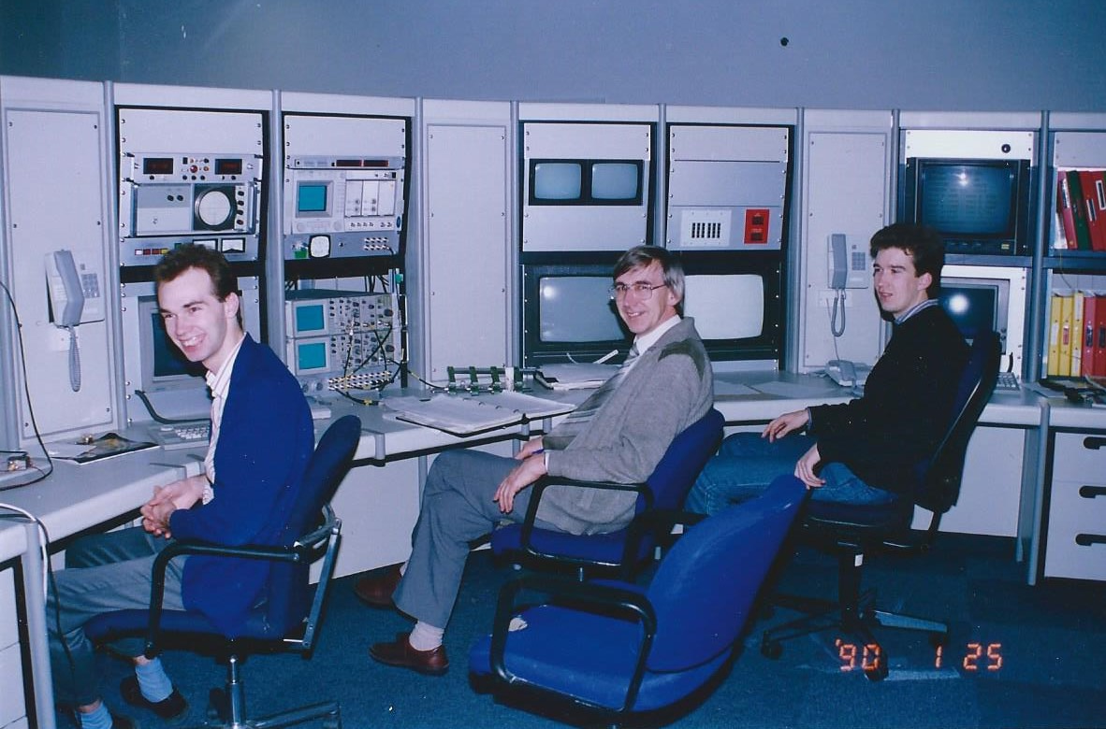
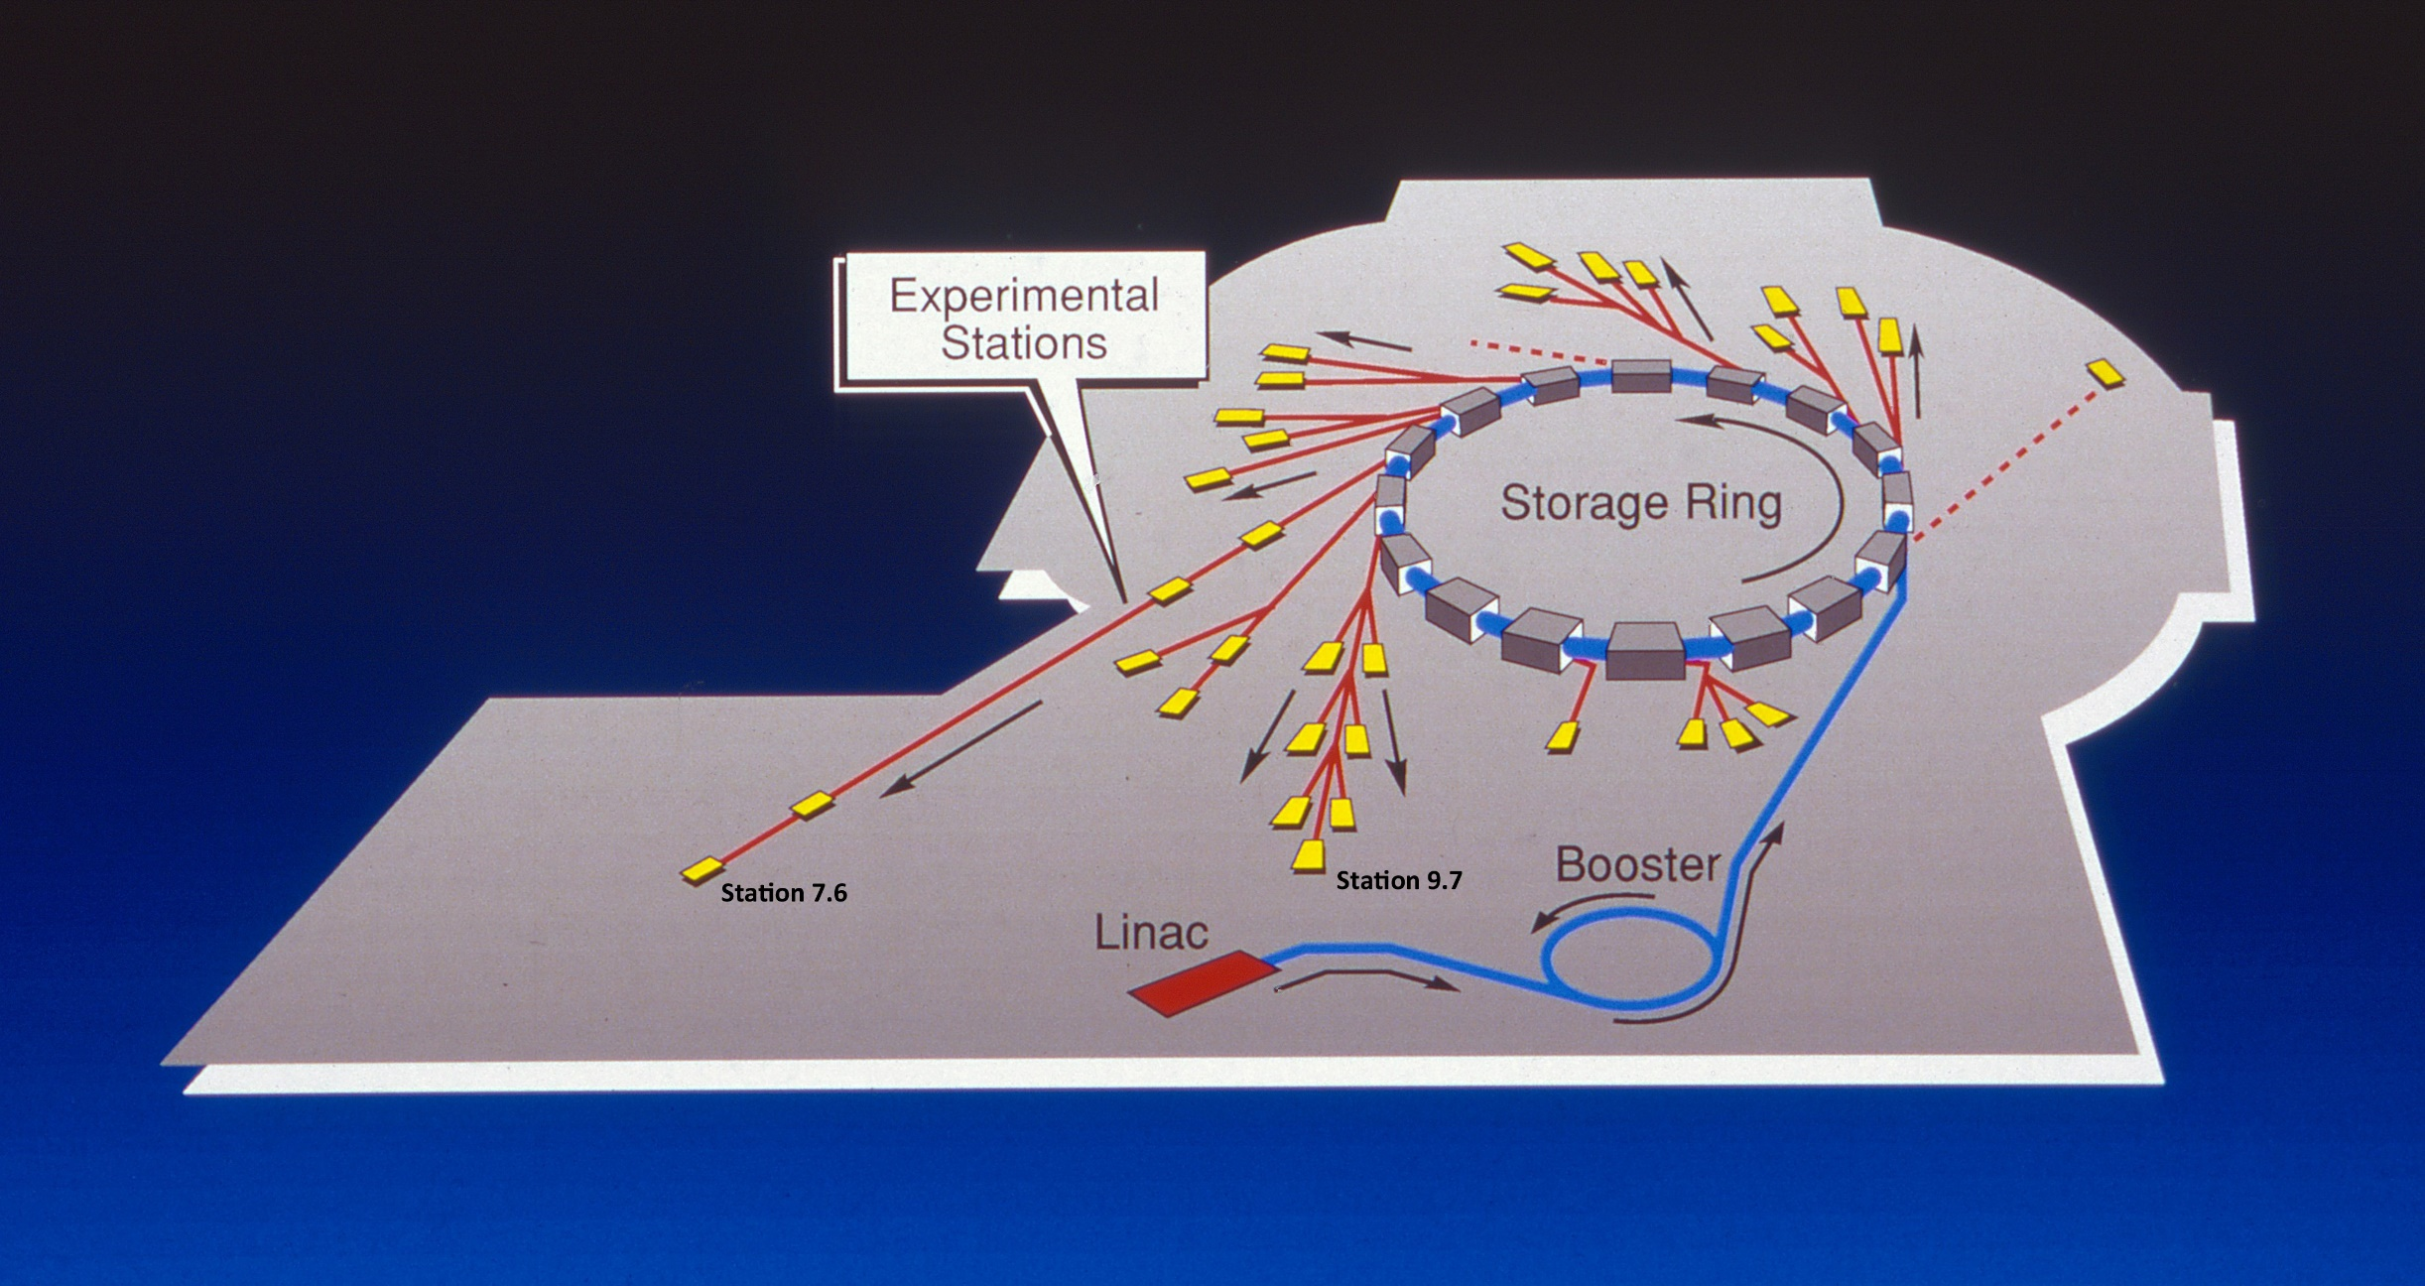
The SRS
We spent around two days per month on shift in the SRS Control Room to maintain and improve the performance of the accelerators, trying to understand the behaviour, and enabling and commissioning ongoing upgrades
My first ever beam shift on the SRS with Vic Suller and Jan Uythoven

Slide 9
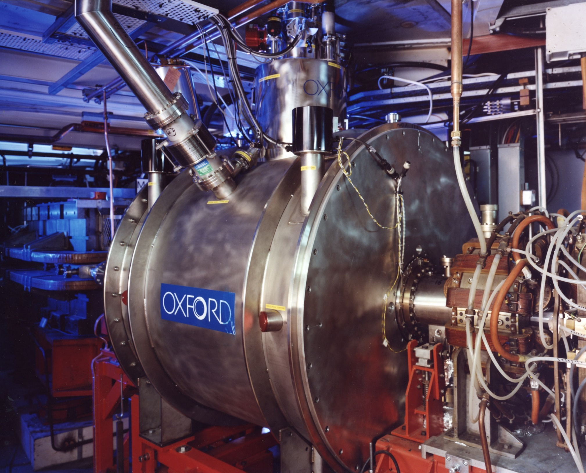
A Second Wiggler…
The 7 hard X-ray end stations on the 5T wiggler were in very high demand and so funding was secured for a second wiggler, this time with 5 end stations
This second superconducting wiggler was procured directly from industry (Oxford Instruments) and had a peak field of 6T
The contract was placed in 1989 and the magnet was installed in 1991.
To physically make space in the straight section quite a few components had to be relocate and the injection elements were replaced.
I was responsible for measuring the magnetic fields of the new kickers and septum

Slide 10
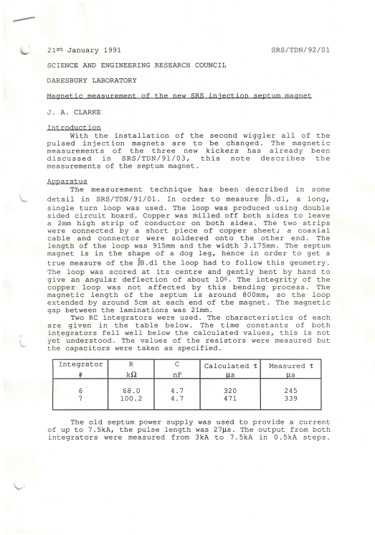
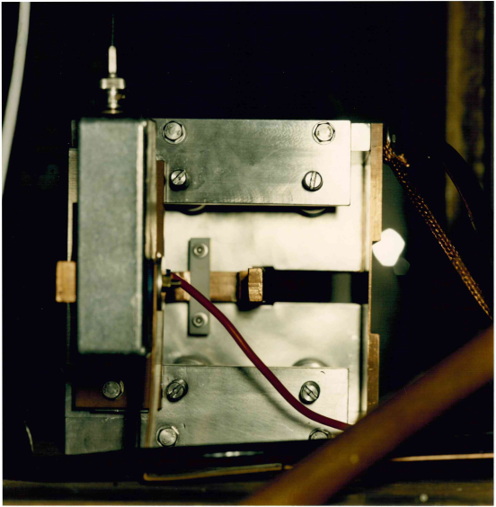
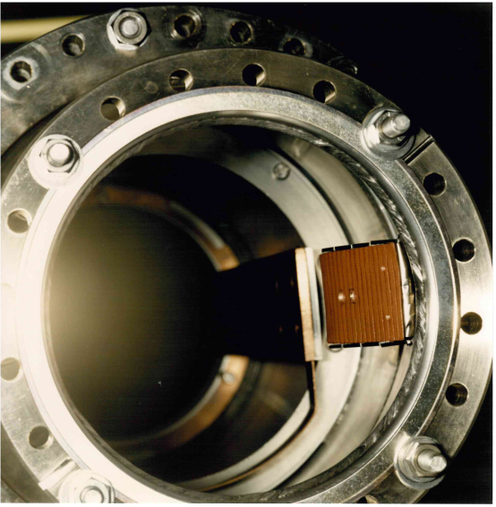
Measuring the Pulsed Magnets
Health and Safety in the 1990s…
Jim - “Is that live?”
John (pulse power supply expert) flicks his hand onto the bus bars - “Yes”
Jim - “OK, thanks” (in state of shock)

Slide 11
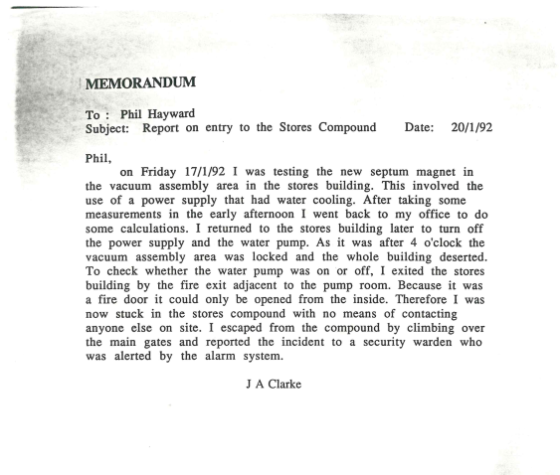
Measuring the Pulsed Magnets
Getting trapped in the Stores Compound…
“I was testing the new septum…”
“As it was after 4 o’clock…the building was deserted”
“I excited the Stores building by the fire exit…”
“…it could only be opened from the inside”
“I was now stuck in the Stores Compound”
“I escaped by climbing over the main gates…”

Slide 12
Designing a New Storage Ring Light Source
As well as working on the SRS my activities were focussed on designing a storage ring to complement the SRS and the newly operational ESRF in Grenoble – this was the so-called “three ring scenario for the UK”
The idea was that there should be a low energy storage ring to serve the longer wavelength users (VUV/SXR), a replacement for the SRS covering X-rays and ESRF for the harder X-rays
This new low energy light source was called The Daresbury Advanced Photon Source (DAPS)
  This is the first of many accelerator based facilities that I have helped to design that have yet to be built…
  [some have been built though! ☺]

Slide 13
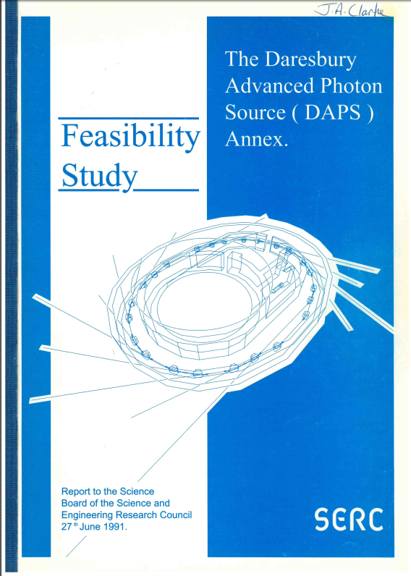
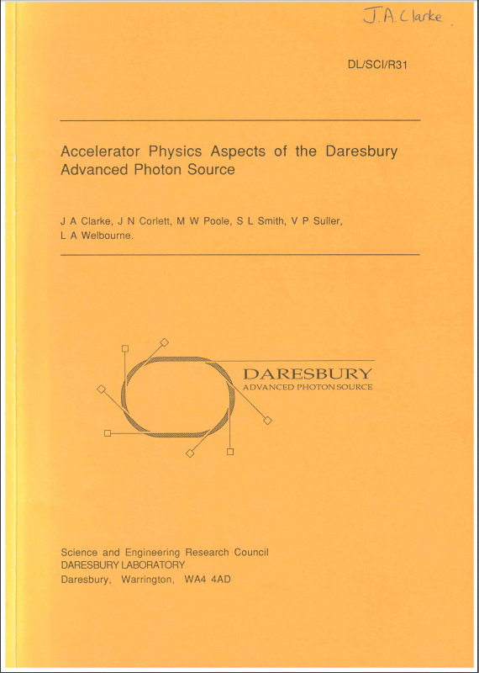
DAPS

Slide 14
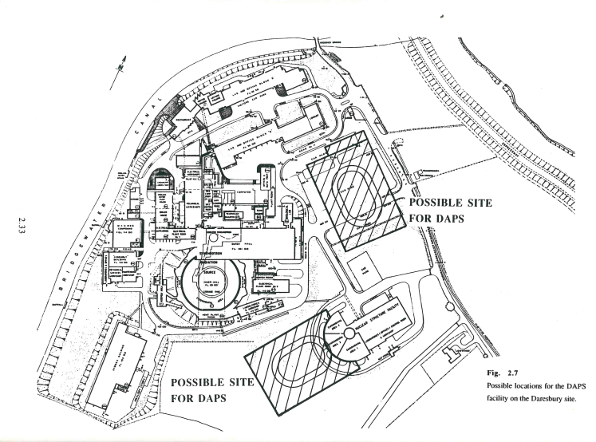
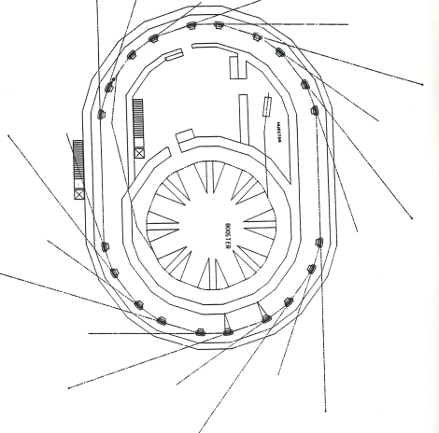
DAPS

Slide 15
Moving on from DAPS…
The DAPS feasibility report was published June 1991 and by May 1992 we had shifted away from DAPS to some reshaped three ring scenario
Minutes of the New Machines Lattice Working Party Meeting held on 13/5/92 [I was secretary]
Present:
V P Suller
L A Welbourne
J A Clarke
M W Poole
S L Smith
VPS summarised the conclusions of the SR Review panel meeting at the end of April. They are interested in a high energy x-ray source on a green field site and a low energy VUV source either in an existing building or on a green field site, possibly with the high energy source. The first draft of the feasibility report on these options is to be completed by the end of '92, to go to the review panel at the end of January '93. J Bordas is organising 3 Town meetings to specify the user case for both machines in mid-July.
The low energy ring was now scaled back to 700 MeV from 1.2 GeV and the SRS replacement was set at 3 GeV

Slide 16
SINBAD and DIAMOND
By the end of August 1992 both new machines had names…
Minutes of the New Machines Lattice Working Party Meeting held on 23/8/92
Present: V P Suller
M W Poole
S L Smith
L A Welbourne
J A Clarke
The chairman reported on the conclusions of the Town meetings organised by J Bordas. The low energy machine photon range was extended from 10 - 100 eV to 5 - 200 eV. It was confirmed that 3 GeV was more desirable than 2.5 GeV for the high energy machine and an overlap in the photon ranges of the two machines would be useful.
SINBAD – Source of INtense Brightness At Daresbury
DIAMOND – DIpole And Multipole Output for the Nation at Daresbury
I remember the conversation around the name for Diamond, which took place over coffee with the above. We wanted a name we weren’t embarrassed by since we all thought SRS was an awful name and the interim name for the 3 GeV ring had been MEXS (medium energy X-ray source). The French had picked SOLEIL which we all envied as a good pick.
So we picked a name that had a D in it, was something bright, hard, and expensive – Diamond was the obvious choice! What the letters actually stood for came the next day

Slide 17
SINBAD and DIAMOND
By the end of 1993 Diamond had clearly emerged as the priority over SINBAD
Notes of the New Machines Lattice Working Party Meeting held on 19/11/93
Present:
V P Suller
S L Smith
M W Poole
J A Clarke
STATUS
VPS discussed with the group the current status of the new machines. Firstly, there was no change to SINBAD which is still unsupported. Science Board had been presented with the following cost information concerning DIAMOND:
£57M using SRS resources
£71M in total (8 lines)
£90M if built at DL with 20 stations.

Slide 18
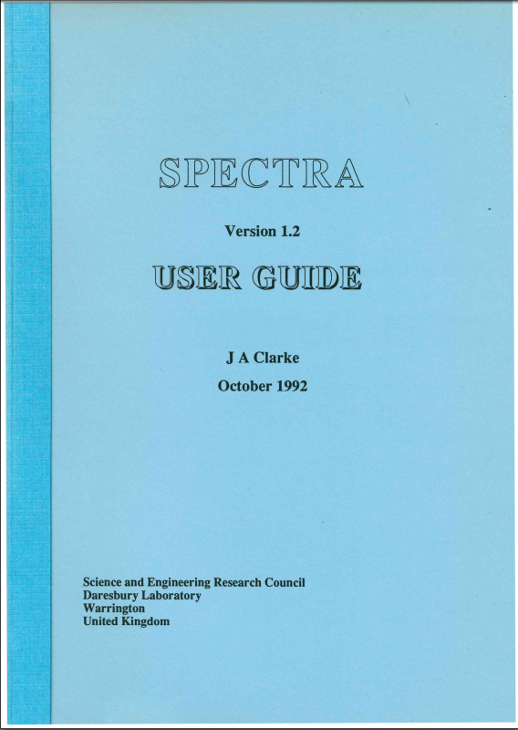
Synchrotron Radiation Calculations
For all of these new light source options someone had to start calculating the SR output to make comparisons to show to the users
At the time I was running the Synchrotron Light Monitor which was a dedicated end station on the SRS which used the visible SR for all sorts of electron beam diagnostics and so I was given the job of writing some software and generating all of the comparison curves…

Slide 19
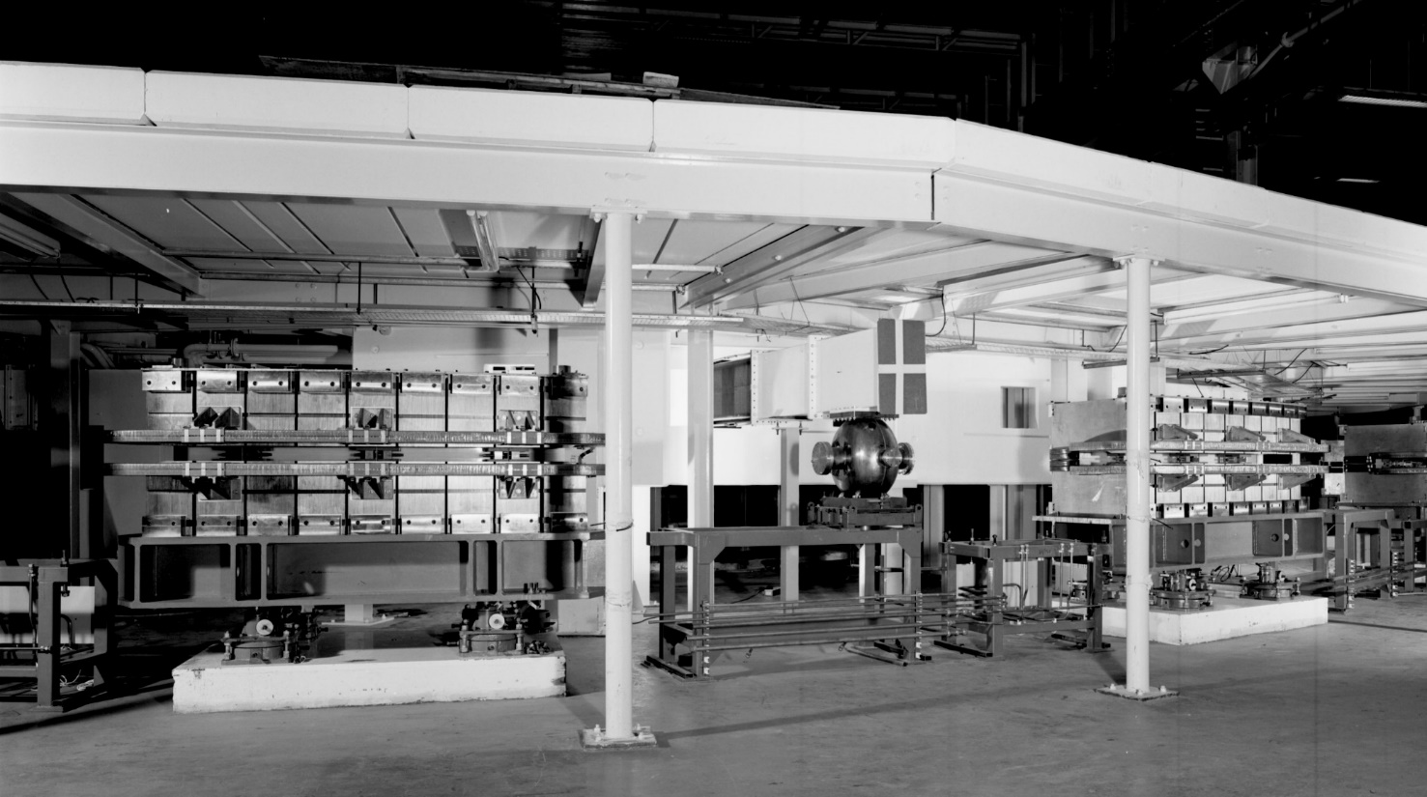
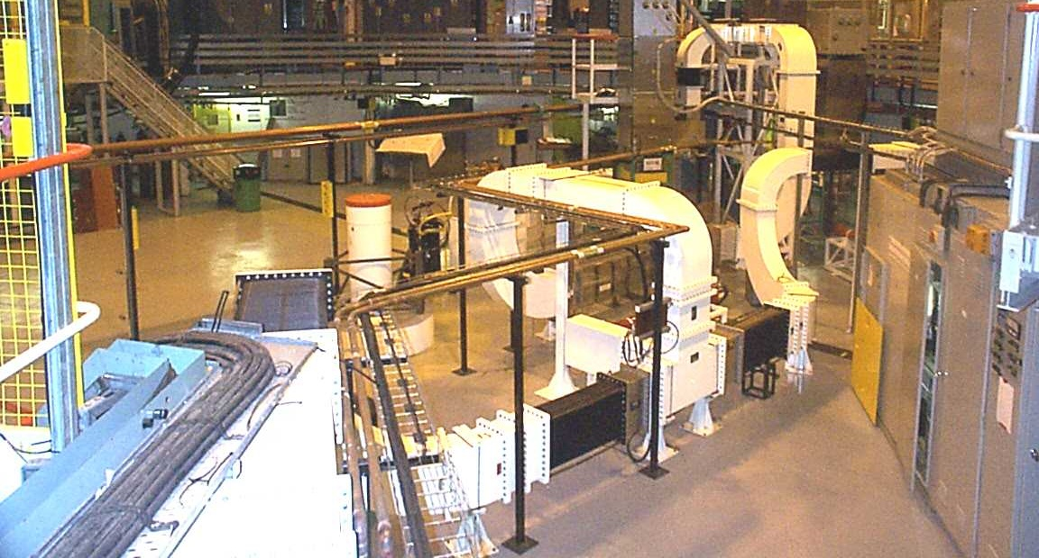
Upgrading the SRS
In the mid 1990s we were asked by the SR science leaders whether we could install anymore insertion devices into the SRS
The initial reaction from the accelerator team was that it would be really challenging (“No Chance!”) as every straight section (each only ~1.2m long) had equipment in it but it was agreed to take a look
Finding space for the photon beamlines and end stations would also not be easy
A viable solution was proposed to move three of the four RF cavities and to consolidate other components to free up space – 9 of the 16 straights had to be rebuilt
I didn’t play any part in this assessment but I was really impressed by the attitude of the team to find a solution and also that without the challenge from outside of the accelerator team we would never have proposed such an upgrade

Slide 20
Upgrading the SRS
My role in the upgrade once it was clear that two straight sections could be made available was to work with the researchers to define what should actually go in them
The demand for hard X-rays was very strong and so it was very clear that multipole wigglers would be the device of choice as undulators would not be feasible
The selected MPW was a permanent magnet/steel pole hybrid with a peak field of 2T, a period of 200mm and 9 full strength poles

Slide 21
Two 2 T Multipole Wigglers
The funding agencies (EPSRC, BBSRC and MRC) agreed to the proposal to fund the two MPWs, photon beamlines and end stations
I then was tasked with carrying out a full 3D magnet design for the first time which was a bit daunting
Working with the engineers to turn my physics simulations into something that could be built and operated was very rewarding – a first for me
Handling such strong permanent magnet blocks was a skill that did not exist at Daresbury so we decided to buy fully assembled magnet arrays built to our design – Sincrotrone Trieste (aka Richard Walker) won the contract and also the separate one for the support structures

Slide 22
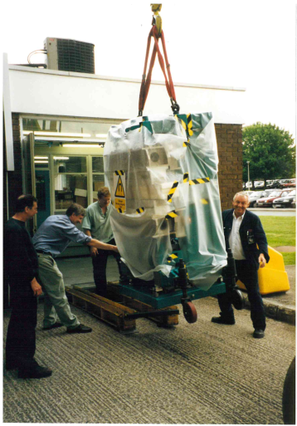
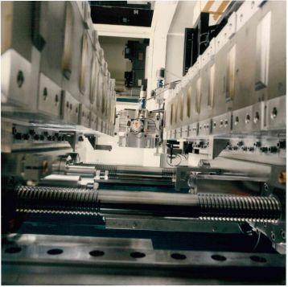
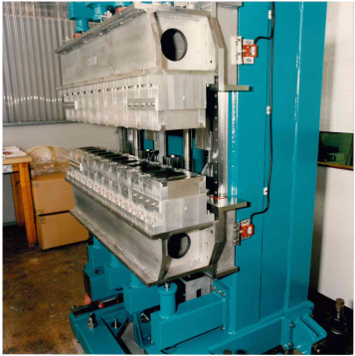
Two 2 T Multipole Wigglers
So, two identical very high field MPWs were delivered and I looked after the magnet measurements, setting up a short Hall probe bench for the purpose
The measurements matched expectations – a great relief !

Slide 23
Two 2 T Multipole Wigglers
They were installed into the SRS successfully and were very popular with the users. There was though a sting in the tale!
The funding agencies didn’t decide what exactly the beamlines would actually be used for until we were well into the project, and they did this through some sort of peer review call
One was selected for hard X-ray based science as expected
BUT the other beamline selected was optimised to work in the XUV region of the spectrum (40 – 350 eV), whereas the MPWs were optimised for multi-keV!
This was brushed under the carpet as it was embarrassing and the beamline was still far better than any other similar ones on the SRS – it just could have been better!
This was another important lesson for me in how not being joined up as a complete facility project can lead to poor outcomes
It’s essential to have an ongoing dialogue between the users and the accelerator team

Slide 24
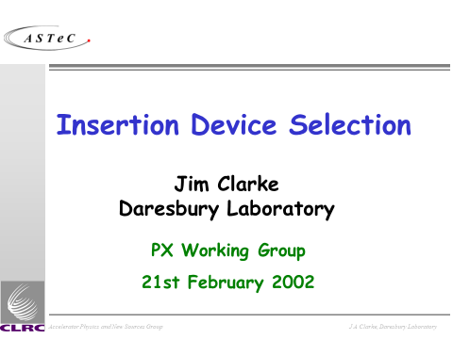
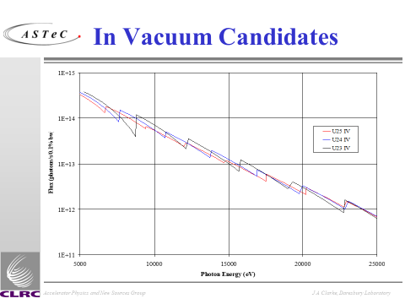
DIAMOND
Whilst working on this upgrade of the SRS we were continuing to develop the design for Diamond. SINBAD was quietly dropped (if I remember correctly)
All through the 1990s we were frustrated at the lack of funding to build Diamond, other countries were building their equivalent facilities and although, looking back, it was an obvious decision to replace the SRS with a next generation light source, there were a lot of doubts at the time that it would ever happen
My work was almost completely focussed on the synchrotron radiation side of things – comparing characteristics of various undulator and multi-pole wiggler options.

Slide 25
Diamond Funding
Funding was finally approved for Diamond in 1998
Then the arguments started about where it would be sited, with Harwell finally being confirmed some time later – this was a low point for Daresbury and for me
I don’t intend to dwell on the rights and wrongs of the decision but it certainly made it clear to me that my world view was somewhat naïve - decisions like these are not black and white and involve a much bigger picture than I appreciated – they are truly political decisions.
What is clear though looking back is that this was a momentous decision which had unintended positive consequences for the UK accelerator community and my career !
Of all the things that have influenced my career this is the one I was most upset about, since I was so invested in the project, and the one which turned out to be the most positive!

Slide 26
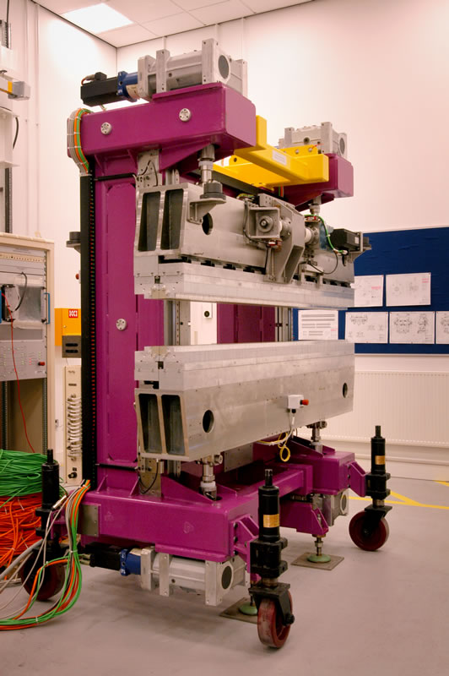
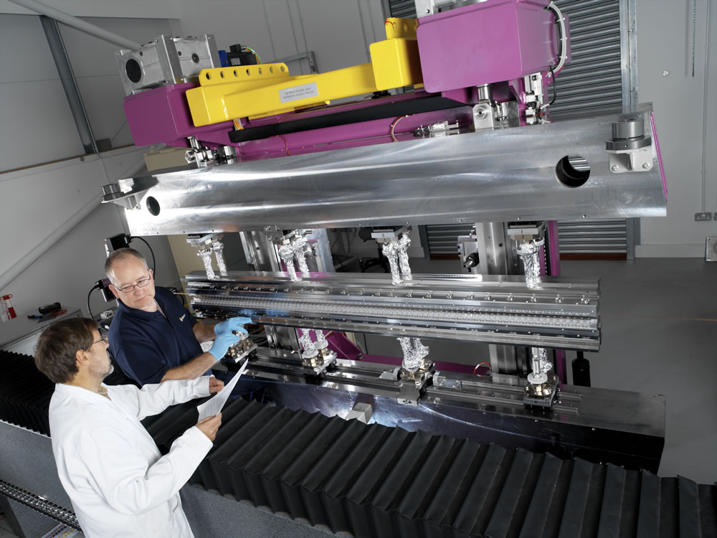
Diamond Insertion Devices
I was responsible for the first 7 insertion devices, which were funded in the construction phase of the project
It was fun working much more closely with the various user interest groups and beamline scientists and learning about what mattered to them
This time the process was very sensible, with the beamlines being allocated up front to particular priority disciplines/techniques and then for each one I worked closely with the user group to optimise the insertion device to their needs
The final selection included in-vacuum undulators, a variable polarisation undulator, and a superconducting multi-pole wiggler – all new technologies to me

Slide 27
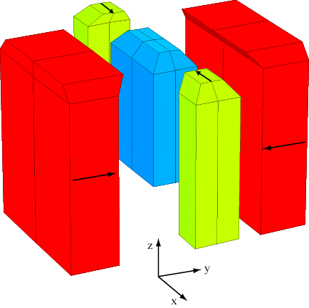
Another multi-pole wiggler for the SRS
The two MPWs were so popular that a case was made successfully to add a third one to the SRS
Somehow we found space for one more in the storage ring
The user case for this one was based on hard X-rays so I was asked to optimise the output for 5 to 13.5keV
Starting from lessons learnt from the 2T versions and just a bit more experience, and a similar device that had been built at the ESRF, I re-optimised the design by shaping the permanent magnets around the steel poles so they were not cuboids anymore
In this way I was able to achieve 2.4 T with a period of 220mm which was a world record and I think still is!
The engineers and technicians had also learnt a lot from the other two MPWs so they were happy to take responsibility for designing and building the device in-house

Slide 28
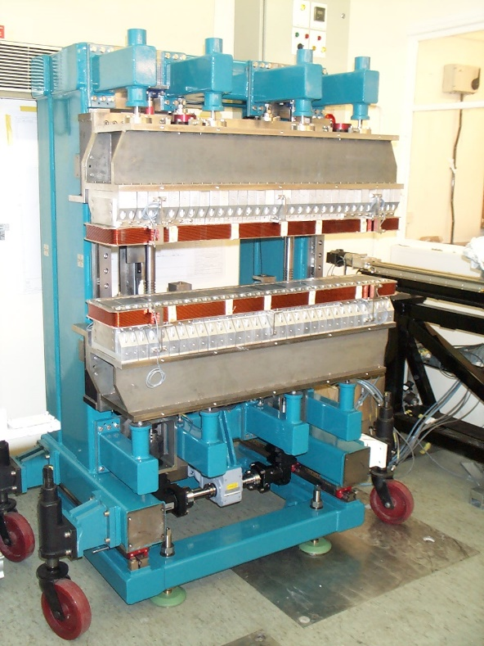
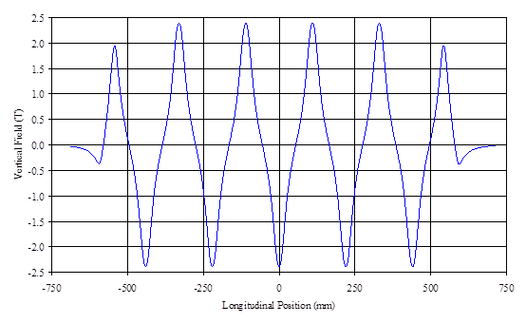
Another multi-pole wiggler for the SRS
The regret I have with this magnet is that since it was a bit special I opted to publish it in a journal instead of a conference proceedings but despite starting to draft the paper I never managed to finish it so you will not find any publications about this magnet anywhere – a big regret!

Slide 29
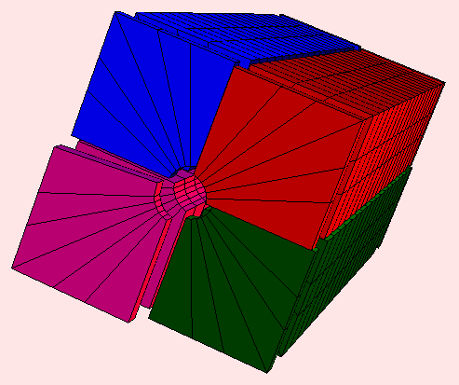
A Variably Polarizing Undulator for the SRS
At about the same time, funds for swapping out the original SRS undulator, which had been installed before I had started at Daresbury, were also secured
This time the case was made for a soft X-ray variably polarizing undulator
The three MPWs and this new undulator were all loaned out to various light sources after the SRS closed (Diamond, ANKA (KIT), and Thailand Light Source)
Another regret is that we painted them all the same colour so they all look the same!

Slide 30
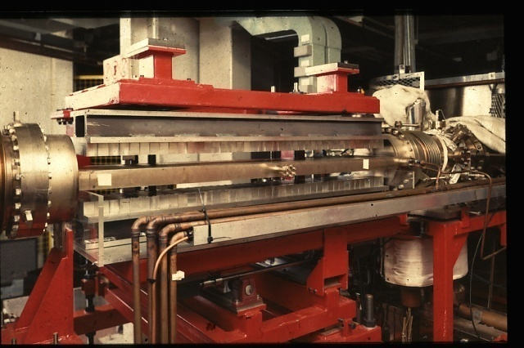
The Original Undulator
The first undulator built in the UK was installed in October 1984
The SRS was not intended to have undulators installed but despite this an undulator was designed and built at Daresbury and installed into the storage ring
It was a 10 period device , built using permanent magnets, and was one of the early examples
The engineering was very simple and the magnet gap was controlled with a simple switch from the Control Room.
There was no control of the gap it was either fully closed or fully open!
Occasionally the operating team forgot to flick the switch and the users would phone the control confused about not seeing any SR – the crew would ‘offer’ to re-optimise the undulator and then just close the gap – the users were always amazed and extremely grateful at how quickly the crew were able to sort out the problem!

Slide 31
4GLS & Free Electron Lasers
With Diamond being built at Harwell it was time start planning a future for Daresbury
With the encouragement of the government we started thinking about a low energy light source again
We started from SINBAD but knew we needed to spice it up a bit so we did two things:
  Decided that the source should be a mix of spontaneous sources and FELs
  Dropped the storage ring approach and picked an Energy Recovery Linac solution instead
The facility was called 4GLS (4th Generation Light Source)

Slide 32

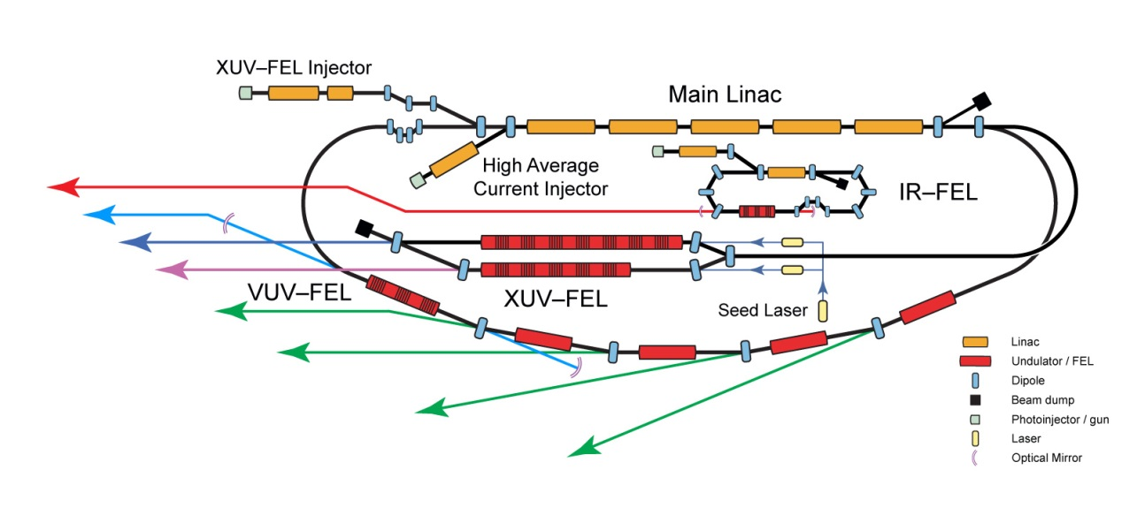
4GLS & Free Electron Lasers
My responsibility in the conceptual design was for the undulators and FELs this time
We had helped to develop the oscillator FEL on the Elettra storage ring in Trieste by this point (an EU funded project) but hadn’t seriously worked on single pass FELs at all
This was a steep learning curve for me and my group but thanks to direct support from Brian McNeil my team rapidly became proficient and started publishing new concepts, especially for generating ultrashort attosecond pulses
4GLS was a CW-ERL driven XUV/VUV/IR light source that still looks state of the art today

Slide 33

ALICE
Modern ERLs had received a big boost from superconducting RF improvements with Jefferson Lab leading the way
We were supported by JLab very much and when an opportunity for some funding arose we bid for an ERL test facility to develop the skills and experience that we lacked – this was initially called ERL Prototype (ERLP) but soon became known as ALICE (Accelerators and Lasers in Combined Experiments)
An infra-red oscillator FEL was included in ALICE from the start, again to develop skills and experience
Although 4GLS was stopped in 2008, ALICE continued to receive support and we demonstrated energy recovery in the same year

Slide 34
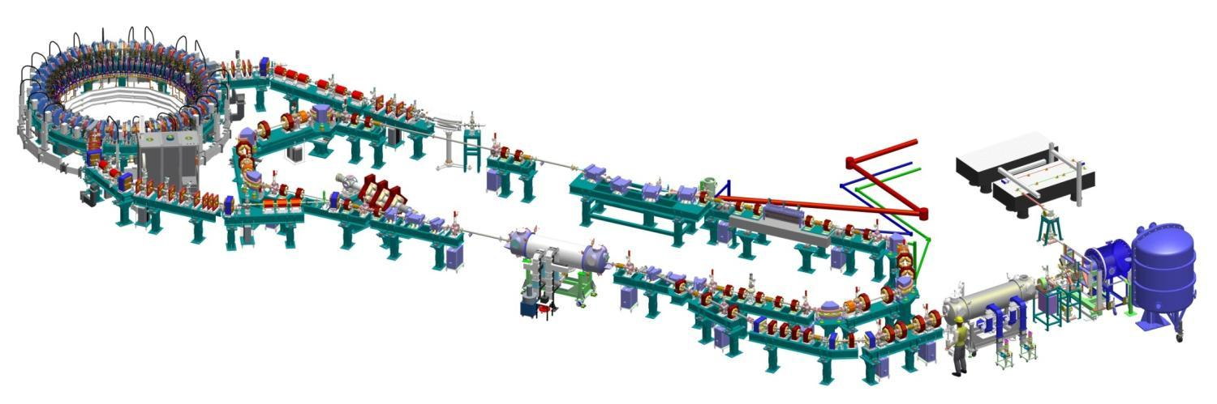
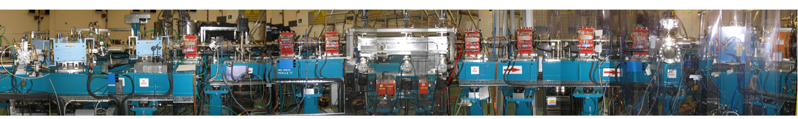
ALICE accelerator and FEL layout
EMMA non-scaling FFAG accelerator
1st arc: TBA on translation stage
Bunch compression chicane
THz beamline
PI laser
6.5MeV
dump
FEL optical cavity
FEL beamline
Buncher cavity
2nd arc
Linac: 2 9-cell SC L-band cavities →27.5MeV, ER
230 kV DC GaAs cathode gun
Booster: 2 9-cell SC L-band cavities →6.5MeV
Upstream mirror
Downstream mirror
Undulator
Electron path
Dave Dunning

Slide 35

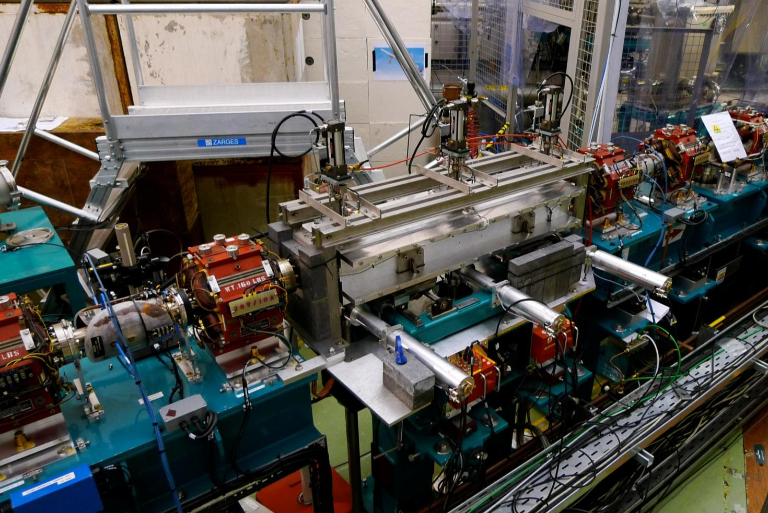
Undulator
Undulator
On loan from JLAB where previously used on IR-DEMO FEL
Now converted to variable gap
PARAMETERS
Type | Hybrid planar
Period | 27mm
No of Periods | 40
Minimum gap | 12mm
Maximum K (rms) | 0.9
Resonant wavelength at minimum gap and 27.5 MeV | 8µm
Dave Dunning

Slide 36
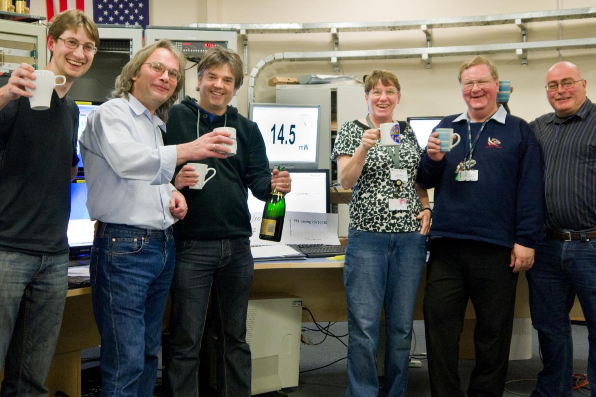
23rd October 2010: ALICE FEL First Lasing
It took a while to achieve first lasing but once the electron bunch charge was pushed up to 100pC it was really easy, in fact it was hard not to lase afterwards, even at lower charges!
First Lasing Data: 23/10/10
The IR from the FEL was used for several years on cancer diagnosis research by a team led by Peter Weightman from Liverpool but once the funding for this dried up we took the decision to close ALICE and concentrate our resources on CLARA instead – more on that later
Simulation (FELO code)
Dave Dunning

Slide 37
CAAST
In the meantime, it was decided that the accelerator part of the SR Department should spin out and stand alone as a new ‘Centre’
This was originally going to be called CAAST – The Centre for Advanced Accelerator Science and Technology
The proposed name wasn’t very popular with the troops, me included, so over coffee time one day we brainstormed new ideas and ASTeC emerged the winner – Accelerator Science and Technology Centre

Slide 38
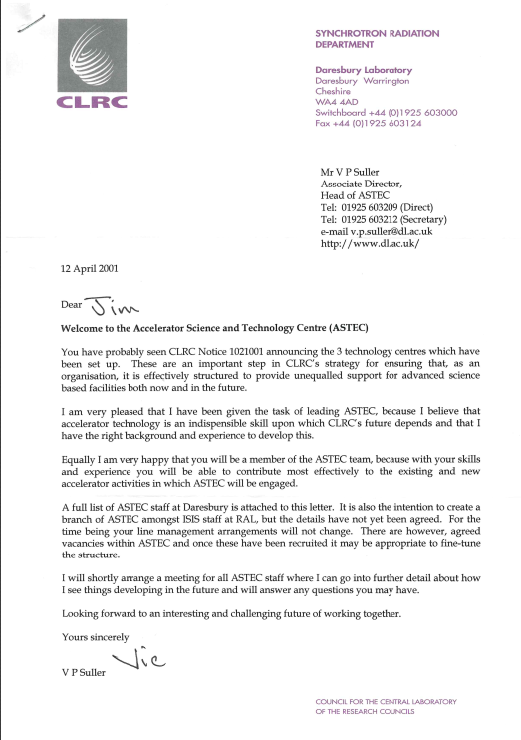
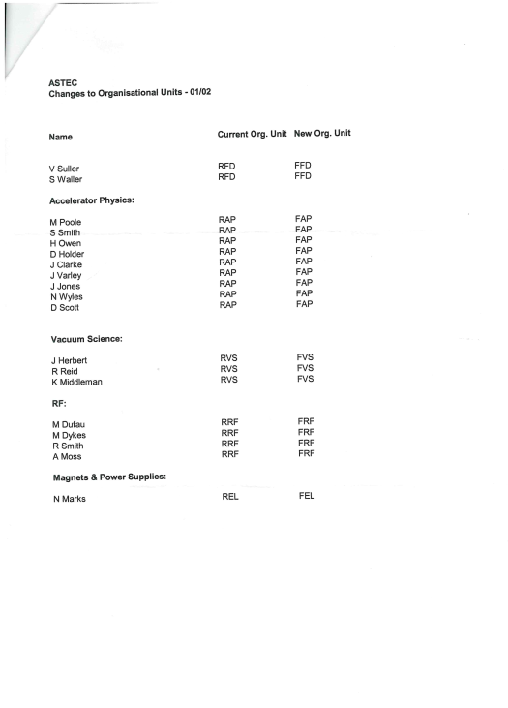
ASTeC
Splitting off from a department whose prime mission was to operate a user facility had really long reaching implications for us
We were able to choose what we worked on, as long as there were the funds to support it !
Over previous years we had been held back from taking on many non-light source opportunities, now we really felt like we had been given our freedom!
Soon we were working on accelerator R&D for particle physics, neutrino factories and linear colliders in particular, but also with industry as well
When ASTeC was set-up in 2001 there were three groups and 19 staff members
Today there are three divisions, eight groups and ~115 staff, apprentices and students

Slide 39
The Universities
At around the same time that ASTeC was being set-up PPARC took the strategic decision to help develop the UK capability in accelerators – in the universities as well as the labs!
This was the impetus that was needed for the UK universities to really take an interest again in accelerator R&D, especially for particle physics
A few years later it was agreed to establish the two accelerator institutes – CI and JAI
Suddenly it was possible to study for a PhD in accelerators in the UK again!
Good Times!

Slide 40
Positron Source for the ILC
I was asked to lead a UK activity in the positron source for the International Linear Collider since one of the main options for achieving the very high bunch charges required was undulator based
The undulator solution had the big advantage that polarized positrons could be generated using circularly polarized gamma rays
This was a very challenging and interesting technical problem and after building permanent magnet and superconducting magnet prototypes we selected to focus on helical superconducting undulator solutions

Slide 41
Positron Source for the ILC
I really enjoyed working in a truly global collaboration for the first time
I quickly realized that not just the positrons were polarized but also the people proposing the alternative solutions for creating them in the first place
The US (and European) members were pro undulator and the Japanese were pro conventional positron source (electrons into a target)
Because of this it was one of the most controversial parts of the design which often led to heated arguments
As there were particularly strong feelings in the US and Japan it was agreed that a European person should run this part of the ILC design and so I took over the leadership for several years
This really helped me work on my diplomatic skills!
Eventually we were asked to pick a baseline solution and the undulator based one was selected – all the work that had been carried out in the UK and elsewhere in the meantime had systematically addressed many of the concerns raised and the physics advantage of polarized positrons tipped the balance

Slide 42
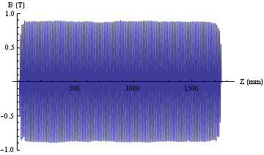
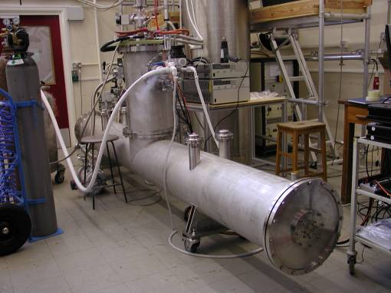
Helical Superconducting Undulator for the ILC
My personal technical involvement was in the R&D for the SCU
A 4m module containing 2 x 1.75m helical undulators (11.5 mm period) was constructed and tested at RAL
Closed loop cryo system with cryocooler
I think this is still the baseline for the ILC

Slide 43
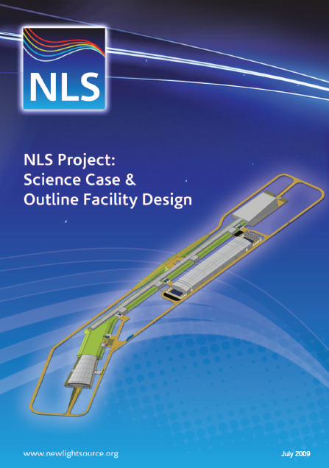
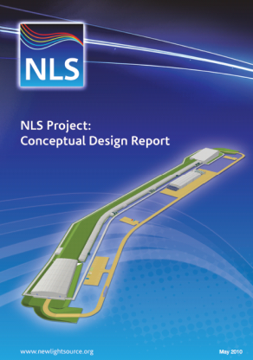
New Light Source
Although 4GLS was stopped in 2008 there was strong interest in the UK SR user community in continuing to explore the potential for FELs
A Science Case for NLS was drafted and well received and so it was full steam ahead on another FEL light source design study!
The Science Case made it clear that we needed to push the output into the soft X-ray region and so we picked a single pass FEL for the NLS concept – this was before any X-ray FEL had even lased
Sadly the NLS was a victim of the financial downturn and was told to go away and come back in a few years!

Slide 44
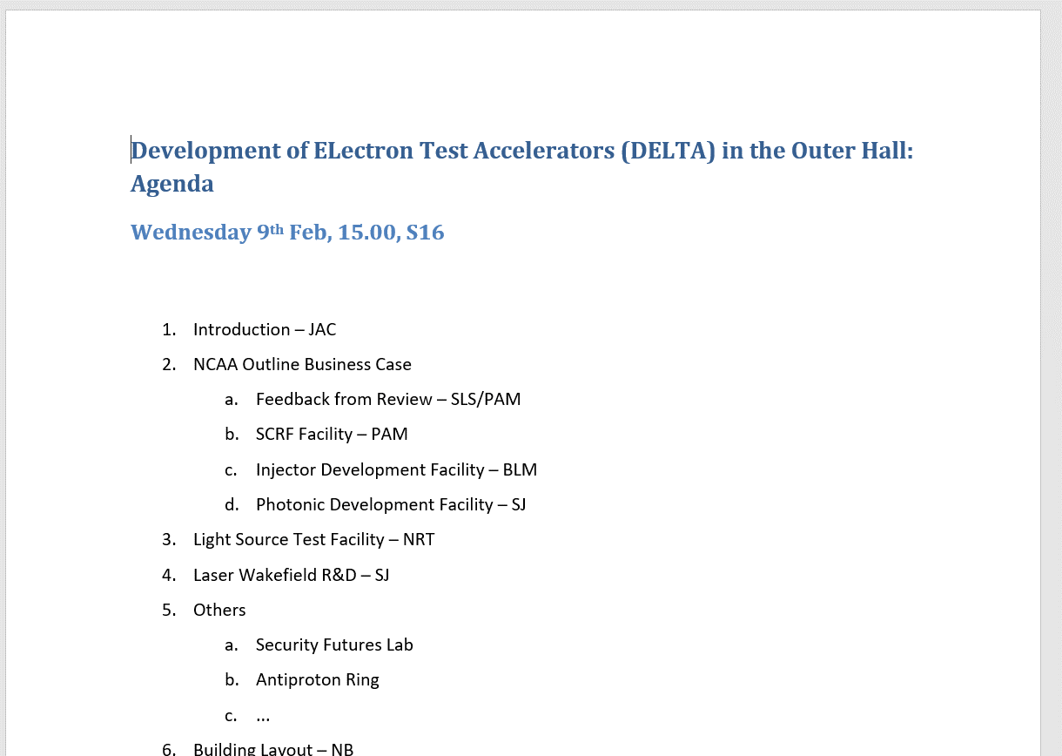
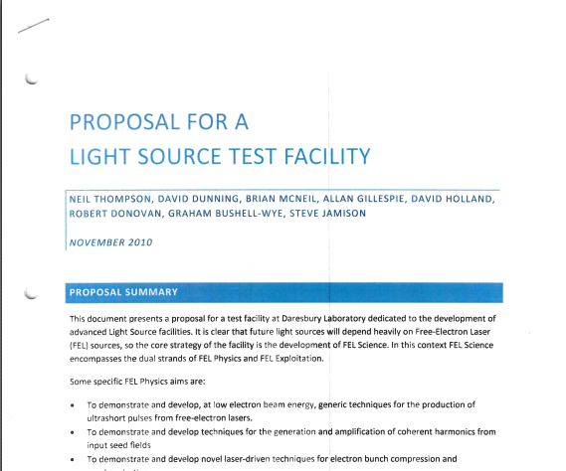
DELTA
The NLS project did convince me and others in ASTeC that single pass FELs, based upon linac technology (not ERL), was the future and so we started thinking about a test facility in late 2010 to demonstrate some of the new concepts that my team and others had generated – codename DELTA

Slide 45
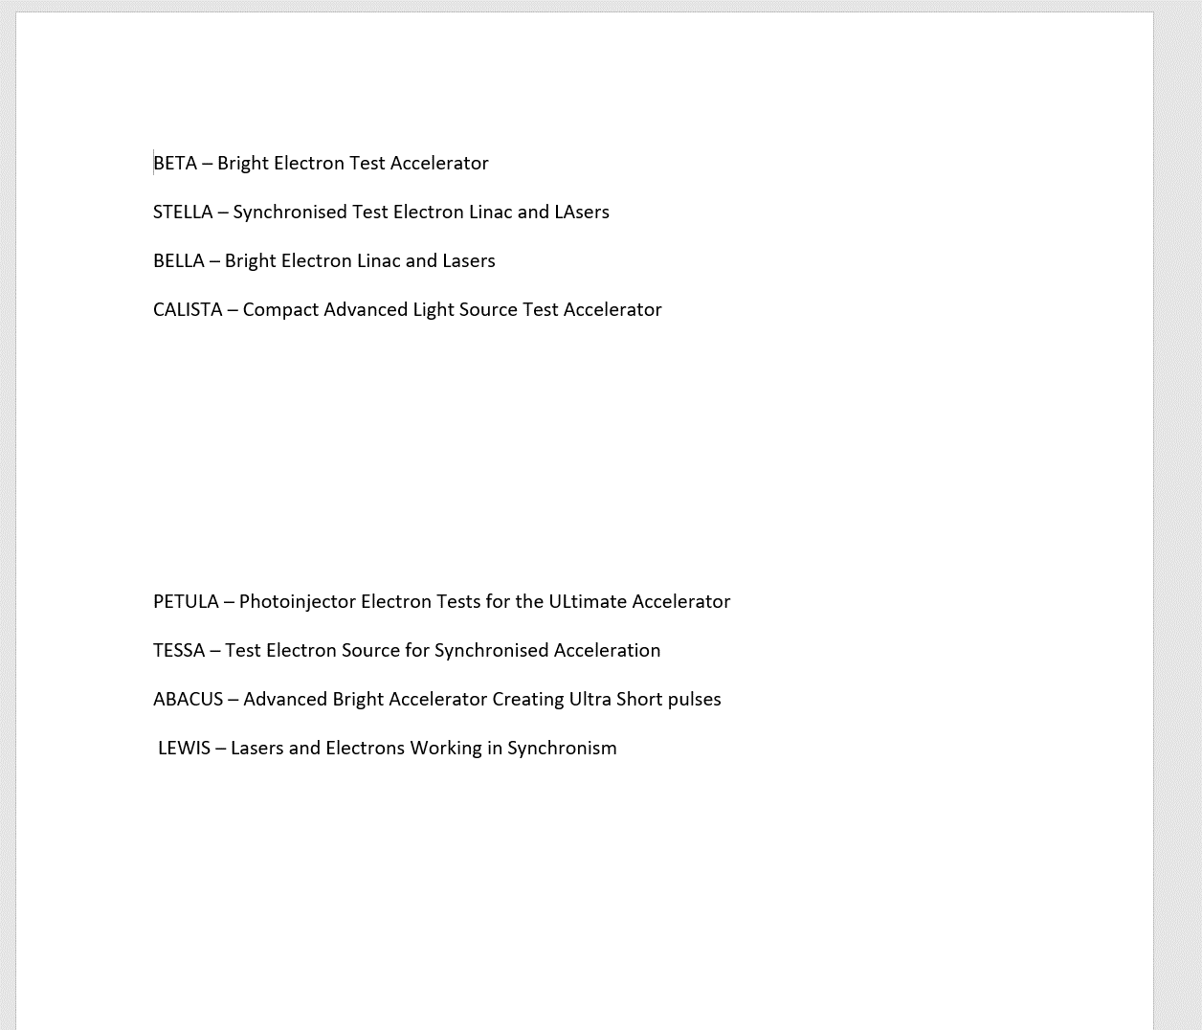
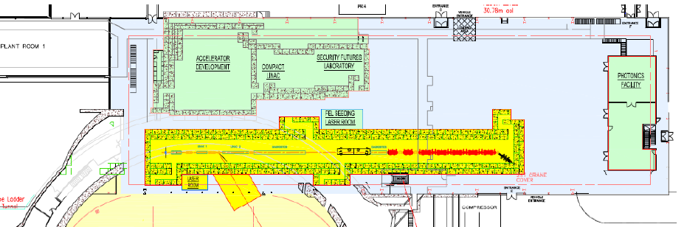
My suggestions at the time
CLARA
I proposed a list of names to Susan Smith for this new test facility
Susan came back with CLARA (the Compact Linear Advanced Research Accelerator)
John Womersley, STFC Chief Exec, then gave a staff talk in which he expressed support for CLARA, the Compact Linear Accelerator for Research and Applications – I agreed with Susan that this was much better so we have stuck with this ever since!

Slide 46
CLARA
Although STFC supported CLARA, it wasn’t able to find the budget so it could be delivered as a simple one off project
Instead we received an annual allocation which certainly made it very hard to manage and forced us to break the project down into phases
Finally, after several years me and Susan persuaded STFC to allocate the remaining funds across multiple years which made the Phase 2 procurement and management a bit easier
Originally CLARA was foreseen as a single pass FEL Test Facility but we are still not there yet!
The space is still reserved for a FEL but the motivation (& funds) will need to come from UK XFEL
Now the focus has shifted to CLARA being a user facility for research that requires access to a high energy, bright electron beam – we have already fitted in two user periods which have been highly successful and these have helped persuade STFC to further invest in a 120TW laser and FEBE (the independent end station)
I’m very much looking forward to seeing CLARA generate 250 MeV electron bunches and welcoming users onto site again

Slide 47
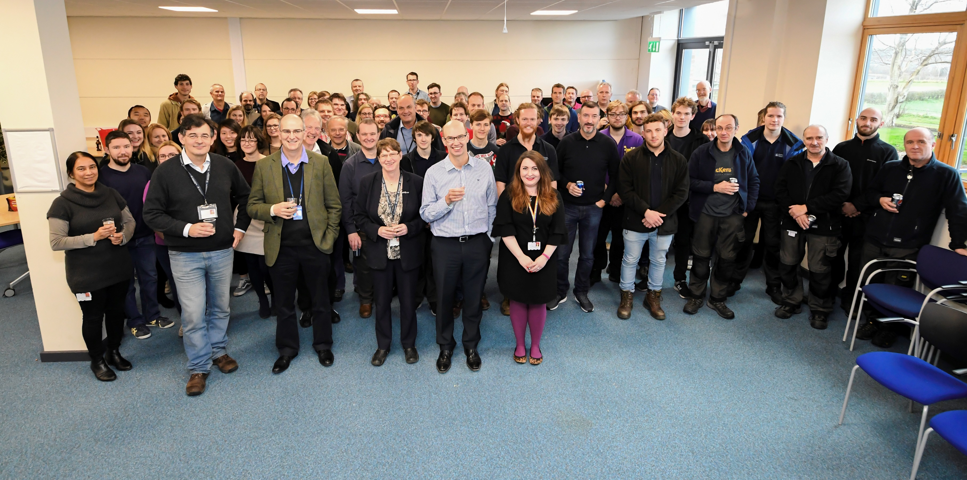
CLARA First Beam Celebration

Slide 48


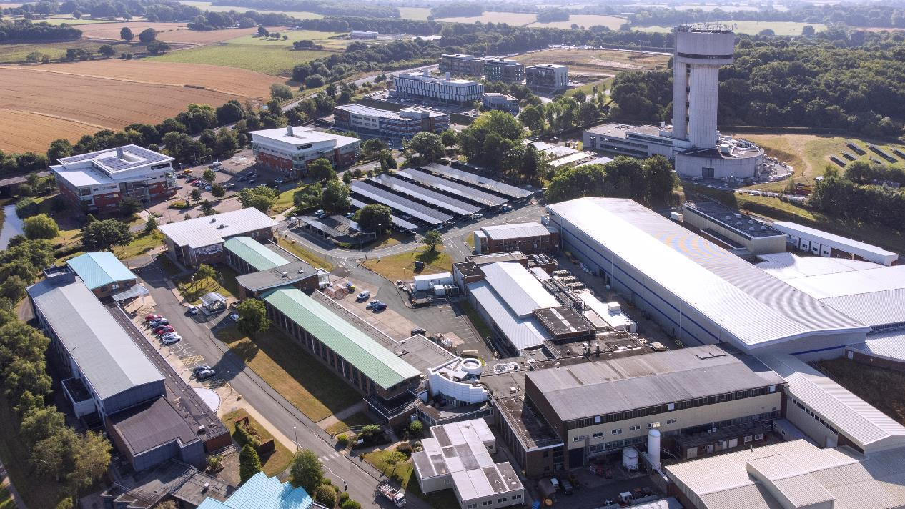
We did manage to persuade STFC to pay to upgrade the Electron Hall so we could control the temperature at the levels required by CLARA
I was given the privilege of picking the colour scheme
So after a quick call to Leicester City Football Club to find out the exact shade of blue they use for their shirts…

Slide 50
UK XFEL – 3rd time lucky?
Since the NLS time, five XFELs have begun operations around the world, with many UK researchers benefitting from access to carry out their research
STFC recognised this and so solicited the community to reassess the user case
A compelling science case was published and the demand for hard X-rays (as well as the other parts of the spectrum) clearly emerged
We are now developing the conceptual design for a possible new national facility – UK XFEL, as well as looking at alternative options for meeting UK user needs, such as major investments in existing overseas XFELs

Slide 51









KEY
to Photon Transports & Experimental Hall
Passive Wakefield Structure
The current conceptual layout of UK XFEL
Each new FEL that I help design gets longer and higher energy !
2m Planar Undulator
2m APPLE-X
1.25m APPLE-X
With delay chicane
2m HELICAL SCU
Cryomodule
Delay Chicane
Kicker + Septum

Slide 52


Sustainability of Accelerators
I want to play my part in making current and future accelerators more sustainable
On the technical side I helped develop the first ZEPTO permanent magnet quadrupoles and dipole
My only patents !
Now, I am concentrating my efforts on making sure that the UK accelerator community is properly funded to lead the way globally in some key technologies, not least because we have a pipeline of new accelerator projects that absolutely must be much more sustainable than present day technology allows – e.g. ISIS-2, UK XFEL, FCC, …
ZEPTO quad installed on Diamond
Denise Völker, Head of Sustainability at DESY
Sustainable Accelerator Workshop, Harwell
23rd May 2024

Slide 53
Back to the Job Advert
“…our group … is embarking on major new design initiatives … state of the art … storage rings and free electron lasers”
“Advanced accelerators use high technology …particle beam design, major computer simulation, large electromagnets, high power RF systems, high-voltage pulse techniques, superconducting magnets, ultra high vacuum equipment, and other topics.”
It’s taken a long time but I have worked on most of the topics listed now, just two more to go!

Slide 54


Acknowledgements
I am particularly indebted to three mentors that I was lucky enough to work with for large parts of my career – Vic Suller, Mike Poole, and Neil Marks
They were all brilliant and inspiring to work with in their own distinctive ways!
Also, all of the activities and projects that I have mentioned were carried out as part of a team of other experts from multiple disciplines and I would have achieved very little without them!
I am extremely grateful to everyone who I have worked with along the way and apologies for not listing you all here, I’m bound to forget someone inadvertently!
Thanks again to the IOP PAB for the prize, it’s a great honour and a surprise and very much appreciated!

