Slide 1


Multi-parameter Bayesian optimisation of laser-driven ion acceleration in particle-in-cell simulations
E. J. Dolier¹, M. King^{1,2}, R. Wilson¹, R. J. Gray¹ and P. McKenna^{1,2}
¹ SUPA Department of Physics, University of Strathclyde, UK
² The Cockcroft Institute, Sci-Tech, Daresbury, Warrington, UK
Particle Accelerators and Beams, University of Strathclyde
Friday 30th June 2023
Particle Accelerators and Beams 2023 ewan.dolier.2015@uni.strath.ac.uk

Slide 2
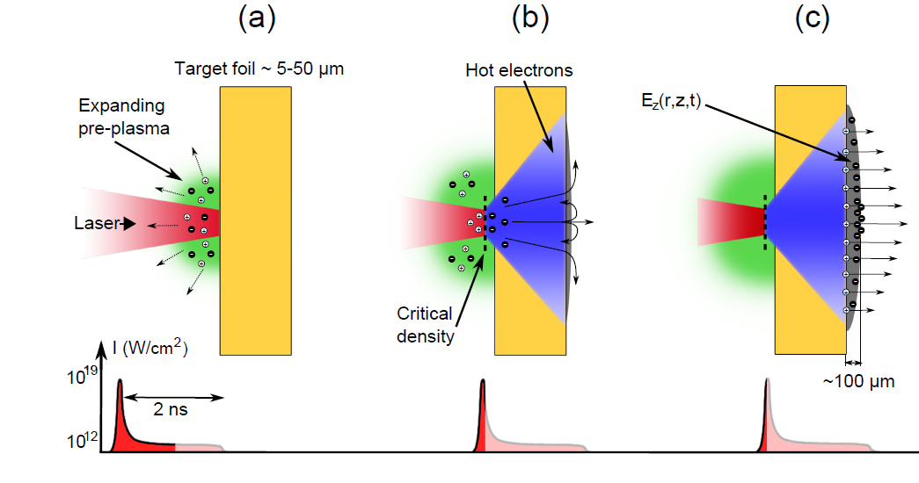

Optimising Sources of Radiation from Laser-Solid Interactions
Radiation sources generated in laser-solid interactions have unique properties which are useful for applications.
However, properties of these sources must be optimised before applications can be realised.
However, these are highly non-linear interactions – very difficult to optimise for all input parameters!
Source of Multi-MeV ions with unique properties for applications!
Laser:
Intensity
Energy
Pulse Duration
Focal spot size
Laser intensity contrast
Polarisation
Plasma:
Energy conversion efficiency
Fast electron divergence angle
Z (scattering, resistivity)
Preplasma scale length
Target Thickness
Incidence angle
Electric sheath field evolution
TNSA maximum proton energy ($E_{max⁡}$)
Particle Accelerators and Beams 2023 ewan.dolier.2015@uni.strath.ac.uk

Slide 3
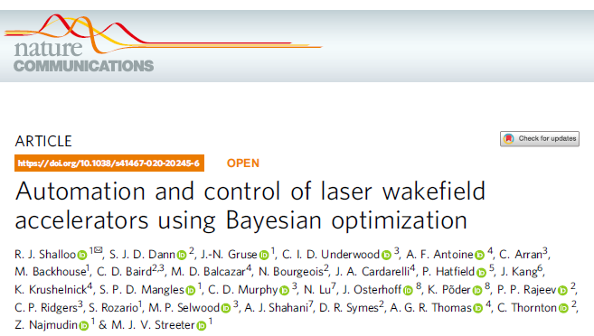
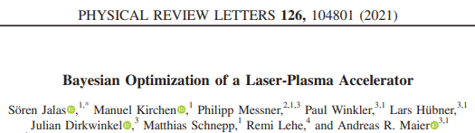
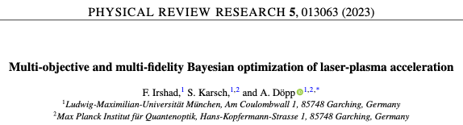
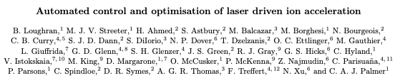
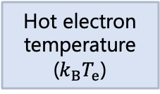
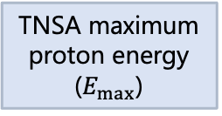
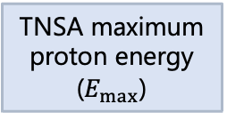
Bayesian Optimisation of Laser-Plasma Accelerators
Optimising in simulations
Optimising in experiments
Some interaction properties are difficult to measure experimentally but can be measured in simulations
These properties define key source properties such as the maximum proton energy
By optimising these properties in simulations, we can guide experimental conditions
Optimise
Input
Optimise
Output
Input
Infer
Output
Hot electron temperature ($k_{B⁡}T_{e}$)
TNSA maximum proton energy ($E_{max⁡}$)
Peak laser intensity
TNSA maximum proton energy ($E_{max⁡}$)
Peak laser intensity
???
Particle Accelerators and Beams 2023 ewan.dolier.2015@uni.strath.ac.uk

Slide 4

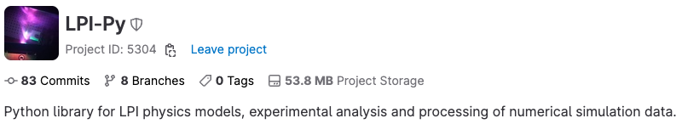

BISHOP code to facilitate Bayesian optimisation
Select a scan type:
Minimum – Maximum
Optimise
Bishop is a platform for automatically generating PIC simulation data and applying machine learning techniques
3. Simulation data is transferred from remote – local server
4. The data is analysed by LPI-Py, providing evaluations, $f(X_{n})$
4. The data is analysed by LPI-Py, providing evaluations, 𝑓(𝑋_𝑛)
2. Simulation with inputs $X_{n}$ is submitted to queue on a remote server
2. Simulation with inputs 𝑋_𝑛 is submitted to queue on a remote server
.
Open source PIC code developed by University of Warwick
Optimise
Next $X_{n}$ values are guided by a GP surrogate model:
$$UCB= μGP+κσGP$$
Matt Alderton Talk – Thursday 14:20
Particle Accelerators and Beams 2023 ewan.dolier.2015@uni.strath.ac.uk

Slide 5
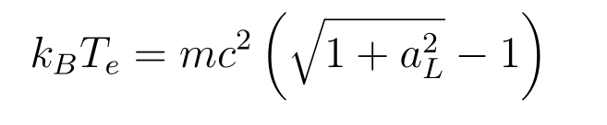
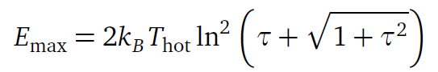
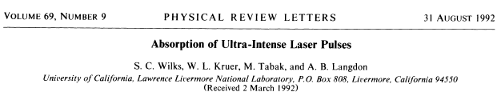
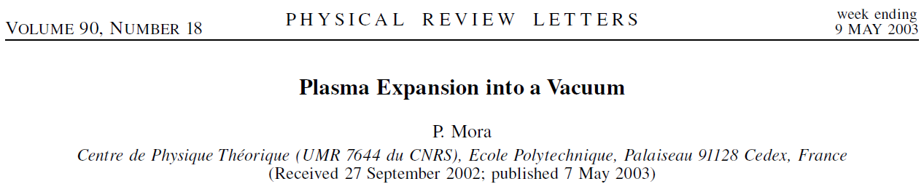
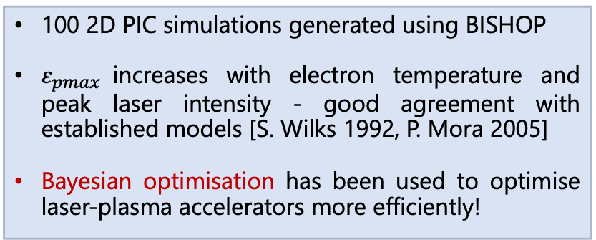
Conventional Optimisation using BISHOP
100 2D PIC simulations generated using BISHOP
$ε_{pmax}$increases with electron temperature and peak laser intensity - good agreement with established models [S. Wilks 1992, P. Mora 2005]
Bayesian optimisation has been used to optimise laser-plasma accelerators more efficiently!
N. P. Dover, et al., Phys. Rev. Lett. 124.8, 084802 (2020)
Particle Accelerators and Beams 2023 ewan.dolier.2015@uni.strath.ac.uk

Slide 6
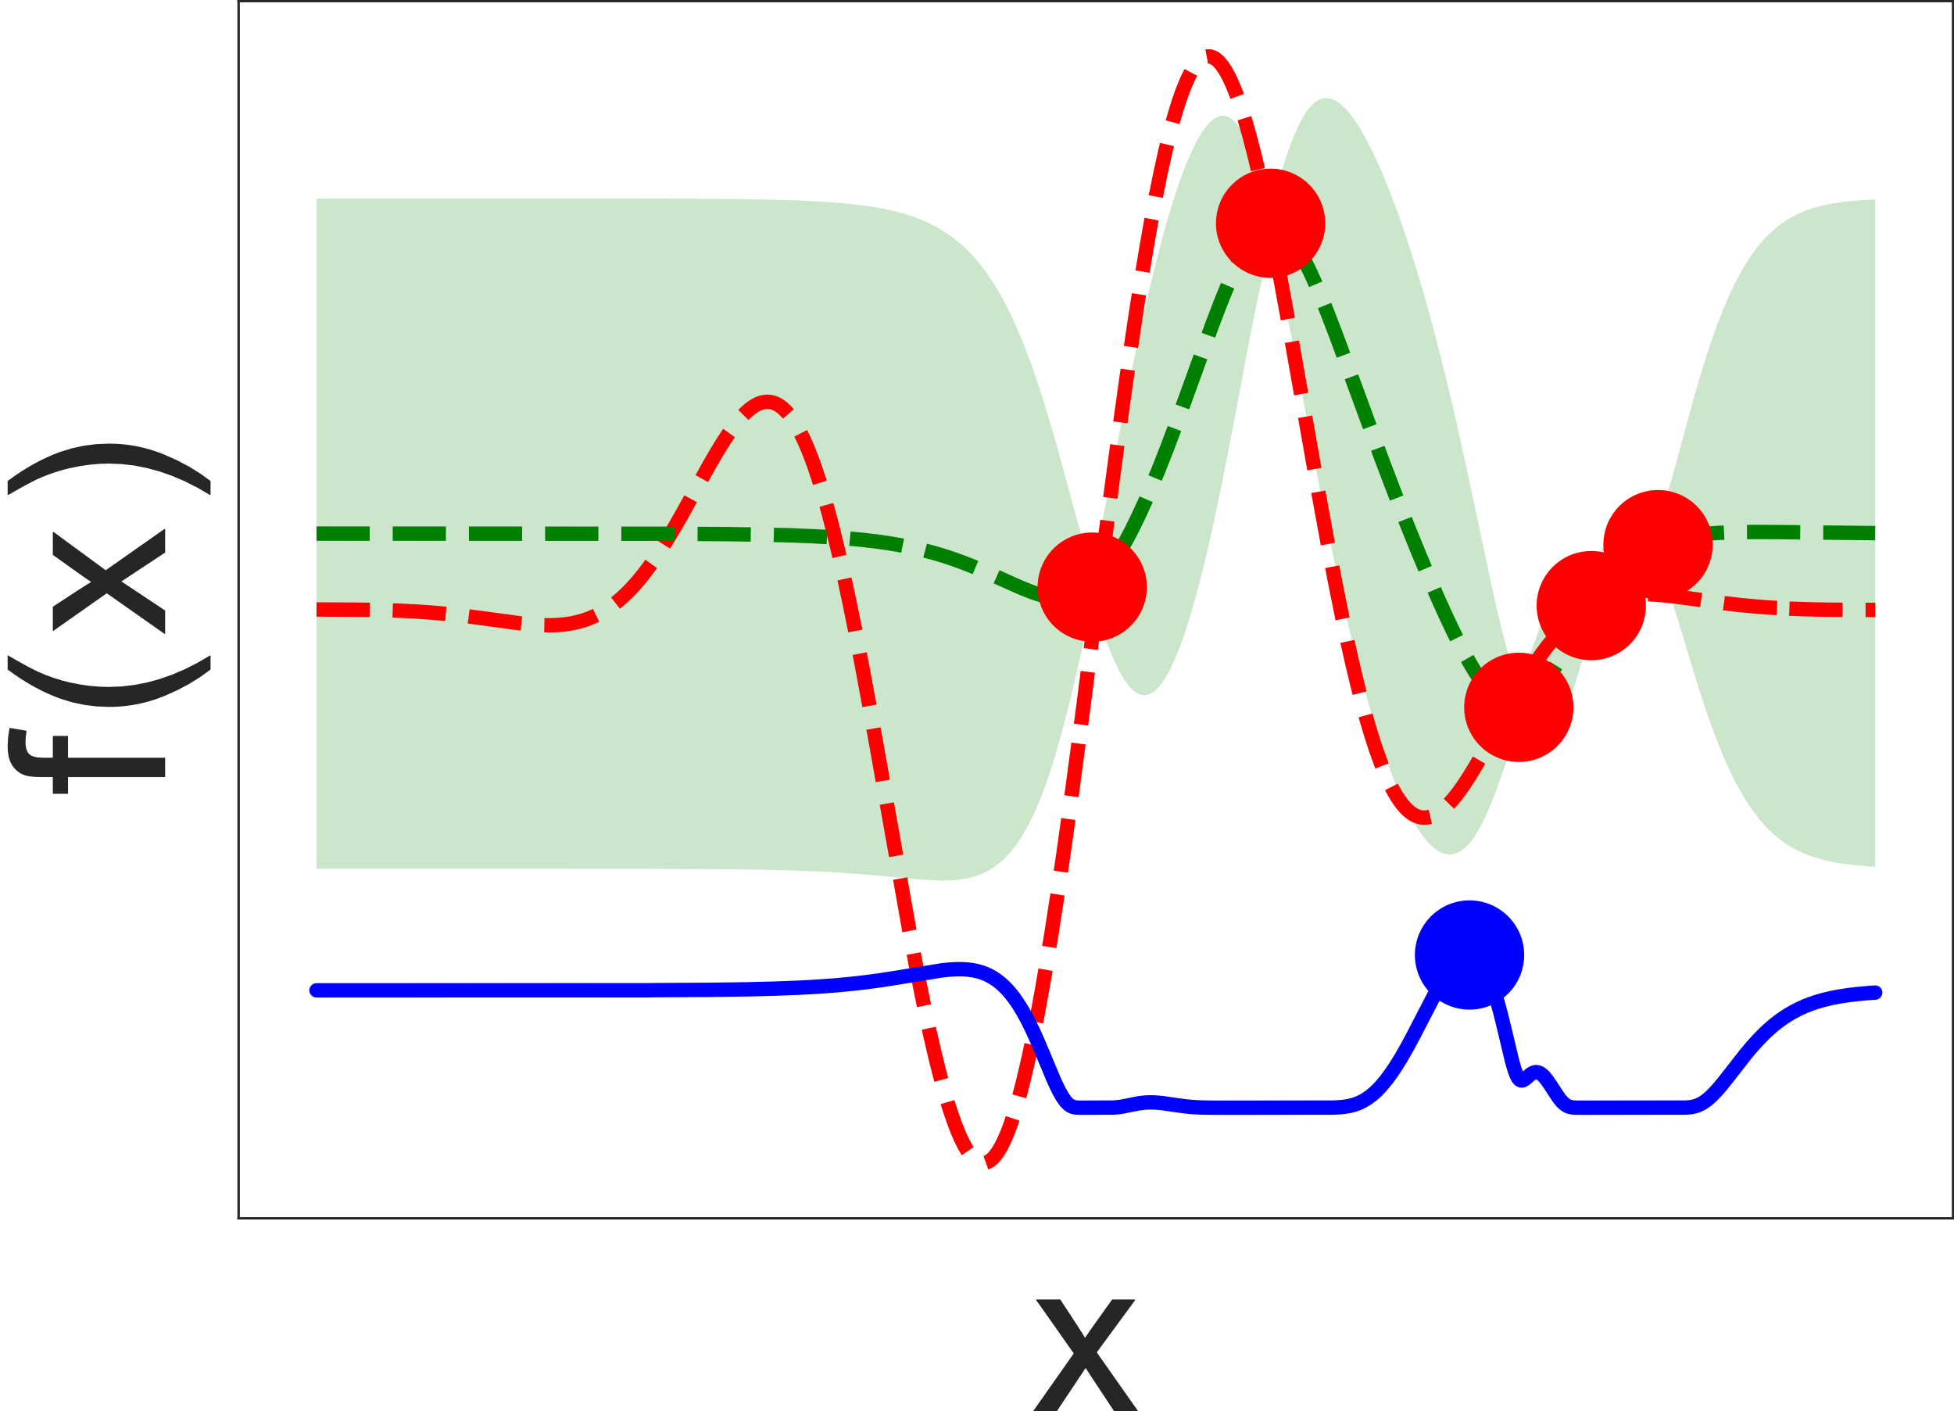
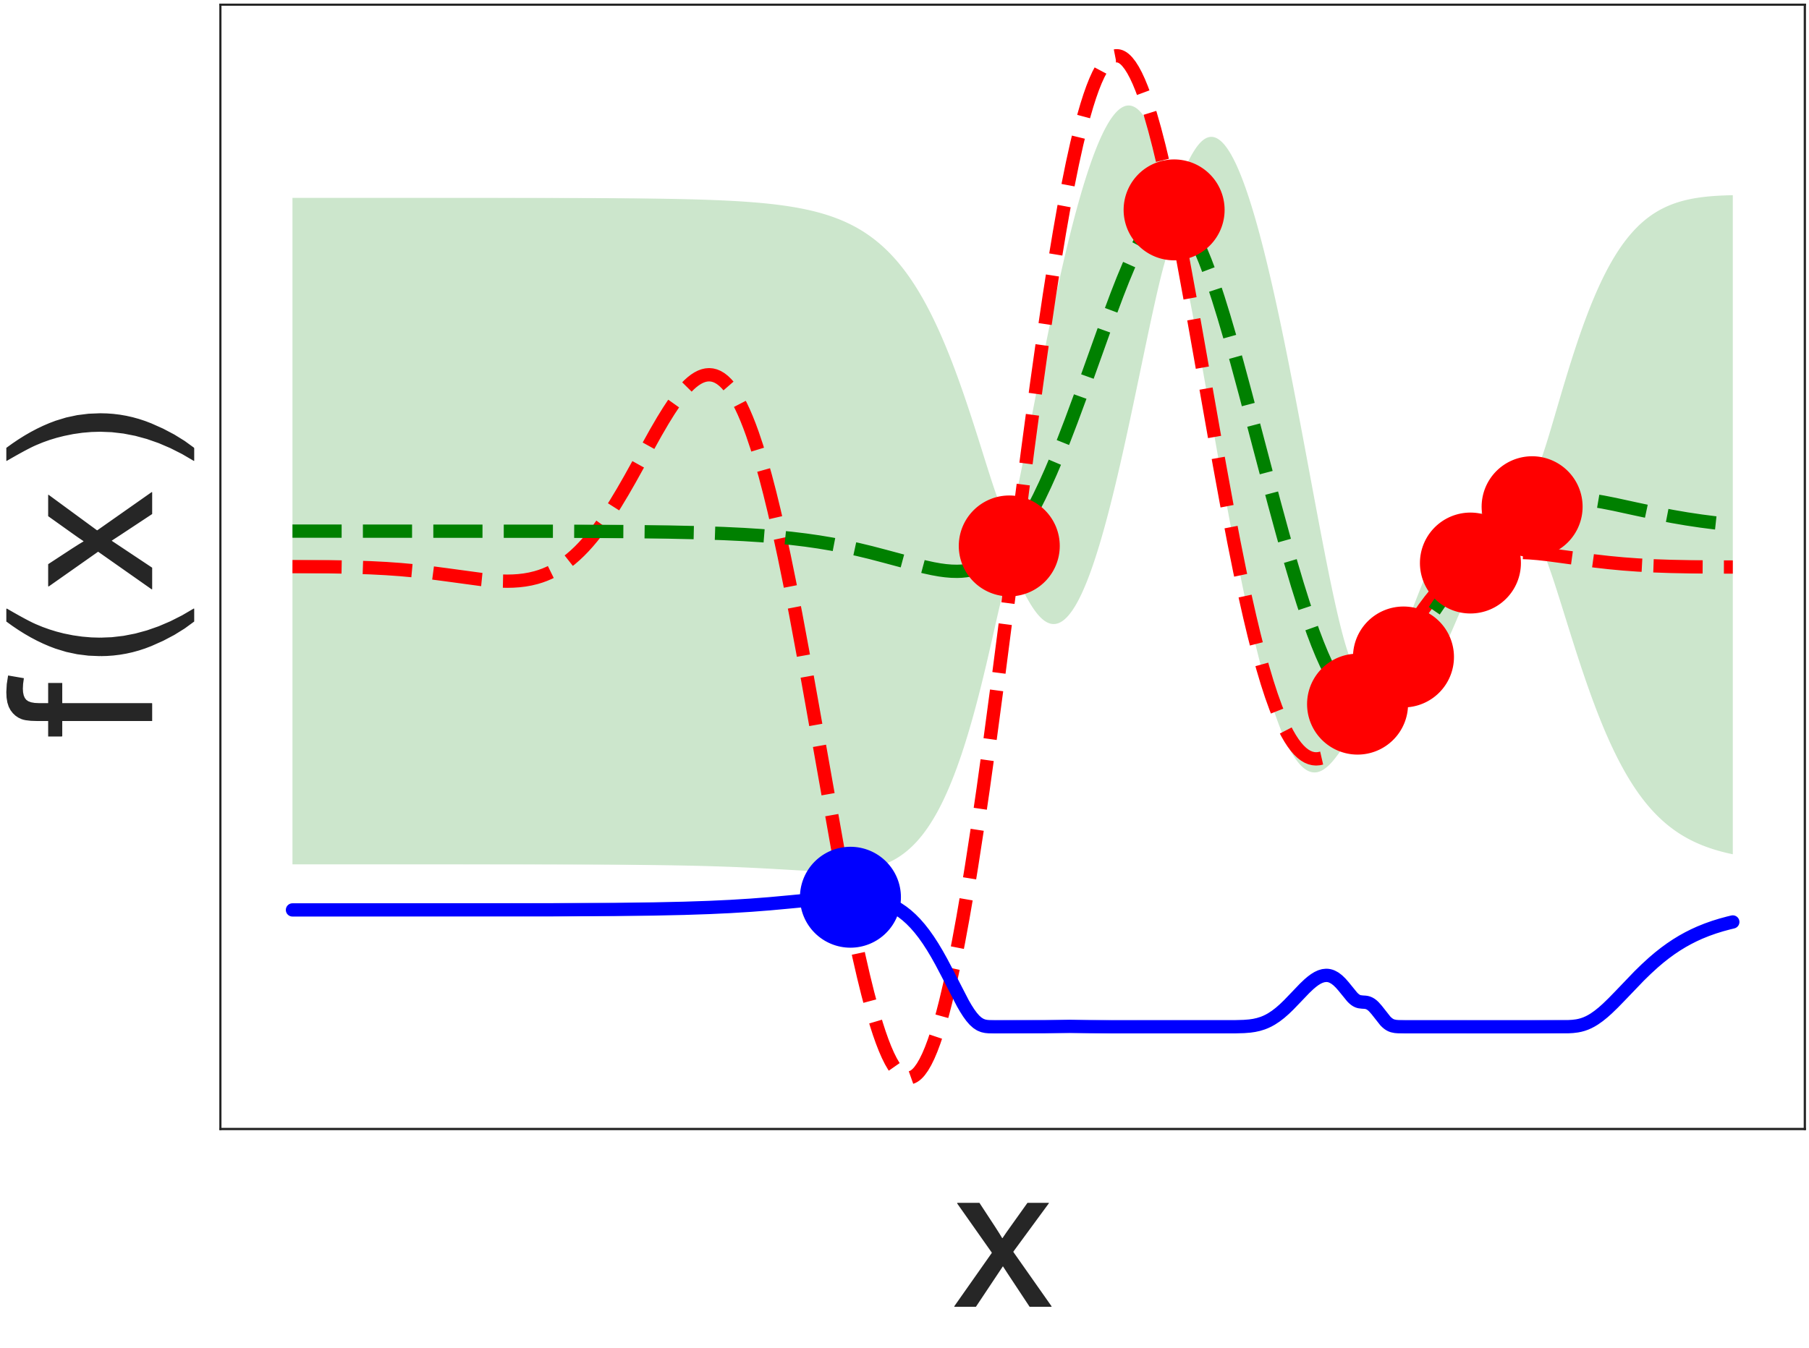
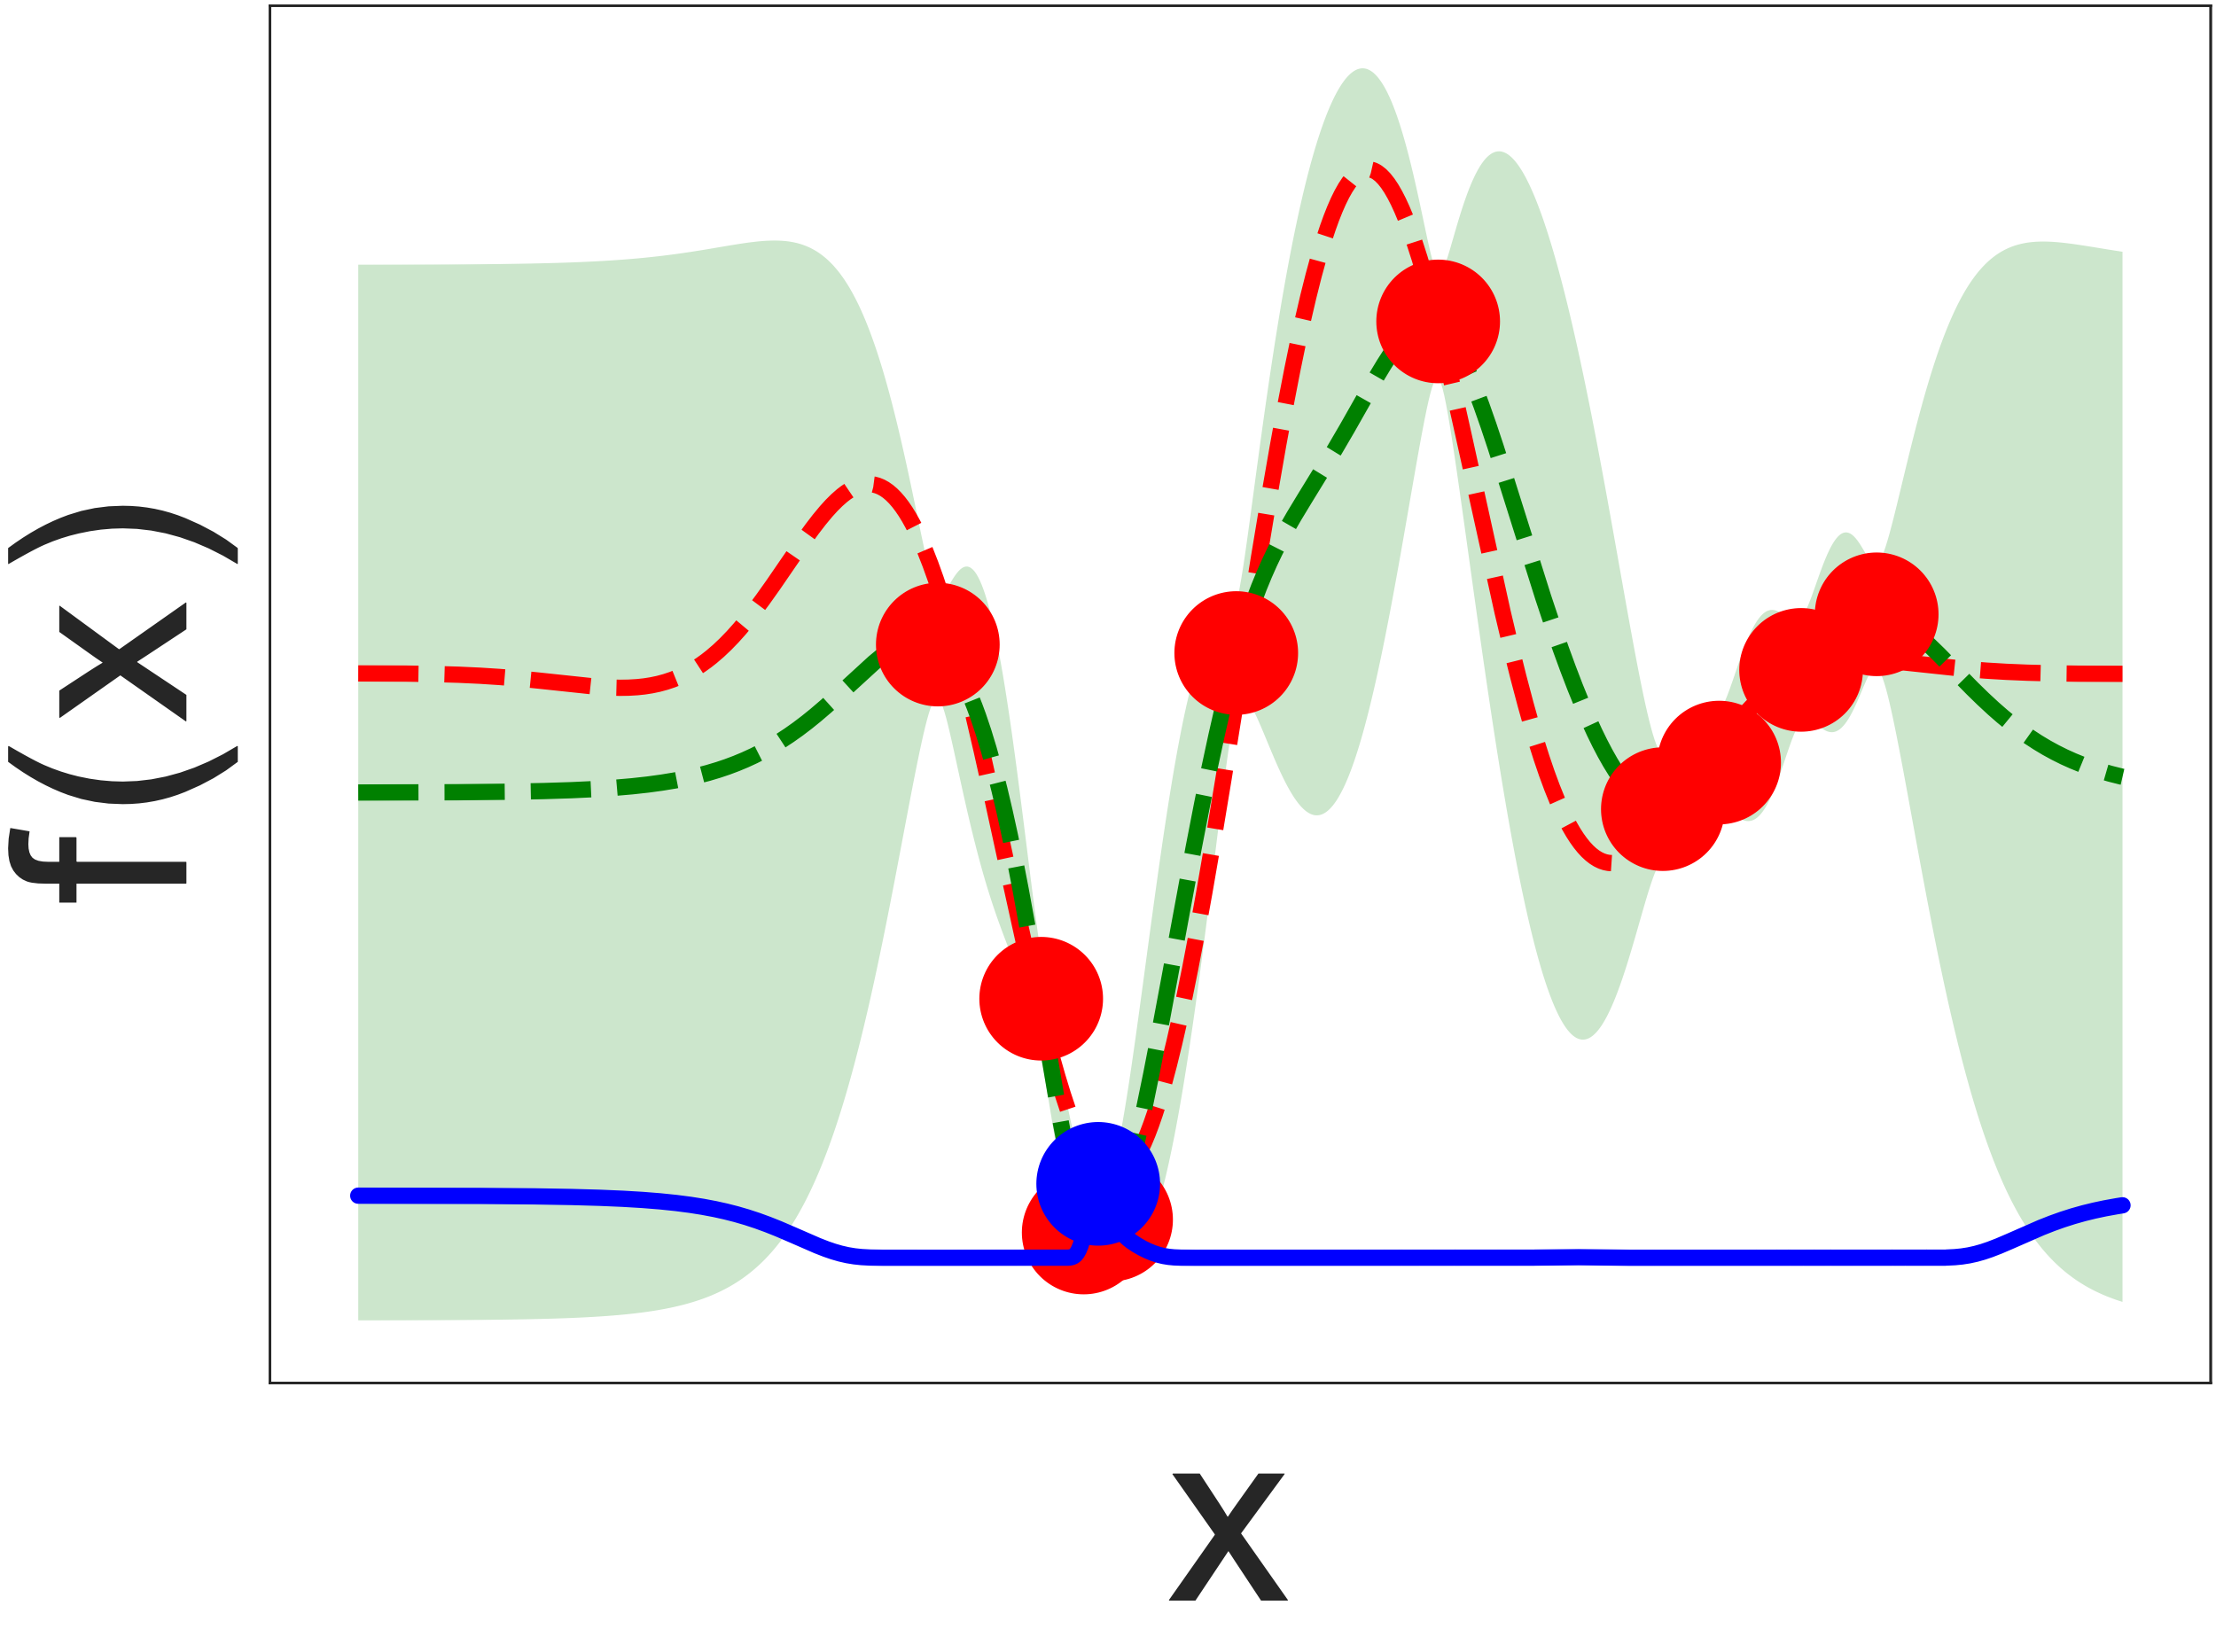
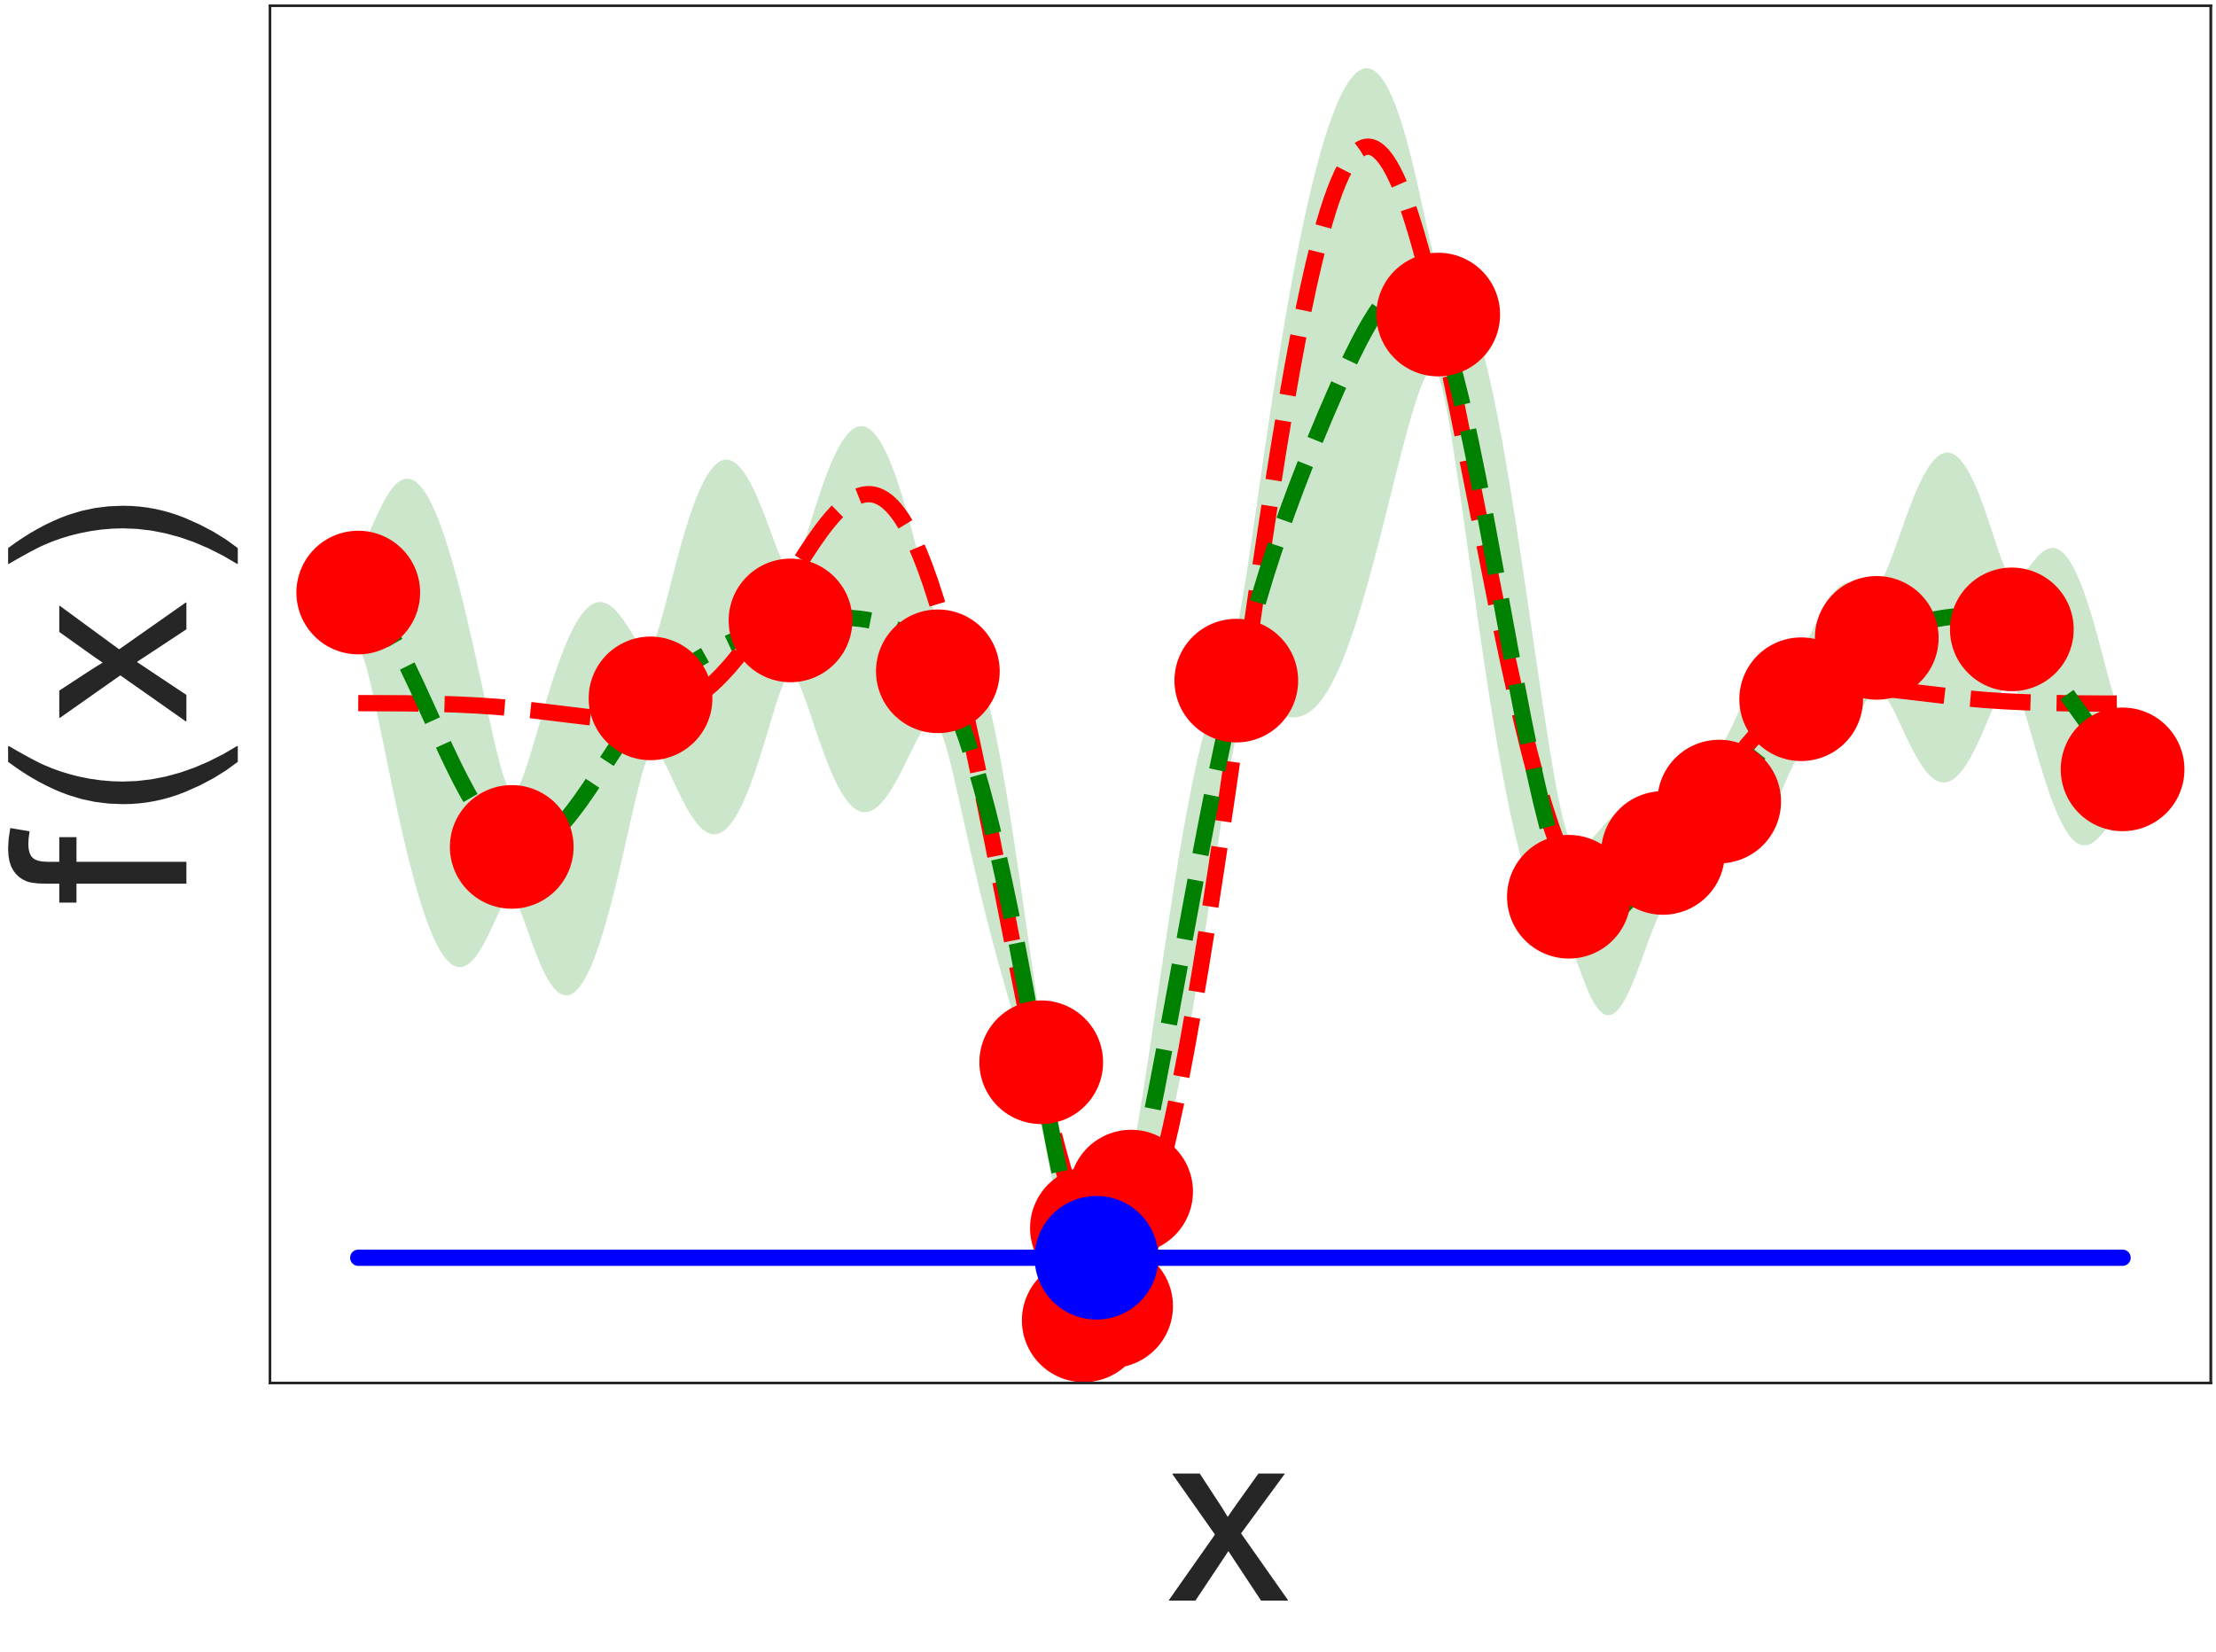


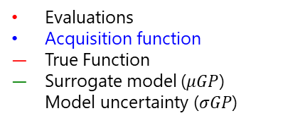



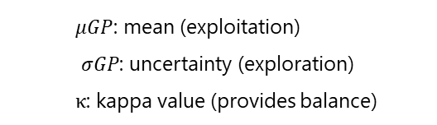

Bayesian Optimisation Example
We can optimise a noisy and expensive function with limited data!
1. Randomly vary X between
$X_{min}=0 →X_{max}=1$
(a)
Random
$$n=5$$
(b)
$$n=6$$
4. Use model to suggest the next X value
Acquisition Function
$$UCB= μGP(X)+κσGP(X)$$
2. Measure the objective function, f(X)
(c)
$$n=10$$
(d)
$$n=20$$
3. Update surrogate model with X and f(X)
Evaluations
Acquisition function
True Function
Surrogate model ($μGP$)
Model uncertainty ($σGP$)
  $μGP$: mean (exploitation)
  $σGP$: uncertainty (exploration)
  $κ$: kappa value (provides balance)
Particle Accelerators and Beams 2023 ewan.dolier.2015@uni.strath.ac.uk

Slide 7
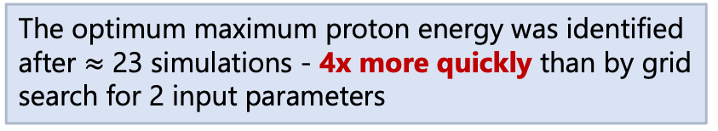
Bayesian Optimisation using BISHOP
The optimum maximum proton energy was identified after $≈$ 23 simulations - 4x more quickly than by grid search for 2 input parameters
Particle Accelerators and Beams 2023 ewan.dolier.2015@uni.strath.ac.uk

Slide 8
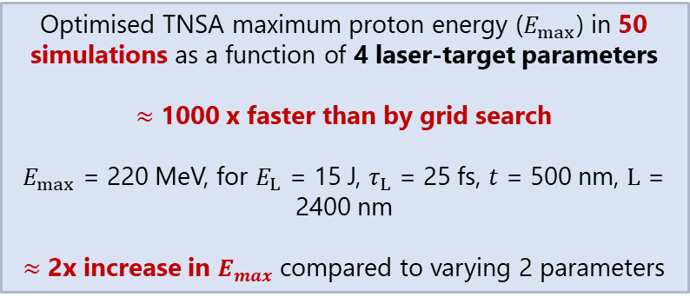
Optimising for Laser AND Target Parameters
Laser:
Intensity
Energy
Pulse Duration
Focal spot size
Laser intensity contrast
Polarisation
Plasma:
Energy conversion efficiency
Fast electron divergence angle
Z (scattering, resistivity)
Preplasma scale length
Target Thickness
Incidence angle
Optimised TNSA maximum proton energy ($E_{max⁡}$) in 50 simulations as a function of 4 laser-target parameters
$≈$ 1000 x faster than by grid search
$E_{max⁡}$ = 220 MeV, for $E_{L⁡}$ = 15 J, $τ_{L⁡}$ = 25 fs, $t_{⁡}$ = 500 nm, $L$ = 2400 nm
$≈$ 2x increase in $E_{max⁡}$compared to varying 2 parameters
Particle Accelerators and Beams 2023 ewan.dolier.2015@uni.strath.ac.uk

Slide 9
Bayesian Optimisation Process
Inputs for each parameter are randomly varied to initialise the model
Model is created and is confident that optimal conditions for laser energy, pulse duration and target thickness have been found
Model focuses on varying scale length from ~ $L$ = 2.7 μm - $L$ = 4.0 μm
Model focuses on varying scale length from ~ $L$ = 2.1 μm - $L$ = 2.4 μm
Particle Accelerators and Beams 2023 ewan.dolier.2015@uni.strath.ac.uk

Slide 10
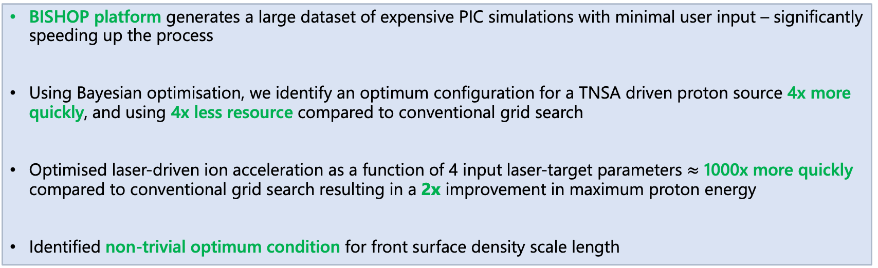
Key Results of Proton Optimisation Work
BISHOP platform generates a large dataset of expensive PIC simulations with minimal user input – significantly speeding up the process
Using Bayesian optimisation, we identify an optimum configuration for a TNSA driven proton source 4x more quickly, and using 4x less resource compared to conventional grid search
Optimised laser-driven ion acceleration as a function of 4 input laser-target parameters $≈$ 1000x more quickly compared to conventional grid search resulting in a 2x improvement in maximum proton energy
Identified non-trivial optimum condition for front surface density scale length
Published Manuscript
Multi-parameter Bayesian optimisation of laser-driven ion acceleration in particle-in-cell simulations
E. J. Dolier et al 2022 New J. Phys. 24 073025
Particle Accelerators and Beams 2023 E. J. Dolier, et al., New J. Phys. 24.7, 073025 (2022) ewan.dolier.2015@uni.strath.ac.uk

Slide 11
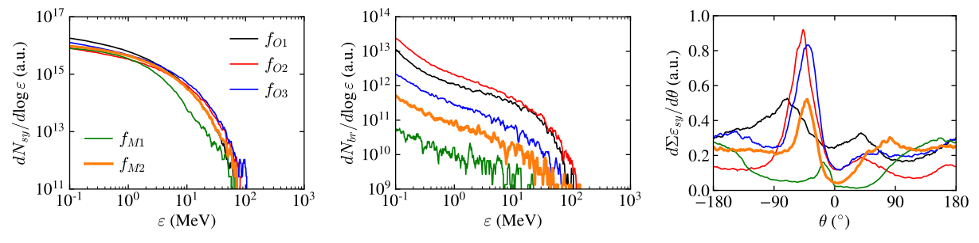
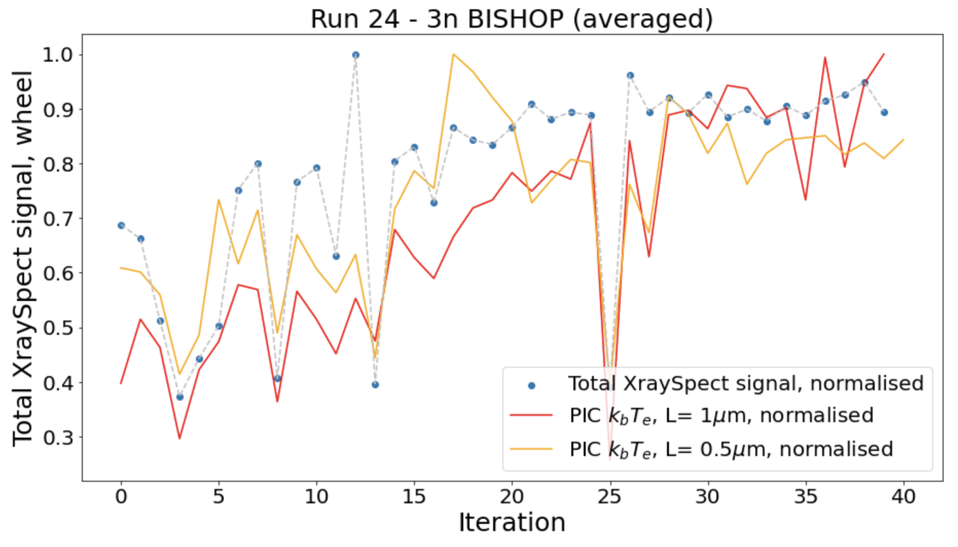
What Next?
Applying Bayesian optimisation to a more complex regime with more input parameters – synchrotron emission!
Synchrotron Emission
Bremsstrahlung Emission
Angle-resolved synchrotron Emission
Published Manuscript
Goodman, J., et. al, 2023. Optimisation and control of synchrotron emission in ultraintense laser-solid interactions using machine learning. HPLSE, pp.1-17.
Using BISHOP, Bayesian optimisation and LPI-Py to guide experiments - ongoing analysis of two experiments and more scheduled soon!
See Poster by Maia Peat from Thursday
Simulation guided Bayesian optimisation of fast electron temperature in laser-solid interactions
See Talk by Matthew Alderton from Thursday
Commissioning experiment on laser-driven proton acceleration on SCAPA
Particle Accelerators and Beams 2023 E. J. Dolier, et al., New J. Phys. 24.7, 073025 (2022) ewan.dolier.2015@uni.strath.ac.uk

Slide 12
Thank you for your time!
Any Questions?
Acknowledgements
I would like to acknowledge my PhD supervisors Prof. Paul McKenna and Dr. Ross Gray, as well as the wider Strathclyde group, all of whom were instrumental in the research presented.
Particle Accelerators and Beams 2023 E. J. Dolier, et al., New J. Phys. 24.7, 073025 (2022) ewan.dolier.2015@uni.strath.ac.uk

Slide 13


Particle Accelerators and Beams 2023 ewan.dolier.2015@uni.strath.ac.uk

