Slide 1
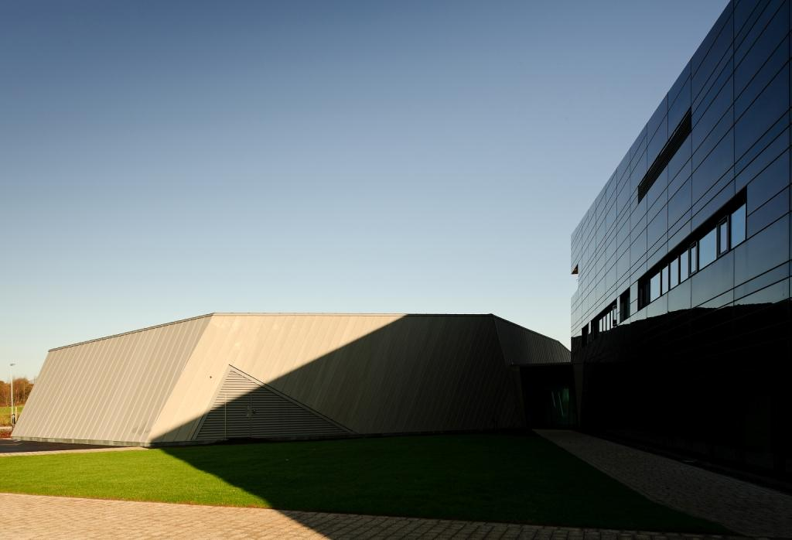





Neutron production in the relativistic frame using heavy ion bombardment
Andy Smith | Samir Shubeita | Fred Currell
Dalton Cumbrian Facility,
University of Manchester
United Kingdom

Slide 2
Why Neutrons ?
Primary cause of radiation damage in nuclear reactors (fission and fusion) is due to very high neutron flux.
Traditional use of test reactors – number decreasing, costly and time consuming.
Effects of neutrons in radiation chemistry not well understood, but of potential wide interest, including effects on human biology.

Slide 3
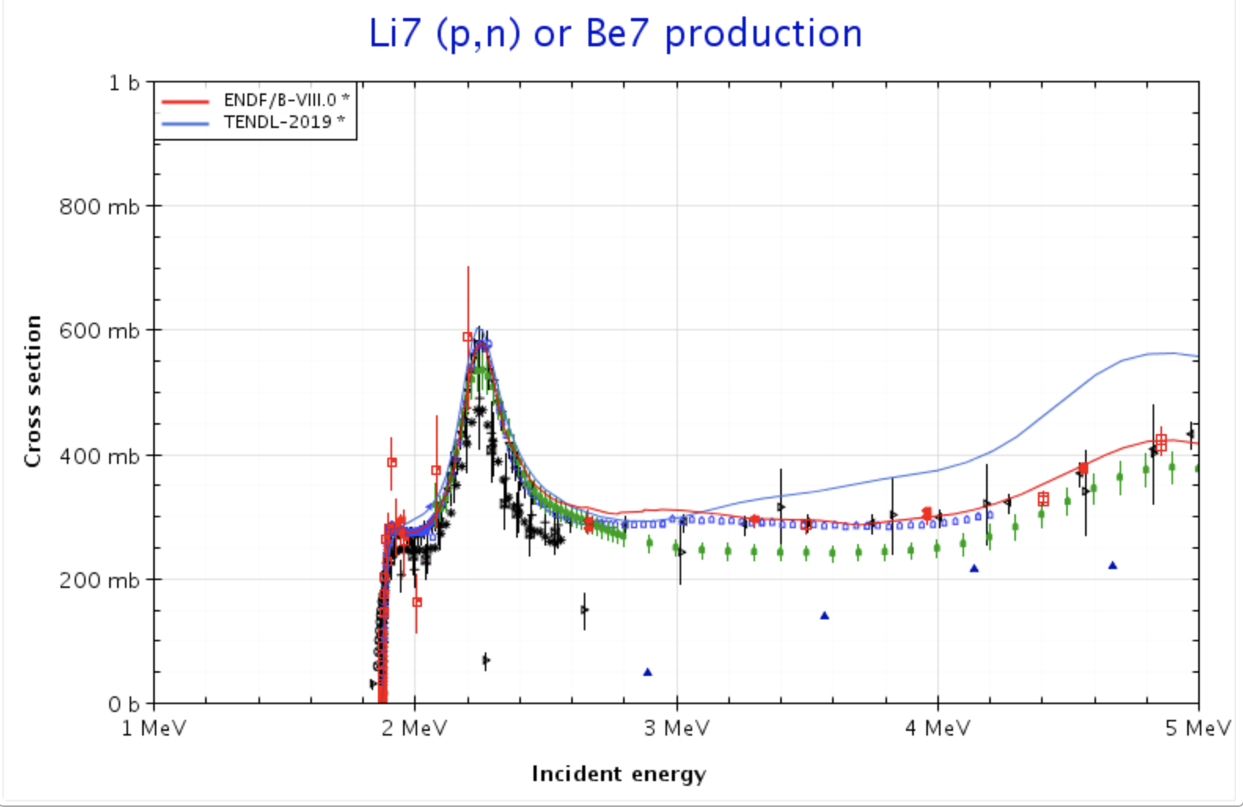
Neutron production – the (p,n) reaction
Proton in, neutron out
⁷Li(p,n)⁷Be,
Threshold ~ 1.88 MeV
target(projectile in,emission out)residual
Isotropic neutron field, would like to concentrate the neutrons at the sample

Slide 4
Inverse kinematics
Moving from the rest frame of the heavy ion (the lab frame) to the rest frame of the proton (actually the c.m. frame) p(⁷Li,n)⁷Be
This has the effect of shifting the ejection direction of the light product ( the neutron) from being isotropic to a cone in the forward direction.
But, the threshold energy increases by a factor = Mproj/Mtarget, Threshold moves to 13.16 MeV (projectile = Li, Target = H)

Slide 5
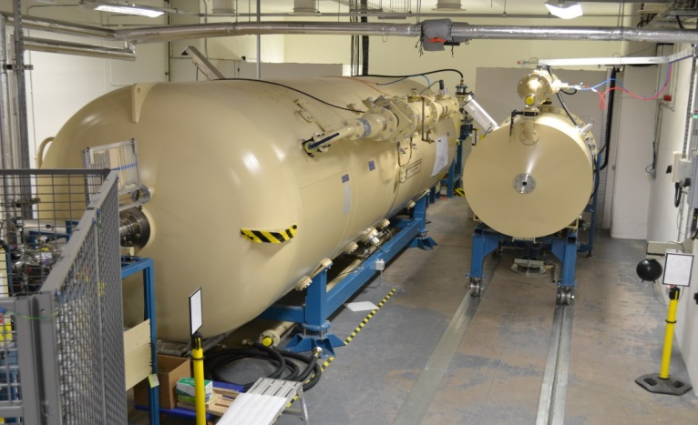
The tools available to us
DCF Ion beam accelerators
  Two Pelletrons - 5 MV tandem & 2.5 MV single
  3 ion sources producing proton, alpha & heavy ions
8 beamlines feeding 6 endstations

Slide 6
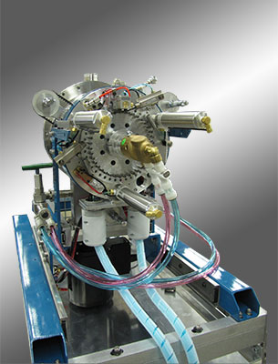
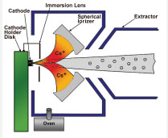

A source of heavy ions
SNICS – Source of Negative Ions by Caesium Sputtering

Slide 7
A hydrogen target ?
Solid hydrogen target ? Possible, but complicated
Freezing point of H = -259 °C
Do we need a pure hydrogen target, or will a hydrogen rich target suffice ?
Polymers are hydrogen rich, cheap and readily available – certainly for a trial
  Polypropylene CH3
  High density Polyethylene (HDPE) C2H4

Slide 8
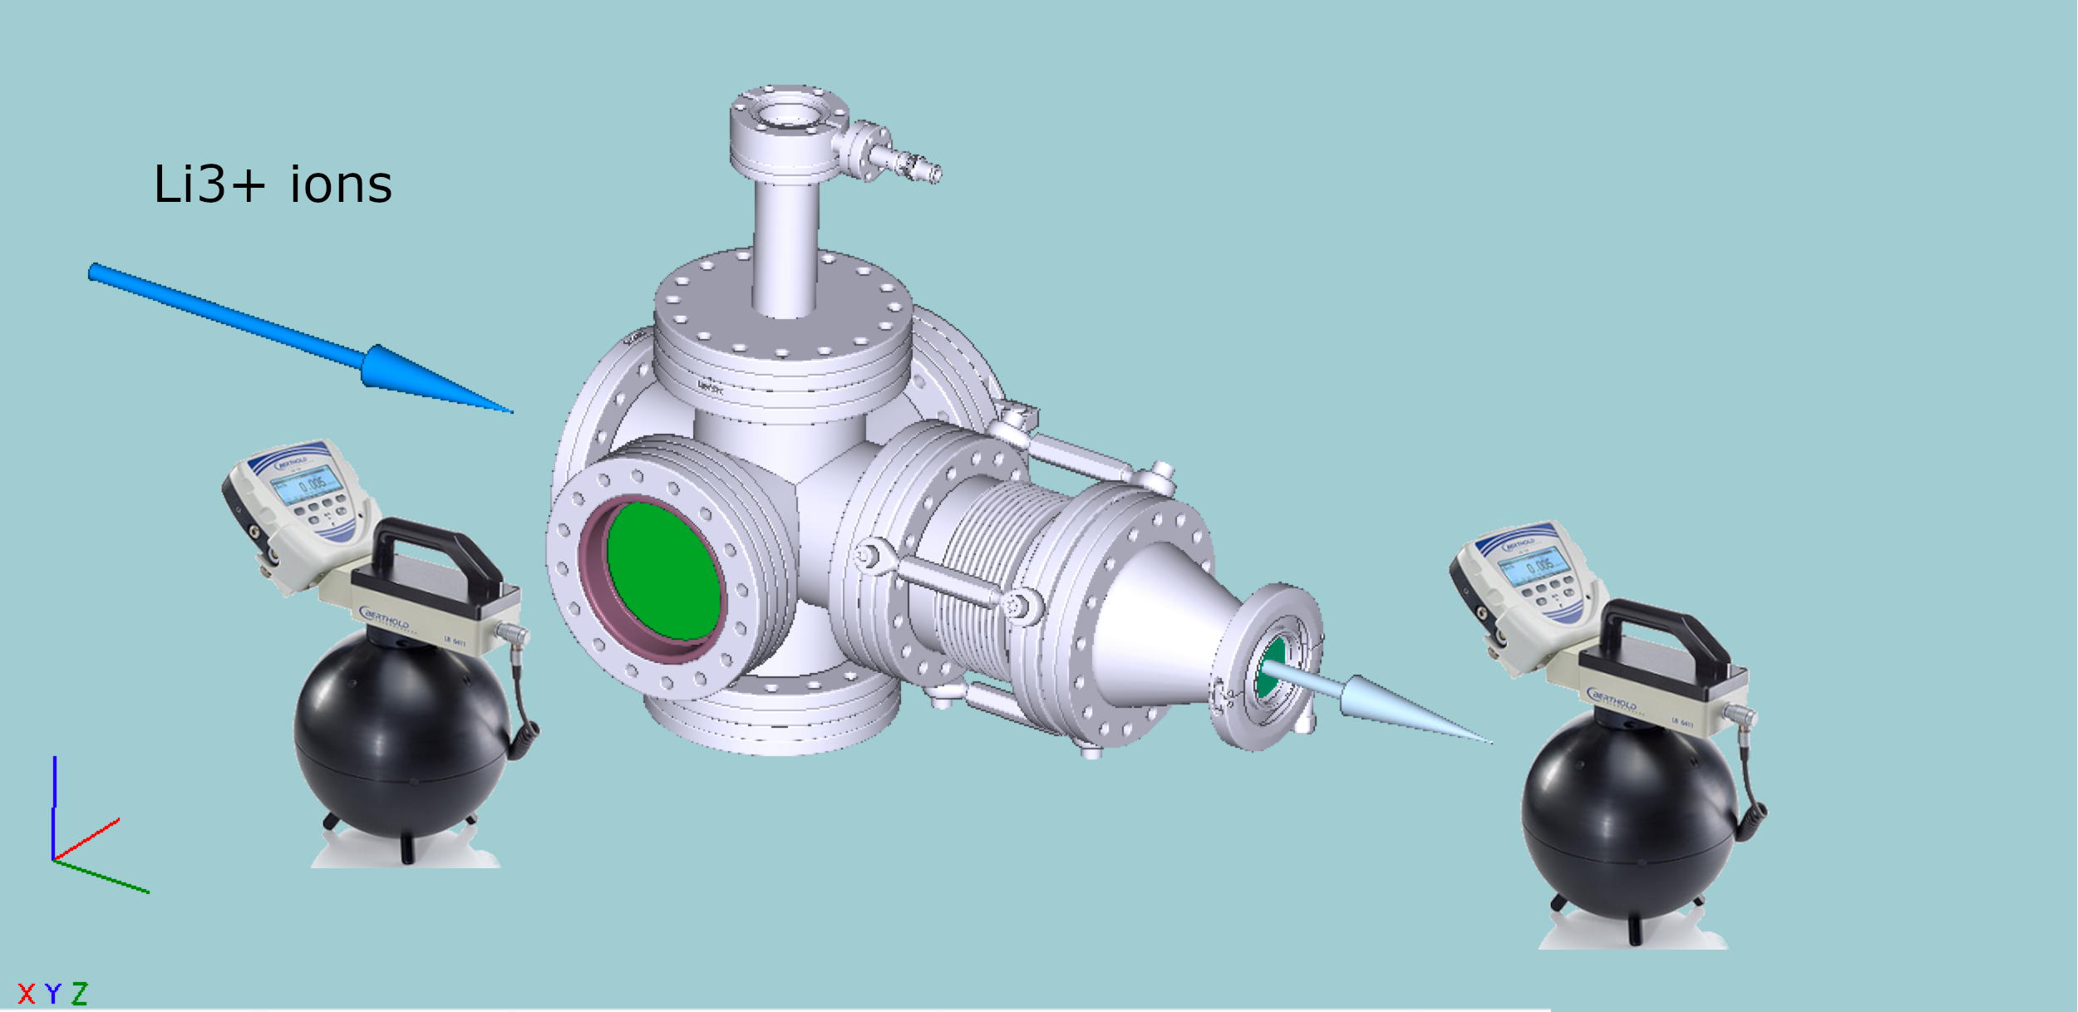
Experimental setup No.1

Slide 9
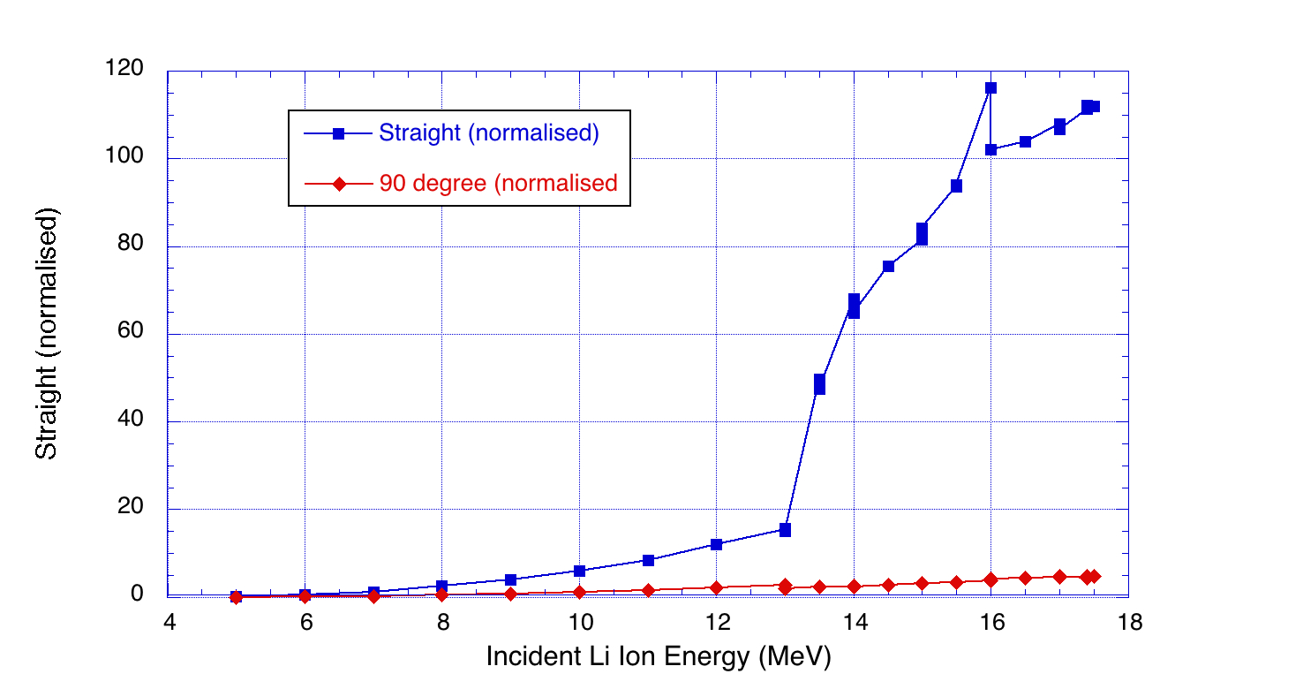
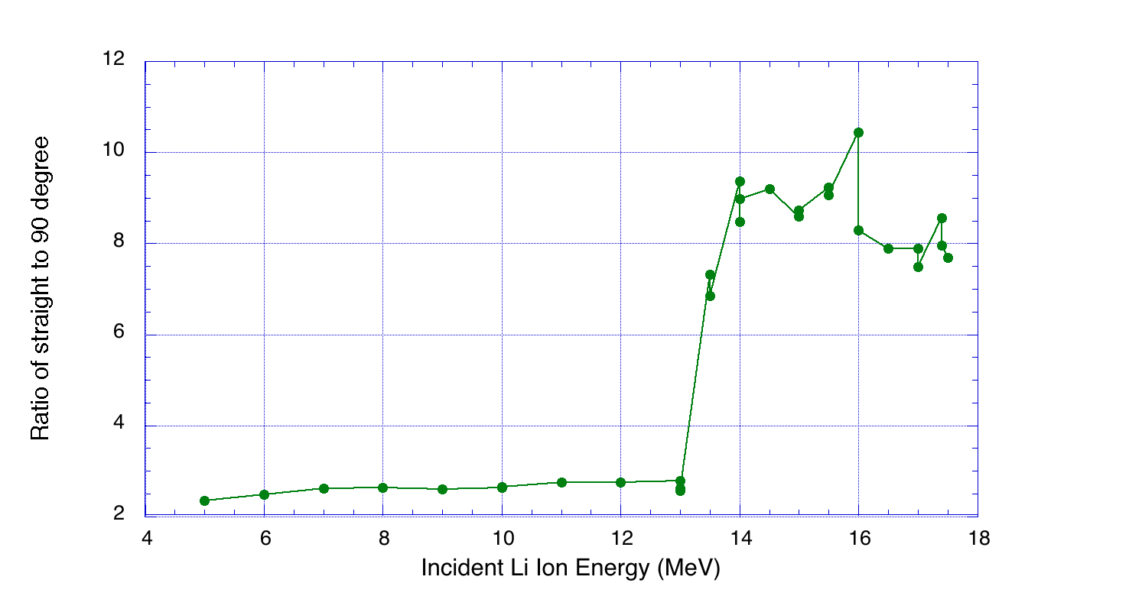
Neutron cross sections
< 1μA Li
Many more neutrons in the forward direction
Some side deflected neutrons, not pure H target
Ratio Forward/side peaks at ~14.2 MeV in p frame (~2 MeV in Li frame)
‘Feature’ at ~15.5 MeV (c.m. frame) = that at 2.2 MeV (lab. frame)

Slide 10
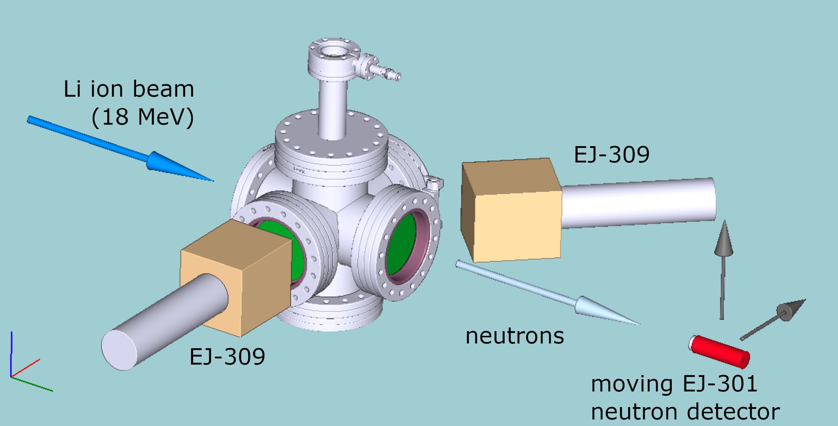
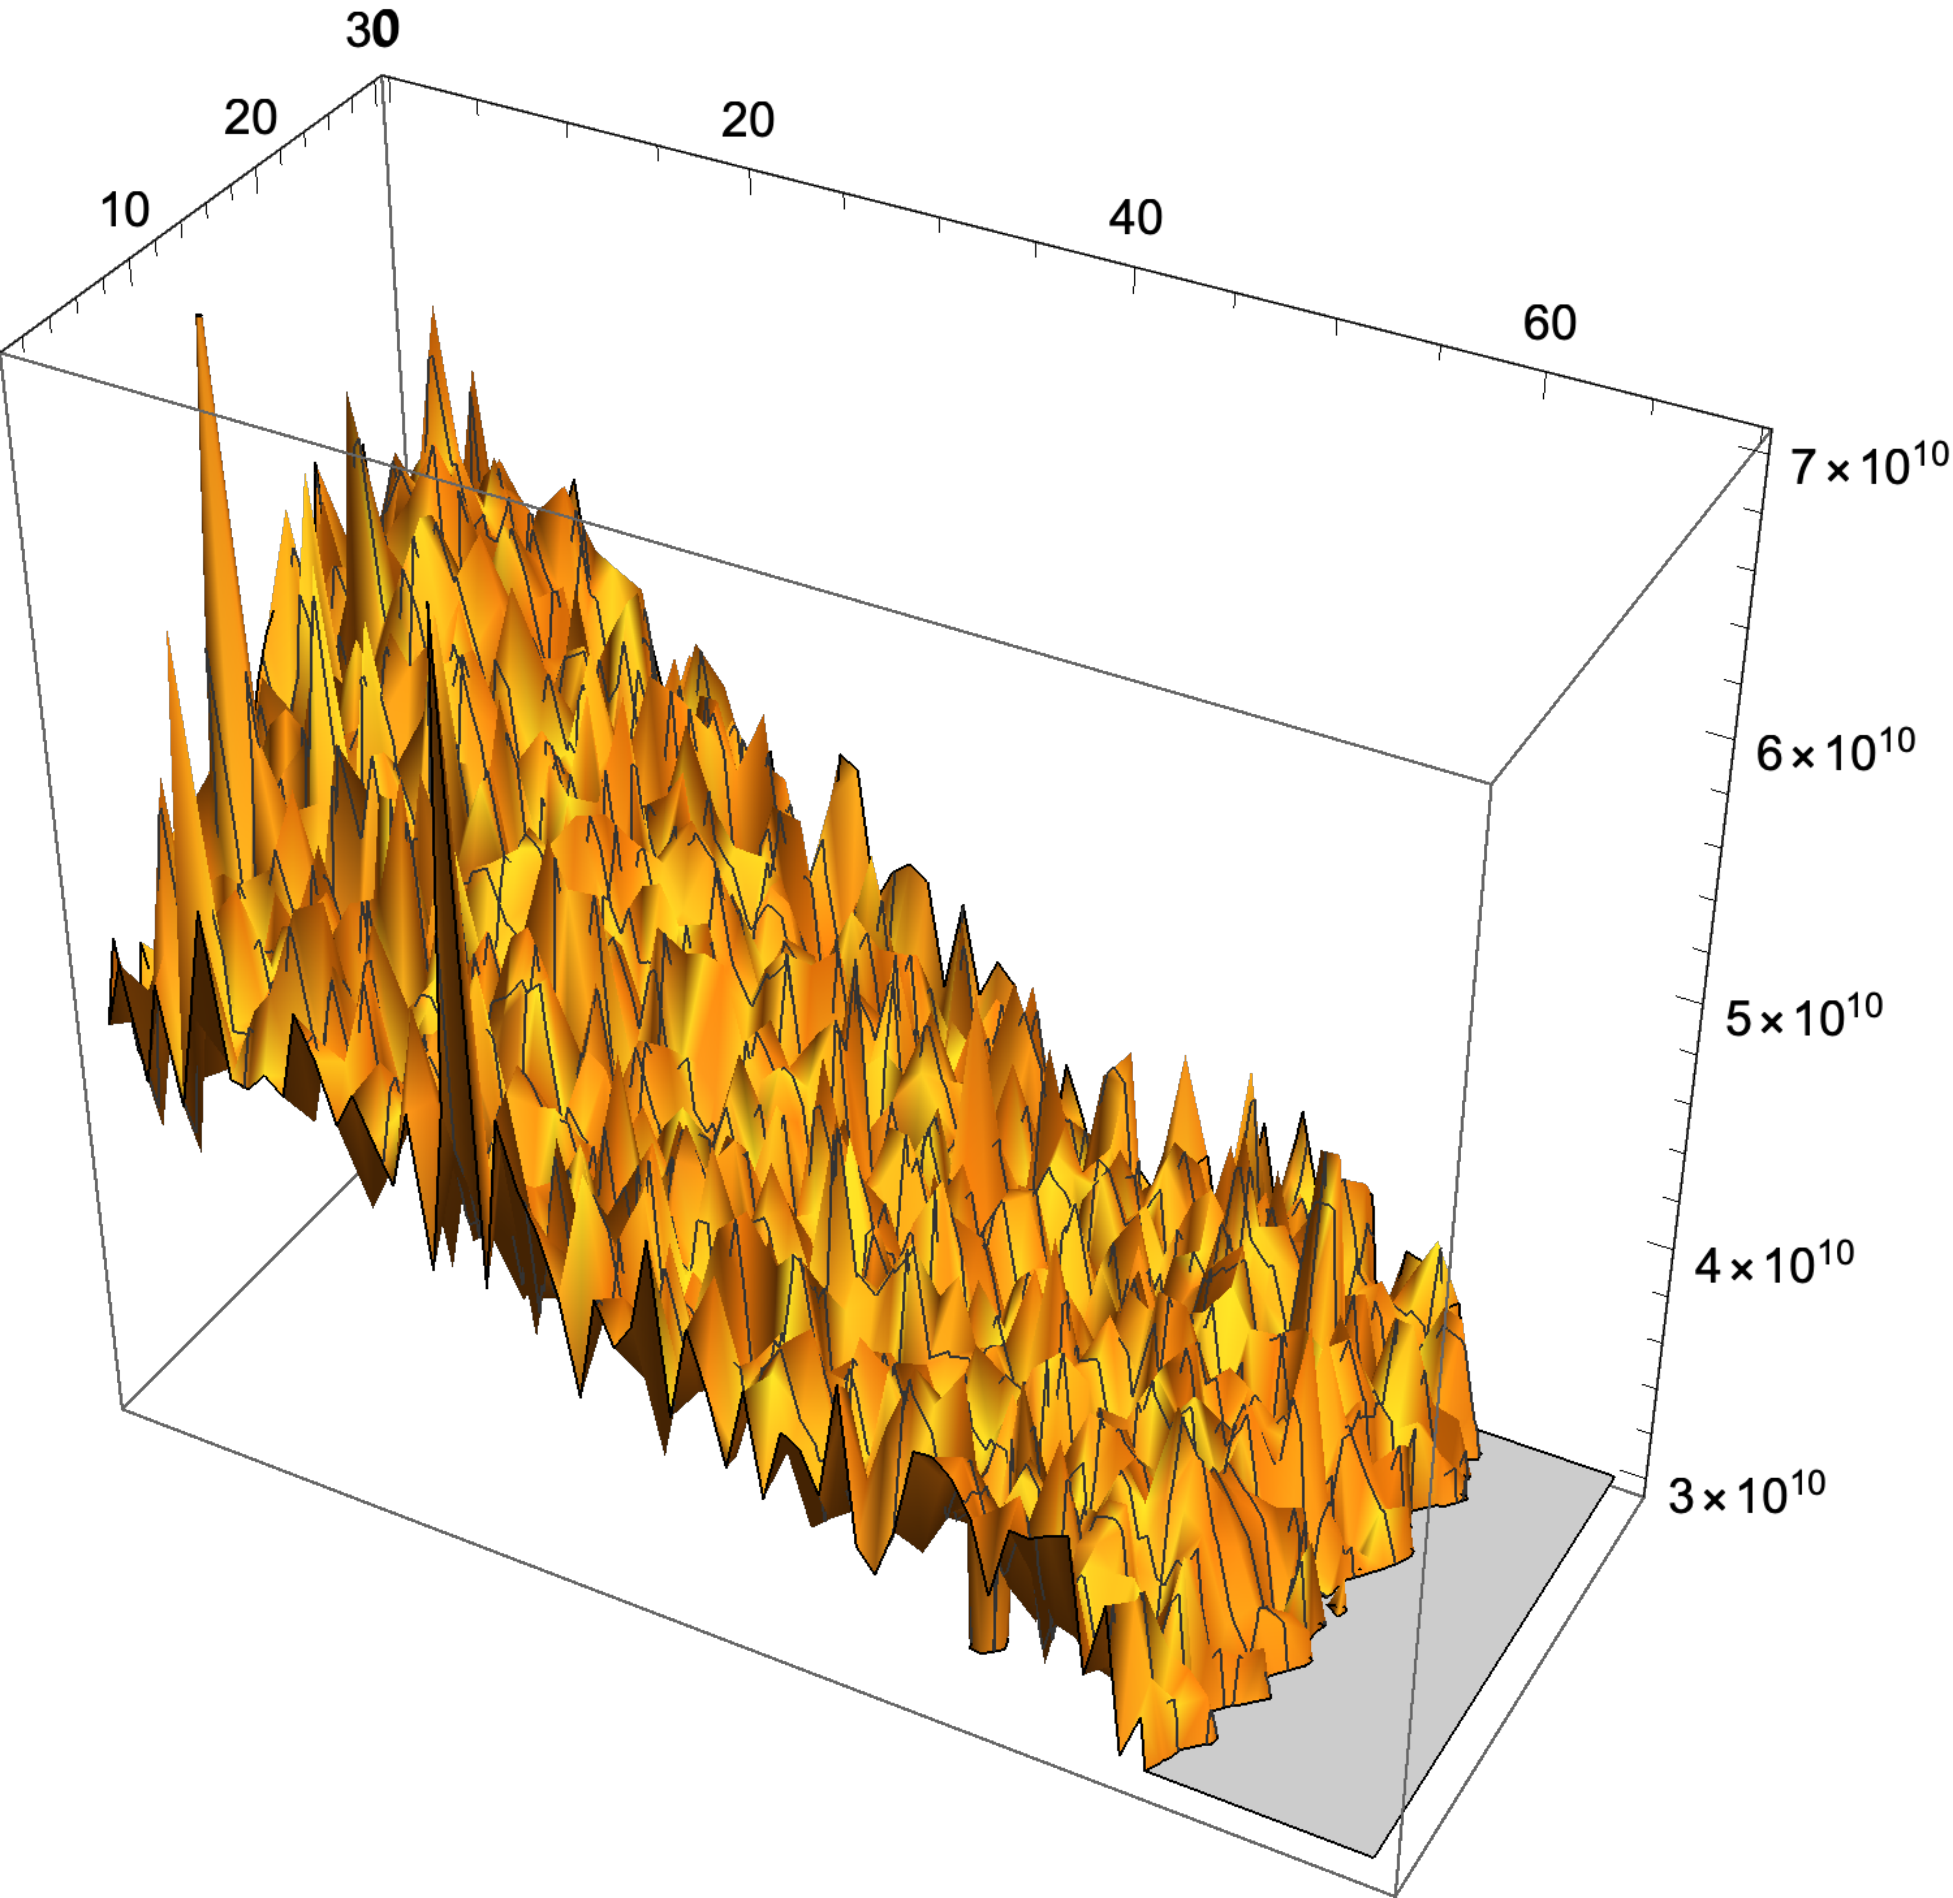

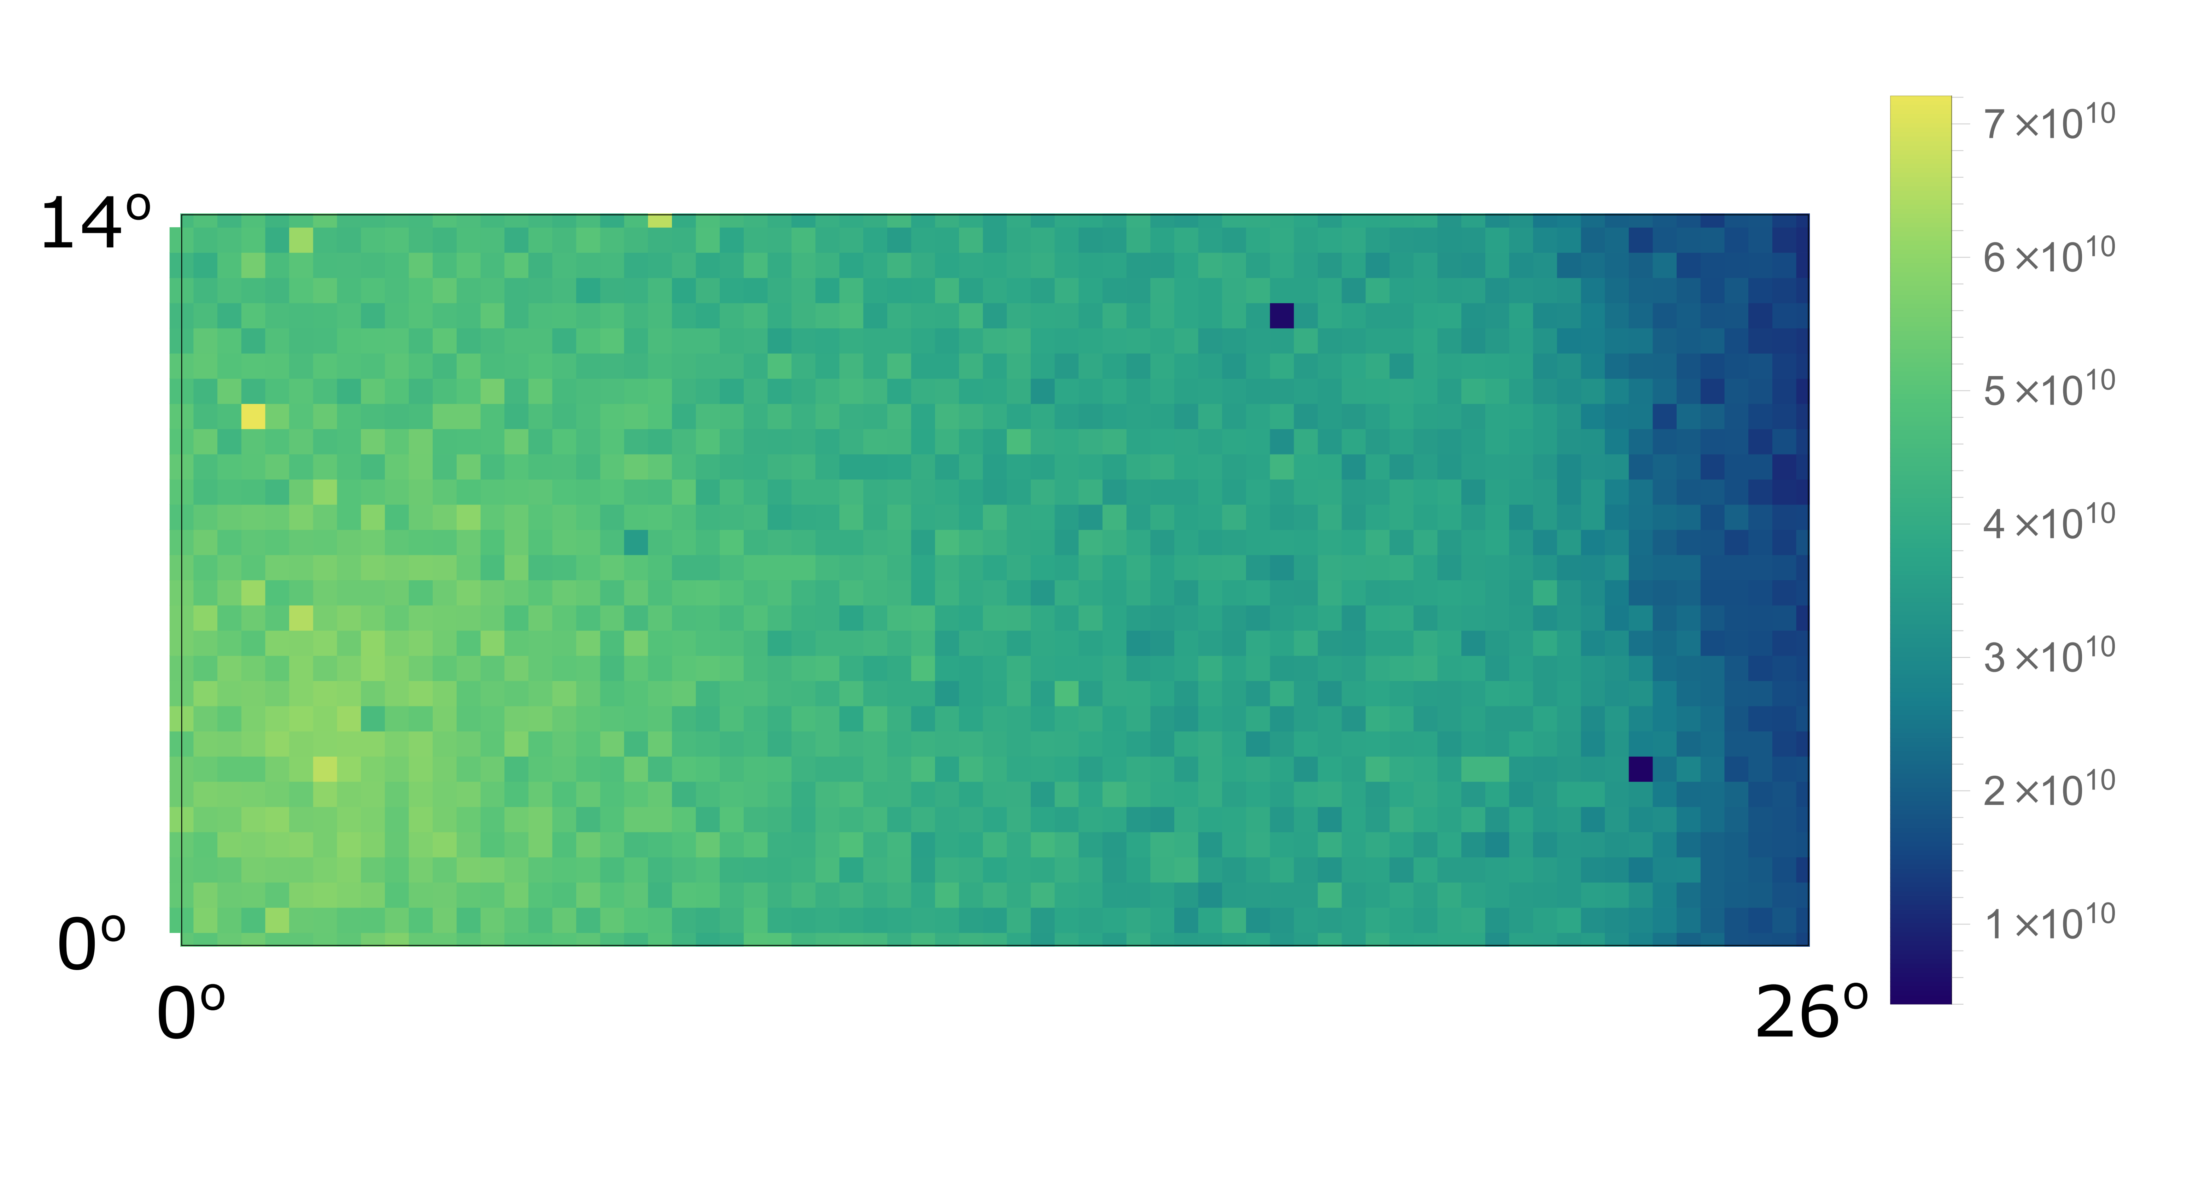
Projection in the forward direction
Li³⁺ ions @ 18 MeV

Slide 11
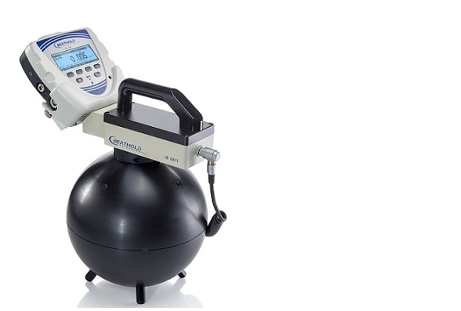
How many neutrons ? and what sort ?
Not many areas have much prior knowledge on required neutron energy
‘Fusion’ KNOWS it wants 14.1 MeV D+T neutrons - but others ?
Neutron fluence from accelerators significantly lower than that available from test reactors, so applications in radiation damage potentially limited
but for biology, we easily got ≥ 1mSv/hr

Slide 12
Conclusions & next steps
We can produce neutrons, no where near enough to simulate radiation damage effects BUT more than enough for some interesting radiation chemistry (including the impact on biology)
Dosimetry ?? How many neutrons ?
A more durable hydrogen rich target – moving tape ?
Would like to repeat maps at different energies
Figure of merit for flux density in forward direction ?

Slide 13
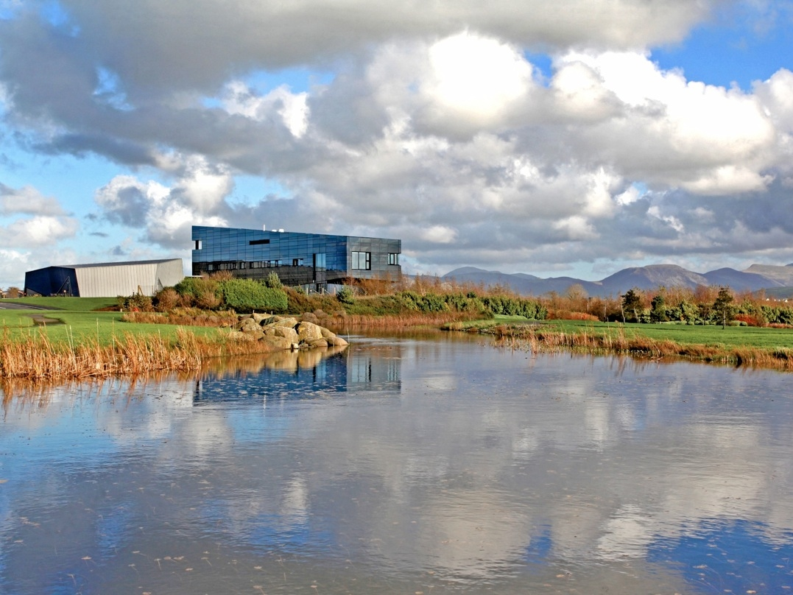


Thank You!
dcf.experiments@manchester.ac.uk
www.dalton.manchester.ac.uk

