Slide 1
Propose a beam halo monitor for hadron machines based on an ionisation monitor with a supersonic molecular curtain beam
H. D. Zhang*, O. Stringer, N. Kumar, A. Webber-Date, C. Welsch
*haozhang@liverpool.ac.uk

Slide 2
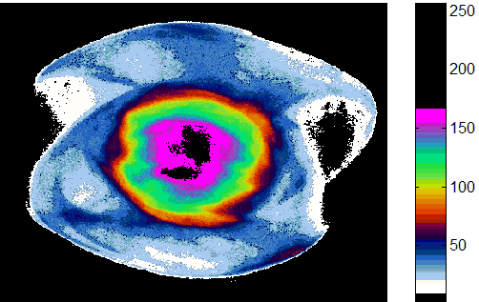
Beam halo
Beam Halo Description
Bad Effects
  Nuclear Activation of The Transport Channel
  Emittance Growth
  Emission of Secondary Electrons
  Increasing Noise in The Detectors
Notes:
ESS, ISIS II, HL-LHC, FCC?

Slide 3
Current measurement methods
Achieve high dynamic range (DR) is essential.
Passive Spatial Filtering
solar coronagraph applied to beams
DR: 10⁵
Wire Scanner and Scraper Assembly
at LEDA ( LANL)
DR: 10⁵
Wangler, et. al. PAC01
T. Mitsuhashi, EPAC 2004.
High Dynamic Range Camera³
Spectra-Cam CID
DR: 10⁶
Adaptive Mask
DMD
DR: >10⁵
C P Welsch et al 2006 Meas. Sci. Technol. 17 2035
H. Zhang, et al. PRAB, 15, 072803(2012)
Notes:
Need pictures for each diagnostics.

Slide 4
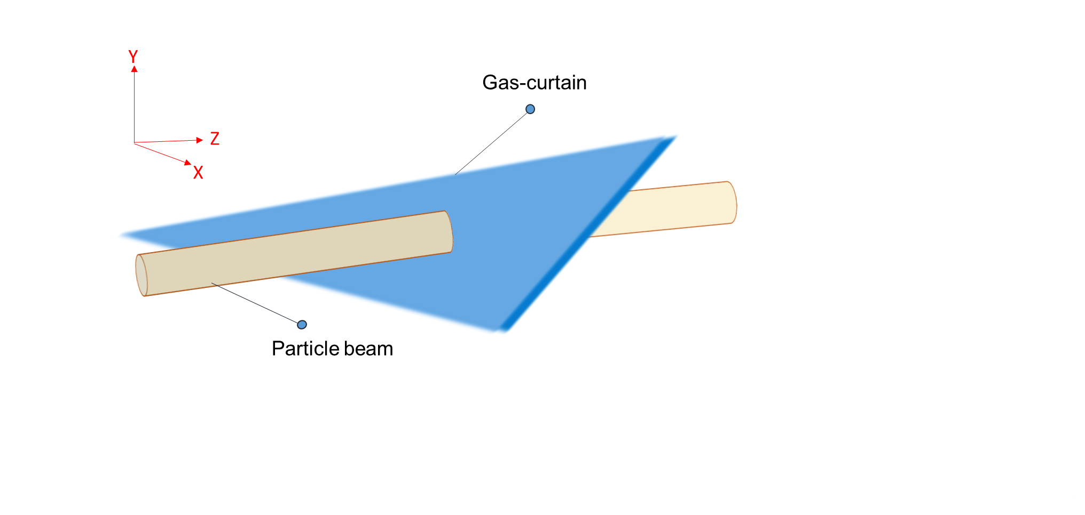
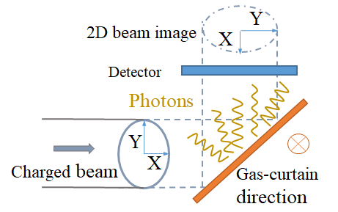
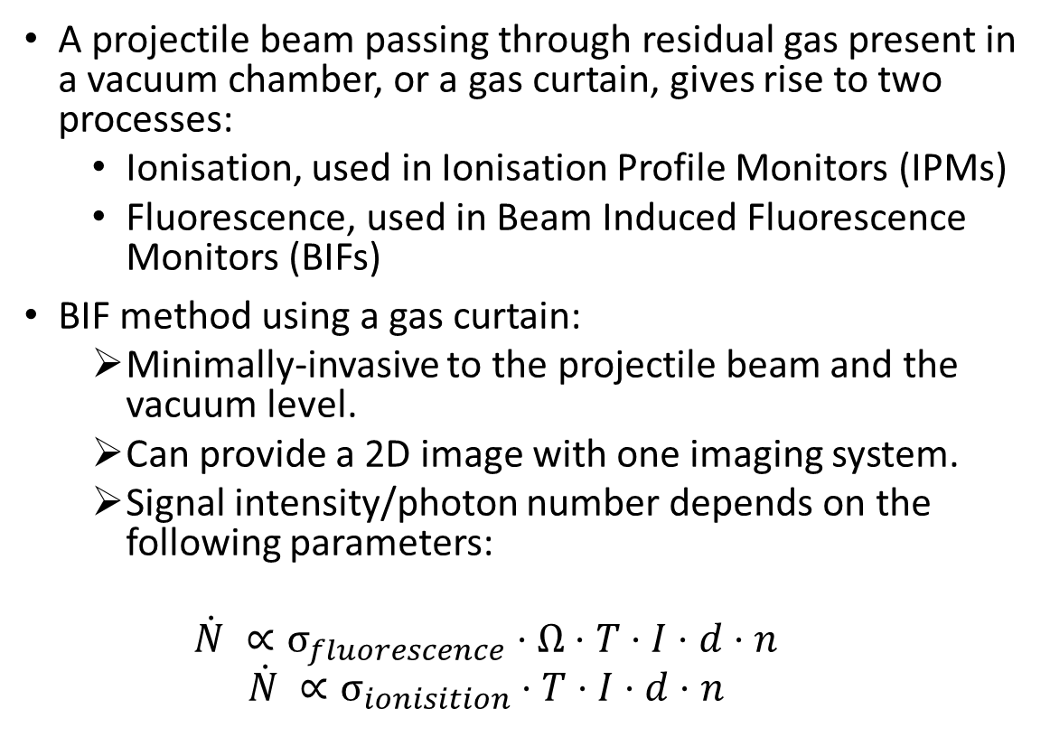
Supersonic molecular curtain-based beam profile monitor
A projectile beam passing through residual gas present in a vacuum chamber, or a gas curtain, gives rise to two processes:
  Ionisation, used in Ionisation Profile Monitors (IPMs)
  Fluorescence, used in Beam Induced Fluorescence Monitors (BIFs)
BIF method using a gas curtain:
  Minimally-invasive to the projectile beam and the vacuum level.
  Can provide a 2D image with one imaging system.
  Signal intensity/photon number depends on the following parameters:
  $$\dot{N} ∝σ_{fluorescence}⋅Ω⋅T⋅I⋅d⋅n$$
  $$\dot{N} ∝σ_{ionisition}⋅T⋅I⋅d⋅n$$
photons, e- and ions
Particle

Slide 5
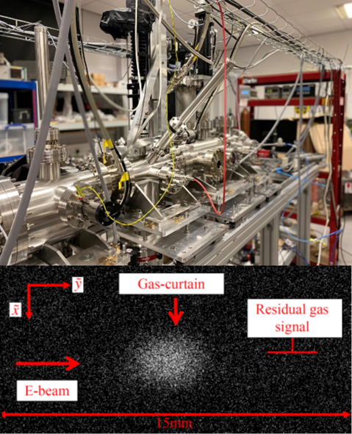
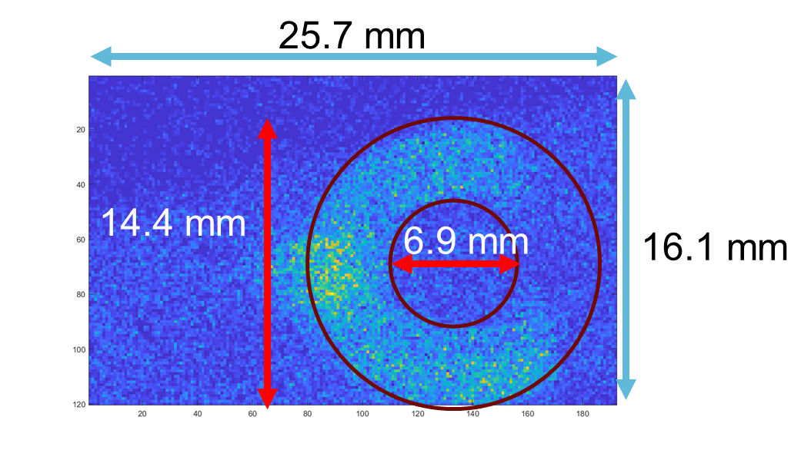
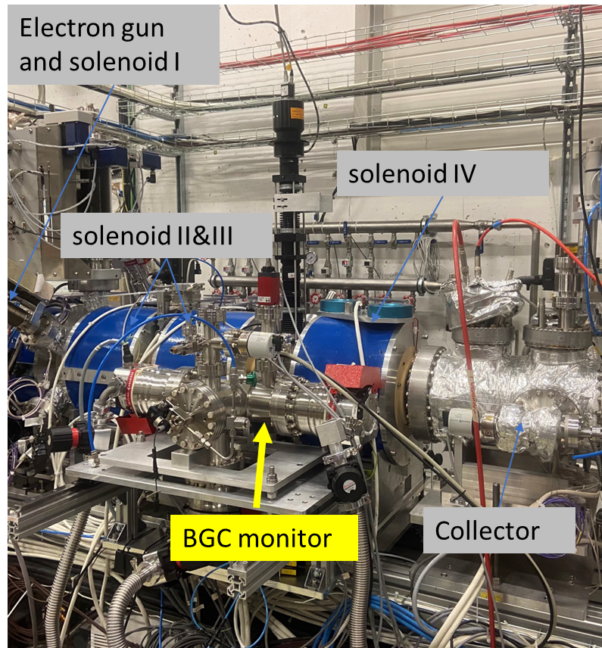
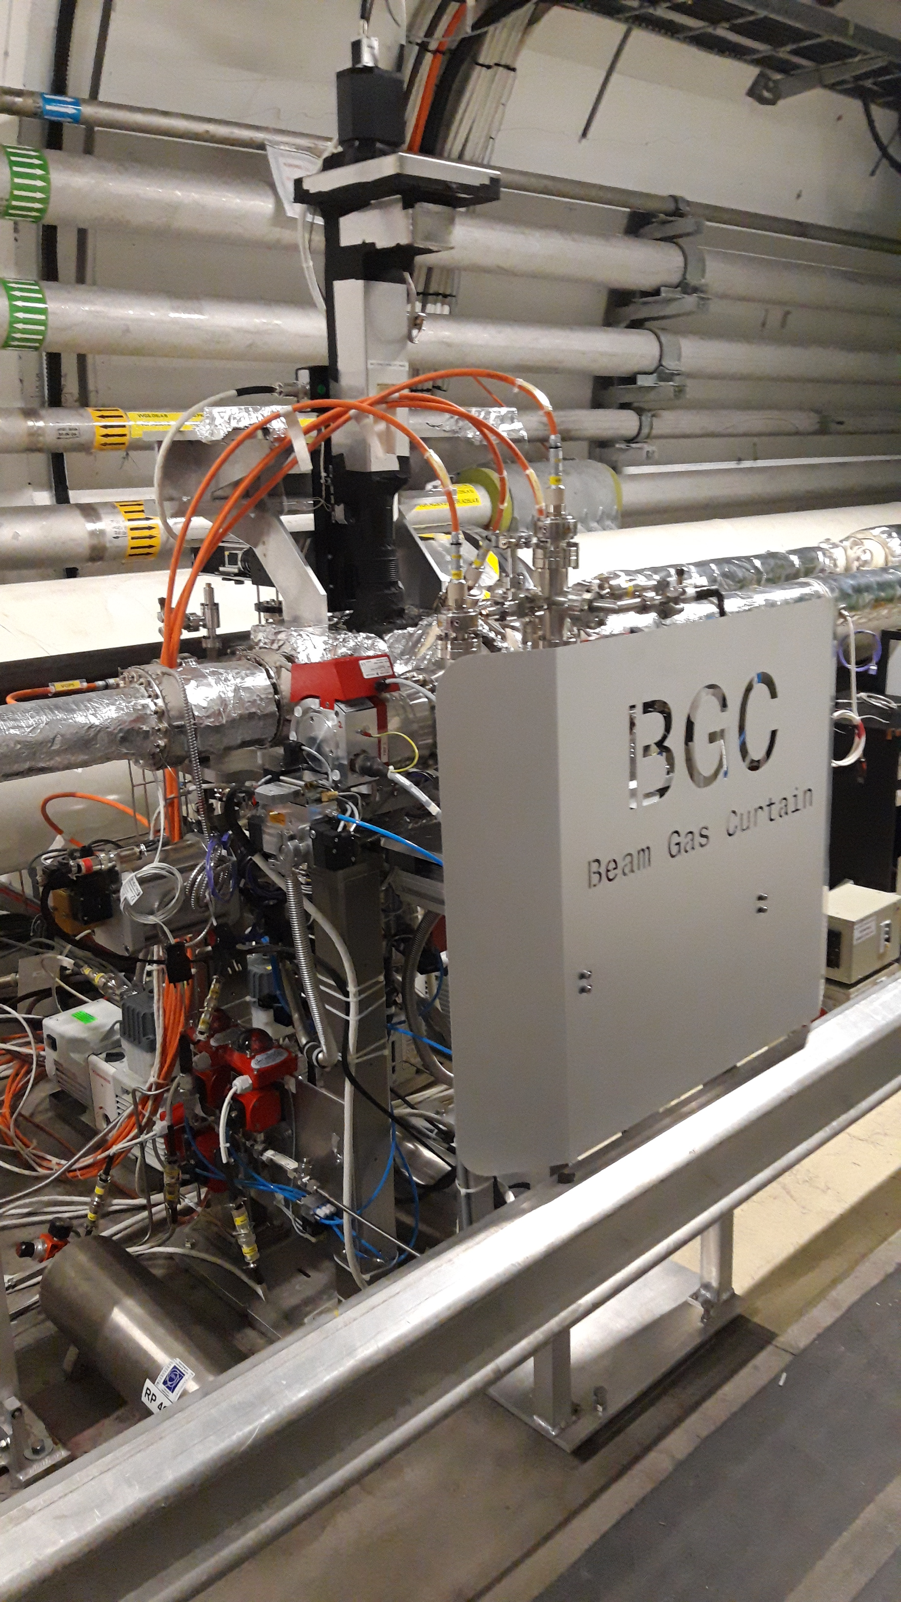
Current status
CI experiment
EBTS experiment
LHC installation
More details about the function in this Video

Slide 6
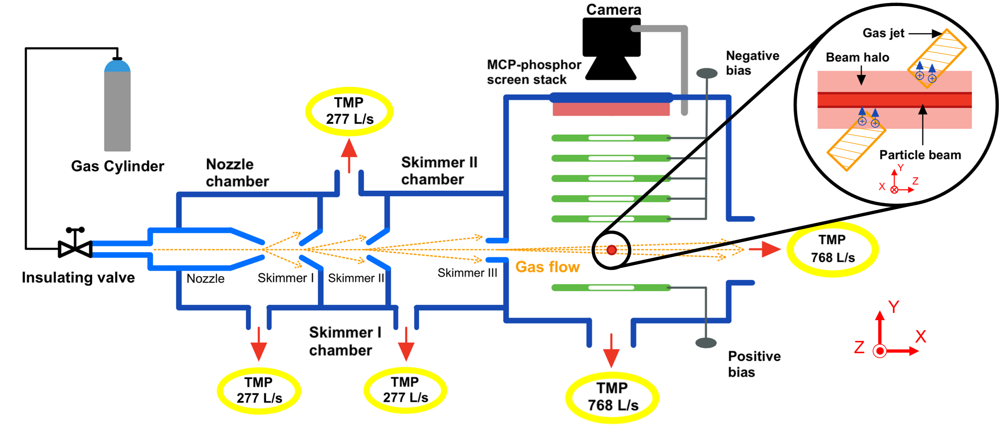
Halo monitor using double slit skimmer
BGC schematic for the measurement of halo particles
Creadt: O. Stringer, et. al, Linac 2022

Slide 7
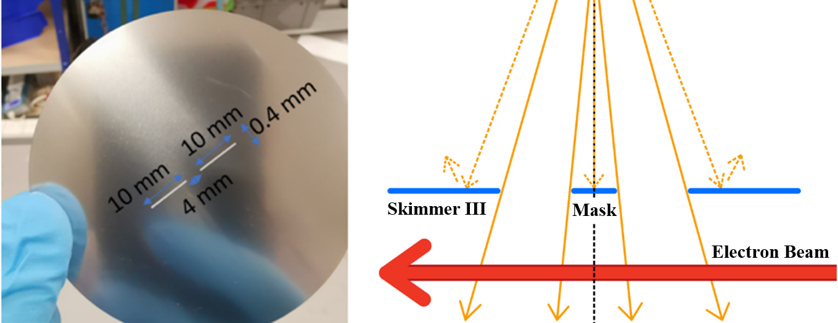
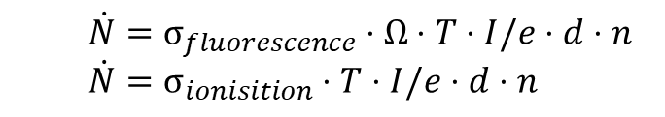
BGC Mask for Halo Measurements
Beam halos could be measured with the BGC using modified 3rd shaping skimmer
Create a mask for the gas jet to filter out core particles
Gas curtain only measures the halo particles
Parameter | SPS
Ring circumference (m) | 7000
Beam Energy (GeV) | 26
Protons per turn | < 6.5E13
BIF Cross section(N₂, cm2) | 3.06E-20
BIF Cross section(Ne, cm2) | 4.70E-22
IPM Cross section (N₂, cm2) | 1.5E-18
Gas jet density (cm⁻³) | 1.0e11
Gas jet thickness d (mm) | 0.1
N_ionisation_core per second | 4.17E+09
N_ionisation_halo per second | 4.17E+04
Possible to have a distribution measurement of the halo in seconds !!
  $$\dot{N}=σ_{fluorescence}⋅Ω⋅T⋅I/e⋅d⋅n$$
  $$\dot{N}=σ_{ionisition}⋅T⋅I/e⋅d⋅n$$

Slide 8
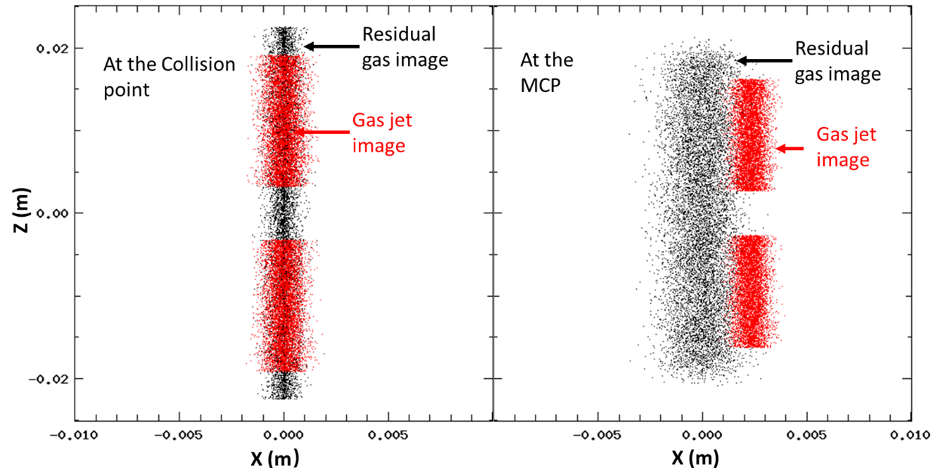
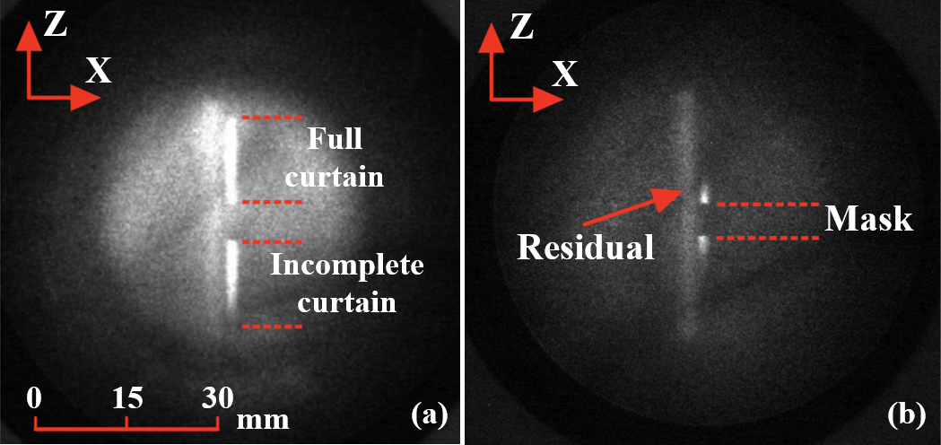
Curtain Characterisation and preliminary experiment
Gas particles simulated using WARP code [4]
Gas curtain has been characterised using eGun with 3rd skimmer at 90 degrees
Experiment test using a E-beam with ~5 keV energy and ~ 1uA current.
[5]

Slide 9
Summary
Measuring the beam halo is still a challenge.
Gas jet based beam profile monitor could be a solution for online halo monitor.
Preliminary experiments are still on going at Cockcroft Institute.

Slide 10
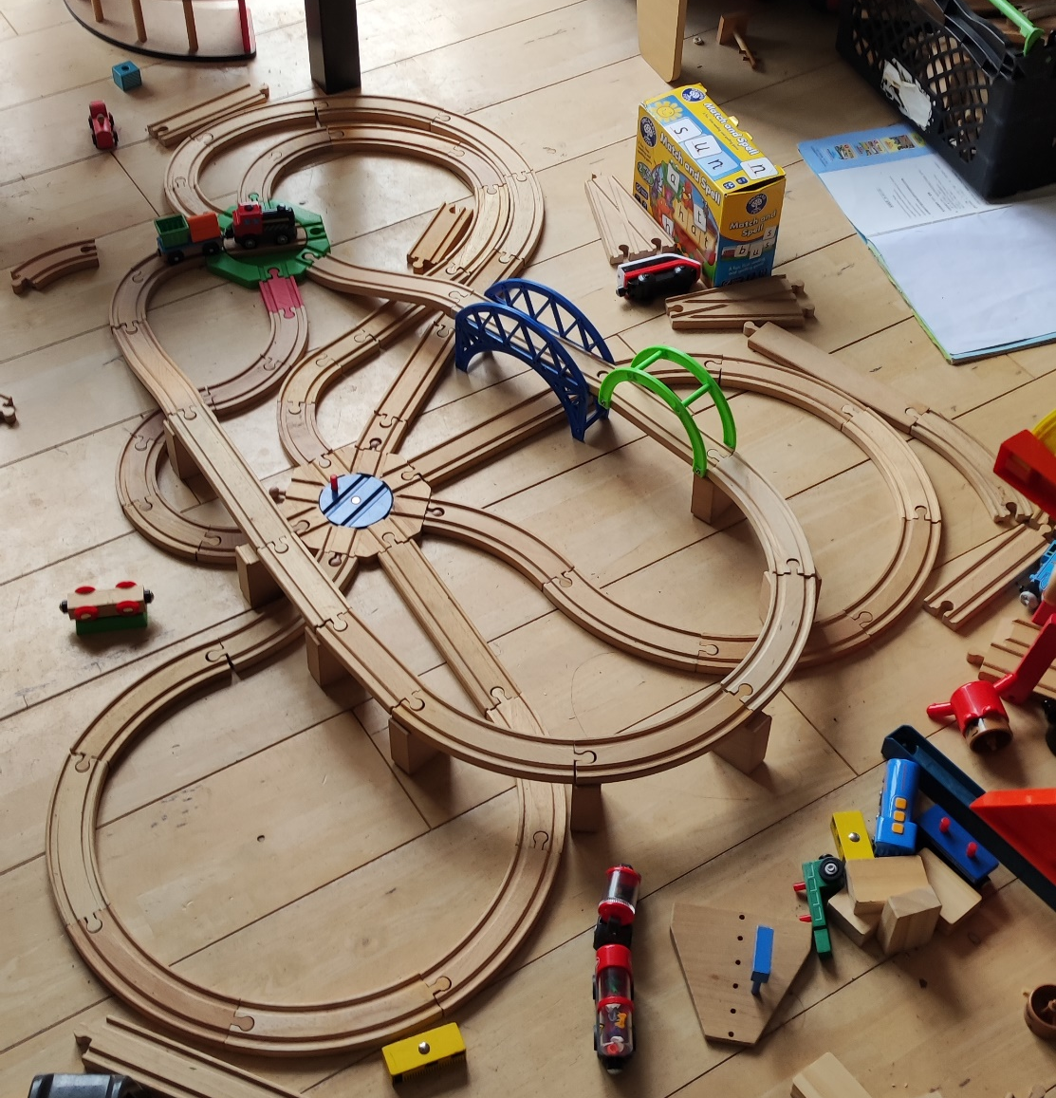
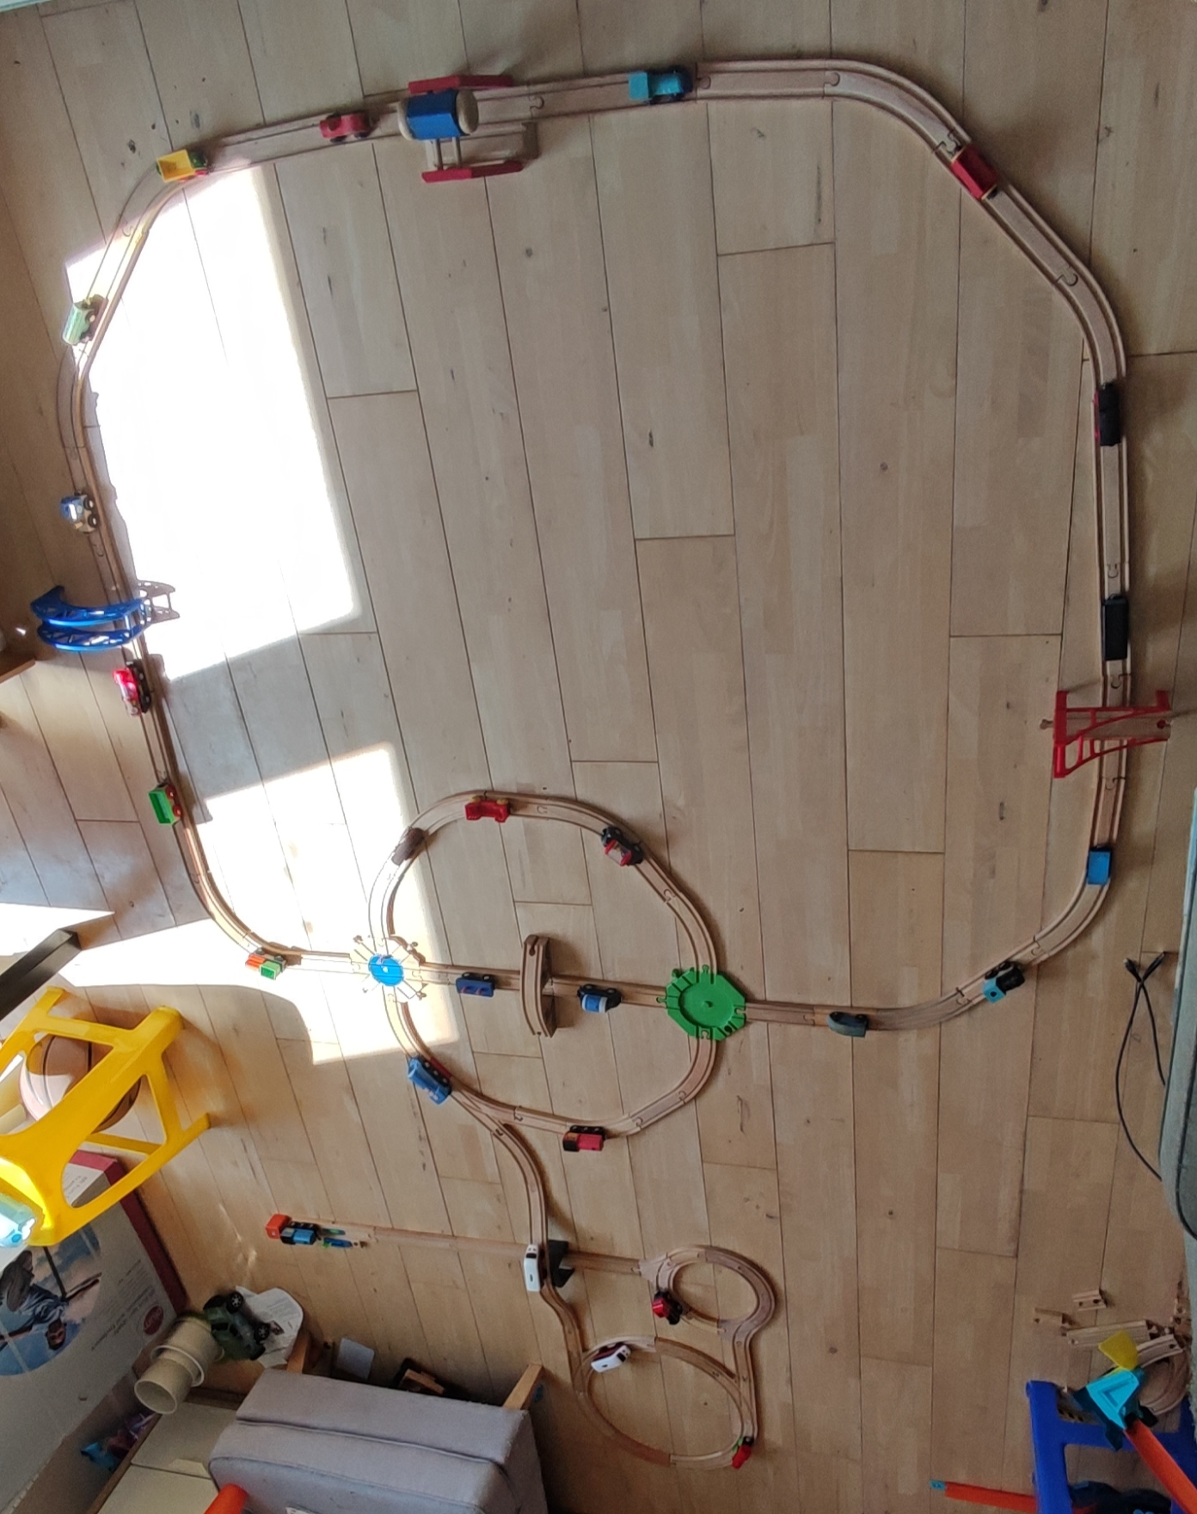
Acknowledgment
Any Questions?
This work is supported by the HL-LHC-UK phase I & II project funded by STFC under Grant Ref: ST/T001925/1 and the STFC Cockcroft Institute core grant No. ST/G008248/1.
LHC
SPS
LINAC
Booster
PS

