Slide 1




Novel emittance diagnostics: utilising optical radiation for single-shot measurements
C. Swain^{1,2}, J. Wolfenden^{1,2}, T. Pacey³, C. Welsch^{1,2}
¹ University of Liverpool, UK
² Cockcroft Institute, Warrington, UK
³ ASTeC, Warrington, UK

Slide 2
Overview
Traditional emittance measurements are generally invasive and often destructive.
Low energy or high space charge beams can be difficult to measure.
Replicating traditional methods utilising optical radiation to make them minimally invasive.
  Currently optical transition radiation (OTR).
  Future plans for optical synchrotron radiation (OSR) would make these methods non-invasive.
This will be of interest to many facilities, but is currently being developed for AWAKE, where emittance is generally 2 – 5 mm mrad^{[1]}.
These all-optical methods will be a compact, high resolution, single-shot alternative.
C. Swain (catherine.swain@liverpool.ac.uk)
IOP PAB conference 28/06/2023
1

Slide 3
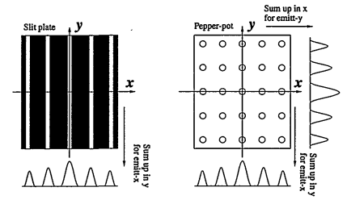

Traditional emittance measurements
Emittance measurement methods being replicated are slit/pinhole scans, and pepperpots.
Metal plates are placed in the path of the beam, with holes etched to let ’beamlets’ through.
Beamlets are imaged and analysed, and emittance calculated.
Screen
[3] M. Zhang, "Emittance Formula for Slits and Pepper-pot Measurement", FERMILAB-TM-1988, Oct. 1996
j^{th} beamlet intensity
Mask
n_{j}
Beam
σ_{j}
Beamlets
x_{j}
C. Swain (catherine.swain@liverpool.ac.uk)
IOP PAB conference 28/06/2023
2
Notes:
Benefit of pepperpot is you gain x and y emittances simultaneously
Pepperpot also good for space charge dominated beams, small beamlets each have low charge – ATHOUGH it is still affected
Beam passes through plate, to scintillator screen (or similar), and light is imaged
Equation uses number and position of slits/pinholes, number of particles, position and divergences of beamlets

Slide 4
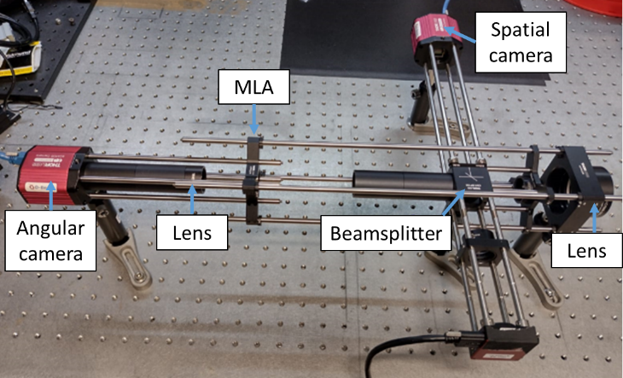
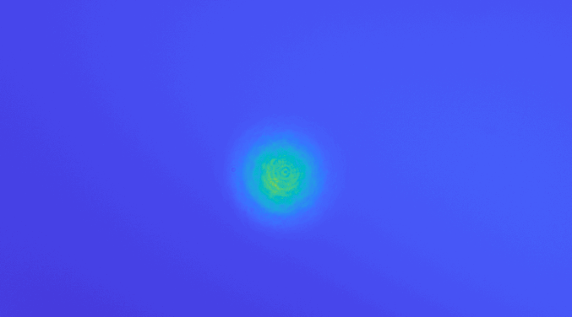
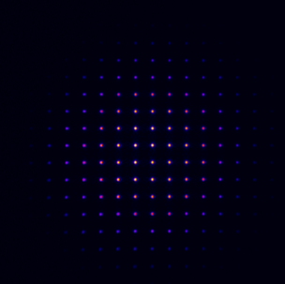
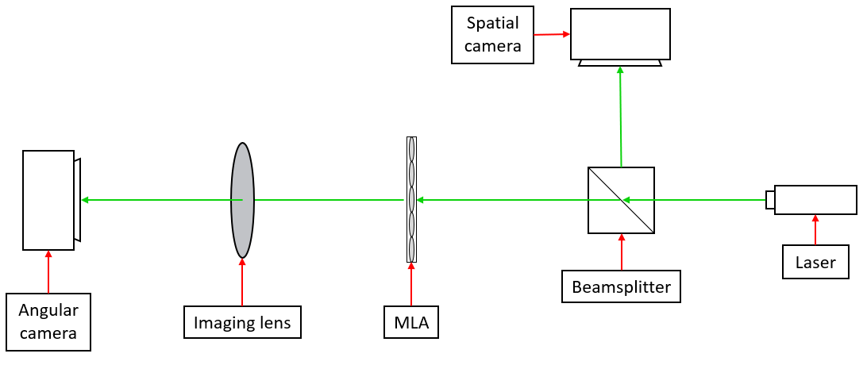
Micro Lens Array
MLA is array of lenses, in this setup with a pitch of 150 μm^{[4]}.
Two cameras are used to image spatial and angular components simultaneously.
Will allow for imaging of x and y emittances simultaneously.
Pre-MLA
Post-MLA
C. Swain (catherine.swain@liverpool.ac.uk)
IOP PAB conference 28/06/2023
3

Slide 5
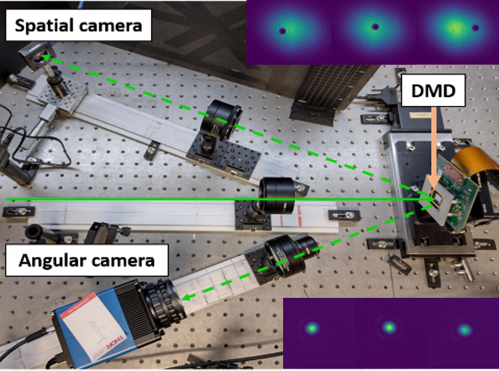
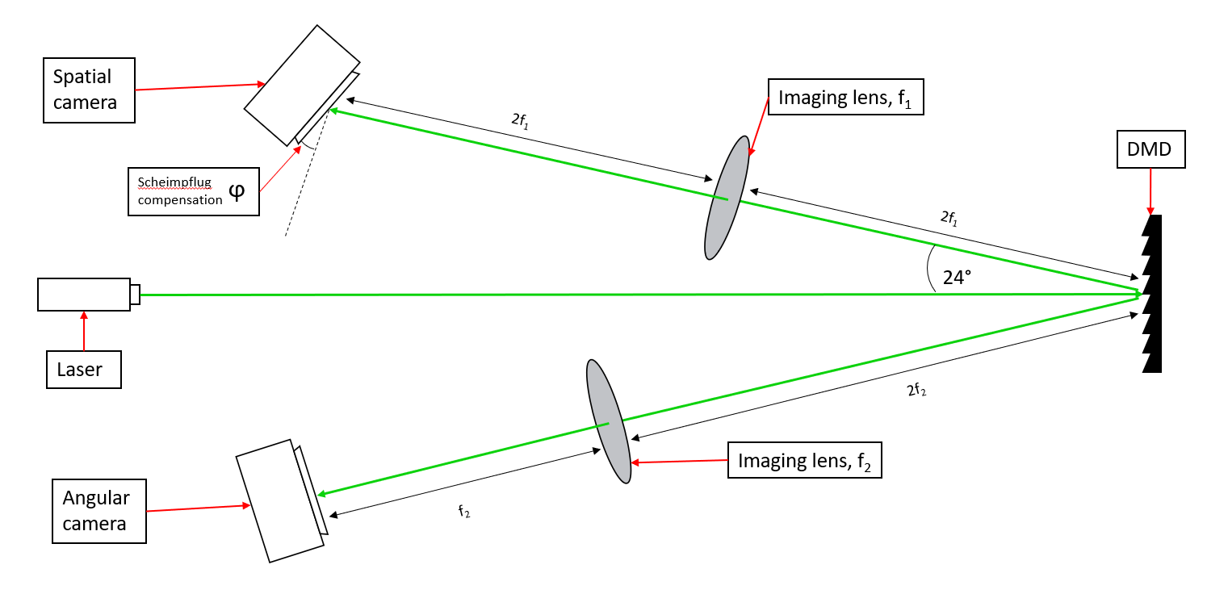
Digital Micro-mirror Device
DMD is an array of individually controllable mirrors, here with 7.56 μm pitch and angular control of ±12°^{[5]}.
Pinholes or slits are created on the DMD, with one section of the reflection imaged for spatial information, and the other for angular information.
DMD masking is very flexible, meaning it can be adjusted for different beam specifications or facility needs.
C. Swain (catherine.swain@liverpool.ac.uk)
IOP PAB conference 28/06/2023
4

Slide 6
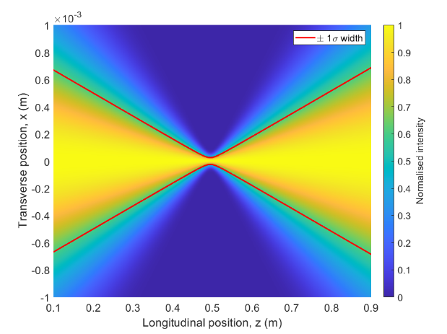
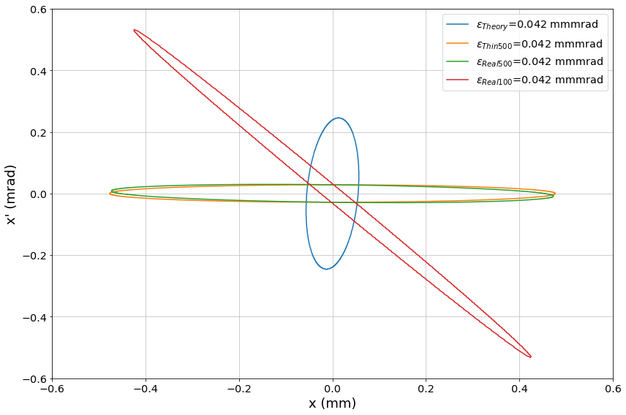
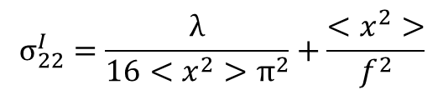
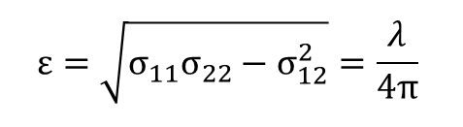
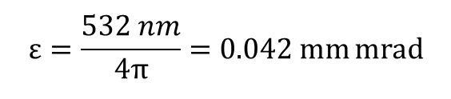
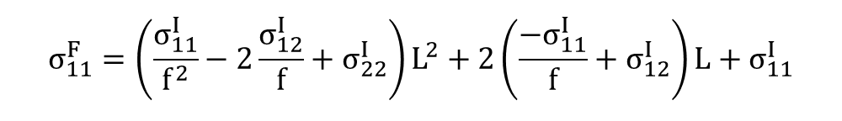
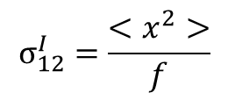


Laser benchmarking: laser ‘emittance’ theory
$$Σ^{F}=ε\left(\begin{matrix}β^{F} & −α^{F} \\ −α^{F} & γ^{F}\end{matrix}\right)=\left(\begin{matrix}σ_{11}^{F} & σ_{12}^{F} \\ σ_{12}^{F} & σ_{22}^{F}\end{matrix}\right)$$
$$ε=\frac{532 nm}{4π}=0.042 mm mrad$$
$$σ_{11}^{F}=\left(\frac{σ_{11}^{I}}{f^{2}}−2\frac{σ_{12}^{I}}{f}+σ_{22}^{I}\right)L^{2}+2\left(\frac{−σ_{11}^{I}}{f}+σ_{12}^{I}\right)L+σ_{11}^{I}$$
When combined with Gaussian laser spot size equations:
$$σ_{12}^{I}=\frac{<x^{2}>}{f}$$
$$σ_{22}^{I}=\frac{λ}{16<x^{2}>π^{2}}+\frac{<x^{2}>}{f^{2}}$$
$$σ_{11}^{I}=<x^{2}>$$
$$ε=\sqrt{σ_{11}σ_{22}−σ_{12}^{2}}=\frac{λ}{4π}$$
C. Swain (catherine.swain@liverpool.ac.uk)
IOP PAB conference 28/06/2023
5
Notes:
4 is because omega^2 is 4<x^2>, because omega is the 1/e^2 width
w^2 = w0^2 + (lambda/4pi)^2 z^2
Gaussian laser equations include Rayleigh length

Slide 7
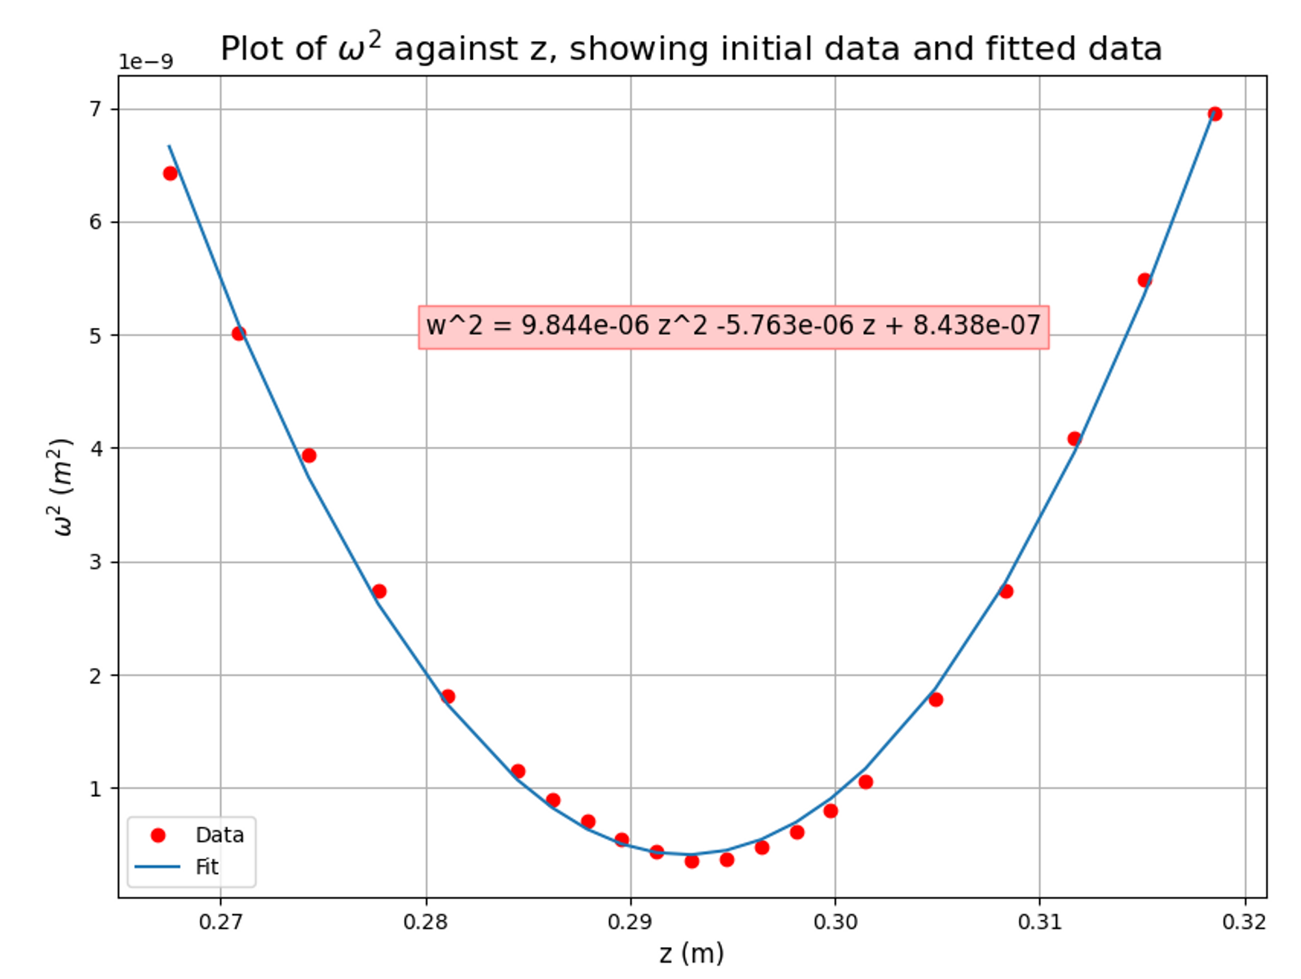
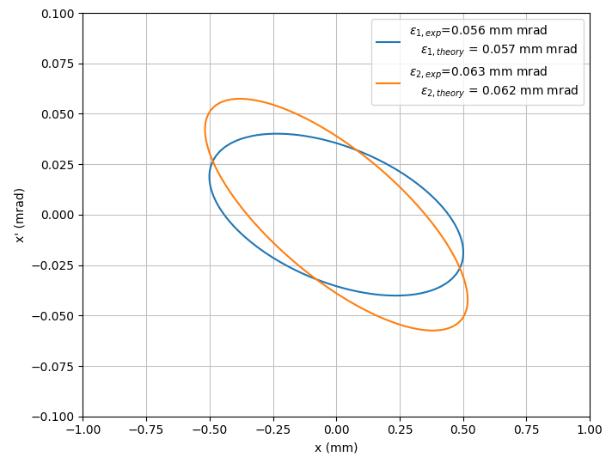
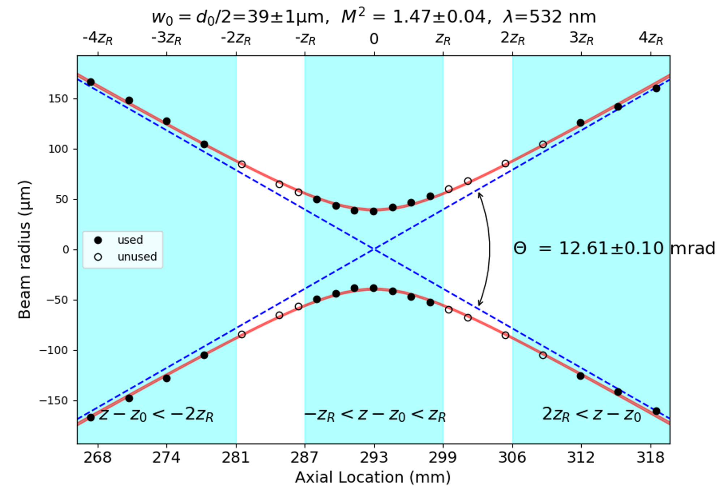
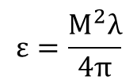
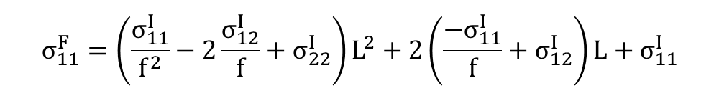
Laser benchmarking: laser ‘emittance’ measurement
$$ε=\frac{M^{2}λ}{4π}$$
$$σ_{11}^{F}=\left(\frac{σ_{11}^{I}}{f^{2}}−2\frac{σ_{12}^{I}}{f}+σ_{22}^{I}\right)L^{2}+2\left(\frac{−σ_{11}^{I}}{f}+σ_{12}^{I}\right)L+σ_{11}^{I}$$
[6] https://github.com/scottprahl/laserbeamsize
[7] J. Wolfenden, "Optical Pepper-pots: Developing single-shot emittance diagnostics", in Proc. IPAC'23, Venezia.
C. Swain (catherine.swain@liverpool.ac.uk)
IOP PAB conference 28/06/2023
6
Notes:
- Laser 1 is from the MLA setup, 2 is from the DMD

Slide 8
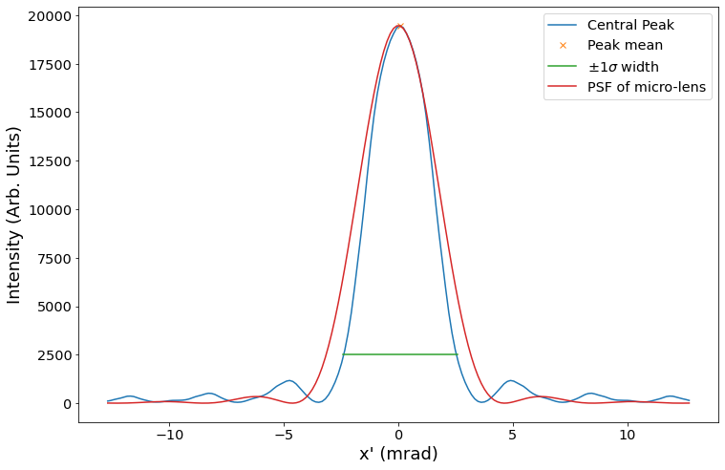
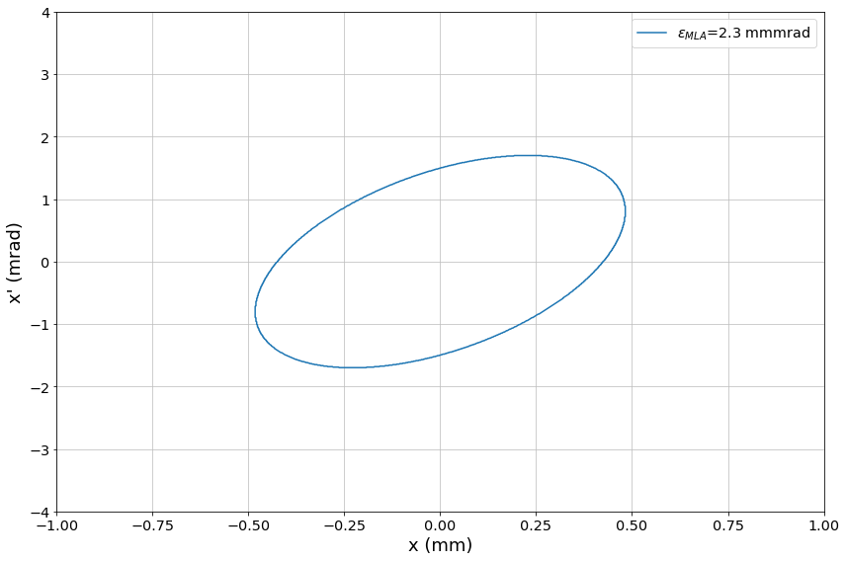
Laser benchmarking: MLA resolution
C. Swain (catherine.swain@liverpool.ac.uk)
IOP PAB conference 28/06/2023
7

Slide 9
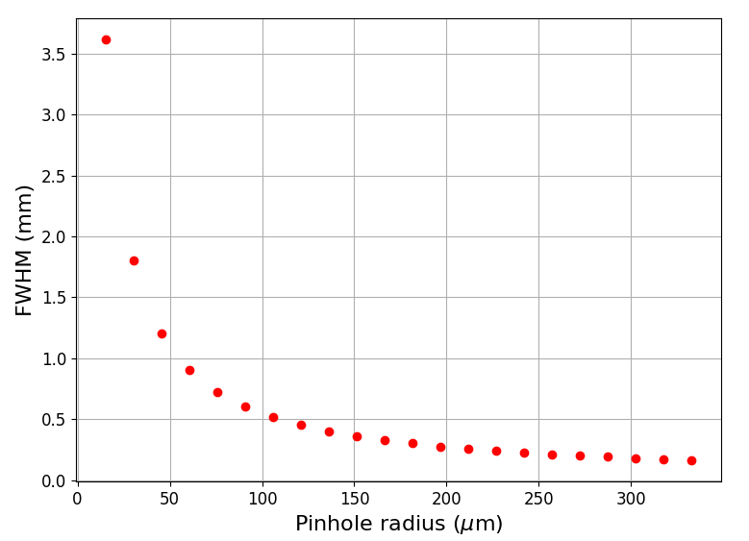
Laser benchmarking: DMD resolution
Theoretical PSF spot size for varying apertures was calculated.
Experimental verification of results will be carried out.
Increasing pinhole radius decreases the PSF.
This means images with larger pinholes will have less contribution from diffraction through the aperture.
Therefore, larger pinholes give higher diffraction resolution.
C. Swain (catherine.swain@liverpool.ac.uk)
IOP PAB conference 28/06/2023
8

Slide 10
Experimental plans for CLEAR
e⁻ beam
Window
OTR target
Beamsplitter
OTR
OTR
In October, both setups will be taken to CLEAR.
Here we hope to gain proof of concept measurements for the divergence resolution of both systems.
Utilising OTR both systems will image simultaneously.
To MLA setup
OTR
Mirror
Mirror
BS
To DMD setup
DMD
MLA
DMD setup
MLA setup
C. Swain (catherine.swain@liverpool.ac.uk)
IOP PAB conference 28/06/2023
9

Slide 11
Summary
Two systems for all-optical emittance measurements have been tested at CI.
Diffraction resolution limits of the two have been compared.
Plans for experimental testing at CLEAR scheduled for October 2023.
Next steps include simulating different radiation sources, e.g non-invasive OSR.
Future plans for testing at FEBE on CLARA.
C. Swain (catherine.swain@liverpool.ac.uk)
IOP PAB conference 28/06/2023
10

Slide 12
Thanks for listening,
any questions?
For any further questions, email:
catherine.swain@liverpool.ac.uk
[1] S. Kim, et. al., (2020), “Commissioning of the electron injector for the AWAKE experiment”, NIM-A, vol. 953
[3] M. Zhang, "Emittance Formula for Slits and Pepper-pot Measurement", FERMILAB-TM-1988, Oct. 1996
[4] https://www.thorlabs.com/newgrouppage9.cfm?objectgroup_id=2861
[5] https://www.ti.com/product/DLP6500FLQ
[6] https://github.com/scottprahl/laserbeamsize
[7] J. Wolfenden, et. al., (2023), "Optical Pepper-pots: Developing single-shot emittance diagnostics", 14th Int. Particle Acc. Conf., pg 3874 - 3877
This work is supported by the AWAKE-UK phase II project funded by STFC grant no. ST/T001941/1, the STFC Cockcroft core grant no. ST/V001612/1.

Slide 13
Additional slides
This work is supported by the AWAKE-UK phase II project funded by STFC grant no. ST/T001941/1, the STFC Cockcroft core grant no. ST/V001612/1.

Slide 14
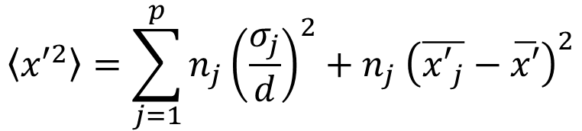

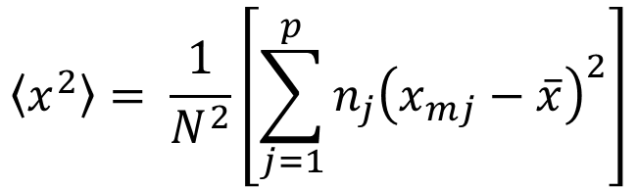
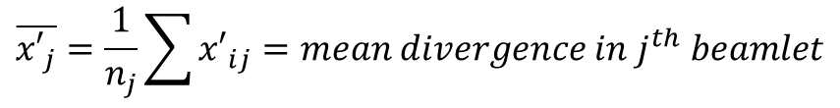
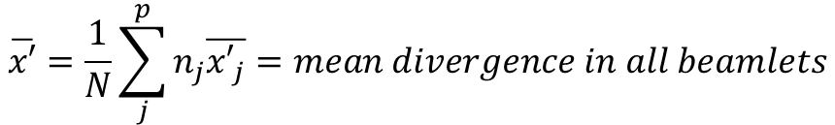

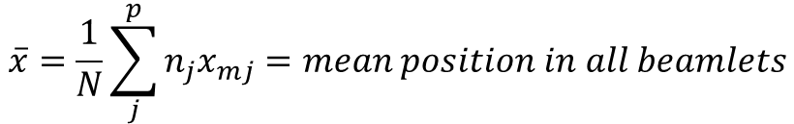
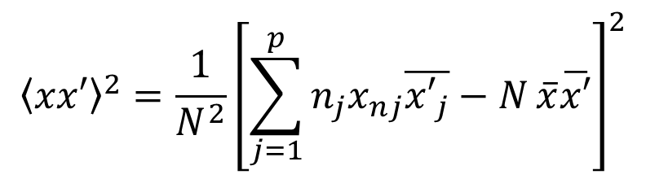

Emittance calculations – M. Zhang (1996)
$$ε_{RMS}\left(x, x^{′}\right)= \sqrt{\left\langle x^{2}\right\rangle \left\langle {x′}^{2}\right\rangle −{\left\langle xx′\right\rangle }^{2}}$$
$$\overline{x}=\frac{1}{N}\sum_{j}^{p}{n_{j}x_{mj}}=mean position in all beamlets$$
$$\left\langle x^{2}\right\rangle = \frac{1}{N^{2}}\left[\sum_{j=1}^{p}{n_{j}{\left(x_{mj}−\overline{x}\right)}^{2}}\right]$$
$$\overline{x′}=\frac{1}{N}\sum_{j}^{p}{n_{j}\overline{{x′}_{j}}}=mean divergence in all beamlets$$
$$\overline{{x′}_{j}}=\frac{1}{n_{j}}\sum{{x′}_{ij}}=mean divergence in j^{th} beamlet$$
$$\left\langle {x′}^{2}\right\rangle =\sum_{j=1}^{p}{n_{j}{\left(\frac{σ_{j}}{d}\right)}^{2}+n_{j} {\left(\overline{{x′}_{j}}−\overline{x′}\right)}^{2}}$$
$$σ_{jx}= \frac{σ_{j}}{d}=RMS divergence$$
$${\left\langle xx′\right\rangle }^{2}=\frac{1}{N^{2}}{\left[\sum_{j=1}^{p}{n_{j}x_{nj}\overline{{x′}_{j}}−N}\overline{x}\overline{x′}\right]}^{2}$$
$$p=number of slits$$
$$x_{mj}=j^{th} slit position$$
$$d=distance between mask and screen$$
$$N=total number of particles behind slit$$
$$n_{j}=number of particles which pass through slit$$
M. Zhang, (1996), Emittance Formula for Slits and Pepper-pot Measurement, Emittance Formula for Slits and Pepper-pot Measurement
C. Swain (catherine.swain@liverpool.ac.uk)
IOP PAB conference 28/06/2023
A1

Slide 15
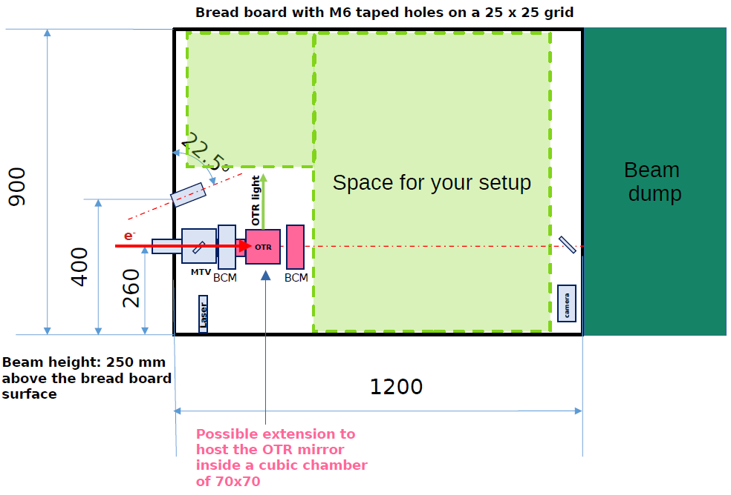
CLEAR test stand
Diagram courtesy of Pierre Korysko (CLEAR, CERN).
C. Swain (catherine.swain@liverpool.ac.uk)
IOP PAB conference 28/06/2023
A2

