Slide 1
An Optimisation Framework for Underexpanded Jets
Particle Accelerators and Beams 2023 Conference
O. Stringer, H. Zhang, C. Welsch

Slide 2
Contents
Underexpanded jets and their applications
Monte-Carlo underexpanded jet model
Multi-Objective Genetic Algorithm optimisation
Future work

Slide 3
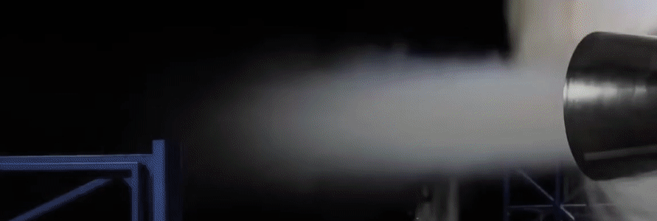
Gas Jets Applications
Underexpanded jet of gas
Beam profile monitors – Ionisation Profile Monitors
Plasma wakefield injectors
Nuclear targets
Ion engine propulsion
Figure 1: SpaceX Raptor engine test [1].

Slide 4
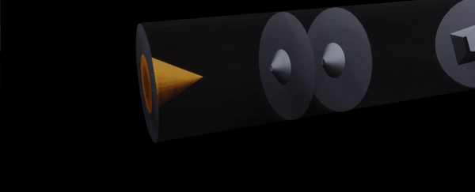

Monte-Carlo Jet Simulation
A Monte-Carlo particle tracking code was previously developed to simulate the density and distribution of the gas jet.
It uses ideal gas laws and a calorically perfect isentropic expansion model and has been shown to accurately simulate the jets behaviour.
Figure 2: Animation of the Monte-Carlo gas jet principal.

Slide 5
Multi-Objective Genetic Algorithm
Non-dominated Sorting Genetic Algorithm (NSGA-II)
Optimisation technique that simulates “Survival of the Fittest” in biological evolution.
Parameter space of 10 variables, 5 design variables
50,000,000 geometric solutions, varying skimmer distance and aperture of all 4 skimmers.

Slide 6
Injection Optimisation
0.00
1.00 – 10.00 mm
6.58 – 48.49 mm
174.94 – 241.11 mm
294.94 mm
346.13 – 409.94 mm
Nozzle
1st Skimmer
2nd Skimmer
3rd Skimmer
IP
4th Skimmer
a
a
d
d
b
b
d: 500 – 7,500 um
d: 30 – 10,000 um
a: 50 – 2,000 um
b: 2 – 60 mm
a: 50 – 10,000 um
b: 2 – 100 mm
Figure 3: Schematic of the injection parameter space used for the optimisation study.

Slide 7
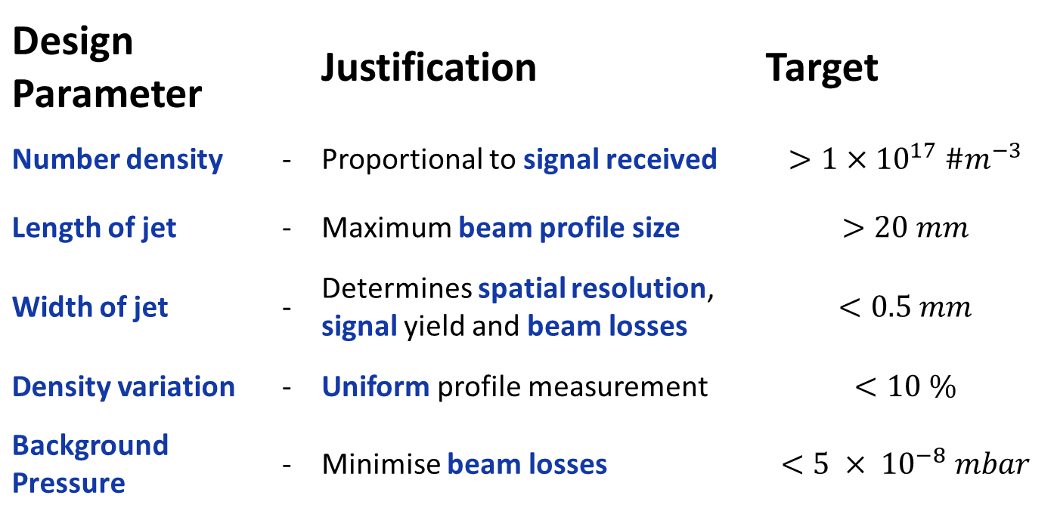
Design Space
Design Parameter |  | Justification | Target
Number density | - | Proportional to signal received | $$>1×{10}^{17} \#m^{−3}$$
Length of jet | - | Maximum beam profile size | $$>20 mm$$
Width of jet | - | Determines spatial resolution, signal yield and beam losses | $$<0.5 mm$$
Density variation | - | Uniform profile measurement | $$<10 \%$$
Background Pressure | - | Minimise beam losses | $$<5 × {10}^{−8} mbar$$

Slide 8
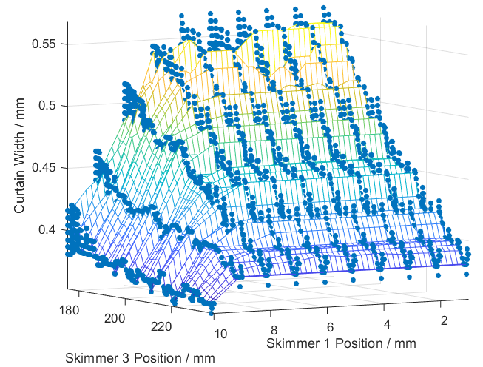
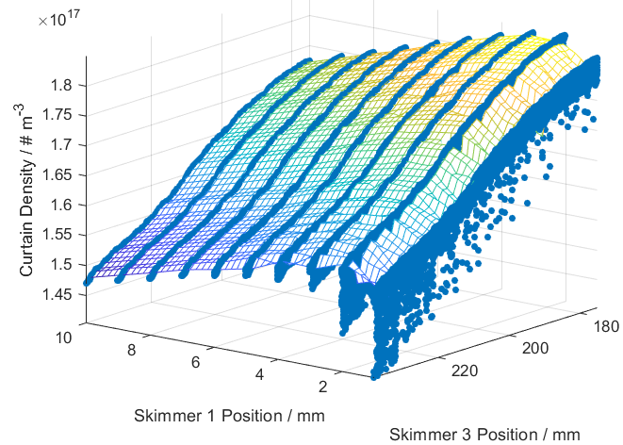
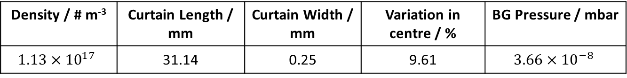
Results
Figure 7: Surface plot of density as a function of skimmers 1 and 3 positions.
Figure 8: Surface plot of width as a function of skimmers 1 and 3 positions.
Density / # m⁻³ | Curtain Length / mm | Curtain Width / mm | Variation in centre / % | BG Pressure / mbar
$$1.13×{10}^{17}$$ | 31.14 | 0.25 | 9.61 | $$3.66×{10}^{−8}$$

Slide 9
Conclusions and Future Work
A high speed optimisation framework for underexpanded jets has been developed.
A best geometric solution has been shown.
Validating analytical background calculations with experimental data
Validate final chosen simulations using MolFlow

Slide 10
Additional Slides

Slide 11
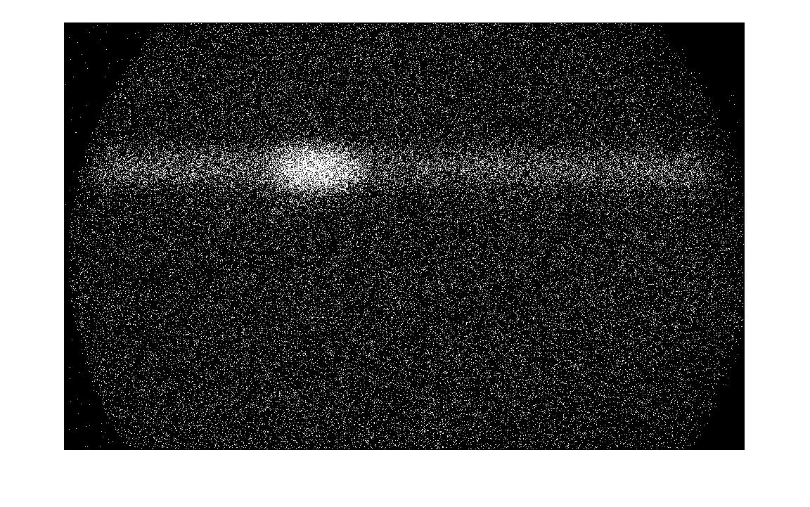
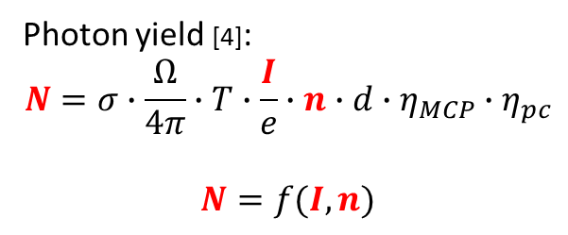
Beam Gas Fluorescence
Photon yield [4]:
$$N=σ∙\frac{Ω}{4π}∙T∙\frac{I}{e}∙n∙d∙η_{MCP}∙η_{pc}$$
$$N=f(I, n)$$
Beam path
Concentrate a higher number density in a small region to minimise losses.
Jet path
Orientating a thin sheet 45º will allow X & Y profiles of beam to be reconstructed.
Circular Jet
45º Jet Curtain
Figure 1: Beam induced fluorescence using circular jet
Figure 1: Beam induced fluorescence using 45 degrees jet
Figure 1: Beam induced fluorescence in chamber background gas
Notes:
****Non-invasive, within energy spread****
Sigma – fluorescence cross-section (a function of beam energy & size)
Omega – solid viewing angle of camera
T – Transmittance of the imaging system
I – Beam current
n – gas curtain number density
d – gas curtain thickness

Slide 12
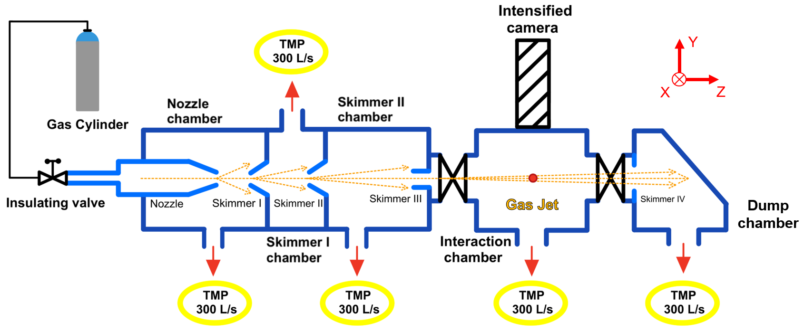
Beam Gas Curtain
Injection
Interaction
Dump

Slide 13
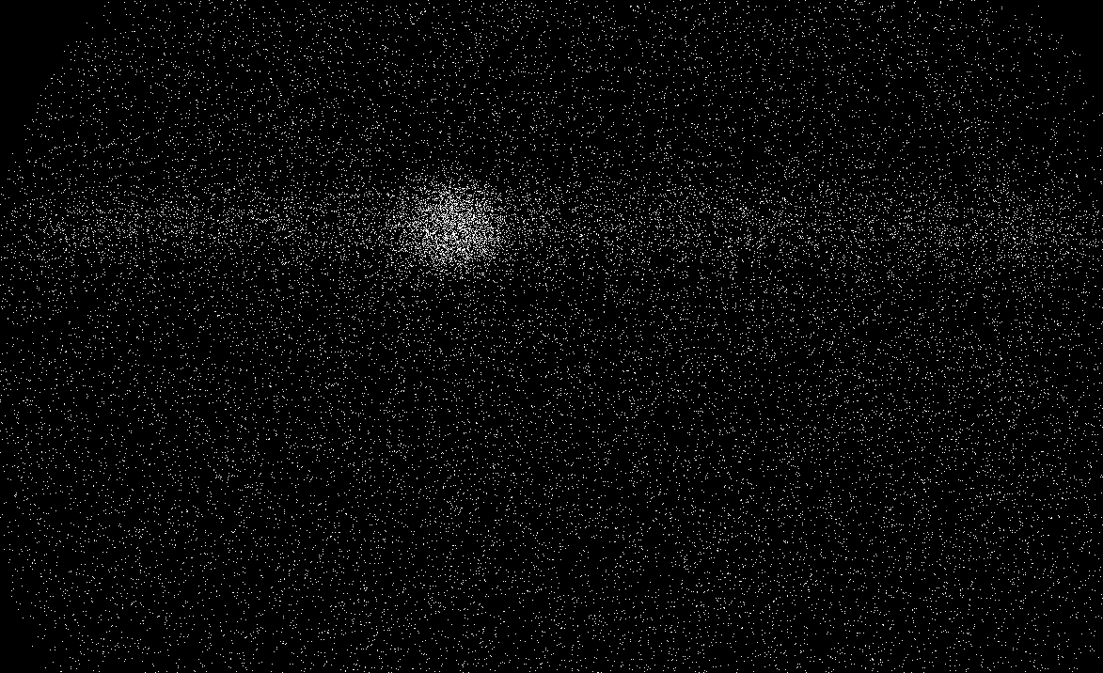
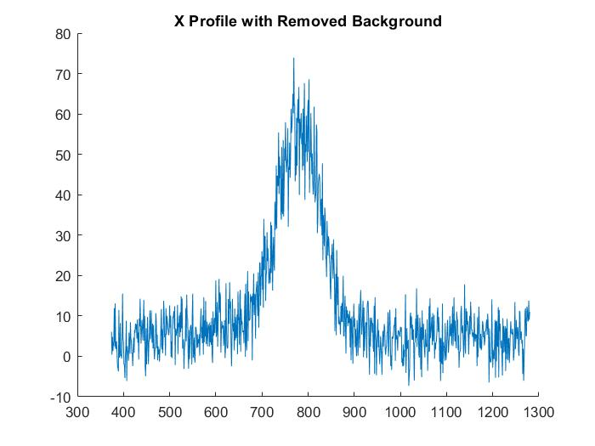
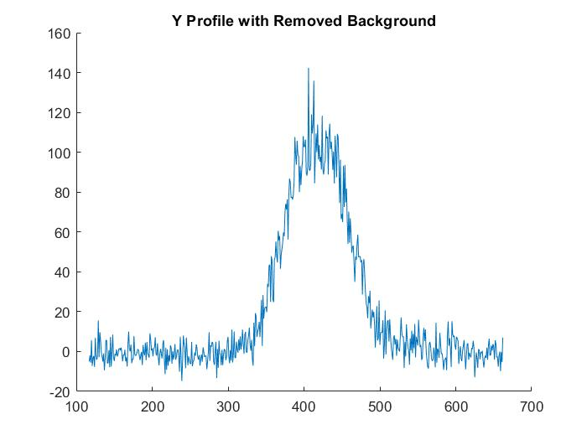


BGC measurements
Beam Path
$σ_{Y}$
$$σ_{X}$$
Number of photons
Number of photons
Pixels
Pixels

Slide 14
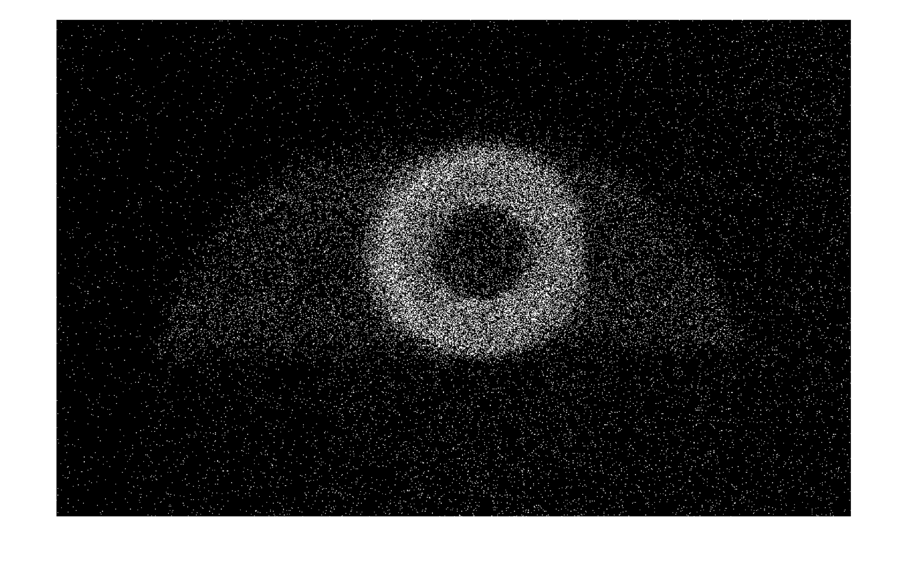
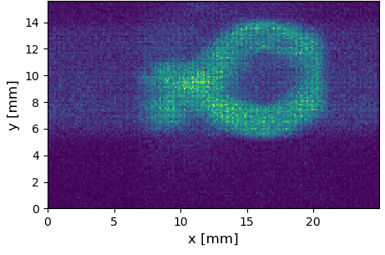
Hollow Electron Beam

Slide 15
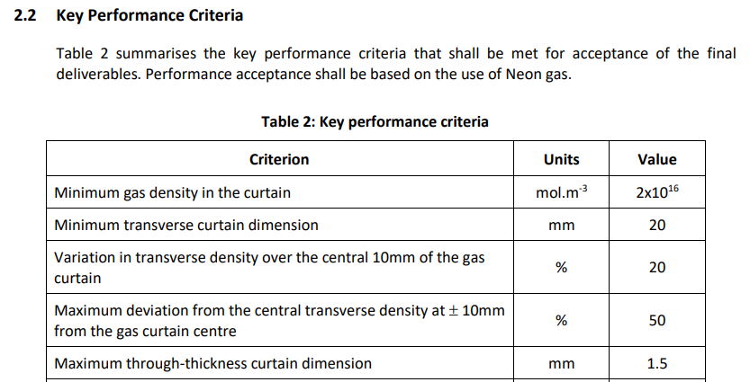
Key Performance Criteria (Required)

Slide 16
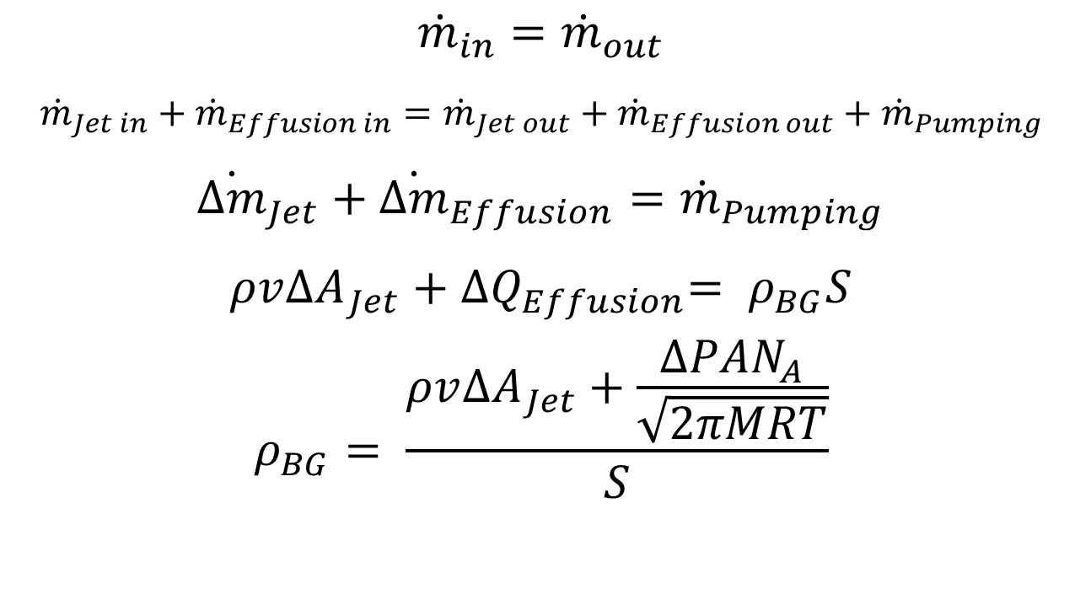
Adaptive Background Pressure
$${\dot{m}}_{in}={\dot{m}}_{out}$$
$${\dot{m}}_{Jet in}+{\dot{m}}_{Effusion in}={\dot{m}}_{Jet out}+{\dot{m}}_{Effusion out}+{\dot{m}}_{Pumping}$$
$${\dot{∆m}}_{Jet}+{\dot{∆m}}_{Effusion}={\dot{m}}_{Pumping}$$
$${ρv∆A}_{Jet}+{∆Q}_{Effusion}= ρ_{BG}S$$
$$ρ_{BG}= \frac{{ρv∆A}_{Jet}+\frac{ΔPAN_{A}}{\sqrt{2πMRT}}}{S}$$
Notes:
Mdot = mass flow rate
Delta mdot jet = mass flow rate of jet that does not pass a skimmer (mdot jet in – mdot jet out)
Delta mdot effusion = mass flow rate of effusion between chambers (mdot effusion in – mdot effusion out) – a result of different chamber pressures and entropy.
Mdot pumping = mass flow rate of volume being pumped.
Rho = density (of jet, unless subscript BG which is Background)
V = velocity of jet.
Delta A jet = difference in area of jet (jet 2D area at skimmer – skimmer area)
Q effusion = flow rate of effusion
S = pumping speed.
Delta P = difference in pressure between two chambers
A = area of skimmer
NA = Avogadro’s constant
M = molar mass of gas
R = Gas Constant
T = Temperature of background.

Slide 17
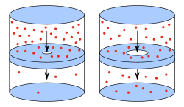
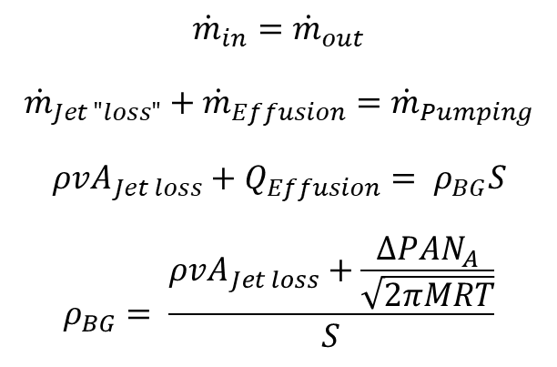
Effusion
2nd Law of Thermodynamic - two connected reservoirs at a pressure differential will eventually converge to equal pressure.
 | BG pressure N2 / mbar | BG pressure Ne / mbar
Jet loss | 0 | 0
Effusion | 1.64E-8 | 2.86E-8
Experimental | 1.14E-8 | 3.60E-8
$${\dot{m}}_{in}={\dot{m}}_{out}$$
$${\dot{m}}_{Jet "loss"}+{\dot{m}}_{Effusion}={\dot{m}}_{Pumping}$$
$${ρvA}_{Jet loss}+Q_{Effusion}= ρ_{BG}S$$
$$ρ_{BG}= \frac{{ρvA}_{Jet loss}+\frac{ΔPAN_{A}}{\sqrt{2πMRT}}}{S}$$
Notes:
$ρ$ BG – number density of background pressure in chamber (# m^-3)
$ρ$ Jet loss – density of the jet (# m^-3)
v Jet loss – velocity of the jet (m s^-1)
A Jet loss – area of the jet remaining in the chamber at the skimmer (size jet – size of skimmer) (m^2)
Delta P – pressure different between two chambers (Pa)
A – Aperture of skimmer (m)
NA – Avogadro’s Number
M – Molar mass of gas
R – Gas constant
T – Temperature of BG (K)
S – Pumping speed of TMP (m^3 s^-1)

Slide 18
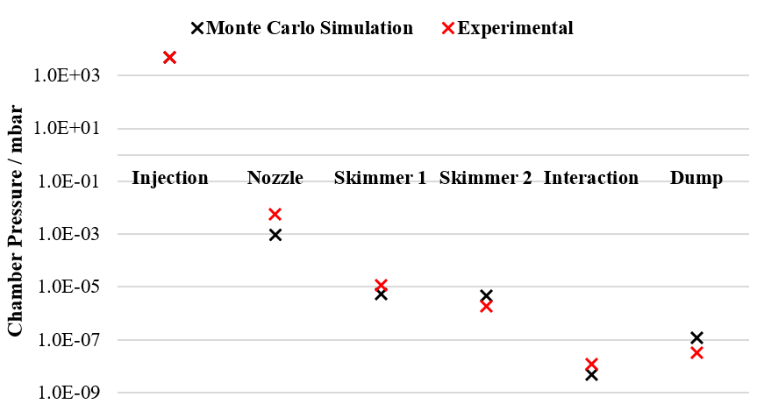
Dynamic Background Check
V3, Neon injection @ 5 bar, Skimmers: 400um, 2mm, 0.3x9mm and 7x31mm.

Slide 19
References
[1] SciNews, Raptor engine test. [Online]. 2016. [Accessed 23 June 2023]. Available from: https://www.youtube.com/watch?v=e7kqFt3nID4&ab_channel=SciNews

