Slide 1


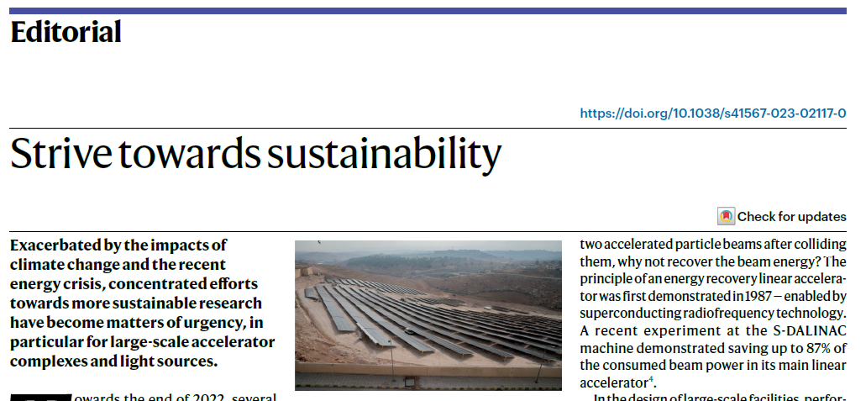
“It’s not just windmills”
STFC and Sustainable Particle Accelerators
Nature Physics 13th June 2023
Hywel Owen
STFC Daresbury Laboratory / Cockcroft Institute
Accelerator Science and Technology Centre
30th June 2023
IOP PAB Conference 2023
Particular thanks to Ben Shepherd (lead researcher, ASTeC Sustainable Accelerators Task Force)
https://doi.org/10.1038/s41567-023-02117-0

Slide 2
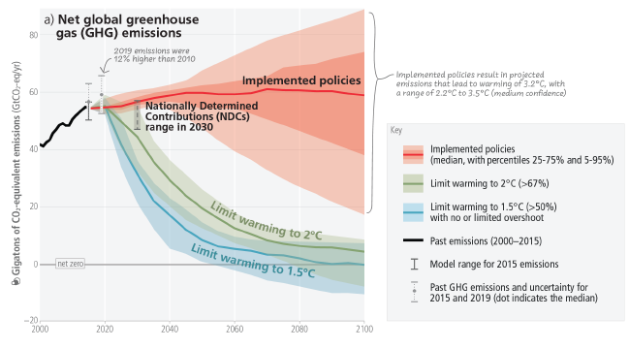
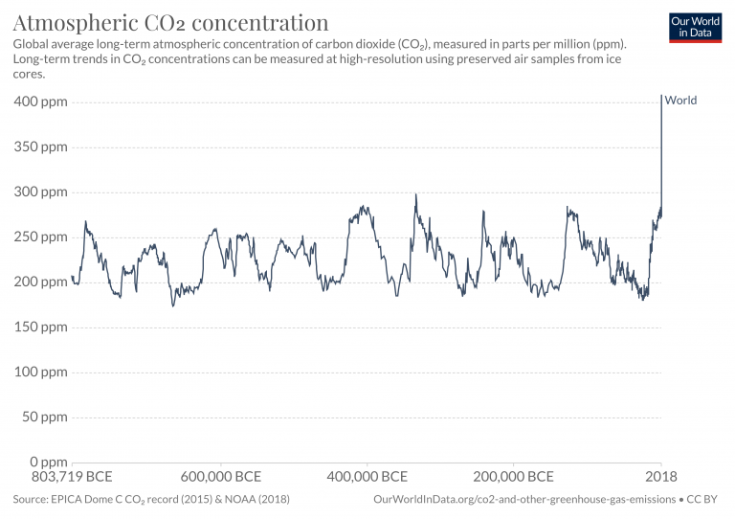
The Need for Sustainability
https://www.ipcc.ch/report/ar6/wg3/
1994 - UNFCC (UN Framework Convention on Climate Change)
1997 – Kyoto Protocol (in force 2005)
COP21 Paris Agreement – economy-wide GHG reduction of 68% by 2030 (cf. 1990)
UK Nationally Determined Contribution – not only CO2, but also GHGs such as CH4;
UK BEIS responsible for climate policy
https://unfccc.int/sites/default/files/NDC/2022-09/UK%20NDC%20ICTU%202022.pdf
2008 UK Climate Change Act – legally binding 80% by 2050 (Climate Change Committee)
2019 Net Zero legislation (UK first)
2021 Net Zero strategy – how to deliver on Carbon Budgets 4,5,6 (but Ukraine war effect)
Industrial Decarbonisation Strategy; https://www.gov.uk/government/publications/industrial-decarbonisation-strategy
Ten Point Plan for a Green Industrial Revolution; https://www.gov.uk/government/publications/the-ten-point-plan-for-a-green-industrial-revolution
Carbon Budgets 1,2 met
Carbon Budget 3 on track
Carbon Budget 4 not on track (2023-2027

Slide 3
Lots of People are Thinking About This
Relevant Sectors:
  Particle Physics
  Astronomy (e.g. land-based)
  HPC
Relevant Initiatives/Studies
  HECAP:
  https://sustainable-hecap.github.io/Sustainability_in_HECAP.pdf
  ALLEA Working Group
  https://allea.org/wg-climate-sustainability-in-the-academic-system/
  Snowmass 2021
  https://arxiv.org/abs/2209.07684
  UCL LEAF https://www.ucl.ac.uk/sustainable/leaf-laboratory-efficiency-assessment-framework
  iFAST WP11
  https://ifast-project.eu/wp11-sustainable-concepts-and-technologies
A few points:
  ‘CO2 is not the only greenhouse gas (note SF6)’
  ‘Science labs don’t have special status’
  ‘Greenwashing is not allowed’
  ‘Research should not reward hypermobility’
  ‘Better software can be more important that efficient IT’
  COVID has prompted a rethink in the need for travel – hub conferences, travelling conferences etc.
  Researcher travel can be a significant part of a project’s environmental impact
‘Separation of concerns’
Standardisation of accounting tools – be careful of local conditions for energy usage and impact
STFC Sustainable Accelerators Workshop
https://indico.stfc.ac.uk/event/646/

Slide 4
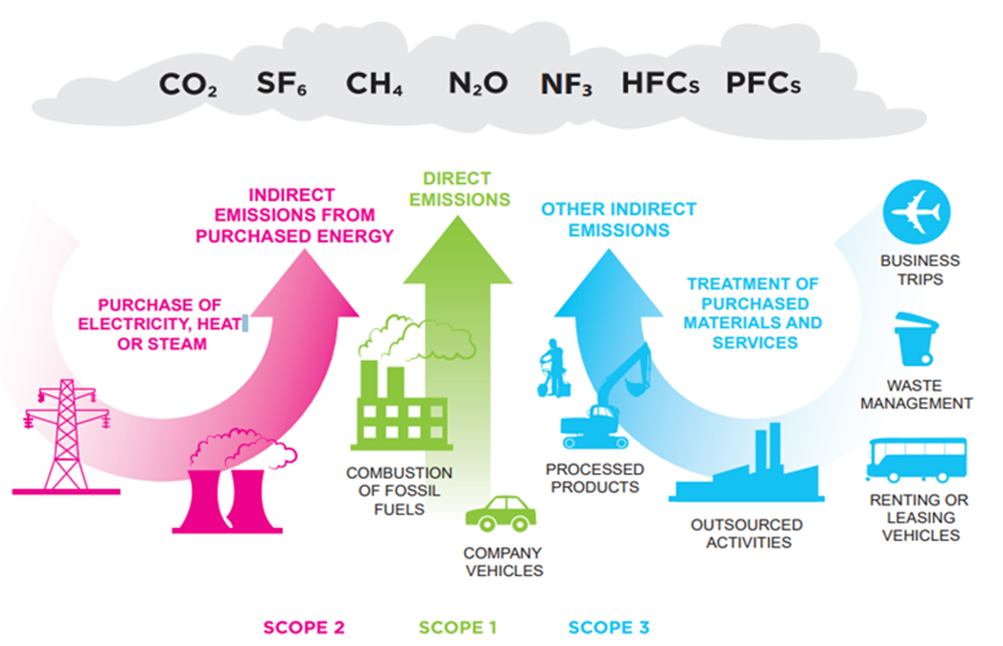
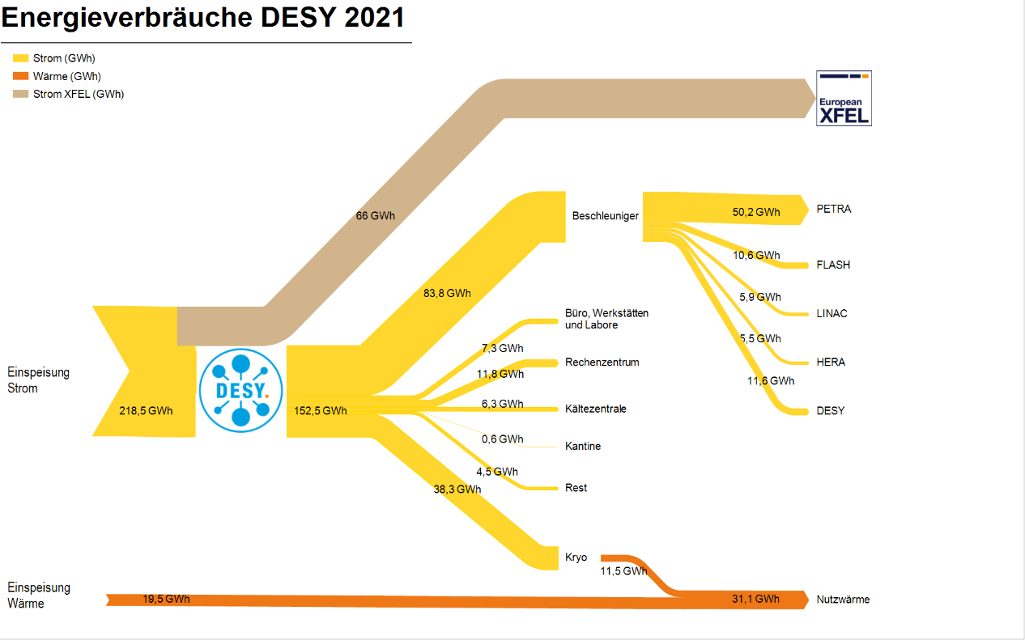
Big Science
=
Big Carbon Footprint
WBCSD/WRI Greenhouse Gas Protocol
You Are Here
Large scientific facilities will create significant carbon footprints during all phases of their lifecycle.
Design, Construct, Operate, Decommission
All emissions scope will be applicable, and the dominance will depend on the lifecycle of the facility.

Slide 5
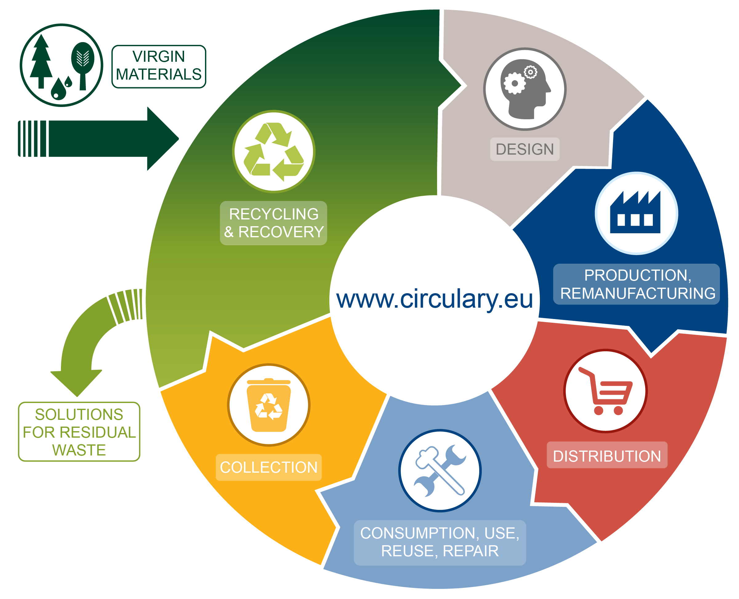
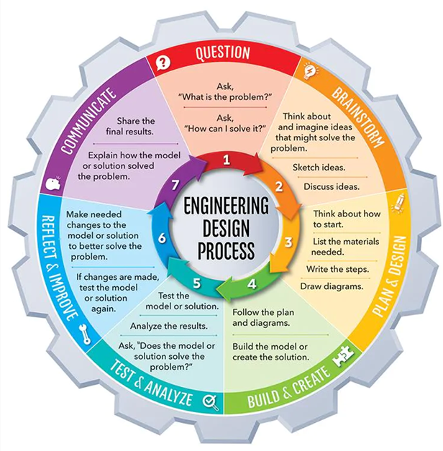


UKRI, STFC and Sustainability
2023 UKRI Sustainability Strategy – ‘embed by 2025’; https://beta.ukri.org/publications/ukri-environmental-sustainability-strategy/
‘Greening Government Commitments’; https://www.gov.uk/government/publications/greening-government-commitments-2021-to-2025/greening-government-commitments-2021-to-2025
STFC Framework for Accelerator Development:
https://www.ukri.org/publications/stfc-strategic-framework-for-future-accelerator-science-and-technology-development/
STFC – net zero by 2040
STFC Hierarchy
Energy reduction
Improving processes and efficiency
Energy substitution
Compensation and offsetting
9: Sustainable Industrialisation and Innovation
12: Sustainable Consumption and Production
13: Action to Combat Climate Change

Slide 6


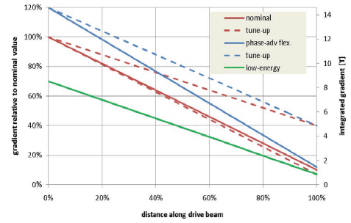
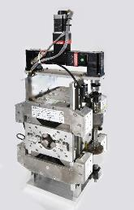
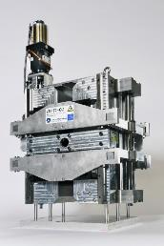
ASTeC Green Projects: ZEPTO
Zero-Power Tunable Optics
Initially, collaboration between ASTeC and CERN to develop tunable PM quadrupole magnets for
CLIC’s drive beam
Nominal 0.24-2.4 GeV, with some tuning range at each point
41,400 quadrupoles required for CLIC drive beam
  Projected 13.5 MW of electricity demand
  Permanent magnet option as an alternative
Two prototypes built at STFC Daresbury Laboratory
  27 mm aperture
  230 mm length
  15-60 T/m, 4-35 T/m ranges
  Fixed poles, movable PMs
  Simple control system with one motor
12.2 T
1.22 T

Slide 7
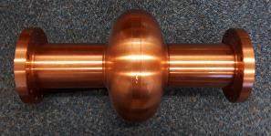
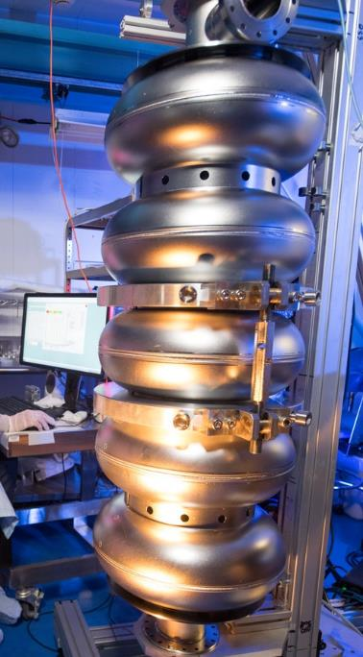
Thin Films at Daresbury
Slide: Andrew Vick / Oleg Malyshev
1.3 GHz cavity for STF deposition
Bulk niobium cavities have been the choice for SRF for the last 50 years
Use a considerable amount of natural material
Performance limit of niobium has been reached
Costly to produce
Run at a temperature of 2 K
  A considerable cryogenic demand and energy load
Thin films open up the possibilities to
  Use a copper supporting cavity
    better thermal properties,cheaper material and production
  Using different superconducting materials (e.g. Nb₃Sn, NbN and MgB₂)
  Higher operation temperature of new alloys
  Theoretical higher accelerating gradients
6 GHz split cavity
Cylindrical magnetron

Slide 8
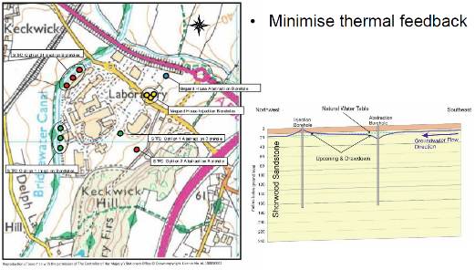
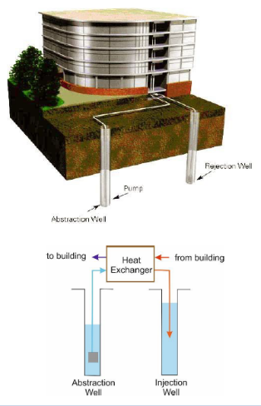
Slide: Andy Goulden
Ground Water Cooling
Feasibility and modelling study
Envireau Water, 2017
Potential 2 MW cooling scheme
Support the cooling of ASTeC’s suite of particle accelerator test facilities
Would reduce electricity consumption by 4000 MWh (> £600k / year*)
Feasibility Study and Numerical Modelling
showed positive results:
48 L/s abstraction
Fixed temperature differential of 10°C
STFC Abstraction temperature rise of 2.3°C
Delivering 2 MW of cooling
Minimal impact on Vanguard House scheme
Environment Agency have reviewed proposed scheme and modelling and have no objections subject to final design
*2019 prices, 16p/kWh: likely saving in ‘22 is much more!

Slide 9


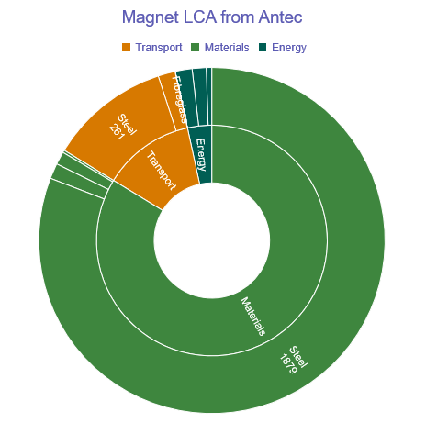
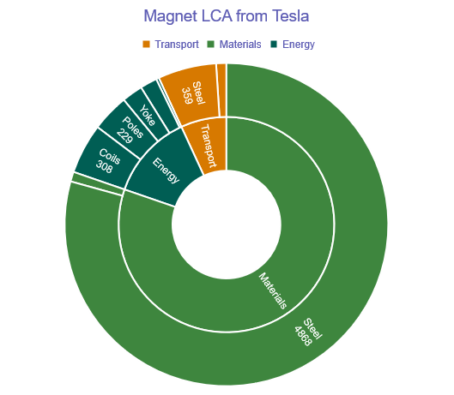
Magnet Carbon Footprints
Scenario | kgCO₂e | % change
Baseline | 2324 | 0%
Mexican steel | 1449 | -38%
Rail freight for steel | 2091 | -10%
EU-average for copper | 2393 | +3%
Total 2.3 tCO₂e
(3 kgCO₂e / kg of finished product)
Total 6.2 tCO₂e
(2.9 kgCO₂e / kg of finished product)

Slide 10
Future UKRI Infrastructures
Future UKRI Infrastructures will need to demonstrate sustainability through their lifecycle
UKRI Infrastructure Fund and Carbon Forecasting
  Burning Fuels
  Process and fugitive emissions (e.g. SF6)
  Process removals
  Water use
  On-site renewables
  UK and overseas Grid use
  Travel of people
  Travel of goods and equipment (e.g. samples)
  Emissions elsewhere caused by infrastructure

Slide 11
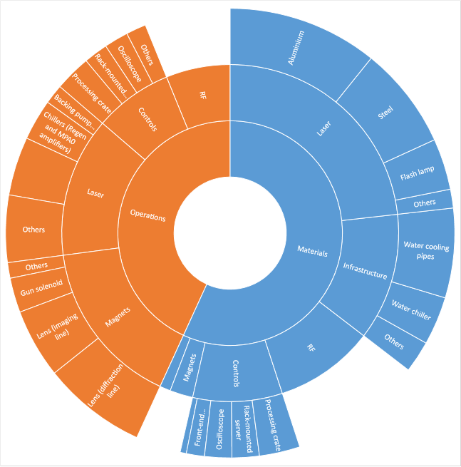
STFC Life Cycle Analysis and Report
Operation
ASTeC Sustainable Accelerators Task Force
LCA using RUEDI project/facility as a model
  1. Inventory of key components and primary materials
  2. Supplier sourcing and energy use
  3. Literature comparison for energy use
  4. Power and resource estimate
Some points:
  Embed sustainability into engineering component design – modularity, materials, energy impact
  Lifespan estimates and component re-use
  Critical materials (e.g. Nb, NdFeB, SF6)
  Energy source (renewable or not)
  Concrete CO2 can dominate – modular shielding and other methods
  Activated materials can have a big environmental burden
Publication later in 2023
Manufacture
Example breakdown of relative kgCO2e emissions in a project
https://www.ukri.org/publications/stfc-strategic-delivery-plan/

