Slide 1



Overview of the
UK XFEL CDOA project
Neil Thompson, ASTeC, STFC Daresbury Laboratory
on behalf of the Project Team
IoP PAB Conference, June 2023

Slide 2



Contents
Background and introduction
Launch event and engagement with overseas XFEL facilities
The current concept
Schematic FEL layout

Slide 3
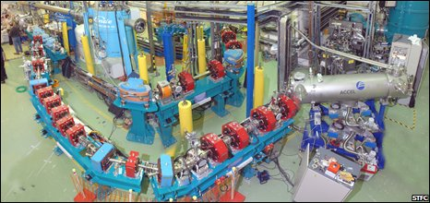
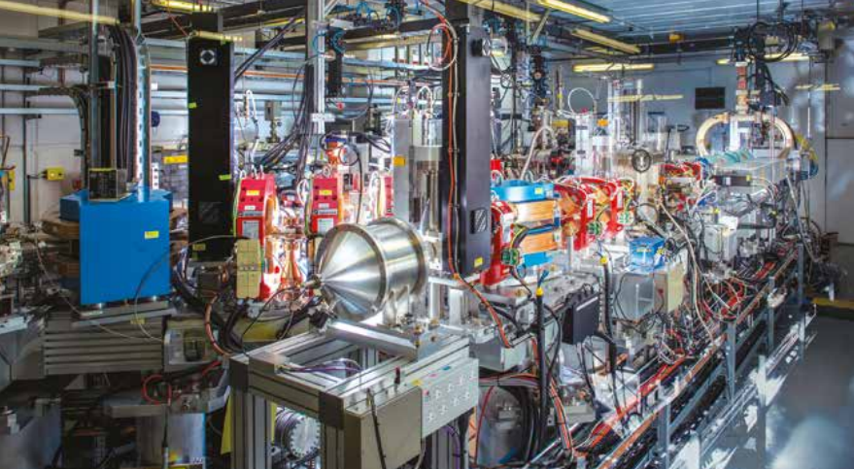




ALICE 27.5 MeV ERL IR FEL
CLARA 250 MeV test facility
Background
2006
2010
2016
2018
UK becomes a member of Eu-XFEL
2020
2022
UK XFEL CDOA phase starts
4GLS Conceptual Design
VUV FEL, 600 MeV @ 1.3 GHz
XUV FEL, 950 MeV @ 1 kHz
+ IR FELs
Led to the ALICE ERL FEL facility
NLS Conceptual Design
FEL-1: 50-300 eV
FEL-2: 250-850 eV
FEL-3: 430-1000 eV
2.25 GeV, 1 kHz to 1 MHz
Led to the CLARA facility
Strategic Review
Not a facility design but highlighted a SwissFEL-like option + increased international engagement
UK XFEL Science Case
Soft x-rays @ 1 MHz
Hard x-rays @ 1 kHz to 1 MHz
See “The origins and developments of FELs in the UK”, E.A. Seddon and M.W. Poole, Royal Society Journal of the History of Science, https://royalsocietypublishing.org/doi/10.1098/rsnr.2022.0038

Slide 4
UK XFEL
Conceptual Design and Options Analysis (CDOA)
Project Aims
To map out how best to deliver advanced XFEL capabilities identified in the Science Case
To develop a Conceptual Design for a unique new machine that can fulfil all required capabilities
To examine and compare other investment options and collaborations in existing XFELs
To update the Science Case to feed into the process and inform future decisions
To hold Townhall Meetings around the UK to engage and expand the user community
To investigate the socioeconomic impact of a next generation XFEL
The Project duration is 3 years, ending in October 2025
Project Sponsor :
Science Lead :
Technical Lead :
Project Manager:
John Collier
Jon Marangos
Jim Clarke
Paul Aden

Slide 5
UK XFEL
A next generation XFEL
Key next-generation capabilities identified in the UK XFEL Science Case:
- Transform limited operation across entire X-ray range with pulse durations from 0.1 – 100 fs
- High efficiency facility, i.e. the simultaneous operation of multiple end stations
- Evenly spaced, high-rep rate pulses to match samples & detectors
- Improved synchronisation/timing data with external lasers to < 1 fs
- Widely separated multiple colour X-rays to least one end-station
- Full array of synchronised sources:
XUV-THz, e-beams, high power & high energy lasers at high rep-rate
UK XFEL Science Case available at xfel.ac.uk

Slide 6
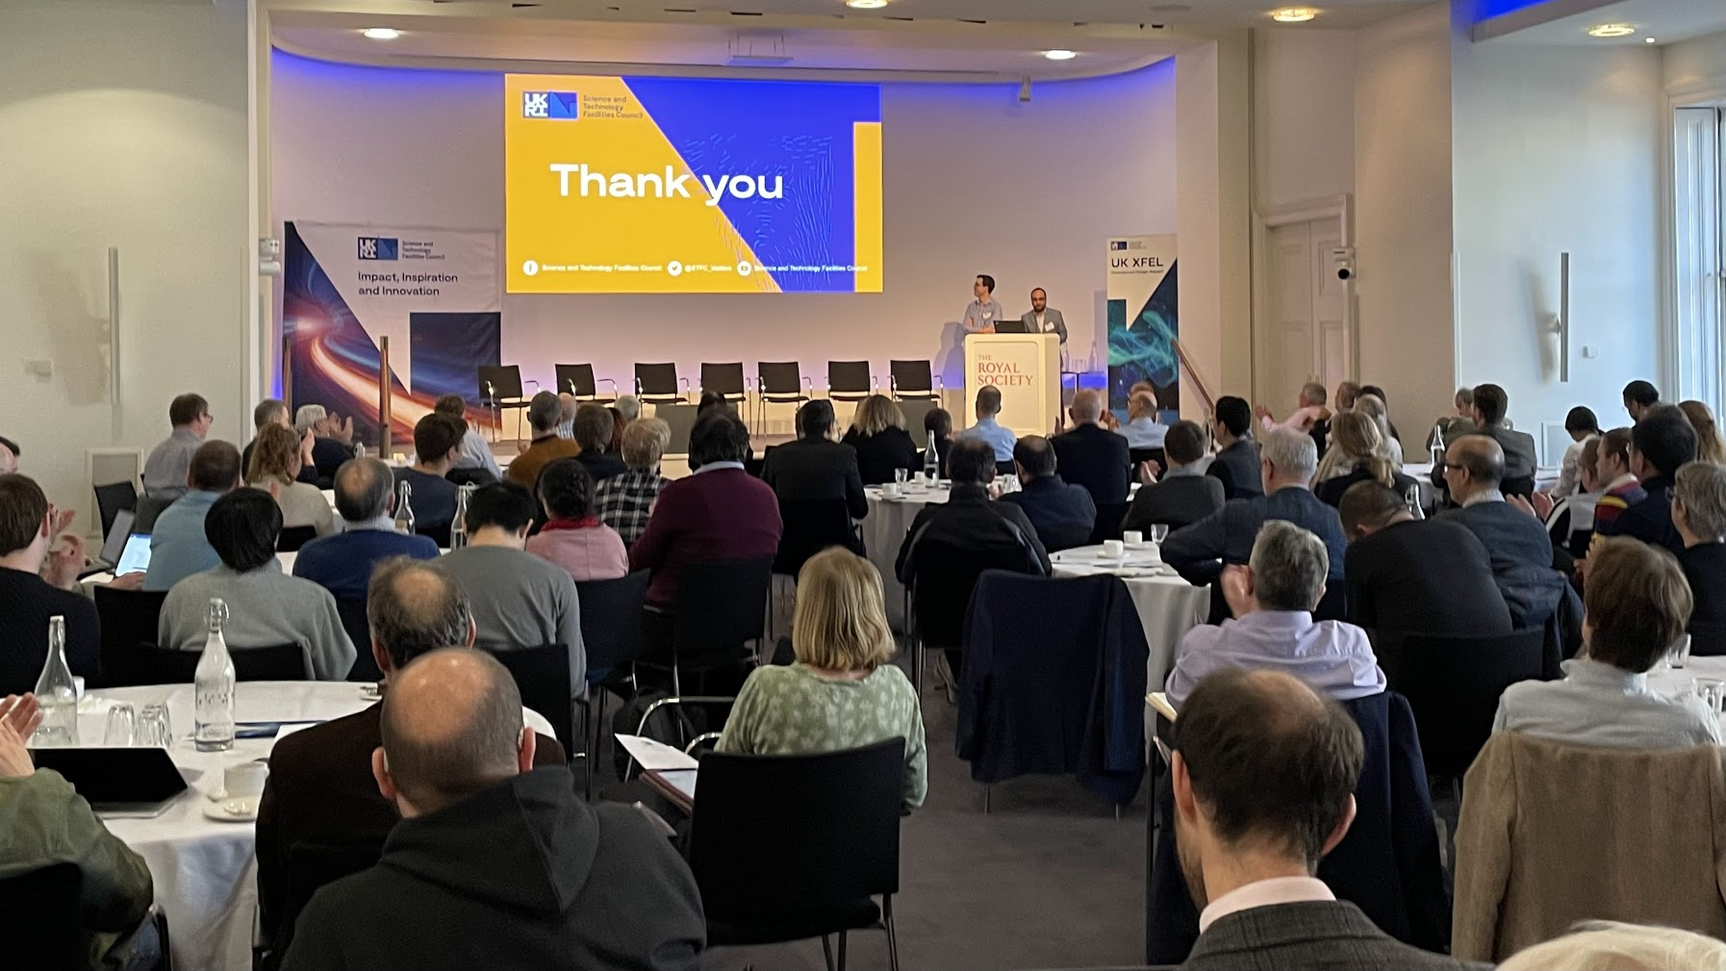
Launch Event
The project was launched at the Royal Society on 30th January 2023
Over 150 in-person attendees from a range of institutions, with another 150 attending virtually.
Positive attention: articles from Physics World and Chemistry World, including podcast interview with John Collier
Presentations available on the UK XFEL website: https://xfel.ac.uk/

Slide 7
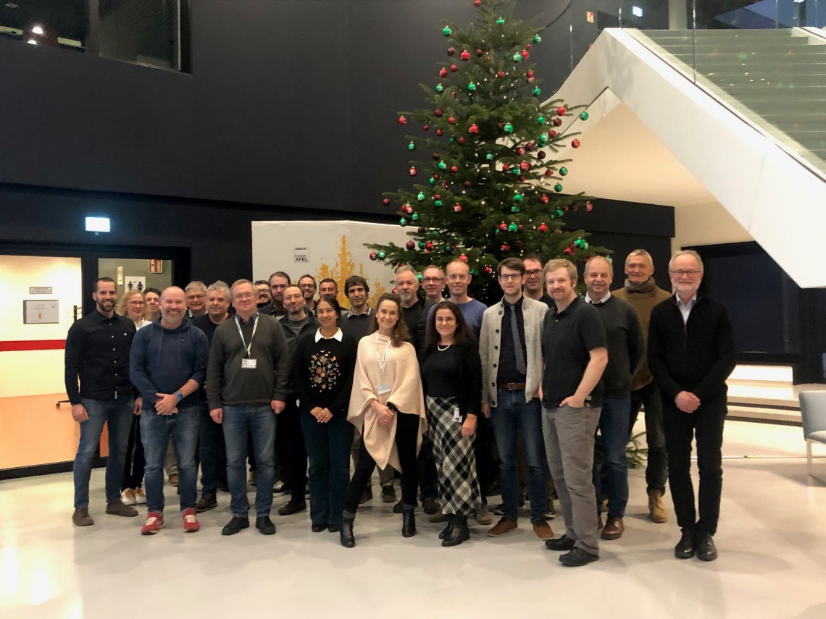
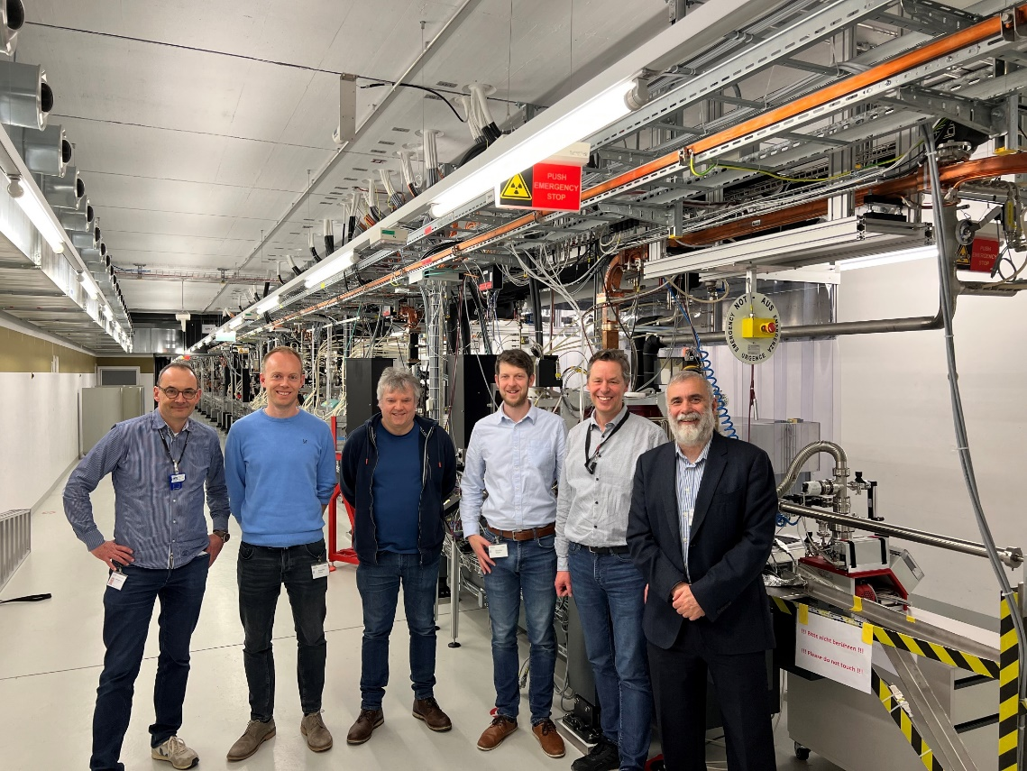
Engagement with overseas XFELs
Preliminary engagement with overseas XFEL facilities is taking place, to identify collaborative R&D topics and potential ‘investment’ opportunities
  Visits to European XFEL and SwissFEL + video meetings
  Video meetings with LCLS with visit planned for October

Slide 8
UK XFEL
Preliminary activities will focus on the most challenging features
Transform-limited generation from
0.1 keV to 20 keV
High efficiency facility with simultaneous operation of multiple end stations
R&D valuable to the international XFEL community
A distinguishing feature of a UK-based machine within the XFEL landscape
More science generated per unit time, maximising investment and efficiency
“Laser-like x-rays” for users - a clear scientific need and vision.
Based on emerging societal and scientific needs, additional beam lines and end stations can be added with time

Slide 9
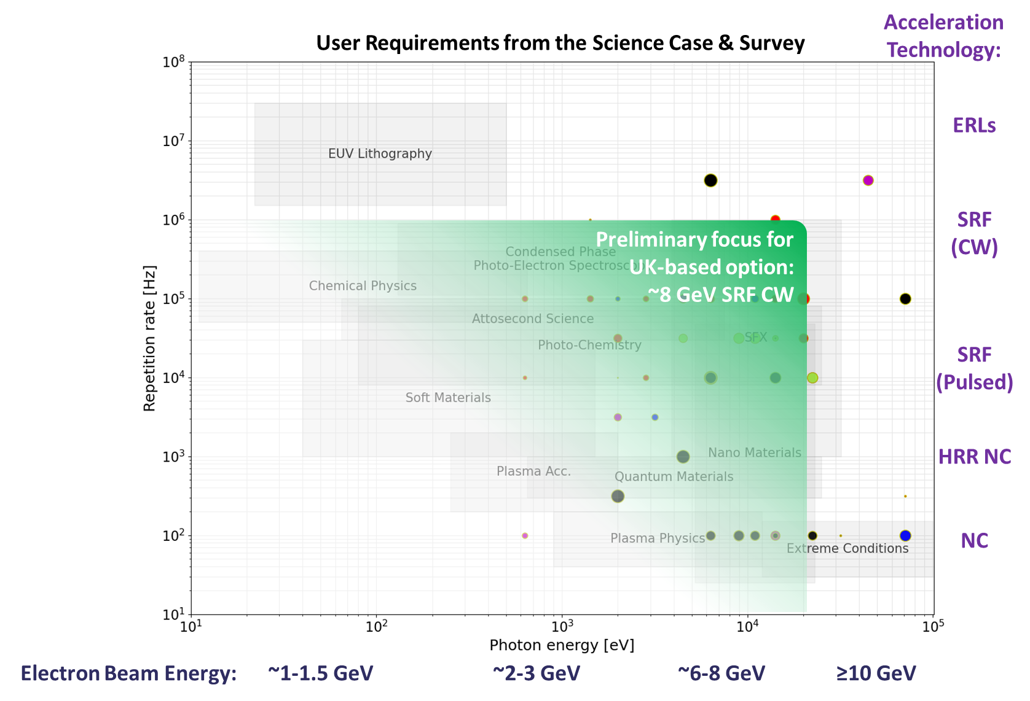
Key Facility Parameters
To satisfy the Science Case we propose
A fully superconducting facility
Repetition rate 0.1-1 MHz
FELs covering photon energies 0.1 – 20 keV
All FELs driven by an ~8 GeV electron beam
The option for a ‘booster accelerator’ to allow photon energies >20keV, but possibly at lower repetition rates

Slide 10
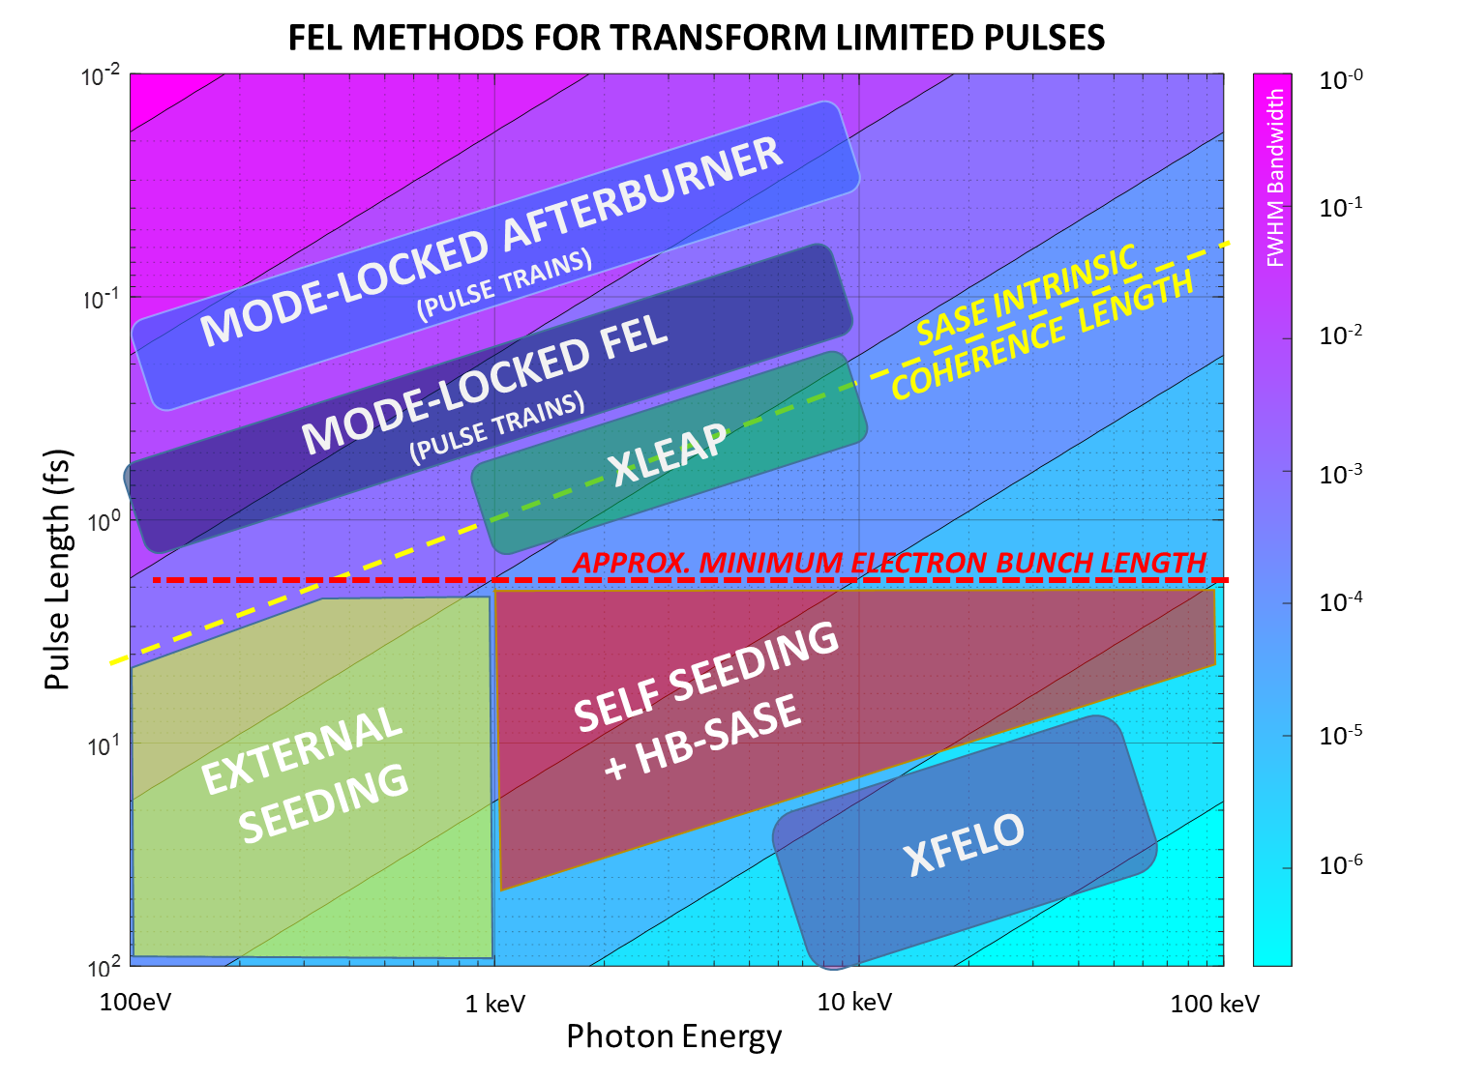
Key Focus: Providing Transform Limited Pulses
Transform-limited x-rays across a wide range of energies and pulse lengths requires a wide range of techniques.
Advances in non-linear lasers can drive external seeding to high rep rate at ≤2 keV
Attosecond pulse schemes e.g. XLEAP can deliver at/below intrinsic coherence length
High brightness SASE can deliver TW peak power, few-fs SX/HX pulses at any rep rate
XFELO for the narrowest bandwidth

Slide 11
Later Challenges to Address
Beyond the preliminary focus, there are several other technical capabilities we will consider – but not necessarily in detail at this moment.
Very high pulse energy (~100 mJ)
An additional feature of UK XFEL, or delivered at another facility?
Very high photon energy (50-100 keV)
An additional feature of UK XFEL, or delivered at another facility?
Synchronous sources
After NIR/ Visible lasers, terahertz is the most requested synchronous source.
What photon energy? (High pulse energy at <20 keV is easier)
Beam based sources have potential implications for machine layout.
Requests for protons, ions and gamma sources need further exploration with Science Team.
Transform-limited pulses necessary?
Low repetition rate, matched to high power lasers?
Transform-limited pulses necessary?
What pulse energies are required - Are harmonics acceptable?

Slide 12

Progress towards an outline FEL concept

Slide 13
FEL output from 0.1keV to 20keV from a 8-ish GeV beam
At fixed energy of 8 GeV can cover 0.1 – 20 keV with six FEL lines
  Every photon energy covered by two FELs – for FEL pump/FEL probe
  As far as possible, common electron bunch to each line
  Passive longitudinal and transverse wakefield manipulations of chirp and effective (lasing) bunch length
Tuning ranges successively narrower for higher photon energies
  At highest photon energies we push the undulator period as short as possible so work at modest K values
  At lower photon energies we have much longer undulator periods and greater available K range
FEL | Photon Energy | Factor | P_{sat}
FEL-6 | 0.1 – 1 keV | X 10 | 88 – 70 GW
FEL-5 | 0.25 – 2 keV | X 8 | 75 – 53 GW
FEL-4 | 1 – 5 keV | X 5 | 65 – 35 GW
FEL-3 | 2.5 – 10 keV | X 5 | 50 – 20 GW
FEL-2 | 5 – 20 keV | X 4 | 40 – 10 GW
FEL-1 | 10 – 20 keV | X 2 | 26 – 13 GW
FEL-6
FEL-5
FEL-4
FEL-3
FEL-2
FEL-1
0.5 keV
0.1 keV
1.0 keV
2.0 keV
5.0 keV
10 keV
20 keV

Slide 14
Parallel Independent Operation and Efficient Throughput
Identical 8GeV Electron Bunches at 1MHz
FEL-6
FEL-5
FEL-4
FEL-3
FEL-2
FEL-1
~100 kHz KICKER
MAGNET

Slide 15
Multiples pulses to single experiments
Identical 8GeV Electron Bunches at 1MHz
FEL-6
FEL-5
FEL-4
FEL-3
FEL-2
FEL-1
~100 kHz KICKER
MAGNET
OFF
GHz SUBHARMONIC
DEFLECTING CAVITY
OFF
ON
ON

Slide 16
Multiples pulses to single experiments
Double Bunches Adjacent RF Cycles
Electron Bunches at 1MHz
FEL-6
FEL-5
FEL-4
FEL-3
FEL-2
FEL1/2 Path Length Difference Equal to
Double-Bunch Spacing
FEL-1
~100 kHz KICKER
MAGNET
OFF
GHz SUBHARMONIC
DEFLECTING CAVITY
OFF
ON
ON

Slide 17
Multiples pulses to single experiments
Double Bunches Adjacent RF Cycles
Double Bunches Adjacent RF Cycles
FEL-6
FEL-5
FEL-4
FEL-3
FEL-2
FEL-1
~100 kHz KICKER
MAGNET
OFF
GHz SUBHARMONIC
DEFLECTING CAVITY
OFF
ON
ON

Slide 18
Summary
THE PROJECT SCOPE
  To develop a conceptual design for a next generation FEL in the UK
  To compare to investment options in other FEL facilities
  To develop the science case and strengthen the user base
  A superconducting ~8 GeV MHz FEL facility
  A switchyard of ~6 parallel FEL beam lines covering 0.1 – 20 keV
  Flexible options of FEL pump/FEL probe experiments
  Transform limited operation at all photon energies
THE ‘BASELINE’ CONCEPT:

Slide 19

Thank you
xfel.ac.uk
@STFC_Matters @UKXFEL

