Slide 1


Gammarchy in the UK: Design of a tunable, quasi-monochromatic gamma ray beam source at Daresbury Laboratory
Outline:
Applications of Monochromatic Gamma-rays
Inverse Compton Scattering (ICS) Theory
Current ICS facilities
Future UK ICS facility?
Summary
Alex Morris, University of Liverpool
alexander.morris@liverpool.ac.uk

Slide 2
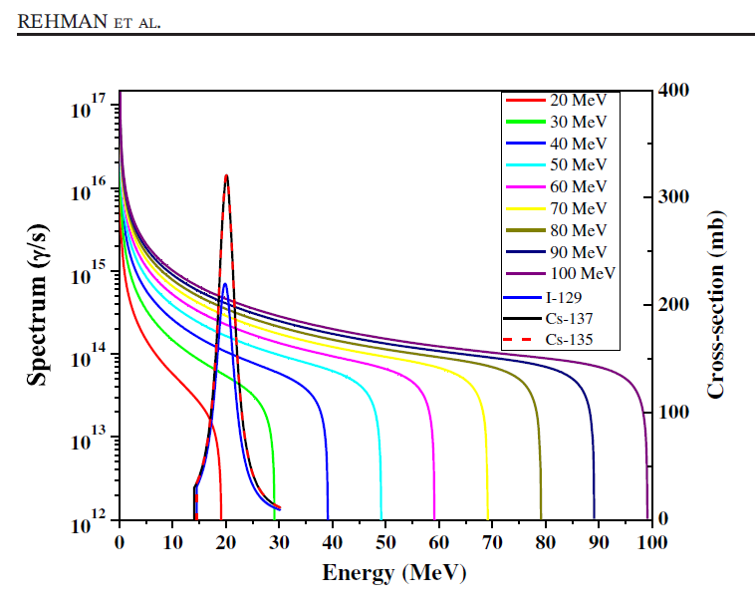
Why Monochromatic Gammas (>1 MeV)?
Gammas are predominantly produced today by high energy electrons impinging on target – Bremsstrahlung = white source, broadband dominated by lower energy photons, even with hardening filters
Example: broad photonuclear “dipole resonances” of nuclear structure are not well matched to bremsstrahlung energy spectrum.
Most photons wasted = far higher dose than necessary in an active interrogation – Radiation Safety’s worst nightmare!
Bremsstrahlung spectra compared to example dipole resonance of Cs-135&137 and I-129
Rehman, H. U., Lee, J., & Kim, Y. (2018). Comparison of the laser-Compton scattering and the conventional Bremsstrahlung X-rays for photonuclear transmutation. International Journal of Energy Research, 42(1), 236–244. https://doi.org/10.1002/er.3904

Slide 3
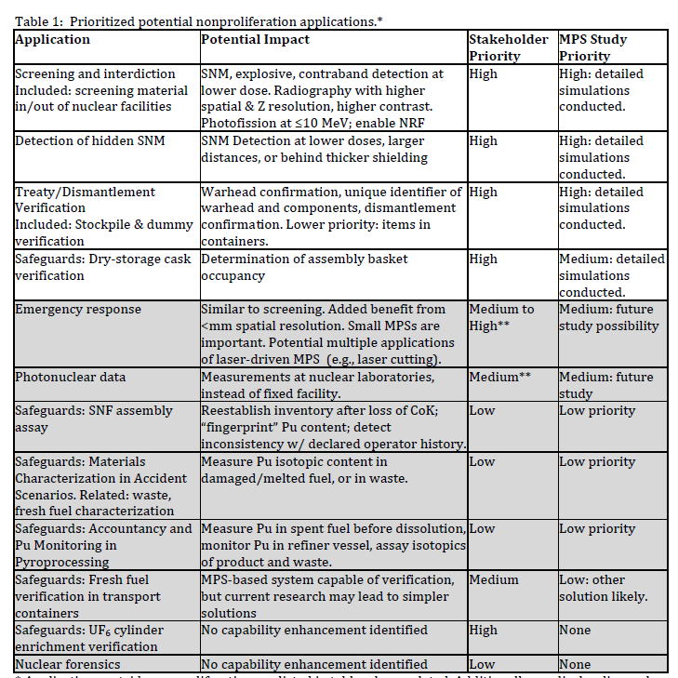

Applications: Security
For gammas > 5.5 MeV: Photonuclear / Photofission (γ, n) (γ, p),(γ, f), stimulate detectable signals in nuclear material. Quantifying detailed signals and backgrounds for narrow band source inputs would allow modelling to assess the benefit of developing such sources for these applications

Slide 4
Why Gammas from Inverse Compton Scattering
What would an “ideal” gamma source look like?
  Easily tunable: peak energy: improve isotopic differentiation
  Monoenergetic: arbitrarily defined as below 1% energy spread: improve isotopic differentiation, reduce total dose
  “Pencil-beam”: small spot size and divergence: improve transverse resolution, small voxel size in an imaging application, high specific activity generated in a transmutation application
  High flux: ability to penetrate large objects of arbitrary geometry and produced results in short time
  In short – something like a “gamma laser”
  An ICS Gamma Source driven by a Superconducting Energy Recovery Linac can do this

Slide 5

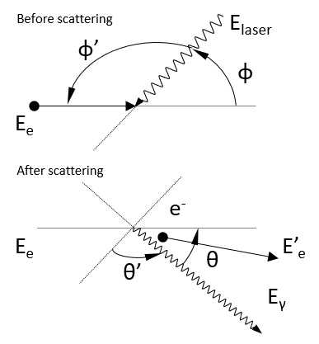

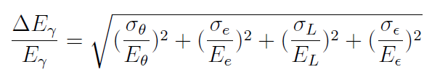

ICS Theory- Monochromatic Gamma rays
Electron
Laser photon
Gamma photon
Energy of the source
Bandwidth of the source
Collimation
Electron Energy Spread
Laser Energy Spread
Emittance of the beam
Deitrick, K., Hoffstaetter, G. H., Franck, C., Muratori, B. D., Williams, P. H., Krafft, G. A., Terzić, B., Crone, J., & Owen, H. (2021). Intense monochromatic photons above 100 keV from an inverse Compton source. Physical Review Accelerators and Beams, 24(5), 1–17. https://doi.org/10.1103/PhysRevAccelBeams.24.050701

Slide 6

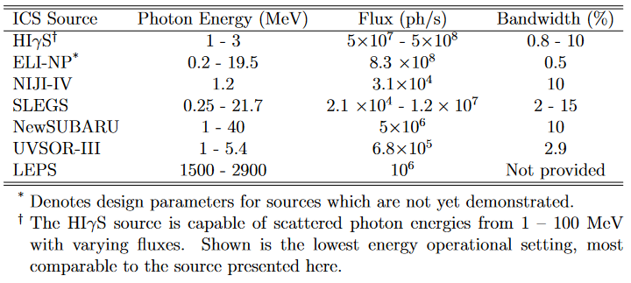
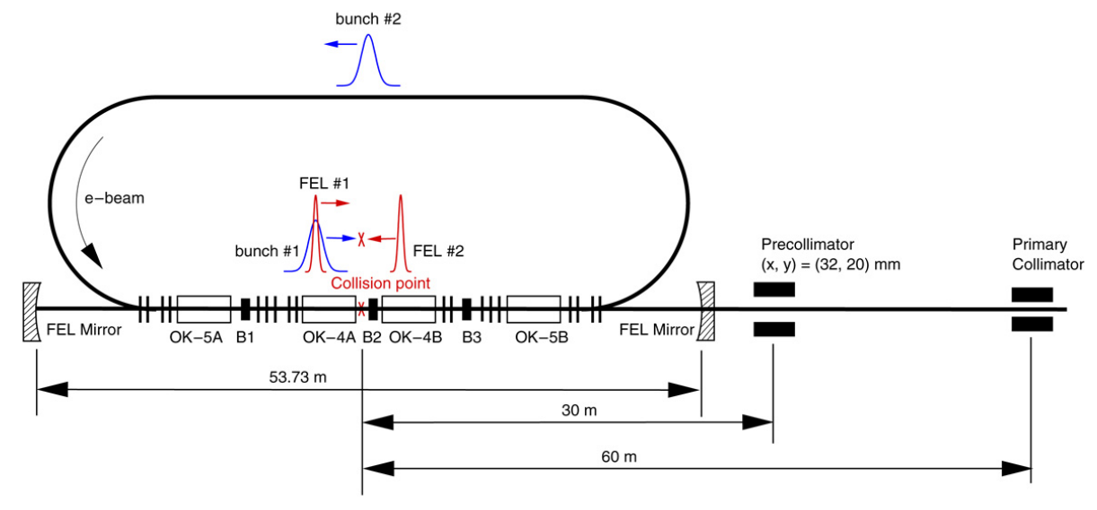
Present: ICS Gamma (MeV) sources in the world
HIGS facility at Duke University, USA is the leading MeV ICS source
H. R. Weller, M. W. Ahmed, H. Gao, et al., “Research opportunities at the upgraded HIGS facility,” Progress in Particle and Nuclear Physics, vol. 62, no. 1, pp. 257–303, 2009, issn: 0146-6410. doi: https://doi.org/10.1016/j.ppnp.2008.07.001. [Online]. Available: http://www.sciencedirect.com/science/article/pii/S0146641008000434.

Slide 7


Present: ICS Gamma (MeV) sources in the UK
No current UK facility:
For security applications and experiments using nuclear material this is a problem

Slide 8
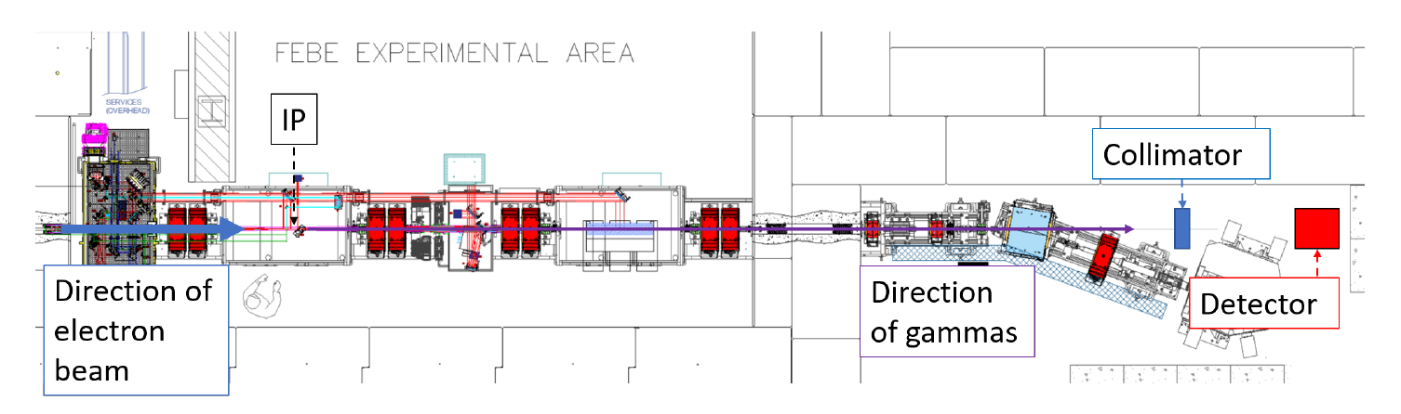
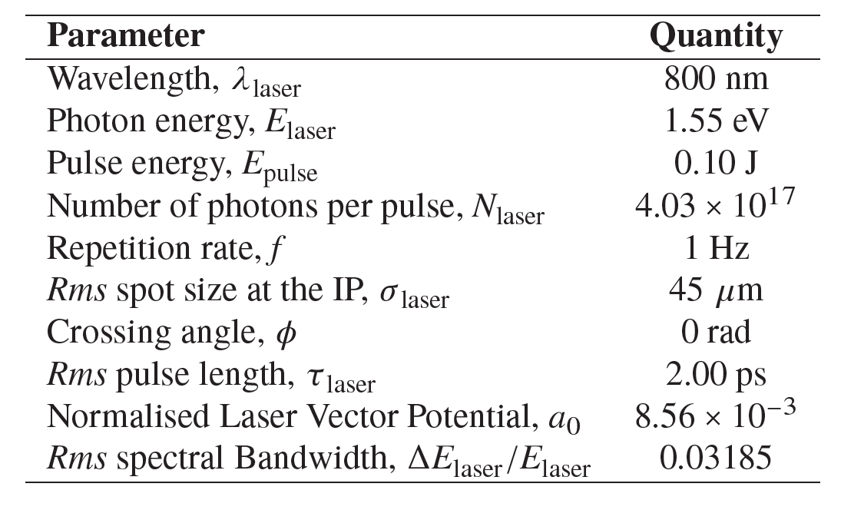
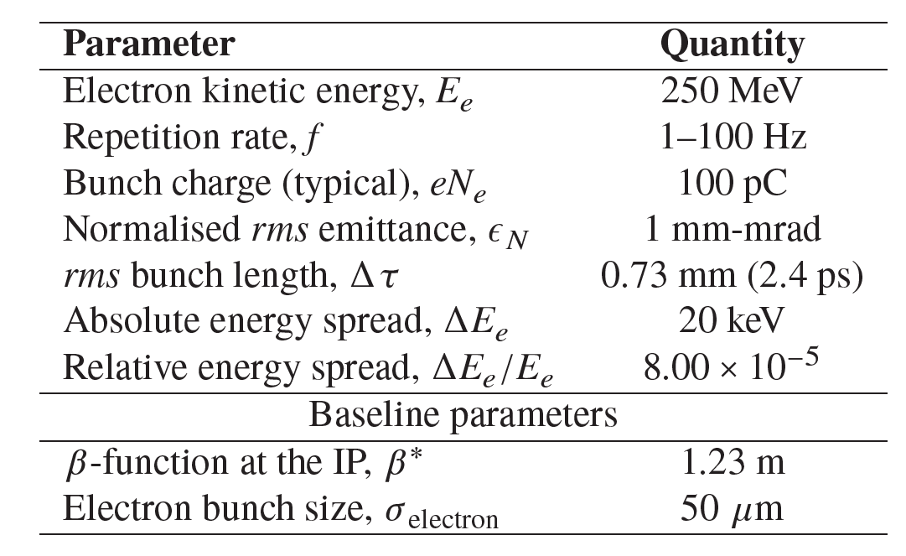
Pathway to UK-XFEL Gamma Source – CLARA Demonstrator
To build community and gain experience a γ-ray ICS source demonstration is being discussed at CLARA, Daresbury – this will be low flux as CLARA is 100 Hz, not ~100 MHz, but can be done soon ~2026
Aim is to demonstrate production, detection and characterisation of the spectrum of collimated γ-rays against semi-analytical spectrum simulations in the linear regime.
Ti:Sa laser (full and reduced power) is baseline, possibility of Nd:YAG system additionally. Electron parameters are widely tuneable, delivering a variety of bunch configurations.
Gammas collimated by a lead collimator post interaction of mm scale aperture radius place 10m downstream and then detected by a HPGe detector placed beyond that.
Top: Ti:Sa laser parameters at IP.
Bottom: Electron bunch parameters at IP.

Slide 9
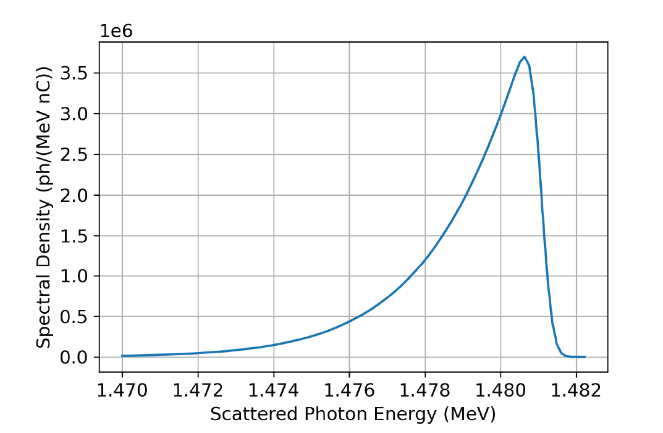
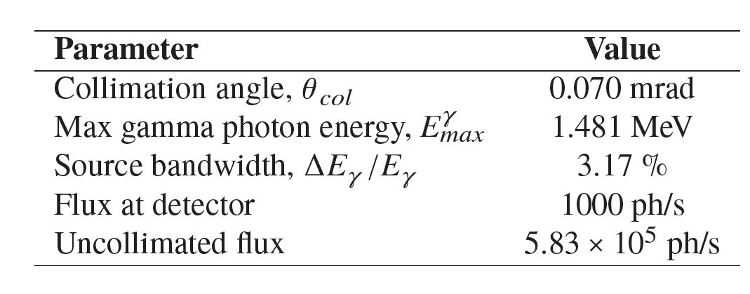
Pathway to UK-XFEL Gamma Source – CLARA Demonstrator
First experiment is designed to scatter 1000 ph/s through a lead collimator to a HPGe detector to detect single photon event. A similar configuration, with larger collimator aperture could be used for NRF test experiments
Potential future experimentation includes: Nuclear Resonance Fluorescence Studies, High repetition rate experimentation with Fabry-Perot laser resonator cavity, Non-linear (intense laser) inverse Compton scattering experiments.
Simulated spectrum of the FEBE ICS experiment for Ti:Sa laser – benchmarked against analytic methods

Slide 10
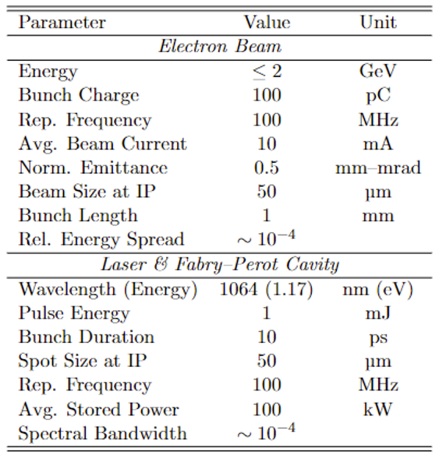
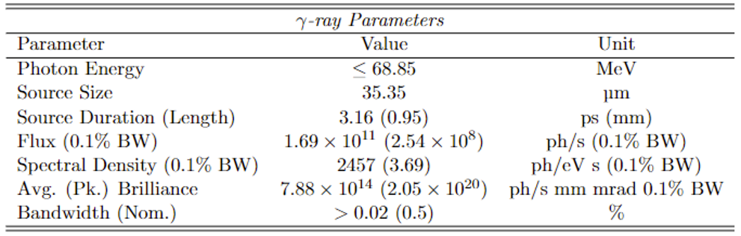
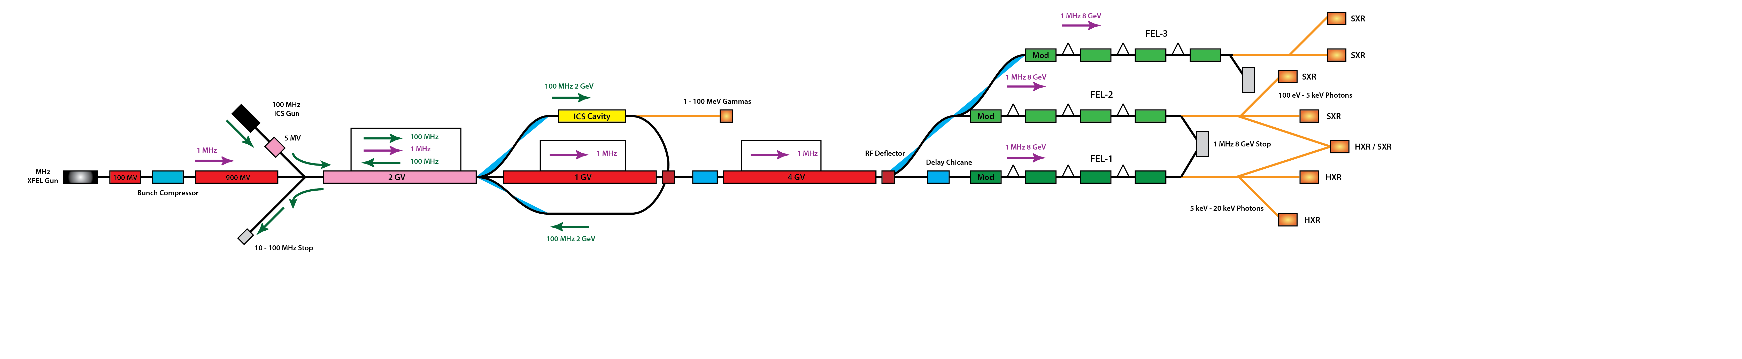
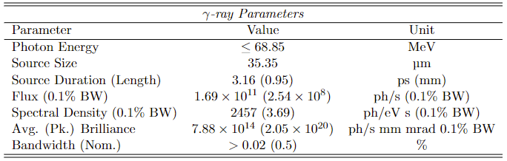
Augmenting UK-XFEL with an ICS Gamma Source?
Marangos J. (2020). UK XFEL Science Case. https://www.clf.stfc.ac.uk/Pages/UK XFEL Science Case 05Oct2020 online version.pdf

Slide 11
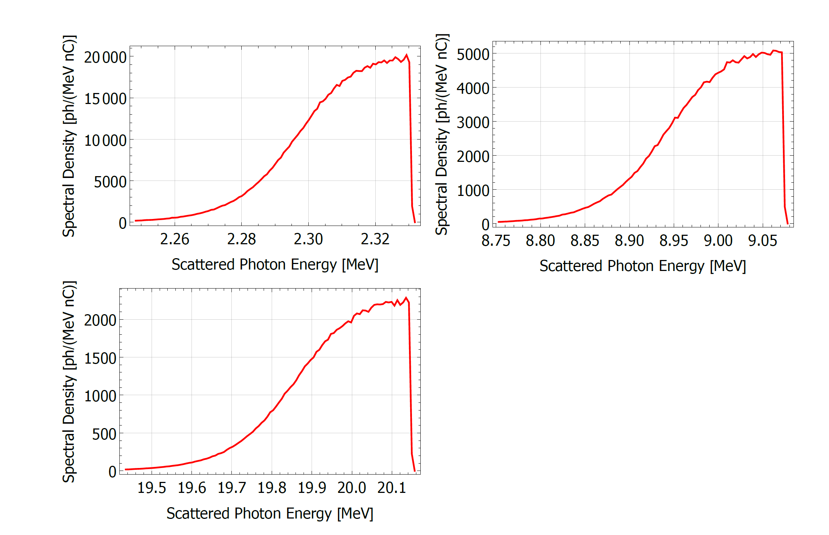
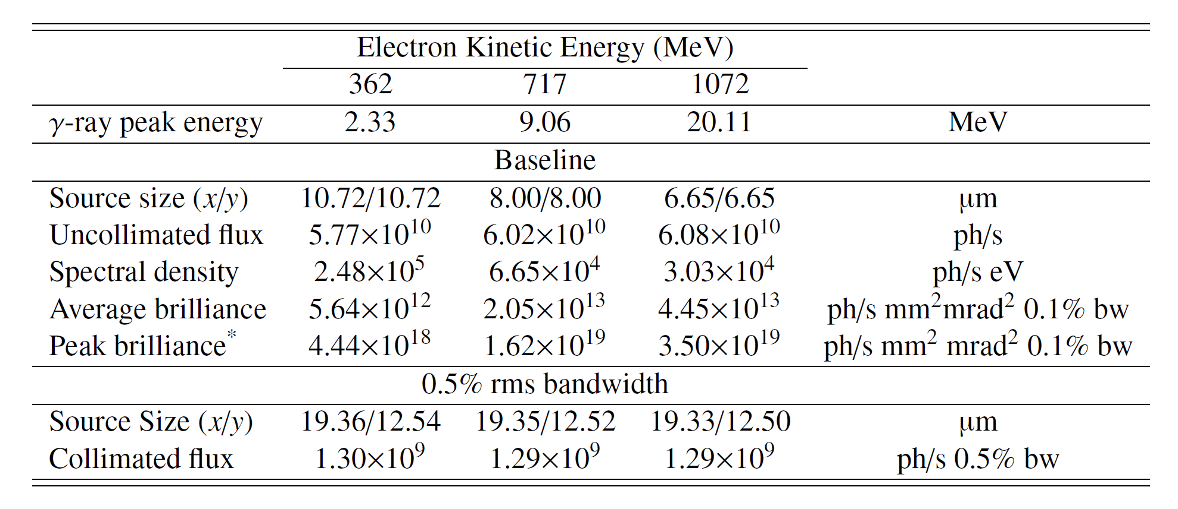
Augmenting UK-XFEL with an ICS Gamma Source?
Dialling the electron energy down to three example energies of 360 MeV, 720 MeV and 1070 MeV results in gammas at 2.3 MeV, 9 MeV and 20 MeV

Slide 12
Summary
ICS is a method of producing high energy narrow bandwidth gamma photons
A demonstrator experiment at Daresbury Laboratory is being discussed
This will provide evidence for a science case for a potential ICS source at UK-XFEL
Thanks for listening, any questions?
Special thanks to my supervisors Laura Corner and Peter Williams, and the staff at STFC especially Joe Crone and Hywel Owen.

