Slide 1

Upgrades to the Injector Complex for Diamond-II
Ian Martin
On behalf of the Diamond-II design team
IoP PABG Annual Conference
29/30 June 2023

Slide 2
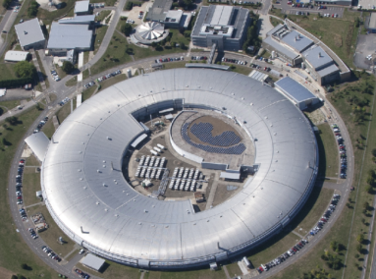
Diamond Light Source and Diamond-II Upgrade
Diamond Light Source is the UK’s national synchrotron radiation facility located on Harwell Campus, Oxfordshire
Currently engaged in a major facility upgrade, Diamond-II:
Objective #1: Optimise the science enabled at Diamond
Objective #2: Maximise the impact it has for researchers both in universities and in industry
Objectives achieved through several means:
New Modified Hybrid 6-Bend Achromat (M-H6BA) storage ring
  Lower emittance to increase brightness and coherence
  Double number of straight sections to increase capacity
Raise energy from 3 GeV to 3.5 GeV to increase flux and brightness above 10 keV
Upgrade insertion devices, new flagship beamlines
Improved data handling/computation, automation, ...
 | Diamond-I | Diamond-II
Lattice Type | DBA | M-H6BA
Circumference | 561.6 m | 560.561 m
Straight Sections | 24 | 48
Energy | 3 GeV | 3.5 GeV
Energy Spread | 0.096 % | 0.094 %
Natural Emittance | 2.7 nm.rad | 161 pm.rad
Emittance with IDs | 3.1 nm.rad | 120 pm.rad
Technical Design Report published in October 2022:
https://www.diamond.ac.uk/Diamond-II.html

Slide 3
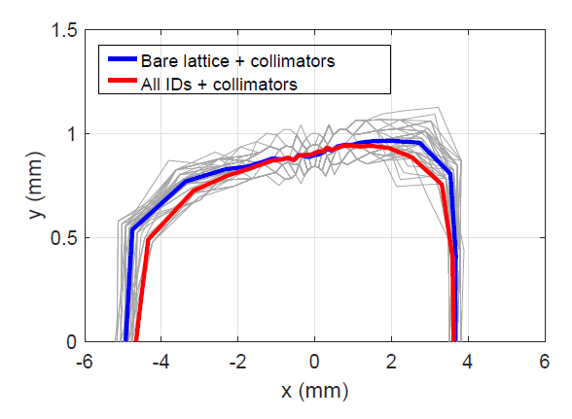
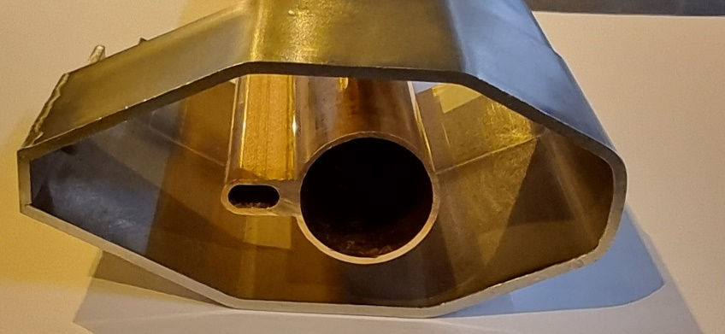
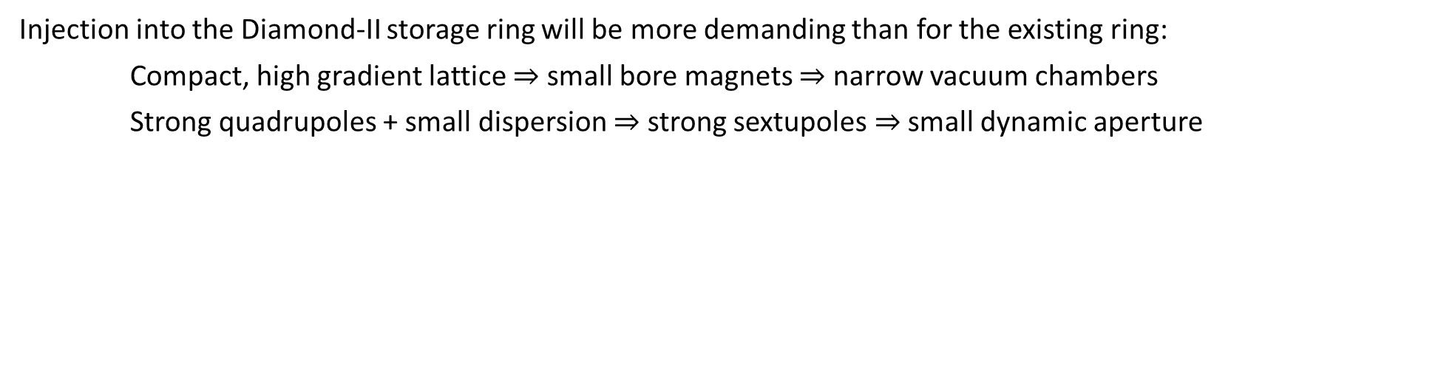
Storage Ring Injection
Injection into the Diamond-II storage ring will be more demanding than for the existing ring:
Compact, high gradient lattice $⇒$ small bore magnets $⇒$ narrow vacuum chambers
Strong quadrupoles + small dispersion $⇒$ strong sextupoles $⇒$small dynamic aperture
Diamond
Factor 4 reduction in aperture horizontally
Factor 6 reduction in aperture vertically
20 mm
38 mm
Diamond-II
89 mm
Expected dynamic aperture
Consequences:
Need to reduce horizontal separation between stored and injected beams
Need to reduce the dimensions of the beam extracted from the booster
 | Existing booster | Target
Energy | 0.1 - 3.0 GeV | 0.1 - 3.5 GeV
Emittance | 134 nm.rad | <30 nm.rad
Bunch length | 100 ps | <40 ps
Max. SB charge | ~0.2-0.4 nC | ~5 nC
Max. MB charge | ~1-2 nC | ~15 nC

Slide 4
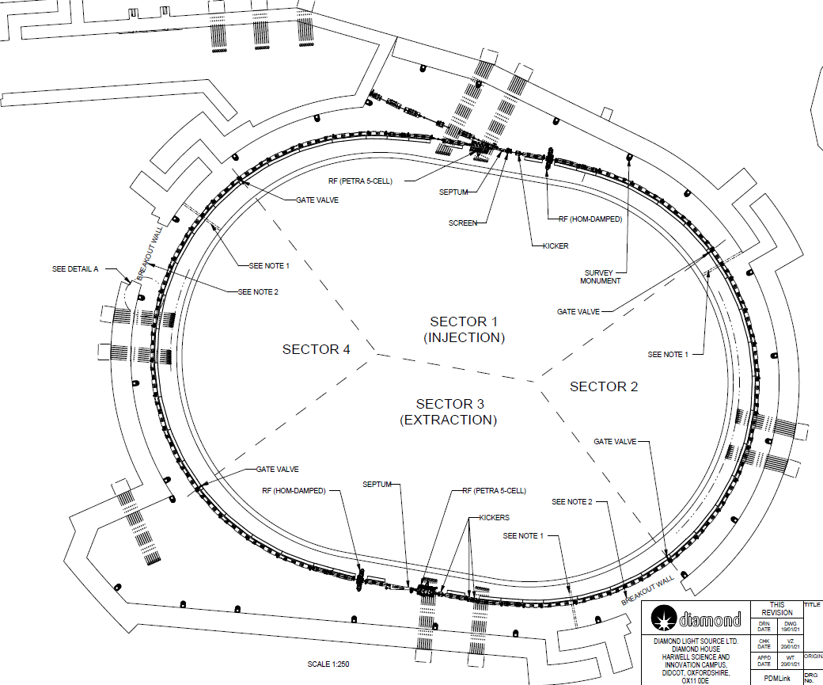
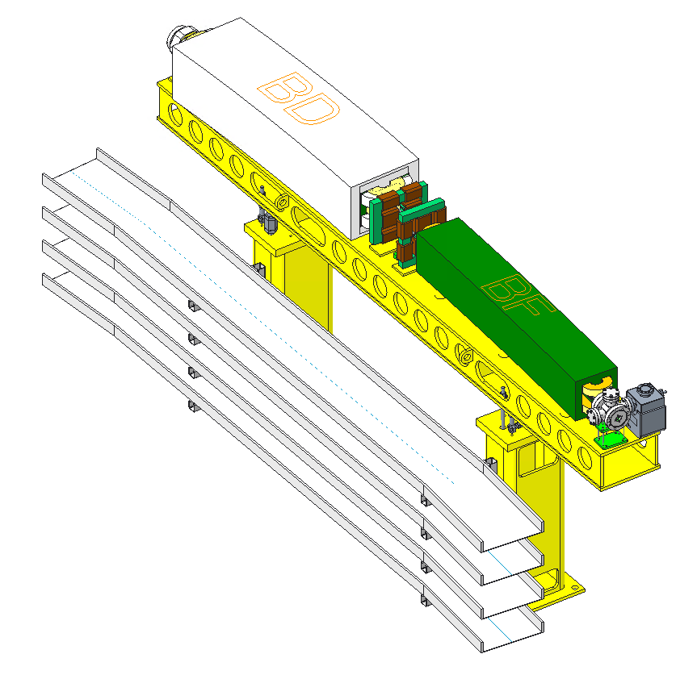
New Booster Synchrotron
Design for Booster-II:
Racetrack structure (fit in existing tunnel)
Unit cells built from combined-function magnets
Two dispersion-free straight sections
Quadrupole triplets in straights for tune control
Distributed trim sextupoles to counter eddy-currents and allow fine-tuning of the chromaticity
Parameter | Booster-I | Booster-II
Energy Range | 0.1-3.0 | 0.1-3.5
Circumference | 158.4 | 163.847
Tunes | [7.18, 4.27] | [12.41, 5.38]
Emittance | 134 nm.rad | 17.4 nm.rad
Energy Spread | 0.073 % | 0.086 %
Bunch Length | 100 ps | 38 ps
Energy Loss / Turn | 580 keV | 947 keV

Slide 5
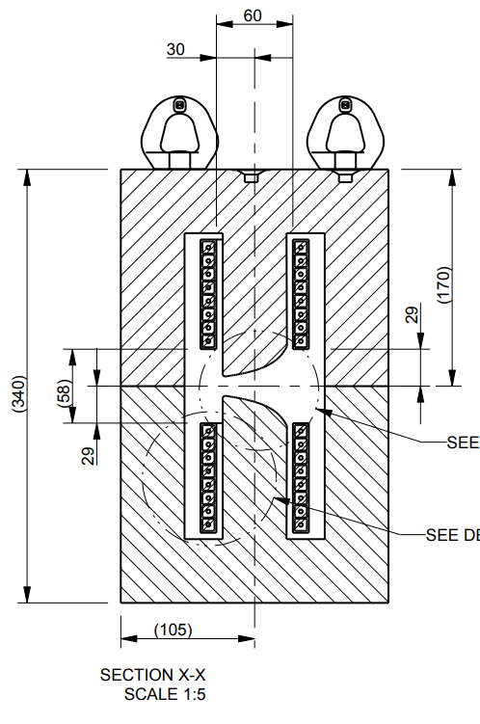
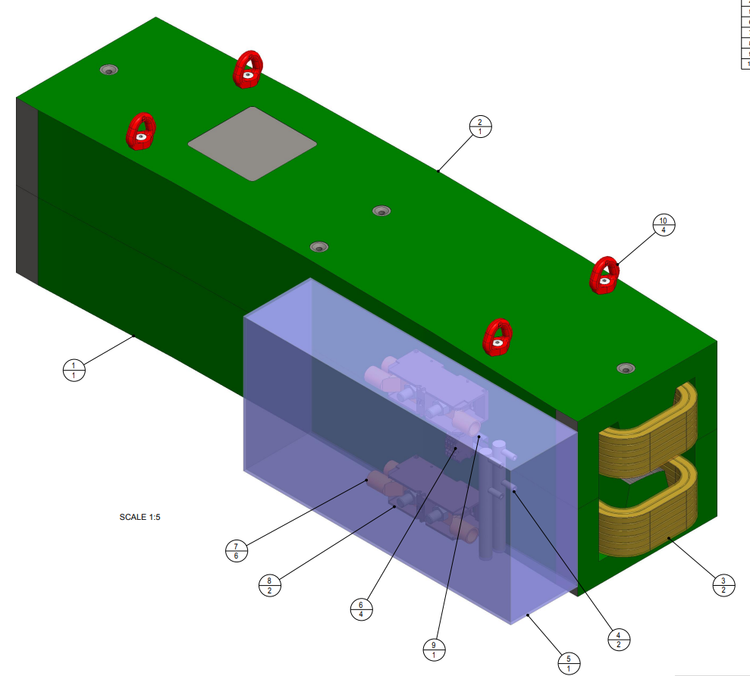
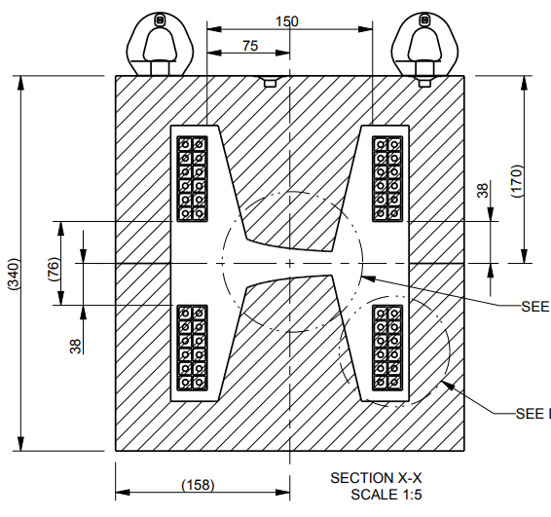
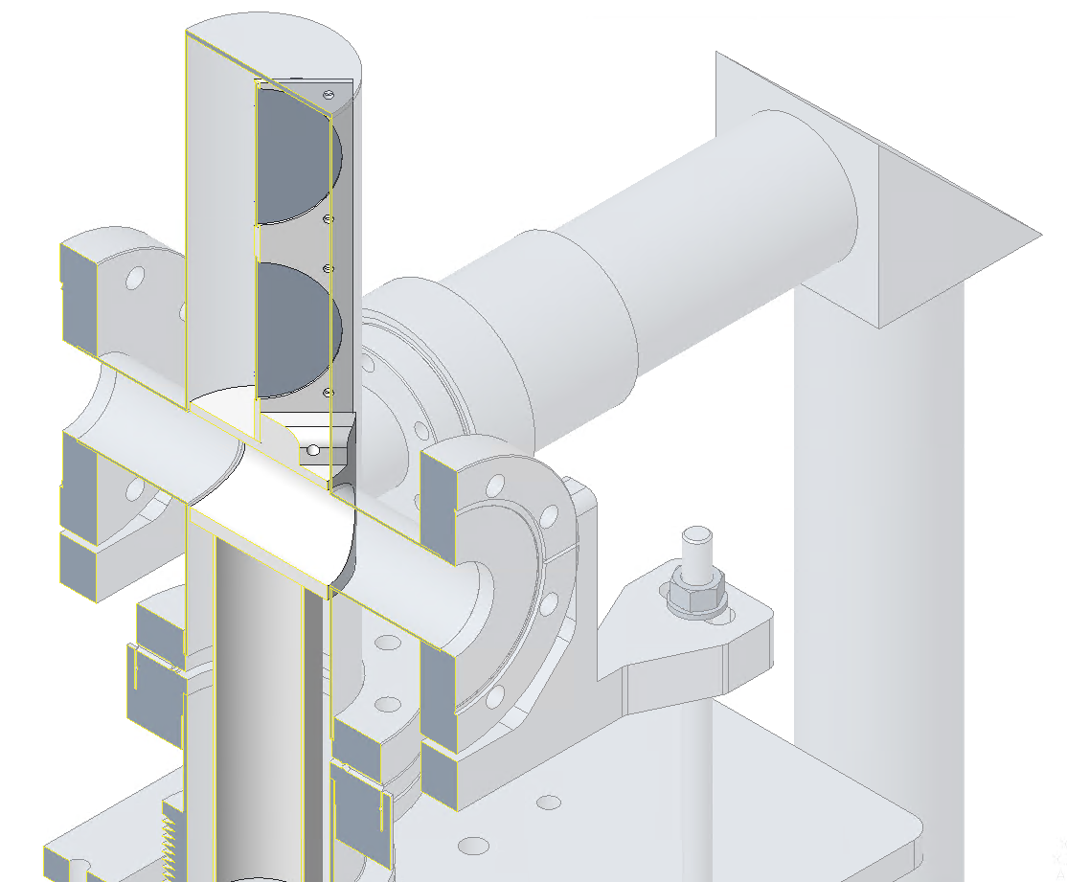
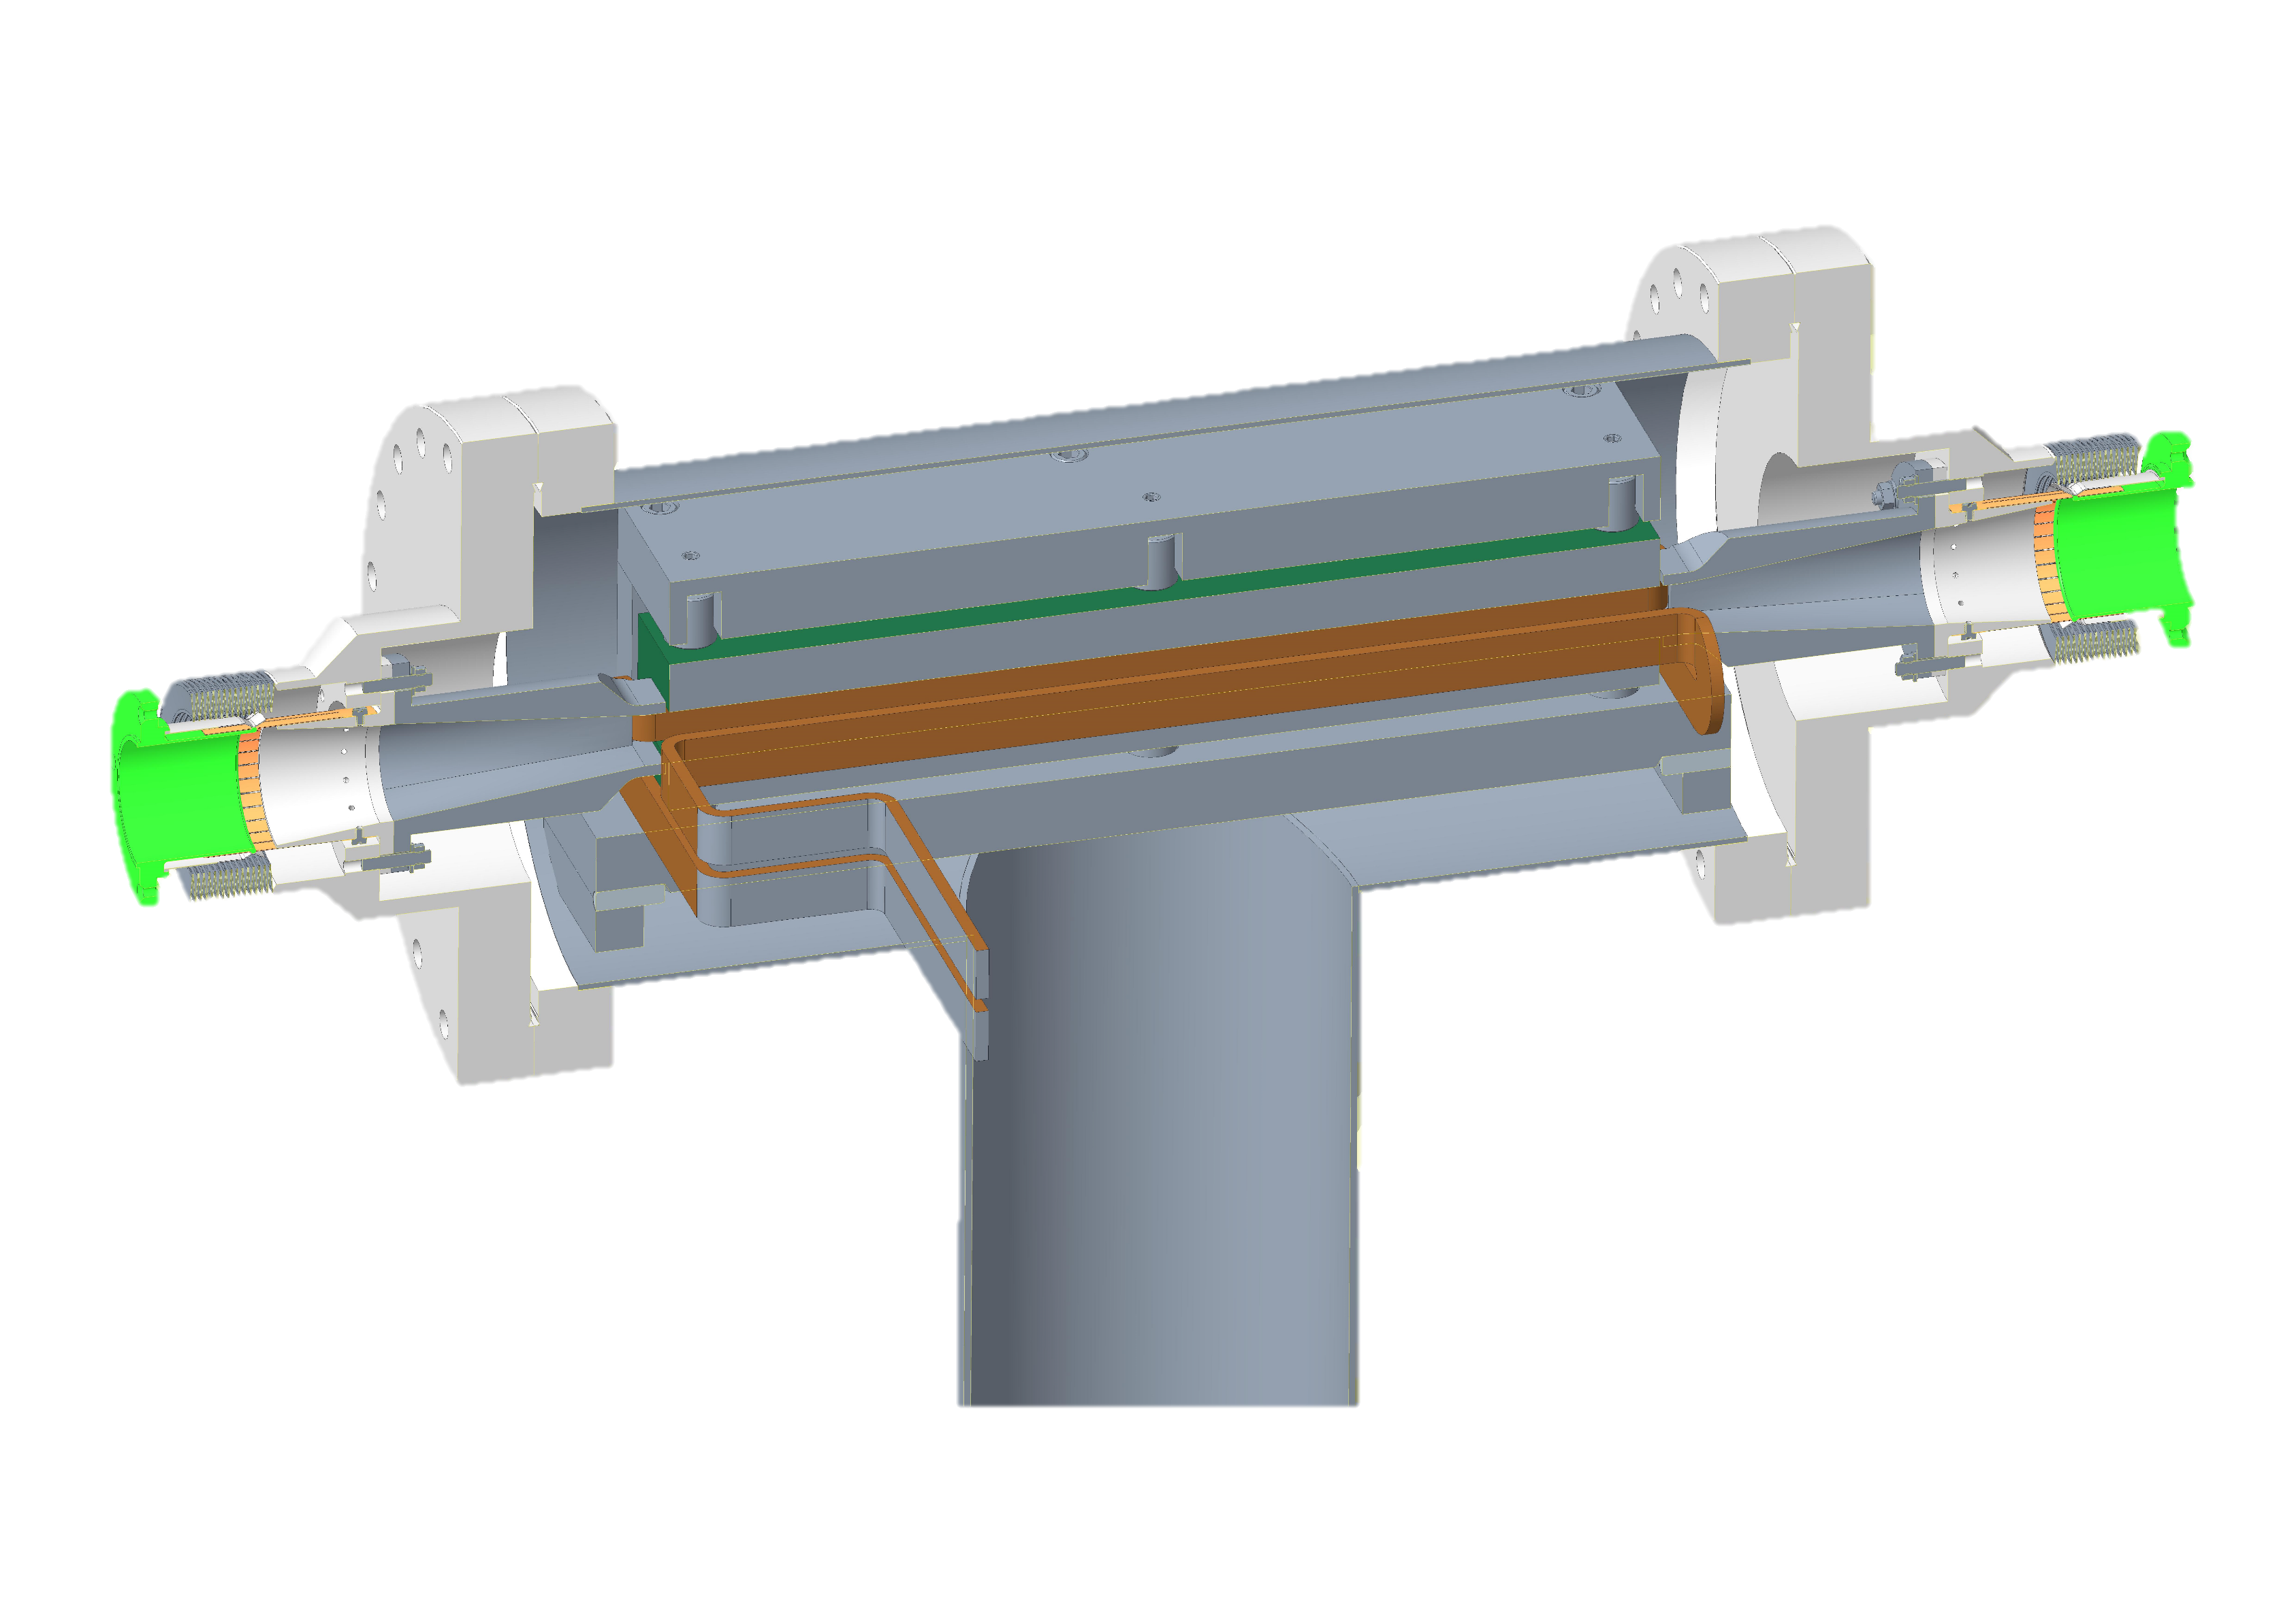
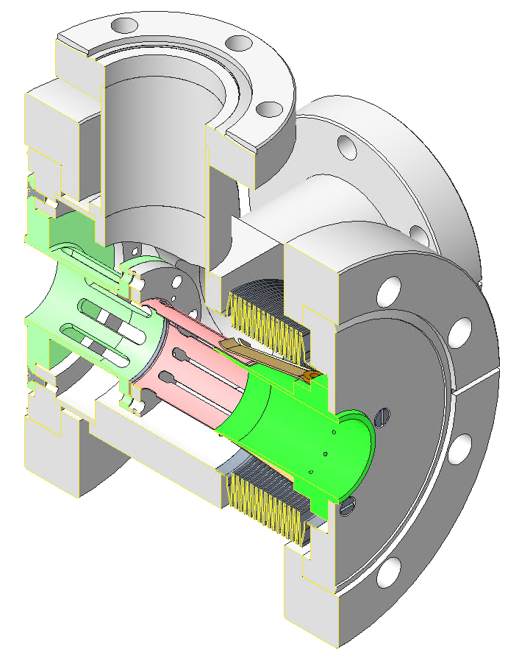
Booster-II Hardware
Magnet Parameters at 3.5 GeV
BD Dipole
BF Dipole
Magnet | Number | L (m) | B (T) | G (T/m) | S (T/m²)
BB | 4 | 1.25 | 0.95 | - | -
BD | 38 | 1.3 | 0.99 | -8.24 | -44.0
BF | 36 | 1.3 | 0.42 | 11.2 | 36.0
Quad. | 20 | 0.45 | - | 30 | -
Sext. | 44 | 0.05 | - | - | 300
Diagnostic Screens
Pumping / Bellows Assembly
Injection / Extraction Kickers
Mirror
Vacuum gauges port
Central body
Integrated bellows
OTR screen
YAG screen
Tapers
Venting slots
Electron beam path
Ion pump port
Camera
RF Fingers
Modular end
Pumping port
Bellows
Folded conductor

Slide 6
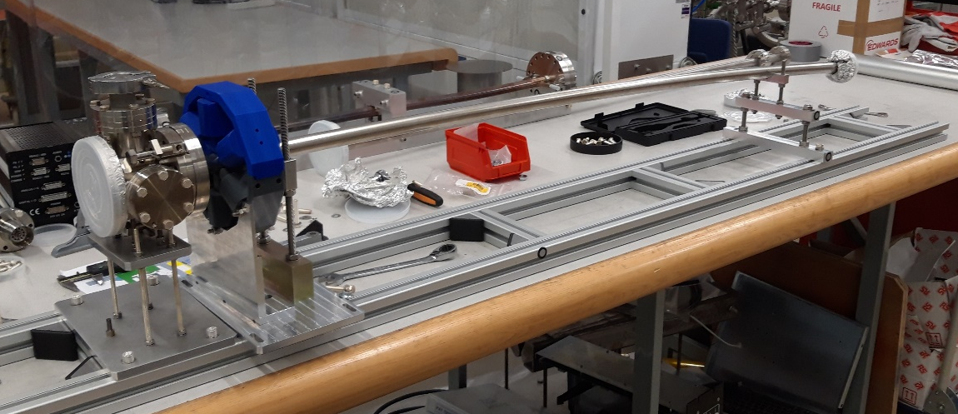
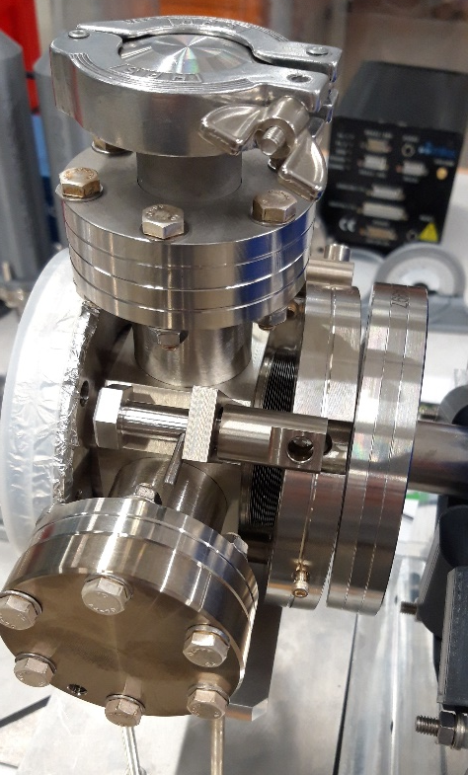
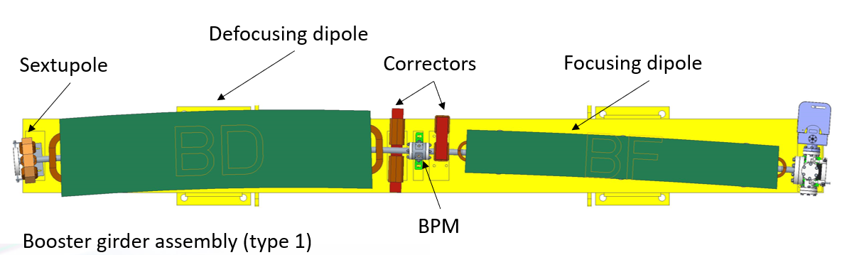
Prototyping for Booster-II
Prototyping of components to check:
Vessel stiffness / clearance from magnet poles
Material thickness (1 mm stainless steel)
Assembly procedure / ease of access to bolts
Functionality of pumping cross / bellow assembly
Robustness of RF fingers
Vessel supports / alignment

Slide 7
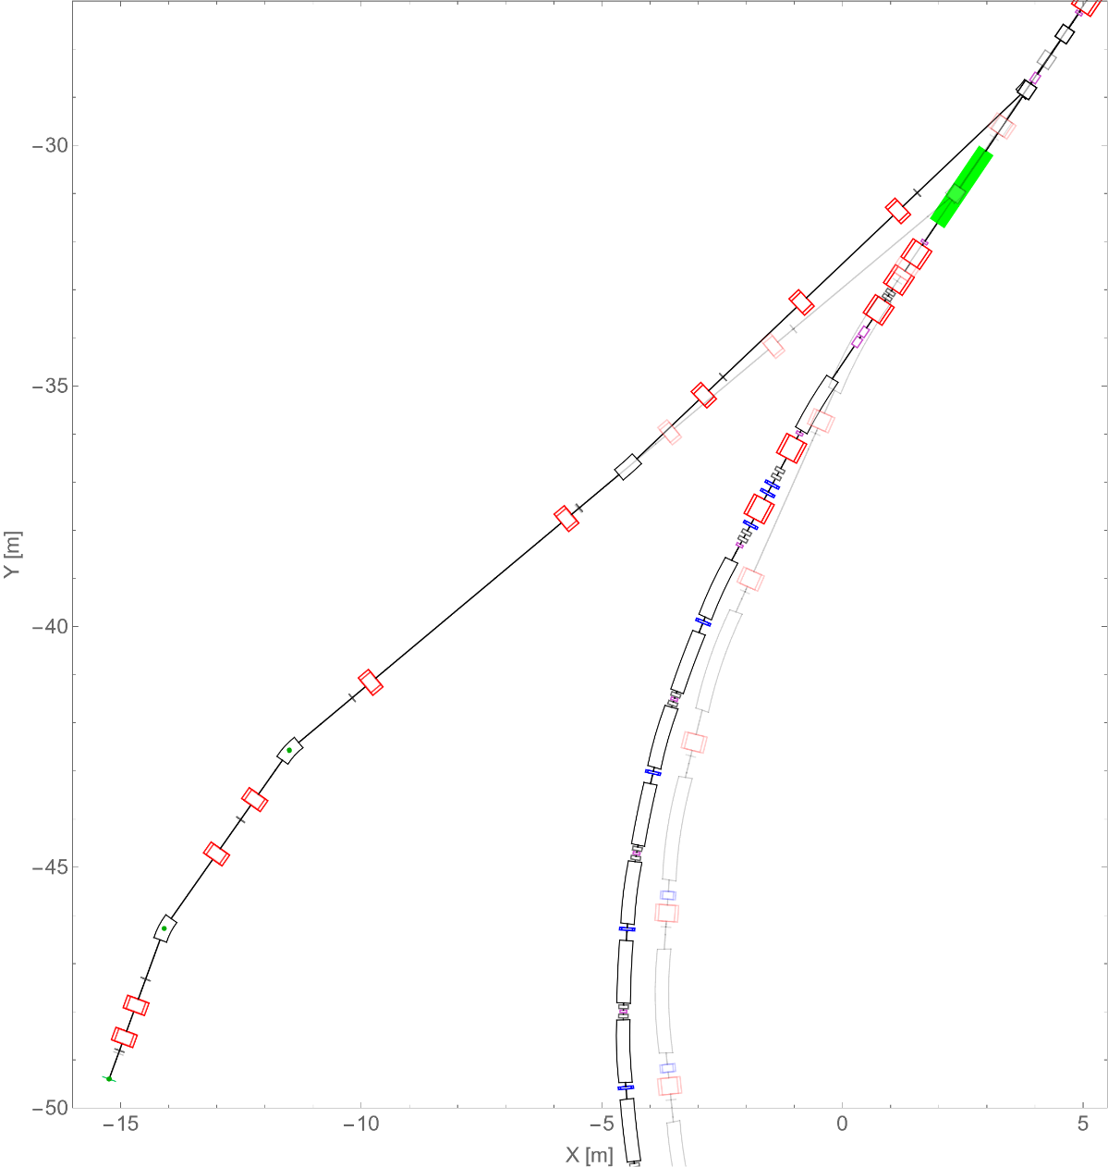
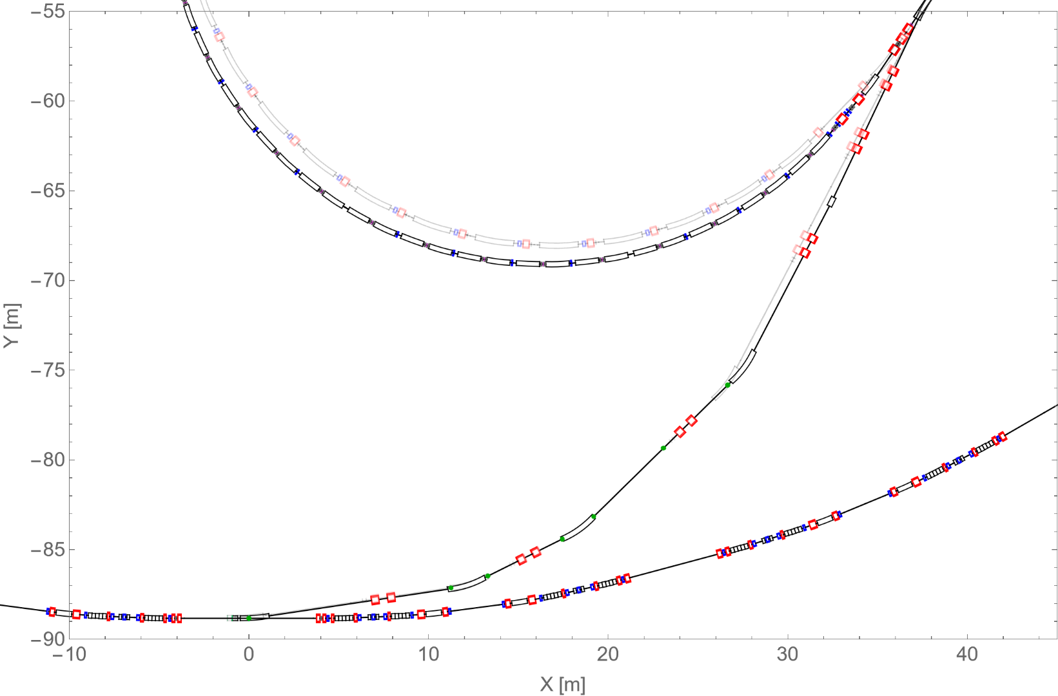
Transfer Line Modifications
Linac-To-Booster (LTB)
Booster-to-Storage Ring (BTS)
Replacement septum and kicker
Replacement septum
New quadrupole
New dipole
New dipole
Relocated quadrupoles
Relocated dipoles
Replacement septa
Existing booster
New booster

Slide 8
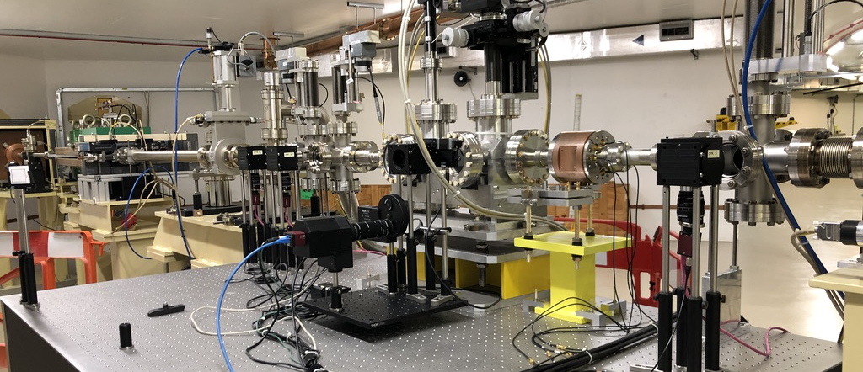
BTS Diagnostics Improvements
The BTS will be upgraded to improve its diagnostics capabilities:
Dispersion-free emittance measurement for the beam extracted from booster
Increase control of the beam position / angle at storage ring injection septum
Space retained for BTS Test Stand
Quads used for emittance measurement
OTR screen
Extra BPM and steerers
R&D:
Pepper pot for single-shot emittance measurement
Cavity BPMs
Cherenkov Diffraction Radiation monitors
…

Slide 9

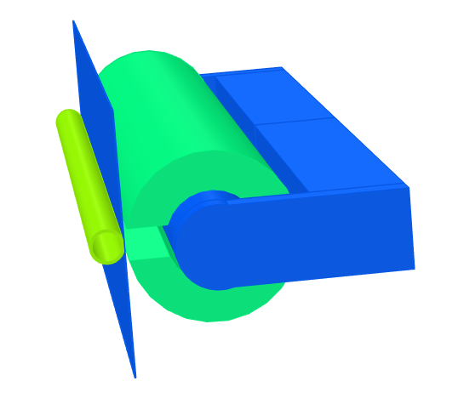
Storage Ring Septum Magnets
Storage ring septum magnet will have several sections:
Investigating PM designs for first two modules
Final section pulsed magnet, with 1 mm plate to reduce separation between stored and injected beams
Short pulse duration to minimise leakage field
Diamond
Diamond-II
3 mm septum plate
1 mm septum plate
135 nm.rad injected beam
17 nm.rad injected beam
8.3 mm
2.7 mm
Storage ring
Parameter | Value
Length | 330 mm
Peak Field | <0.6 T
Bend angle | ~1 degree
Septum blade thickness | 1 mm
Pole gap | ±5 mm
Pulse shape | Full-sine
Pulse duration | 10 μs
Peak magnet current | <6 kA
Leakage field (pulsed) | <3 µT
Septum #2
Thin Septum
Active copper conductor
Mumetal shielding
From booster
Septum #1
Iron powder yoke
Injected beam
Stored beam
Passive copper conductor (shield)

Slide 10


Storage Ring Septum Magnets
PM designs for main septa under study:
PM septum reduces shot-to-shot jitter for injected beam position and angle
Storage ring main septum has two modules, each optimised for leakage field and bend angles
Booster extraction septum challenging due to larger aperture requirements
Pulsed Septa
PM Septa
Tracked beam centroid
SmCo
Iron
Permendur pole and shielding
Steel
Parameter | Module 1 | Module 2
Length | 1400 mm? | 200 mm?
Peak Field | <1.5 T | <0.6 T
Bend angle | ~6.9 degree | ~0.6 degree
Septum blade thickness | - | 1 mm (4 mm gap)
Pole full gap | 10 mm | 8 mm
Leakage field (static) | - | Below 1 mT
Good field region
4mm
Stored beam region
PM septa module 2 – end section

Slide 11
Project Status
Milestone | Planned Date
Treasury approval for the Diamond-II Project and start of funding | July / August 2023?
Start of dark period | 1st December 2027
Start of booster commissioning | 1st June 2028
Start of storage ring commissioning | 1st December 2028
End of dark period / start of regular beamline x-ray commissioning | 1st June 2029
First operational beamline | 1st September 2029
End of Diamond-II project | 1st March 2030
Acknowledgements (partial!)
DLS: Jonas Kallestrup, Filip Malinowski, Ben Nicholson, Walter Tizzano, Vitalii Zhiltsov
ASTeC/DL: Alex Bainbridge, James Jones
JAI/Oxford: Riyasat Husain

Slide 12
Extra Slides

Slide 13
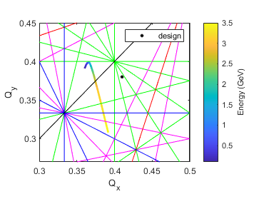
Booster-II Simulated Performance (WIP!)
Beam dynamics studies are ongoing:
Dynamic aperture including field and alignment errors, vacuum chamber eddy currents, etc.
Impact of magnet fringe fields and saturation effects
Intra-beam scattering
Short and long range wakefields
Transfer efficiency and loss locations
So far, so good!
Electron beam parameters during the ramp for 100 MeV injection / zero chromaticity
Initial beam blow-up at injection from wakefields
Intra-beam scattering increases bunch size at extraction
Betatron tunes vs energy
Average dynamic aperture vs energy
Dynamic aperture
Beam loss at injection for high-charge bunches
Losses reduced for small positive chromaticity
Physical aperture

