Slide 1



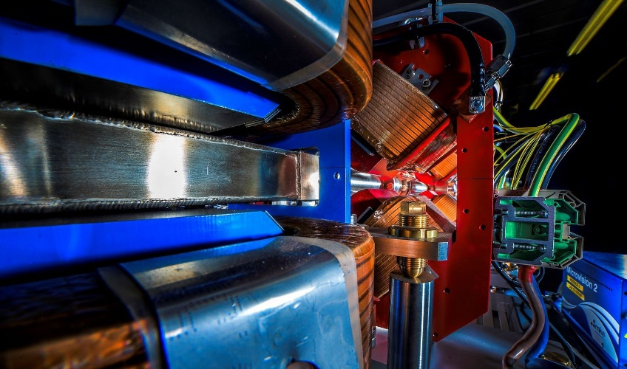

Making a brighter future through advanced accelerators
Update on CLARA Facility at Daresbury Laboratory
Deepa Angal-Kalinin on behalf of the CLARA Team
ASTeC, STFC Daresbury Laboratory and The Cockcroft Institute
IoP PAB Conference, 30th June 2023, Glasgow

Slide 2

Making a brighter future through advanced accelerators
Outline
Introduction
High Repetition Rate Gun Commissioning
Current Status
Plans

Slide 3
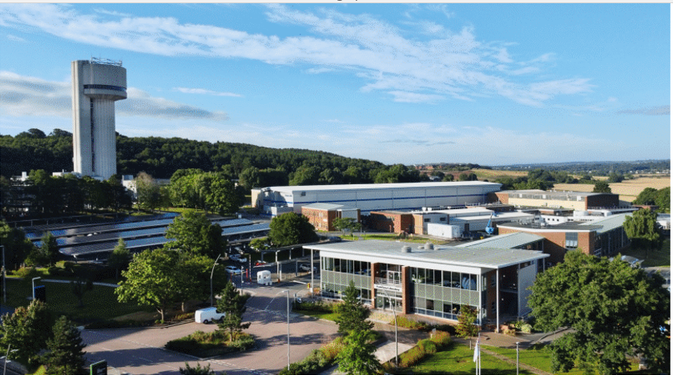
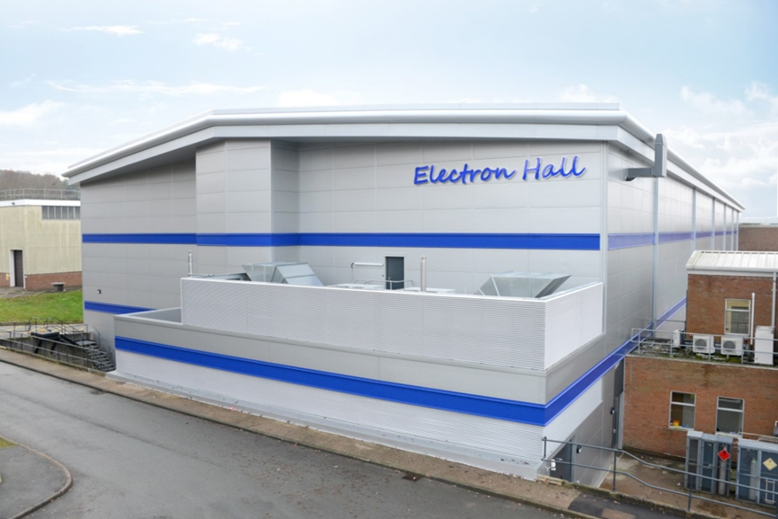
Making a brighter future through advanced accelerators
Compact Linear Accelerator for Research and Applications
Ambition: UK Next Generation X-ray FEL with World Leading Capabilities
Addressing many scientific and technology challenges for future large scale facility
  Proving new FEL concepts
  Developing UK skills
  Testing new accelerator & FEL technologies
  Ramping up from 1st October 2022 - UK XFEL CDOA funded for 3 years (Neil Thompson’s talk)
Provide an electron beam research facility for
  Accelerator R&D
  Industrial & healthcare applications
  Strong demand – oversubscribed by factor of 2
Upgrade to VELA Photoinjector based test facility.
CDR published in 2013.
Project divided in three phases – funding availability
VELA/CLARA

Slide 4
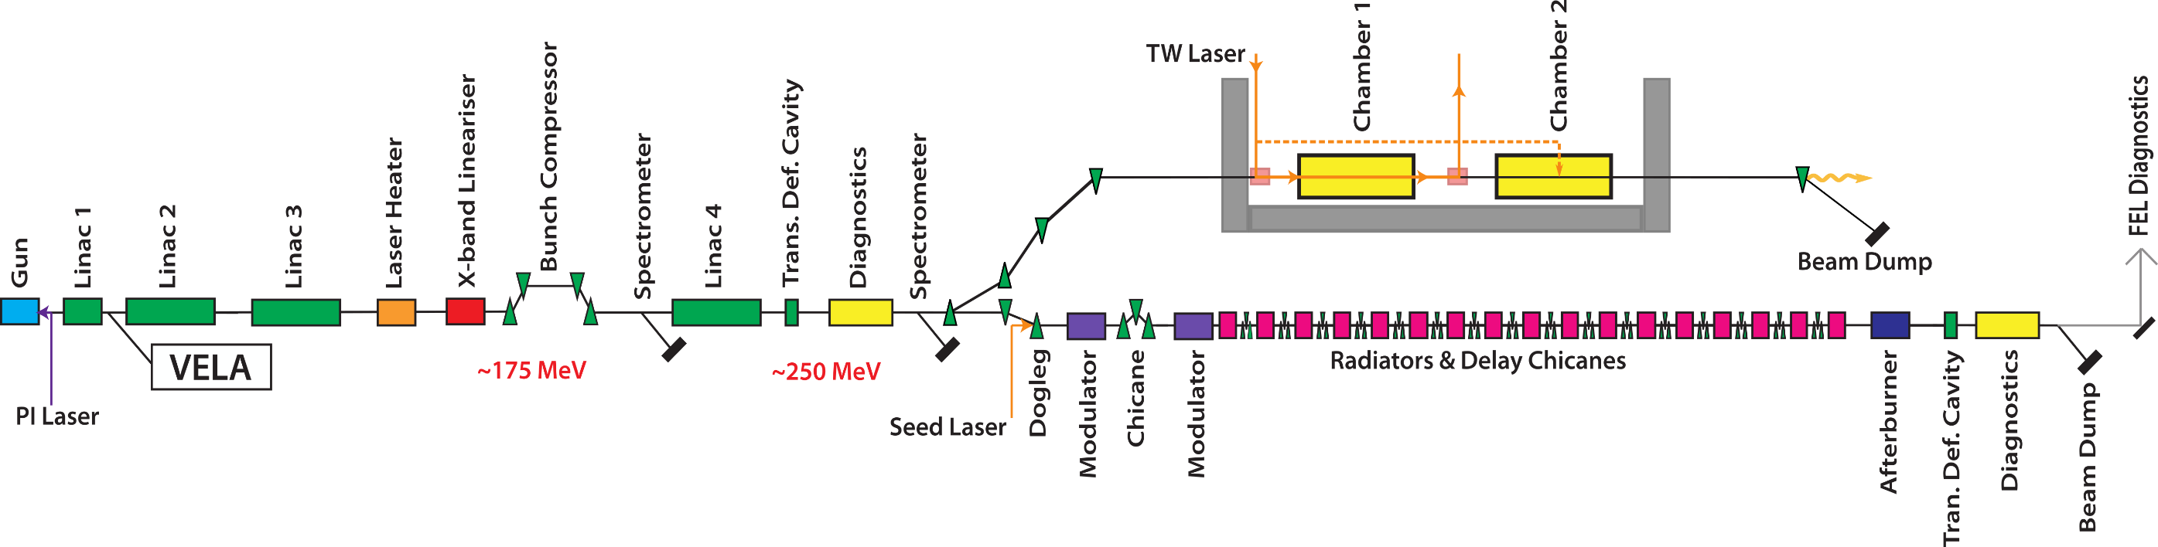
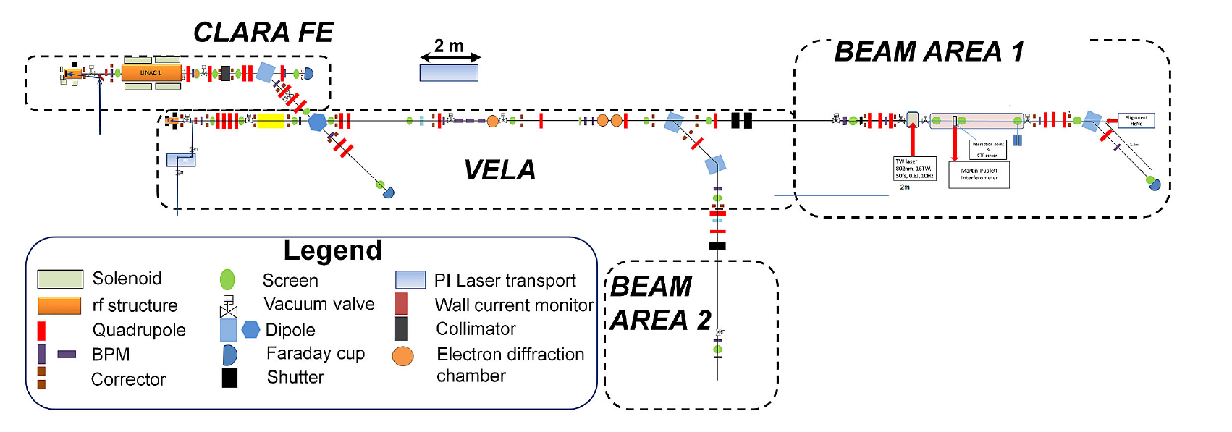
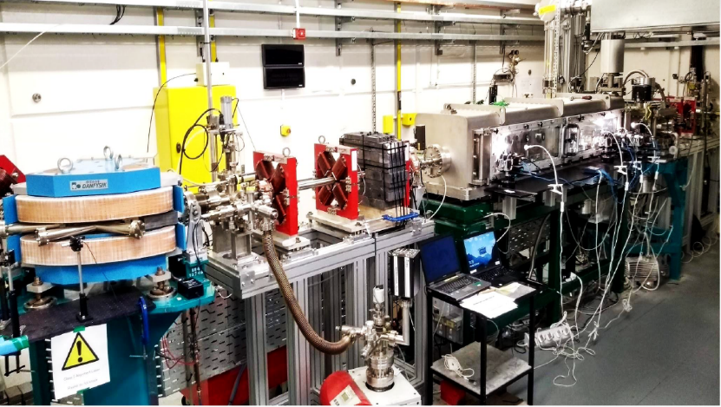
CLARA Phase1 & VELA
50 MeV, 250 pC at 10 Hz (2017)
User exploitation from CLARA FE to VELA line (since 2018 till April 2022)
HRRG commissioned on VELA line (March 2023) ready to swap guns.
Making a brighter future through advanced accelerators
FEBE Hutch
VELA & CLARA photoinjectors share the same RF and laser infrastructure.
FEBE Arc
D. Angal-Kalinin et al., Phys. Rev. Accel. Beams 23, 044801

Slide 5
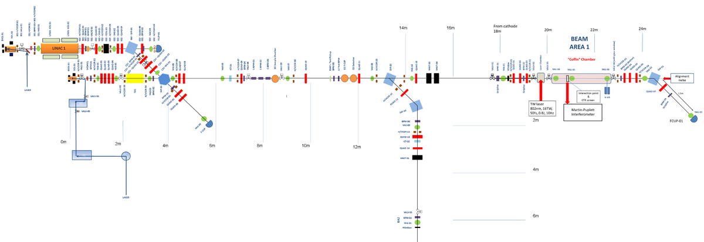
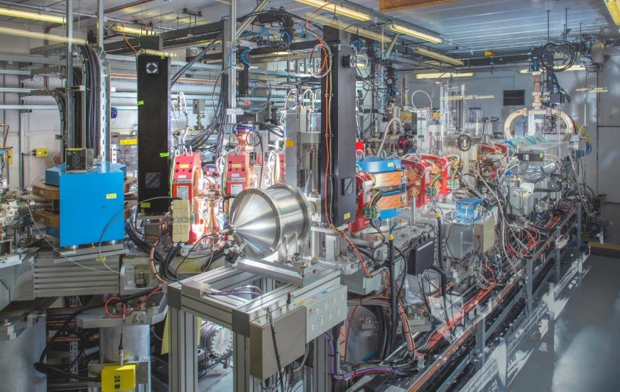

CLARA Phase 1- Experimental Areas
Making a brighter future through advanced accelerators
CLARA Front End
VHEE,…Experiments
e-beam
VELA
Novel Acceleration,… experiments
e-beam

Slide 6
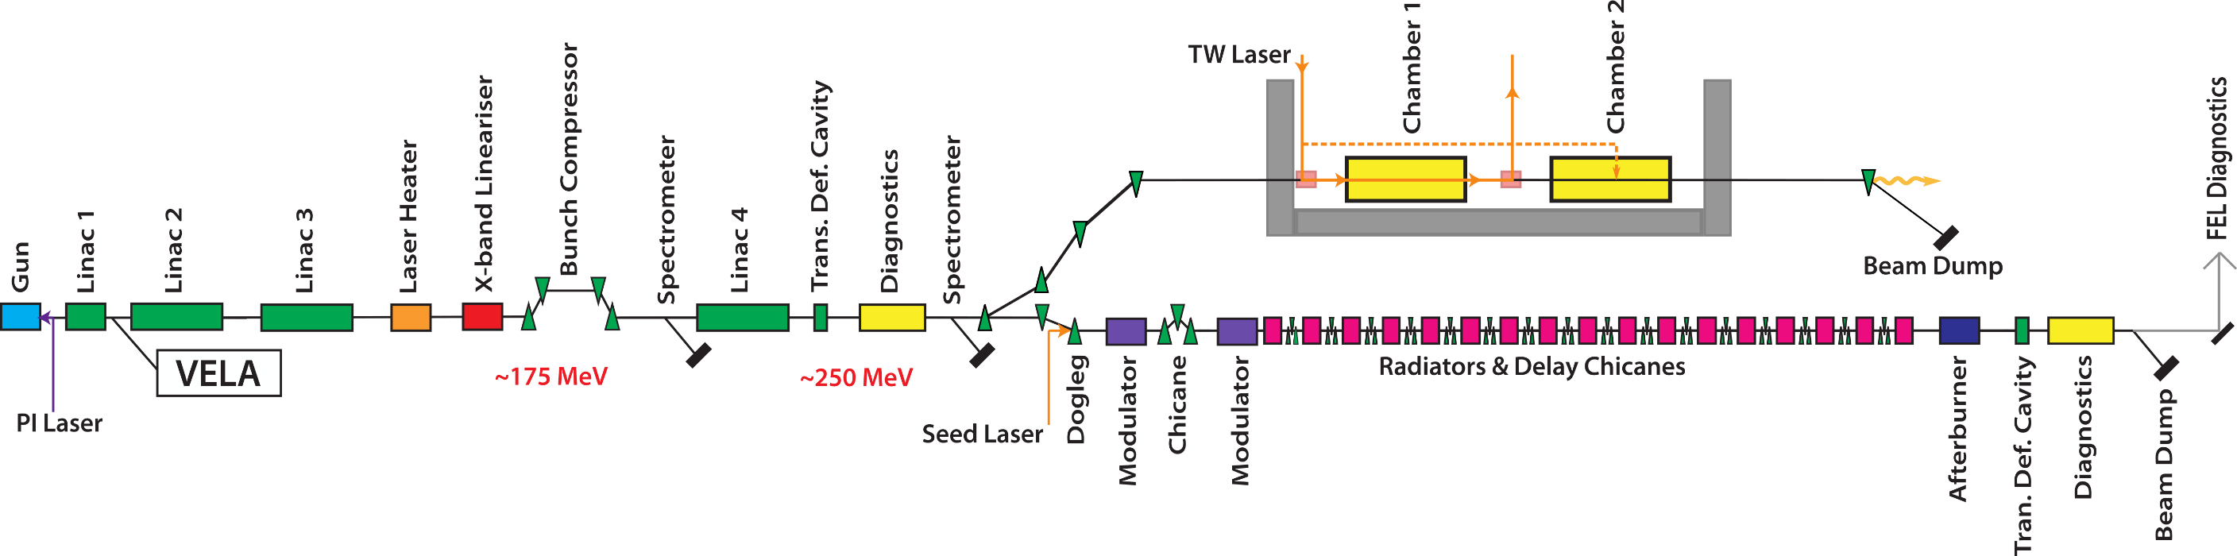
CLARA Phase2
Making a brighter future through advanced accelerators
250 MeV, ASSEMBLED OFFLINE, Partially installed whilst operating Phase 1.
Shutdown (March – October 2023) for installation in Phase 1 area.
Includes dedicated 250 MeV beamline (FEBE) for novel experiments (approved in 2019 ahead of Phase 3) and 100 TW laser in FEBE hutch (funding approved FY23/24, FY24/25).
FEBE Hutch
FEBE Arc

Slide 7
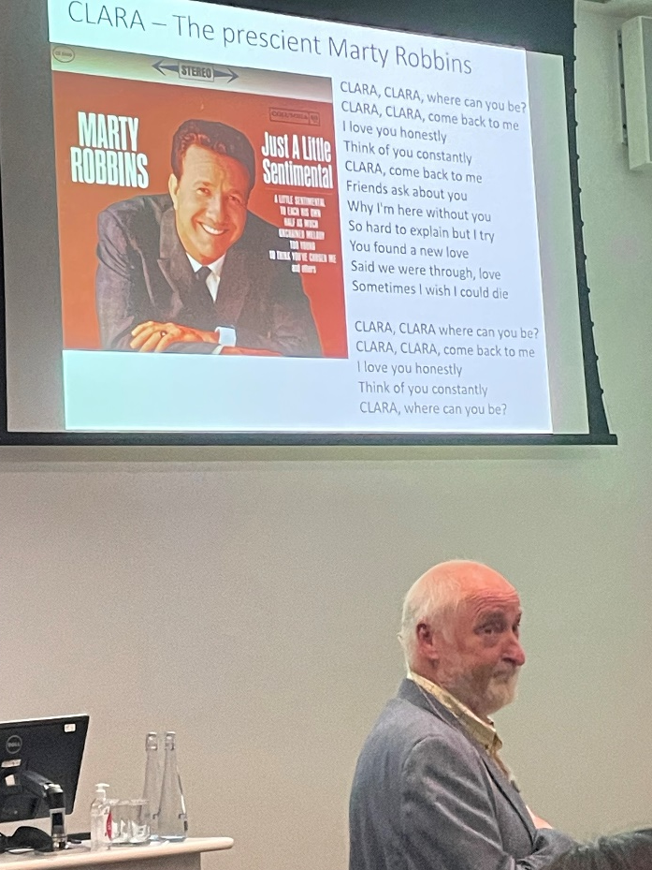
CLARA Phase3
Making a brighter future through advanced accelerators
100 nm FEL
NOT YET FUNDED. Decision tied to UK XFEL. Space is reserved.

Slide 8
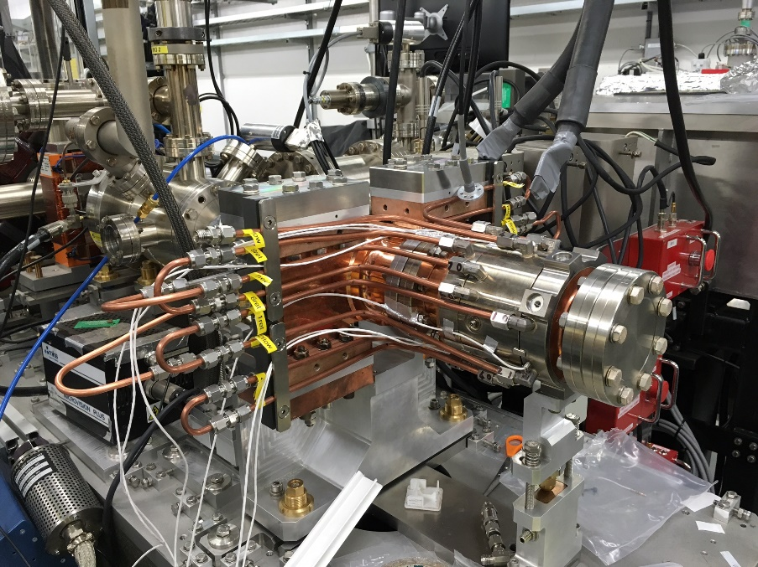
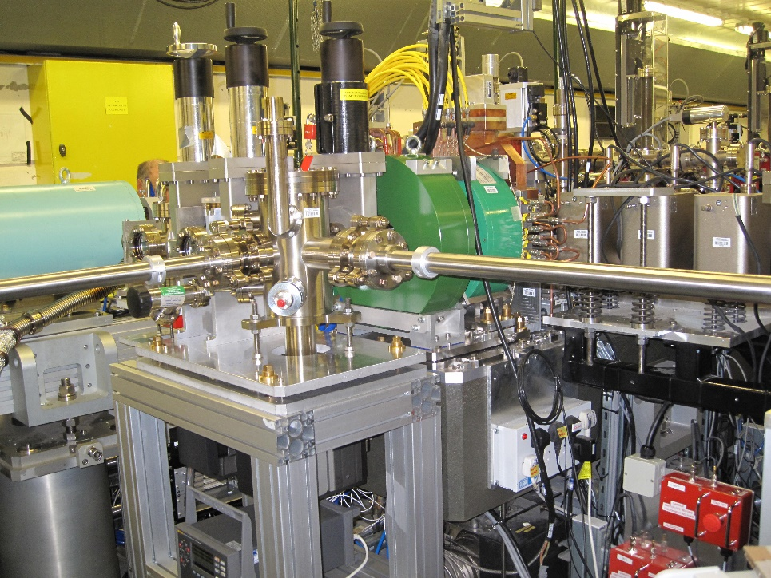
High Repetition Rate (400 Hz) Gun
Making a brighter future through advanced accelerators
1.5-cell S-band High Repetition Rate Gun (HRRG) designed by STFC/CI/INR collaboration.
CLARA specification is 100 Hz, 400 Hz for technology demonstration. Installed on VELA line for commissioning.
Fitted with vacuum load-lock system which allows to transport and swap cathodes without breaking vacuum.
Time allocated for conditioning after user run from April’22.
Auto-conditioning script developed & used for unmanned conditioning.
8

Slide 9
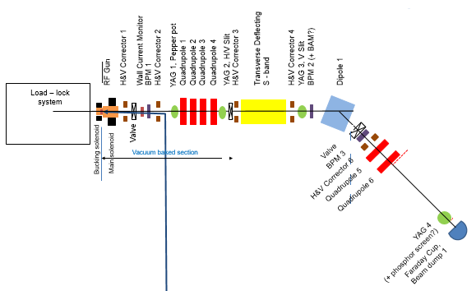
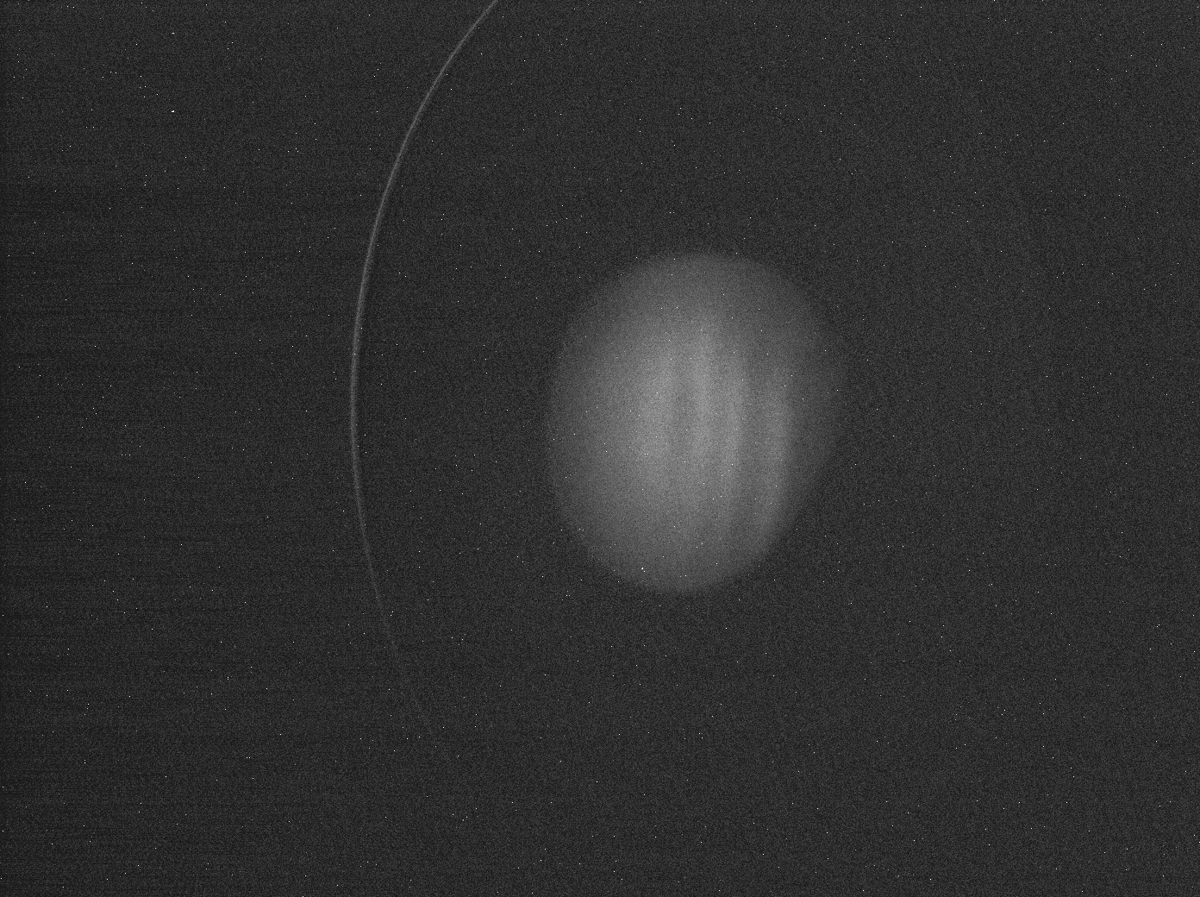
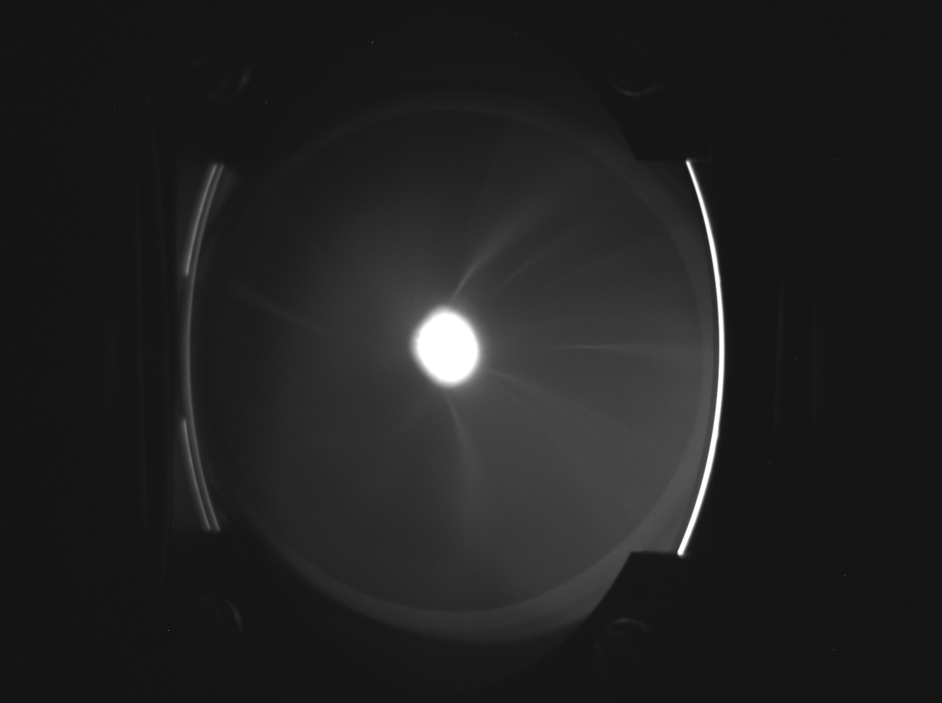
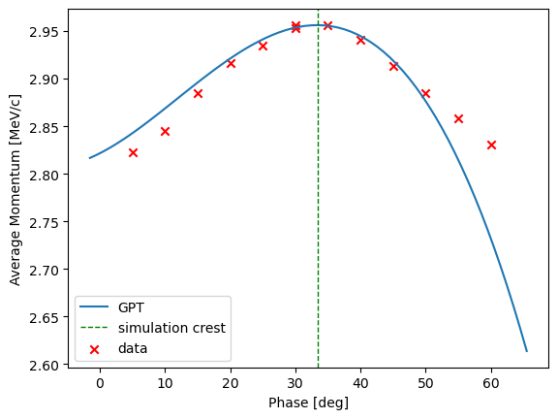
HRRG Beam Commissioning
Making a brighter future through advanced accelerators
Demonstrated 1st beam from HRRG in March 2023. Due to problems with waveguide and issues with the modulator to operate at higher than 100 Hz, RF conditioning took long time.
1.25us pulse length, 5.2MW klystron, 2.6MW probe, 3 MeV/c beam momentum
100 pC on F-cup (stopped at 100pC and didn’t turn laser up higher)
Successful demonstration of first in-house designed RF gun to swap the gun on CLARA line. Sufficient time has been set in the commissioning plan to demonstrate design specifications.
YAG4
YAG1
YAG1
QE~2e-4

Slide 10
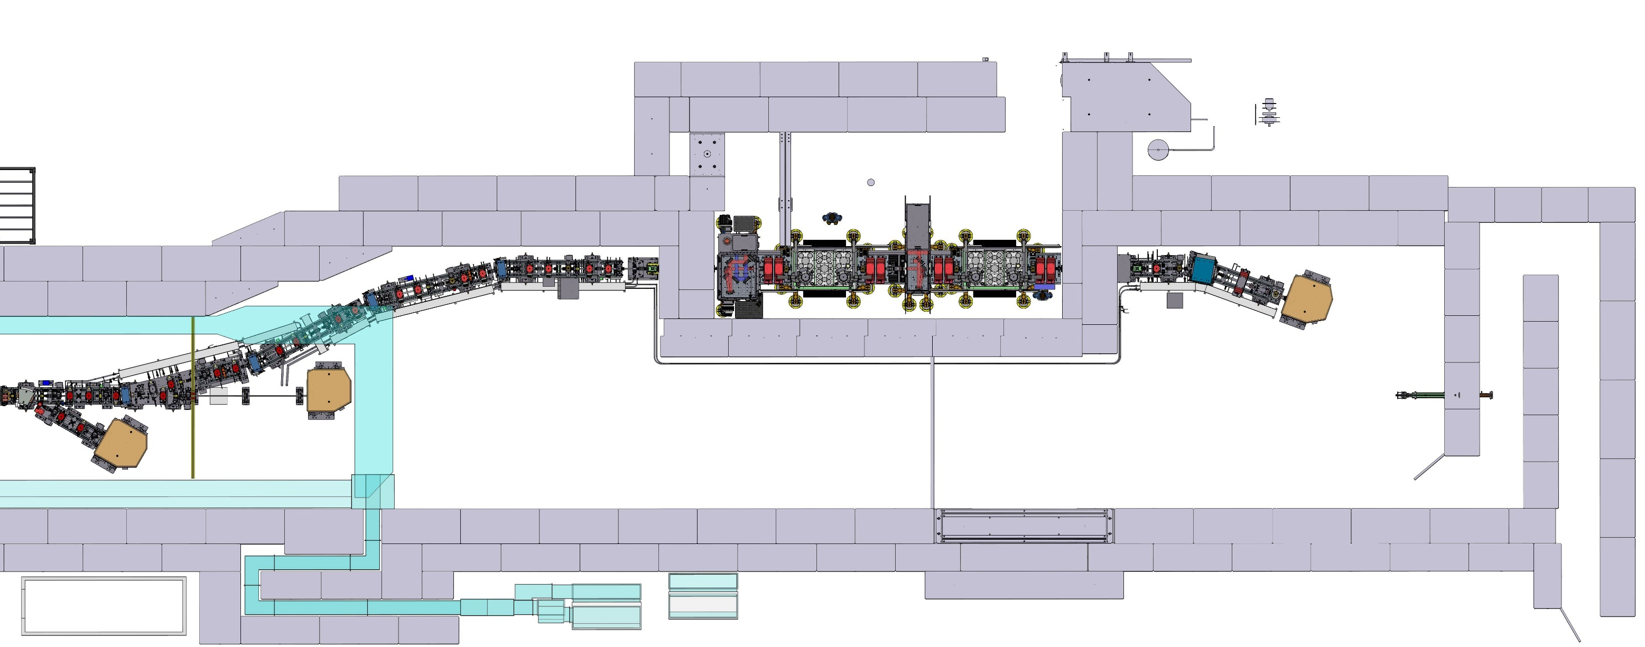
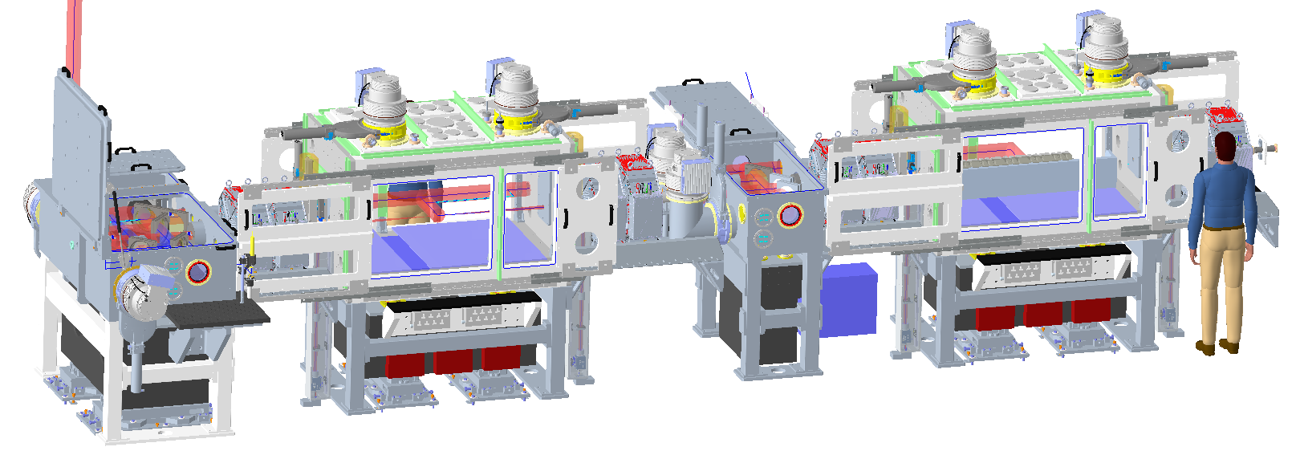
FEBE Experimental Hutch
Making a brighter future through advanced accelerators
FEC1 Exp. Chamber
FEC2 Exp. Chamber
Shield Door
  Offered parameters to evolve
  ‘Day 1’ → Nominal → R&D
FEBE Arcline
Shutter S1
9.8 m
Shutter S2
FEBE Hutch
5.4 m
Parameter | High charge | Low charge
Energy [MeV] | 250 | 250
Charge [pC] | 250 | 5
RMS t [fs] | 100 (50) | 50 (≤50)
σ_{E}/E [%] | <5 (1) | <1 (<1)
RMS x [µm] | 100 (50) | 20 (1)
RMS y [µm] | 100 (50) | 20 (1)
ε_{N} x @ 250 MeV [µm] | 5 (<5) | 2 (1)
ε_{N} y @ 250 MeV [µm] | 5 (<1) | 2 (<1)
FEBE Beam Dump
CLARA Hall
FMBOX1 Laser Chamber
FMBOX2 Laser Chamber
e-beam
Straight-on Beam Dump
FEBE Hutch
FEC 2
FEC 1
FMBOX2
FMBOX1
To be confirmed through measurement using appropriate diagnostics (and R&D)

Slide 11
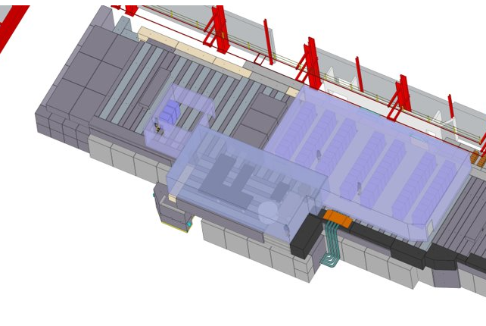
FEBE Laser
Making a brighter future through advanced accelerators
CLARA can combine electrons with a
120 TW, 5 Hz laser (Arco, Amplitude).
The laser is housed immediately on top of the FEBE hutch, with light directed to target via a shielded periscope.
Installation is scheduled for the second half of 2024, with the laser ready for exploitation at the beginning of 2025.
Laser control room
FEBE hutch
Laser room

Slide 12
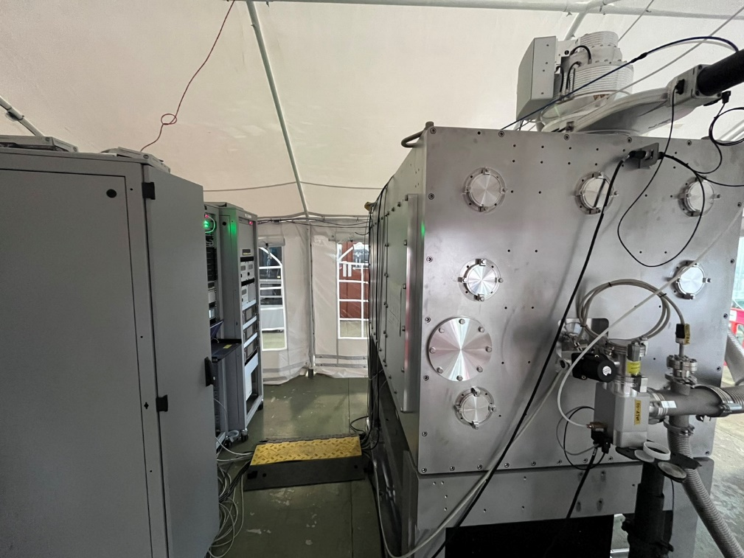
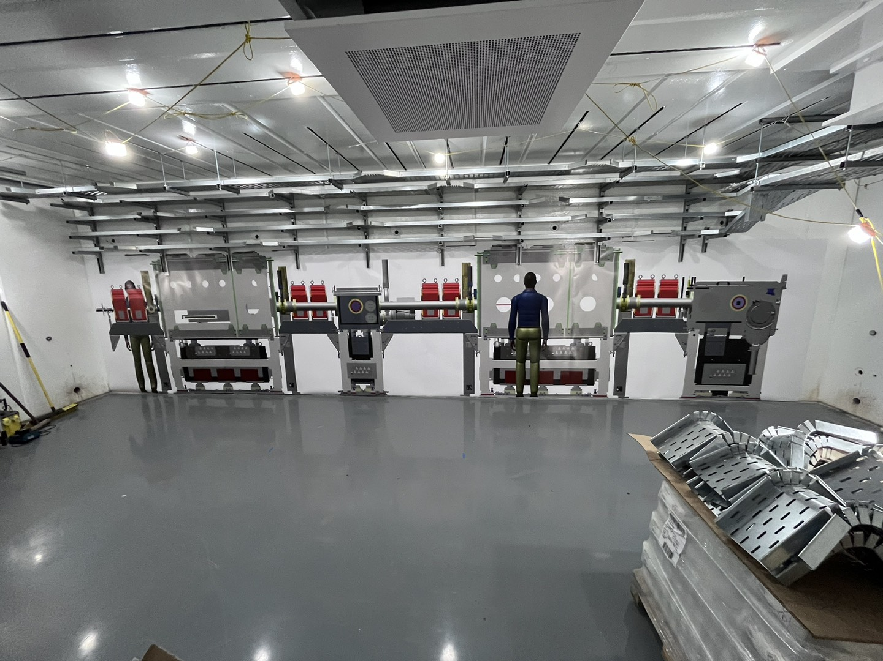
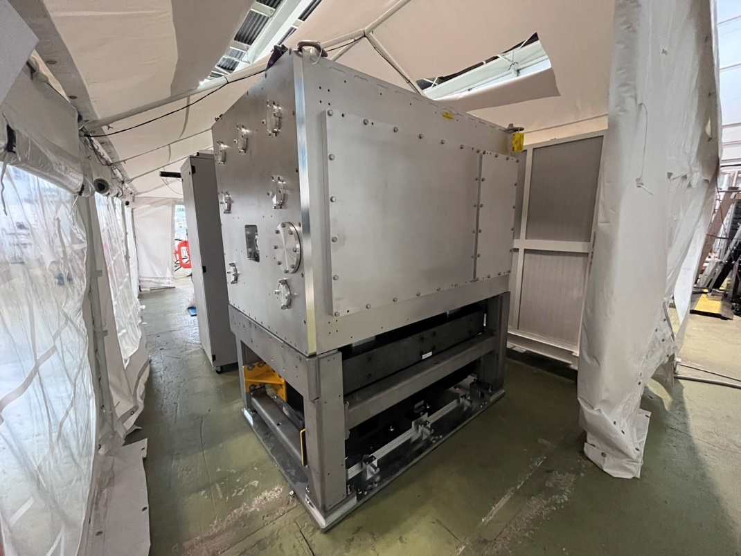
FEBE Hutch & Chambers
Making a brighter future through advanced accelerators

Slide 13
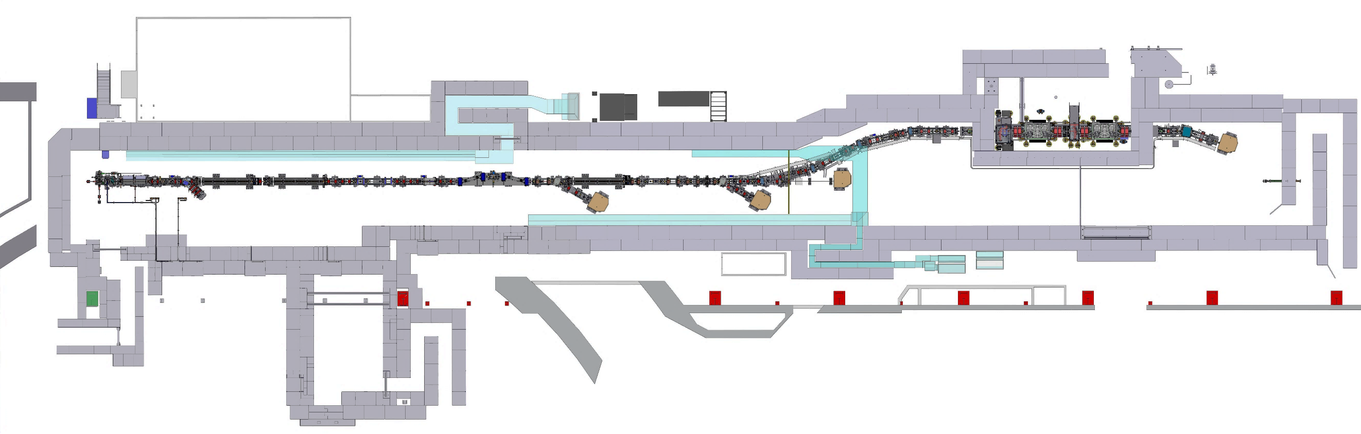
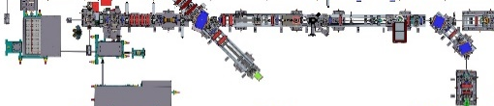
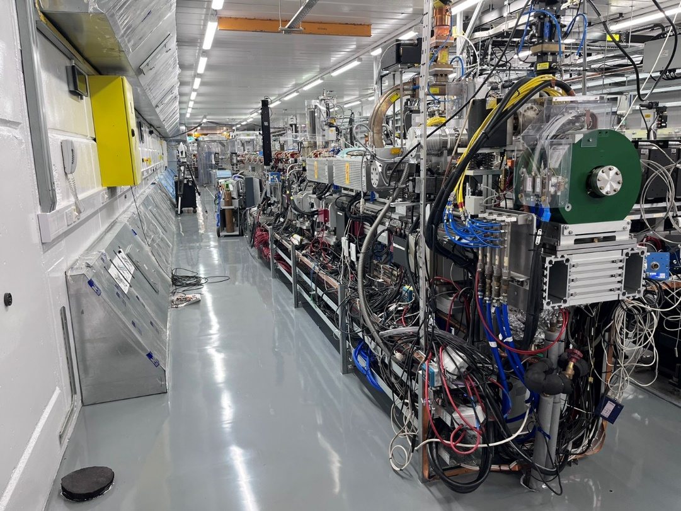
CLARA 2023
Making a brighter future through advanced accelerators
FEC1 Exp. Chamber
FEC2 Exp. Chamber
Shield Door
LATTE Lab
FEBE Arcline
Shutter S1
Shutter S2
FEBE Hutch
Gun
Linac1
Linac2
Linac3
Linac4
TDC1
FMBOX1 Laser Chamber
FMBOX2 Laser Chamber
FEBE Beam Dump
4HC
VBC
VELA
CLARA
e-beam
SP2 Beam Dump
SP3 Beam Dump
Straight-on Beam Dump
Beam Area1 beamline and wall removed

Slide 14
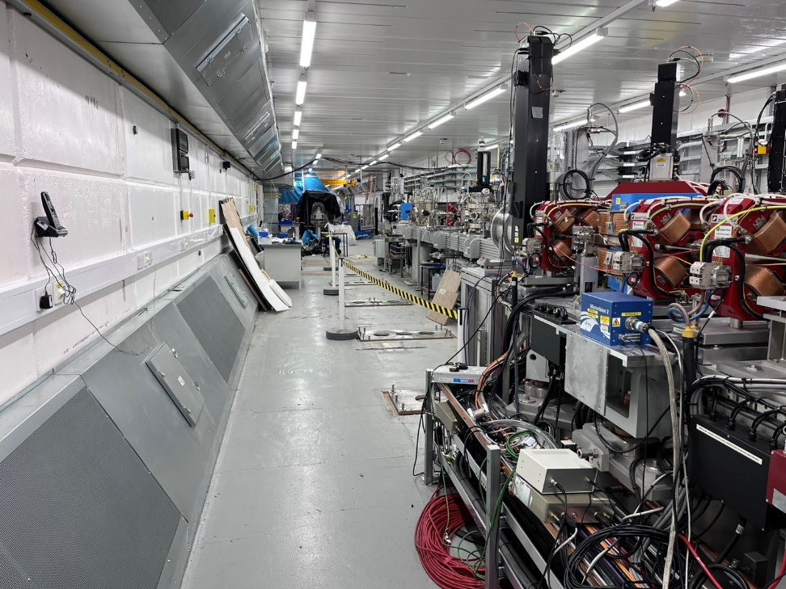
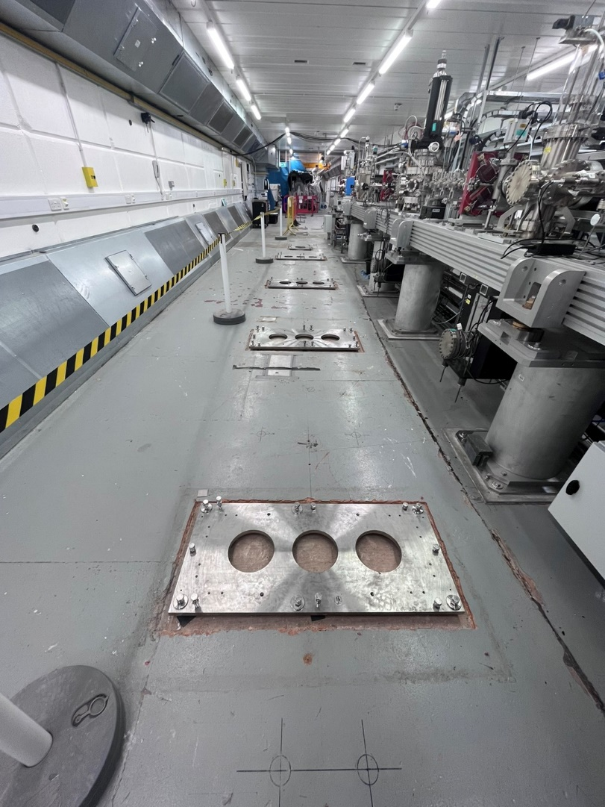
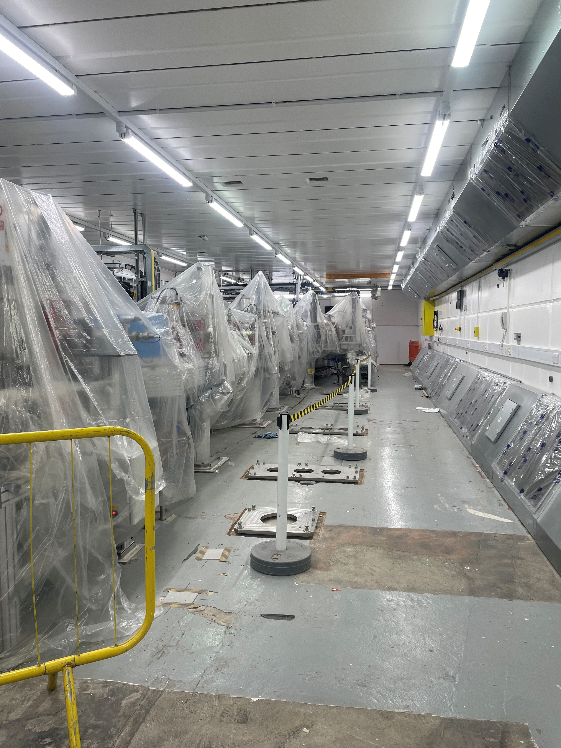
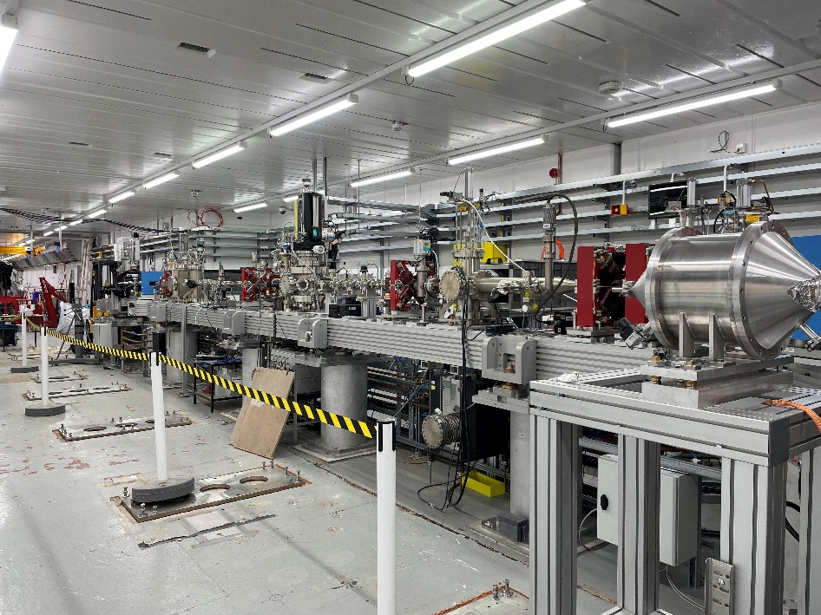
Making a brighter future through advanced accelerators
Preparation of Installation in Phase 1 Area (May 2023)

Slide 15
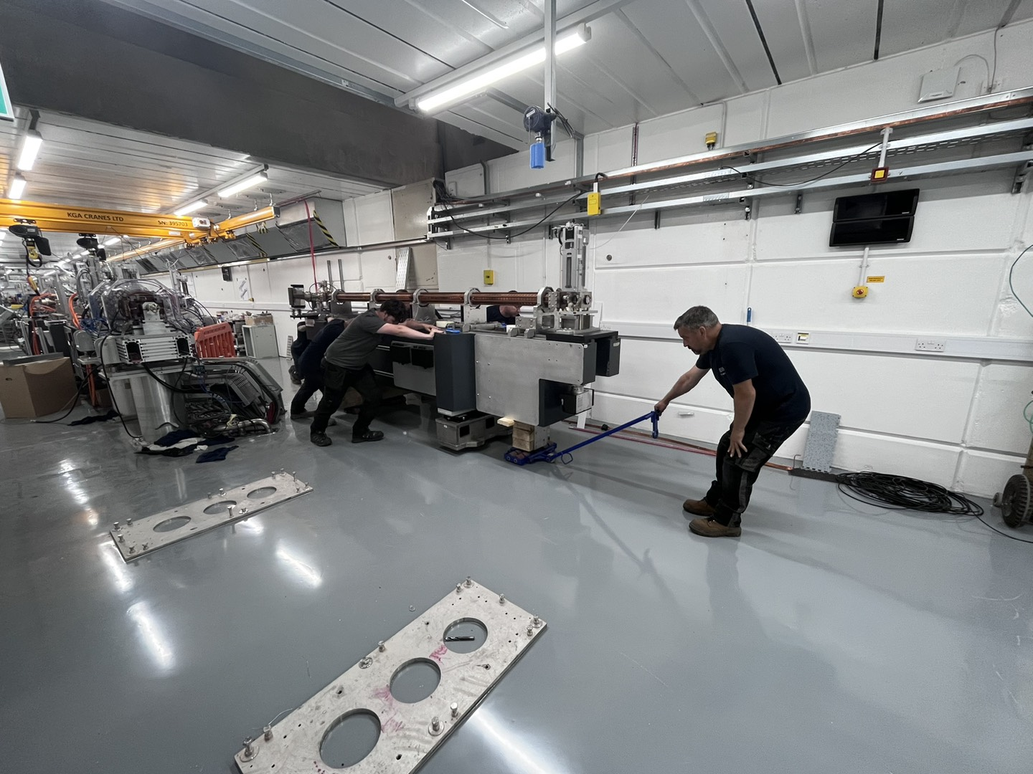
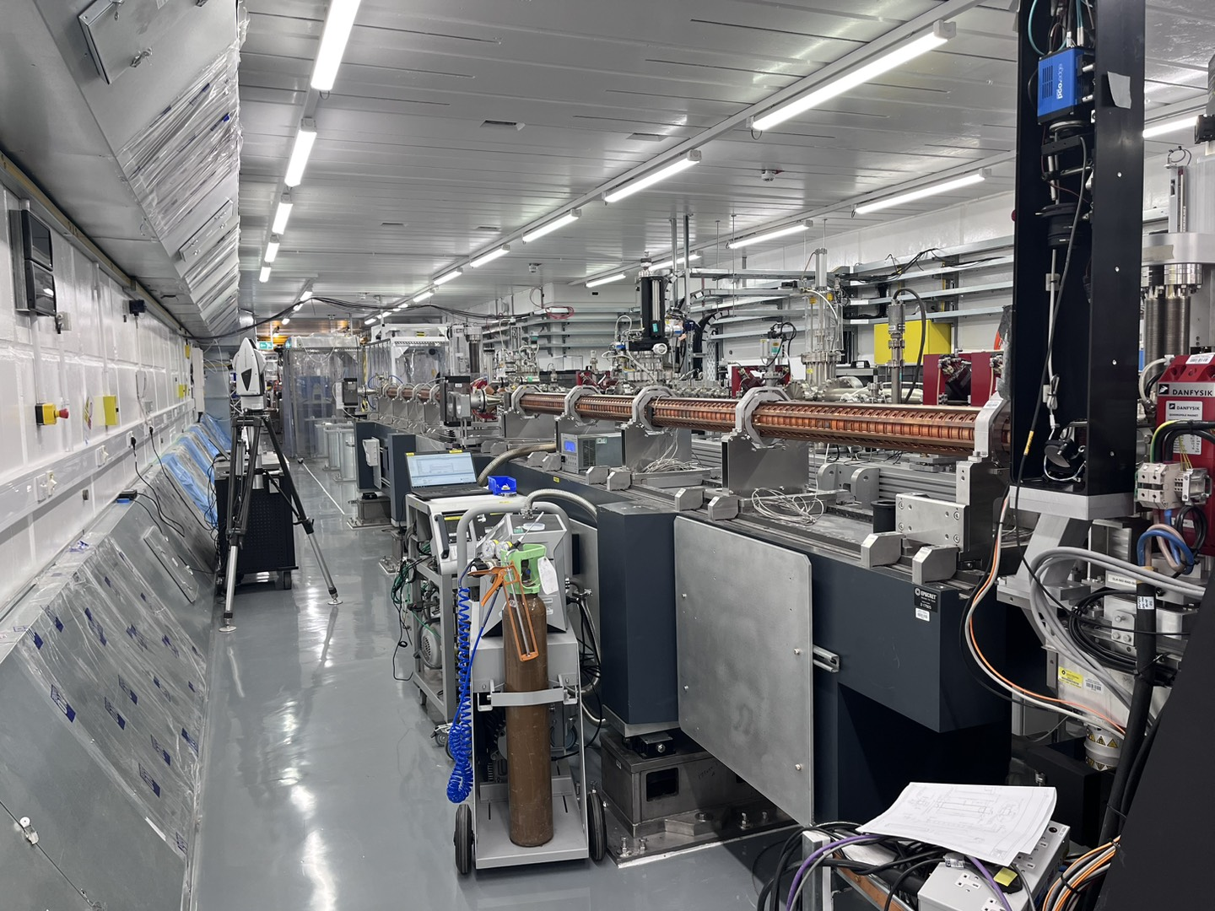
Installation
Making a brighter future through advanced accelerators

Slide 16
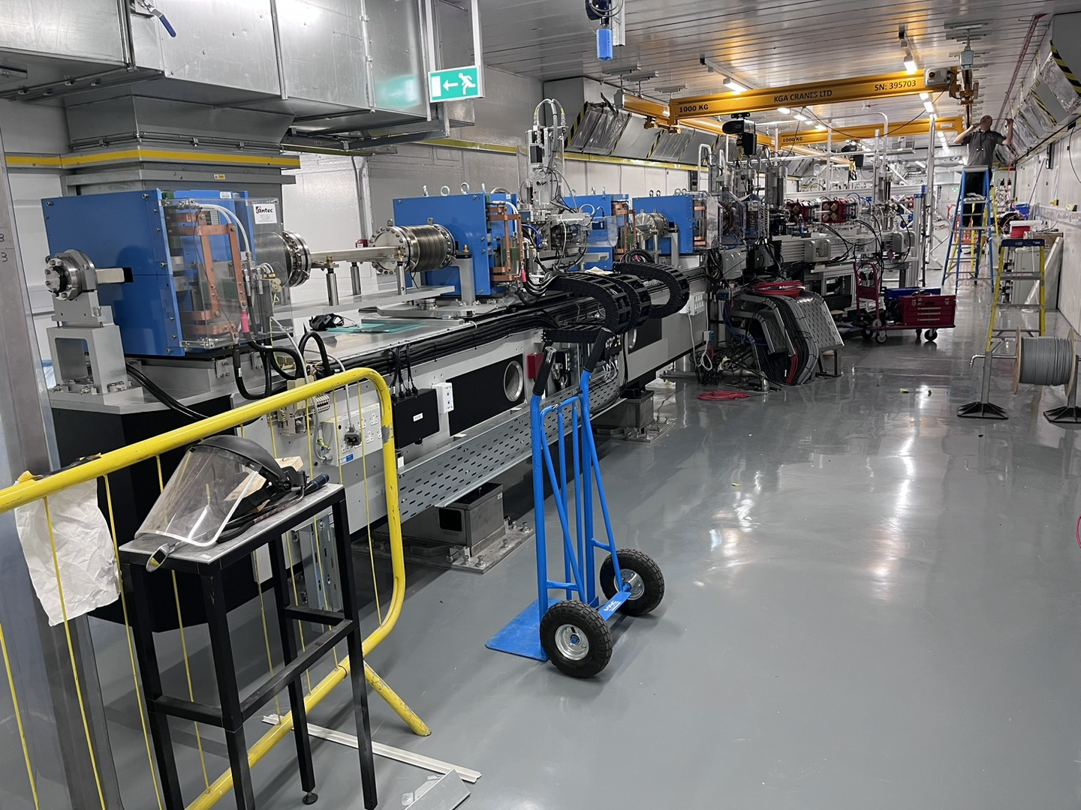

Installation
Making a brighter future through advanced accelerators

Slide 17
Plans
Making a brighter future through advanced accelerators
Phase 2 technical commissioning followed by beam commissioning plan will run from November 2023 to February 2024
Goal is to confirm “Day 1” parameters experimentally.
Beam commissioning software tools (“Apps”) development currently ongoing using Virtual machine.
Expect user exploitation programme start early 2025.
2022
2023
2024
2025
2026
2027
2028
2029
2030
2031
CLARA
SD1
HRRG
SD2
Technical Beam FEBE
Commissioning
Machine Development and CLARA Exploitation
UK XFEL
CDOA
TDR
Construction
FEBE Laser contract begins
FEBE Exploitation kick off meeting
FEBE Laser ready for exploitation
SD1
SD2
Shutdown – Gun RF swap
Shutdown – Phase 2 installation

Slide 18

Making a brighter future through advanced accelerators
Thank you!

