Slide 1



Developing a two-colour all-fibre balanced optical cross-correlator for sub-femtosecond synchronisation
J. Christie¹, J. R. Henderson², E. W. Snedden², L. Corner¹
Jonathan.Christie@liverpool.ac.uk
Contents:
Introduction to balanced optical cross-correlators (BOXCs)
Two-colour fibre-coupled BOXC design
Experiment setup and results
1 – Cockcroft Institute, University of Liverpool, UK
2 – Science and Technology Facilities Council, Daresbury, UK
Notes:
Hello, my name is Jonathan Christie and I’m here to give a talk on developing a two-colour all-fibre balanced optical cross-correlator for sub-femtosecond synchronisation. In this talk I will give a quick overview of balanced optical cross-correlators and the importance of femtosecond synchronisation for accelerators. Then, I’ll go over my fibre-coupled cross-correlator design and some results from testing this design.

Slide 2
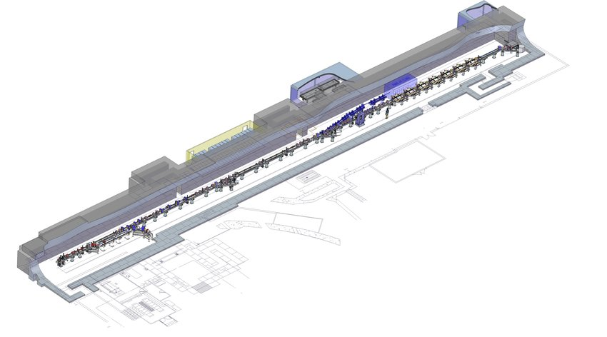
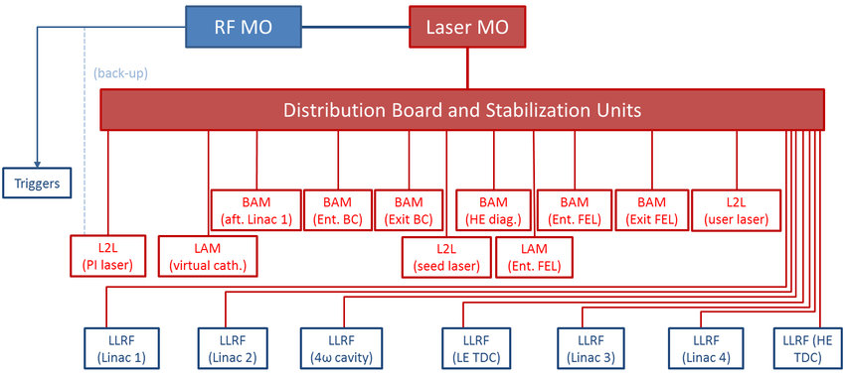
Introduction
PAB 2023
29/06/2023
In modern accelerator facilities, ultra-precise timing distribution systems play an increasingly important role.
  Pump-probe spectroscopy, laser wakefield acceleration (LWFA) require femtosecond synchronisation between a high-power laser and the accelerator facility [1, 2].
Can use a mode-locked laser as an optical master oscillator (OMO).
  Distribute low-noise laser pulses via optical fibre to accelerator systems.
  Sub-femtosecond fluctuations in pulse arrival time over short distances [3].
Need method of synchronising high-power laser to OMO pulse train to < 10 fs for these experiments.
[1] - A. J. Reitsma, R. A. Cairns, R. Bingham, and D. A. Jaroszynski, “Efficiency and energy spread in laser-wakefield acceleration,” Physical Review Letters, vol. 94, no. 8, pp. 1–4 (2005).
[2] - P. Vester et al., “Ultrafast structural dynamics of photo-reactions observed by time-resolved x-ray cross-correlation analysis,” Structural Dynamics, vol. 6, no. 2, p. 024301, (2019).
[3] - H. Kim et al., “Sub-20-Attosecond Timing Jitter Mode-Locked Fiber Lasers,” IEEE Journal of Selected Topics in Quantum Electronics, vol. 20, pp. 260–267 (2014).
Notes:
In modern accelerator facilities, ultra-precise timing distribution systems are playing an increasingly important role. Experiments such as pump-probe spectroscopy and laser wakefield acceleration require femtosecond-level synchronisation between the high-power laser used for the experiment and the accelerator facility in order to achieve sufficient temporal resolution. Such synchronisation performance requires a very stable and precise timing signal.
This can be achieved by using a mode-locked laser as an optical master oscillator (OMO) whose pulses are distributed across the accelerator facility. Such lasers can achieve sub-femtosecond fluctuations in pulse arrival time over short distances. Pulses from the OMO can then trigger the required accelerator and laser systems.
However, a method of synchronising the high-power laser to the timing laser pulse train to within the few femtoseconds required for these experiments is needed.
Sub-fs synchronisation between two lasers at start point of 800 nm, not sub-fs synchronisation at interaction point (beam-arrival monitors, laser-arrival monitors etc.), small part of large synchronisation system.

Slide 3
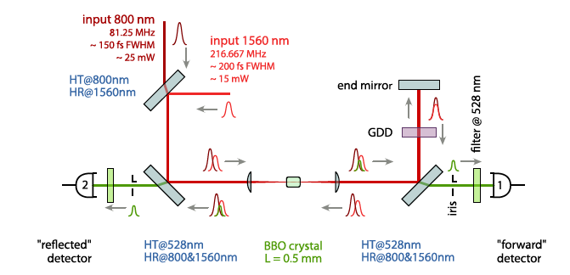
Balanced optical cross-correlator (BOXC)
PAB 2023
29/06/2023
One of the best methods is the balanced optical cross-correlator (BOXC).
  Determines timing delay between two laser pulses via generating sum-frequency radiation in a nonlinear crystal.
  Amplitude of sum-frequency pulse increases with increasing temporal overlap.
  Works for lasers of different wavelengths (e.g. 1560 nm OMO, 800 nm experiment laser).
Existing two-colour BOXCs are free-space coupled.
  Resolution limited to ~ 10 fs due to environmental fluctuations, difficulty in maintaining optical alignment [1].
  Need resolution of < 1 fs for future free-electron laser or LWFA experiments.
Two-colour all-fibre BOXC is highly desirable.
  Improved long-term stability, potential for sub-fs synchronisation between different wavelength lasers.
  Never been demonstrated before.
  I have designed and tested a working prototype.
[1] – S. Schulz. (2011). Implementation of the Laser-Based Femtosecond Precision Synchronization System at FLASH [Doctoral thesis, University of Hamburg].
Notes:
One of the best methods for femtosecond optical synchronisation is the balanced optical cross-correlator (BOXC), which determines the timing delay between two laser pulses via the generation of sum-frequency radiation in a nonlinear crystal. Greater temporal overlap of the two pulses entering the crystal results in a more intense sum-frequency pulse, allowing for very precise measurements of the timing delay to be made. Additionally, assuming a suitable nonlinear crystal can be found, this method will work for a wide range of wavelengths, including the case I’m interested in with a 1560 nm timing laser and a 800 nm high-power laser.
However, existing two-colour BOXCs are free-space coupled, utilising numerous mirrors and lenses. This limits their resolution to ~ 10 fs due to environmental fluctuations causing the free-space optics to become misaligned over time. Although this is acceptable for current free-electron laser and accelerator experiments, future experiments will require sub-femtosecond resolution to fully exploit the short laser pulse durations and to increase the number of successful interactions.
These issues could be addressed by a two-colour fibre-coupled BOXC, where the laser pulses travel through optical fibres to interact in a fibre-coupled nonlinear crystal. Such a device would be highly desirable as it would have significantly fewer free-space components, thus improving long-term stability and synchronisation performance with the potential for sub-fs synchronisation. As you can imagine, this would open up many possibilities for the next generation of free-electron lasers and accelerators. However, a two-colour fibre-coupled BOXC has never been demonstrated to the best of my knowledge. As such, I have been working on designing and testing a working prototype of a two-colour fibre-coupled BOXC to determine what synchronisation performance it can achieve.

Slide 4
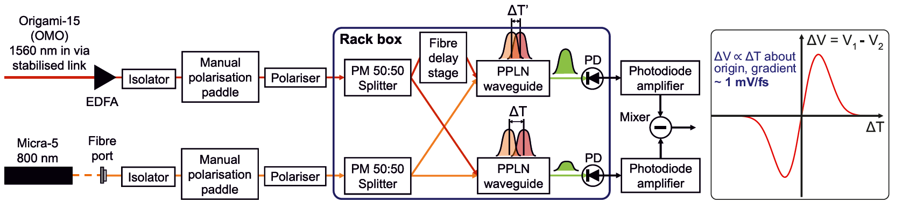
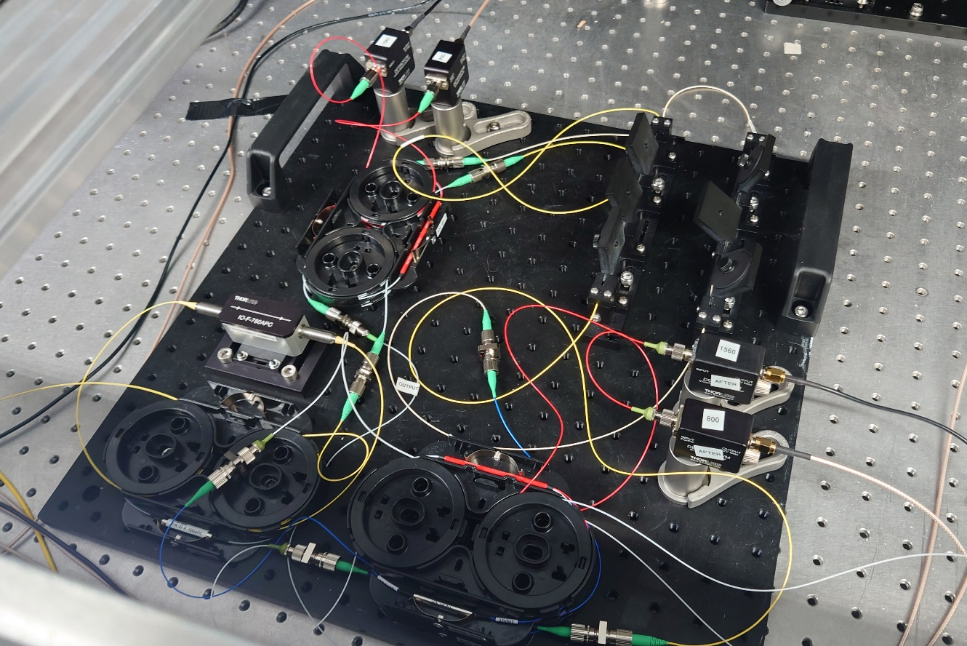
Two-colour fibre-coupled BOXC design
PAB 2023
29/06/2023
Coupling and Polarisation:
1560 nm and 800 nm coupled into fibre, travel to separate fibre polarisation paddles and polarisers to ensure correct polarisation for periodically-poled lithium niobate (PPLN) waveguides.
  Both wavelengths travel in optical fibre matched to respective wavelengths.
  After paddles, polarisation-maintaining (PM) fibre is used to prevent polarisation changes.
Notes:
This is my design for my two-colour fibre-coupled BOXC. I must admit it is quite hard to follow, but we can better understand this design by breaking it down into 3 sections.
The first section is coupling and polarisation, got a picture of what this section looks like in the lab. Firstly, 1560 nm pulses from our optical master oscillator are transported to the BOXC via a stabilised fibre link, then amplified to 10 dBm by an erbium-doped fibre amplifier. The 800 nm pulses from our Micra-5 laser are coupled into single mode optical fibre.
Then, both wavelengths travel to separate fibre polarisation paddles and polarisers to ensure they have the correct polarisation for the periodically-poled lithium niobate waveguides, shown here. Note that both wavelengths travel through different optical fibre matched to their respective wavelengths in order to minimise losses. After the polarisation paddles, polarisation-maintaining (PM) fibre is used to prevent polarisation changes.

Slide 5
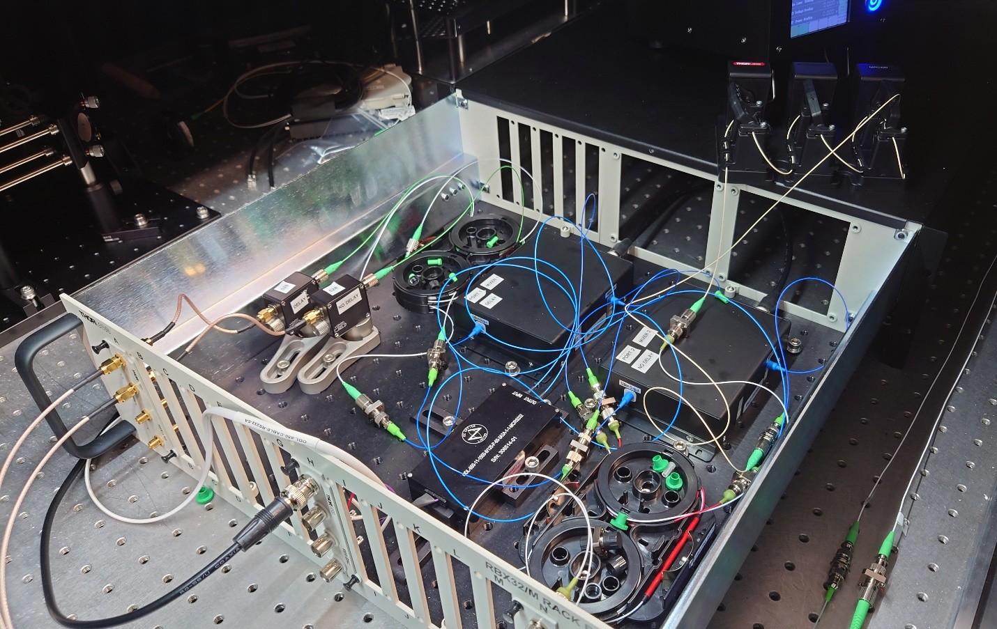
Two-colour fibre-coupled BOXC design
PAB 2023
29/06/2023
Sum-Frequency Generation:
Pulses are split 50:50 and sent to separate PPLN waveguides.
  Fibre delay stage imparts additional time delay D to one of the 1560 nm components.
  Sets of pulses have different delays ΔT and ΔT’ = ΔT – D.
Waveguides generate two sum-frequency pulses with different intensities due to different temporal overlap of pulses.
  Converted to electrical signals by identical photodetectors (PDs).
Notes:
The next section is sum-frequency generation, here’s what it looks like in the lab. In this section, the pulses are split 50:50 and sent to separate PPLN waveguides. To generate the BOXC signal, one of the 1560 nm pulse components is coupled into a fibre delay stage, which imparts an additional fixed time delay D. Thus, at the waveguides, the sets of pulses will have different time delays.
As a result, the waveguides generate two sum-frequency pulses with different intensities due to the different temporal overlap of the input pulses. These sum-frequency pulses are then measured by two identical photodetectors.

Slide 6
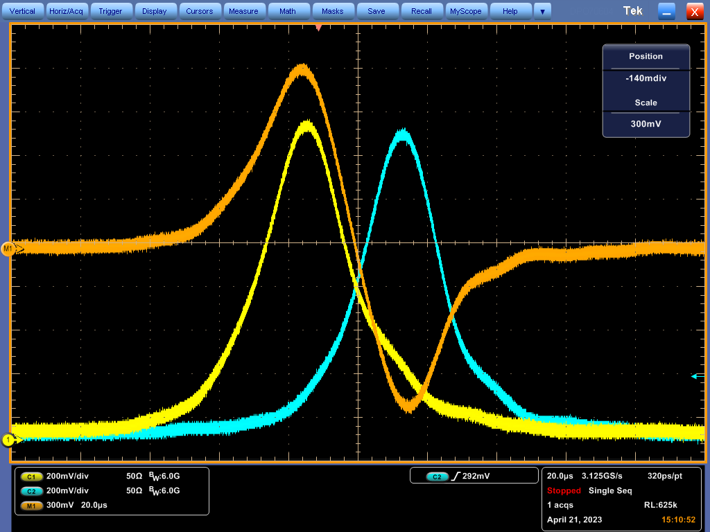
Two-colour fibre-coupled BOXC design
PAB 2023
29/06/2023
Signal Generation:
Signal from photodetectors is amplified and the difference between the two voltages is taken to give ΔV.
  By scanning over ΔT, can obtain a plot of ΔV against ΔT.
  Gradient is linear about zero-crossing point (where ΔV = 0).
Can adjust laser pulse arrival time to lock lasers to zero-crossing point, keeps relative timing between laser pulses constant to within a few femtoseconds.
Notes:
The final section is signal generation. Here, the signal from photodetectors is amplified and the difference between the two voltages is taken to give ΔV. This provides a balanced measurement that is insensitive to amplitude fluctuations in the initial pulses. Then, by scanning over the full range of pulse temporal overlaps, we obtain a plot of ΔV against ΔT where the difference in voltage is linearly proportional to the pulse temporal overlap about the zero-crossing point.
The signal can then be used to adjust the cavity length and hence repetition rate of the 800 nm laser, with the aim of keeping the voltage difference signal locked to the zero-crossing point, resulting in the phase-locking of the two lasers to within a few femtoseconds.
However, in order to use the fibre-coupled BOXC to measure timing jitter, the calibration curve (this red curve in the top right) has to be determined so that the gradient about the zero-crossing point, and hence the sensitivity of the BOXC, is known.

Slide 7
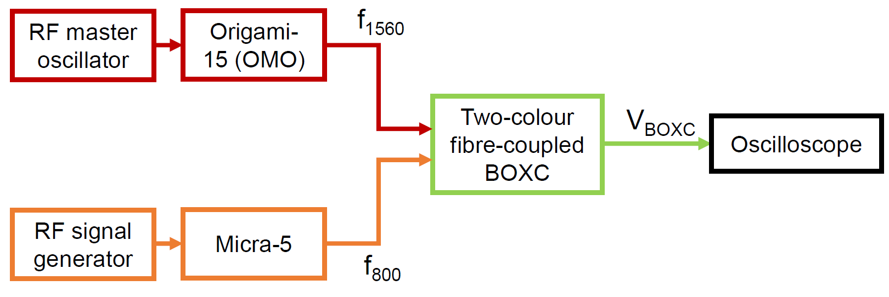
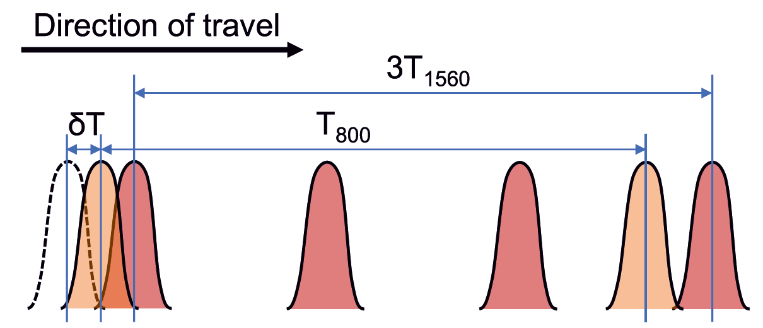
Measuring BOXC sensitivity
PAB 2023
29/06/2023
OMO (Origami-15) locked to RF master oscillator, operates at:
f_{RF} = 2998.5 MHz
OMO produces 1560 ± 10 nm pulses at:
f₁₅₆₀ = f_{RF} /12 = 249.875 MHz
800 nm laser (Micra-5) locked to signal generator at:
f₈₀₀ = (f₁₅₆₀ /3) + δf , δf = 2.93 Hz << f₈₀₀ , f₁₅₆₀
f₁₅₆₀ is not an exact multiple of f₈₀₀.
  800 nm and 1560 nm pulse trains slowly scan over each other, generating multiple sum-frequency pulses.
  Automatically generates BOXC signal V_{BOXC}, recorded by oscilloscope.
Notes:
Here’s the setup for generating this calibration curve. Essentially, the optical master oscillator is locked to the RF master oscillator which operates at a frequency of almost 3 GHz, and the OMO then produces 1560 nm pulses at a repetition rate of one twelfth of the RF frequency, so almost 250 MHz. However, the 800 nm laser is locked to a signal generator producing an RF signal at a frequency of one third the 1560 nm repetition rate plus some small frequency offset delta f.
Thus, as shown by this figure, the laser repetition rates are not exact multiples of each other, resulting in the two pulse trains slowly scanning over each other and generating multiple sum-frequency pulses. This will automatically generate the calibration curve, which we can record using an oscilloscope.

Slide 8
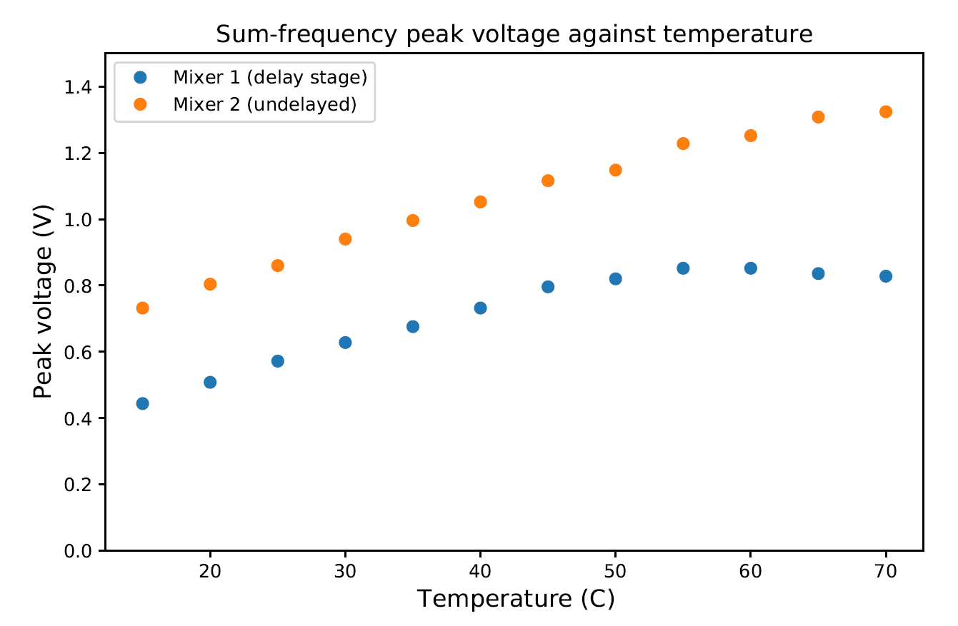
Experiment parameters
PAB 2023
29/06/2023
Waveguides housed in box containing thermoelectric cooler.
  Changing the crystal temperature reduces refractive index, allows for fine-tuning of SFG process.
  Temperature can be changed from 15°C to 70°C; performed temperature scan over that range.
Maximum sum-frequency signal at 60°C for waveguide connected to delay stage, 70°C for undelayed waveguide.
  Minute differences in manufacture cause different optimum temperatures.
PPLN mixer | PPLN temperature (°C) | Average input power (mW) |  | FWHM pulse width (ps) |  | Photodetector responsivity (A/W) | Transimpedance gain (V/A)
 |  | 800 nm | 1560 nm | 800 nm | 1560 nm
Mixer 1 (delayed) | 60.0 | 3.98 | 2.70 | ~1.5 | 0.8 | 0.18 | 10⁵
Mixer 2 (undelayed) | 70.0 | 2.45 | 2.08
Notes:
Here’s a quick summary of the waveguide, laser and photodetector parameters used in this experiment. Since the waveguides are housed in boxes containing a thermoelectric cooler, I was able to scan over the allowed temperature range of the waveguide to find the optimum temperature for producing sum-frequency radiation. Due to minute differences in the manufacturing process, the crystals have different optimum temperatures of 60 C for the waveguide connected to the fibre delay stage and 70 C for the undelayed waveguide.
Additionally, both pulses have much larger pulse widths at the input of the waveguide, with the 800 nm pulse broadening from 50 fs to 1.5 ps and the 1560 nm pulse from 200 fs to 800 fs. This is due to chromatic dispersion, where the group velocity of the light travelling through the fibre depends on the optical frequency. In order to produce these ultrashort pulses, the pulse must necessarily have large spectral bandwidths (of 50 nm and 10 nm respectively). Thus, the different frequency components in each pulse have different group velocities in the fibre, resulting in the pulse stretching and becoming broader in time.
800 nm has larger bandwidth (50 nm vs 10 nm), and 800 nm fibre has larger dispersion coefficient (-118 vs 18 ps/(nm km)), thus broadens more quickly

Slide 9
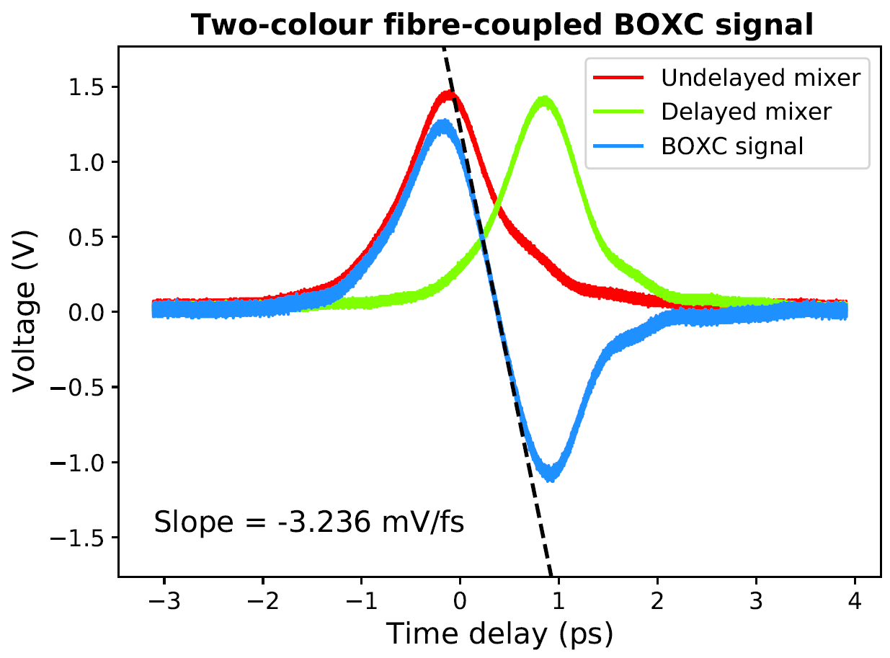
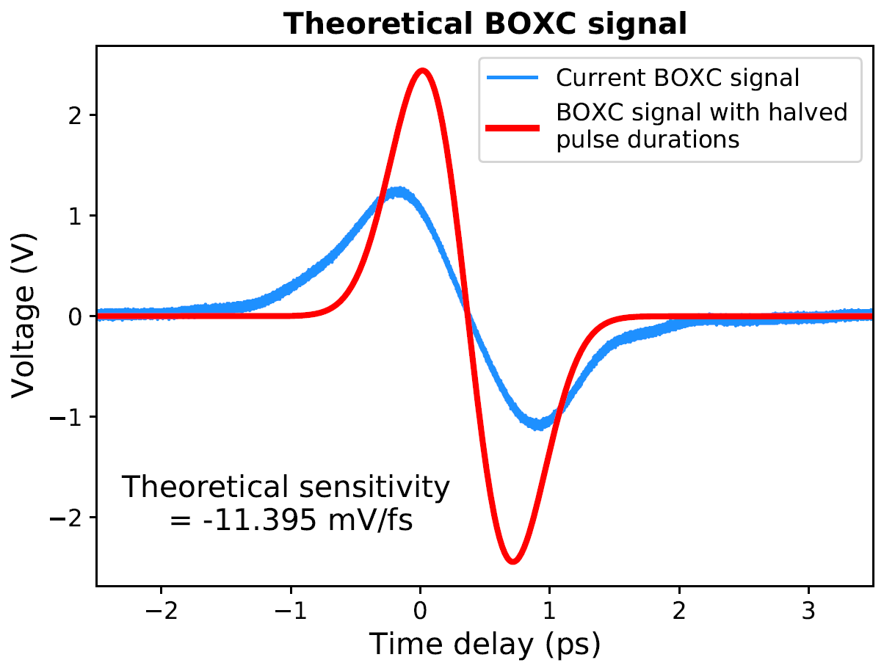
BOXC performance
PAB 2023
29/06/2023
Using current setup, BOXC sensitivity of 3.2 mV/fs achieved.
  7 times greater than current free-space two-colour BOXCs after accounting for difference in responsivity, transimpedance gain [1].
Halving the 800 nm and 1560 nm pulse durations (through e.g. dispersion compensation) leads to a theoretical sensitivity of 11.4 mV/fs.
  Increased sensitivity due to increased pulse intensity and sharper sum-frequency signals.
  Almost 30 times greater than current BOXCs.
[1] - C. Li et al, “Two Color Balanced Optical Cross Correlator to Synchronize Distributed Lasers for SHINE Project,” JACoW IBIC2021 (2021) WEPP05.
Notes:
However, despite the much broader laser pulses, the cross-correlator is able to achieve a sensitivity of 3.2 mV/fs, more than 7 times greater than current free-space two-colour cross-correlators after accounting for differences in photodetector responsivity and transimpedance gain.
One optimisation to increase the sensitivity of the BOXC would be to compensate for the dispersive broadening of both laser pulses as they travel through optical fibre. From simulations, we can see that by halving the pulse durations of both wavelengths, the theoretical sensitivity increases to 11.4 mV/fs, almost 4 times greater compared to the current results. This increase is due to the greater pulse intensity and the sharper sum-frequency voltage signals, leading to a larger gradient. Thus, from the results and simulations, we can see that improvements to the current design could result in sensitivities almost 30 times greater than current free-space two-colour BOXCs, which could allow for sub-fs synchronisation.

Slide 10
Conclusion and future work
PAB 2023
29/06/2023
A two-colour fibre-coupled balanced optical cross-correlator has been demonstrated for the first time.
  Sensitivity of 3.236 mV/fs achieved.
  Much greater than current free-space two-colour BOXCs after accounting for transimpedance gain and photodetector responsivity.
  Potential for > 10 mV/fs with optimisation, important step towards sub-fs synchronisation.
Future work includes:
  Optimising BOXC signal.
    Compensate for dispersive broadening of pulses, increase laser power and coupling efficiency.
    Package BOXC into single rack box by minimising number of fibre components.
  Using BOXC to phase-lock 800 nm laser to 1560 nm OMO, compare long-term timing stability with free-space BOXC.
    Goal of sub-femtosecond long-term synchronisation.
    Potential for implementation into synchronisation system at Daresbury Laboratory.
Notes:
In conclusion, a two-colour fibre-coupled balanced optical cross-correlator has been demonstrated for the first time to the best of my knowledge. A sensitivity of 3.236 mV/fs was achieved, which is much greater than comparable free-space two-colour BOXCs after accounting for transimpedance gain and photodetector responsivity. Additionally, optimisations to the current design could see the sensitivity increase beyond 10 mV/fs, which would be a very important step towards sub-fs synchronisation between a high-power experiment laser and the timing laser system.
Future work will involve optimising the BOXC signal, mainly through dispersion compensation as mentioned before, but also through smaller changes such as increasing the laser power in the waveguides and increasing the proportion of 800 nm power coupled into the fibre. Additionally, I am looking into packaging the fibre-coupled BOXC into a single rack box instead of the two that it currently occupies by minimising the number of fibre components and the amount of optical fibre used, which will also improve the sensitivity.
My main goal is using the fibre-coupled BOXC to phase-lock the 800 nm laser to the 1560 nm optical master oscillator, then comparing the long-term timing stability of the fibre-coupled BOXC to a free-space BOXC to determine the impact of using fibre-coupled components. If successful, this design could be implemented into the synchronisation system at Daresbury Laboratory, potentially making sub-femtosecond temporal resolution on pump-probe and novel acceleration experiments possible.

Slide 11
Thank you!
Special thanks to Femtosecond Lasers and Timing Group at Daresbury Laboratory and HC Photonics.

Slide 13
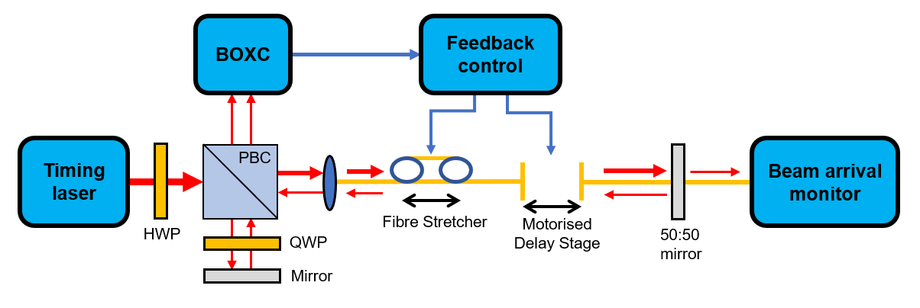
Fibre timing links

Slide 14
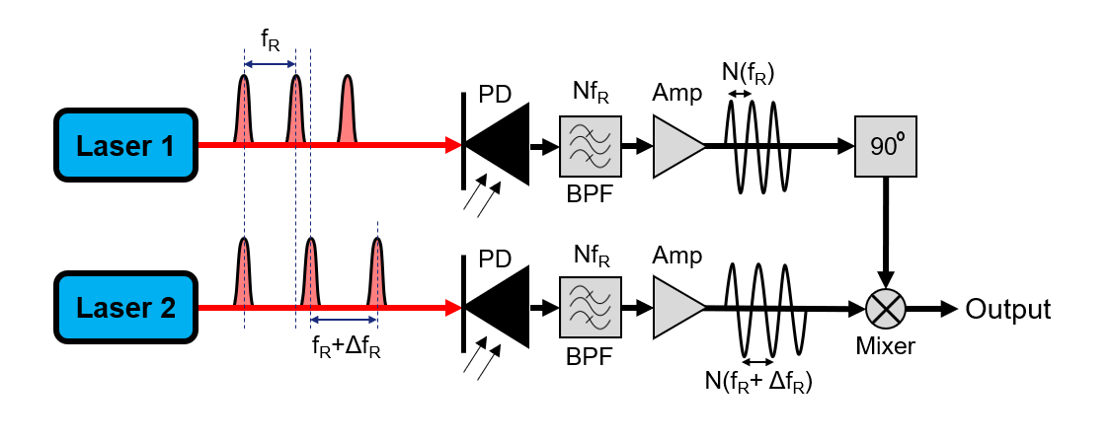
Direct conversion
Directly detect laser pulses using photodetectors. Difference in pulse repetition rate corresponds to different electrical pulse frequency. Pass pulses through mixer to obtain timing difference.
  Performance limited by amplitude modulation to phase modulation (AM-PM) effects and thermal noise.
  Sensitivity of 1 μV/fs, synchronisation limited to > 100 fs, not acceptable for modern accelerator facilities.

Slide 15

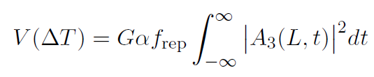

BOXC signal derivation
Integrate over length of crystal L to get A₃(L, t)

