Slide 1




LhARA: The Laser-hybrid Accelerator for Radiobiological Applications
William Shields
On behalf of the LhARA Collaboration
william.shields@rhul.ac.uk
IOP Particle Accelerators and Beams Conference
29th June 2023

Slide 2

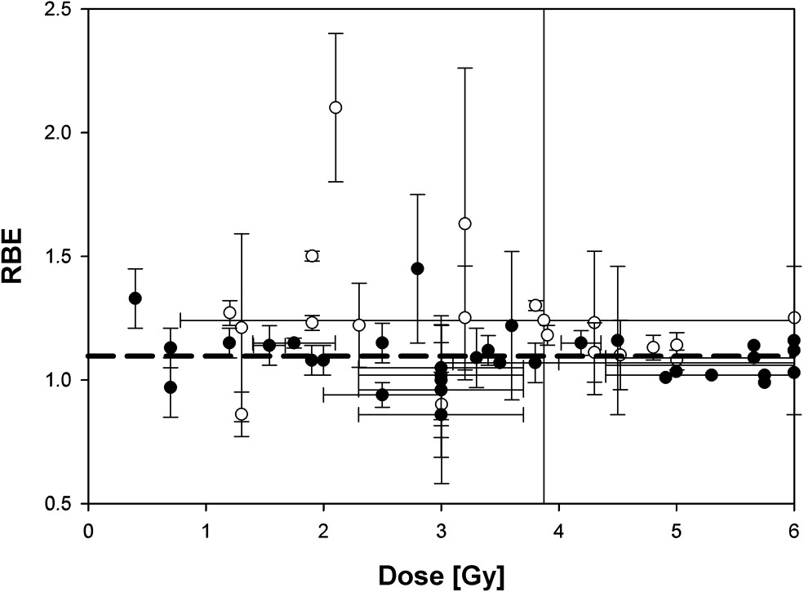
The Case for LhARA
Growing global requirement for radiotherapy
  Improve availability & accessibility with new & cost-effective technologies
Systematic study of the radiobiology of ion beams
  Treatment planning is RBE dependant
  Uncertainties due to:
    Energy, ion species, dose, spatial distribution, dose rate, tissue type, biological endpoint
  Proton RBE variation
    All p-treatment planning uses RBE = 1.1
    Ion RBE as high as 2 – 3.
Paganetti,
van Luijk
(2013)
SemRadOncol
Novel treatment modalities
  Ultra-high dose rates: FLASH
  Spatially fractionated – mini-beams
Further research is required, both in-vitro and in-vivo
DATA
MACHINE

Slide 3
The LhARA Collaboration
Deliver a systematic and definitive radiobiology programme
Prove the feasibility of the laser-driven hybrid-accelerator approach
Lay the technological foundations for the transformation of PBT

Slide 4
LhARA & ITRF
£2M UKRI Infrastructure Fund grant – establishment of Ion Therapy Research Facility (ITRF)
  Compact, single-site national research facility
  2 year “Preliminary Activity”
    3 year pre-construction phase
  Facility CDR by October 2024
LhARA to serve ITRF
  Conventional technology study (NIMMS)
    Synchrotron & injector from established ion sources & acceleration methods
LhARA work package structure:
  WP1.1: Project management
  WP1.2: Laser-driven source
  WP1.3: Beam capture
  WP1.4: Ion acoustic diagnostics
  WP1.5: Novel end station
  WP1.6: Design & integration
Outreach & engagement
  Users, Patient and Public Involvement
  Website
  Peer group consultation meetings, Dec 2022, June 2023.

Slide 5
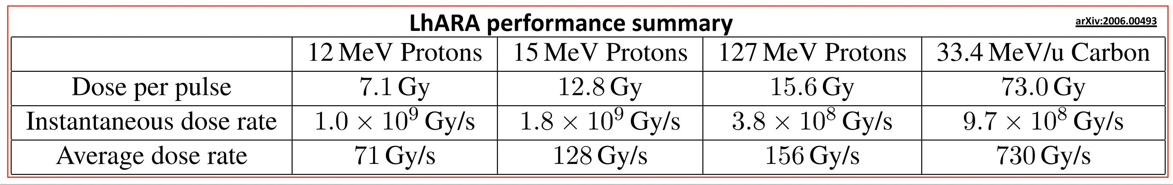
The LhARA Accelerator
Pre-conceptual design report (pre-CDR) publication:
LhARA baseline design technical note:
Aymar, G. et al, Frontiers in Physics, (8), September 2020, 567738
https://ccap.hep.ph.ic.ac.uk/trac/raw- attachment/wiki/Communication/Notes/CCAP-TN-11-LhARA-Design- Baseline.pdf

Slide 6
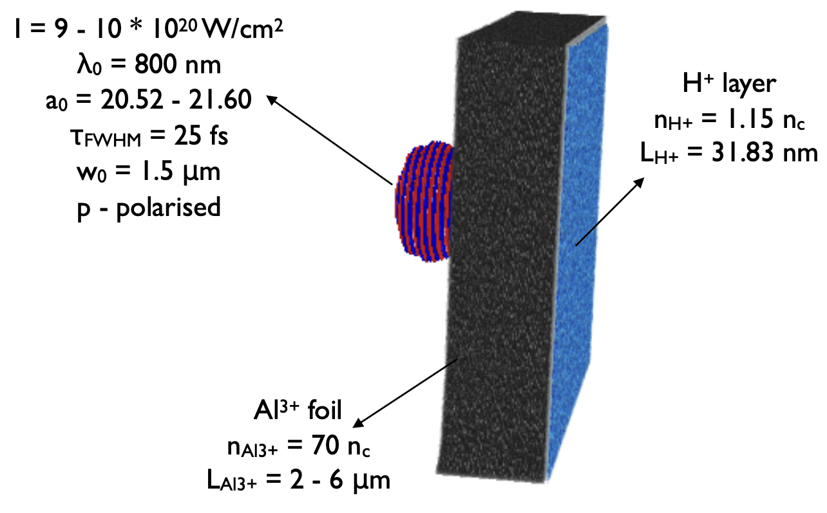
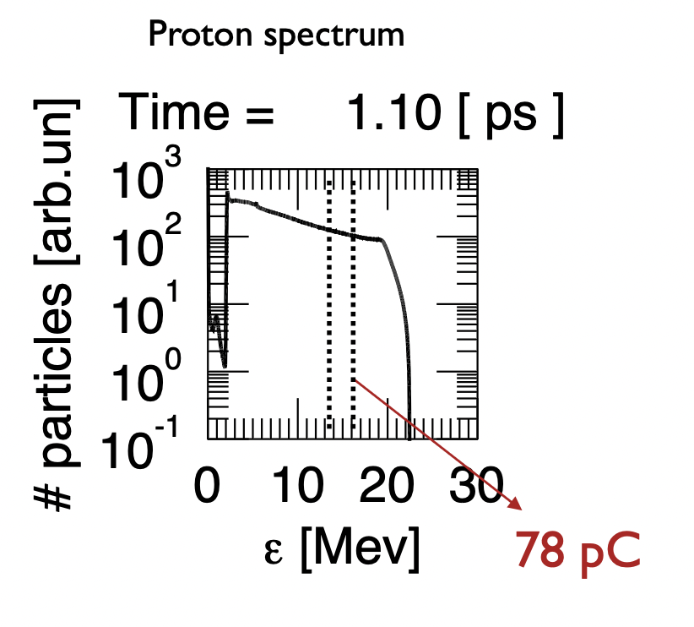
Laser-driven Proton & Ion Source
High intensity laser driven ion sources:
  High instantaneous dose rate - 10-40 ns bunches
  Triggerable; arbitrary pulse structure
  High energy from source (up to ~100 MeV)
Proton & ion source prediction
  3D TNSA simulations
  SCAPA facility & experimental beam time
Identify LhARA facility laser-target requirements
  Generation of proton (15 MeV) and carbon (4 MeV/u) beams using existing “tape” targets
  10 Hz operation
  Understanding of debris & stabilisation schemes

Slide 7
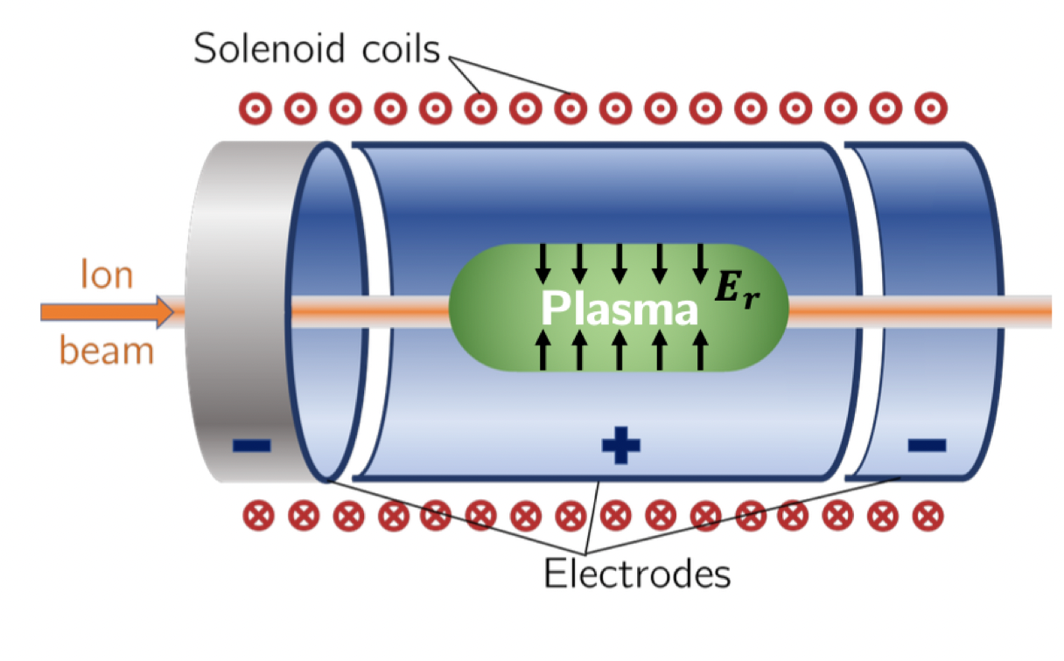
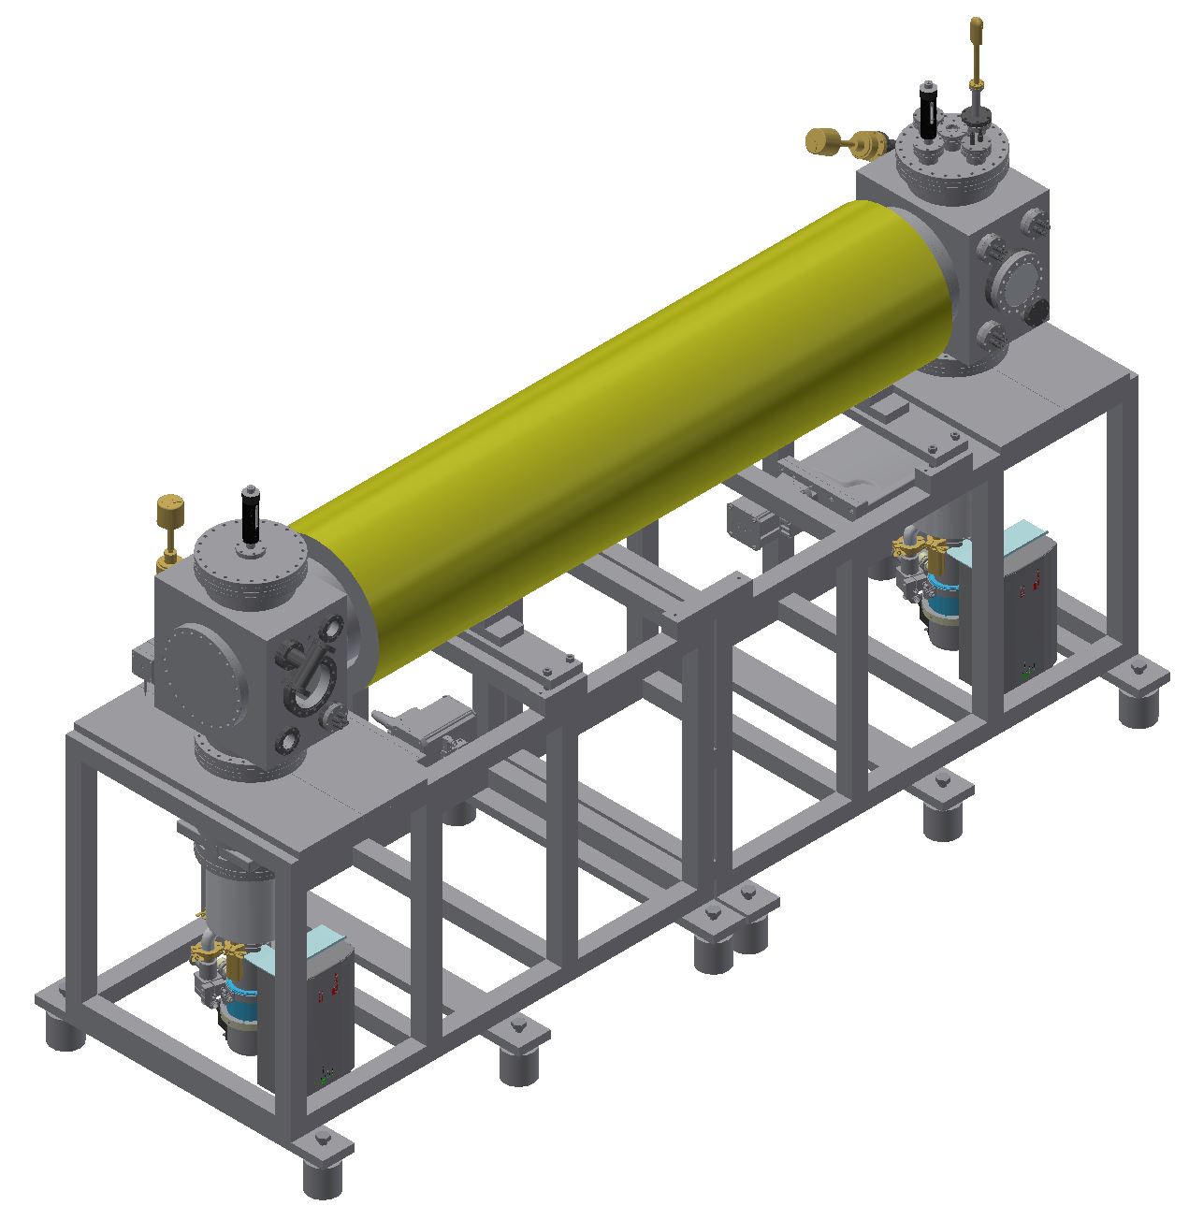


Proton & Ion Capture
Novel Gabor electron-plasma-lens
  Capture & focusing
  Solenoid-like strong focusing without high power, high-field magnet
  Radial focussing in both planes simultaneously
  Energy-dependent focusing strength
Develop a detailed design of the next generation Gabor-lens prototype
Experimental setup at Swansea University
  Electron-plasma dynamics measurements
  Bench-mark simulations
    VSim & WarpX
$e^{−}$ source
B~0.1T
P-screen
~2m
Electrodes

Slide 8
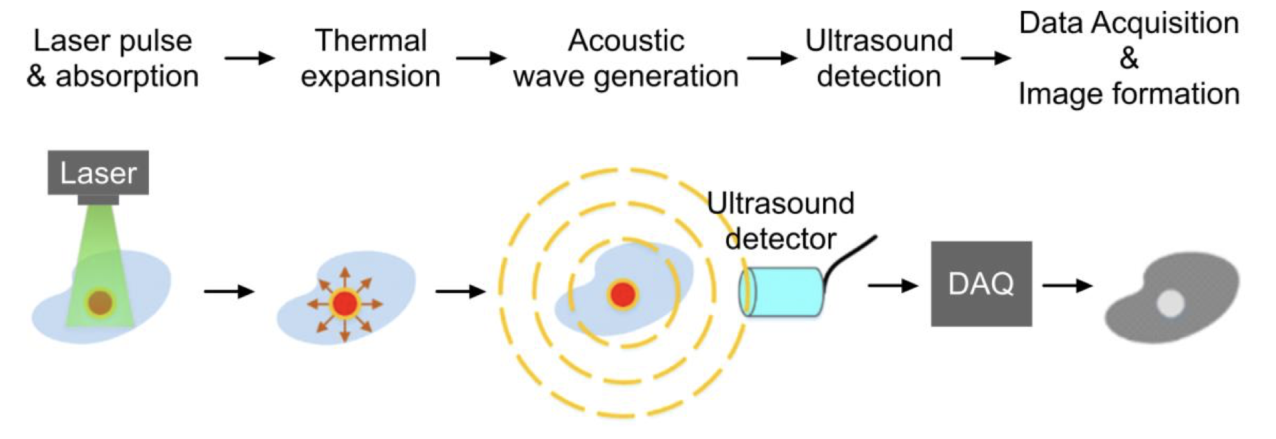



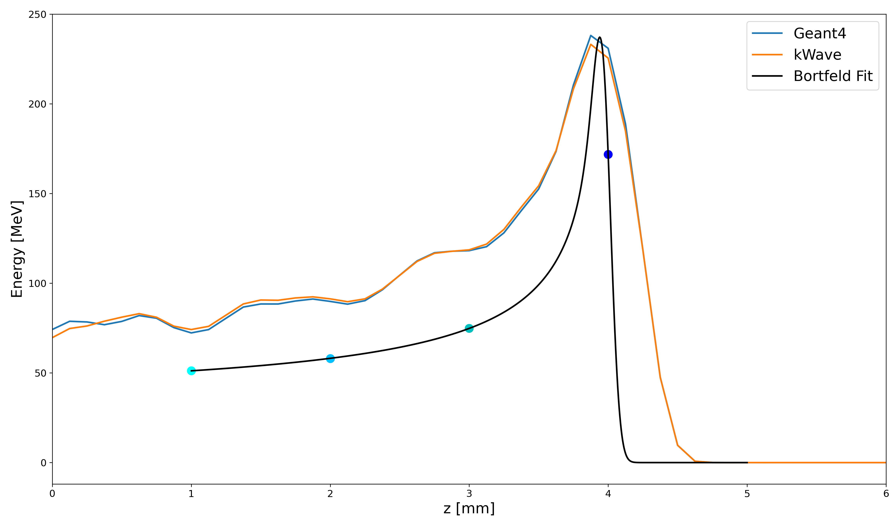
Ion-Acoustic Dose Mapping
On-the-fly, non-invasive, range verification system
  Real-time dose deposition profile
  Bragg peak localization
Beam induced thermoelastic expansion
  Increase in pressure - acoustic wave (thermoacoustic effect)
  Ultrasound detector
  Image reconstruction
Design proof of principle experiment
  Geant4 MC simulation
  K-wave acoustic model
LION beamline at CALA (LMU Munich)
  BDSIM modelling of experimental setup

Slide 9
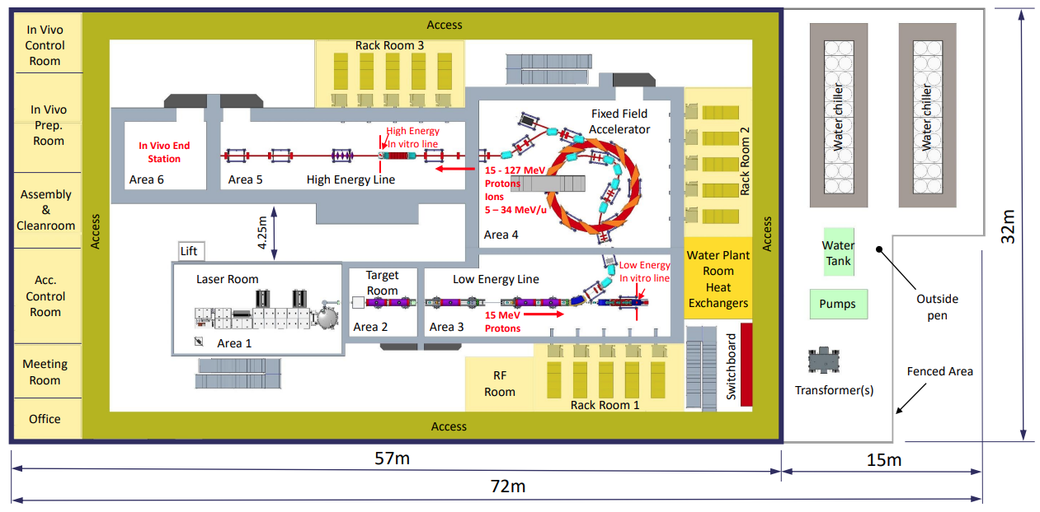
LhARA Facility Infrastructure
Engineering design underway
  Iterate as systems develop
Magnets, RF, Diagnostics, End stations, Shielding, Electrical power, Cooling, Vacuum, Controls, …

Slide 10
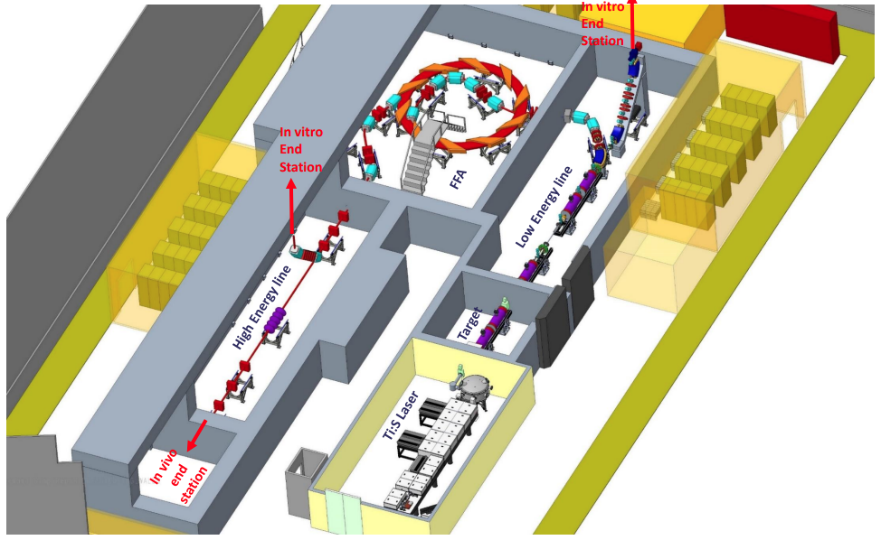
LhARA Facility
Engineering design underway
  Iterate as systems develop
CAD modelling
  Survey generation from BDSIM

Slide 11
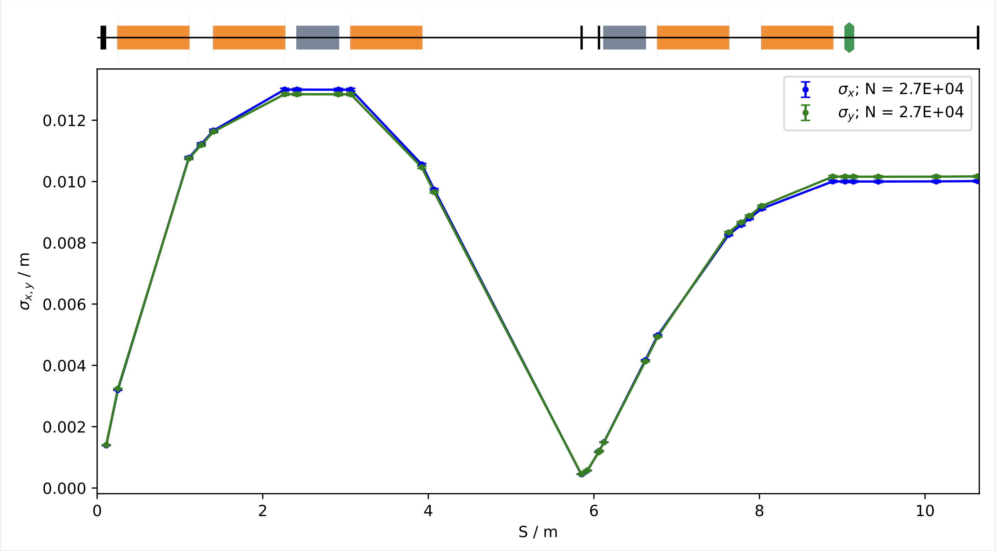
LhARA Stage 1
Conceptual design of the LhARA facility, the accelerator systems, and their integration with the end station
Hybrid simulation strategy
  MADX & BeamOptics
  BDSIM
  GPT
SCAPA beam from TNSA PIC simulations
Optimised to mitigate emittance growth from space-charge forces
Modelling Gabor lenses as solenoids - simultaneously consider contingency
Beam requirements for FFA injection remain challenging

Slide 12
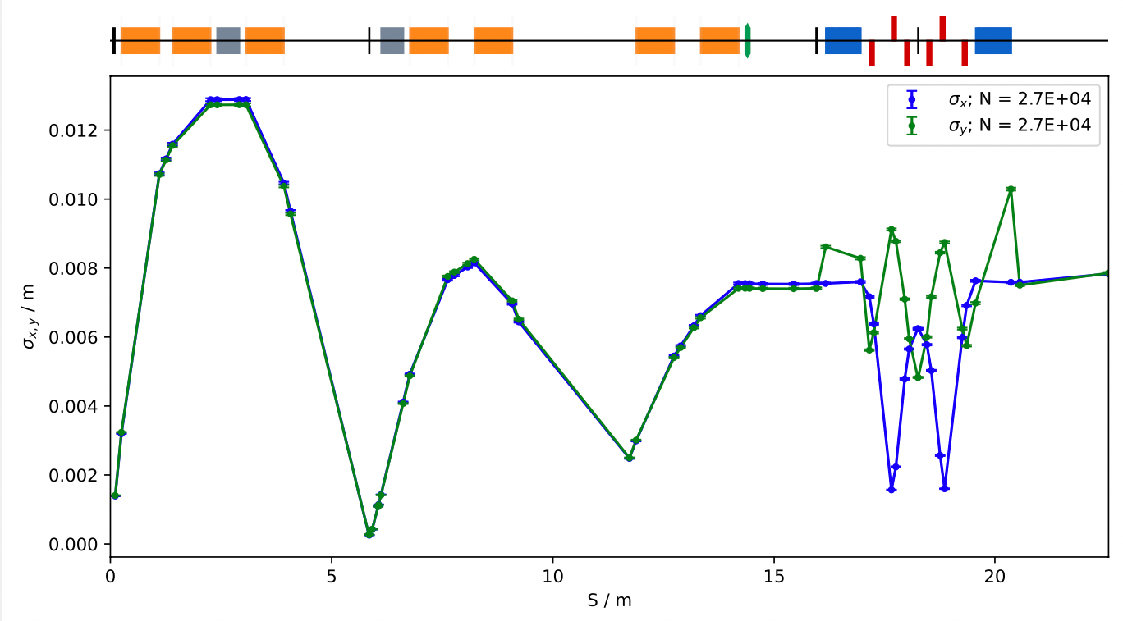
Alternative Configuration
Deliver spot-size flexibility
FFA injection line requirements nominally achievable
  Space charge considerations
Ongoing optimisation efforts
  Optics, collimation, octupoles, etc.
Evaluate deliverable dose rates

Slide 13
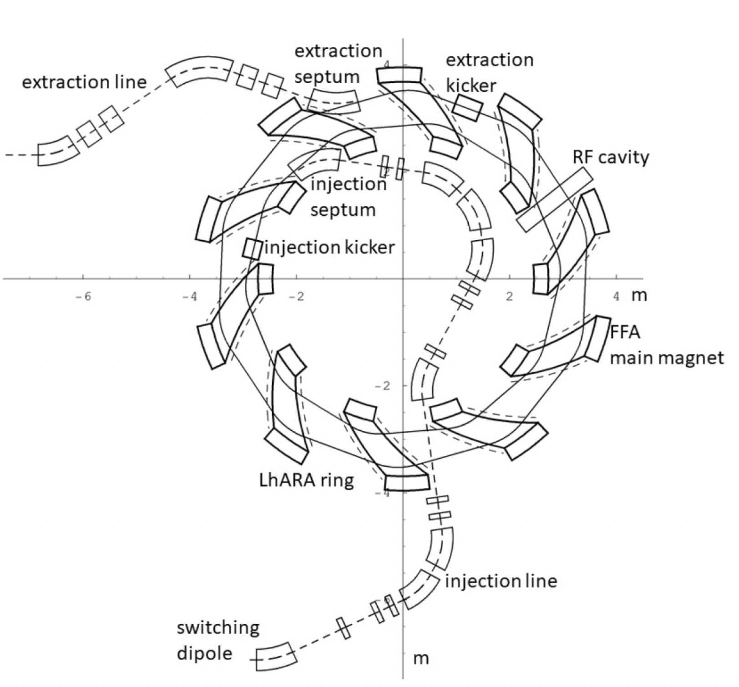
LhARA Stage 2
Injection line, FFA ring, extraction line, 2 end stations
FixField FFA tracking
  Space charge considerations needed
Injection line redesign to accommodate facility shielding
FFA tunability
10 cells, R_{max} = 3.48m
Spiral angle = 48.7°
Q_{x}, Q_{y} = 2.82, 1.22
P_{f} = 0.34
RF freq = 2.89 – 6.48 MHz

Slide 14
Summary
LhARA will serve the radiobiology community using a laser-hybrid approach
  Overcome dose-rate limitations of current and proton & ion therapy sources.
  Offer unparalleled flexibility by deliver a range of ion species, energies, dose, dose-rate and time and spatial distributions.
The LhARA and ITRF “Preliminary Activity ” programme is underway!
  Prove technical feasibility of novel accelerator technologies.
  Develop & deliver a broad radiation biology programme.
  Create the capability to transform proton and ion therapy.

Slide 15


Thank you
William Shields
william.shields@rhul.ac.uk

