Slide 1




Particle Accelerator and Beams Conference | 29-30th June 2023
Terahertz-driven electron bunch manipulation for advanced accelerators
Morgan Hibberd | STFC Ernest Rutherford Fellow | The University of Manchester
Terahertz Acceleration Group @ The Cockcroft Institute | www.THzAG.uk

Slide 2
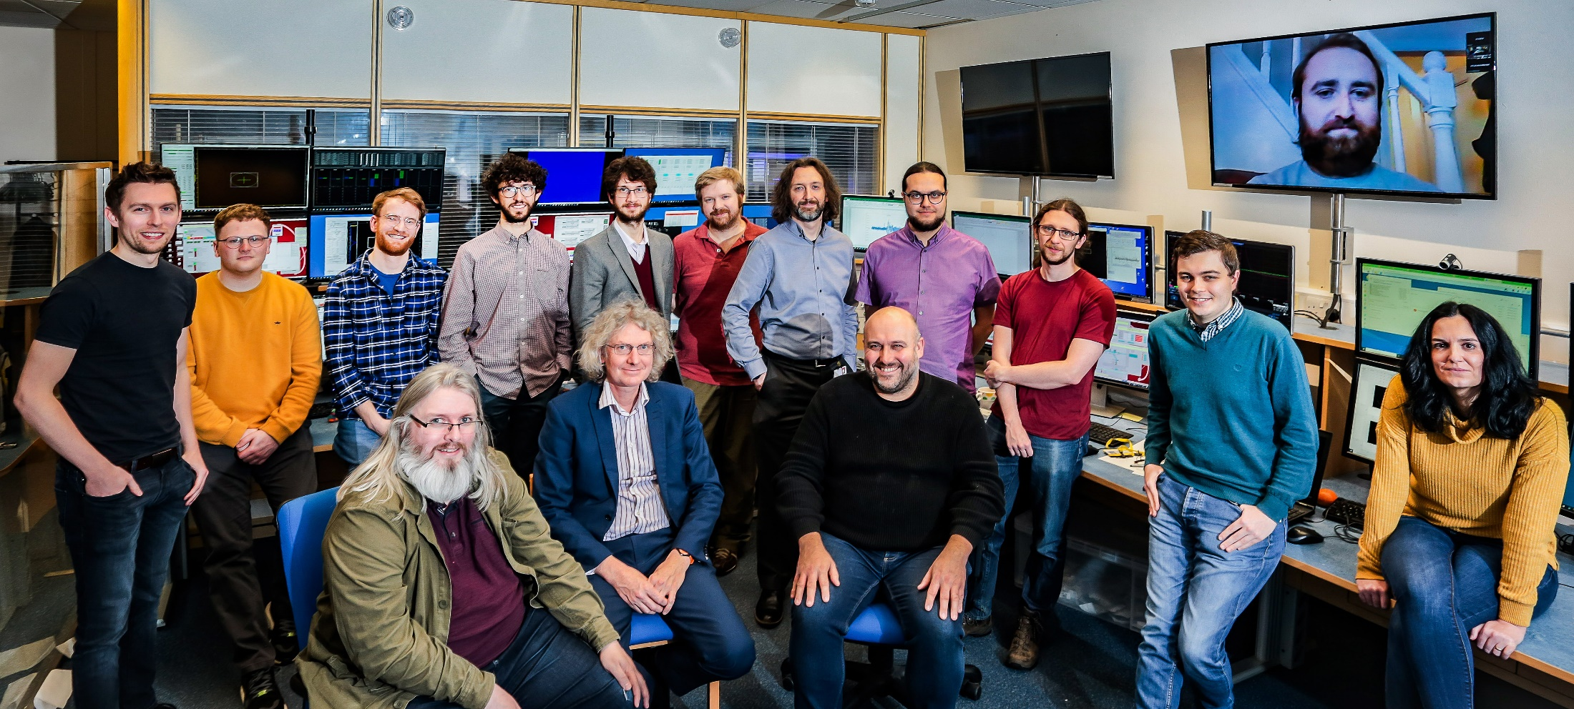


Terahertz Acceleration Group @ The Cockcroft Institute
www.THzAG.uk
Morgan Hibberd
Joseph Bradbury
Sergey Siaber
Darren Graham
Laurence Nix
Connor Mosley
Dan Lake
Christopher Shaw
Beatriz Higuera Gonzalez
Graeme Burt
Steven Jamison
Rob Appleby
Morgan Hibberd | Terahertz-driven electron bunch manipulation for advanced accelerators | 1/13

Slide 3
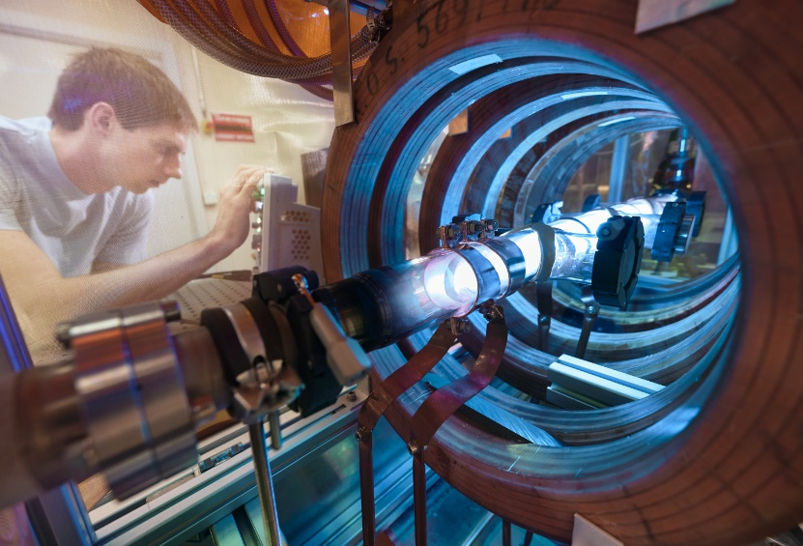

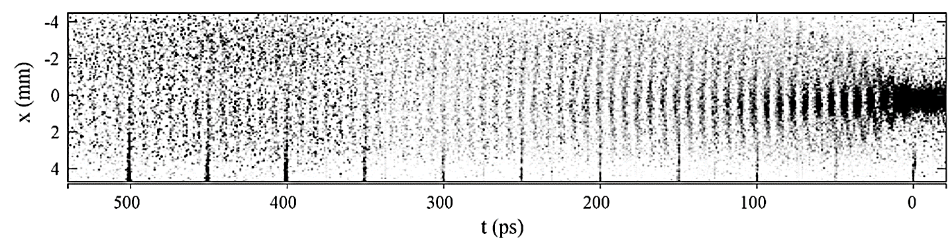
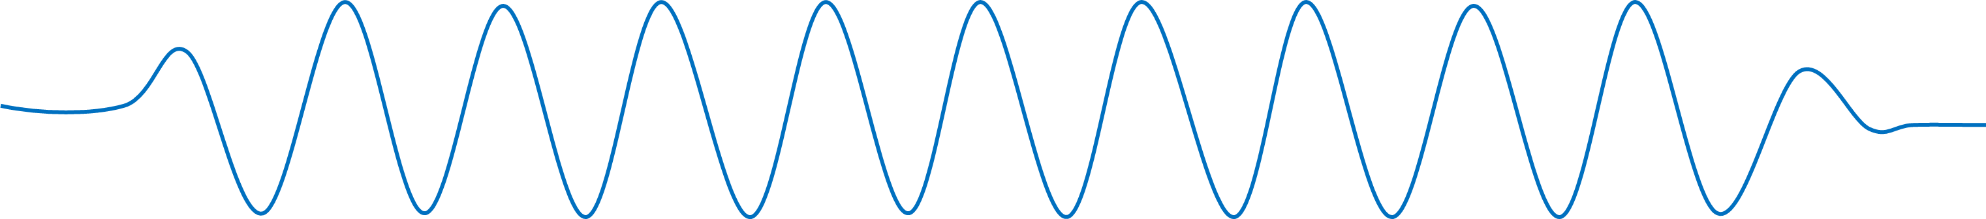
Why do THz techniques complement other advanced accelerators?
Advanced accelerators use THz frequency fields
Wakefields driven by lasers, electrons or protons
Plasma frequency ranges from 0.1 – 10 THz
The Advanced Wakefield Experiment (AWAKE)
Proton beam-driven wakefield
Plasma frequency ≈ 0.25 THz
In this talk
Image of modulated proton bunch
THz-driven bunching
Ultrashort duration
Temporal locking
Bunch trains at THz rep rates
For AWAKE
External injection schemes
RF ≈ 3 GHz
E. Gschwendtner et al. Symmetry 14,1680 (2022)
THz pulse ≈ 0.1-10 THz
Morgan Hibberd | Terahertz-driven electron bunch manipulation for advanced accelerators | 2/13

Slide 4
Why do THz techniques complement other advanced accelerators?
Advanced accelerators use THz frequency fields
Wakefields driven by lasers, electrons or protons
Plasma frequency ranges from 0.1 – 10 THz
The Advanced Wakefield Experiment (AWAKE)
Proton beam-driven wakefield
Plasma frequency ≈ 0.25 THz
In this talk
Image of modulated proton bunch
THz bunching
Run 1
THz-driven bunching
Ultrashort duration
Temporal locking
Bunch trains at THz rep rates
For AWAKE
External injection schemes
…+
E. Gschwendtner et al. Symmetry 14,1680 (2022)
Morgan Hibberd | Terahertz-driven electron bunch manipulation for advanced accelerators | 2/13

Slide 5
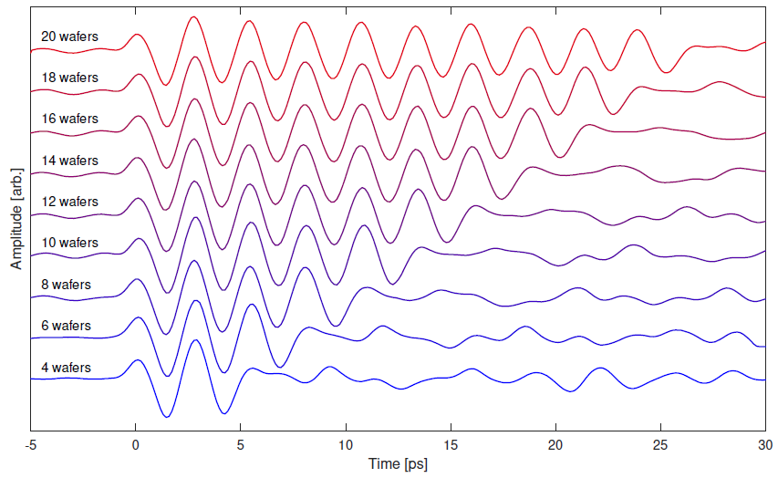
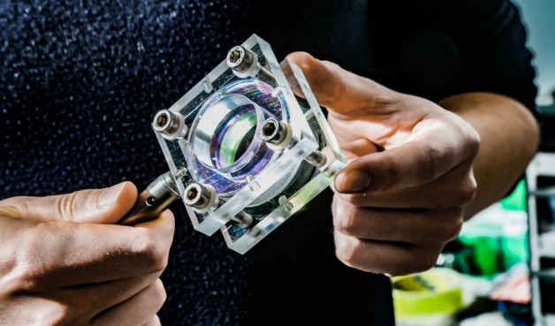
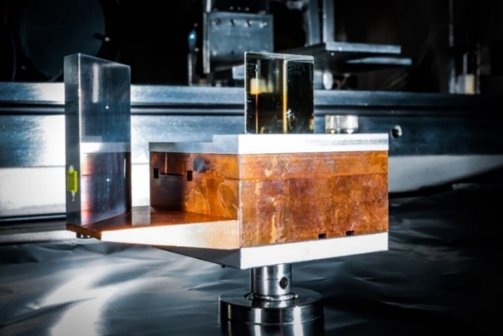
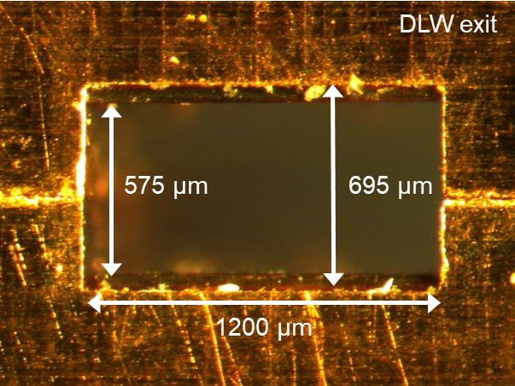
Why are terahertz pulses ideal for bunch manipulation?
High electric field strengths
100 MV/m to >GV/m possible
Periodically-poled lithium niobate wafer stack source
Laser and THz pulse shaping
Bandwidth and frequency tuning
Polarisation modes
Laser timing synchronisation
THz sources generated by drive laser
Synchronise to the fs-scale
C. D. W. Mosley et al. Opt. Express 31,4041 (2023)
Compact mm-scale structures
Minimal beam-line footprint
High-charge throughput (>100 pC)
Dielectric lined THz waveguide structure
Morgan Hibberd | Terahertz-driven electron bunch manipulation for advanced accelerators | 3/13

Slide 6
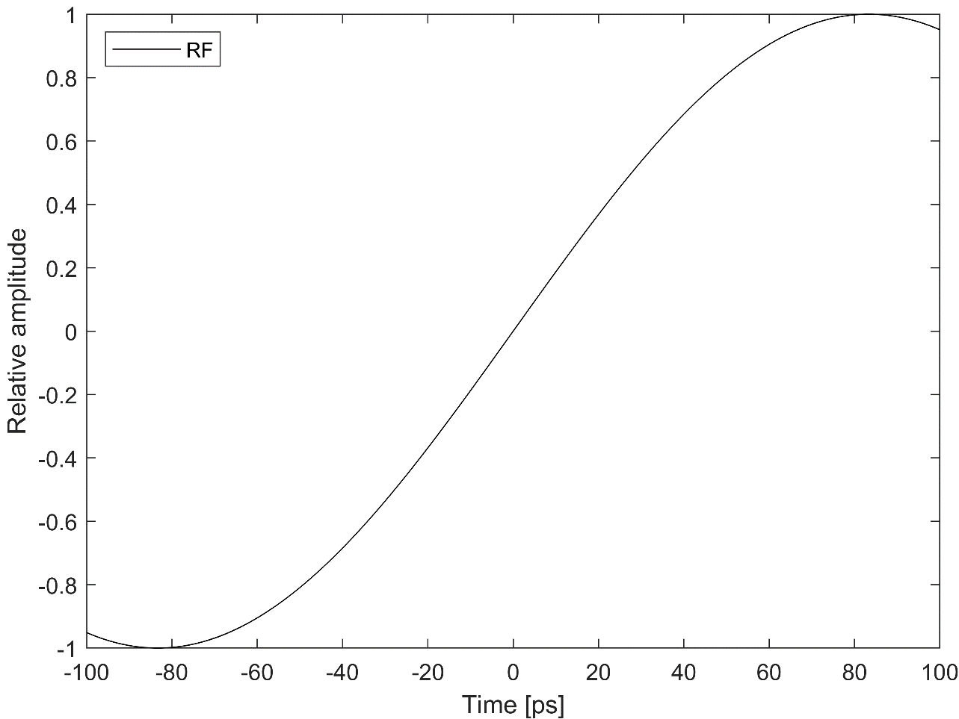
Why are terahertz pulses ideal for bunch manipulation?
High electric field strengths
100 MV/m to >GV/m possible
Laser and THz pulse shaping
Bandwidth and frequency tuning
Polarisation modes
Laser timing synchronisation
THz sources generated by drive laser
Synchronise to the fs-scale
Compact mm-scale structures
Minimal beam-line footprint
High-charge throughput (>100 pC)
Optimal frequency for manipulation
Short enough field cycle for fs control
Long enough for ps-scale bunch lengths
Morgan Hibberd | Terahertz-driven electron bunch manipulation for advanced accelerators | 3/13

Slide 7
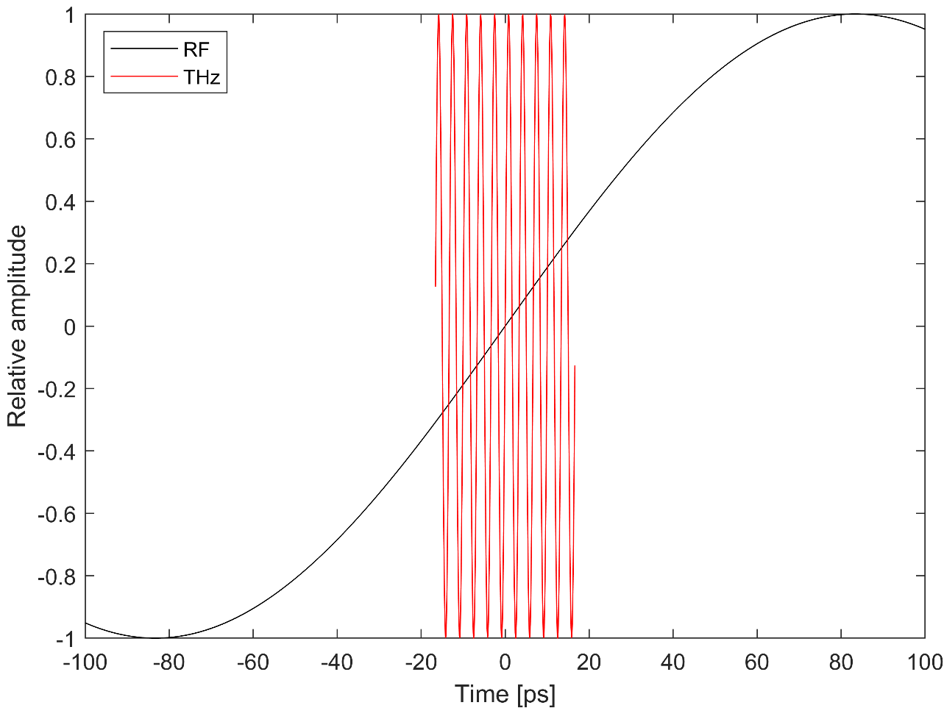
Why are terahertz pulses ideal for bunch manipulation?
High electric field strengths
100 MV/m to >GV/m possible
Laser and THz pulse shaping
Bandwidth and frequency tuning
Polarisation modes
Laser timing synchronisation
THz sources generated by drive laser
Synchronise to the fs-scale
Compact mm-scale structures
Minimal beam-line footprint
High-charge throughput (>100 pC)
Optimal frequency for manipulation
Short enough field cycle for fs control
Long enough for ps-scale bunch lengths
Morgan Hibberd | Terahertz-driven electron bunch manipulation for advanced accelerators | 3/13

Slide 8
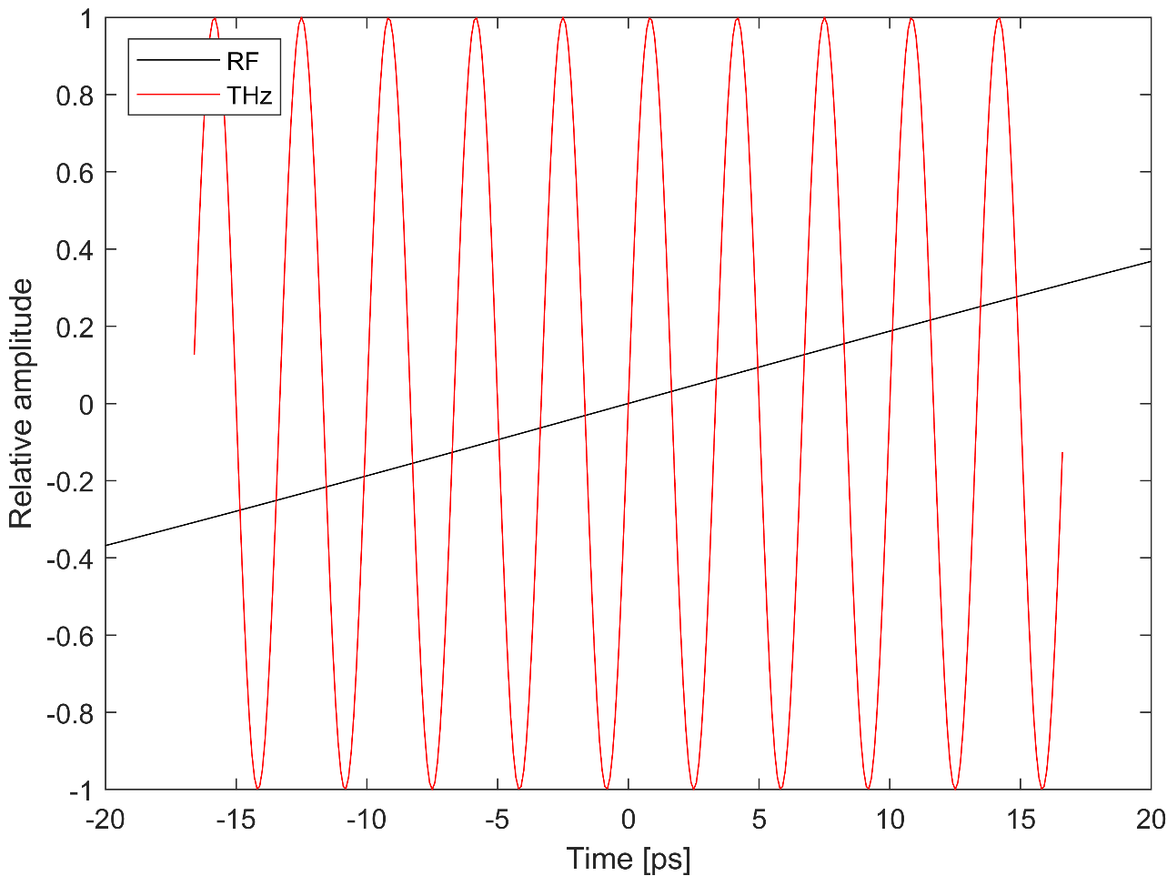
Why are terahertz pulses ideal for bunch manipulation?
High electric field strengths
100 MV/m to >GV/m possible
Laser and THz pulse shaping
Bandwidth and frequency tuning
Polarisation modes
Laser timing synchronisation
THz sources generated by drive laser
Synchronise to the fs-scale
Compact mm-scale structures
Minimal beam-line footprint
High-charge throughput (>100 pC)
Optimal frequency for manipulation
Short enough field cycle for fs control
Long enough for ps-scale bunch lengths
Morgan Hibberd | Terahertz-driven electron bunch manipulation for advanced accelerators | 3/13

Slide 9
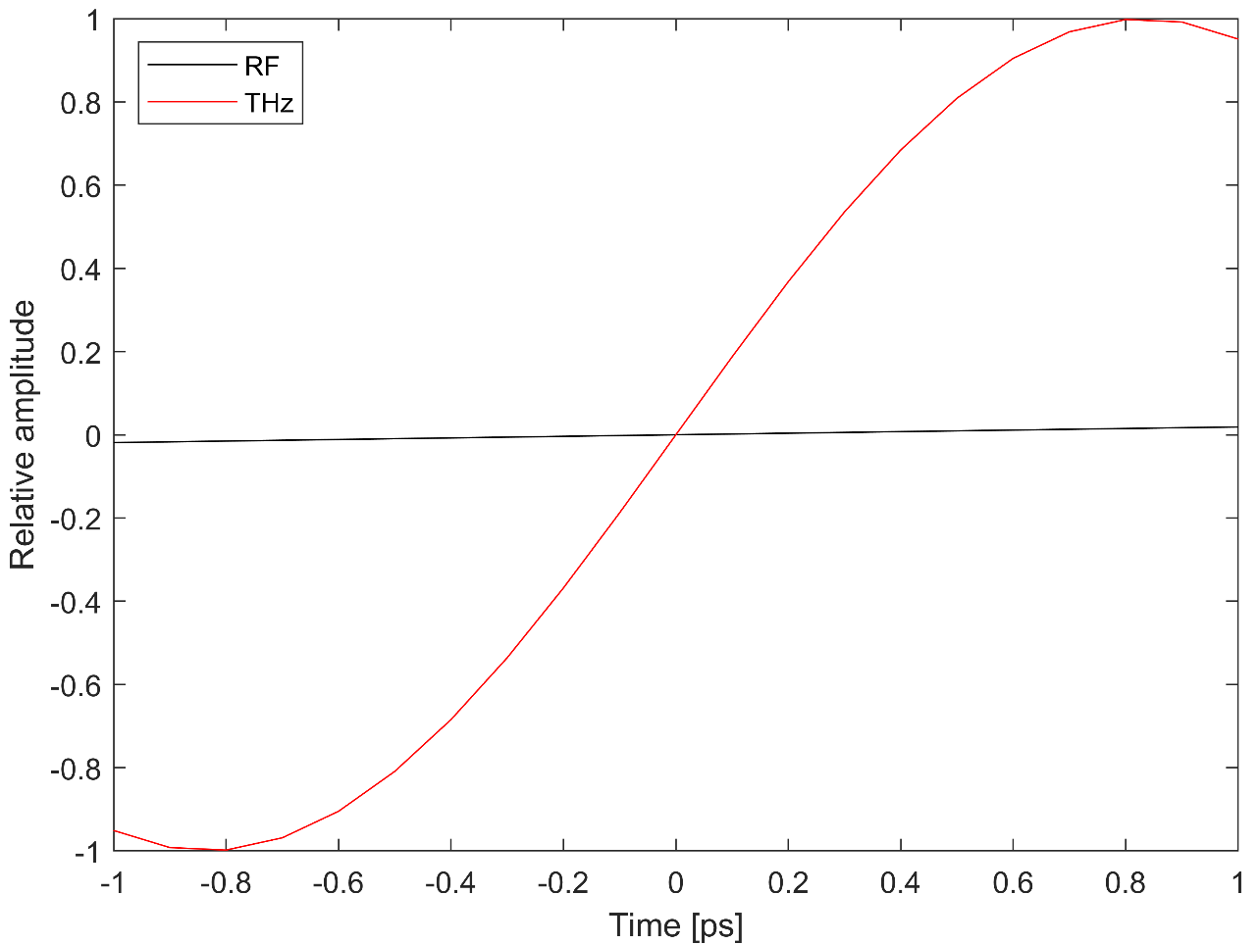
Why are terahertz pulses ideal for bunch manipulation?
High electric field strengths
100 MV/m to >GV/m possible
Laser and THz pulse shaping
Bandwidth and frequency tuning
Polarisation modes
Laser timing synchronisation
THz sources generated by drive laser
Synchronise to the fs-scale
Compact mm-scale structures
Minimal beam-line footprint
High-charge throughput (>100 pC)
Optimal frequency for manipulation
Short enough field cycle for fs control
Long enough for ps-scale bunch lengths
Morgan Hibberd | Terahertz-driven electron bunch manipulation for advanced accelerators | 3/13

Slide 10
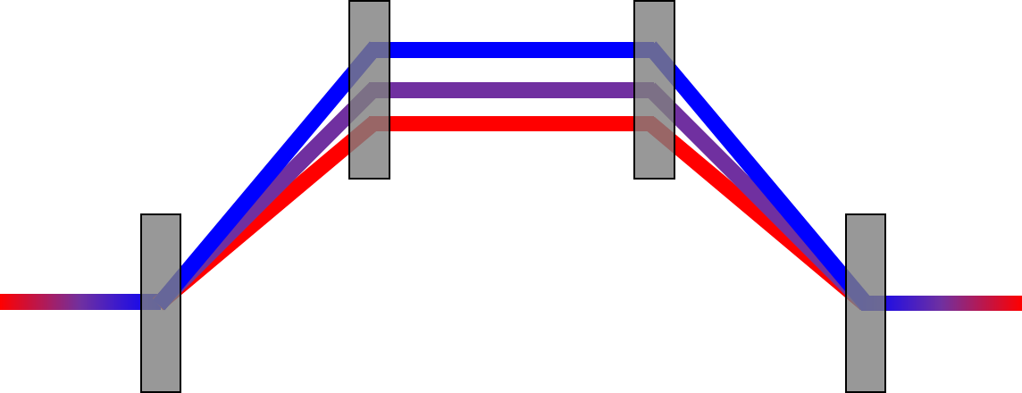

How does terahertz-driven bunching work?
Induce an energy chirp (or modulation) followed by compression
Analogous to standard RF-based zero-crossing compression
Higher THz frequency makes interaction more efficient
And… makes multi-bunch generation possible
Magnetic chicane
Lower energy
Multi-cycle THz pulse
Higher energy
Dipole magnets
Short electron bunch
Longer chirped electron bunch
Or a dog-leg
Energy
THz energy modulation
R₅₆ compression
Micro-bunch train
Time
Morgan Hibberd | Terahertz-driven electron bunch manipulation for advanced accelerators | 4/13

Slide 11
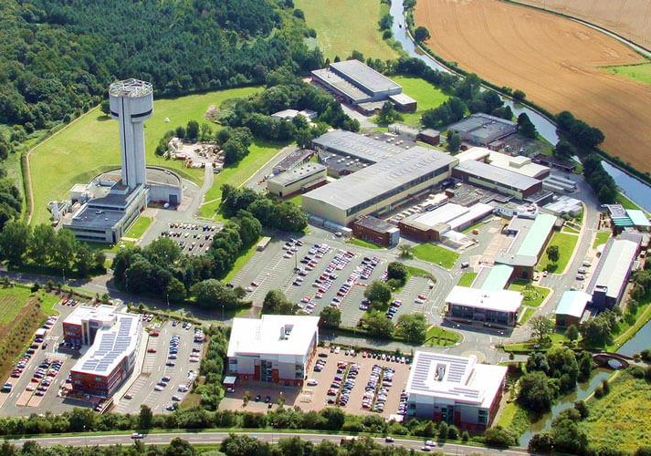
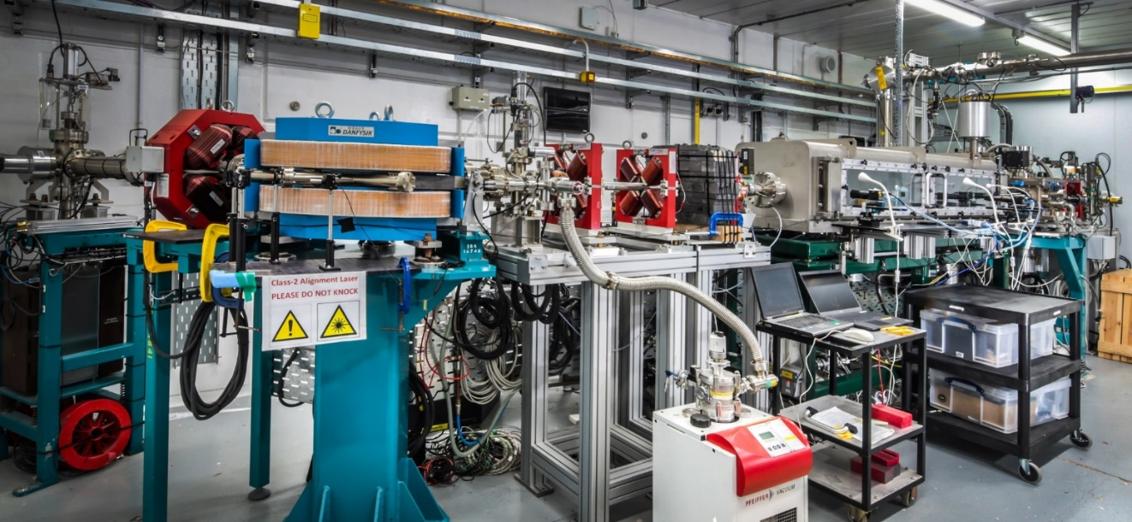

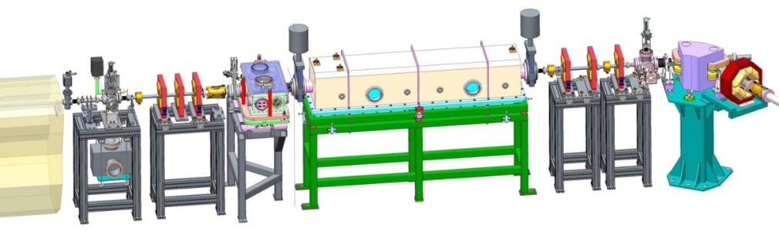
Experiments on CLARA @ Daresbury Laboratory
CLARA
Beam Area 1
Energy spectrometer
Interaction chamber
Compact Linear Accelerator for Research and Applications
Bunch parameters
Energy: 35.5 MeV
Charge: 2 – 100 pC
Duration: 0.2 – 6 ps
Spot size: 100 µm
Rep. rate: 10 Hz
Optical breadboard
Morgan Hibberd | Terahertz-driven electron bunch manipulation for advanced accelerators | 5/13

Slide 12
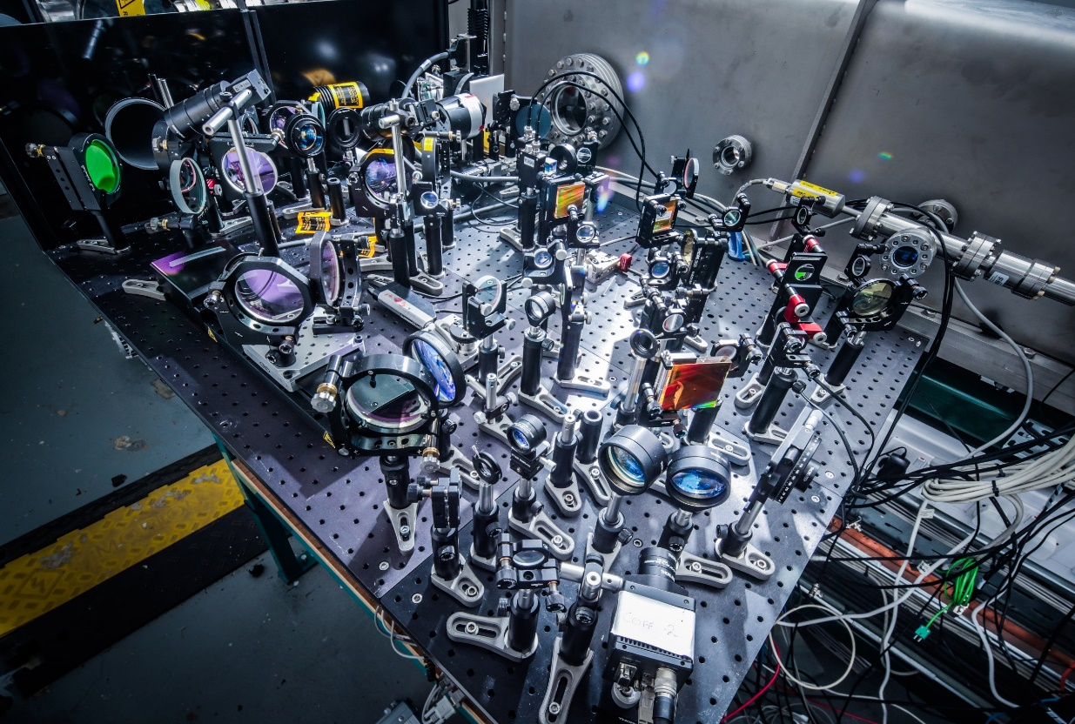
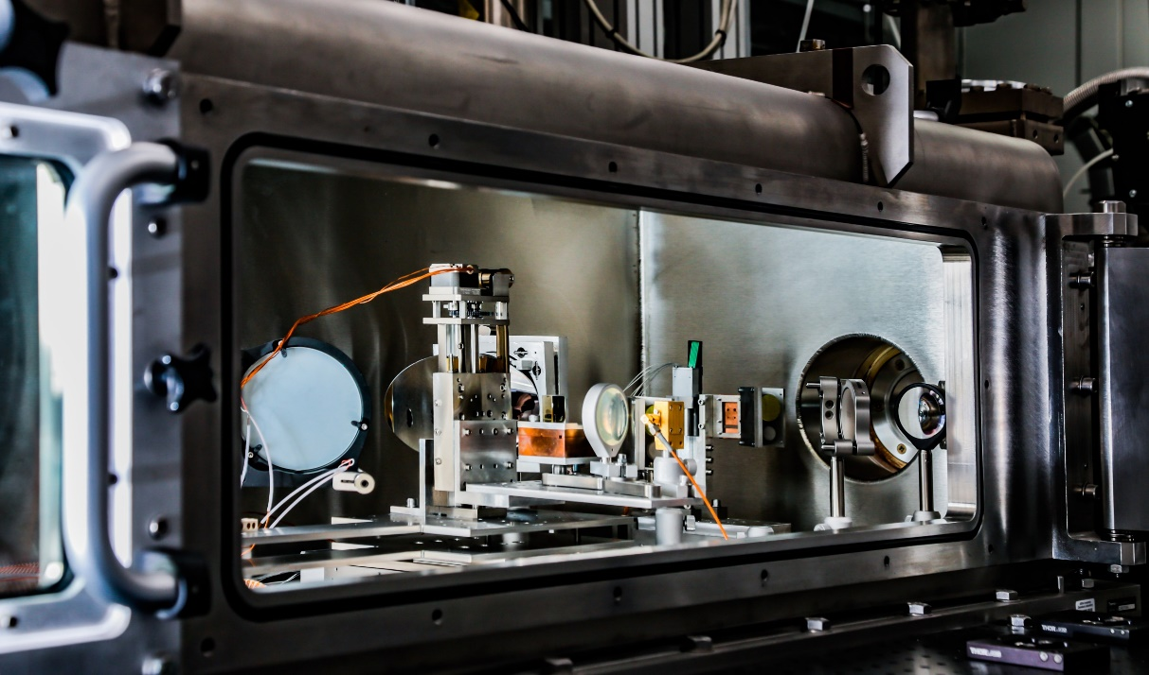
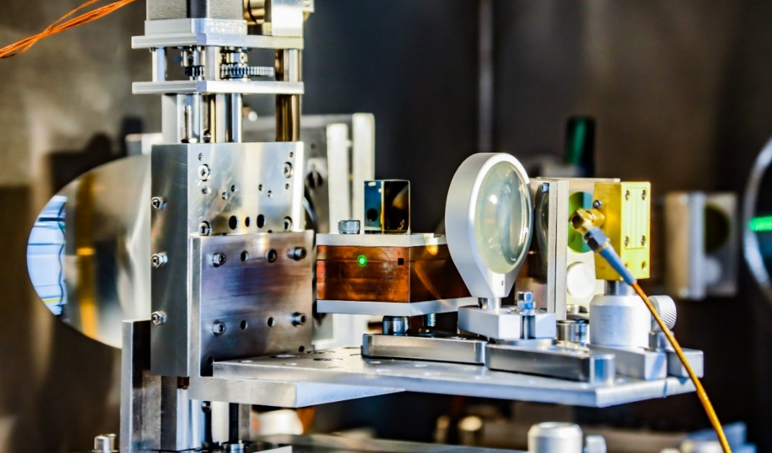
Experimental setup
THz-electron interaction point inside vacuum chamber
1.2m x 0.9m
Laser and THz optics outside chamber
Laser parameters
Wavelength: 800 nm
Pulse length: 50 fs
Chirped to 750 fs
Pulse energy: 300 mJ
≈150 mJ on THz source
THz parameters
Frequency: 0.4 THz
Bandwidth: 40 GHz
10 cycles each 2.5 ps
Pulse energy: ≈100 μJ
<20% coupling
Morgan Hibberd | Terahertz-driven electron bunch manipulation for advanced accelerators | 6/13

Slide 13

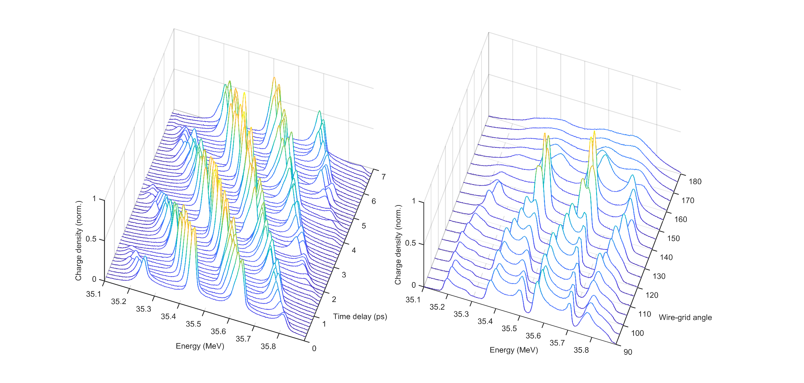
Terahertz-driven multi-cycle energy modulation
Energy modulation demonstrated experimentally
Chirped (>4 ps rms) bunches interact with multiple THz field cycles
Can tune THz field strength and injection timing to control energy modulation
M. T. Hibberd et al. Nature Photonics 14,755-759 (2020)
Varying THz field strength
Varying THz injection timing
Morgan Hibberd | Terahertz-driven electron bunch manipulation for advanced accelerators | 7/13

Slide 14
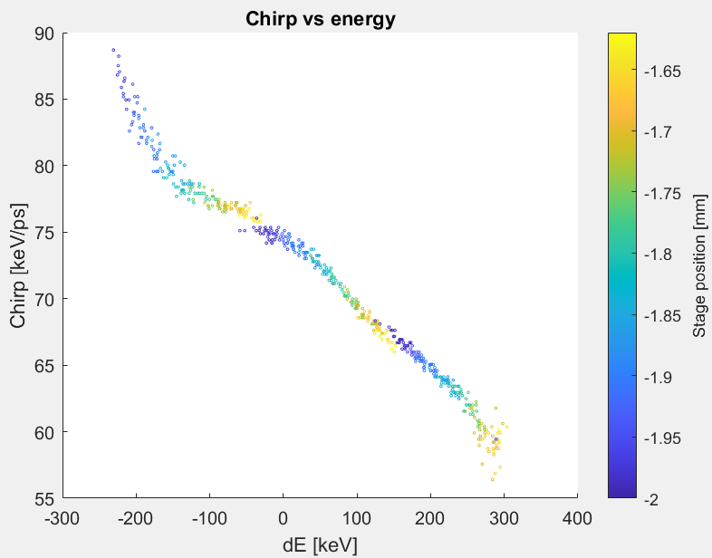
Terahertz-driven multi-cycle energy modulation
Energy modulation demonstrated experimentally
Chirped (>4 ps rms) bunches interact with multiple THz field cycles
Can tune THz field strength and injection timing to control energy modulation
Longitudinal phase space diagnostic
Varying THz field strength
Varying THz injection timing
Now just need magnetic compression to convert into micro-bunches
Can model this using our experimental data for now
Morgan Hibberd | Terahertz-driven electron bunch manipulation for advanced accelerators | 7/13

Slide 15
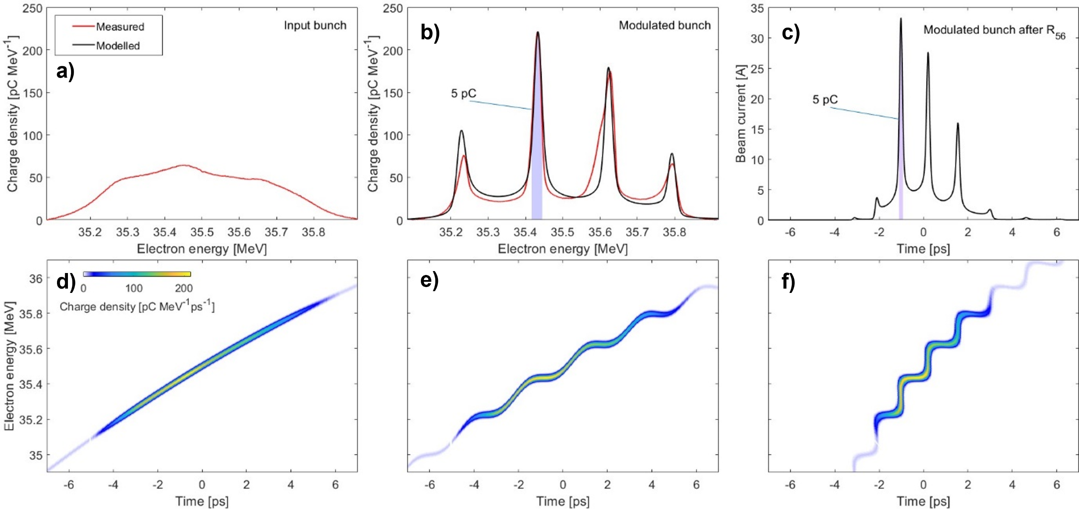
Terahertz-driven micro-bunching
THz off
THz on (sharpest energy peaks)
After R₅₆ compression
75 fs rms
4.4 ps rms
W_{THz} ≈ 2 μJ
E_{acc} ≈ 3 MV/m
Morgan Hibberd | Terahertz-driven electron bunch manipulation for advanced accelerators | 8/13
Notes:
R56 = - 6.8 ps/MeV = 7.2 cm

Slide 16
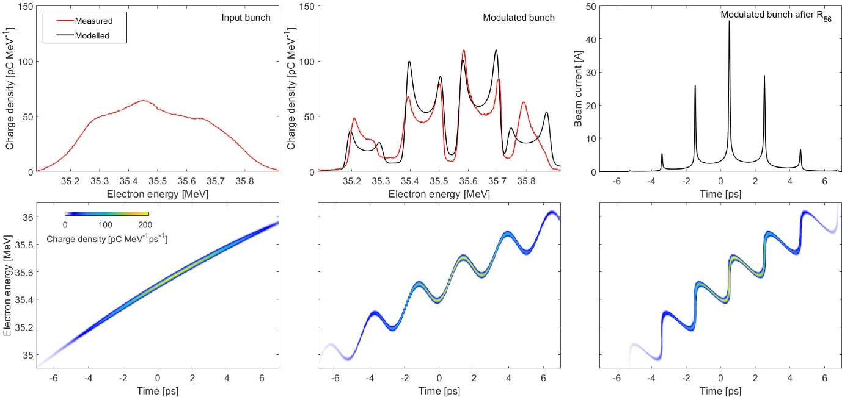
Terahertz-driven micro-bunching
THz off
THz on (largest peak splitting)
After R₅₆ compression
45 fs rms
4.4 ps rms
W_{THz} ≈ 20 μJ
E_{acc} ≈ 10 MV/m
Morgan Hibberd | Terahertz-driven electron bunch manipulation for advanced accelerators | 9/13
Notes:
R56 = - 3.1 ps/MeV = 3.3 cm

Slide 17
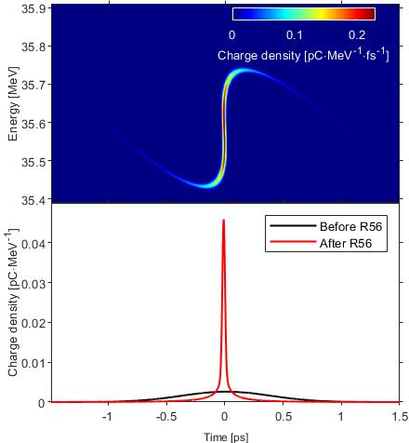
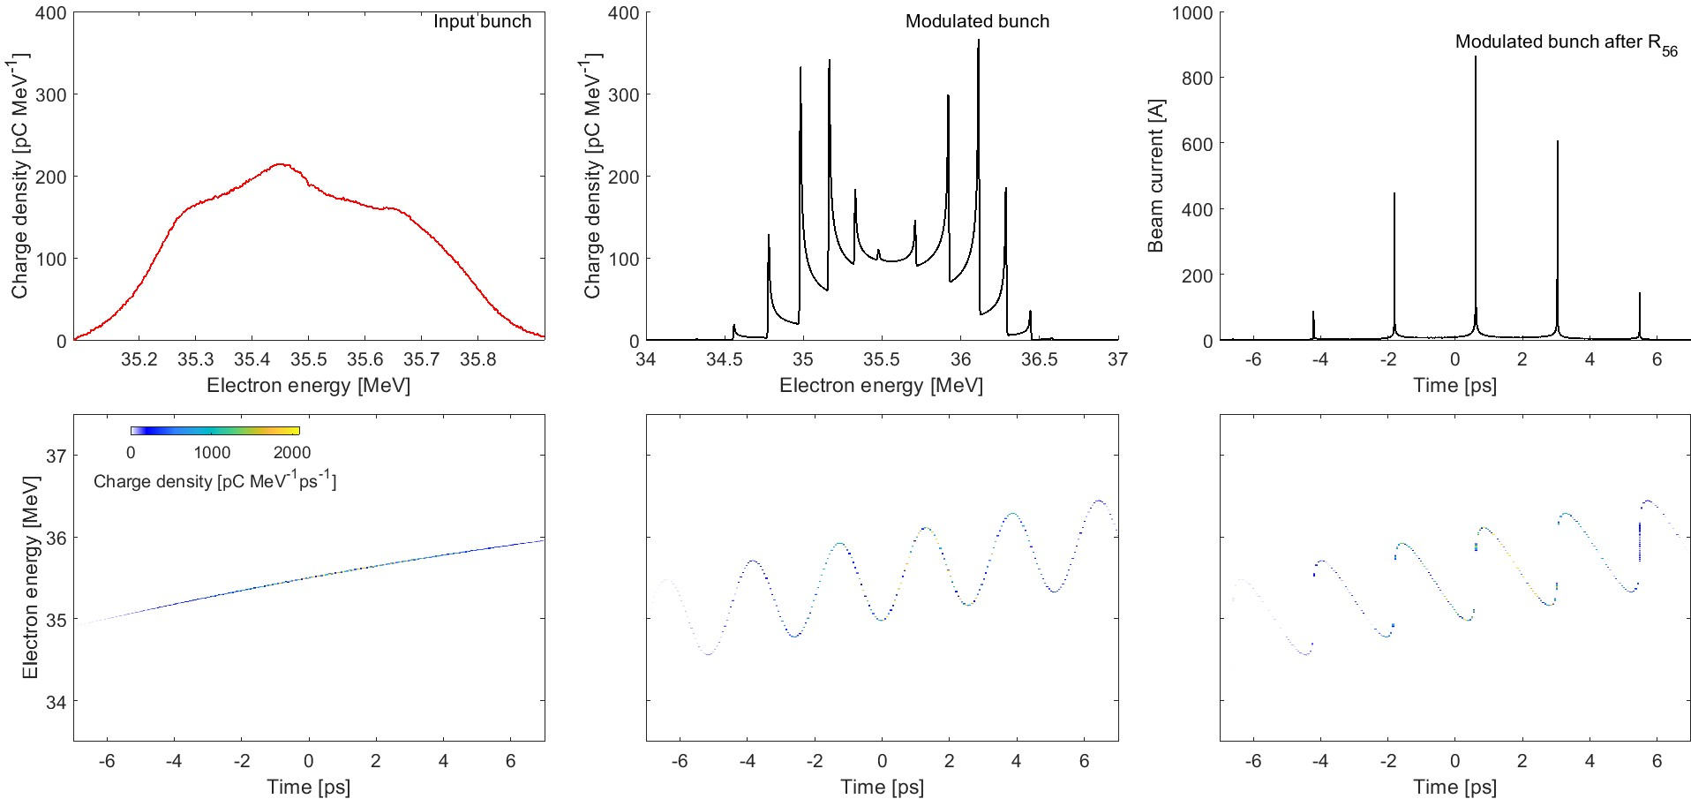
Terahertz-driven bunching
Single bunch compression
THz on
After R₅₆ compression
<10 fs rms
≈ 10 fs rms
kA peak current
From experimental measurements
Shorter (< 1 ps) input bunch
Injected into a single THz cycle
50 MV/m THz fields
4 keV uncorrelated energy spread
Duration, spacing and number of micro-bunches controlled by:
THz source frequency
THz field strength
Electron bunch chirp
Electron bunch length
Magnitude of R₅₆ compression
Morgan Hibberd | Terahertz-driven electron bunch manipulation for advanced accelerators | 10/13
Notes:
R56 = - 2.5 ps/MeV = 2.7 cm
R56 = - 2.4 ps/MeV = 2.6 cm

Slide 18
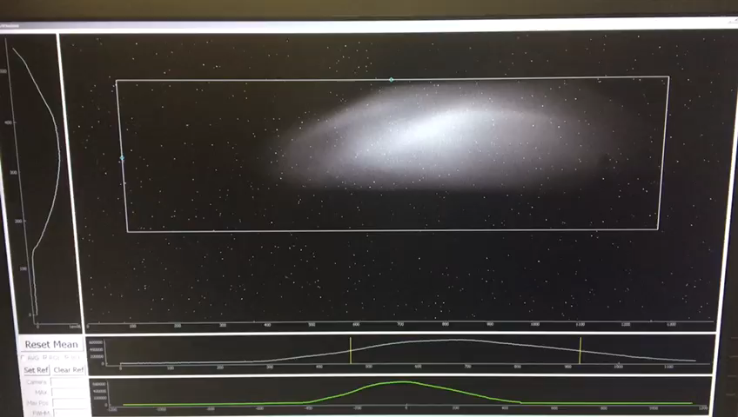
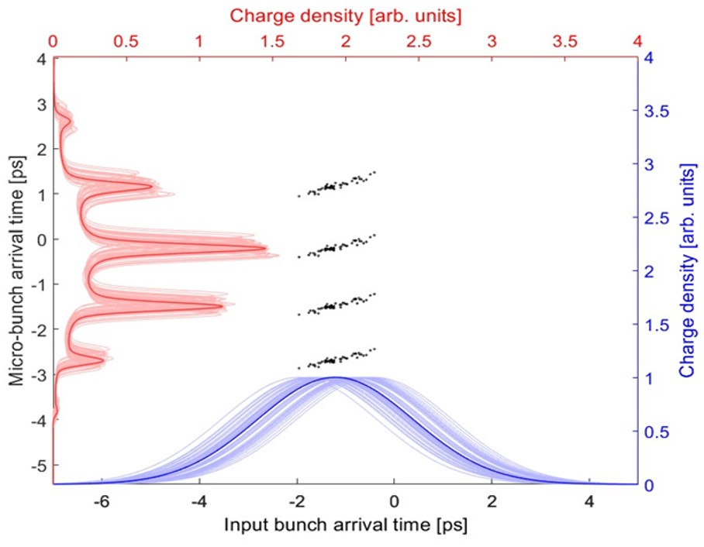
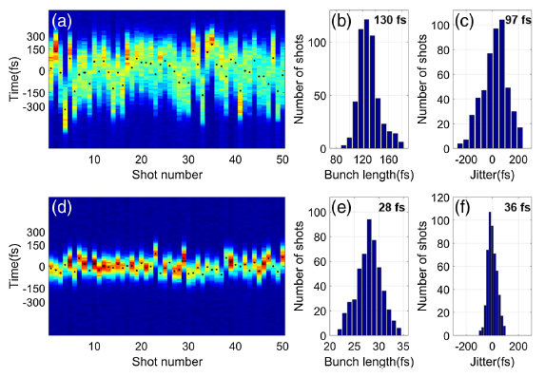
Terahertz-driven bunching – temporal locking
THz-induced energy and timing jitter reduction
  Energy jitter on the initial electron bunch
  THz-induced energy modulation observed to be more stable
Energy spectrometer with THz on and off
Shanghai group – compression and timing jitter reduction
≈ 400 fs
≈ 100 fs
  Micro-bunches locked to the THz pulse (laser) timing
  Experimental data indicates 4x reduction in timing jitter
L. Zhao et al. Phys. Rev. Lett. 124,054802 (2020)
Morgan Hibberd | Terahertz-driven electron bunch manipulation for advanced accelerators | 11/13

Slide 19
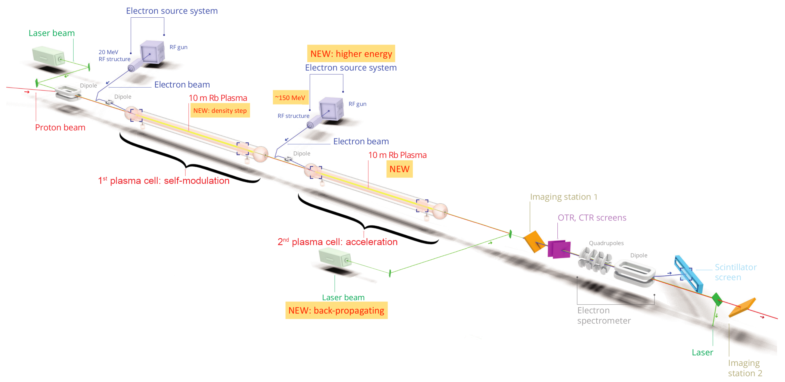
Opportunities at AWAKE
150 MeV electron beam
Vacuum chamber
THz injection time delay
THz waveguide
THz source
Optical breadboard
Located between injector and dog-leg
Laser
Key features for AWAKE
Ultrashort bunches for injection
Temporal locking between witness bunch and wakefield
Bunch trains matched to wakefield
  Multi-bunch injection + acceleration
  Pump-probe wakefield dynamics
Longitudinal diagnostic for witness
E. Gschwendtner et al. Symmetry 14(8),1680 (2022)
Morgan Hibberd | Terahertz-driven electron bunch manipulation for advanced accelerators | 12/13

Slide 20
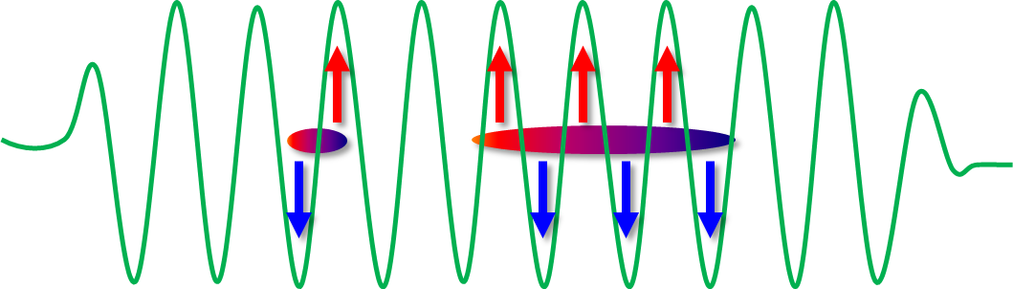
Summary
THz-driven electron bunch manipulation
Ultrashort bunches with phase-locked timing jitter
  Optimised injection
Bunch trains at THz repetition rates
  Multi-bunch injection
  Pump-probe wakefield dynamics
Energy-modulation for longitudinal bunch diagnostics
  Measure bunch length and chirp
Acknowledgements
Terahertz Acceleration Group
Steven Jamison Connor Mosley
Darren Graham Daniel Lake
Graeme Burt Sergey Siaber
Rob Appleby Laurence Nix
Christopher Shaw
Joseph Bradbury
Beatriz Higuera-Gonzalez
STFC staff
Thomas Pacey
James Jones
David Walsh
+ CLARA operators
Further advanced accelerator applications
  Wakefield drivers
  Free-electron lasers
  Ultrafast electron diffraction
Job advert!
2x PDRA positions in the Terahertz Acceleration Group
Links can be found at: www.THzAG.uk
Deadlines 10th and 14th July
Thank you for listening!
Any questions?
Morgan Hibberd | Terahertz-driven electron bunch manipulation for advanced accelerators | 13/13

Slide 21
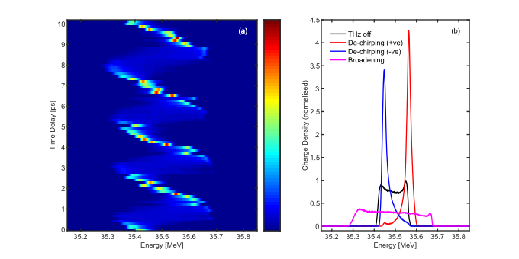
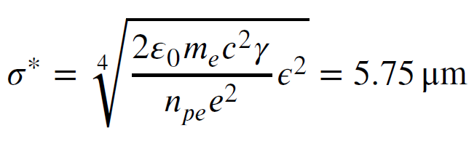
Terahertz-driven bunch de-chirper
THz frequency is 100-1000x higher than RF-driven injectors
Allows for RF compression followed by efficient THz de-chirping
De-chirping controlled by the THz injection timing
Reduce initial spread by a factor of 7 from 148 keV to 21 keV
Final energy spread <0.06% of the 35.5 MeV bunch energy
Potential benefits for AWAKE
Energy spread (0.2% ≡ 300 keV) removal to improve beam focusing at wakefield injection
Achieve challenging beam size parameters
R. Ramjiawan et al. Nucl. Instrum. Methods Phys. Rev. A 1049,168094 (2023)
Morgan Hibberd | Terahertz-driven electron bunch manipulation for advanced accelerators | 14/15

Slide 22
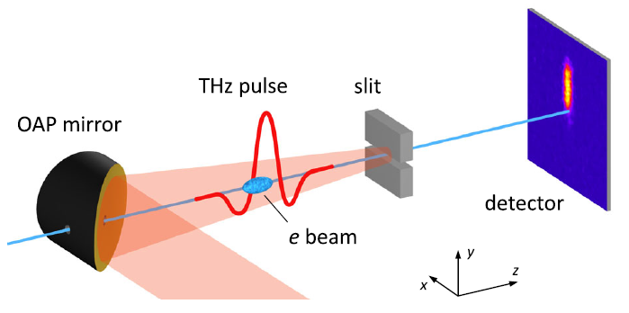
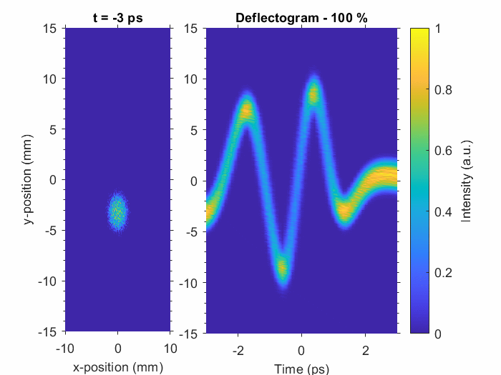
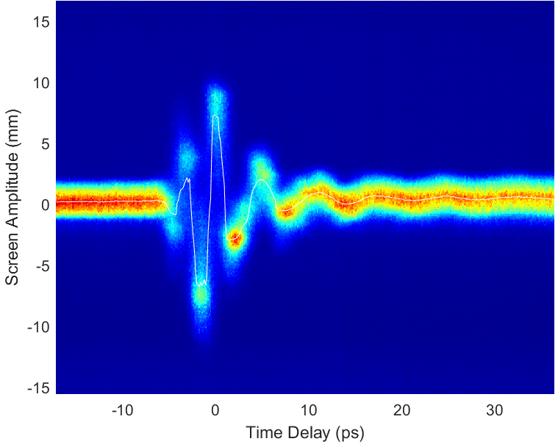
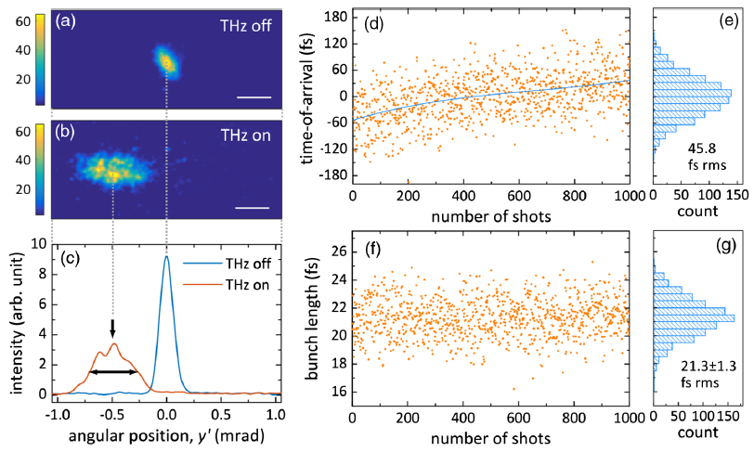
Terahertz-driven transverse streaking
Map the longitudinal coordinate to a transverse coordinate
Analogous to RF-driven transverse deflecting cavity (TDC)
Measure bunch length and time-of-arrival with fs-scale resolution
Demonstrated at SLAC with 3 MeV electron beams
100 keV electrons
Simulation
Potential benefits for AWAKE
Absolute measurement of sub-ps bunches from injector
Combine with energy spectrometer for full LPS extraction
Same THz structure → Just switch THz mode and frequency
R. K. Li et al. Phys. Rev. Accel. Beams 22,012803 (2019)
Morgan Hibberd | Terahertz-driven electron bunch manipulation for advanced accelerators | 15/15

