Slide 1
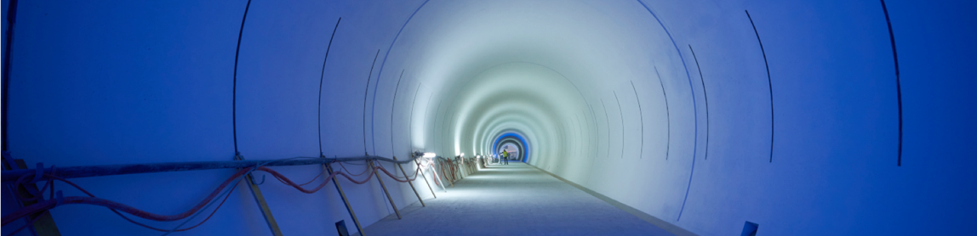
CERN's Collider Options:
The Path Forward
Mike Lamont
Particle Accelerators and Beams Conference
30th June 2023

Slide 2
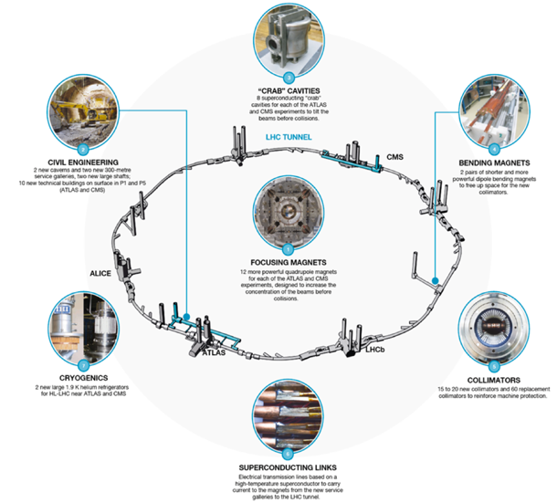
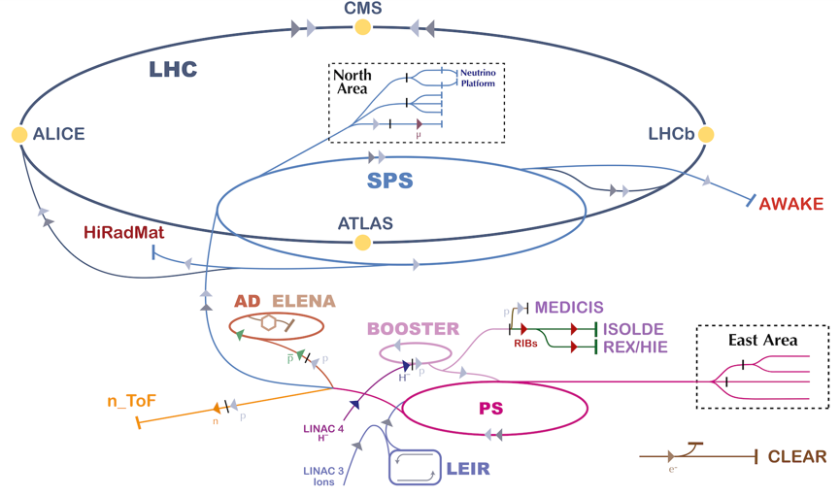
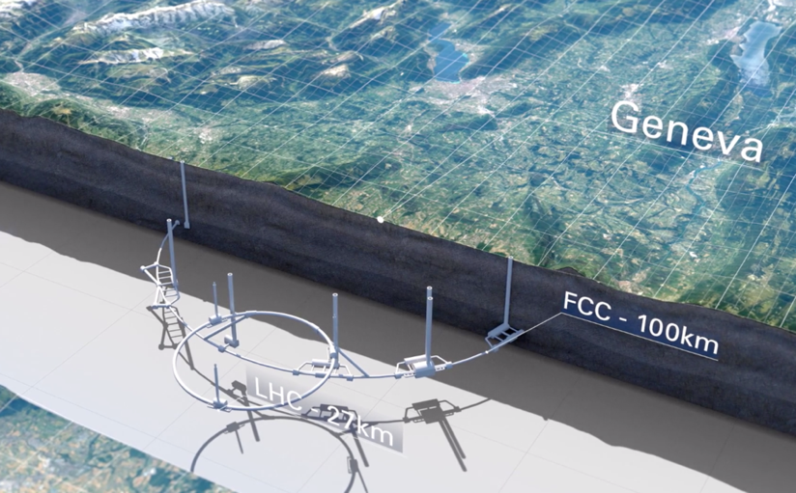
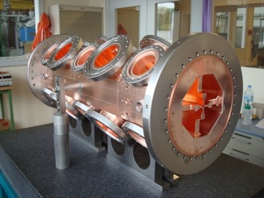
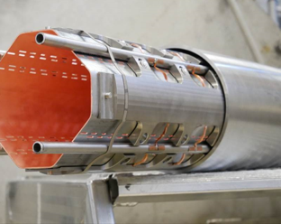
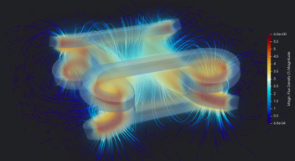
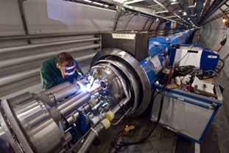
Exploitation
HL-LHC
Future Options
Technology/Engineering/R&D

Slide 3
European Strategy for Particle Physics 2020 Update
The successful completion of the high-luminosity upgrade of the machine and detectors should remain the focal point of European particle physics, together with continued innovation in experimental techniques.
The full physics potential of the LHC and the HL-LHC, including the study of flavour physics and the quark-gluon plasma, should be exploited.
2022 Snowmass Energy Frontier Summary
Our highest immediate priority accelerator and project is the HL-LHC, the successful completion of the detector upgrades, operations of the detectors at the HL-LHC, data taking and analysis, including the construction of auxiliary experiments that extend the reach of HL-LHC in kinematic regions uncovered by the detector upgrades.

Slide 4
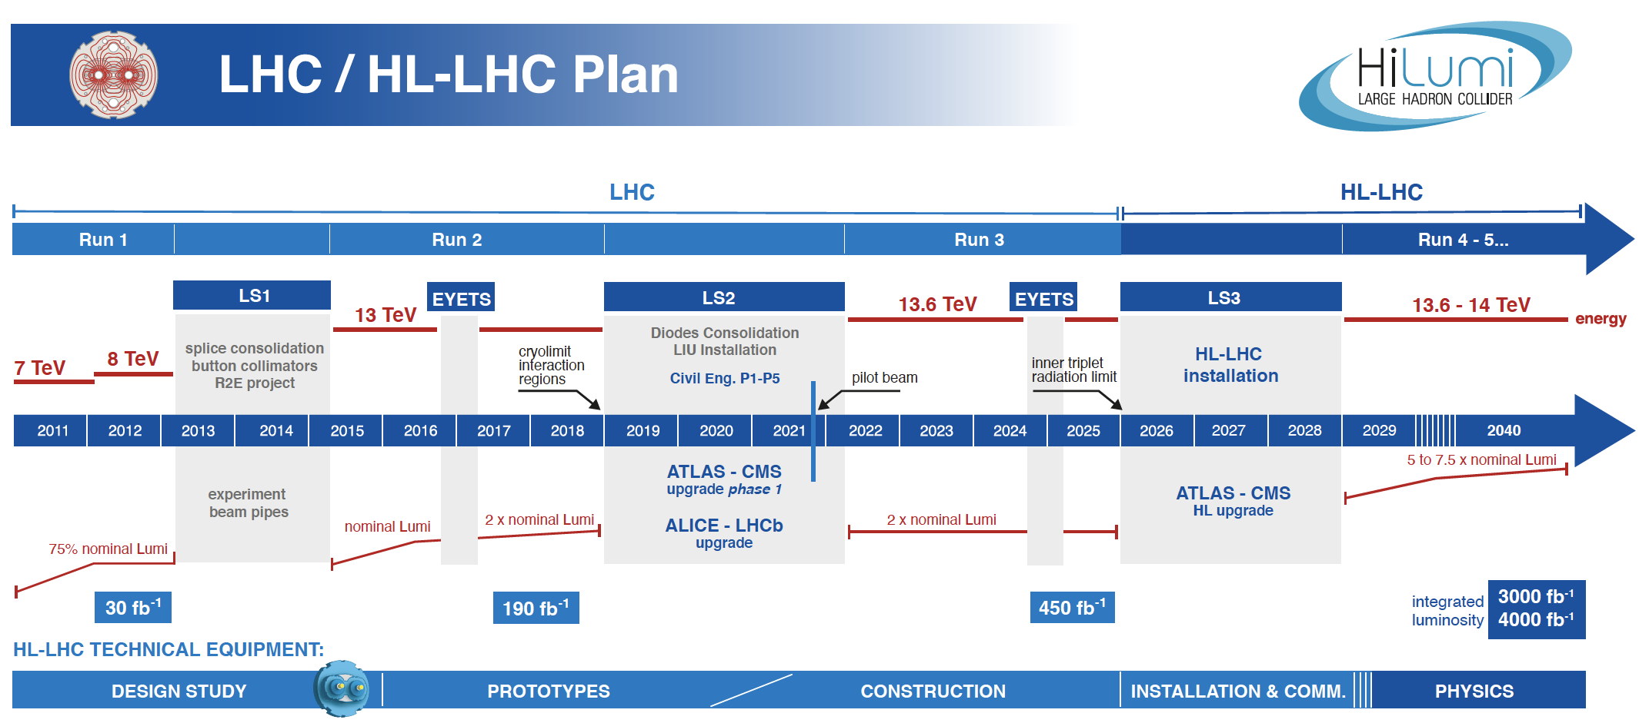

Slide 5
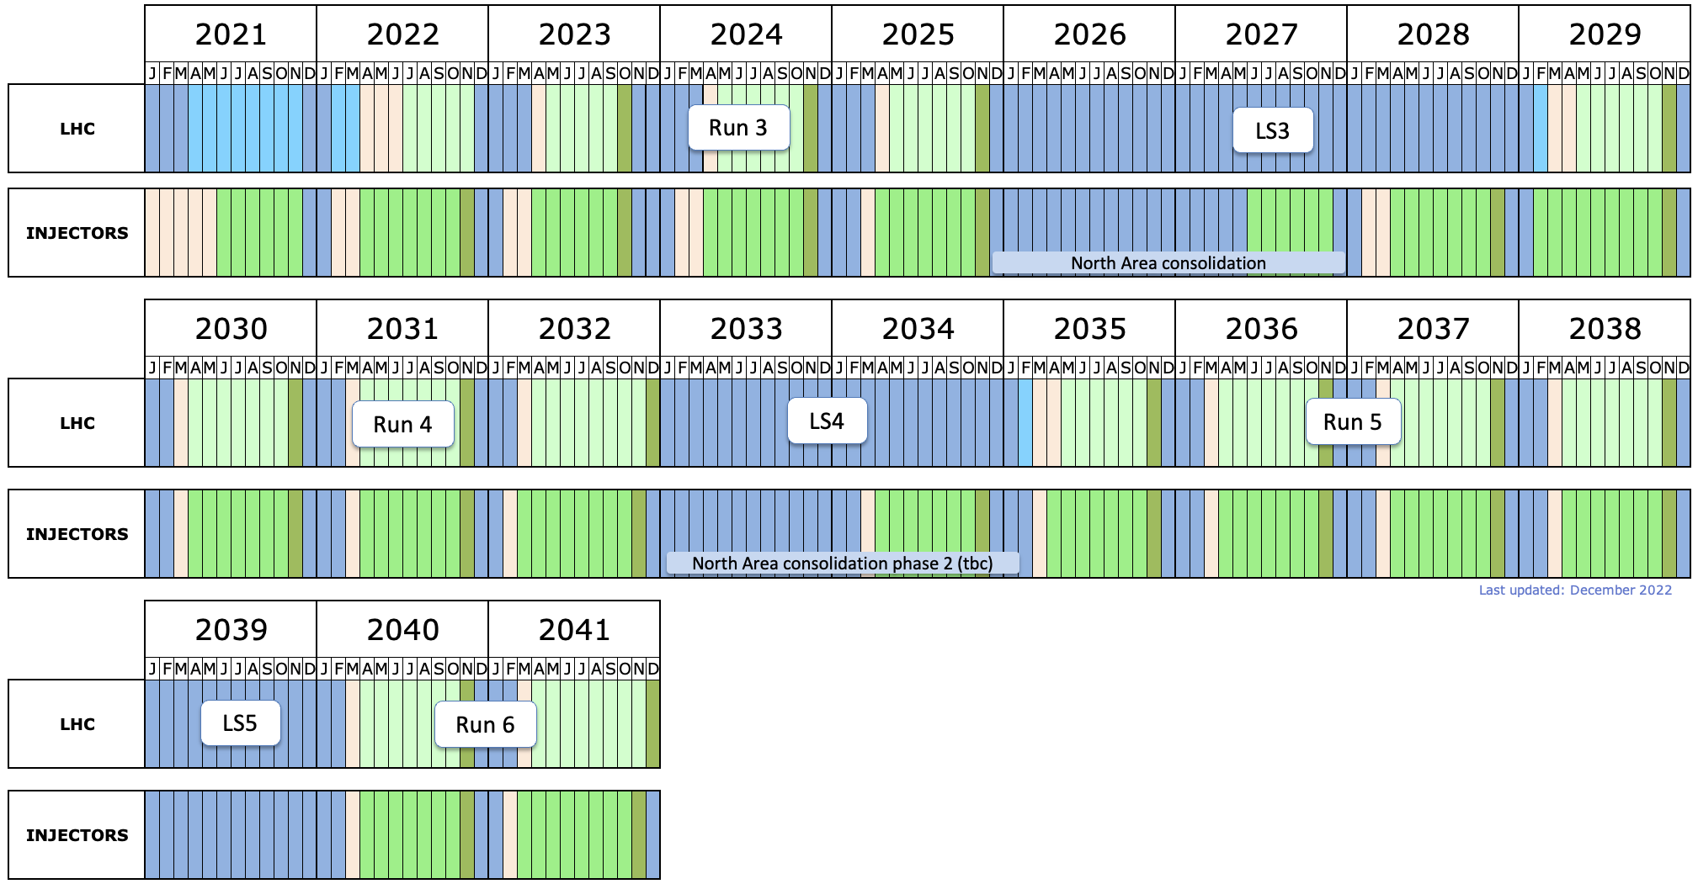
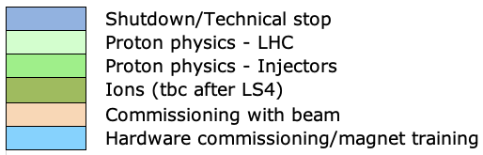
Securing the medium-term future
LHCb-II prep (tbc)
LHCb-II, ALICE3 upgrades (tbc)

Slide 6
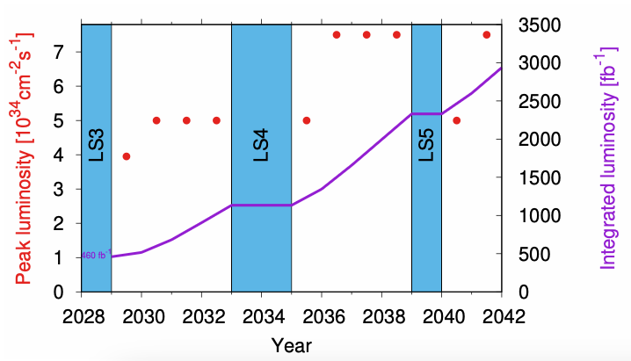
LHC: diverse physics programme
Headline deliverable is 3 ab⁻¹ p-p but the physics programme promises to be impressively diverse…
Ions (ALICE3 proposed for LS4)
b-physics (LHCb-II upgrade proposed for LS4)
Forward physics (CMS-PPS2)
Neutrinos (SND, FASERnu, Forward Physics Facility)
Long Lived Particles (GPDs, FASER, MoEDAL, milliQan, FPF, CODEX-b, MATHUSLA, ANIBUS)
Fixed target (SMOG-2, Crystal-FT)

Slide 7
ESPPU2022 also said…
“An electron-positron Higgs factory is the highest-priority next collider.
For the longer term, the European particle physics community has the ambition to operate a proton-proton collider at the highest achievable energy.”
“Europe, together with its international partners, should investigate the technical and financial feasibility of a future hadron collider at CERN with a centre-of-mass energy of at least 100 TeV and with an electron-positron Higgs and electroweak factory as a possible first stage.”
“Such a feasibility study of the colliders and related infrastructure should be established as a global endeavour and be completed on the timescale of the next Strategy update.”
CLIC, Muon Collider, ILC also in the mix

Slide 8
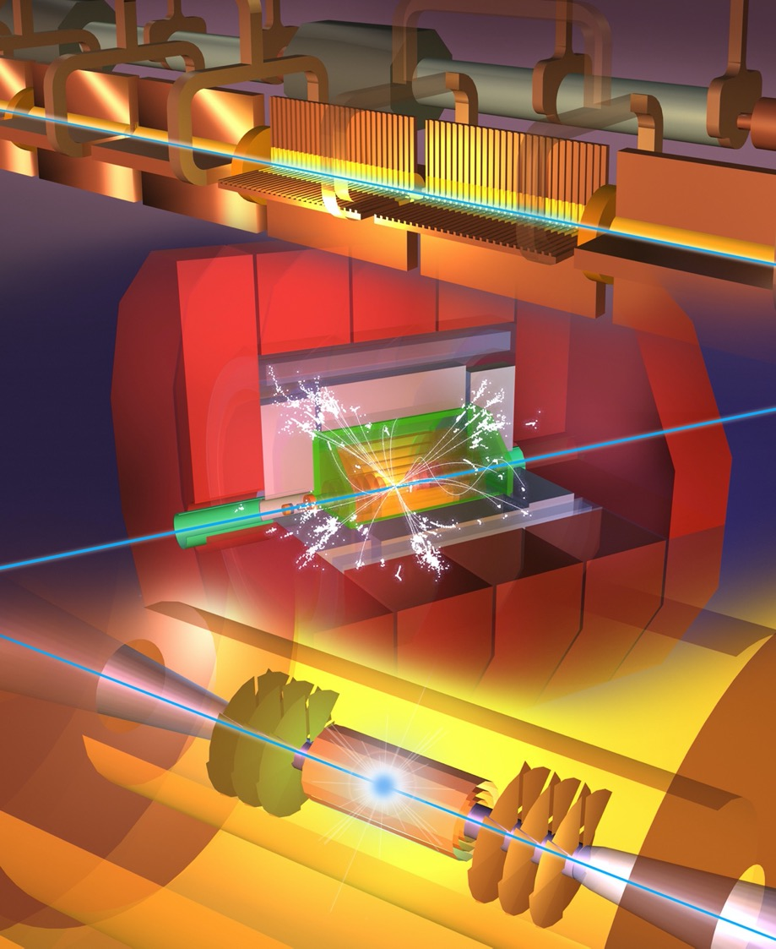
Future Collider options
Higgs factory
  Plan A1: FCC-ee
  Plan A2: ILC in Japan
  Plan B: CLIC
  Plan C: CepC, C³
Multi-TeV
  e+e- : CLIC, C³
  muons: Muon Collider
  protons: FCC-hh, SppC
Options under consideration at CERN given by European Strategy for Particle Physics Update 2020

Slide 9
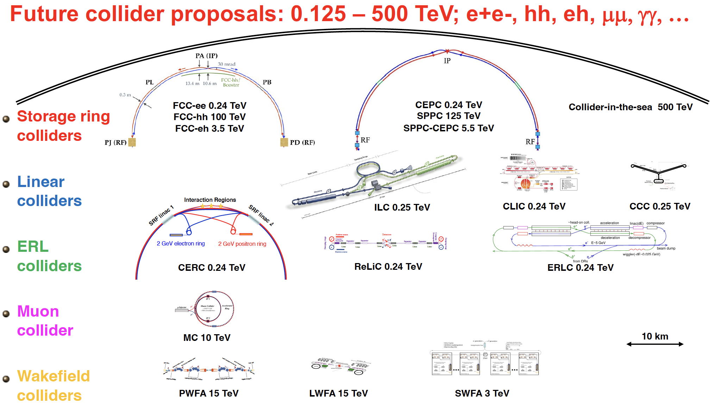
Snowmass’21
Collider Implementation Task Force

Slide 10
Recall Context
On the ground, the HL-LHC baseline schedule foresees operation until to the end 2041.
CERN/European Physics Community is positioning themselves to be able to start operating a new major facility in the second half of the forties (2045 - 2050).
That major new facility should be an e+e- Higgs factory.
Next ESPP update: ~2026-2027 – confirmation of priorities – down-selection
This could imply approval and resource commitment in the 2028 – 2030 timeframe, with subsequent project preparation and execution in the following decade.
There are clear implications for the necessity to bring to maturity any requisite technology for the alternatives under consideration. Given the projected large scale component production in the thirties, associated accelerator and detector technologies would need to be relatively mature as one moves into that phase.

Slide 11
Options at CERN
Options within specified timeframe
Options outside specified timeframe
FCC-ee
CLIC-380
(ILC-250)
(LEP3, LHeC, HE-LHC)
Muon Collider
FCC-hh (natural follow-on to FCC-ee)
++
Options possibly in timeframe not at CERN: ILC, CEPC, C³

Slide 12




LEGEND
CERN ExistingLHC
LHC
FCC
Muon Collider
CLIC
FCC
CLIC
Muon Collider ring
Muon Acceleration ring

Slide 13
In brief…
Option | Status
FCC feasibility study | Good progress – delivery of study foreseen end 2025 Serious mid–term review – Q4 2023
ILC | Mature design, slow progress moving to Pre-lab phase Targeted R&D phase as a bridge (ITN)
CLIC | Mature design, X-band KT, luminosity optimization, sustainability studies Project Readiness Report as a step toward a TDR for next ESPPU
Muon collider | International Study established, collaboration up and running Successful INFRA-DEV bid (MuCol), lively interest
Physics Beyond Colliders | Numerous smaller scale initiatives, medium scale projects under active consideration (ECN3 options, Forward Physics Facility)

Slide 14


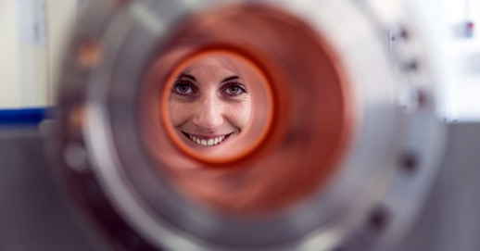

Accelerator R&D
Accelerator technologies and R&D
RF technologies R&D (SRF, X-band)
High-field superconducting accelerator magnets R&D
Proton-driven plasma wakefield acceleration (AWAKE)
CERN Linear Electron Accelerator for Research (CLEAR)
Other accelerator R&D

Slide 15
FCC Feasibility Study 2021-2025: main objectives
Geological, technical, environmental and administrative feasibility
Optimisation of placement and layout of the ring and related infrastructure
Preparatory administrative processes
Optimisation of the design of FCC-ee and FCC-hh
Sustainable operational model for the machine and experiments
Consolidated cost estimate, as well as the funding and organisational models
Identification of substantial resources from outside CERN’s budget
Consolidation of the physics case and detector concepts and technologies
Serious mid-term review (including cost) incoming this year

Slide 16

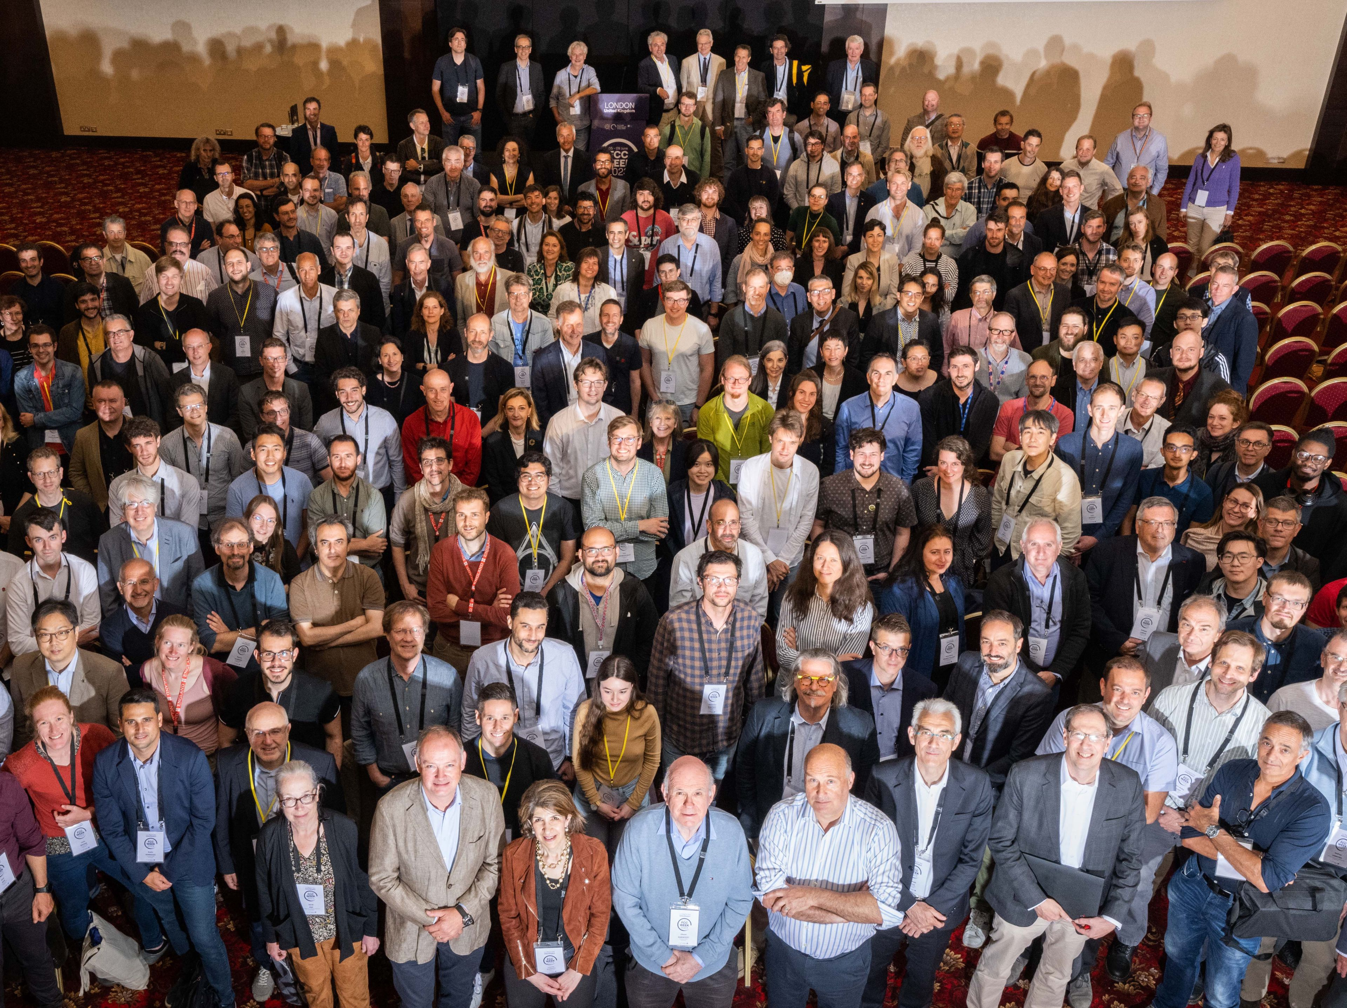
FCC Week 2023
473 participants
362 in person and 111 remote
Great progress everywhere!
A wonderful energetic & competent team and it’s getting younger.

Slide 17
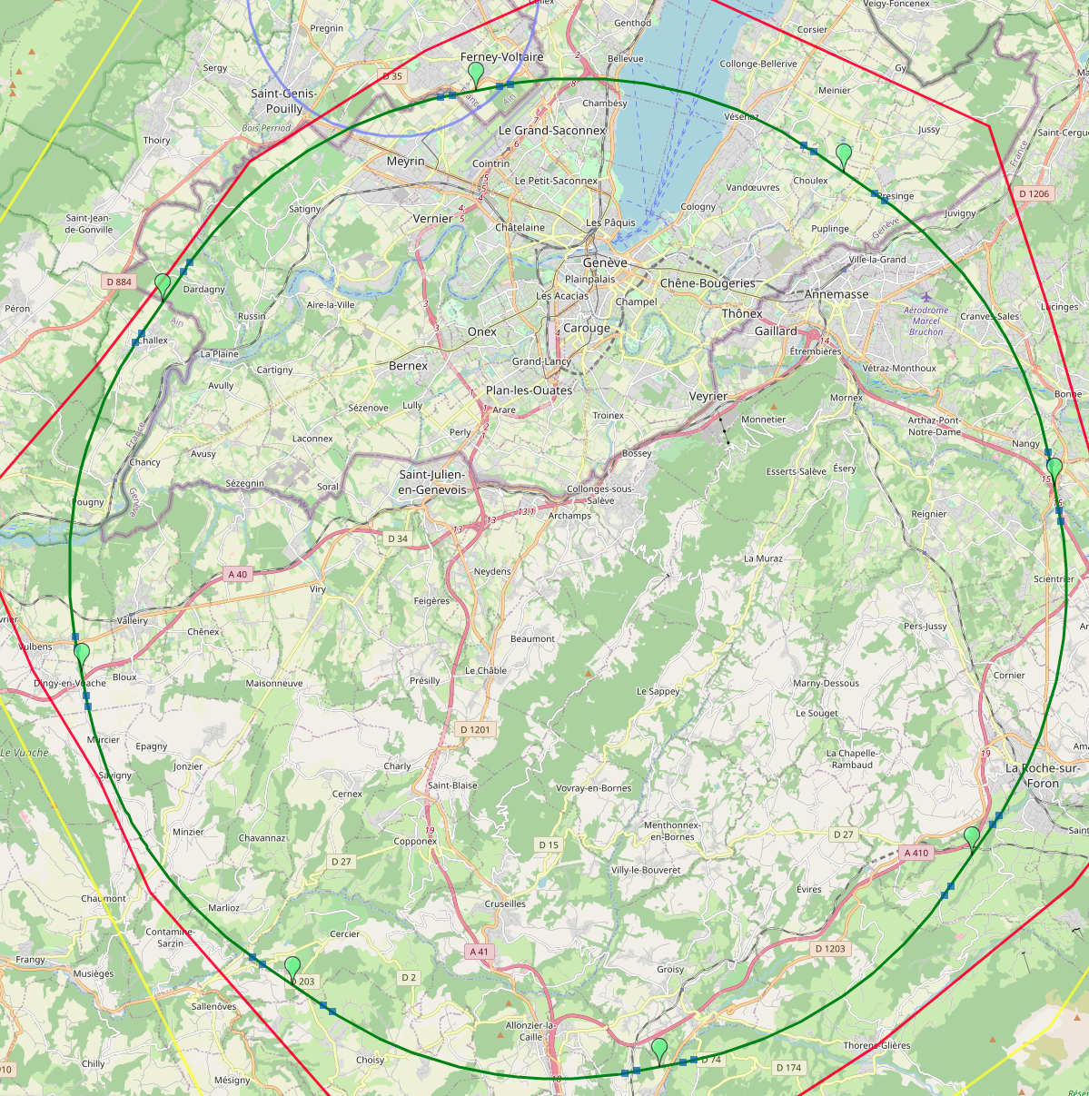
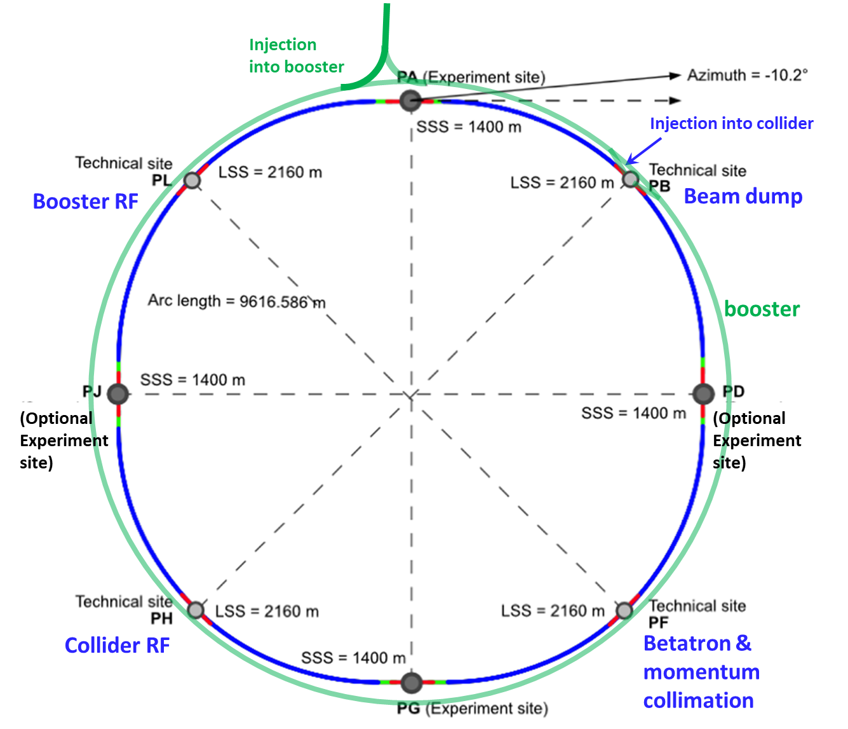
Optimized placement and layout for feasibility study
Major achievement: optimization of the ring placement
Layout chosen out of ~ 100 initial variants, based on geology and
surface constraints (land availability, access to roads, etc.), environment
(protected zones), infrastructure (water, electricity, transport), etc.
“Éviter, reduire, compenser” principle of EU and French regulations
V. Mertens,
J. Gutleber
PA: Experiment
PB: technical
Lowest-risk baseline: 90.7 km ring, 8 surface points,
4-fold superperiodicity, possibility of 2 or 4 IPs
Whole project now adapted to this placement
PL: technical
PD: experiment
Number of surface sites | 8
LSS@IP (PA, PD, PG, PJ) | 1400 m
LSS@TECH (PB, PF, PH, PL) | 2032 m
Arc length | 9.6 km
Sum of arc lengths | 76.9 m
Total length | 90.7 km
PJ: experiment
PF: technical
PH: technical
17
PG: experiment

Slide 18
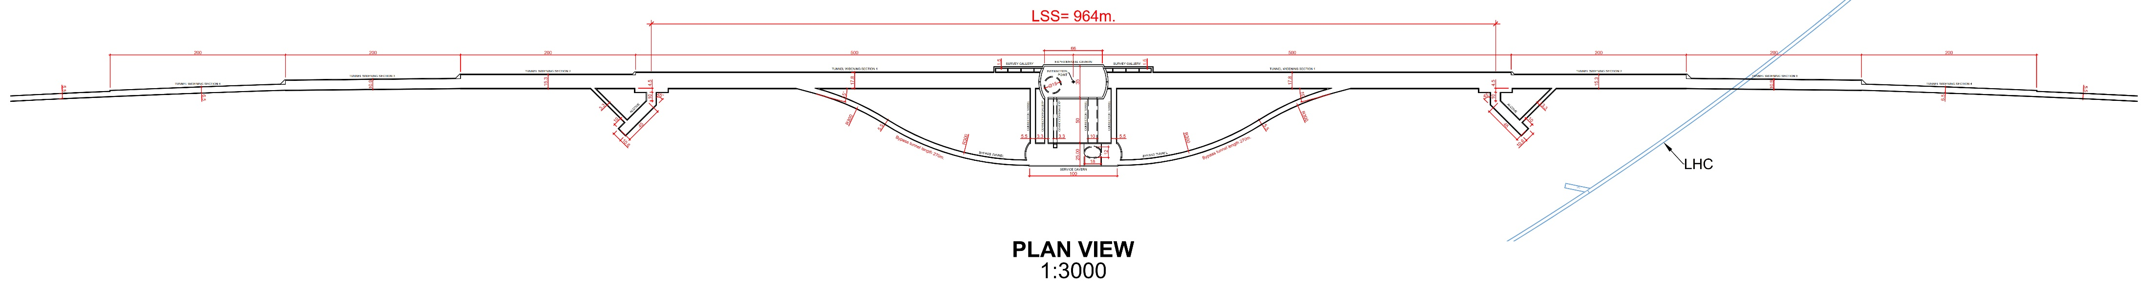
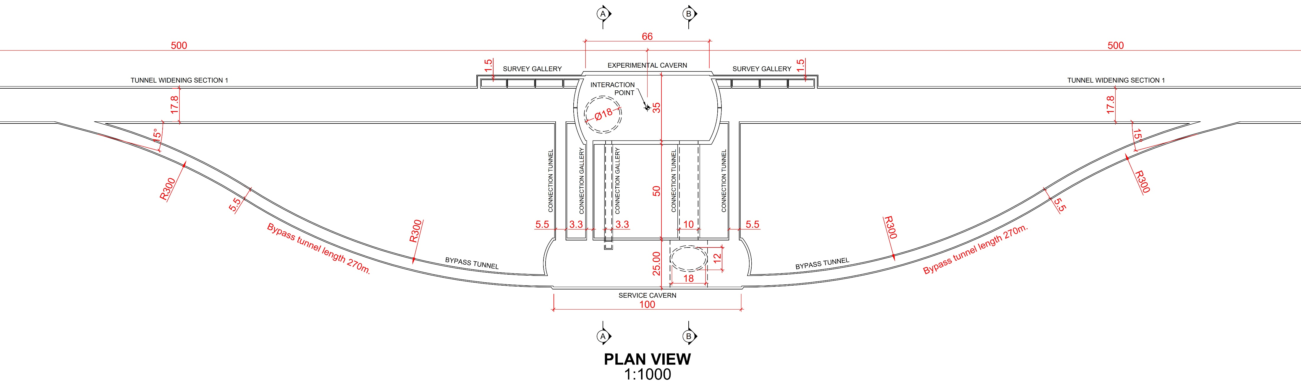
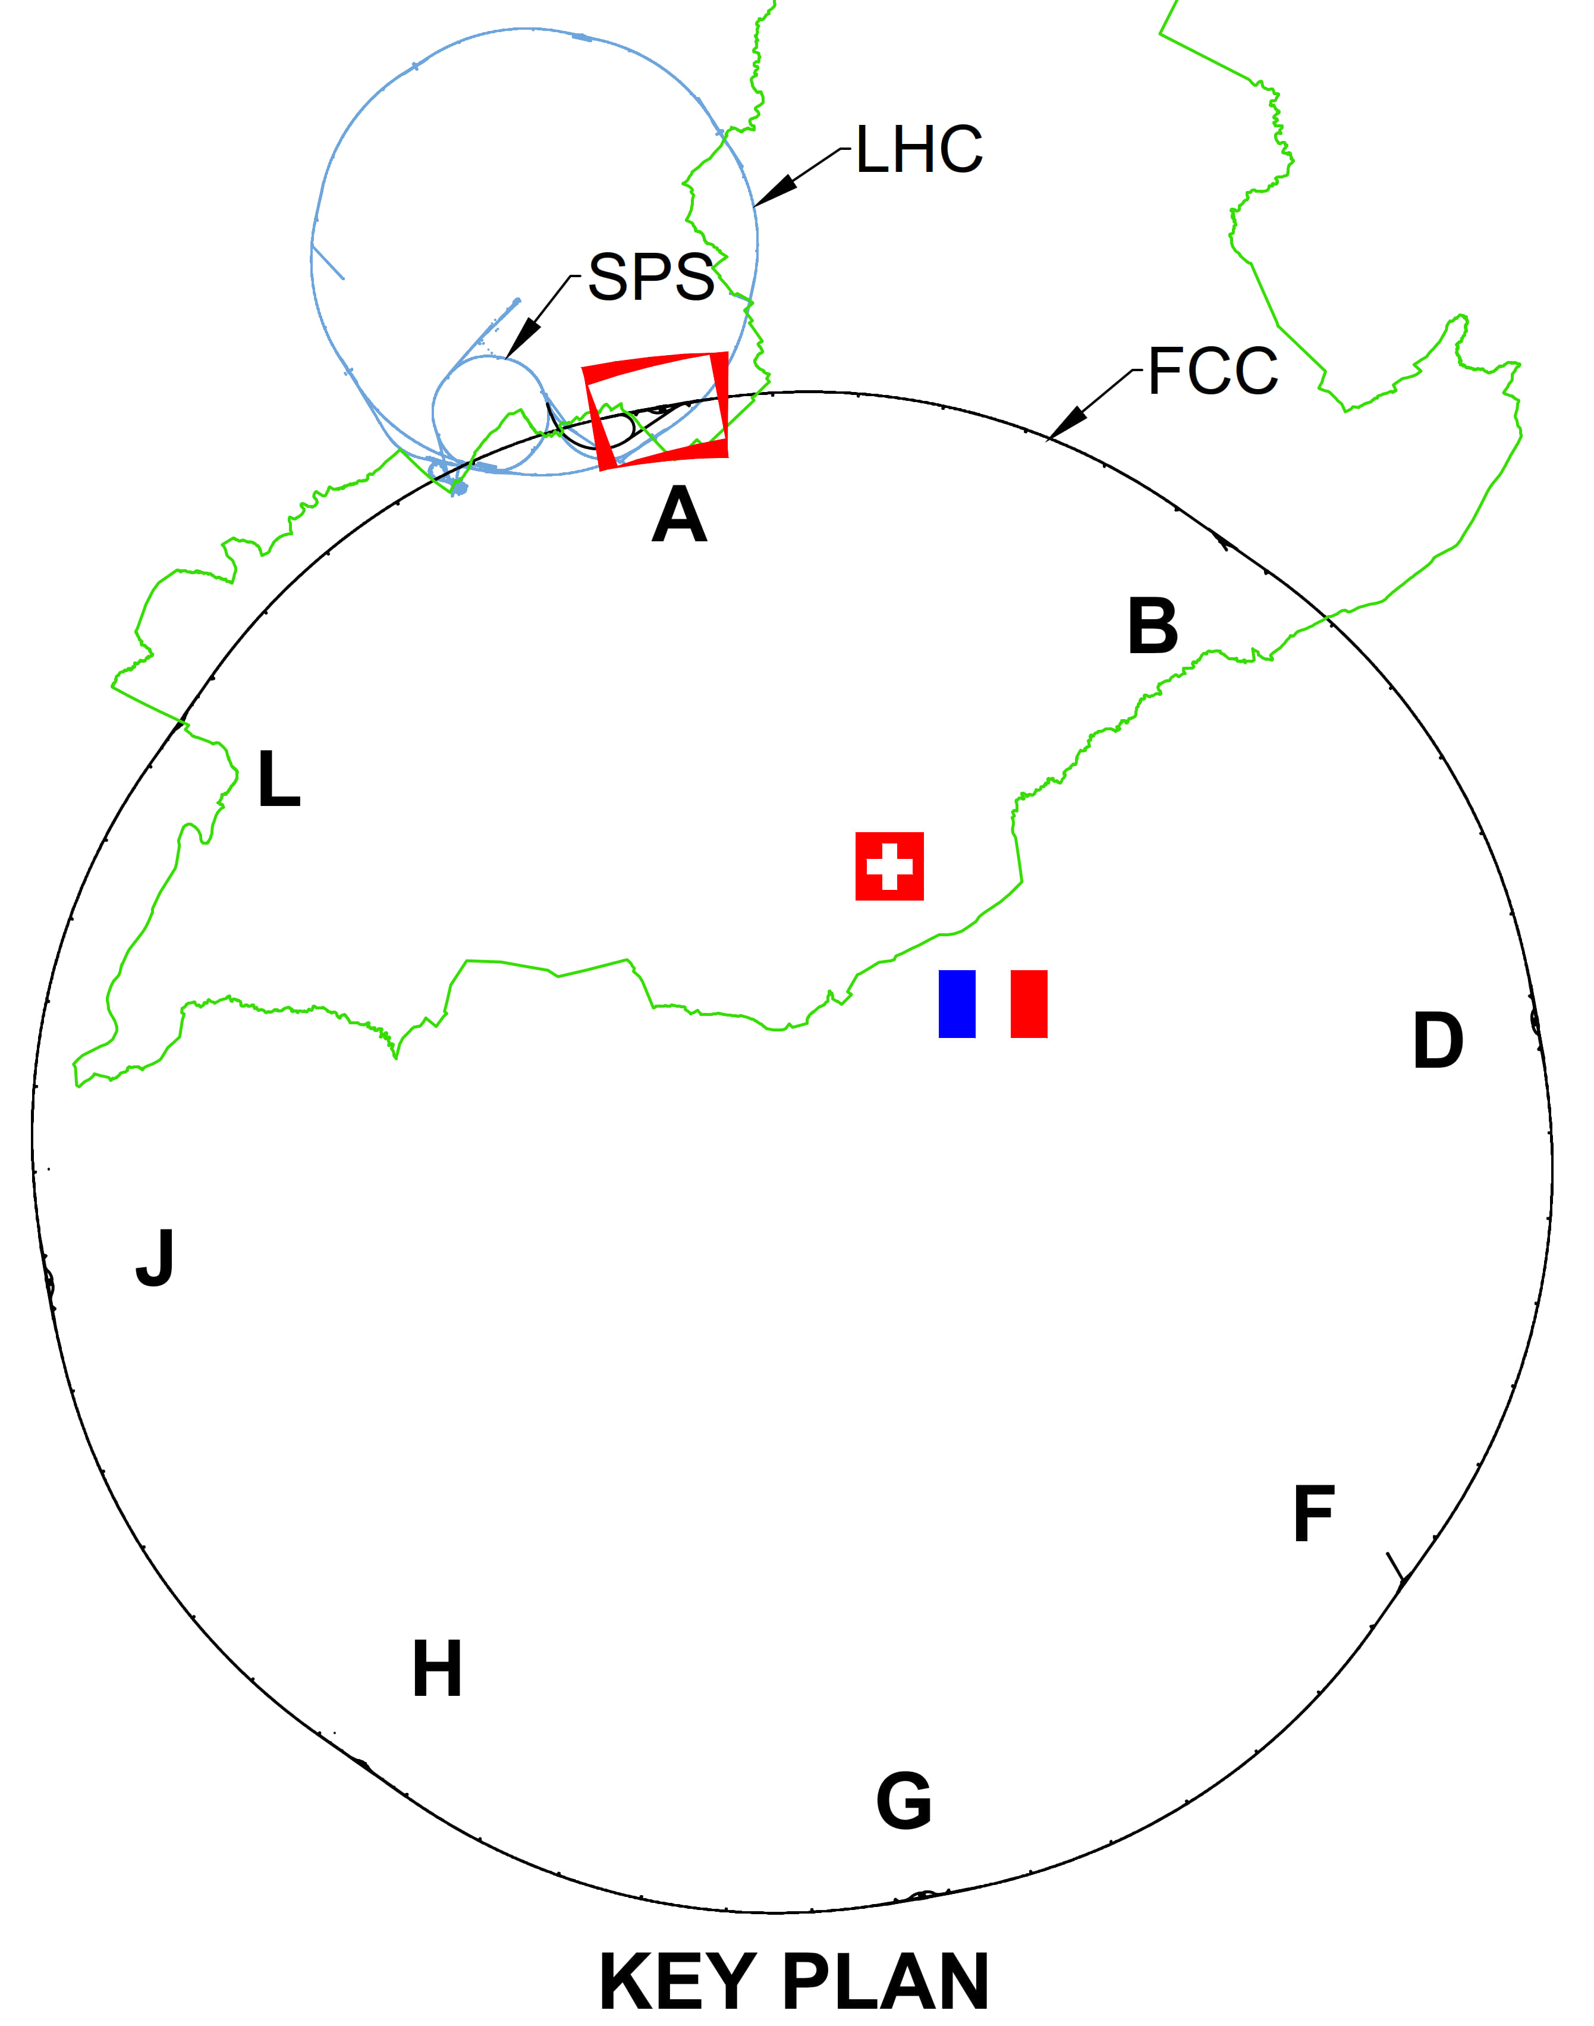
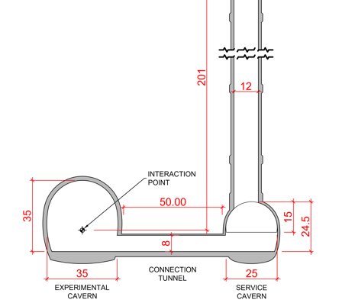
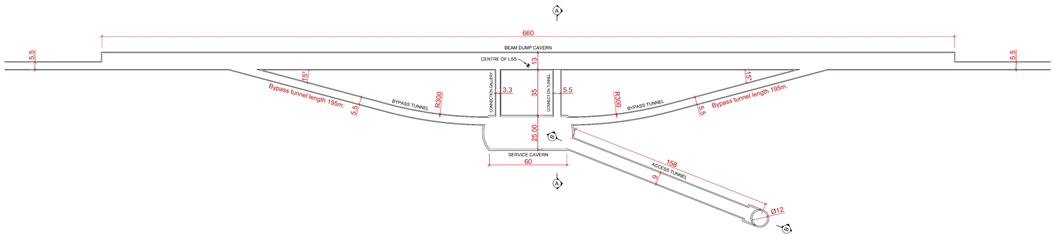
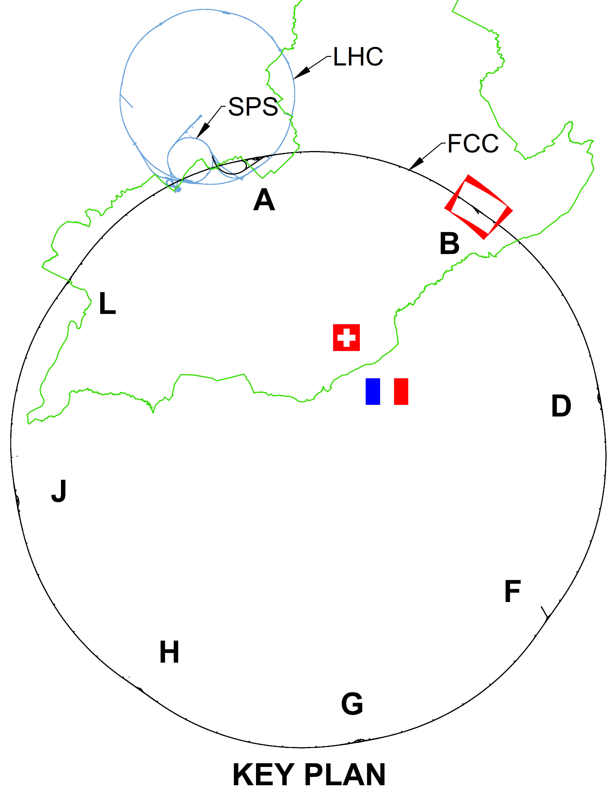
CE underground progress
Full 3D model of underground structures as basis for costing exercies
Experiment Site (PA)
Update of scheduling and costing with external consultant ongoing
Independent second costing exercise based on same bill of quantities will be done
Technical Site (PB)

Slide 19
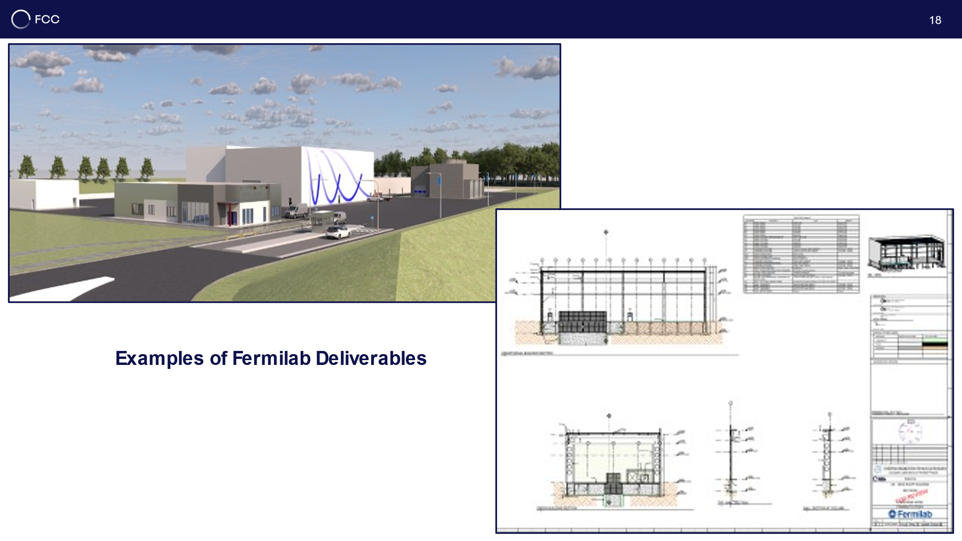
CE surface progress
Generic study of experiment site and technical site by FNAL
Bills of quantities extracted from FNAL designs
Basis for cost estimate by consultant with experience on industrial constructions in CH-FR area.

Slide 20
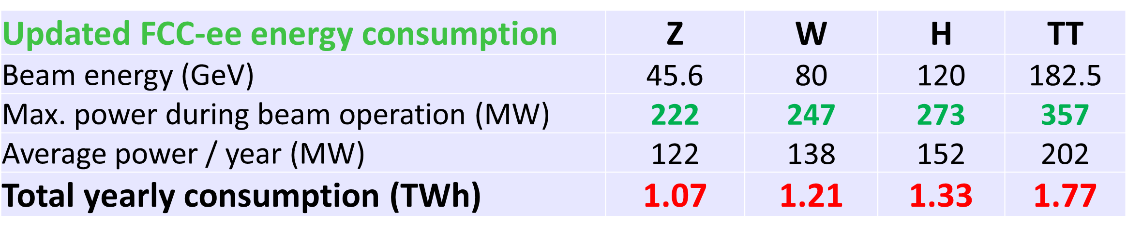
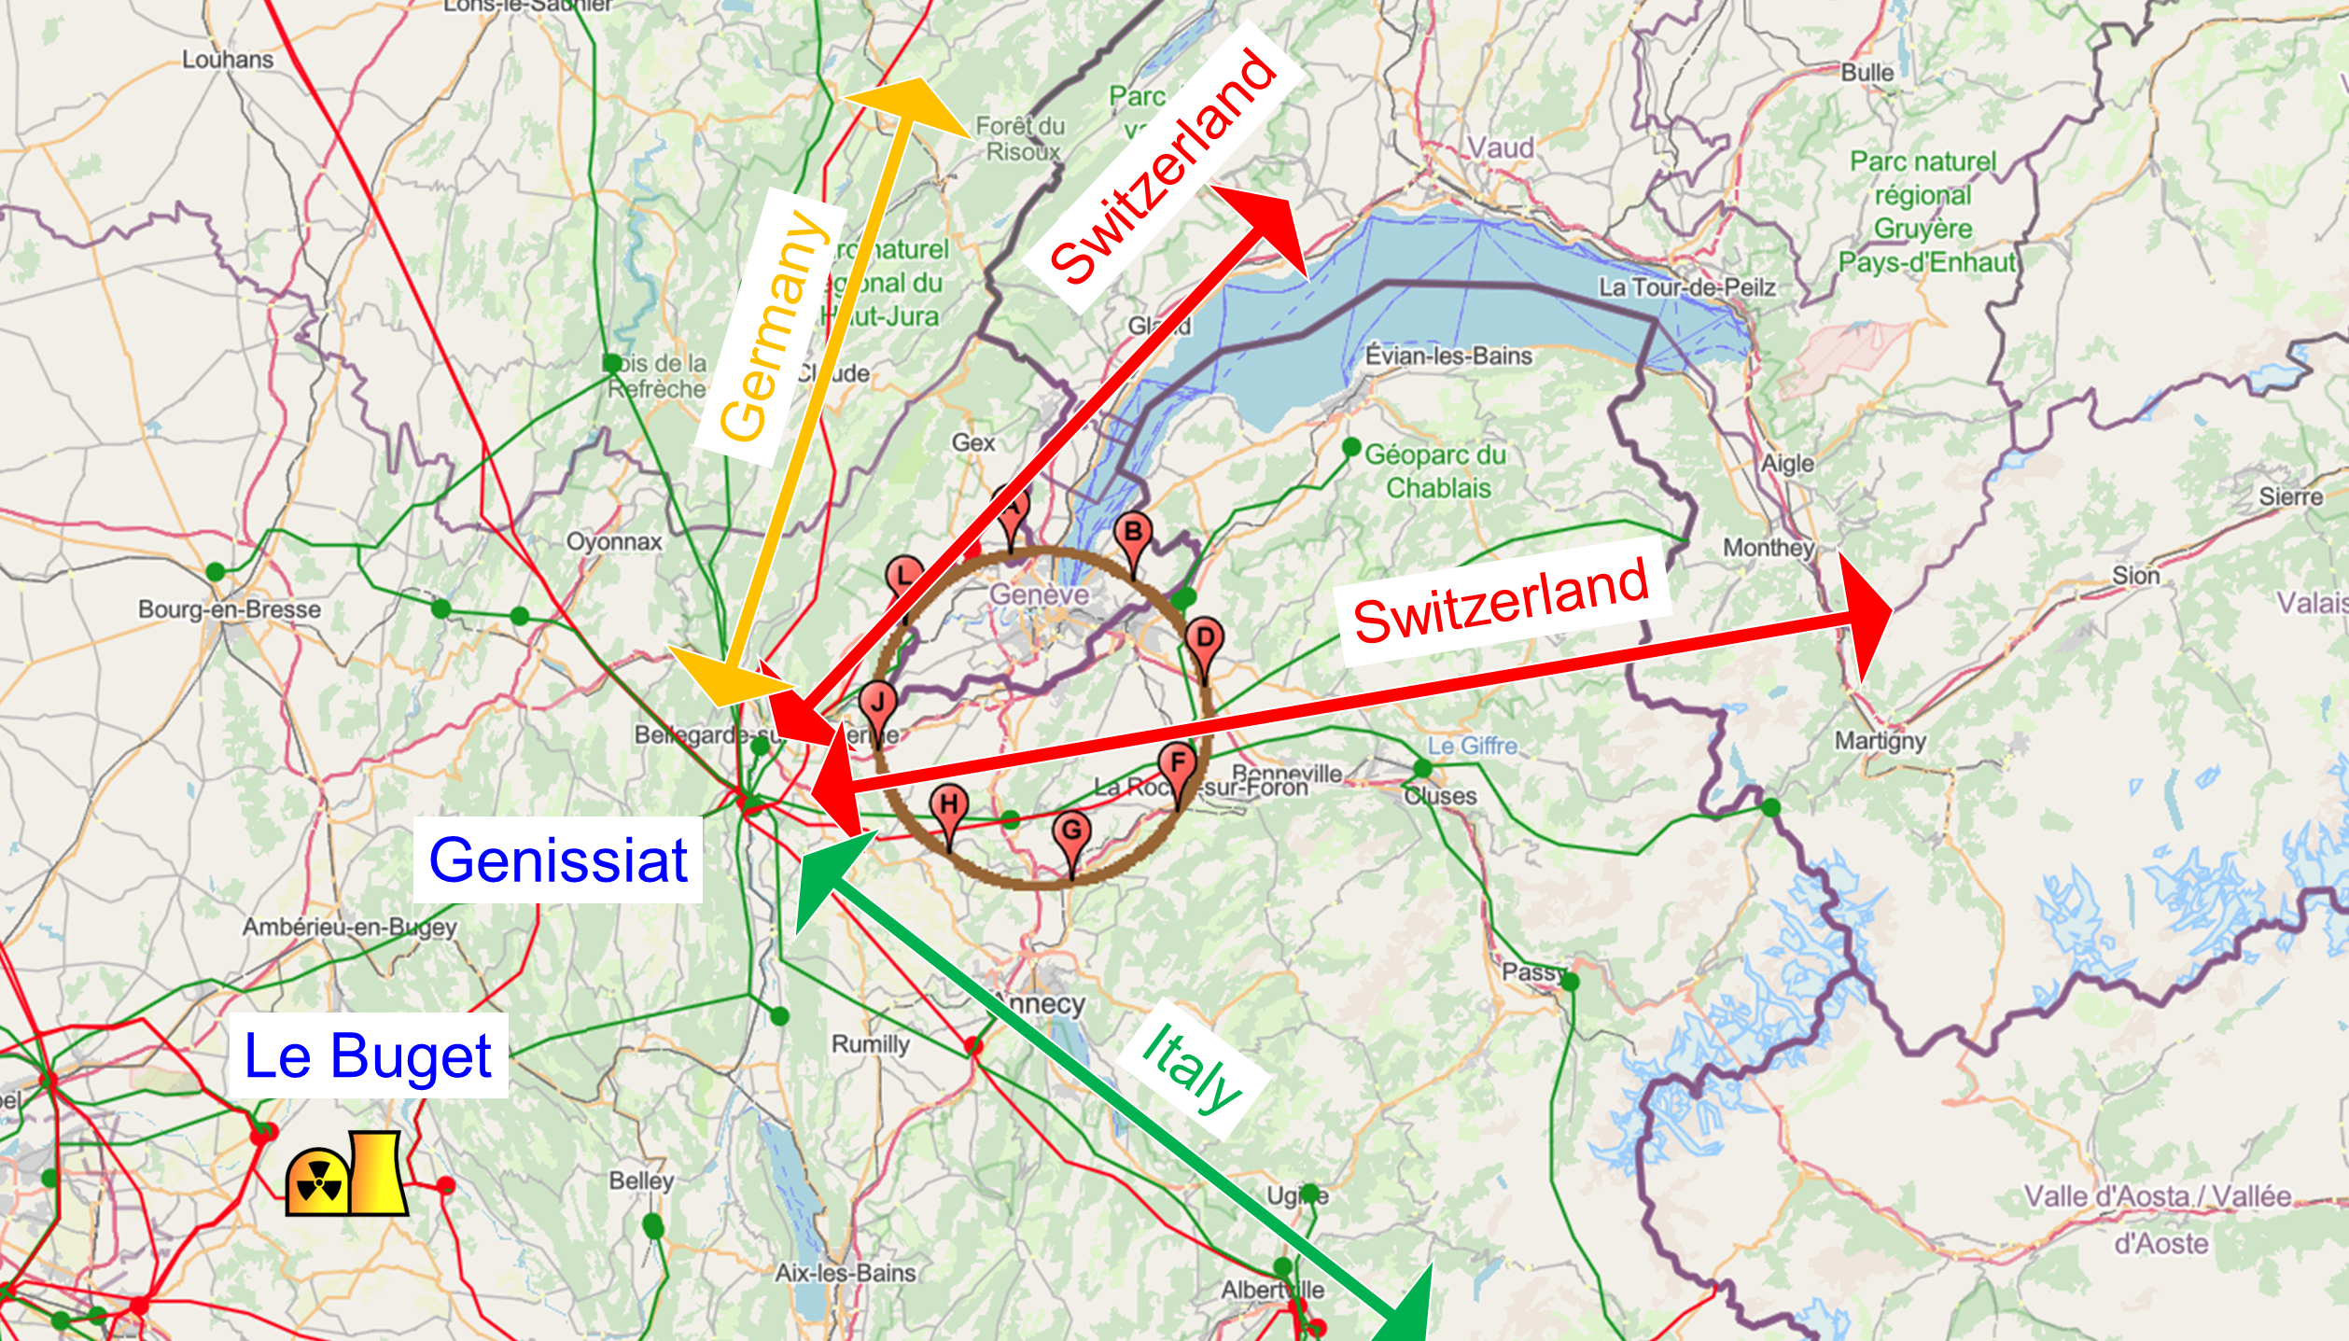
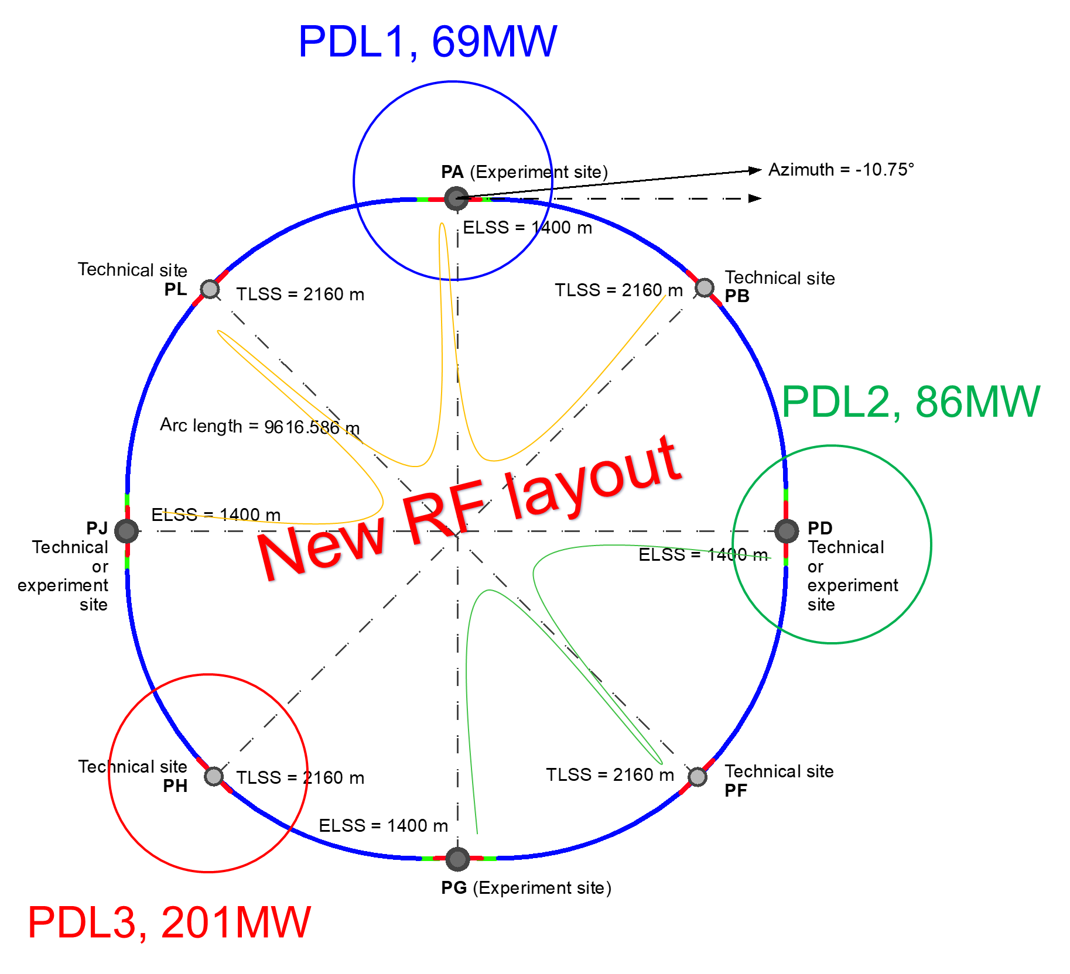

Power consumption and electrical grid infrastructure
Powering concept and max power load by sub-stations:
The loads could be charged on the three sub-stations (optimum connections to existing regional HV grid):
Point D, with a new sub-station covering PB – PD – PF – PG
Point H with a new dedicated sub-station for collider RF
Point L, with a sub-station covering PJ – PL – PA
→ Alternative to new sub-station at Point L is reusing the existing CERN Prevession station to PA
All options pursued with RTE
Powering concept and max. power rating of the three sub-stations compatible FCC-hh.

Slide 21
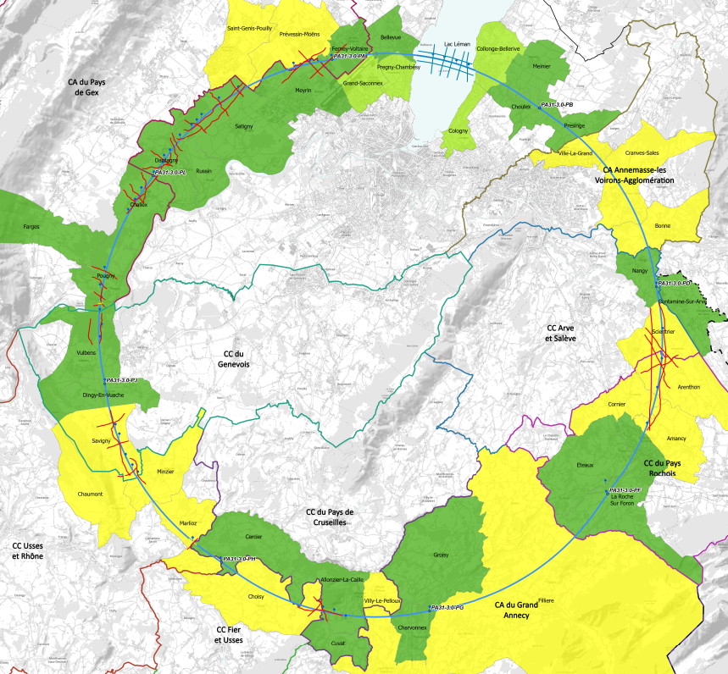
implementation baseline PA31 90.7 km
Meetings with municipalities concerned
in France (31) and Switzerland (10)
PA – Ferney Voltaire (FR) – site experimental
PB – Présinge/Choulex (CH) – site technique
PD – Nangy (FR) – site technique et experimental
PF – Roche sur Foron/Etaux (FR) – site technique
PG – Charvonnex/Groisy (FR) – site experimental
PH – Cercier (FR) – site technique
PJ – Vulbens/Dingy en Vuache (FR) site technique et experimental
PL – Challex (FR) – site technique
status as of 20 June 2023
Rencontrée individuellement
Rencontre collective
Rendez-vous proposé / programmé
FCC study positively received by all communes
Willingness to work on optimization of surface sites and development of synergies
Particular thanks to the Host State authorities

Slide 22
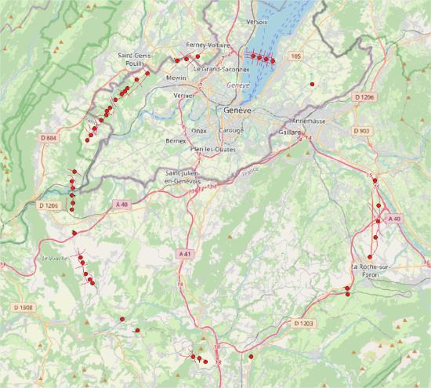
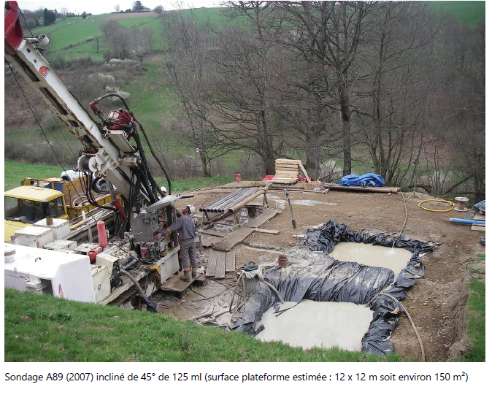
Activities on site
Environmental studies on all surface sites ongoing since February 2023
Site investigations planned for 2024 and 2025 in areas with uncertain geological conditions:
  Optimisation of localisation of drilling locations ongoing with site visits since end 2022.
  Direct interaction with land plot owners only after agreement with communes concerned.
  Interaction with host states on authorisation procedures ongoing → critical for start of drillings in March 2024.
  Localisation of sites:

Slide 23
Tripartite Committee on the
territorial implementation of the FCC
Composition
  Director General of CERN,
  Permanent Representative of Switzerland to the international organizations in Geneva
  Geneva State Councilor in charge of the territory
  Prefect of the Auvergne-Rhône-Alpes region
  Permanent Representative of France to the international organizations in Geneva.
Topics discussed in the 3rd meeting on 30 May 2023
  Progress on field studies, dialogue with communes, interaction with local media, launch of reflections on the public consultation process in France
  Placement report and progress on surface site optimization
Outlook and follow-up topics
  Obtain authorizations for exploratory drilling from the authorities and landowners
  Implementation of measures to preserve the land for surface sites
  Update the placement report and surface site constraints in autumn 2023

Slide 24
FCC week: take home messages
Implementation scenario well defined and all design parameters adapted to new layout
Significant progress with host states at departmental/cantonal and local level. Direct exchange with communes concerned by surface sites as basis for detailed optimization. Environmental studies ongoing.
3D underground civil engineering model established for scheduling and costing.
Significant effort in FCC-ee lattice design with two complete optics solutions. Major progress towards full performance simulations including beam-beam and full optics with alignment errors.
Siting study for implementation of FCC-ee pre-injector on CERN Prévessin site. Flexible transfer line solutions for FCC-ee and hh for potential use of SPS tunnel/scSPS.
FCC-ee SRF configuration and layout further optimized and international R&D collaborations being prepared
FCC powering concept defined in cooperation with French network operator RTE.

Slide 25
The path forward
The vision is for another major project commensurate with the laboratory’s capabilities, communities, and resources to assure the future of CERN for the next 50+ years
    Engine for continued investment, innovation, R&D and scientific engagement
    CERN remains a world leading Research Infrastructure
    CERN remains a prestigious symbol of worldwide collaboration, scientific excellence at the leading edge
    Geopolitical implications
The preferred direction for a future collider at CERN is the FCC
    As mandated by the European Strategy for Particle Physics
    Feasibility study to be delivered end 2025 – expect full and detailed scrutiny
    This a big, hairy, audacious goal – but then so was LEP, so was the LHC
There is a plan B

Slide 26
Remaining fully aligned with ESPPU2020
Full, safe, exploitation of the remarkable potential of CERN’s complex
HL-LHC - flagship machine at the energy frontier out to end ~2041
Future Colliders with FCC as the leading option – significant progress
Execution of a European Accelerator R&D Roadmap (High Field Magnets, RF, Muon Collider, Plasma Wakefield Acceleration)
Scientific diversity programme exploiting complex and facilities via Physics Beyond Colliders. Enthusiastic and ambitious user communities.
Sustainability and Societal impact, Outreach and Education as part of our mission. Nexus of an impressive collaborative ecosystem.
Thanks!

