Slide 1






Slide 2

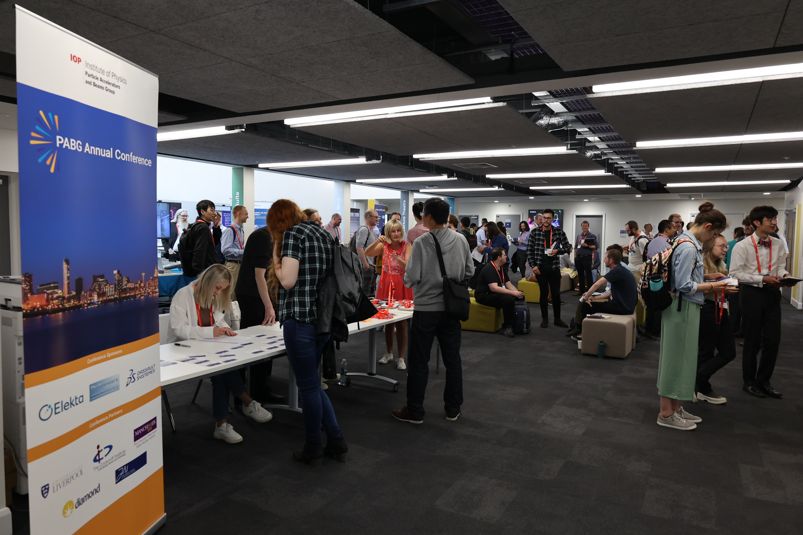
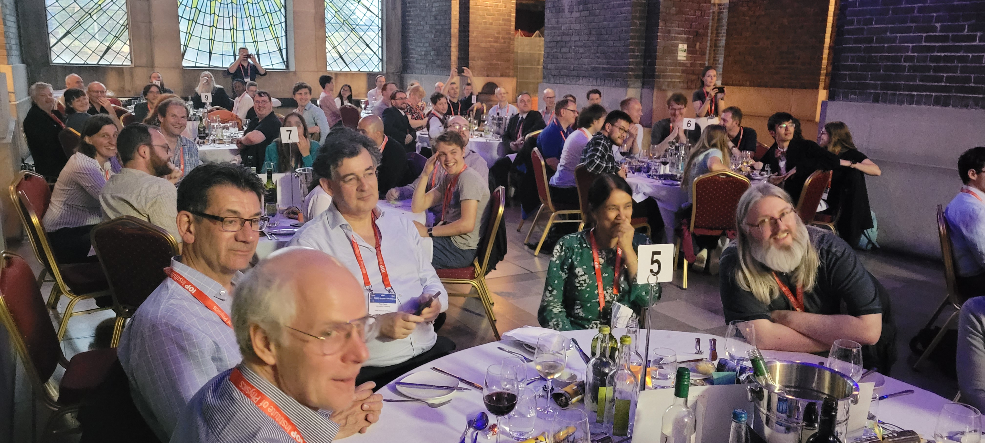
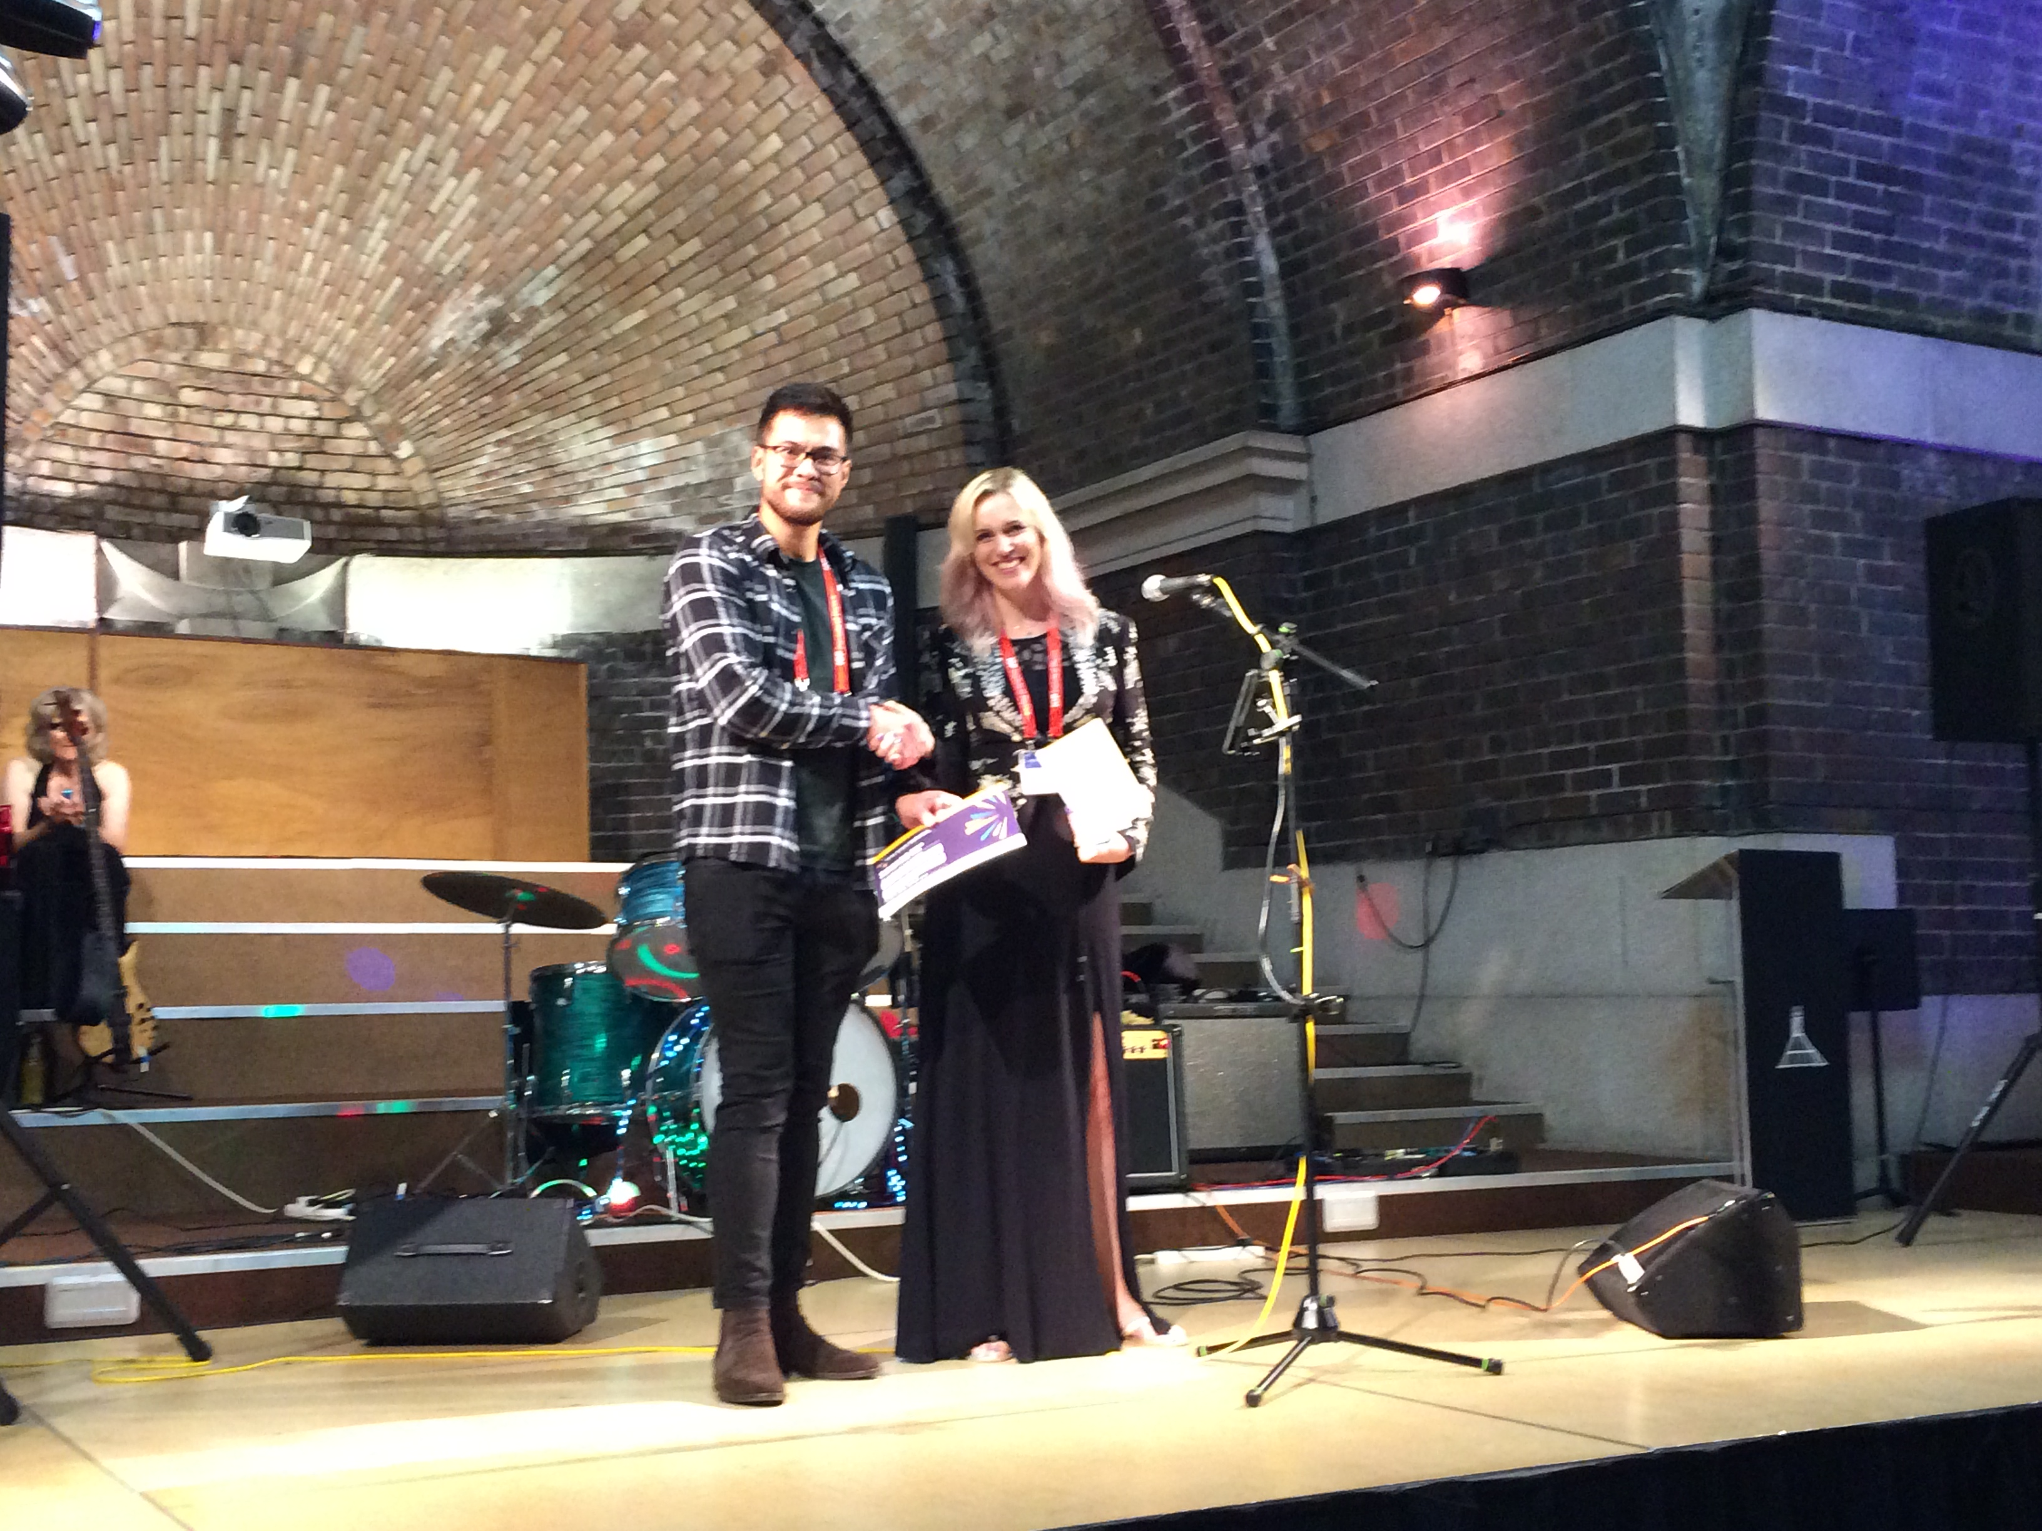
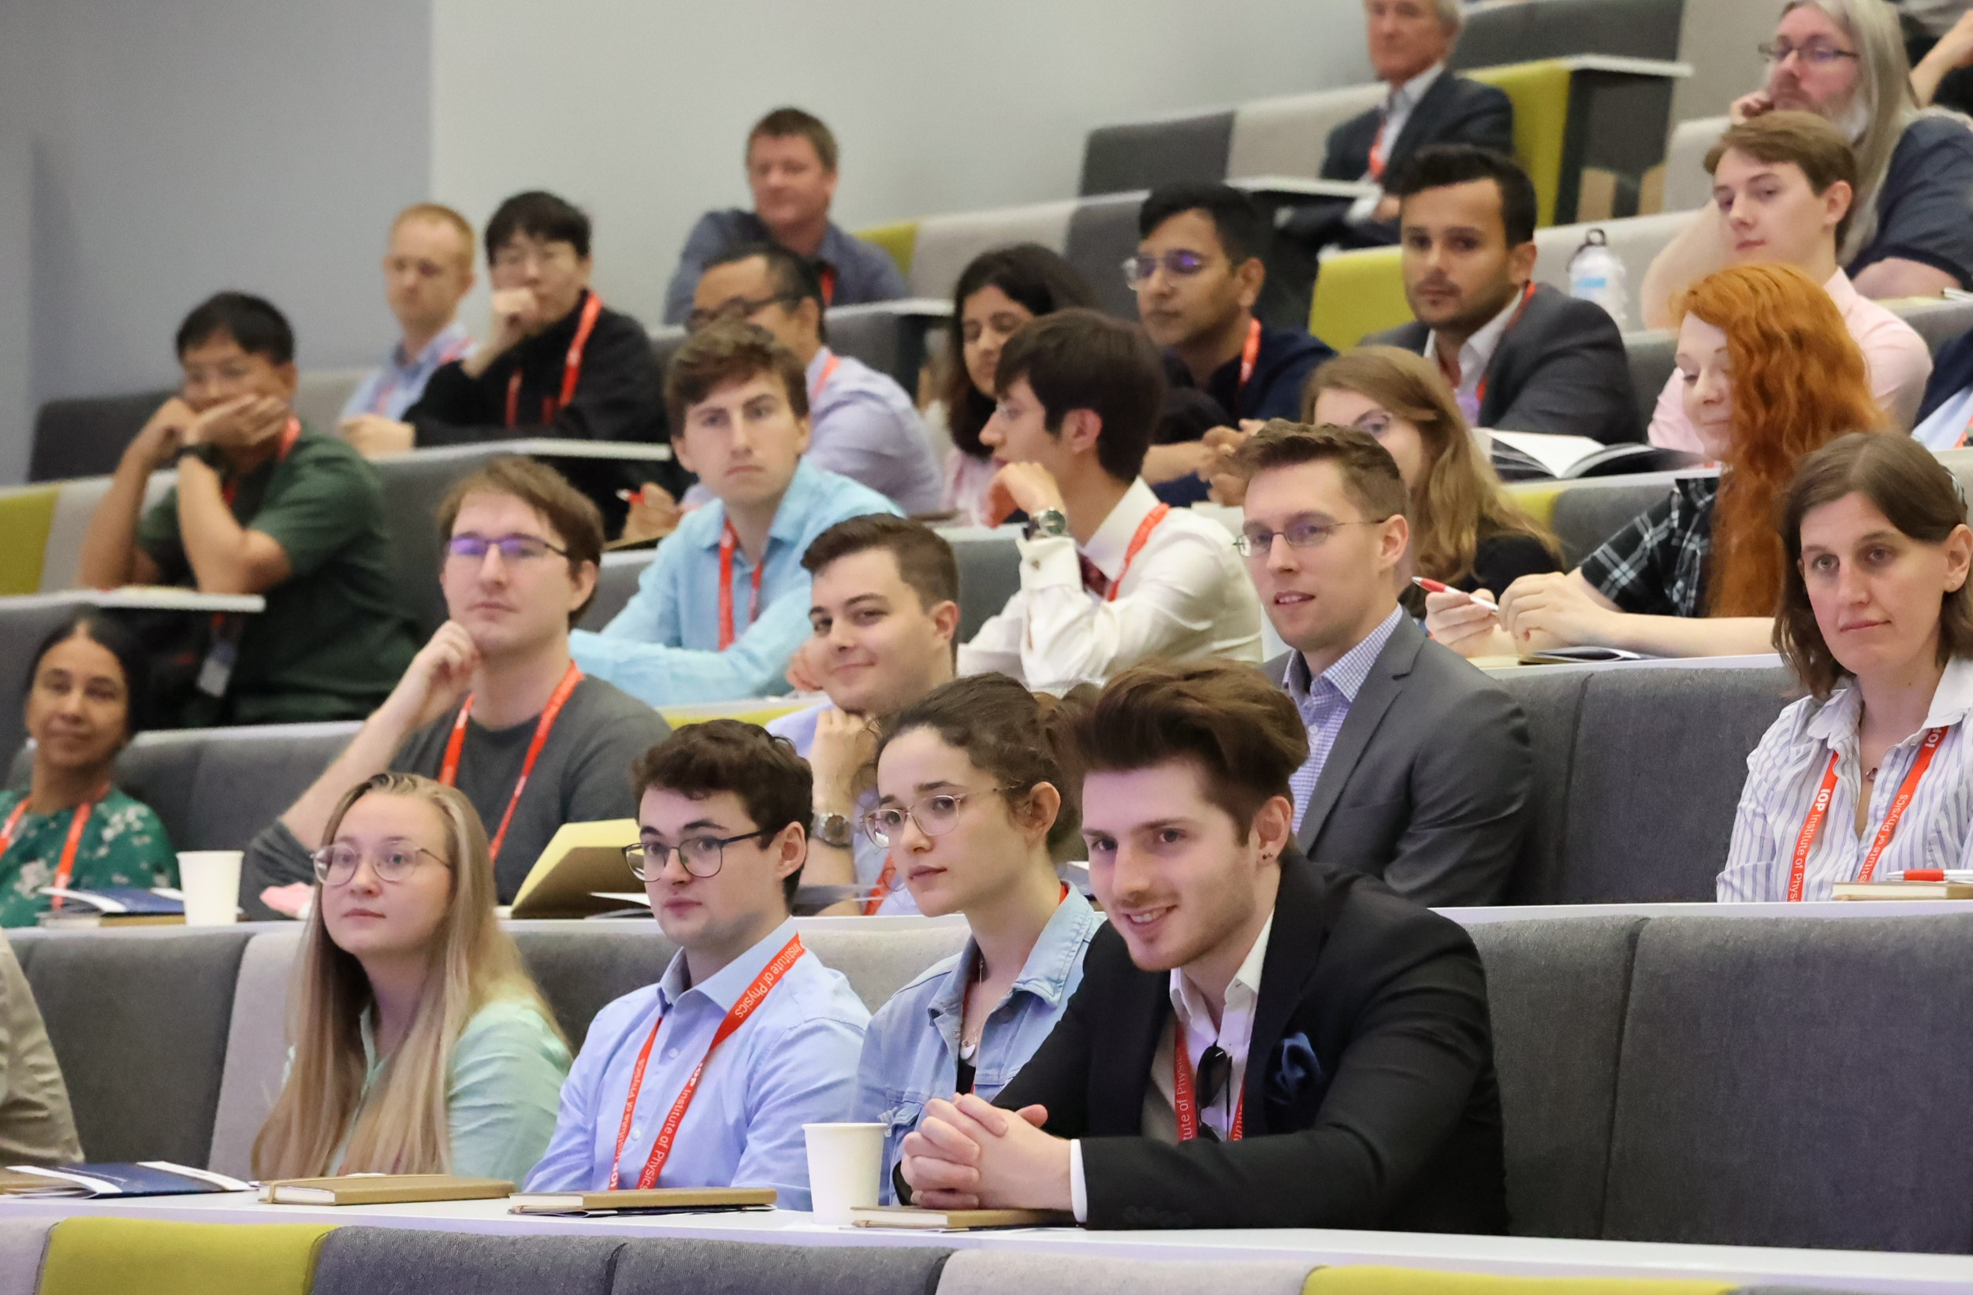
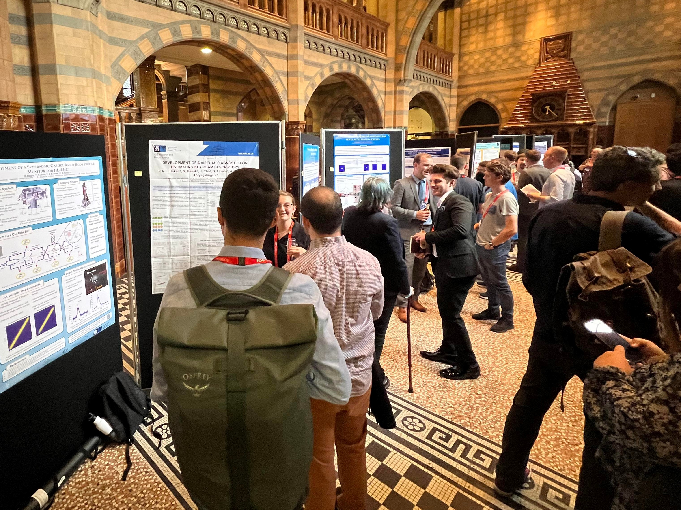
Inaugural Year 2022 Liverpool
Panel Session: UK Accelerator Science and Engineering in Today’s Changing World, 6 plenary talks
  + Chris Densham’s prize talk & Elaine Seddon’s keynote.
20 Parallel talks, 19 Posters.

Slide 3
Agenda
Keynote talks, plenary talks, prize talk, panel session, 22 parallel talks and 25 posters.
Conference Photo – after the last talk today.
SCAPA Tour – tomorrow at 4pm for all who are keen.
Civic reception at Glasgow city Chambers from 6pm.
  Followed by the conference banquet and poster prize award.
Committee room 9 – for a night of dancing to bagpipe rock band Scot Rock, with a free drink and lorne sausage baps.

Slide 5



Slide 6
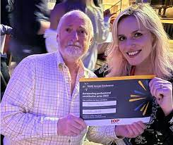
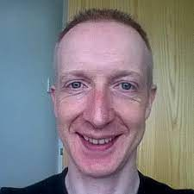
Jason Mill
Maia Peat
Baris Bingol
Radhika Nayli
Robert Kyle
Pornthep PongChalee
^{Brian}
^{McNeil}
^{Mark}
^{Wiggins}

