Slide 1

Overview of the thin film SRF programme at Daresbury Laboratory
Daniel Seal
^{Lancaster} ^{University/Cockcroft Institute}

Slide 2
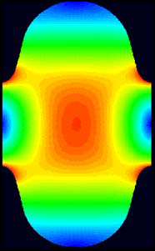
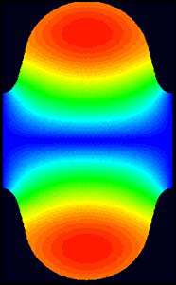
Bulk Nb SRF
Max field
Bulk Nb
  Highest T_{c} and H_{c1} of any element
  Large Q₀ (10¹⁰- 10¹¹)
  CW operation
Some figures of merit
  E_{acc} ∝ E_{peak} ∝ B_{peak} - limitation = magnetic transition
  Q₀ ∝ 1/R_{S} - limitation = thermal transition
  Duty cycle (=> 100%) - limitation = cryogenic power
However, bulk Nb cavities are close to reaching theoretical limits in E_{acc}!
B_{peak}
E_{peak}
E Field
B Field
0
Nb : Limits @ 2 K, 1.3 GHz :
E_{acc} ~ 55 MV/m (± 5 MV/m)
(Geometry : H/E_{acc} ~ 42 Oe/(MV/m))
R_{s} = R_{BCS} + R_{rés}.
Q₀
High field dissipations
Quench
E_{acc}
Courtesy of C. Antoine (CEA)

Slide 3
From bulk Nb cavities to thin film cavities
Superconducting films coated on copper:
  Lower production costs!
  Copper substrate → higher thermal conductivity than Nb
  Keeps the SRF properties of the film with the thermal properties of the bulk
Main goals for thin film SRF:
  Improve accelerator performance - higher Q₀ and E_{acc}
  Explore various high T_{c} materials (Nb₃Sn, V₃Si, NbN, NbTiN, MgB₂, and multilayer structures)
  Reduce cost:
    Copper vs bulk Nb
    Lower cryogenic power consumption (increased Carnot efficiency at higher T)
    Shorter accelerator structures – total cost reduction

Slide 4
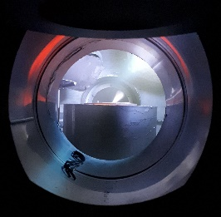
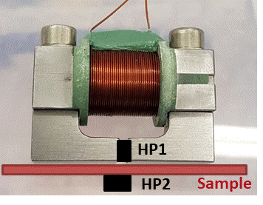
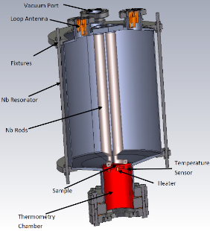
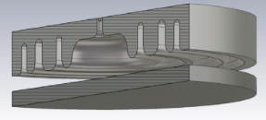
Superconducting thin film development
Thin film deposition
PVD: DC, pulsed, HIPIMS…
Film characterisation
SEM, FIB, AFM,
XPS, XRD, RBS, TEM…
Superconducting RF properties evaluation
Superconducting properties measurement
DC magnetic susceptibility,
QPR at CERN
QPR at HZB
Choke cavity at DL
Nb, NbN, Nb₃Sn, MgB₂, etc.
Surface preparation
Cleaning, etching,
Polishing, passivating
Field penetration
RRR, H_{c}, H_{fp}, H_{sh}, T_{c}
Laser treatment of Nb film
Key aim: Is there a correlation?
Film deposition
SEM image of a NbN thin film
DC magnetisation
QPR
Mainly planar samples for easier analysis
Choke cavity

Slide 5
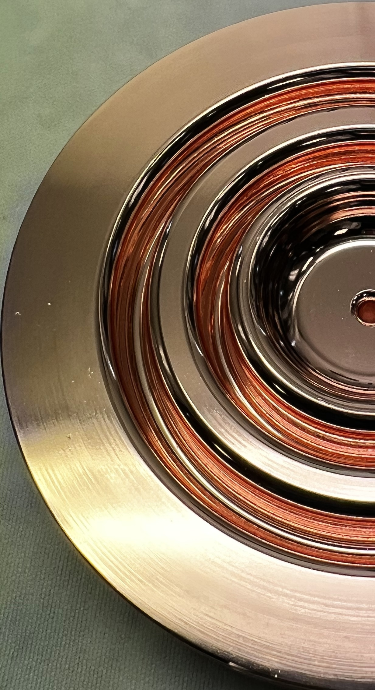
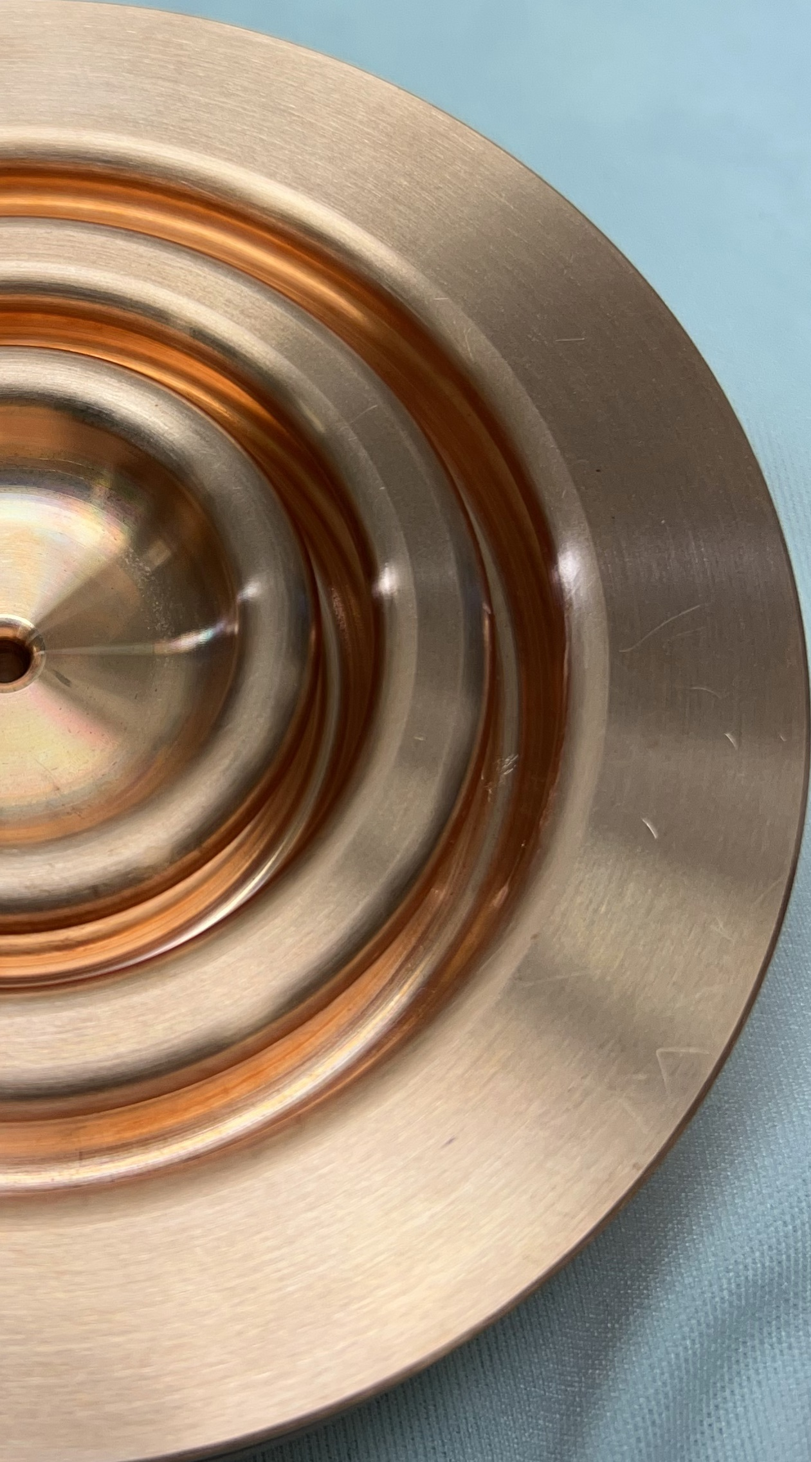
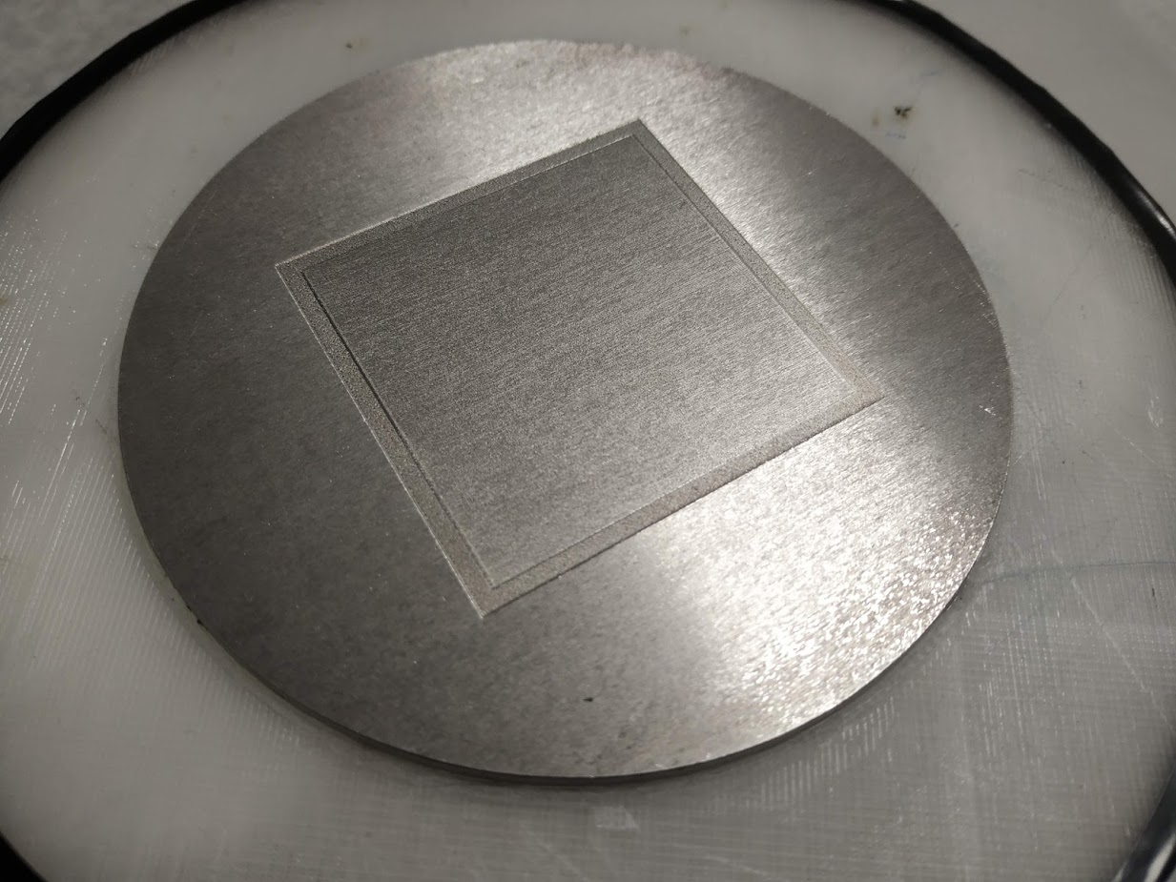
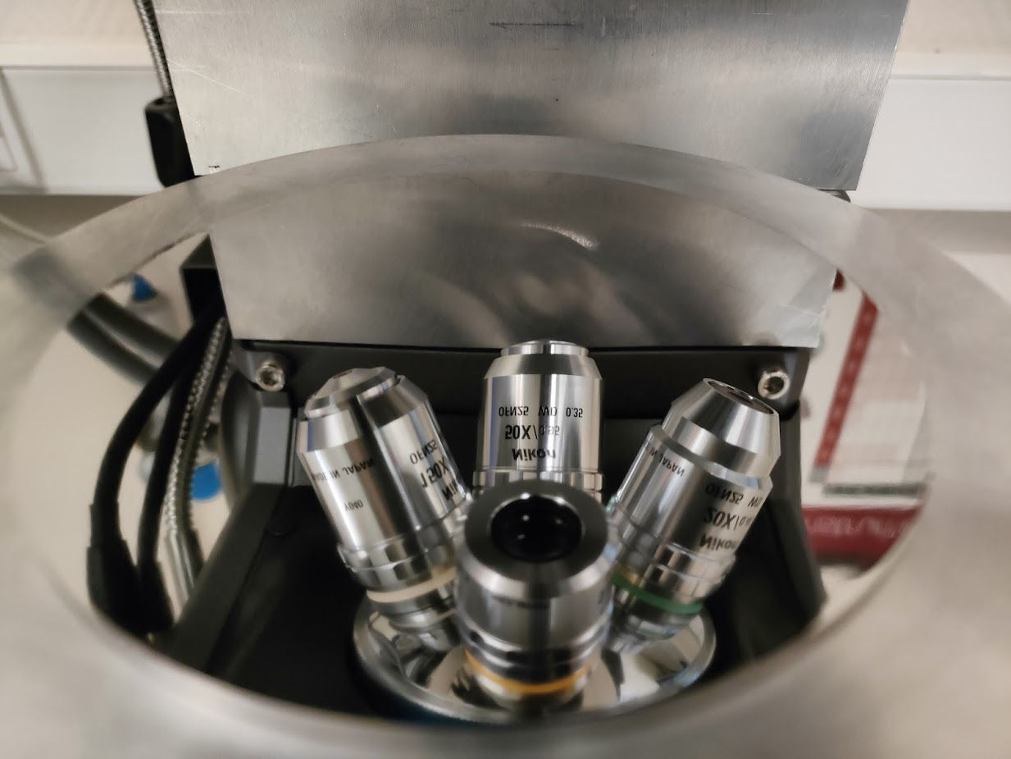
How is the substrate surface prepared?
Surface preparation
Superconducting properties measurement
Superconducting RF properties evaluation
Thin film deposition
Film characterisation
At Daresbury Laboratory
Mechanical polishing
Elsewhere
Fine mechanical polishing
  tumbling
  diamond turning
  Metallographic
Chemical polishing:
  SUBU5 solution
  Electropolishing (EP)
Laser polishing for pre- and post-treatment (new technology!)
Combination of different techniques
Would like to develop these at DL
SUBU5 polishing at INFN courtesy of E.Chyhyrynets, C. Pira
Metallographic polishing at IJCLab courtesy of O. Hryhorenko

Slide 6
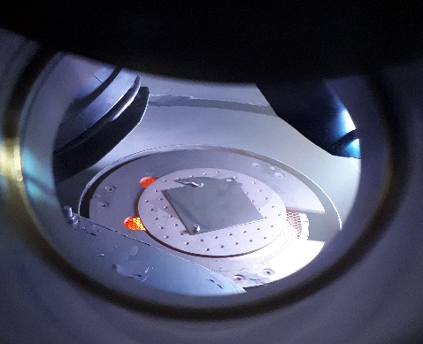
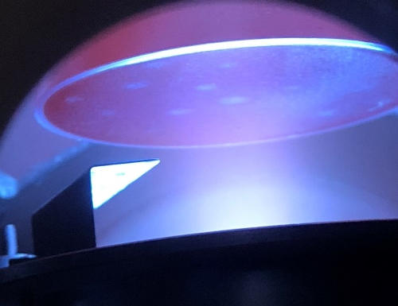
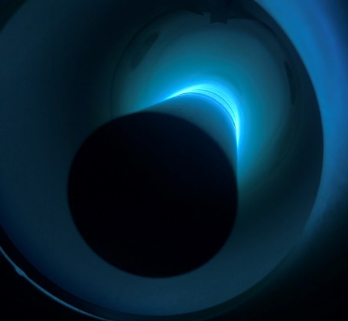
How is a thin film developed?
Surface preparation
Superconducting properties measurement
Superconducting RF properties evaluation
Thin film deposition
Film characterisation
Techniques:
  Physical Vapour Deposition (PVD) - DC, pulsed, High-power impulse magnetron (HIPIMS)…
  Chemical Vapour Deposition (CVD)
  Plasma-enhanced CVD (PECVD), plasma-enhanced Atomic Layer Deposition (PEALD) – under development
  Combined: PCVD
Materials:
  Nb
  NbN, Nb₃Sn, NbTiN, V₃Sn, MgB₂, etc.
  Multilayer structures
Deposition facilities at DL
  For planar samples
  For Quadrupole Resonator (QPR) samples
  For cavities
A planar sample during the Nb deposition
A QPR sample during Nb TF deposition
Courtesy of R. Valizadeh (STFC)
Cavity prototype deposition

Slide 7
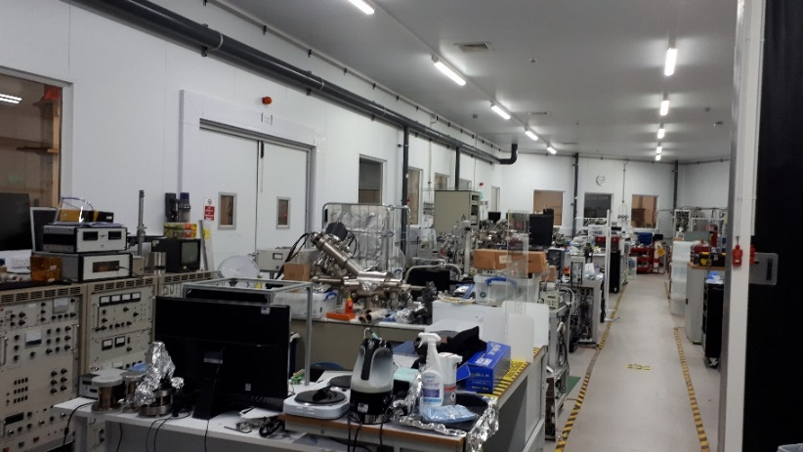
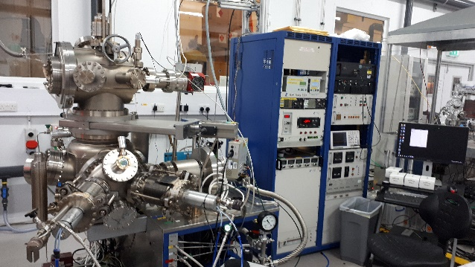
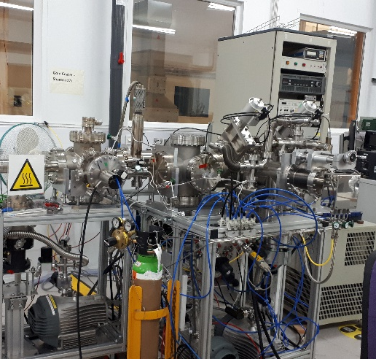
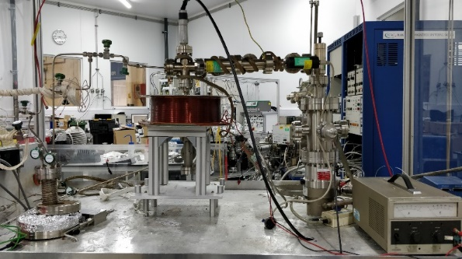
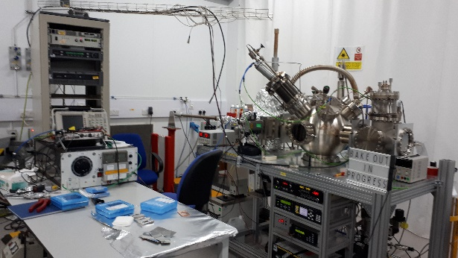
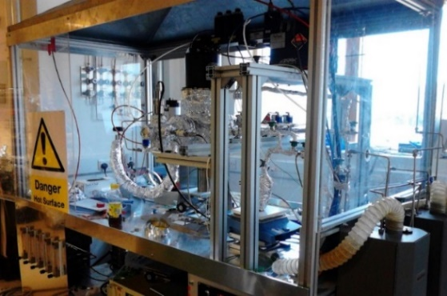
Surface preparation
Superconducting properties measurement
Superconducting RF properties evaluation
Thin film deposition
Film characterisation
VISTA Laboratory
Physical Vapour Deposition (PVD)
Hybrid Physical Chemical Vapour Deposition (HPCVD)
Chemical Vapour Deposition (CVD)

Slide 8
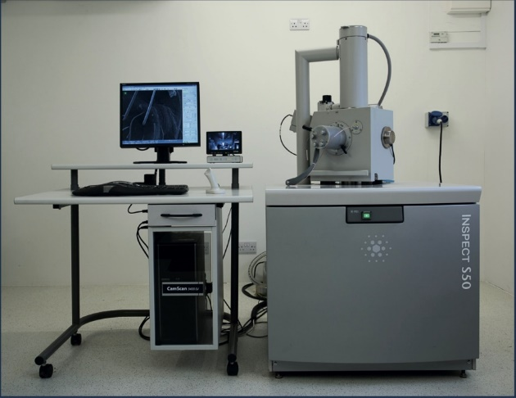
How are films characterised?
Surface preparation
Superconducting properties measurement
Superconducting RF properties evaluation
Thin film deposition
Film characterisation
Films are sensitive to defects
A wide range of techniques:
  Scanning Electron microscope (SEM)
  Focused Ion Beam (FIB)
  Atomic Force Microscope (AFM)
  X-ray Photoelectron Spectroscopy (XPS)
  X-ray Diffraction (XRD)
  Rutherford Backscattering Spectrometry (RBS)
  Transmission Electron Microscopy (TEM)
  Energy-Dispersive X-Ray Spectroscopy (EDX)
FEI inspect S50 SEM
X-section SEM of Nb₃Sn with a Nb underlayer as double structure on Cu
Courtesy of R. Valizadeh (STFC)

Slide 9
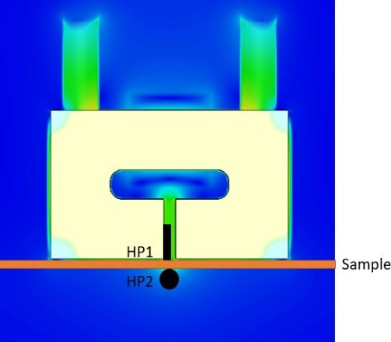
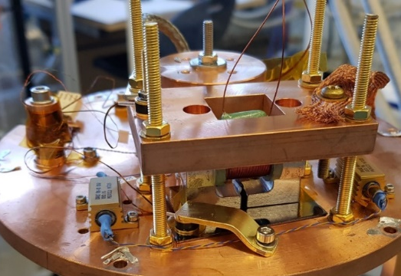
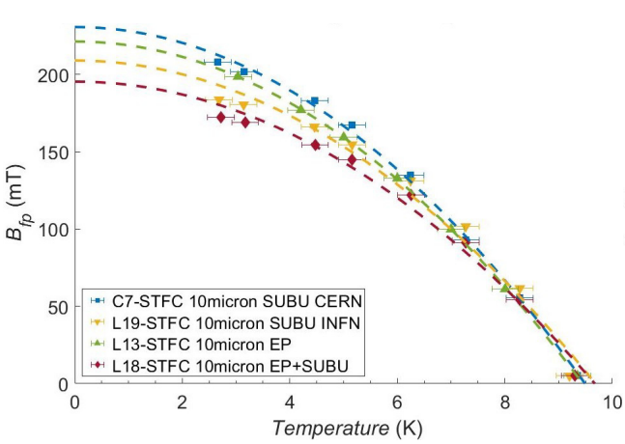
Magnetic field Penetration
Surface preparation
Superconducting properties measurement
Superconducting RF properties evaluation
Thin film deposition
Film characterisation
Similar to cavity conditions:
  DC magnetic field parallel to surface
  Field only from one side of sample
Field local to the sample surface:
  Avoid edge effect
  Allow possibility of sample scanning
  Applied and penetrated fields measured by Hall probe sensors
Facility is easy to operate:
  T_{min} = 2.5 K, B_{max} ~ 612 mT
  LHe free system
  Data acquisition fully automated
  Field of full flux penetration, B_{fp} vs T
Nb on Cu samples with different substrate treatments
Courtesy of D. Turner (DL/Lancaster)
See D. Turner et al. 2022. A facility for the characterisation of planar multilayer structures with preliminary niobium results. Superconductor Science and Technology.

Slide 10
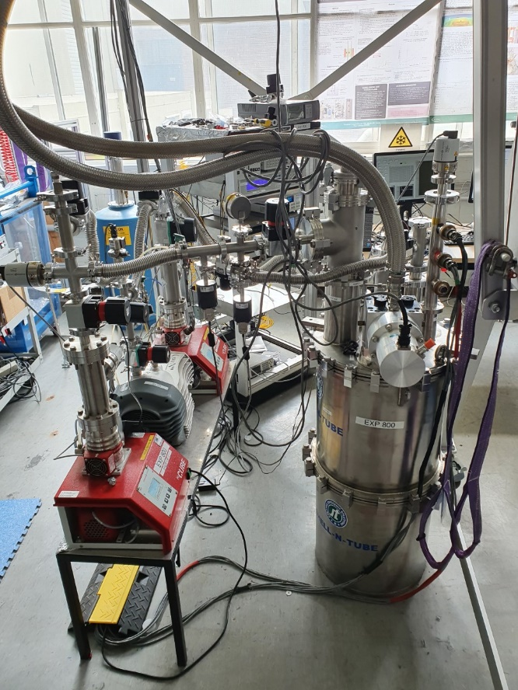
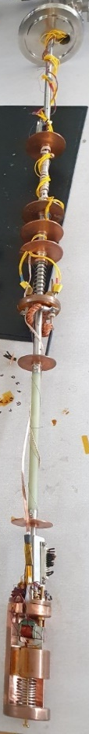
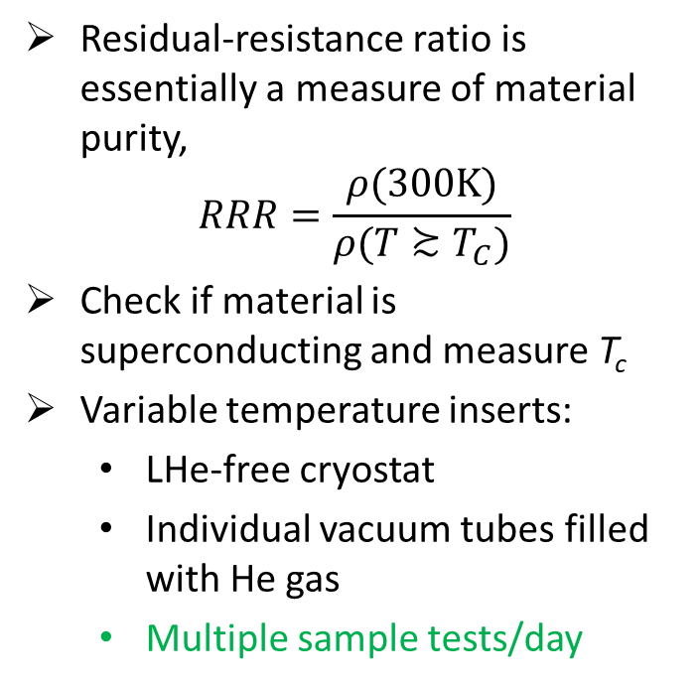
RRR and T_{c}
Surface preparation
Superconducting properties measurement
Superconducting RF properties evaluation
Thin film deposition
Film characterisation
Residual-resistance ratio is essentially a measure of material purity,
$$RRR=\frac{ρ(300K)}{ρ(T≿T_{C})}$$
Check if material is superconducting and measure T_{c}
Variable temperature inserts:
  LHe-free cryostat
  Individual vacuum tubes filled with He gas
  Multiple sample tests/day

Slide 11
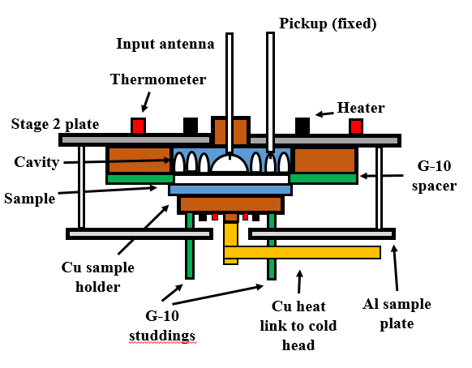
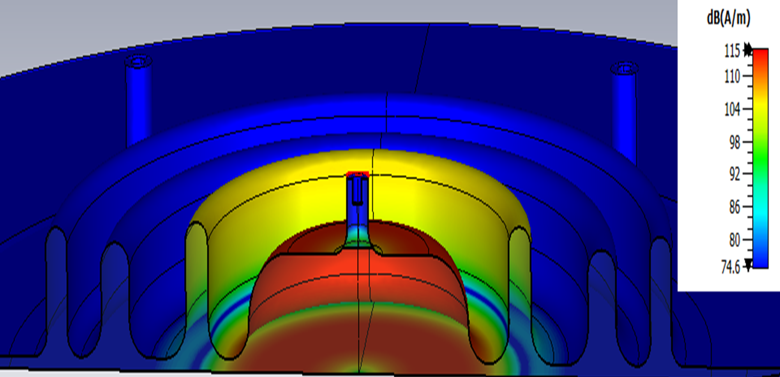
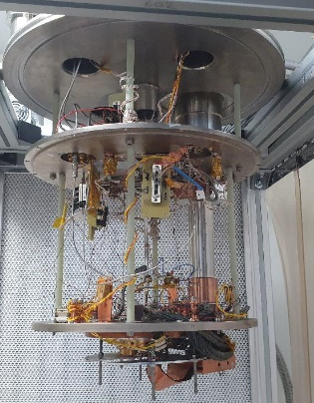
RF Evaluation
Surface preparation
Superconducting properties measurement
Superconducting RF properties evaluation
Thin film deposition
Film characterisation
Bulk Nb 3 Choke Cavity
An RF choke is designed to reflect the cavity’s fundamental mode frequency back into the cavity
No physical welding between cavity and sample required!
Direct measurements of sample R_{s}

Slide 12
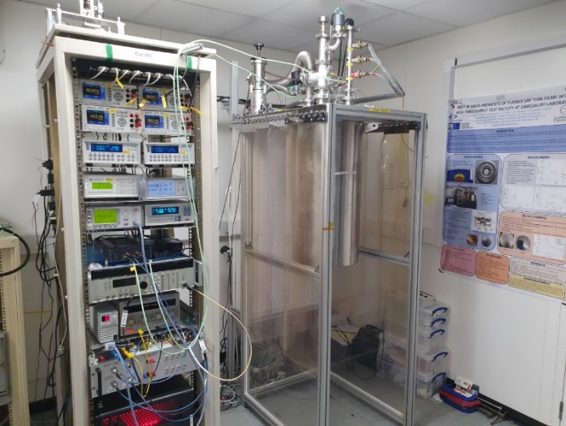
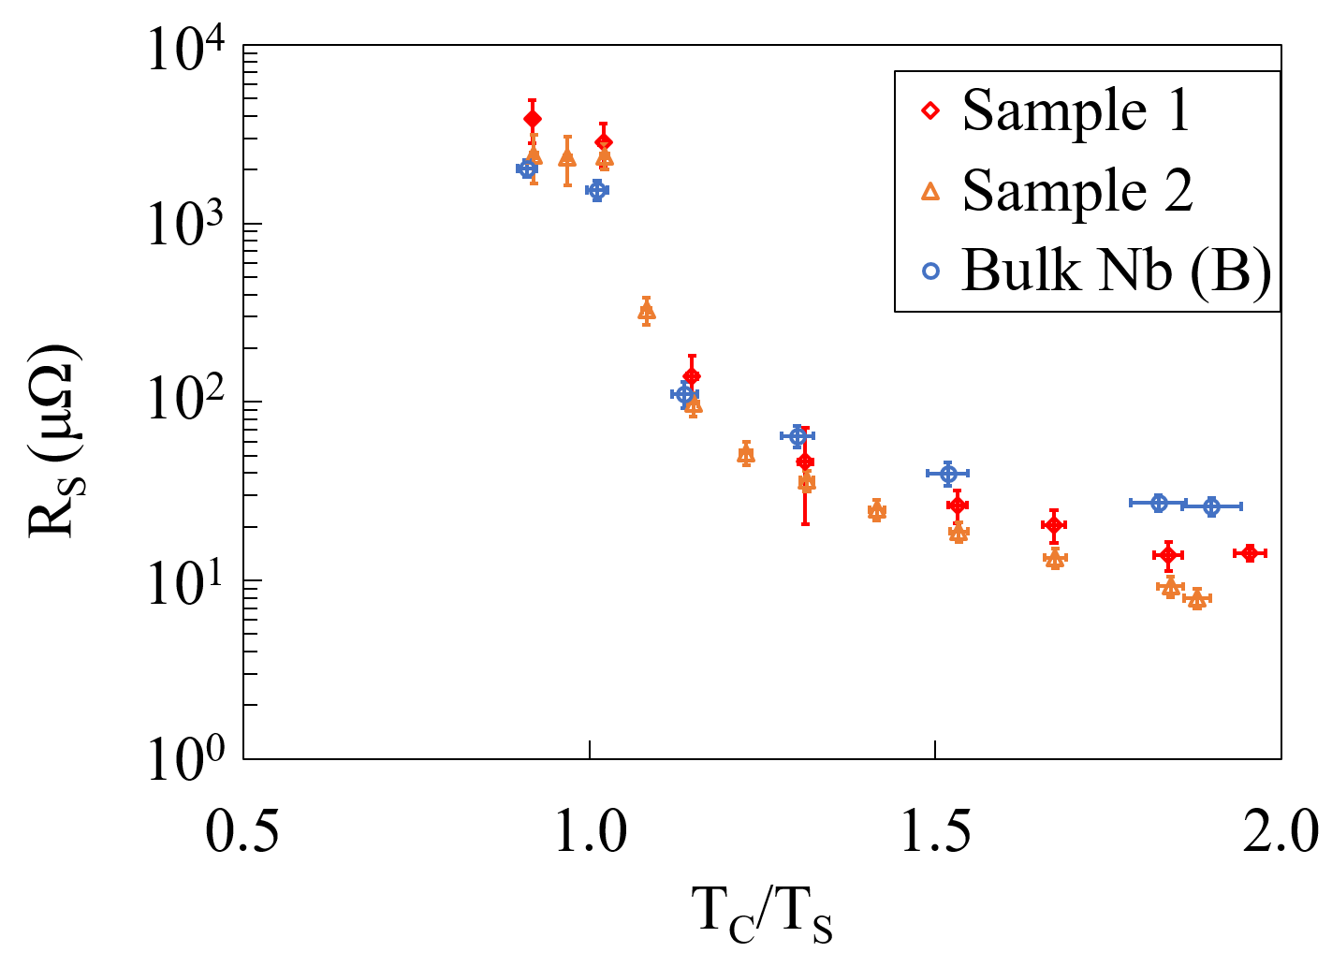
Surface preparation
Superconducting properties measurement
Superconducting RF properties evaluation
Thin film deposition
Film characterisation
Low power measurements of R_{s}(T,B), of flat samples 90 – 110 mm diameter
Parameters:
  Frequency = 7.8 GHz
  Sample temperatures, T_{𝑆} > 4 K
  B-fields ≤ 0.8 mT
  RF power ≤ 1 W
Simple to operate and change sample (1 PhD student!)
Simple sample design (low cost)
LHe-free system
~ 2-3 sample tests per week (fast turnaround)
  More details in poster
Commissioning with bulk Nb (no treatment yet!) and Nb on Cu samples

Slide 13
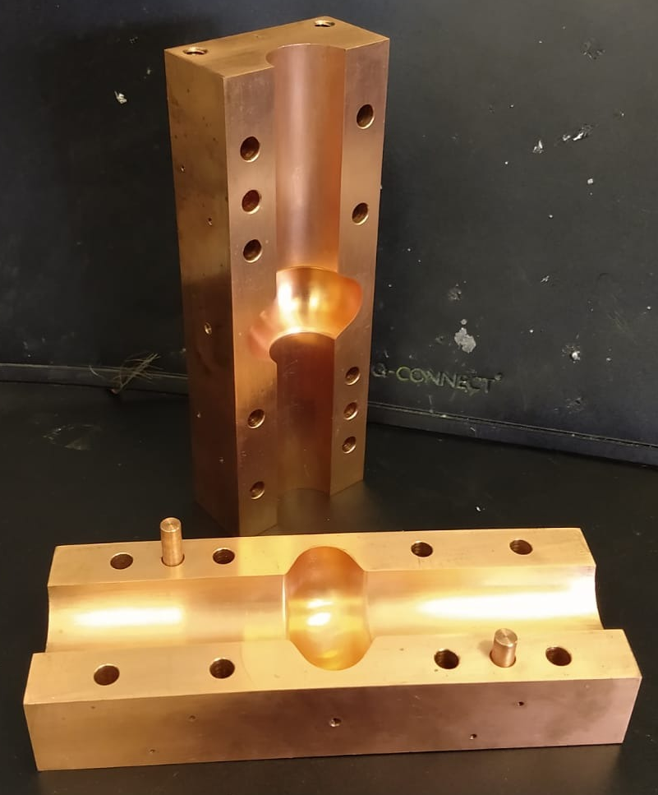
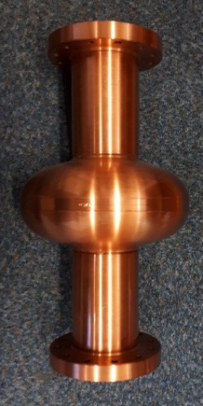
What next?
Ultimate Goal: produce a 1.3 GHz thin film coated cavity
Thin film deposition
Film characterisation
Superconducting RF properties evaluation
Superconducting properties measurement
Surface preparation
Real cavity measurement
6 GHz split-cavity
1.3 GHz cavity

Slide 14
Conclusions
Significant progress since the programme started in 2014
An ongoing systematic study of correlation between deposition parameters and superconducting properties:
  Small sample depositions, characterisation and testing
  Mastering Nb deposition
  Development in non-Nb films, e.g. Nb₃Sn, NbTiN, Mg₂B, …
  Depositing multilayer structures, e.g. Cu-Nb-AlN-Nb₃Sn
Ultimate goal: beyond Nb coated cavity:
  6 GHz split cavity tests
  Develop a 1.3 GHz deposition and RF testing facility

Slide 15

Acknowledgements
STFC/CI: O. B. Malyshev, R. Valizadeh, P. Goudket, S. Hitchen, L. Smith, J. Conlon, K. Dumbell, N. Pattalwar, S. Pattalwar, A. May, F. Lockwood-Estrin, A. Hannah, A. Vick, E. Marshall, S. Bibby-Trevor, R. McAllister
Lancaster University/CI: G. Burt, T. Sian, D. Turner, H. Marks
INFN: C. Pira, E. Chyhyrynets
IJCLAB: O. Hryhorenko
CEA: C. Antoine
This work has been supported by: the IFAST collaboration which has
received funding from the European Union’s Horizon 2020 Research and
Innovation programme under Grant Agreement No 101004730.

Slide 16
Thank you for listening
Daniel Seal
daniel.seal@cockcroft.ac.uk

