Slide 1
A Dielectric Wakefield Streaker for Longitudinal Bunch Profile Measurements
Toby Overton¹, Y. Saveliev², T. Pacey², G. Xia¹
¹The University of Manchester
²ASTeC/STFC, Daresbury Laboratory
All at The Cockcroft Institute, Daresbury Laboratory
toby.overton@cockcroft.ac.uk

Slide 2
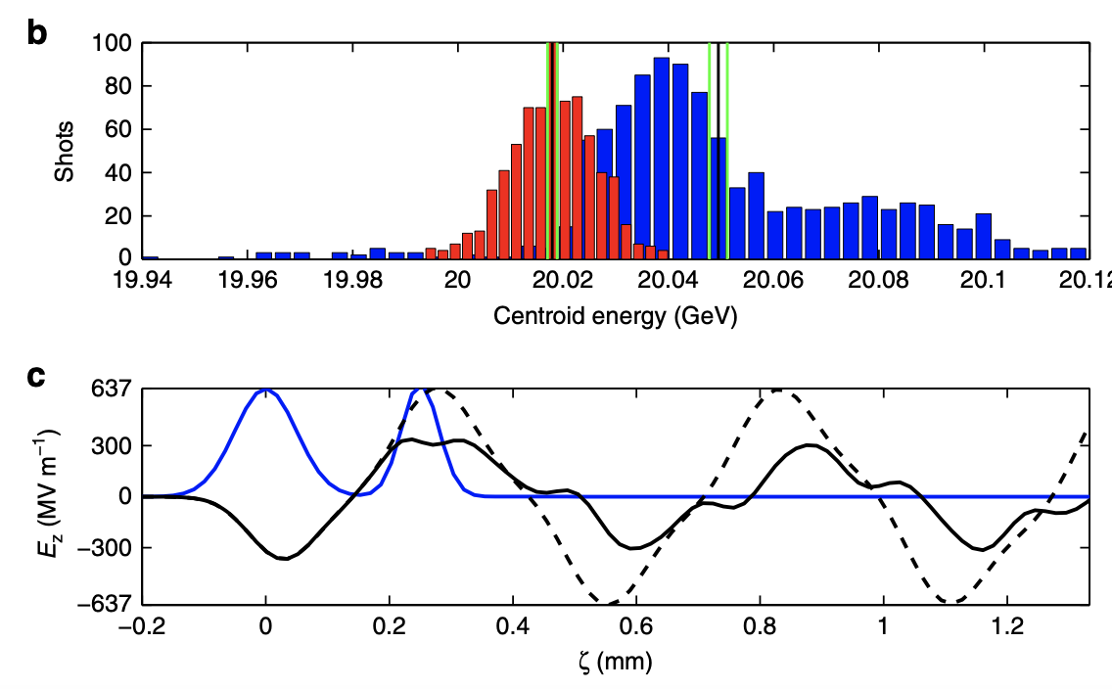
Dielectric Wakefield Acceleration
Cherenkov radiation produced by electron beams in a DLW:
  Trailing witness/main bunch accelerated by the wakefield produced
  Structures can sustain ~800 MV/m accelerating gradients
Area of large focus internationally (Snowmass, ESPP)
  Aim to show the technology can work over large distances
300 MV/m accelerating gradient for electron bunch at SLAC (O’Shea et.al 2016 Nature)
Longitudinal field produced by a drive electron bunch, accelerating a trailing bunch

Slide 3
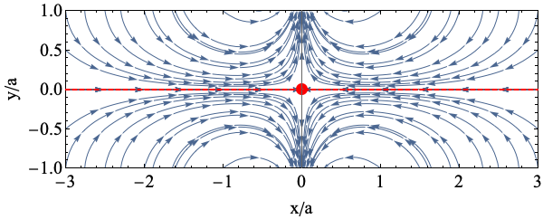
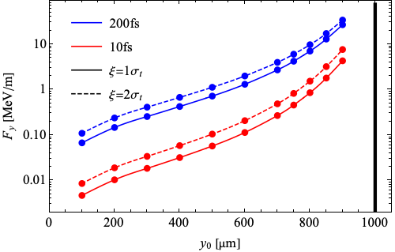
Transverse Fields in DLWs
Fields can be approximated as quadrupole-like with dipole term growing with offset
Field strength grows exponentially with distance from axis
We have shown the streaking effect and behavior with offset at CLARA
Transverse field lines produced by an electron bunch on-axis
Transverse field vs. offset for 250 pC bunches at 2 longitudinal positions

Slide 4
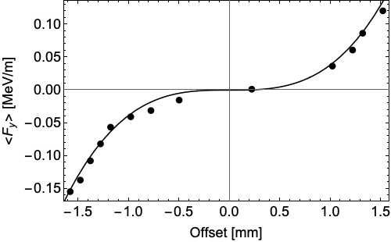
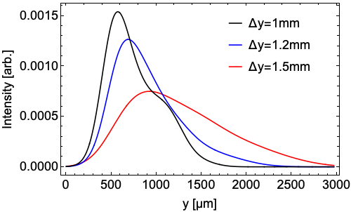
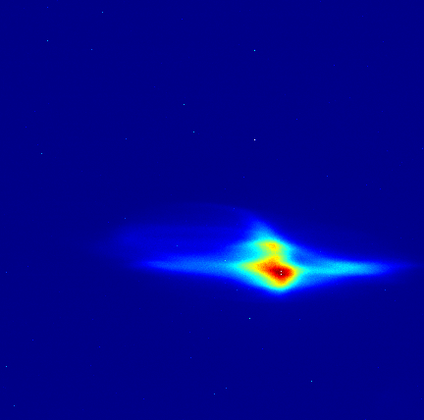
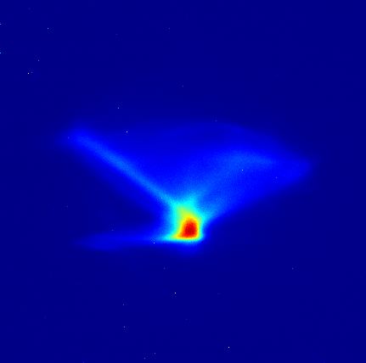
Measurements at CLARA using 35 MeV, ~100 pC, 800 fs bunches
DLW had a 200um thick quartz layer, with a 2mm half-gap
Average vertical streaking force vs. offset
Beam on-axis
Beam off-axis
Measured longitudinal profile for streaked bunches at 3 offsets

Slide 5
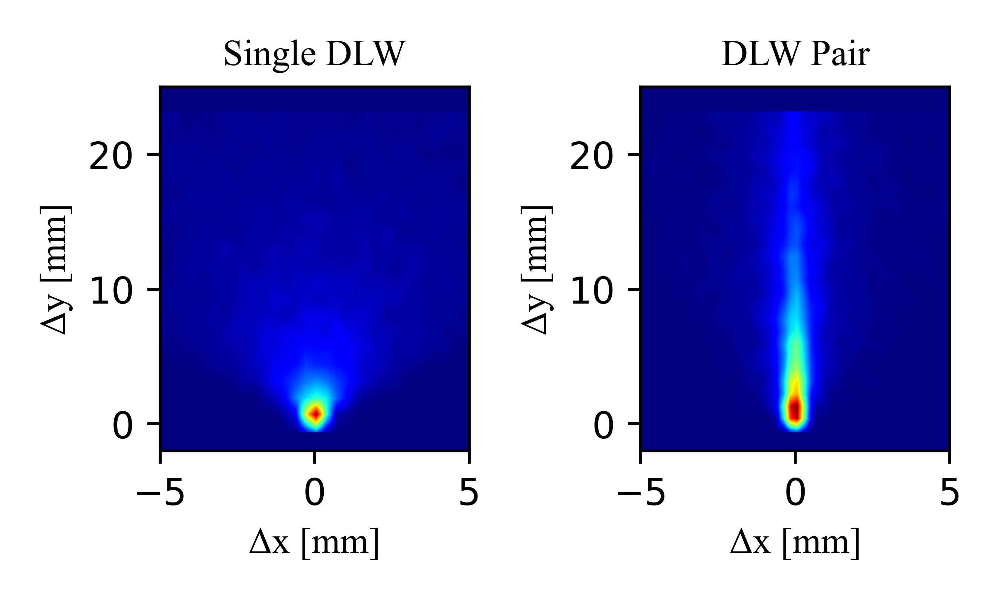
Passive Diagnostics with Dielectrics
So long as the streak is monotonic:
  Self-synchronised -> fields independent of beam-to-beam variation
  Longitudinal profile converted to transverse profile
  Small physical and energy footprint
Diagnostic for a wide range of facilities
  Focus on either ‘novel accelerator’ type beam or facility like CLARA FEBE upgrade

Slide 6
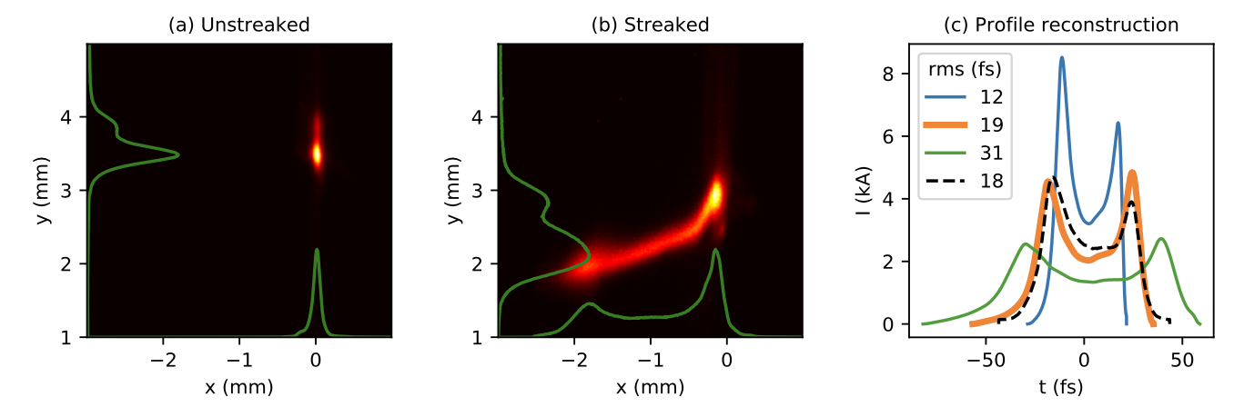
Dielectric Streakers
Other facilities have explored the potential of dipole wakefields for streaking
  Corrugated structure at SwissFEL for bunch reconstruction and FEL power profile reconstruction
  Femtosecond resolution obtained for bunches with rms bunch length 10-30 fs
Example streaked/unstreaked beam and reconstructed profiles at SwissFEL (Dijkstal 2022 Physical Review Research)

Slide 7
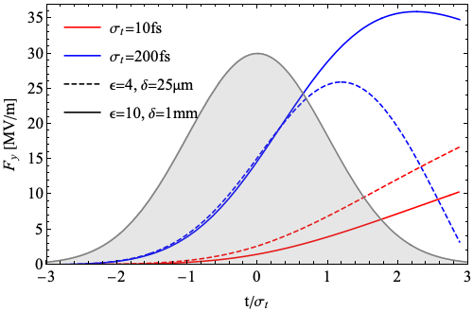
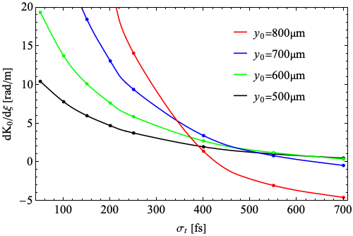
Streaker Optimisation
Shorter bunches:
  Always monotonic so maximise the streak only
    Very thin, quartz layer
Longer bunches:
  Need to increase wavelength for monotonic profile
    Thicker plate, higher permittivity
For even longer bunches reduce the offset for longer wavelength
Vertical streaking field with the 2 streakers offset 900um from axis
Gradient of the streak at z = +2σ_{t} for varying offsets and bunch lengths

Slide 8
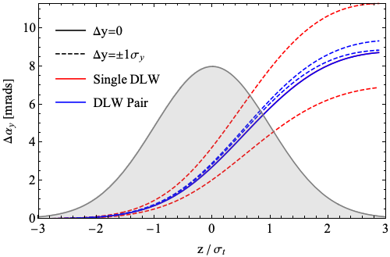
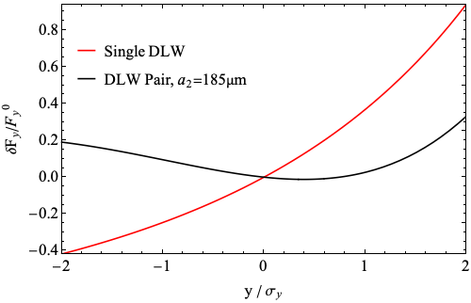
Minimising Transverse Streak Variation
Take advantage of the quadrupole-like fields to cancel streak variation
Electron beam on-axis through second shorter DLW
Reduction from 120% variation to 30% variation
More monotonic streak
Transverse streak variation with/without a second DLW
Angular kick along the bunch with/without a second DLW

Slide 9
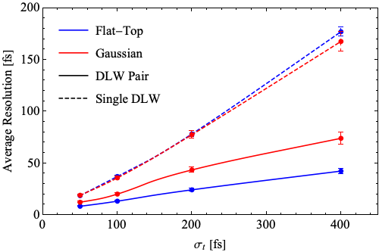
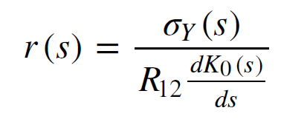
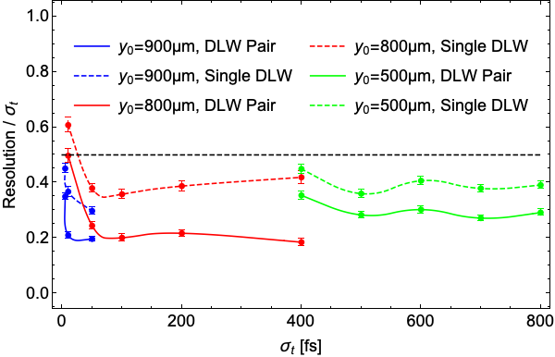
Expected Resolution
Resolution is given by:
Average is the instantaneous resolution weighted by charge
Resolution is enough for reconstruction across 5 to 800 fs
Transverse beam size at s
Longitudinal variation in streak
Average resolution for the ‘long bunch’ streaker with bunch length
Normalised average resolution for varying streaker type and offset

Slide 10
Bunch Profile Reconstruction
Transverse profile gives a first estimate for Fy profile
Reconstructed profile is the minimized variation with measured streak
Coordinate transform for first longitudinal profile estimate
Calculate expected Fy from this profile
Simulate the streak from this profile and Fy
Change the profile
Variation with actual measured streak

Slide 11
Conclusions and Outlook
Dielectric streaker can be used to effectively convert longitudinal bunch profile to a transverse profile on screen
Two ways to make this diagnostic work across a ‘broadband’ bunch length range
  High frequency and low frequency streaker together
  Reduce the offset for longer bunches
Need to show reconstruction will work experimentally, especially with very short bunches
  Upcoming experiments at the Gemini facility to test streaker and streak reconstruction

Slide 12
Additional slides

Slide 13
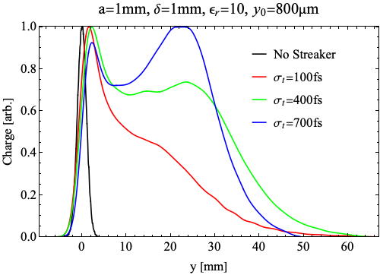
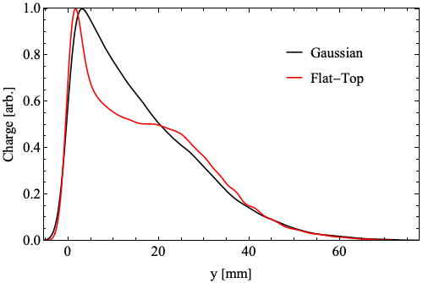
Varying Bunch Profile

Slide 14
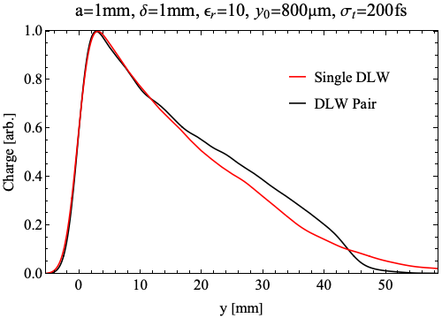
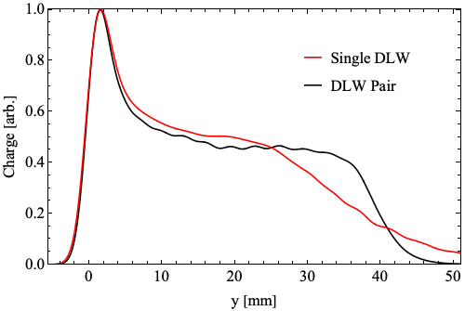
DLW Pair

