Slide 1


THz Driven Deflection and Tomographic Retrieval of Bunch Parameters
Dan Lake
Department of Physics, Lancaster University, U.K.​
Cockcroft Institute for Accelerator Science, Daresbury, U.K.
Terahertz Acceleration Group - https://www.thzag.uk/

Slide 2
Motivation
THz Deflection Experiment using 100 keV Electron Gun
Work towards THz Compressor and THz Acceleration
What other useful information can we extract from these measurements?
Can Tomography techniques be applied to data we already have?

Slide 3
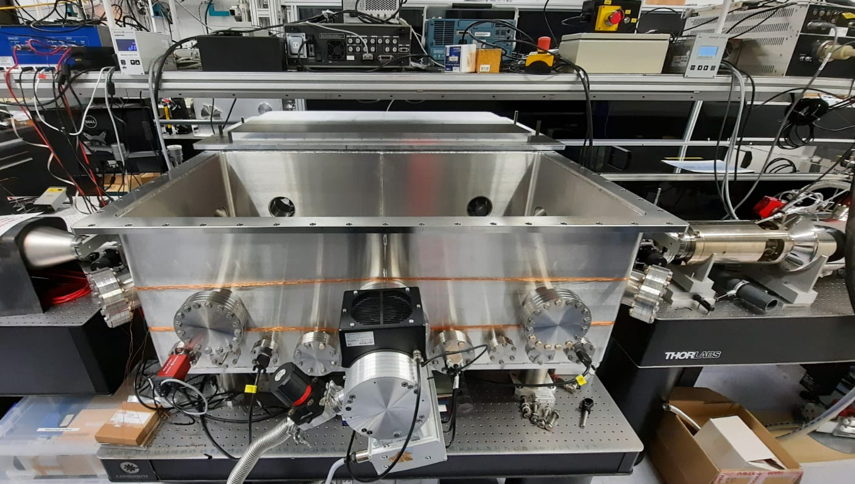
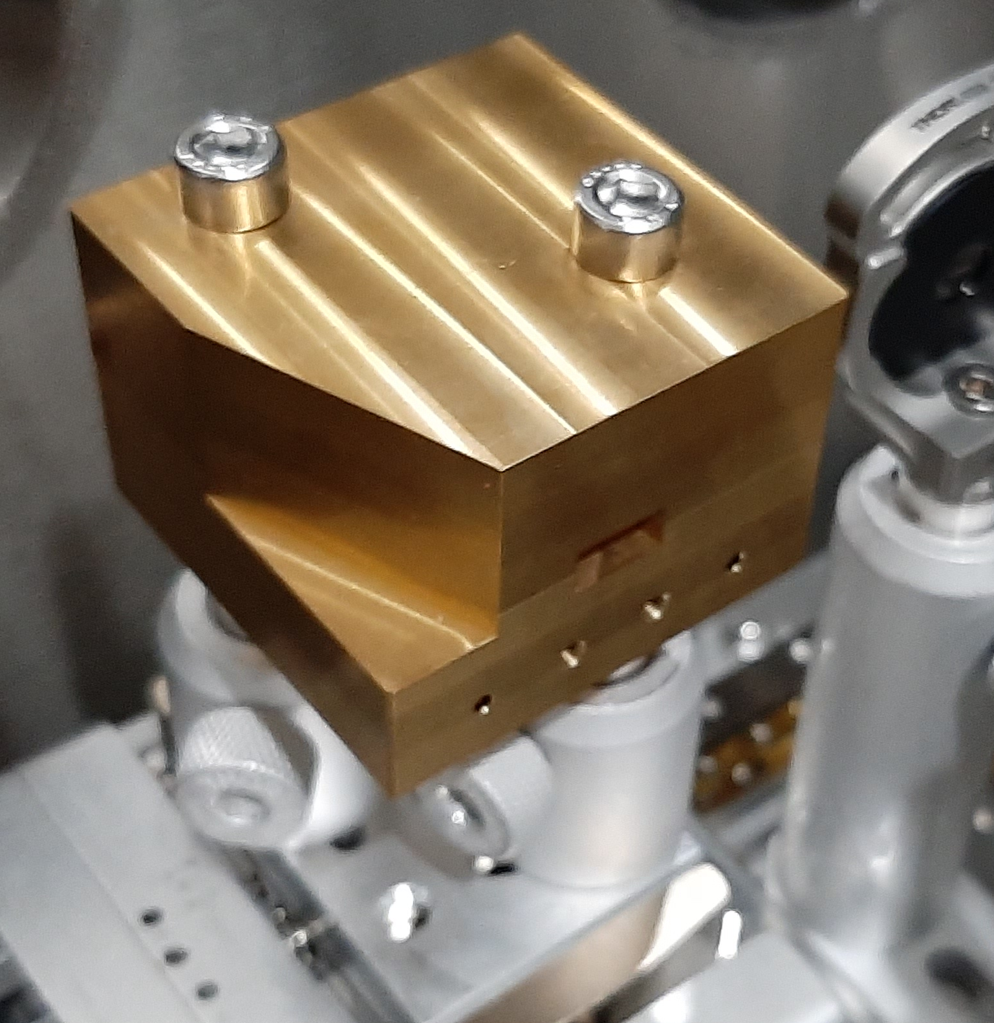
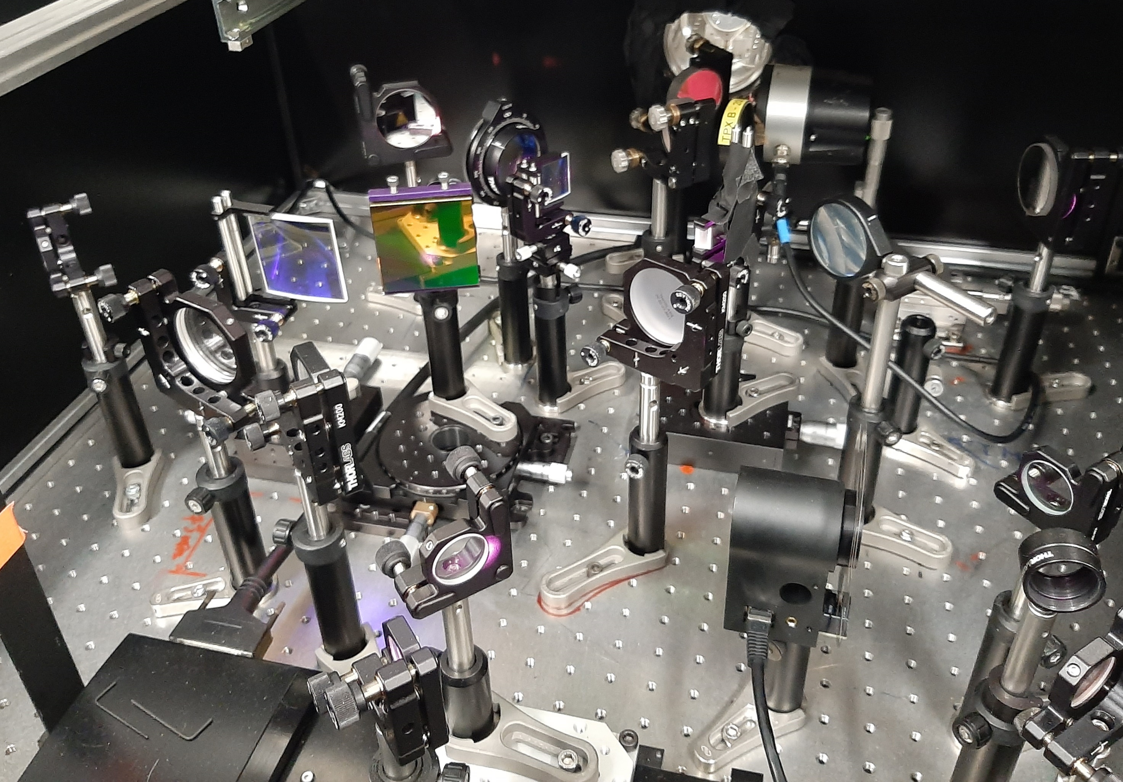
THz Deflection - Experimental Overview
100 keV
Electron Gun
MCP
DLW
100 keV Electron gun set up combined with THz pulses generated using an amplified laser system
Electrons and THz pulse generated using same laser pulse giving inherent synchronization
THz Source

Slide 4
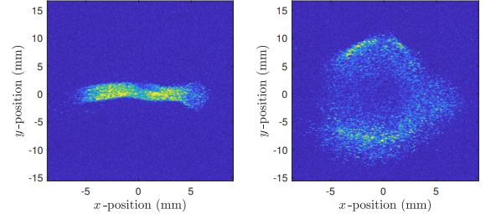
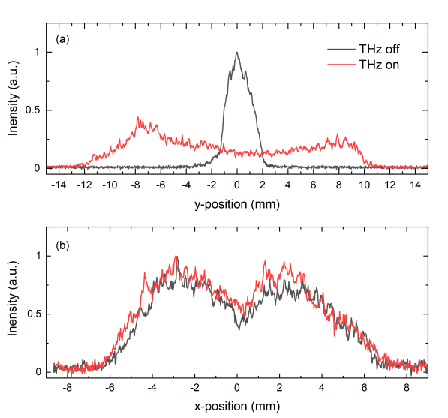
THz Deflection –
Measurements
THz Off
THz On
Electron bunch spatial profile measured using MCP detector
Electrons focused through a DLW with copropagating THz pulse
THz pulse used to deflect electrons in y
Relative arrival time of THz pulse scanned
‘deflectogram’ built from the measured y-projections at different time delays

Slide 5
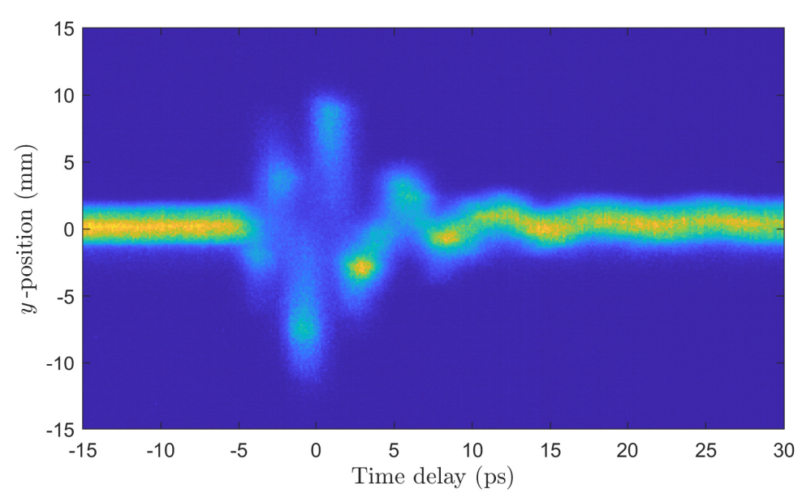
THz Deflection – Deflectogram Measurements
F_{THz} – 0.38 THz
Peak Deflecting Field Strength – 1.1 MV/m
Estimated bunch duration – 3.5 ps

Slide 6
Why Tomography?
Tomographic reconstruction techniques enable a 2-dimensional profile to be retrieved from a series of 1-dimensional projection measurements
Established technique – used for longitudinal and transverse phase space measurements
In our case, series of y-projections at different Δt
Attempt to retrieve ρ(y,t) from series of ∫ρ(y,t)dt measurements

Slide 7
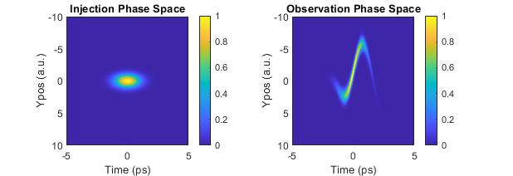
Transfer Function
Transfer Function is key to successful retrieval
Describes the transformation of input to observed
Currently using simple transfer function
Assume uniform interaction across DLW structure
Simulations are underway to give improved transfer function

Slide 8
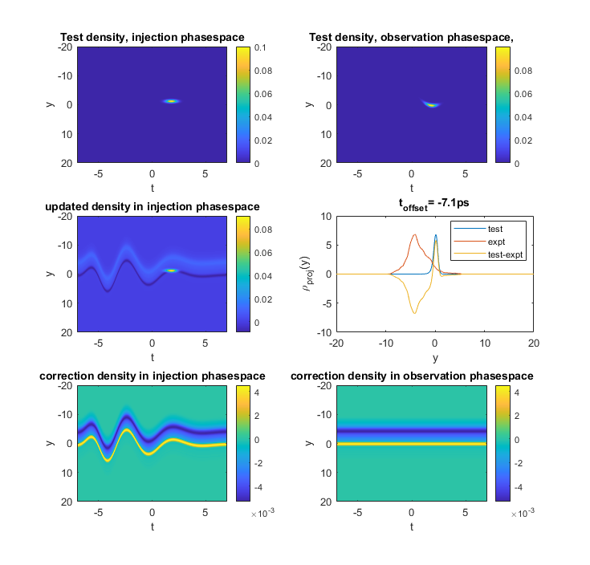
Tomography Retrieval Algorithm
Transfer Function
Test Injection Phase Space
Forward Propagate with random Time Step
Subtract Correction Injection Phase Space from Initial Test Injection Phase Space
Compare projection with Experiment
Back Propagate the difference to get Correction Injection Phase Space
Take the Difference and average over observation space
Transfer Function

Slide 9
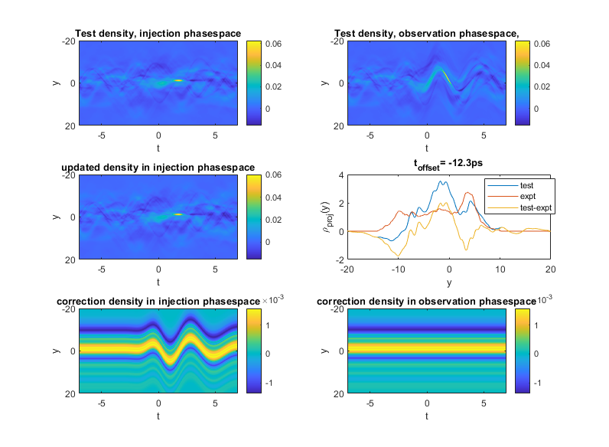
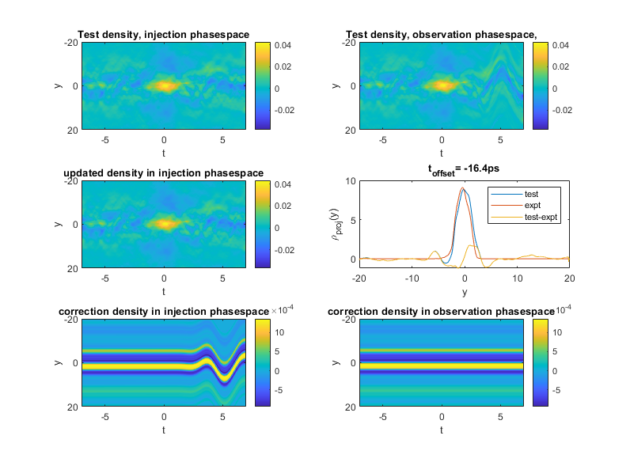
Tomography Retrieval Algorithm
50 Iterations
500 Iterations

Slide 10
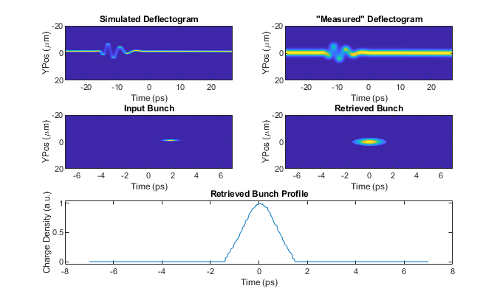
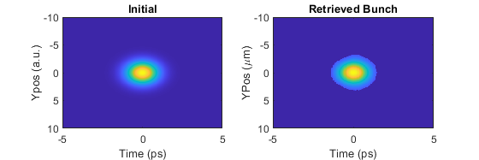
‘Ideal’ Test Case Results
Start with simulated data
Artificial deflectogram generated using known initial conditions
Tomography retrieval used to estimate initial conditions from artificial deflectogram
Good agreement
True Bunch
Retrieved Bunch

Slide 11
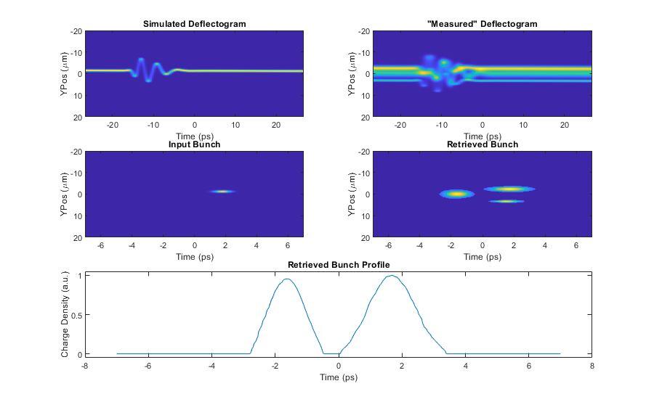
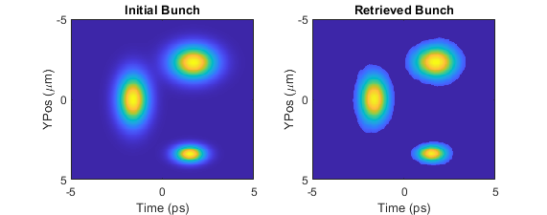
Complex Test Case Results
Does this still work for more complex initial conditions?
Started with a more complex bunch profile consisting of three distinct sections
Still good agreement
True Bunch
Retrieved Bunch

Slide 12
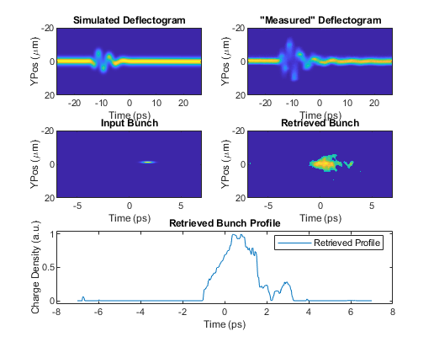
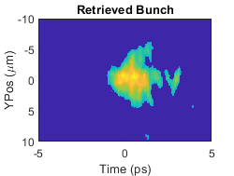
Real Data – THz Deflection
Experimentally measured deflectogram
Initial conditions are unknown
Attempt to retrieve through Tomographic retrieval
True Bunch
?

Slide 13
Conclusions + Future Work
Successfully measured THz-Driven Deflection of Electrons
Promising attempts to determine bunch length through tomographic methods
To get full longitudinal phase space measurements, need some energy resolution on measurements
Future experiments looking at THz acceleration, and the addition of an energy spectrometer before the MCP detector will enable this

Slide 14
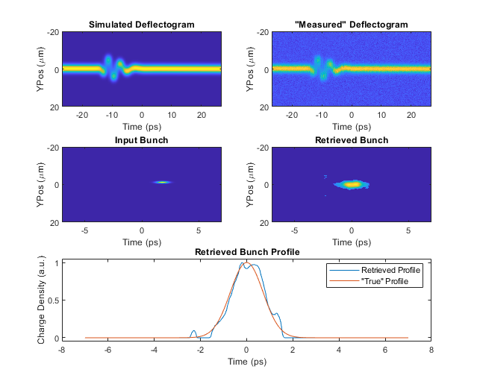
Ideal Case – With Noise
Added white noise and timing jitter to each simulated measurement
Retrieved Bunch still in good agreement with the “True Bunch”

