Slide 1
Injection Schemes for Diamond-II
Jonas Kallestrup
Ian Martin
IoP PABG Annual Conference
26/07/2022

Slide 2
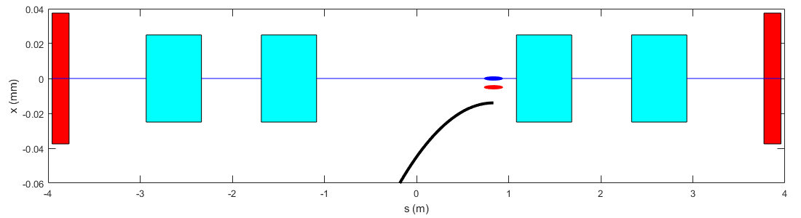
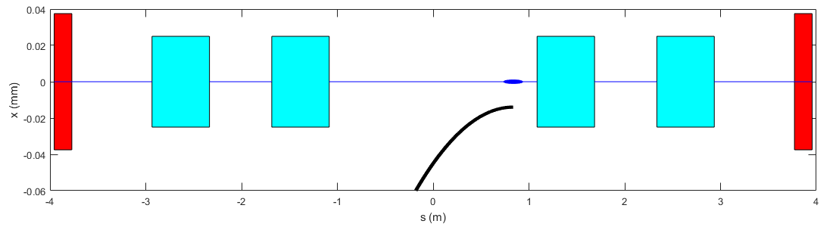
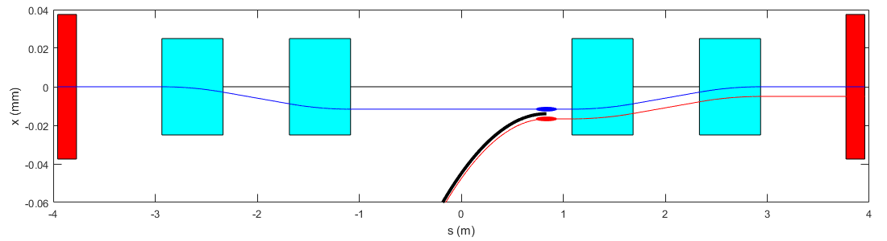
Standard Off-axis Injection Scheme
Before injection: - all four kickers and septum magnet are off
- stored beam (blue) travels on a straight line
During injection: - kicker magnets fire, bumping the stored beam towards the septum magnet
- injected beam is deflected by the septum magnet and exits parallel to stored beam
After injection: - kicker magnets and septum are switched off
- injected beam is inside storage ring but displaced
- radiation damping causes the injected bunch to damp down over few 10s ms
Injection Straight
Direction of travel
Quadrupole
Dipole kicker
Septum magnet

Slide 3
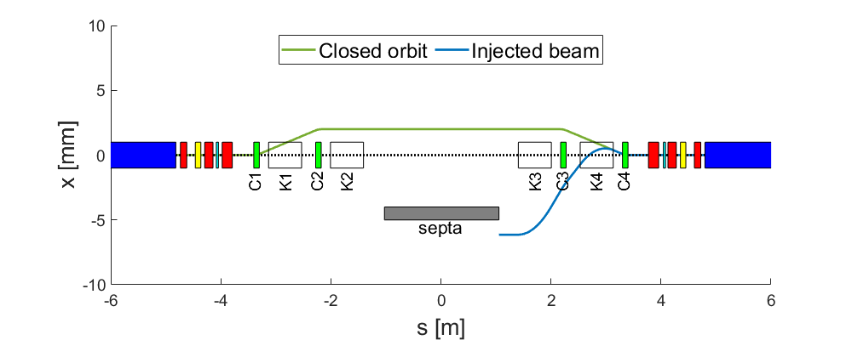
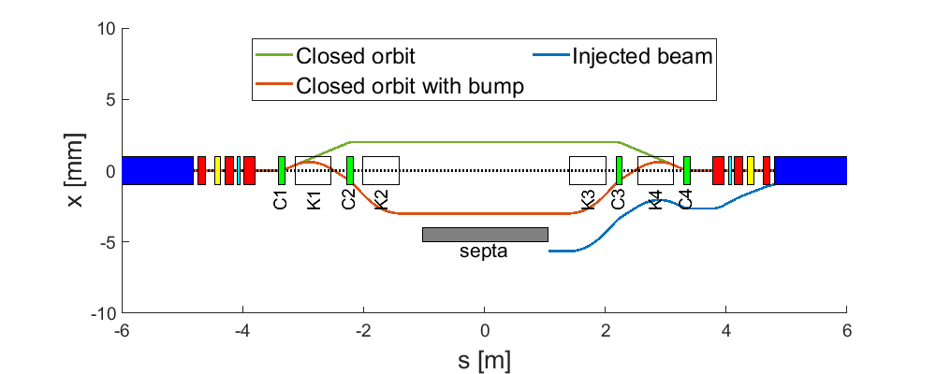
Standard Off-axis Injection Scheme
The four-kicker bump is a robust and reliable method of injection:
Proven technology, used at Diamond >15 years
Can be used to inject single bunches or trains of bunches
Very flexible in terms of on or off-axis injection
Four-kicker bump will be used for commissioning:
On-axis injection for beam-threading and first-turns
Off-axis accumulation with unclosed bump (better efficiency)
Off-axis accumulation with closed bump

Slide 4
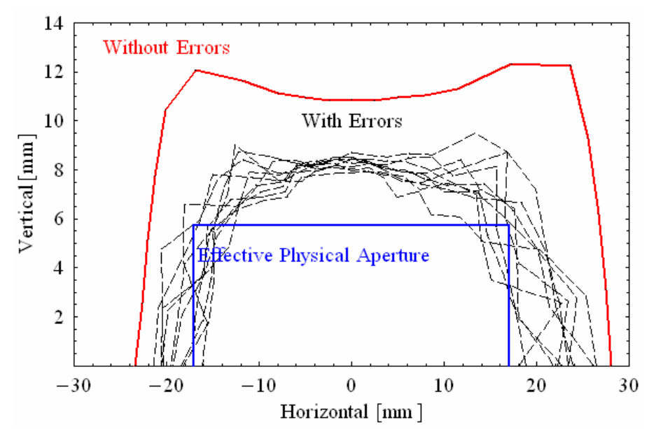
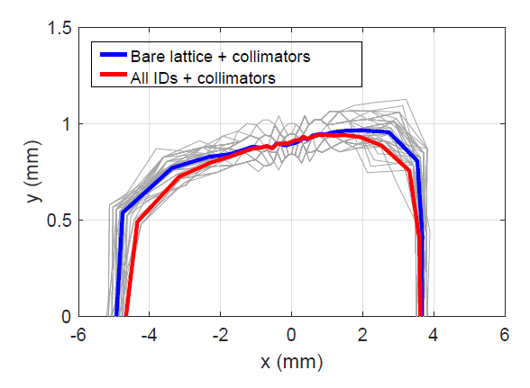
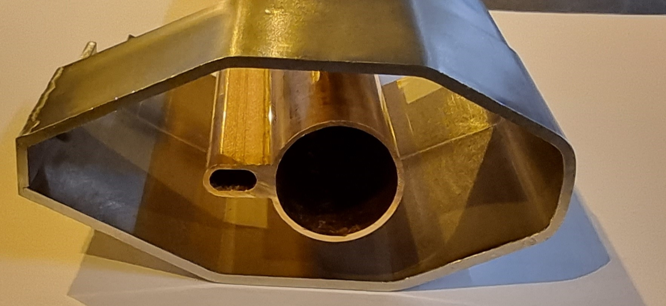
Dynamic Aperture Reduction for Diamond-II
Diamond
Diamond-II
S. Smith, J. Jones, H. Owen, EPAC’02
H.C. Chao, Diamond-II TDR, 2022
0.9 mm
5.5 mm
34 mm
9 mm
Diamond
Factor 4 reduction in available aperture horizontally
Factor 6 reduction in available aperture vertically
20 mm
38 mm
Diamond-II
89 mm

Slide 5
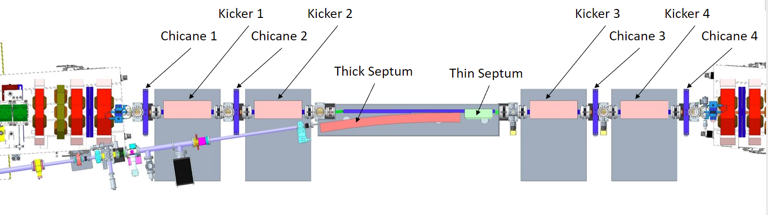
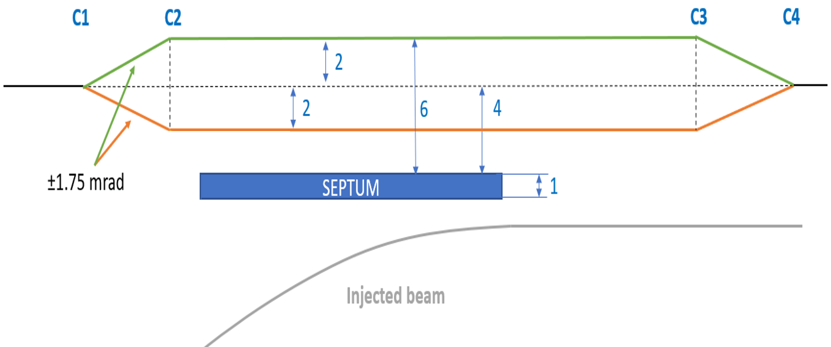
Injection Straight for Diamond-II
Injection Straight Components
Combined thick and thin septum magnets to steer the injected beam (new)
Four dipole kickers to bump the stored beam towards the septum magnet during injection (reuse existing)
Four DC chicane magnets (adjust position and angle of stored beam separately from injected beam)
Diamond
Diamond-II
3 mm septum plate
1 mm septum plate
135 nm.rad injected beam
17 nm.rad injected beam
8.3 mm
2.7 mm

Slide 6
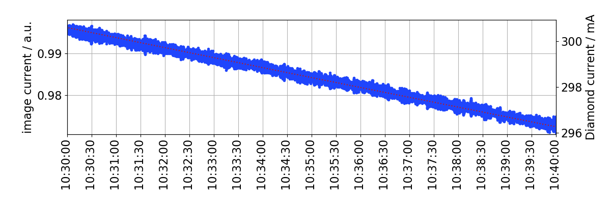
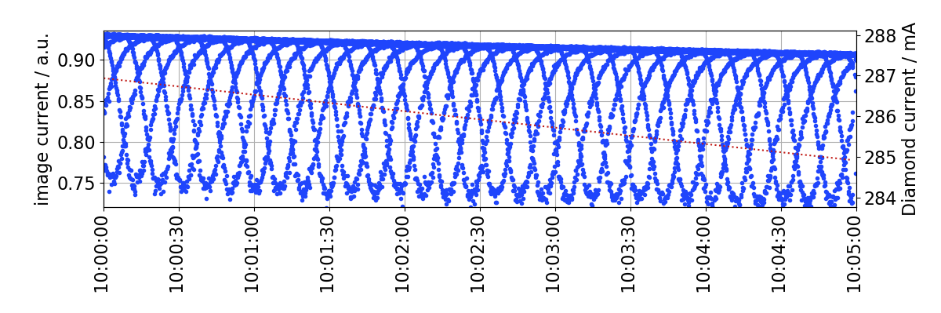
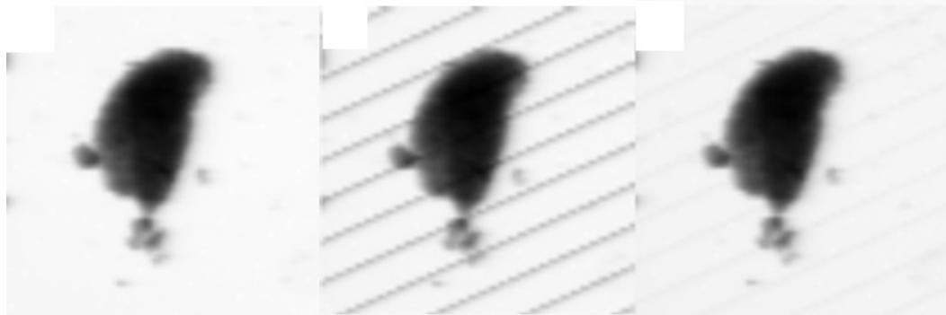
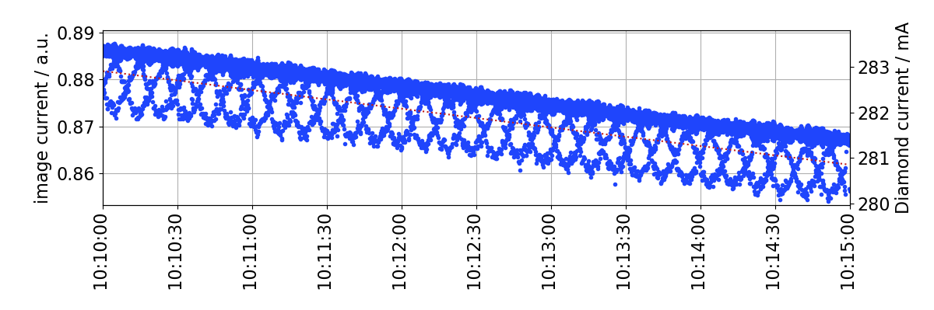
Injection Transparency
Unfortunately, not perfectly transparent ….
Data taken at Diamond on I13-2
Image current on final mirror
No injection
Data taken at Diamond on I08
Continuous raster scan, 10 ms/pixel exposure
No injection
Injection
Injection + compensation
Injection
20% drop in intensity
Injection + compensation
2% drop in intensity

Slide 7
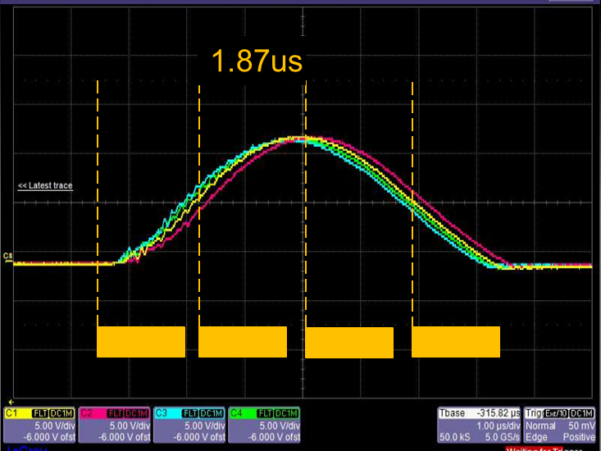
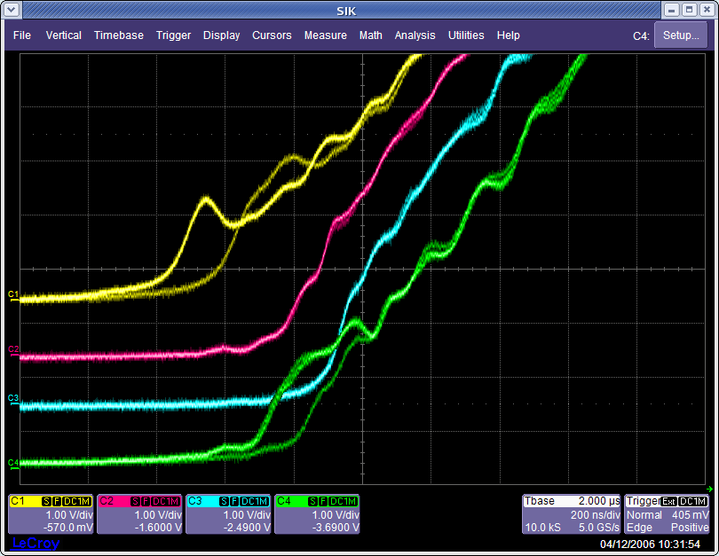
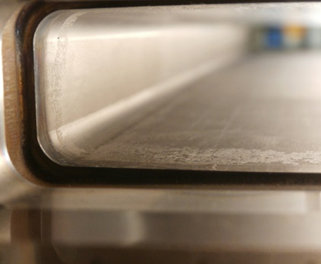
Injection Transparency
There are a number of reasons why injection is not transparent in reality
The kicker magnets may be rolled slightly, transferring some of the horizontal kick into the vertical
The kickers have independent power supplies which may not be matched in shape, amplitude or timing
The titanium coating on the ceramic vessels could be damaged or non-uniform
The stored beam may not be completely shielded from the septum magnet field
Damage to vessel coating

Slide 8
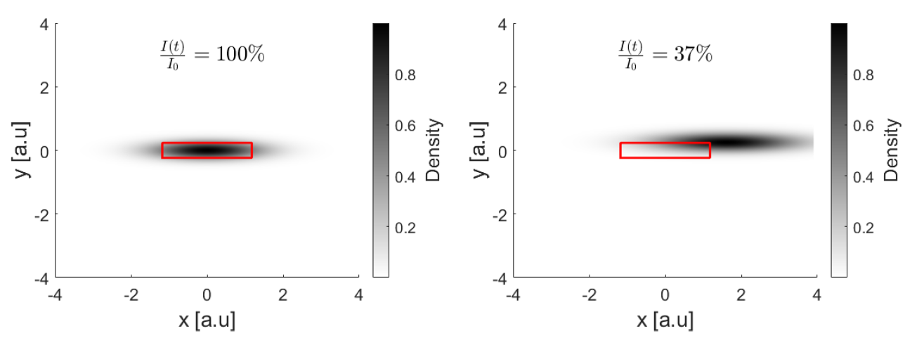
Injection Transparency
Goal for Diamond-II is to make injection transparent to users.
Diamond-II Figure of Merit (FoM) definition of “transparent” injection:
“Intensity integrated over 100 μs through 2D FWHM slit 45 meter downstream from
source point must remain above 99% of nominal at all times at all beamlines”
How can we improve transparency during top-up?
$⇒$Transparency improves as the number of kicked bunches is reduced

Slide 9
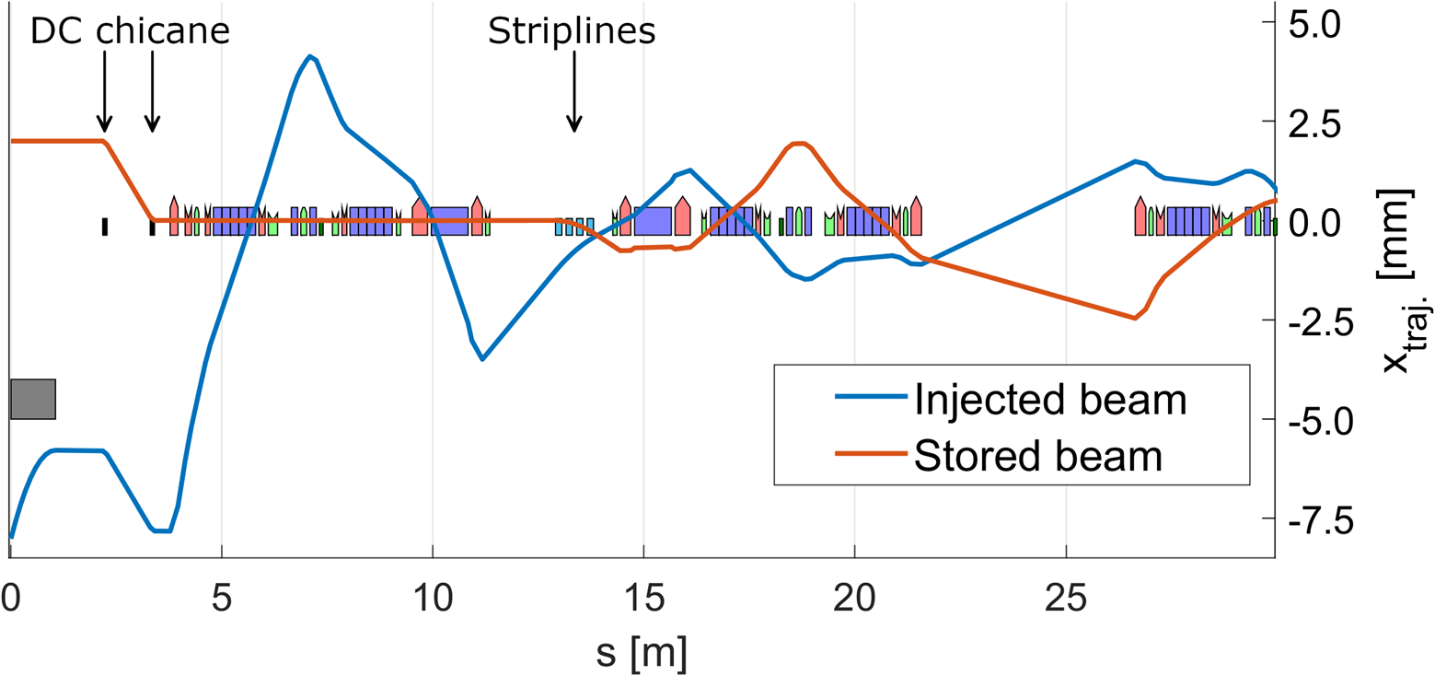
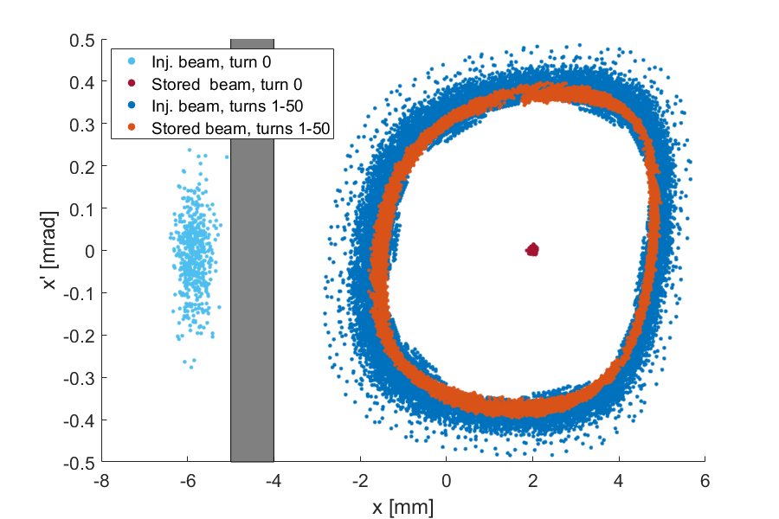
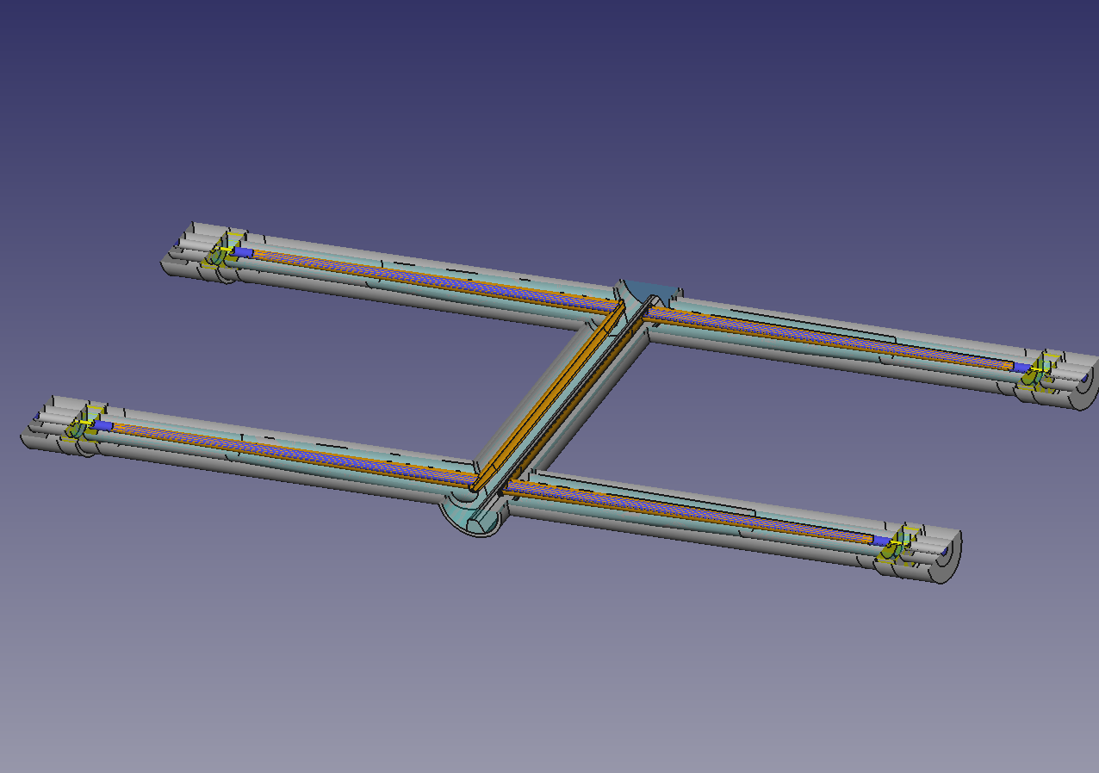
Single Bunch Injection with Stripline Kickers
Top-up injection will use ‘aperture sharing’
Four × 0.15 m long striplines in first mid straight
Pulse length <3 ns full width, >1 ns flat-top
Single bunch injection only
1 bunch in 899 will be disturbed
Much improved transparency!
8.8 mm
2 ns
<1 ns
>1 ns
<1 ns

Slide 10
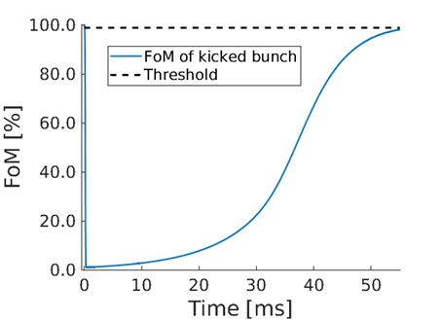
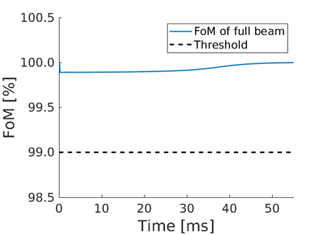
Single Bunch Injection with Stripline Kickers
Intensity for the kicked bunch drops to zero but recovers in ~50-60 ms
Intensity for the beam as a whole stays above 99.9% during injection

Slide 11
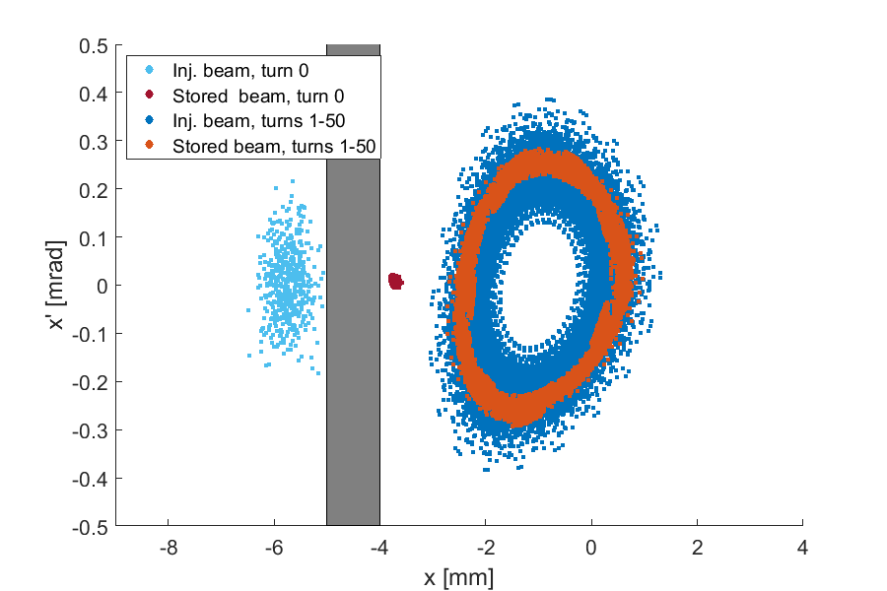
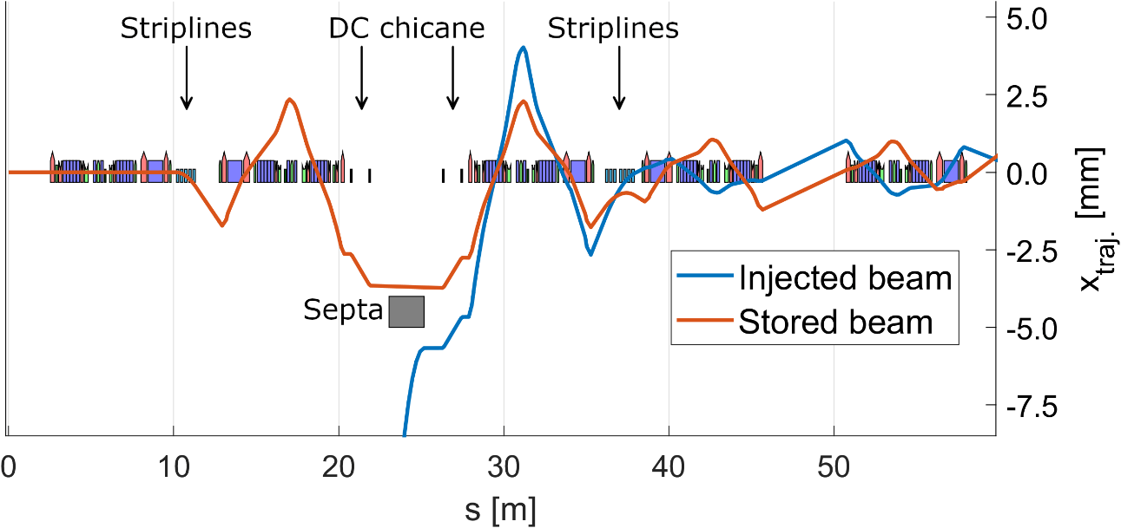
‘Enhanced’ aperture sharing
Concept:
Try to combine closed-orbit bump for stored beam with single-bunch kickers for transparency
Striplines in mid-straight upstream of septum
Kick stored bunch close to septum
Stored and injected beam kicked back in downstream mid-straight
4.4 mm

Slide 12
Summary
Two injection schemes developed for Diamond-II
Updated ‘classic’ four-kicker bump scheme for commissioning:
Flexibility & adjustability
Can be single or multi-bunch injection (reduces fill-time and/or number of injection shots per cycle)
Risk minimization: maintains fallback options; robust, proven technology
Transparent injection possible using single-bunch ‘aperture-sharing’ injection:
Only 1 bunch in 900 is kicked
Can be installed / tested / developed separately from basic injection scheme
Upgrade path for injection into potential future ‘high-brightness’ lattices
Several key technologies under development:
In-vacuum thick-thin eddy current septa
150 mm striplines
Few nanosecond pulsers from industry
Stage | Scheme
Commissioning | Traditional 4-kicker bump | Multi/single bunch
User mode | Single-bunch aperture sharing | single-bunch
High-brightness | Enhanced aperture sharing | single-bunch

