Slide 1
Experimental demonstration of the acceleration of electrons from a linear accelerator by a laser driven plasma wakefield at CLARA
L. R. Reid^{1,2}, L. Boulton^{2,3,4}, J. Christie^{1,2}, H. Jones^{1,2,3}, A. Knetsch⁵, A. Morris^{1,2}, W. Okell^{2,6}, T. Pacey^{2,6}, M. Radford^{1,2}, D. Walsh^{2,6} and L. Corner^{1,2}
1: School of Engineering, University of Liverpool, Liverpool, United Kingdom, 2: Cockcroft institute, Warrington, United Kingdom, 3: Deutsches Elektronen-Synchrotron DESY, Hamburg, Germany, 4: SUPA, Department of Physics, University of Strathclyde, Glasgow, United Kingdom, 5: Laboratoire d’Optique Appliquée, Paris, France, 6: ASTeC, STFC Daresbury Laboratory, Warrington, United Kingdom
Notes:
Here to report on recent results from the CLARA accelerator investigating the external injection of electrons into plasma accelerators

Slide 2
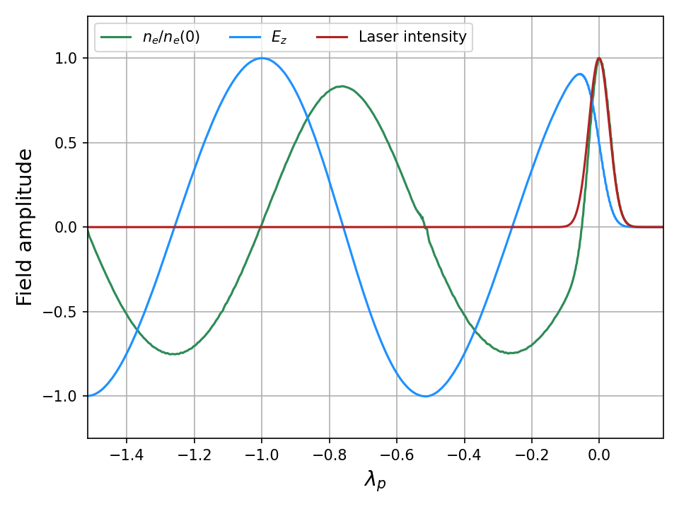
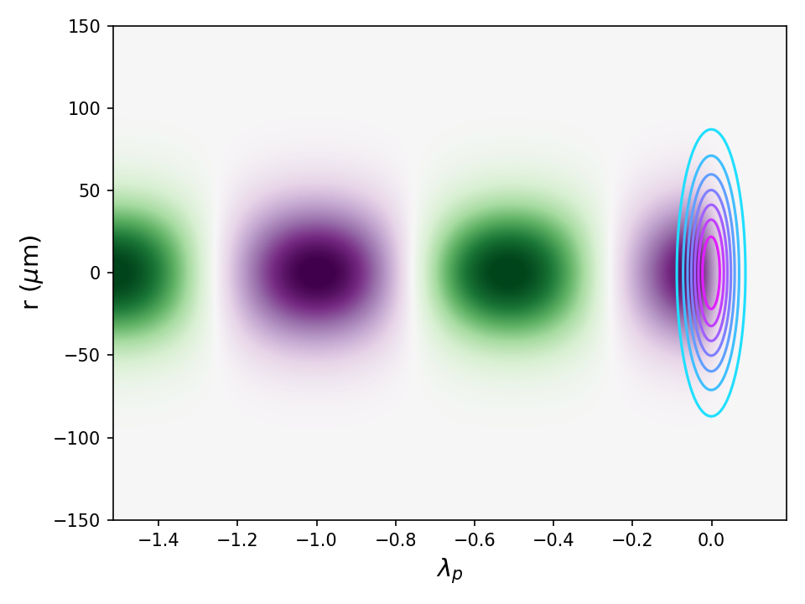
Laser wakefield acceleration
Laser wakefield acceleration is a method of generating high energy (MeV – GeV) electrons.
A high intensity laser pulse ionises gas into a plasma.
Laser then drives a wake wave of electron density behind it.
Accelerating field can reach 100s GVm⁻¹.

Slide 3
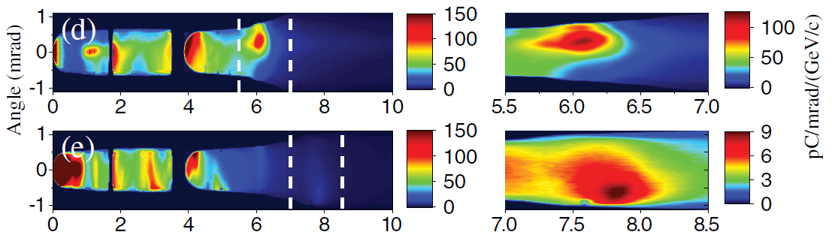
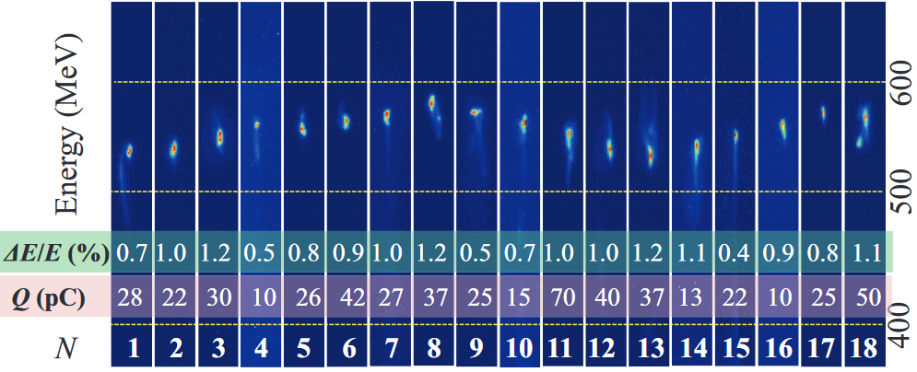
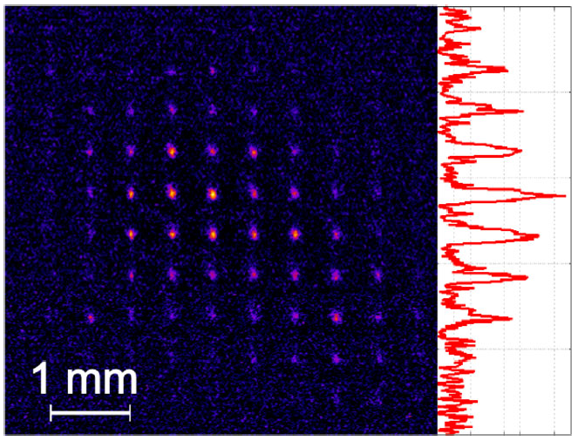
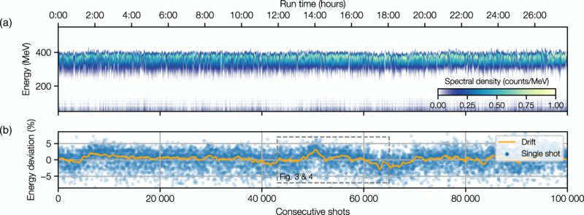
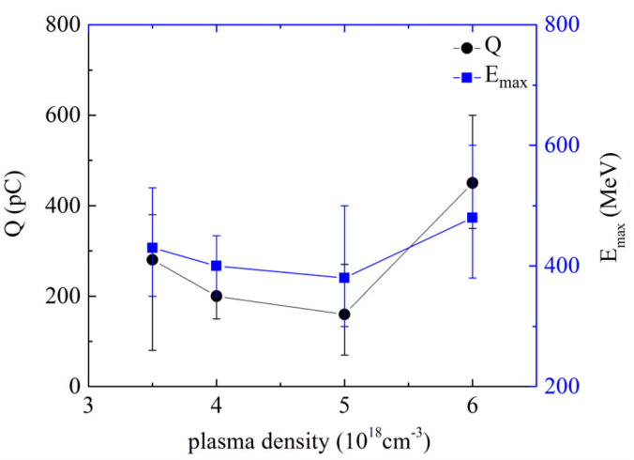
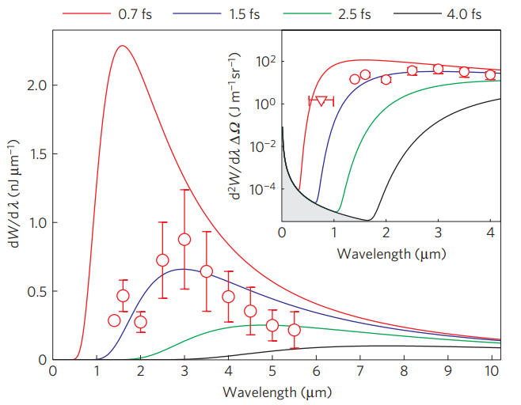
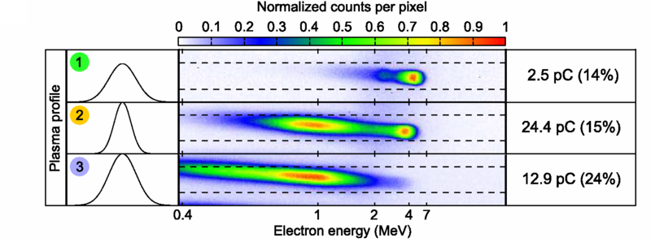
Achievements of LWFA
Electrons up to 8 GeV
Gonsalves et al., PRL, 122, 084801 (2019)
Sub-percent energy spread
Wang et al., Phys. Rev. Lett. 117, 124801 (2016)
< 1 mm mrad emittance
Brunetti et al., Phys. Rev. Lett. 105, 215007 (2010)
Stability over >24 hrs
Maier et al., PHYS. REV. X 10, 031039 (2020)
Up to 500 pC charge
Li et al., Phys. Plasmas 24, 023108 (2017)
Ultrashort electron beams
Lundh et al., Nature physics, 7, 219–222 (2011)
Operation at 1 kHz
Gustas et al., Phys. Rev. Accel. Beams 21, 013401 (2018)

Slide 4
External injection
Combines advantages of conventional and plasma based accelerators.
Beam quality preservation has been shown in simulation only.
Ideal candidate for testing staged plasma acceleration.
The CERN expert panel identified beam quality and staged acceleration of plasma accelerators as an important milestone for the field.
In the EuPRAXIA conceptual design report, 3 out of 4 laser wakefield schemes require external or staged acceleration with beam quality preservation.
Single demonstration to date with low charge beam.
CLARA is one of the few facilities with electron beam and high power laser.
https://e-publishing.cern.ch/index.php/CYRM/issue/view/146
Assmann, R.W. et al. EuPRAXIA Conceptual Design Report. Eur. Phys. J. Spec. Top. 229, 3675–4284 (2020).
Wu, Y. et al. Nature Physics volume 17, pages 801–806 (2021)
Notes:
High gradient of plasma accelerators + high stability and quality of RF accelerators
An RF accelerator as a source of electrons to inject into a plasma accelerator is an ideal way of testing staged acceleration in a controlled way in isolation of the complexities of plasma accelerators.
Experiment – 20 fC, 250 MV/m gradient.
CLARA is one of the few facilities worldwide with high brightness electron beam and TW laser where these experiments can be conducted.

Slide 5
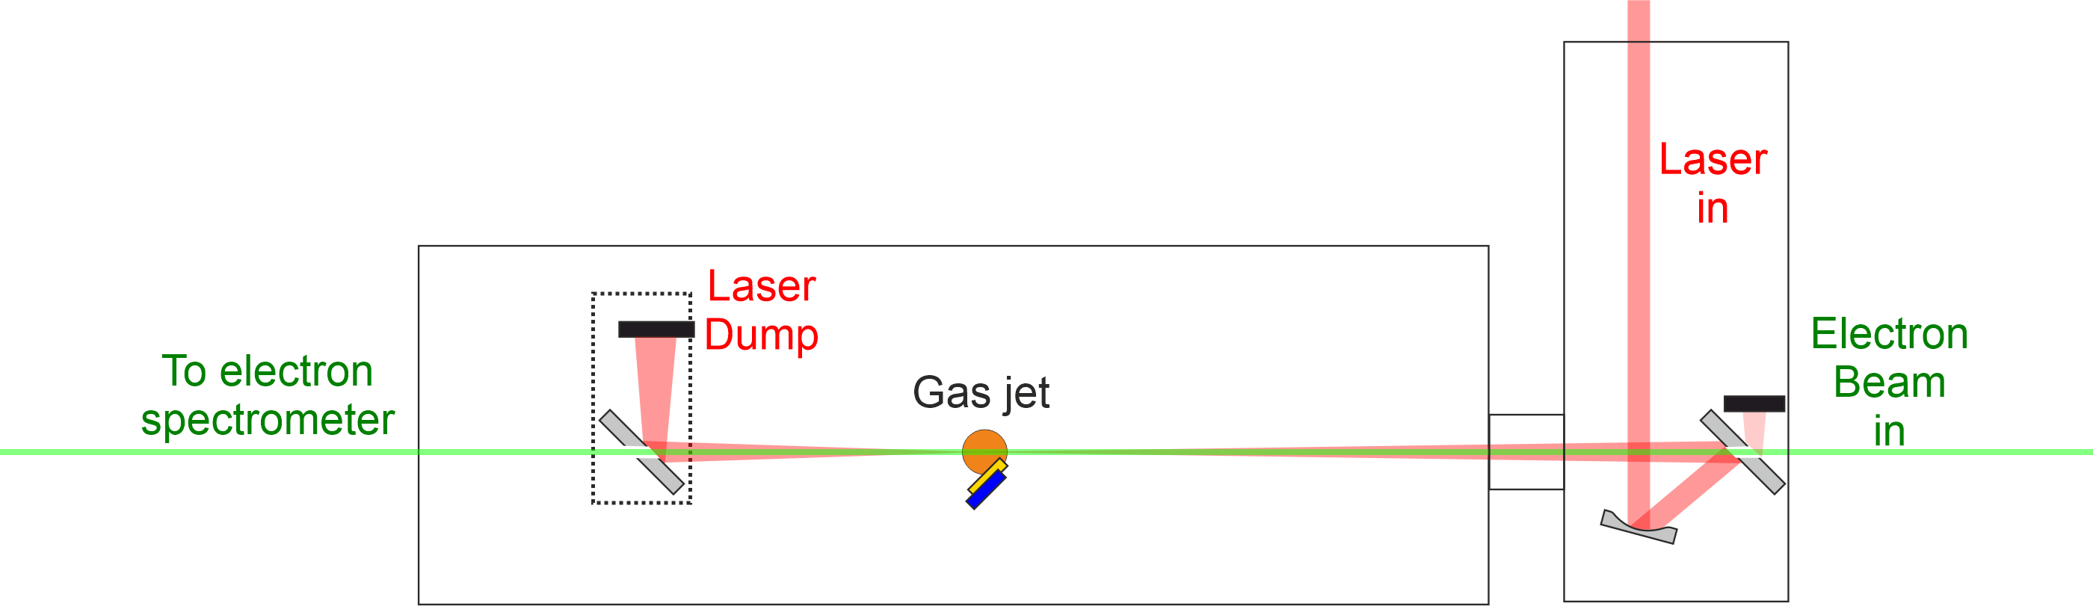
Experimental layout
Experiment performed on CLARA accelerator at Daresbury laboratory.
Gas jet backed with Nitrogen gas at 6 bar. Laser ~ 5 mm above it.
Laser & electron beam timed to arrive above the gas jet at the same time.
Proof of principle experiment at CLARA – We aim to build on this.
Notes:
Electron beam comes from CLARA, focused above the gas jet
Laser beam delivered from laser room and focused with f ~ 1.7 m parabola.
Parabolic mirror and holed mirror allow the two beams to be collinear with each other.
Gas jet is backed with Nitrogen gas at 6 bar with the laser 5 mm above it.
This is a first proof of principle experiment which we aim to build upon in the future.

Slide 6
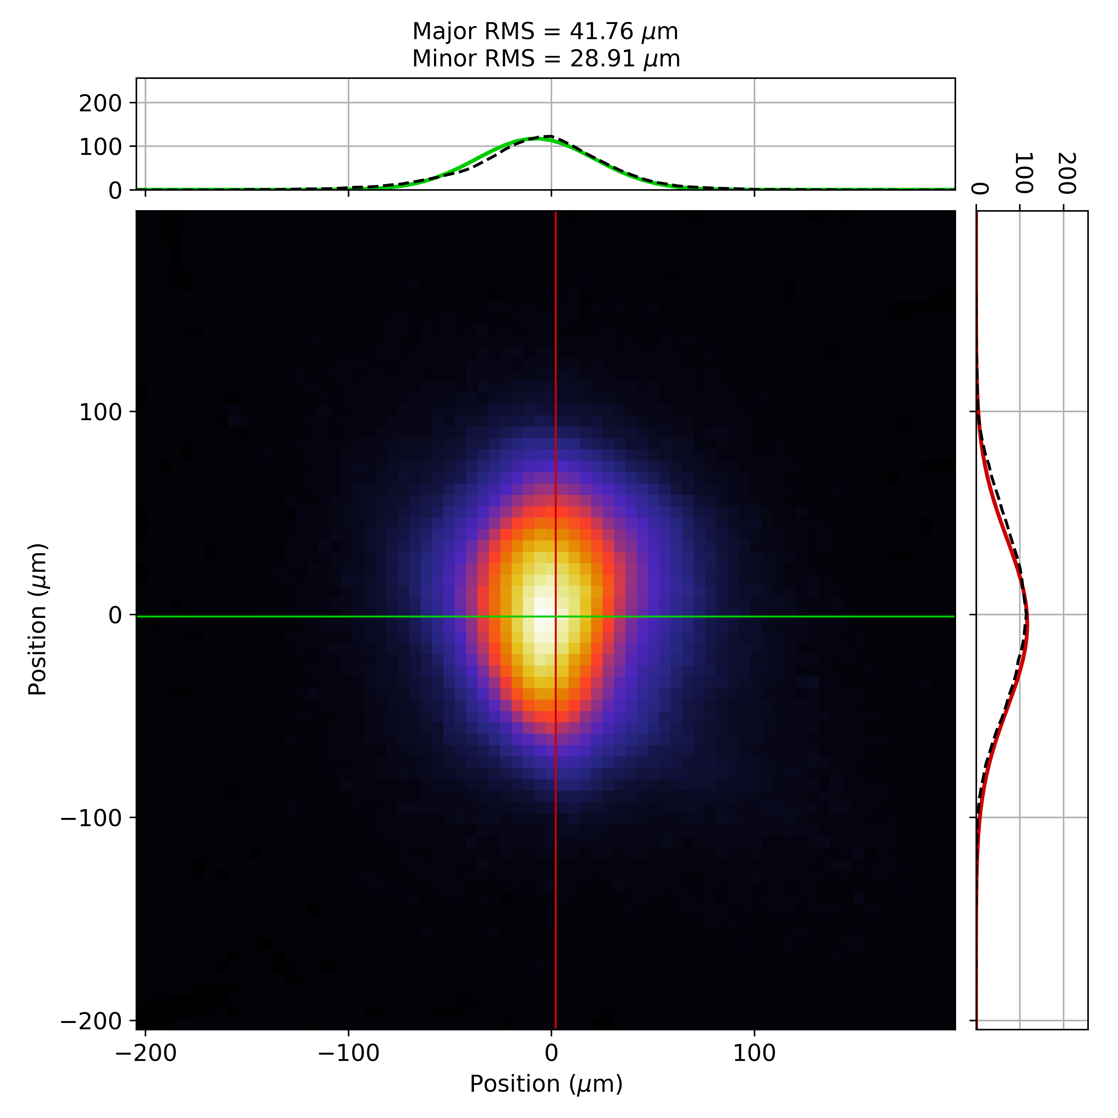
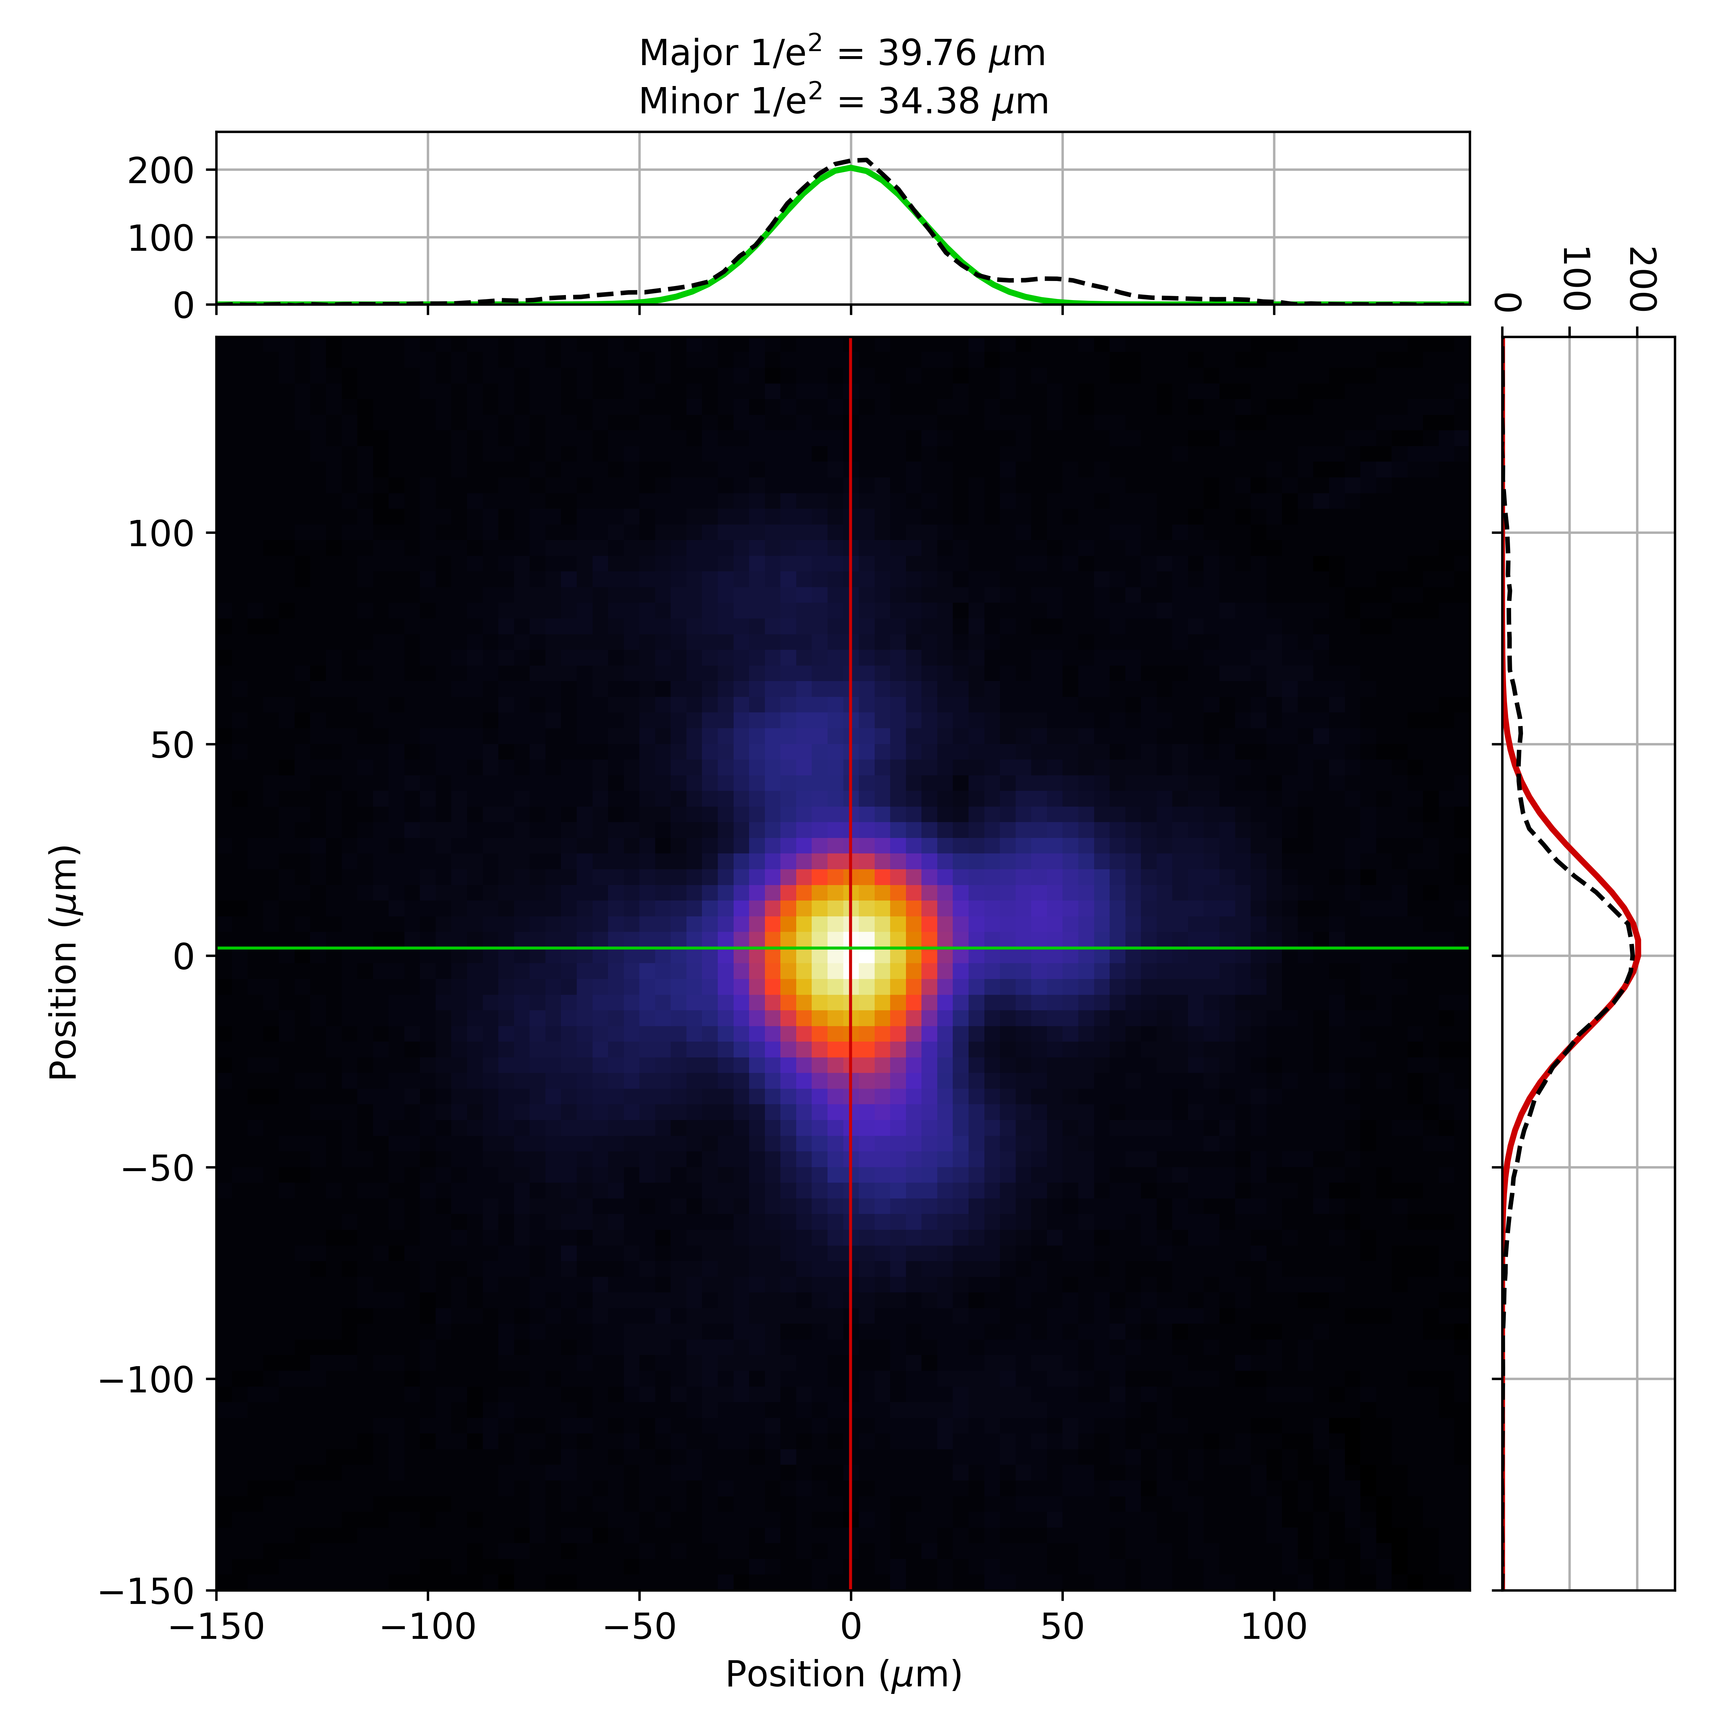
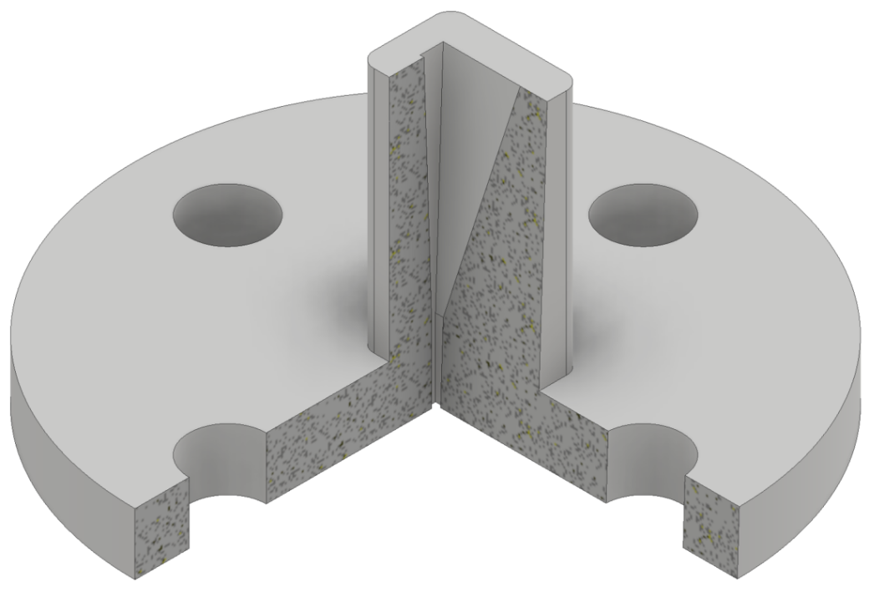
External injection at CLARA
Electron beam:
E = 35 MeV
σ_{r} ~ 35 μm
σ_{z} ~ 450 μm
σ_{E} = 10 – 20 keV
Q = 20 pC
Laser:
E = 8 – 40 mJ
τ_{FWHM} = 90 fs
ω₀ = 40 μm
a₀ = 0.04 – 0.08
Plasma:
n_{e} = 2.1×10¹⁸ cm⁻³
λ_{p} = 23 μm
L_{p} ~ 8 mm
σ_{z} >> λ_{p} – signature of a successful interaction is a broadening of the electron beam energy spectrum.

Slide 7
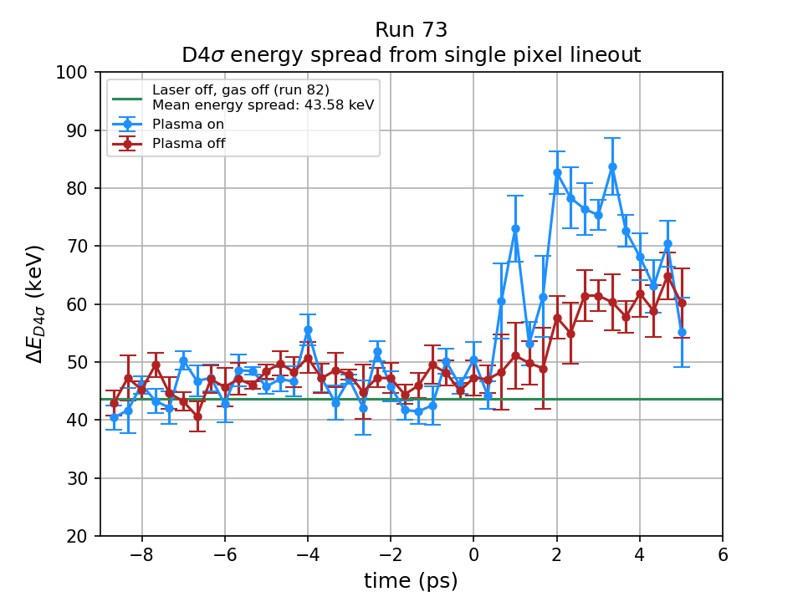
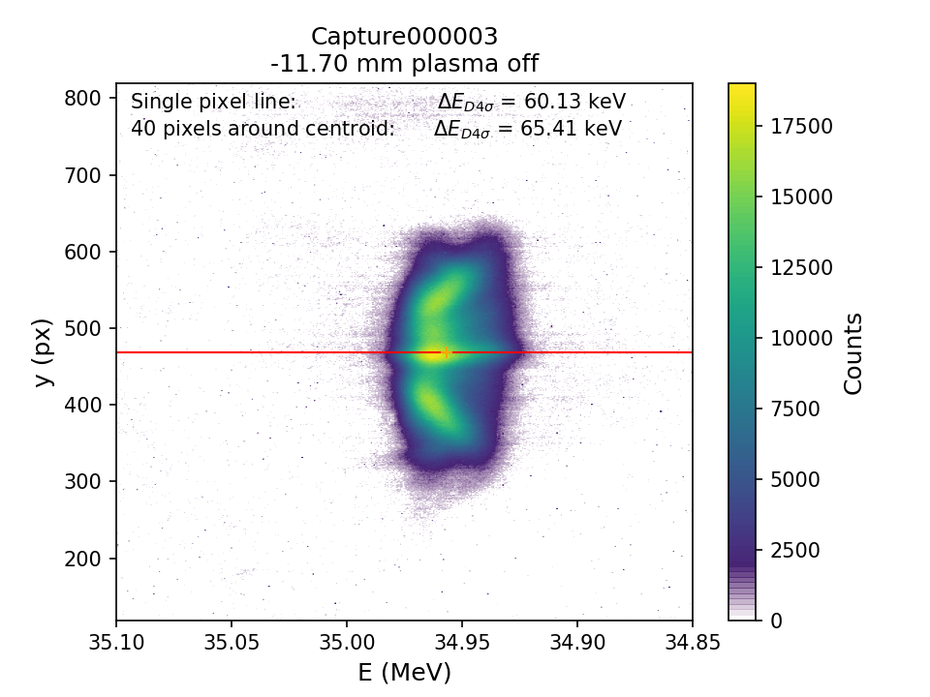
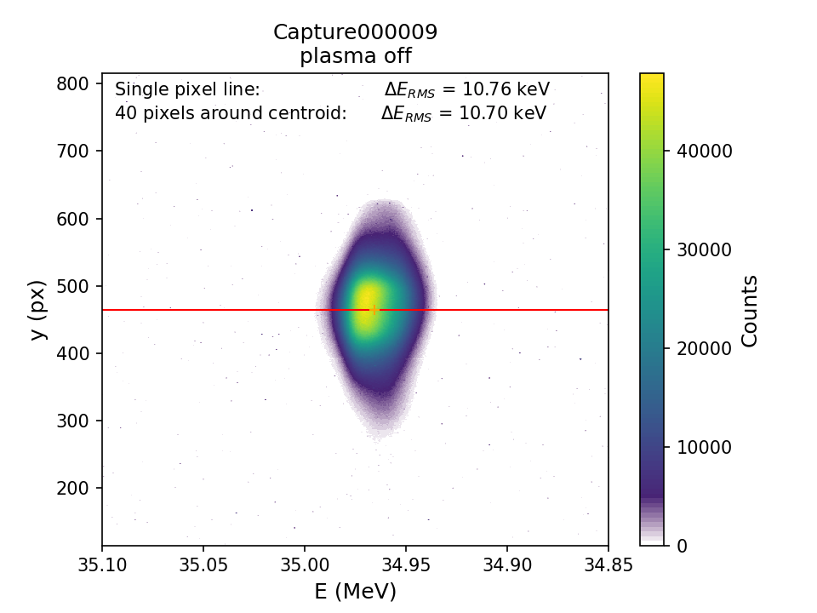
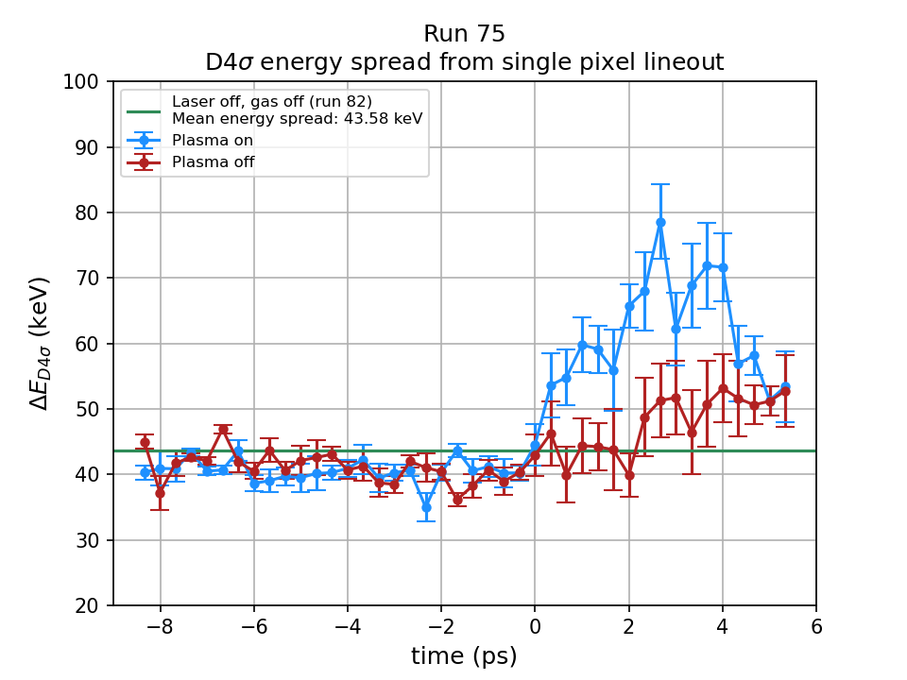
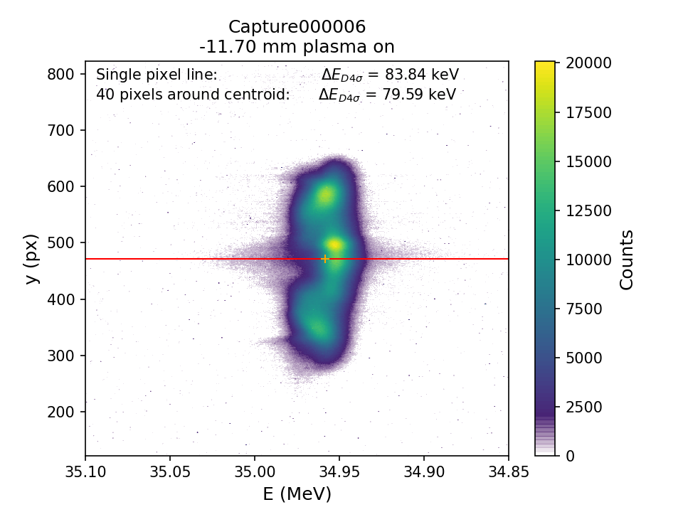
Results – Preliminary
250 mJ in laser lab – 40 mJ on target
Laser & electron beam – 10 Hz, gas jet opening – 5 Hz.
Complicated by low density plasma in chamber when gas jet off.
Looking at width (energy spread) of electron beam on e-spec with arrival time of laser & e⁻ bunch.
40 mJ
32 mJ
Notes:
Vacuum system wasn’t able to handle gas load so there was a constant low density gas in the chamber
Laser ionised this for ~100 mm total length. Electron beam scattered off of this causing spurious energy spread growth when the gas jet doesn’t fire.

Slide 8
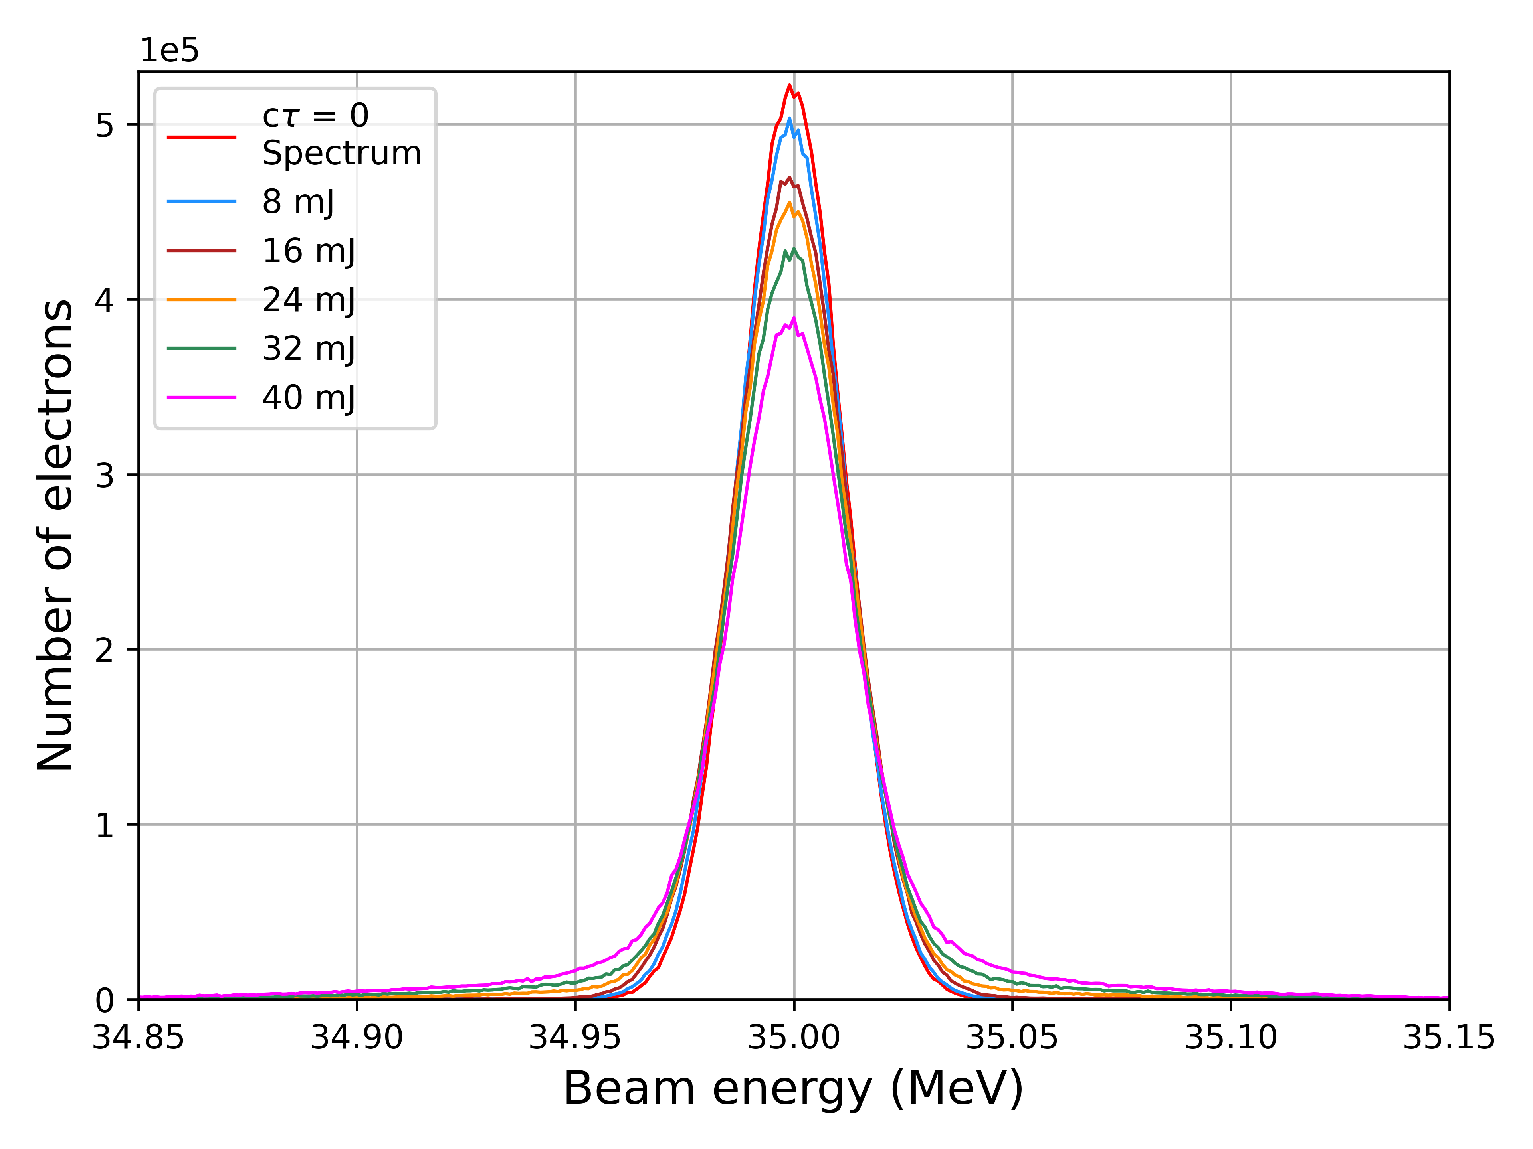
Simulations
Experimental measurements were compared to FBPIC simulations.
Laser & electron parameters taken from experiment.
Gas profile taken from FLUENT simulation of target.
ADK ionisation of N gas included to correctly model laser propagation.

Slide 9
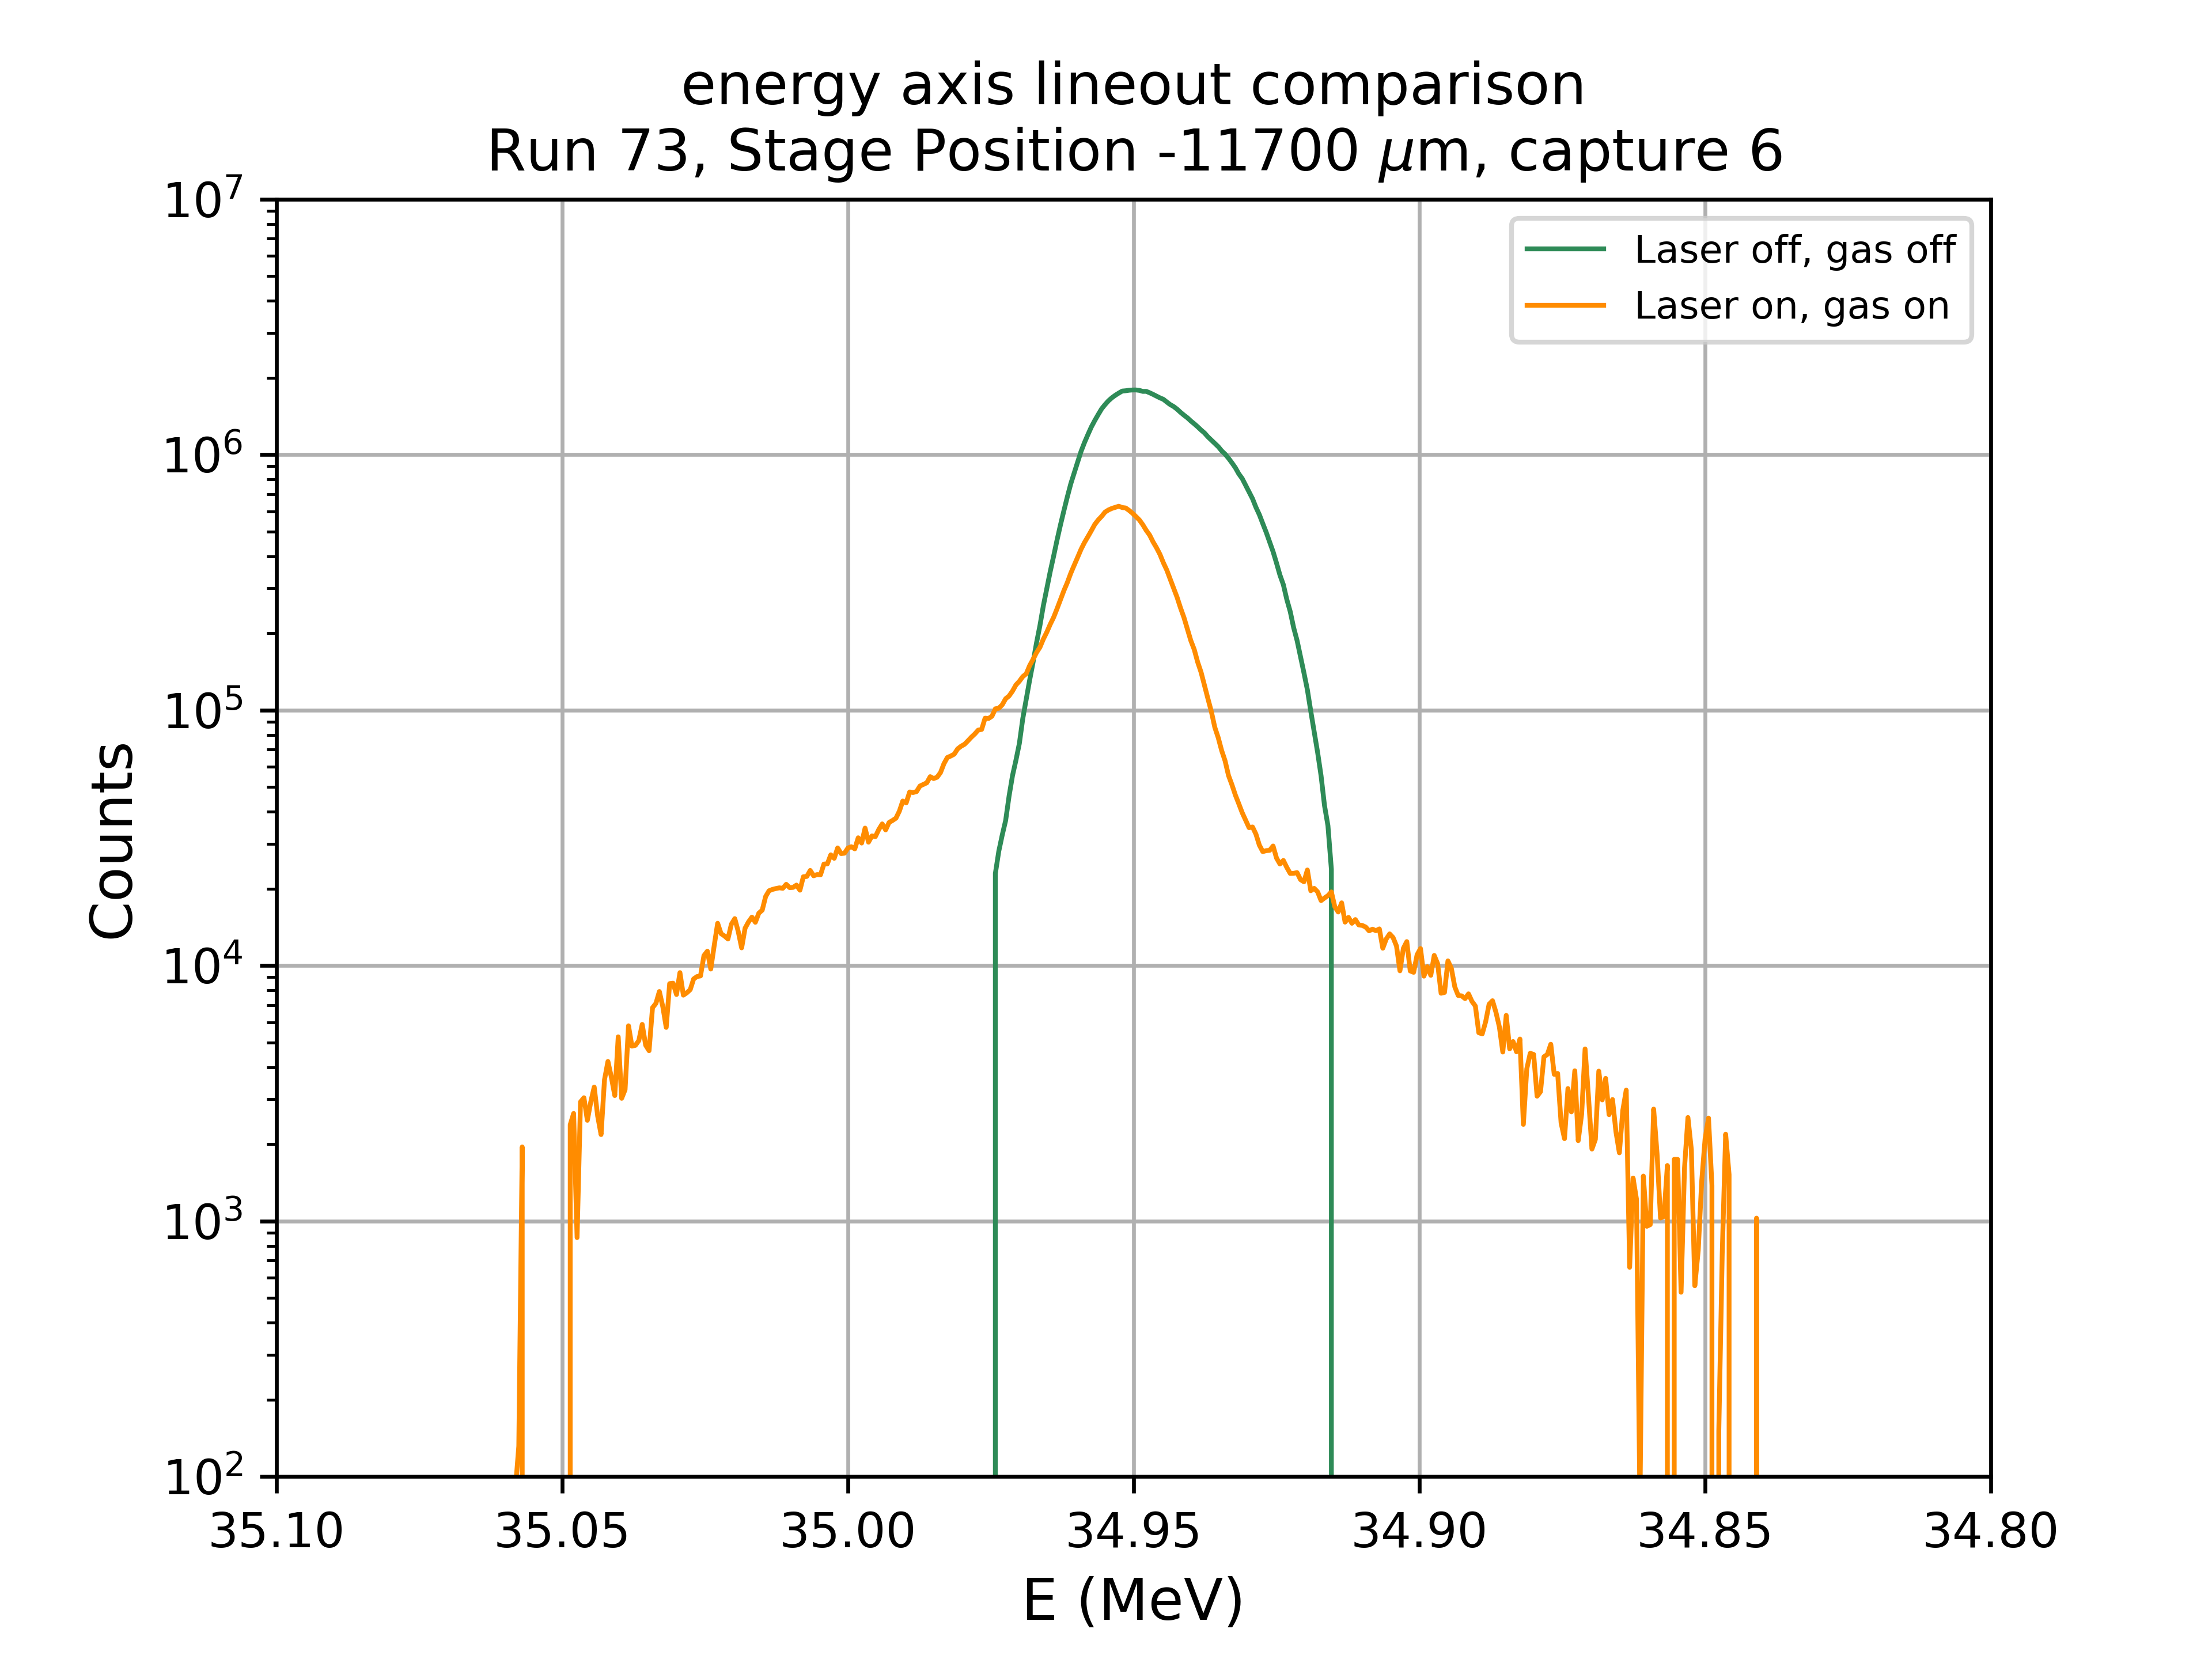
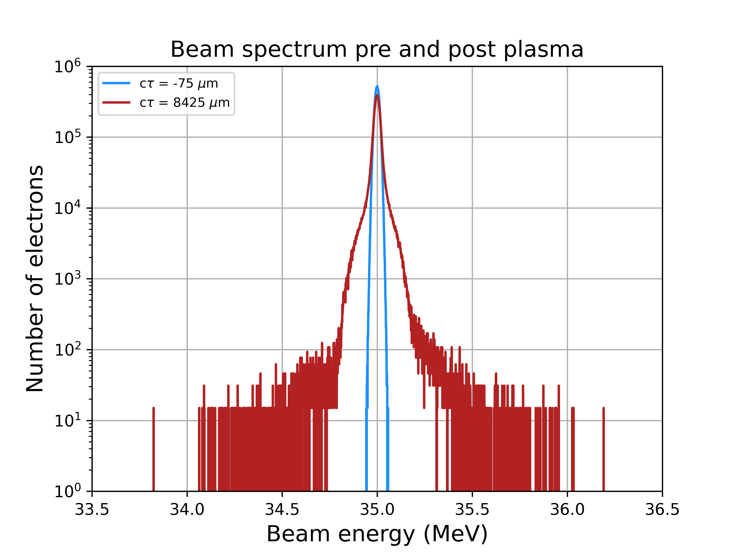
Accelerating gradient
Experiment:
Max. energy gain ~ 100 keV.
8 mm plasma: gradient ~ 12.5 MV/m.
Simulation:
Max. energy gain ~ 900 keV.
8 mm plasma: gradient ~ 112 MV/m.
Camera response must be taken into account.
12 bit camera, 200 keV energy gain: 25 MV/m

Slide 10
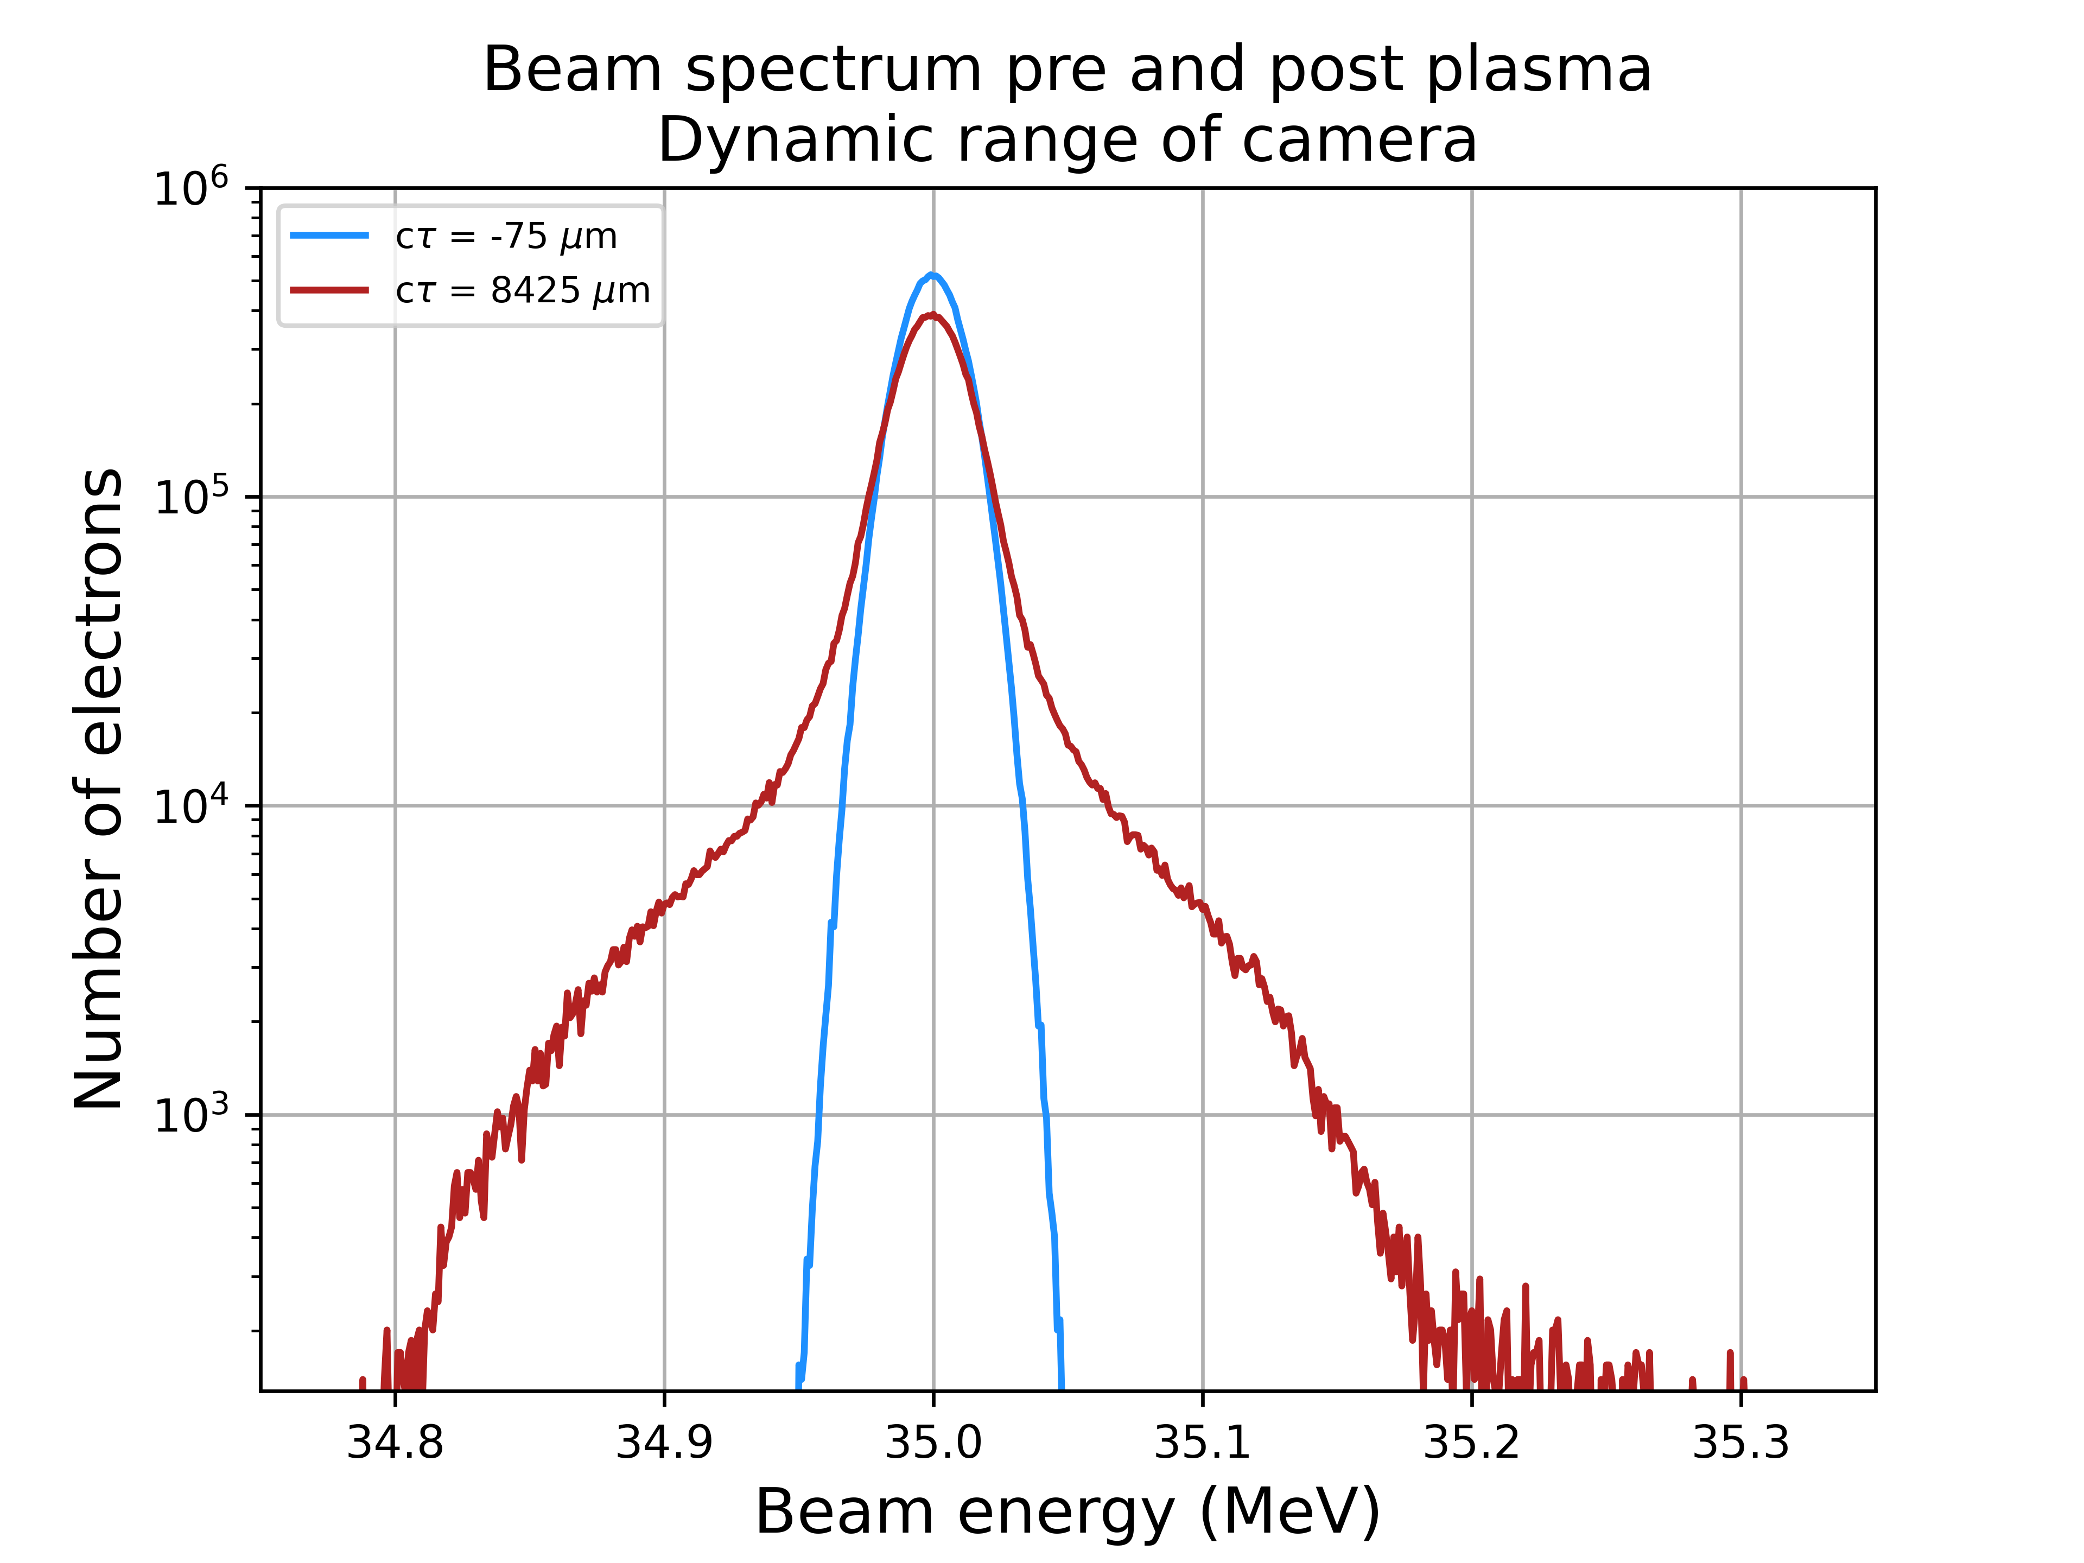
Accelerating gradient
Experiment:
Max. energy gain ~ 100 keV.
8 mm plasma: gradient ~ 12.5 MV/m.
Simulation:
Max. energy gain ~ 900 keV.
8 mm plasma: gradient ~ 112 MV/m.
Camera response must be taken into account.
12 bit camera, 200 keV energy gain: 25 MV/m

Slide 11
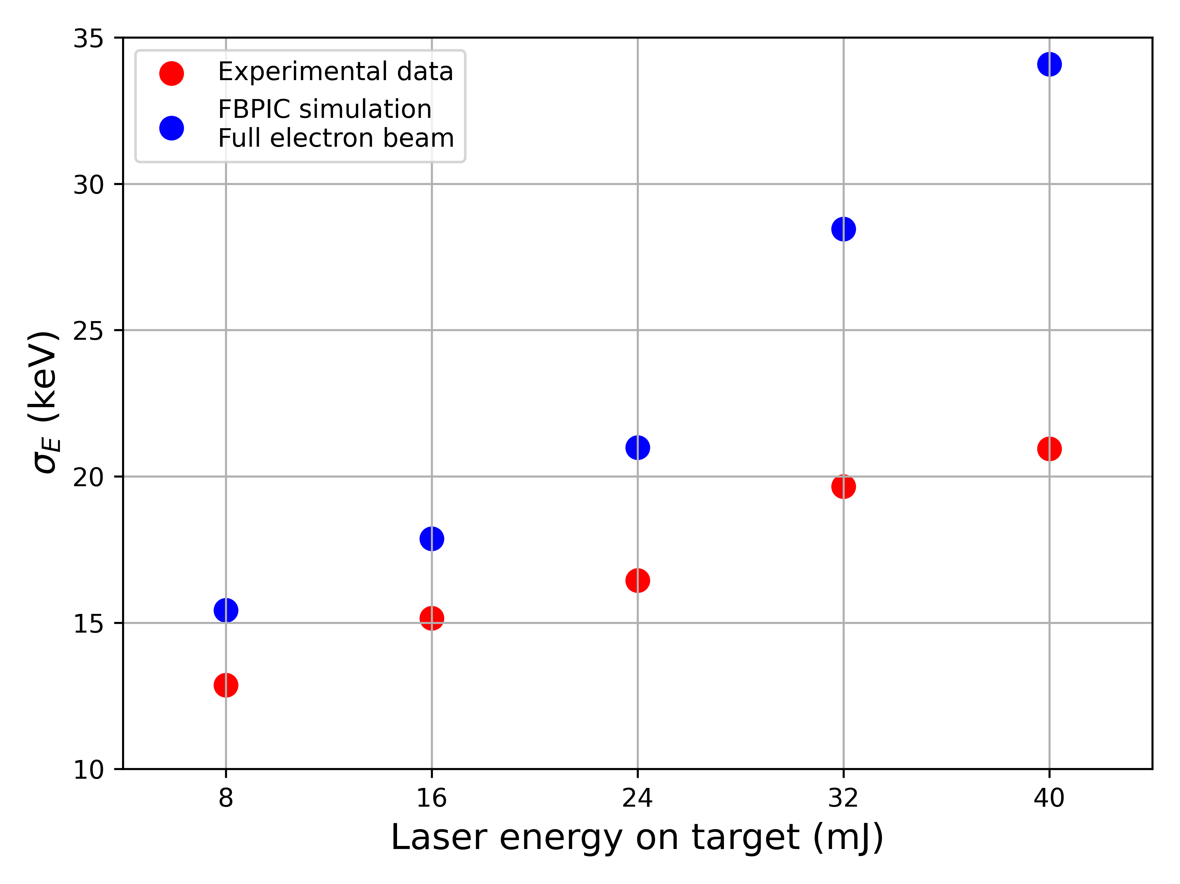
Scaling with laser energy
Scan of laser energy delivered to interaction point
Experimental measurements in red.
FBPIC simulation results in blue.
Notes:
Experimental points from peak of interaction shown in red.
Calculated energy spread from electron beam in FBPIC simulations shown in blue.
In both cases the energy spread grows with laser energy which is what we expect from linear wakefield theory.
E_{z} α a₀² α I α E_{laser}

Slide 12
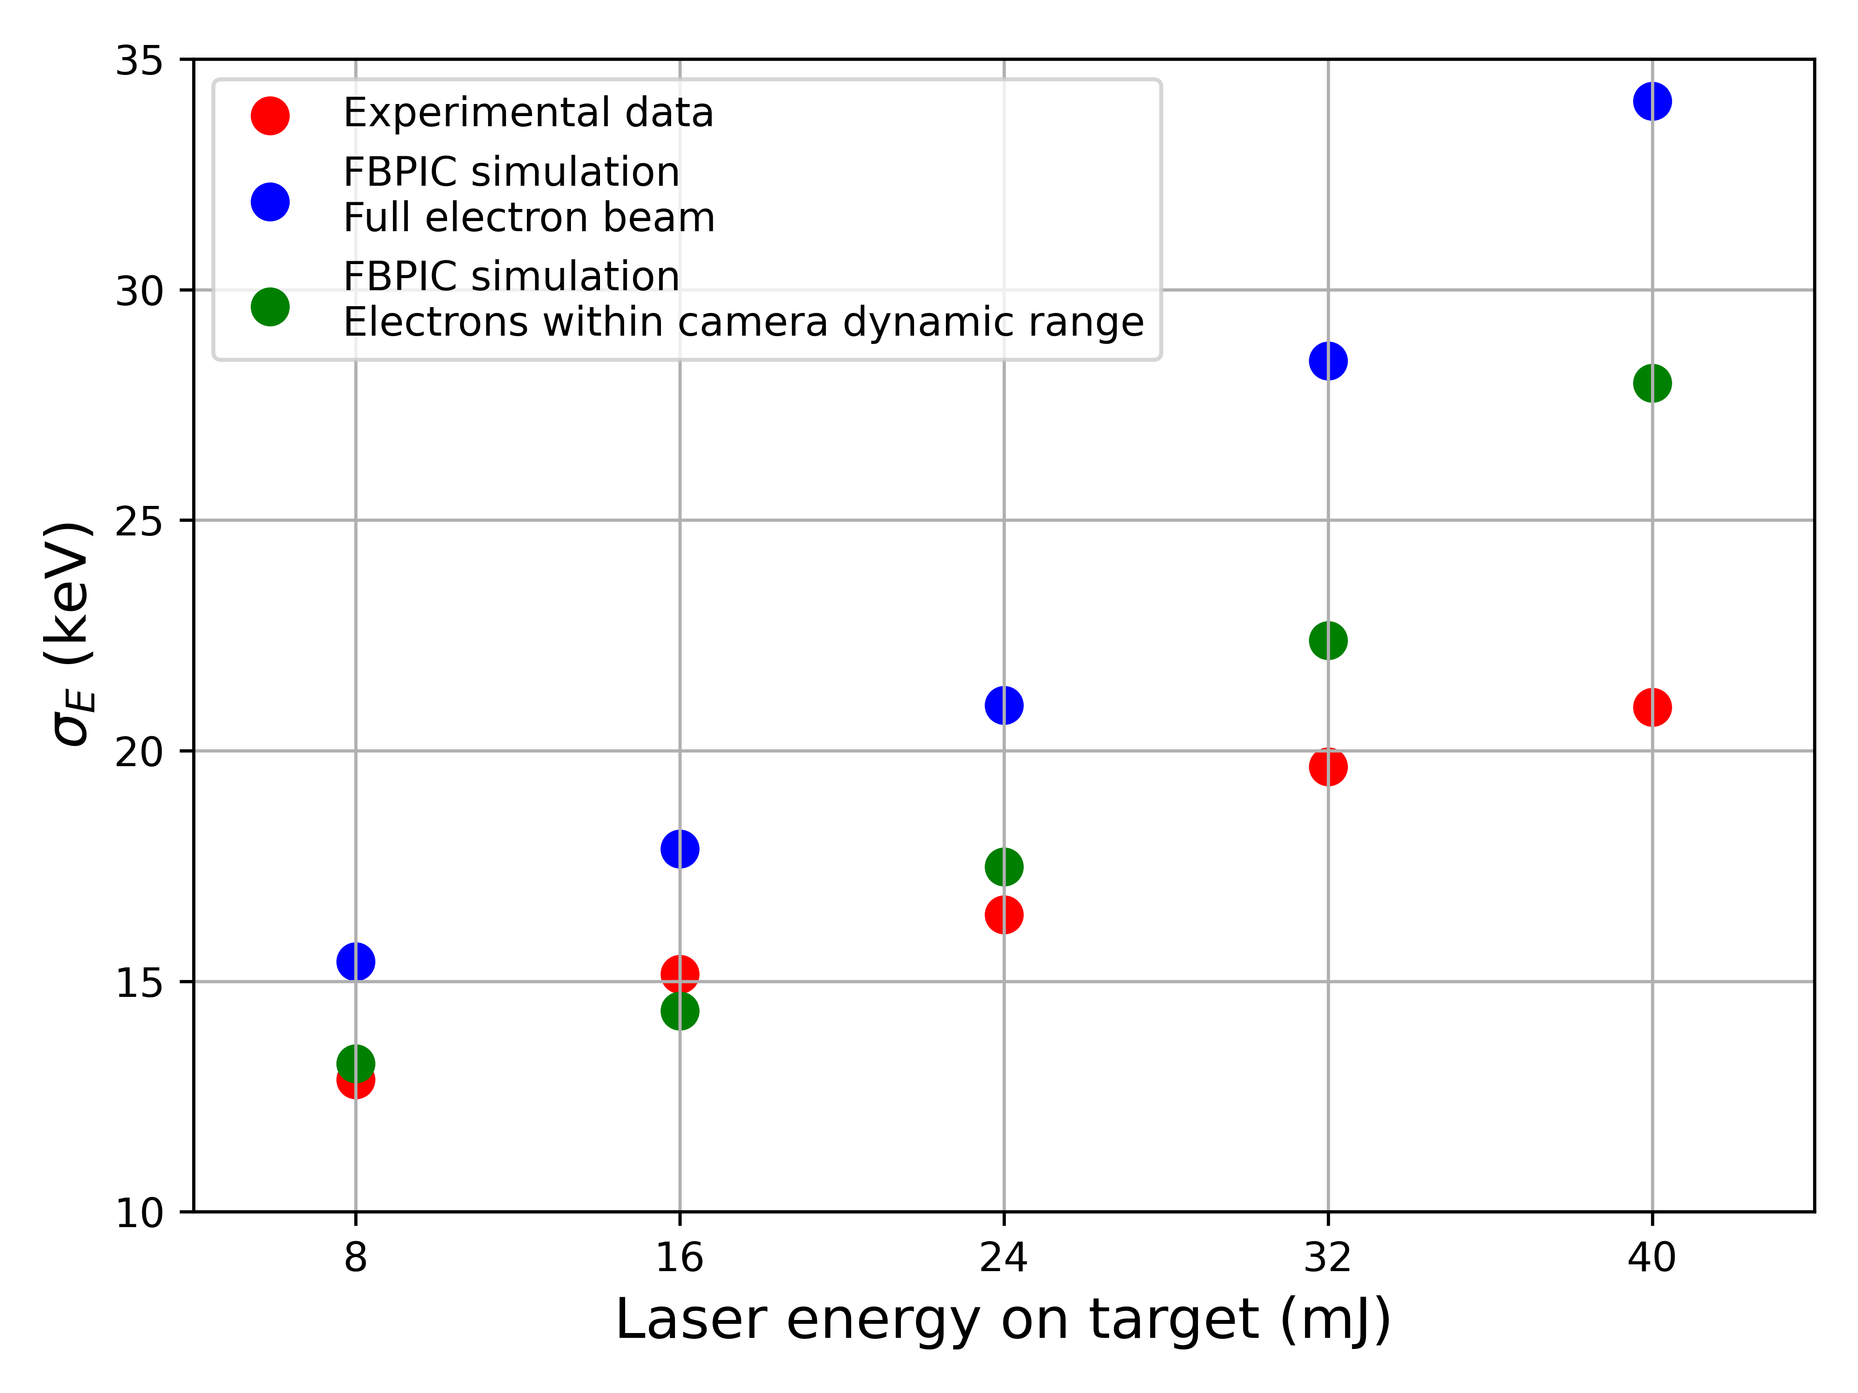
Scaling with laser energy
Scan of laser energy delivered to interaction point
Experimental measurements in red.
FBPIC simulation results in blue.
FBPIC simulation only taking electrons within the dynamic range of the camera in green.
Notes:
If we consider only electrons we would expect within the dynamic range of the camera and calculate the energy spread, then we get the green points which much better match experimental data.

Slide 13
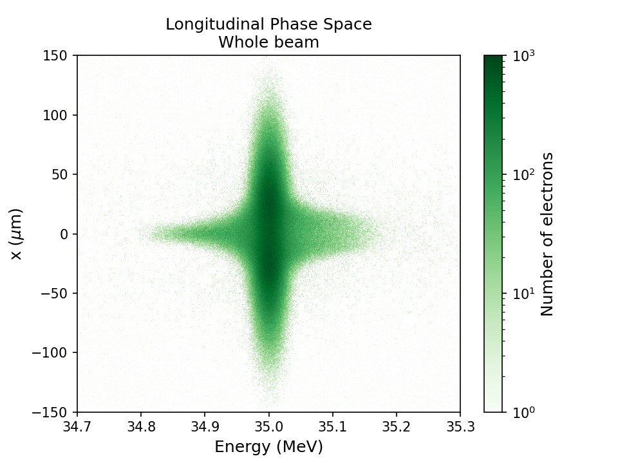
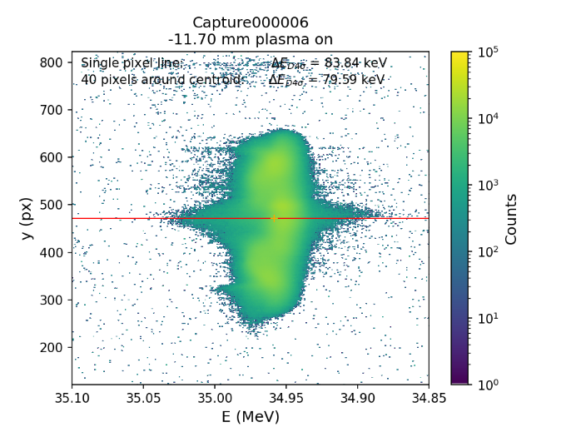
Projection of beam onto spectrometer
Simulated (left) and experimental (right) electron spectrometer images showing electron spectral broadening.
Notes:
Strong interaction along the axis of the electron beam where the fields of the plasma wave are highest.

Slide 14

Conclusions
External injection is a method to improve the quality and stability of accelerated electron beams from laser wakefield accelerators.
Broadening of the electron beam spectrum was observed at CLARA.
Accelerating gradient of ~12.5 MVm⁻¹ observed but from simulations, we can extrapolate a gradient of ~110 MVm⁻¹.
Next experiments will have a new laser and upgraded electron beam so GVm⁻¹ gradients are expected with near perfect beam quality preservation.

Slide 15
Acknowledgements
Liverpool: Laura Corner, Harry Jones, Miles Radford, Jonathan Christie, Alex Morris
DESY: Lewis Boulton
LOA: Alex Knetsch
Lancaster: Elisabetta Boella
Strathclyde: Bernhard Hidding
ASTeC: Tom Pacey, Will Okell, Dave Walsh, Ed Snedden, Keith Middleman, Andrew Vick, Matthew King, Duncan Scott
(and more!)

Slide 16
Backup slides

Slide 17
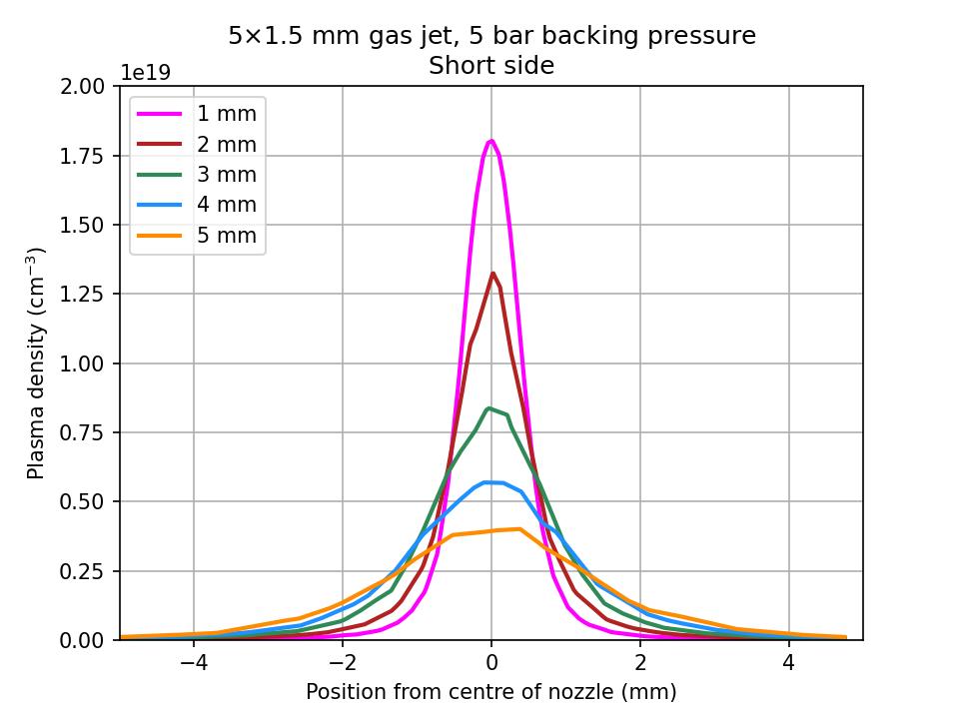
Gas target
Target comprised of 1.5×5 mm asymmetric slit jet. The short side of the jet was used as well as positioning the laser well above the outlet of the nozzle.
Longitudinal profile did not contain a region of constant density.
Total plasma length ~8 mm.
Gas density from FLUENT simulation
n_{e} = 2.1×10¹⁸ cm⁻³
λ_{p} = 23 μm
T_{p} = 76 fs

Slide 18
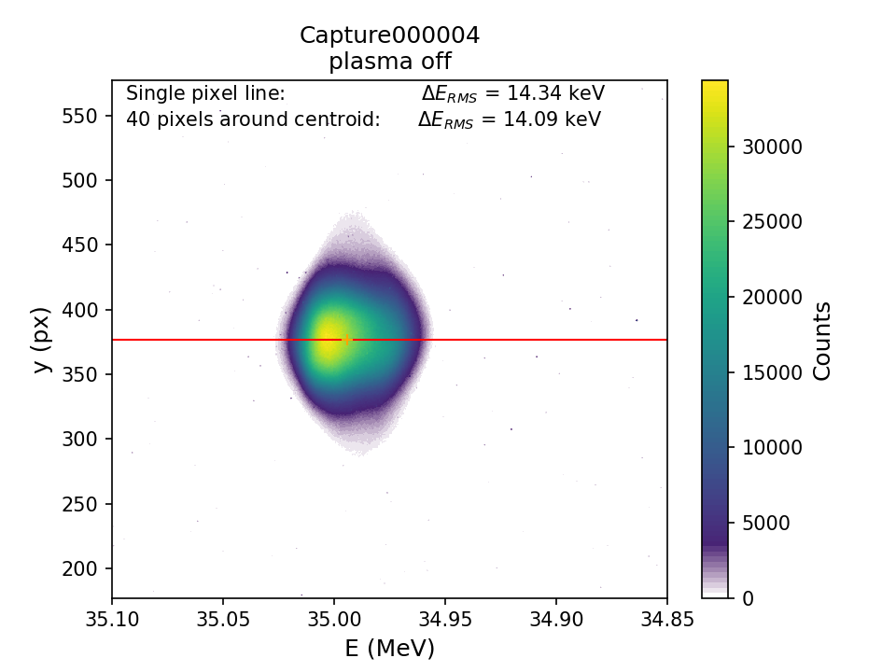
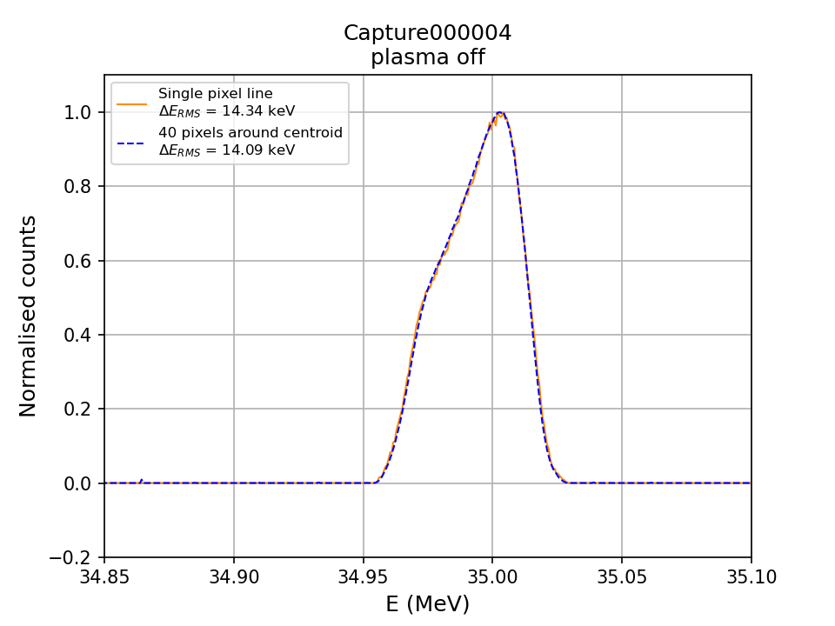
Electron beam
Electron beam was configured so that maximum radial focusing could be achieved. This gave a long electron beam with a narrow energy spread.
σ_{r} ~ 35 μm
σ_{z} ~ 450 μm
(σ_{z}/c ~ 1.5 ps)
σ_{E} = 10 – 20 keV
Q = 20 pC
4σ_{z}/λ_{p} = 78 so the broadening of the energy spectrum indicates a successful interaction

Slide 19
Laser
Laser pulses were delivered from the LATTE laser and focused with a f = 1780 mm off-axis parabola to a vacuum spot size of ω₀ = 40 μm.
Laser energy on target varied between 15 – 75 mJ.
52.5% of the total laser energy is within 1/e² diameter
Laser pulse compressed to τ_{FWHM} = 90 fs.
Normalised laser vector potential a₀ = 0.04 – 0.08.

Slide 20
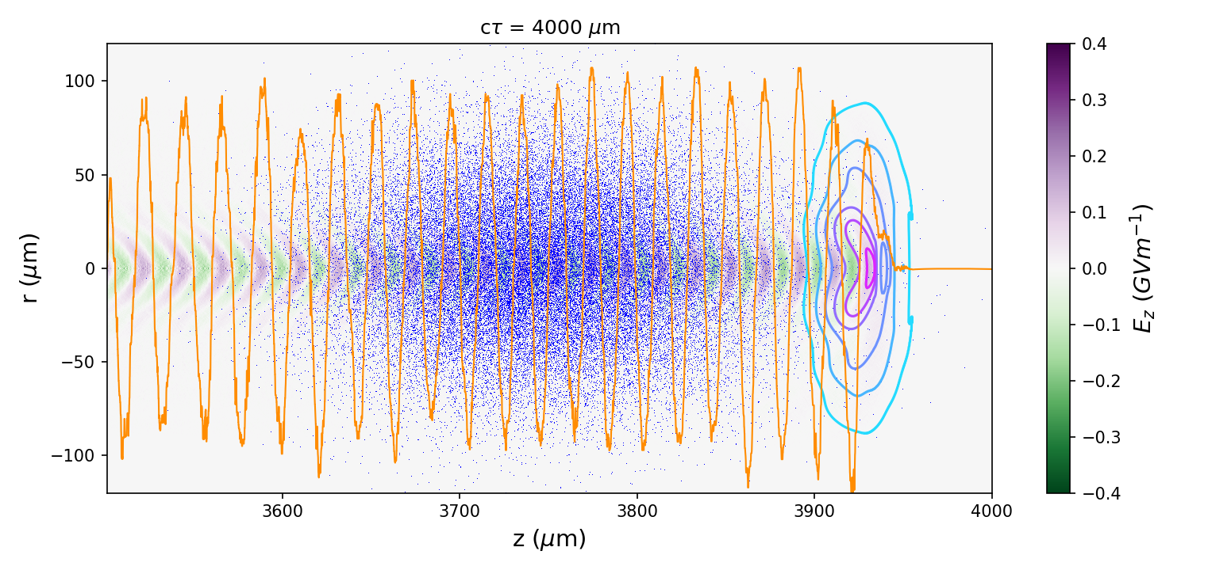
Simulations
Experimental measurements were compared to fbpic simulations.
The electron beam length makes simulating in unfeasible so a reduced electron beam of σ_{z} = 60 μm was chosen as a proxy.
Electron beam still extends over multiple plasma periods so we expect this to be valid and this was checked with a single full beam simulation.
The beam charge was also reduced so that the charge density of the electron beam was the same as the full length electron beam.

Slide 21
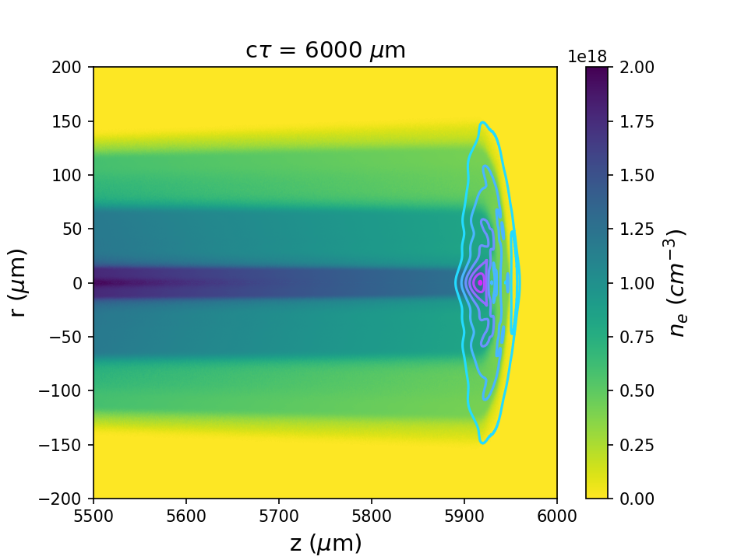
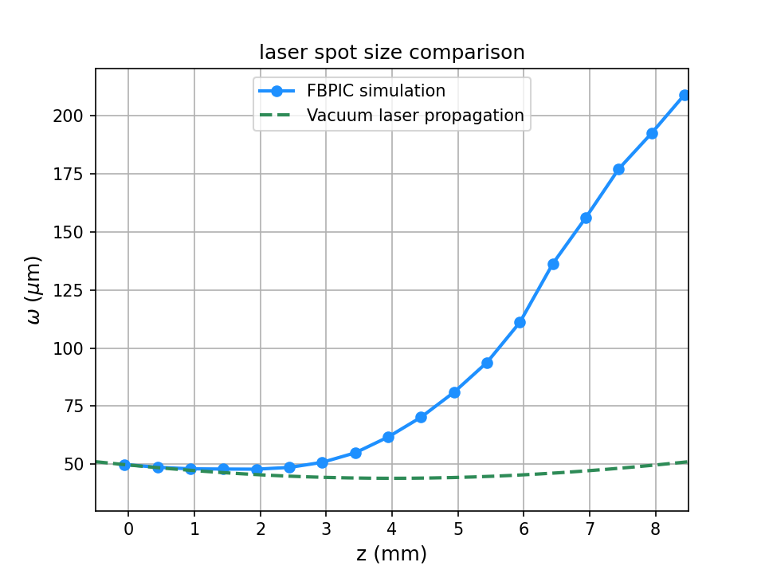
ADK ionisation
Due to the low laser intensity, the ionisation of the Nitrogen gas was included using the ADK model to correctly model the propagation of the laser through the target. The non-uniform radial ionisation of the gas made the plasma act as a negative lens which causes rapid laser pulse defocusing.

Slide 22
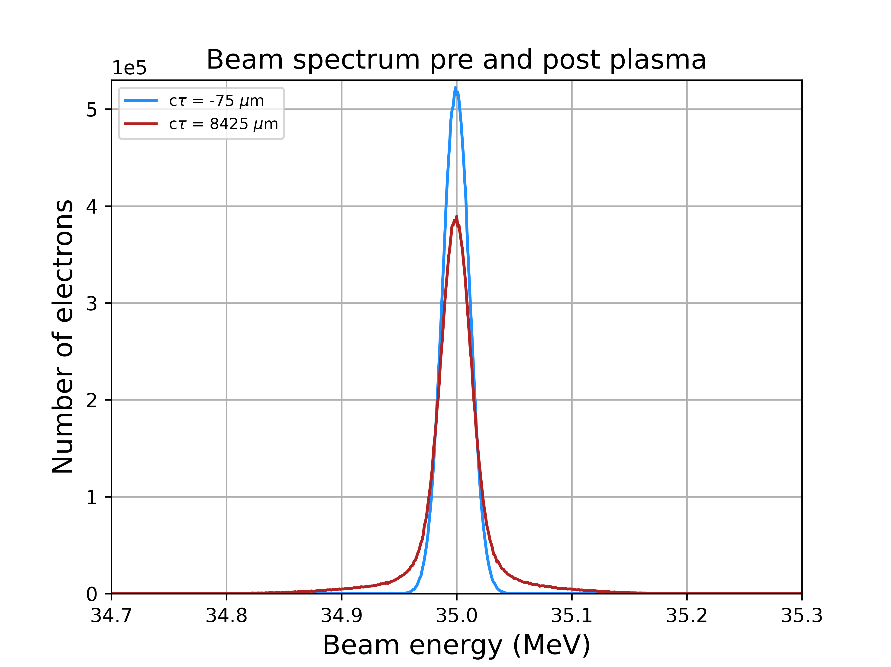
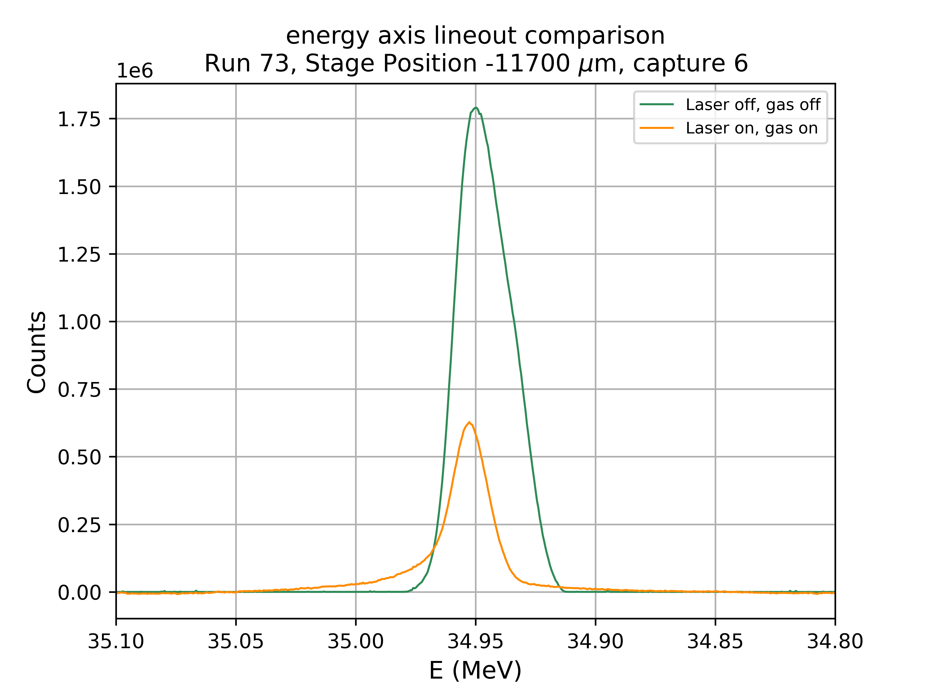
Simulation vs experiment
FBPIC simulation predicts a 200 keV energy gain/loss within the dynamic range of the camera
Measurement shows 100 keV energy gain/loss
400 keV
200 keV

Slide 23
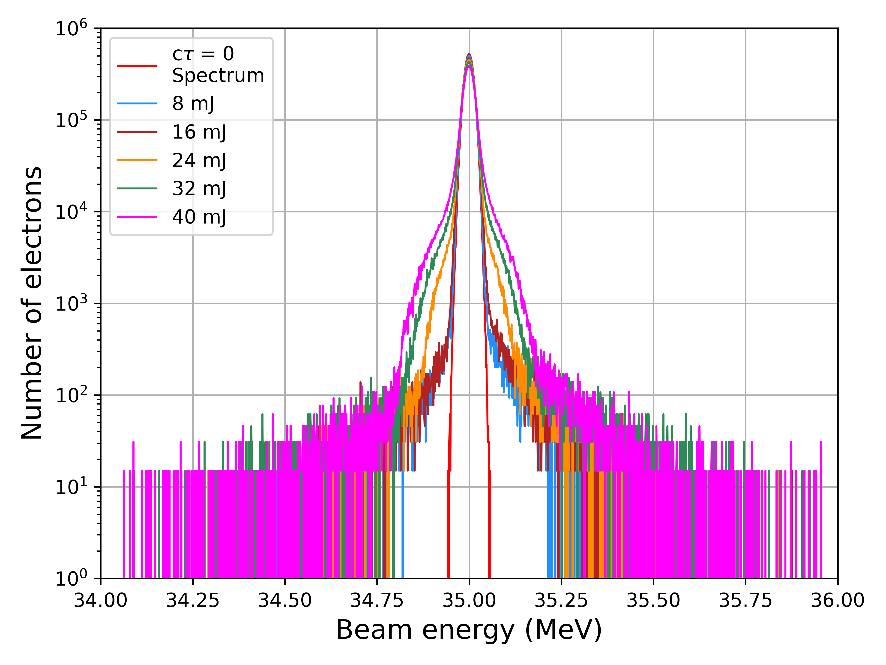
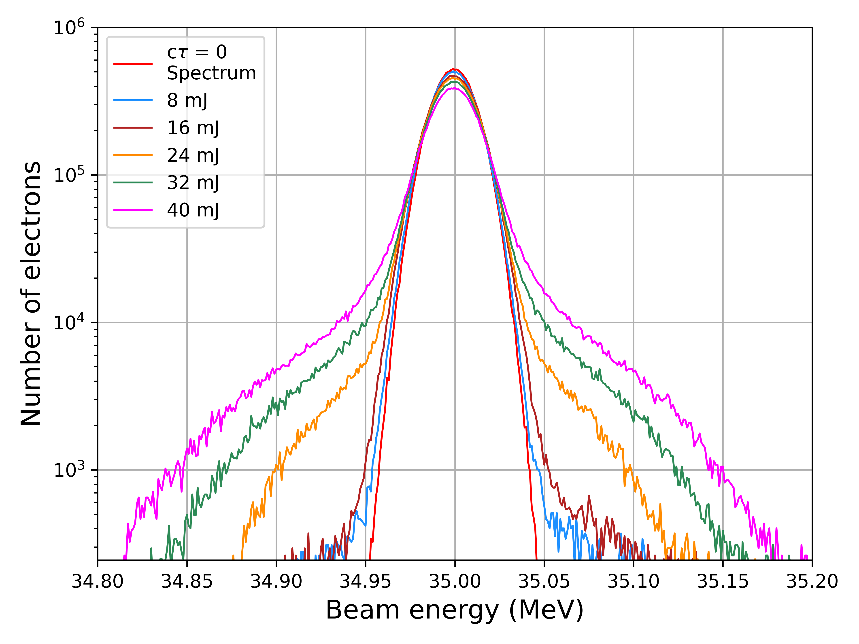
Simulation – Energy scan
Full electron beam spectra
Electrons within camera dynamic range

Slide 24
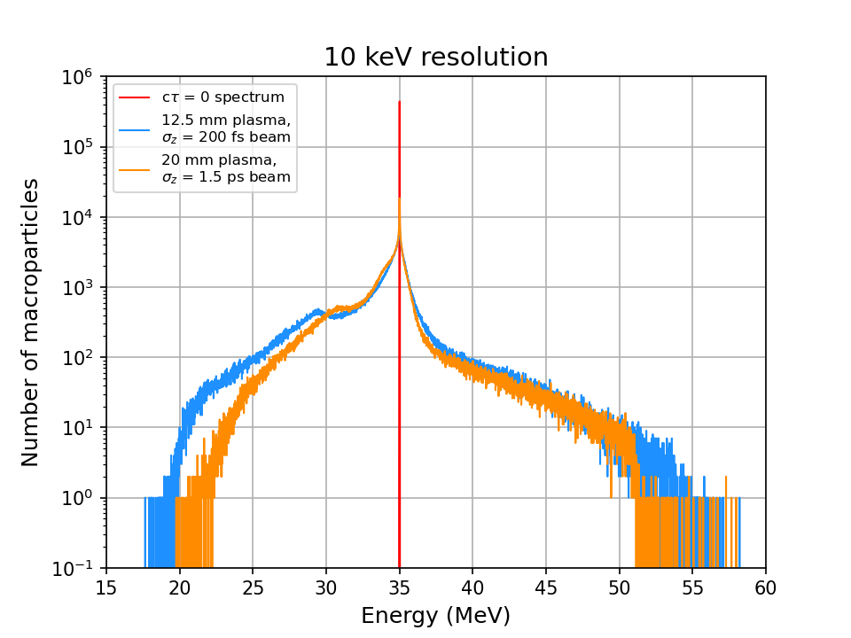
200 fs, 1.5 ps electron beam comparison
Ahead of the experiment, simulations were run with a longer plasma length and 300 mJ of laser energy on target.
Simulations were run for the full 1.5 ps electron beam and the reduced 200 fs beam.
The post-interaction energy spectrum is similar in each case.
This validates the assumption that the 200 fs simulations are is a good approximation because it is so much longer than the plasma wavelength.
Notes:
The plasma lengths are different in the two simulations but the plateau lengths are similar (10 mm and 12 mm). The plasma density is also 10% higher in the case of the σ_{z} = 1.5 ps beam to better match the FLUENT simulation.
20210806_den2e18_w0_40_E_300mJ_t_200fs_sig_30um_E_35MeV_dE_015keV_12mm
20210820_den22e17_w0_40_t_1500fs_sig_30um_E_35MeV_dE_015keV_boost_2

Slide 25
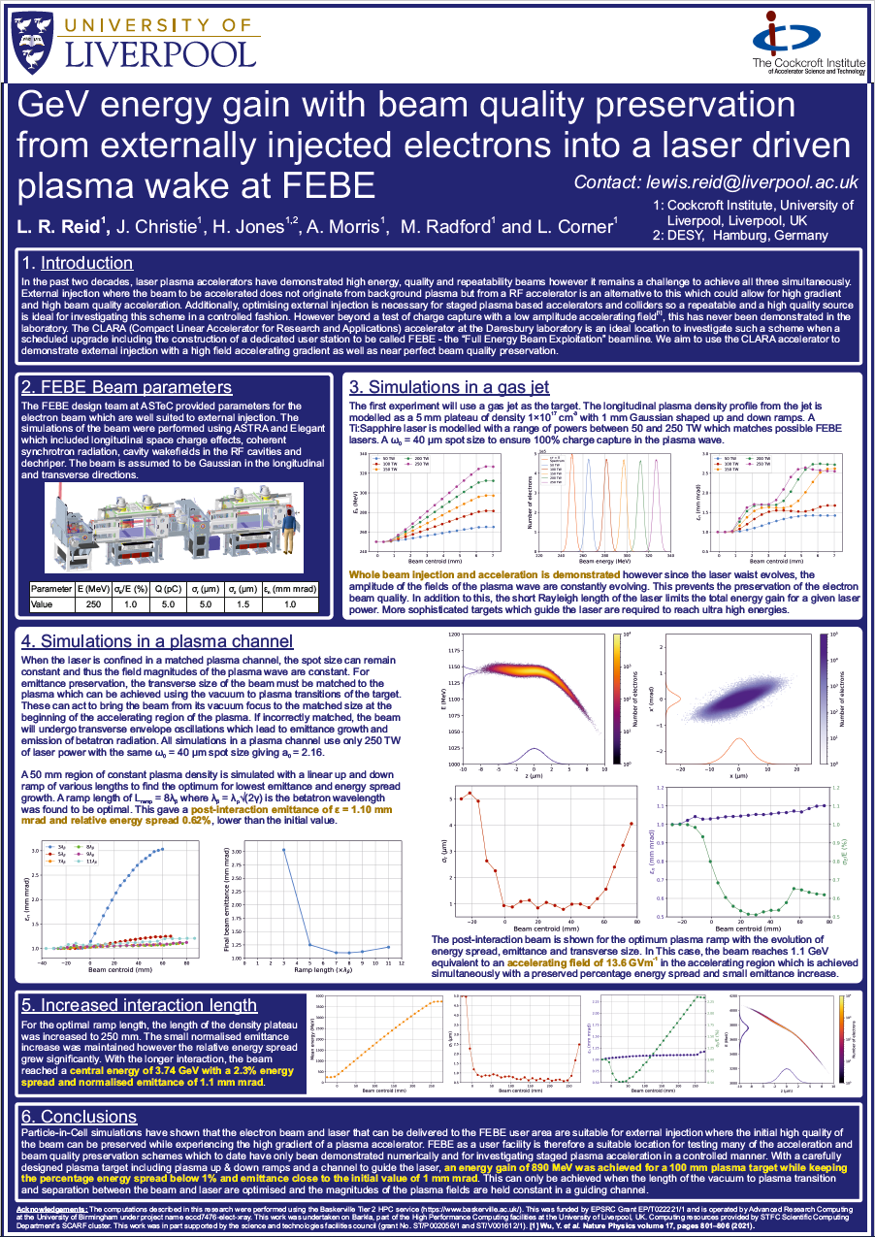
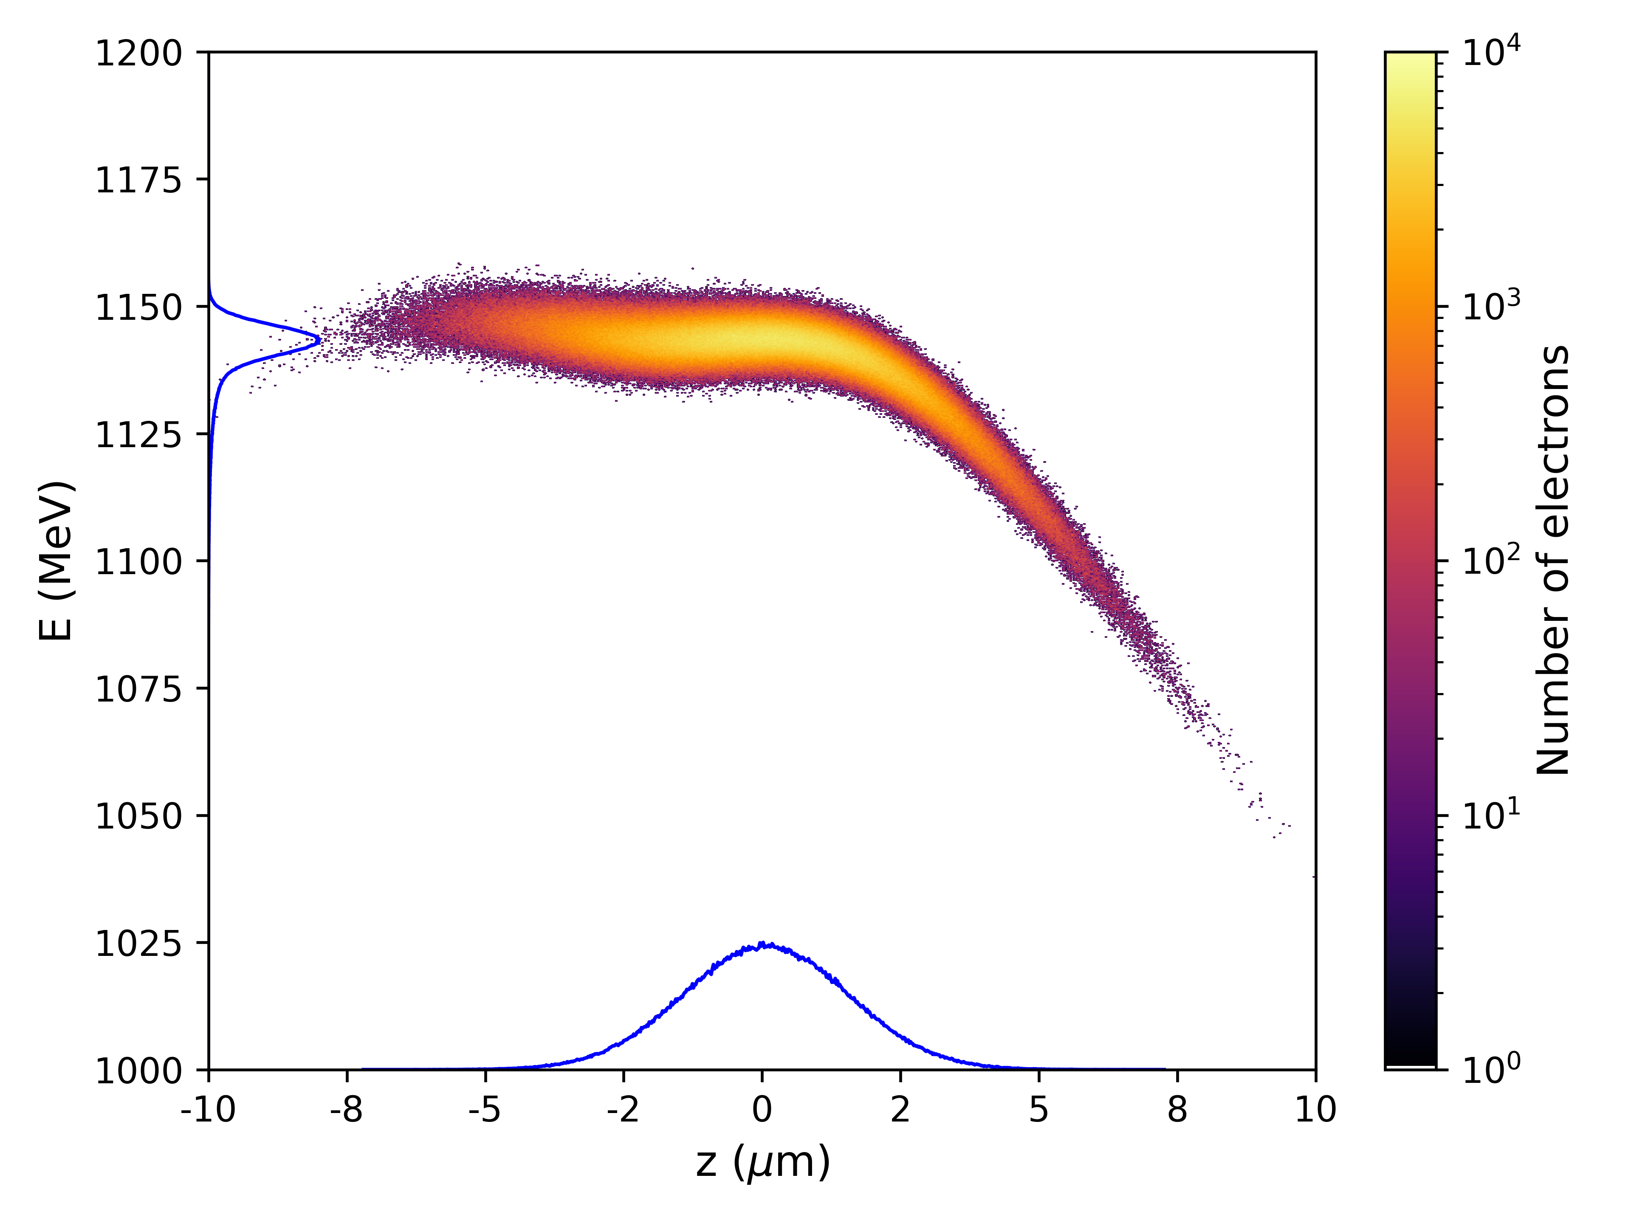
Future work
Next campaign will take place once the accelerator and infrastructure at Daresbury has been upgraded.
The laboratory will be far better optimised for external injection.
Whole beam capture and acceleration will be possible and by optimising the target, acceleration to several GeV is achievable without loss of electron beam quality.
For more information, see my poster during the poster session.

