Slide 1



First proton beam measurements with gas jet in-vivo dosimeter for medical applications
Narender Kumar

Slide 2


Overview
Motivation and clinical benefits
Background and R&D
Measurements at UoB's Scanditronix MC40 cyclotron
IOP PABG Annual Conference, Liverpool 25th-26th July 2022

Slide 3
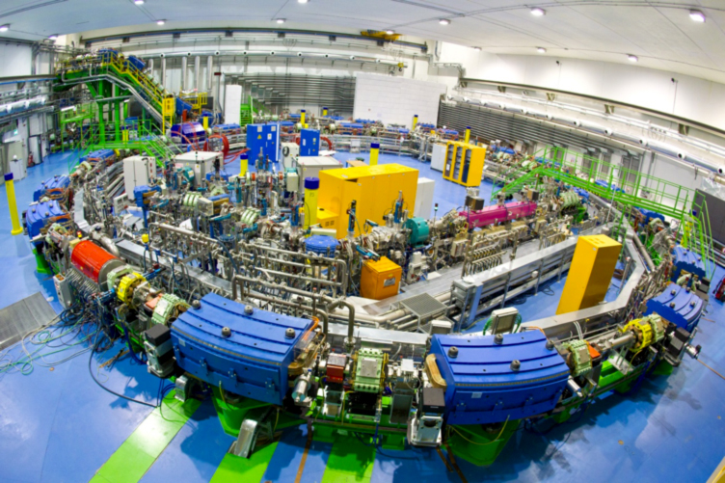
Hadron beam therapy
Clear healthcare benefits for certain cancer types;
Significant investment through NHS and private facilities in the UK;
Optimization of Medical Accelerators (OMA) network identified key R&D challenges:
  Significant time goes into Q&A
  New technology solutions needed for novel treatment modalities such as FLASH
  Desirable machine operation modes not currently possible due to lack of non-invasive (online) diagnostics
CNAO Synchrotron, image courtesy CNAO.
IOP PABG Annual Conference, Liverpool 25th-26th July 2022

Slide 4
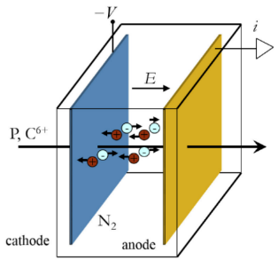
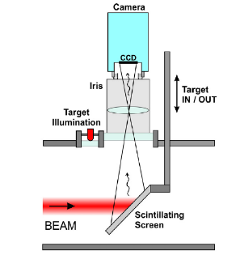
Existing diagnostics
High resolution
Reliability
Validity
Interceptive
Ongoing calibration
Beam perturbation
Limited live feedback
B. Walasek-Höhne, GSI and G. Kube, DESY
S. Giordanengo & M. Donetti, arXiv:1803.00893
IOP PABG Annual Conference, Liverpool 25th-26th July 2022

Slide 5


JetDose - Novel diagnostics solution
1
2
No mechanical parts interact with the beam
All key parameters monitored remotely
Significantly reduced maintenance
Minimally invasive
Significantly reduced calibration time
No beam perturbation
Online monitoring
Superior error detection
3
2
Enabling technology for FLASH and Mini-Beam treatments
Active machine regulation based on live feedback becomes feasible
Novel treatments and improved operation
1
USP
3
N. Kumar, C.P. Welsch, et. al, Physica Medica 73, p 173-178 (2020).
S. Jolly, C.P. Welsch, et al., “Technical challenges for FLASH proton therapy“, Phys Med 2020 – Galileo Galilei Award, best paper in 2020
“Non-Invasive Gas Jet In-Vivo Dosimetry for Particle Beam Therapy”, contributed talk at IPAC21
IOP PABG Annual Conference, Liverpool 25th-26th July 2022

Slide 6
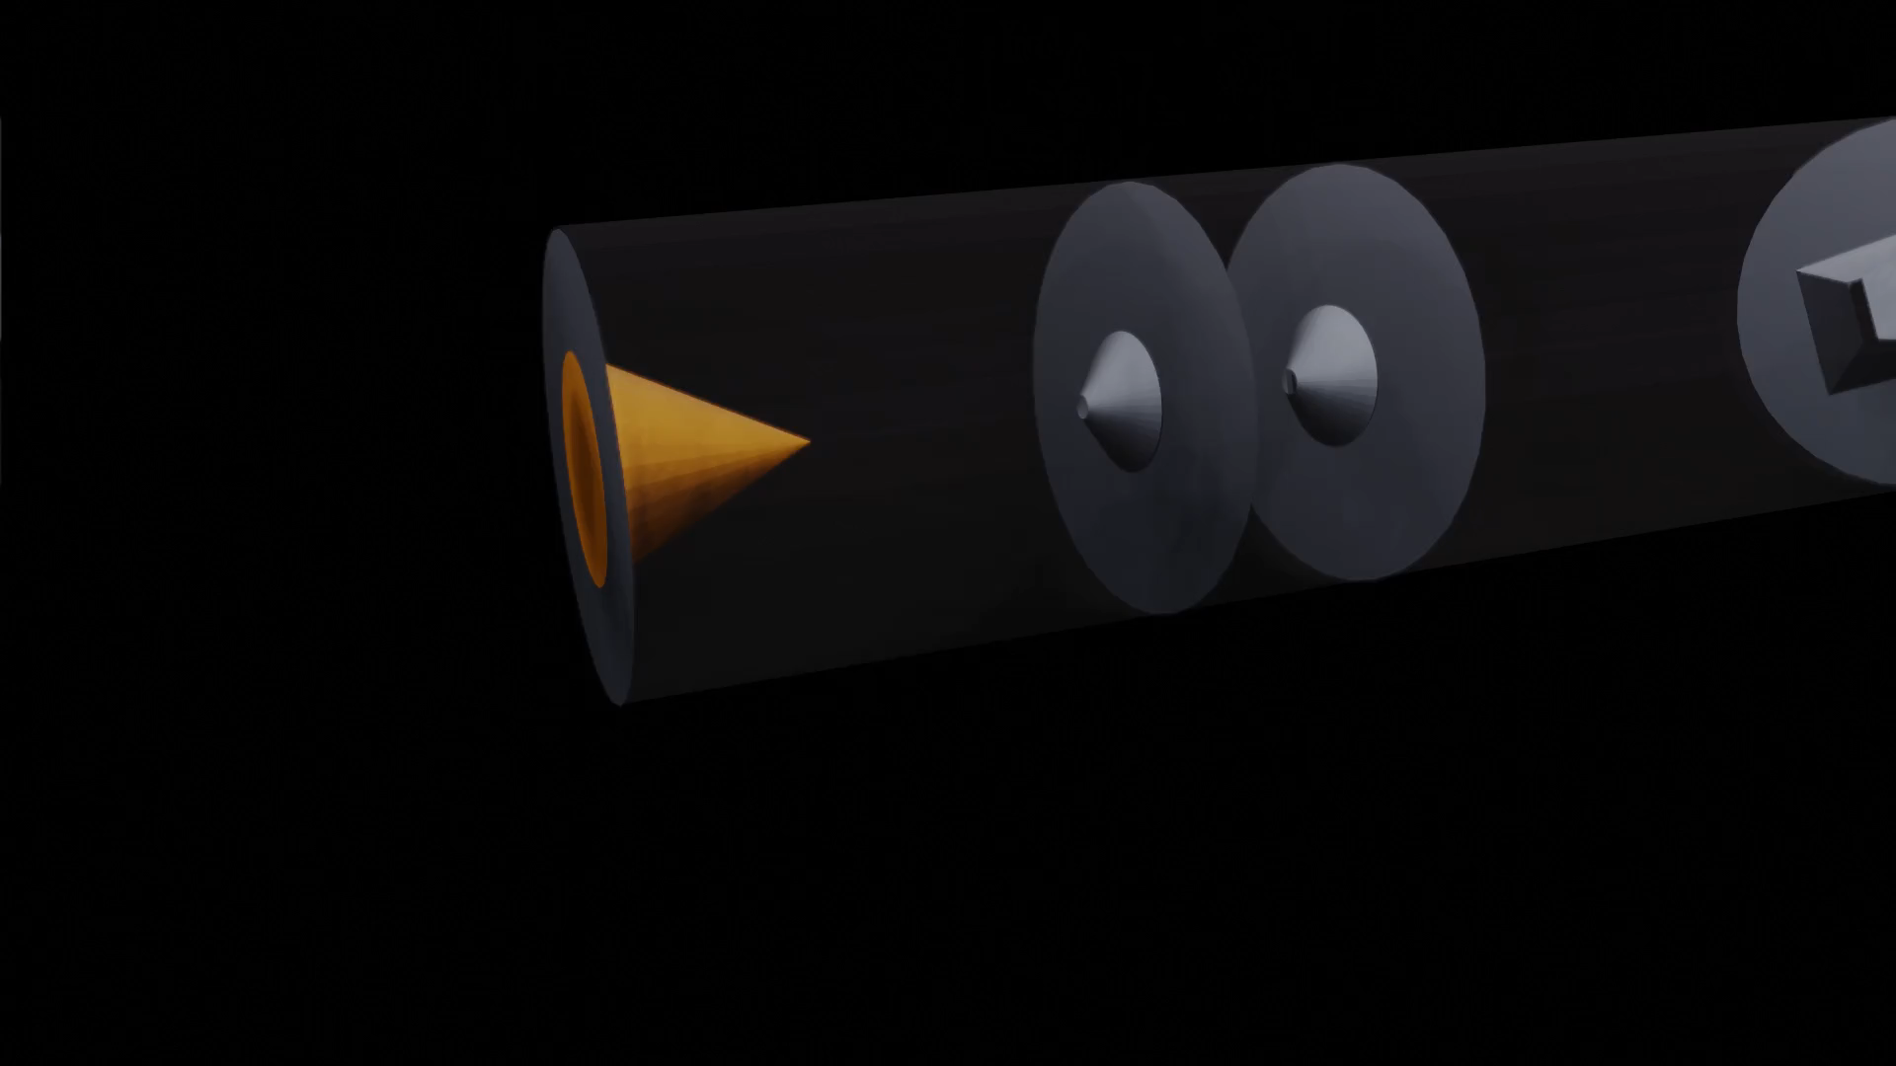
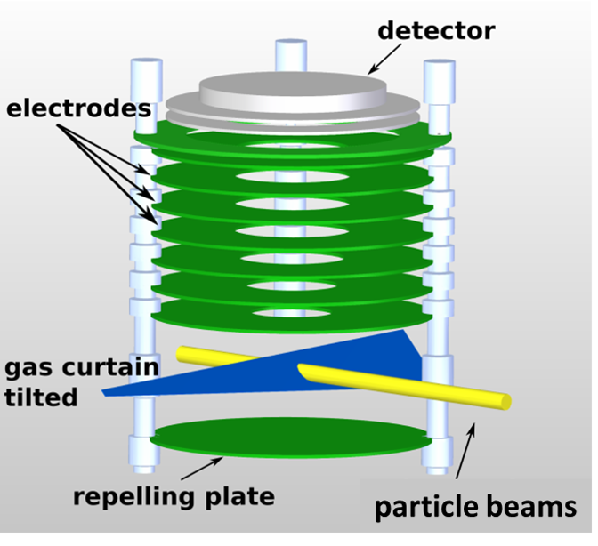
Building up on previous developments
Detector
Visible light
Phosphor screen
MCP
Ion extraction
Ionization
Gas jet shaping
IOP PABG Annual Conference, Liverpool 25th-26th July 2022

Slide 7
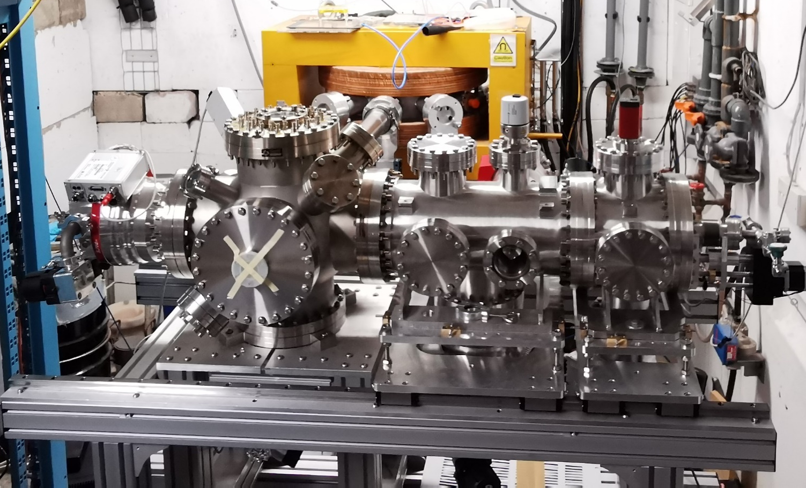
Measurements with protons at UoB's Scanditronix MC40 cyclotron
Beamline
(ending with Ti foil)
Proton
beam
(in vacuum)
125 µm
Ti foil
Interaction chamber
Beam
dump
Beam Parameters
Beam Species: Protons
Beam Energy: 28 MeV
Beam Current: 150-750 nA (on FC1)
Beam Collimator Area: 4-100 mm²
125 µm
Ti foil
Proton
beam
(in air)
Proton
beam
(in vacuum)
IOP PABG Annual Conference, Liverpool 25th-26th July 2022

Slide 8
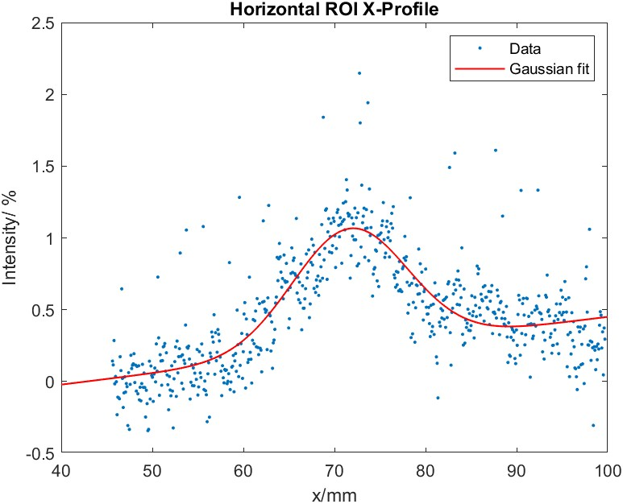
Measurements with protons at UoB's Scanditronix MC40 cyclotron
Beam collimator Area= 100 mm²
Integration time = 1second
Gas Pressure in Interaction chamber = 1.2 ×10⁻⁵ mbar
σ = 5.4mm
Beam current at FC1= 150nA
Beam collimator Area= 4 mm²
Integration time = 20seconds
Gas Pressure in Interaction chamber = 1.2 ×10⁻⁵ mbar
σ = 6.4mm
Beam current at FC1= 150nA
IOP PABG Annual Conference, Liverpool 25th-26th July 2022

Slide 9
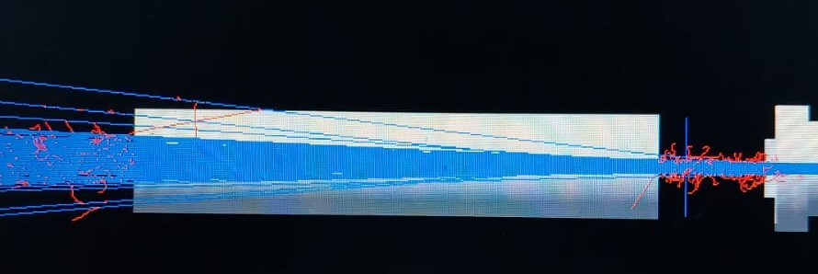
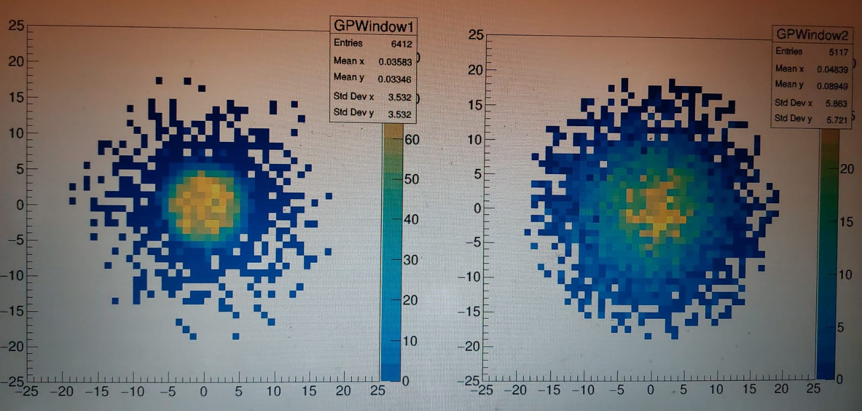
Measurements with protons at UoB's Scanditronix MC40 cyclotron
Beam collimator Area= 4 mm²
Integration time = 20seconds
Gas Pressure in IC= 1.2 ×10⁻⁵ mbar
σ = 6.6mm
Beam current at FC1= 750nA
GEANT4 simulations
IOP PABG Annual Conference, Liverpool 25th-26th July 2022

Slide 10
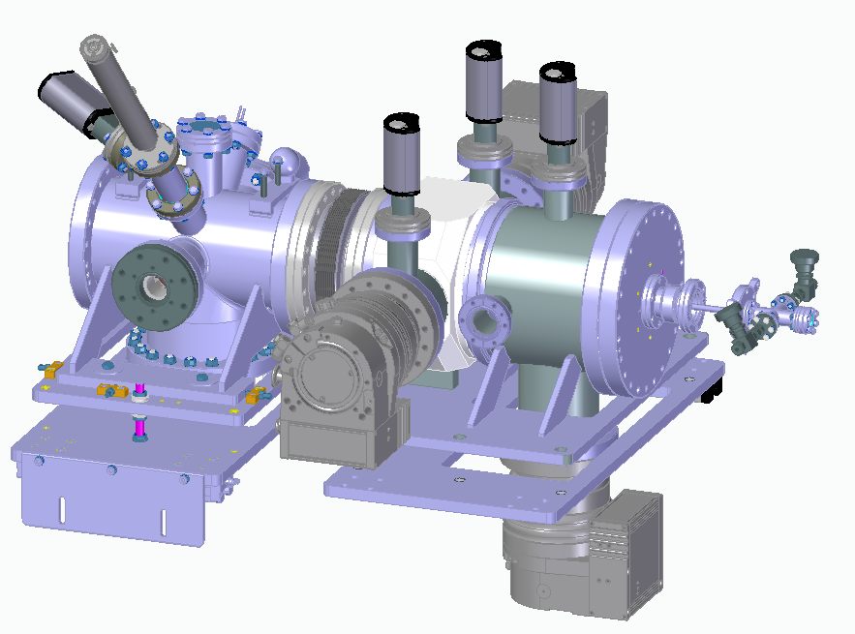
Updated design
More flexible design for nozzle skimmer assembly and tuning
Compact system: total length ≈ 1m
Skimmer Chamber
Interaction Chamber
Nozzle Chamber
Port for Laser Interferometry measurements
IOP PABG Annual Conference, Liverpool 25th-26th July 2022

Slide 11
Summary
First measurements were done with a proton beam. Good agreement was found with results from simulation.
It was shown that 1 s integration time is sufficient for having a density equivalent to 10⁻⁵ mbar gas pressure.
System integration is subject to optimization; considering direct coupling to existing system.
R&D into increasing gas jet density at the interaction point is ongoing.
IOP PABG Annual Conference, Liverpool 25th-26th July 2022

Slide 12
Thank you for your attention
Special thanks to
I. Maltusch, O. Stringer, J. Wolfenden, H. Zhang, T. Price, C.P. Welsch

