Slide 1
Development of gas-jet based diagnostics at the CI
Hao D. Zhang, N. Kumar, A. Salehilashkajani, O. Sedlacek, O. Stringer, C. P. Welsch (Univ. Liverpool / CI)
M. Ady, T. Lefevre, S. Mazzoni, I. Papazoglou, A. Rossi, G. Schneider, K. Sidorowski, R. Veness (CERN)
P. Forck, S. Udrea (GSI)
haozhang@liverpool.ac.uk

Slide 2
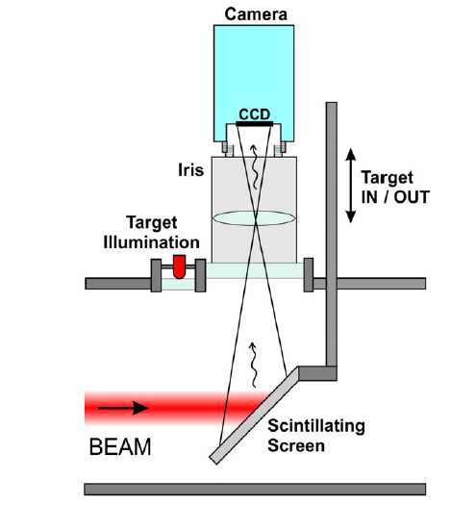
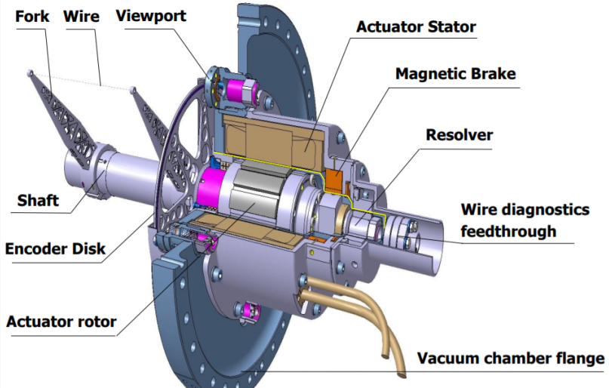
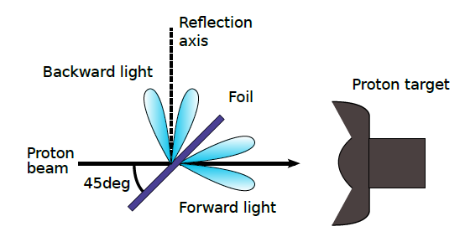
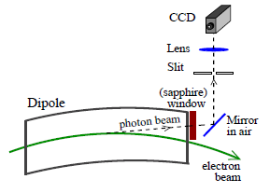
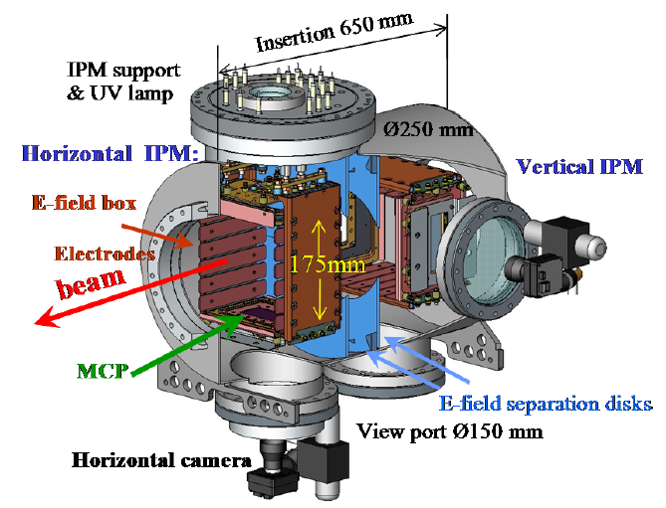
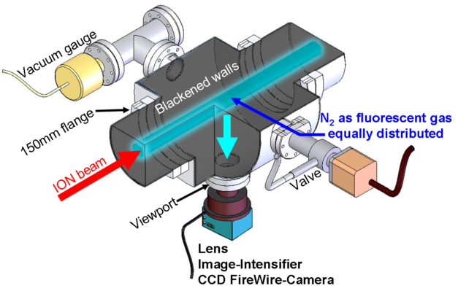
Diagnostics: Beam profile monitors
Intercepting method
Scintillating screen
Wire scanner or slits
OTR
phosphor
YAG, etc.
Credit: B. Walasek-Höhne, GSI and G. Kube, DESY
Credit: B. Dehning et al., CERN
Credit: D. Morris, et al., TRIUMF
Non-Invasive method
SR
Residual gas based IPM monitor
BIF monitor
Resolution, S/N ratio
Long integration time!
Credit: U. Iriso and F. P´erez, ALBA
Credit: P. Fork, GSI
Credit: P. Fork, GSI
Notes:
Diagnostics are sensing organ of the accelerators. Today I will mainly focus on the beam profile monitors.
Traditionally, the intercepting methods were used for example S-screen such as YAG or phosphor screen, wire scanner or slits, OTR screen. These methods are normally used in LINAC or commissioning of high intensity machines. Non-intercepting method are preferred due to their robustness. SR is one of the good example but not every beam is energized enough to product SL. There are two monitor based on interaction between the charged particle beam and the residual gas. The IPM collect ions or electrons while the BIF detect the fluorescent photon. Due to usage of the residual gas, they tent to have low resolution, low S/N ratio which normally means long integration time. Here we need a way to increase the signal level without sacrifice the vacuum.

Slide 3
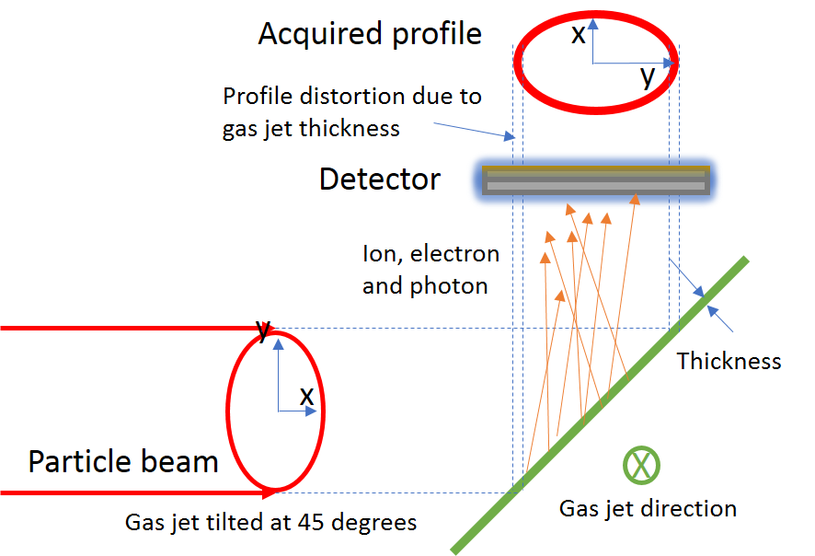
Gas jet based beam profile monitors
Principle
Advantage
  Non-Invasive
  Minimum vacuum interference
  2D profile with high resolution
  Versatile
  Not affected by space charge (Neutral emitter)
Using a supersonic gas jet curtain
Notes:
The solution is to use a supersonic gas jet. The principle is simple, you generate a supersonic gas jet curtain, which interact with the primary beam the same way as the residual gas and detect the secondaries the same way as the IPM or BIF. Due to the finite thickness of the gas curtain, the profile you got will be 2D.
The advantage will be it is an invasive method, with minimum vacuum interference. It give 2d profile with high resolution due to the low temperature of the gas jet molecule. It is very versatile to change the curtain size. If a neutral emitter is chosen, there will be no space charge effect.

Slide 4
Gas jet monitor setup
Notes:
To generate the such a curtain, 5bar nitrogen or neon flow through a 30 um nozzle to form a supersonic gas jet. then this jet is be shaped through 2 conical skimmers and a rectangular skimmer. The skimmers divide the vacuum volume into differential pumping stages to maintain the pressure in the beam pipe. the jet flow through will dumped to the final pumping station. To prevent back flow, a 4th skimmer slightly larger than the jet is applied.

Slide 5
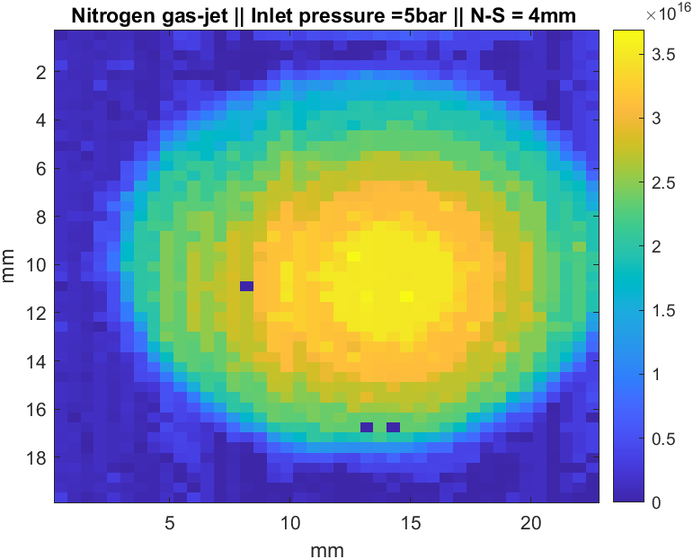
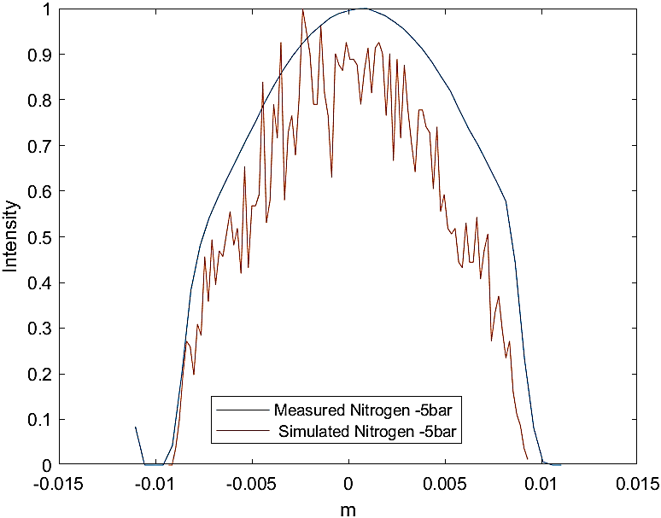
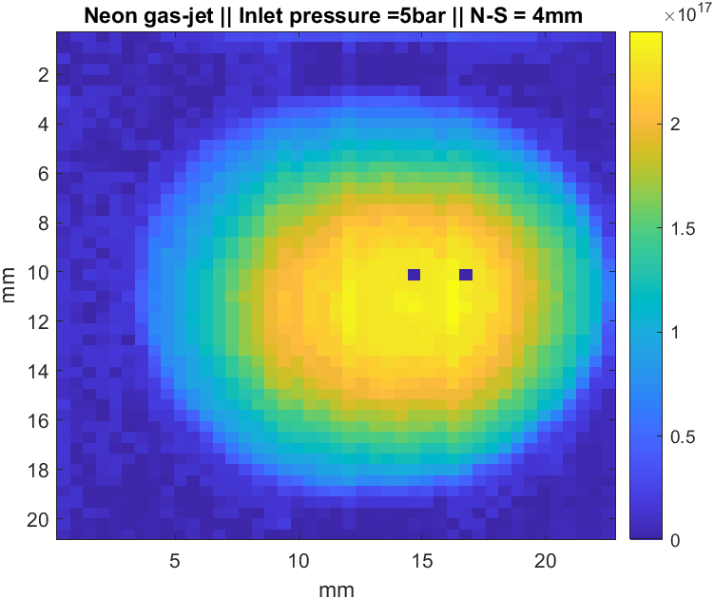
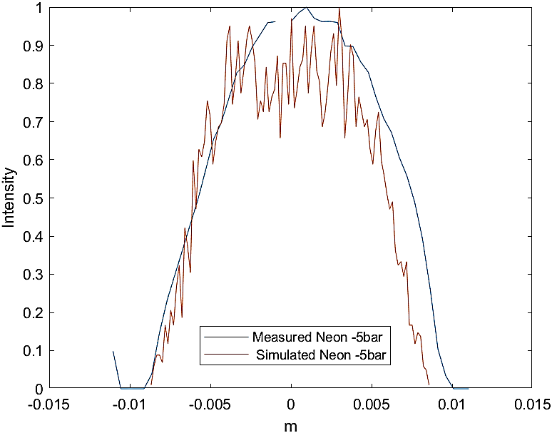
Curtain simulation and verification
Continuous flow:
Quitting surface + analytical formular
Gas jet density distribution verified at 264 mm from nozzle:
    Nozzle : 30 μm; 1st Skimmer I : 180 μm; 2nd Skimmer: 2mm
Nitrogen
FWHM = 13.6 mm
FWHM = 15.8 mm
Y
X
Molecular flow:
Particle ray tracing
Neon
FWHM = 12.5 mm
FWHM = 13.3 mm

Slide 6

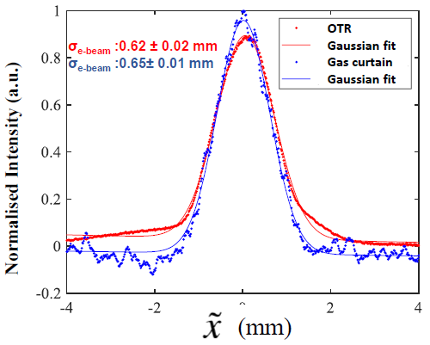
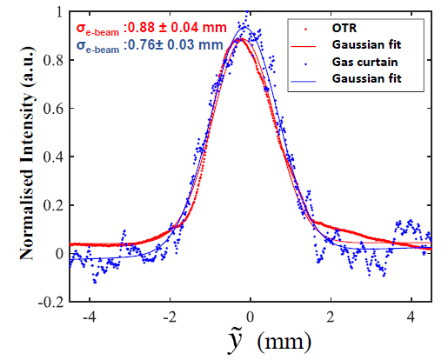
Beam profile Measurement
IPM mode (See Narender’s talk)
BIF mode
Measurement
E-beam:
0.66mA, 5keV
Image:
200 frames with
2s exposure time each
Photon number
σ(cross section, N₂, 391 nm) | 9.2*10⁻¹⁹ cm²
I (electron current) | 0.66 mA
n (gas jet density) | 4×10¹⁵ m⁻³
d (jet thickness) | 0.7 mm
Optical parameter | 2.9×10⁻⁴
Photon rate estimation | 49 ± 39 s⁻¹
Photon rate measured | 18.0 ± 0.3 s⁻¹
Verified with OTR
A. Salehilashkajani, H. D. Zhang, et al. Appl. Phys. Lett. 120, 174101

Slide 7
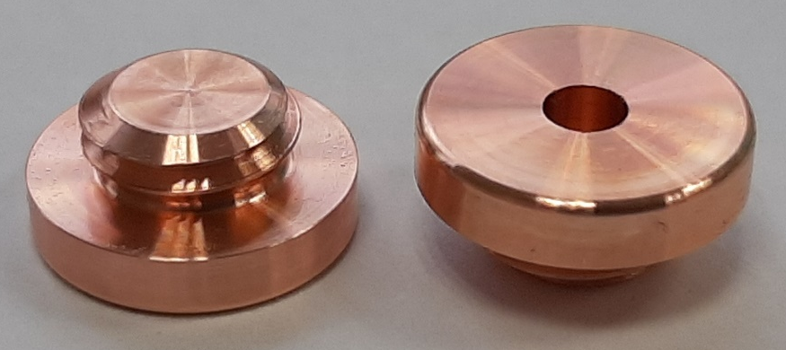
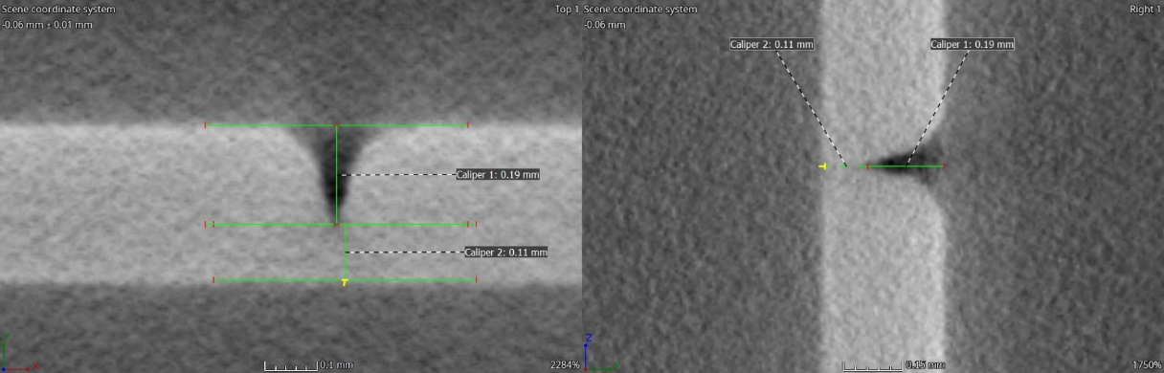
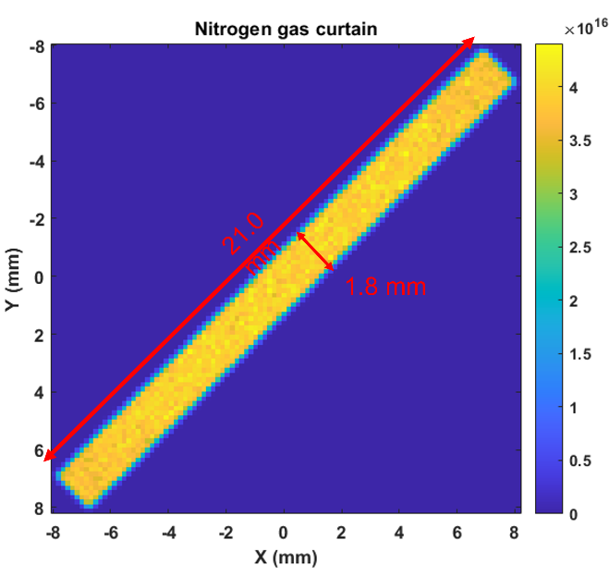
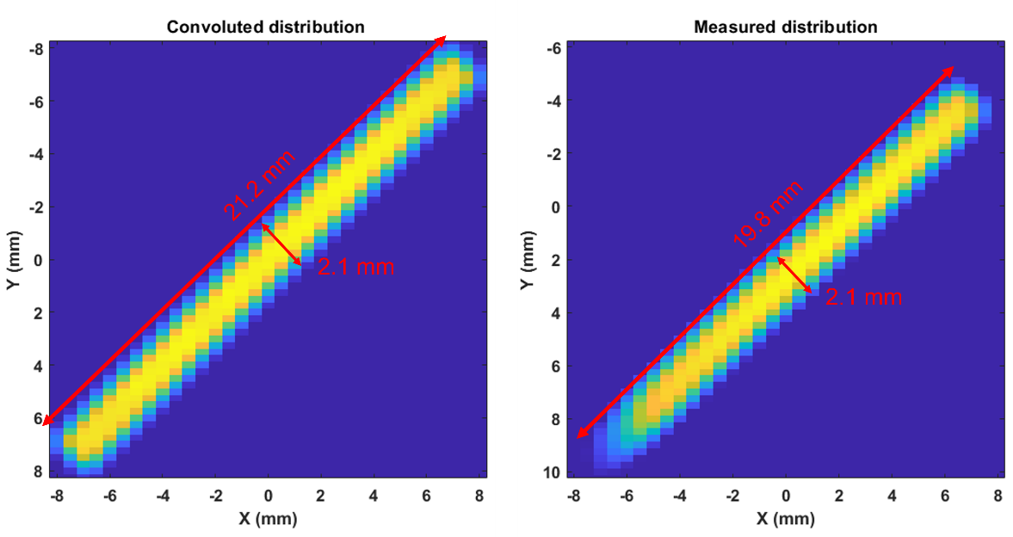
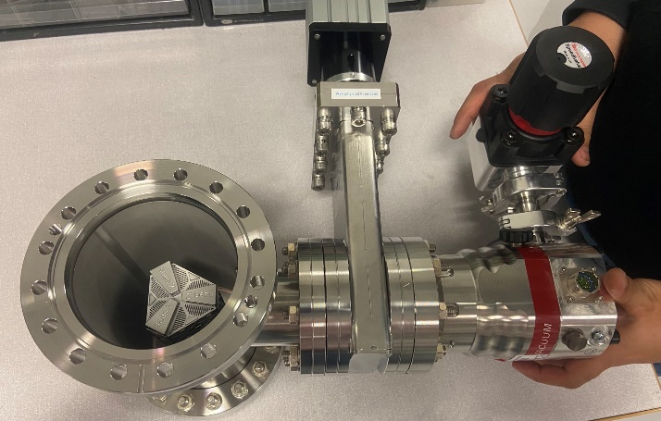
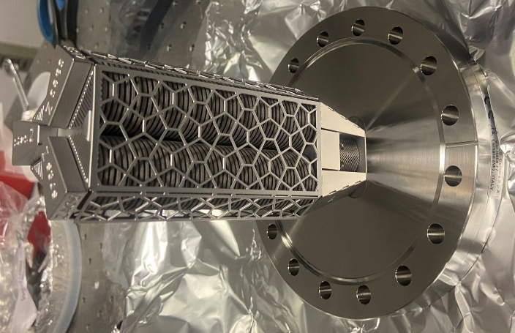
Design a monitor for LHC
Generate a uniform gas jet with 20 mm
Vacuum behaviour (when jet in on)
Nozzle chamber | Skimmer chamber I | Skimmer chamber II | Interaction chamber
5.56×10⁻³ mbar | 1.13×10⁻⁵ mbar | 1.52×10⁻⁶ mbar | <5×10⁻⁹ mbar
Old configuration
  30 μm nozzle
  180 μm 1st skimmer
  2 mm 2nd skimmer
  9*0.7 mm² 3rd skimmer
New configuration
  30 μm nozzle
  400 μm 1st skimmer
  2 mm 2nd skimmer
  9*0.7 mm² 3rd skimmer
Nozzles testing
Simulation
Convolution
Experiment
Credit: A. Cherif
Convergent-Divergent (CD) Nozzles
Replace TMP with NEG
For high B-field applications

Slide 8
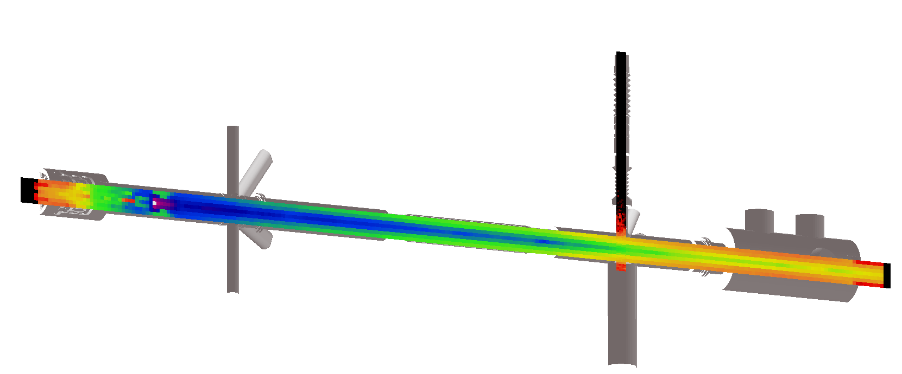
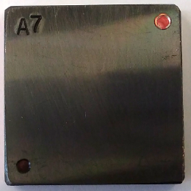
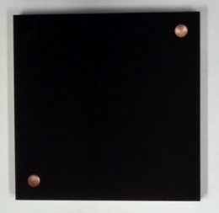
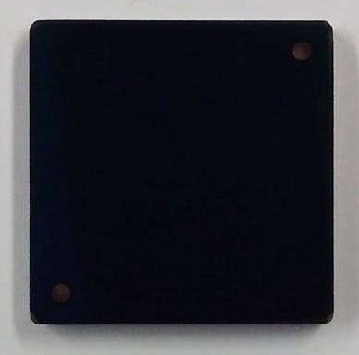
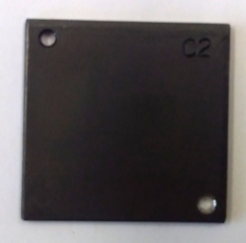
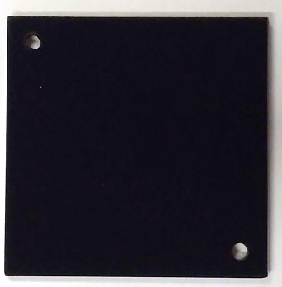
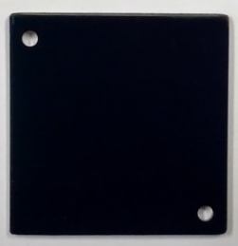

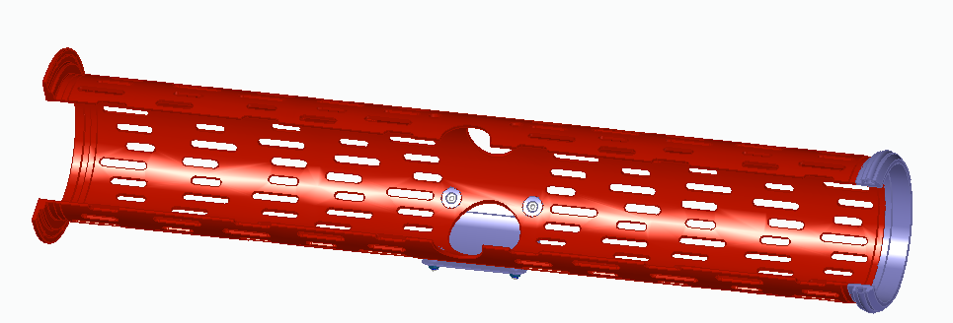
Noise reduction and stray photon estimation
Chamber blackening to reduce stray photons
Stray photons from cathode and Synchrotron light
 | Amorphous carbon | LESS (Dundee) | Multilayer sputtering (Polyteknik) | Carbon nanotubes (Vantablack)
Copper | ≈ 13% | ≈ 2% | ≈ 0.2%
Steel | ≈ 14% | ≈ 2% | ≈ 0.2% | ≈ 0.15%
Molflow simulation
Cathode
Imaging system
for gas jet monitor
Electron lens test stand for HEL
Credit: Noah Jens
Reflectivity test at neon wavelength 584nm
Imaging system
Conclusion:
α-C coating used in the copper liner and the vacuum chamber with reflection of 10-15%
Multi-layer optimized coating used under the interaction point with reflection of < 0.2%
Amorphous carbon
Beam
Multilayer coating

Slide 9
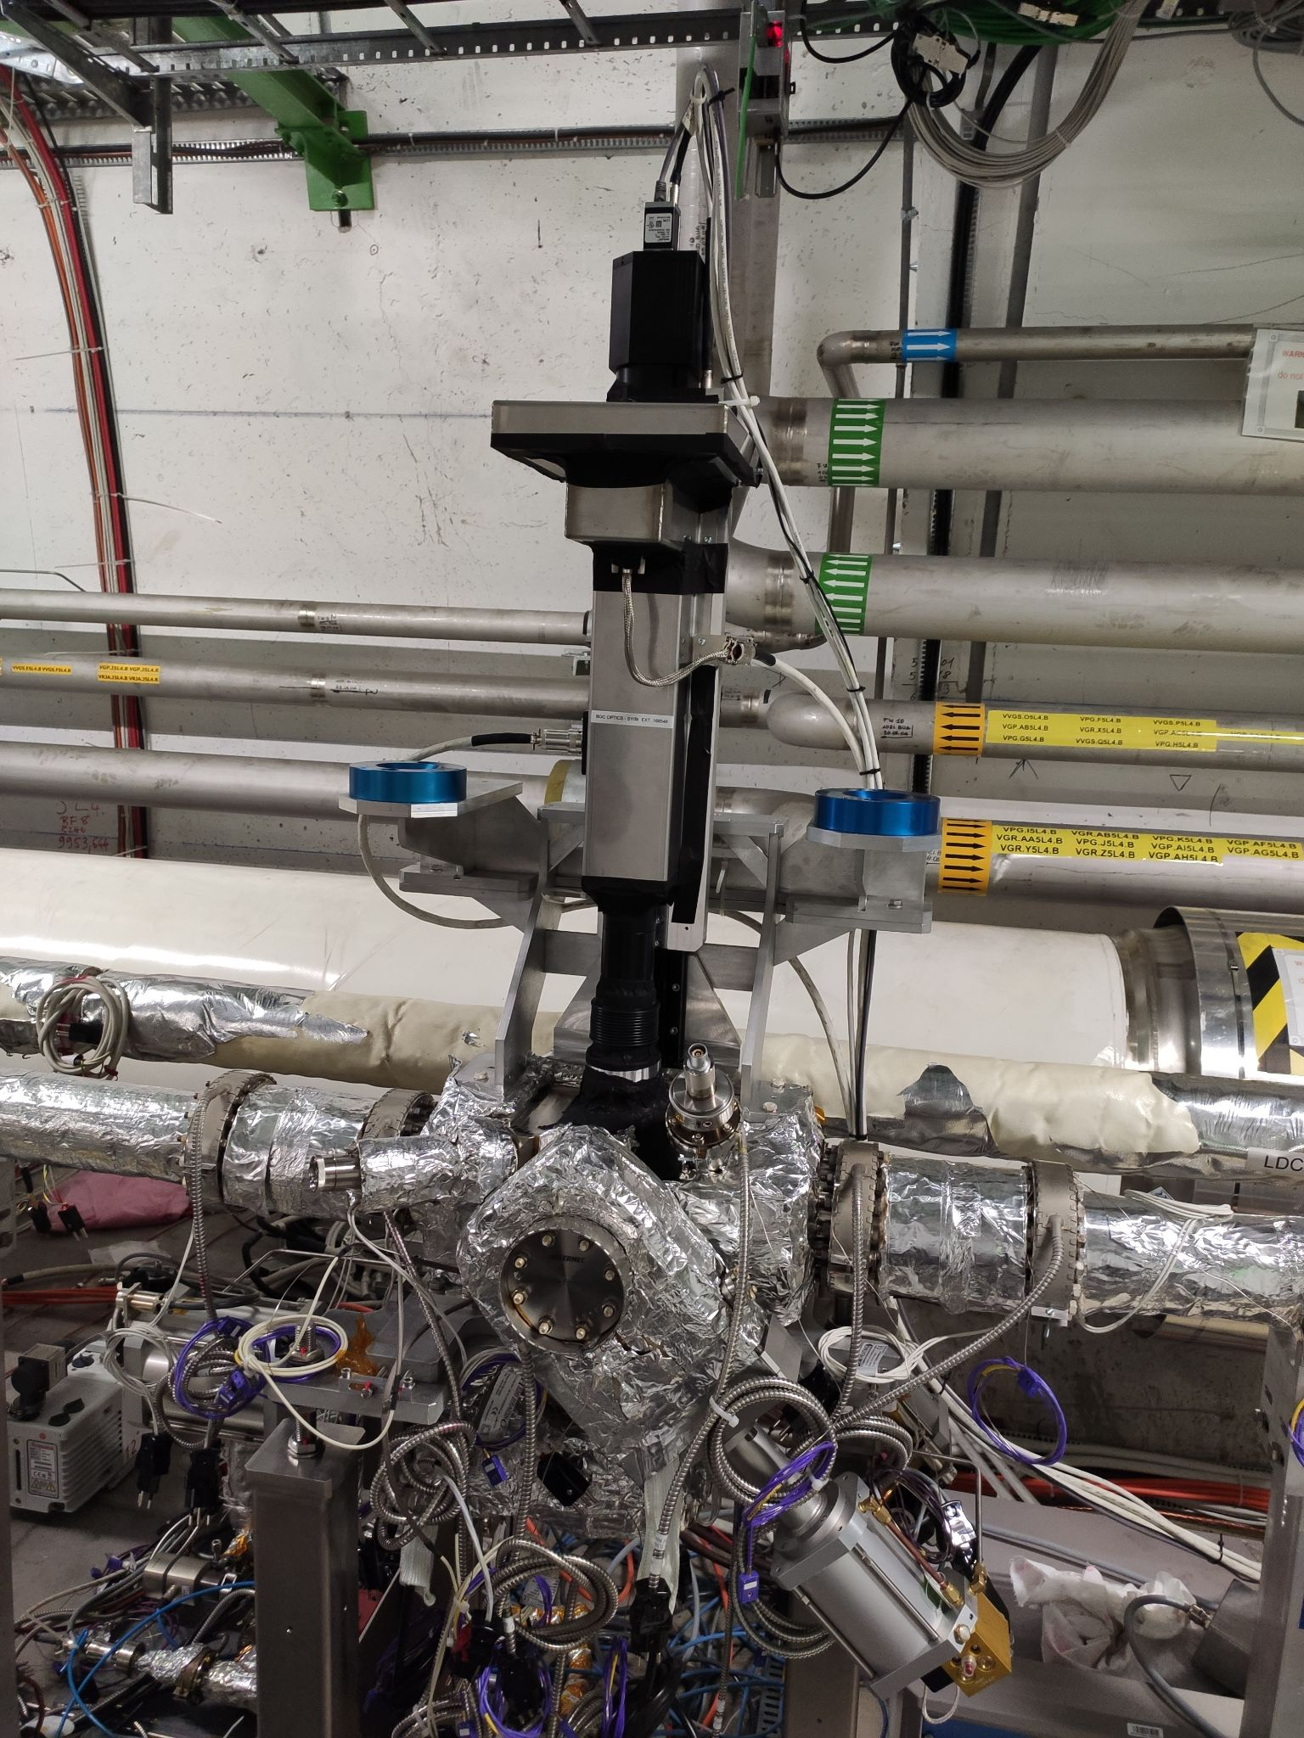
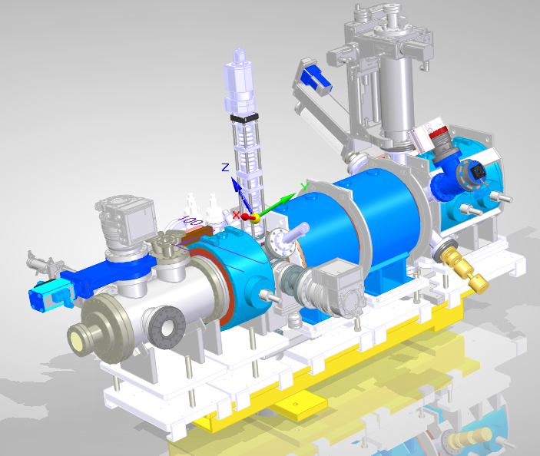
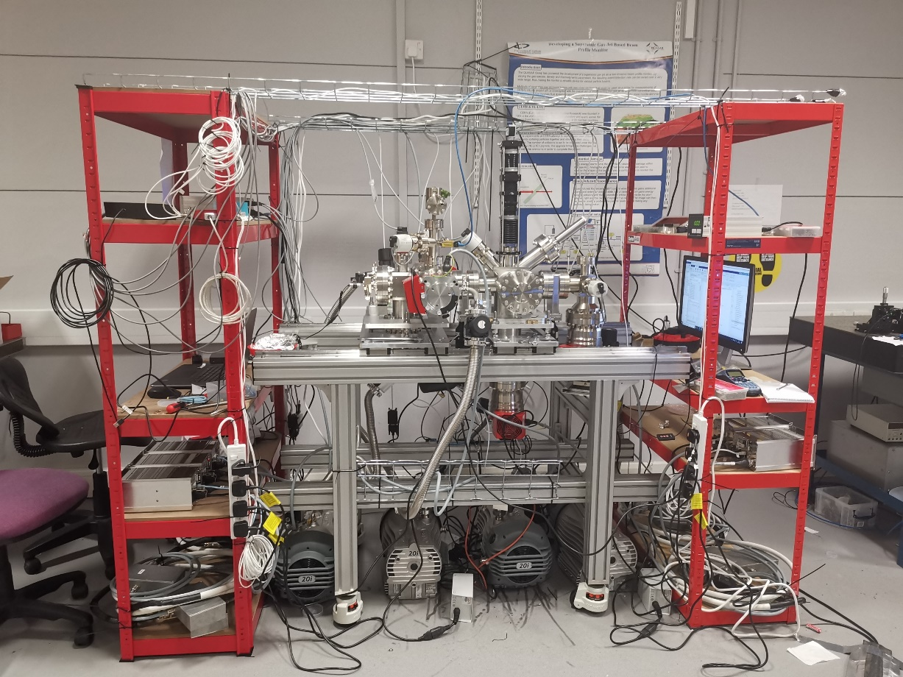
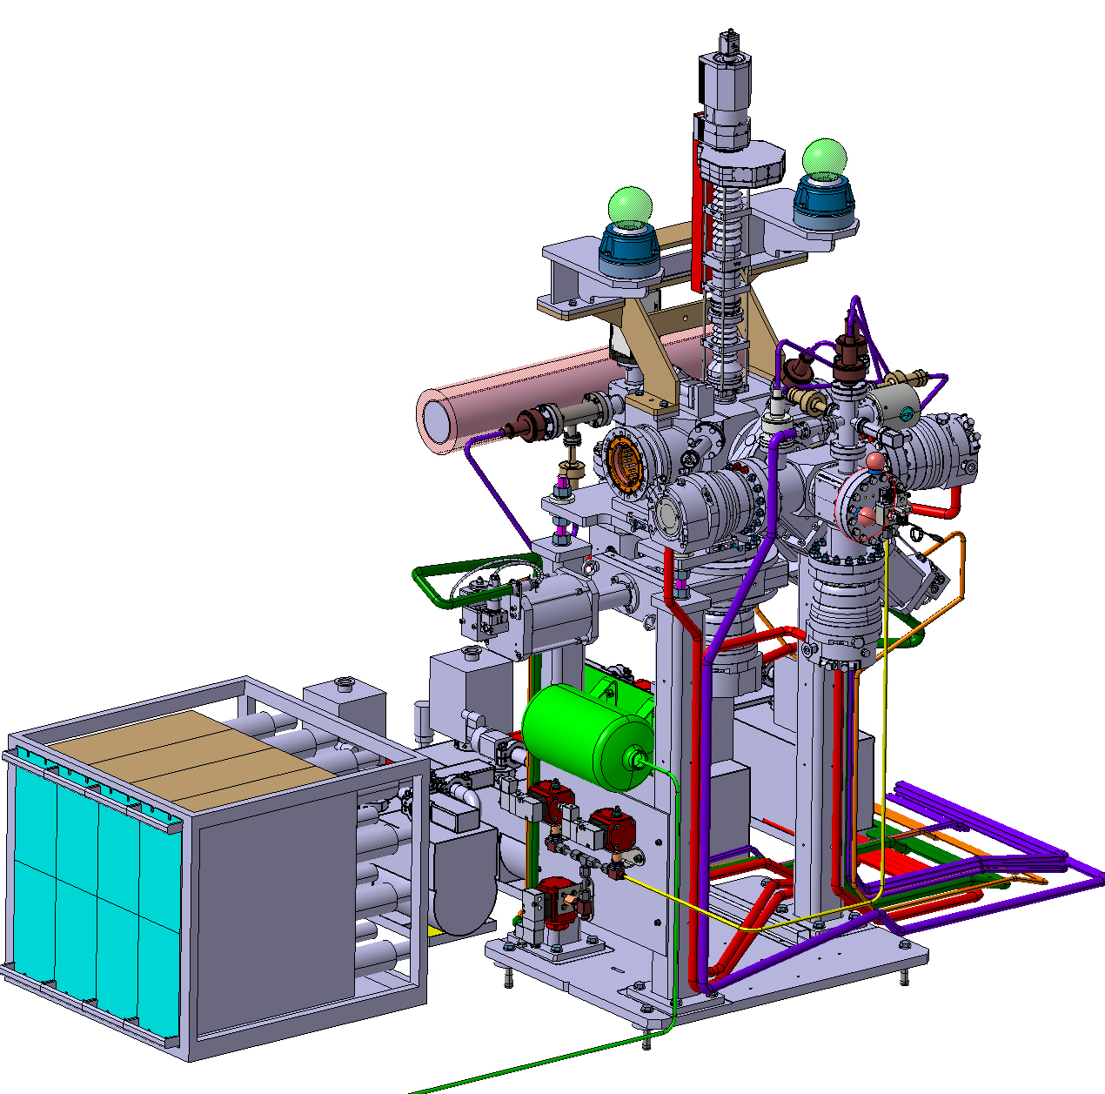
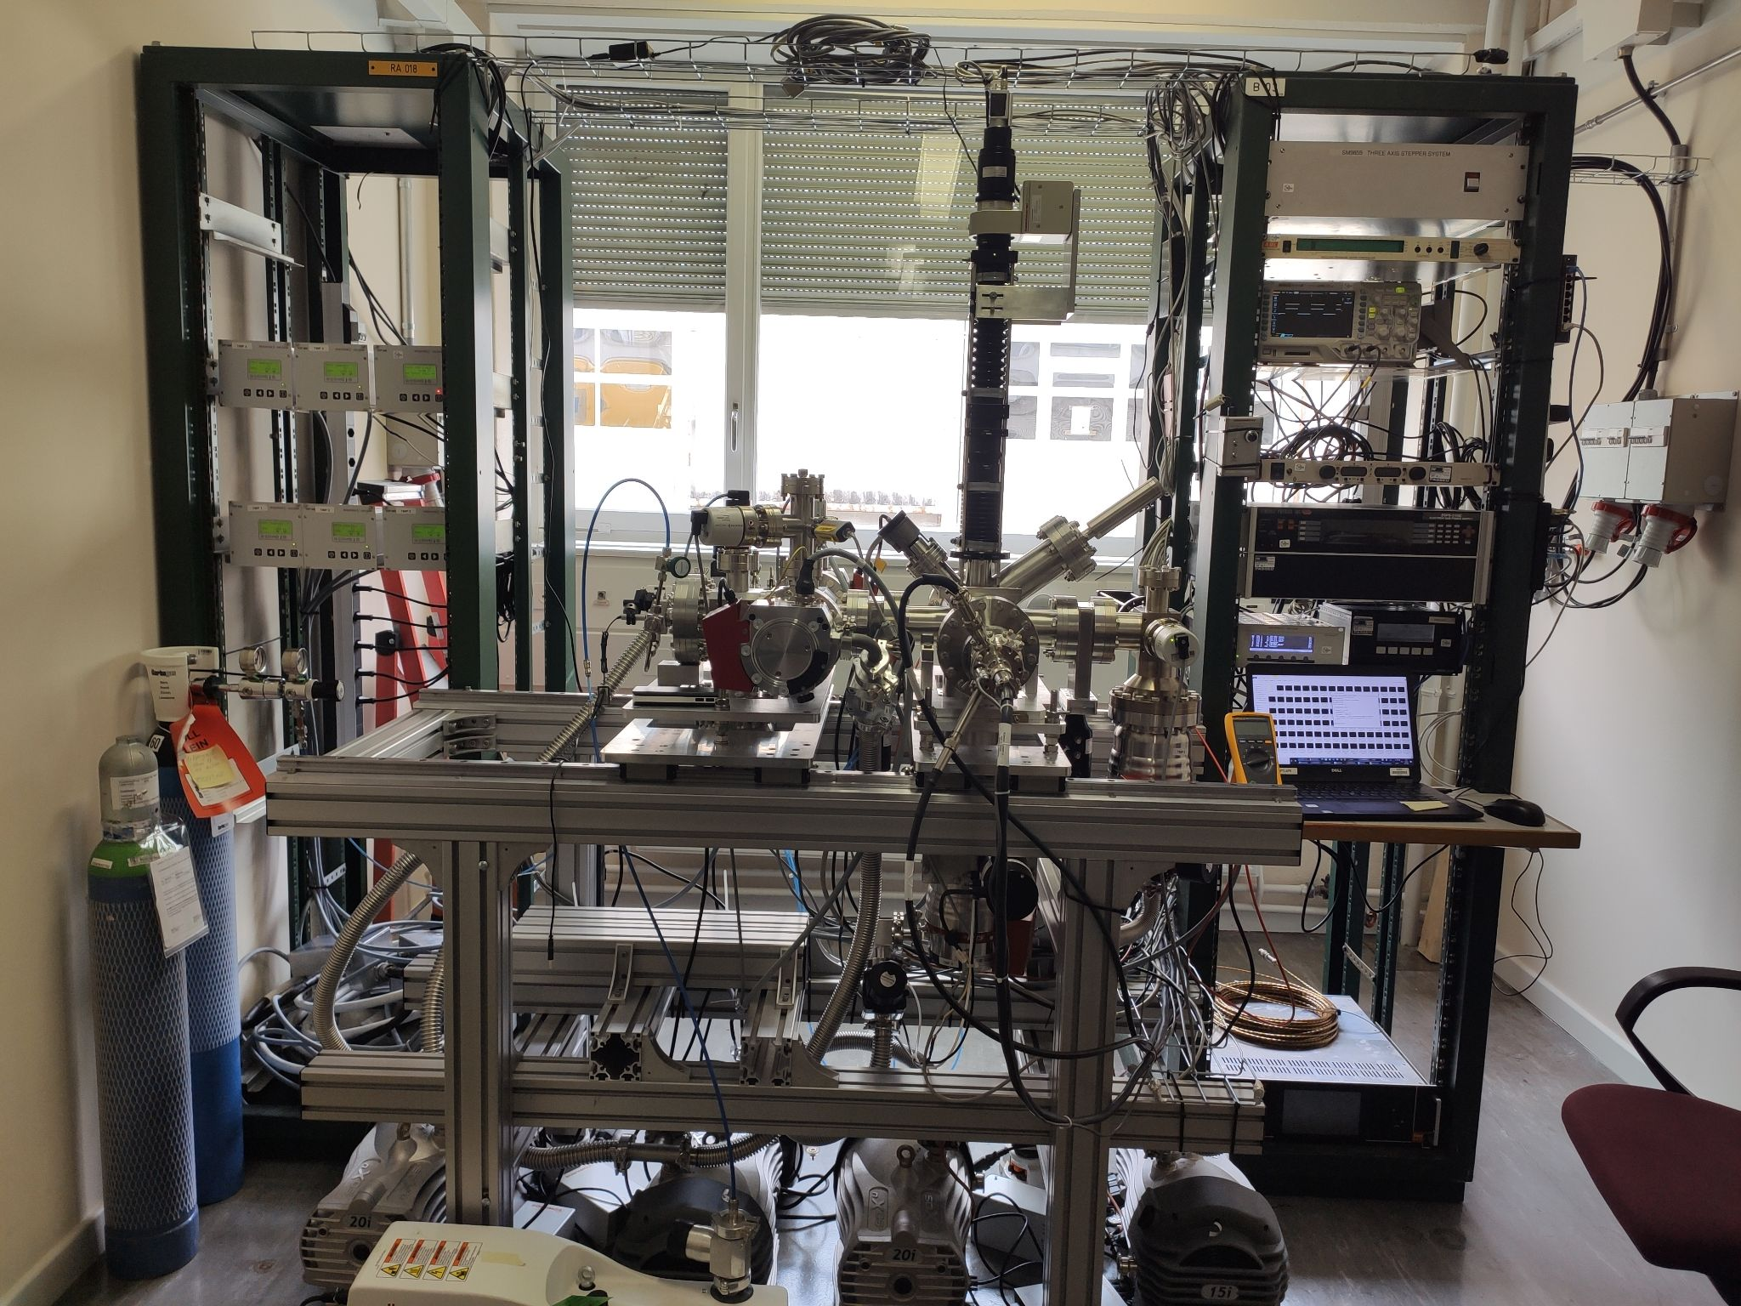
Gas jet monitor delivered to CERN
LHC installation during LS2
(interaction chamber and optics)
Measure beam profile using residual gas
& fluorescence cross section with 6.8 TeV beam
Electron beam test stand for HEL in Sep.
Measure hollow electron beam (test v4 concept)
LHC installation in later YETS
(Gas jet generation and dump chambers)
V3 gas jet monitor in CI
See Oliver's poster for more details.
Standalone lab space in CERN
Validate CI result and vacuum compatibility test

Slide 10
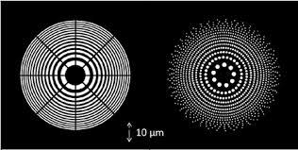
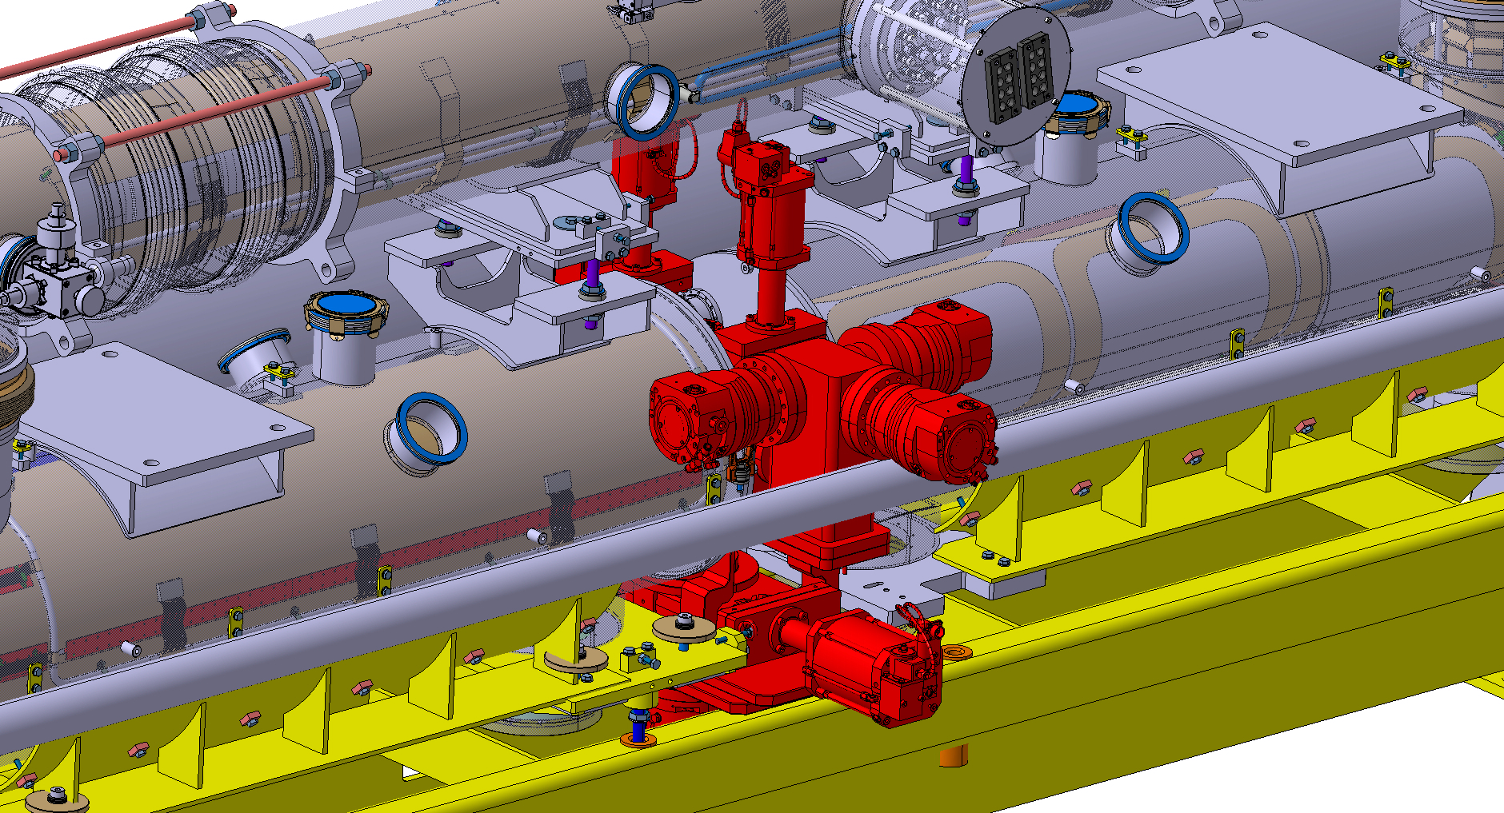
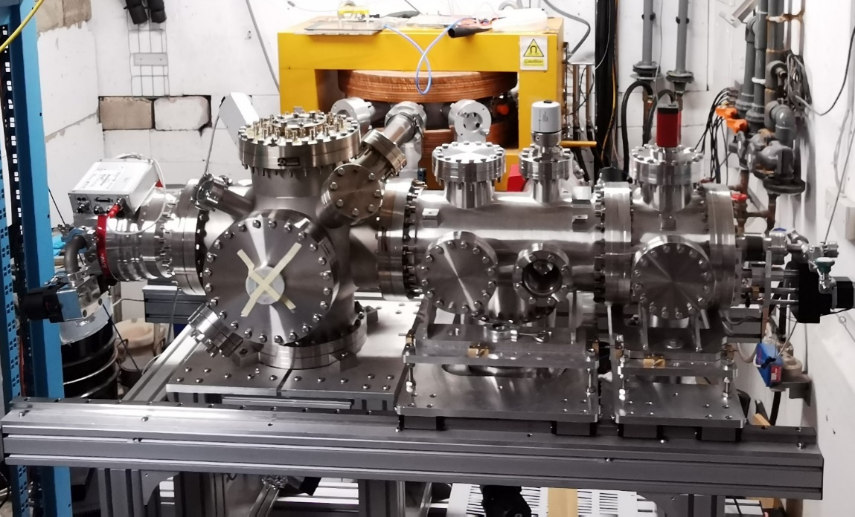
Ongoing work
qHAM & QuantumJet
Gas jet v4 for HLLHC (hollow electron lens)
Credit: T. Reisinger, S. Eder, et.al
JetDose (see Narender’s talk)
Gas jet monitor

Slide 11
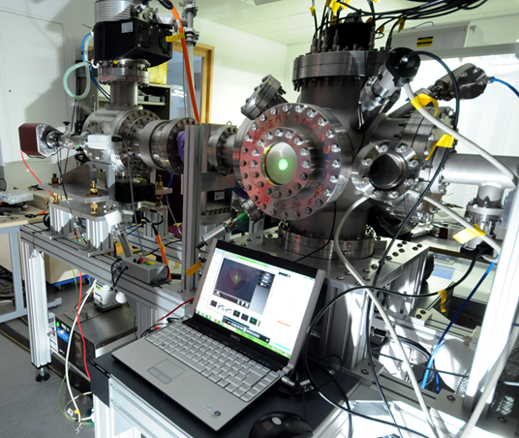
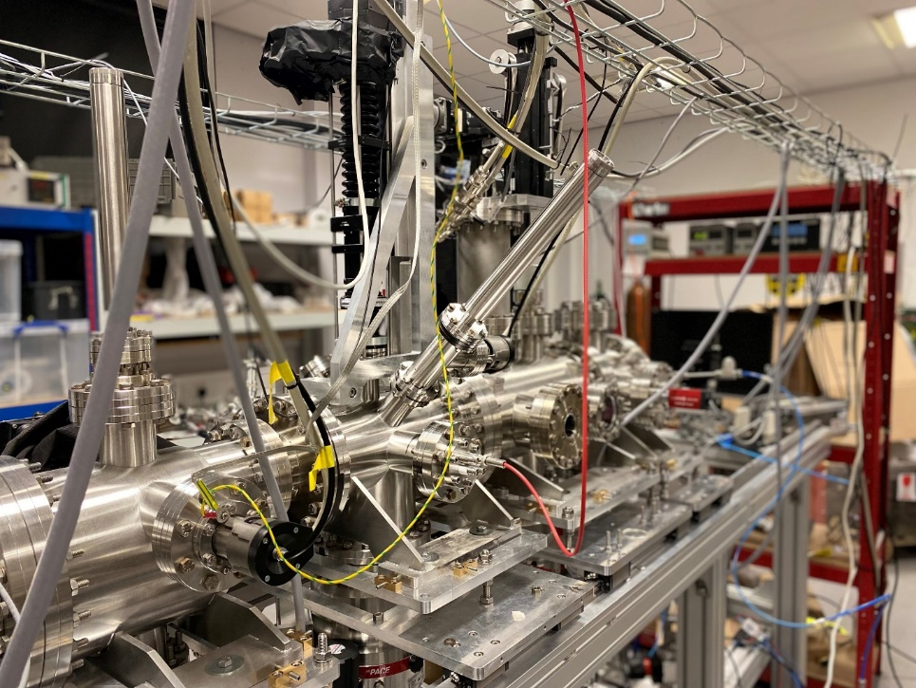
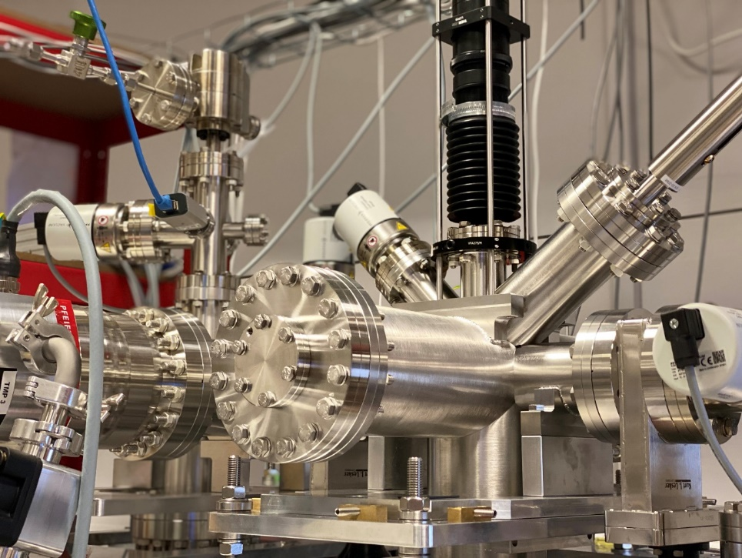
Conclusion
Gas jet based diagnostics has
  Developed over a decade at the CI from a lab test equipment to an accelerator module.
  Been equipped with simulation and experimental tools for versatile design to meet different beam environment.
  Expanded to wider applications such as Medical and Microscopy.
Monitor for keV beams
HLLHC prototype
HLLHC compatible instrument

Slide 12
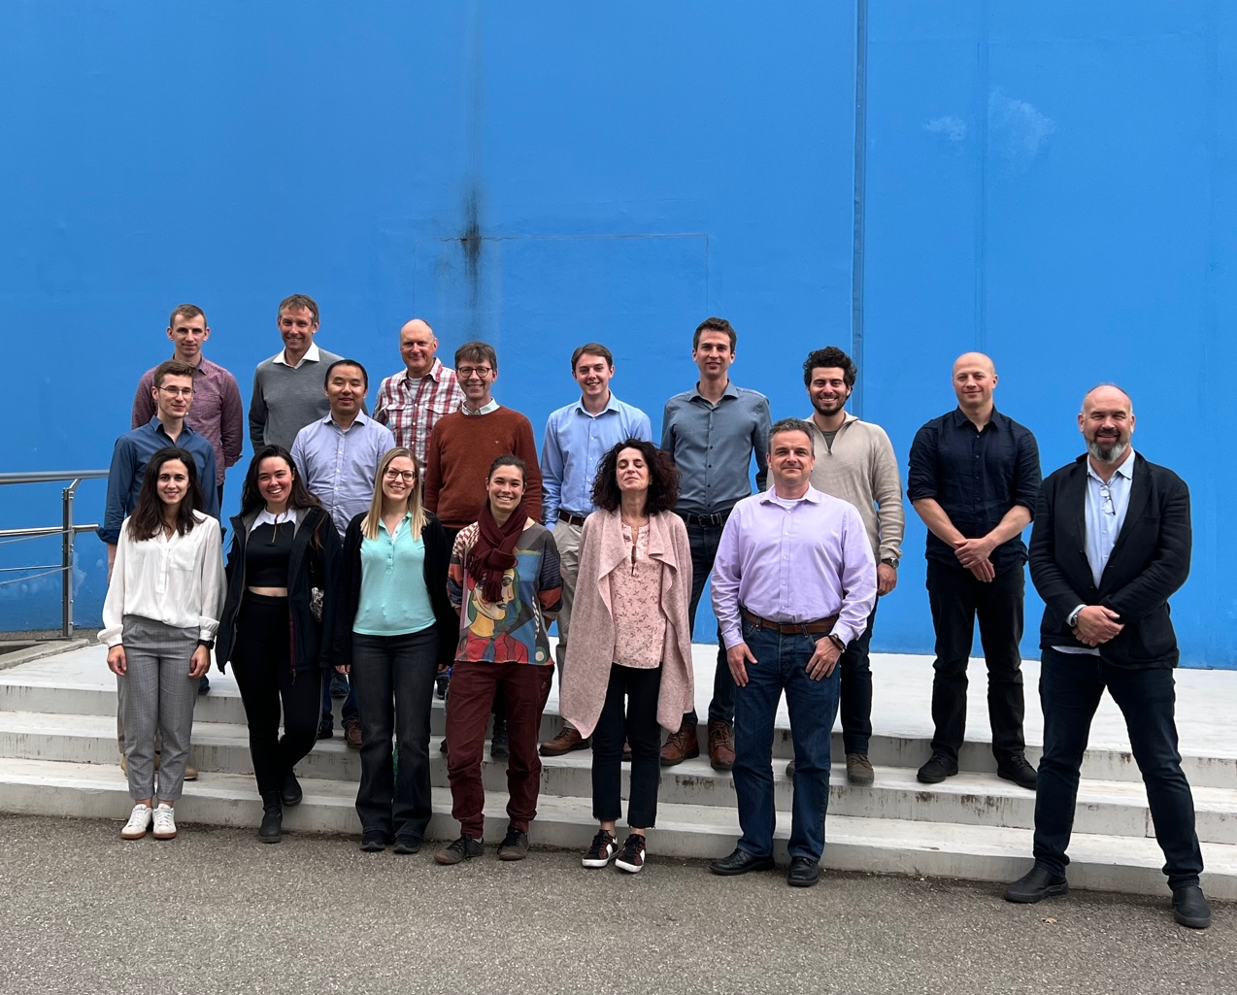
Acknowledgment
I would like to thank the whole BGC team.
Any Questions?
This work is supported by the HL-LHC-UK phase I & II project funded by STFC under Grant Ref: ST/T001925/1 and the STFC Cockcroft Institute core grant No. ST/G008248/1.

