Slide 1



Impact of the Beam Loading Patterns on the ERL Stabilities
Sadiq Setiniyaz^{1, 2} and Rob Apsimon^{1, 2}
Peter. H. Williams²
¹Engineering Department, Lancaster University, Lancaster, LA1 4YW, UK
²Cockcroft Institute, Daresbury Laboratory, Warrington, WA4 4AD, UK
IOP Particle Accelerators and Beams Group (PABG) Annual Conference
25th-26th July, Liverpool

Slide 2

Energy Recovery Linac (ERL)
Recovers the KE of the beam
By decelerating the beam
Acceleration: E_{cavity} → KE_{beam} Deceleration: KE_{beam} → E_{cavity}
injection
1
1
1
1
2
Accelerating bunch:
Decelerating bunch:
2
2
2
1
Transition
linac
2
$$Δφ=180°$$
2
1
1
2
1
2
1
2
2
extraction
Notes:
Firstly, what is an ERL?
ERL is a linac that recovers the KE of the used beam by decelerating the beam in the same RF cavity.
In acceleration, beam take energy from the cavity. In the deceleration, beam deposits the energy to the cavity.
Deceleration is achieved by delaying the bunch by extra half RF cycle.

Slide 3
Beam loading pattern
The order bunches pass through the cavity.
Pattern {1,2,3,4,5,6}
Pattern{1,4,2,5,3,6}
1
2
3
4
5
6
1
4
2
5
3
6
injection
linac
injection
linac
1
1
1
2
3
4
5
6
1
4
2
5
3
6
6
1
2
3
4
5
6
6
1
4
2
5
3
6
extraction
extraction
Notes:
Beam loading pattern describes the order bunches passes through the cavity.
Very simple example is bunch 1,2,3,4,5,6, where the 1st bunch passes through the cavity is the bunch at its first turn, and the 2nd bunch is at 2nd turn. So on so forth.
Here is another example, where we have alternating accelerating and decelerating bunches.

Slide 4
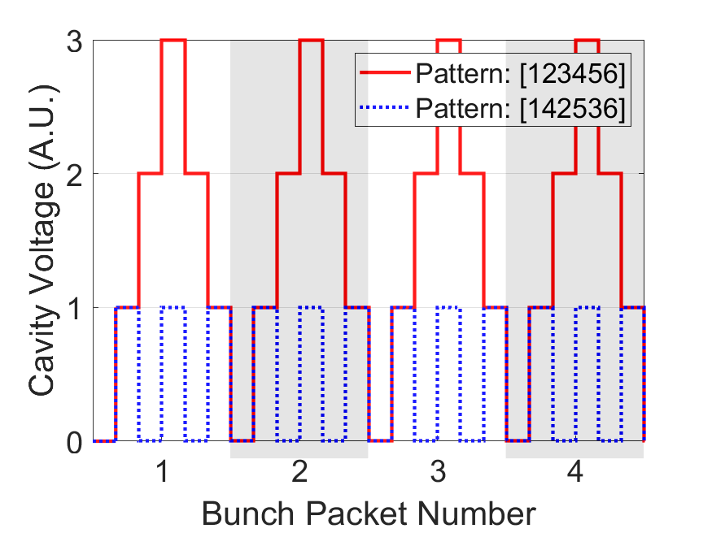



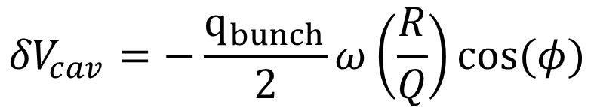
Cavity voltage
1
2
3
4
5
6
1
4
2
5
3
6
$${δV}_{cav}=−\frac{q_{bunch}}{2}ω\left(\frac{R}{Q}\right)cos⁡(φ)$$
$$φ:bunch phase$$
Accelerating bunch:
Decelerating bunch:
$$φ=0°$$
$$φ=180°$$
Notes:
How does a beam loading pattern impact cavity voltage?
Beam takes or adds energy to the cavity, depending on the beam loading phase.
Cavity voltage drops when beam takes energy, and visa versa.
Here we have diagram to show the cavity voltage fluctuation of two different patterns.
The 1st pattern {1,2,3,4,5,6} has 3 consecutive accelerating and decelerating bunches, so it creates 3 up and 3 down voltage fluctuation.
The 2nd pattern has alternating bunches, therefore, creates much smaller cavity voltage fluctuation.

Slide 5
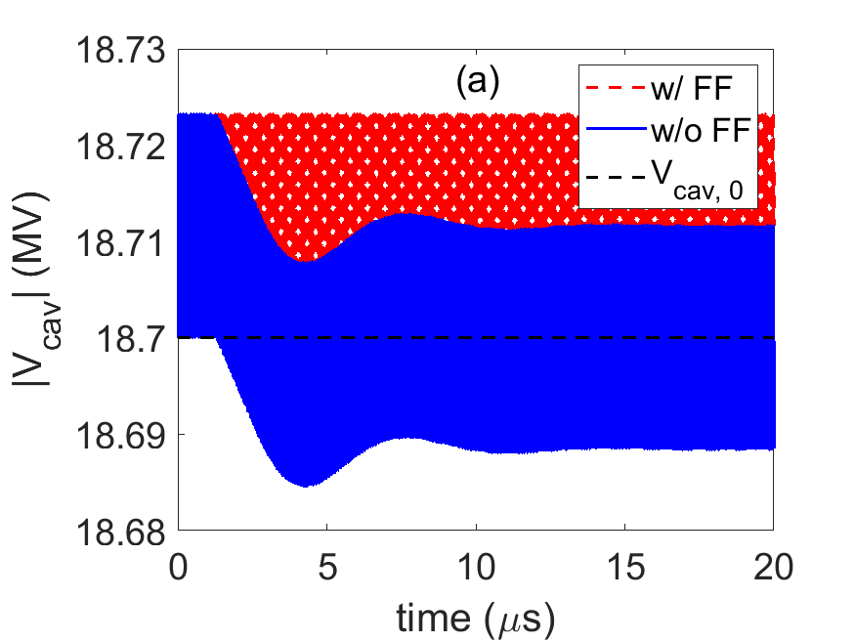
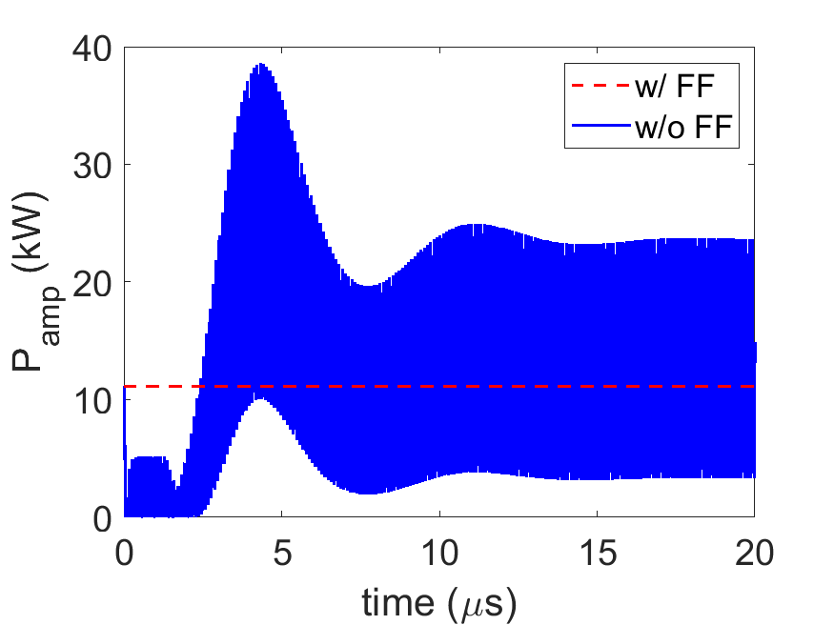
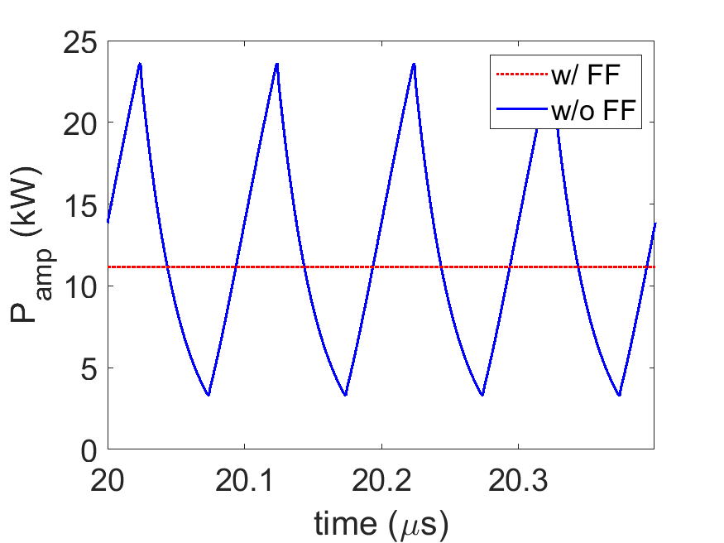
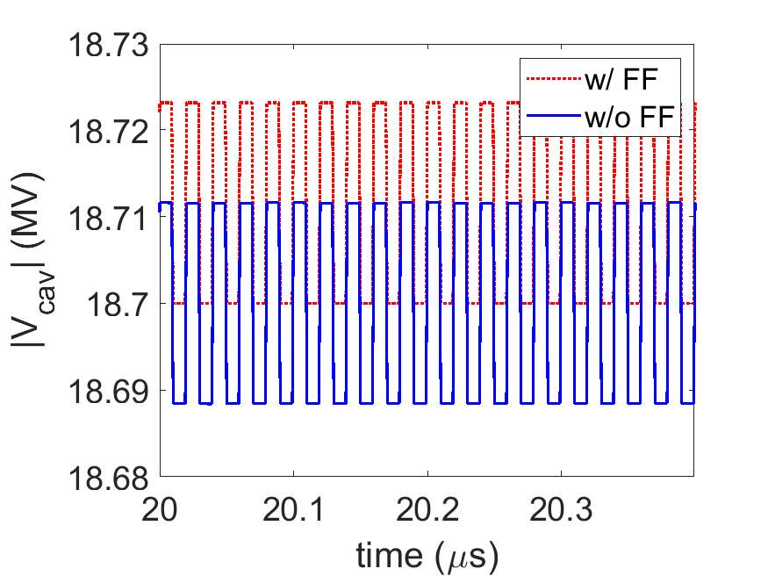
LLRF Feed forward
ERL net beam loading = zero
A feed forward to LLRF can prevent bunch-to-bunch correction.
Without feed forward, the LLRF can trigger amplifier and cause unnecessary fluctuation.
Feed forward stabilizes V_{cav} and P_{amp}.
Notes:
In most accelerators, when cavity voltage drops during beam loading, the LLRF system will turn on the amplifier to replenish the cavity with RF energy.
In ERLs, we can see the net beam loading effect is zero over time. So, we don’t need to correct for the bunch-to-bunch beam loading during the stable operation.
We can prevent such bunch-to-bunch correction by sending a feed forward signal to LLRF system.
The feed forward signal will inform the LLRF system of the anticipated the cavity voltage with beam loading.
We can see without feedforward, the amplifier has much larger fluctuation.

Slide 6
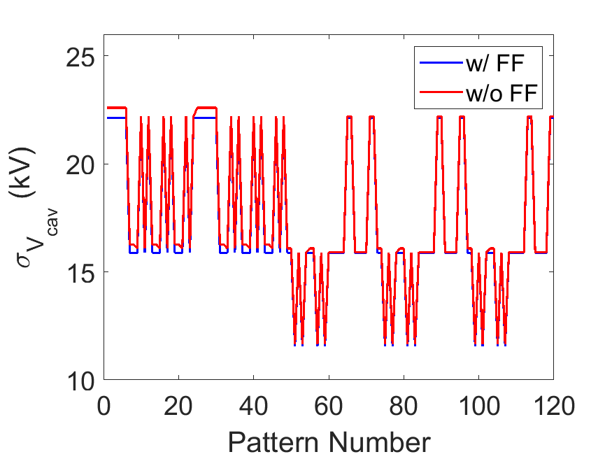
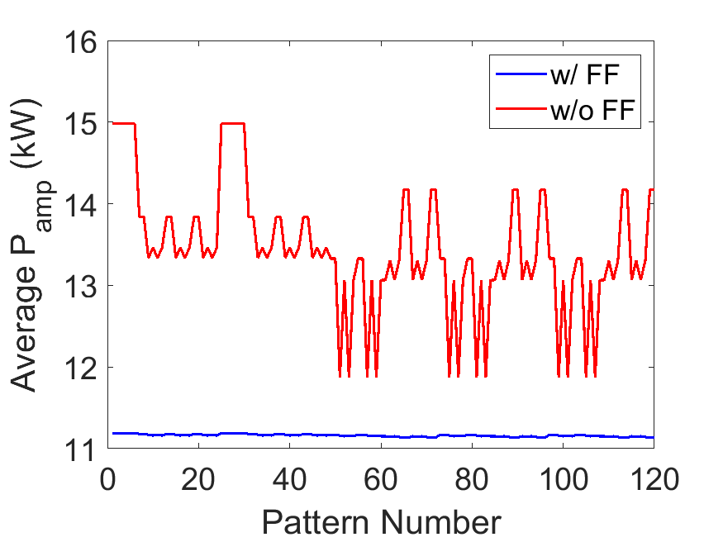
Pattern dependance
Pattern #1: {1,2,3,4,5,6}
Pattern #2: {1,2,3,4,6,5}
…
Pattern #120: {1,6,5,4,2,1}
V_{cav} and P_{amp} are pattern dependent
Some patterns are stabler than others
Notes:
We observe the cavity voltage and amplifier powers are pattern dependent.
Some patterns are stabler than others

Slide 7
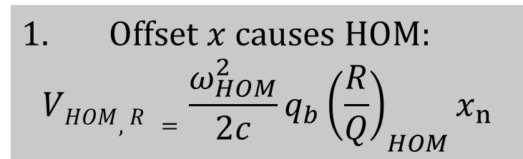
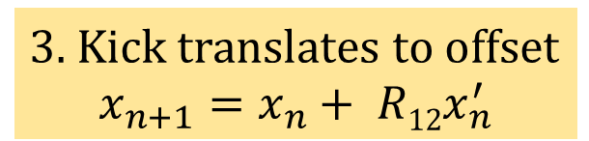
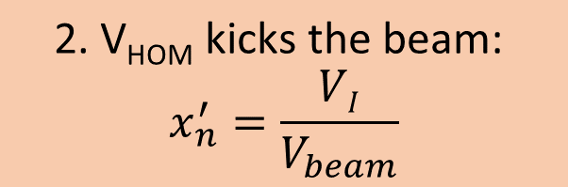
Beam Breakup (BBU) instabilities
$Offset x causes HOM:$
$$VHOM,R =\frac{ω_{HOM}^{2}}{2c}q_{b}{\left(\frac{R}{Q}\right)}_{HOM}x_{n}$$
$$\text{2. }\text{VHOM} \text{k}\text{ick}\text{s} \text{the} \text{beam}\text{:}$$
$$x_{n}^{′}=\frac{VI}{V_{beam}}$$
3. Kick translates to offset
$$x_{n+1}=x_{n}+ R12x_{n}^{′}$$
Notes:
Beam injected into the ERL will excite Higher Order Mode (HOM).
The HOM voltage in-turn will kick the next bunch.
Then the kick is translated to the position offset in the next turn, which will increase the HOM voltage further.
So, position offset and HOM voltage forms a positive feedback loop.
If the beam current is larger than certain threshold current, the HOM voltage can not be damped fast enough and both HOM voltage and position offset will grow and finally cause beam loss.
This is called regenerative BBU instability.
That threshold current is the maximum current for an ERL.

Slide 8
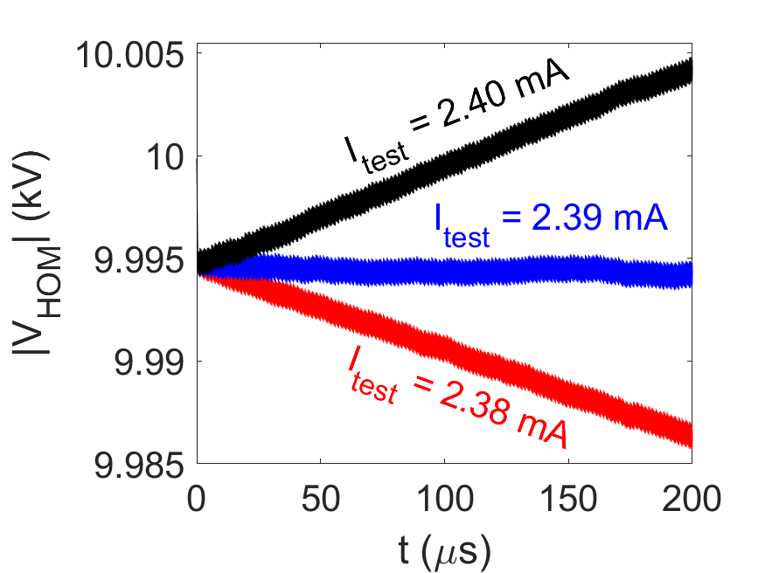
BBU simulation
Our code can calculate the threshold current under different beam loading patterns
Benchmarked against the experimental results of the Ref. [1].
I_{threshold} = 2.39 mA
[1] Christopher D. Tennant, “STUDIES OF ENERGY RECOVERY LINACS AT JEFFERSON LABORATORY”, Dissertation, (2006).
Notes:
We developed an ERL algorithm to simulate BBU with different beam loading patterns and estimate the threshold currents.
We benchmarked our code against the experimental results.
The code starts with a test current and check if the HOM voltage is stable. The figure show the HOM voltage is table at the threshold current, shown by the blue line.
When the beam current is below the threshold current, HOM voltage declines, and vice versa.

Slide 9
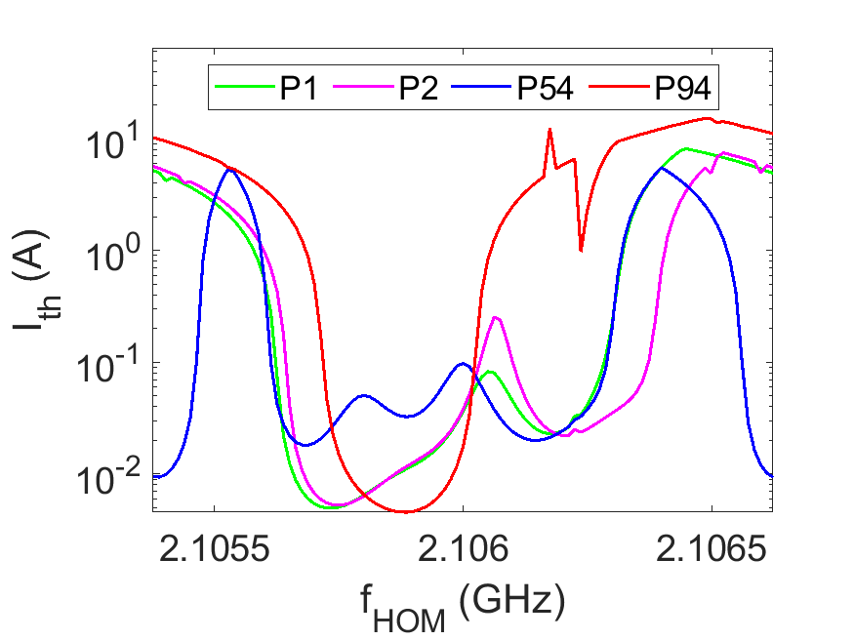
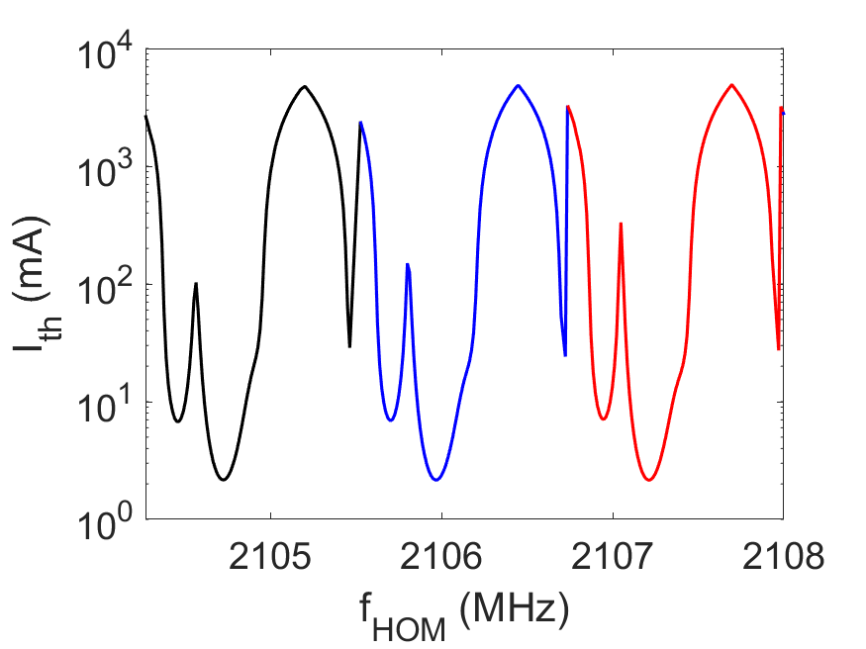
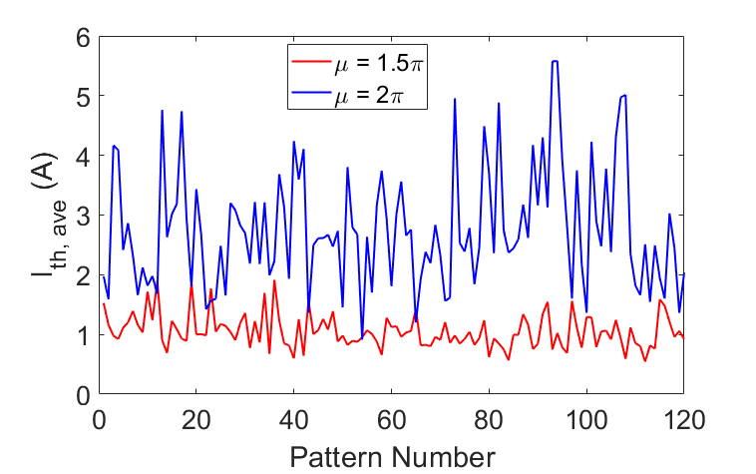
BBU pattern dependance
I_{th} is higher when μ is integer of π.
Significant difference between patterns
Periodic
Notes:
We scanned 120 filling patterns and estimated their threshold currents.
We found that the BBU instability and threshold currents are beam loading pattern dependent in ERLs.
We observed significant difference in their threshold current.
The threshold current is periodic over HOM frequency.
We scanned 120 patterns over 1 period and estimated the average threshold current.
We see the threshold current is higher when phase advance is an integer of π.
We also overed factor of 5 difference between best and worst pattern in the average threshold current.

Slide 10
Conclusion
Developed mathematical construct to analyze ERL bunches over many turns.
This can be applied to different scenarios like RF stability and BBU.
ERL LLRF requires feed forward for stability.
ERL cavity voltage, amplifier power, and BBU are beam loading pattern dependent.
ERL stability in these 3 areas can be improved significantly by optimizing the beam loading pattern.
Notes:
We have developed mathematical construct to analyze bunches over many turns.
This can be applied to different scenarios like RF stability and BBU.
Our studies show that ERL LLRF requires feed forward for stable operation.
ERL cavity voltage, amplifier power, and BBU are beam loading pattern dependent.
ERL stability in these 3 areas can be improved significantly by optimizing the beam loading pattern.

Slide 11
The End
Thank you for your attention
Email: s.saitiniyazi@lancaster.ac.uk

