Slide 1


Institute of Physics
Particle Accelerators and Beams Annual Conference
Liverpool, 25th-26th July 2022
Terahertz-driven acceleration and manipulation of relativistic electron beams
Morgan T. Hibberd
The Cockcroft Institute & The University of Manchester
Representing the Terahertz Acceleration Group

Slide 2
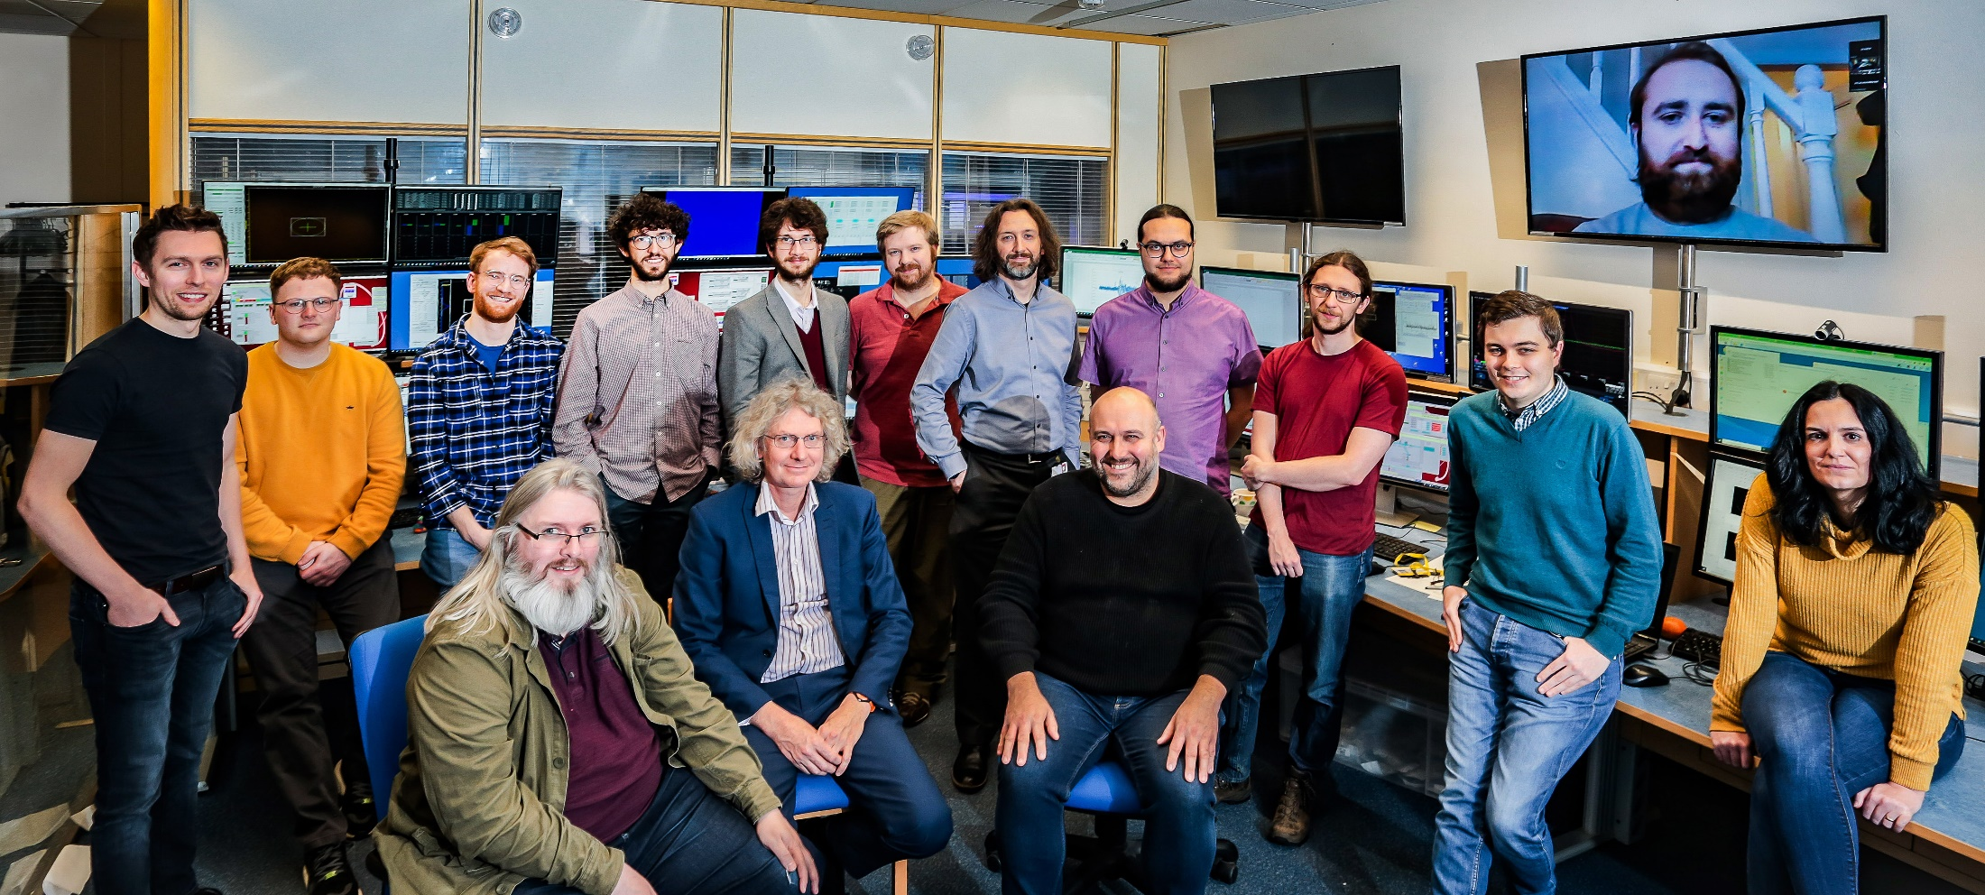

Terahertz acceleration group @ The Cockcroft Institute
Connor Mosley
Morgan Hibberd
Joseph Bradbury
Sergey Siaber
Darren Graham
Laurence Nix
Dan Lake
Christopher Shaw
Beatriz Higuera Gonzalez
Graeme Burt
Steven Jamison
Rob Appleby

Slide 3
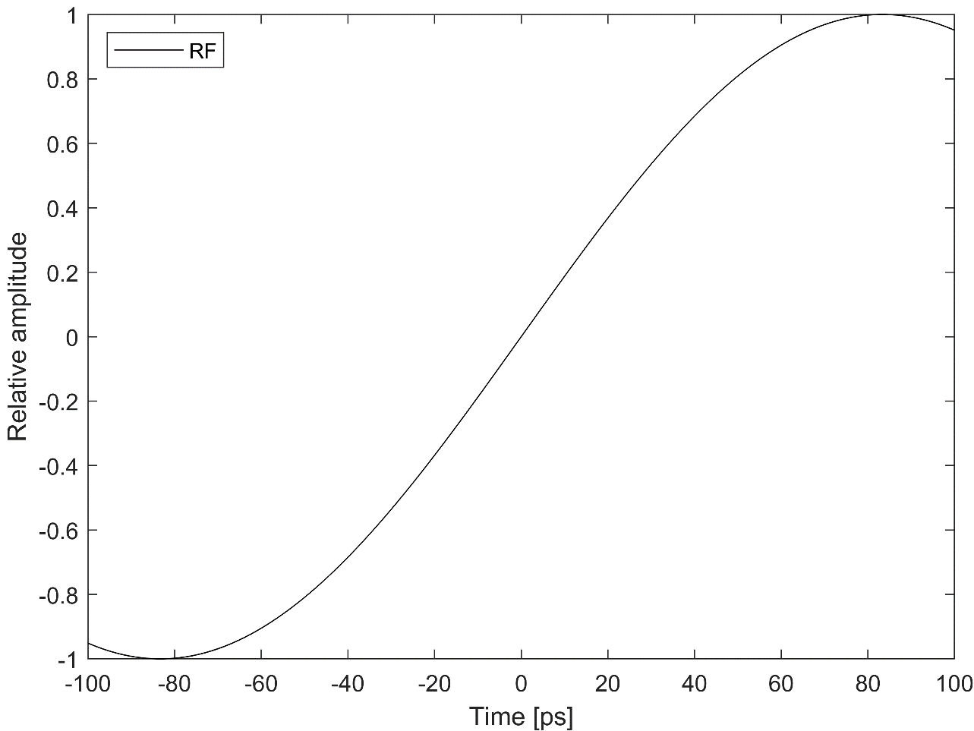
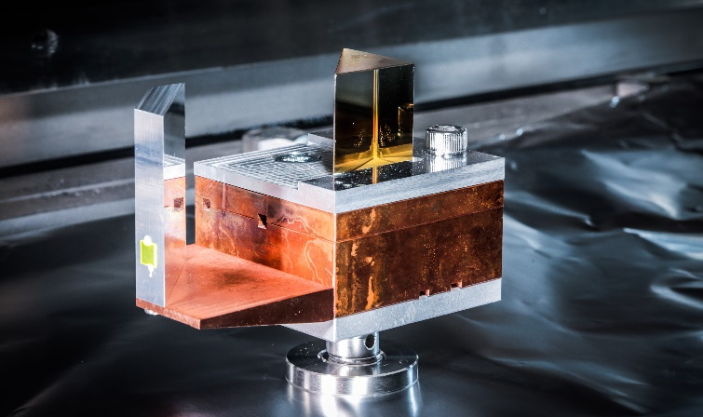
Why use terahertz radiation for particle acceleration and manipulation?
Advantages of THz accelerators
High field strengths possible (100 MV/m to >GV/m)
Wavelength allows easy fabrication of structures
Oscillation period well-matched to typical bunch duration

Slide 4
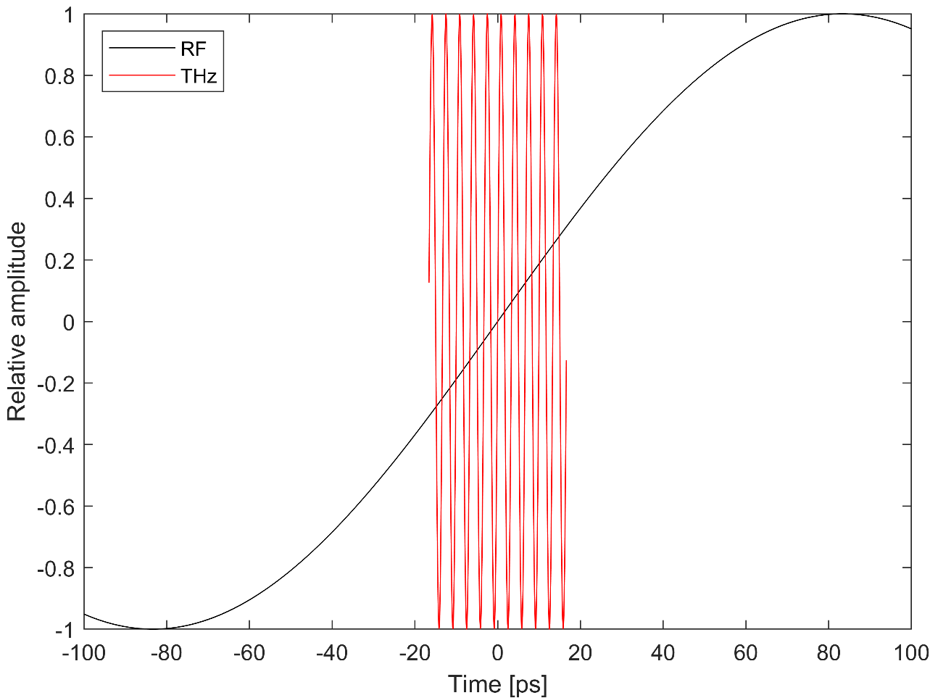
Why use terahertz radiation for particle acceleration and manipulation?
Advantages of THz accelerators
High field strengths possible (100 MV/m to >GV/m)
Wavelength allows easy fabrication of structures
Oscillation period well-matched to typical bunch duration

Slide 5
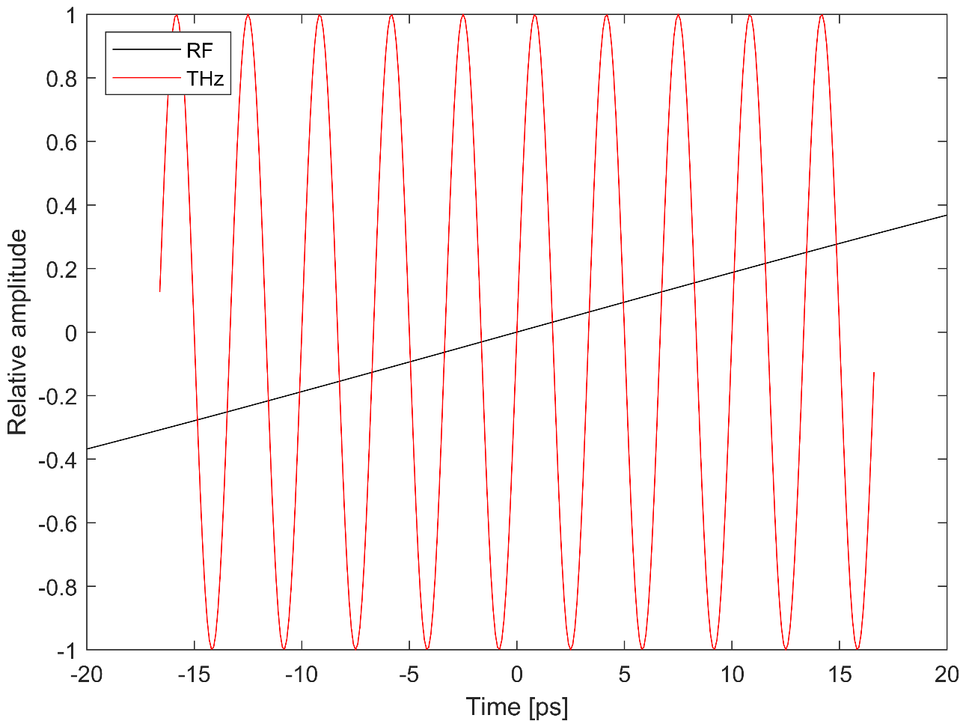
Why use terahertz radiation for particle acceleration and manipulation?
Advantages of THz accelerators
High field strengths possible (100 MV/m to >GV/m)
Wavelength allows easy fabrication of structures
Oscillation period well-matched to typical bunch duration

Slide 6
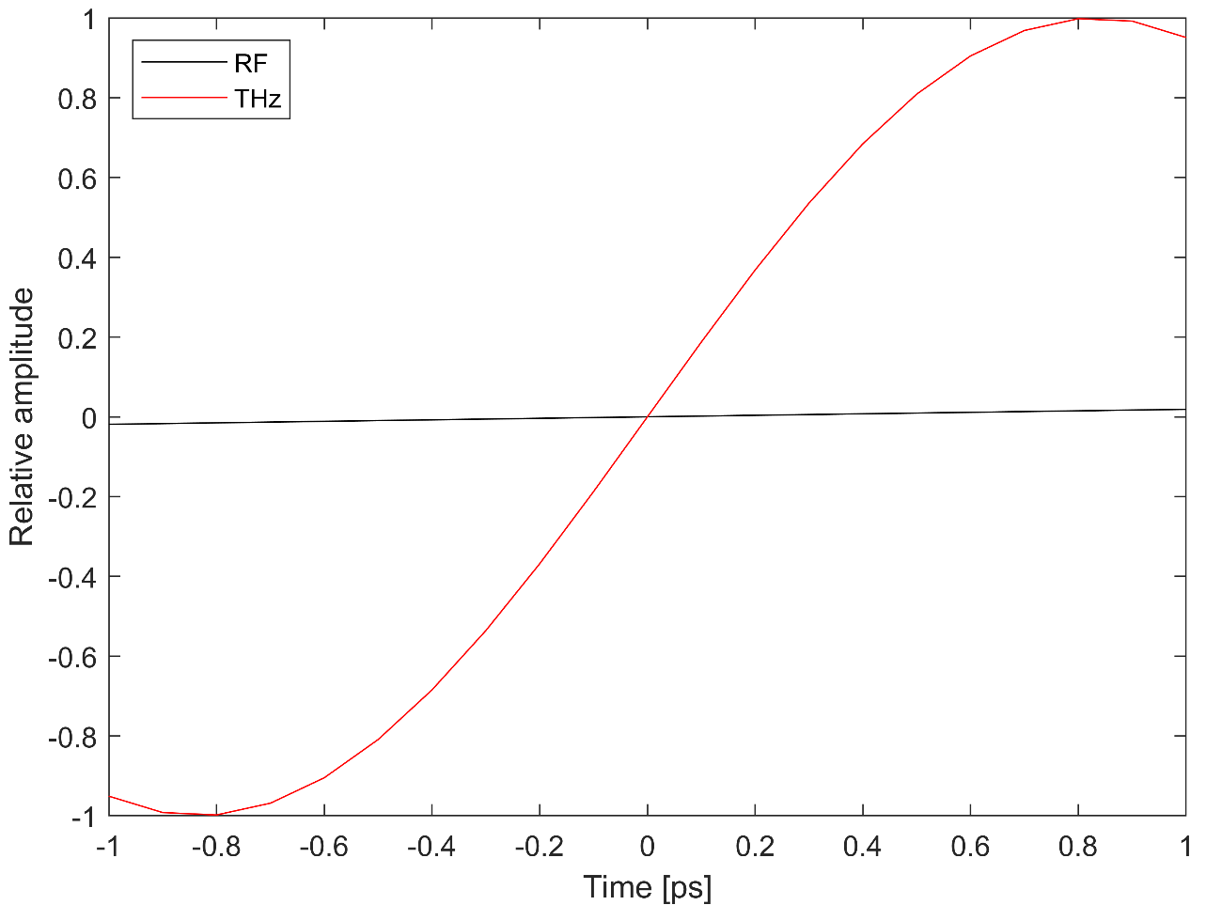
Why use terahertz radiation for particle acceleration and manipulation?
Advantages of THz accelerators
High field strengths possible (100 MV/m to >GV/m)
Wavelength allows easy fabrication of structures
Oscillation period well-matched to typical bunch duration
Short enough for fs-scale control
→ Ultrafast bunch manipulation
Long enough for significant charge capture → 10-100 pC bunch charge
Challenges for THz accelerators
Phase-velocity matching and group walk-off
Broadband pulse dispersion
High-field narrowband sources

Slide 7
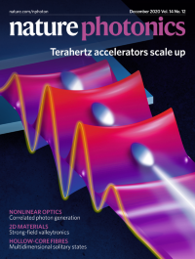
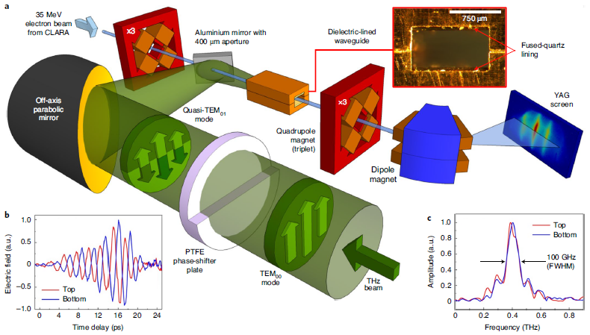
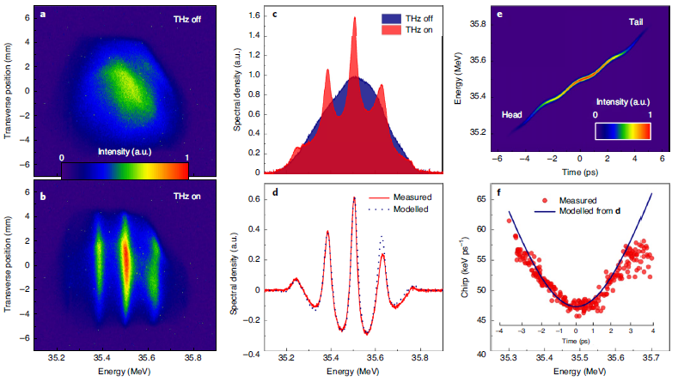
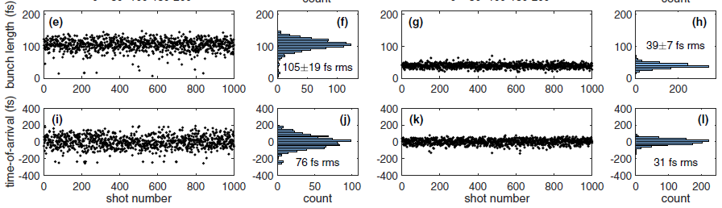
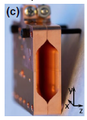
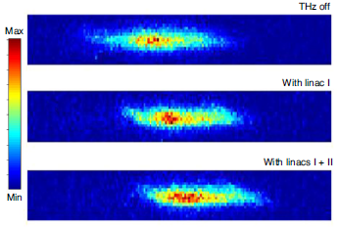
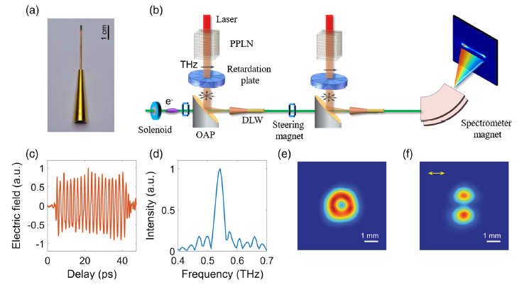
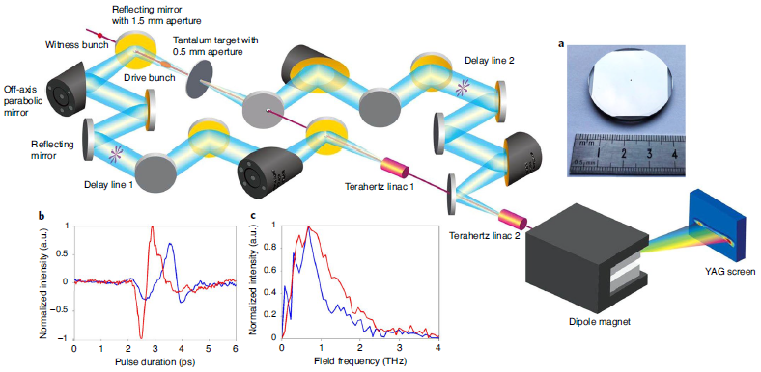
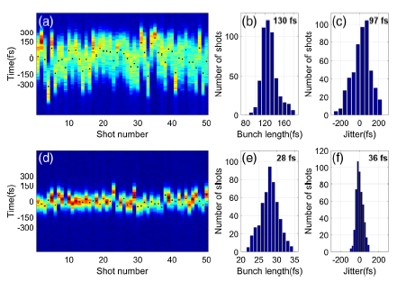
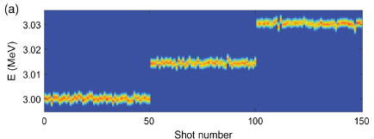
Terahertz-driven interactions: Relativistic electron beams
M.T. Hibberd et al. Nat. Photon. 14, 755-759 (2020)
First THz-driven linear acceleration of a relativistic electron beam
Narrowband THz pulse in dielectric-lined waveguide
10 keV peak energy gain
Our group’s front-cover publication in Nature Photonics
E. C. Snively et al. Phys. Rev. Lett. 124, 054801 (2020)
H. Xu et al. Nat. Photon. 15, 426-430 (2021)
Cascaded acceleration using CTR-generated THz pulses
H. Tang et al. Phys. Rev. Lett. 127, 074801 (2021)
Cascaded acceleration
Unchanged energy spread
30 keV total energy gain
Whole-bunch acceleration
85 MV/m gradient
204 keV energy gain
THz-driven compression (3-5x) and jitter-reduction (2-3x) of 3 MeV electron beams
L. Zhao et al. Phys. Rev. Lett. 124, 054802 (2020)

Slide 8
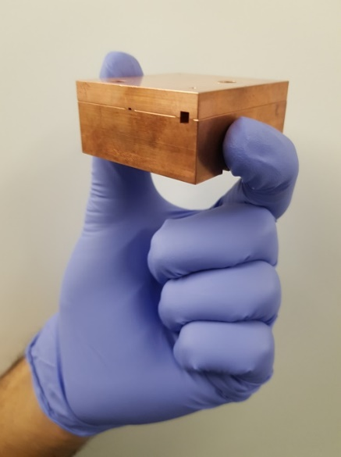
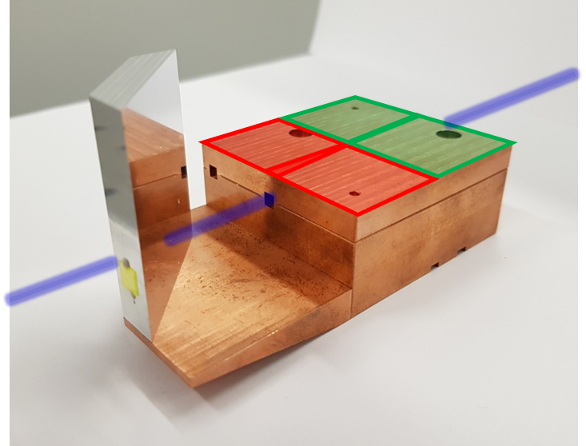
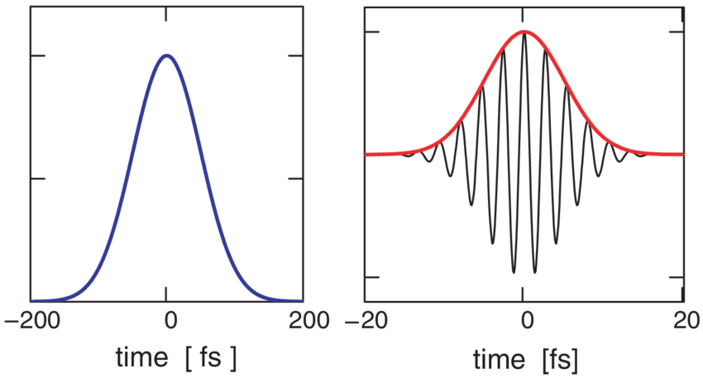
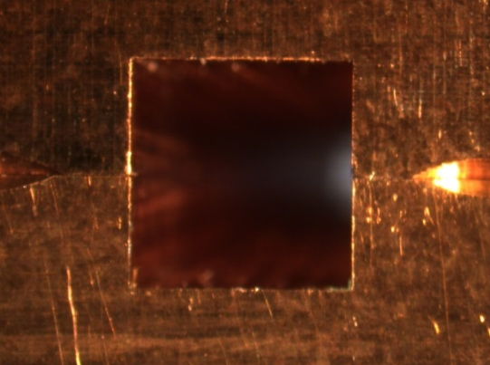
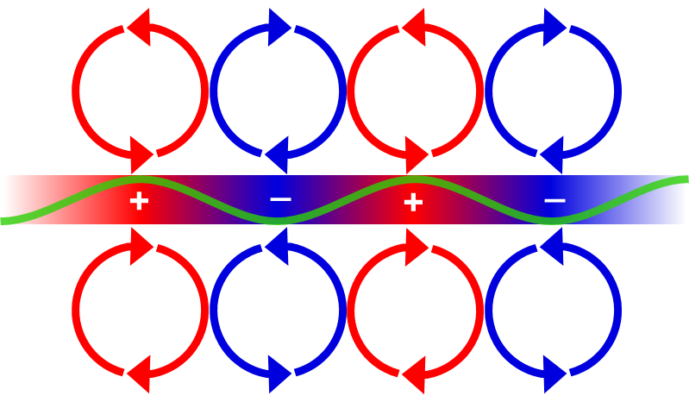
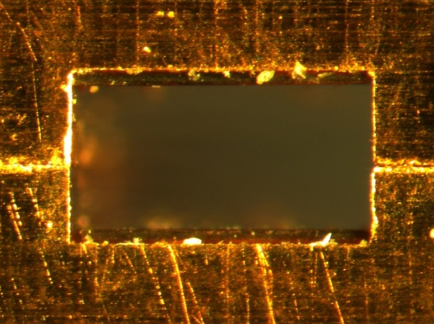
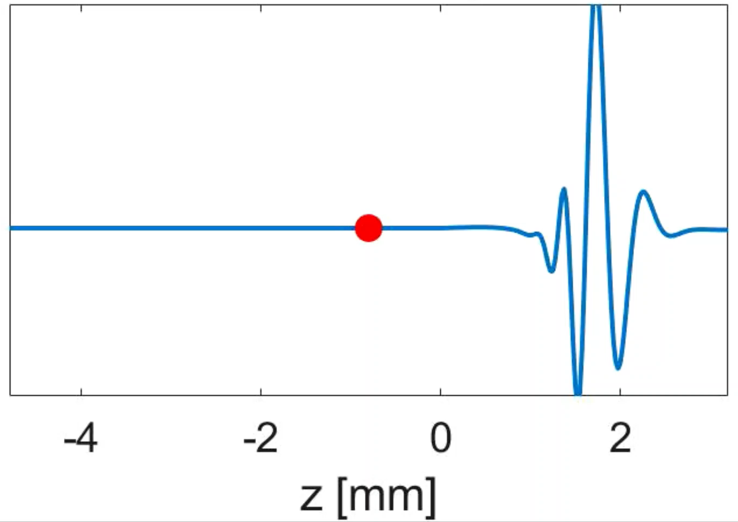
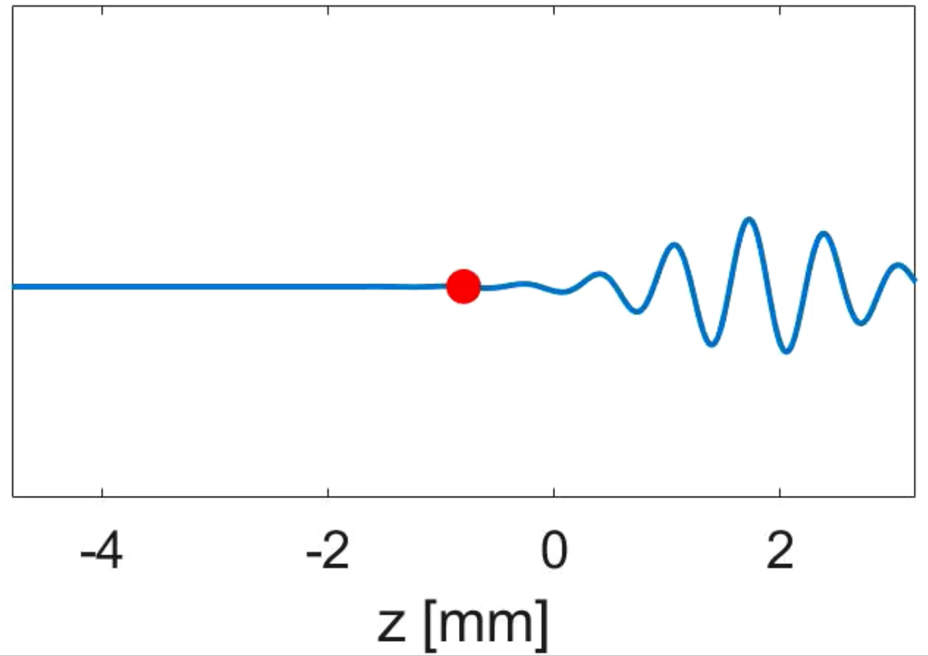
Terahertz dielectric-lined waveguide
Envelope travels at the group velocity
Carrier wave travels at
the phase velocity
at 0.4 THz
Coupler entrance
v_{p} = 0.9999c = v_{e}
3.25 mm
v_{g} = 0.585c
3.18 mm
DLW exit
Quartz lining
Single-cycle
Multi-cycle
575 μm
695 μm
Dielectric lining
→ Longitudinal Section Magnetic modes
LSM₁₁ for acceleration
Velocity-matching to 35 MeV electrons
1200 μm

Slide 9

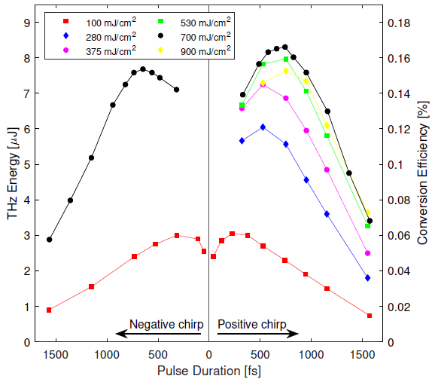
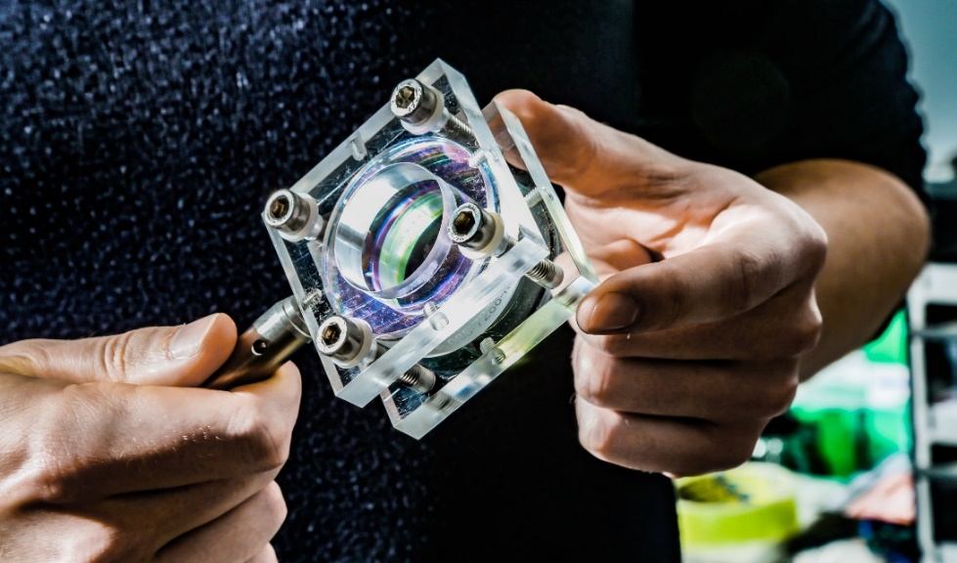
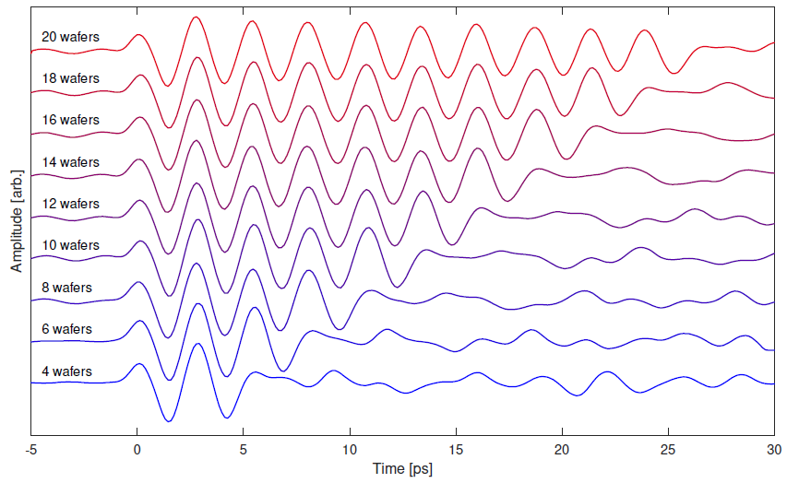
Narrowband terahertz source development
Periodically-poled lithium niobate wafer-stacks
→ Custom-built large-area narrowband THz sources
→ Developed on the concept by:
Source optimisation in lab with 5 mJ laser
F. Lemery et al. Commun. Phys. 3, 150 (2020)
+ more wafers
Large-area wafers are commonly manufactured
Inexpensive compared to bulk PPLN crystals
Customisable frequency, bandwidth, pulse-shaping
High-energy narrowband source up to mJ-level
Source developed for CLARA Run 2
High-power TW laser system
Up to 1000x more THz pulse energy compared to previous run

Slide 10
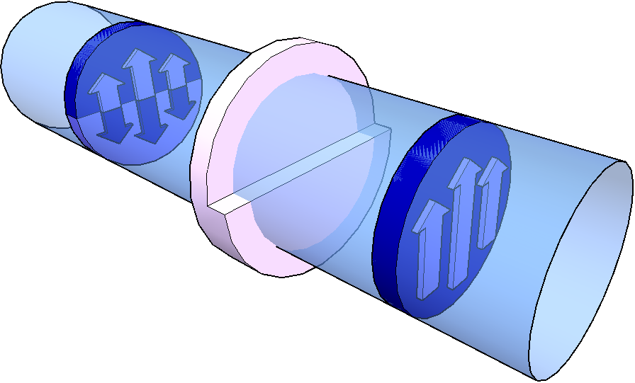
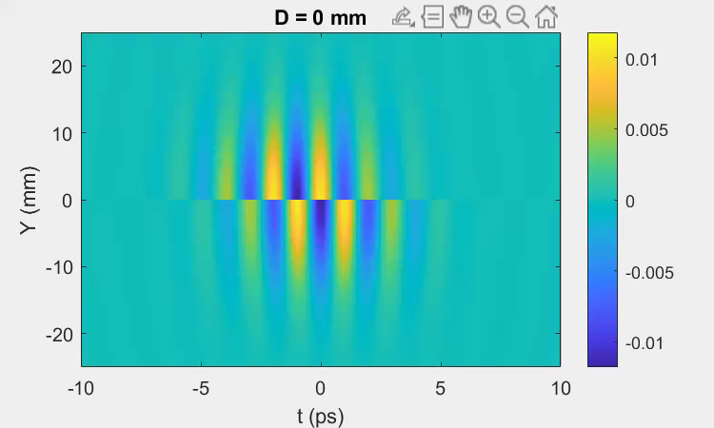
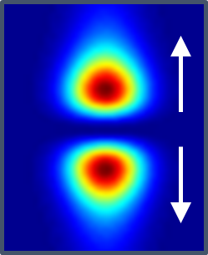
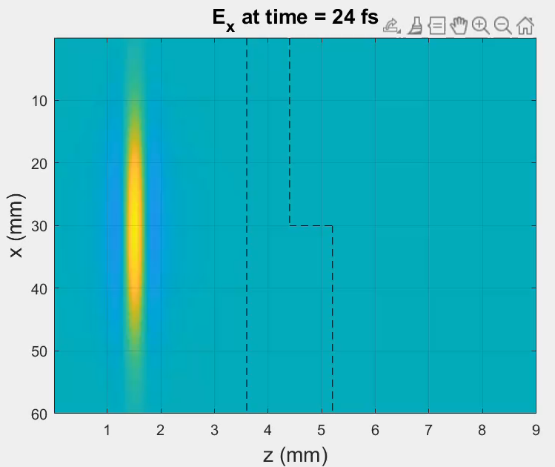
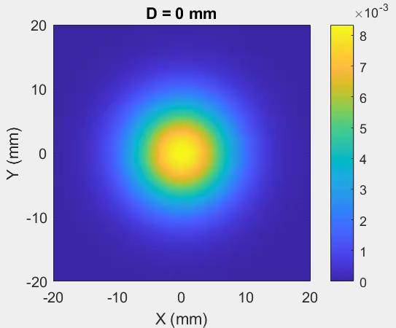
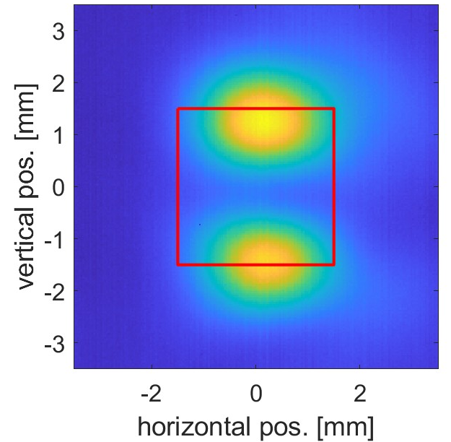
Generating the terahertz accelerating mode
quasi-TEM₀₁
Far-field propagation and focusing
PTFE phase-plate
TEM₀₀
Waveguide coupler aperture
Energy lost by clipping
Close match to mode
Phase-plate near-field
Time-integrated transverse fields
(simulated THz camera image)
Measured THz profile at focus (real THz camera image)

Slide 11
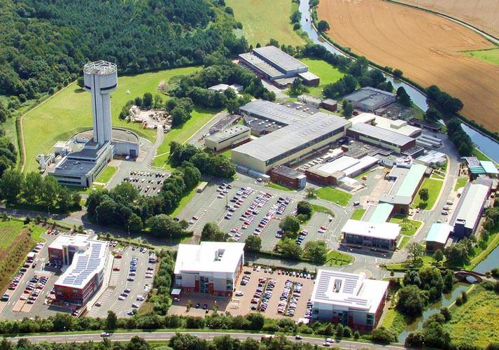
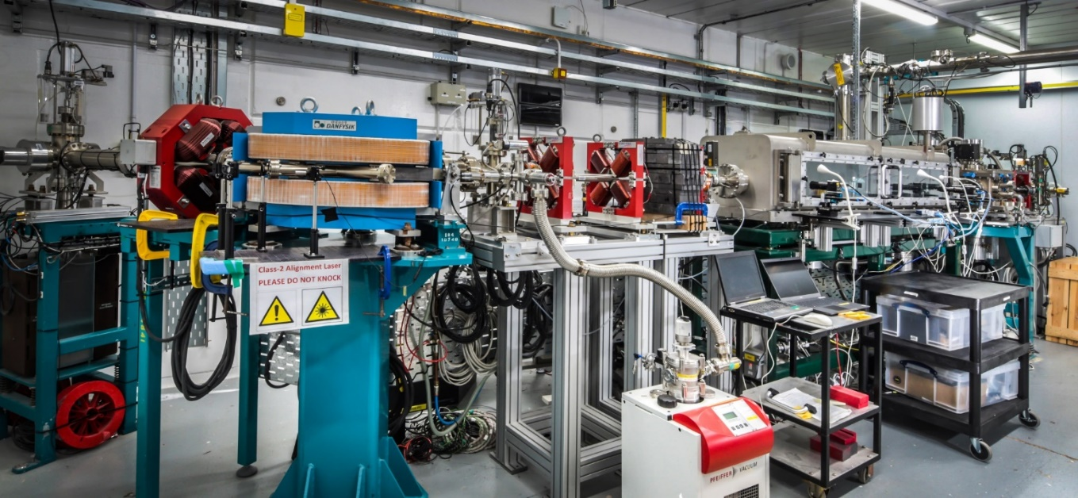

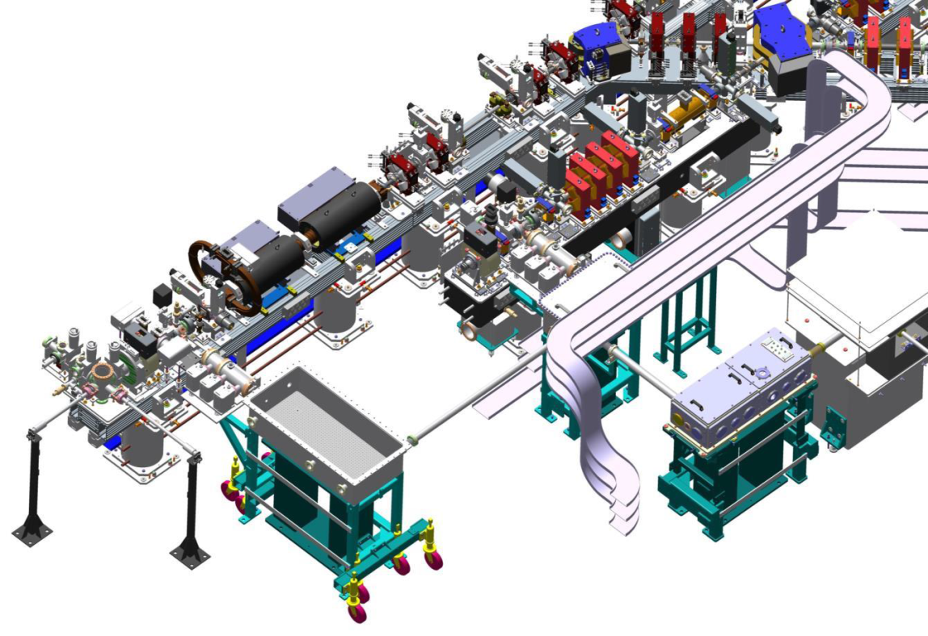
CLARA test facility @ Daresbury Laboratory
CLARA
Beam Area 1
≈ 35 MeV
≈ 5 MeV
Compact Linear Accelerator for Research and Applications
Bunch parameters
Energy: 35 MeV
Charge: 2 – 100 pC
Duration: 0.2 – 6 ps
Spot size: 100 µm
Rep. rate: 10 Hz

Slide 12
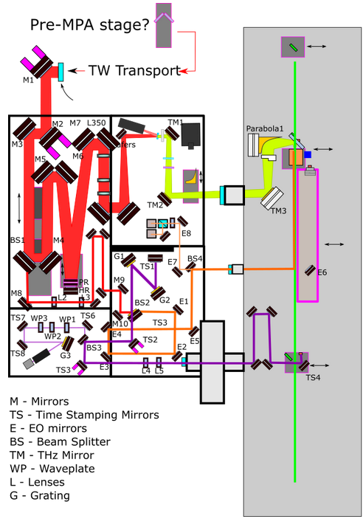
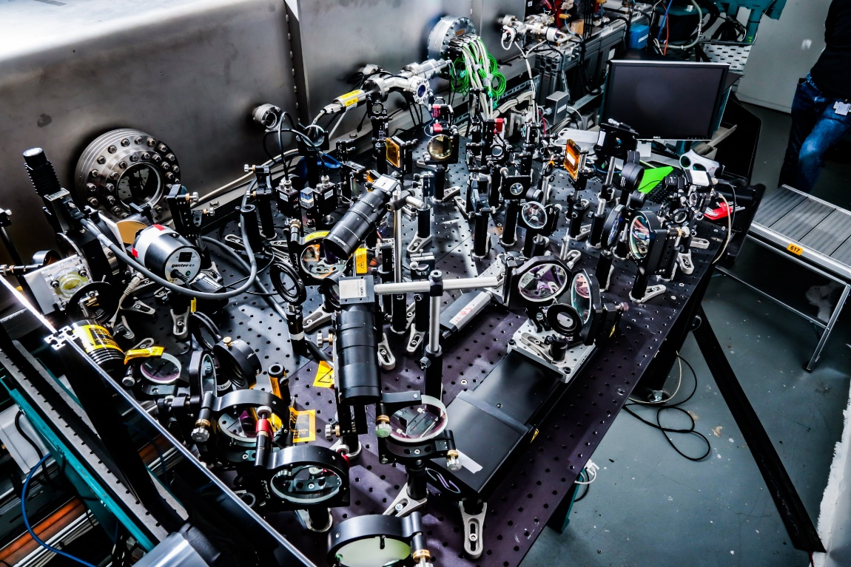
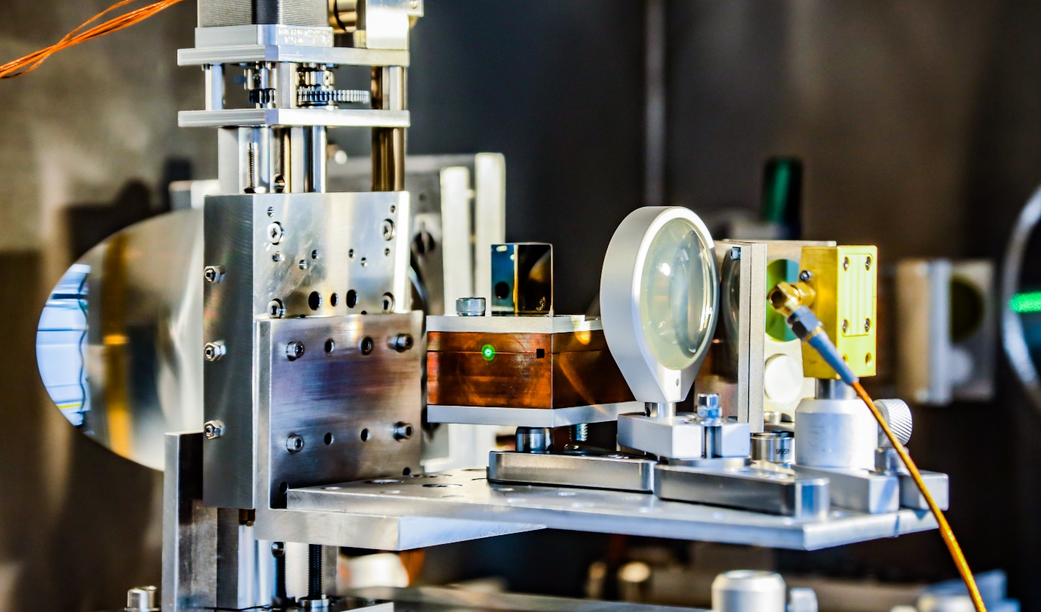
Experimental setup in Beam Area 1
Chirped laser to ≈750 fs to avoid damage
Terawatt laser
Pulse energy: 800 mJ
(max 300 mJ to BA1)
Pulse length: 50 fs
Wavelength: 800 nm
Repetition rate: 10 Hz
Laser and THz optics outside chamber
THz-electron interaction point inside vacuum chamber

Slide 13
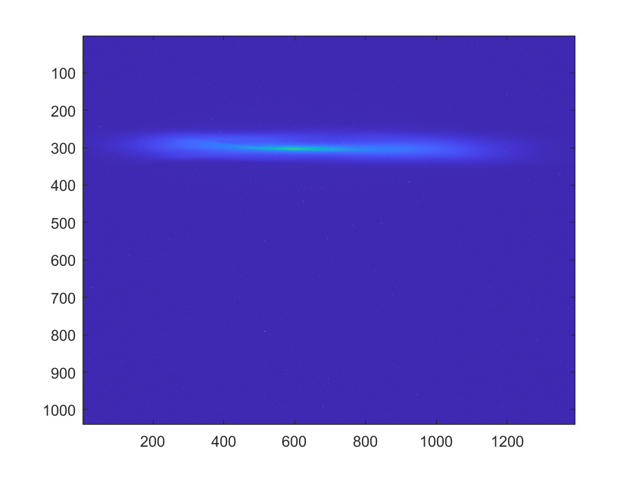
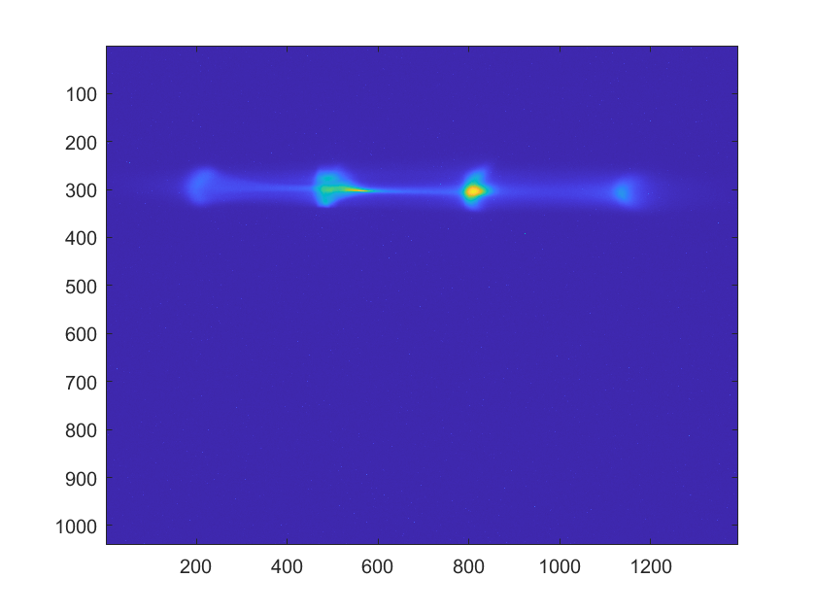
CLARA Run 2 results
Experimental parameters
Electron spectrometer images
CLARA machine operated with different bunch configurations
Bunch lengths from 200 fs up to 6 ps (FWHM)
With varying chirp and energy spread
Bunch charge from 2 – 100 pC
THz source controlled for desired bunch manipulation
Pulse energy from 100 nJ to >100 μJ
Injection timing
Number of cycles (i.e. bandwidth)
THz off
THz on
35
35.2
35.4
35.6
35.8
36
Electron energy [MeV]
THz pulse (f = 0.39 THz, T = 2.6 ps, 10 cycles)
Demonstrations of THz-driven bunch manipulation
On-crest acceleration of sub-ps bunches
Bunch with single (half) cycle and near-uniformly accelerated
Off-crest de-chirping
Control and minimise bunch energy spread
Multi-cycle spectral bunching
→ Pre-cursor to bunch train generation
Staging using a double-pulse structure
→ Two-stage acceleration or Two-stage acceleration and de-chirp
THz off
THz on
Energy
Energy
Longitudinal phase space
Time
Time

Slide 14
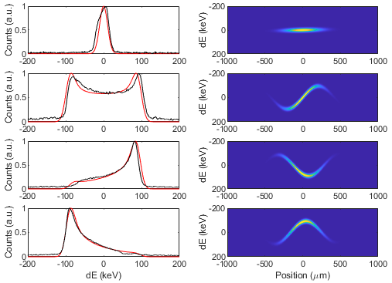
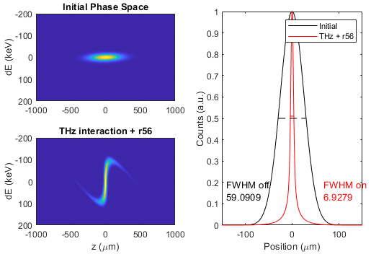
CLARA Run 2 results
High gradients on short(ish) bunches
(Predicted) bunch compression
Experiment & model
Phase-space ‘model’
Standard accelerator technique of magnetic chicane compression
Apply chirp (time-energy correlation)
Differing path length compresses the bunch length
THz off
THz off
Varying THz injection time
Observed energy spectra with varying THz injection time:
Determine the (unknown) bunch energy-time phase-space
Residual ‘uncorrelated’ energy spread of ≈ 20 keV
Bunch length ≈ 200 fs FWHM (≈ 60 um)
Compression with optimised injection phase and chicane R₅₆
Compressed pulse duration ≈ 23 fs FWHM
Energy-spread limited so <10 fs feasible

Slide 15
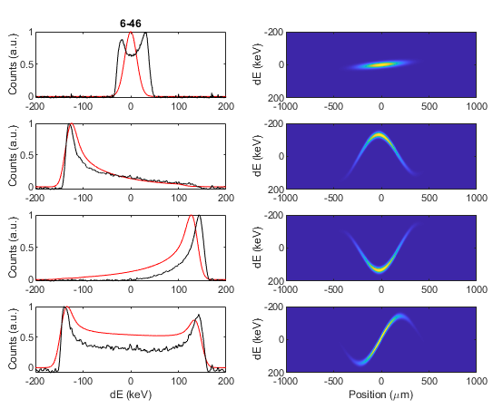
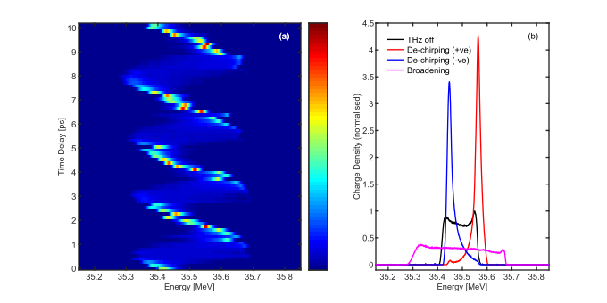
CLARA Run 2 results
High gradients on short(ish) bunches
THz-driven energy de-chirper
Experiment & model
Phase-space ‘model’
THz frequency is 100x higher than RF-driven injectors
→ Allows for RF compression followed by THz de-chirping
THz off
Varying THz injection time
Observed >150keV gain in ≈8 mm interaction length
20 MV/m accelerating gradient, comparable to RF accelerators
Limited by THz propagation/coupling losses (estimated <20%)
Issues with THz source frequency-matching to waveguide
Observed THz-driven de-chirping (and spectral broadening) controlled by THz injection timing
Reduce initial spread from 148 keV to 21 keV – factor of 7
Final energy spread <0.06% of the 35.5 MeV bunch energy

Slide 16
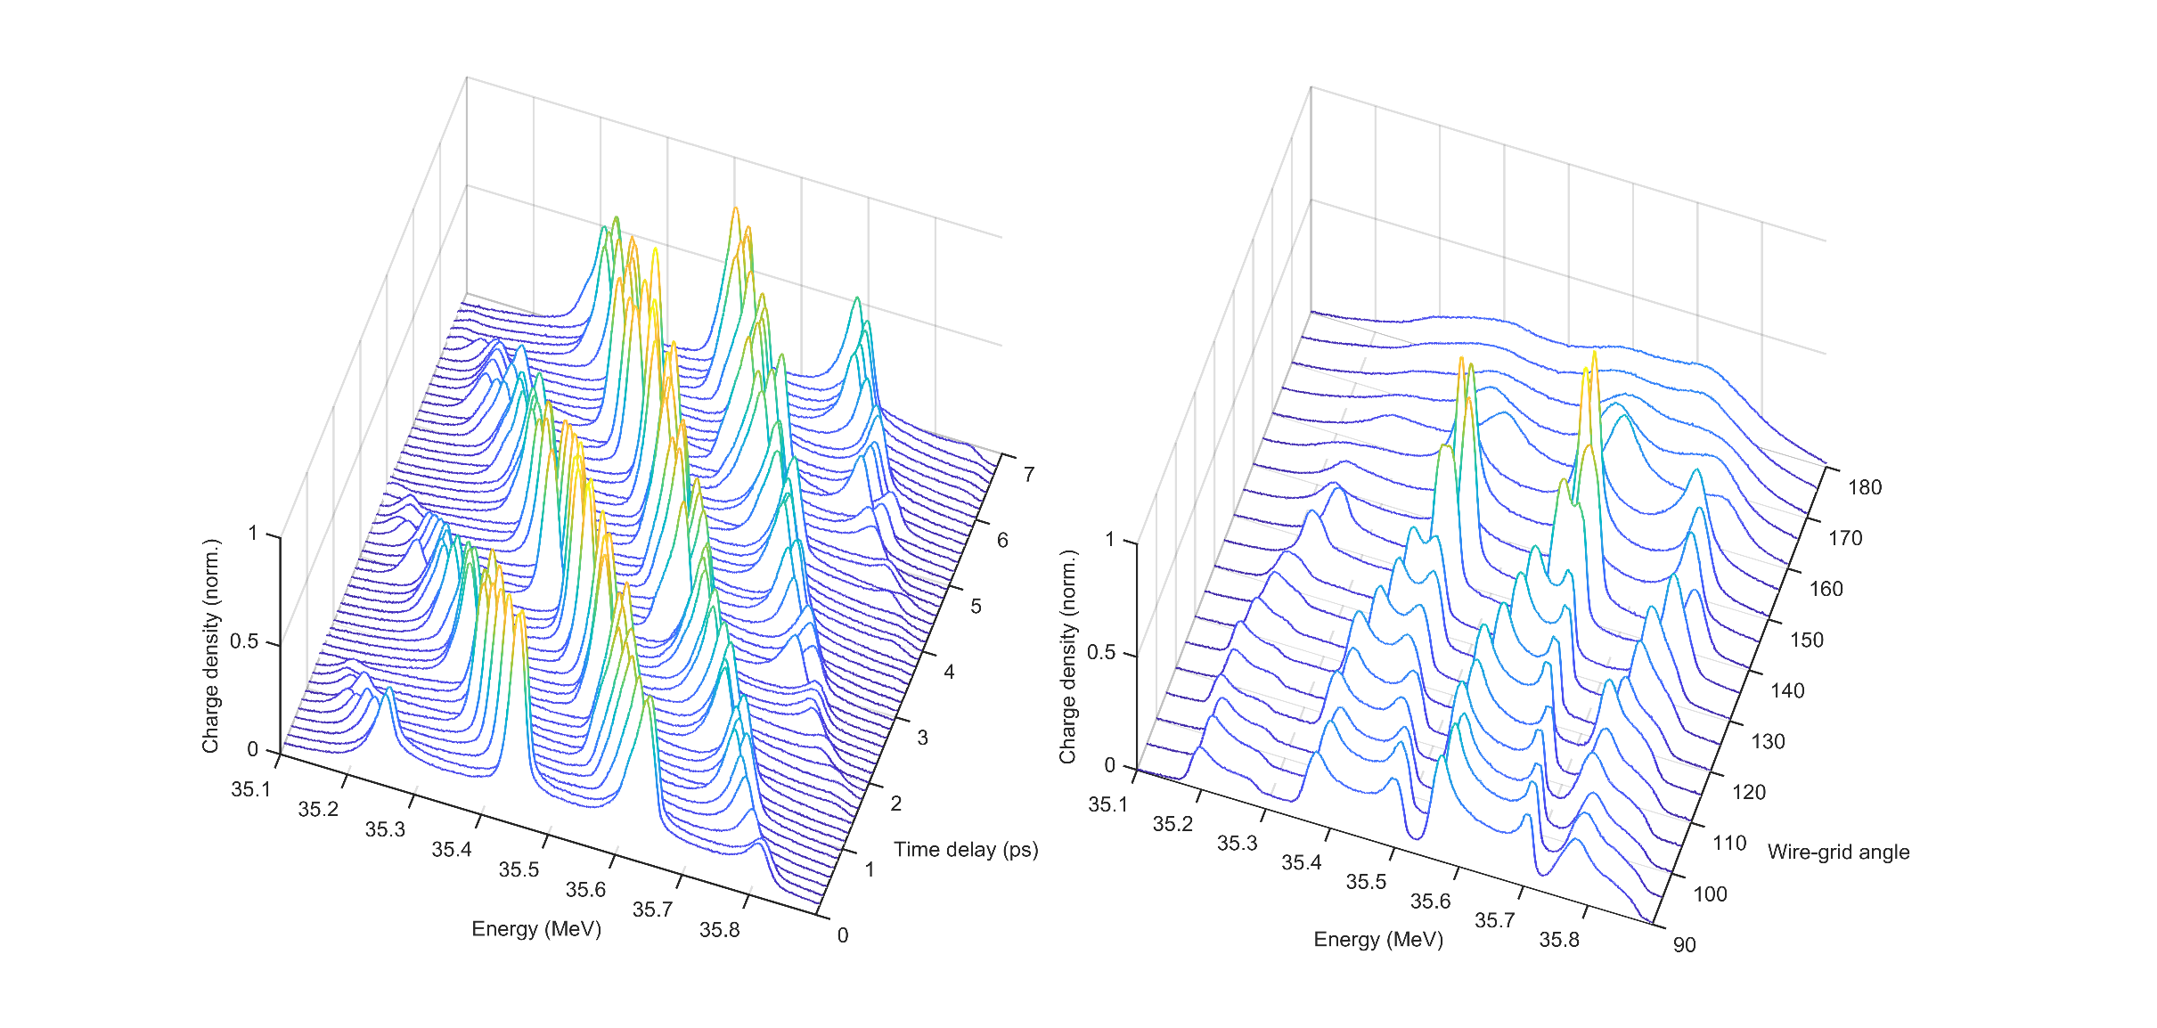
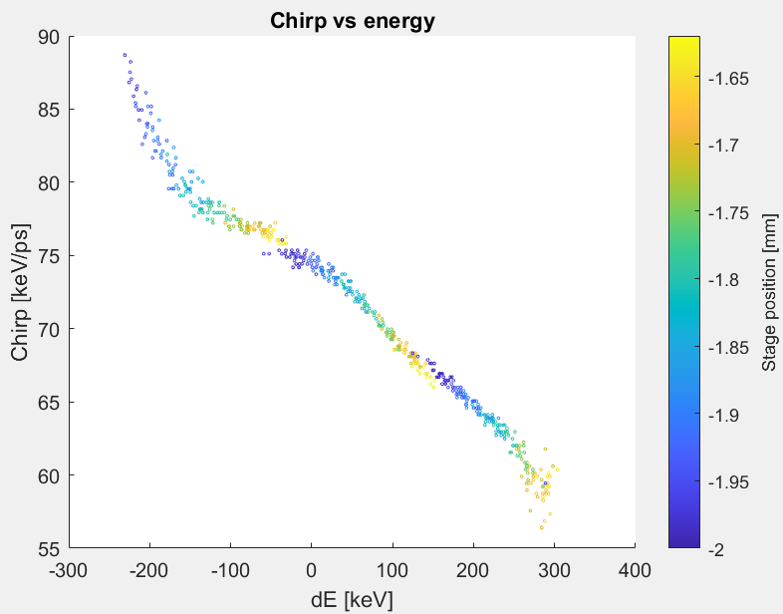
CLARA Run 2 results
Towards micro-bunching with multi-cycle THz pulses
Longitudinal bunch diagnostic
Varying THz pulse energy
Varying THz injection timing
Can use THz frequency and variable injection to “scan” the bunch chirp
Multi-cycle THz-induced “spectral-bunching”
Start with long “linearly”-chirped electron bunch
Optimise THz driving field strength
Minimum 20 keV peak width observed
Non-linear peak-splitting observed beyond that
Magnetic chicane will convert into a train of ultrashort micro-bunches with ps-scale separation
Potential for <10 fs bunches with THz-induced fs timing stability
Demonstrated with 100 pC charge
Capability for 10-100 micro-bunches using narrower bandwidth THz sources

Slide 17

Acknowledgements
+ STFC staff
Dave Walsh
Connor Mosley
Morgan Hibberd
Joseph Bradbury
Sergey Siaber
Darren Graham
Laurence Nix
Matt King
Tom Pacey
Dan Lake
Christopher Shaw
Beatriz Higuera Gonzalez
Graeme Burt
Steven Jamison
Rob Appleby
Any questions?

