Slide 1



Developing a two-colour all-fibre balanced optical cross-correlator for sub-femtosecond synchronisation
J. Christie¹, J. Henderson², E. Snedden², L. Reid¹, H. Jones^{1, 3}, M. Radford¹, A. Morris¹, L. Corner¹
1 – Cockcroft Institute, University of Liverpool, UK
2 – Science and Technology Facilities Council, Daresbury, UK
3 – DESY, Hamburg, Germany
25/07/2022
Notes:
Hello, my name is Jonathan Christie and I’m here to give a talk on developing a two-colour all-fibre balanced optical cross-correlator for sub-femtosecond synchronisation. In this talk I will discuss the importance of femtosecond synchronisation for accelerator facilities and the methods used to achieve this. Then I will talk about my proposed design for femtosecond synchronisation at CLARA and my plan for constructing and testing my design.

Slide 2
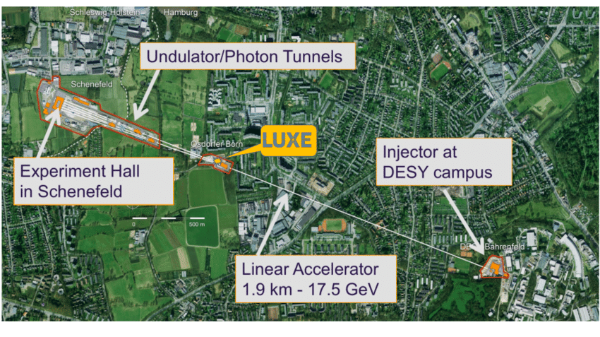
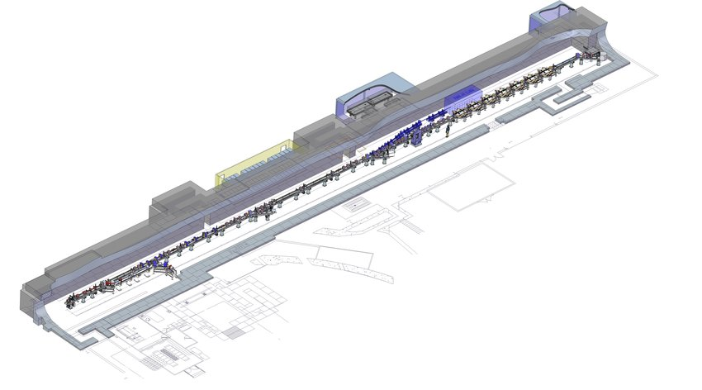
Introduction
Modern accelerator and X-ray free-electron laser (XFEL) facilities require ultra-precise timing.
  Facilities such as EUXFEL and CLARA (Compact Linear Accelerator for Research Applications) used for experiments that require high-power lasers such as pump-probe spectroscopy and laser wakefield acceleration (LWFA).
  Less than 10 fs synchronisation needed over accelerator complex that can be kilometres long.
RF timing signal not suitable for long distances.
  Coaxial cables highly sensitive to temperature fluctuations.
  Timing precision limited to 50 – 100 fs [1].
[1] - J. M. Glownia et al., “Time-resolved pump-probe experiments at the LCLS,” Optics Express, vol. 18, no. 17, p. 17620 (2010).
Notes:
So, modern accelerator and x-ray free electron laser facilities require very precise timing in order to accelerate electron bunches.
Additionally, a lot of these facilities such as EUXFEL (Hamburg) and CLARA (Daresbury) are user facilities, where users are able to use the accelerator for their own experiments. Some of these experiments such as pump-probe spectroscopy and laser wakefield acceleration require femtosecond level synchronisation between a high-power laser used for the experiment and the accelerator, and similar synchronisation is needed over the entire accelerator facility that can be many kilometres long.
The easy solution would be to use a low-noise electrical signal to synchronise the entire facility. However, the coaxial cables used to transmit these signals are very susceptible to fluctuations in temperature and humidity especially over long distances. This limits the achievable timing precision to around 50-100 fs which is not acceptable.
EUXFEL, DESY Hamburg
CLARA, Daresbury

Slide 3
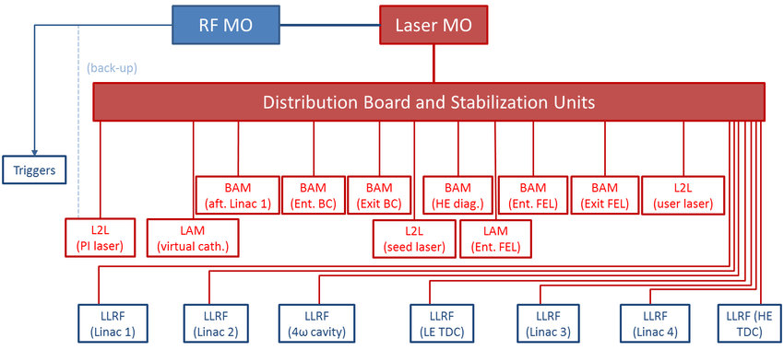
Fibre timing links
Can distribute low-noise laser pulses via optical fibre to accelerator systems.
  Less than a femtosecond jitter in pulse arrival time over short distances [1].
  Optical fibre still susceptible to temperature fluctuations over long distances.
  1 K fluctuation over a 1 km fibre with a thermal expansion coefficient of 5 × 10⁻⁷ K⁻¹ leads to ~ 2 ps timing error.
Need methods for:
Keeping timing pulse arrival time constant to a few fs.
Synchronising timing laser pulse to external laser.
CLARA timing system [2]
[1] - H. Kim et al., “Sub-20-Attosecond Timing Jitter Mode-Locked Fiber Lasers,” IEEE Journal of Selected Topics in Quantum Electronics, vol. 20, pp. 260–267 (2014).
[2] - J. Clarke et al., “Clara conceptual design report,” Journal of Instrumentation, vol. 9, 01 (2014).
Notes:
One solution is to use fibre timing links, where optical fibres are used to distribute pulses from a low-noise timing laser. Such lasers can achieve sub-femtosecond fluctuations in pulse arrival time over short distances, which is more than suitable for accelerators.
However, although they are better than coaxial cables, optical fibres are still susceptible to environmental fluctuations. For example, a change of 1 K over a 1 km long fibre can lead to changes in pulse arrival time of around 2 ps, which is not acceptable.
As such, we need methods for firstly ensuring that the timing pulse arrival time can be kept constant to within a few fs and secondly synchronising the timing laser pulse to an external laser used for experiments or a photocathode laser used to generate electron bunches for the accelerator, for example.
Methods involving converting laser pulses to RF via photodiodes and measuring phase difference between them limited by amplitude modulation to phase modulation (AM-PM) effects and thermal noise.
Sensitivity of 1 μV/fs, synchronisation limited to > 100 fs [2], not acceptable for modern accelerator facilities.

Slide 4
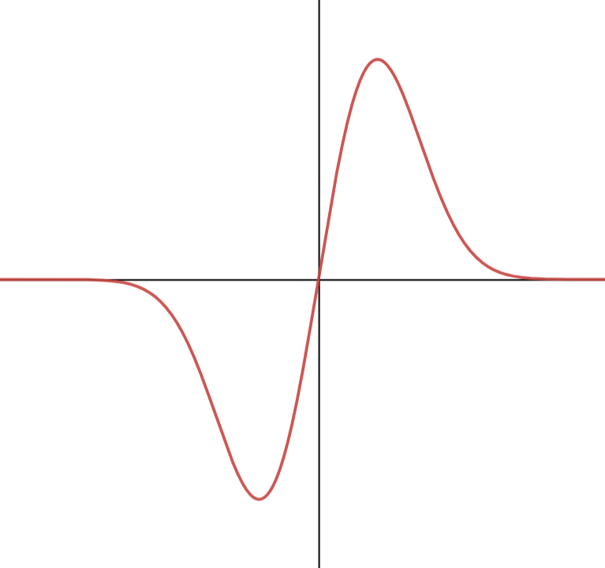
Balanced optical cross-correlator (BOXC)
Forward Pass
ΔT
ΔT’
ΔV = V₁ - V₂
Nonlinear crystal
V₁
ΔT’
Dichroic mirrors:
Highly reflective for fundamental (1560 nm) pulses
Highly transmissive for second harmonic (780 nm) pulses
Reverse Pass
About origin, voltage difference varies (approx.) linearly with timing difference.
Gradient on order of 1 mV/fs, 1000 times greater sensitivity than direct photodetection methods.
V₂
Nonlinear crystal
Notes:
Both of these issues can be solved by the balanced optical cross-correlator, or BOXC. First, you take two pulses from your laser source with some time delay delta T between them. These pulses pass through a nonlinear crystal, which generates a sum frequency pulse that can be detected by a photodetector. Note that the amplitude of the sum frequency pulse is highly dependent on the timing between the initial pulses. The greater the temporal overlap, the larger the amplitude of the sum frequency pulse.
The initial pulses are then reflected back through the nonlinear crystal with some additional known delay due to, for example, the birefringence of the nonlinear crystal causing one of the pulses to travel slower through the crystal than the other pulse. This generates a second sum frequency pulse that is detected.
We can plot the voltage difference, V1 – V2, against the time delay between the pulses, delta T prime, and by scanning over a range of values of delta T prime we obtain a curve that looks like this. We can see that the voltage difference is linearly proportional to the timing difference, with a gradient of around 1 mV/fs. This is 1000 times greater than the sensitivity achieved by direct photodetection methods, where the initial pulses are converted into electrical pulse trains and the phase difference between the signals is measured.
For timing link, compare pulse reflected back from accelerator system with reference pulse. Fluctuations in delay used to adjust timing link path length.
Allows for pulse arrival time to be constant to < 5 fs.
Phase comparison occurs in optical domain, no AM-PM effects.
Balanced nature of method removes amplitude fluctuations.
Due to timing detection occurring in optical domain rather than RF, process is immune to thermal variations. Method is also immune to difference in amplitudes of input pulses (to first order) due to balanced method.

Slide 5
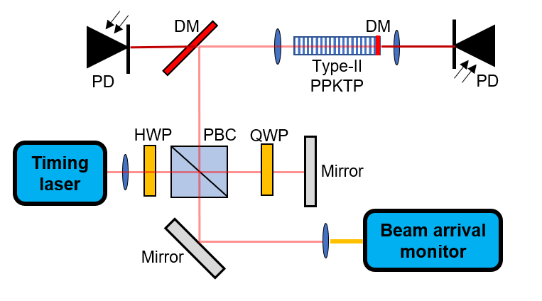
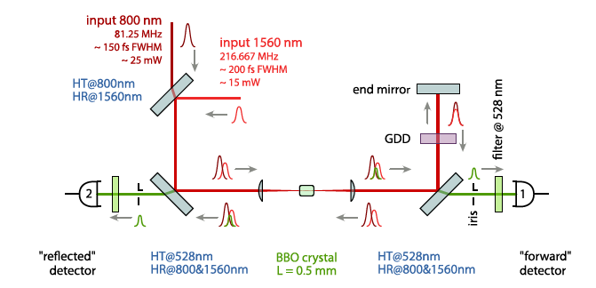
Free-space BOXCs
Vast majority of BOXCs are free-space coupled.
  Method has been demonstrated for initial laser pulses with the same wavelength (one-colour, top) and for different wavelengths (two-colour, bottom).
  Can achieve sensitivities of 1 – 10 mV/fs.
Free-space limits achievable BOXC resolution to ~10 fs due to environmental fluctuations, difficulty in maintaining optical alignment.
  Need resolution of < 1 fs for future XFEL or LWFA experiments.
  Current XFELs require up to 25 BOXCs [1], installing and maintaining alignment for such a number of BOXCs is extremely challenging.
Nonlinear crystal
HWP: Half-wave plate; PBC: polarising beamsplitter cube; QWP: Quarter-wave plate; DM: Dichroic mirror; PD: Photodetector
One-colour, free-space
Two-colour, free space [1]
[1] – S. Schulz. (2011). Implementation of the Laser-Based Femtosecond Precision Synchronization System at FLASH [Doctoral thesis, University of Hamburg].
Notes:
So, the vast majority of balanced optical cross-correlators are free-space coupled, meaning that the laser pulses travel through air rather than optical fibre. This method has been demonstrated for laser pulses of the same wavelength and of different wavelengths, with sensitivities of between 1 and 10 mV/fs being achieved.
However, because the pulses travel in air, the maximum achievable synchronisation is limited to around 10 fs due to temperature and humidity fluctuations affecting the optical path length and the optical components becoming misaligned over time. Whilst this is fine for current accelerators, future XFELs will require sub-femtosecond synchronisation which is just not possible with free-space BOXCs.
Additionally, current XFELs require around 25 BOXCs to synchronise the entire facility, and as you can imagine maintaining alignment on such a number of BOXCs is extremely challenging and will only become more difficult as facilities become larger and more BOXCs are needed.

Slide 6
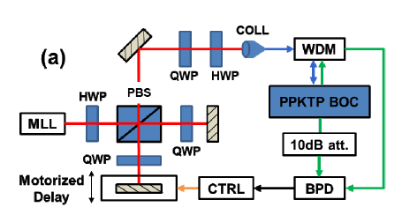
Fibre-coupled BOXCs
One-colour fibre-coupled BOXCs have been demonstrated [1].
  More robust against environmental fluctuations.
  Easier to align and keep stable.
  Waveguide implemented in crystal to reduce diffraction of laser pulses, 10 – 100 times greater conversion efficiency than bulk crystal [1, 2].
Two-colour fibre-coupled BOXC has not been demonstrated.
  Allows for improved synchronisation of timing laser (1560 nm) to Ti:Sapphire experiment and photocathode lasers (800 nm).
  Main aim of my work is to design, build and test a two-colour fibre-coupled BOXC.
One-colour, fibre-coupled [1]
[1] - P. Callahan et al, "Fiber-coupled balanced optical cross-correlator using PPKTP waveguides," Opt. Express 22, 9749-9758 (2014).
[2] - A. Nejadmalayeri et al, "Guided wave optics in periodically poled KTP: quadratic nonlinearity and prospects for attosecond jitter characterization," Opt. Lett. 34, 2522-2524 (2009).
Notes:
These problems can be somewhat solved by fibre-coupled BOXCs, where the laser pulses travel through optical fibre instead of air. This has been demonstrated for laser pulses of the same wavelength. The use of fibre-coupled components makes the system much more robust against environmental fluctuations, and it is easier to align and keep stable over long periods of time. Additionally, a waveguide was implemented in the nonlinear crystal to reduce diffraction of the laser pulses as they travel through the crystal, but this has the additional benefit of increasing the amount of sum-frequency light generated by 10 – 100 times compared to the equivalent bulk crystal. This massively increases the performance of the BOXC.
However, although this has been demonstrated for laser pulses of the same wavelength, a two-colour fibre-coupled balanced optical cross-correlator has never been demonstrated. Such a device would be incredibly important for achieving sub-femtosecond synchronisation between a timing laser and an experiment laser which typically have very different wavelengths. As such, the main aim of my work is to design, build and test a two-colour fibre-coupled BOXC. The first step was to make some initial designs and source some suitable components.

Slide 7
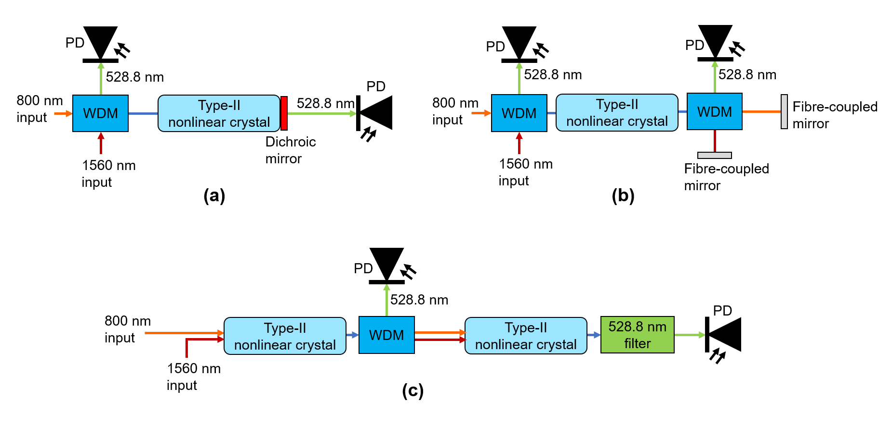
Initial BOXC designs
Interaction of interest is 1560 nm + 800 nm -> 528.8 nm. Crystal needs waveguide to keep light coupled into fibre.
First idea was to use a Type-II crystal, reflect light back through crystal (top). Second idea was to use two crystals in series (bottom).
  Type-II phase-matching requires the initial pulses to be orthogonally polarised.
  Can use birefringence of nonlinear crystal to impart necessary delay to initial pulses.
WDM: Wavelength division multiplexer; PD: Photodetector
First prototype design
Number of issues with designs:
  Could not find suitable crystal that allows light to travel in both directions.
  Can’t couple all 3 wavelengths into one fibre and maintain single-mode and polarisation, could not find nonlinear crystal with 3 separate outputs.
Second prototype design
Notes:
So the interaction that I’m interested in is sum-frequency generation between 1560 and 800 nm light. Additionally, the nonlinear crystal needs to have a waveguide implemented so that the laser light can be coupled back into optical fibre. My first idea was to use a type 2 phase-matched nonlinear crystal and to reflect the two initial pulses back through the crystal to generate the two sum-frequency pulses, similar to the one-colour design. I also had the idea of using two nonlinear crystals in series to generate the sum-frequency pulses, removing the need for passing the initial pulses through the same crystal twice.
The main reason for using a type 2 phase-matched crystal was that type 2 phase matching requires the initial pulses to be orthogonally polarised to generate sum-frequency light. Thus, the birefringence of the nonlinear crystal can be used to impart the necessary delay to one of the pulses in order for the cross-correlator to work.
However, there are a number of issues with these designs. Firstly, I could not find a suitable crystal that allows light to travel through it in both directions, making the first design impossible. Secondly, as shown by the blue lines, there are sections in both designs where all 3 wavelengths of light need to be coupled into the same optical fibre, which leads to large coupling losses as the fibre can’t be matched for all 3 wavelengths at once. Additionally, I could not find a nonlinear crystal with 3 separate outputs matched to each wavelength of light, making this issue unavoidable. Thus, I had to come up with another design.

Slide 8
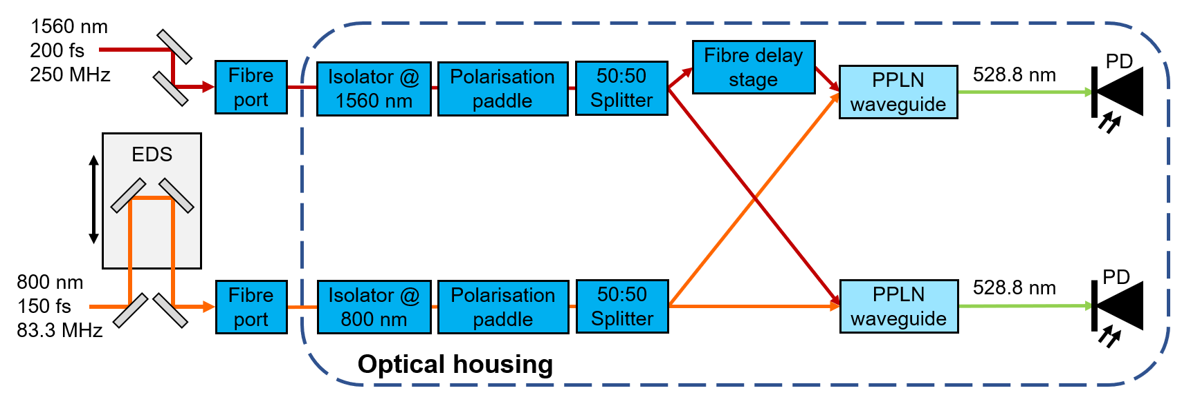
Improved BOXC design
ΔT’
ΔT
EDS: External delay stage; PD: Photodetector;
PPLN: Periodically-poled lithium niobate, purchased from HC Photonics
ΔV
Fibre delay stage imparts time delay D to one of the 1560 nm pulses, ΔT’ = ΔT - D.
  Can adjust D to maximise sensitivity of BOXC.
  Delay stage has maximum delay of 167 ps, resolution of 1.4 fs.
Can scan over range of ΔT’ by adjusting arrival time of 800 nm pulse at fibre port to obtain BOXC voltage curve, determine sensitivity.
ΔT’
Notes:
My next idea was to use two nonlinear crystals in parallel, as shown by the light blue boxes. The plan is to take your two initial laser pulses of different wavelengths and propagate them to separate 50:50 splitters. This will split the 1560 nm and 800 nm pulses into two components which will be sent to separate crystals. However, one of the 1560 nm components will pass through a fibre delay stage and receive an additional delay D. Thus, at the nonlinear crystals, the sets of pulses will have different delays delta T and delta T prime. The value of D can be adjusted to maximise the sensitivity of the BOXC, which is a benefit over using other methods for delaying the laser pulse.
Then, the two nonlinear crystals generate two sum-frequency pulses which are detected by photodiodes. By moving the external delay stage, we can vary the arrival time of the 800 nm pulse and hence vary delta T prime, which allows us to obtain a voltage difference curve similar to that of the one-colour cross-correlator. This can then be used to measure the time delay between the two laser pulses and synchronise the two lasers together.
We can have a closer look at the optical housing, which is where most of the components will be contained.

Slide 9
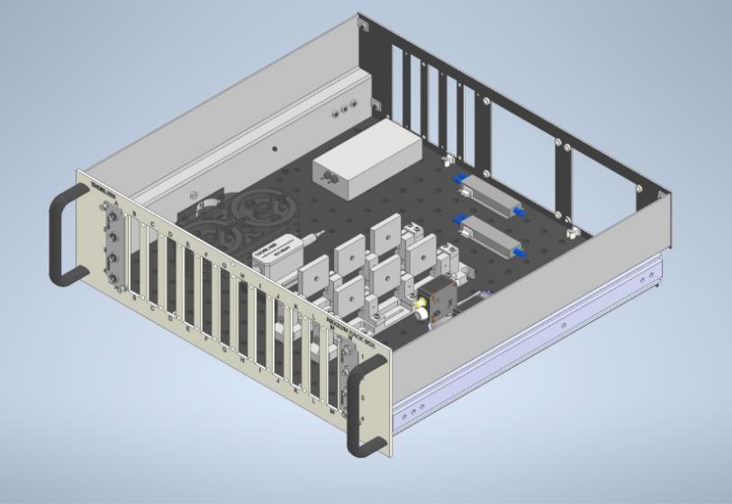
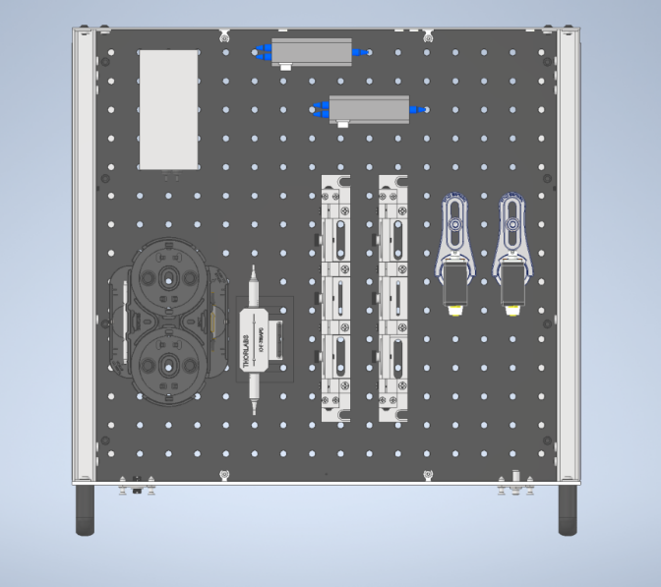
Optical housing layout
PPLN
Fibre delay stage
PPLN
132.1 mm
Photodiode
Photodiode
446.8 mm
Paddle
Paddle
50:50 splitter
Isolator
Isolator
1560 nm fibre
800 nm fibre
528.8 nm fibre
SMA cable
Laser in
RF out
447.8 mm
Notes:
From the CAD drawing, the components will be mounted in a standard Thorlabs rack box, which can be kept in a shelving unit that can house around 10 rack boxes. These shelves can easily be stored in a temperature-controlled environment, and as you can fit multiple rack boxes in a single shelving unit, it has a much smaller footprint than the same number of free-space BOXCs, saving space and money.

Slide 10
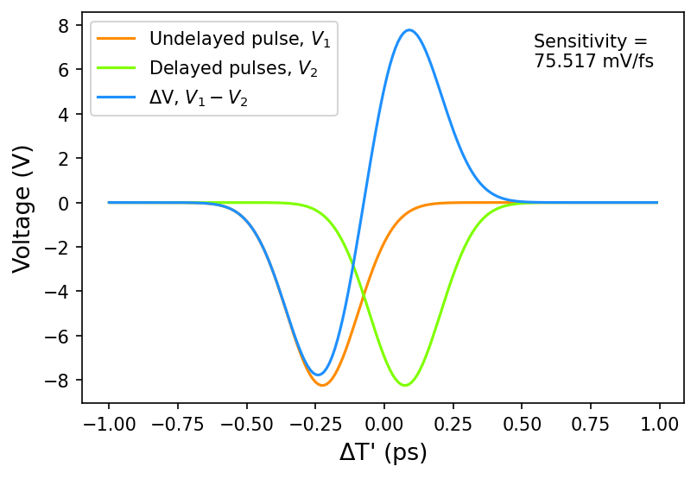
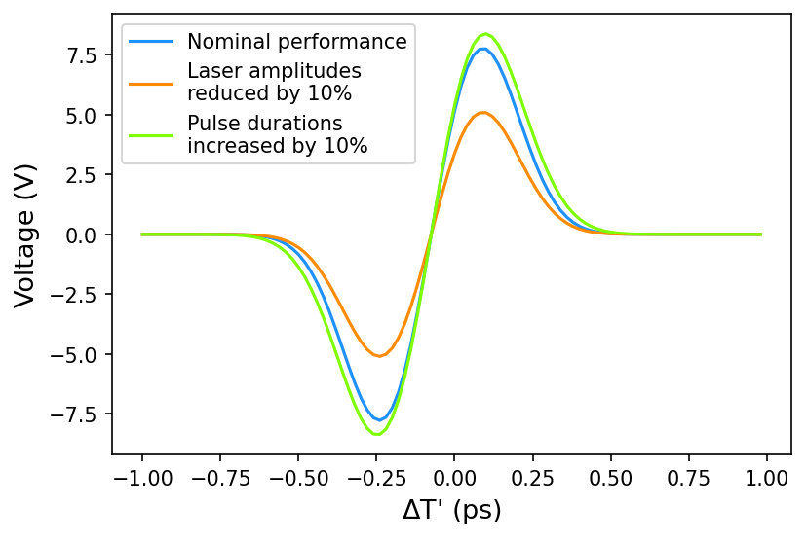
Theoretical BOXC performance
From wave equation for sum-frequency pulse, can determine maximum sensitivity achievable by BOXC [1].
Using parameters from HC Photonics, theoretical maximum sensitivity of ~ 75 mV/fs possible.
  Sensitivity > 5 times greater than free-space two-colour systems [2, 3].
  Good sensitivity even with fluctuations in amplitude and pulse duration.
[1] - P. Callahan et al, "Fiber-coupled balanced optical cross-correlator using PPKTP waveguides," Opt. Express 22, 9749-9758 (2014).
[2] - C. Li et al, “Two Color Balanced Optical Cross Correlator to Synchronize Distributed Lasers for SHINE Project,” JACoW IBIC2021 (2021) WEPP05.
[3] - Cycle Lasers, “TCBOC – Two-Color Balanced Optical Cross Correlator”, https://www.cyclelasers.com/synchronization-modules/tcboc/
Notes:
As for the performance of my proposed BOXC design, we can determine the theoretical maximum sensitivity that can be achieved from the wave equation of the sum-frequency pulse. I won’t go into detail about the derivation, but essentially from numerically integrating the wave equation over the length of the nonlinear crystal we can get the photodetector voltage and the sensitivity of the BOXC.
Thus, using nonlinear crystal parameters provided by the crystal supplier and our laser parameters, we can achieve a theoretical maximum sensitivity of around 75 mV/fs, more than 5 times greater than comparable free-space two-colour systems. Additionally, good sensitivity is achieved even with fluctuations in the laser pulse amplitude and duration of 10%, which is more than typical fluctuations from most laser sources.

Slide 11
Conclusion and future work
Modelled and designed a two-colour fibre-coupled balanced optical cross-correlator.
  Has never been demonstrated before.
  Theoretical sensitivity 5 times greater than free-space variants, less sensitive to environment, easier to keep aligned.
Future work includes:
  Assembling and testing two-colour BOXC.
    Characterise performance of components, sources of loss and noise.
  Developing BOXC code to account for noise, error.
    Obtain more accurate theoretical sensitivity.
  Determining BOXC performance by locking two lasers together using BOXC, measuring long-term timing jitter between the lasers.
    Goal of sub-femtosecond long-term synchronisation.
Notes:
In conclusion, I have modelled and designed a two-colour fibre-coupled balanced optical cross-correlator, which to my knowledge has never been demonstrated before. This design can potentially achieve 5 times greater sensitivity than free-space two-colour cross-correlators whilst being less susceptible to environmental fluctuations and significantly easier to keep aligned.
As for my future work, the next step is to assemble and test this cross-correlator design, which will involve characterising the performance of the optical components and determining any sources of loss and noise. This information can be fed back into my cross-correlator code to obtain a more accurate theoretical sensitivity value. My main aim is to use my balanced optical cross-correlator design to lock a 1560 nm timing laser and an 800 nm photocathode laser at Daresbury Laboratory over a long period of time, with the goal of achieving sub-femtosecond long-term synchronisation.

Slide 12
Thank you!
Special thanks to Femtosecond Lasers and Timing Group at Daresbury Laboratory and HC Photonics. Funded by the University of Liverpool.
Notes:
That is it for my talk, thank you very much for listening.

Slide 14
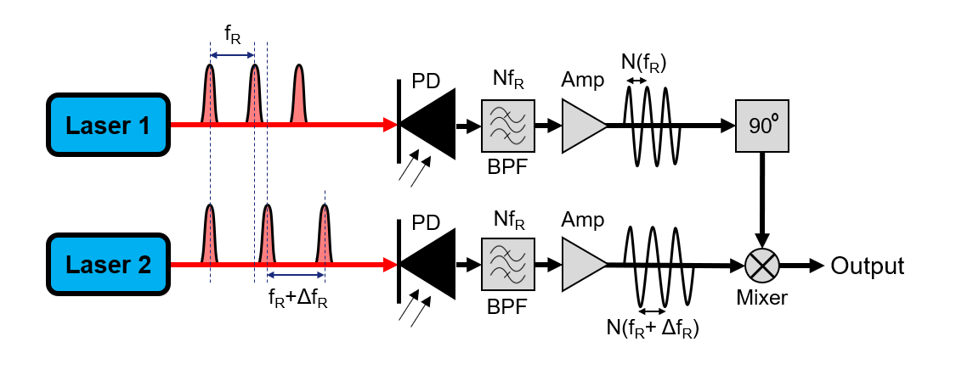
Direct conversion
Directly detect laser pulses using photodetectors. Difference in pulse repetition rate corresponds to different electrical pulse frequency. Pass pulses through mixer to obtain timing difference.
  Performance limited by amplitude modulation to phase modulation (AM-PM) effects and thermal noise.
  Sensitivity of 1 μV/fs, synchronisation limited to > 100 fs, not acceptable for modern accelerator facilities.

Slide 15

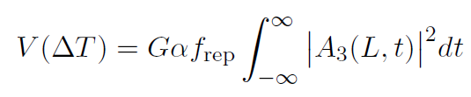

BOXC signal derivation
Integrate over length of crystal L to get A₃(L, t)

Slide 16
Theoretical BOXC performance
Crystal parameters
Mode coupling coefficient κ₃ (W ^{- 0.5}) | 0.202
Crystal length L (mm) | 0.5
Ti:Sapphire laser parameters
Mode amplitude A₁₀ (W ^{0.5}) | 11.1
Pulse duration τ₁ (fs) | 200
Group velocity mismatch ζ₁ (fs/mm) | - 150
Yb:Fibre laser parameters
Mode amplitude A₂₀ (W ^{0.5}) | 7.4
Pulse duration τ₂ (fs) | 150
Group velocity mismatch ζ₂ (fs/mm) | 150
Other parameters
Repetition rate (MHz) | 83.3
Photodetector responsivity (A/W) | 0.5
Trans-impedance gain (MΩ) | 2.0

Slide 17
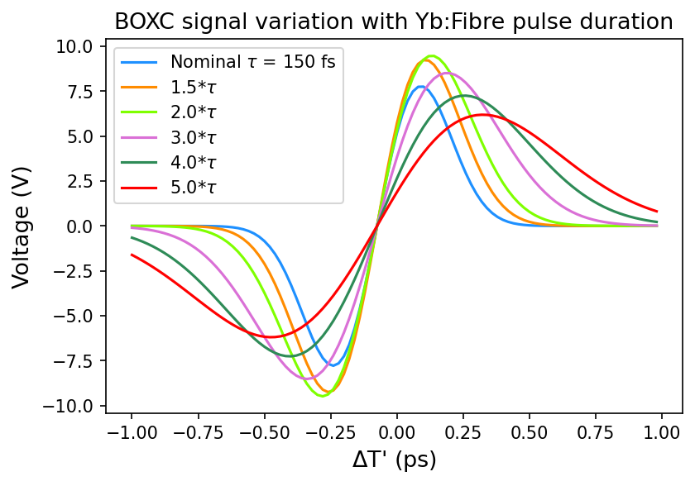
BOXC performance with amplitude and duration fluctuations
Notes:
Sensitivities:
Amplitude decrease = 49.5 mV/fs
Duration increase = 78.4 mV/fs
Nominal = 75.1 mV/fs
1.5 x = 82.2 mV/fs
2 x = 75.2 mV/fs
3 x = 52.9 mV/fs
4 x = 36.2 mV/fs
5 x = 25.5 mV/fs

