Slide 1
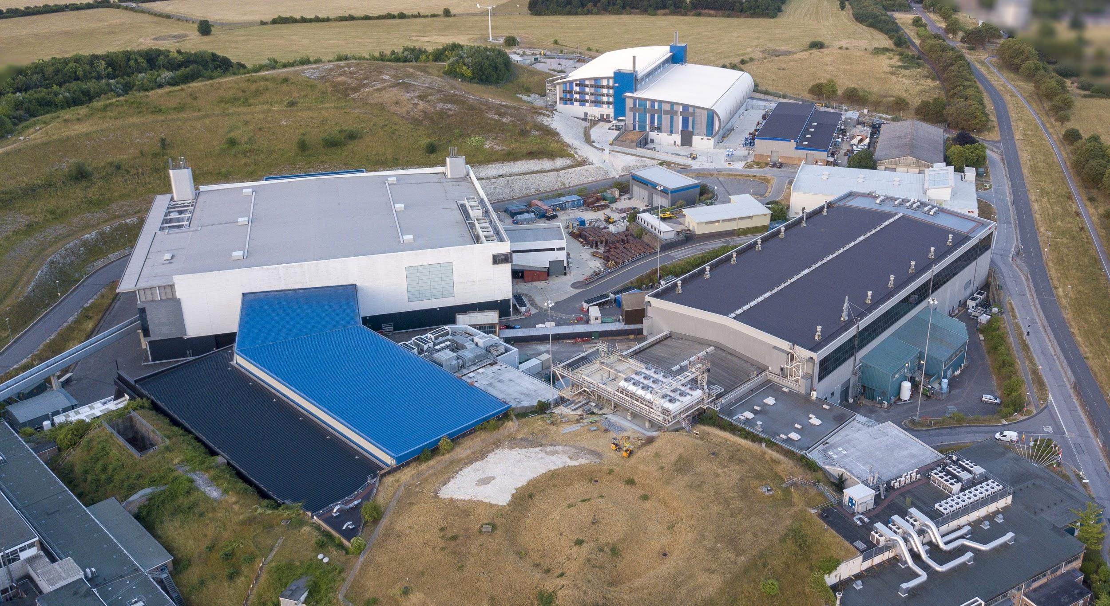

Accelerator Developments at ISIS
Hayley Cavanagh – July 2022
Notes:
Good afternoon, I’m Hayley Cavanagh, Beam Physics Operations Section Leader at the ISIS Synchrotron. In this short talk I will give an overview of some of the accelerator developments at ISIS that have lead to recent record performance. This work is the culmination of many long term projects and is presented on behalf of the whole accelerator division.

Slide 2

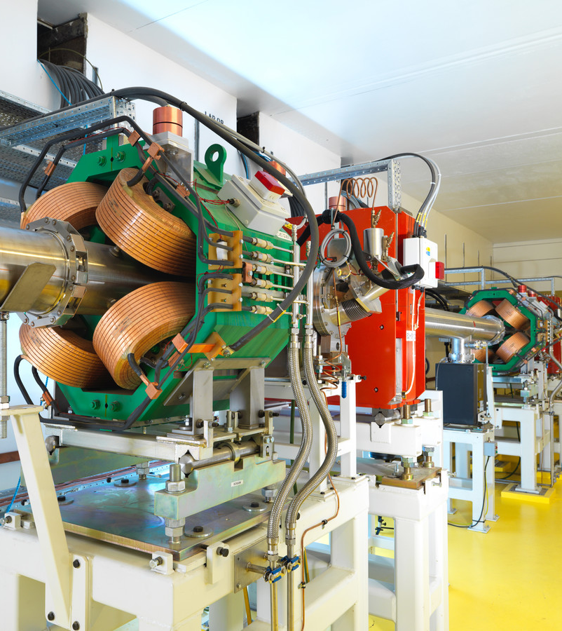
Brief Re-Cap/Introduction to ISIS
Developments Leading to Record Performance (2019-20)
Recent Long Shutdown 2021-22
Present & Future Work
Summary & Questions
Notes:
I’ll firstly give a very short re-cap or introduction to the ISIS facility, before talking about the developments that lead us to record performance. That may seem like a global pandemic ago, but this is one of the first opportunities we’ve had to present this in person. I will also then look at the developments during the latest long-shutdown, how we are sitting presently and future work. And then I’ll be happy to take any questions at the end.

Slide 3
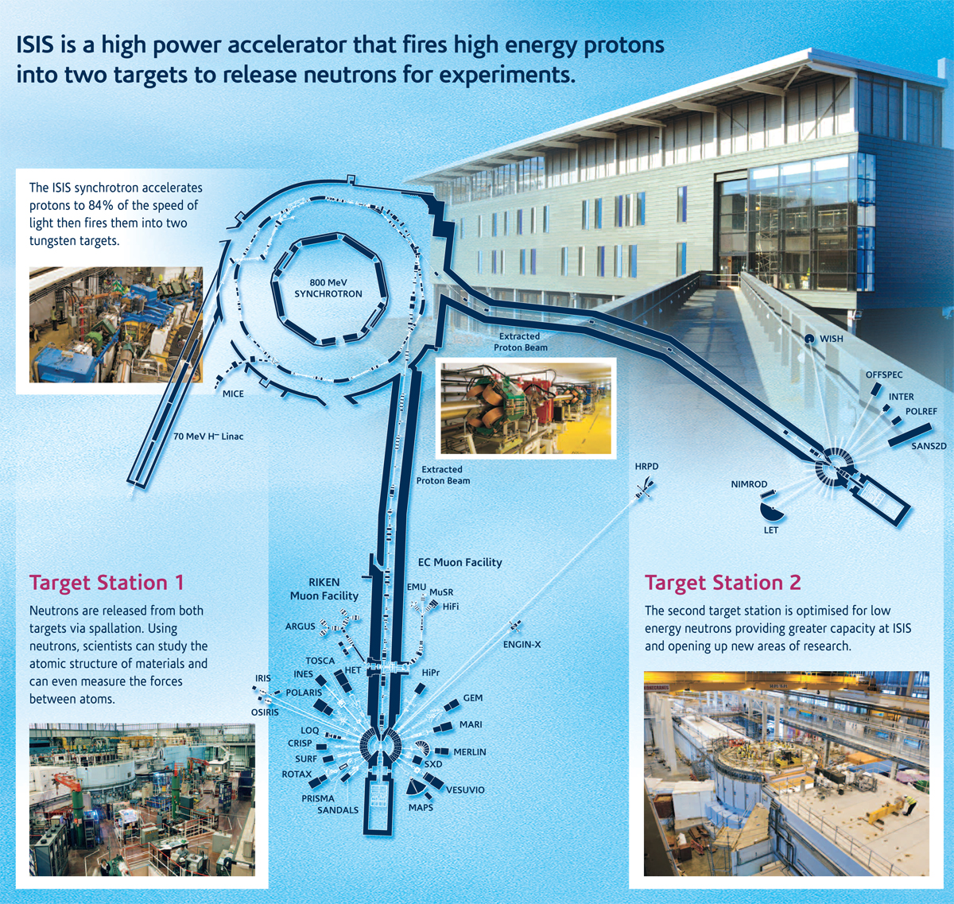
The ISIS Facility
Neutron and Muon Source
      29 neutron instruments
    5 muon instruments
  Rutherford Appleton Laboratory, Oxfordshire
  Research into physical and life sciences
    >2000 strong community
Notes:
ISIS is a neutron and muon source based at the STFC Rutherford Appleton Laboratory in Oxfordshire. It is a world leading centre for research in the physical and life sciences. It supports a national and international community of more than 2000 research scientists who use the neutrons and muons to study materials on the atomic scale using our suite of instruments.

Slide 4

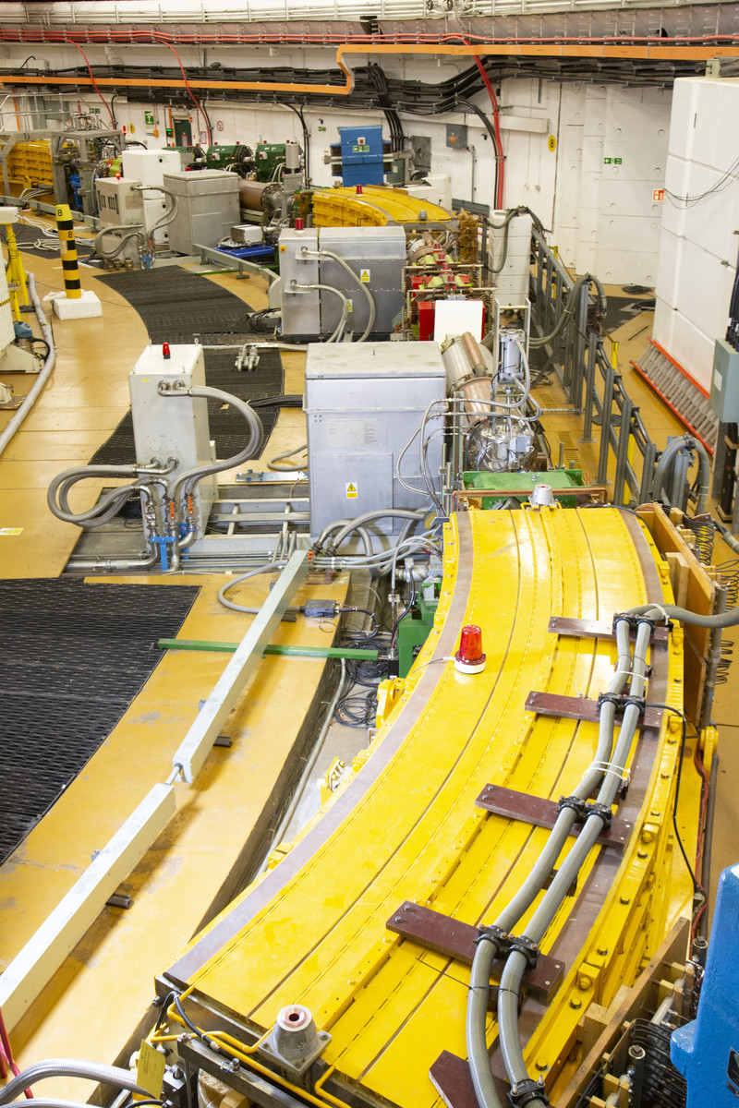
The ISIS Accelerators
35 kV H⁻ Ion Source
665 keV RFQ
70 MeV DTL
200 µs, multi-turn charge exchange injection
3e13 ppp, 50 Hz, 240 µA (192 kW )
163 m, x10 super-period, 800 MeV RCS
x6 fundamental and x4 dual harmonic RF cavities
Extract 100 ns bunches, 154 and 144 m EPBs
x2 Neutron (Ta/W) targets, x1 Muon target (C)
Notes:
The accelerator chain begins with a 35 keV 60 mA output H- penning ion source.
This is then accelerated to 665 keV in the RFQ and then 70 MeV in the linac.
Through the process of multi-turn charge exchange injection, we accumulate up to 3e13 protons per pulse over 120 turns into the rapid cycling synchrotron. The high intensity proton beam is then accelerated around the 10 super period 163 m circumference ring to 800 MeV in 10 ms at a repetition rate of 50 Hz.
The 240 uA beam is split between the two extracted proton beam lines, 40 Hz to target station 1 and 10 Hz to target station 2. The neutron targets are tungsten, clad in tantalum, with a separate carbon target for muon production.

Slide 5
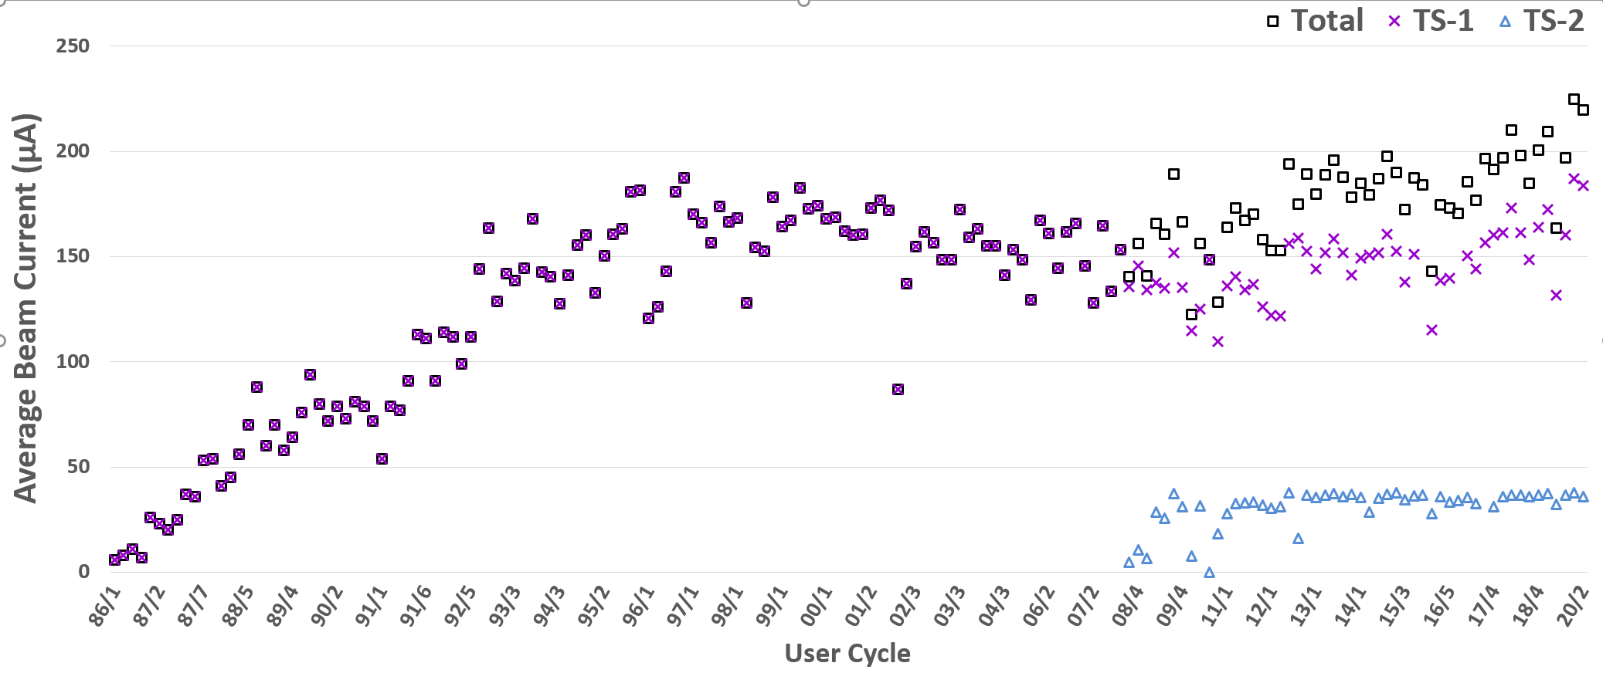
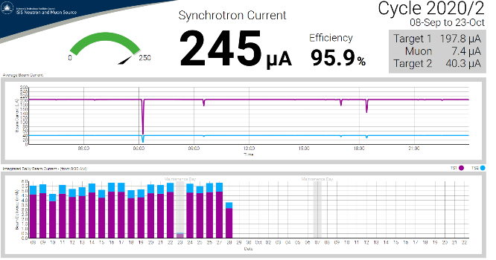
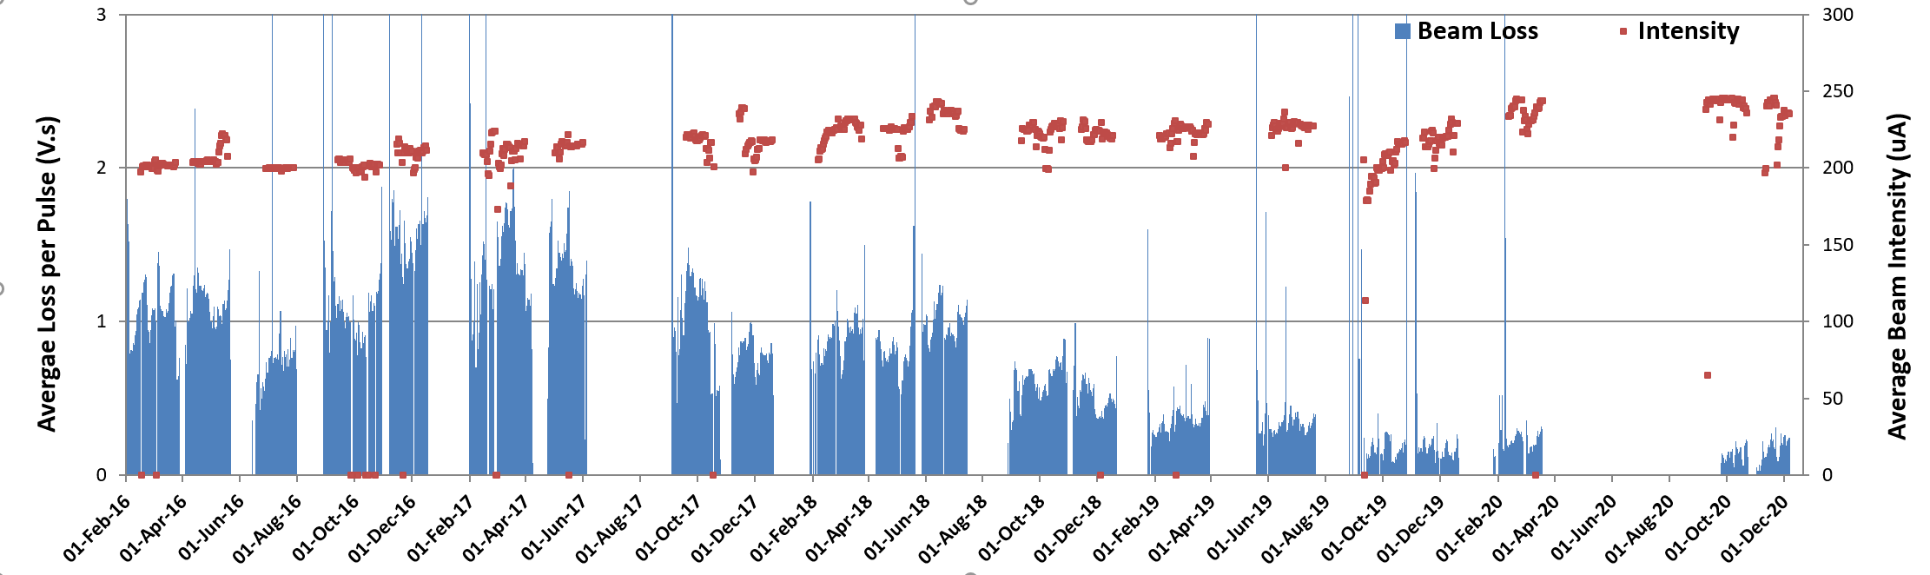
Record Performance - Operations
    2019 record day 5.64 mAh
    Feb 2020 record day 5.84 mAh
    Sept 2020 record day 5.87 mAh
    Maximum beam 245 µA for 24 hrs
    (2 minutes off!)
Notes:
2020 was a strange year for everyone, but it was a record year for the ISIS synchrotron, built on many years of increasing performance as we can see from the top graph of average beam current per cycle.
Our recent record performance began in 2019, with 5.64 mAh and then in February 2020 we set and then broke our record on five occasions, getting a 5.84 mAh day!
By Wednesday 18th March the accelerator availability for the cycle was 95%, the second highest on record, but due to the covid lockdown the cycle ended abruptly and the next cycle was cancelled.
But – with a lot of hard work and dedication we resumed operations in early September 2020 and set and broke our records a further three times – recording a 5.87 mAh day.
This was running at 245 uA, the maximum current targets can take, for 24 hrs with only 2 minutes of beam off time. So this is a record that could stand for a while!
And as you can see from the bottom graph not only are we increasing beam current but we are reducing beam loss, so increasing the overall efficiency of the accelerators as our R&D studies feed into operations.

Slide 6
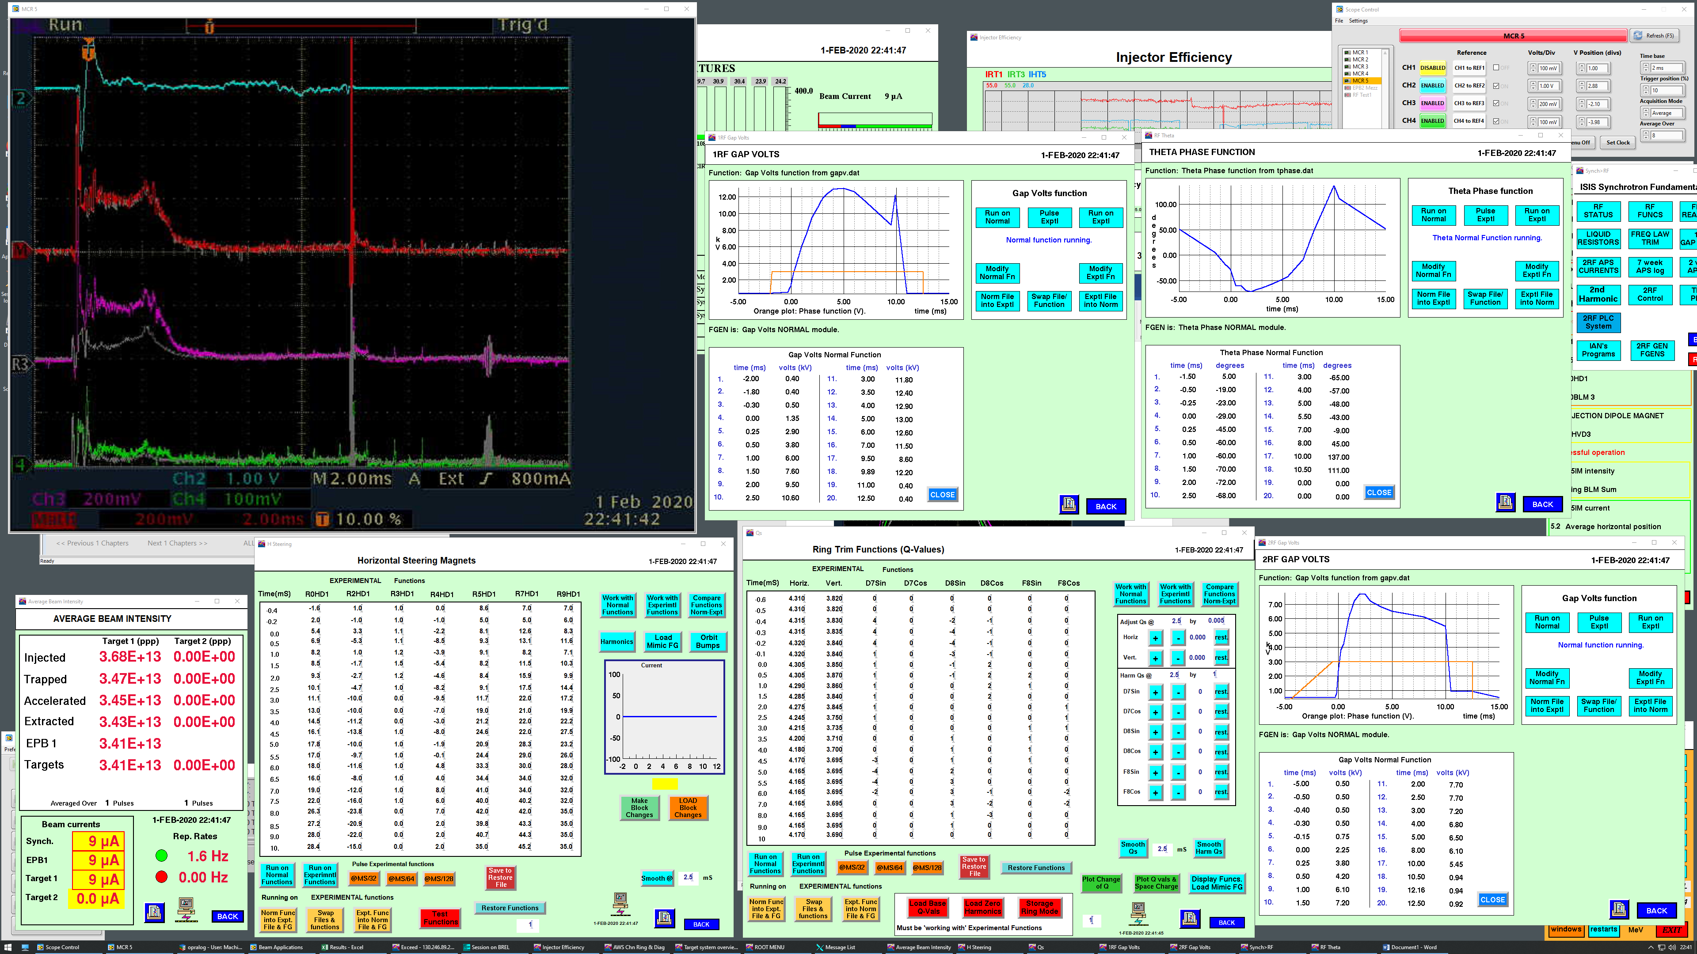
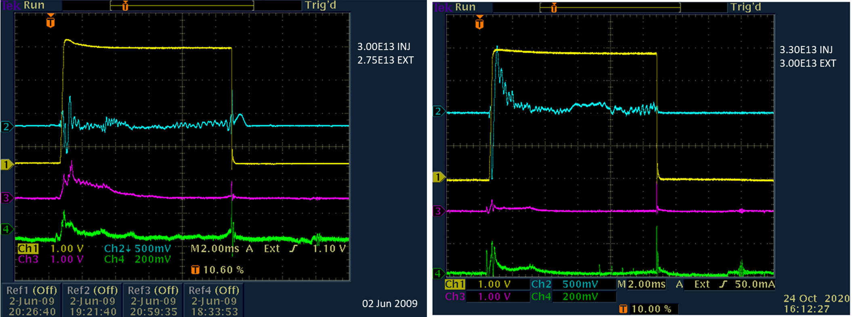
Record Performance – Machine Physics
    275 µA equivalent beam demonstrated during Feb 2020 machine physics
    Comparison of
    220–240 µA beam loss between 2009–2020
    Beam loss control enables increased collimator aperture to accept higher intensities
Same 1 V Scale
(now routinely run at 200 mV Scale)
220 µA June 2009
240 µA October 2020
Notes:
Machine physics is extremely valuable time at the end of each cycle, usually x3 days, in which we progress our R&D studies.
Dean Adams has had a long running campaign of high intensity studies in the ISIS synchrotron and in February 2020 greatly surpassed his record, demonstrating 3.4e13 protons on target, equivalent to 275 uA at 50 Hz!
The bottom scope traces here show the comparison between beam loss levels for 220 uA in 2009 and 240 uA in 2020 on the same 1V/div scale.
So again, to emphasise that the increase in beam intensity has come hand-in-hand with reduction in beam losses, therefore minimising residual activation and maintaining the ability for hands on maintenance.
All of these records are the result of many years of development and I’ll now highlight three projects that have had a big impact towards this:

Slide 7
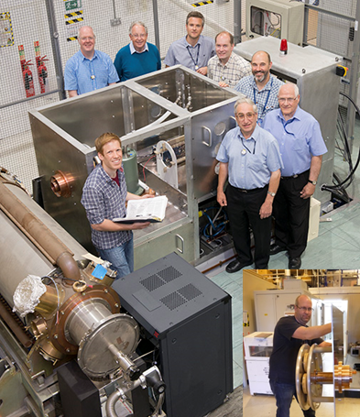
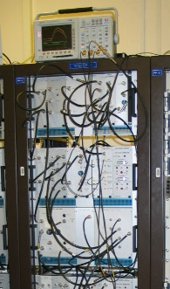
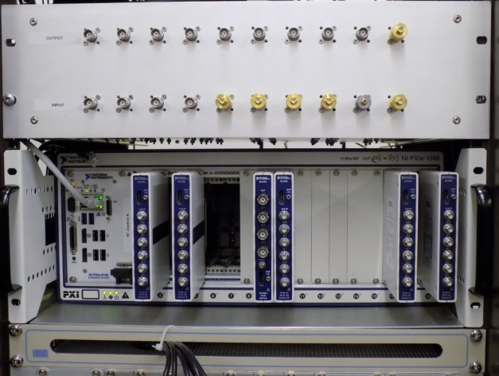
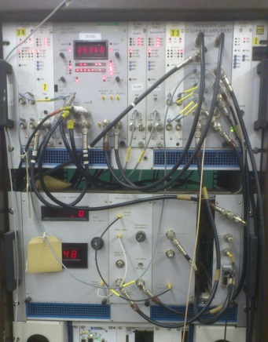
Accelerator Developments
Synchrotron RF Digital Low-Level Control
>35 year old analogue controls obsolete
New digital system based on NI FlexRIO Platform
Frequency Law Generator demonstrated 2016
Modular system developed, incorporating feed-forward beam compensation
Analogue/Digital comparison over first 3 ms of acceleration
x10 Cavity Control
Frequency Law Generator
https://arxiv.org/abs/1910.07302
Notes:
Synchrotron RF Control:
The analogue RF controls have been in service for over 35 years and the ageing components were becoming obsolete. So a new digital system based on NI FlexRIO platform has been developed and commissioned for both fundamental and dual harmonic systems.
Digitisation began with the main frequency law generator and this was first demonstrated in 2016. The modular system has expanded since then and now the RF control loops, cavity tuning and gap volt demand is all controlled digitally. This has led to improved RF stability and incorporation of feed-forward beam compensation into the acceleration cycle. The small controller is now doing the job of many racks worth of analogue controls, with excellent results!

Slide 8
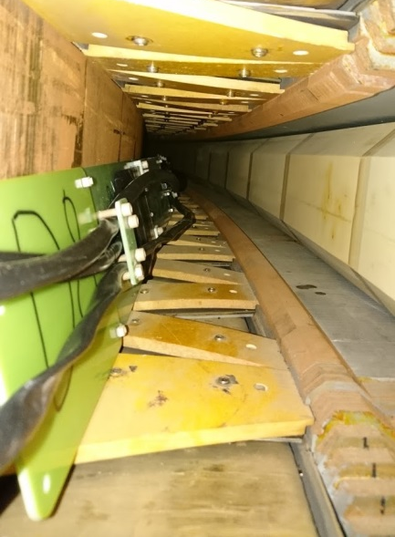
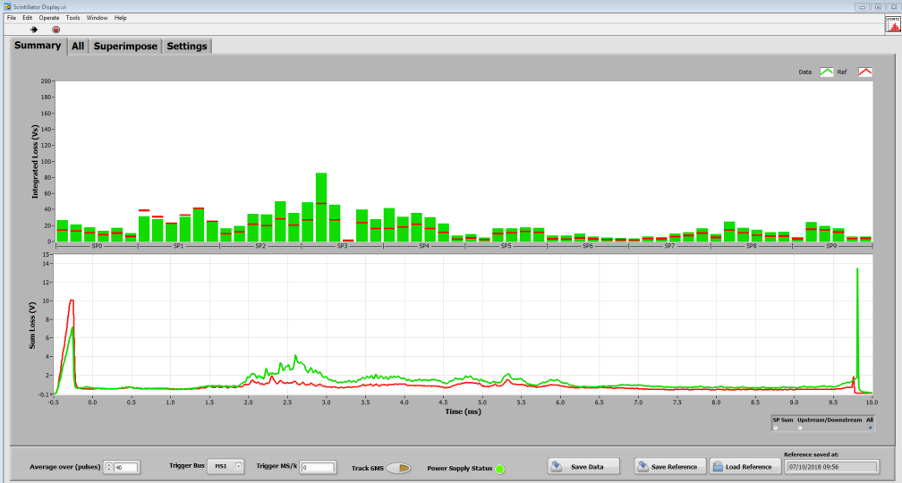
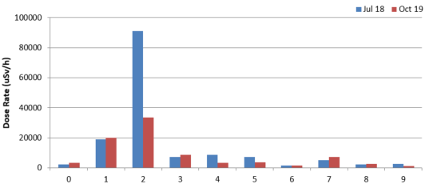
Accelerator Developments
Synchrotron Scintillator BLM System
x6 novel BC408 plastic scintillators installed in each dipole since 2018
Previously unseen beam losses in dipoles now measured
40% reduction in residual dipole activation
Health Physics Dipole Survey Comparison
Vacuum
Vessel
Super Period
http://accelconf.web.cern.ch/AccelConf/ipac2019/papers/wepgw091.pdf
Notes:
Synchrotron Scintillators:
Primarily loss is detected in ionisation chambers around the inner radius of the ring. However these are ineffective at measuring loss inside the main dipoles which cover about a quarter of the machine circumference, as losses are shielded by thick steel yokes. This has resulted in damage to dipoles and lengthy downtime in the past. The novel use of BC408 plastic scintillators, ensuring no metal components, inside a dipole was first demonstrated in 2006 and then proposed for all dipoles. This goal was realised in August 2018. Machine physicists have since used the increased sensitivity and coverage of scintillators to tune the previously hidden beam loss back towards the collimation straight which in turn has given us the control and confidence to increase the collimator aperture, to accelerate the higher beam intensities. Radiation surveys of the dipoles also show a 40% reduction in dose rates over this period.

Slide 9
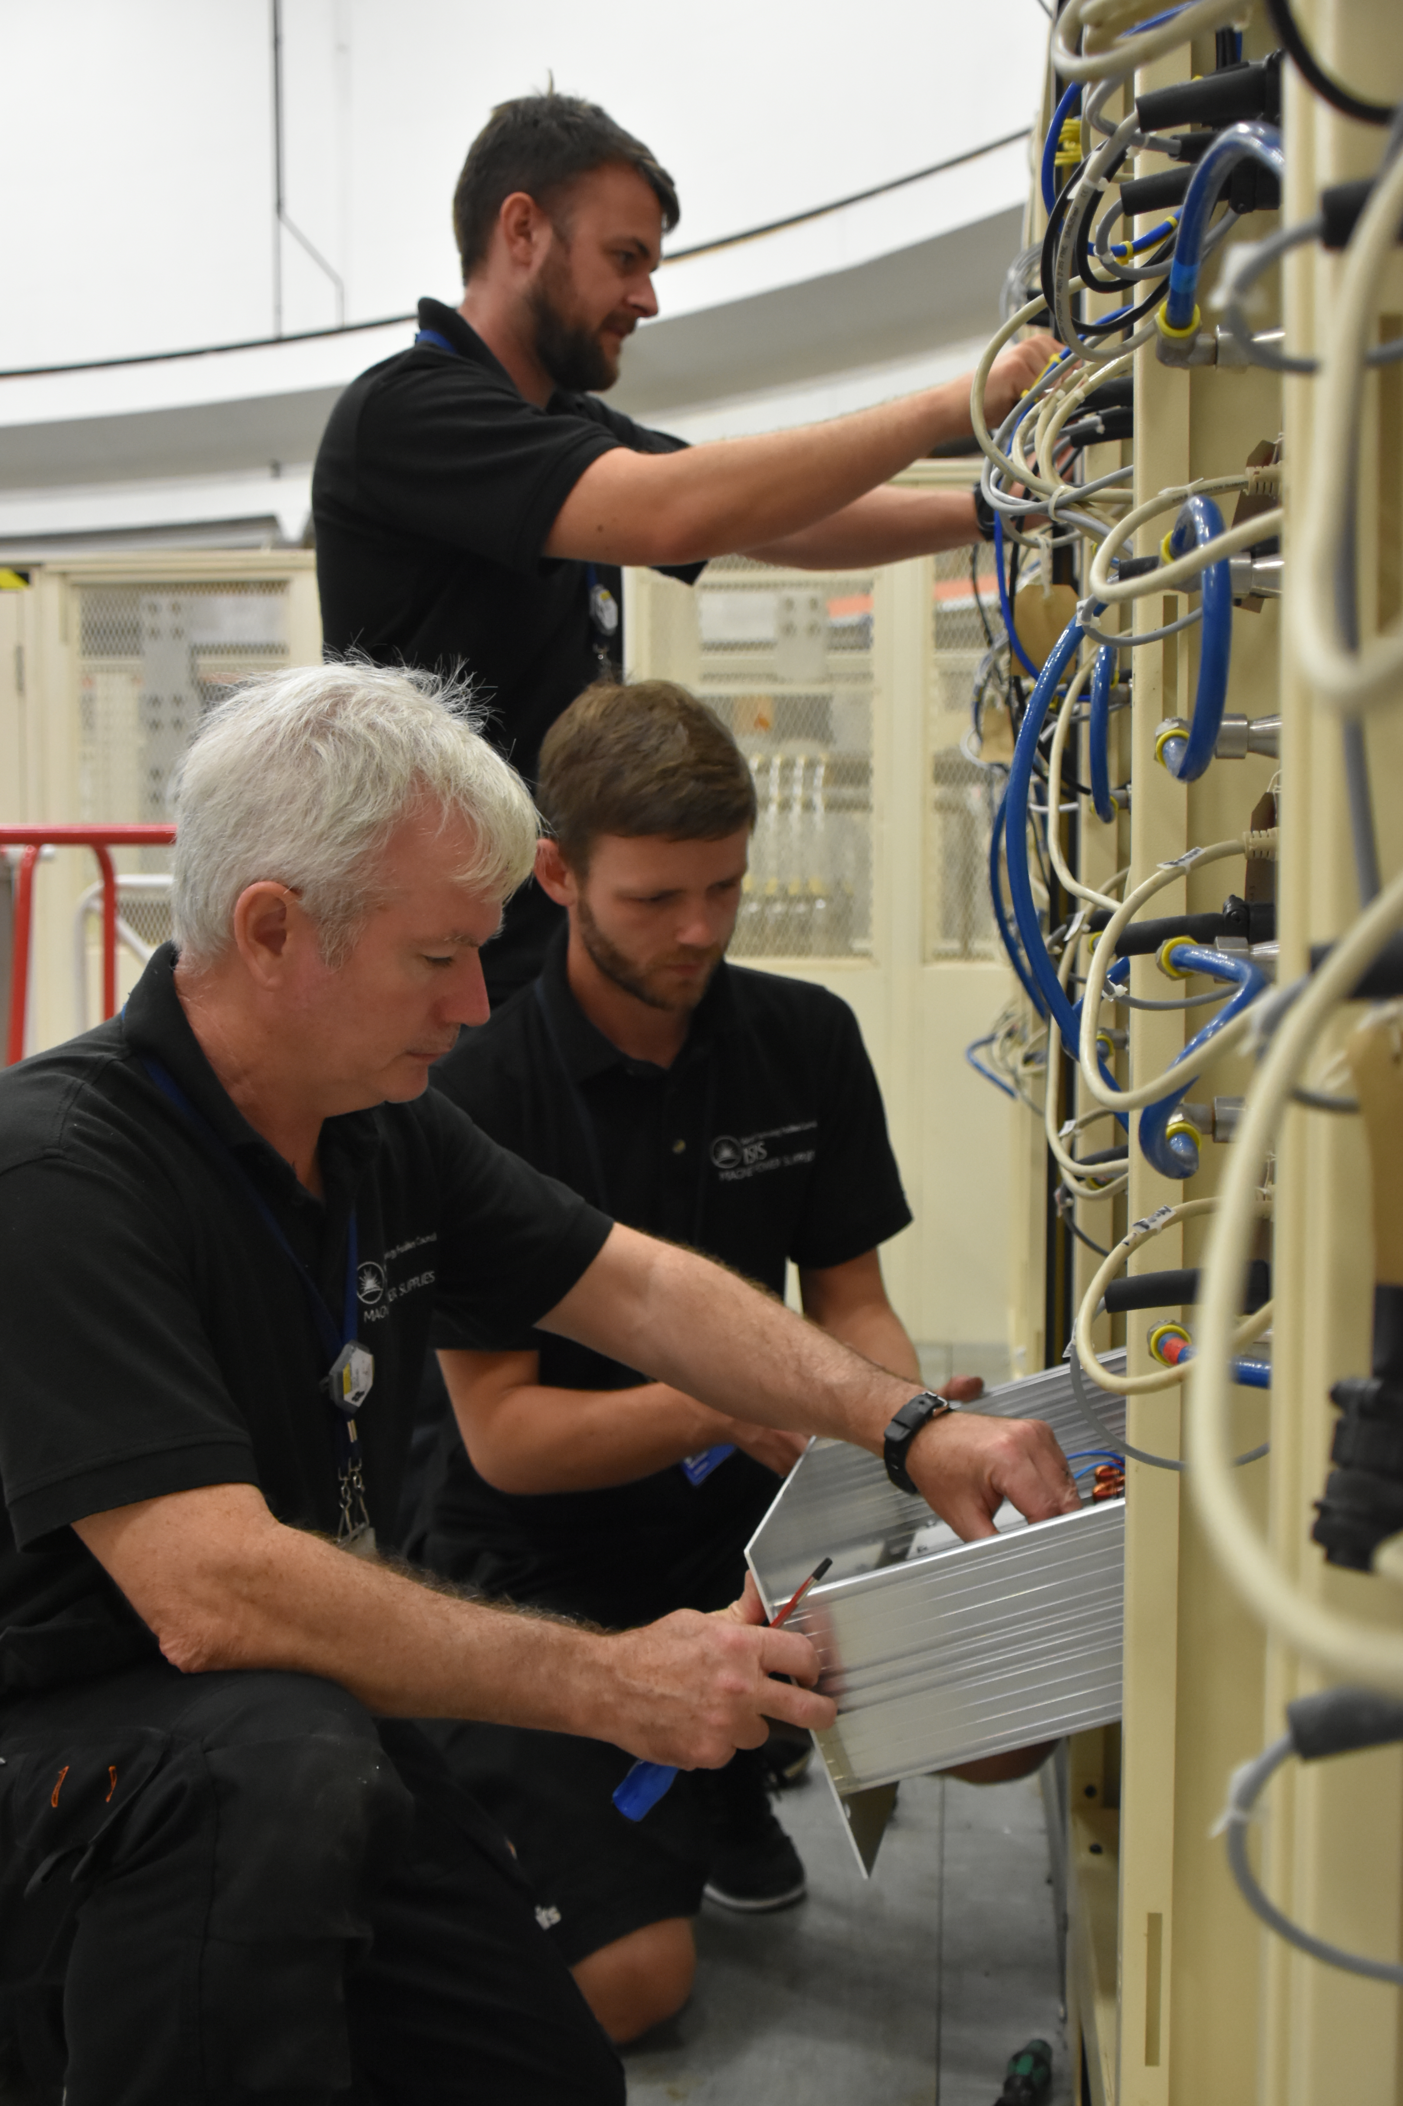
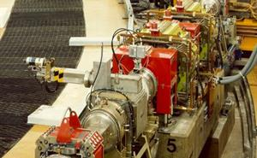
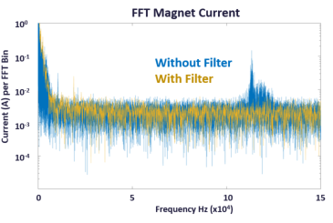
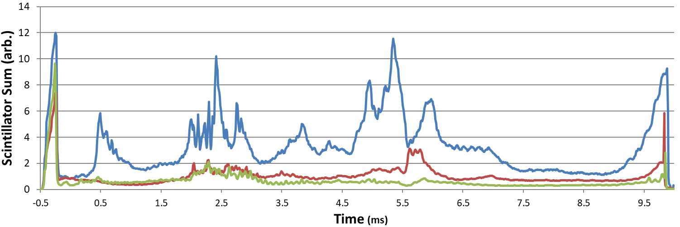
Accelerator Developments
Trim Quad Power Supply Filtering
x20 programmable trim quadrupoles, PSUs replaced 2010
Switching frequency (120 kHz) seen by beam
Filters applied to PSUs
Trim Quad filtering
Beam Losses
September 2018 November 2018 February 2019
Notes:
Trim Quad Power Supply Filtering
There are 20 programmable trim quadrupoles in synchrotron which allow fine tuning of the beam dynamics. These power supplies were replaced back in 2010 to address reliability issues. Although achieving that goal it had the adverse affect of increasing beam loss, since unexpectedly the switching frequency of each power supply is seen in the magnet current. And the beam was getting a kick from the first harmonic of this as it was accelerate. The combined effect of this from 20 supplies caused significant beam loss that was difficult to tune out. Under tight space, heat and slew rate constraints, a filter was designed for the power supplies and applied to families of magnets over a number of shutdowns. The plot here shows beam losses with and without filtering.

Slide 10
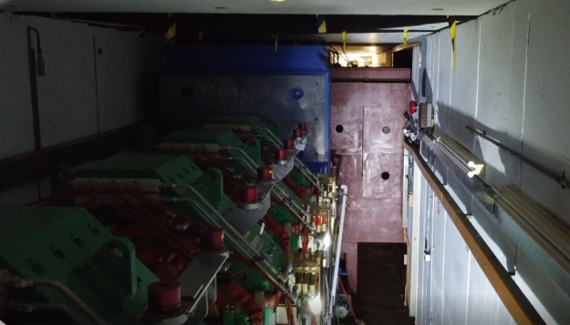
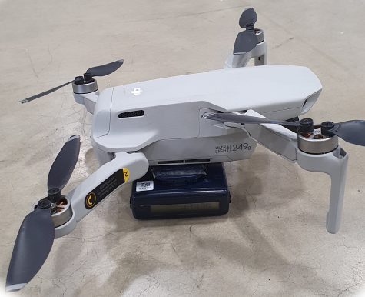
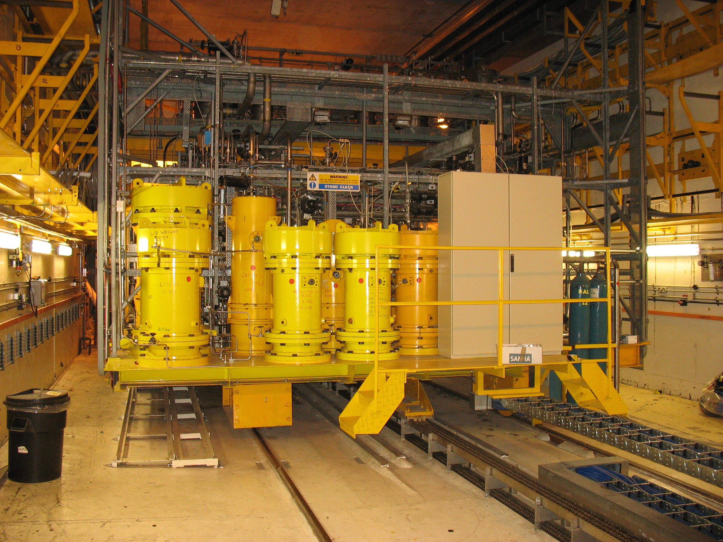
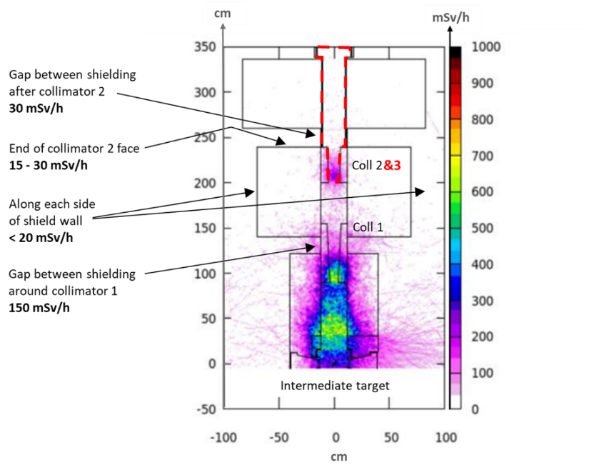
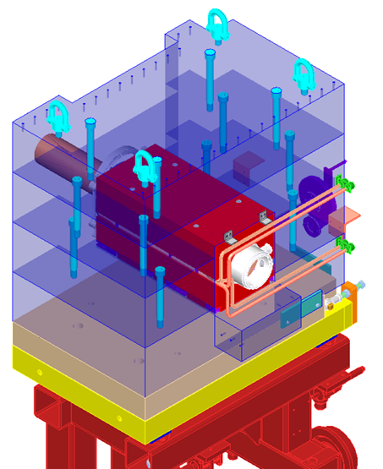
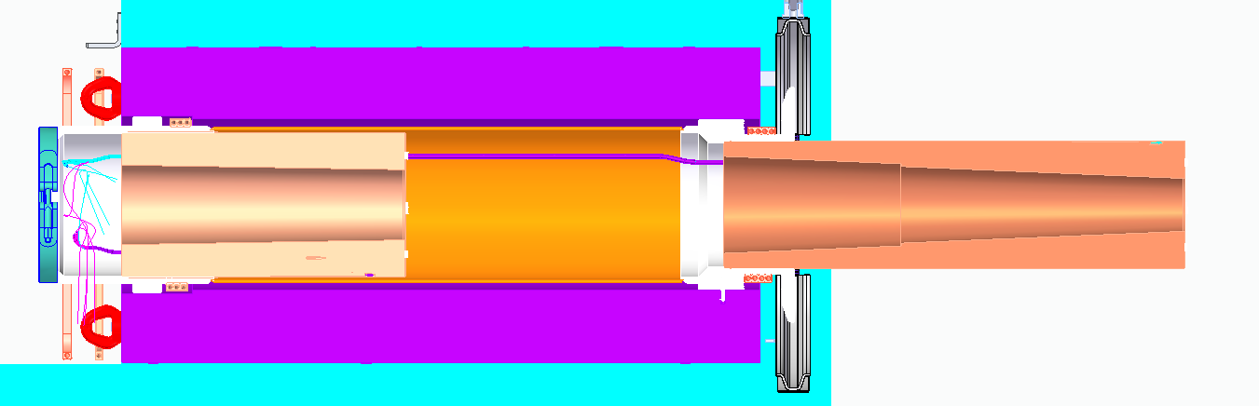
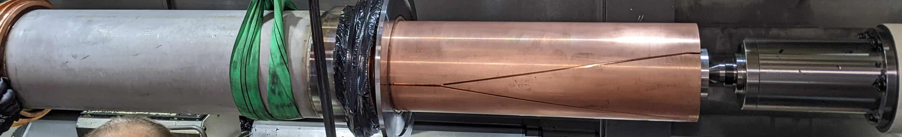
Long Shutdown Projects
TS-1 Upgrade
Muon Target
Collimator
Water leak November 2020
High Dose Rates
New collimator manufactured and replaced
Commissioning Autumn 2022
Target, Moderator, Reflector, and Services
Due Autumn 2022!
Notes:
We then began the long shutdown in June 2021 with a very busy schedule, I can’t mention everything here but I’ll just highlight a few of the large projects, there’s more detail in John’s talk tomorrow..
Firstly there is the complete replacement of Target station 1 systems. The assembly was largely unchanged over the previous 35 years, so this project addressed the target design, cooling, moderators, reflector and all services. The new modular target design and inclusion of pre-moderators is designed for neutronics optimisation and improved the performance and lifetime of the cryogenics brining big operational benefits. This was a roughly 18£M project over an 11 year time frame.
The other target related project was replacement of the muon target collimator, the conical copper sections that capture stray proton beam after the strong focus for the muon target. These developed a water leak in November 2020, on a previously repaired joint in 2014. So the long shutdown was used to replace the entire collimator assembly. As a beam physics group we were involved in the project from the beginning and contributed to design choices and detailed FLUKA activation modelling. Due to the high radiation in the area, and tight conditions in the tunnel, a drone carrying an electronic personal dosimeter was also used to measure the dose rates in the area. The collimator has now been successfully installed and under vacuum, awaiting commissioning when target station one beams become available.

Slide 11
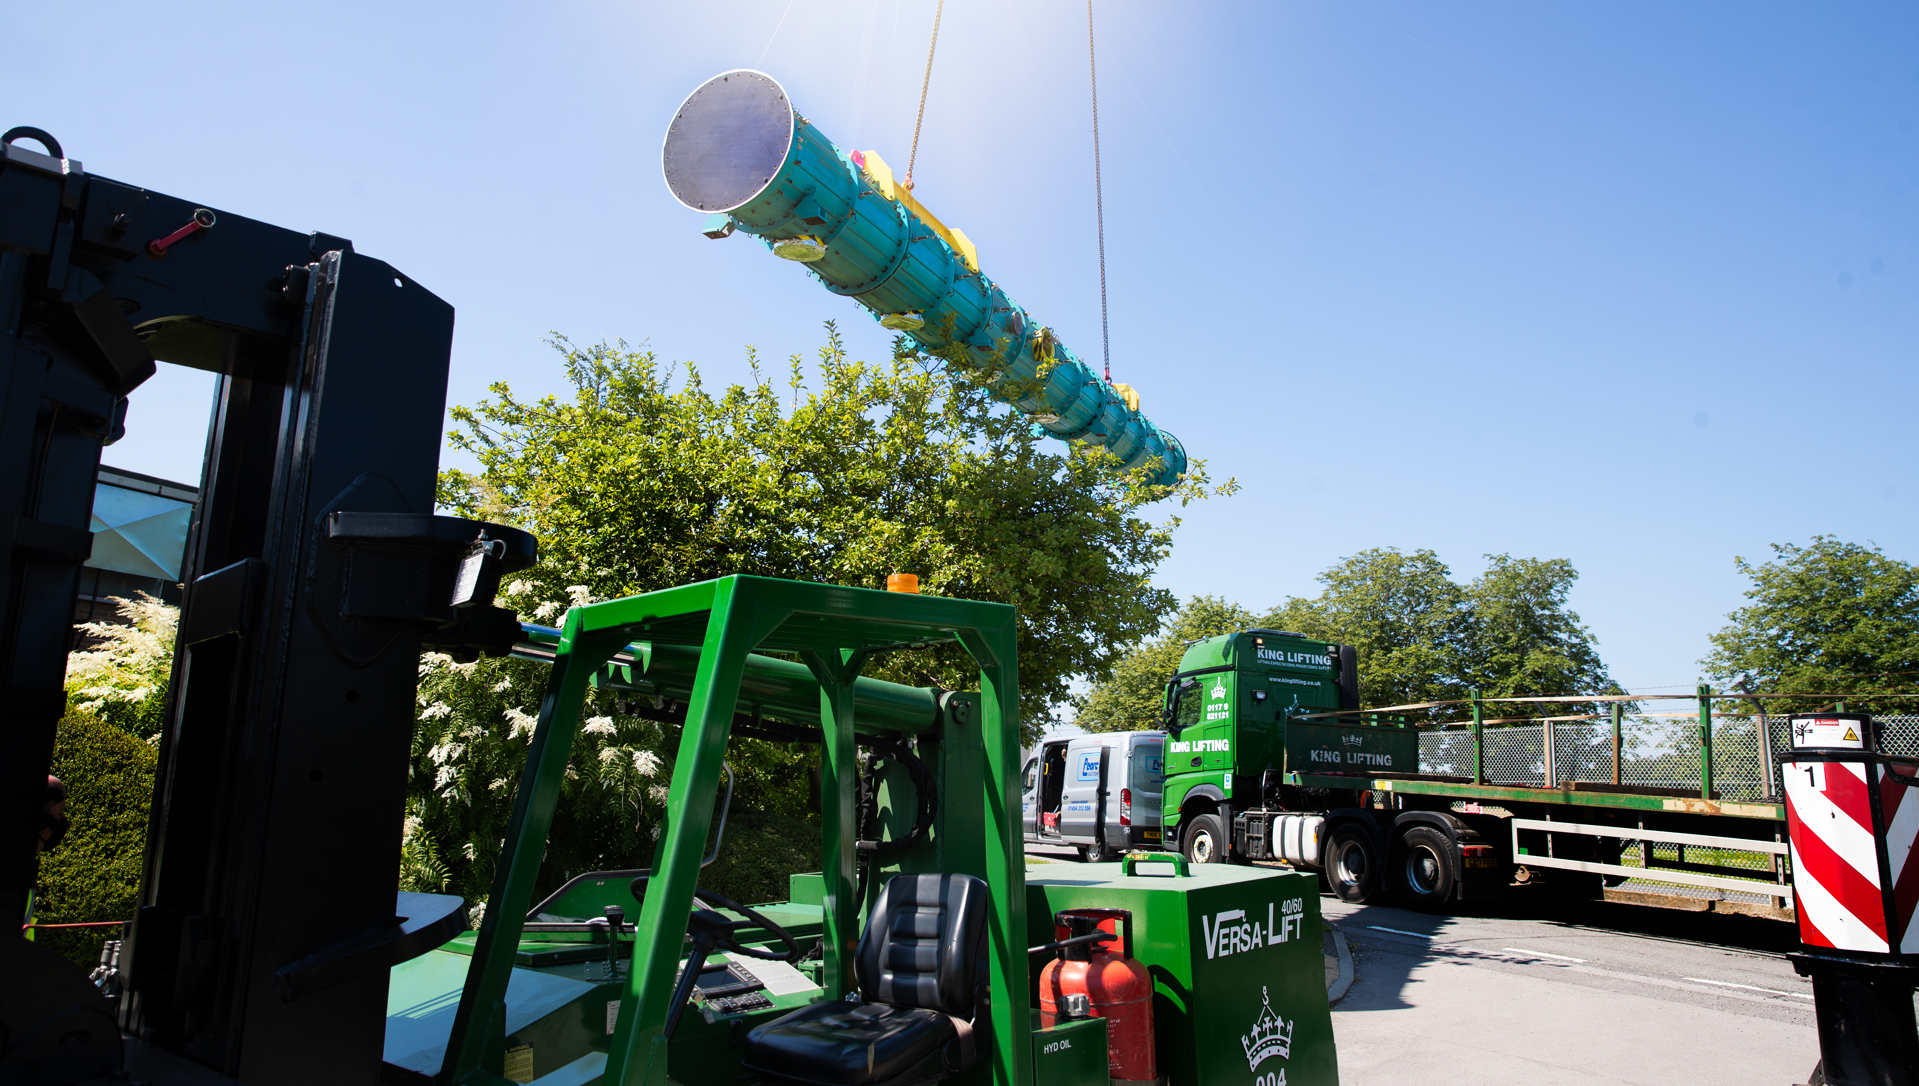
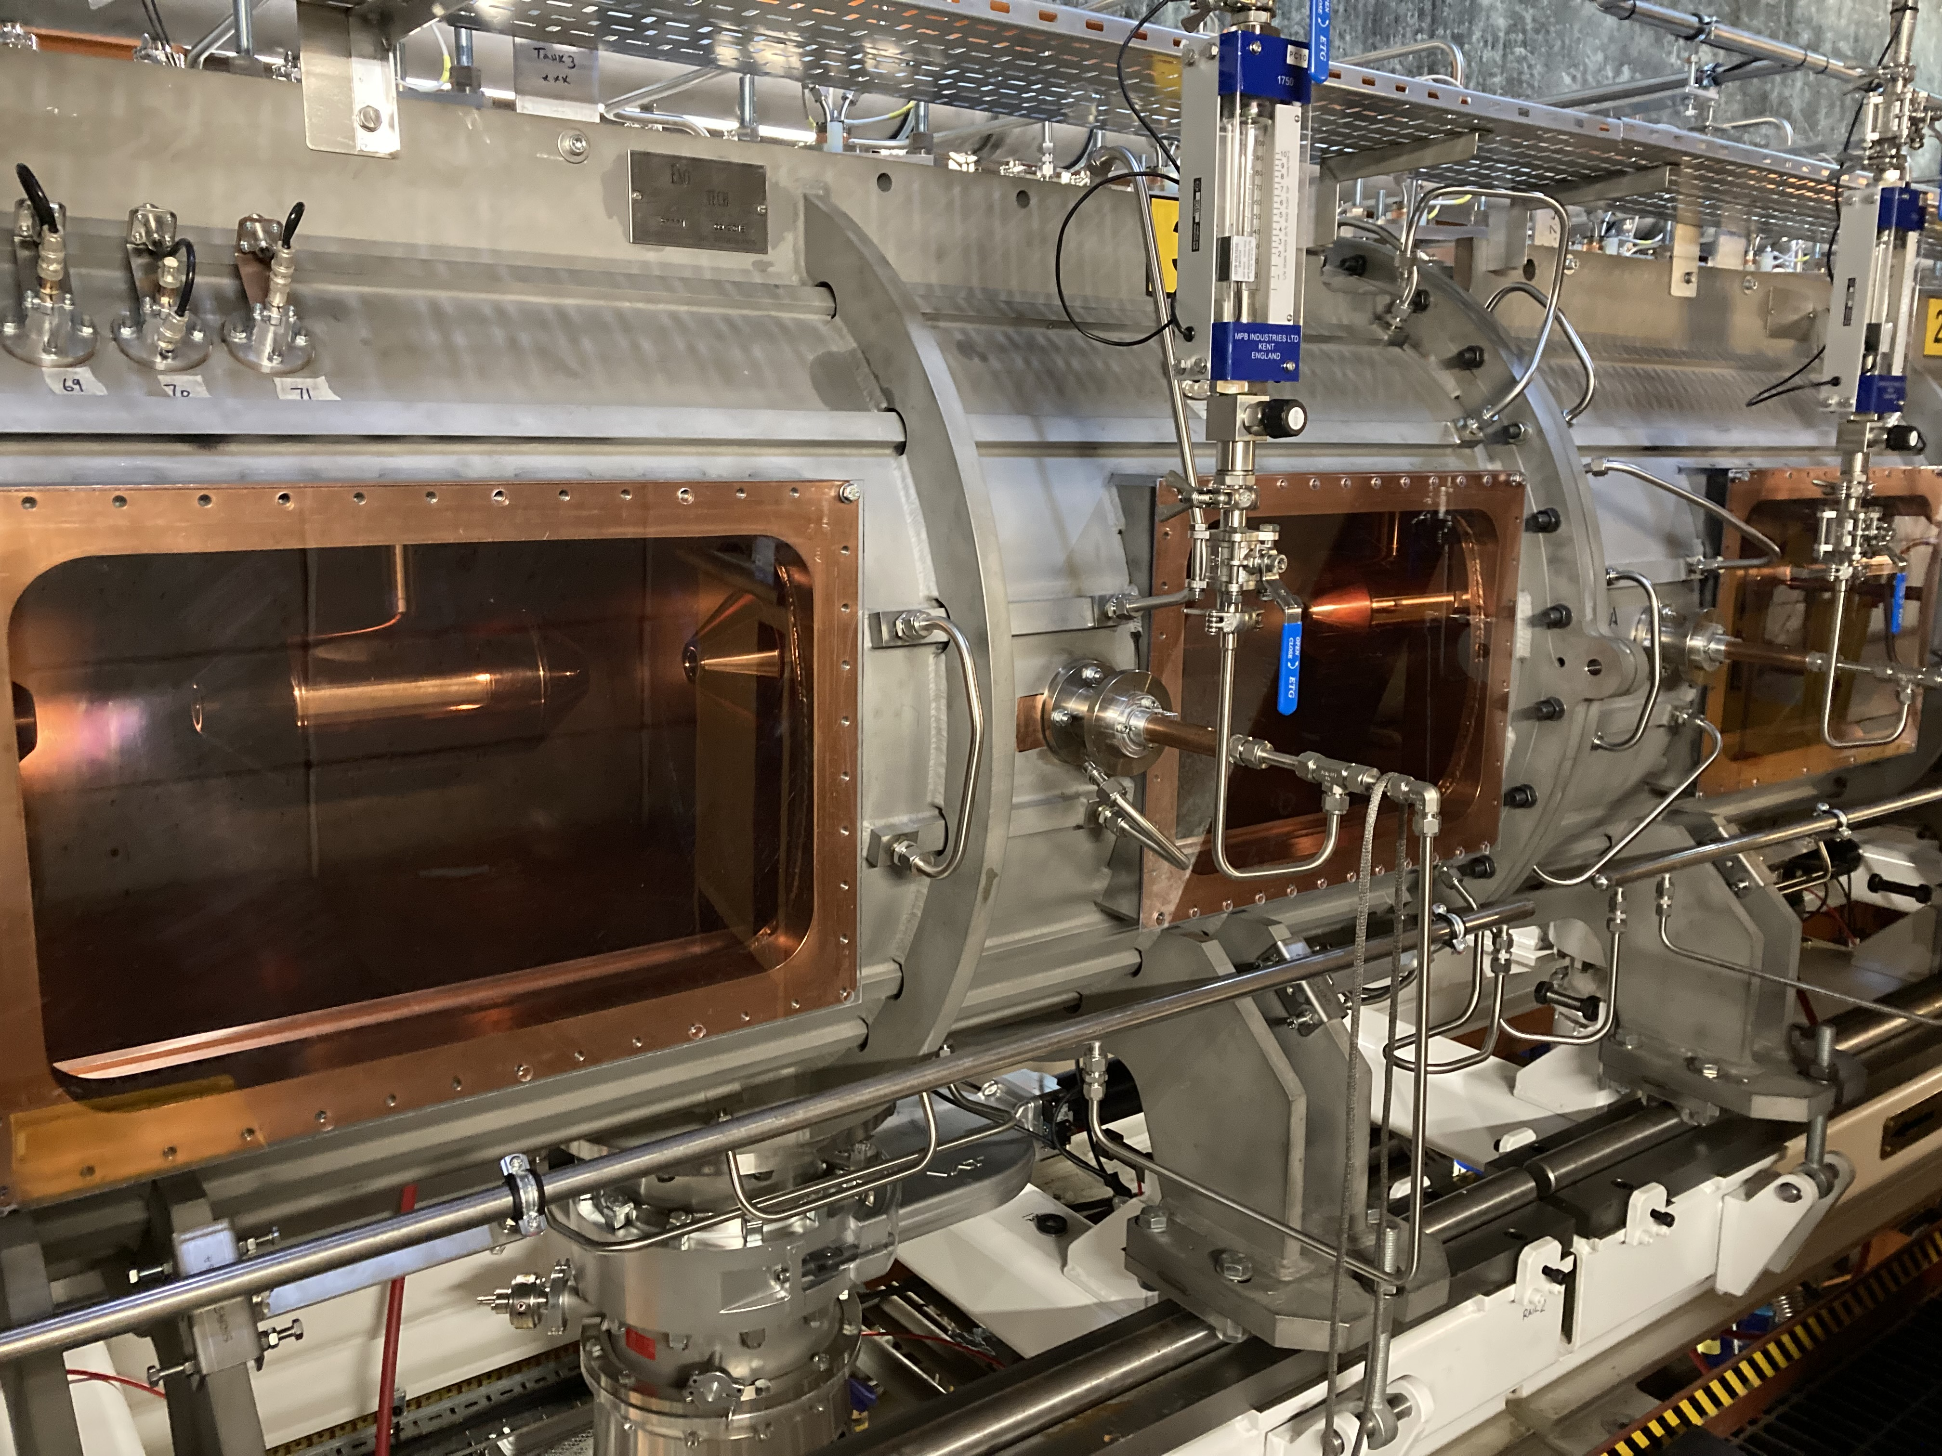
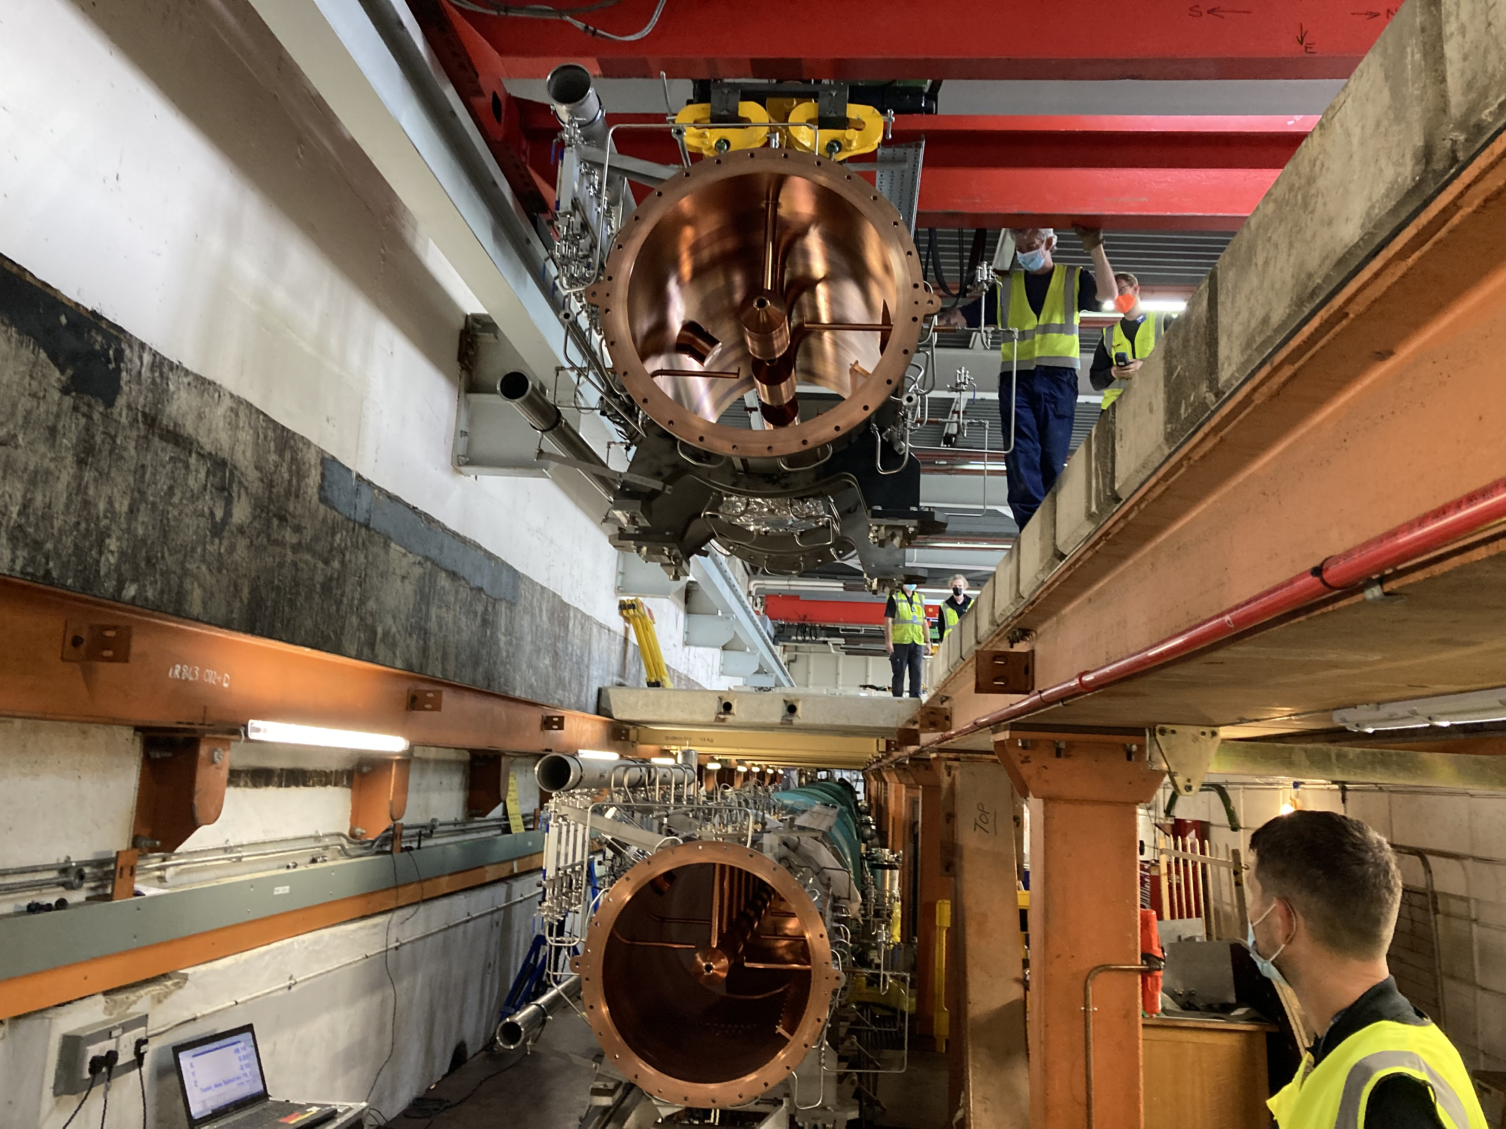
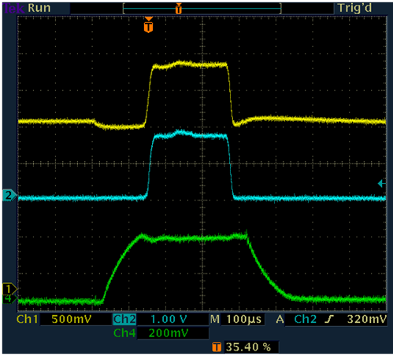
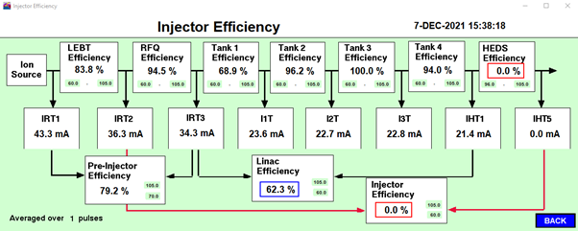
Long Shutdown Projects
Linac Tank 4 Replacement
New Tank Installation
Old Tank Removal
First beam
7th December 2021
94% transmission
I3T
IHT1
T4 Field
Notes:
The other headline project of the long shutdown was the replacement of linac tank 4. The original tank was built in 1976 for ISIS’s predecessor, NIMROD, but was becoming difficult to maintain. The 12 m tank was re-engineering to be built in x6 2m sections that are bolted together with access ports for improved maintainability. All of the newly designed drift tubes were manufactured on site and the tank efficiency has increased by 25%. This was another large project, £7M project over 10 years.
On 7th December last year we saw first beam through the tank, with 94% transmission achieved.

Slide 12
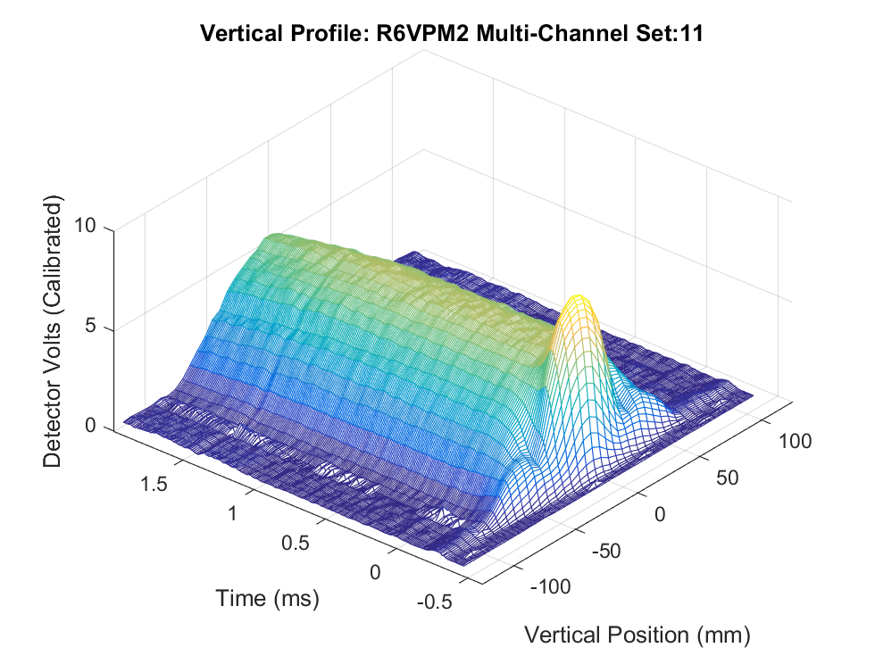
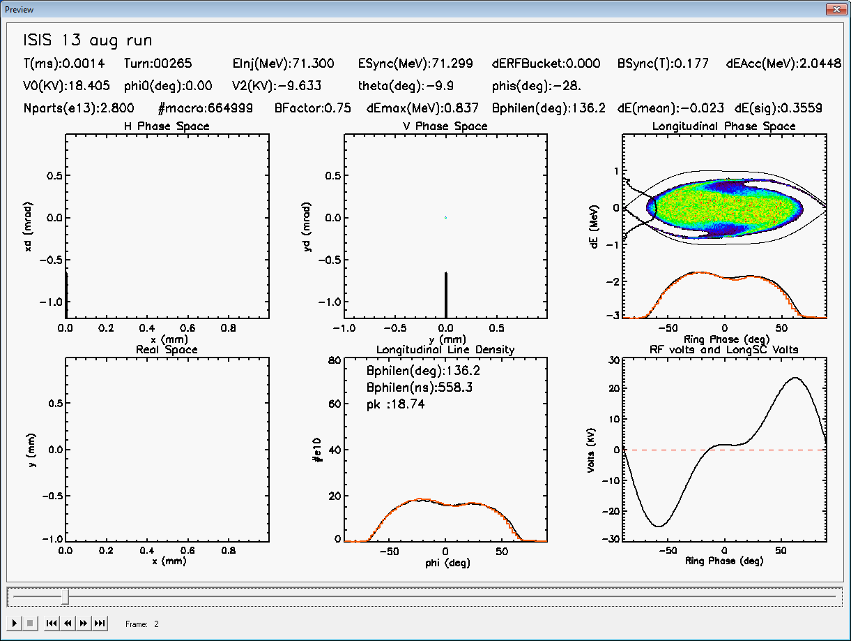
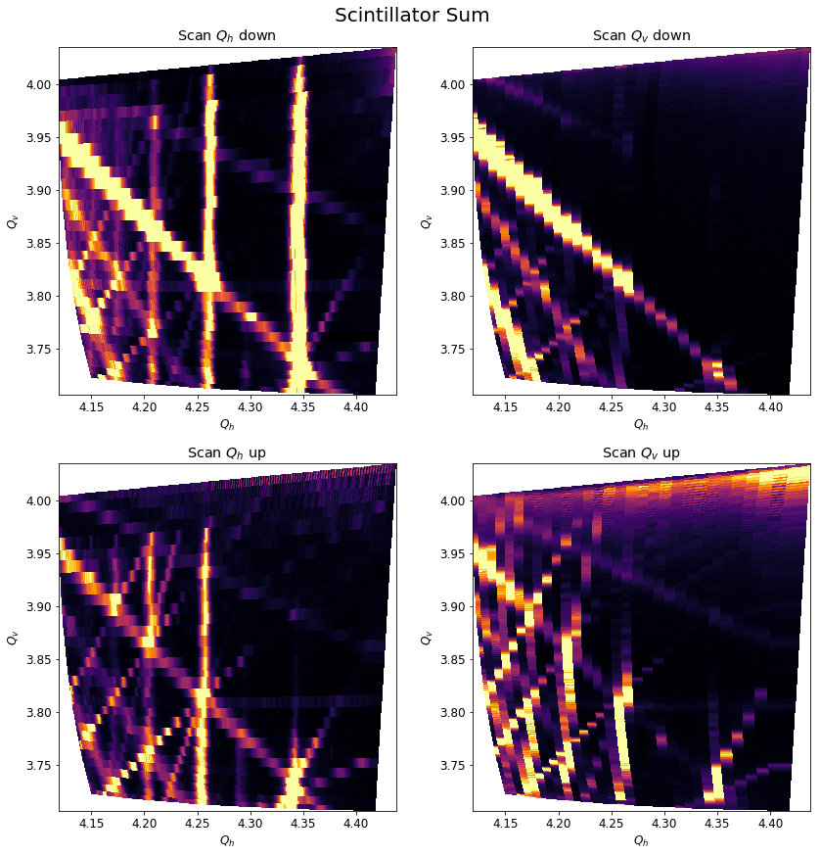
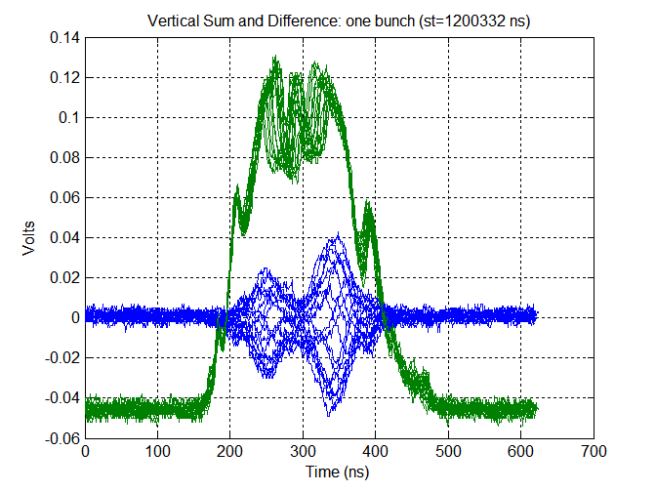
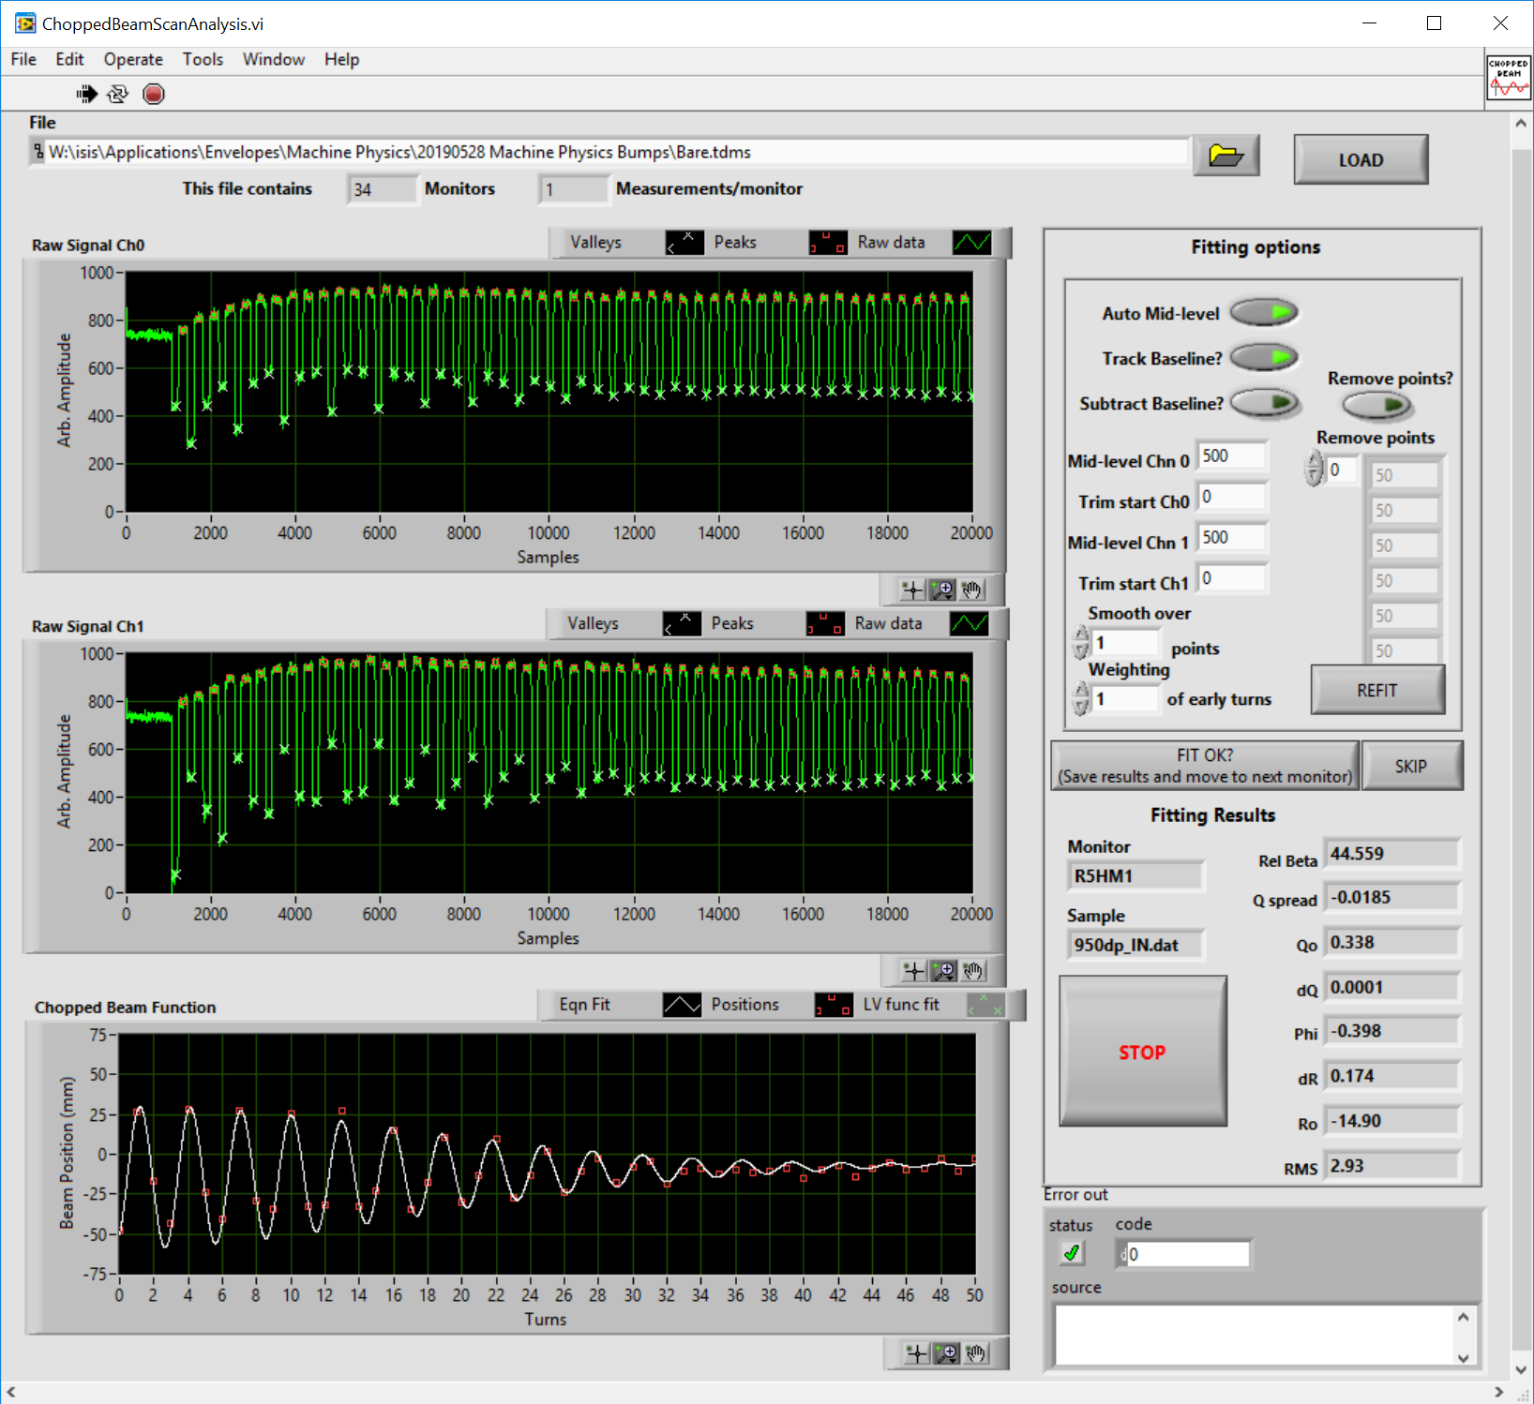
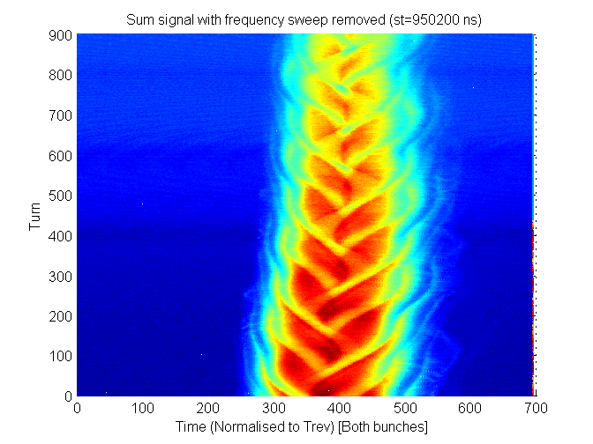
Present & Future Work
Machine Physics, Research & Development
TS-2 only, recovering from long shutdown, yet to restore full performance
High intensity space charge studies and simulations
Transverse dynamics – resonance and losses
Low intensity lattice measurements
Head-tail instability & impedances
Longitudinal dynamics
Tune space mapping
Notes:
Since January we’ve been running only to our second target station, whist the TS1 upgrade is on-going.
We’re still recovering from the long shutdown, re-commissioning after a number of major machine changes, and have yet to restore full beam performance.
Although ISIS is an older machine there is still much to understand about the high intensity ring that will help us now and for future machines. We use our machine physics time to pursue our R&D running the machine in novel modes such as storage ring mode, or with low intensity 100 ns chopped beams, and within the group we have many studies but the few I’ve highlighted here are:
Campaigns to demonstrate high intensity running
Transverse dynamics studies, measuring and modelling the evolution of the half integer resonance
Chopped beam measurements of low intensity lattice parameters
Measurement and modelling of the head tail instability
Mapping the available tune space
Amongst many others…

Slide 13
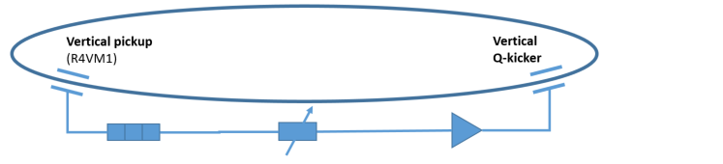
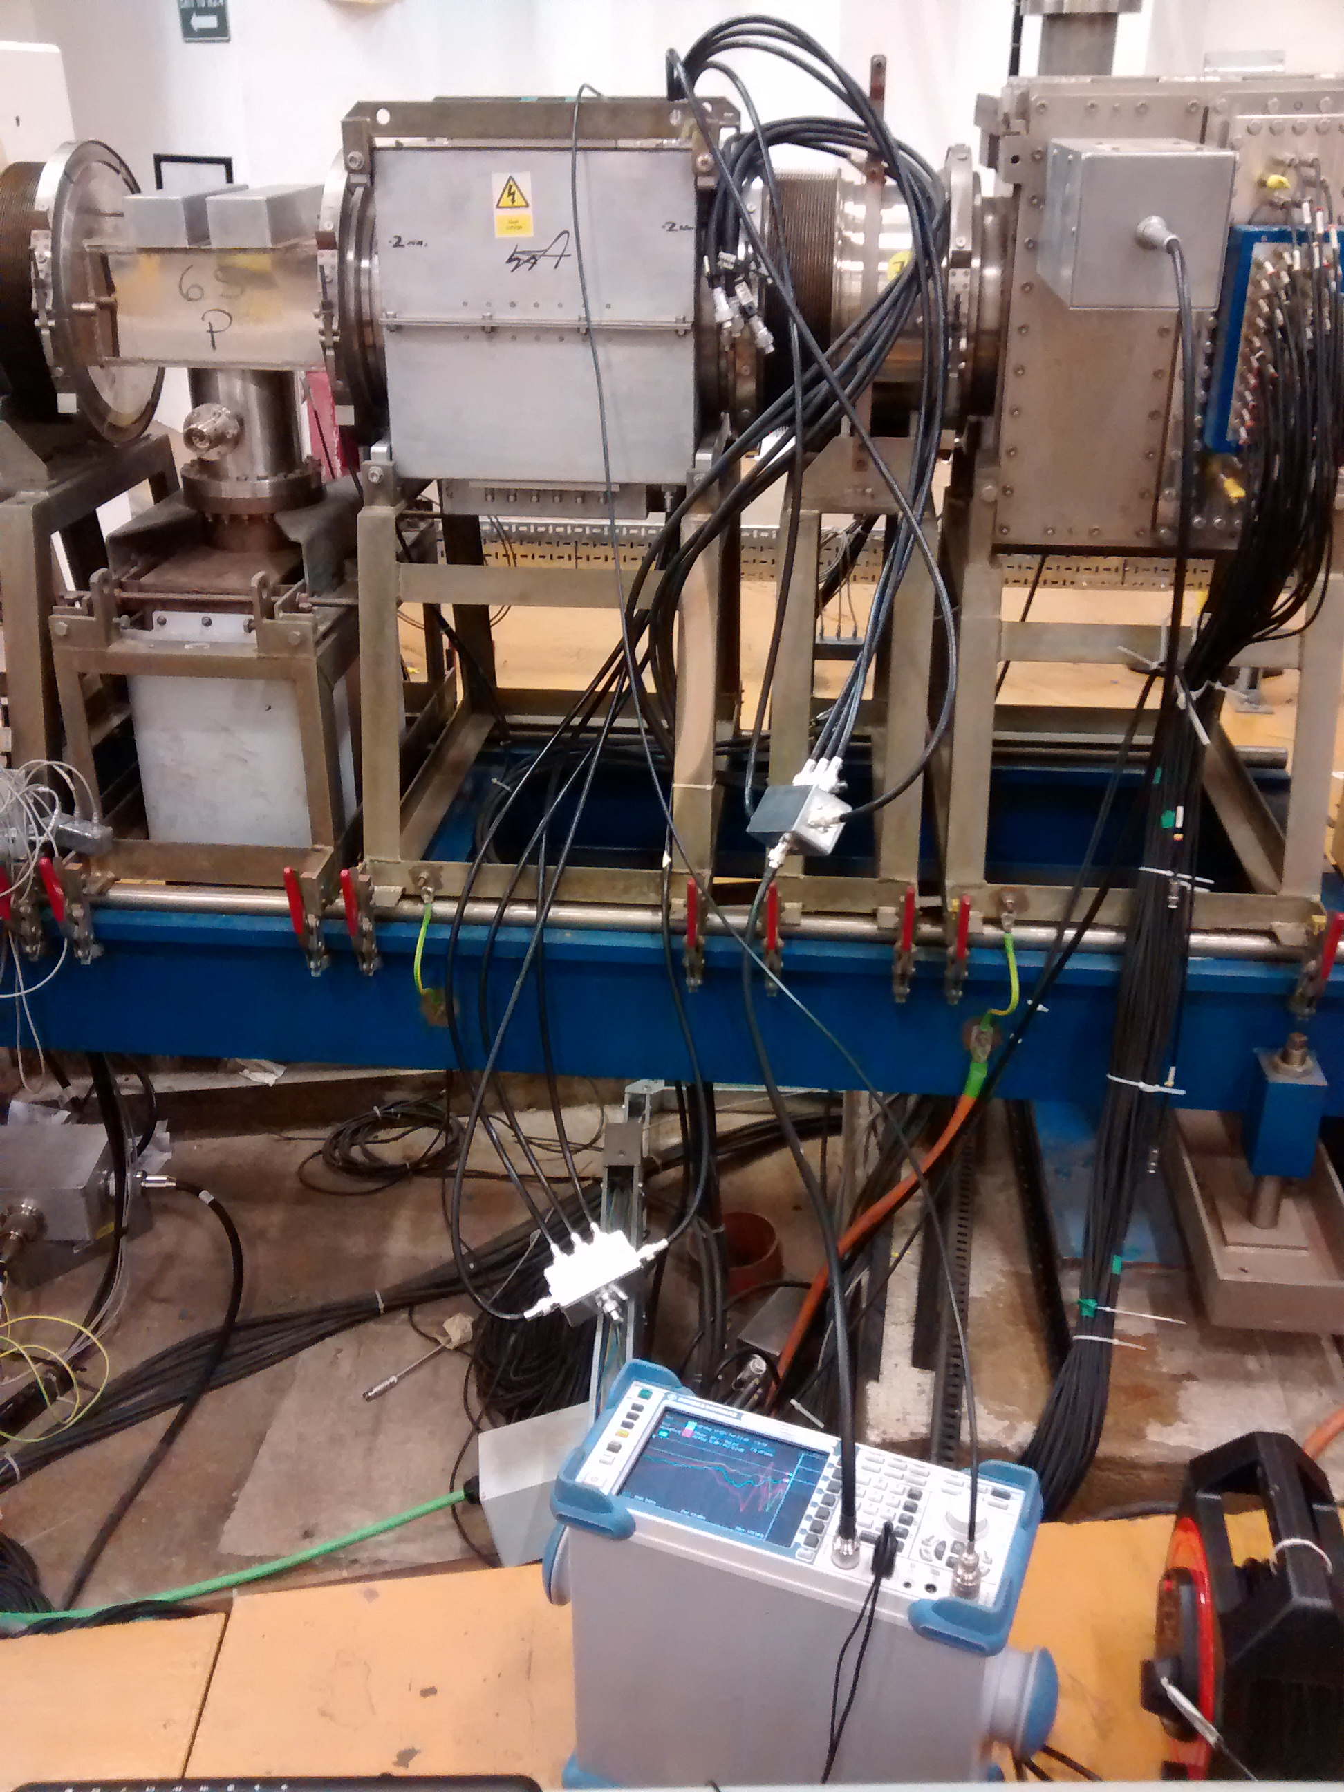
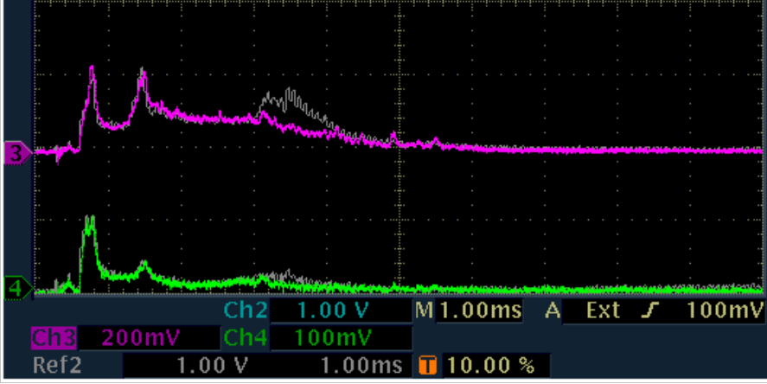
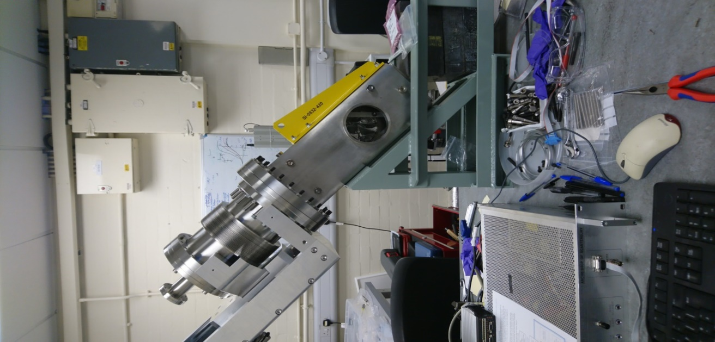
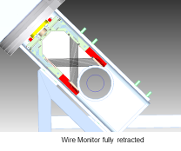
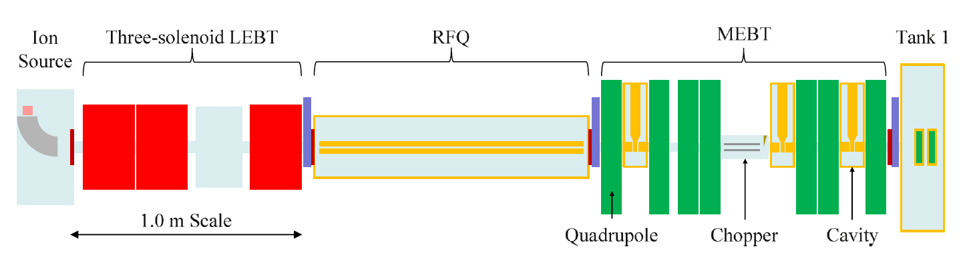
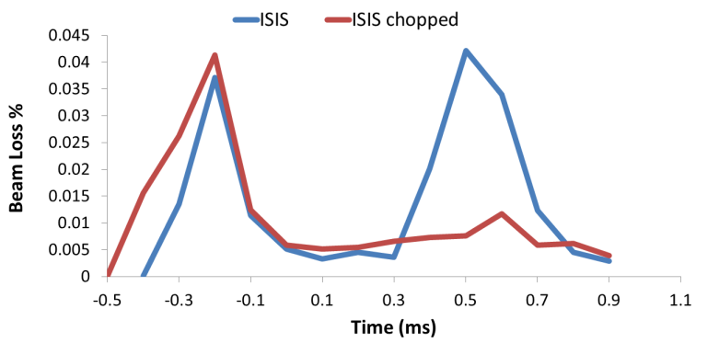
Present & Future Work
Hardware Upgrades
220 µA operational
Beam Damper System
Multi-Wire Injector Profile Monitors
220 µA with damping
Next Long Shutdown
MEBT! Reduce beam losses by injecting a chopped beam
Many other Accelerator Development Projects at ISIS…
RF Ion Sources, FETS, ISIS-II, FFA Magnets …
Notes:
We also have various new hardware projects underway.
Hand-in-hand with the head tail R&D is the development of a beam damper system. This was originally conceived as a strip-line kicker but has evolved into using the existing Q kicker in a feedback damper system using the pickup from a vertical beam position monitor. Here we can see the demonstration of significant reduction in beam losses at 50 Hz. Further development and testing is underway and this will soon be available in operations.
Next month we will install a set of three new injector profile monitors. The new multi-wire head design will enable single shot profile measurements, which will be faster and cause less activation that then existing moving wire design which takes ~2min and intercepts 234 beam pulses.
And plans are already well underway for the next long-shutdown period in four or five years time, when a MEBT section will be installed between the RFQ and Tank 1 of the injector. At present the match is poor in this section and we only manage to transport 70% the beam in Tank 1. With a well designed matching section and beam chopper the injection and trapping losses in the synchrotron, will be greatly reduced.
These slides is just based on work from the synchrotron group, but of course there is a whole lot more accelerator development ongoing at ISIS that I can’t talk about here, such as development of RF ion sources, FETS (front end test stand) making first beams, work on designing ISIS-II, FFA magnet design etc etc

Slide 14
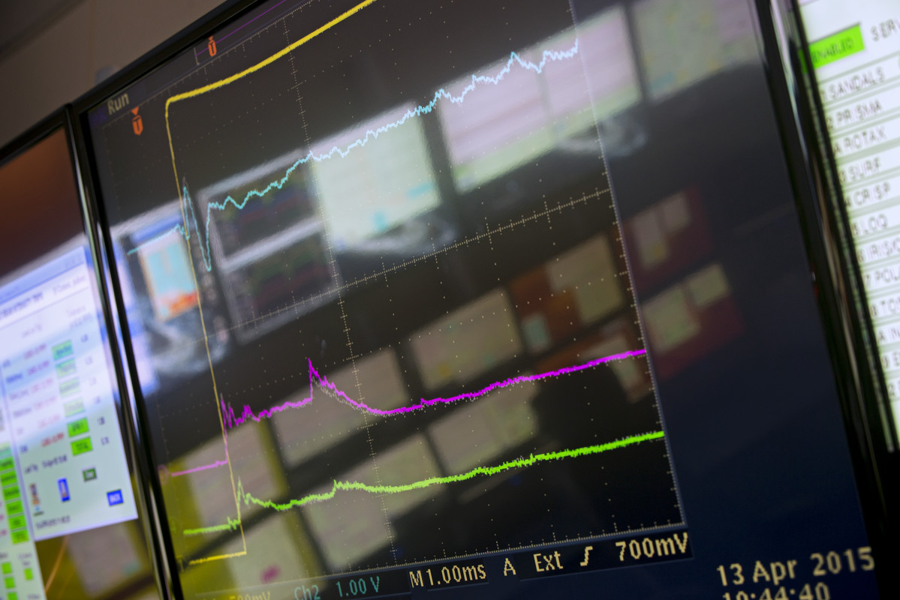
Summary
2020, record performance
2021, major projects in long shutdown
2022, busy operational year
2023+, lots to look forward to!
Notes:
To conclude, we’ve made significant progress over the past few years in terms of beam intensity as well as general machine reliability, which has led to records being set and broken.
There is naturally more work to do in recovering from the major surgery of the long shutdown, commissioning Linac Tank 4 and exciting work coming up bringing online the new Target station 1.
We keep driving forward with the task of improving the synchrotron stability and improving operational performance, increasing the intensity whilst improving machine efficiency.

Slide 15







isis.stfc.ac.uk
@ISISNeutronMuon
STFC
Notes:
All that’s left to say is thank you very much for listening, and I’d welcome any questions you may have.

