Slide 1




Introducing RUEDI
A Proposed Relativistic Ultrafast Electron Diffraction & Imaging Facility for the UK
Julian McKenzie
(on behalf of the RUEDI team)
IOP PABG Annual Conference
26th July 2022, Liverpool

Slide 2

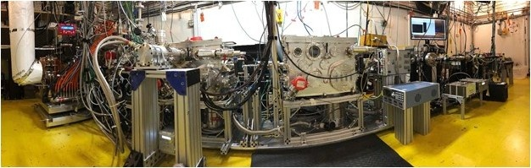
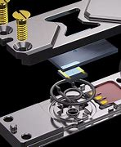
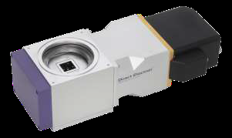
What is RUEDI?
A national user facility using MeV electrons for
imaging and diffraction on ultrafast timescales
Transformative Science Themes Accelerating UK Technologies
Dynamics of Chemical Change
Materials in Extremes
Quantum Materials & Processes
Energy Generation, Storage and Conversion
In Vivo Biosciences
World leading advances in accelerator, lens, operando stages and detector designs coupled to advances in artificial intelligence
2

Slide 3
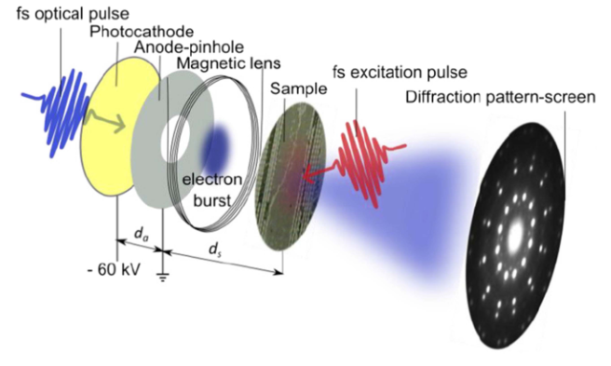
Electron Diffraction + Microscopy
Relativistic Ultra-fast Electron Diffraction & Imaging
Facility for Structural Dynamics on the Femtosecond Timescale
RUEDI allows the evolution of structural changes in materials to be observed through time-resolved pump-probe experiments
EPSRC “mid-range” national facility sited at Daresbury Laboratory
Image from Rep. Prog. Phys.74(2011) 096101
Image from Rep. Prog. Phys.74(2011) 096101
3

Slide 4
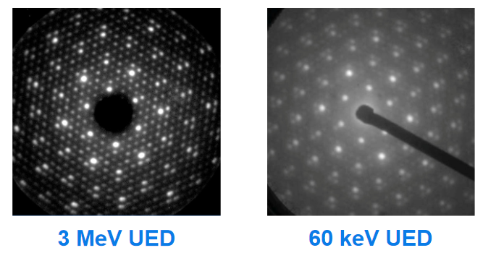
Going from keV to MeV
Greater penetration depth (thicker samples)
No velocity mismatch as β≈1
Electron wavelength below atomic level → direct observation of movement of atoms
Less multiple scattering and “real” flat Ewald-sphere
Much reduced space-charge effects (1/(β²γ³) leads to greater spatial-temporal resolution, more electrons per pulse
Images from BNL
4

Slide 5
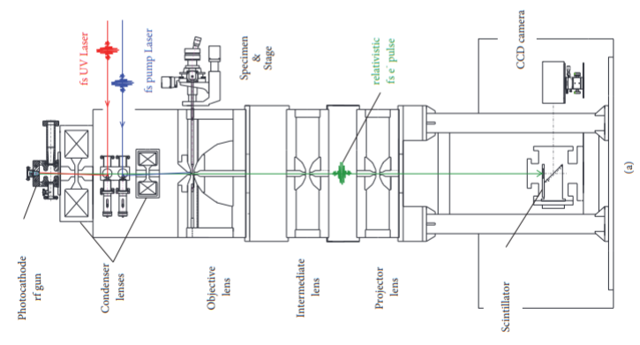
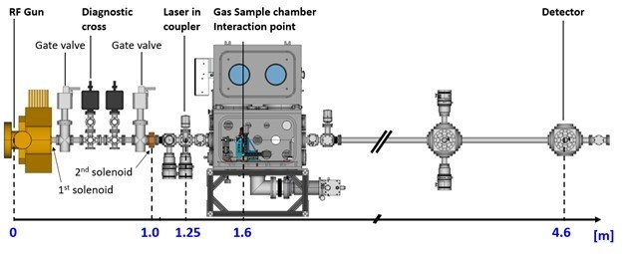
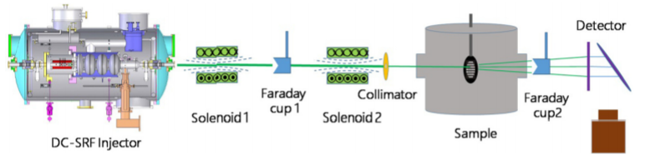
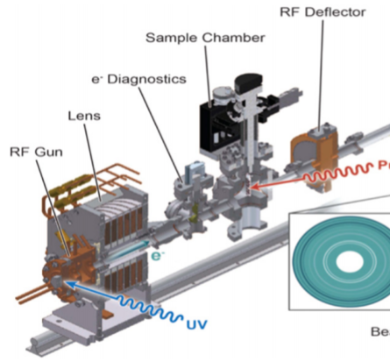
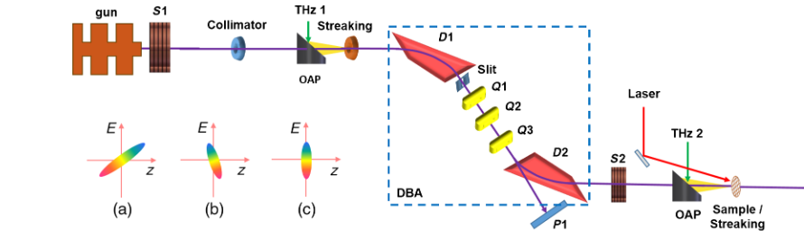
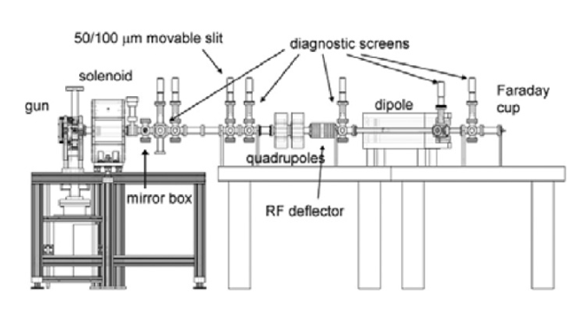
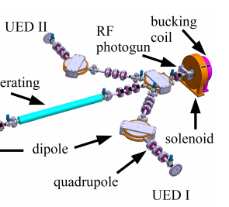
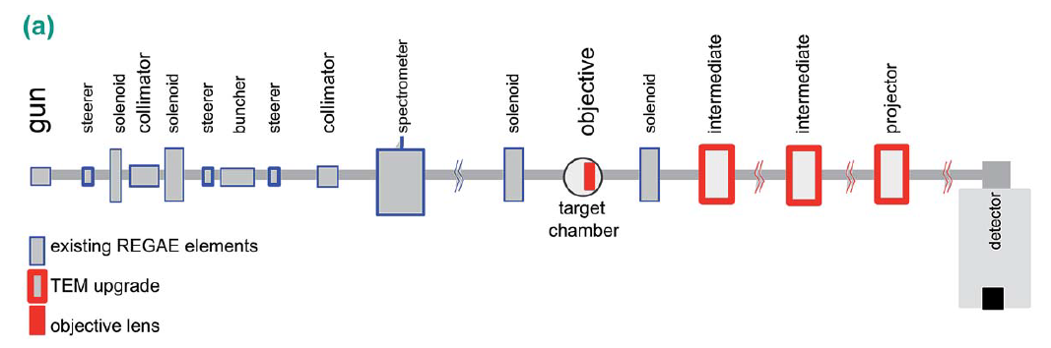
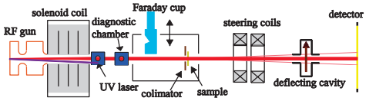
Existing MeV-UED Facilities Worldwide:
SLAC
Osaka University
Peking University
Shanghai
BNL
UCLA
KAERI
Shanghai
DESY
Tsinghua
5

Slide 6
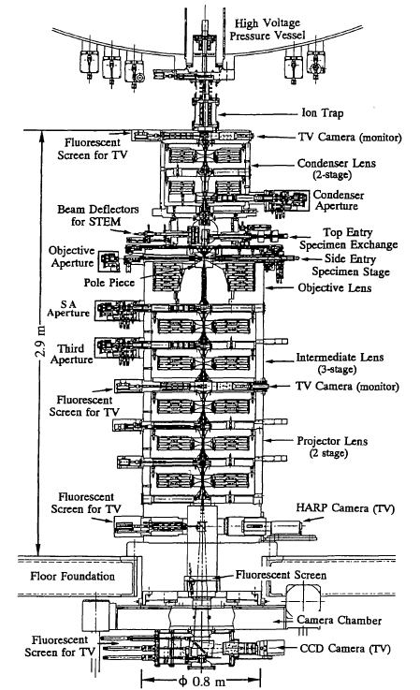
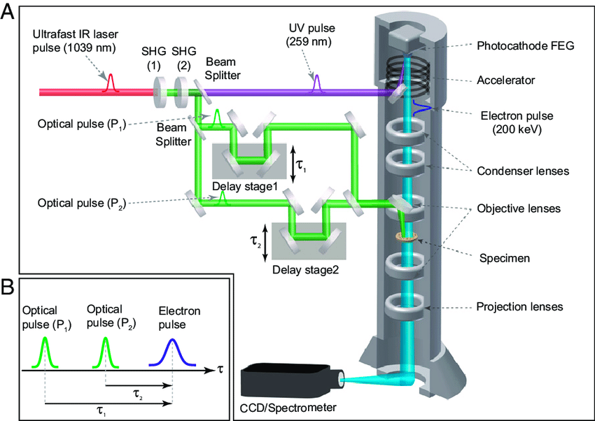
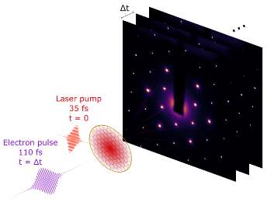
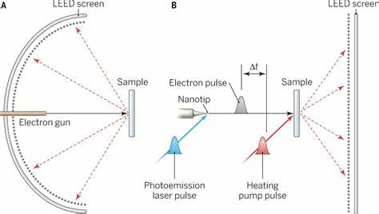
What Will Make RUEDI Unique?
Combining MeV-UED with MeV UEM
Imaging dynamics with single electron precision
Operando temp, pressure, liquid, mechanical, optical, full rotation
Integrated AI for Low-signal image analytics
RUEDI Ecosystem (Hub and Spoke)
RUEDI Ecosystem combining main MeV instrument with smaller facilities at partner institutions around the country
Leveraging partners expertise in instrumentation, imaging, ultrafast methods, lasers, materials science, structural biology
keV-UEM
keV-UED
ULEED/ULEEM
MeV-TEM Osaka

Slide 7
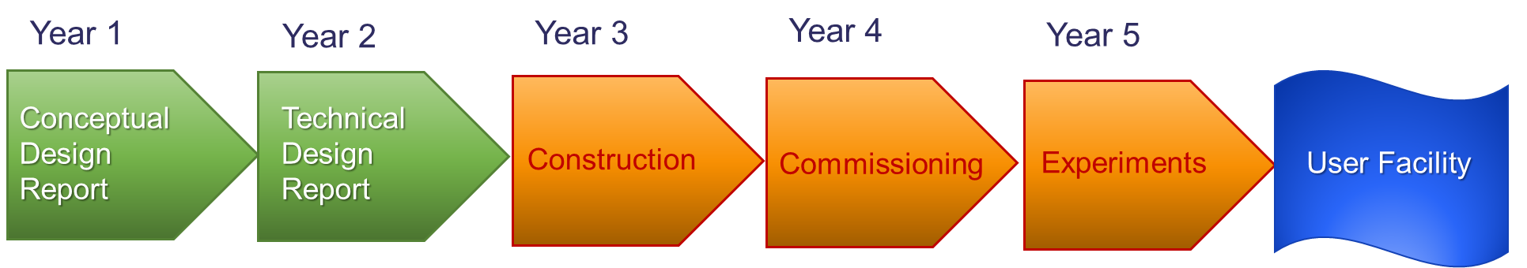
Funding + Timescales
UKRI Infrastructure Fund preliminary activity approved
EPSRC National Facility
Conceptual Design Report due end 2022
Technical Design Report due end 2023
~£40M, 3 year construction project starting in 2024
  Awaiting next stage Infrastructure Funding
7

Slide 8

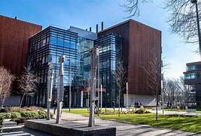
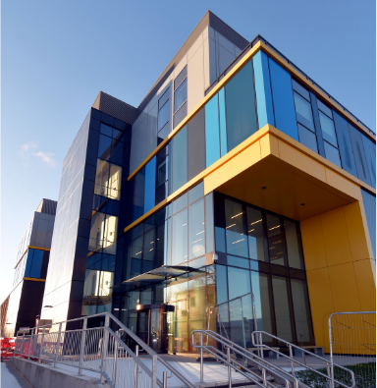
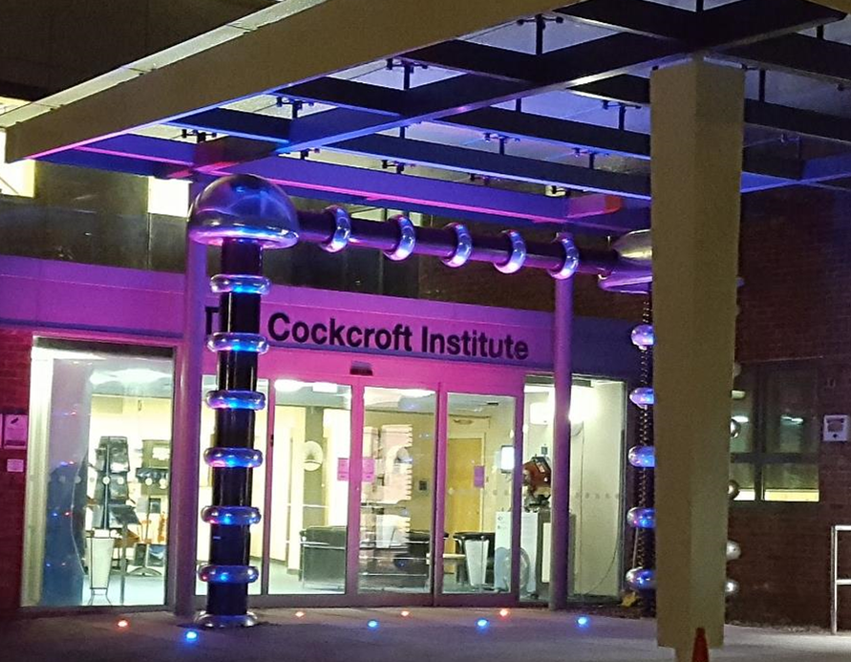
Leveraging UK Research Infrastructures
-the core team developing the facility
Daresbury Laboratory
The Materials Innovation Factory
Harwell Campus Hub
Cockcroft Institute
Negotiations underway to link access modes and research areas with national institutes and facilities

Slide 9
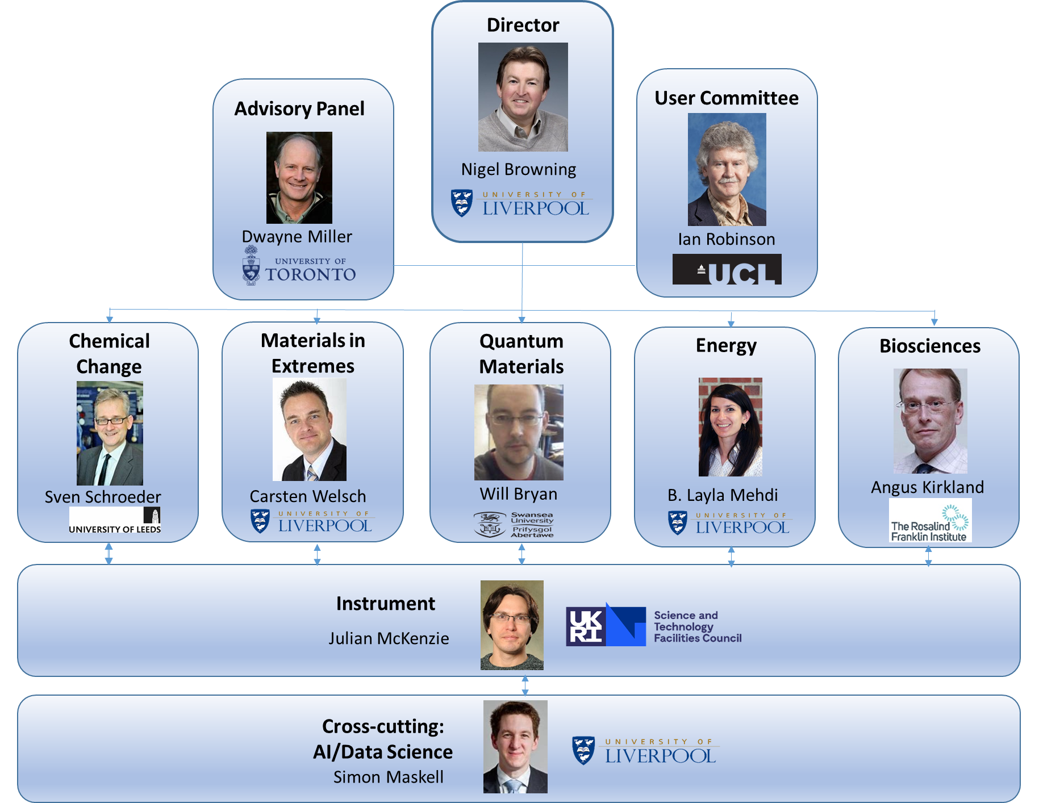
RUEDI Organisation
9

Slide 10
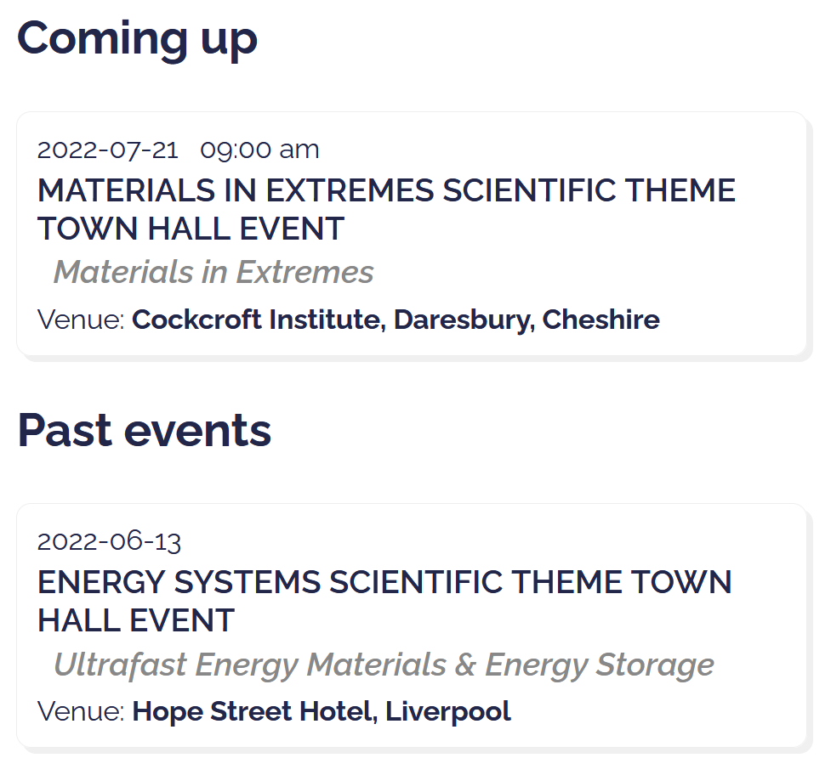
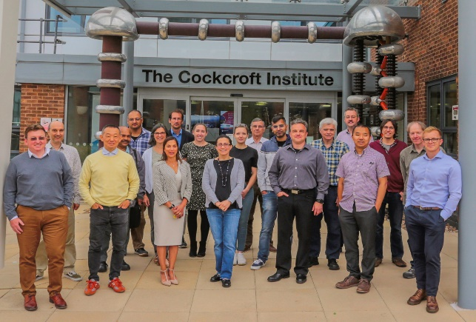
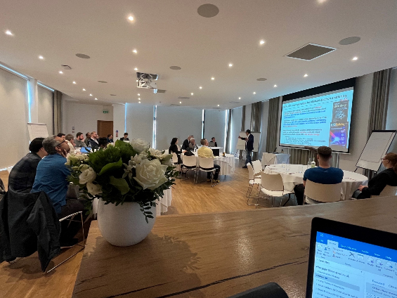
Science Theme Meetings
“Town Hall” meetings being arranged for each of the science themes
More info and slides from past events on: http://www.ruedi.uk/events
Scientific Summary Report on Energy Generation, Conversion and Storage to be uploaded soon
Sign up to mailing list on website for updates on future events
In-vivo Biosciences, 26th September
Quantum Materials, September TBA
Chemical Change, September TBA

Slide 11
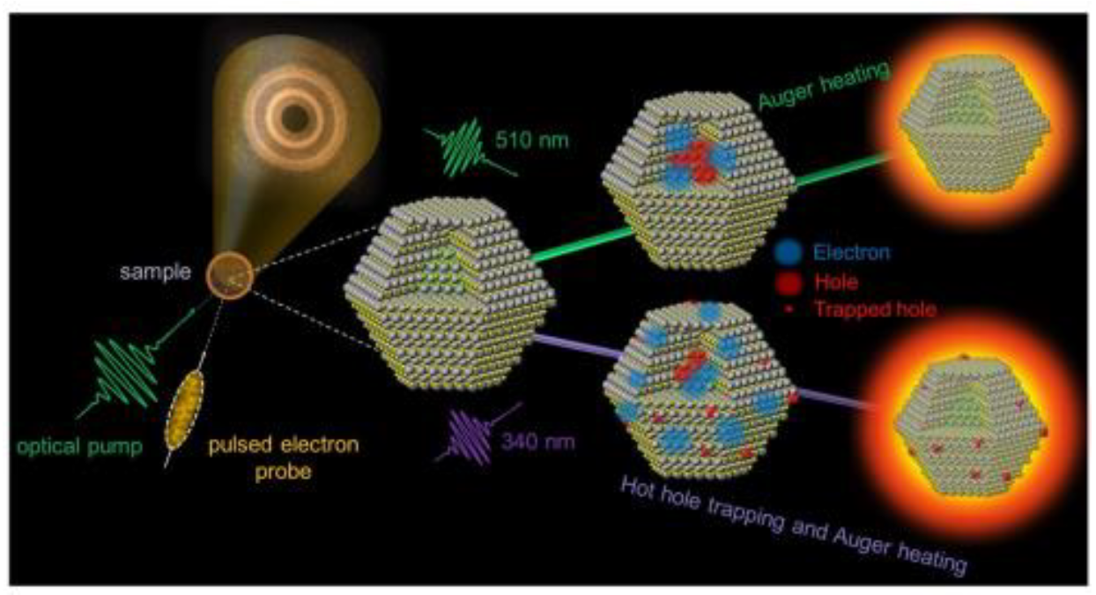
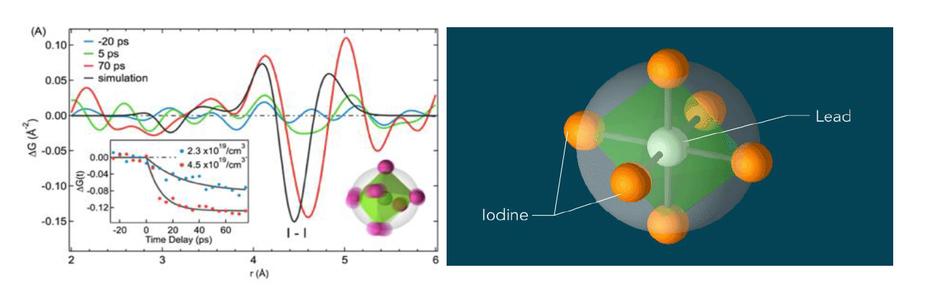
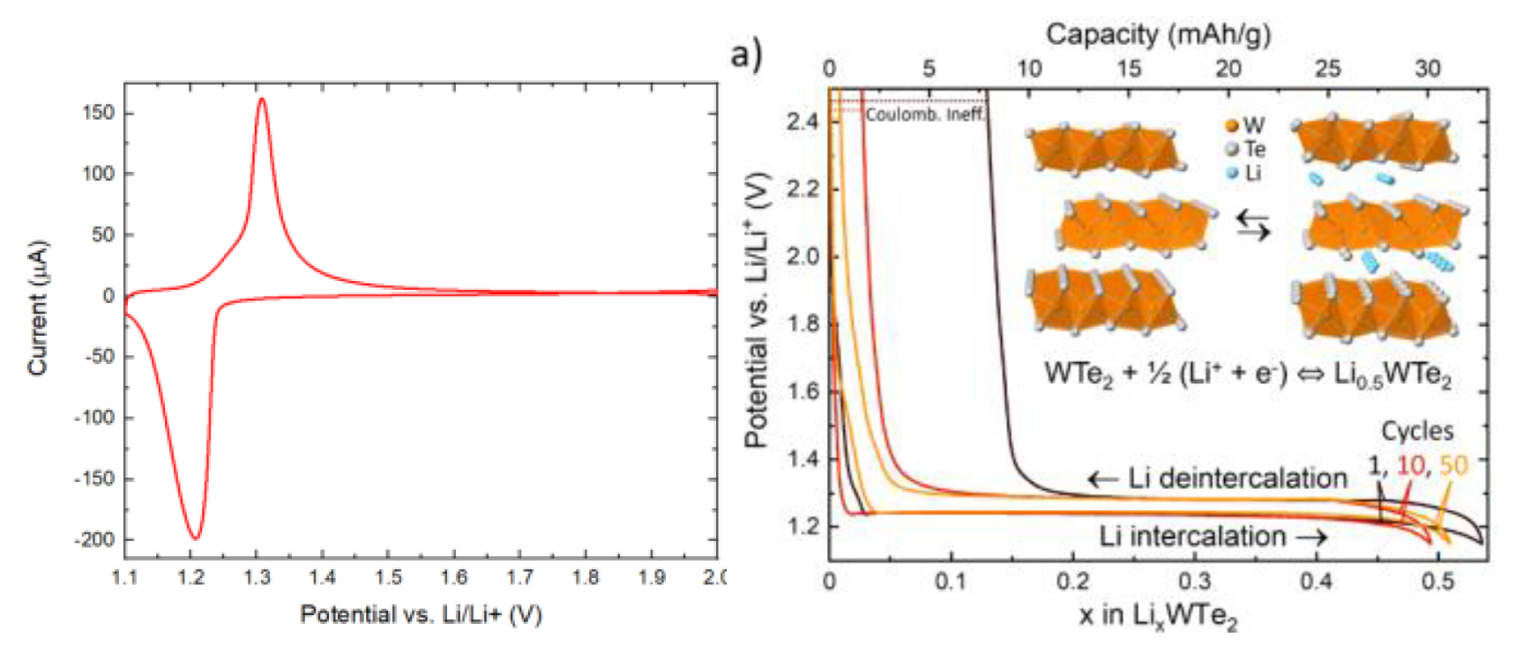
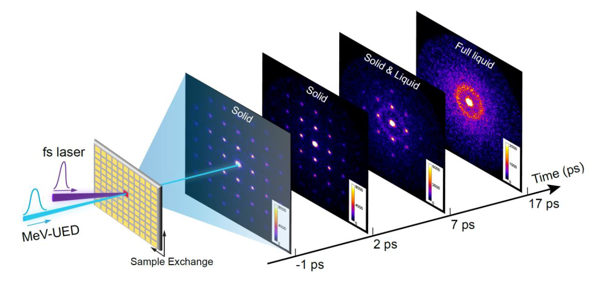
Projects from the Energy Town Hall
4 demonstration projects with wide-ranging applicability
Photocatalysis
  Conversion efficiency across full reaction
Hybrid Solar Cells
  Optical absorption and defect formation
Batteries
  Degradation linked to transport at solid-liquid interface
Glass Systems (nuclear)
  Stability of structures under applied conditions
11

Slide 12
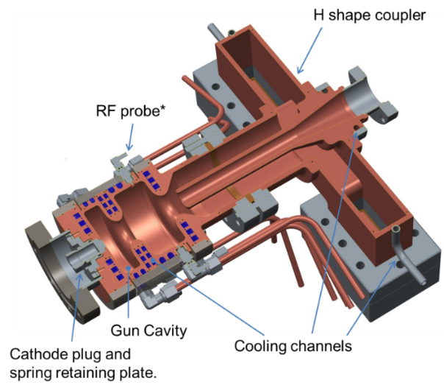
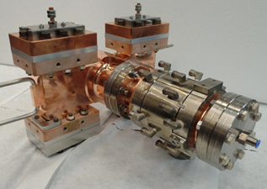
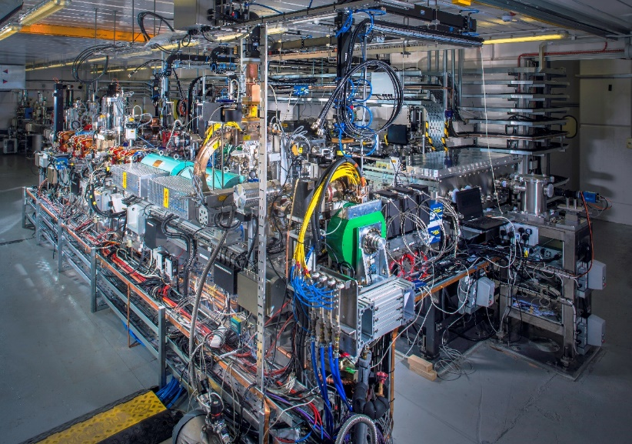
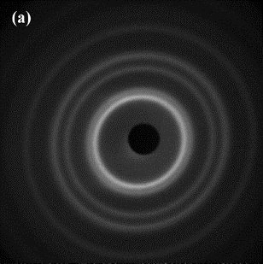
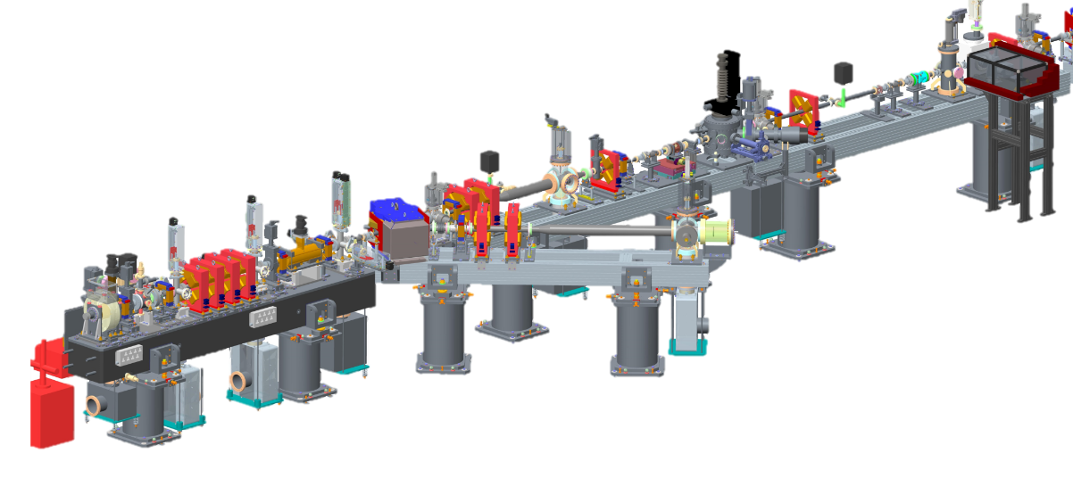
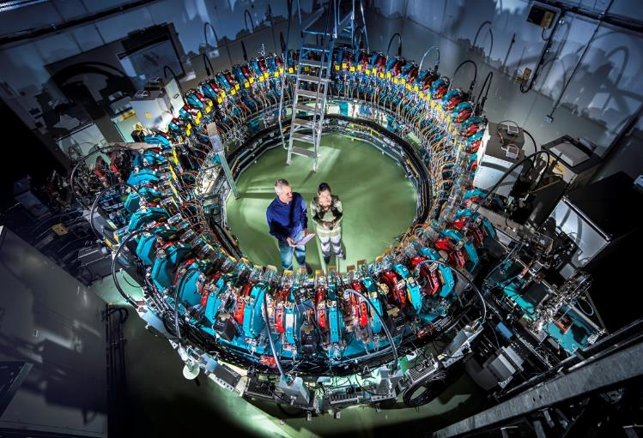
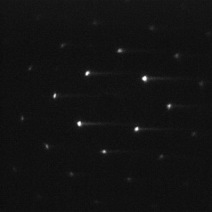
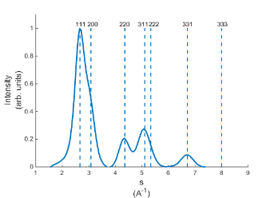
Leveraging STFC Daresbury Expertise
Femtosecond photoinjector development
Design, build, and operation of particle accelerator facilities
MeV ED experience
Proof-of principle static MeV electron diffraction on VELA
12

Slide 13
Instrument Design Principles
RUEDI must be a reliable and robust user facility
RUEDI should be a state-of-the-art facility as far as possible without compromising reliability
RUEDI should measure key parameters shot-by-shot and make them available to users as far as reasonably practical
The RUEDI design should leave scope for upgradability
RUEDI should strive to be an environmentally sustainable facility

Slide 14
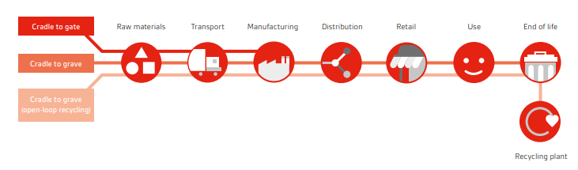
ASTeC Sustainable Accelerators Task Force
Sustainability: Accelerator Impact Review – Lifecycle analysis
Detailed review of the climate impact of accelerator activities
Where are the Big Sources of emissions?
  Manufacturing? Steel / Copper / Aluminium / Concrete
  Operations? Running RF and magnet systems. Cooling & AC
  Disposal? End of life of components
How could we reduce these for the biggest impact?
  Using different materials
  Smart powering schemes
RUEDI is our ‘model facility’ for this exercise
Consider wider applicability for other accelerators too
Figure of merit should be kgCO₂e per “delivered unit”
  So at the end, we should have a database
  listing carbon emissions for components in every area
Look at the big picture; not every gram of CO₂ - not a bean-counting exercise!

Slide 15
Modes of Operation
# | Purpose | Electron beam energy | Electrons per bunch | Temporal resolution | Spatial resolution | Spot size
1 | Imaging (higher resolution) | 2 MeV | 10^6 | Few ps | <1nm
2 | Imaging (ultra-fast) | 2 MeV | 10^6 | <800 fs | ~10nm
3 | Diffraction | 4 MeV | 10^6 | 100 fs |  | 100um
4 | Diffraction (low-charge) | 4 MeV | 10^4 | 10 fs |  | 10um
5 | Diffraction (Streaking*) | 4 MeV | 10^7 | 10 fs |  | 100um
*streaking mode is single-shot, time-resolved, where the time information implanted onto transverse plane via a deflector/streaker
Range of pump laser wavelength/durations/intensities
All modes limited to 100Hz repetition rate
(with potential future upgrade to 1kHz )
15

Slide 16
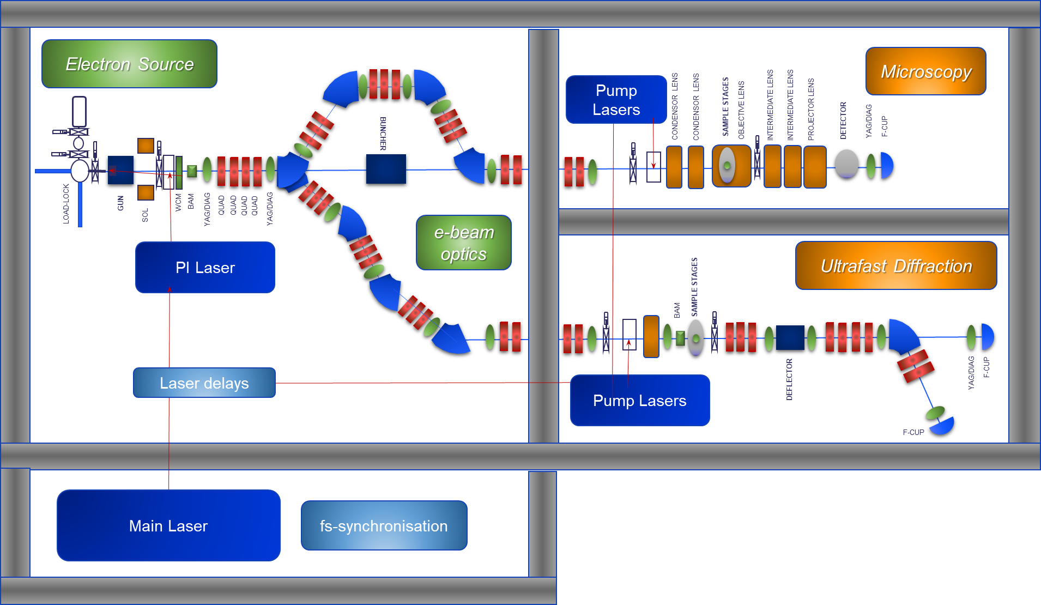
RUEDI Schematic v2.0
Design options to be studied and presented in CDR
Space reserved in the Daresbury Laboratory Electron Hall
(~15m x 35m)

Slide 17
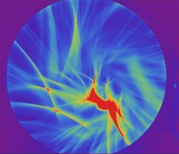
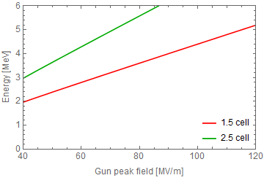
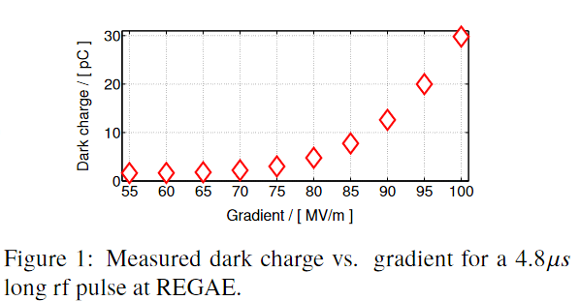
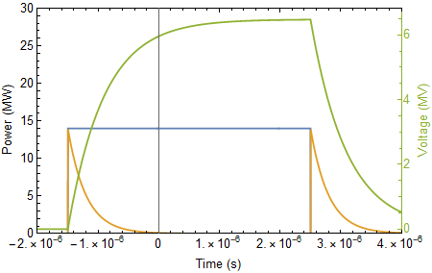
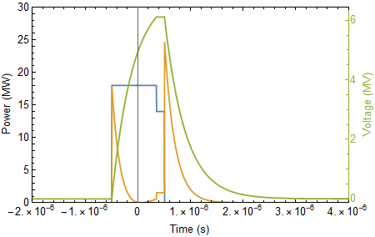
Electron Gun
S-band normal conducting RF gun
Experience from CLARA design
Dark current the main issue
  Potentially larger charge than photoemitted beam!
  Can swamp, interfere and distort images
Design changes to lower dark current
  Increase from 1.5 to 2.5 cell gun, lower field for same beam energy
  No cathode interchange to reduce high field areas which produce more DC
  Overcoupling for shorter RF pulse
CLARA gun
Dark current
Normal coupling
Over-coupling
Steady state after ~2.9 µs
Steady state after ~ 0.8 µs
17

Slide 18
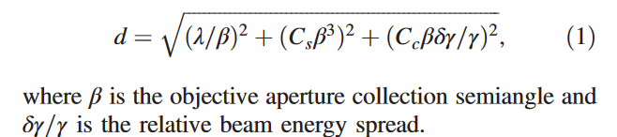
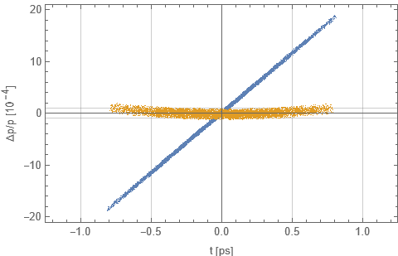
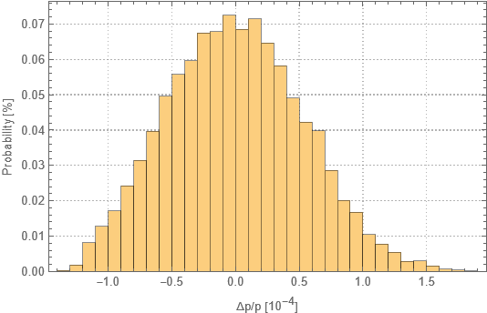
Electron Beam Transport - Microscopy
Resolution limits:
β ~ 1mrad
Cs ~ 10mm, spherical aberration coefficient
Cc ~ 10mm, chromatic aberration coefficient
For 1nm resolution, need <10⁻⁴ relative energy spread
Blue – pre-dechirper
Yellow – post-dechirper
Possible energy filter in chicane/alpha/omega magnet
RF dechirper cavity
  Also used to decelerate from 4 to 2 MeV
(1) Li & Musumeci, Phys. Rev. Applied, 2, 024003 (2014)
18

Slide 19
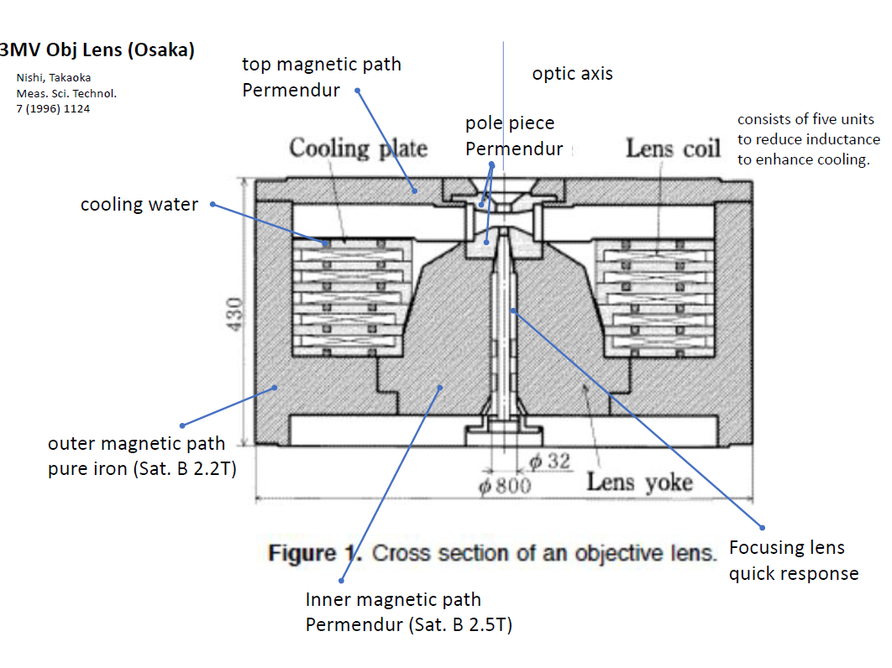
Imaging Lens Design
Objective lens is the key to whole system
S
UEM Mode 1
Diffraction
C1
C2
OL
IL
Field selecting Ap 1
PL
CL Ap 2
OL Ap 3
Detector 2
64M pixel direct electron detector from DE, single electron sensitivity
S
Samples inserted into middle of magnet (red arrow)
Consultation with leading EM producer – round lens saturates at ~ 2 MeV
UEM Mode 2
Imaging
C1
C2
OL
IL
PL
Round lenses/quadrupoles/deflectors – emittance, astigmatism, aberrations, pulse broadening

Slide 20
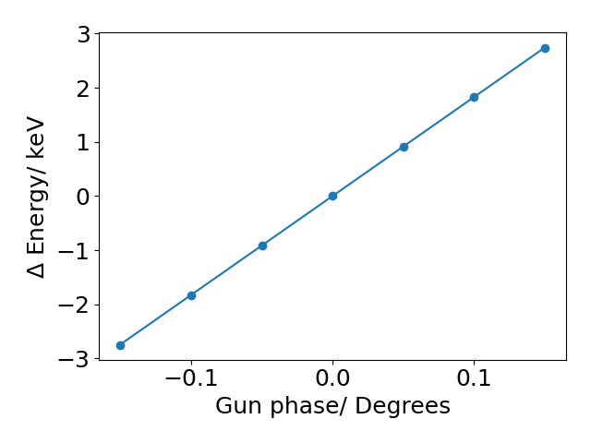



Beam Transport - Diffraction
Gun exit
Gun exit
Aim to provide ultrashort bunches with small time of arrival jitter
Laser to RF timing jitter leads to time of arrival jitter at the exit of the gun
We can tune the R56 of the magnetic transport line to cancel this initial timing jitter at the position of the sample
The space charge forces will change particles energy along the bunch, allowing them to be compressed with the same R56
Source
Gun exit
Sample
Diffraction
Gun exit
Sample

Slide 21
Ultrafast Diffraction Beamline
More general purpose sample chamber to take same sample stages as imaging beamline, full goniometry, solid, liquid, gases, cryogenics
Cavity based Beam Arrival Monitors
Bunch length monitoring via RF Transverse Deflecting Cavity + THz
Option for detector with hole to allow shot by shot measurements on non-diffracted beam
21

Slide 22
Laser system outline
Pump laser conversions
Photo-injector laser conversion
Laser delays
Pump laser conversions
THz diagnostics
Laser
Oscillator + Amplifier
fs sync
All systems driven by the same laser for synchronisation
22

Slide 23

Ultrafast dynamics vs Pump laser parameters
Some examples, doesn’t cover all applications!
23

Slide 24
Conceptual Laser System
e⁻ Beam Probe
Laser System (800nm)
Photoinjector Arm
‘Diffraction’ mode gun
Beam Shaping
Laser Compressor
UV Generation
3rd Harmonic
Spatial Cleaning
Intensity Control
Temporal & Spatial Shaping (picosecond)
‘Microscopy’ mode gun
Tilted Optical Rectification (LNBO)
~1-0.03 mm
Bunch Compressor / Energy Filter
Laser Split
Pump Pulse Arm
e⁻ beam Delay Compensation
Scanning Optical Delay Line
THz Gen.
Organ. Crystals (BNA, DAST, OH1 )
~300-33 μm
High Energy*
Tunable OPA
Microscopy & Diffraction Chambers
Mot. Delay
Pump Compressor
Laser Oscillator + Amplifier
MIR Gen. (DFG)
~3-13 μm
Harmonic Generation
2nd/3rd/4th
~1.2-2.6 μm
~240-1160 nm
Pump Monitor
UV/Vis Gen. (SFG)
~400/264/200 nm
Electron
Detector
Laser Arrival Monitor (LAM) TC-BOCX
LAM – TC-BOCX
Hollow-Core Fiber Post-Compression
~< 10 fs ,
400/800/1200
1800 nm
Timing System
Spectrometer (energy tagging ) / THz Time Tagging
RF oscillator
Laser Master Oscillator (LMO) +
Laser-RF locking
Stabilised Fibre Link Hub
RF Klystron
LAM: Laser Arrival Monitor, TC-BOCX: Two-Colour balanced optical cross-correlator

Slide 25

Overall layout
Air handling units
Stairs
Microscopy
Station
Utilise roof area for RF rooms, potential control rooms etc
Rack room
Ultrafast Diffraction
Station
Sync room
Space reserved in Daresbury Laboratory Electron Hall
Crane drop zone
Accelerator Area
Laser room
Stairs

Slide 26
Summary
2-year design process underway
  Funding by UKRI Infrastructure Fund
CDR to be published at end of this year
5 Science Themes cases progressing:
  Dynamics of Chemical Change
  Materials in Extremes
  Quantum Materials & Processes
  Energy Generation, Storage and Conversion
  In Vivo Biosciences
Visit www.ruedi.uk for more info

Slide 27




Acknowledgements
Tim Noakes
Mike Ellis
Jim Clarke
Boris Militsyn
Alan Wheelhouse
Mark Roper
Nirav Joshi
Yuri Saveliev
Clive Hill
Graham Cox
Rachael Buckley
Ben Hounsell
Joe Crone
Hywel Owen
James Jones
Bruno Muratori
Omair Ghafur
Storm Mathisen
Tom Pacey
Louise Cowie
Russell McLean
Anthony Gilfellon
Andy Moss
Conor Jenkins
Ed Snedden
Ben Shepherd
Frank Jackson
Tom Jones
Mitchell Kane
and more…
Nigel Browning
Angus Kirkland
Yoshie Murooka
Jan Nugara
Will Bryan
Simon Maskell
B. Layla Mehdi
Sven Schroeder
Carsten Welsch
Oznur Apsimon
Gwyndaf Evans
Dwayne Miller
Ian Robinson
Jasper Van Thor
Lee Kelsall
Alberto Acuto
and more…

Slide 28

Thank you for your attention!

