Slide 1


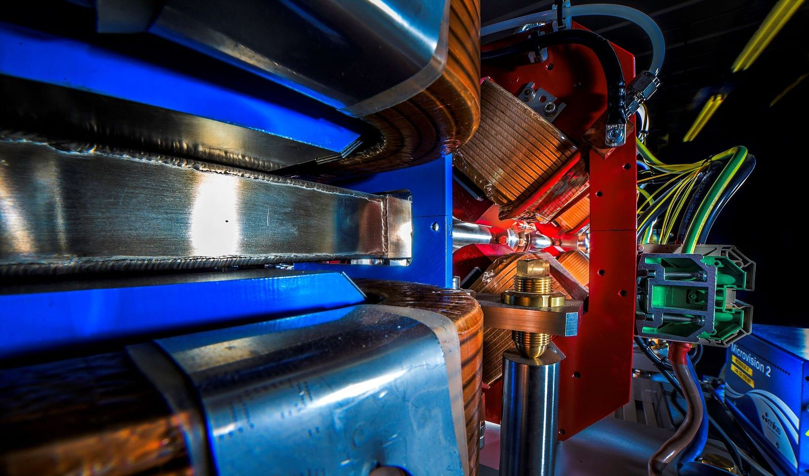
Making a brighter future through advanced accelerators
CLARA as an Accelerator Test Facility for the UK
Deepa Angal-Kalinin on behalf of the CLARA Team
25th July 2022
IoP PAB Conference, Liverpool, 25-26th July 2022

Slide 2
Contents
Introduction to CLARA
Phases of CLARA
Exploitation on CLARA Phase 1/VELA line
Status of CLARA Phase 2
Summary

Slide 3
Compact Linear Accelerator for Research and Applications
CLARA is a high brightness electron test facility enabling the broad range of accelerator and FEL R&D necessary to ensure a future UK XFEL facility is world leading
Addressing many scientific and technology challenges for future large scale facility
Establishing key technologies in the UK
  Photoinjectors and photocathodes
  Novel undulators
  New accelerating structures
  Advanced single bunch diagnostics
  Machine learning
  …….
Flexible test facility to demonstrate novel concepts.

Slide 4
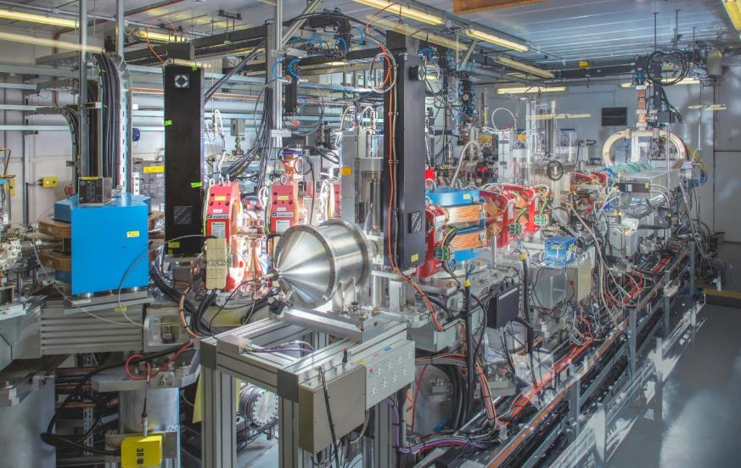
Accelerator Hall Configuration until 2023
VELA (Versatile Electron Linear Accelerator)
  Photoinjector incorporates dedicated diagnostics suite
  Beamline delivers beam two beam areas (BA1 & BA2)
CLARA Front End
VELA & CLARA photoinjectors share the same RF and laser infrastructure.
  ALPHA-X gun (S-Band, 10 Hz)
  HRRG (S-Band, 400 Hz)
CLARA and VELA Accelerator Hall
4

Slide 5
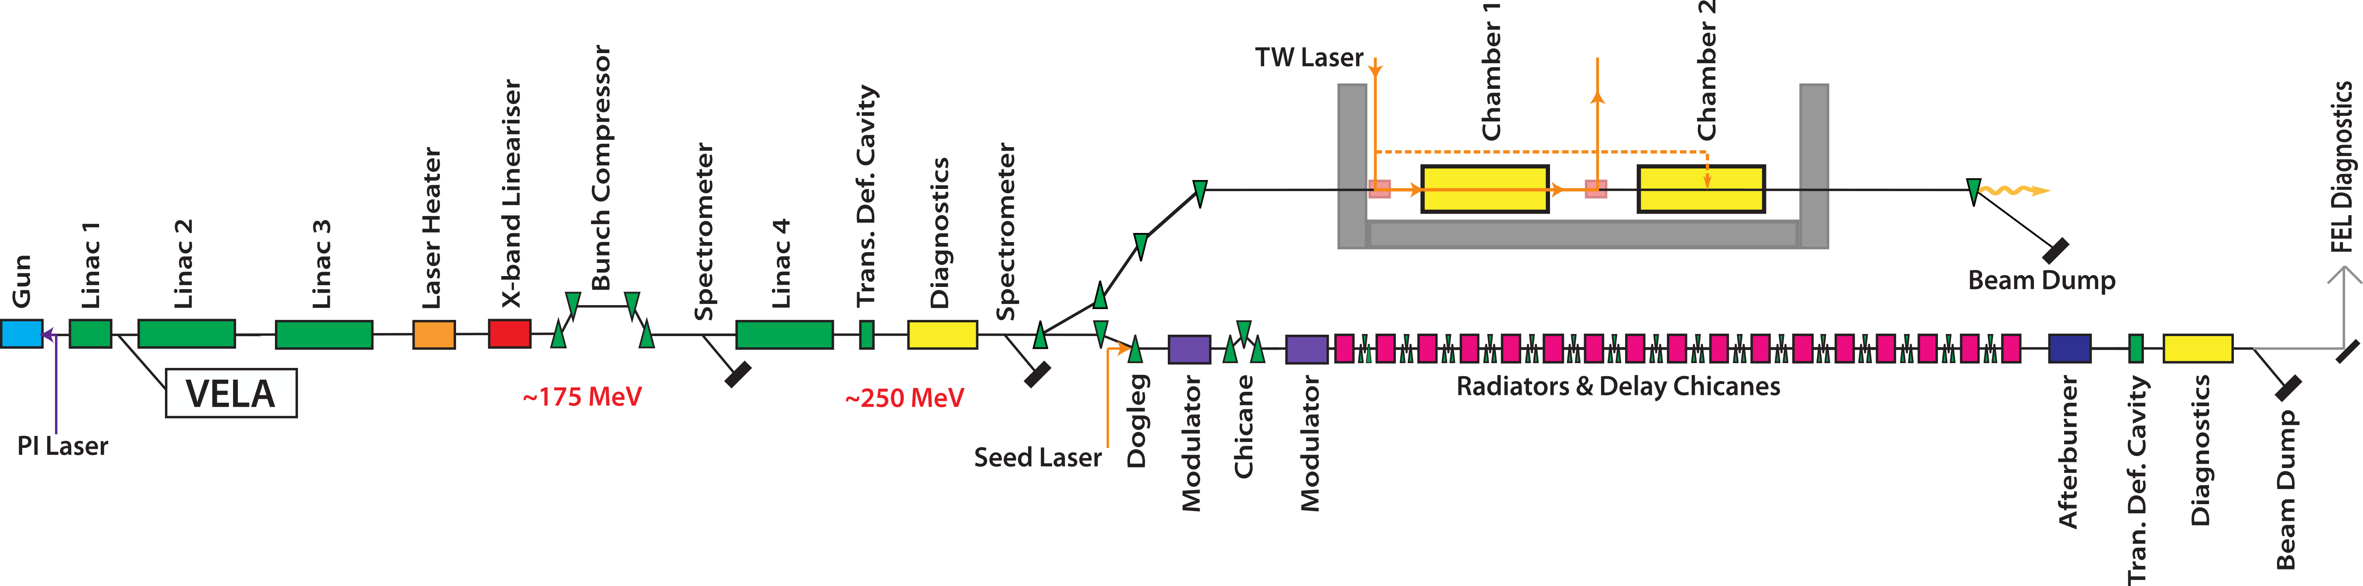
CLARA Schematic & Project Phases
FEBE Hutch
FEBE Arc
PHASE 1:
50 MeV, 250 pC at 10 Hz ACHIEVED (2017)
PHASE 2:
250 MeV, ASSEMBLED OFFLINE,
Partly installed in the accelerator hall.
Includes dedicated 250 MeV beamline (FEBE) for novel experiments (approved in 2019 ahead of Phase 3)
PHASE 3:
100 nm FEL
NOT YET FUNDED
Decision tied to UK XFEL
Total length = 95 m

Slide 6
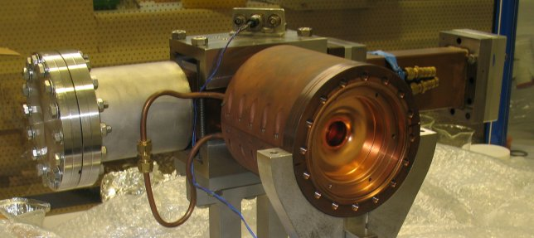
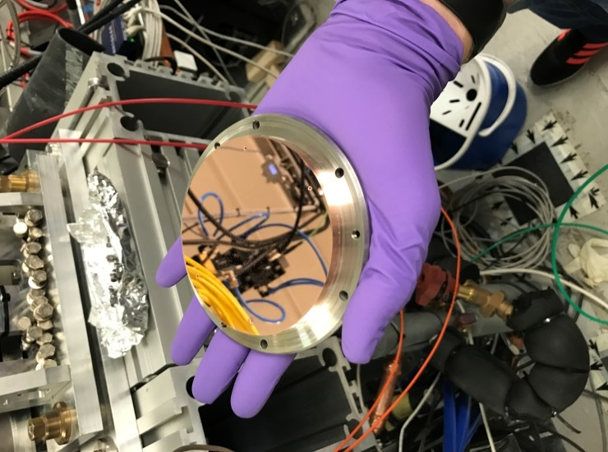
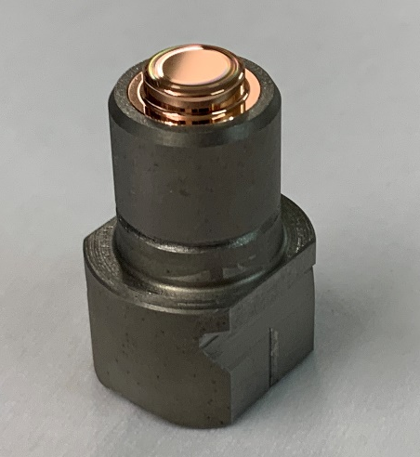
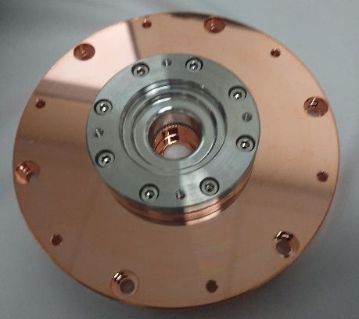
ALPHA-X Gun (10 Hz)
2.5-cell S-Band RF gun, 10 Hz repetition rate ALPHA-X gun on loan from Strathclyde.
Commissioned and operated on VELA line from 2013-2016. Swapped to CLARA line in 2017.
Gun was upgraded to operate with interchangeable photocathode plug in 2019 which allows to transport and swap cathodes without breaking vacuum.
Back wall Copper photocathode replaced with hybrid Cu/Mo photocathode with off-centred diamond turned tip.
Major efforts concentrated on improving beam quality and mitigation of dark current.
Extensive photocathode R&D underpinning programme in dedicated lab space.
Back wall photocathode
Hybrid Cu/Mo photocathode with off-centre diamond turned tip
Back wall of the cavity
with photocathode socket

Slide 7
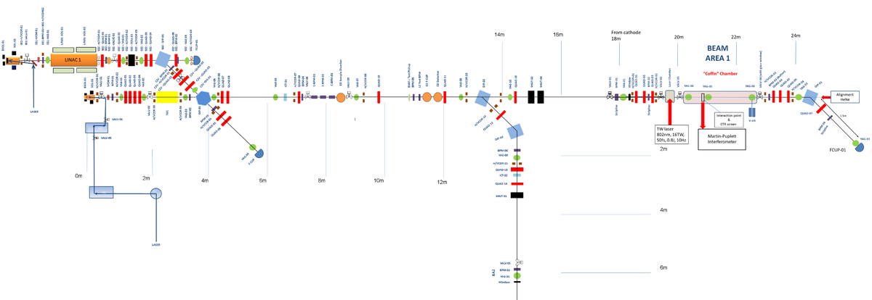
CLARA Phase 1 Exploitation Experiments (2018-22)
RF gun + Linac accelerates beam to 50 MeV. S-bend merges beam with the VELA beamline.
High energy beam delivered to users in two user runs (2018/19 & 2021/22) following competitive beam time allocation process.
Beam time requests oversubscribed by a factor of two. High demand for BA1 and experiments utilising TW laser.
Beam Area 1
VHEE, Plasmid/Cell, SCU, ….
10Hz gun
400Hz gun
CBPMs
DWA, THz acceleration & deflection, Plasma afterglow metrology, CDR, external injection into Laser driven wakefield, pulsed radiolysis,…….
wall
Beam Area 2
Details of the beam line available at:
Angal-Kalinin et al, Phys. Rev. Accel. Beams 23, 044801, 2020
7

Slide 8
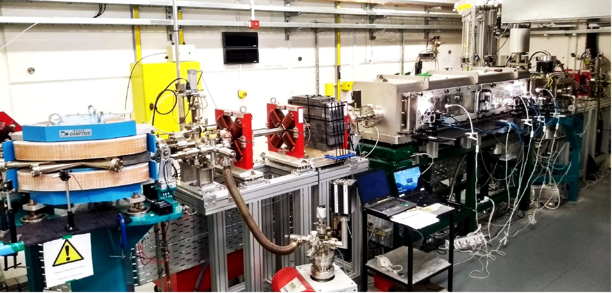
VELA Beam Area 1
Electron beam:
  35 MeV, 100 pC, 10 Hz
  300 fs (RMS) length, 100 µm (RMS) radius
Laser:
  ~500 mJ, 50 fs, 10 Hz, synchronized ~100 fs
  f/19 parabola
User Chamber:
  Old SRS ‘empty box’, retrofitted with breadboard and gas/electrical feedthroughs
  Diagnostics for beam profile – IP & Upstream and downstream of IP
  Can be pumped down in few hours
Beam line incorporates spectrometer dipole to measure energy spectra & FCUP for charge measurement.

Slide 9
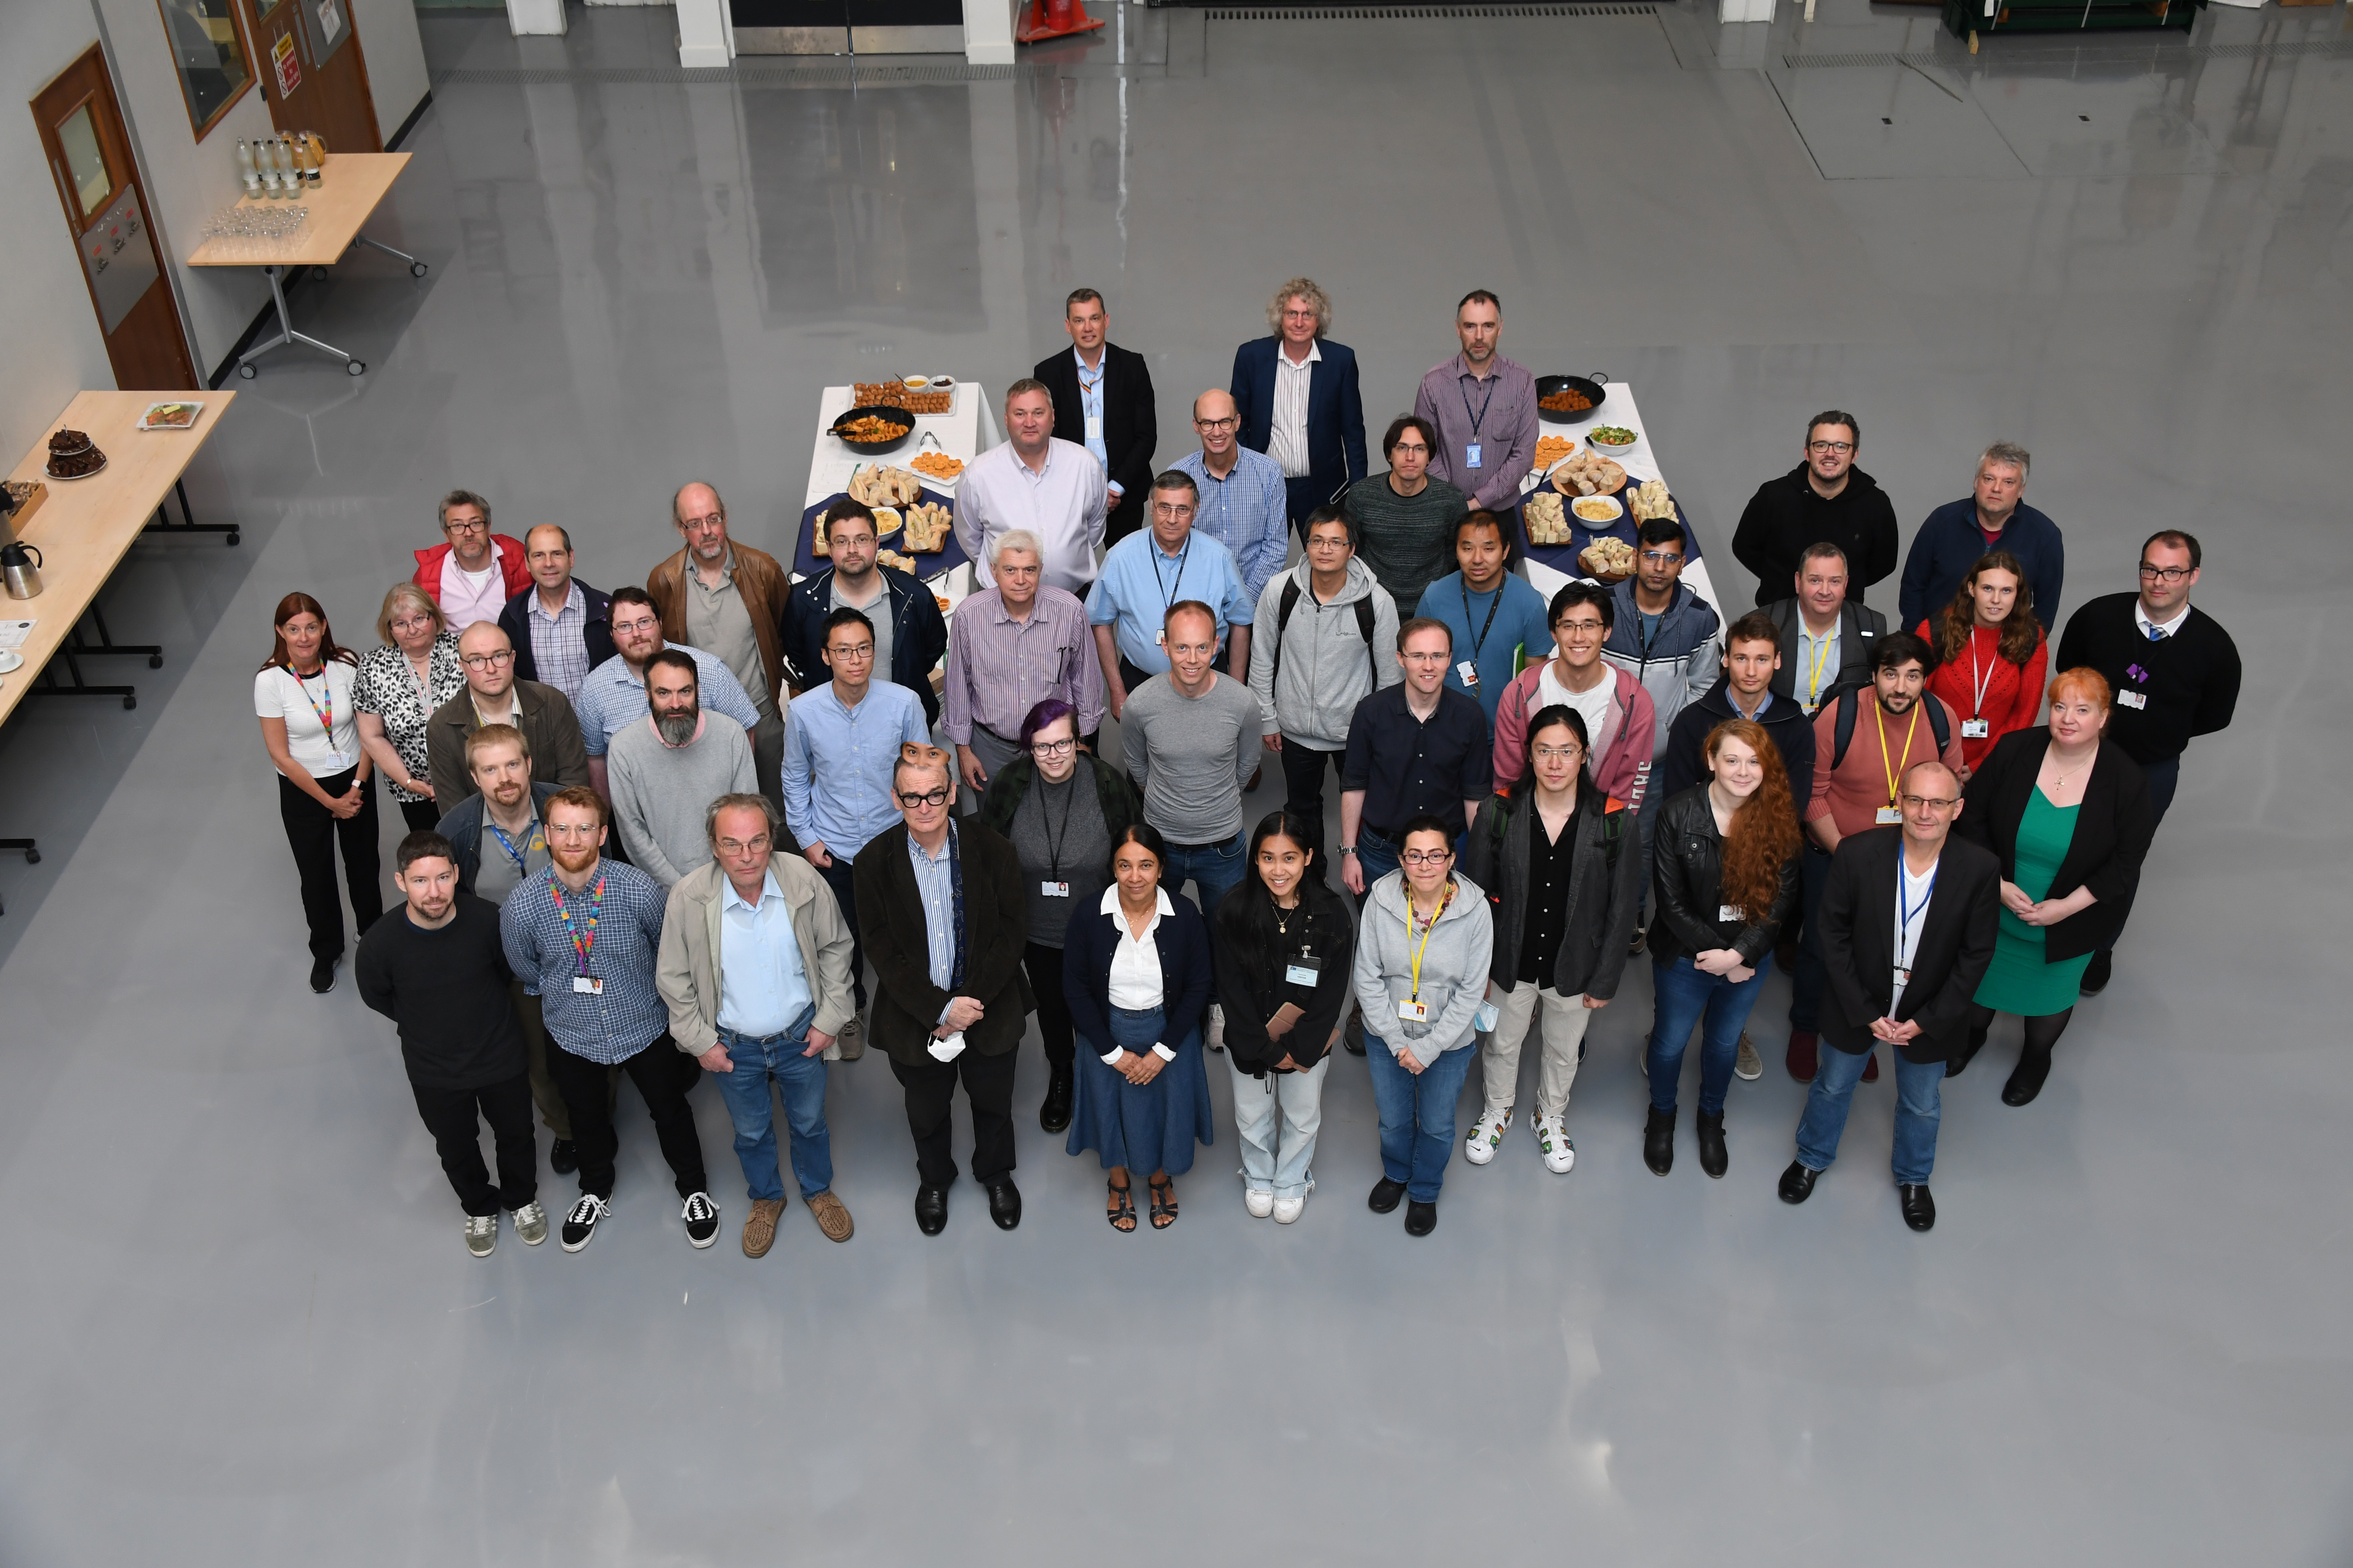
CLARA User Meeting
Following successful exploitation run (October’21-April’22), Third CLARA User Meeting was held on 5th of July’22 at Daresbury Laboratory in a hybrid format with 55 participants attending in person and 20 connected remotely.
All experimental teams presented results from their experiments and outlined plans for publications of their results.
The CLARA team presented the plans and timeline for completion of Phase 2.
Detailed presentations available at: https://indico.stfc.ac.uk/event/574/
Talks by Morgan Hibberd, Lewis Reid, Toby Overton at this conference.

Slide 10
VELA/CLARA Accelerator Hall & Phase 2
Temporary shield wall at the end of BA1 allows operation of VELA/CLARA FE whilst installation of Phase 2 continues beyond this wall.
When Phase 2 beam line will be installed, existing BA1 beamline will not be operational due to component clash (also due to preference not to switch off the accelerator to maintain stable operation).
Option to move BA1 beamline and TW laser to BA2 has been worked out but is currently not prioritised.
LINAC2, LINAC3, 4HC, VBC will be installed here
10Hz gun
Temporary Shield Wall
400Hz gun
Beam Area 2
wall
10

Slide 11
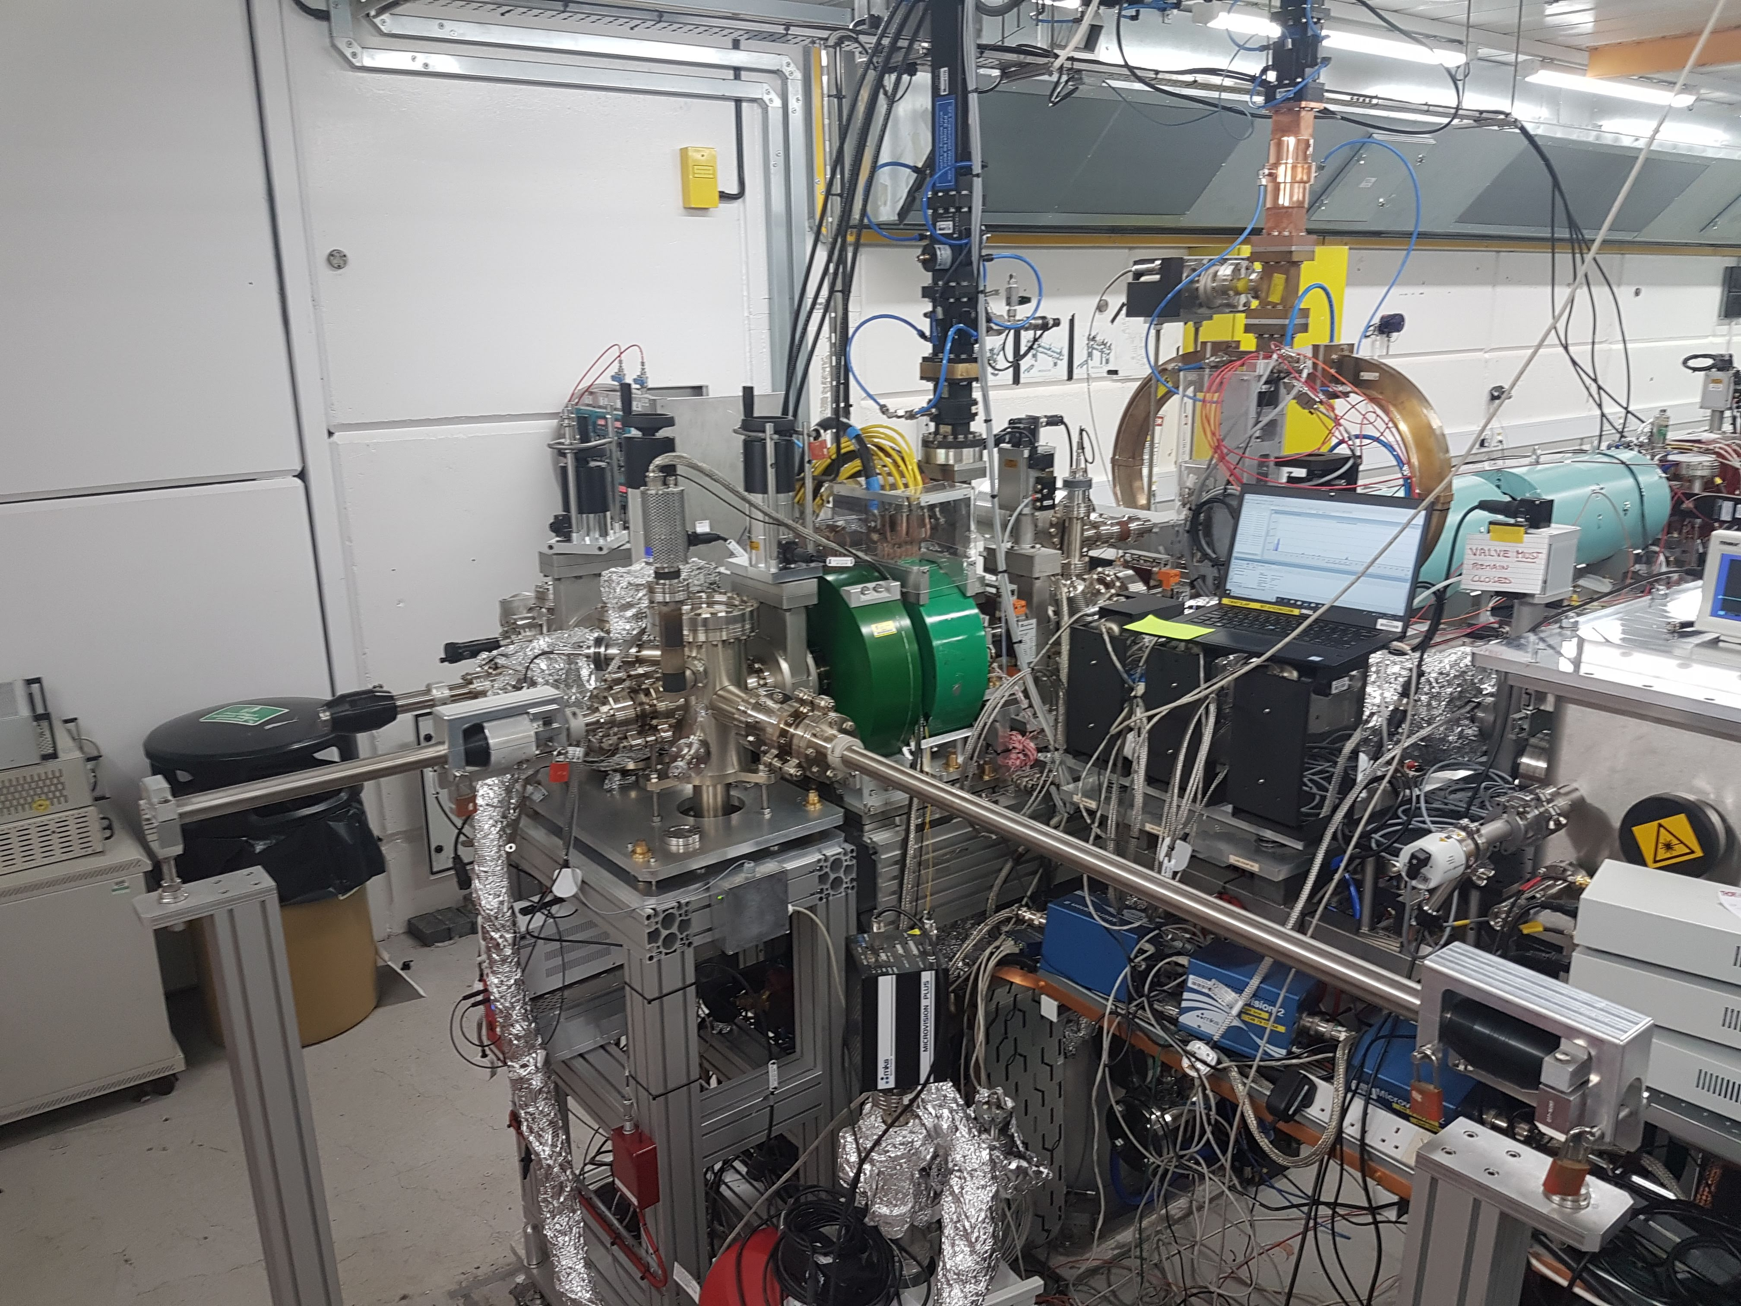
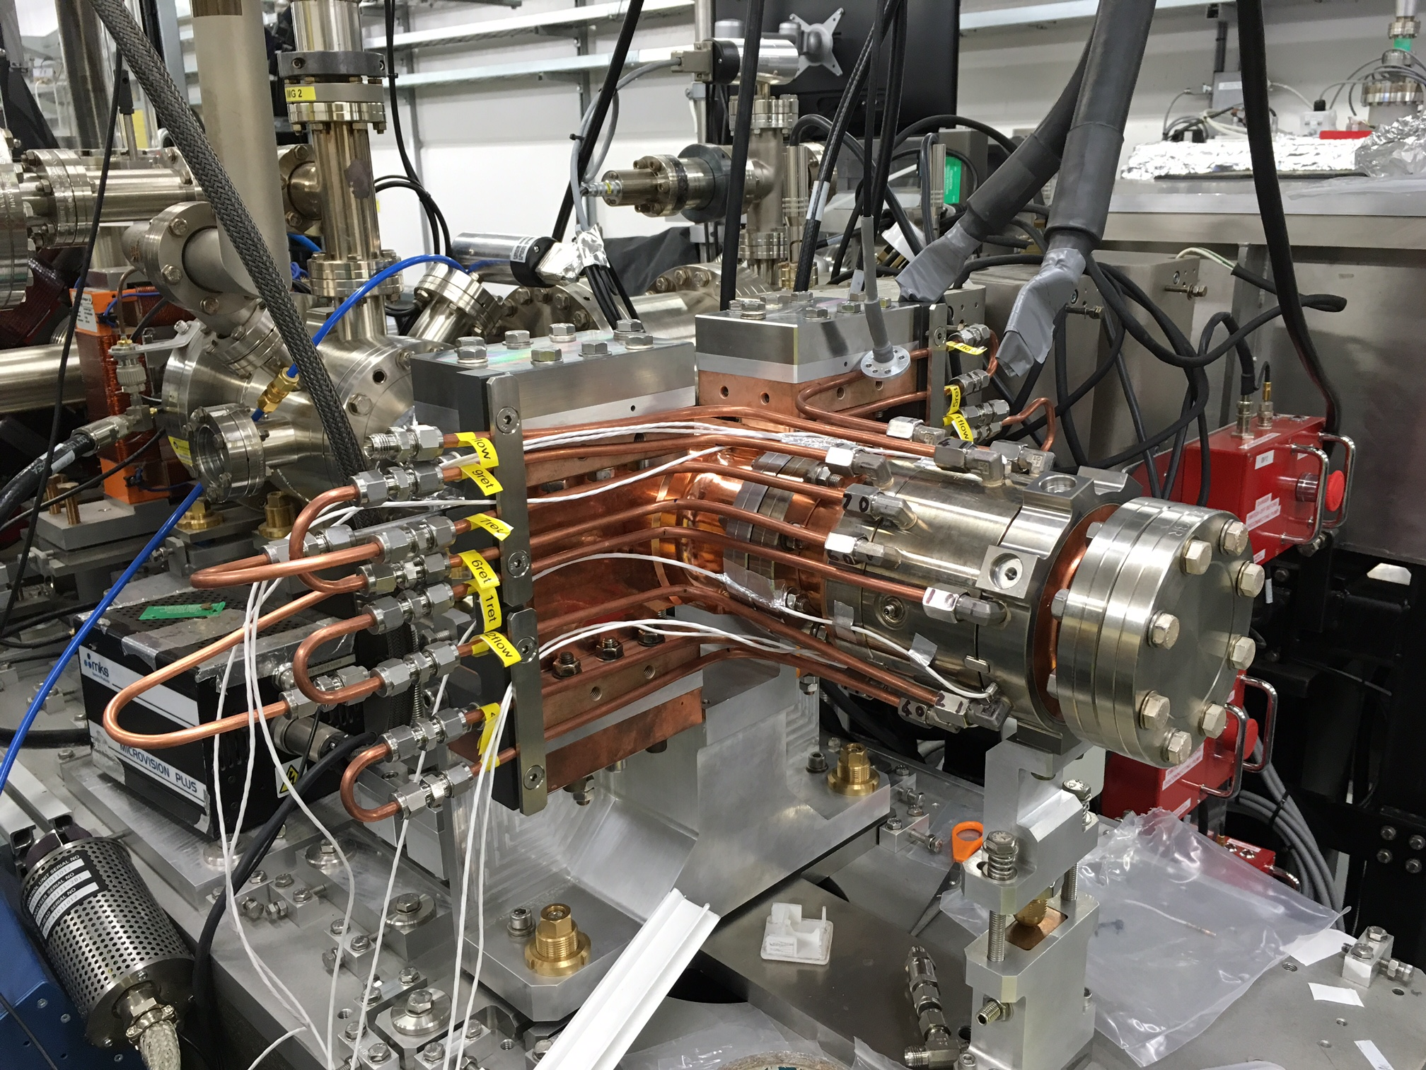
High Repetition Rate Gun (400 Hz)
1.5-cell S-band High Repetition Rate Gun (HRRG) designed by STFC/CI/INR collaboration.
Fitted with vacuum load-lock system which allows to transport and swap cathodes without breaking vacuum.
Gun installed on VELA line in 2016 shutdown. RF auto-conditioning script developed & tested for unmanned conditioning.
Time sharing with CLARA line and issues with RF waveguide switch delayed commissioning.
Conditioning followed by commissioning to start August’22.
Gun will be swapped to CLARA line from VELA line in 2023.

Slide 12
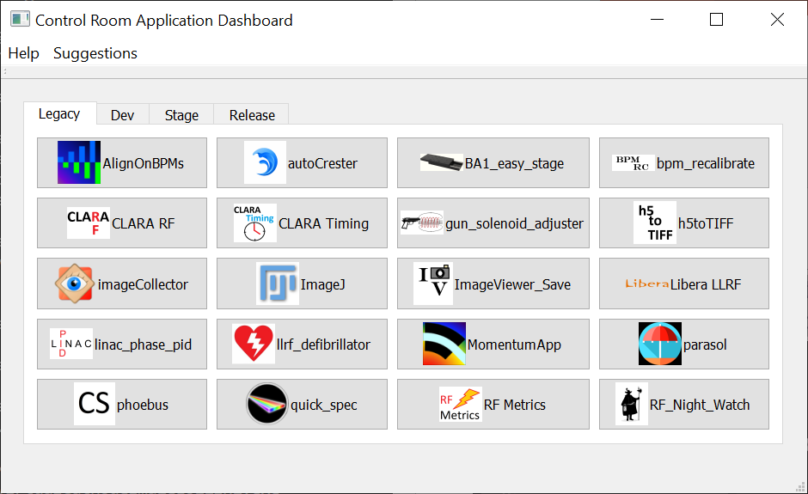
CLARA Software Tools & Simulations
Major effort to ensure robustness of control room software.
All software accessed from Application dashboard, documentation on CLARA wiki
Work in progress to establish consistency with the online model - will allow seamless comparison of machine status with simulations.
Number of brand new tools being developed for new diagnostics and for exploitation experiments in collaboration with users.
Effort is now ramping up to apply Machine Learning in several areas on CLARA
Great potential to use CLARA for application of ML.

Slide 13
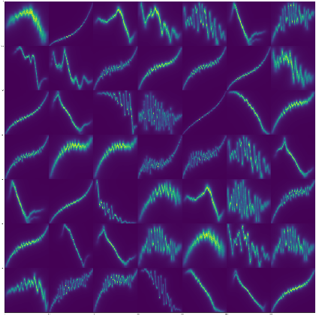
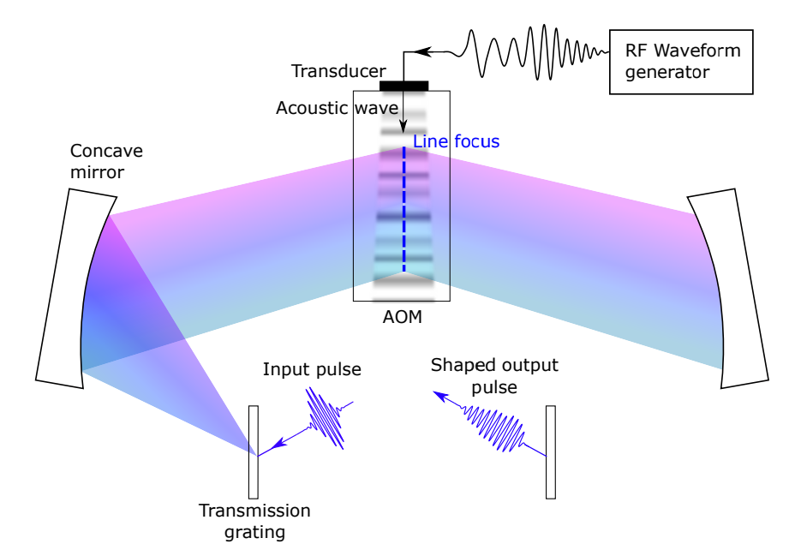

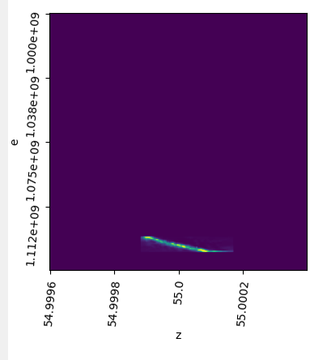
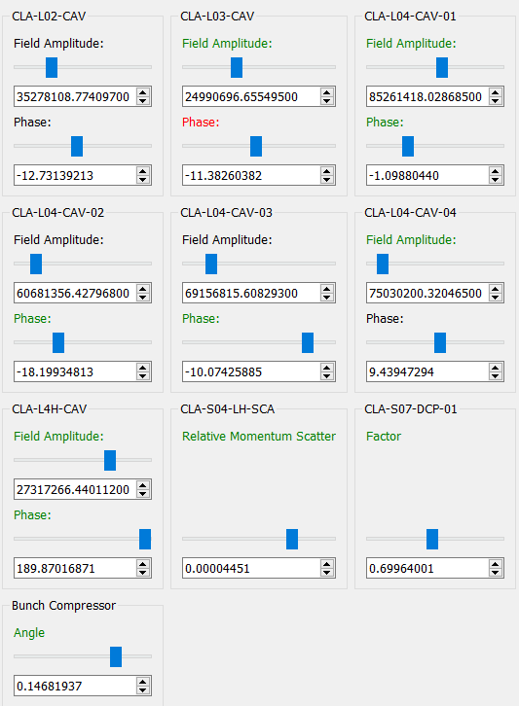
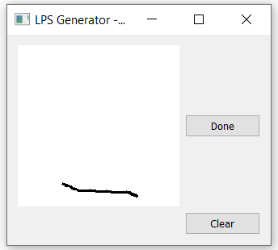
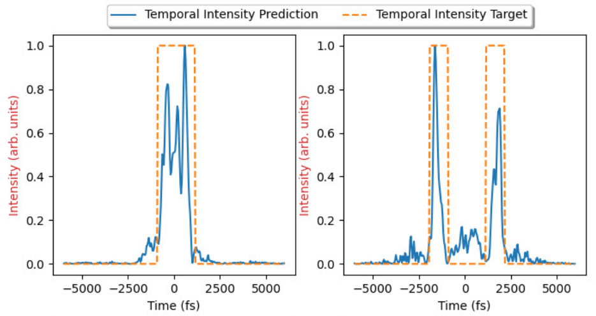
Machine Learning – Custom Bunch Shaping
We aim to use Machine Learning to deliver an efficient, automated accelerator with rapidly customisable beam properties.
Simulation-based example to learn the relationship between accelerator settings and longitudinal phase space:
Trained using ~10k examples
Users can draw the desired LPS to get the required machine settings
Simulation/experiment-based project to deploy ML-based pulse shaping for the CLARA photo-injector laser:
Schematic of the temporal pulse shaper at CLARA, featuring an acousto-optic modulator (AOM)
Demonstration of solutions found for arbitrary pulse shapes (the model takes into account physical constraints)
Poster presentation by Amelia Pollard
https://accelconf.web.cern.ch/icalepcs2021/papers/wepv020.pdf
https://accelconf.web.cern.ch/ipac2022/papers/thpotk061.pdf

Slide 14
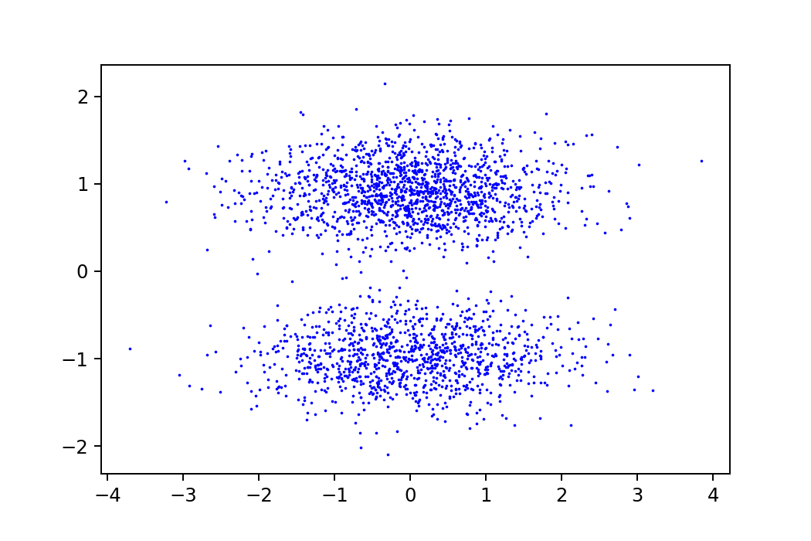
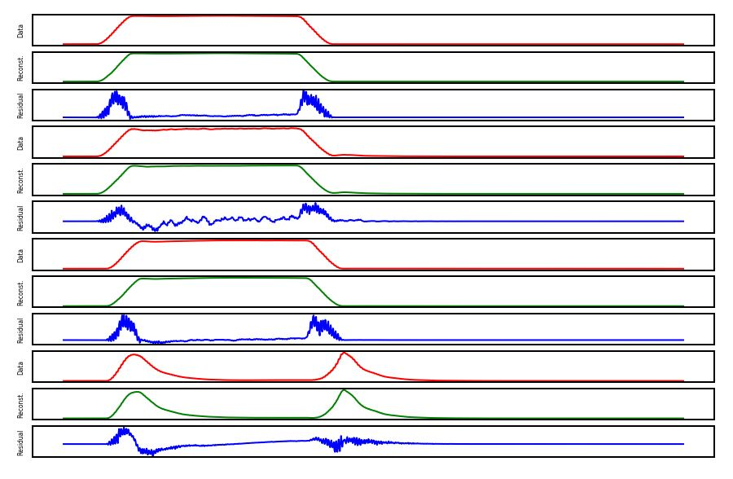
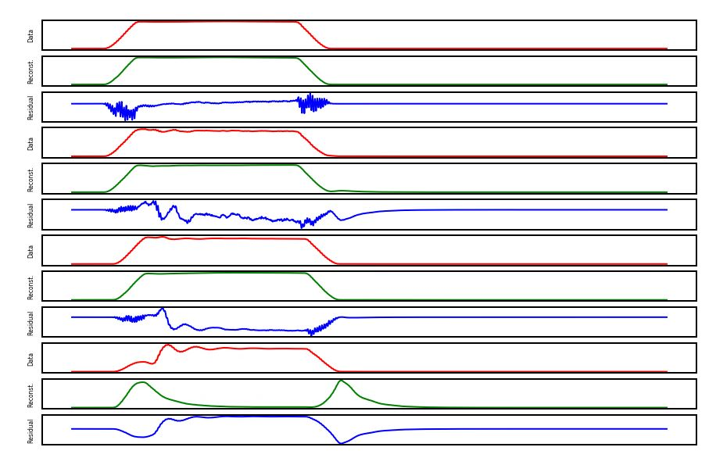
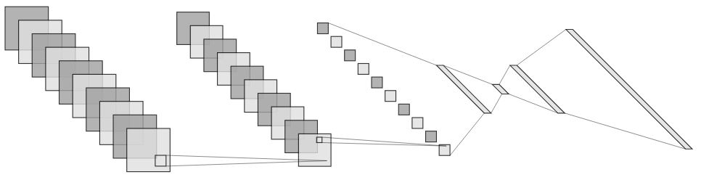
Machine Learning – RF Breakdown Detection
Work is ongoing to use machine learning for improved detection of RF breakdowns, to be used in HRRG & Phase 2 RF conditioning.
2D Latent Space
Data – Reconstruction = Residual
An anomaly detection method has been used, whereby an autoencoder is ‘over-trained’ using healthy RF traces.
When shown a breakdown trace the reconstruction will not match the data.
High accuracy and recall show it is an effective classifier of breakdowns.
Healthy Pulse
Encoder
Decoder
Breakdown Pulse
μ
σ
Latent Space (1x2)
There is a UK interest group on machine learning for accelerators – contact: david.dunning@stfc.ac.uk
Input layer (4x1017)
Convolution
Max Pooling
Dense (1x4)
ReLU
Dense (1x8)
ReLU
Dense
(1x32)
ReLU
Dense
(1x4068)
Sigmoid
https://accelconf.web.cern.ch/icalepcs2021/papers/wepv021.pdf

Slide 15

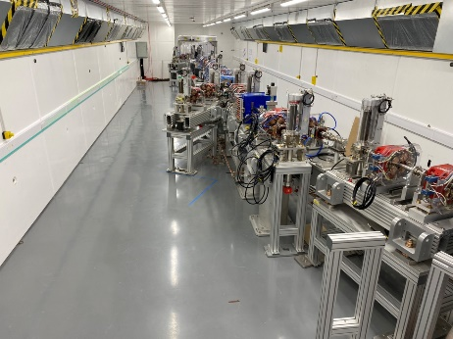

CLARA Phase 2

Slide 16
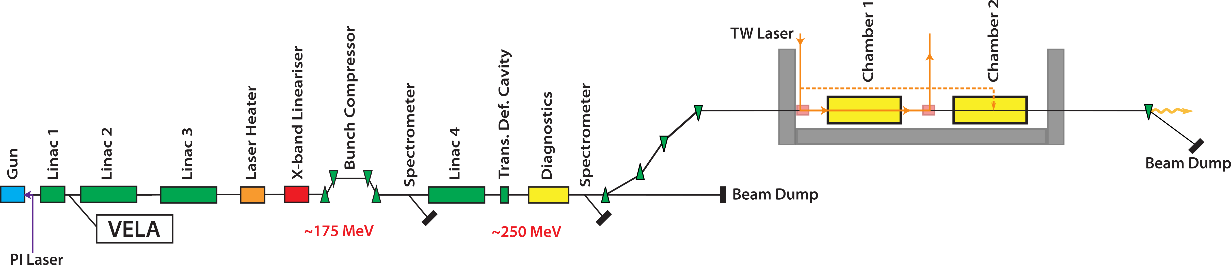
CLARA Phase 2 - Schematic
250 MeV, 250 pC FEL ready bunches at 100 Hz
FEBE Hutch
FEBE Arc
Three 4 m long S-band Linacs, Variable Bunch Compressor, X-band lineariser, space reserved for Laser Heater.
Full 6-D beam characterisation using S-band TDC at 250 MeV.
Beamline incorporates DWA dechirper (Half of the wakefield energy dechirper tested in BA1)
Full Energy Beamline for Exploitation (FEBE) delivers beam to dedicated shielded enclosure.

Slide 17
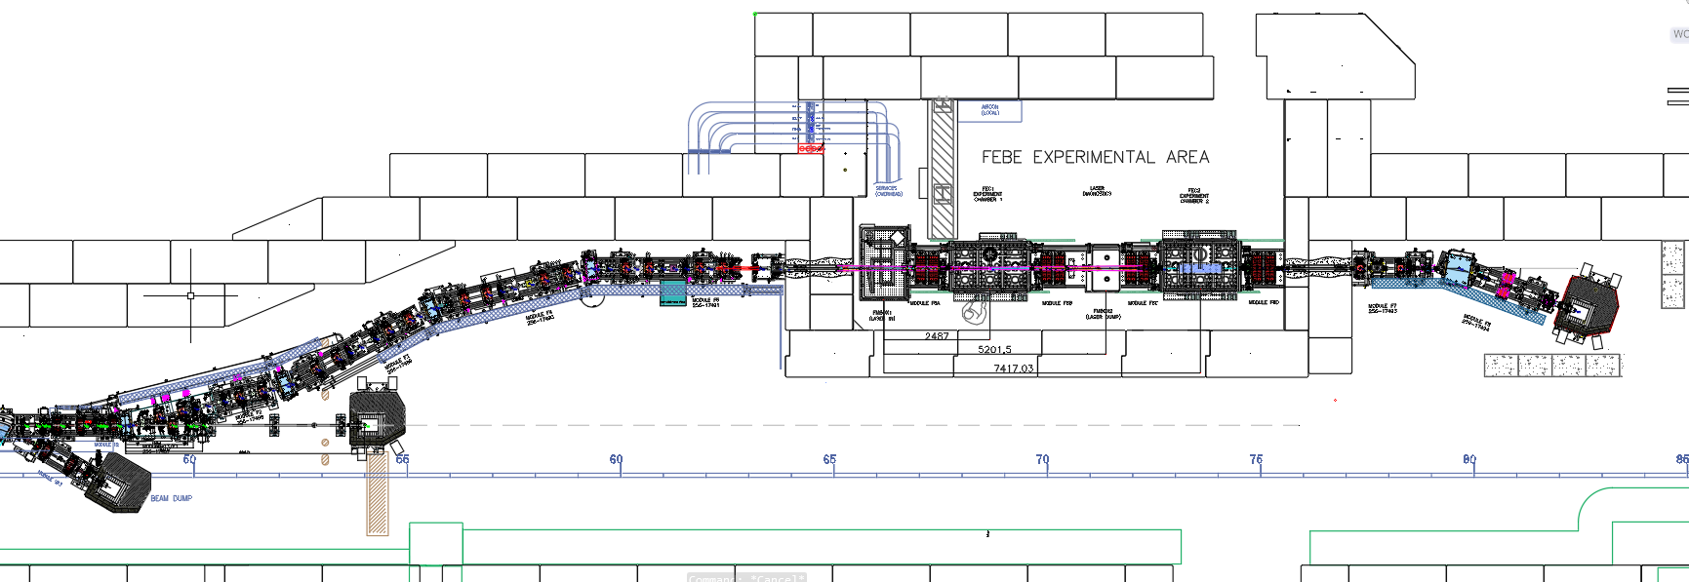
FEBE Design Overview
Laser insertion
Two interaction points
Matching section
Post-interaction spectrometer line
Flexible compression arc + mask
Radiation shutters
FEBE design is conceived and developed in collaboration with stakeholders and is building upon the existing community interest and demonstrations on CLARA FE.
FEBE arc is designed to mitigate CSR
Dedicated diagnostics pre- and post interaction point to fully characterise beams.

Slide 18
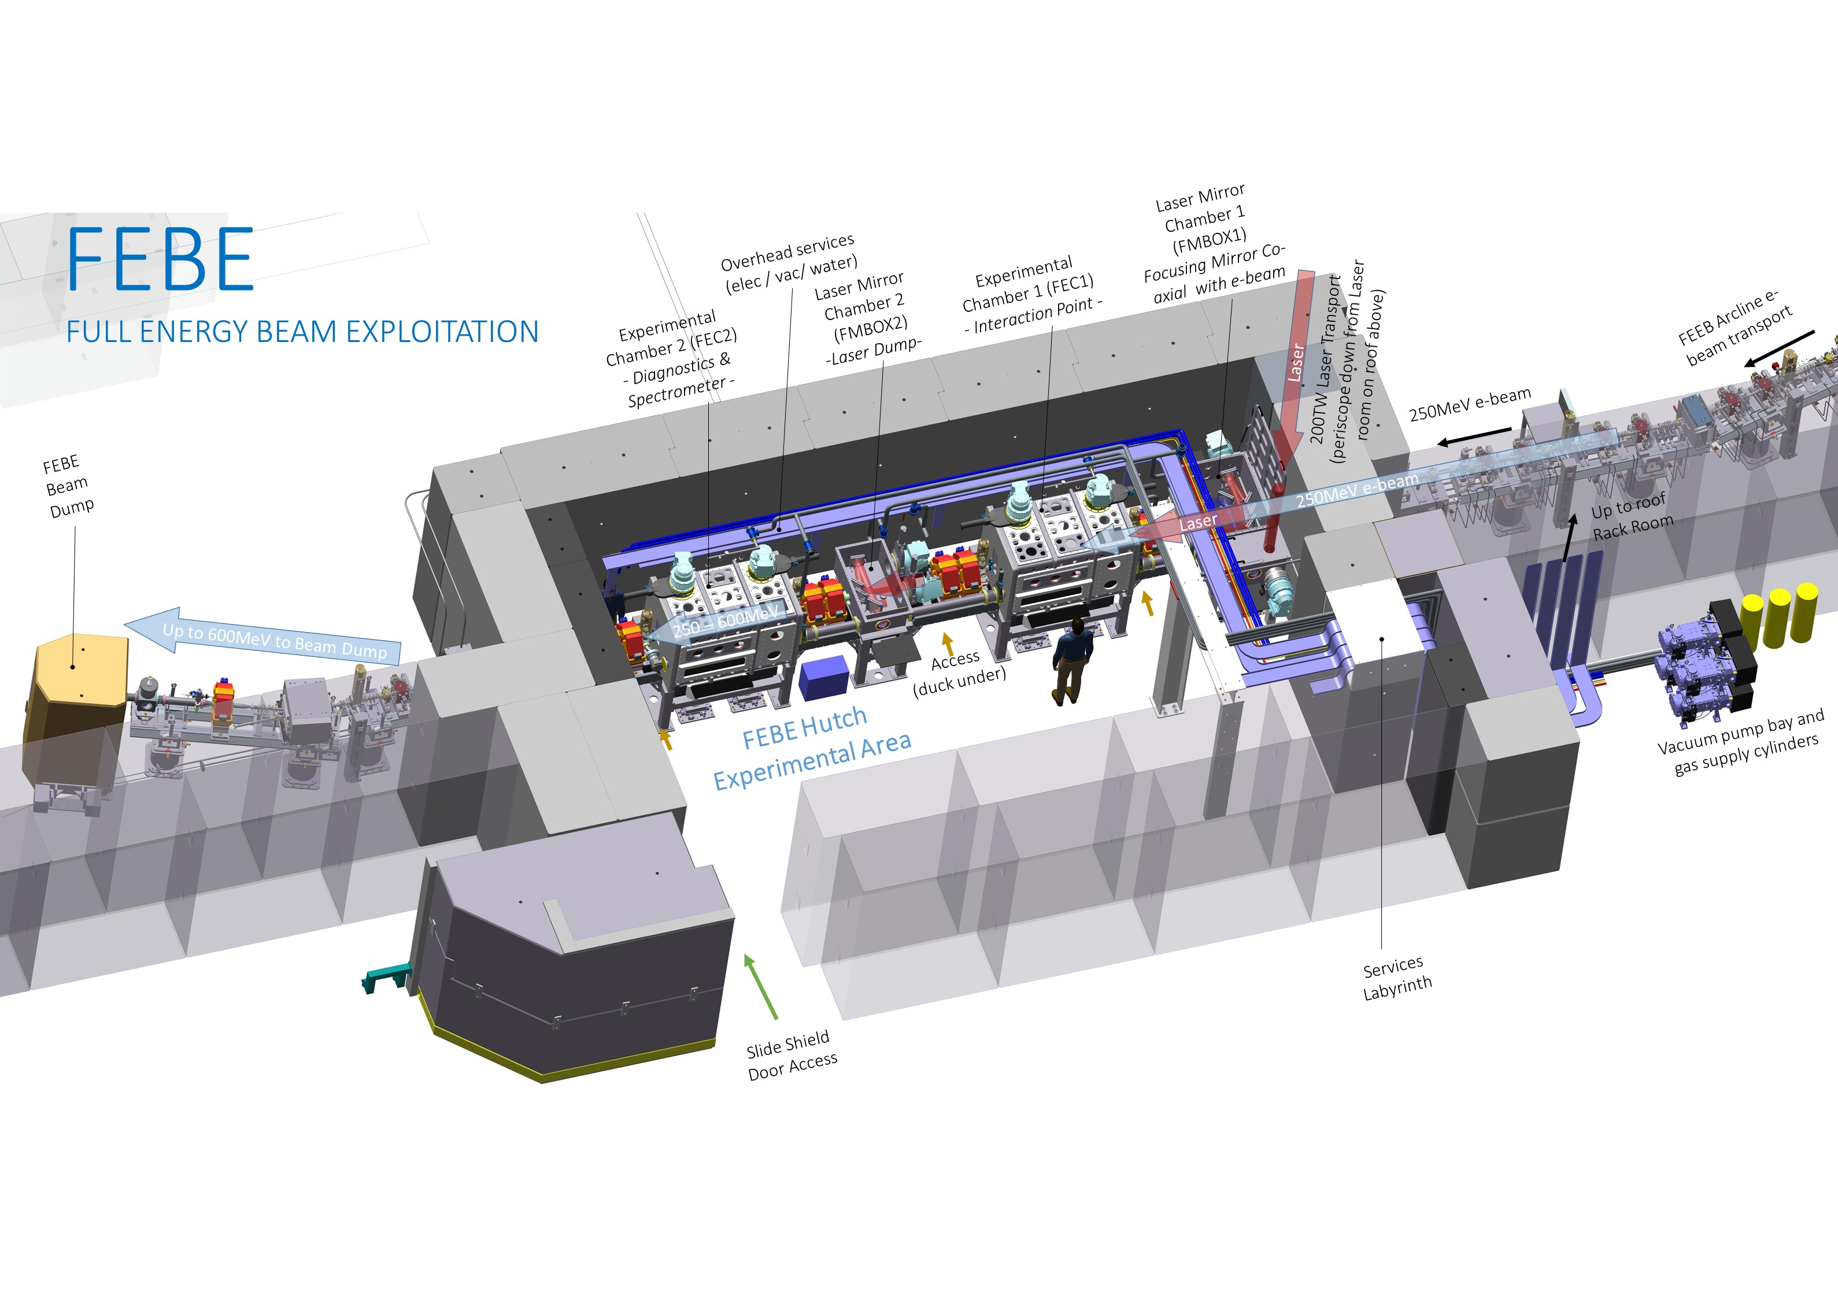
FEBE Hutch Overview
Hutch footprint: 10×5.4×3 m³, Shielding: total beam power 6 W
Flexibility with bunch charge (maximum 250 pC), bunch repetition rate (maximum 100 Hz),
beam energy (250 MeV – 2 GeV)
Two identical chambers: more flexible, provides diagnostic support, and a route towards ambitious interaction/transport/application

Slide 19
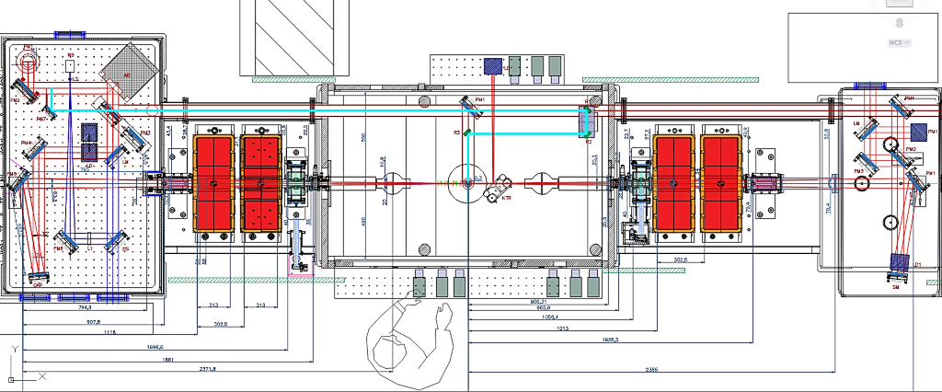
FEBE Laser
Wavefront sensor
Deformable mirror
Pass through to chamber
IP Probe line (representative)
Down-periscope from laser room
CLARA Beam
CLARA Beam
CLARA Beam
OAP
~3.5m Focal Length
FEBE Laser
Commercial 100 TW, 5 Hz – recently funded by STFC – delivery 2024/25
‘Upgrade ready’ to 250 TW
Femtosecond synchronization to CLARA Optical Timing Network
Primary Laser IP (could move focus upstream)

Slide 20
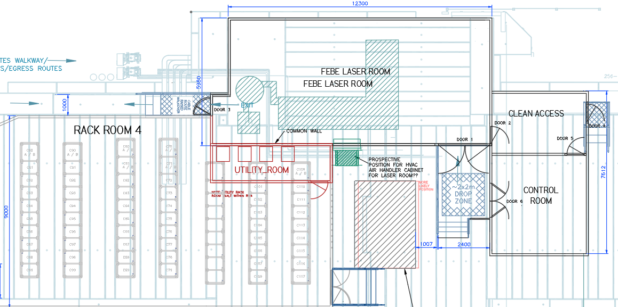
FEBE Laser
Immediately on top of the FEBE hutch to minimise path length to target.
Class 10,000 (ISO 7) clean room with environment control.
Operated from immediately adjacent laser control room.
Power suppliers will be housed in nearby Rack Room 4.

Slide 21
Tracking Tools
Tracking performed in SimFrame – ASTRA + Elegant
  Includes LSC, CSR, Cavity Wakefields, De-chirper Wakefields
  Optimisation using GA and Simplex
Strong CSR/LSC effects (low energy, high charge)
Gun + Linac1
Linac 2-4, 4HC, VBC, De-chirper
FEBE Arc, FEBE Hutch, IP
Generator (Cathode)
ASTRA (Injector)
Elegant (CLARA)
Elegant (FEBE)
0-35 MeV/c
Space-charge
35-250MeV/c
LSC/CSR
250MeV/c
LSC/CSR
21

Slide 22
Beam parameters
  Offered parameters to evolve, based on development time
  ‘Day 1’ → Nominal → R&D
Parameter | High charge | Low charge
Energy [MeV] | 250 | 250
Charge [pC] | 250 | 5
RMS t [fs] | 100 (50) | 50 (≤50)
σ_{E}/E [%] | <5 (1) | <1 (<1)
RMS x [µm] | 100 (50) | 20 (1)
RMS y [µm] | 100 (50) | 20 (1)
ε_{N} x @ 250 MeV [µm] | 5 (<5) | 2 (1)
ε_{N} y @ 250 MeV [µm] | 5 (<1) | 2 (<1)
All parameters to be confirmed through measurement using appropriate diagnostics.
R&D: dedicated effort required beyond standard operations, and/or new diagnostics technology required.

Slide 23
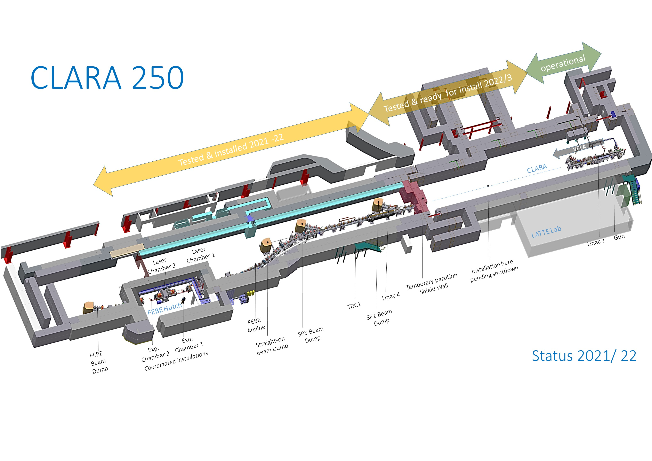
CLARA 250 MeV - Accelerator Hall
Tested & ready for install 2023
Tested & installed 2021-22
BA1
Status 2022

Slide 24
CLARA 250 MeV - Accelerator Hall Roof
RF, Rack and FEBE laser rooms

Slide 25
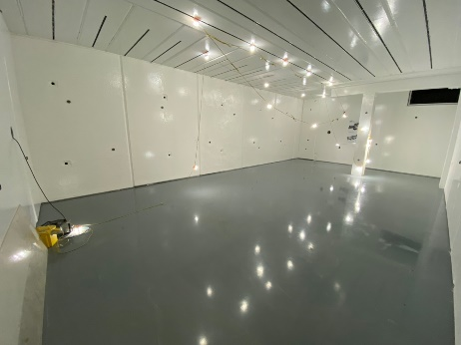
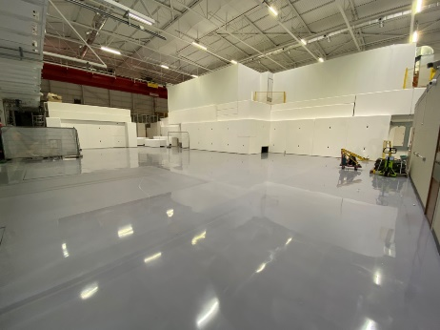
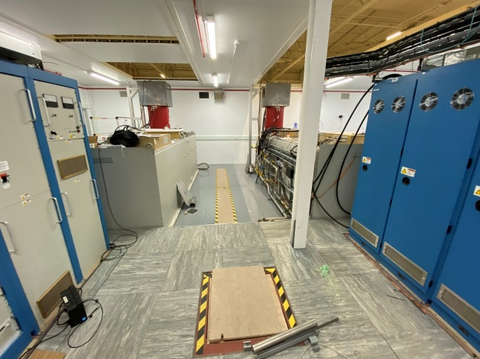
Phase 2 Preparation Progress
Accelerator module construction & installation progressing as planned
All modules built off-line in the Engg Technology Centre.
Mechanical build, alignment, vacuum and electrical tests of all modules is complete
Completion of 100TW Laser room complex
Electrical/mechanical services installation
Painting floors and bunker surfaces to allow clean installation
Phase 2 Installation
FEBE Hutch
FEBE Laser Room and Rack Room 4 on Roof
RF Room 2
Linac 2 & 3 modulators

Slide 26
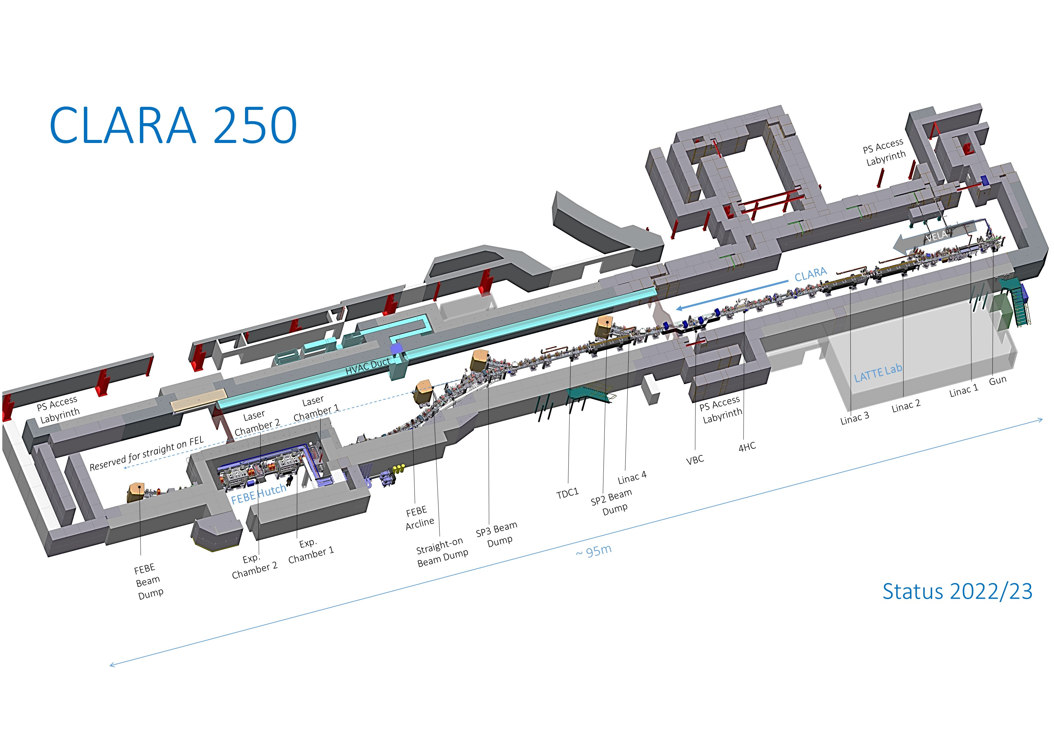
CLARA 250 MeV - Accelerator Hall
Status 2023

Slide 27
CLARA & UK XFEL Schedule
2022
2023
2024
2025
2026
2027
2028
2029
2030
2031
CLARA
SD1
HRRG
SD2
Technical Beam FEBE
Commissioning
Machine Development and CLARA Exploitation
UK XFEL
CDR: Options analysis
TDR
Construction
FEBE Laser contract begins
FEBE Exploitation kick off meeting
FEBE Laser ready for exploitation
SD1
Shutdown - Gun Modulator/klystron change
SD2
Shutdown - Phase 2 installation

Slide 28
Summary
CLARA FE has delivered high brightness beam for several novel applications successfully over two user runs from 2018 leading to many high impact publications.
Upon completion of CLARA Phase 2 in 2024, 250 MeV FEL ready beam will be available to UK and international community.
FEBE will offer a unique facility to users to work on a configurable, easily accessible (both regular calls and the hutch) high quality electron beam with femtosecond synchronised high energy laser light.
400 Hz gun conditioning/commissioning will start in August 2022 on the VELA line, which will allow us to swap this gun to CLARA line during Phase 2 shutdown (planned to start February 2023)
Straight-on space (Phase 3) is retained for accelerator technology R&D in support of UK XFEL.

Slide 29
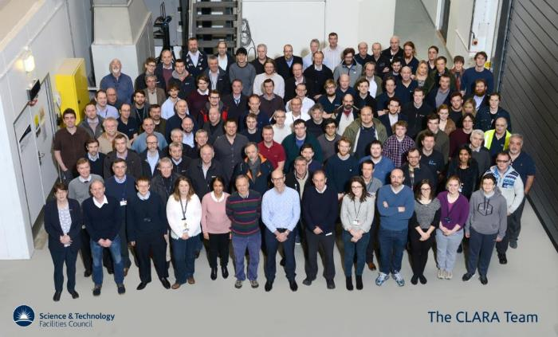

Acknowledgments
Thanks to everyone in the CLARA team & CLARA Users.
astec.stfc.ac.uk
@ASTeCSTFC

