Slide 1


ROOT: Functions & Fitting
Harinder Singh Bawa
California State University Fresno

Slide 2
Review of previous sessions: Any Question?
* Good to practice some exercises side by side in order to understand

Slide 3
Functions

Slide 4
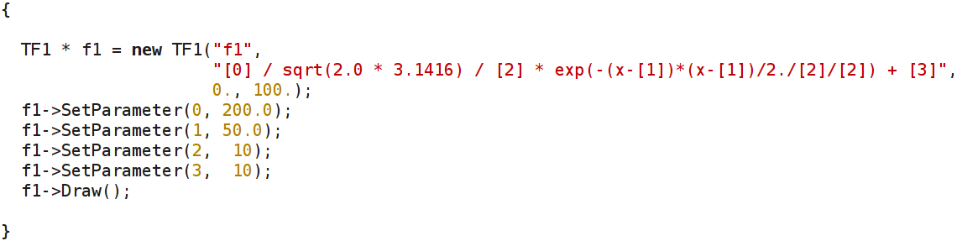
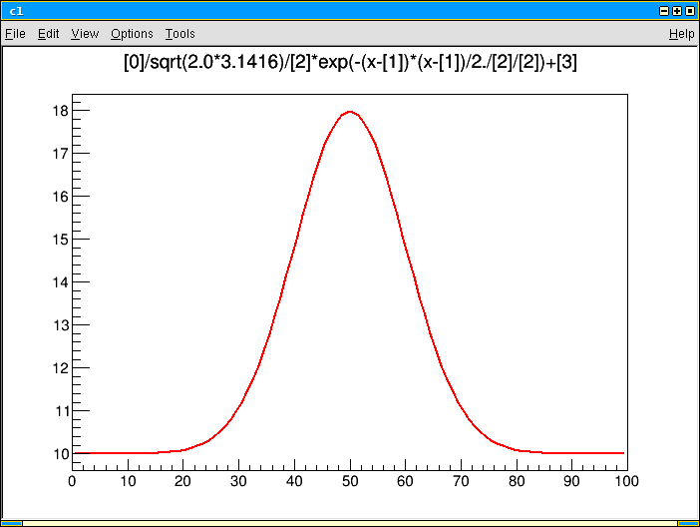
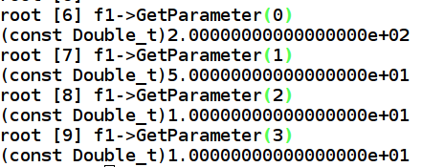
TF1 with parameters
A function can have parameters (e.g. floating parameters for fits...)

Slide 5
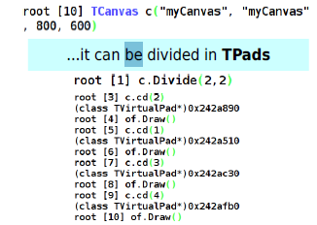

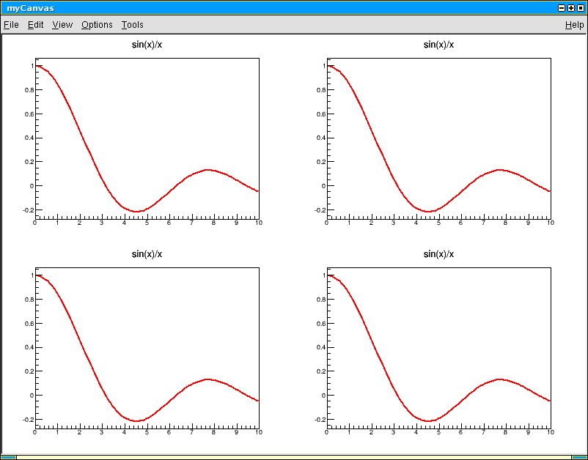


Let's draw a TF1 on a TCanvas
Like most objects in ROOT, functions can be drawn on a canvas
a TCanvas is an object too...

Slide 6
Functions and Histograms
Define a function:
TF1 *myfunc=new TF1(“myfunc”,”gaus”,0,3);
Myfunc->SetParameters(10., 1.5, 0.5);
Myfunc->Draw();
Generate histograms from functions:
(Myfunc->GetHistogram())->Draw();
Generate histograms with random numbers from a function:
TH1F *hgaus=new TH1F(“hgaus”,”histo from gaus”, 50, 0,3);
hgaus->FillRandom(“myfunc”,10000);
hgaus->Draw();
Write histogram to a rootfile:
TFile *myfile= new Tfile(“hgaus.root”,”RECREATE”);
hgaus->Write();
Myfile->Close();

Slide 7
Fitting Histograms
Let us try to fit the histogram created by the previous step:
Interactively:
Open rootfile containing histogram:
root –l hgaus.root
Draw histogram
hgaus->Draw()
Right click on the histogram and select “Fit Panel”
Check to ensure:
“gaus” is selected in the Function->Predefined pop-menu
“Chi-square” is selected in the Fit Settings->Method menu
Click on “Fit” at the bottom
[Display fit parameters: Select Options->FitParameters]

Slide 8
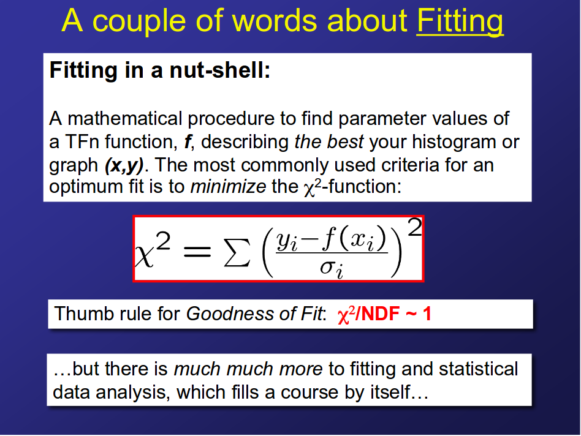

Slide 9
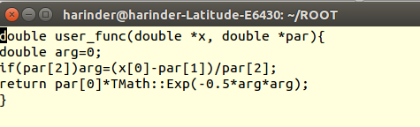
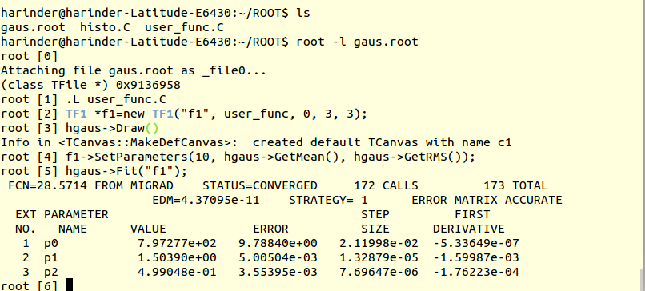
Fitting contd:
Using user defined functions:
Create a file called user_func.C with the following contents:
Last 3 parameters specify the number of parameters for the function

Slide 10
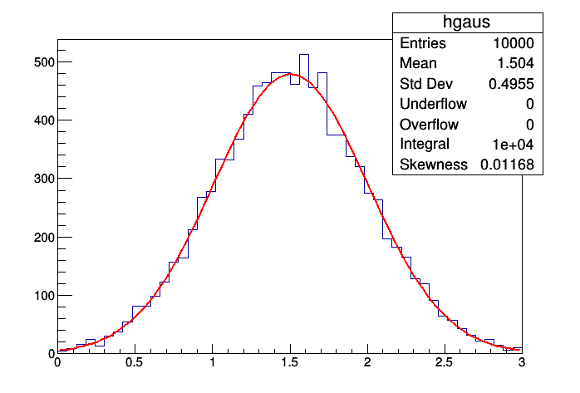
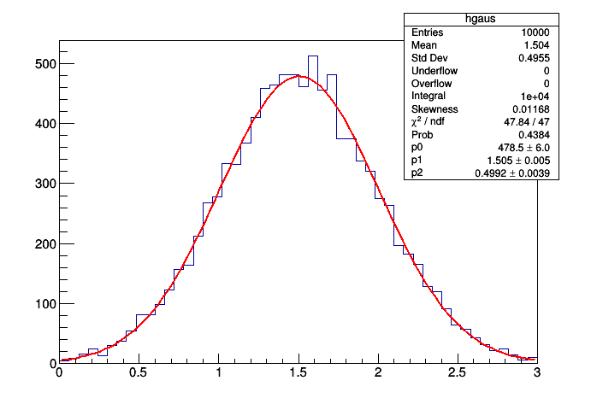
gStyle->SetOptStat(1111111)
Also can try :
gStyle->SetOptFit(1111)

Slide 11
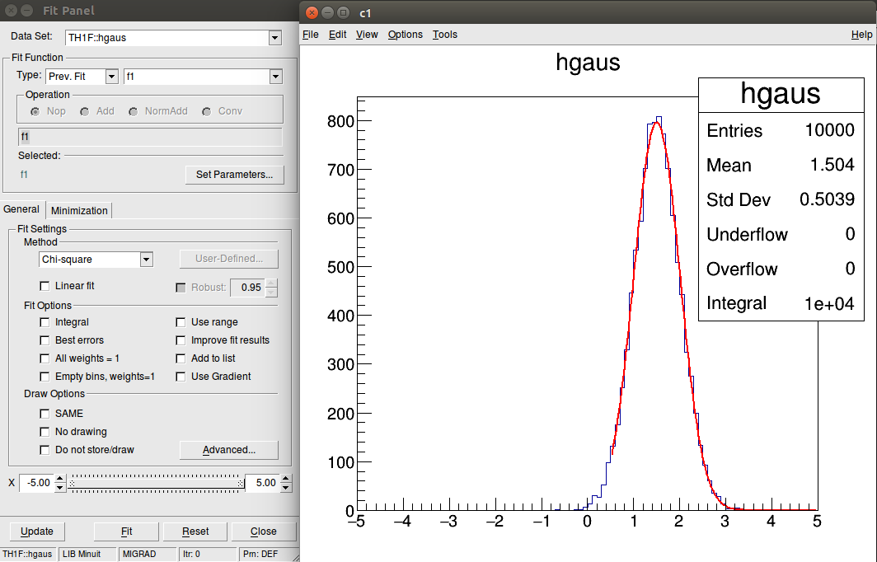
Fitting contd:
Move the slider to change fit Range

Slide 12
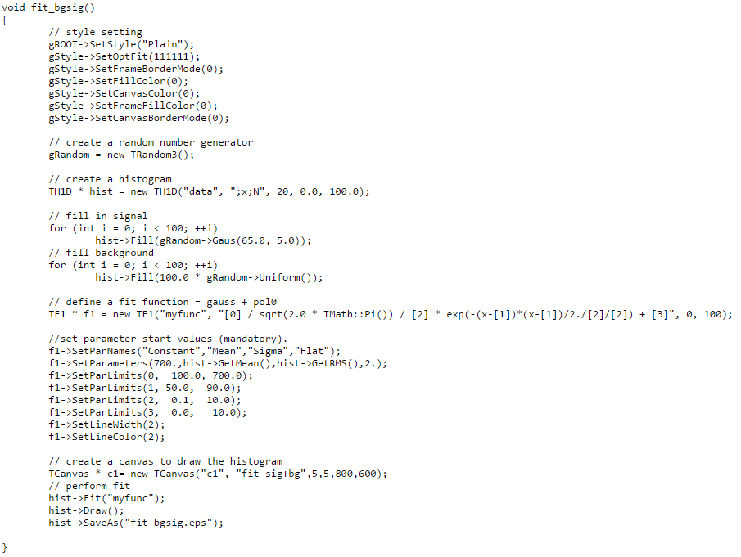
Mean=65, sigma=5.

Slide 13
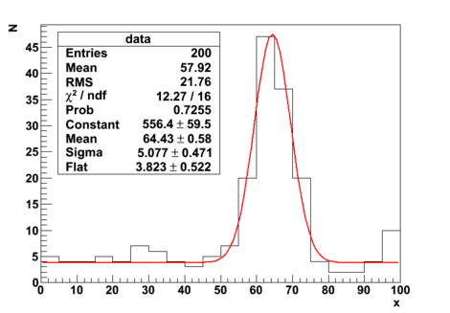

Slide 14
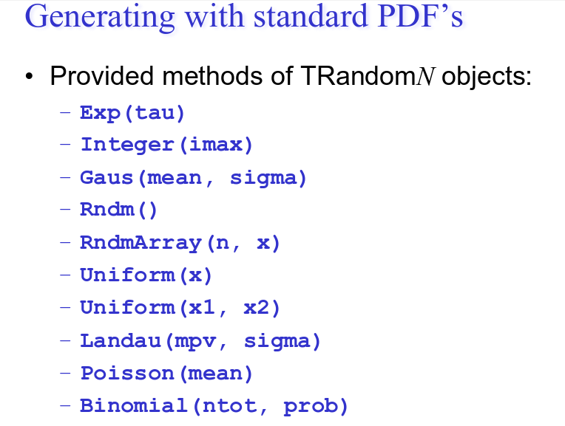
https://root.cern.ch/doc/master/classTRandom.html

Slide 15
Exercise:
1)
Create a gaussian function using TF1 class of Root, set its parameters(500.,65.,5.), plot it and finally save the plot.
Hint: Gaussian function:
TF1 f1("gauss", "[0] / sqrt(2.0 * TMath::Pi()) / [2] * exp(-(x-[1])*(x-[1])/2./[2]/[2])", 0, 100)
Create a gaussian distributed random numbers using the Random number generator class TRandom3 and using the provided basic Random distribution "Gaus(mean=65,sigma=5)". Create a 1-dimensional histogram TH1D and fill in with the generated random numbers. Finally book a canvas TCanvas and plot the distribution and save it
Fit the histogram from (2) with function (1)
2) Write a root macro that creates randomly generated data as a signal peak (gaussian) with mean= 125.0 & sigma=10.0. Perform fit with a gaussian function and inspect the parameters .
Add background as uniform
Fit using function gaus+pol2
Write down the good parameters.

Slide 16
Full Exercise upto now
Fill a histogram randomly (n=~10,000) with a Landau distribution with a most probable value at 20 and a “width” of 5 (use the ROOT website to find out about the Landau function)
Fill the same histogram randomly (n=~5,000) with a Gaussian distribution centered at 5 with a “width” of 3
Write a compiled script with a fit function that describes the total histogram nicely (it might be a good idea to fit both peaks individually first and use the fit parameters for a combined fit)
Add titles to x- and y-axis
Include a legend of the histogram with number of entries, mean, and RMS values
Add text to the canvas with the fitted function parameters
Draw everything on a square-size canvas (histogram in blue, fit in red)
Save as png, eps, and root file

