Slide 1


ROOT: Functions & Histograms
Harinder Singh Bawa
California State University Fresno

Slide 2
Review of previous sessions: Any Question?
* Good to practice some exercises side by side in order to understand

Slide 3
So far in Histograms
Booking
TH1F(const char* name, const char* title, int nbinsx, double xlow, double xup);
TH1F(const char* name, const char* title, int nbinsx, const double* xbins);
Filling
virtual int Fill(double x);
virtual int Fill(double x, double w);
Getting information
virtual double GetBinContent(int bin) const;
virtual double GetMaximum(double maxval = FLT_MAX) const;
virtual double GetMaximum(double maxval = FLT_MAX) const;
Drawing
virtual void Draw(Option_t* option);
Writing to a file (inherited from TObject)
virtual int Write(const char* name = "0", int option = 0, int bufsize = 0);

Slide 4
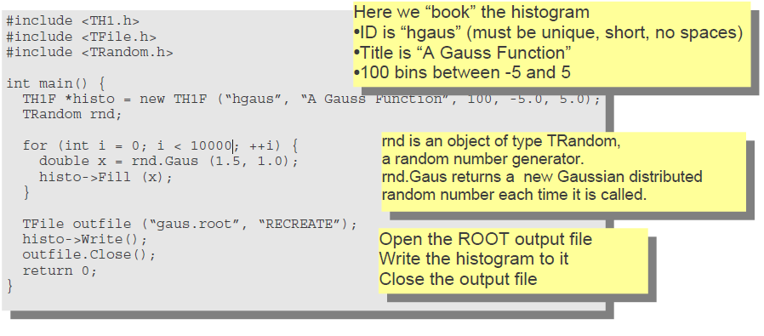
Review: Histogram
Samples a random number from the standard Normal (Gaussian) Distribution with the given mean and sigma.
https://root.cern.ch/doc/master/classTRandom.html

Slide 5
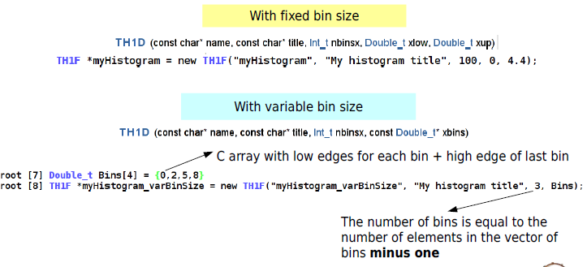
1-D Histograms
1-D histograms can be instantiated in various ways

Slide 6
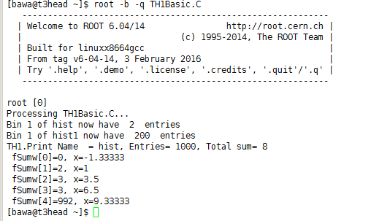
1-D Histograms (2)
Filling histograms, getting information in various ways
{
Double_t Bins[4]={0,2,5,8};
TH1F *hist=new TH1F("hist","",3,Bins);
TH1F *hist1=new TH1F("hist1","",3,Bins);
for(Int_t i=0;i<1000;i++) {
hist->Fill(i);
hist1->Fill(i,100); }//100 is weight given to histogram entries
cout<<"Bin 1 of hist now have\t"<<hist->GetBinContent(1)<<"\tentries"<<endl;
cout<<"Bin 1 of hist1 now have\t"<<hist1->GetBinContent(1)<<"\tentries"<<endl;
hist->Print("all");
}

Slide 7
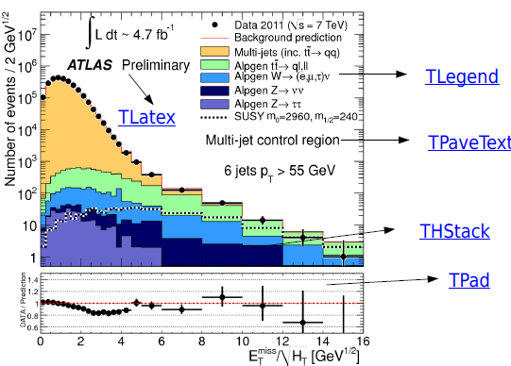
Many 1-Dimensional histograms (1)
How to plot many histograms at once

Slide 8
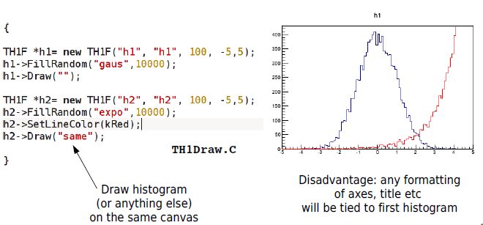
Many 1-Dimensional histograms (2)
How to plot many histograms at once, in easy way

Slide 9
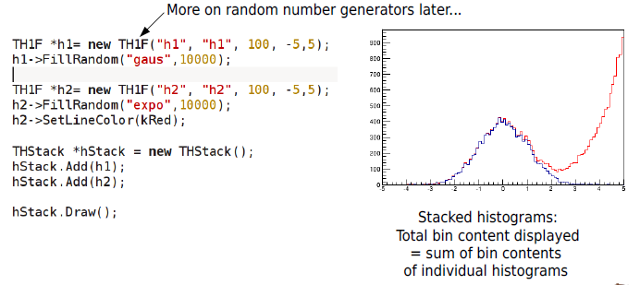
THStack (1)
How to plot many histograms at once and stack them as well

Slide 10
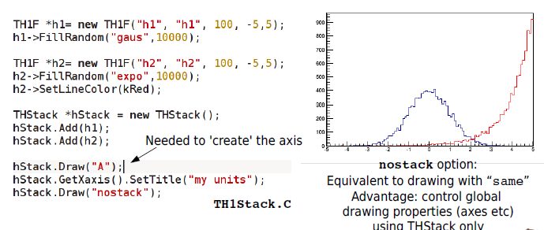
THStack (2)
How to plot many histograms at once and stack them as well

Slide 11
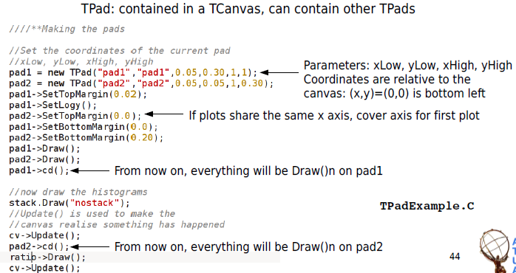
TPad
How to have e.g. a data/MC inset on the bottom of your plot

Slide 12
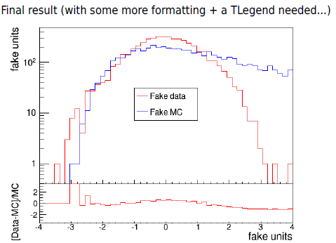
TPad
How to have e.g. a data/MC inset on the bottom of your plot

Slide 13
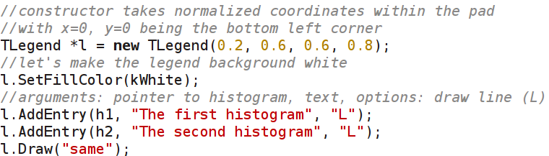
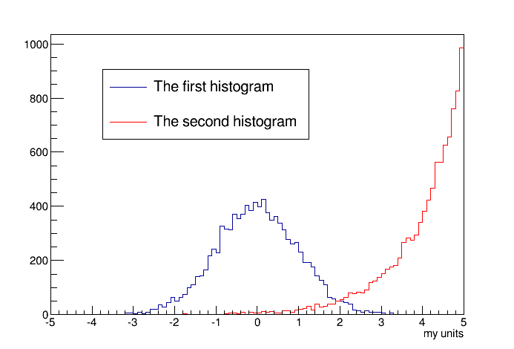
TLegend
How to draw a legend for multiple histograms

Slide 14
Functions

Slide 15
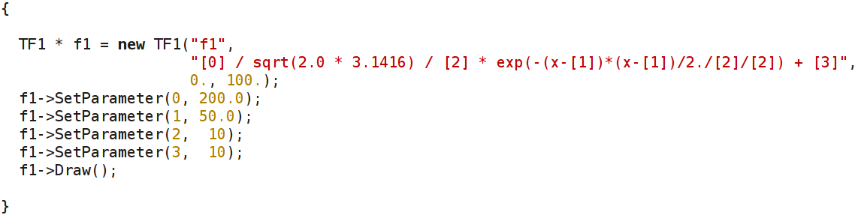
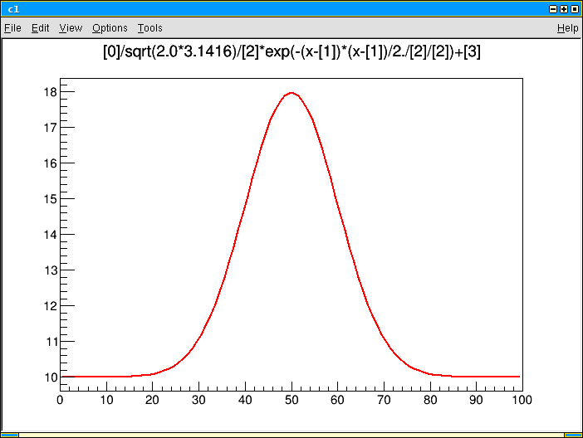
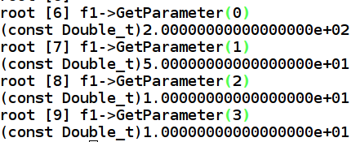
TF1 with parameters
A function can have parameters (e.g. floating parameters for fits...)

Slide 16
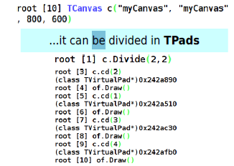

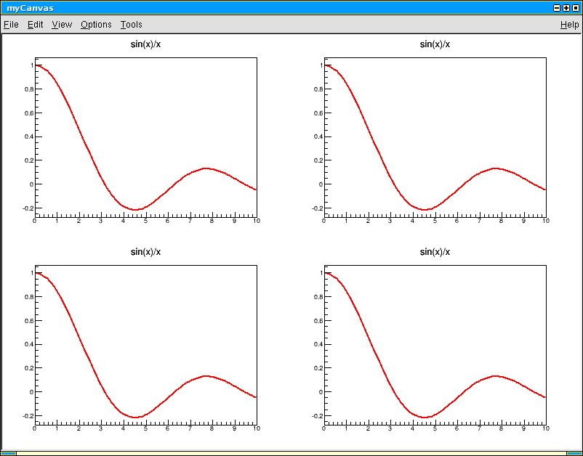


Let's draw a TF1 on a TCanvas
Like most objects in ROOT, functions can be drawn on a canvas
a TCanvas is an object too...

Slide 17
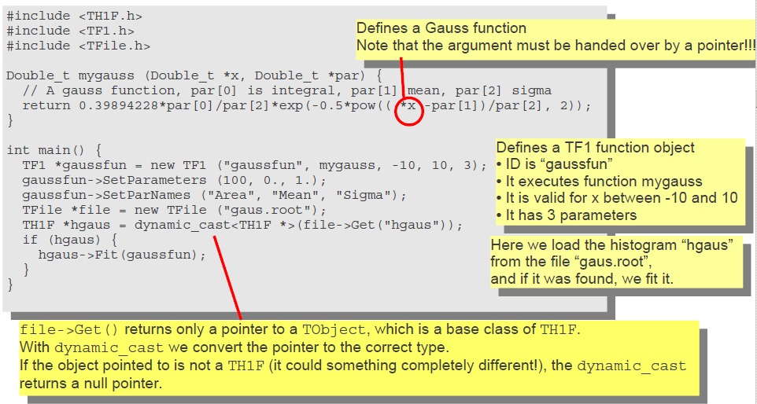
TF1 Functions and Fit:

Slide 18
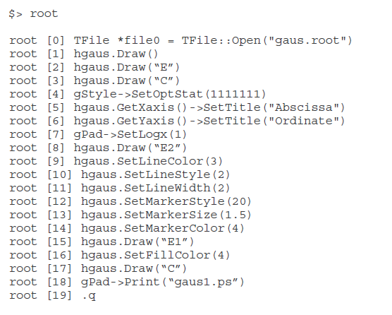
Some ROOT commands

Slide 19
Graphs

Slide 20
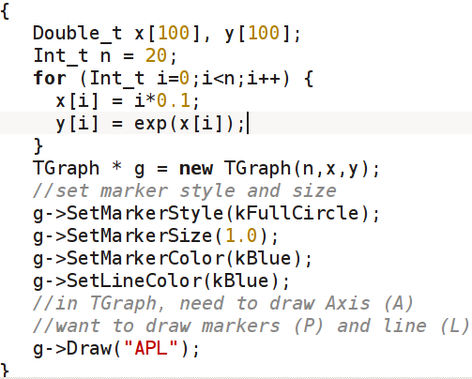
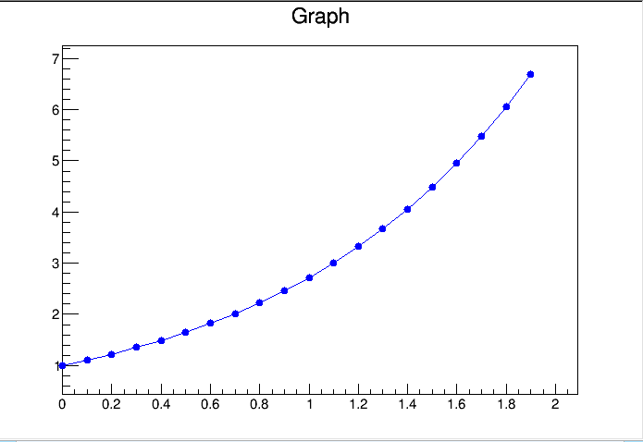
TGraph
TGraph: two arrays of points representing x and y coordinates
TGraphErrors: TGraph with symmetric errors on x and y points
TGraphAsymmErrors: TgraphErrors, with asymmetric errors

Slide 21
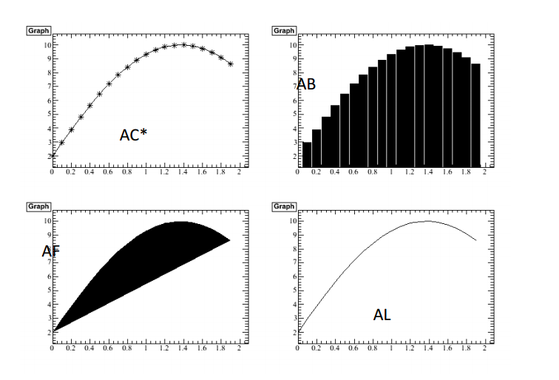
Graph Drawing options

Slide 22
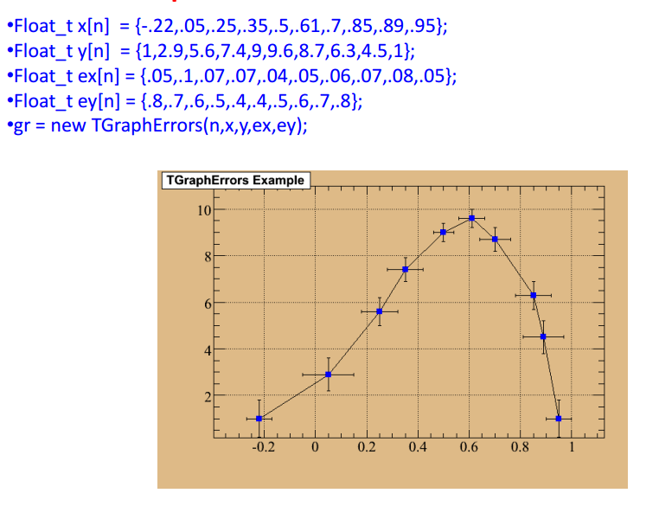
TGraph Error bar

Slide 23
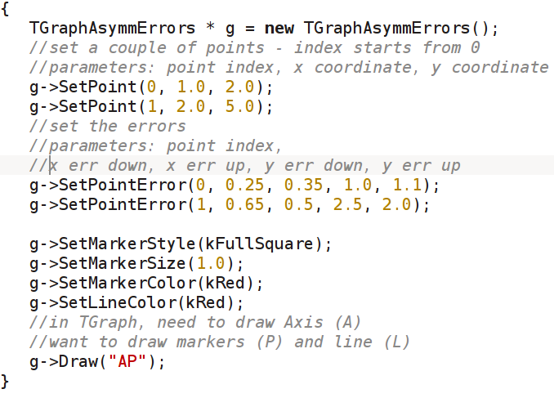
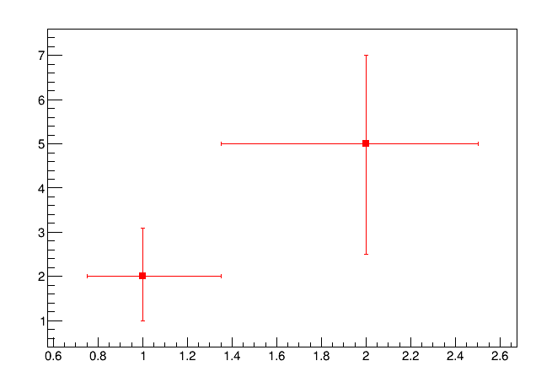
TGraphAsymmErrors
TGraph: two arrays of points representing x and y coordinates
TGraphErrors: TGraph with symmetric errors on x and y points
TGraphAsymmErrors: TgraphErrors, with asymmetric errors

Slide 24
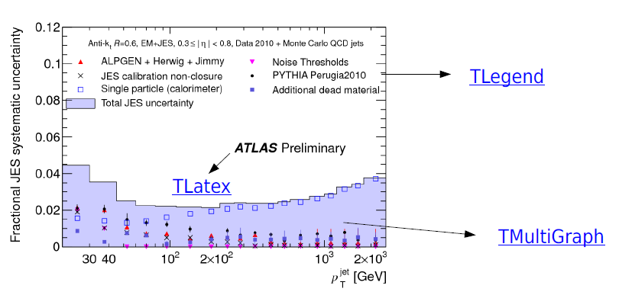
Many TGraphs
How to plot many graphs at once?

Slide 25
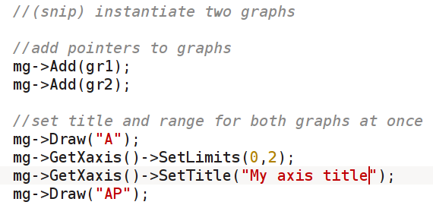
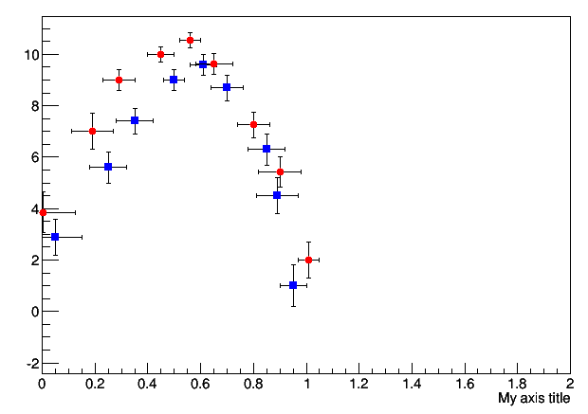
TMultigraph
TMultiGraph *mg = new TMultiGraph();

Slide 26
Exercises (1)
Create two histograms with 10 bins ranging from -5. to 5. with no title and two different names. (* Also try to use variable binning by your own)
Fill the first histogram with a Gaussian distribution by using hist1->FillRandom("gaus", 500);
Fill the second histogram with a second order polynomial distribution by using hist2->FillRandom("pol2", 500);
Create a new TCanvas with name "c1" and title "gauss" and draw the first histogram.
Create a new TCanvas with name "c2" and title "poly" and draw the second histogram.
Set the line color of the first histogram to red (kRed) and the second to blue (kBlue). *Using hist->SetLineColor()
Create a third canvas and draw the first histogram. Then draw the second histogram with option "same" to have both histograms in the same plot.
Create a legend at position (0.16, 0.63, 0.45, 0.91) and add entries for both histograms to it. Draw the legend.
Save the third canvas as a PDF file and open the PDF
Save the third canvas as a ROOT file (gaussian-polynomial.root).

Slide 27
Exercise(2)
Create a one dimensional function f(x)=sin(x)/x+a in the region 0 - 10.
Set the parameter a=5.
Draw the function.
Create a graph with symmetric errors and 5 points.
Set the following points: (1.0, 2.1), (2.0, 2.9), (3.0, 4.05), (4.0, 5.2), (5.0, 5.95)
Set the errors on x to 0.0 and the errors on y to 0.1.
Draw the graph including the axes and error bars.
Exercise(3)

