Slide 1


Caustic Analysis in Accelerators
Tessa Charles
University of Liverpool
Cockcroft Institute

Slide 2
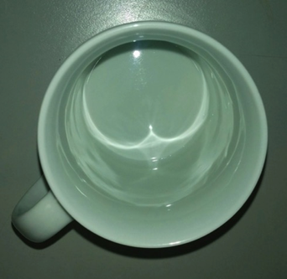
The envelope of trajectories forms the caustics lines.
2

Slide 3
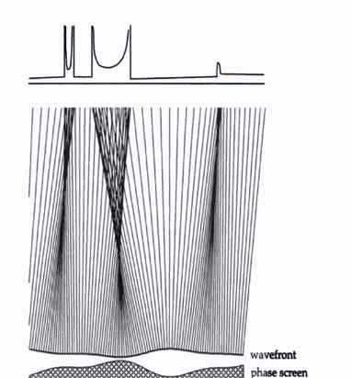
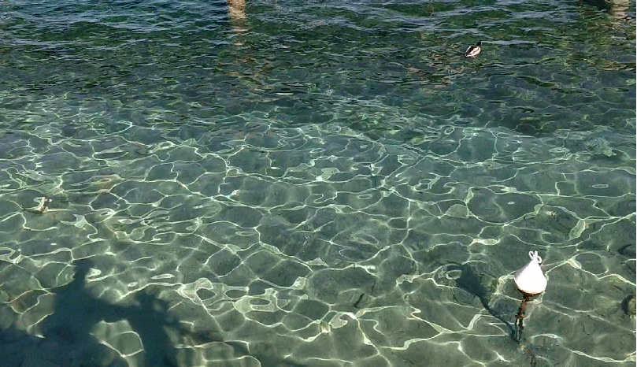
Caustics lines are an envelope of trajectories,
or the projection of that envelope on another surface.
Surface of water
J.F. Nye “Natural Focusing and Fine Structure of Light: Caustics and Wave Dislocations”, (Taylor & Francis, Philadelphia, 1999).
3

Slide 4
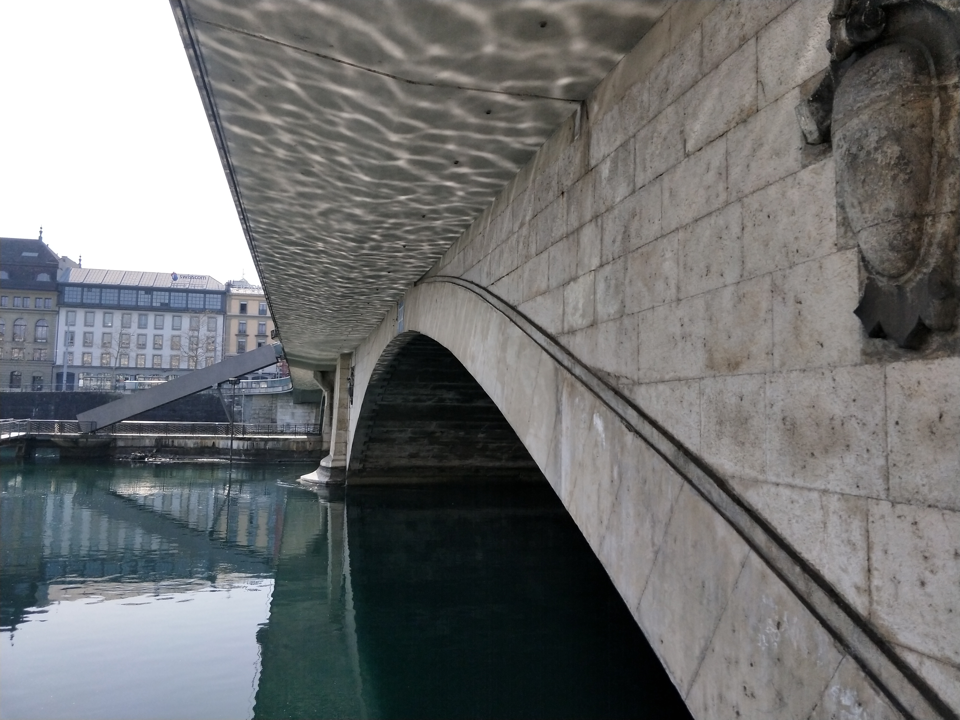
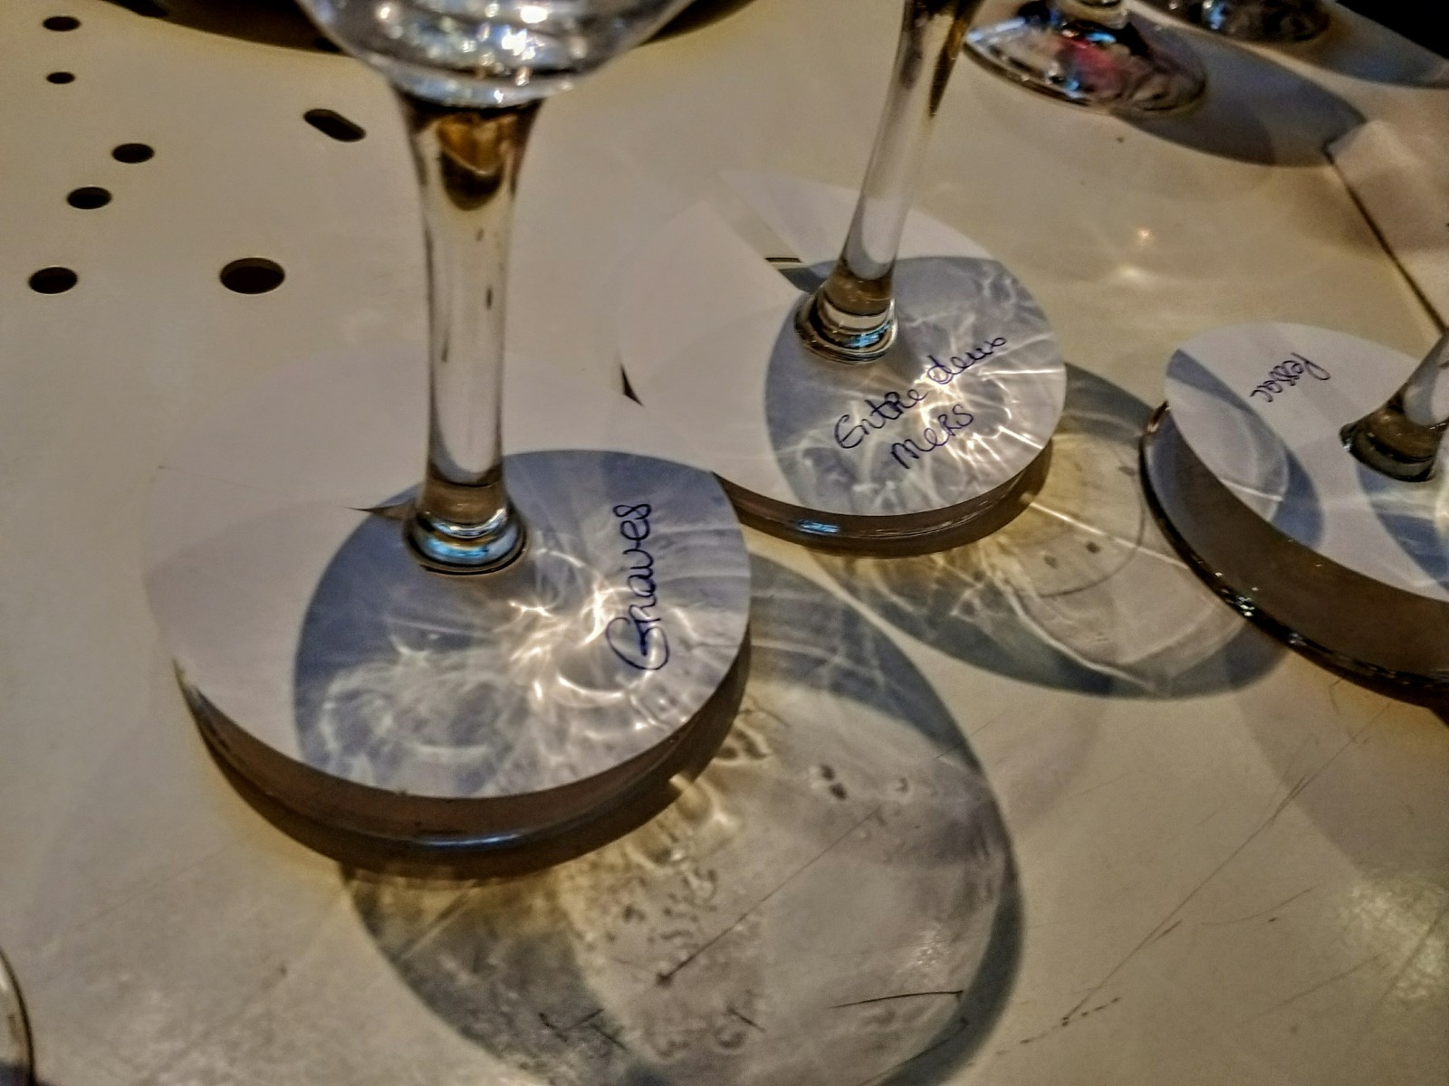
Caustics lines are an envelope of trajectories,
or the projection of that envelope on another surface.
Surface of water
J.F. Nye “Natural Focusing and Fine Structure of Light: Caustics and Wave Dislocations”, (Taylor & Francis, Philadelphia, 1999).
4

Slide 5
Outline
Introduction of caustics
Current horn suppression
MAX IV experimental measurements
Longitudinal Phase Space manipulation in recirculating machines
Microbunching instability
5

Slide 6
Outline
Introduction of caustics
Current horn suppression (example of the usefulness of caustics)
MAX IV experimental measurements
Longitudinal Phase Space manipulation in recirculating machines (example of the usefulness of caustics)
Microbunching instability (example of the usefulness of caustics)
6

Slide 7
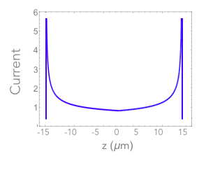
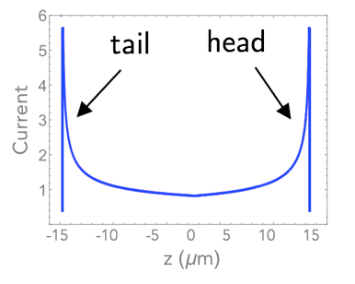
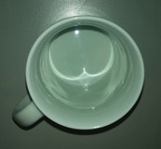
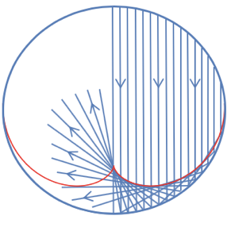
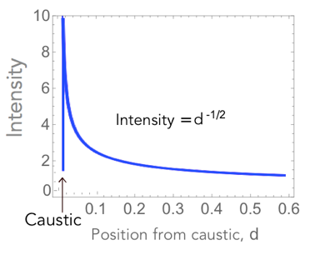
Electron trajectories in a bunch compressor:
head of
bunch
150
tail
head
75
z (µm)
Current
0
-75
tail of bunch
-150
z (µm)
0
2
4
6
8
Position (m)
Where there are caustics, there will be current spikes.
Optical caustics example:
Intensity
Distance from caustic
caustic
7

Slide 8
Caustics are singularities in the density of families of trajectories.
8

Slide 9
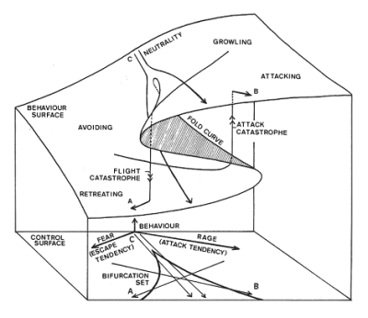
Caustics fall into catastrophe theory
z
x
y
9
Figure: EC Zeeman (1976) Catastrophe Theory in Scientific American.

Slide 10
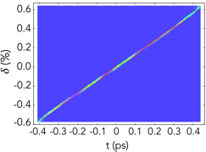
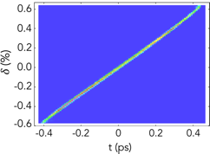
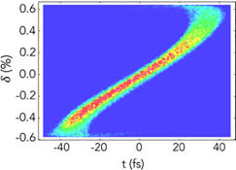
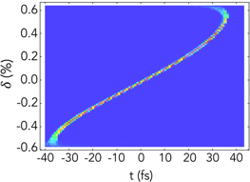
Longitudinal phase space evolution through a bunch compression
tail
Fractional
energy spread
head
z (ps)
z (ps)
z (fs)
z (fs)
dipole
magnet
10

Slide 11
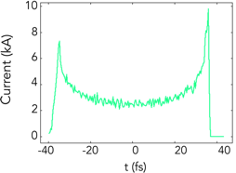
Longitudinal phase space dist. at bunch compression exit
Energy spread induced by Coherent Synchrotron Radiation (CSR):
λ = linear charge density
z (fs)
-λ
Current spikes are problematic, leading to CSR-induced emittance growth.
BC2_3
BC2_2
BC2_4
BC2_1
BC2_5
11

Slide 12
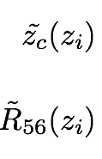
Caustic expression:
Initial phase space distribution:
T.K.Charles et al. Phys. Rev. Accel. Beams, (2016) 19, 104402
12

Slide 13
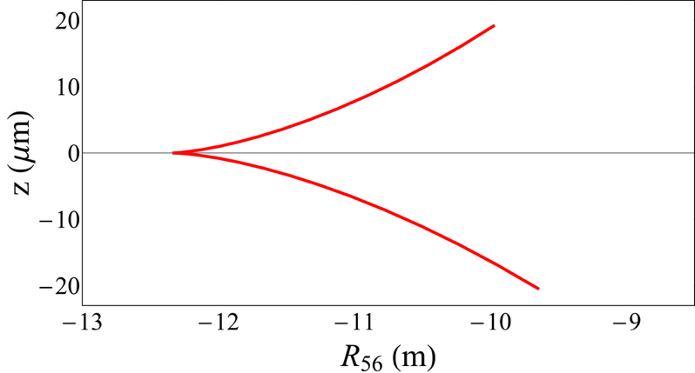
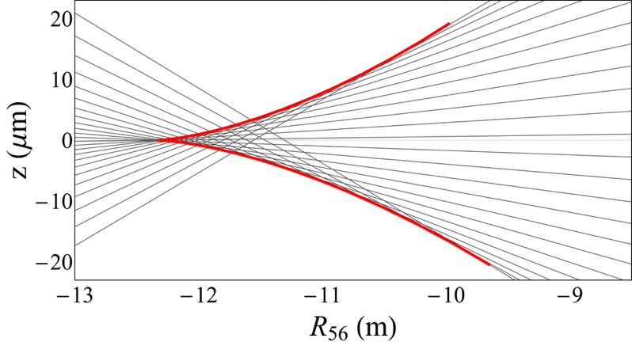
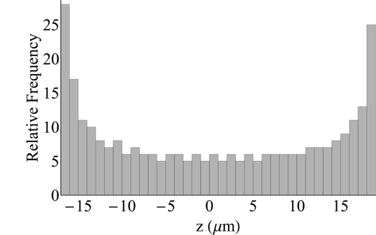
Caustic expression for a chicane
Caustic expression (red)
R₅₆ = -10 mm
13

Slide 14
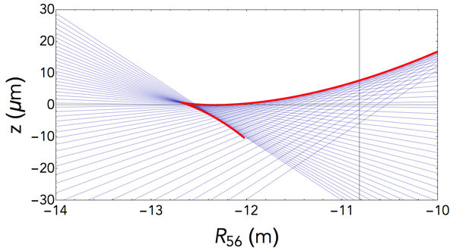
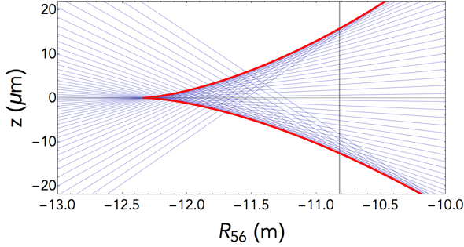
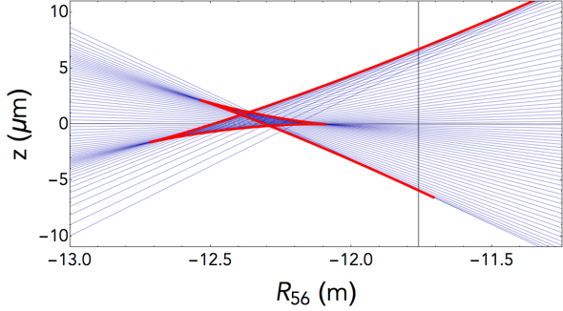
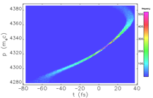
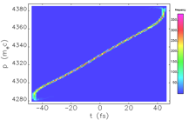
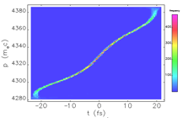
Fold
Cusp
Butterfly
T₅₆₆ = 18.1 mm, U₅₆₆₆ = -24 mm
T₅₆₆ = 16.4 mm, U₅₆₆₆ = -11.4 mm
T₅₆₆ =16.1 mm, U₅₆₆₆ = 2.6 m
E.g. single spike bunch compression [S. Huang et al, Phys. Rev. AB (2014) 17 120703]
E.g. LCLS
[Y. Ding et al. Phys. Rev. AB 19, 100703]
E.g. MAX IV
[S. Thorin et al. FEL2010,
WEPB34]
14

Slide 15
A closer look…
3 types of catastrophes, but all described by the same parametric expression.
These 3 cases give us an idea of how we might be able to sculpt electron trajectories to our benefit.
15

Slide 16
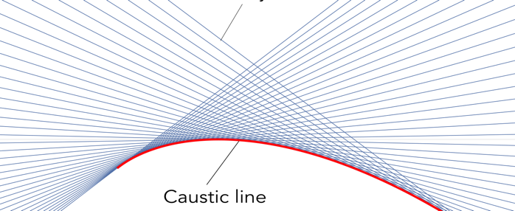
Current horn suppression
Example of the usefulness of caustics

Slide 17
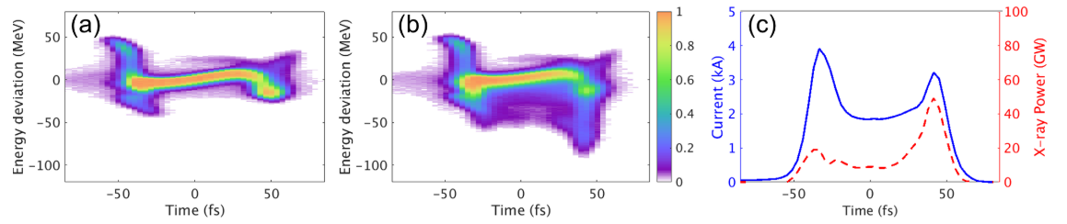
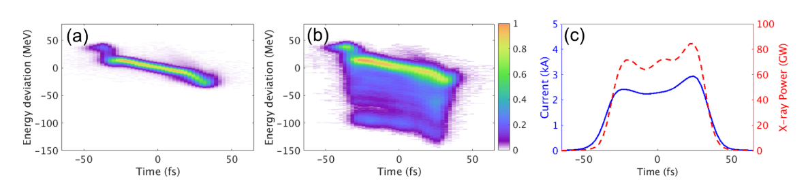
LSLC’s experience - current spikes diminish FEL performance
Before collimation
FEL power increased from ~3.5 mJ to 4-5 mJ.
After collimation
Y. Ding et al. (2016) Phys. Rev. AB 19, 100703
17

Slide 18
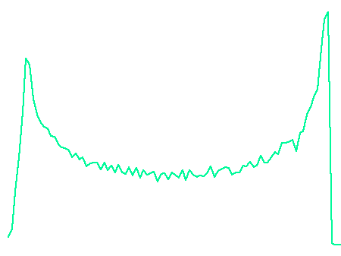
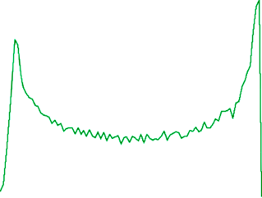
Current horn suppression - an S-band FEL Linac example
Elegant simulations of longitudinal phase space and current profile at the end of Linac2.
18

Slide 19
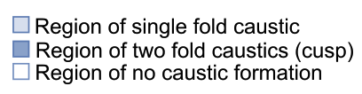
Caustic condition
Point (a) is the working point of the S-band linac example
19

Slide 20
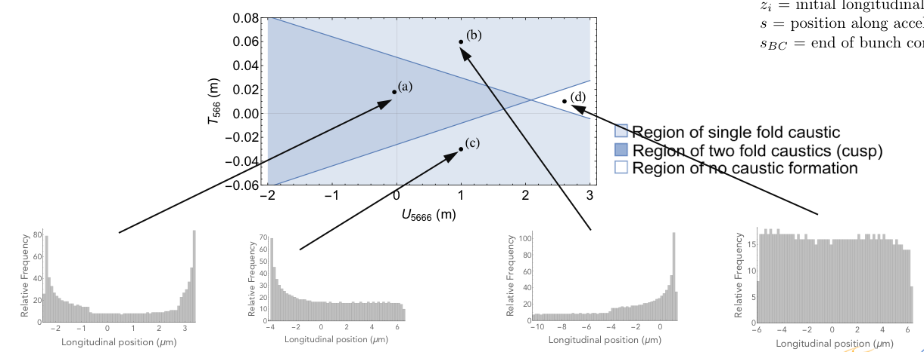
Caustic condition

Slide 21

Caustic current horn suppression - S-band FEL linac
Octupole added to BC1 to vary U5666.
21

Slide 22
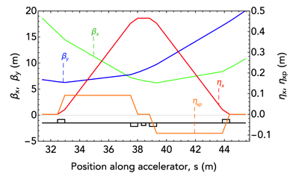
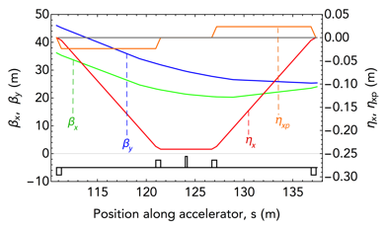
Caustic current horn suppression - S-band FEL linac
Octupole added to BC1 to vary U5666.

Slide 23
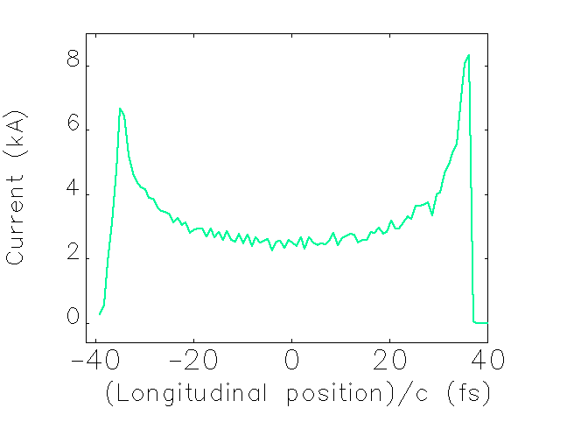
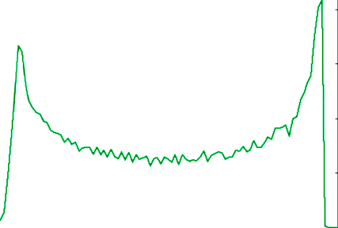
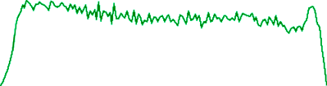
Caustic current horn suppression
Without octupole:
With octupole:
63% reduction in the CSR-induced emittance growth.
T.K.Charles et al. Phys. Rev. Accel. Beams, (2017) 20, 030705
23

Slide 24
Experimental results from MAX IV
with Andrea Latina (CERN), Sara Thorin (MAX IV), Jonas Björklund Svensson (MAX IV)

Slide 25
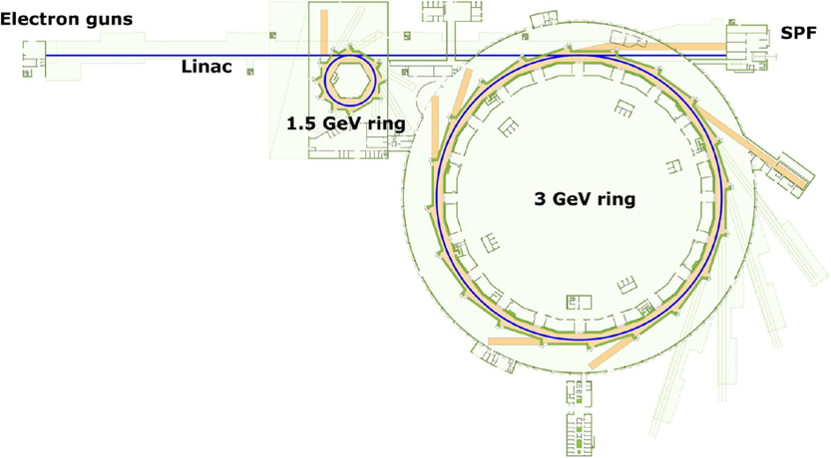
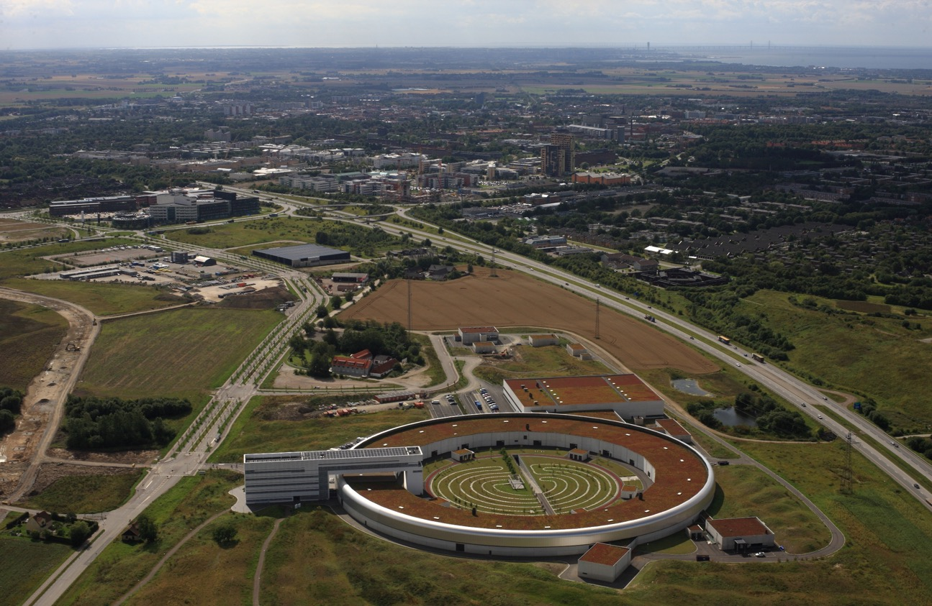
MAX IV
Linac
1.5 GeV
3 GeV
SPF
25

Slide 26
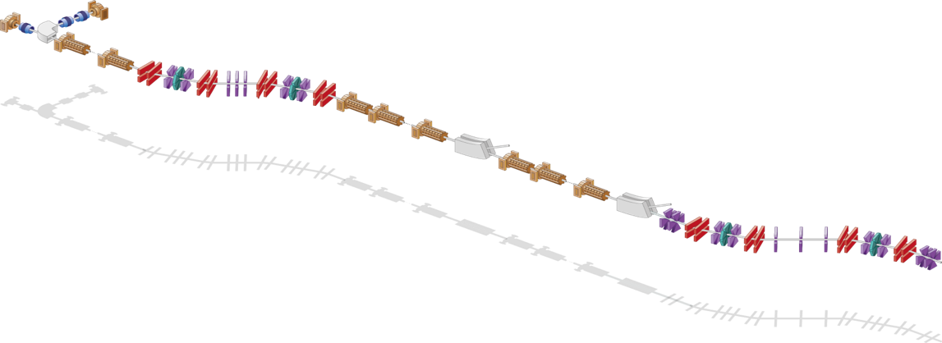
MAX IV Linac
Thermionic RF gun
Photo cathode RF gun
Extraction
1.5 GeV
BC1 @ 260 MeV
Extraction
3 GeV
BC2 @ 3 GeV
SPF
Photocathode and thermionic electron guns
2 double achromat bunch compressors (BCs)
RF frequency 2.998 GHz
26

Slide 27
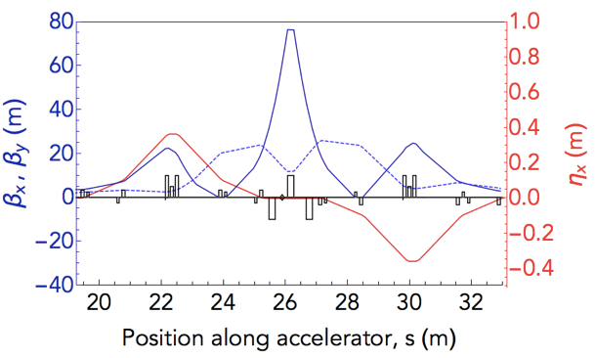
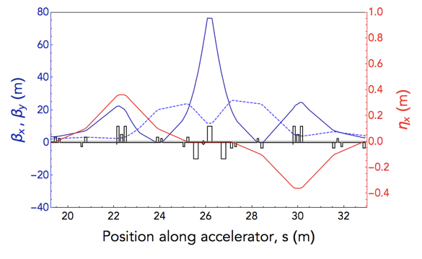
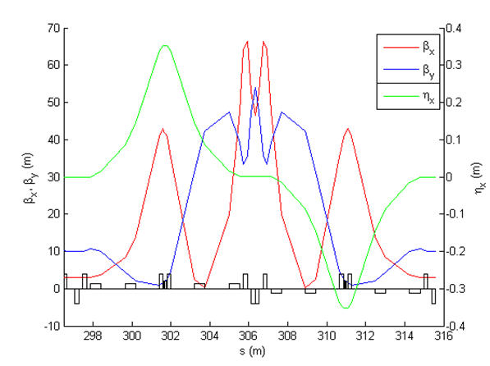

MAX IV Bunch Compressors
Double achromat bunch compressors:
positive fixed R56 (energy chirp from falling RF slope)
natural T566 used for linearization, self-linearizing
weak sextupoles at the center of each achromat used for fine tuning T566
dipole
quadrupole
sextupole
corrector
27

Slide 28
Zero-crossing method
RF phase at 40º
SPF
TG
BC1 @ 260 MeV
PG
L2A
L2B
L2B
L19B
BC2 @ 3 GeV
Extraction
1.5 GeV ring
Extraction
3 GeV ring
L0
L1B
Screen
(after first dipole)
Sextupole strengths varied
28

Slide 29
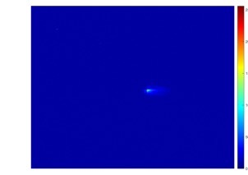

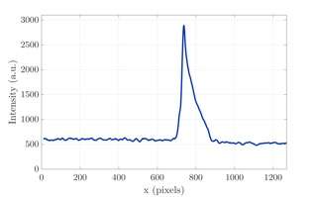
Zero-crossing method
RF phase at 40º
SPF
TG
BC1 @ 260 MeV
PG
L2A
L2B
L2B
L19B
BC2 @ 3 GeV
Extraction
1.5 GeV ring
Extraction
3 GeV ring
L0
L1B
Sextupole strengths varied
29

Slide 30
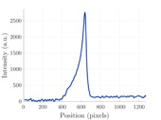
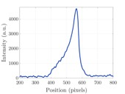
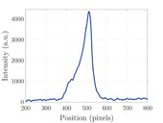
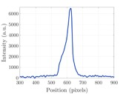





Experimental results – linearly ramped current profiles
Sextupole strengths
[m⁻³]:
1.0
7.0
13.0
19.0
25.0
31.0
37.0
30

Slide 31
Caustic expression:
Illustration of compressed bunches
Distance between peak and origin.
(Same expression as shown on slide 11, simply re-arranged)
The origin is found as being the distance from one bunch edge to the position within the bunch where the accumulated integrated charge equals half of the total charge.
31

Slide 32


Mapping out caustic lines
Offset removed
Caustic expression (red)
Offset due to the combined effects of wakefields and curvature of the phase space distribution.
32

Slide 33
Mapping out caustic lines
Where the caustic expression is undefined, the longitudinal phase space is considered well linearized, resulting in a short bunch with a symmetrical current profile.
Offset of 14 micrometers removed
33
T.K.Charles et al. IPAC19, WEYYPLS2

Slide 34
Longitudinal Phase Space manipulation in recirculating machines
Example of the usefulness of caustics
with
Dave Douglas, JLAB
Peter Williams, Cockcroft Institute

Slide 35

A UK recirculating FEL concept
with
Dave Douglas, JLAB
Peter Williams, Cockcroft Institute
35

Slide 36




Caustic exclusion plots for each arc of a recirculating machine during acceleration
Arc no.
12345678
Non-caustic region
Region of single fold caustic (single current spike)
Region of two fold caustics (multiple current spike)
36

Slide 37


Caustic exclusion plots for each arc of a recirculating machine during acceleration
Arc no.
12345678
Non-caustic region
Region of single fold caustic (single current spike)
Region of two fold caustics (multiple current spike)
37

Slide 38








Bunch distributions at various positions around the accelerator
Bunch Distribution from gun:
With thanks to Julian McKenzie (Daresbury, UK) for this distribution.
Distribution at end of arc 8:
Distribution after lasing:
38

Slide 39


Caustic exclusion plots for each arc of a recirculating machine during deceleration
Arc no.
9
101112131415
16
Non-caustic region
Region of single fold caustic (single current spike)
Region of two fold caustics (multiple current spike)
39

Slide 40

Caustic exclusion plots for each arc of a recirculating machine during deceleration
Arc no.
9
101112131415
16
Non-caustic region
Region of single fold caustic (single current spike)
Region of two fold caustics (multiple current spike)
40

Slide 41


Caustic exclusion plots for each arc of a recirculating machine during deceleration
Arc no.
9
101112131415
16
Non-caustic region
Region of single fold caustic (single current spike)
Region of two fold caustics (multiple current spike)
41

Slide 42


Caustic exclusion plots for each arc of a recirculating machine during deceleration
Arc no.
9
101112131415
16
Non-caustic region
Region of single fold caustic (single current spike)
Region of two fold caustics (multiple current spike)
42

Slide 43



Bunch distributions at various positions around the accelerator
Distribution after lasing:
Distribution at dump:
43
T.K.Charles et al. IPAC18, WEYGBE2

Slide 44
Microbunching instability
Example of caustics

Slide 45


Micro-bunching caustics
A caustic expression can also be derived for micro-bunching. Each line shows where a current spike will be seen.
45

Slide 46








Caustic nature leads to bifurcated current peaks
46

Slide 47


Micro-bunching with higher-order effects
Hyper-caustics = ‘caustics of caustics’
grey: T₅₆₆ = 0, U₅₆₆₆ = 0 mm
red: T₅₆₆ = -30 mm, U₅₆₆₆ = 0 mm
grey: T₅₆₆ = 0, U₅₆₆₆ = 0 mm
red: T₅₆₆ = 0, U₅₆₆₆ = -2 m
47

Slide 48
CSR with microbunching
The caustic nature of microbunching results in sharp peaks in the linear charge density function, 𝜆(z), which means the numerical evaluation of d𝜆/dz is risky. Making matters even more difficult, this numerically problematic data set is then convolved with a function that also contains a singularity, 1/z^{1/3}.
Numerically hazardous!
48

Slide 49
Conclusions ...
Caustics are a useful way that we can look at various types of focusing.
Caustics are commonplace in optics, they are ultilised in electron microscopy, and they are also seen in accelerator physics.
Applied to accelerator physics, we can explore the high-order focusing.
Current horns (often seen in FELs) can be suppressed by considering the underlying caustics, resulting in 63% reduction in the CSR-induced emittance growth.
Without octupole:
With octupole:
Fold
Cusp
Butterfly
Phys. Rev. Accel. Beams, (2016) 19, 104402
Phys. Rev. Accel. Beams, (2017) 20, 030705

Slide 50





Conclusions
Caustics are a useful way that we can look at various types of focusing.
Longitudinal phase space manipulation in recirculating & energy recovery machines
Experimental demonstration of linearly-ramped current profiles and caustics!
Microbunching is also a caustic phenomenon and can be used to better model microbunching.
Linearly-ramped current profile achieved through T566 variation.
Caustic exclusion plots can be used to pair down viable parameter space.
14 𝜇m offset removed
Caustic expression
Bifurcated current peaks
Exclusion plots identify regions where caustics of different codimension exist
IPAC18, WEYGBE2
IPAC19, WEYYPLS2

Slide 51
Acknowledgements
With acknowledgments and thanks to the people who have supported and contributed to this work:
  Sara Thorin and Jonas Björklund Svensson (MAX IV)
  Andrea Latina and Frank Zimmermann (CERN)
  Rohan Dowd (Australian Synchrotron)
  David Paganin (Monash University)
  Mark Boland (Canadian Light Source)
  Peter Williams (Daresbury Laboratory)
  Dave Douglas (J-Lab)
Thank you
51

Slide 52
Back up slides

Slide 53
Final bunch slice properties
Without octupole: *
With octupole: •
53

Slide 54

What about chromatic and geometric aberrations?
54

Slide 55


Slide 56



MAX IV Bunch Compressors
dipole
quadrupole
sextupole
corrector

Slide 57
Illustration of compressed bunches
Distance between peak and origin.
The origin is found as being the distance from one bunch edge to half of the accumulated charge,
The light grey portion of the distribution will be mapped to a smaller x value, lengthening out the bunch on the screen.
57

Slide 58


Current profile analytical expression
non-caustic region
caustic region
= analytical expression
= histogram, particle tracking data
58

Slide 59

Current profile analytical expressions – caustic region
Piecewise analytical functions (orange) can model the caustic current profiles.
(These are mono-energetic, longitudinal plane only.)
59

Slide 60





X-band linac example
Non-caustic region
Region of single fold caustic (single current spike)
Region of two fold caustics (multiple current spike)
Without CSR:
With CSR:
Without octupole:
With octupole:

Slide 61


X-band linac example
Without CSR:
With CSR:
Non-caustic region
Region of single fold caustic (single current spike)
Region of two fold caustics (multiple current spike)
Without sextupole:
With sextupole:

Slide 62


X-band linac example
X-band Linac
Bunch Compressor 1
Bunch Compressor 2
Bunch Compressor 2

Slide 63




X-band linac example
X-band Linac
Without octupole & sextupole:
With octupole & sextupole:
49% reduction in the CSR-induced emittance growth.
T. K. Charles et al. (2017) Phys. Rev. AB, 30, 030705

Slide 64

FEL, X-band linac

Slide 65
X-band linac, final bunch slice properties
X-band linac
Without octupole: •
With octupole: +
With octupole and sextupole: *

