Slide 1
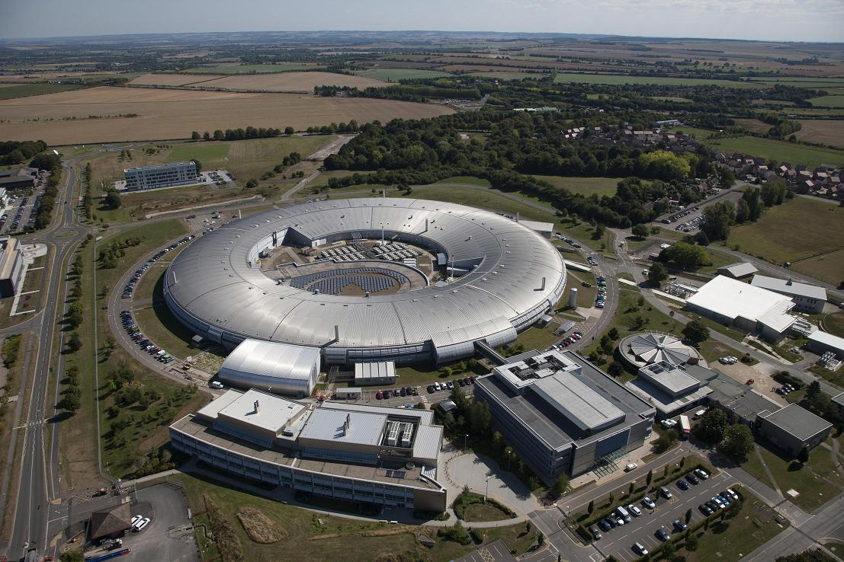
Progress with Diamond-II storage ring lattice
Hossein Ghasem
hossein.ghasem@diamond.ac.uk
Diamond Light Source
IOP PAB Annual Conference 2021

Slide 2
Outline
Introduction to Diamond storage ring
Motivation, wish-list and constraints for the new storage ring
Paths to low emittance - general introduction of the techniques being exploited
Diamond-II storage ring lattice structure and main alternatives
  CDR (15-1-1)
  Lattice development after CDR
  Optimization strategy
  Baseline lattice 34-1-1 (Off axis injection)
  Lattice 34-2-2 (On axis injection)
Overview of lattices
  Parameters – ID, IBS, 3HC
  DA
  Inj. Eff.
    Lifetime.
  Magnets
  Timeline
Conclusion
H. Ghasem, Diamond Status, IOP PABG 2021

Slide 3
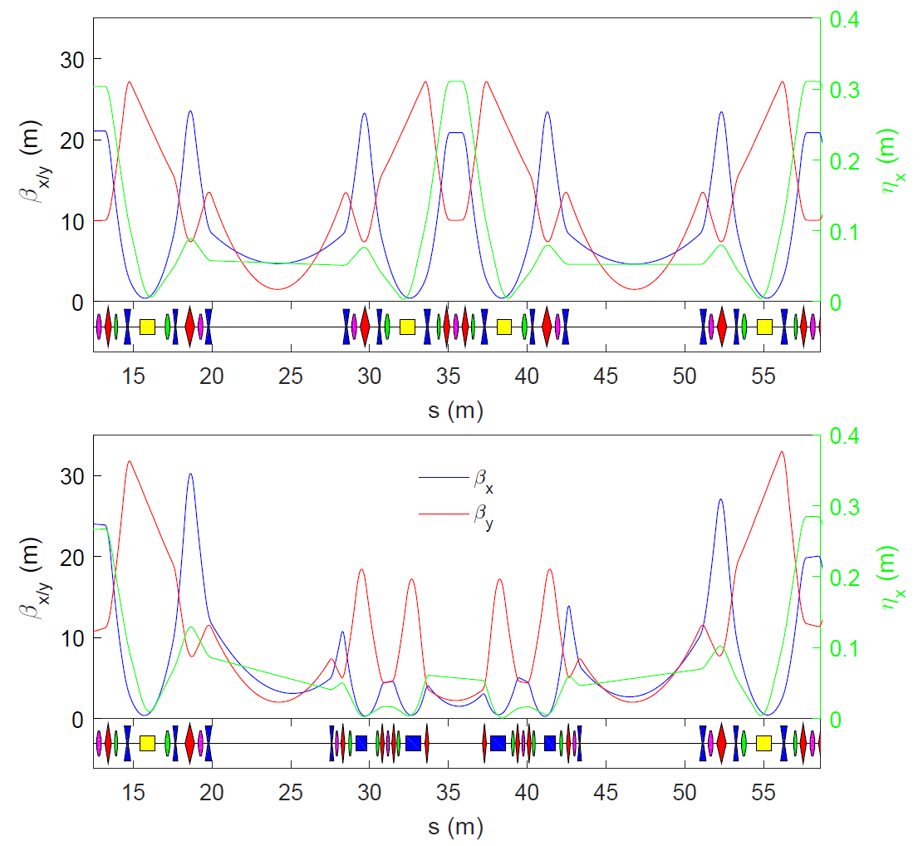
Diamond Light Source
Diamond is the UK’s national synchrotron radiation facility.
Located at Rutherford Appleton Laboratory, Oxfordshire
Commissioning 2005 - 2006
Start of user operations Jan 2007
DDBA installed since Nov. 2016
35 Beamlines:
All straights now occupied
Lattice | Combined DBA/DDBA
Structure | 24 cells
Straights | 18 × 5.3 m / 6 × 8.3 m / 1 x 3.4 m
Energy | 3 GeV
Circumference | 561.571 m
H/V Emittance | 2.72 nm.rad / 8 pm.rad
Energy spread | 0.096 %
Current | 300 mA
Lifetime | 10 h
H. Ghasem, Diamond Status, IOP PABG 2021

Slide 4
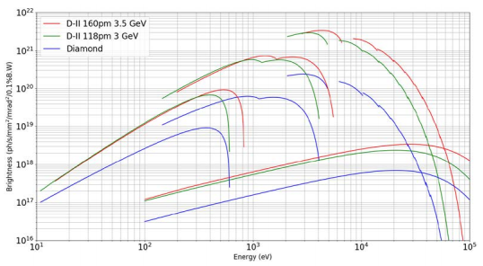
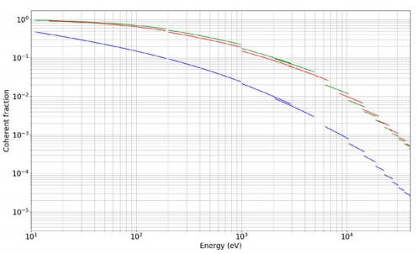
Diamond-II upgrade
Motivation: Improve quality of photon beams delivered to users:
  Increase spectral brightness and transverse coherence
  Reduced source size, line-width
  Optimise spectral range
  Space for new beamlines
Starting wish-list
  Low horizontal emittance
  Increase in number of straight-sections for IDs
  Maintain existing beamlines
  Re-use existing hardware where possible (RF, IDs, injector, …)
  Short pulse capabilities?
Constraints:
  Must fit in the existing tunnel, Source-point changes kept to a minimum
  Minimize technology risks
  Minimize shutdown period
NOTE: Beam energy in Diamond-II storage ring will be to 3.5GeV
H. Ghasem, Diamond Status, IOP PABG 2021

Slide 5
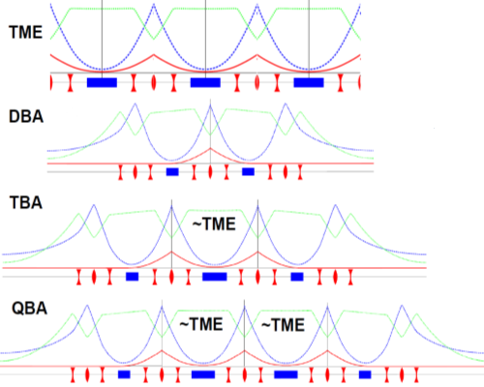
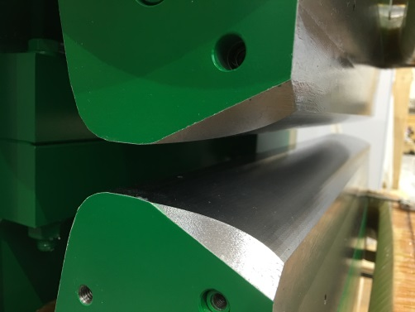



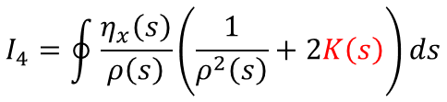

Paths to low emittance
increase number of dipoles (MBA)
control Jx with trans. gradient dipoles
$$ε_{x}∝\frac{1}{N_{d}^{3}}$$
TME-like (Theoretical Minimum Emittance) cells provide lowest possible beam emittance by shaping dispersion and beta-functions to have a waist in the centre of the bending magnets.
Starting from TME-like cells and increasing number of dipoles lead to substitutional reduction in beam emittance.
Emittance lowered by increasing $J_{x}$
$$ε_{x}=C_{q}γ^{2}\frac{I_{5}}{J_{x}I_{2}}$$
Damping Partition Numbers:
$$J_{x}=1−\frac{I_{4}}{I_{2}}$$
Emittance adjusted by introducing a vertically-focussing gradient in the dipoles
$$I_{4}=\oint{\frac{η_{x}\left(s\right)}{ρ\left(s\right)}\left(\frac{1}{ρ^{2}\left(s\right)}+2K\left(s\right)\right)ds}$$
H. Ghasem, Diamond Status, IOP PABG 2021
Notes:
5

Slide 6
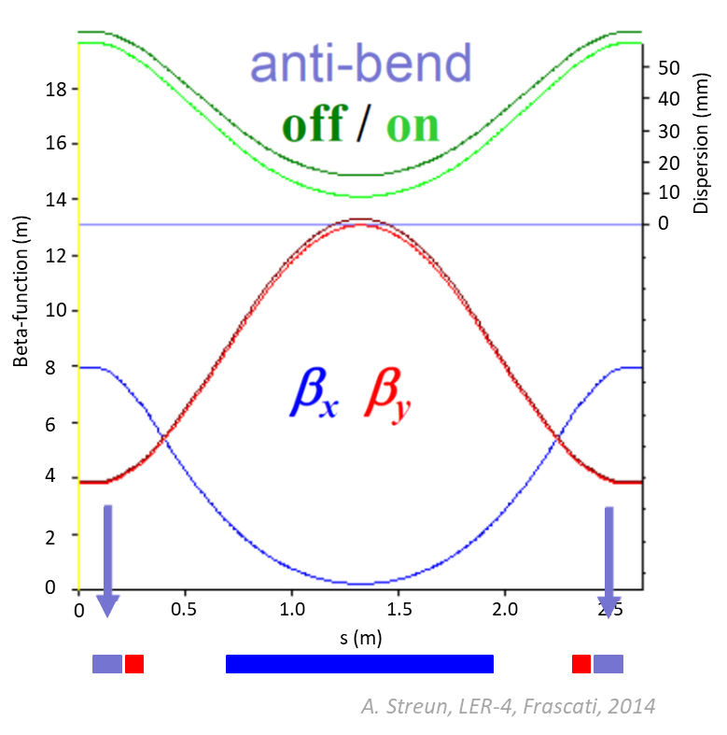

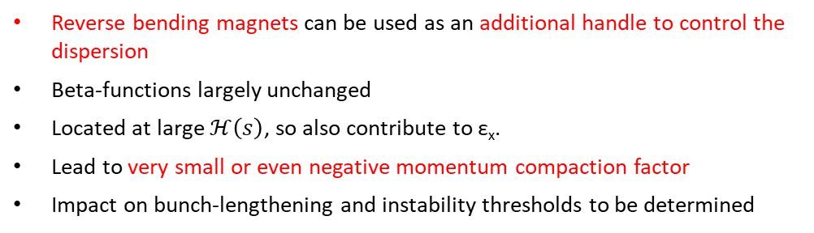



Paths to low emittance
use long. gradient dipoles
employ reverse bending magnets
Emittance lowered by minimising $I_{5}$
$$ε_{x}=C_{q}γ^{2}\frac{I_{5}}{J_{x}I_{2}}$$
$$I_{5}=\oint{\frac{ℋ\left(s\right)}{ρ^{3}\left(s\right)}ds}$$
Make the dipole field strongest where the dispersion is at a minimum
Total bend angle is kept constant
Can get below TME of uniform dipole
Have the benefit of producing hard x-rays where B-field is large
$$ℋ\left(s\right)=γ_{x}η_{x}^{2}+2α_{x}η_{x}η_{x′}+β_{x}η_{x′}^{2}$$
Reverse bending magnets can be used as an additional handle to control the dispersion
Beta-functions largely unchanged
Located at large $ℋ\left(s\right)$, so also contribute to ε_{x}.
Lead to very small or even negative momentum compaction factor
Impact on bunch-lengthening and instability thresholds to be determined
H. Ghasem, Diamond Status, IOP PABG 2021
Notes:
6

Slide 7
Diamond-II lattice structure
Magnets
Long Straight
Standard Straight
Mid Straight
~11.3m
~8.3m
Diamond-I super-period
~7.5m
~2.9m
~5.2m
Diamond-II super-period
6 long straights, ~7.5 m long: IDs, injection elements
18 standard straights, ~5.2 m long: IDs
24 mid straights, ~2.9 m long: IDs, 3PW/dipole sources, RF, 3HC, diagnostics, stripline kickers
>35 % of the ring consists of insertion straights (quad to quad)
H. Ghasem, Diamond Status, IOP PABG 2021

Slide 8
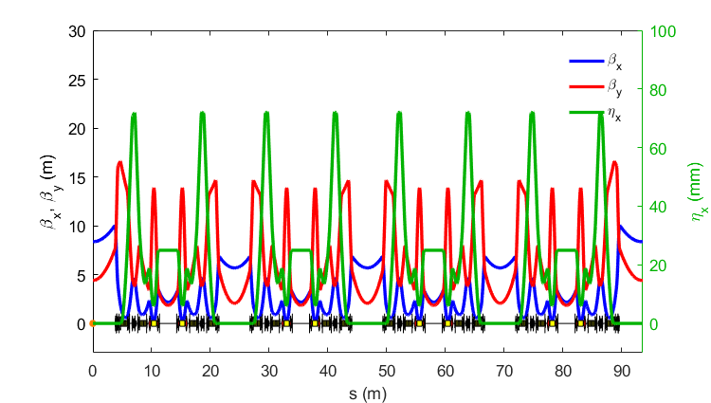

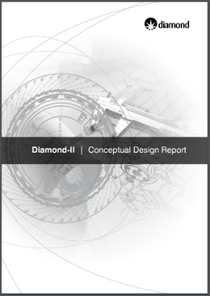
Diamond II CDR
ESRF-EBS Hybrid 7BC cell
Double-Double Bend Achromat cell
Lattice structure is called as ‘Modified-Hybrid 6-Bend Achromat’
All Diamond-II storage ring options are based on the Modified-Hybrid 6 Bend Achromat structure.
Version M-H6BA-15-1-1 of the lattice is the one presented in CDR.
Each cell consists of:
  4 long. dipoles + 2 trans. gradient dipoles
  16 (17) quadrupoles
  12 sextupoles
  2 octupoles
Parameter | Values
Energy (GeV) | 3.5
Betatron tunes | [57.16, 20.25]
Natural emittance (pm.rad) | 157
Emittance with IDs (pm.rad) | 149
Natural chromaticity | [-75.7, -89.7]
Momentum compaction factor | 1.2×10⁻⁴
Energy Loss per turn (MeV) | 0.67
Conceptual Design Report (May 2019):
https://www.diamond.ac.uk/Home/About/Vision/Diamond-II.html
H. Ghasem, Diamond Status, IOP PABG 2021

Slide 9
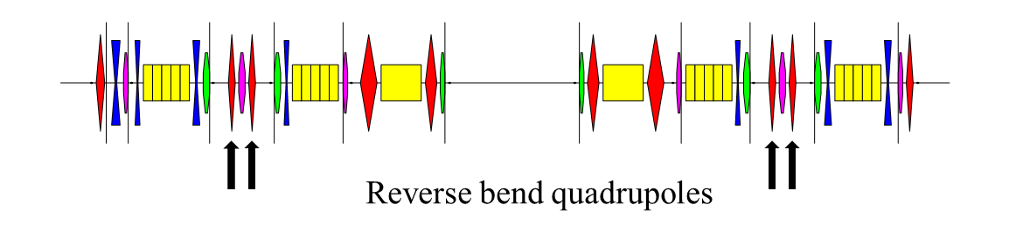
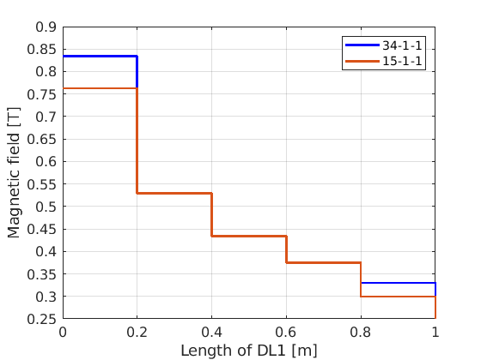
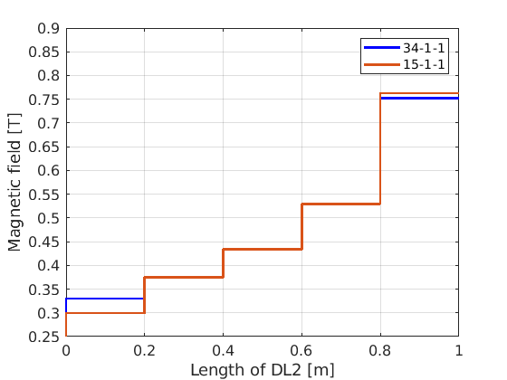
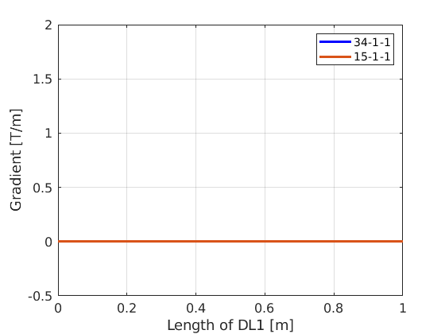
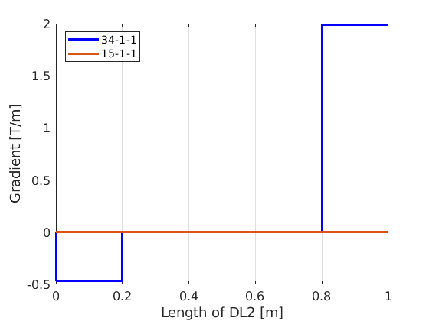
Diamond II lattice development after CDR
Addition of reverse bend quadrupoles to control dispersion found to be beneficial, either to:
  increase dispersion at chromatic sextupoles (height of dispersion bump) which results to maximise momentum acceptance (lattice 34-1-1)-> (lifetime gain)
  reduce dispersion in dipoles as well as MSS (emittance reduction)
B-field for the Long. Variable bend (DL) dipoles optimised:
  improved variation w.r.t dispersion function
  helps to lower the emittance
  DL2 now different from DL1
Tra. gradient added to two pieces of DL2 dipoles:
  Additional knobs to control phase advance for –I transformer and optics in mid-straight
H. Ghasem, Diamond Status, IOP PABG 2021

Slide 10
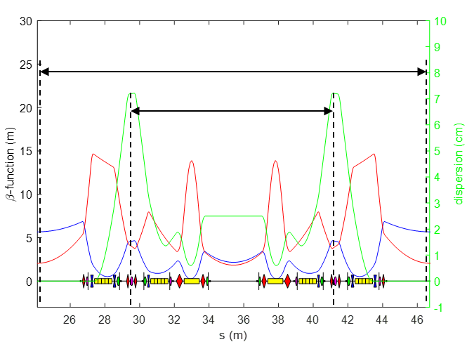
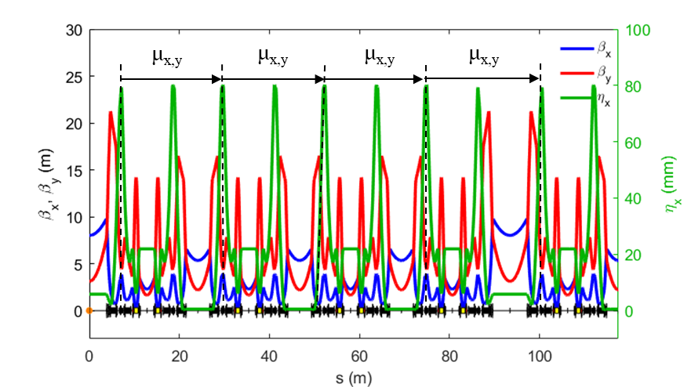
NLBD Optimization strategy
Nonlinear beam dynamic (NLBD) optimization is based on combination of:
-I transformer: Phase advance between focussing chromatic sextupoles:
μ_{x} = ~3π
μ_{y} = ~π
Higher order achromat: Cell tunes chosen to cancel resonance driving terms over 8 cells:
μ_{x} = ~2π*19/8
μ_{y} = ~2π*7/8
Some detuning necessary:
ring tunes must avoid main resonances
-I transformer drives 2nd order chromaticity (Δμ/2π ~ 0.025)
tolerance of Δμ/2π ~ 0.01 for cell tunes
Phase advance symmetrisation between sextupoles
higher-order achromat
-I transformer
H. Ghasem, Diamond Status, IOP PABG 2021

Slide 11
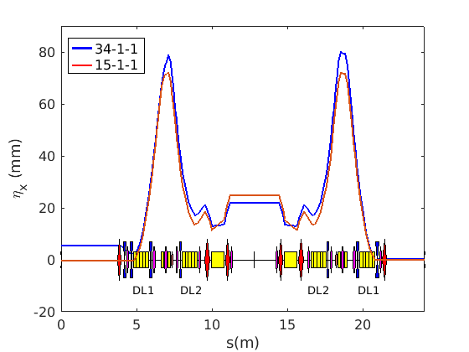
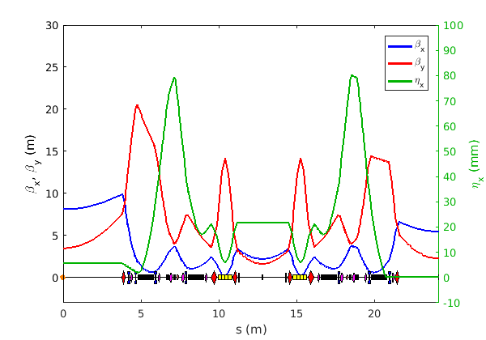
Baseline lattice 34-1-1 _OFF axis INJ.
  Increase margin of safety for off-axis injection
  Improve the lifetime
  Maintain brightness achieved during CDR
Parameter | Values
Energy (GeV) | 3.5
Betatron tunes | [54.15, 20.27]
Natural emittance (pm.rad) | 161
Emittance with IDs (pm rad) | 139
Natural chromaticity | [-67.5, -88.6]
Momentum compaction factor | 1.0×10⁻⁴
Energy Loss per turn (MeV) | 0.72
Peak dispersion (mm) | 80 mm
~25%
reduction
H. Ghasem, Diamond Status, IOP PABG 2021

Slide 12
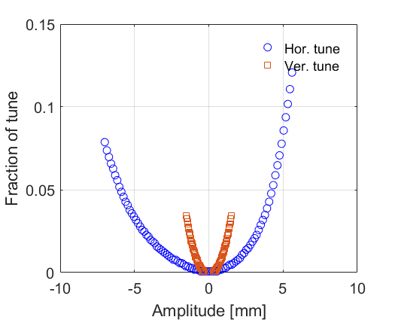
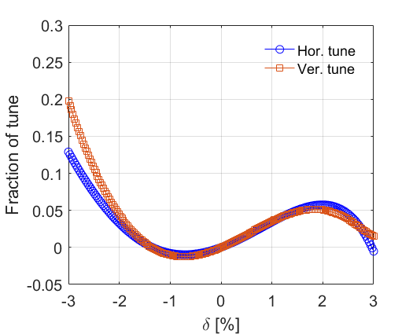
Baseline lattice 34-1-1 _OFF axis INJ.
DA: Physical stable area
Natural chromaticity has been corrected by the chromatic sextupoles to +2.3/+2.7.
Single particle tracking has been done for 2500 turns through the ring.
H. Ghasem, Diamond Status, IOP PABG 2021

Slide 13
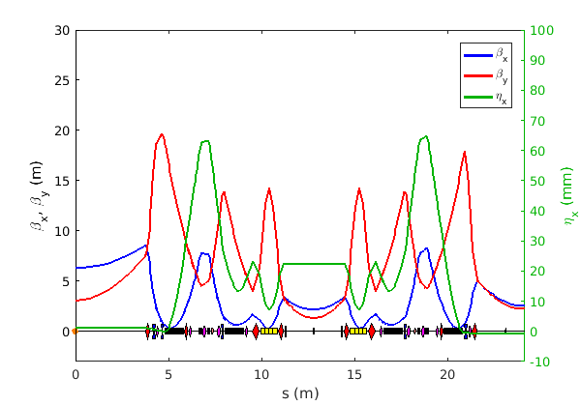
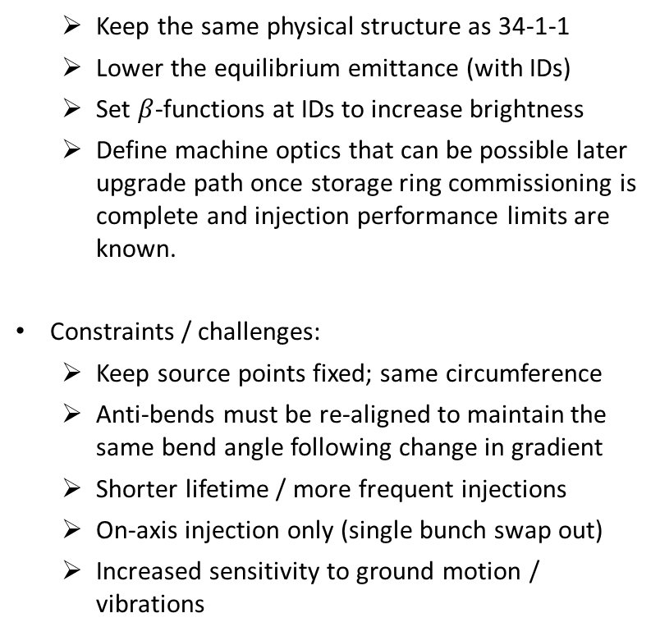
Lattice 34-2-2 _ ON axis INJ.
  Keep the same physical structure as 34-1-1
  Lower the equilibrium emittance (with IDs)
  Set $β$-functions at IDs to increase brightness
  Define machine optics that can be possible later upgrade path once storage ring commissioning is complete and injection performance limits are known.
Constraints / challenges:
  Keep source points fixed; same circumference
  Anti-bends must be re-aligned to maintain the same bend angle following change in gradient
  Shorter lifetime / more frequent injections
  On-axis injection only (single bunch swap out)
  Increased sensitivity to ground motion / vibrations
Parameter | Values
Energy (GeV) | 3.5
Betatron tunes | [62.19, 20.30]
Natural emittance (pm.rad) | 106
Emittance with IDs (pm.rad) | 106
Natural chromaticity | [-90.4, -111.7]
Momentum compaction factor | 1.0×10⁻⁴
Energy Loss per turn (MeV) | 0.72
Peak dispersion (mm) | 65
H. Ghasem, Diamond Status, IOP PABG 2021

Slide 14
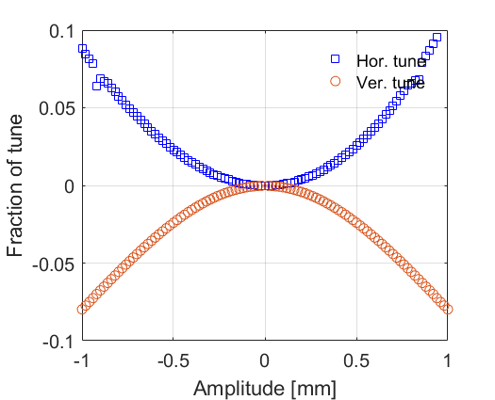
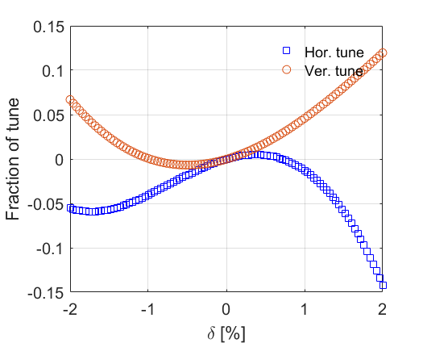
Lattice 34-2-2 _ON axis INJ.
Natural chromaticity has been corrected by the chromatic sextupoles to +2.0/+2.3.
Single particle tracking has been done for 2500 turns through the ring.
H. Ghasem, Diamond Status, IOP PABG 2021

Slide 15
Overview of lattices: parameters
Parameter |  | Units | 15-1-1 (CDR) | 34-1-1 | 34-2-2
Circumference |  | m | 560.573856 | 560.560644 | 560.560644
Betatron tunes |  |  | [57.16, 20.25] | [54.15, 20.27] | [62.19, 20.30]
Natural chromaticity |  |  | [-75.7, -89.7] | [-67.5, -88.6] | [-90.4, -111.7]
Momentum compaction factor |  |  | 1.2×10⁻⁴ | 1.0×10⁻⁴ | 1.0×10⁻⁴
Energy Loss per turn (without/with IDs) |  | MeV | 0.67 / 1.71 | 0.72 / 1.76 | 0.72 / 1.76
Total absolute bend angle |  | degrees | 360 | 388.8 | 388.8
Number of anti-bend dipoles |  | - | 0 | 96 | 96
Emittance (bare lattice) |  | pm.rad | 157 | 161 | 106
Energy spread (bare lattice) |  | % | 0.078 | 0.094 | 0.091
Bunch length (bare lattice) |  | mm | 3.5 | 3.8 | 3.8
Emittance (with IDs, IBS, 3HC*) |  | pm.rad | 147.5 | 138.7 | 106
Energy spread (with IDs, IBS, 3HC*) |  | % | 0.10 | 0.11 | 0.11
Bunch length (with IDs, IBS, 3HC*) |  | mm | 10.9 | 10.3 | 10.6
Anti-bend gradient / offset / angle | QF4 | Tm⁻¹ / mm / deg | - | 56.4 / 3.61 / 0.150 | 53.1 / 3.84 / 0.150
 | QF4L | Tm⁻¹ / mm / deg | - | 73.3 / 3.24 / 0.175 | 58.7 / 4.05 / 0.175
 | QF4_C1 | Tm⁻¹ / mm / deg | - | 33.5 / 5.06 / 0.125 | 48.3 / 3.52 / 0.125
*Assumes factor 3 bunch lengthening for all bunches
H. Ghasem, Diamond Status, IOP PABG 2021

Slide 16
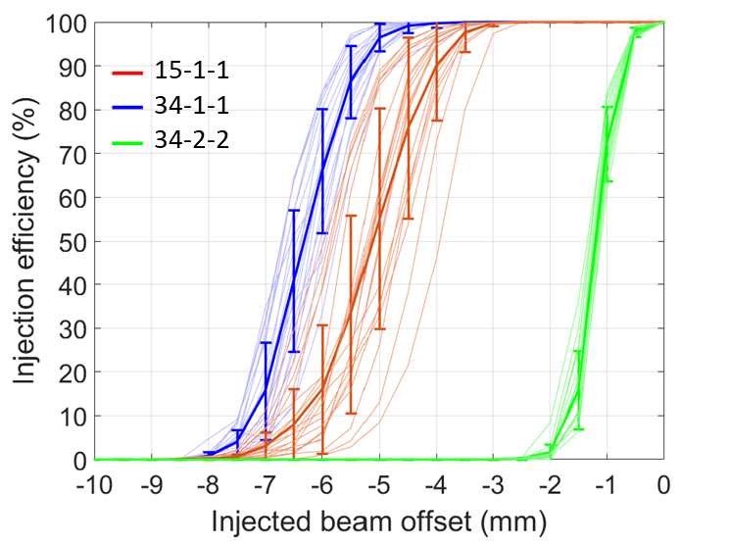
Overview of lattices: Inj. Eff.
Injection efficiency calculations carried out in ELEGANT over 2048 turns, with physical apertures
Injected bunch parameters taken from latest Booster-II parameters
Inj. Bunch Parameter | Unit | Value
Horizontal emittance | nm.rad | 17.7
Vertical emittance | nm.rad | 1.8
Energy spread | % | 0.086
Bunch length | mm | 11.6
Transfer line optics re-optimised for each lattice and each injected beam offset
Lattice 34-1-1:
  Clear improvement over 15-1-1 in terms of available dynamic aperture
  Less sensitive to individual seeds
Lattice 34-2-2 would require on-axis swap-out injection
H. Ghasem, Diamond Status, IOP PABG 2021

Slide 17
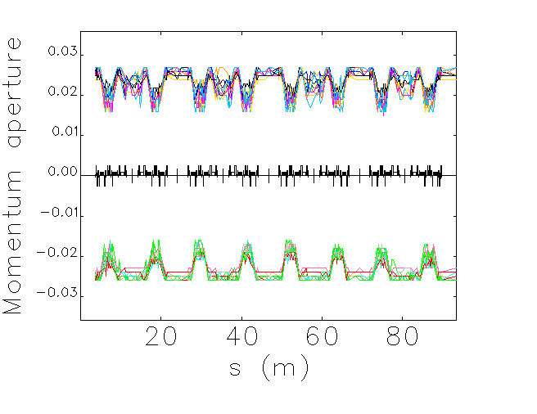
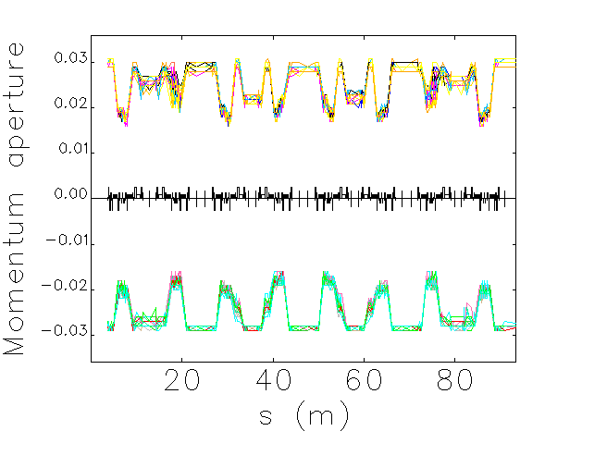
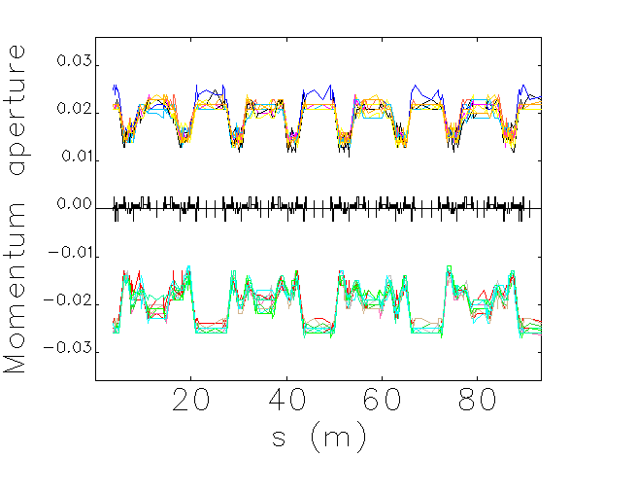
Overview of lattices: Lifetime
15-1-1
34-1-1
34-2-2
Lifetime is calculated in ELEGANT using calculated dynamic and momentum apertures
Uniform pressure distribution: 100 % CO, pressure = 1×10⁻⁹ mbar
Parameter | Units | 15-1-1 | 34-1-1 | 34-2-2
RF voltage | MV | 1.27 | 1.42 | 1.25
Bunch length | mm | 3.51 | 3.75 | 3.83
Bunch current | mA | 0.33 | 0.33 | 0.33
Average Touschek lifetime | h | 1.16 | 1.80 | 0.65
Coulomb lifetime | h | 33.01 | 48.99 | 9.17
Bremsstrahlung lifetime | h | 72.64 | 73.56 | 68.45
Total gas | h | 22.70 | 29.41 | 8.09
Averafe Touschek lifetime (with IDs, IBS, 3HC) | h | 4.07 | 5.04 | 2.14
Overall lifetime | h | 3.45 | 4.30 | 1.70
Larger dynamic and momentum apertures for 34-1-1 lead to increased gas lifetime compared to 15-1-1
H. Ghasem, Diamond Status, IOP PABG 2021

Slide 18
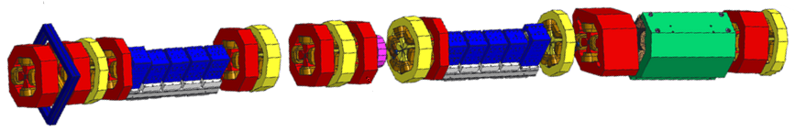
Magnets
courtesy A. Shahveh
Magnet Type | Description | Max Strength | Type
CFDL | Combined function longi. gradient dipole | 0.33 to 0.83 T -0.5 to 2 T/m | Permanent
DQ |  | 0.6951 T -32.397 T/m | Electromagnet
Quadrupole |  | 85.2 T/m | Electromagnet
Antibend Quads | Offset quadrupole, 3.2<dx<5.1 | 73 T/m 3.24 mm | Electromagnet
Sextupole | Sextupoles with correctors | 4186.29 T/m^2 | Electromagnet
Octupole | Simple octupoles | 45401.77 T/m^3 | Electromagnet
H. Ghasem, Diamond Status, IOP PABG 2021

Slide 19
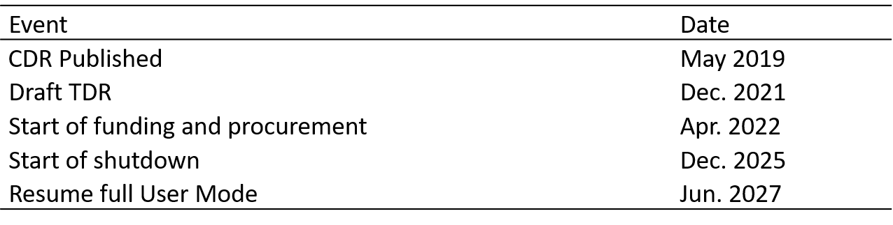
Possible Timeline for Diamond-II
H. Ghasem, Diamond Status, IOP PABG 2021

Slide 20
Conclusion
Unique: combines low emittance with high-capacity
Lattice design exploits many advanced techniques.
  MBA
  anti-bends
  longitudinal variable bends
  transverse gradient dipoles
Several lattice alternatives have been investigated and the propose lattice is 34-1-1.
  CDR 15-1-1
  34-1-1 (Baseline solution - Off axis injection)
  34-2-2 (High brightness lattice as possible later upgrade path -On axis injection)
Diamond-II is aiming for off axis injection.
High brightness mode is under consideration. This would require on axis injection scheme.
Engineering, vacuum and magnet design are in progress. No significant problems are foreseen.
H. Ghasem, Diamond Status, IOP PABG 2021

Slide 21
Acknowledgments
Diamond-II Lattice Design Team:
R. Fielder, A. Jury, J. Kallestrup, I. Martin, T. Olsson, B. Singh, R. Walker,
Former Members:
A. Alekou, M. Apollonio, R. Bartolini, J. Bengtsson , T. Pulampong, F. B. Taheri
Thank you for your attention
H. Ghasem, Diamond Status, IOP PABG 2021

Slide 22
Back up slides
H. Ghasem, Diamond Status, IOP PABG 2021

Slide 23
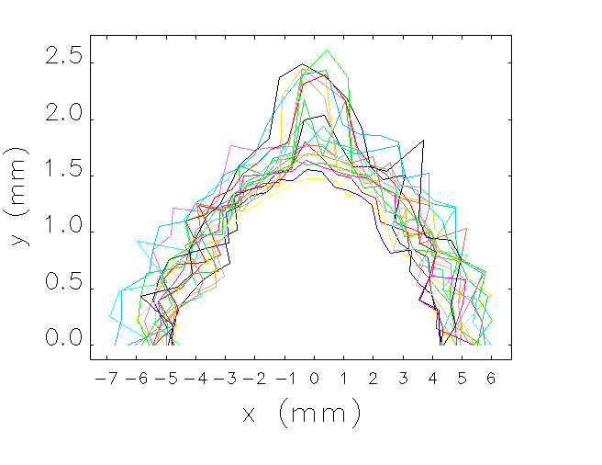
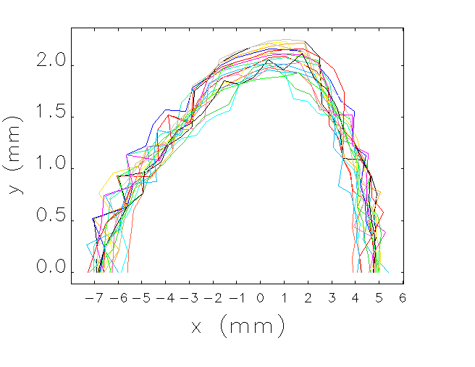
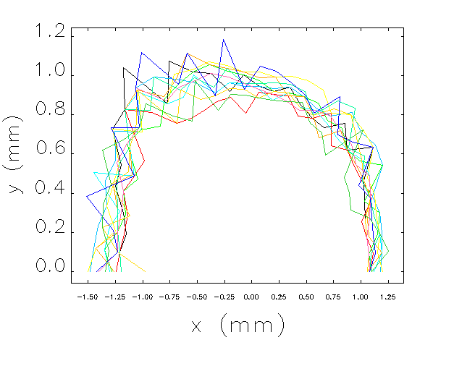
Overview of lattices: DA
Initial characterisation of lattices uses reduced errors
Orbit, tunes and chromaticity correction only (no beta-beat or coupling correction)
Physical apertures are included, with s-dependent ID gaps down to 4 mm taken into account
DA, injection efficiency and lifetime values validated using full errors in AT2 with Simulated Commissioning Toolbox.
 | Δx, Δy (μm) | Roll (μrad) | Strength error
Dipole | 15 | 100 | 1×10⁻⁴
Quadrupole | 15 | 100 | 1×10⁻³
Sextupole | 15 | 100 | 1×10⁻³
Octupole | 15 | 100 | 1×10⁻³
BPM | 20 | 10 | -
15-1-1
34-1-1
34-2-2
H. Ghasem, Diamond Status, IOP PABG 2021

Slide 24
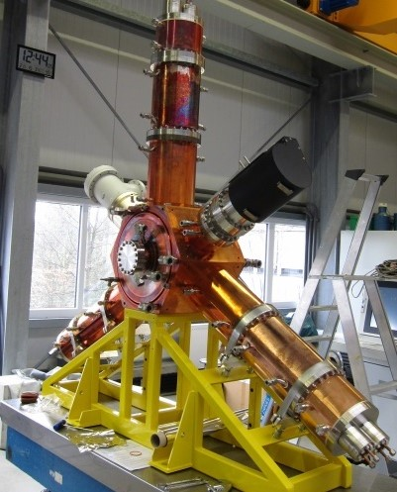
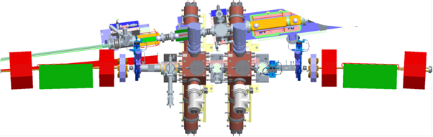
Diamond-II RF system
Use HOM-damped normal-conducting cavities (500 MHz):
  More robust and more easily repaired than superconducting cavities
  Releases current long RF straight for a new flagship beamline ID
  Broader frequency tuning range allows Diamond-I NC cavities to be used in Diamond-II
  Latest iteration of cavities used in BESSY, ALBA and ESRF (scaled for frequency)
  Smaller footprint than superconducting cavities in cryostats
  Effective HOM-damping has been demonstrated in Diamond-I
Eight RF cavities arranged in pairs in mid-section straights:
  Multiple low-voltage cavities gives lower wall losses
  Use of multiple cavities introduces redundancy of operation
Courtesy C. Christou
H. Ghasem, Diamond Status, IOP PABG 2021

Slide 25
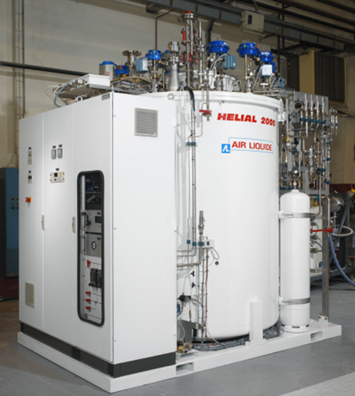
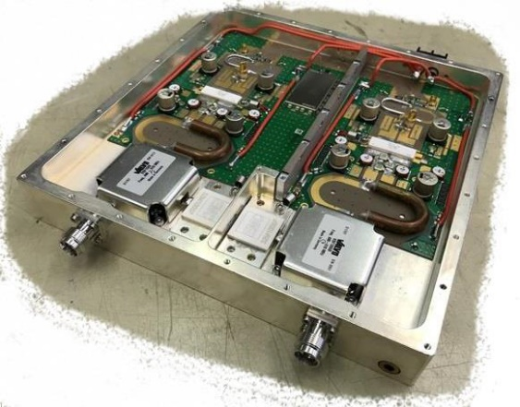
Diamond-II RF system
Amplifiers
Each cavity powered by single solid state amplifier
  100 kW amplifier many 800 W power transistors
  Redundancy ensures continuity of operation
  Several commercial suppliers exist
Amplifier/cavity operation regulated by digital LLRF
  IQ or polar PI loops for cavity ampl./phase
  Based on the MicroTCA standard
  Digital (functionality can be added as required)
  Based on system developed at ALBA
Higher harmonic cavity
  Minimise storage ring heating
  Alleviate collective instabilities
  Maximise beam lifetime
Passive superconducting HHC
  Needs no new amplifier
  Operates across all beam currents
  Can fit in mid-section straight
  Available from industry (CEA design: SLS, Elettra)
Can use the existing Diamond-I cryogenic plant
Courtesy C. Christou
H. Ghasem, Diamond Status, IOP PABG 2021

Slide 26
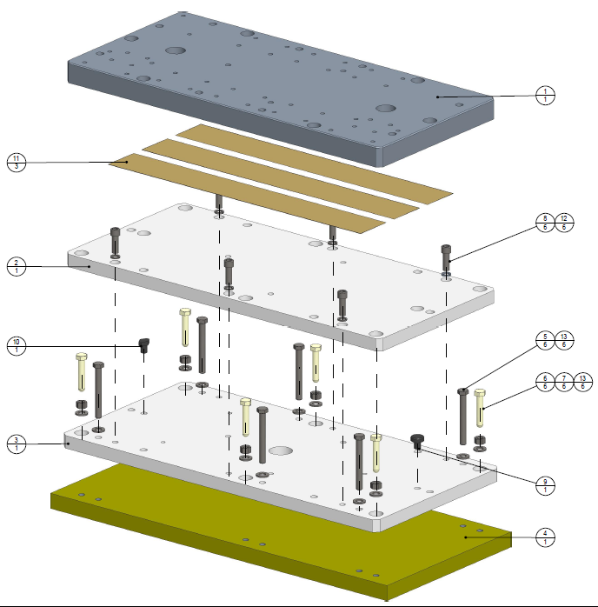
Diamond-II Girders
Present solution:
Magnets to be supported on single girder per half-cell (~8 m long)
Manual adjustment system (screw-thread adjustment in each plane))
Aim to achieve overall transmissibility of ~1 in 1-100 Hz band
Electron beam is most sensitive to vertical girder motion
Use viscoelastic tape in baseplates
  stiff at high frequency to reduce transmissibility
  Soft at low frequencies to allow expansion and contraction
Choice of material from trial girders
  steel fabrication (same as existing girders, good stiffness)
  cast grey iron (better damping properties, easy to produce, cost-effective)
  carbon composite (lightweight, high natural frequency, expensive)
Test girders will inform final choice of material and support system (in progress).
Courtesy J. Dymoke Bradshaw
H. Ghasem, Diamond Status, IOP PABG 2021

Slide 27
Diamond-II vacuum chamber
Requirement: Target average pressure ≤ 10⁻⁹ mbar at 300 mA after 100 A.h beam conditioning
Current solution (WIP)
Vessel cross-section: Mainly circular (20 mm inner diameter)
  Antechamber in those dipole vessels with photon beam extraction
Pumping: Non-evaporable getter (NEG) coated apart from antechamber vessels
  Plus discrete ion pumps and NEG cartridge pumps
  3D vacuum sims to confirm vacuum (Synrad+, Molflow+, Comsol Multiphysics®)
Heat load management: Mix of discrete and distributed absorbers
Materials/manufacturing: Most vessels copper; antechamber vessels aluminium
  CuCrZr discrete absorbers possibly with some additive manufacturing
  Fully RF-shielded gate valves, flanges and bellows
  NEG coating by industry
Assembly process: Ex-situ bakeout only
  Vacuum strings (~7m) built up, baked out and NEG activated on assembly trolleys
  Remain under vacuum during installation
Courtesy M. Cox
H. Ghasem, Diamond Status, IOP PABG 2021

Slide 28
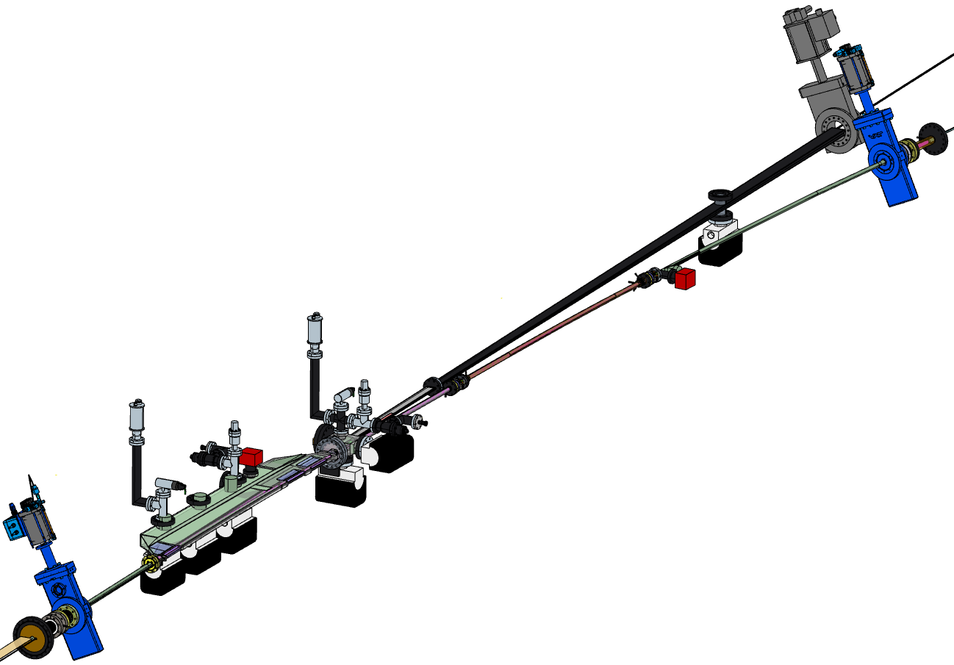
Diamond-II vacuum chamber
Four different girder types:
Long to Mid (LM)
Mid to Standard (MS)
Standard to Mid (SM)
Mid to Long (ML)
plus some special variants for particular beamlines
Electron beam exit
Photon beam exit
RF gate valve
Dipole
3 vessel (Cu/NEG)
Residual gas analyser (RGA) ports
Dipole
2 vessel (Cu/NEG)
Crotch 1 vessel and absorber (Cu)
Ion/NEG pumps (not all labelled in this diagram)
Beam direction →
Dipole 1 vessel (Al)
Courtesy M. Cox
H. Ghasem, Diamond Status, IOP PABG 2021

