Slide 1

Terahertz Acceleration
Daniel. S. Lake
Department of Physics, Lancaster University, U.K.
Cockcroft Institute for Accelerator Science, Daresbury, U.K.

Slide 2





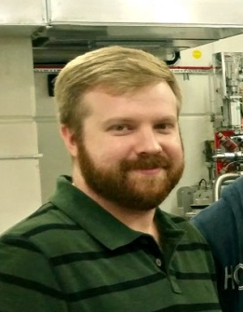








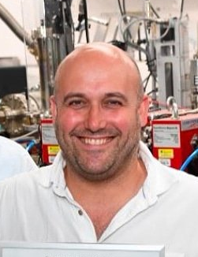
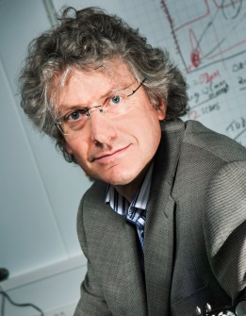
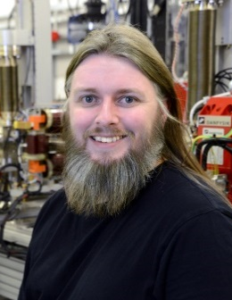
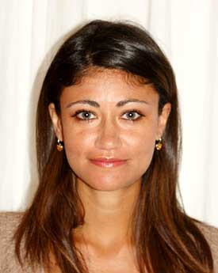



The Cockcroft Institute: Terahertz acceleration group
Terahertz acceleration group
Vasileios Georgiadis
Elliott Smith
Oliver Finlay
Dr. David Walsh
Dr. Edward Snedden
Dr. Morgan Hibberd
Dr. Daniel Lake
Dr. Sergey Siaber
Dr. Conor Mosley
Dr. Oznur Apsimon
Dr. Darren Graham
Dr. Robert Appleby
Prof. Steven Jamison
Prof. Graeme Burt
Dr. Rosa Letizia
Dr. Osman Akin
D.S. Lake, IOP Particle & Beams Group Annual Meeting 2020, September 2020

Slide 3
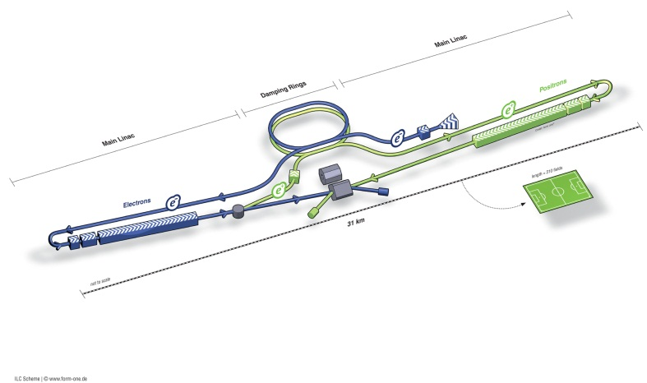
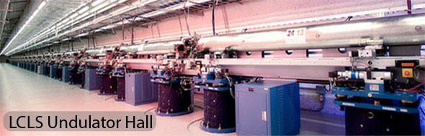
Why THz radiation for particle acceleration?
Light sources: xray Free-electron lasers
Particle physics
for femtosecond x-ray pulses
5GeV beams, <10fs bunches sought
International Linear Collider ~30km
SACLA, Japan
‘CERN’s ‘Compact Linear Collider’ ~48km
LCLS, USA
Scale of accelerators set by O(100MV/m) gradient limitation
(fundamental limits, atomic lattice distortion
Femtosecond manipulation of relativistic
electron bunches using nanosecond period
Radio Frequency sources
THz driven
Acceleration
Field strengths O(100MV/cm)
Picosecond period, broad-bandwidth,
direct waveform control
D.S. Lake, IOP Particle & Beams Group Annual Meeting 2020, September 2020

Slide 4
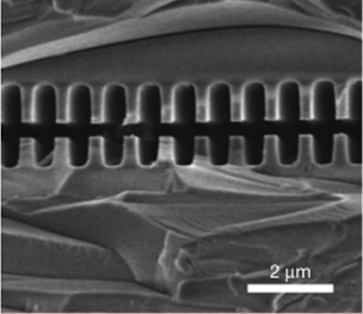
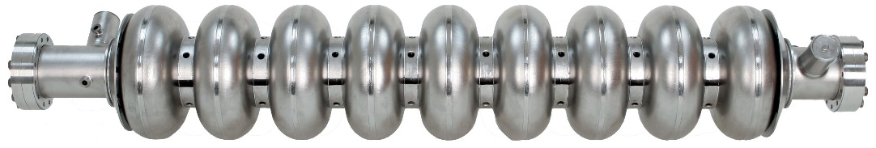
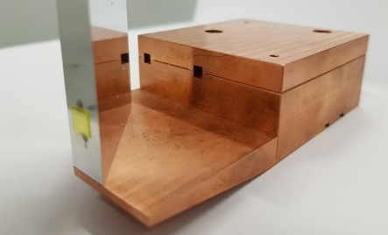
Why THz radiation for particle acceleration?
Radio frequencies
THz frequencies
Optical frequencies
Frequency ≈3 GHz
period ≈ 300 ps,
λ ≈ 10 cm
Cavity aperture ~ 2 cm
E_{acc} ~ 10 - 100 MV m⁻¹
Pulse length: 5 ms (superconducting)
5 μs (normal conducting)
Frequency ≈1 THz
period ≈ 1 ps,
λ ≈ 300 μm – 1 mm
Cavity aperture ≈ 1 mm
E_{acc} ≈ 100 MV/m to > GV/m
Pulse length 1-5 ps
Frequency ≈300 THz
period ≈ 3 fs,
λ ≈ 0.8 – 1 μm
Cavity aperture ≈ 1 μm
E_{acc} ≈ 100 MV m⁻¹ to >> GV/m
Pulse length 20 fs – 1 ps
THz advantages:
50um silica
Oscillation period short, and well matched to the bunch duration
High field strengths possible.
Wavelength allows for easy fabrication of structures.
THz challenges:
Obtaining sub-luminal phase velocities
Broadband pulses – controlling dispersion
High field THz sources still challenging
[2] E.A Peralta et al., Nature,
503.7474 (2013): 91-94
D.S. Lake, IOP Particle & Beams Group Annual Meeting 2020, September 2020

Slide 5
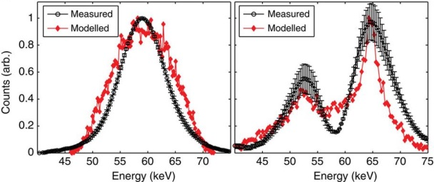
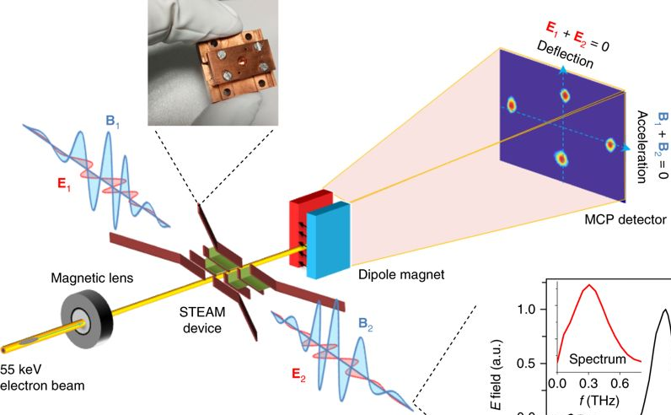
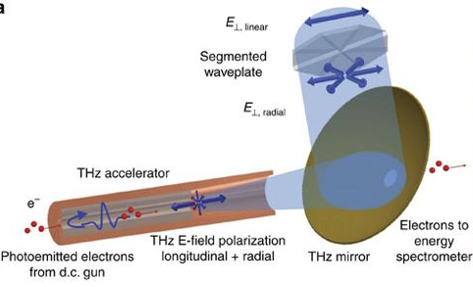
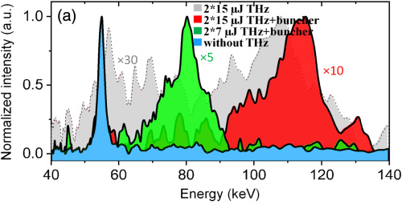
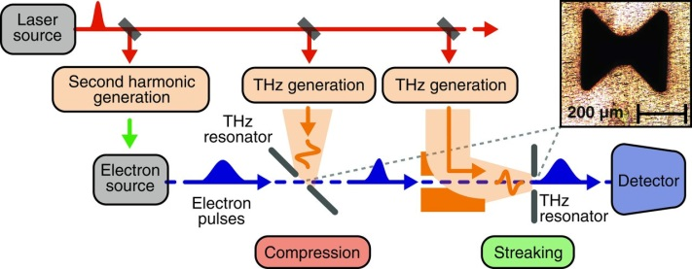
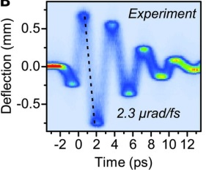
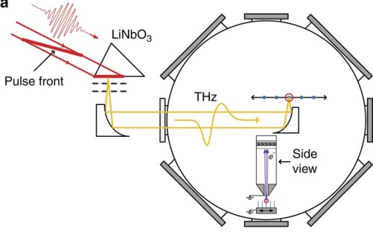
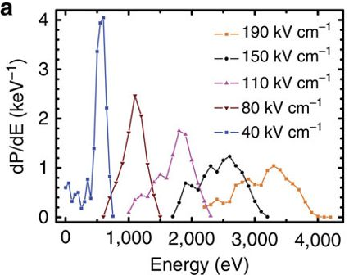
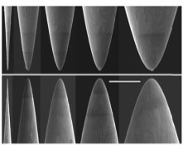
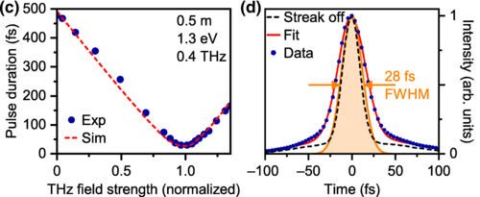
Terahertz-driven interactions: Sub-relativistic electrons (<100 keV)
THz-driven acceleration
THz-driven acceleration, streaking and compression
“STEAM” segmented waveguide device
7 keV acceleration of 60 keV electron beams using a cylindrical waveguide
E. A. Nanni et al. Nat. Commun. 6, 8486 (2015)
D. Zhang et al. Nat. Photonics 12, 336-342 (2018)
THz-driven streaking and compression
C. Kealhofer et al. Science 352, 429-433 (2016)
Two-stage STEAM setup for 70 keV acceleration
D. Zhang et al. Optica 6, 872-877 (2019)
THz-driven emission
Using metal resonators
and a planar mirror
membrane
<4 keV from metallic nanotips
D. Ehberger et al. Phys. Rev. Appl. 11, 024034 (2019)
S. Li & R. R. Jones, Nat. Commun. 7, 13405 (2016)
D.S. Lake, IOP Particle & Beams Group Annual Meeting 2020, September 2020

Slide 6
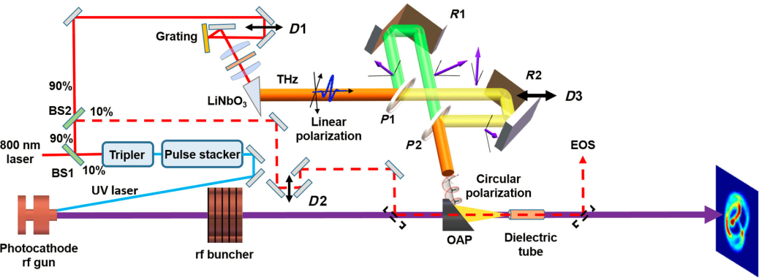
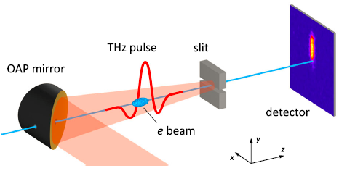
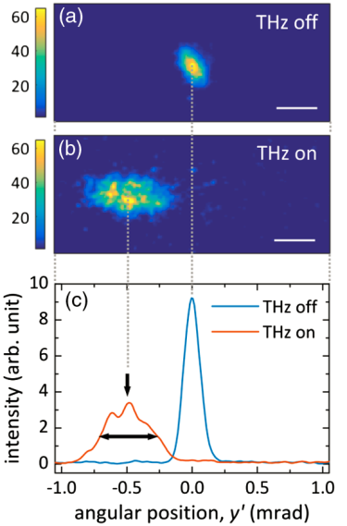
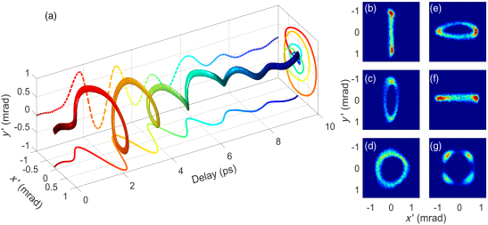
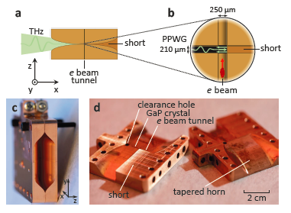
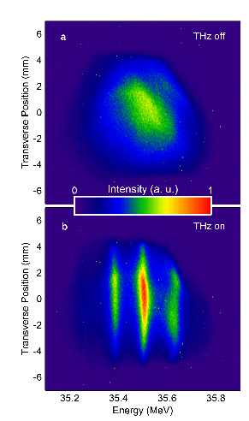
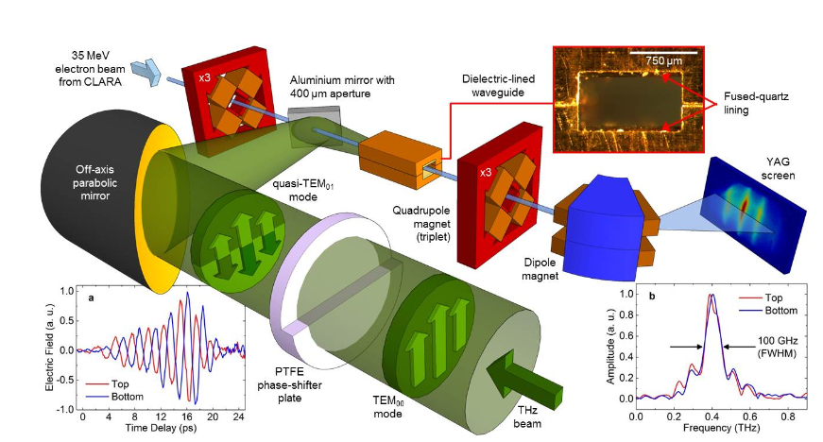
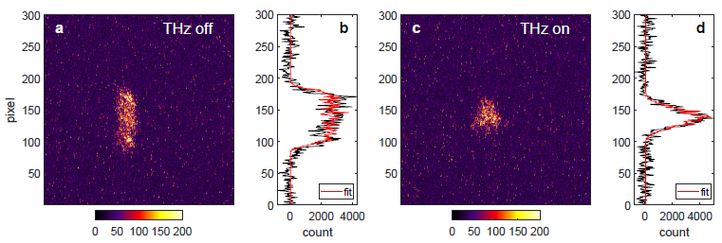
Terahertz-driven interactions: Relativistic electrons
THz-driven streaking
THz-driven streaking
Dielectric tube, helical deflection for 50-fold longitudinal compression
of 3.4 MeV beam
Streaking of a 3.1 MeV electron beam using a parallel-plate waveguide
L. Zhao et al. Phys. Rev. Lett. 122, 144801 (2019)
R. K. Li et al. Phys. Rev. Accel. Beams 22, 012803 (2019)
THz-driven compression
THz-driven acceleration
2.5 MeV electron beam
x3 compression
x2 timing jitter reduction
E. C. Snively et al. arXiv:1906.03358 (2019)
Dielectric lined waveguide
Quasi-monochromatic THz
Energy modulation &
acceleration on 35MeV beam
M.T. Hibberd et al,
arXiv 1908.04055 (2019)
Nature Photonics, August 2020
D.S. Lake, IOP Particle & Beams Group Annual Meeting 2020, September 2020

Slide 7
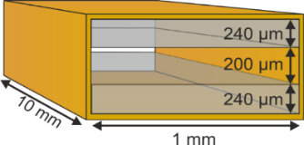
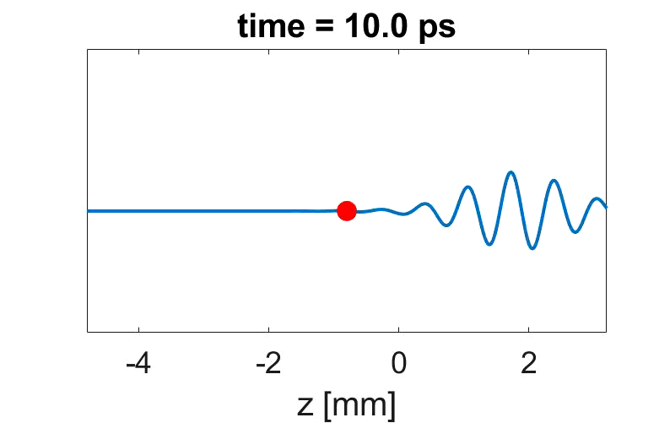
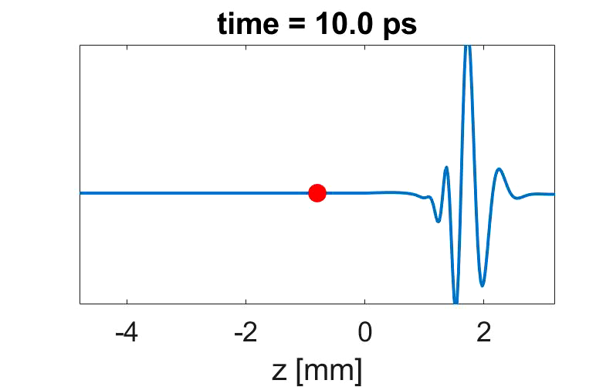
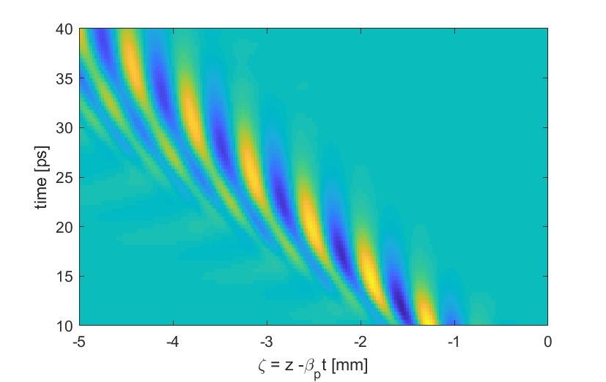
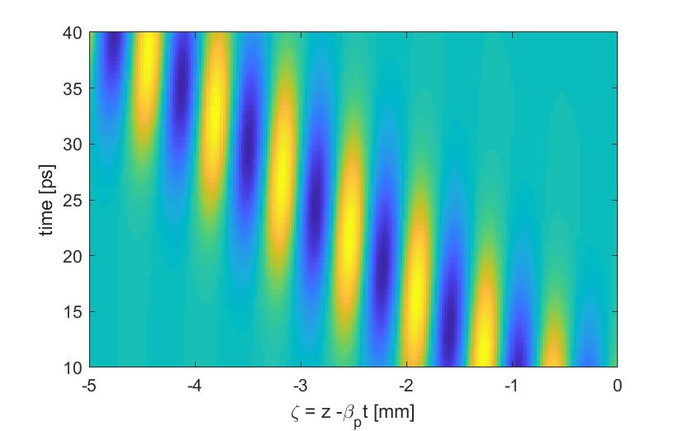
What is needed for THz acceleration?
Strong longitudinal field component
Phase matched to particle velocity
Dielectric Lined Waveguides
used to achieve both
Phase velocity matching, v_{φ} = β c
Group velocity v_{g} << v_{φ}
few-cycle THz input
(quasi-monochromatic)
Single-cycle THz input
Particle
trajectory
Particle
trajectory
Field in frame of 50MeV
electron beam (v = 0.9995 c)
Particle see constant electric field phase (accelerator or decelerating)
D.S. Lake, IOP Particle & Beams Group Annual Meeting 2020, September 2020

Slide 8
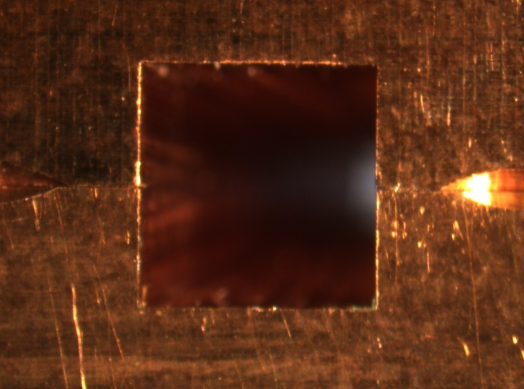
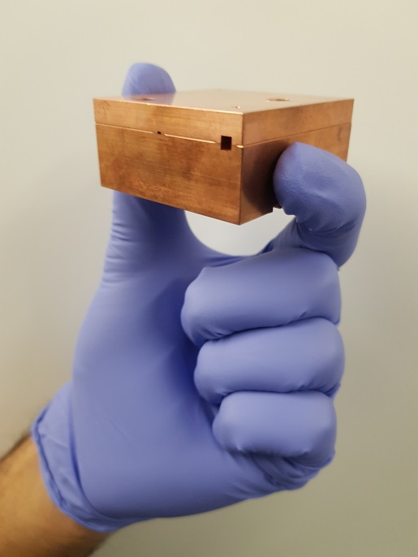
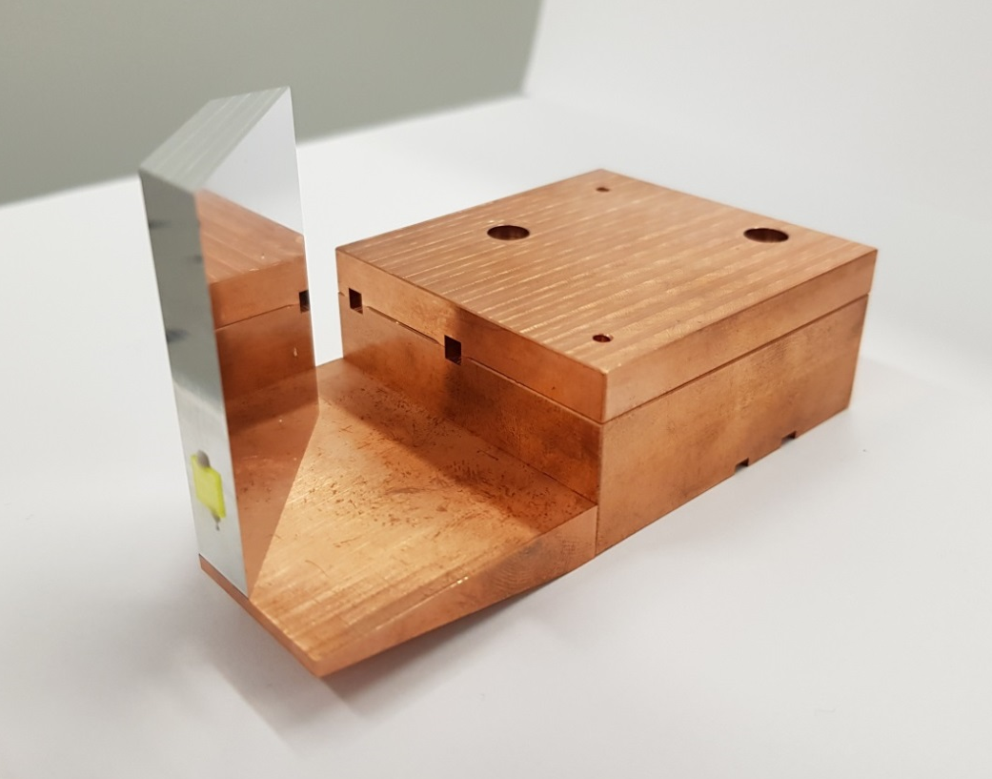
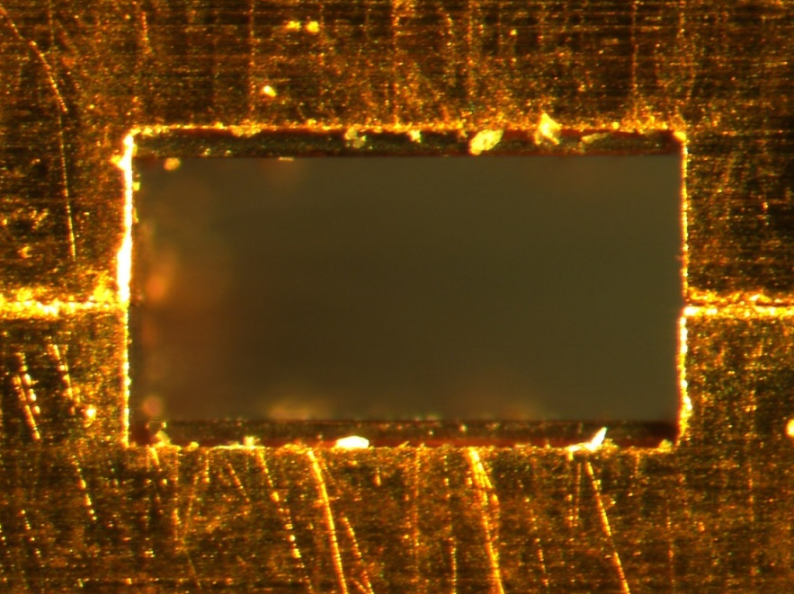
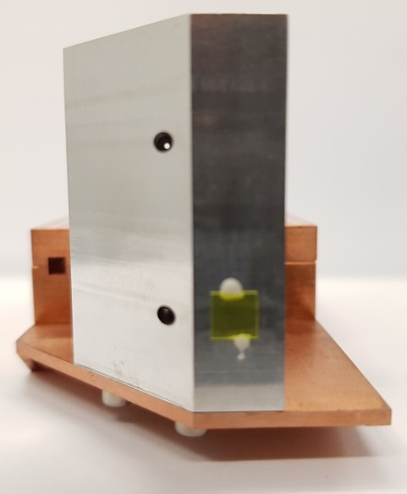
Our approach: Rectangular dielectric-lined waveguide
Coupler entrance
DLW side
DLW assembly
3.25 mm
3.18 mm
DLW exit
575 μm
695 μm
Dielectric lining results in:
Longitudinal Section Magnetic modes
LSM₁₁ for acceleration
Designed for velocity-matching to the 35 MeV electron beam
1200 μm
Mirror side
D.S. Lake, IOP Particle & Beams Group Annual Meeting 2020, September 2020

Slide 9
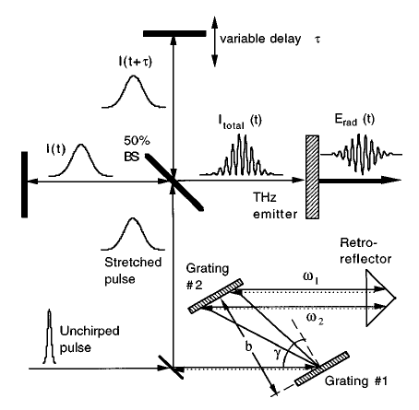
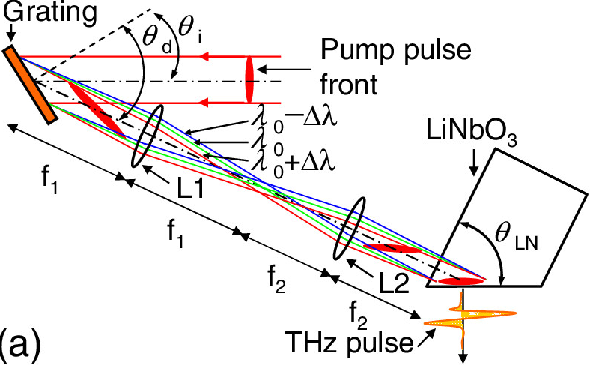
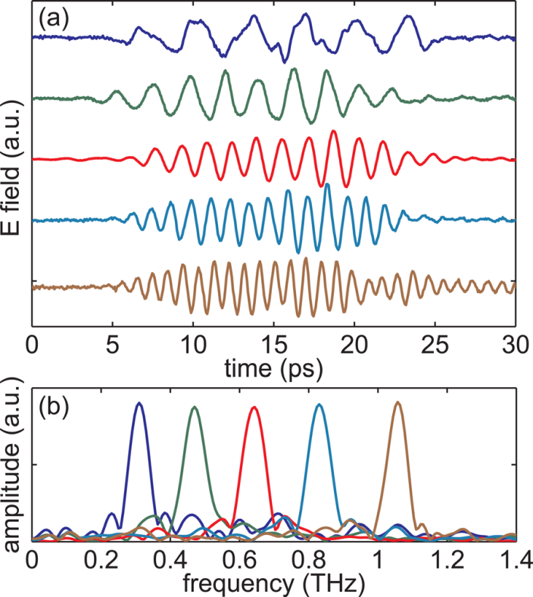
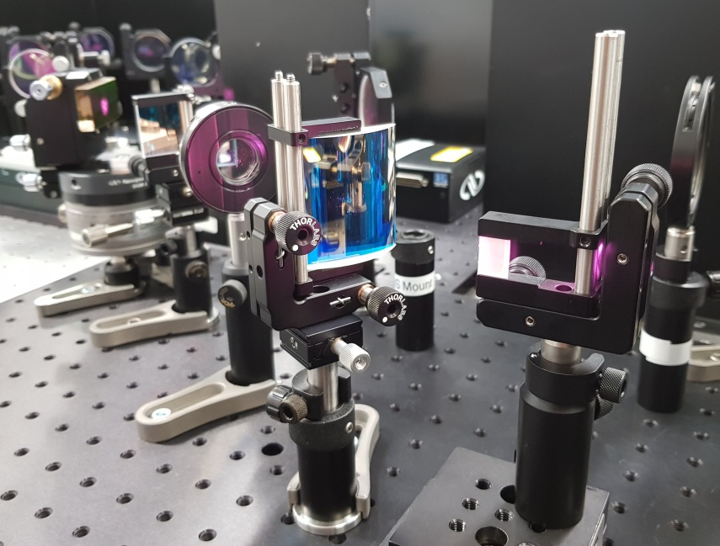
Our approach: Narrowband terahertz source
Tilted-pulse-front pumping in LiNbO₃
Chirped-pulse beating for narrowband THz generation
First demonstrated using a Michelson interferometer with a photoconductive antenna
A.S. Weling & D.H. Auston, J. Opt. Soc. Am. B 13, 2783 (1996)
J. Hebling et al. Opt. Express 10, 1161-1166 (2002)
Diagram from:
H. Hirori et al. Appl. Phys. Lett. 98, 091106 (2011)
Our tilted-pulse-front setup
Also shown using an etalon with a LiNbO₃ crystal for a high-power, tunable multi-cycle THz source
Z. Chen et al. Appl. Phys. Lett. 99, 071102 (2011)
D.S. Lake, IOP Particle & Beams Group Annual Meeting 2020, September 2020

Slide 10
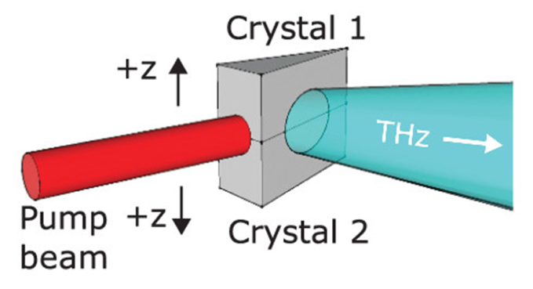
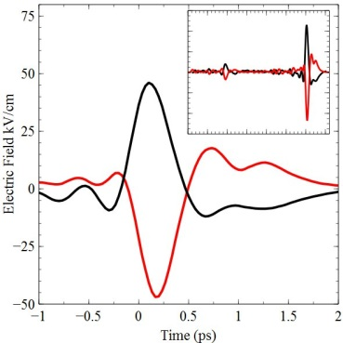
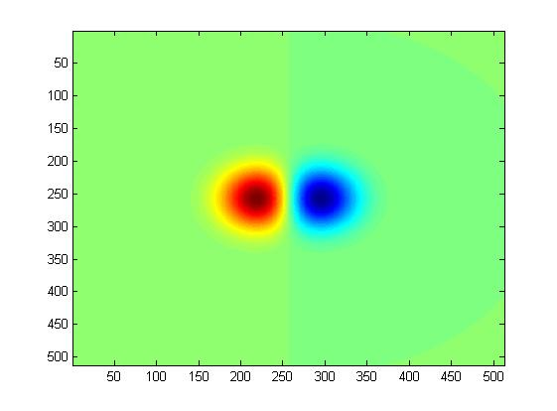
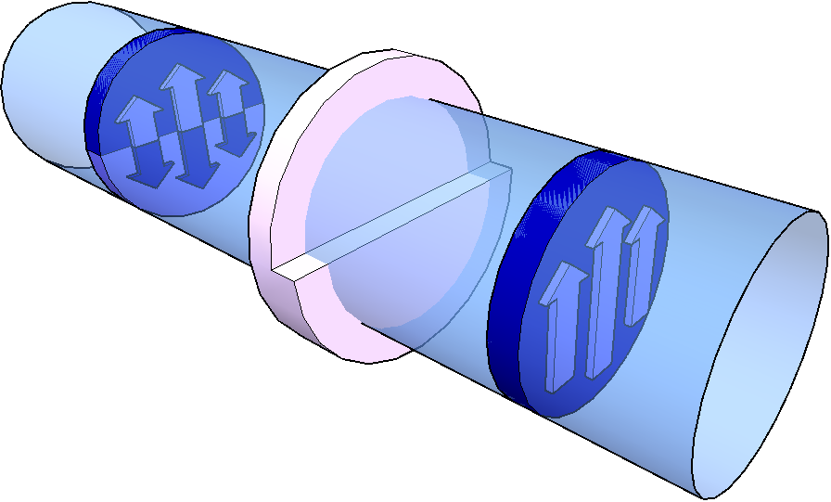
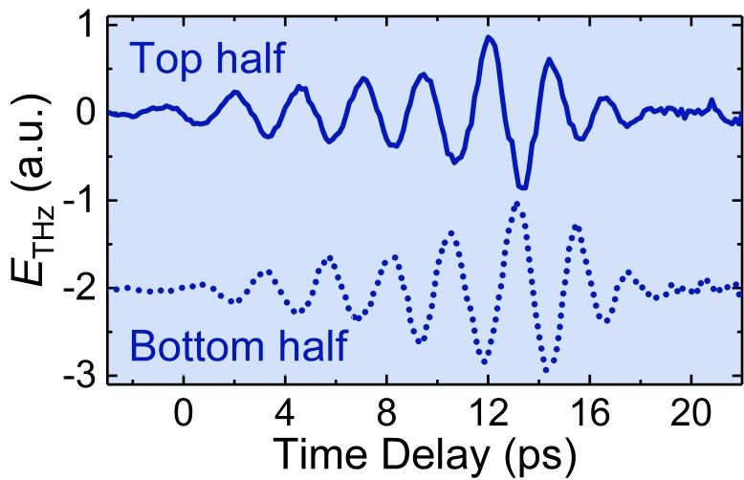
Our approach: Polarisation of the terahertz beam
To excite the accelerating mode of the DLW
→ THz beam with a TEM₀₁ mode is required
TEM₀₁ mode
Previously demonstrated using the interferometric recombination of two polarity-inverted, linearly polarised THz beams
M. Cliffe et al. Appl. Phys. Lett. 108, 221102 (2016)
quasi-TEM₀₁
PTFE
phase-shifter plate
Phase-shifter plate
Achieve effective polarity inversion by using a phase delay
TEM₀₀
THz beam
Half-cycle phase delay difference between top and bottom halves of the THz pulse
D.S. Lake, IOP Particle & Beams Group Annual Meeting 2020, September 2020

Slide 11
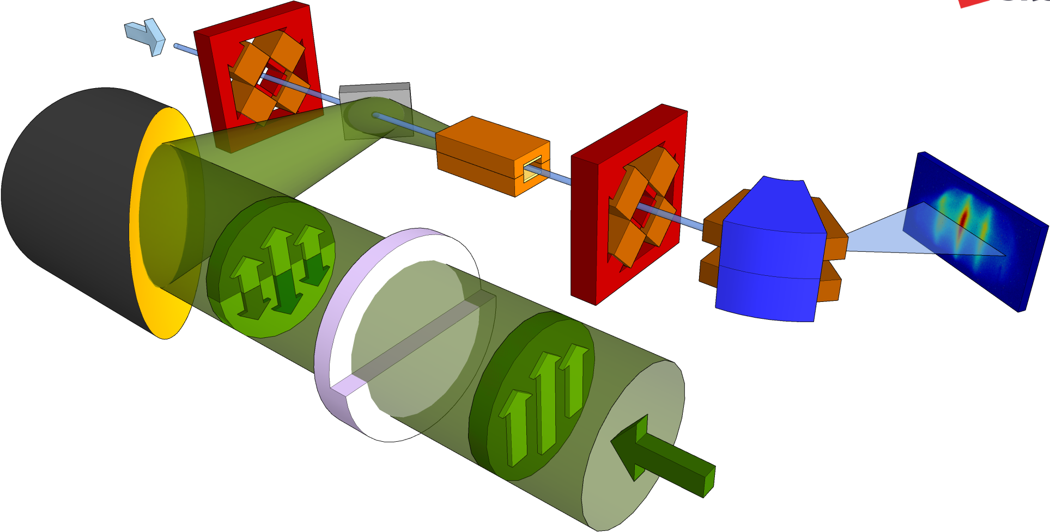
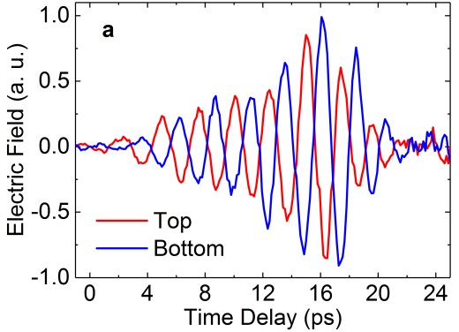
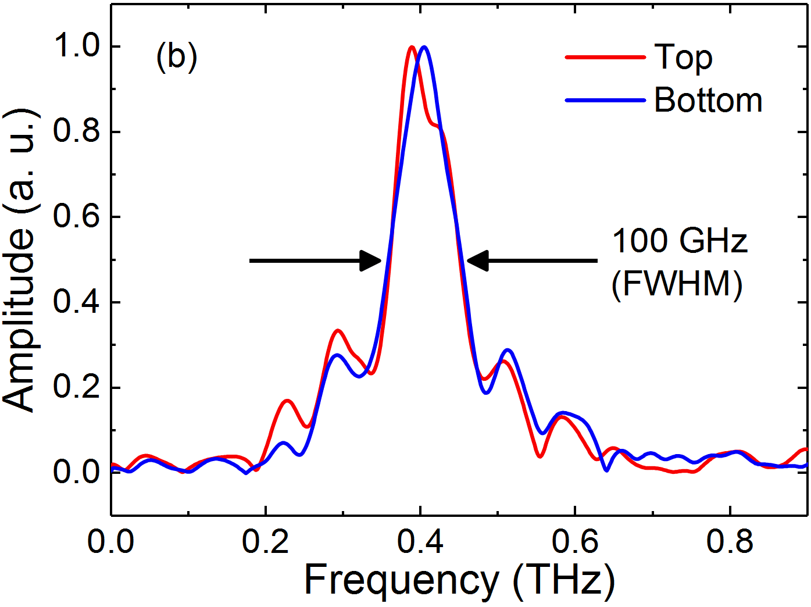
Our approach: Experimental approach
35 MeV
CLARA electron beam
Mirror with
400 µm aperture
x3
Dielectric-lined
waveguide
Off-axis parabolic mirror
x3
Quadrupole
magnet (triplet)
YAG screen
Dipole
magnet
quasi-TEM₀₁
mode
PTFE
phase-shifter
plate
TEM₀₀
mode
THz
beam
D.S. Lake, IOP Particle & Beams Group Annual Meeting 2020, September 2020

Slide 12



Our approach: Experimental setup
D.S. Lake, IOP Particle & Beams Group Annual Meeting 2020, September 2020

Slide 13





Results: Chirped electron bunch
CLARA operated in a long electron bunch configuration
Bunch duration of 6 ps FWHM
Linear (approx.) chirp of 53 keV/ps
Bunch charge of 60 pC
Image on electron energy spectrometer
Estimated from beam dynamics simulations
6 ps
Electron bunch
f = 0.4 THz
Δf = 100 GHz
THz pulse
Intensity (arb. units)
THz off
THz on
2.5 ps
Energy
Energy
Longitudinal phase space
Time
Time
D.S. Lake, IOP Particle & Beams Group Annual Meeting 2020, September 2020

Slide 14


Results: Chirped electron bunch
CLARA operated in a long electron bunch configuration
Bunch duration of 6 ps FWHM
Linear (approx.) chirp of 53 keV/ps
Bunch charge of 60 pC
Determining the peak terahertz-driven acceleration
Calculation imposing a sinusoidal THz-driven modulation on to a model electron bunch, including:
→ Bunch emittance, energy spread and chirp
Estimated from beam dynamics simulations
Measured longitudinal phase-space distribution
Obtained from 100 single-shot spectra with varying THz-electron bunch timing, using:
The measured energy modulation period δE(E)
The known THz period τ = 2.5 ps (0.4 THz)
δE_{THz} = 8.8 keV
Linear chirp = 47.3 keV/ps
Estimated from beam dynamics simulations
100 shots
2.5 ps
2.5 ps
Linear chirp 47.5 keV/ps
M.T. Hibberd et al,
arXiv 1908.04055 (2019)
Nature Photonics, August 2020
D.S. Lake, IOP Particle & Beams Group Annual Meeting 2020, September 2020

Slide 15





Results: Short electron bunch
CLARA operated in a short electron bunch configuration
Bunch duration of 2 ps FWHM
Residual linear chirp of <10 keV/ps
“Single-bucket” acceleration
Estimated from beam dynamics simulations
2 ps
Electron bunch
f = 0.4 THz
Δf = 100 GHz
THz pulse
THz off
THz on
Energy
2.5 ps
Energy
Longitudinal phase space
Time
Time
Modelled
Modelled
M.T. Hibberd et al,
arXiv 1908.04055 (2019)
Nature Photonics, August 2020
D.S. Lake, IOP Particle & Beams Group Annual Meeting 2020, September 2020

Slide 16



Another Approach: Travelling Wave THz Source
Use evanescent wave formed at crystal-vacuum boundary
Additional pulse-front-tilt gives time delay across THz pulse
Effective phase velocity matched to particles by tuning angle of extra tilt
Can use single cycle pulse – No need for narrowband
No need for a ‘structure’
D.A. Walsh et al,
Nature Communications, September 2017
D.S. Lake, IOP Particle & Beams Group Annual Meeting 2020, September 2020

Slide 17




Our Approach: Travelling Wave THz Source
Proof of principle experiment
Showed Velocity matching possible over wide range
Accelerating fields behave as dispersion free
Requires complex 3d geometries to generate the THz when compared to waveguide schemes.
D.A. Walsh et al,
Nature Communications, September 2017
D.S. Lake, IOP Particle & Beams Group Annual Meeting 2020, September 2020

Slide 18



Our Approach: 100 keV Gun Experiment
Similar to the experiment with the DLW and relativistic electrons
100 keV photo-electron gun
Vacuum chamber designed for two interaction points
MCP detector
Different waveguide matched to 100 keV electrons
Short term goals
  Terahertz driven electron deflection
  Terahertz driven compression
  Terahertz driven acceleration of compressed bunch
D.S. Lake, IOP Particle & Beams Group Annual Meeting 2020, September 2020

Slide 19
Summary
Demonstrated THz-driven linear acceleration of a 35 MeV relativistic electron beam
  Measurements performed at the CLARA test facility, Daresbury Laboratory
  Generation of narrowband THz pulses with required polarity-inversion
  Energy spectra modulation of chirped electron beams,
  Near-single bucket acceleration/deceleration of short bunches
Progress towards THz-driven compression and acceleration of non-relativistic bunches
  Early stages of experiments
  THz deflection observed
  Eventual goal of acceleration to from 100 keV to MeV and above
D.S. Lake, IOP Particle & Beams Group Annual Meeting 2020, September 2020

