Slide 1


UK XFEL and FEL test facilities
Louise Cowie
Accelerator Science and Technology Centre
Science and technology Facilities Council, UKRI, UK
IOP PAB Annual Meeting, 30 September 2020

Slide 2
Outline
UK XFEL introduction and timeline
CLARA as a test facility
XARA proposal and benefits as a test facility
Image © STFC John Dawson

Slide 3
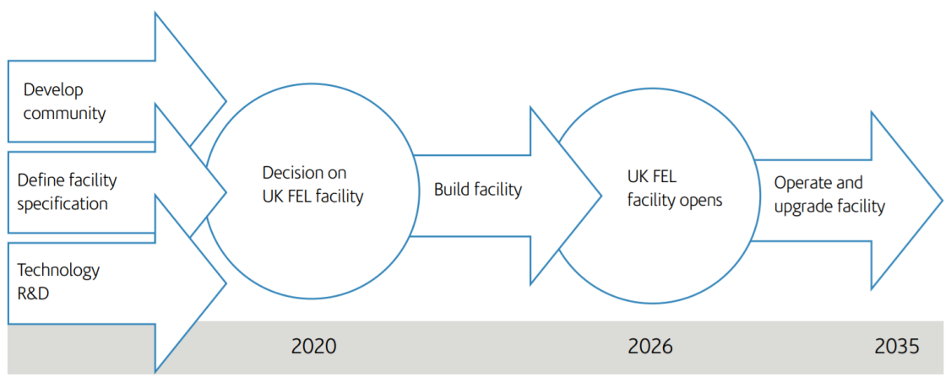
UK XFEL
An X-ray Free Electron Laser built in the UK to enable the UK science community to tackle emerging scientific and societal challenges
Science case released July 2020.

Slide 4
Science case
Controlled X-rays and samples will extend the power of serial femtosecond nanocrystallography
for advancing knowledge and drug discovery
Physics and X-ray photonics
Matter in extreme conditions
Quantum and nanomaterials
Chemical sciences and energy
Life sciences
UK industry, society and defence
Ultrafast X-rays probe attosecond electron dynamics, radiation damage of materials & biomolecules & elementary processes in chemical reactions

Slide 5
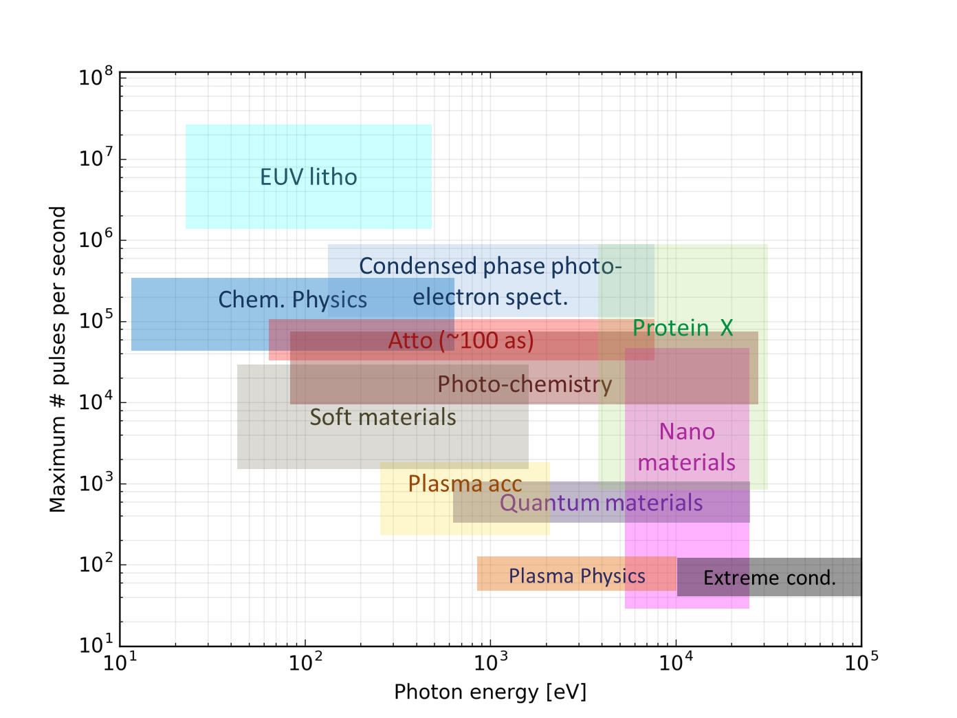
Facility X-ray requirements
Soft and hard X-rays at up to MHz repetition rate
Very hard X-rays with high pulse energy (at lower repetition rate)
High power EUV/gamma source (multi-MHz repetition rate)
+
Reproducibility, high spectral purity and control of other pulse properties
Attosecond pulses at all photon energies, synchronised to external sources
Multi-colour modes and combination between sources

Slide 6
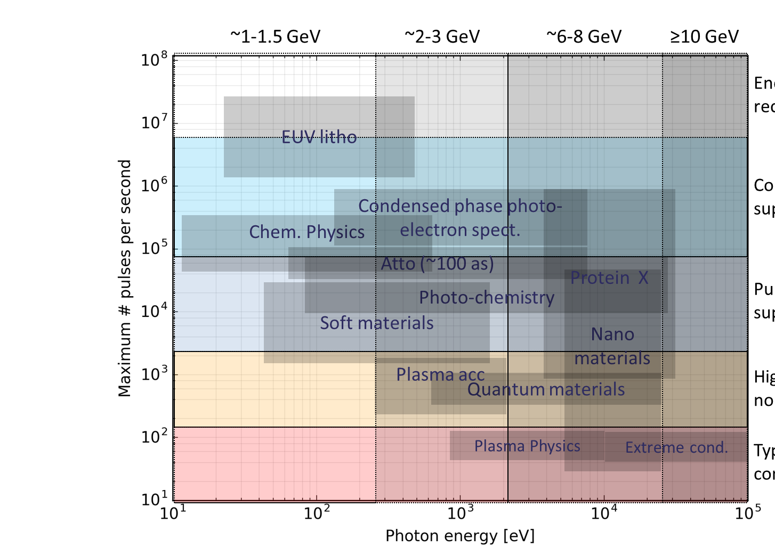
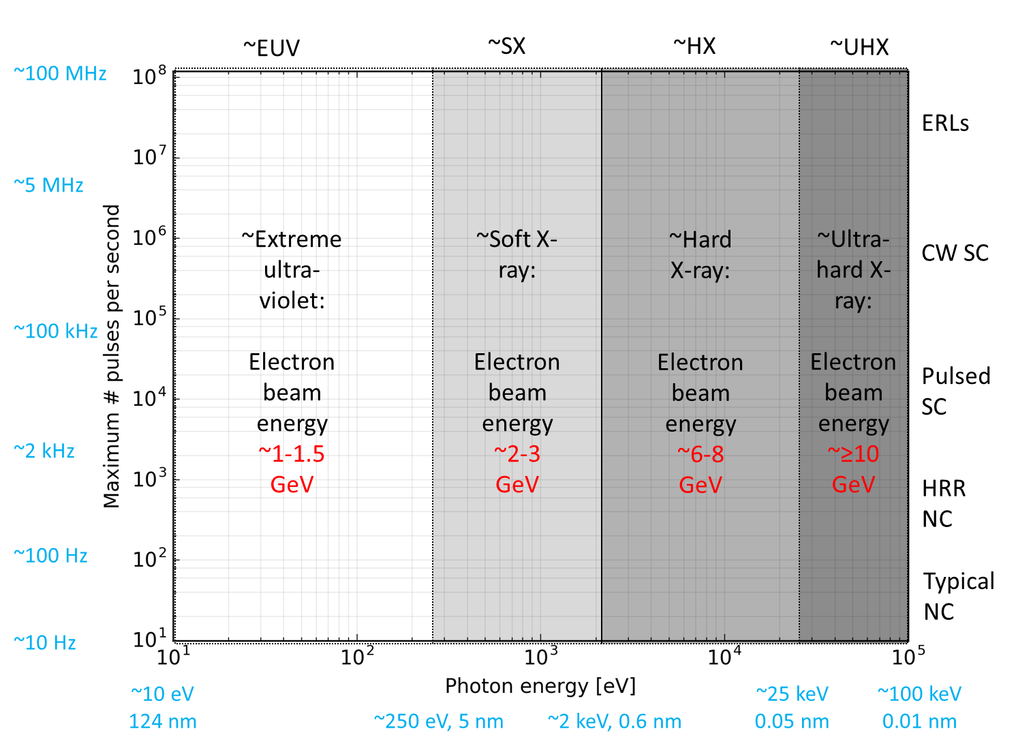
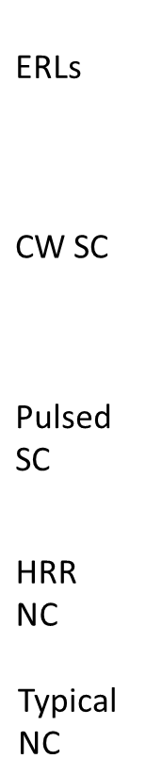
Overlay
Overlaying the science requirements with the facility considerations suggests that:
SC ~essential for SX
SC ideal for HX
NC well suited to VHX
+
ERL for EUV?

Slide 7
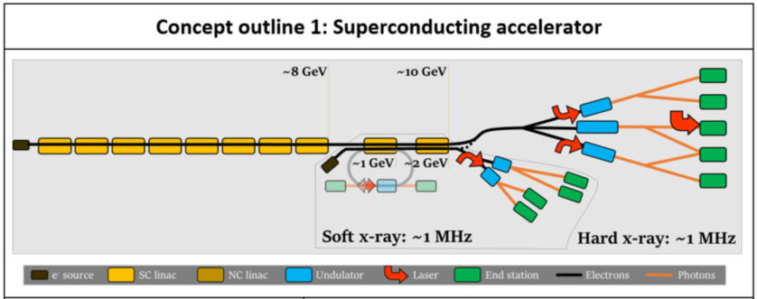
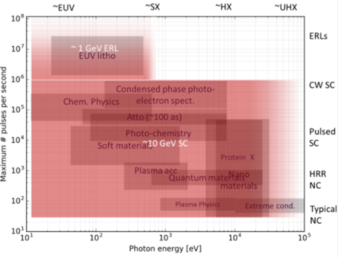
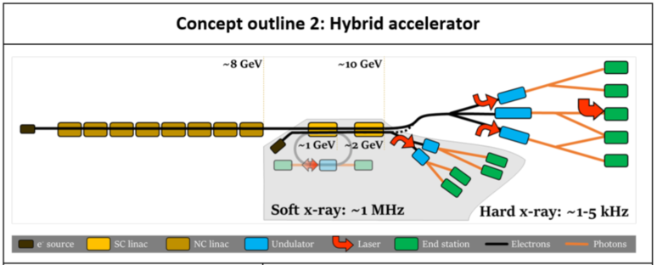
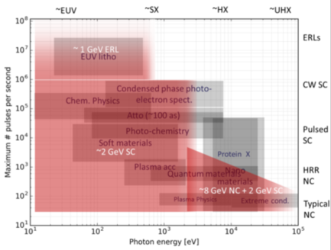
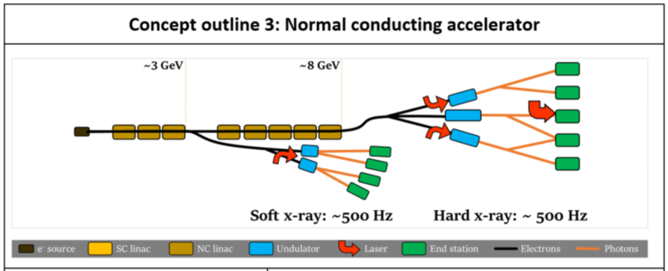
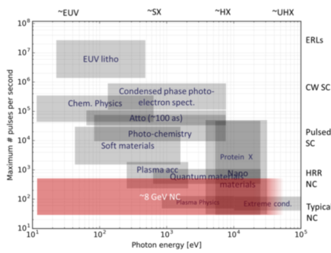
Reference Science Case Concepts

Slide 8
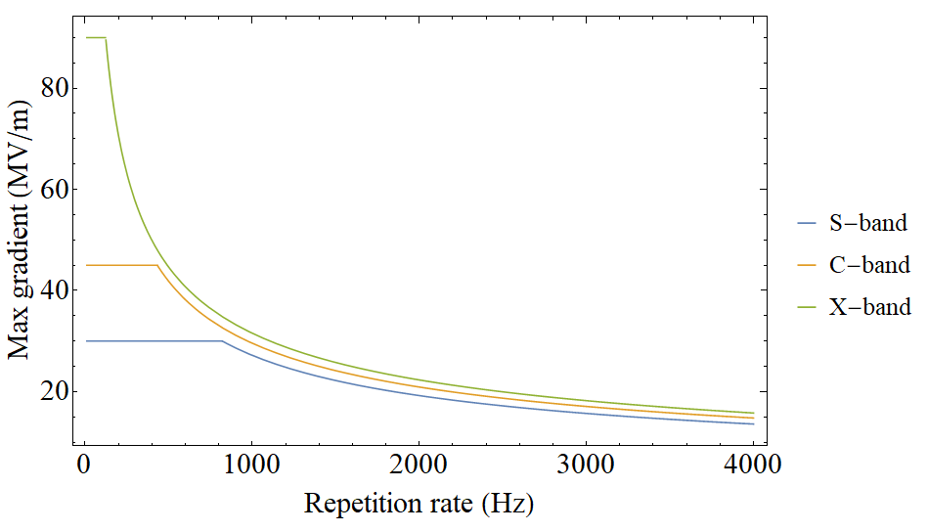
NCRF gradient
Extrapolated gradients of current high average power structures
Average power limited
Peak field (breakdown) limited

Slide 9
A long term view
Emerging technologies we are considering:
High repetition rate NCRF
Permanent magnets
Fast ferroelectric SRF cavity tuners
New FEL schemes (XFELO, HB-SASE, direct X-ray seeding…)
High repetition rate injectors
Helical SC undulators
The takeaway: R&D required!

Slide 10
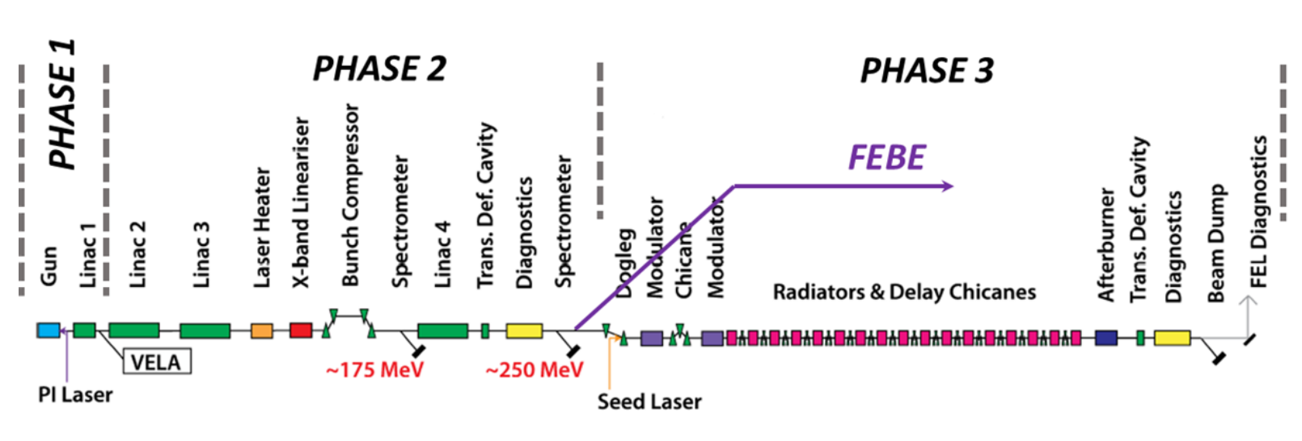
CLARA
S-band linear acceleration up to 250 MeV
Bunch charge 20-250 pC
High repetition rate up to 400 Hz
Electron bunch lengths 250-850 fs
FEL wavelengths in the UV
Phase 2 shutdown in 2022 will include FEBE line

Slide 11
CLARA as a test bed for a UK FEL
A dedicated facility for testing FEL schemes:
Ultra short photon pulse generation
Increasing FEL output intensity stability, wavelength stability and longitudinal coherence
Higher harmonics of a seed source
Accelerator technology development
Very bright (in 6D) electron bunch generation
High repetition rate NCRF technology
Timing and synchronization
Short pulse diagnostics
Infrastructure
Notes:
High level software : a C++/python API interface to EPICS & a virtual machine: Automated accelerator controls for repeatability and self-optimisation- cavity conditioning, cresting, BPM calibration, beam alignment.

Slide 12
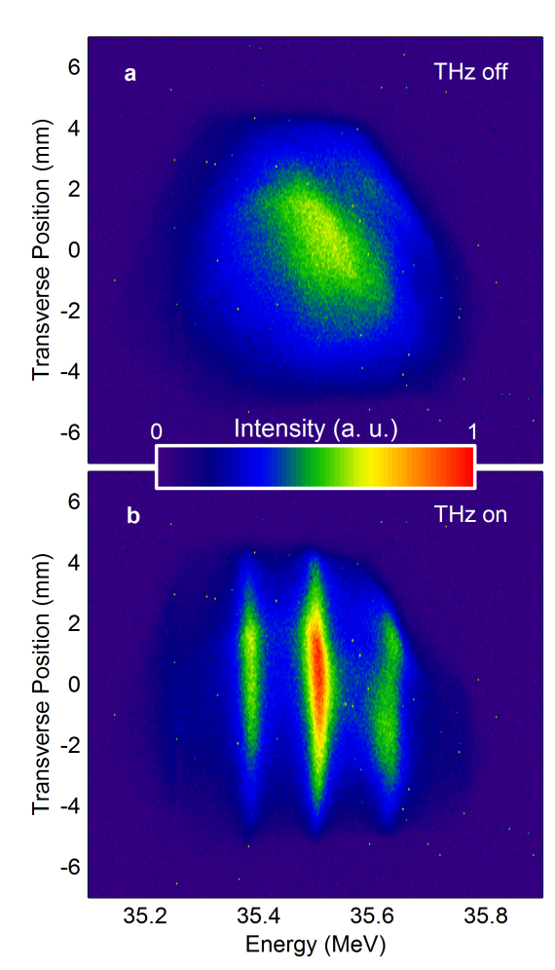
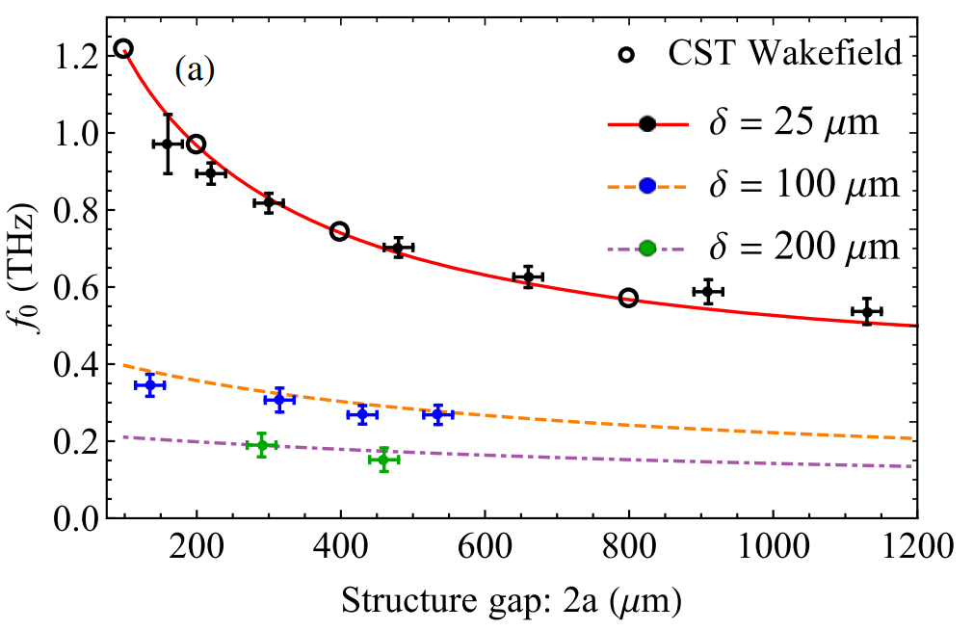
CLARA front end exploitation
THz-driven Manipulation of Relativistic Electron Beams
M. Hibberd et al.
Nature Photonics, 10.08.2020
12 experiments completed in 2018/19 covering:
Novel acceleration techniques
Accelerator systems development
Medical physics applications
First demonstration of continuously tunable THz generation with dielectric wakefield structure
T. Pacey et al.
PRAB 22, 091302, 2019
Notes:
spectrometer

Slide 13
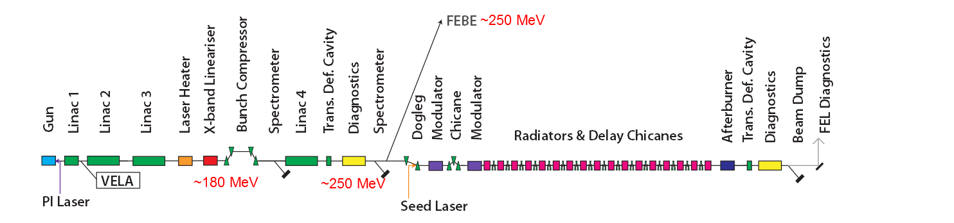
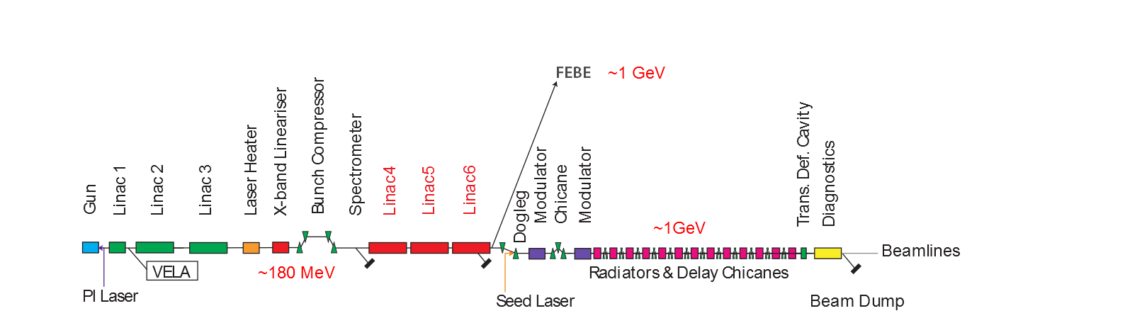
Upgrade proposal: XARA
X-band Accelerator for Research and Applications
Inexpensive upgrade to CLARA
The 4th CLARA linac is replaced by an X-band accelerating section to reach 1 GeV
Novel FEL technology
An EUV/soft x-ray FEL facility for ultra fast chemistry and biology, and a centre of accelerator R&D.
Notes:
Photoinjector operating at 400 Hz with dual feed H-coupler and load-lock cathode exchange system
High level software : a C++/python API interface to EPICS & a virtual machine: Automated accelerator controls for repeatability and self-optimisation- cavity conditioning, cresting, BPM calibration, beam alignment.
CLARA electron beam already been exploited for accelerator R&D, higher energies and multi-bunch operation will add to capabilities

Slide 14
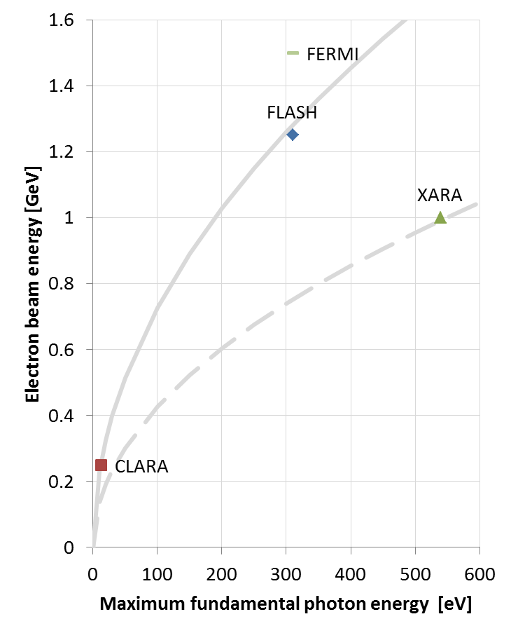
Photon energy range
The photon energy of FEL radiation is proportional to the electron beam energy squared.
CLARA at 250 MeV was designed for a shortest wavelength of 100 nm (12.4 eV)
Increasing to 1GeV would therefore give a factor of 16 change to 6 nm (200 eV)
Utilising more ambitious undulator technology would allow a significant further reduction, potentially as far as ~2.3 nm (540 eV), so as to cover the ‘water-window’ region of particular scientific interest.

Slide 15
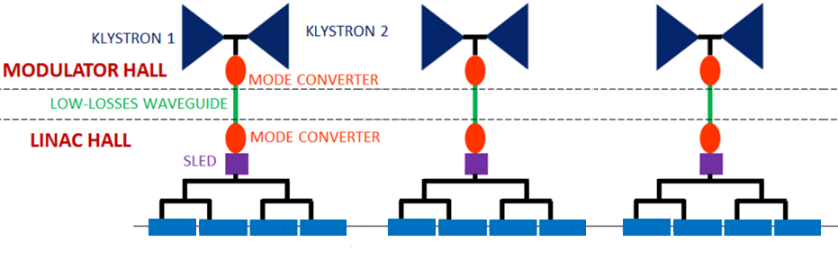
X-band linac
Based on EuPRAXIA@SPARC_LAB/CompactLight/Electrons into SPS RF module
4 x 1 m 80 MV/m x-band cavities per module
3 modules
Could be used at lower gradients to achieve longer pulse lengths
M. Diomede et al 2014, NIMA Vol. 909

Slide 16
FEL options
  New FEL techniques for few-cycle pulses would enable attosecond pulses
  With ~100nJ pulse energy
  A longer undulator (~15 m) would allow access to a larger parameter space, including longer pulses with significantly higher pulse energy (>100 uJ). Seeding and associated FEL schemes could be implemented
  Multi-bunch operation with a alkali-antimonide cathode would allow a RAFEL
~200uJ, 100fs
Notes:
, higher than HighHarmonicGeneration
Multi-bunch operation enable operation of a RAFEL (regenerative amplifier FEL) – a high-gain FEL with an optical cavity to improve temporal coherence and shot-to-shot stability.

Slide 17
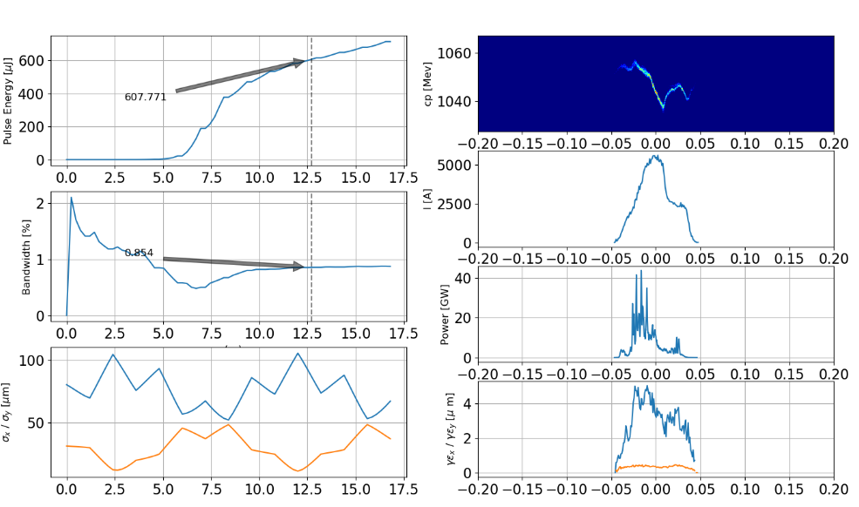
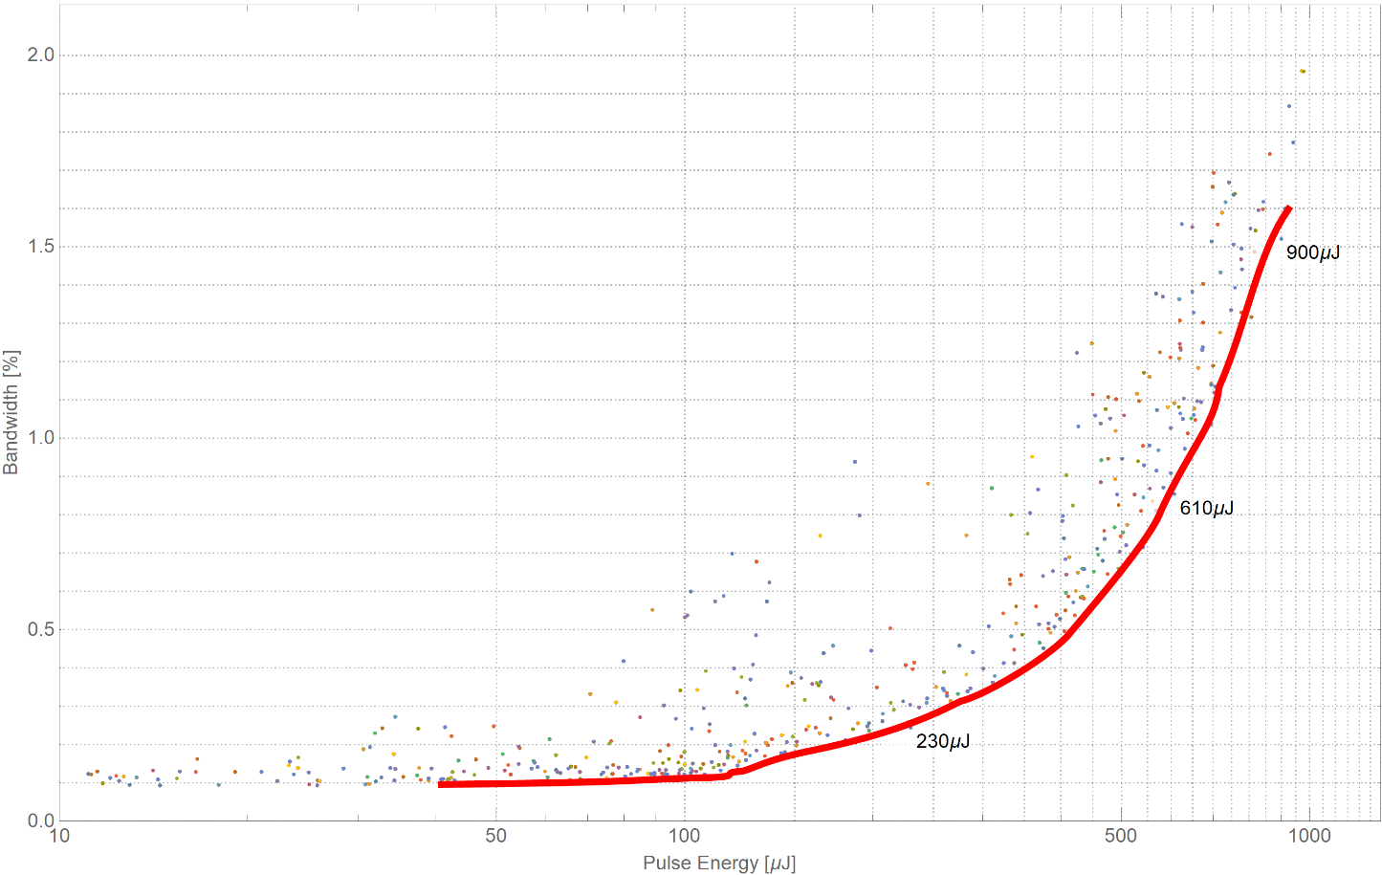
Start to end simulations
Using python-based Simulation Framework
ASTRA to Elegant to Genesis2
Cathode-to-FEL MOGA simulation

Slide 18
XARA as a test bed for UK XFEL
All the benefits of CLARA, plus:
More options for FEL schemes
Experience of seeding at soft x-ray
Test NCRF gradient/average power trade off
Working with soft X-rays
Build a user base for X-rays

Slide 19
Conclusion
UK XFEL will benefit the UK accelerator and wider science communities
CLARA is a useful test bed for a UK XFEL
XARA proposed to further increase UK FEL test facility relevance to UK XFEL

Slide 20
Acknowledgements
Thanks to everyone on the UK XFEL, CLARA and XARA teams, particularly David Dunning & James Jones.

Slide 21
Thank you
Notes:
Thank you for your attention

Slide 22
Benefits of CLARA as injector
Photoinjector operating at 400 Hz with dual feed H-coupler and load-lock cathode exchange system
High level software : a C++/python API interface to EPICS & a virtual machine: Automated accelerator controls for repeatability and self-optimisation- cavity conditioning, cresting, BPM calibration, beam alignment.
CLARA electron beam already been exploited for accelerator R&D, higher energies and multi-bunch operation will add to capabilities

Slide 23
Start to end simulations
Generations
Pareto Front

Slide 24
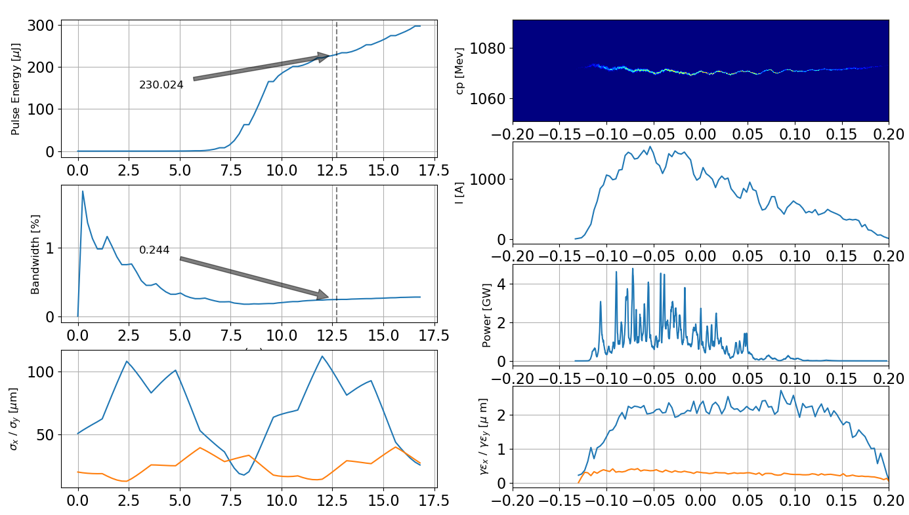
Start to end simulations

Slide 25
Start to end simulations
Using python-based Simulation Framework
  ASTRA to Elegant to Genesis2 (transparently!)
Longitudinal matching only
  All linac phases/amplitudes
  Bunch Compressor angles
  Dielectric De-chirper “gap”
Includes: CSR, 3D-SC (Injector), LSC, Wake-fields (!)
MOGA optimisation looking at SASE:
  Bandwidth (min) and Energy (max) at 12.5m

Slide 26

Start to end simulations

Slide 27
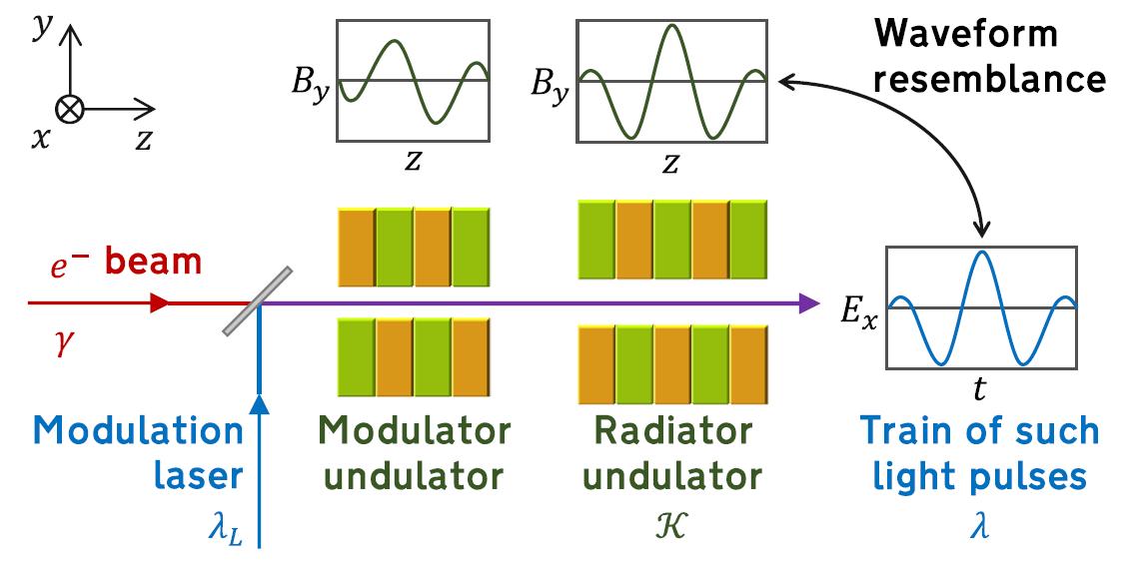
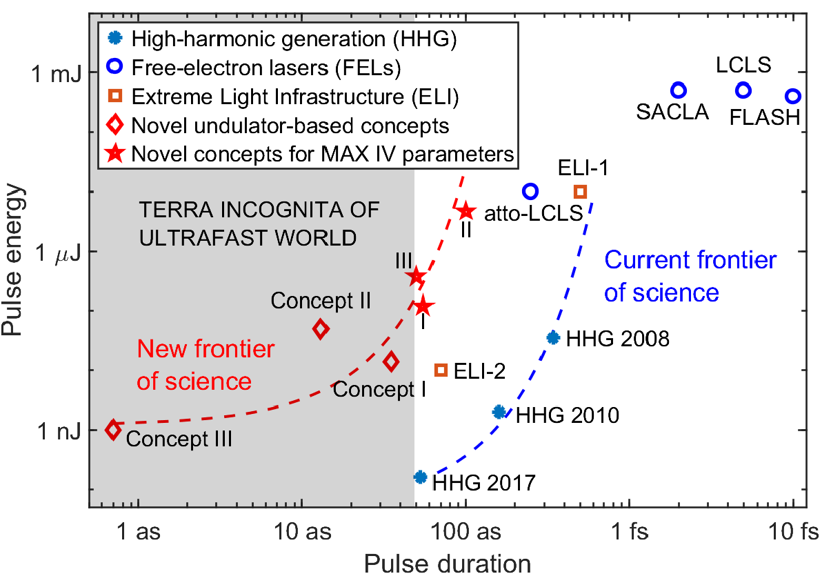
FEL options (1)
New FEL techniques for few-cycle pulses would enable:
  Attosecond pulses
  Very compact undulator (few meters)
  ~100nJ pulse energy, higher than HHG
~100nJ, 50 as
Tibai Z et al 2014, Phys. Rev. Lett. 113 104801
Alan Mak et al 2019 Rep. Prog. Phys. 82 025901
Notes:
the stars on the plot to the right show simulation results with similar parameters to XARA – a significant enhancement on present sources.

Slide 28
FEL options (2)
A longer undulator (~15 m) would allow access to a larger parameter space, including longer pulses with significantly higher pulse energy (>100 uJ).
Results below show a simple SASE case at 2.3 nm and 4.4 nm.
Seeding and associated advanced FEL schemes could also be implemented.
~200uJ, 100fs

Slide 29
Multi-bunch operation
Photoinjector cathode can be exchanged for an alkali antimonide cathode
An upgrade to 10 MHz green photoinjector laser allows multi-bunch operation
Multi-bunch operation allows drive/witness plasma acceleration beam exploitation.
Multi-bunch operation enable operation of a RAFEL (regenerative amplifier FEL) – a high-gain FEL with an optical cavity to improve temporal coherence and shot-to-shot stability.
Notes:
While external seeding already performs this function at XARA wavelengths, demonstration of a RAFEL would be relevant as a testbed for hard x-ray wavelengths including a potential UK XFEL.

