Slide 1

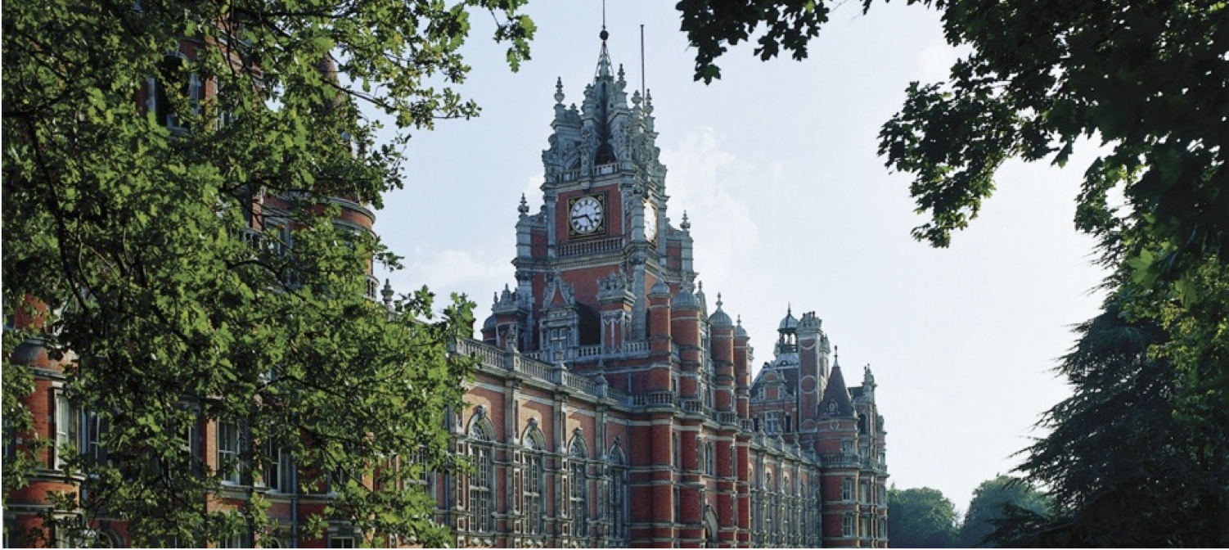



The annual meeting of the Institute of Physics Particle Accelerators and Beams Group will take place at Royal Holloway, University of London, on April 7th, 2017.

Slide 2
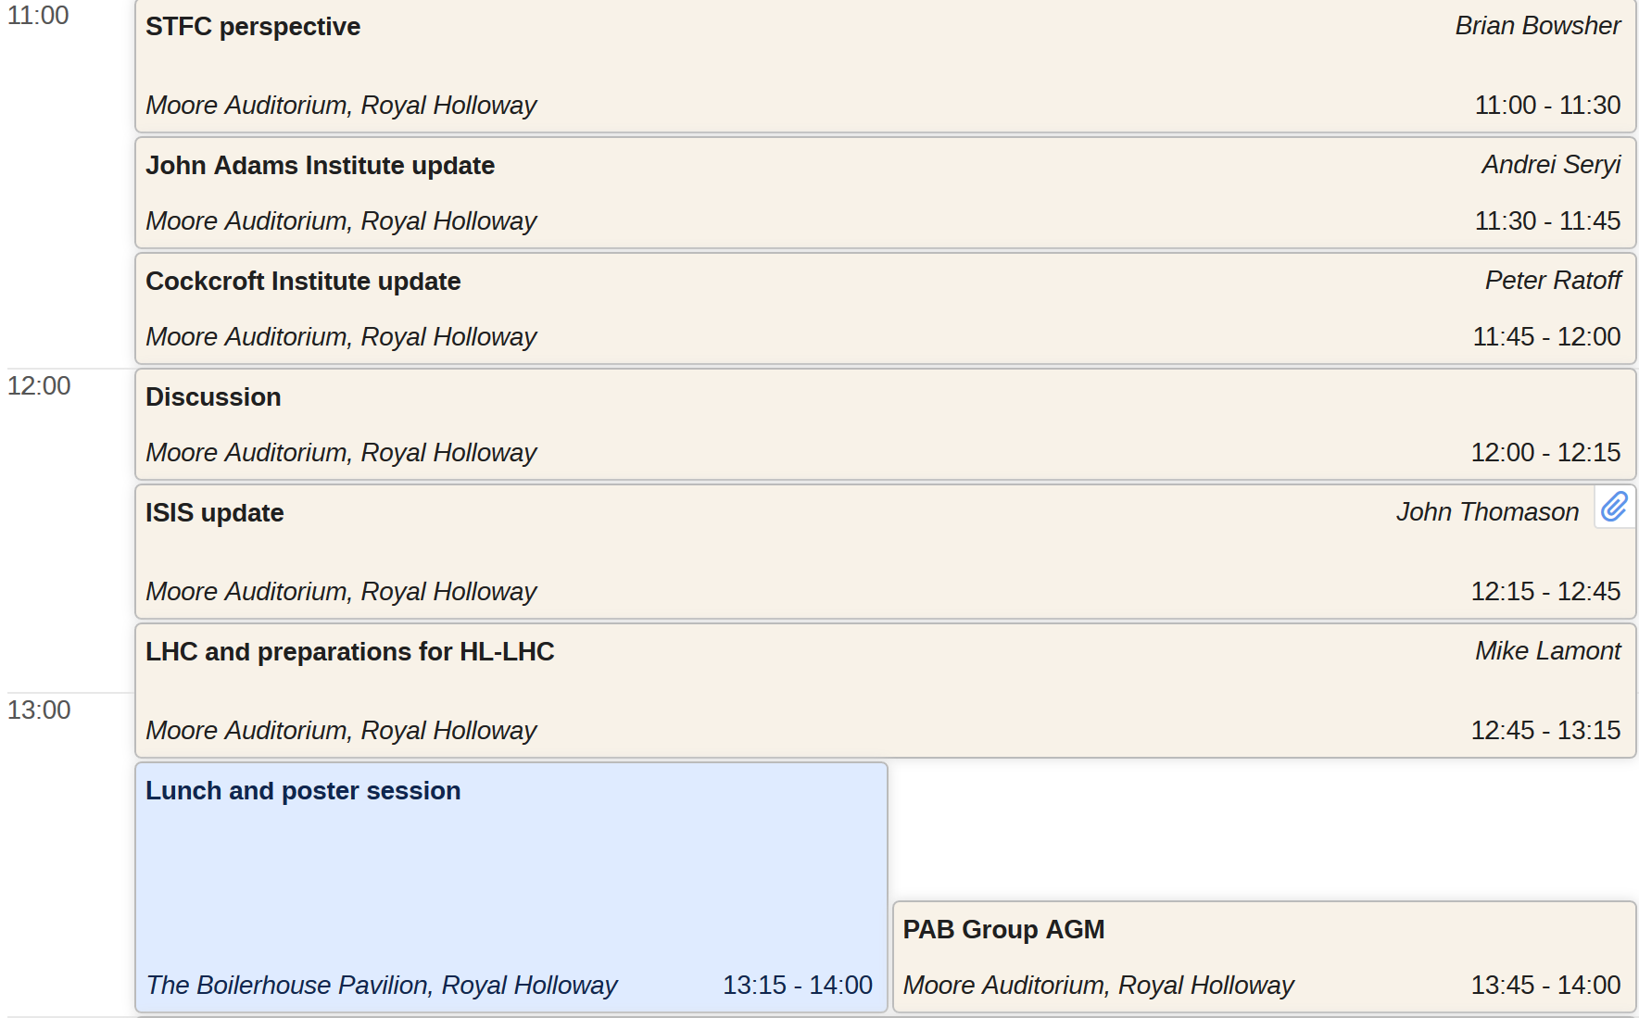
The annual meeting of the Institute of Physics Particle Accelerators and Beams Group will take place at Royal Holloway, University of London, on April 7th, 2017.
Chair: Brian McNeil
Chair: Phil Burrows

Slide 3
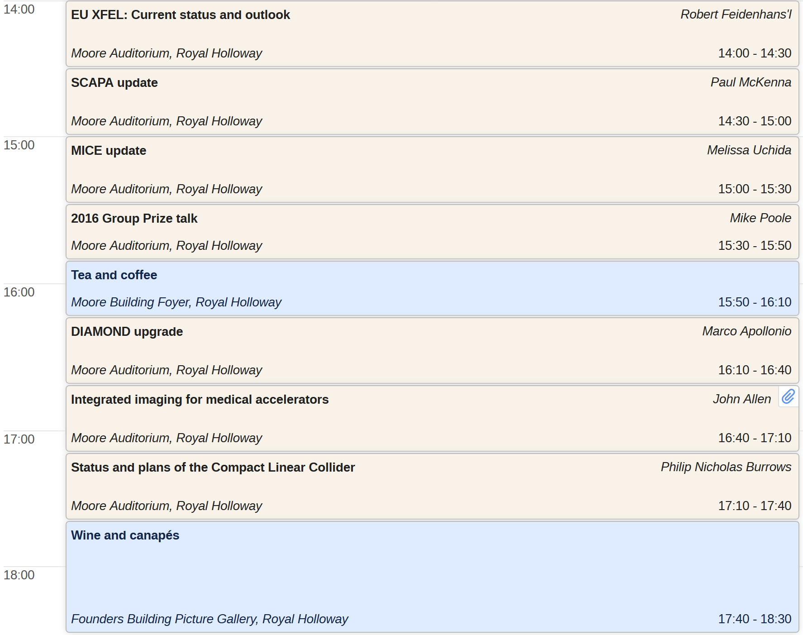
The annual meeting of the Institute of Physics Particle Accelerators and Beams Group will take place at Royal Holloway, University of London, on April 7th, 2017.
Chair: Aled Jones
Chair: Brian McNeil
Chair: Peter Williams

Slide 4
11:00-12:15 Brian McNeil
12:15-13:15 Phil Burrows
14:00-15:30 Susan Smith
15:30-15:50 Brian McNeil
16:10-17:40 Peter Williams

