Slide 1
The relationship between imaging and RT
How imaging has changed radiotherapy linac design
John Allen
Chief Engineer

Slide 2
Outline of talk
Precision and radiotherapy
Benefits of radiobiology
Targeting and conformality
Seeing the target
Seeing the target at treatment time
Seeing moving target
Future challenges

Slide 3
The relationship to radiotherapy and Precision
Radiotherapy did not begin as a precision treatment
  Early radiotherapy was targeted at superficial tumours or exploited the benefit that tumours were more susceptible to radiation than healthy tissue.
  This was much improved by discovering the benefits of fractionation
  For many years radiotherapy relied on limited imaging and radiotherapy worked for organs that had favourable therapeutic ratios (e.g. lymphomas)
  Tumours without favourable therapeutic ratio where left to other modalities.
    E.g. kidneys where treated by surgery rather than radiotherapy.

Slide 4
Radiosurgery
An early practitioner of precision
Outside of radiotherapy the neurosurgeons looked at things differently
Neurosurgery often requires very precise interventions.
  AVM, Acoustic neuroma
  Here the benefit of radiation was avoiding damage that the surgeon’s knife might do.
  Radiosurgery differs from radiotherapy because it does benefit from therapeutic ratio or fractionation.
  But for certain neurological disorders it has advantages over surgery.
The Elekta story….

Slide 5
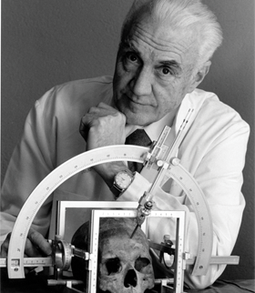
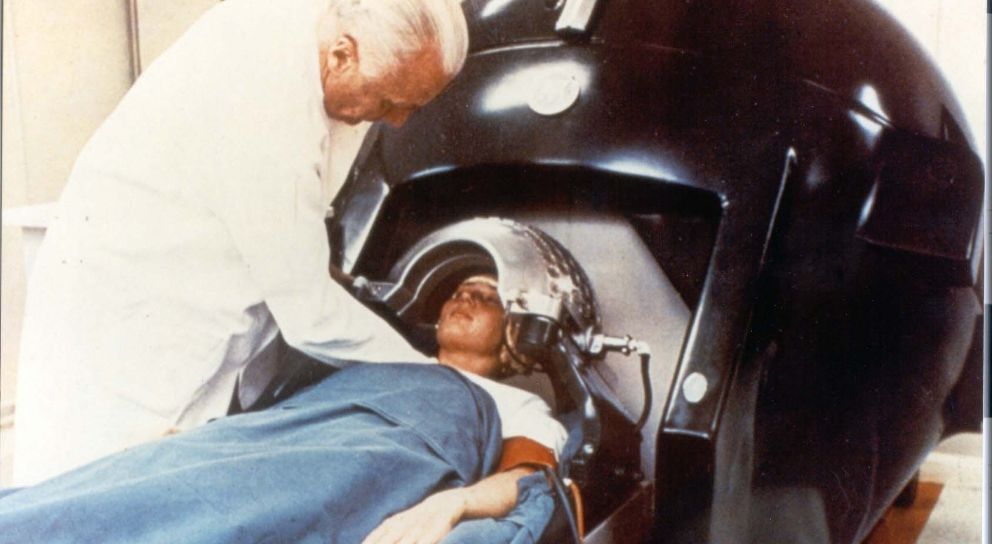
Our history is what drives us forward
Elekta was founded by Lars Leksell more than 45 years ago. We have dedicated ourselves to pioneering advancements for cancer care.
Dr. Lars Leksell (1907 – 1986)
Professor of Neurosurgery

Slide 6
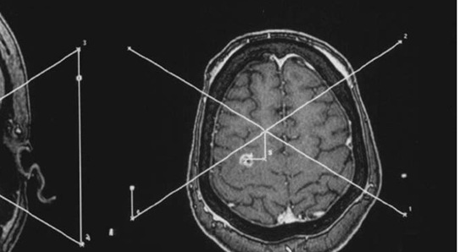
What did stereotaxy bring to RT?
Although RT had used imaging, that relationship was not a numerical one.
X-ray films and fluoroscopy were analogue the medical objectives were also analogue.
Stereotactic treatment required coordinates, to localise the target.
The key enabling technology for these technique was CT
CT may be though of as a imaging modality but it also brought numerical images to the clinic.
For the fist time the image existed as numbers in a computer and this presented new opportunities.
NUMBERS

Slide 7
CT and radiotherapy
Changes in planning came first
CT would go on revolutionise RT as well as radiosurgery
RT was already well established but the benefits of imaging evolved slowly
CT coincided with the development of computerised treatment planning.
This allowed more complex RT techniques, with greater conformity.
However the reproducibility of patient position and motion remained unaccounted uncertainties.
This era fostered a false picture of radiotherapy being a static problem.
Computer reconstructed DRR, despite using CT for planning alignment checks at treatment time still relied on simple planar imaging.

Slide 8
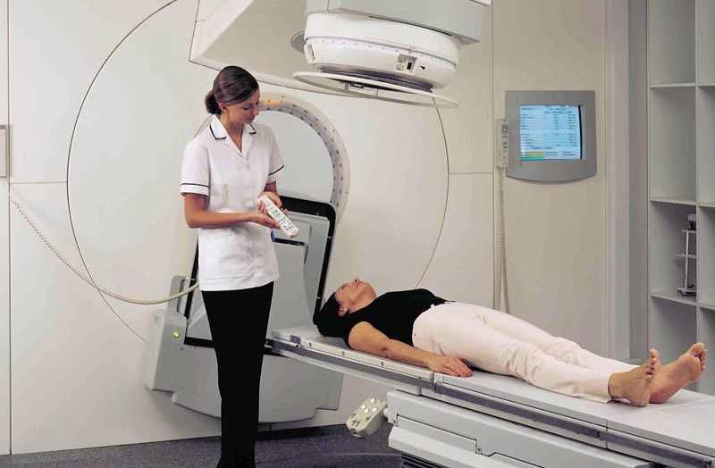
Imaging at treatment time.
Until the early 2000s imaging at treatment time was limited.
A portal image of the treatment field could was taken
Confirms the correct field shape
Patient position cannot be confirmed, unless bony anatomy is in the beam.
Movement in soft tissue went unnoticed.

Slide 9
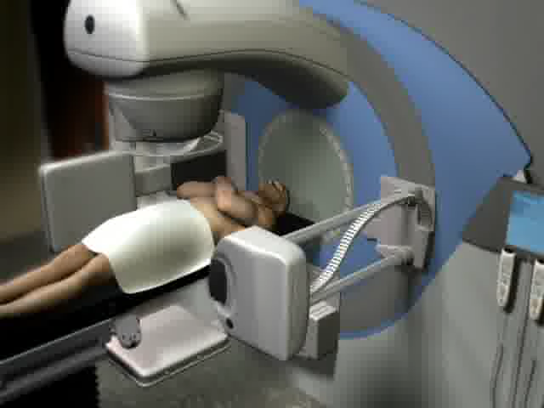
Cone Beam CT
3D images at treatment time
2003 saw a significant revolution in radiotherapy.
By adding cone beam CT to a treatment linac it was now possible to see detail 3D images immediately before treatment
This development was facilitated buy the development of large area amorphous silicon detectors
Cone beam CT differs from conventional CT by collecting the whole volume in a single revolution
A scan before treatment takes about 1 minute

Slide 10
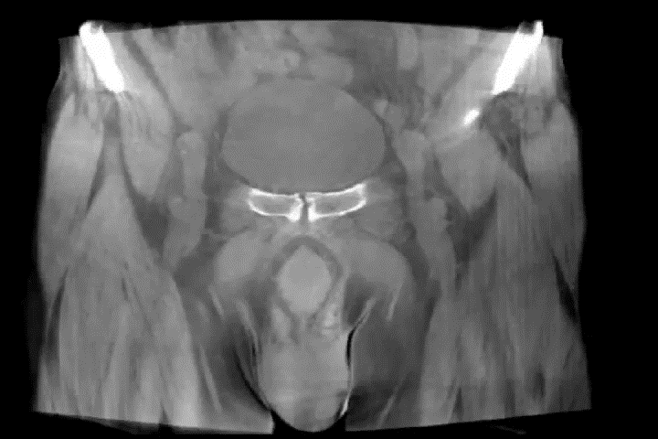
Image Quality really does matter
Patient position v target position
Old style DRR
3D volume from cone beam CT

Slide 11

Extending cone beam to handle motion
4D cone beam
Where there is good contrast it is possible to pages bin cone beam projections to create a moving view by phase binning

Slide 12
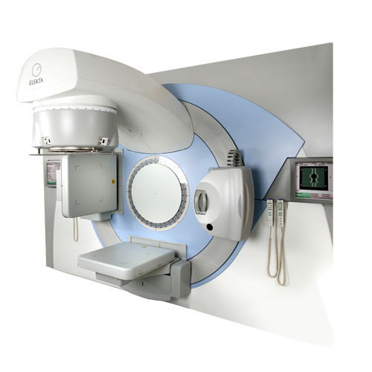
Today IGRT is the standard of care
IGRT has
  Allowed dose escalation
  Resulted in less toxicity
  Resulted in better long-term survival
  Allowed more conformal plan to be design with increasing the risk of mistreatment.

Slide 13
Why CT is not enough
Radiotherapy is not the standard of care for all tumour sites
Limited Soft tissue resolution
  Organ level not tumour level
  Limited ability to handle motion
  Cannot image during treatment
  Additional imaging dose

Slide 14
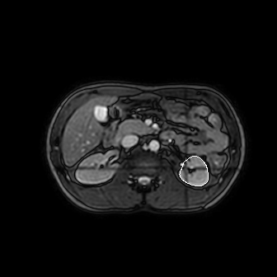
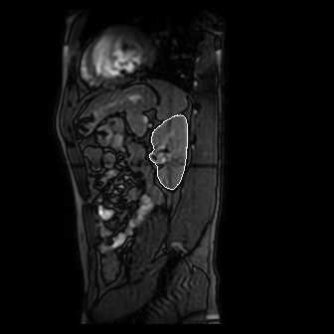
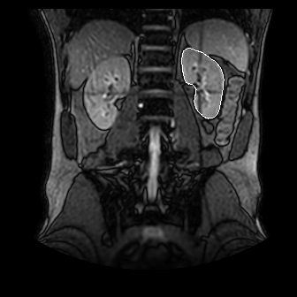
MRI a soft tissue revolution
MR imaging has many advantages over CT
Excellent soft tissue contrast
Ability to acquire images in arbitrary planes or volumes
Ability to image during radiation-on
Images courtesy of Philips, segmentation by Elekta software

Slide 15
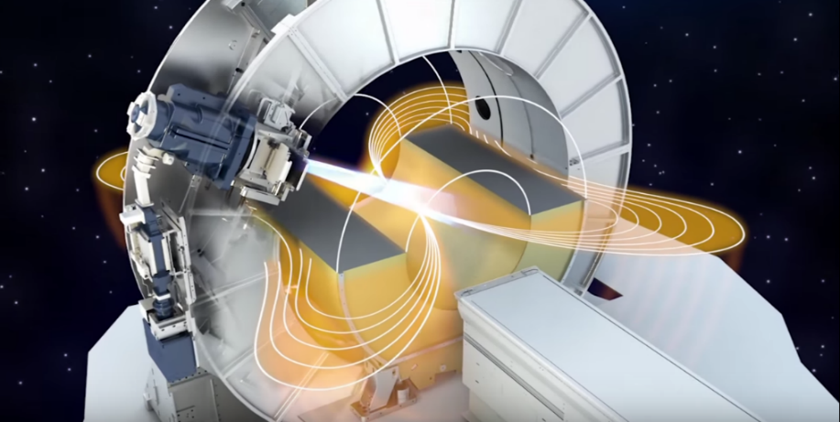
Combine MR & linac
Cannot just put two pieces of equipment in the same room
High magnetic field required for MRI
MRI requires RF shielding
MR requires uniform B-field
Linacs require some ferromagnetic material which moves in the MR fringe field
Solution:
Design a special linac

Slide 16
MR linac
A big technical challenge but huge potential benefits
Unlike Cone beam CT an MR linac requires a specially designed linac
Some design challenges
  Linac must operate near a high field magnet
  Cryogen tank surrounds patient during imaging
  MR requires a room free from RF interference
  Treatment planning needs to correct for magnetic field
    (Lorentz force on secondary electrons)

Slide 17
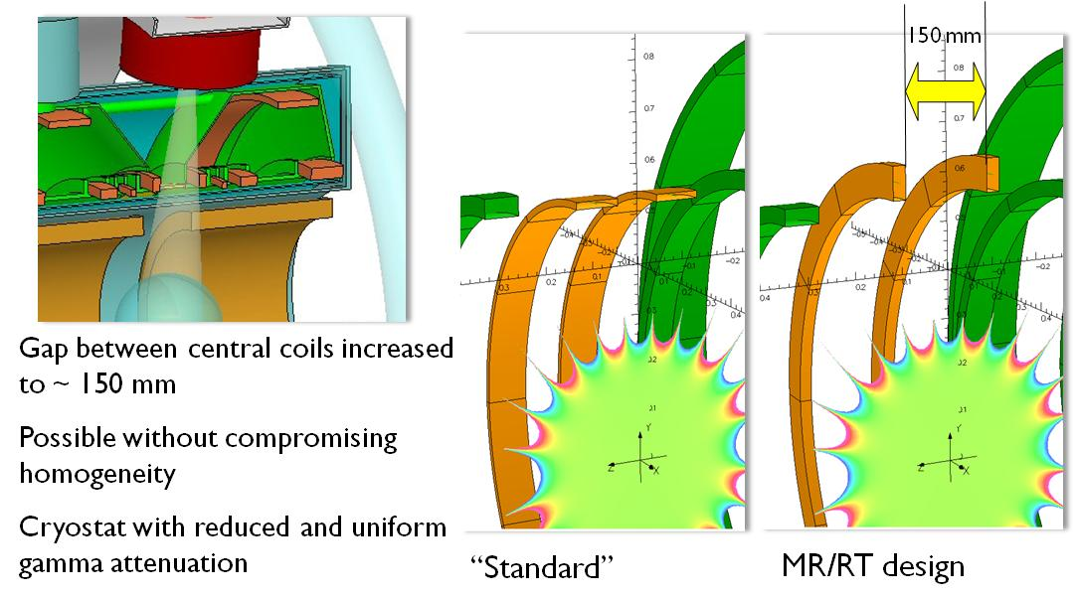
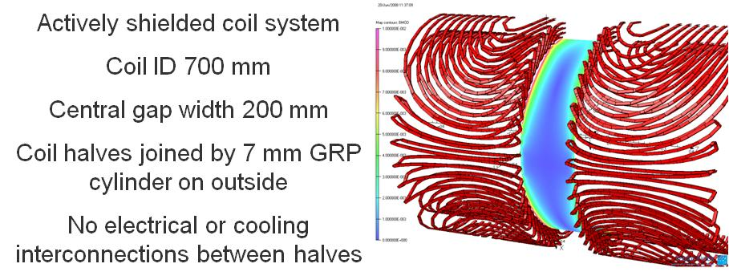
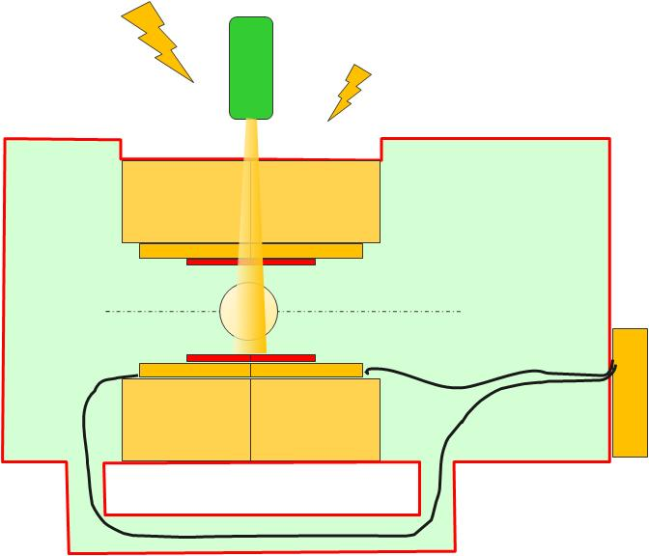
Elekta MR-linac system
Technology platform
1.5T Cylindrical Magnet
Split Gradient Coil with gap
RF shielding
MR-Linac is a research program. It is not available for sale and its future availability cannot be guaranteed

Slide 18
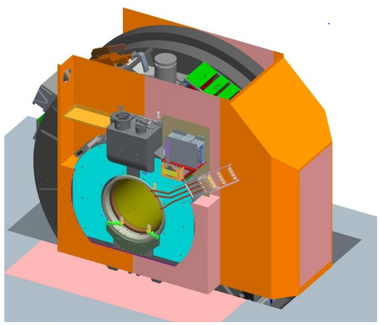
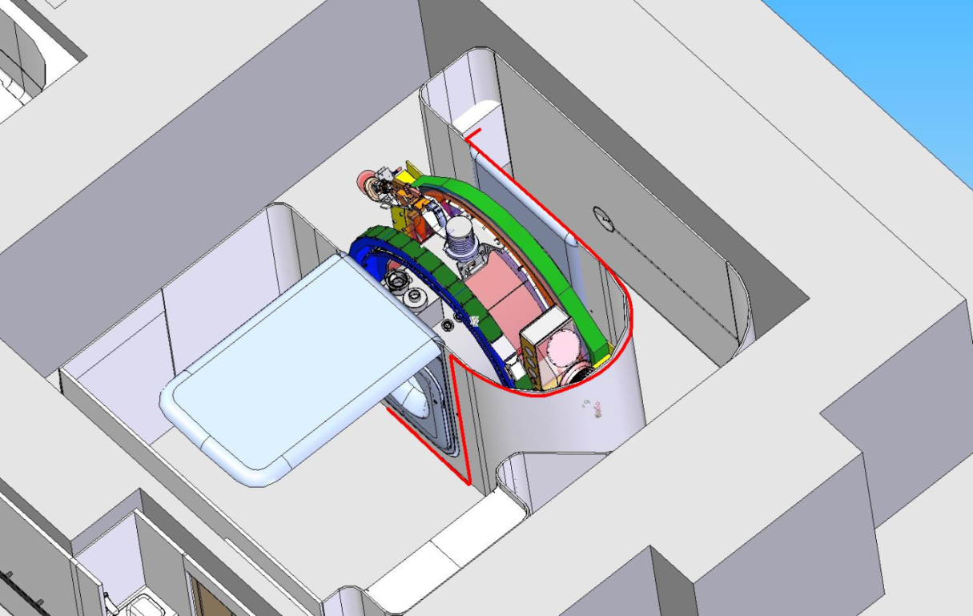
Room within a Room Concept
There is a RF shield Room inside the Radiation bunker
All gantry systems are outside the RF room

Slide 19
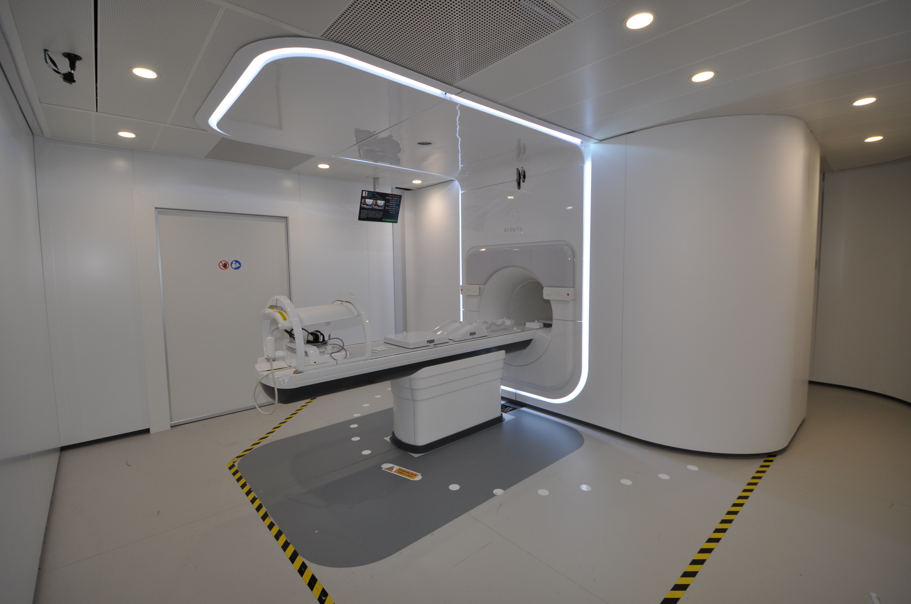
MR Guided Radiotherapy system
MR-Linac is a research program. It is not available for sale and its future availability cannot be guaranteed

Slide 20
Provocative debate topic at this year’s ESTRO Meeting in Vienna
Online MR guided therapy
“This house believes that proton guided photons will be superior to photon guided protons”
…an interesting way to think about the role of protons in RT.
CBCT proton therapy

Slide 21
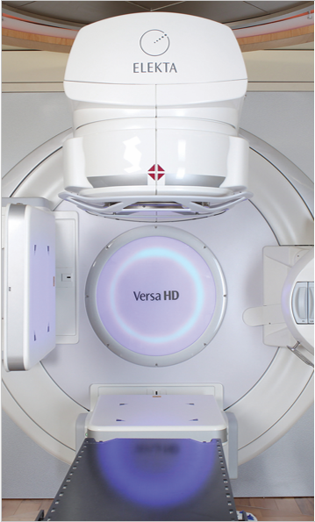
Questions?
More than….
3000 linac systems in hospitals worldwide
1.5M people treated every year
140000 patients a day interacting with Elekta’s solutions

