Slide 1
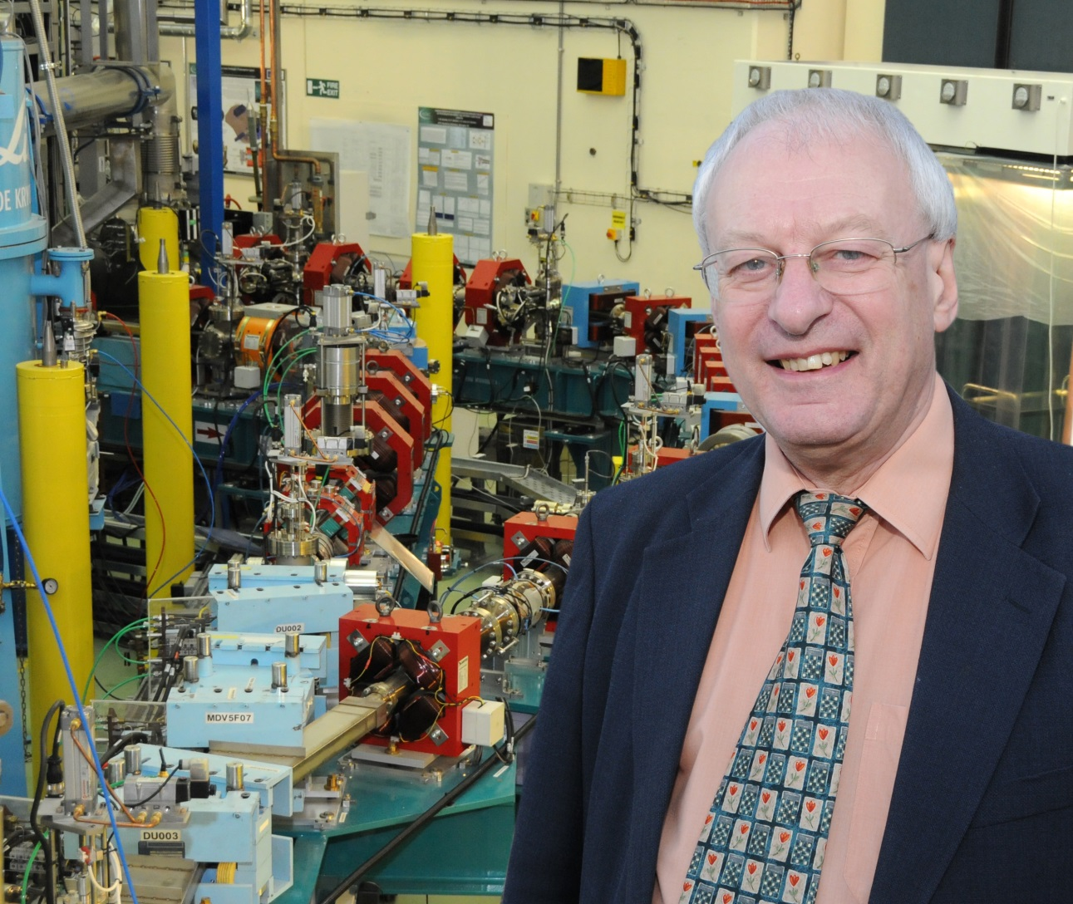
Mike Poole
Career Highlights and (a few) Disappointments

Slide 2
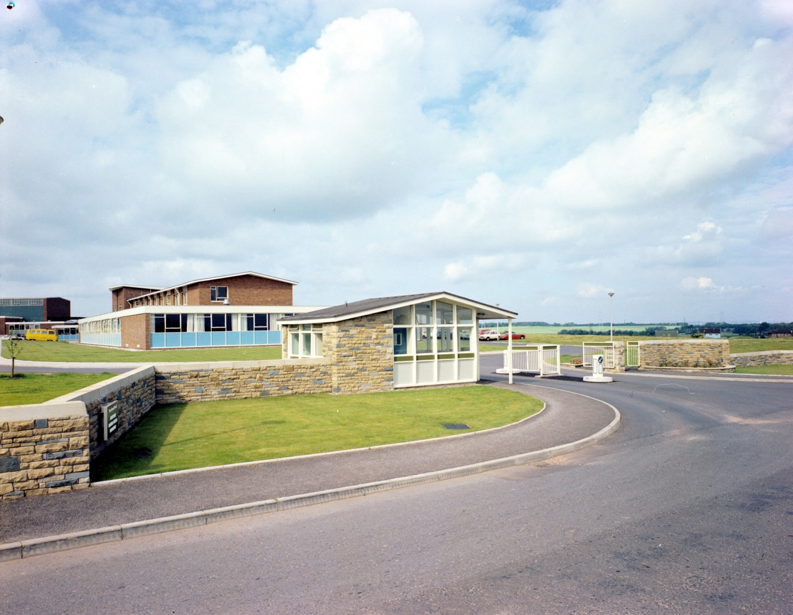
Early Years
1966 Graduated and joined DNPL, employed by SRC

Slide 3
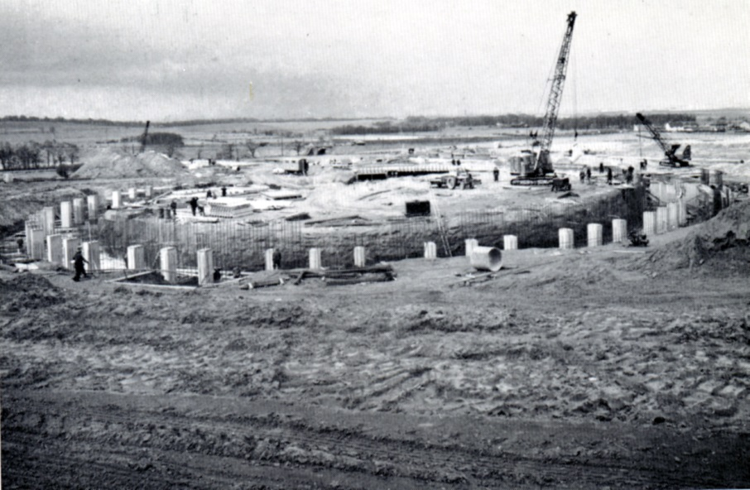
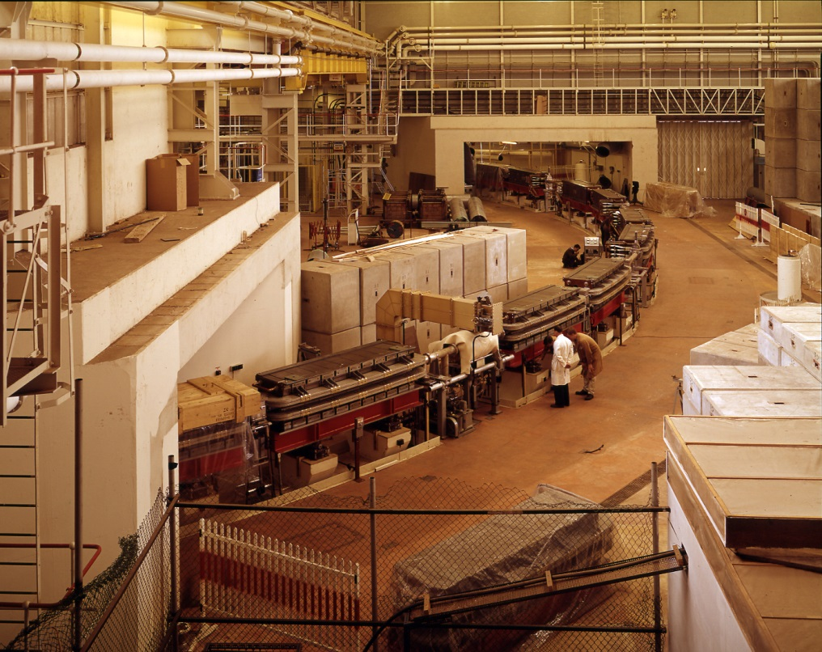
Early Years
1966 Graduated and joined DNPL, employed by SRC
      Beam Physics Section (NINA 5GeV synchrotron e- and photon beams) (Tom Aitken)
      1st project – beam loss monitoring ‘glass bombs’ !

Slide 4
Early Years
1966 Graduated and joined DNPL, employed by SRC
      Beam transport codes (dropped card: 1 in 2000 identified in wrong place! 4 weeks to find!)
      Self taught beam dynamics
      Compton Backscatter feasibility studies (not pursued)
      High power Faraday Cup designed/built
      Hydrogen target venting simulation
      Few external links/collaborations mean low profile Daresbury !
      Accelerator publications almost non-existent
      NB Vic Suller joined 1 month later

Slide 5
Specialisation (1969 onwards)
Design, construction and testing of electromagnets
(later: superconducting and permanent magnets too)
NINA Programmed Quadrupoles (N Marks)
Tune control in energy ramp
50Hz AC cycle
Air cooled, laminated
High silicone steel, epoxy/glass coils etc
Successful project – skills boost
(industrial and contractual skills training too)
SRS Design Study published and Project approved 1975
My big chance !

Slide 6
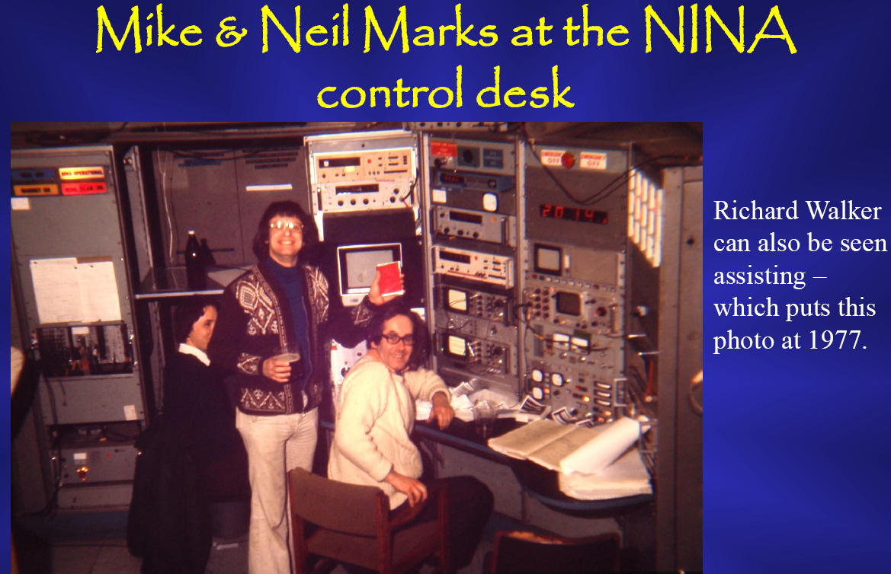

Slide 7
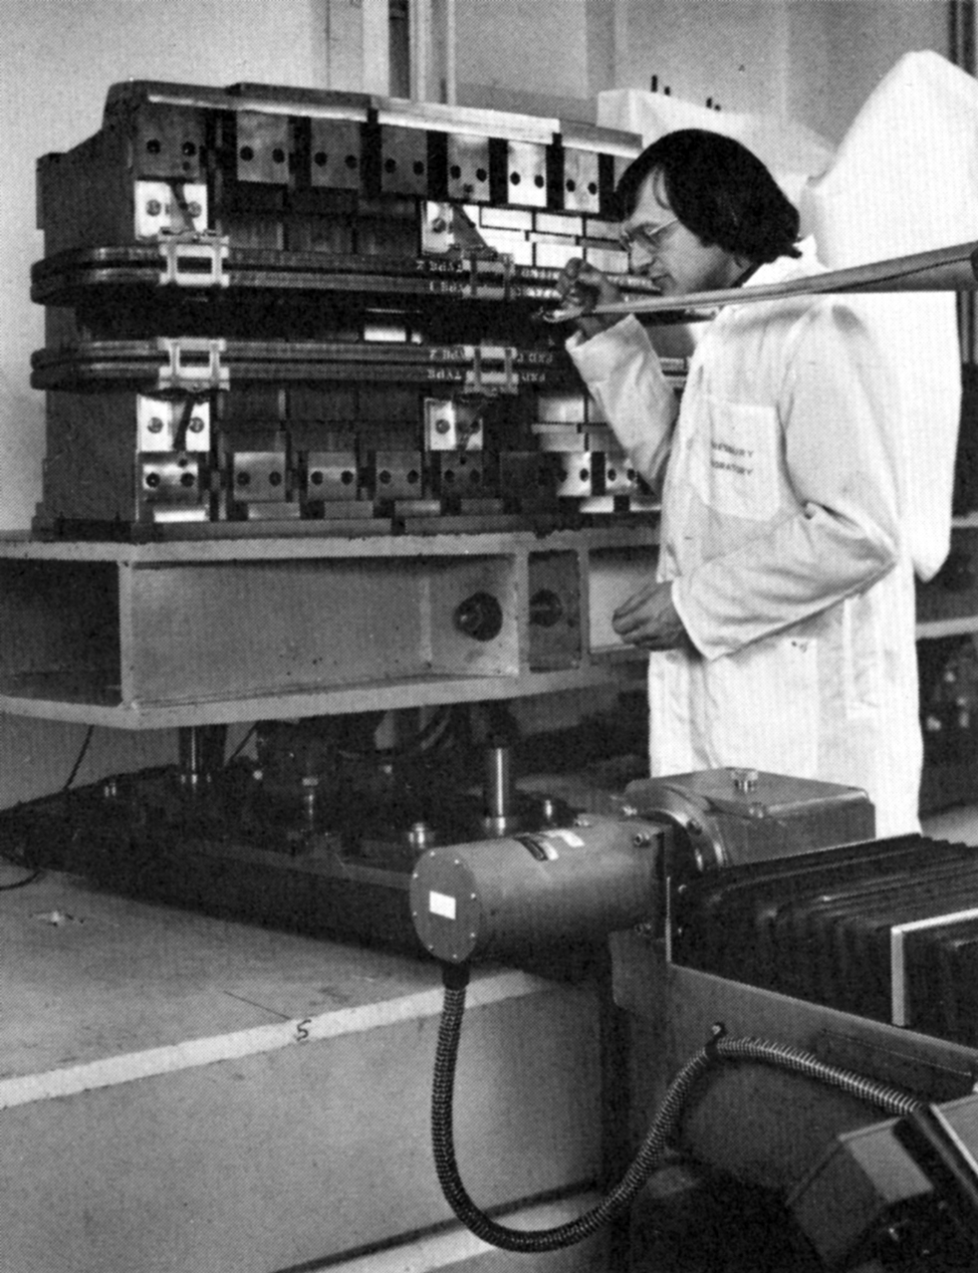
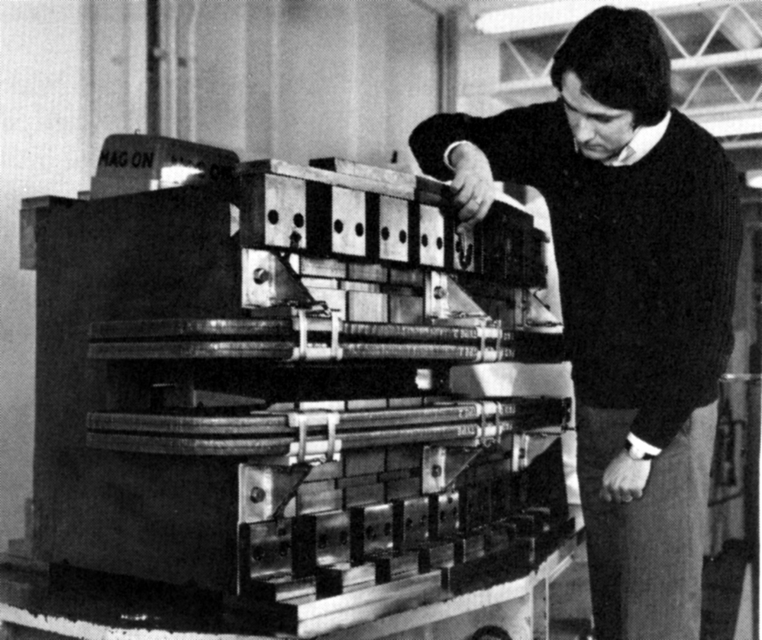
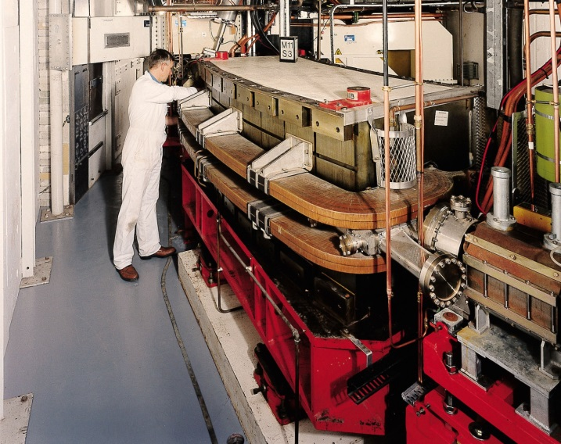
SRS Construction (1975-81)
Responsible for delivery of all magnet systems on booster and storage ring
10 Hz Booster Combined Function/Alternating Gradient
Slow ramped main ring dipoles, quadrupoles, sextupoles and multipole correctors (RPW)
Laminated magnets: glued (epoxy) + glass Major contracts
Magnet measurement facilities, fully computer controlled (RPW)
(world first ?) Hall plate calibration

Slide 8
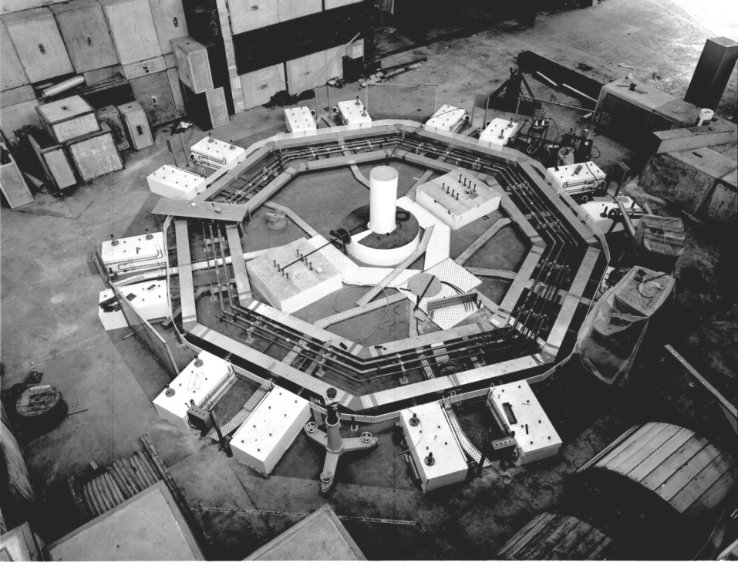
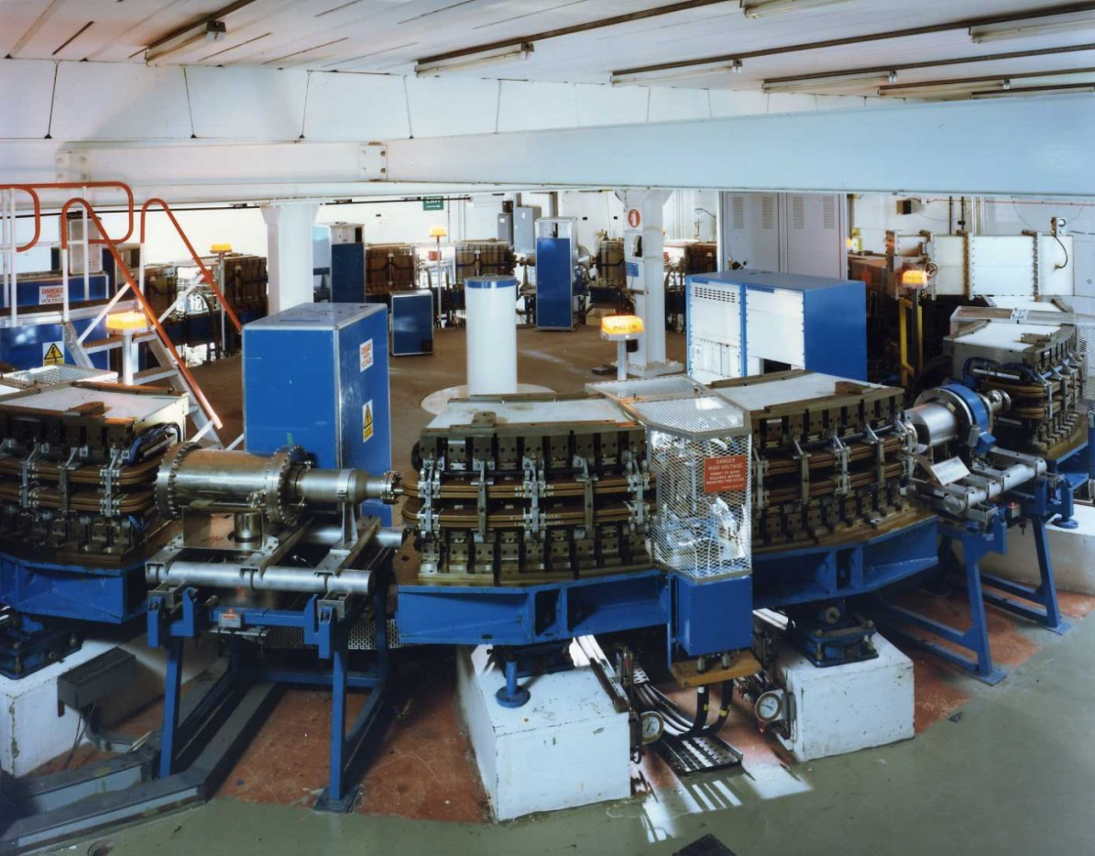

Slide 9
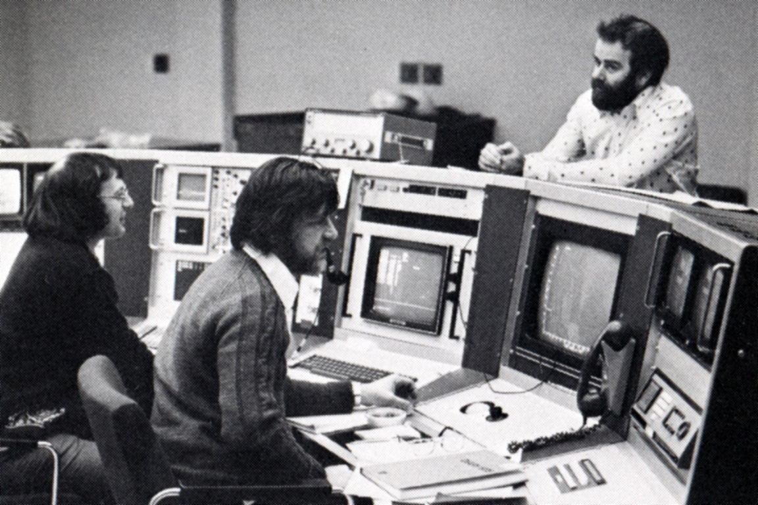
SRS Construction (1975-81)
Major role in SRS Commissioning
Broad learning experience (AP)
Established publication habit
International profile and improved publications (self + DL)
Promoted to Head of New Accelerator Projects Group (1980)

Slide 10
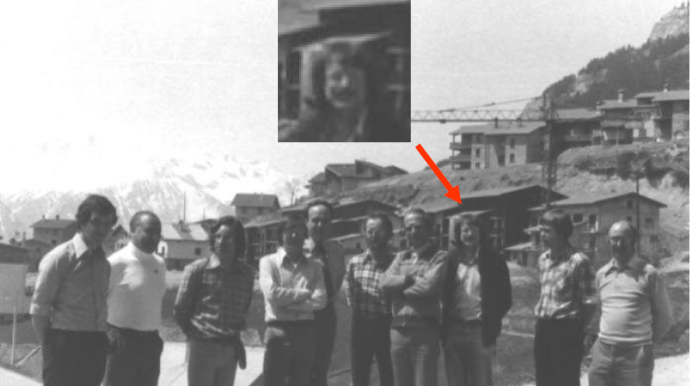
ESRF design contributions (Blue Book)

Slide 11
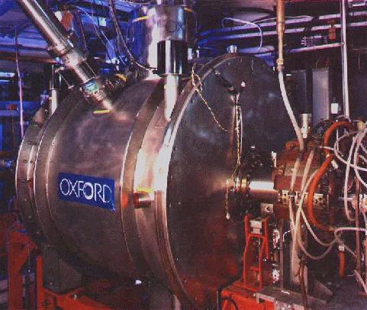
SRS Upgrades
SCW 5T RAL collaboration. V expensive !
Installed 1982
SCW 6T Commercial contract (OI) – Project Leader
Installed 1992

Slide 12
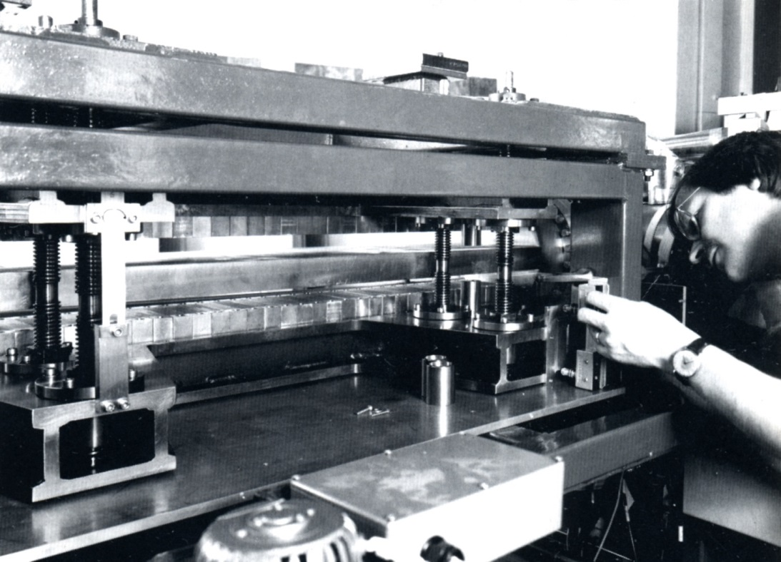
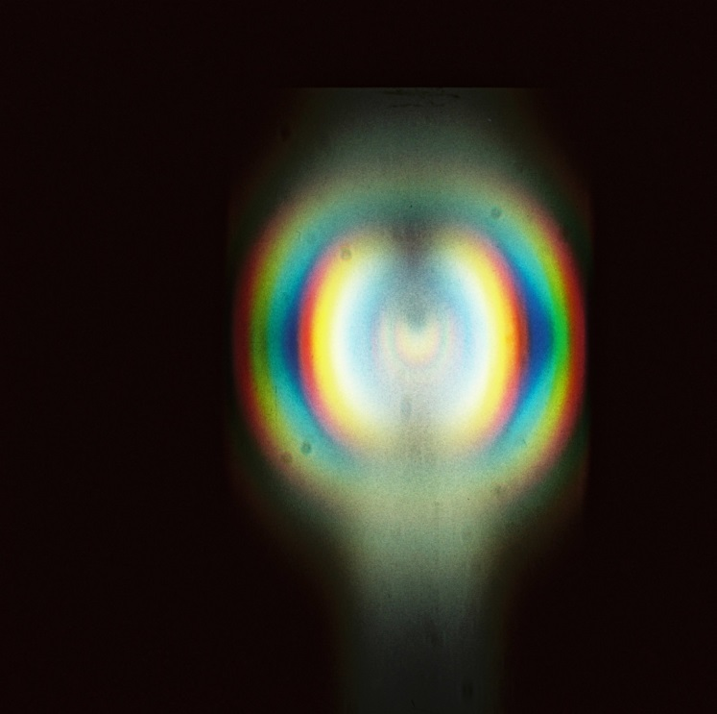
SRS Upgrades
PMU Design/deliver R&D PMU on SRS (1985) RPW
Appointed Daresbury Accelerator Physics Group Leader (1984)

Slide 13
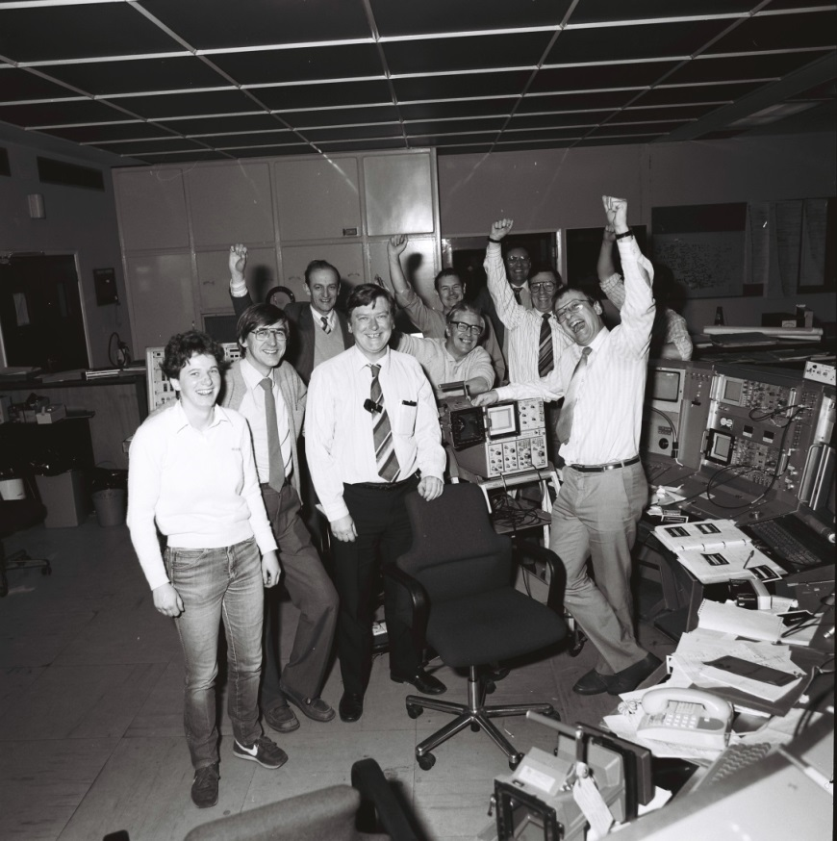
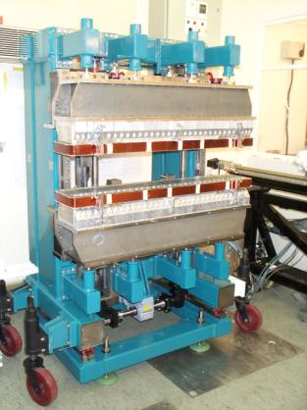
SRS Upgrades
HBL (SRS2) Major lattice evolution – high brightness
New ring magnet systems
Headed SRS-2 commissioning (1986)
Later: project leader 2T MPW additions (1996-98) JAC

Slide 14
Compact Source Development
AP leader OI contract development of HELIOS (1985-94) 700MeV SC dipoles
Assisted sale to IBM and later lead commissioning
Substantial Royalties earned for SERC (and staff)
    2001 CLRC Inventors Award
HELIOS 2 sold to Singapore university
No more Almost a gold strike !
Note: some OI staff took their new skills to DIAMOND !

Slide 15
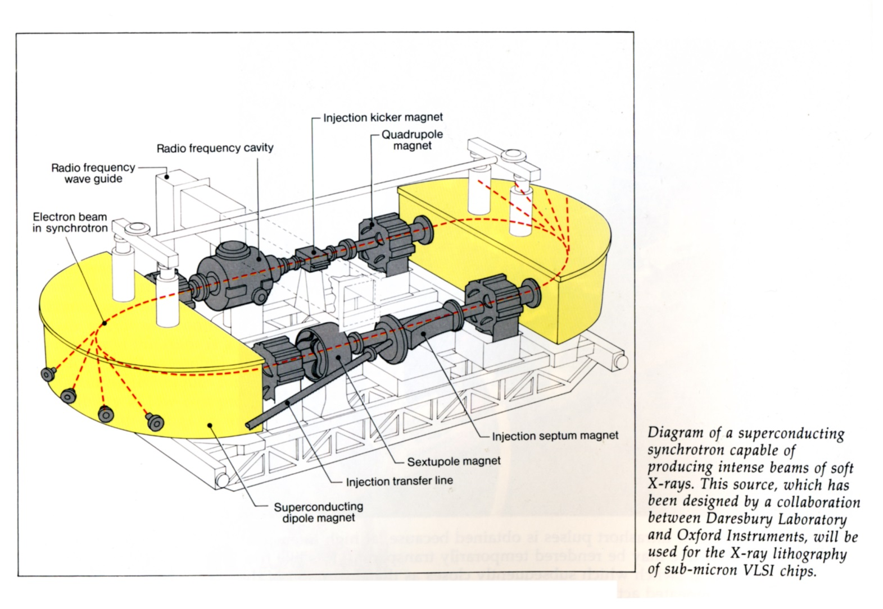
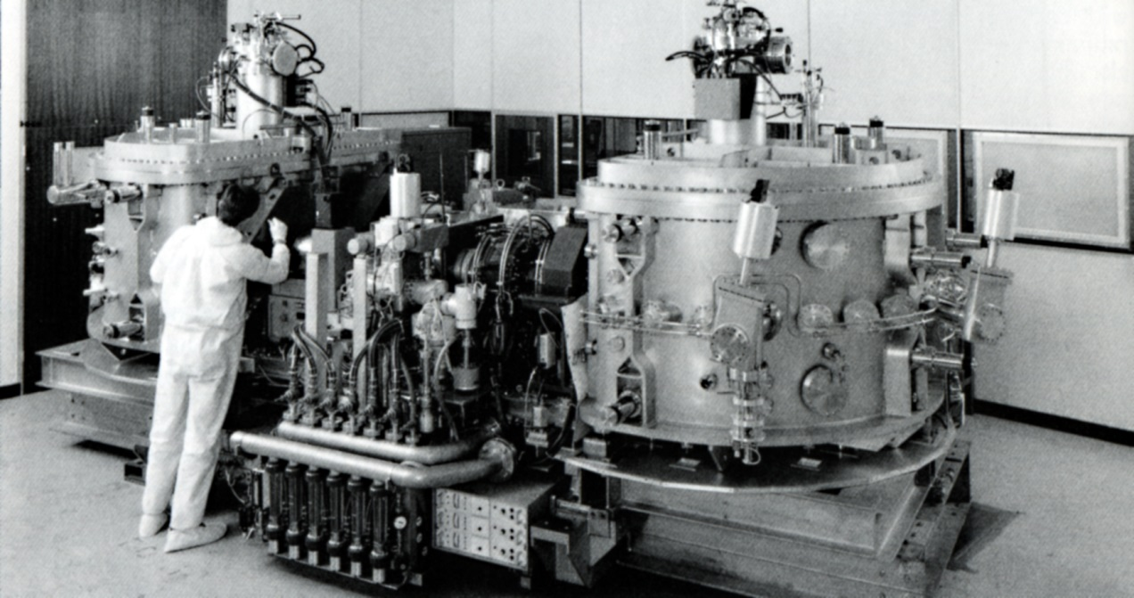

Slide 16
Free Electron Lasers
Long term advocate (since 1979) !
Failed Daresbury proposal (1980) despite international support HEI work ?
Funding later awarded to UKFEL collaboration (1982) DL/Glasgow/Heriot Watt
Advanced 5m 4 stage undulator magnet from DL (RPW) Technology mastery
Useful gain achieved (1985) but no oscillation - terminated 1986 (bad linac)
Negotiated transfer of undulator (split in 2) to FELIX project Nieuwegein (NL)
FELIX international advisor 1988-95 Lased 1992
Oxford electrostatic FEL proposal (1990) not funded
Collaboration in World record 190nm SRFEL at Trieste 1999-2002 (RPW)
ALICE FEL delivery - after 30 year wait !!!

Slide 17
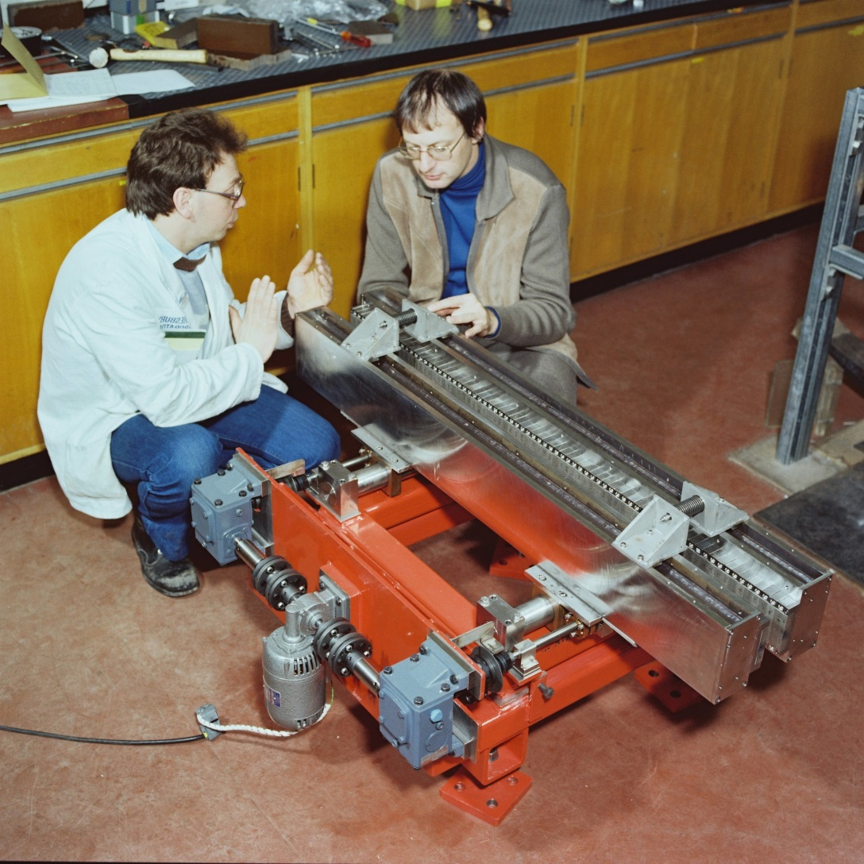

Slide 18
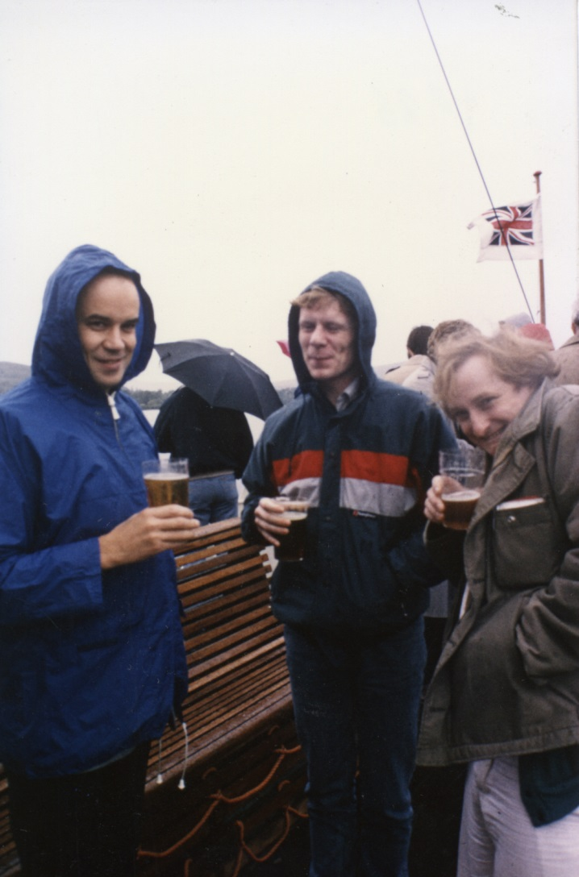
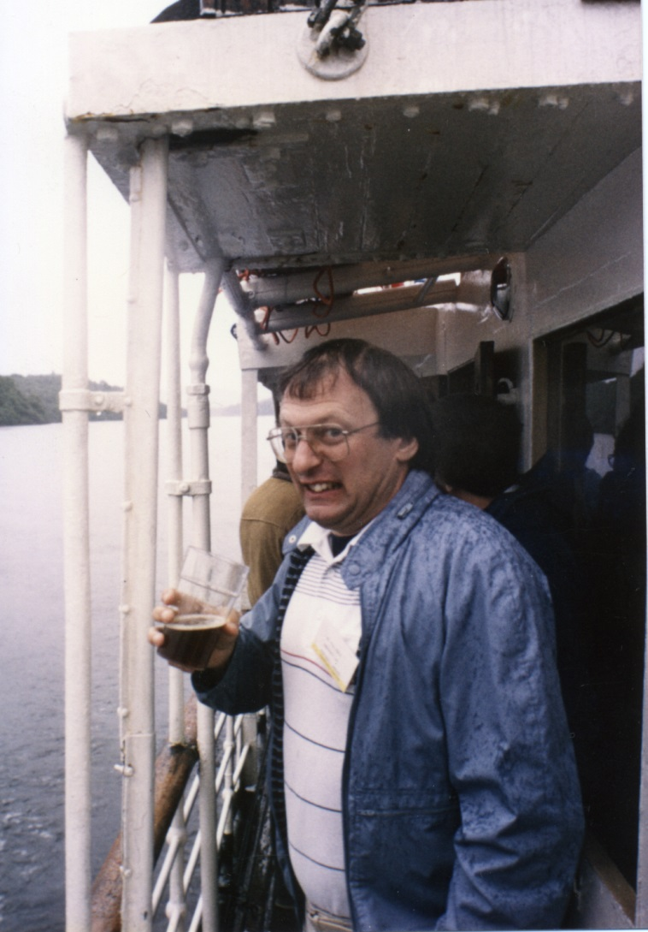

Slide 19
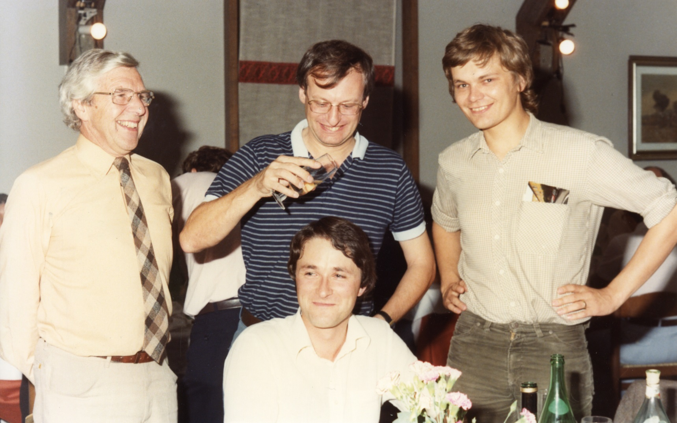

Slide 20
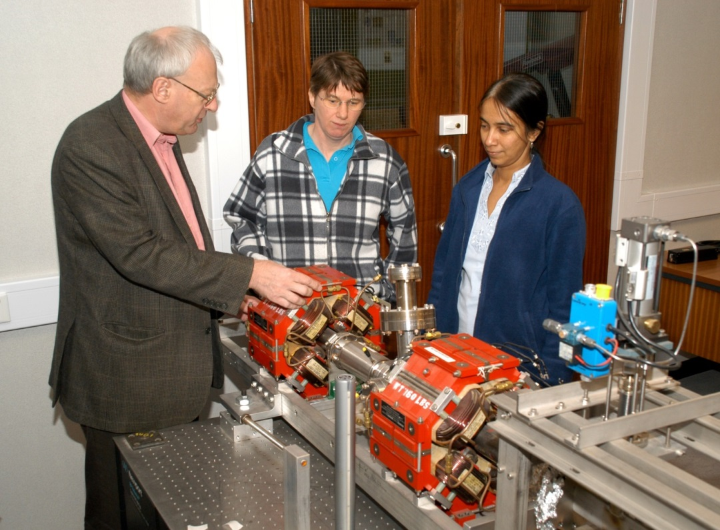
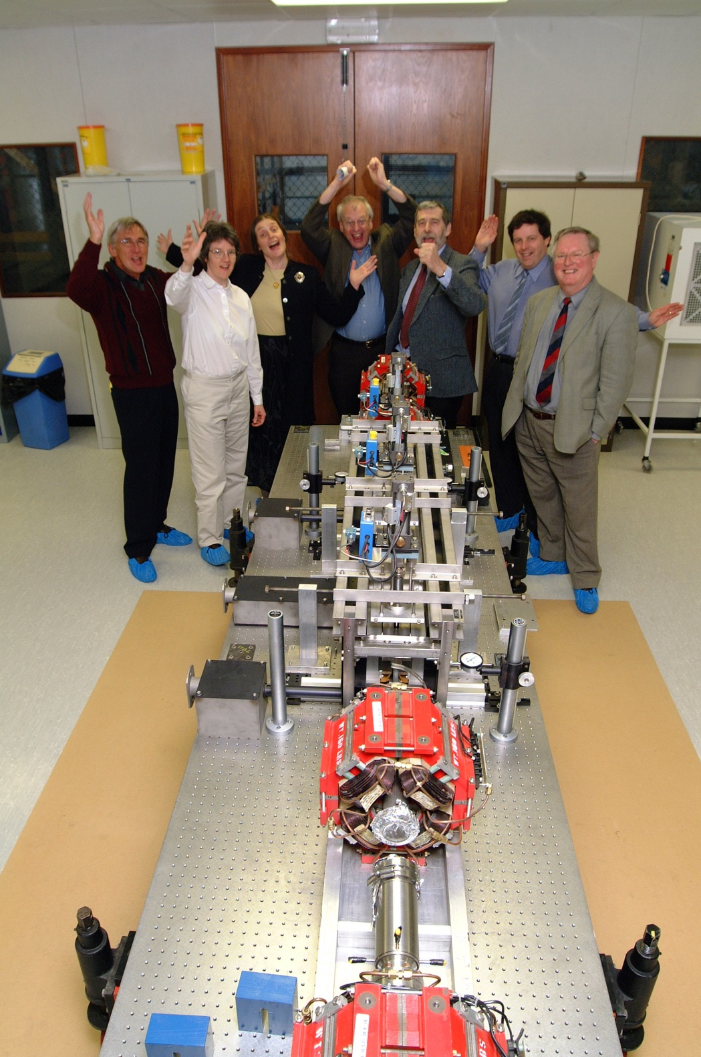
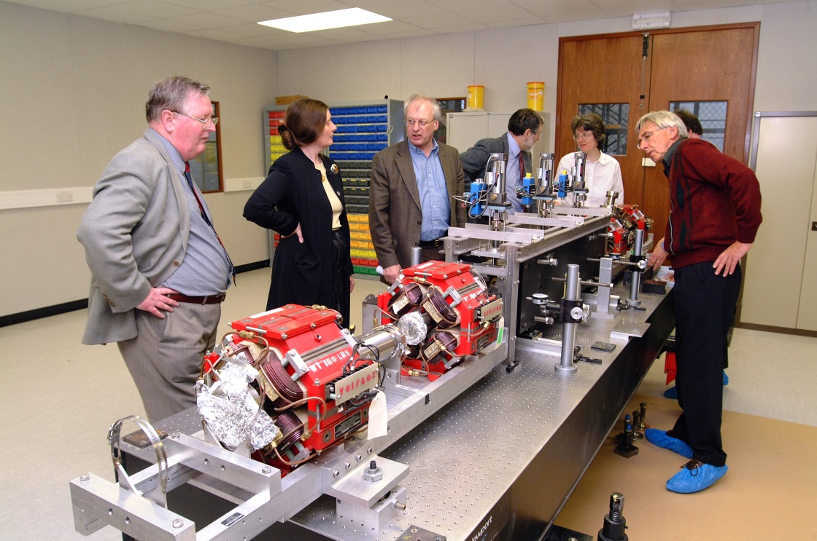

Slide 21
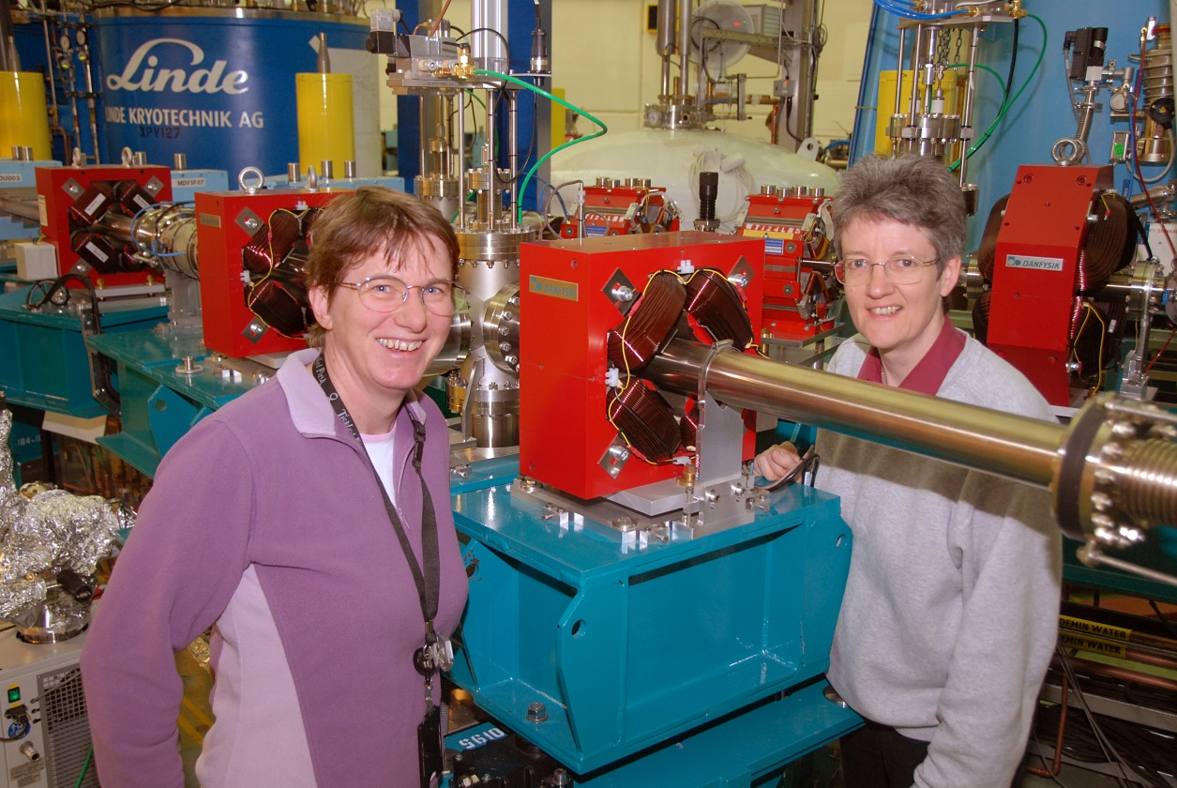
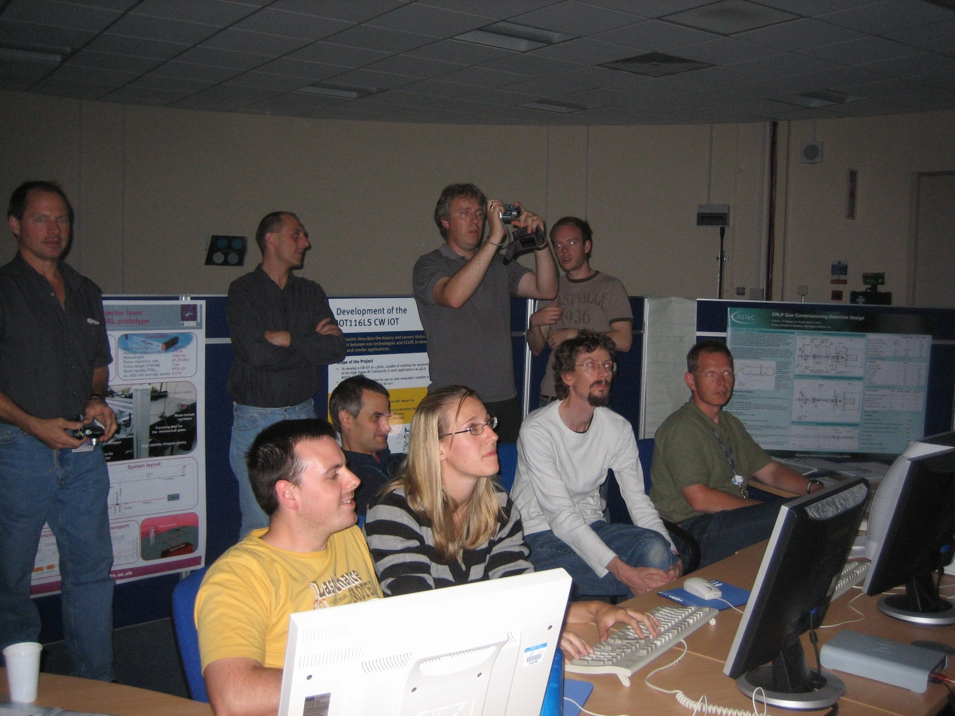

Slide 22
Other Roles and Challenges
ESRF Purchasing Committee (UK Rep) 1988-92
Vice-Chair, SOLEIL Intl Advisory Committee 2001-08
MAC: Sincrotrone Trieste 2002-2010
SAC: FOM Plasma Physics Institute 2004-10
Chair, ESFRI FEL Working Group 2001-05
Leader, Technology WP, LC-ABD 2004-07
Elected to EPS Inter-Divisional Group on Accelerators 1996-2002
Associate Editor, Phys Rev ST-AB 2002-08
Elected to IOP Council 2008
Elected PAB Chair 2008-12
Lecturer: CAS(4) JUAS Nordic School ERICE CI
Director, SERC Career Development Scheme for Scientists 1992-94
1992: Joint UK Research Councils Individual Merit Promotion (3 knights !)

Slide 23
Major Project Proposals
DAPS AP Leader 1989-93
4GLS and ERL Prototype (ALICE) 2002
SRS-X 1991 Early next generation studies
Diamond 1993-2003 Green Book
NLS Proposal 2007-2010

Slide 24
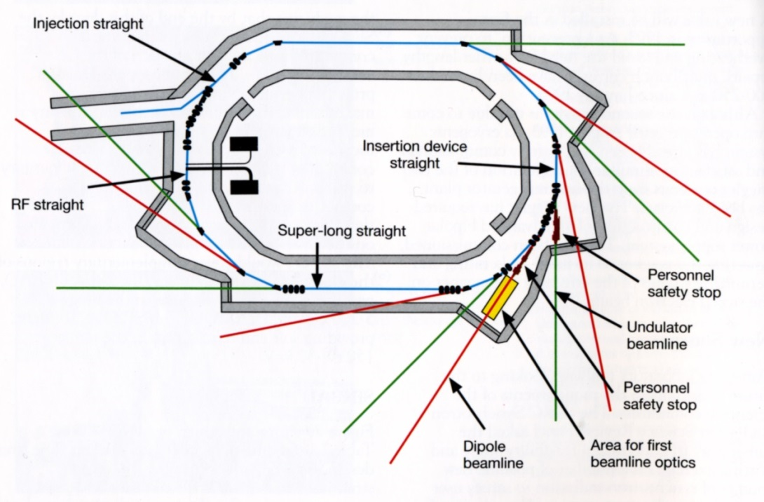
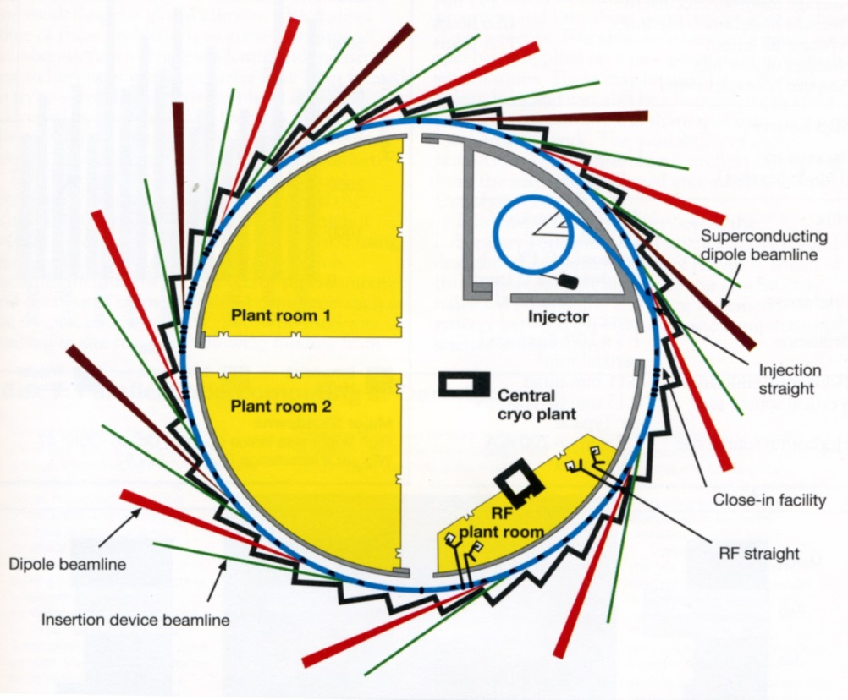
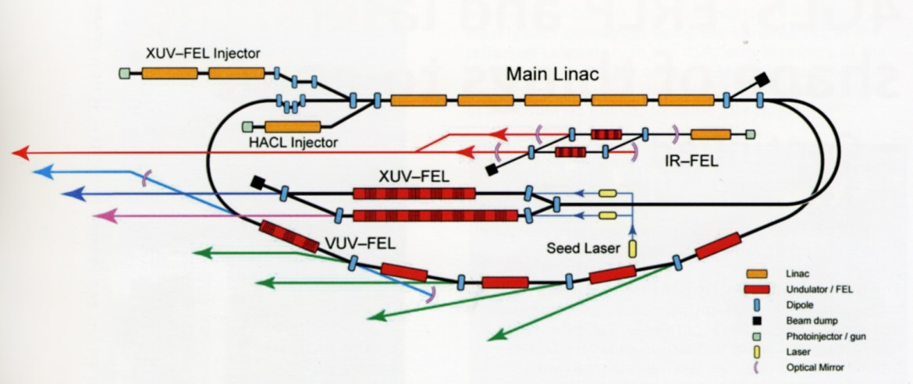

Slide 25
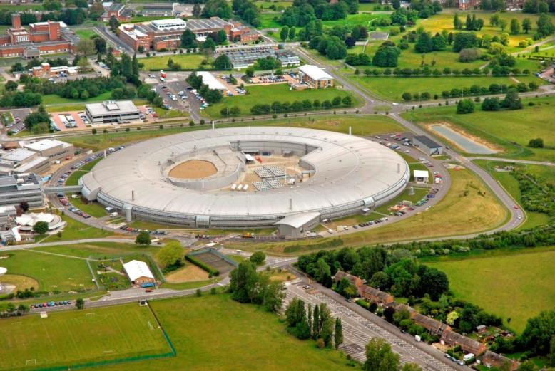

Slide 26
Final Contributions
ASTeC Director (2003-10)
Visiting Professor, Liverpool Physics Dept (2003-16)
Honorary Scientist, STFC Daresbury Lab
Distinguished Affiliate, Cockcroft Institute
Fellow, European Physical Society
Fellow, Inst of Physics
Cockcroft Institute co-founder

Slide 27
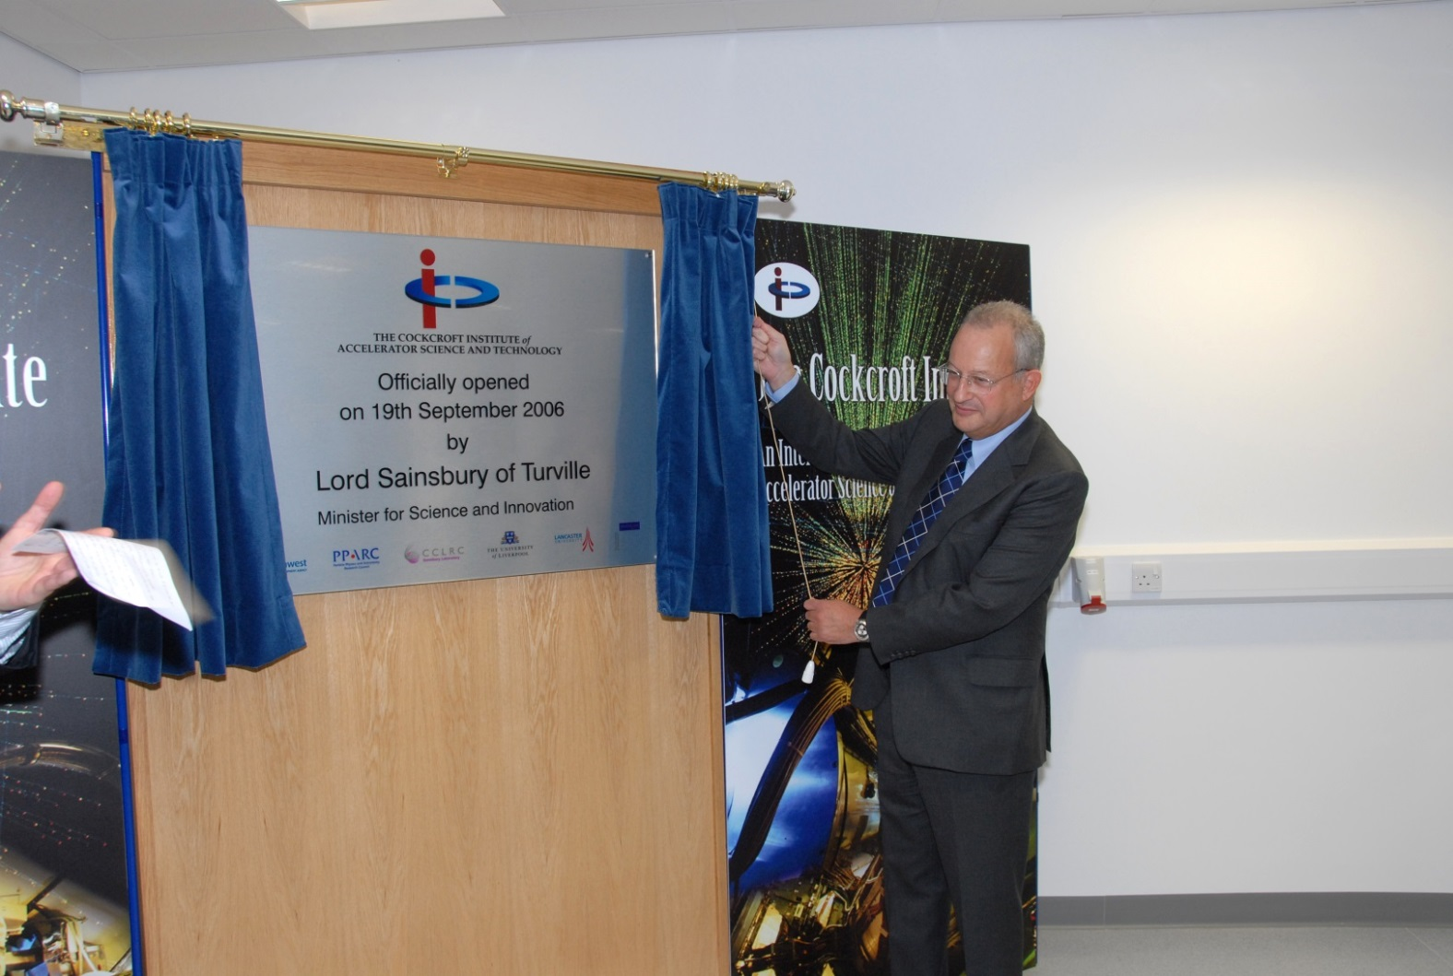
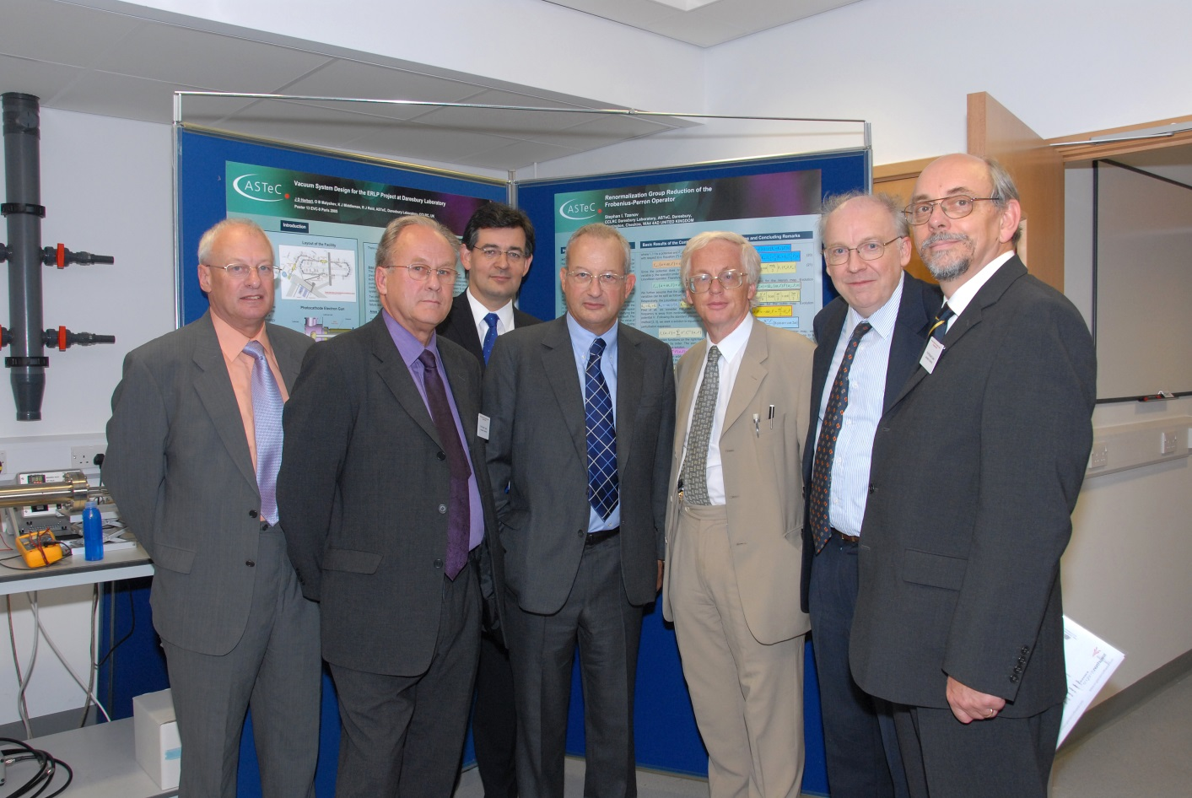

Slide 28
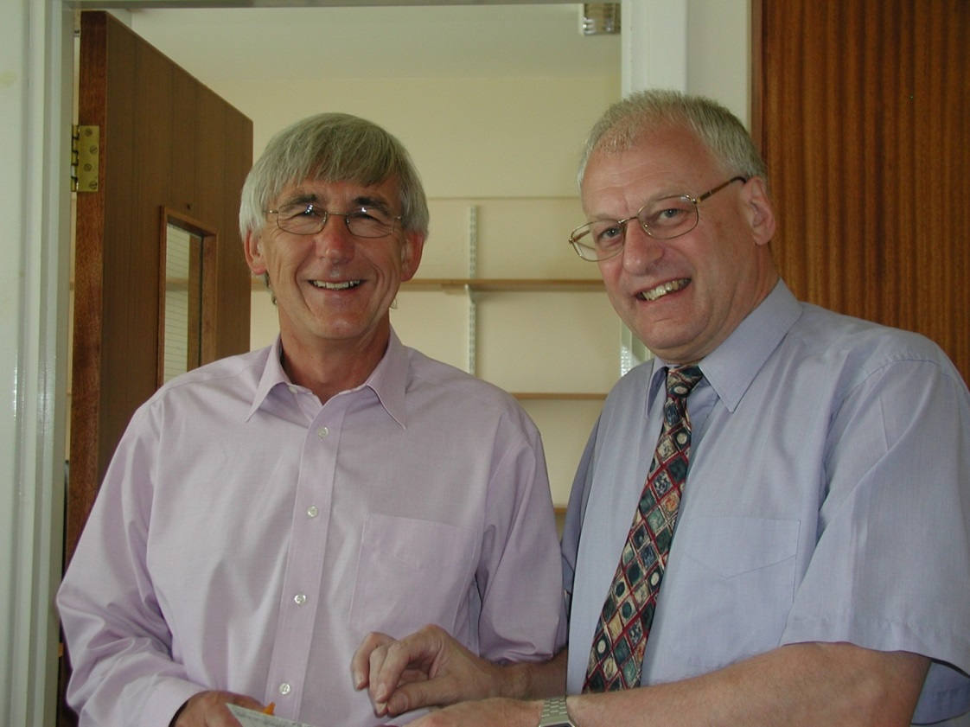
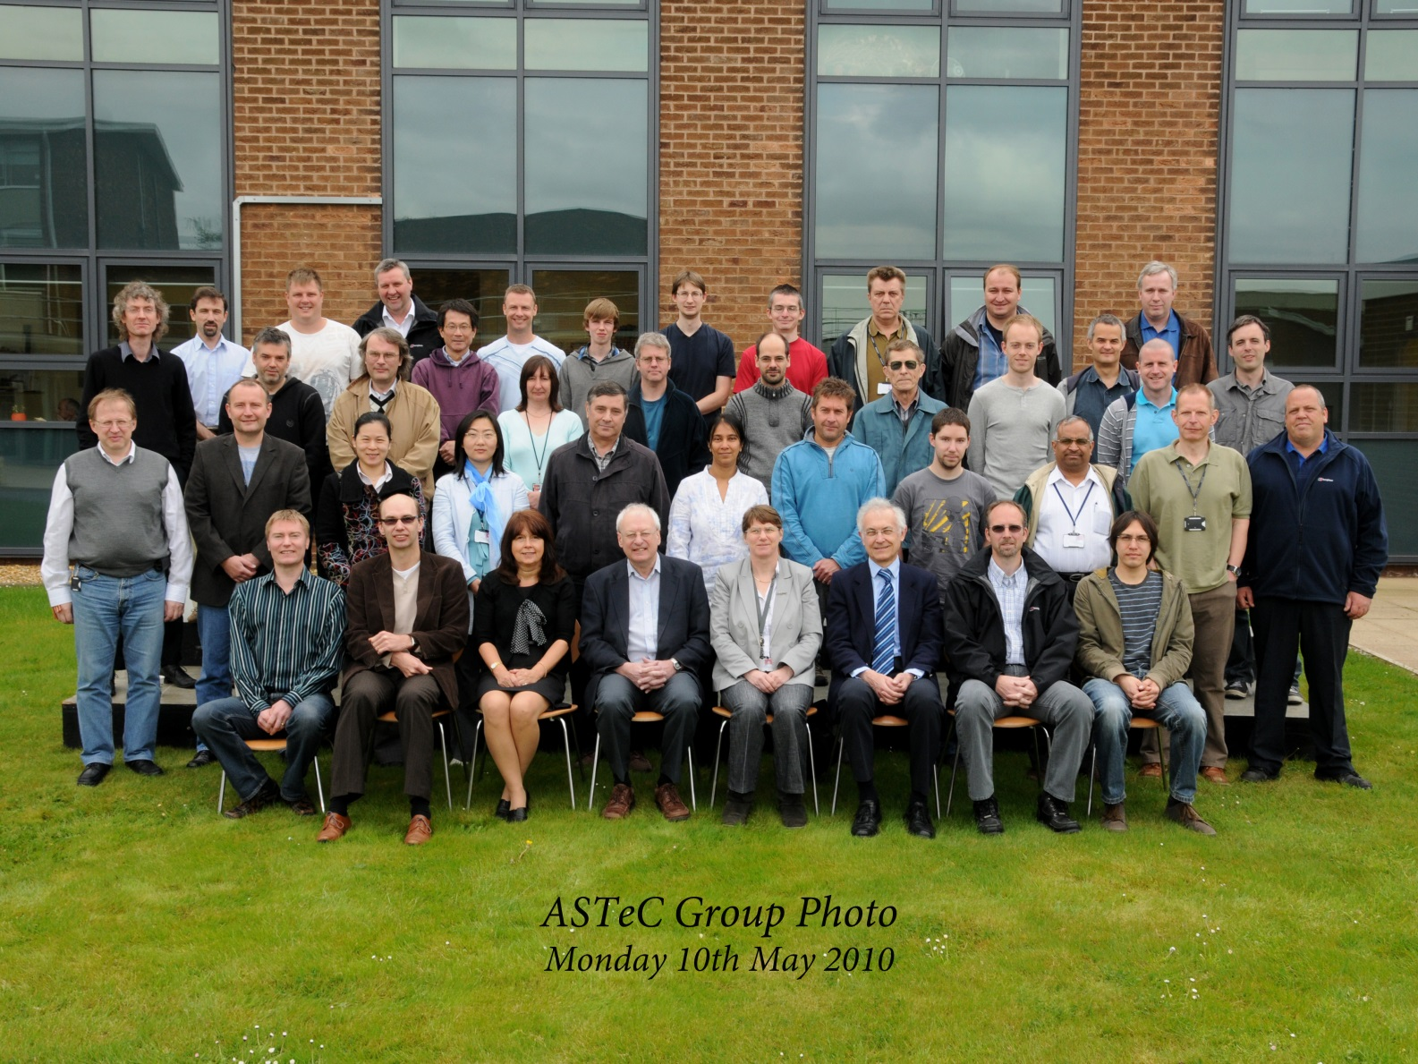

Slide 29
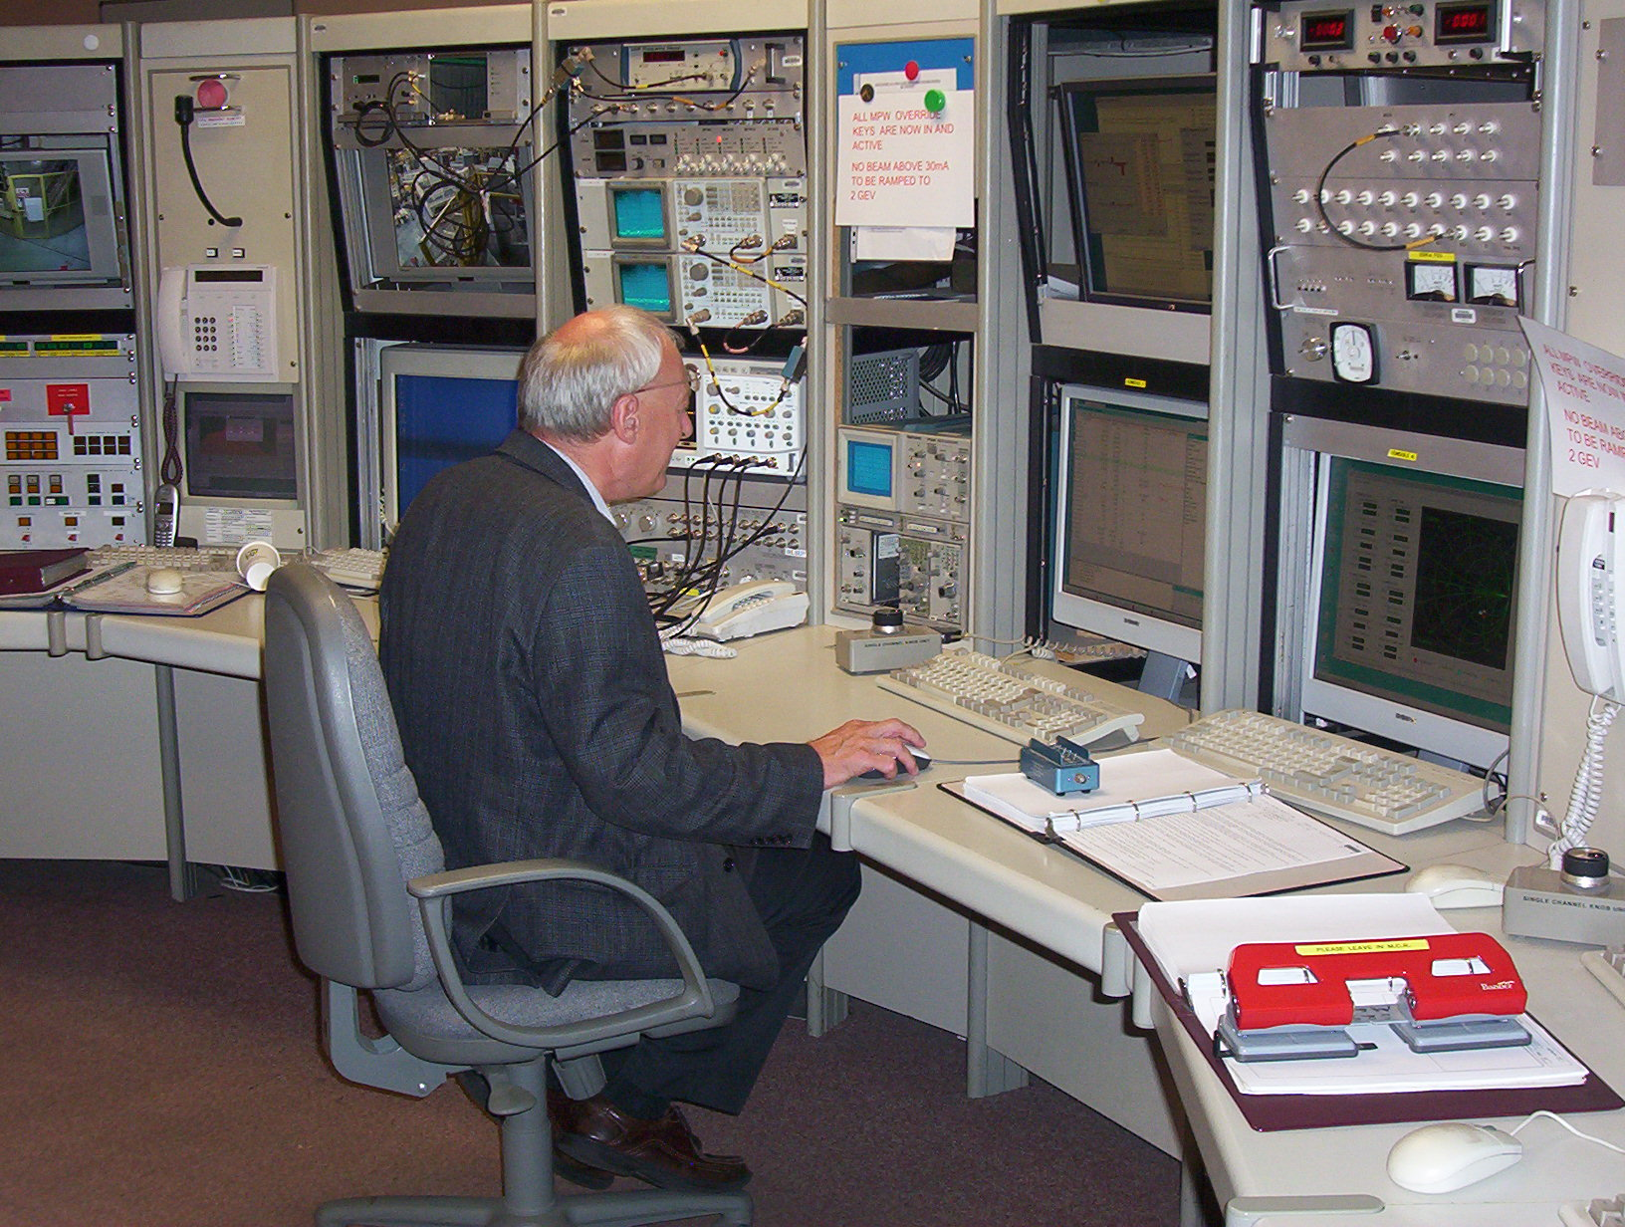

Slide 30
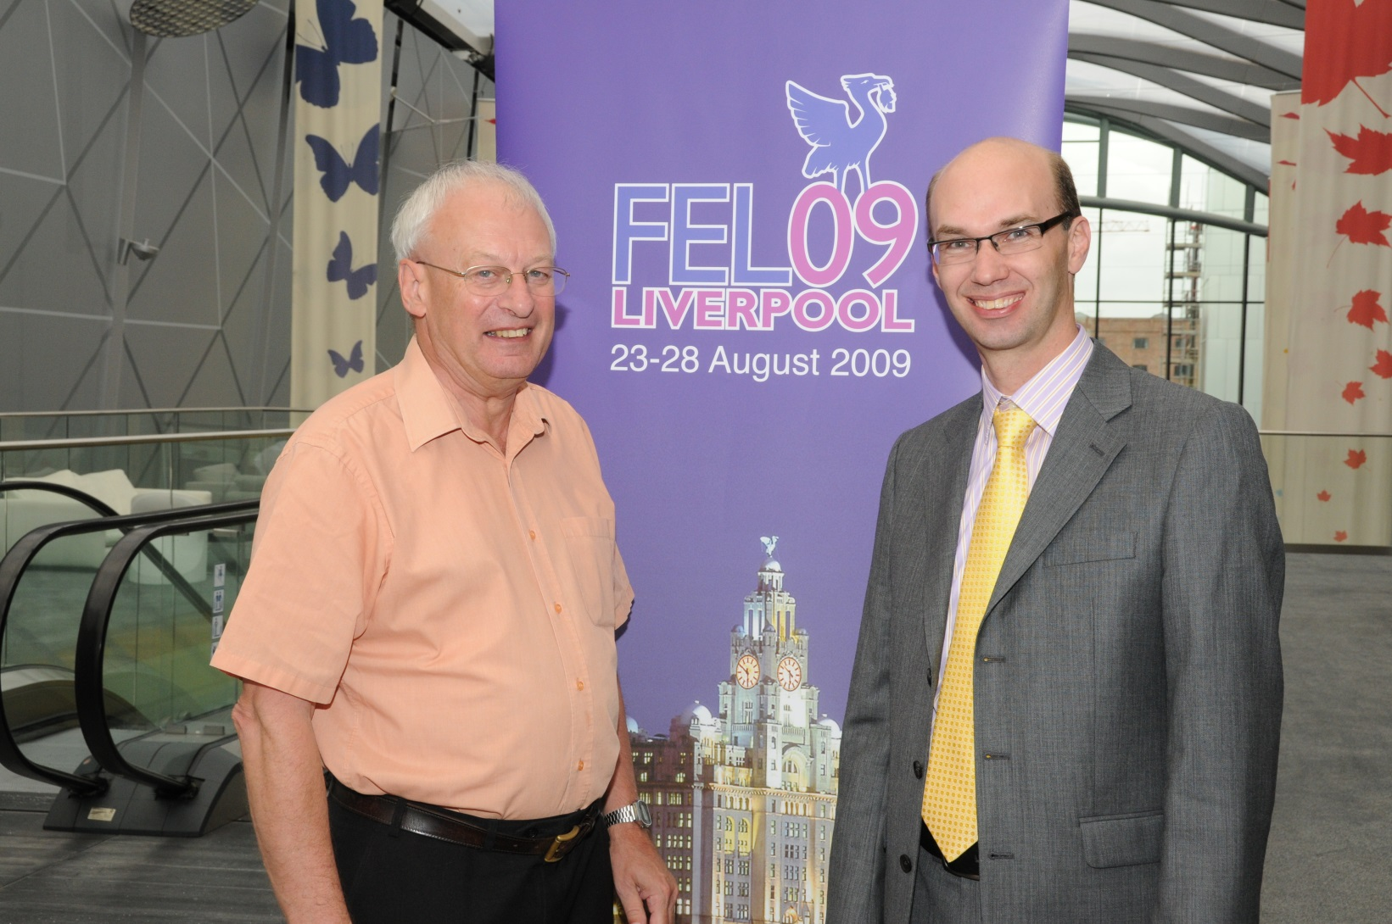
Thanks for your attention

