Slide 1
Diamond upgrade
M. Apollonio – Diamond Light Source Ltd.
Institute of Physics PABG 2017
RHUL, London thanks and credits to:
A. Alekou, T. Pulampong, R. Bartolini, R. P. Walker (DLS)
S. Liuzzo, P. Raimondi, N. Carmignani (ESRF)

Slide 2
Outline
  Diamond today
    ... and other facilities
  Low Emittance
    Brilliance and coherence
    From 2.7nm to < 270pm
    Constraints on new machine
  Evolution of Diamond-II low emittance lattice
    Double Double Bend Achromat (DDBA)
    Double Triple Bend Achromat (DTBA)
  Where we stand
    Optimizations
    Open issues
  Summary

Slide 3
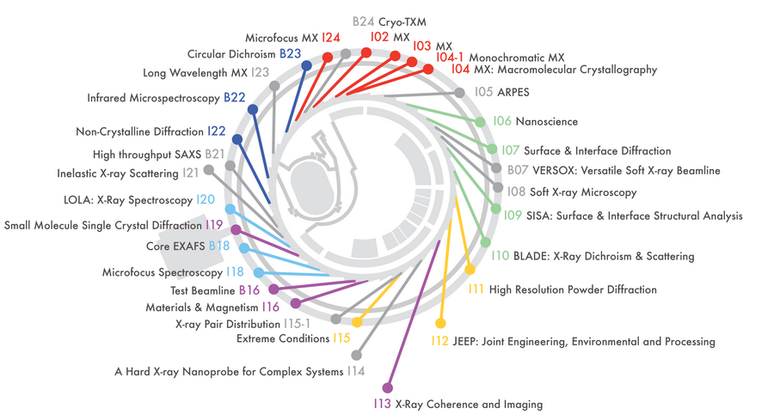
lattices
Diamond Low Emittance DDBA HMBA DTBA optimization conclusions
  Diamond
  3rd generation synchrotron light source
  world class facility
  31 beamlines
    7 bending magnet BLs
    24 undulator/wiggler BLs
      2 SC wigglers BLs
  Machine parameters
    E = 3.0 GeV
    ε = 2.7nm / C=0.3% / ν =(0.172,0.273) / ξ = (1.5,2) /
    LT > 12 hrs [usergaps/Wig-on/300mA] / top-up mode

Slide 4
lattices
Others Low Emittance DDBA HMBA DTBA optimization conclusions
MAX IV (Sweden): reached 200mA (end of 2016), first users
ESRF upgrade (France): placing contracts
magnets placed, large scale prod. 2017-mid2018;
assembly phase. Long SD end of 2018, back in op. 2020
Sirius (Brazil) under construction
APS-U (US) has passed CD1
ALS-U (US) at CD0 stage
BAPS (China) got money for R&D programmes (ready in 2022?)
SLS-II (Switzerland) and Diamond II
advanced consultations with PBSs and users in view of CDR
many labs are investigating options (SOLEIL, ELETTRA, ILSF, ...)
Notes:
4
Talk only about ESRF, Sirius, ALS U, Diamond II

Slide 5
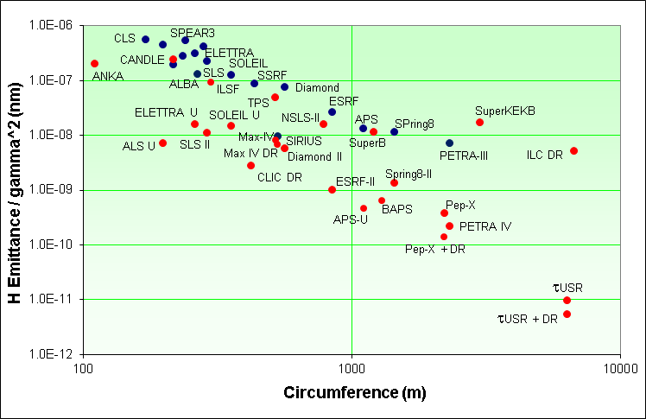
lattices
Diamond Low Emittance DDBA HMBA DTBA optimization conclusions

Slide 6
lattices
Diamond Low Emittance DDBA HMBA DTBA optimization conclusions

Slide 7
lattices
Diamond Low Emittance DDBA HMBA DTBA beamlines conclusions
electron beam sizes (standard straight)
photon phase space at 12.4 keV (i=7)
Parameter (rms values) | Diamond | Diamond-II (DTBA)
Horizontal size, σ_{x} [μm] | 123.5 | 23.6
Vertical size, σ_{y} [μm] | 3.5 | 3.5
Horizontal divergence, σ_{x’} [μrad] | 24.1 | 5.1
Vertical divergence, σ_{y’} [μrad] | 2.3 | 2.3
Product | 2.38 10⁴ | 9.60 10²
Electron beam brightness ratio | 1 | 24.8
Parameter (rms values) | Diamond | Diamond-II
Horizontal size, Σ_{x} [μm] | 123.6 | 23.8
Vertical size, Σ_{y} [μm] | 4.7 | 4.7
Horizontal div. Σ_{x’} [μrad] | 25.8 | 10.5
Vertical div., Σ_{y’} [μrad] | 9.5 | 9.5
Product | 1.44 10⁵ | 1.13 10⁴
Brightness ratio | 1 | 12.7
The electron beam brightness is improved by nearly a factor of 25.

Slide 8
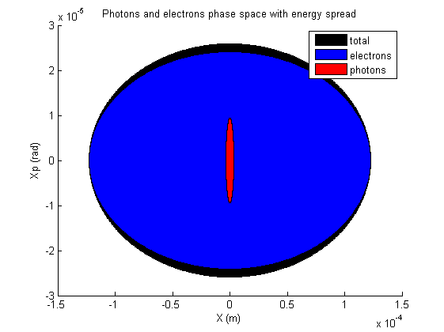
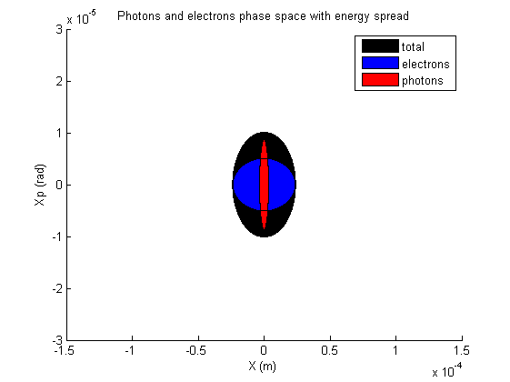
lattices
Diamond Low Emittance DDBA HMBA DTBA beamlines conclusions
Comparison of phase space (at 1Å)
Diamond
Diamond-II

Slide 9
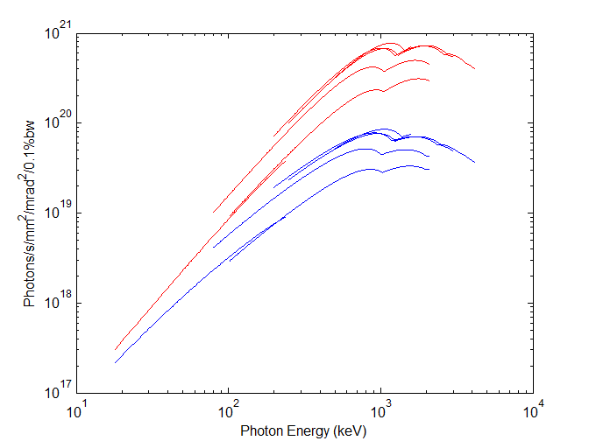
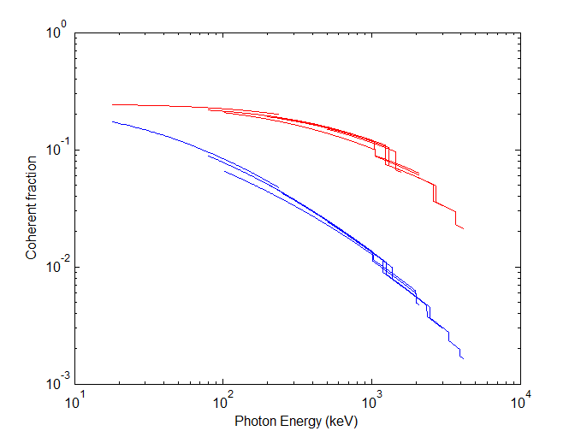
Brightness improvement with Diamond-II (120pm)
lattices
Diamond Low Emittance DDBA HMBA DTBA beamlines conclusions
The improvement in brightness/coherence is approximately a factor of x3 at 100 eV and x10 at 1 keV, the main benefit coming from the reduction in horizontal source size and divergence
Soft X-rays undulators
APPLE-II for I05, I06, I08, J09, I10 ,I21
Photon Energy (eV)

Slide 10
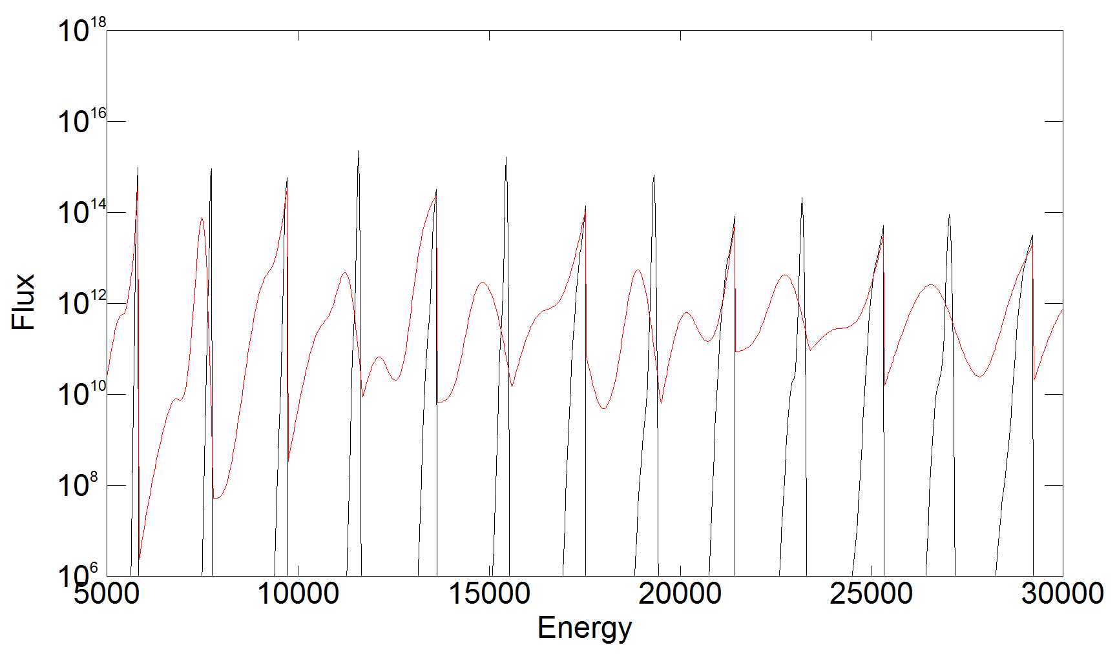
Flux through an aperture
lattices
Diamond Low Emittance DDBA HMBA DTBA beamlines conclusions
Photon Energy (eV)
Flux through a 40 μrad * 40 μrad aperture for the Diamond CMPU in the existing ring (red) and in Diamond-II (black).

Slide 11
lattices
Diamond Low Emittance DDBA HMBA DTBA optimization conclusions
  Diamond II wish list
  Emittance: from 2.7 nm to < 270pm
  Minimal changes to present machine
    Keep tunnel / beamline structure
    Leave straight sections as they are
    Re-use hardware wherever possible (RF, magnets, …)
  Keep I09-I13 optics (mini-beta sections)
  Maintain short pulse operations
  Minimize dead-time
  Minimize technology risks

Slide 12

lattices
Diamond Low Emittance DDBA HMBA DTBA optimization conclusions
  Broadly speaking, emittance reduction is achievable with usual approach, i.e.
  Increase n. of dipoles
  Increase Jx with combined function dipoles
  MBA solutions with longitudinal gradient dipoles
  However, reducing emittance may not be the only target
  increase ratio of straight_sections / C
  This twofold request leads to the Double DBA concept (DDBA)
  - a 4BA cell with a central straight for an extra ID

Slide 13
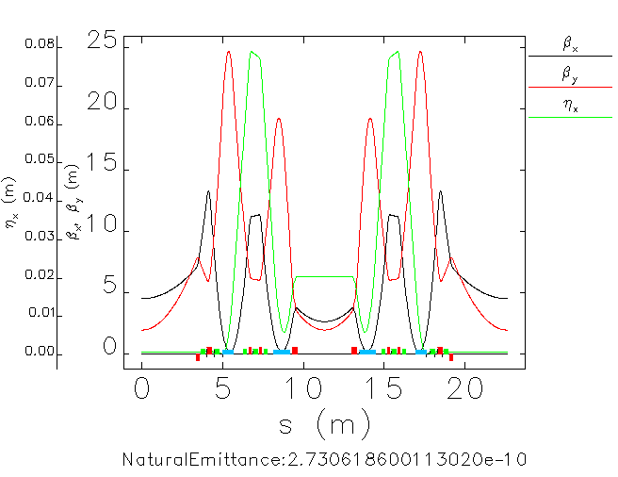
lattices
Diamond Low Emittance DDBA HMBA DTBA optimization conclusions
  The Double Double-Bend Achromat concept (DDBA) is a modification of the standard Diamond DBA cell, where the central region has been “cleared” to host a new insertion device (VMX)
  It is a modified 4BA with a 10x emittance reduction factor and 2x n. of possible beamlines
  Baseline design for Diamond-II
  until the end of 2015

Slide 14
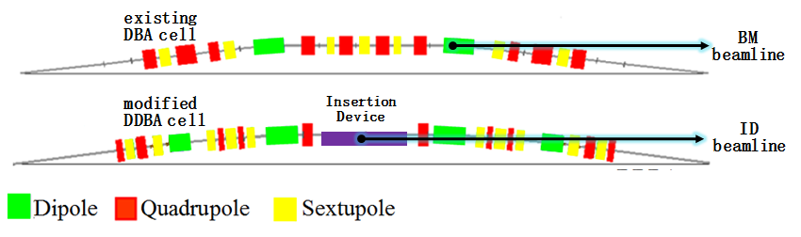
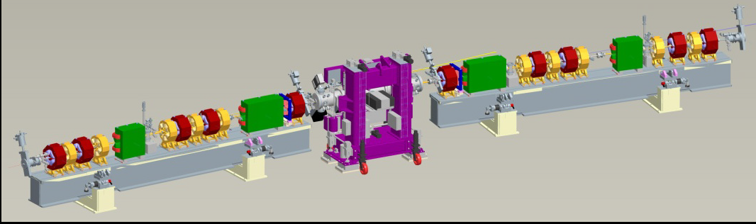
lattices
Diamond Low Emittance DDBA HMBA DTBA optimization conclusions
  at present one DDBA cell has been installed in Diamond and has been commissioned

Slide 15
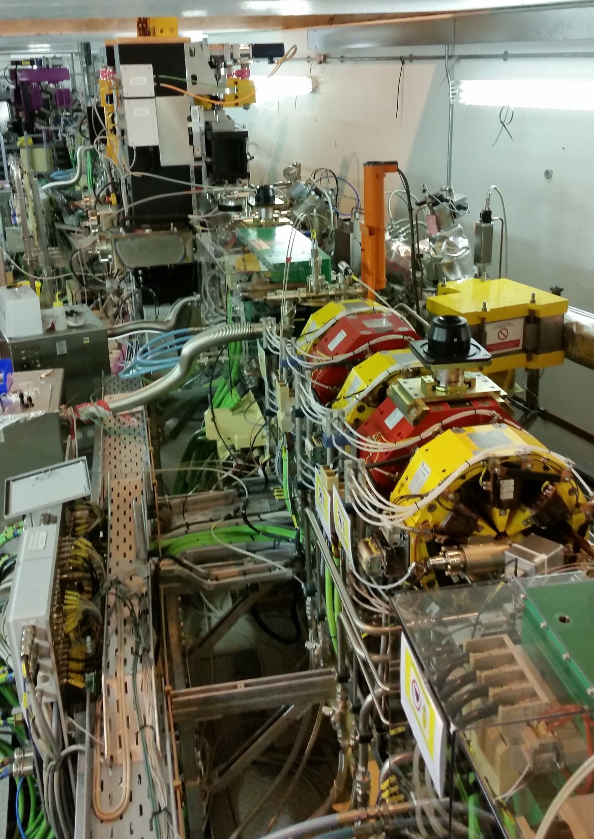
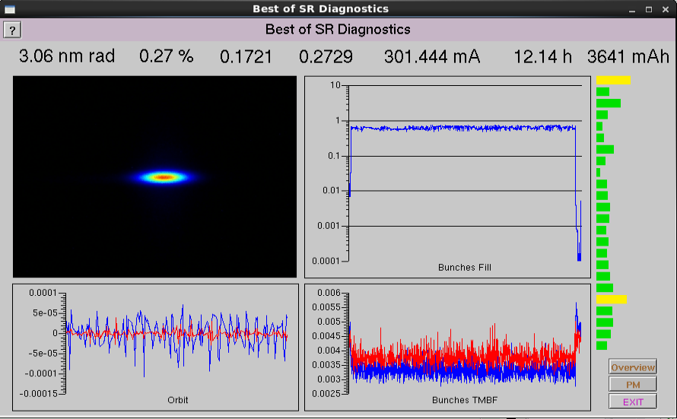
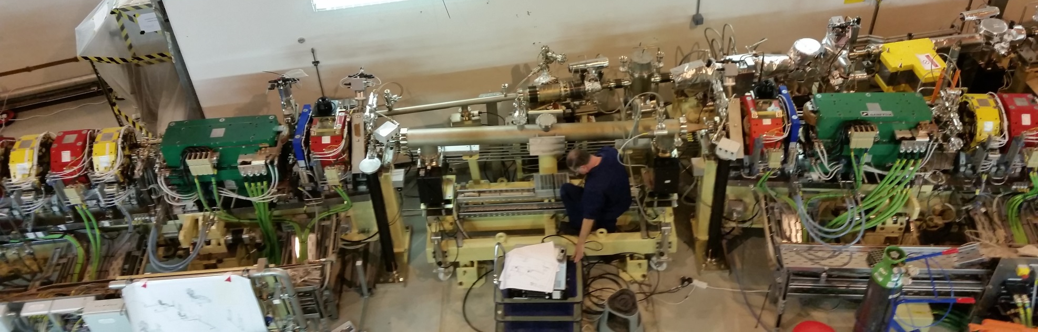
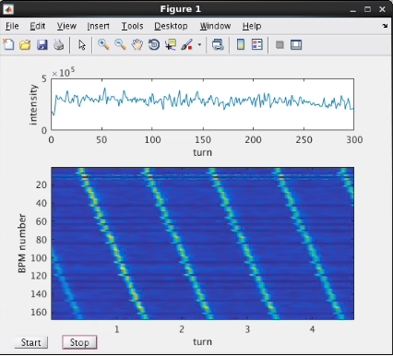
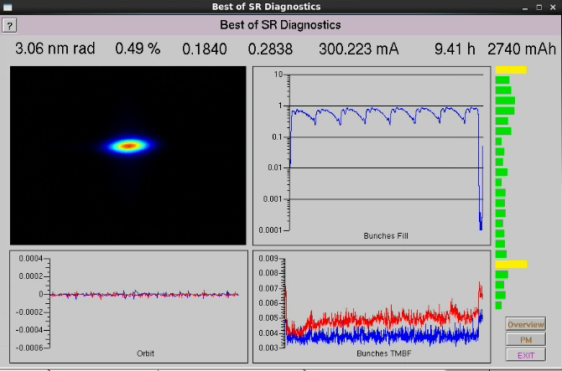
lattices
Diamond Low Emittance DDBA HMBA DTBA optimization conclusions
DDBA cell installation (16/11/2016)
8/3/2017
Ib = 300mA
C = 0.27%
LT ~ 12hrs
New tune point
Wigglers ON
Emi = 3.06 → 2.8nm (Low-Eta lattice)
Beam current = 300mA
(24/11/2016)
beam accumulation in the SR
(17/11/2016)
J02 – undulator
March 2017
shut-down
installation

Slide 16
lattices
Diamond Low Emittance DDBA HMBA DTBA optimization conclusions
  There were few reasons to go beyond the DDBA concept:
    a request from beamlines for a more aggressive scheme: 20x reduction in emittance
    Challenges in the optimization of Lifetime, Dynamic Aperture
  Point (1) led to a 6BA-like approach, where the 7BA ESRF cell (HMBA) was modified to create a central ID straight
  Collaboration with ESRF very fruitful in overcoming some design difficulties
  Emittance → 140 pm

Slide 17
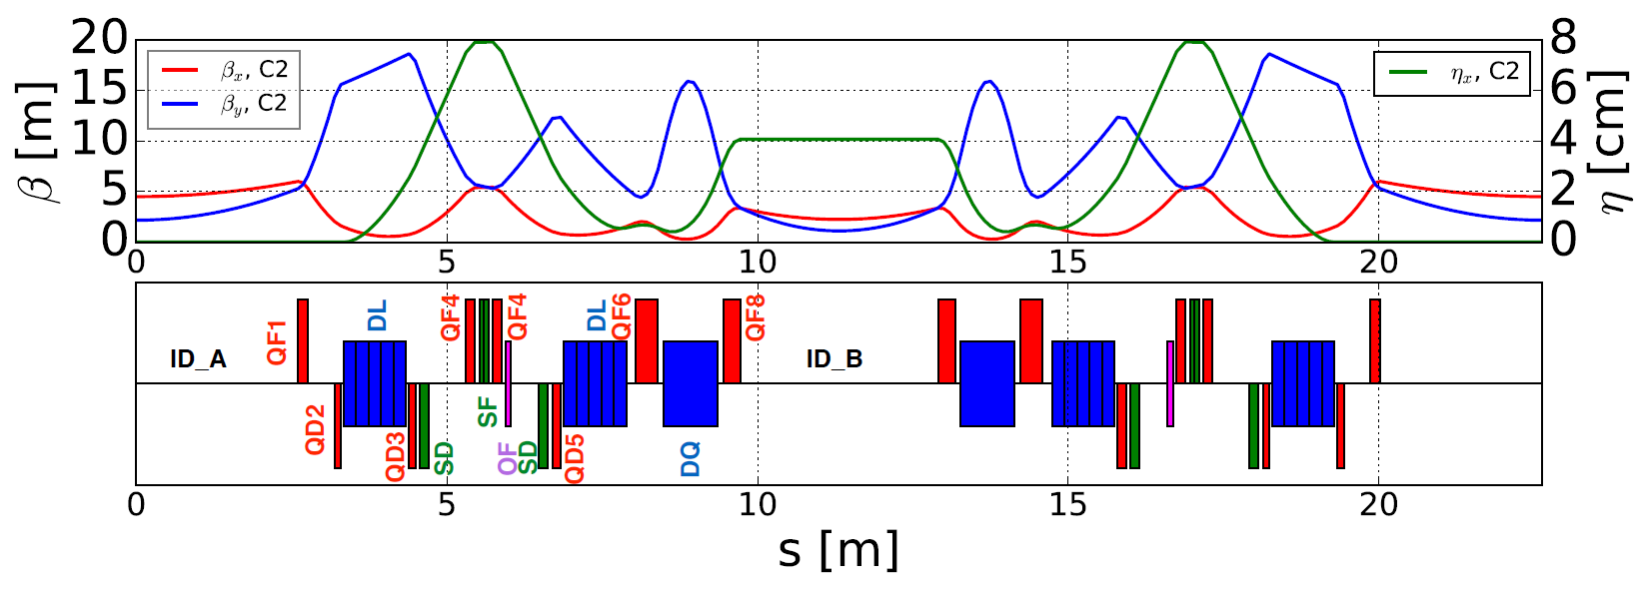
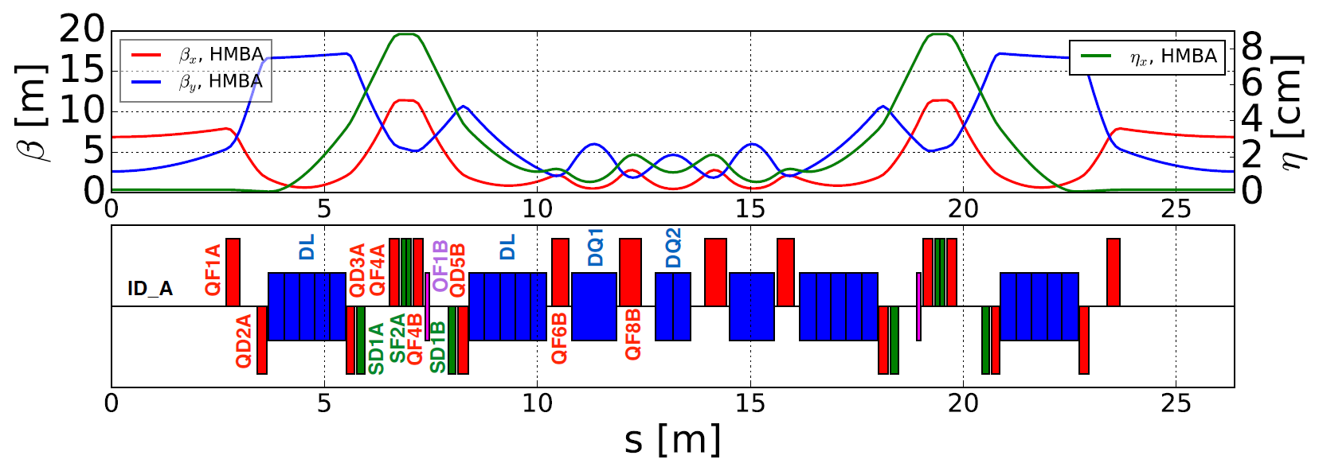
lattices
Diamond Low Emittance DDBA HMBA DTBA optimization conclusions
Sextupoles located at large η_{x} dispersion bumps
DII - DTBA
E: 3 GeV
Cell lenghts: 22.6m
C: 561m (24 cells)
Central DQ2 removed
Drift spaces kept equal
Magnet lengths shortened thanks to
reduced gradient (6GeV → 3GeV)
ESRF - HMBA
E: 6 GeV
Cell lenghts: 26.4m
C: 844m (32 cells)
DII-DTBA
ESRF-HMBA
C2
~ (3π,π) phase advance
Porting the ESRF-HMBA concept into Diamond SR:
by scaling magnet lengths while keeping the same
inter-distances
by shortening cells to fit Diamond length constraints
Notes:
Sextupoles @ dispersion bumps, more effective, weaker ➔ less geometric aberrations

Slide 18
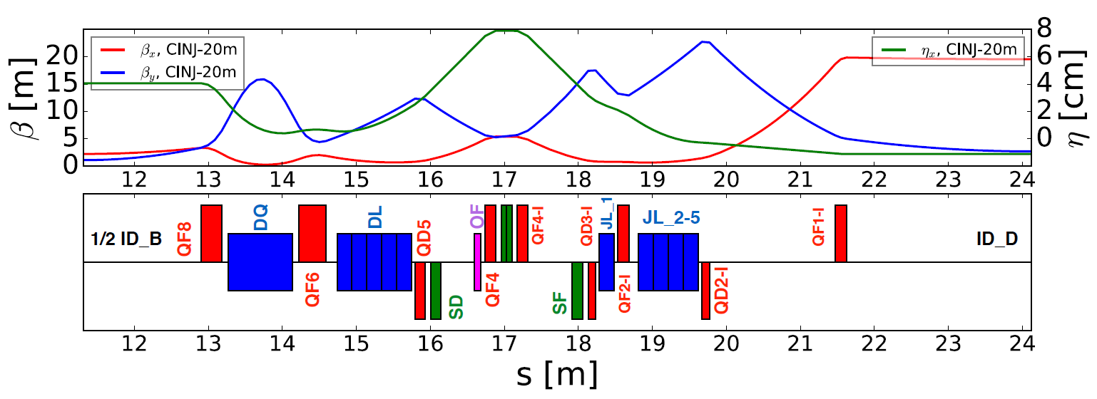
lattices
Diamond Low Emittance DDBA HMBA DTBA optimization conclusions
There are indeed two kinds of cell, C1 and C2, used to reproduce the SP-6 structure of the present lattice (1long / 3 short straights):
-C1 C2 C2 C1
C1 is an asymmetric cell: +1.5m w.r.t. C2
a modified C1 is needed as
injection cell (Cinj)
long straight
short straight
new straight
ID_C
ID_B
ID_B
ID_B
ID_B
ID_C
2 x ID_A
2 x ID_A
2 x ID_A
DII-SuperPeriod

Slide 19
lattices
Diamond Low Emittance DDBA HMBA DTBA optimization conclusions
DA@C2 independent from beta@injection
DA@Cinj grows with beta@injection
MA larger with no inj cell
no CINJ
no CINJ
no CINJ
courtesy of A. Alekou
Notes:
DA at different positions. When at C2 the DA is small and independent from the beta chosen at injection. Instead the DA at injection is directly connected to the beta chosen by varying the entry quadrupole.
MA for the different cases. Hard to see, but without injection cell (better symmetry) the MA increases (and therefore the LT)

Slide 20
lattices
Diamond Low Emittance DDBA HMBA DTBA optimization conclusions
Optimizing the lattice:
  Matching technique
    Analytic cancellation of non-linear driving terms
      Cell-length adaptation
        Injection Cell
          MOGA (DA, LT, InjEff ...)

Slide 21
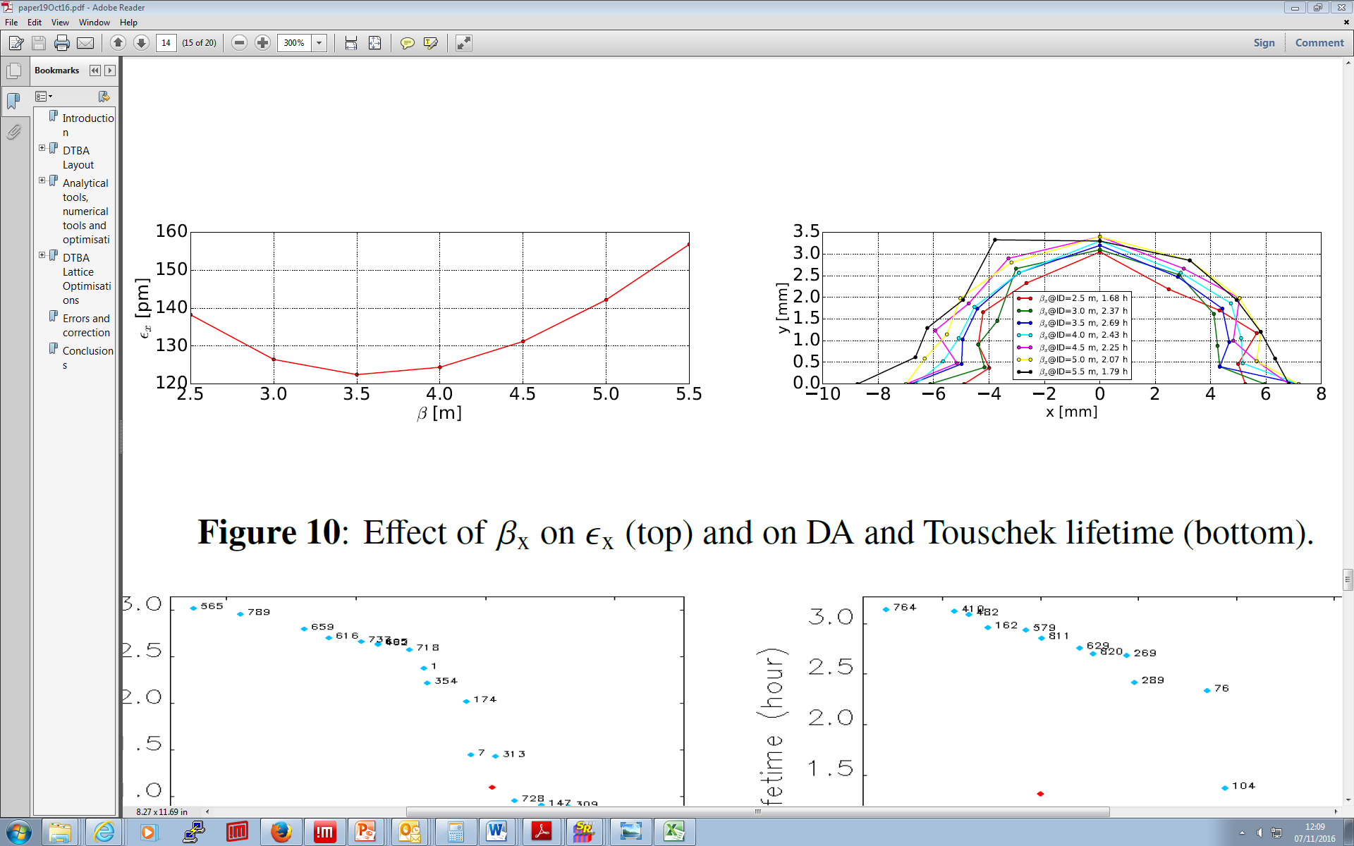
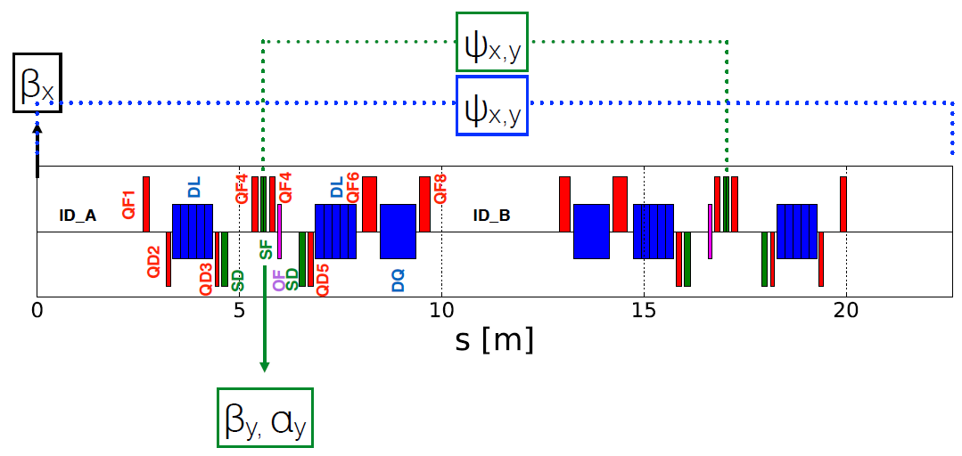
lattices
Diamond Low Emittance DDBA HMBA DTBA optimization conclusions
These parameters have been:
kept fixed when changing cell length (HMBA → DTBA)
scanned when tuning quads during DTBA optimization (later)
varied with Multi-Objective Genetic Algorithm (MOGA) optimizer
cell matching technique:
− β_{x} @ IDs
β_{y},α_{y} at central SF sextupoles
ϕ_{x,y} advance between sextupoles [3π/π]
ϕ_{x,y} advance in the cell
β_{x} @ IDs → ε_{x}
β_{y} @ sext → ε_{x}, ξ_{x}
α_{y} @ sext → dQ_{y}/dy
ϕ_{y} advance between sextupoles → dQ_{x}/dy
Notes:
Fast …

Slide 22
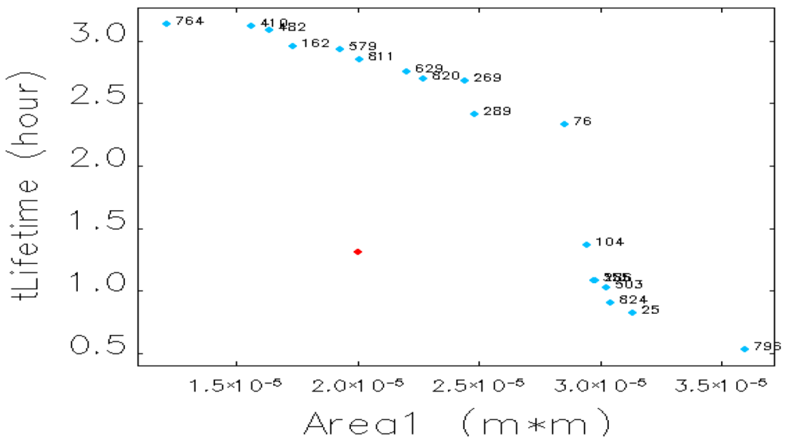
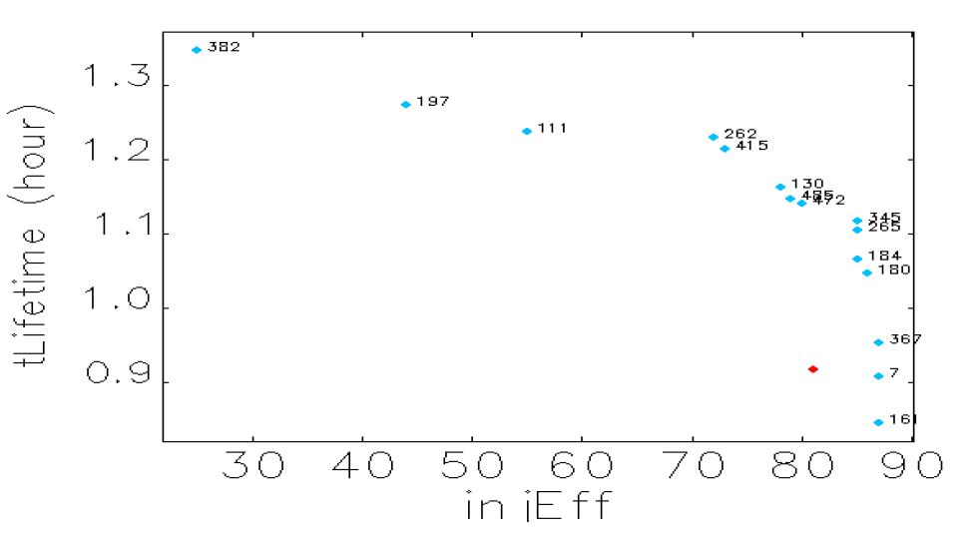
lattices
Diamond Low Emittance DDBA HMBA DTBA optimization conclusions
MOGA optimization^{(*)} on the whole set of parameters
(β_{x}, β_{y}, α_{y}, Κ4, ϕ_{x,y}) → (τ,DA) [keep ξ=(2,2)]
Promising improvement, BUT still errors to be included
(*) 24xC2 ring
Ib = 300mA
Nb = 900
Bl = 1.71 mm
C = 1.0%
With a DA of 11 mm and a lifetime of 3.2hr the DTBA is a promising candidate for Diamond II.
Most of the design effort is concentrating on this lattice
sextupoles / octupoles
chromaticity control (2,2)
(τ,DA) optimization
MOGA improvement in DA [no change in τ]
Injection Efficiency optimization → DTBA lattice with InjCELL
(τ,IE) optimization
➔ IE~85%, τ ~ 1.1hr
HHC cavities for bunch lengthening considered
to increase Touschek lifetime
IE parameters
N_{part} = 1e3
N_{turns} = 512
ε_{x} = 150nm
InjGap = 6.8mm

Slide 23
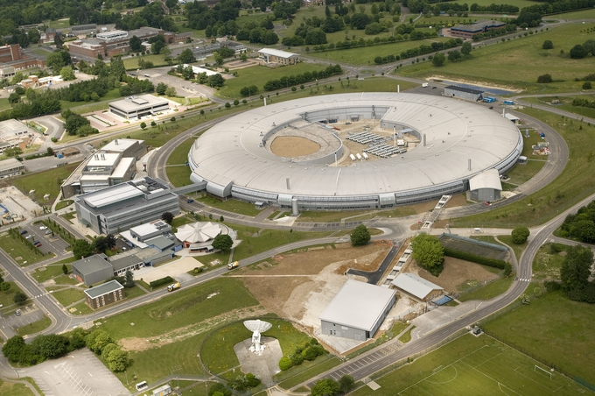
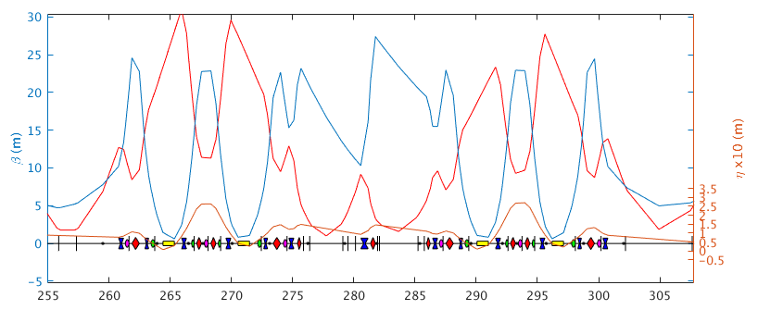
lattices
Low Emittance DDBA HMBA DTBA open issues conclusions
I13: coherence
imaging
Issues : integration of present features into new lattice
I09 / I13 straight @ mini-β
I21 strong focussing section
Short-pulse
improve performance @ BL
mini-β straights critical, with low β_{y} and virtual focussing
present proposed solution under study for mini-β cases
250m

Slide 24
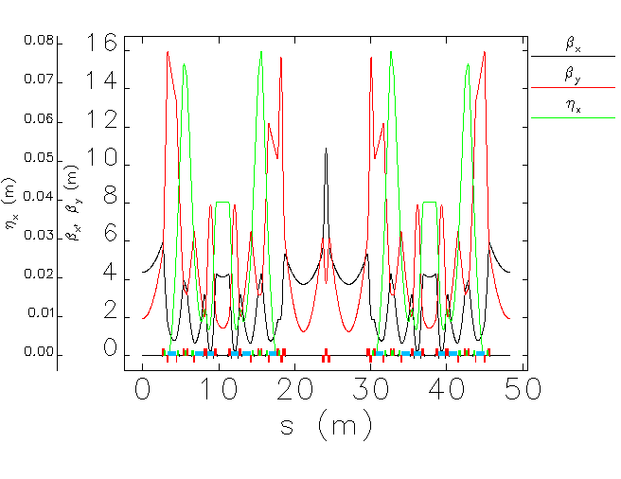
lattices
Low Emittance DDBA HMBA DTBA present situation conclusions
mini-β
STR Q-Q: 4.88m straight section
courtesy of T. Pulampong
Notes:
Check better newer plots

Slide 25
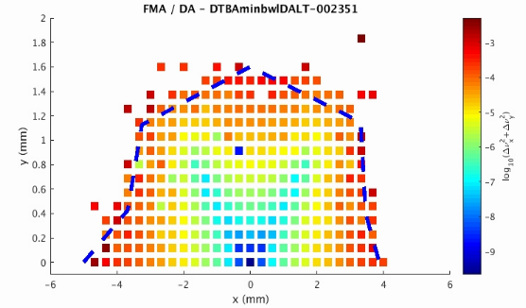
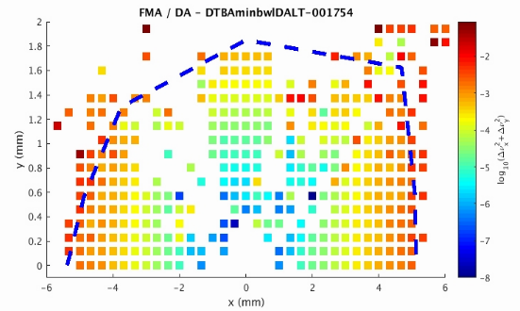
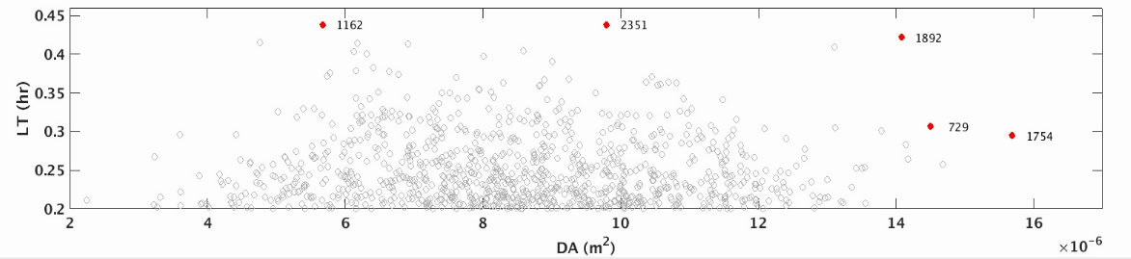
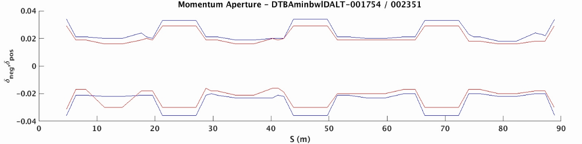
lattices
Low Emittance DDBA HMBA DTBA present situation conclusions
LT ~ 0.44 hr (!)
|DA| > 5mm
MOGA optimization
courtesy of T. Pulampong
courtesy of T. Pulampong
2351-0.44hr
1754 – 0.3hr
Notes:
Check newest results with TP

Slide 26
lattices
Low Emittance DDBA HMBA DTBA present situation conclusions
Initial consideration on layout, engineering
Integration, girders, beamline layout, etc.
courtesy of R. Bartolini

Slide 27
lattices
Low Emittance DDBA HMBA DTBA present situation conclusions
Diamond is considering a development to reduce emittance by a factor 10x to 20x
Following the DDBA concept, and the expertise developed at ESRF the DTBA concept emerged, which should double the n. of beamlines
Initial studies suggest a DTBA cells organized in 6-fold SP could fulfil the 20x emittance reduction
However optimization process is underway to ensure:
  Good LT/DA are achievable
  Non linearities can be controlled
  Present machine requirements are met
  (mini-β / short-pulse operations)

Slide 28
Thanks for your attention

