Slide 1

The LHC and preparations for HL-LHC
Mike Lamont for the LHC team
Annual meeting of the Institute of Physics Particle Accelerators and Beams Group
7th April 2017
*
*c/o Joel Butler Aspen March 17

Slide 2
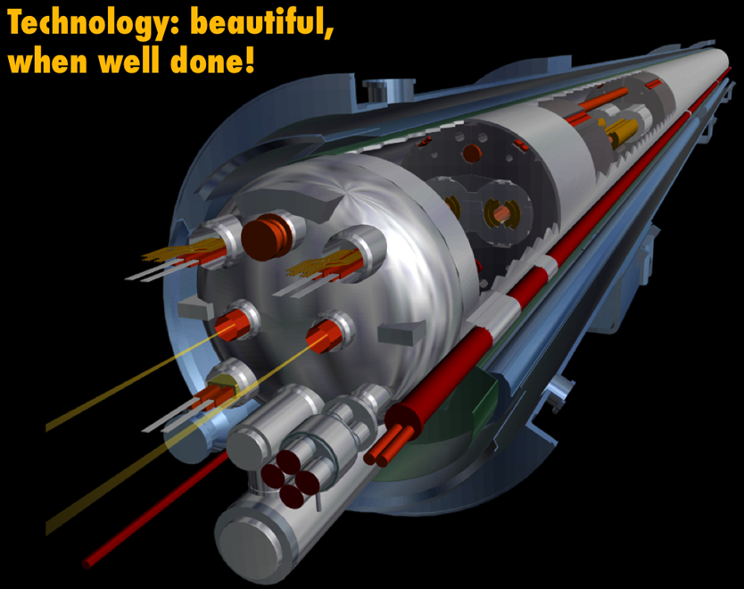
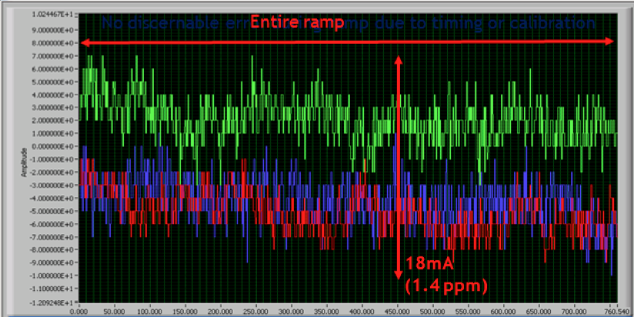
Exit Run 1(2010 – 2012)
Foundations well proven at 4 TeV
  Magnets, vacuum, cryogenics, RF, powering, instrumentation, collimation, beam dumps etc.
Huge amount of experience gained
  Operations, optics, collimation…
Healthy respect for machine protection
Main bend power converters: tracking error between sector 12 & 23 in ramp to 1.1 TeV

Slide 3
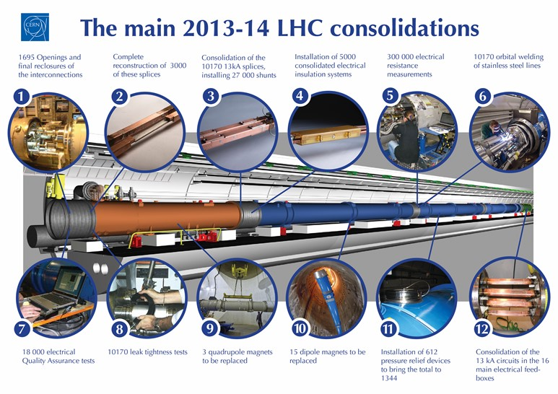
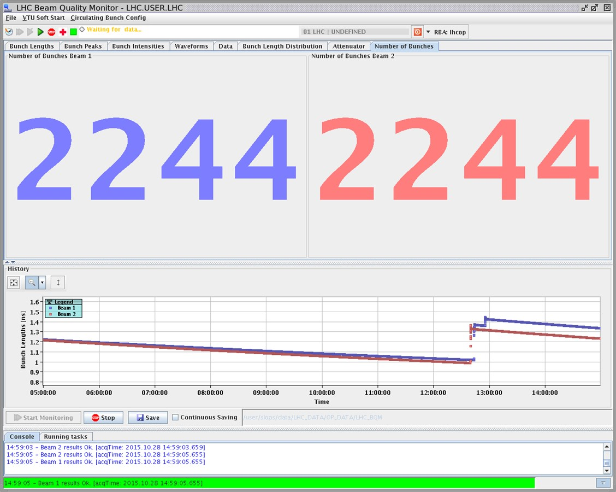
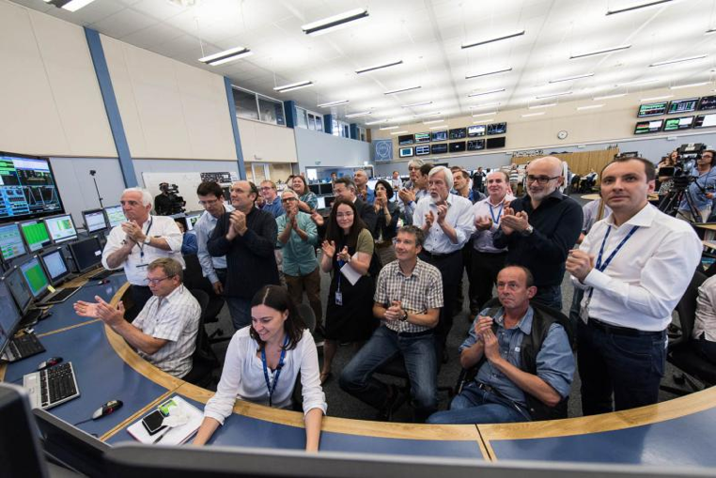

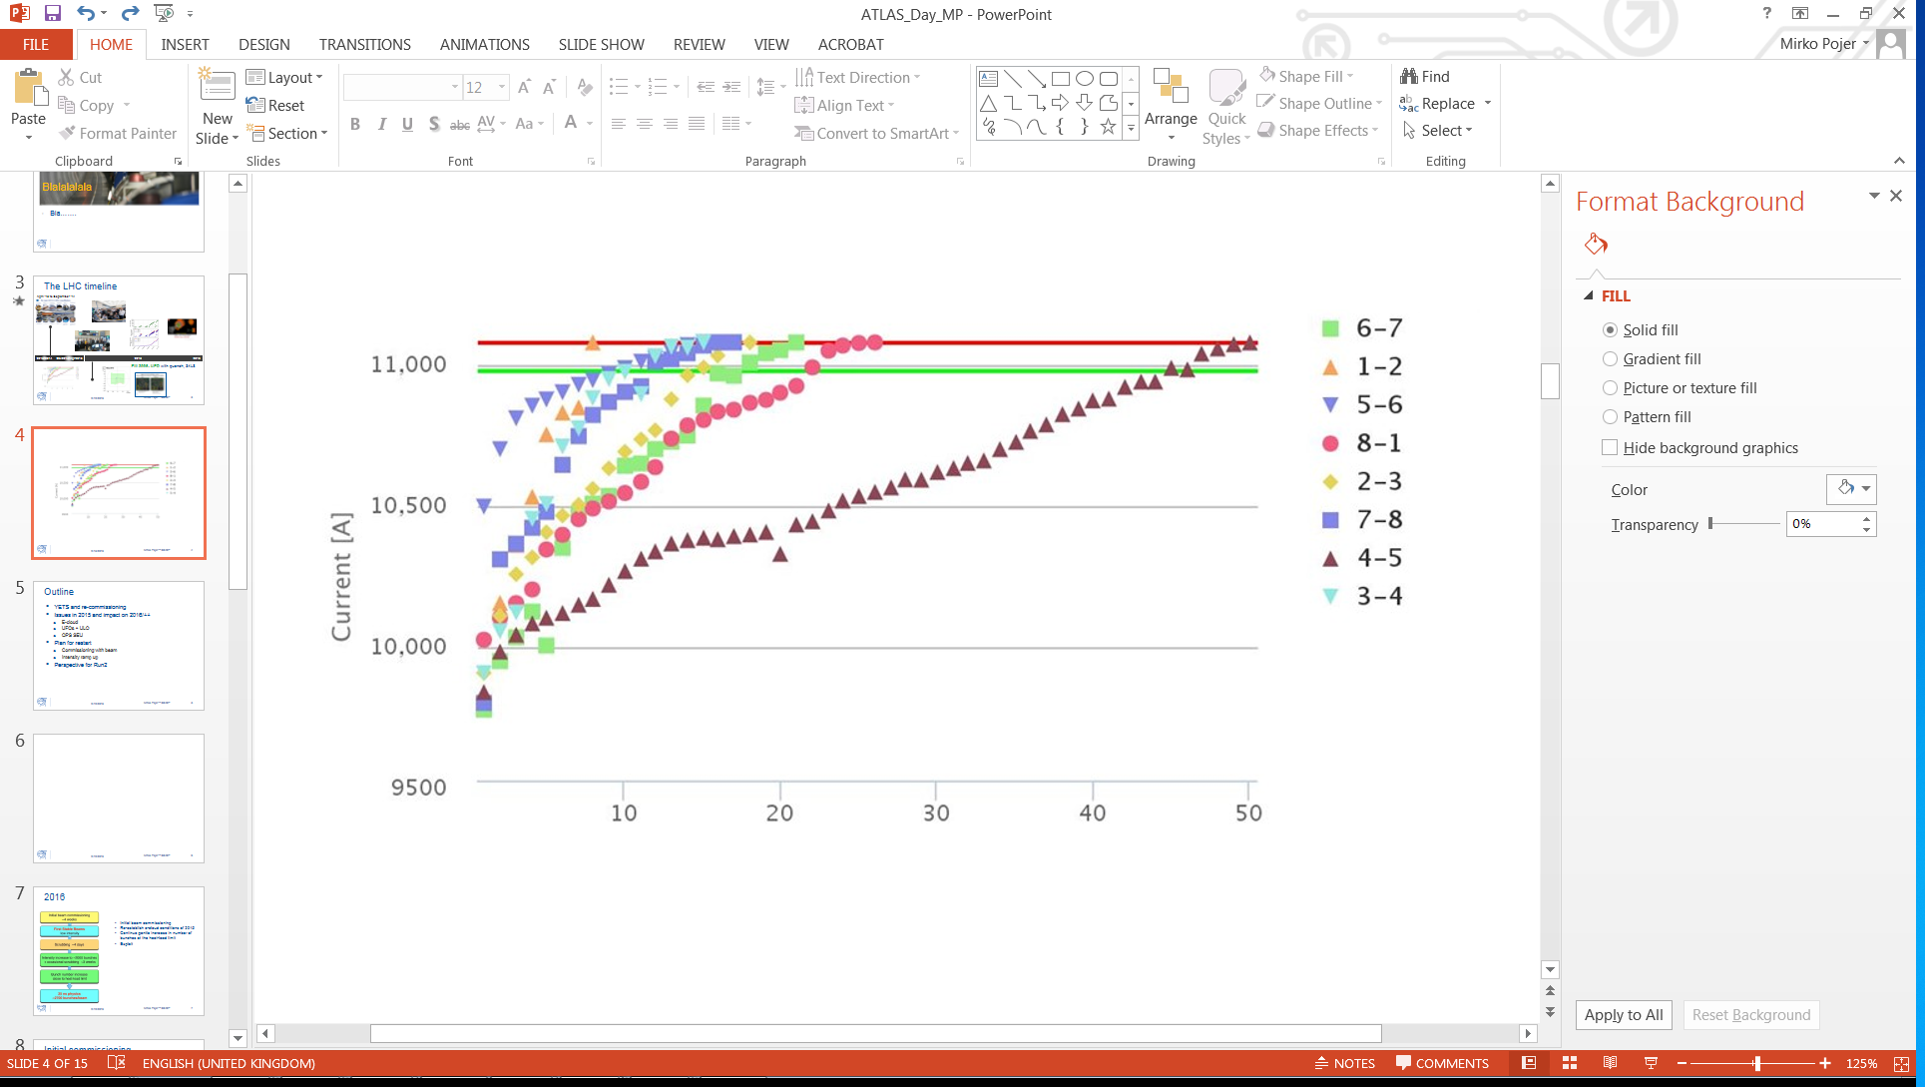
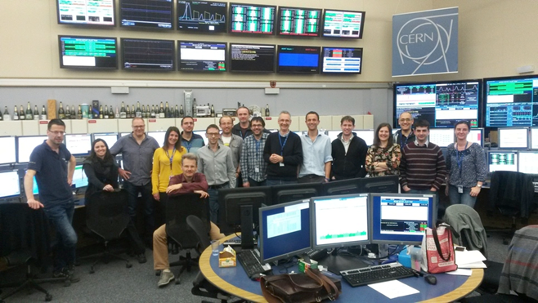
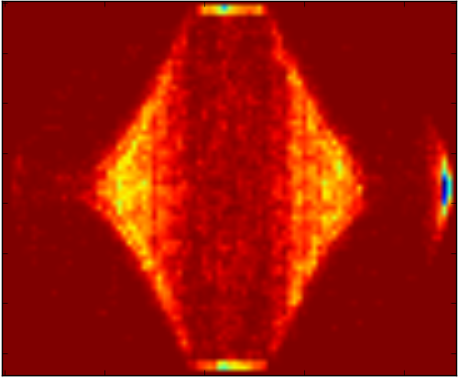
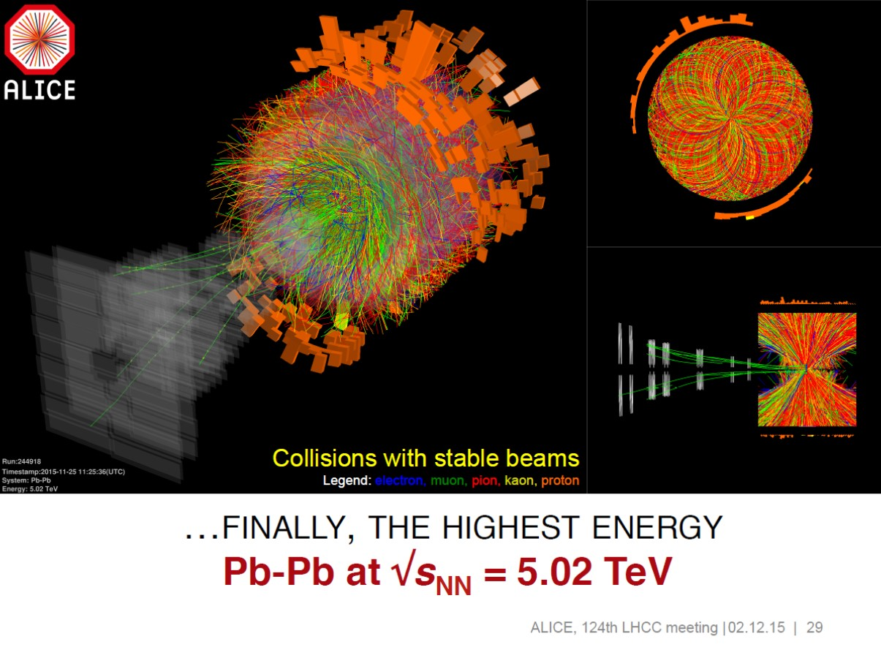

2013 - 2015
28th October
Physics with record number of bunches
Peak luminosity 5 x 10³³ cm⁻²s⁻¹
April ‘13 to Sep. ‘14
3rd June
First Stable Beams
5th April
1st B E A M
13-14
Aug 14-Apr 15
2015
Struggle
IONS
10th April
Beam at 6.5 TeV
Dipole training campaign

Slide 4
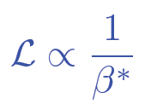
LHC 2016
Choose a relatively bold set of operational parameters based on past experience
Energy: 6.5 TeV
25 ns beam - nominal bunch population (~1.2e11)
Low emittance from injectors – variations possible
Squeeze harder in ATLAS and CMS
  beta* = 40 cm
  cf. 80 cm in 2015
  cf. 55 cm design

Slide 5
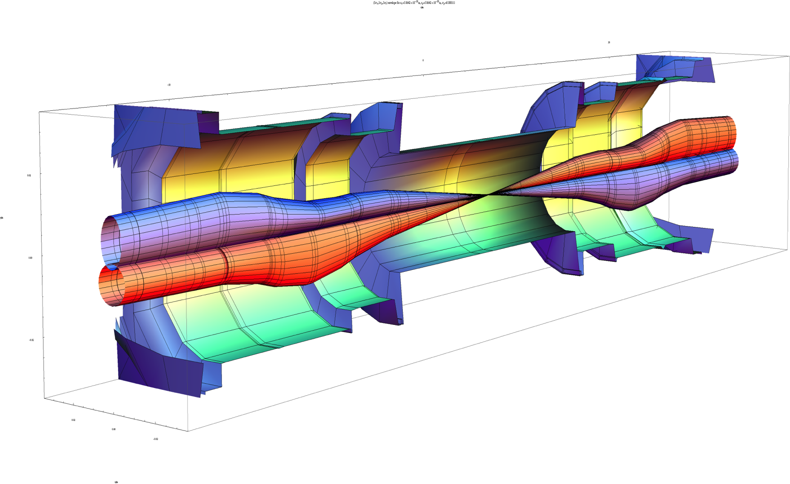
Squeeze in ATLAS/CMS
Lower beta* implies larger beams in the triplet magnets
Larger beams implies a larger crossing angle
Aperture concerns dictate caution – experience counts
β_{triplet} | Sigma triplet | β* | Sigma*
~4.5 km | 1.5 mm | 40 cm | 13 um
Image courtesy John Jowett

Slide 6

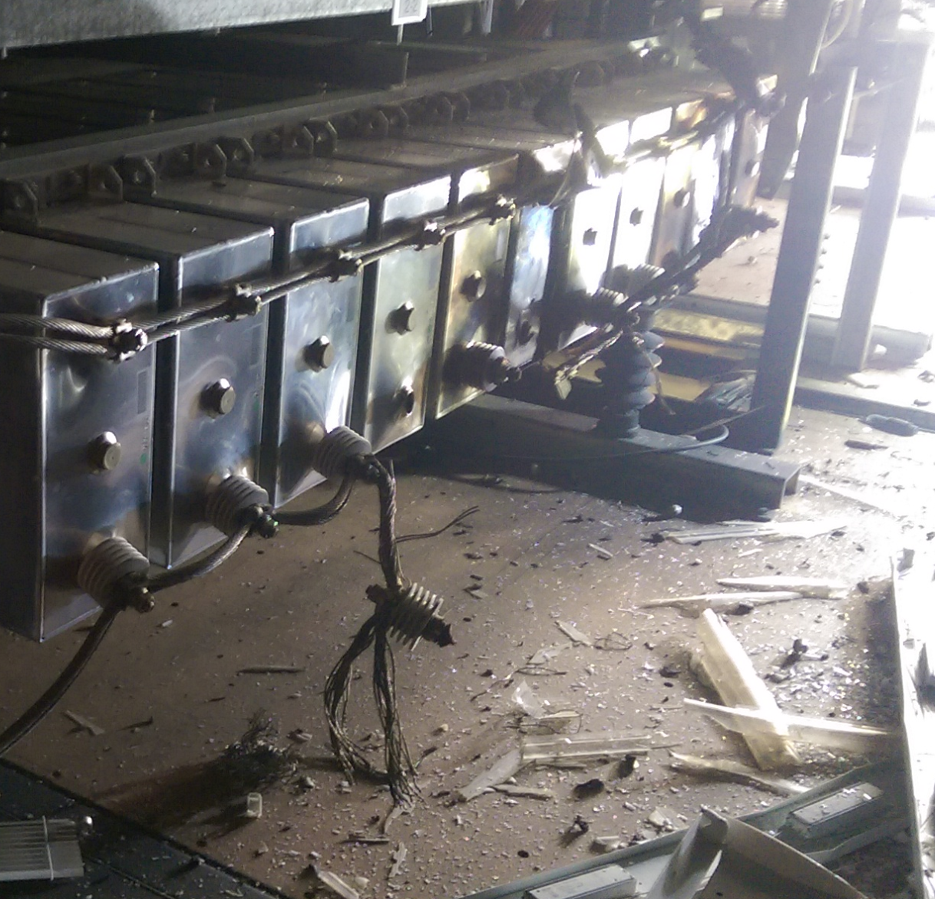
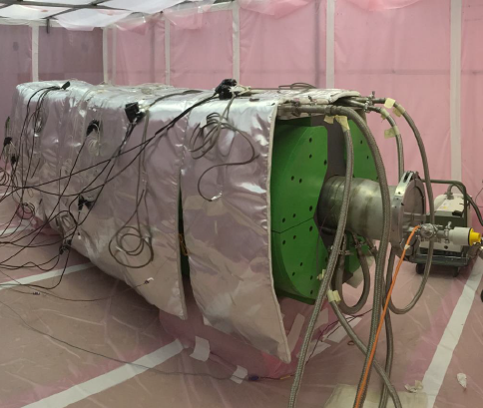
2016 - overcome a few problems
WEASEL
PS MAIN POWER SUPPLY
SPS BEAM DUMP
Limited to 96 bunches per injection in 2016
2220 bunches per beam cf. 2750

Slide 7
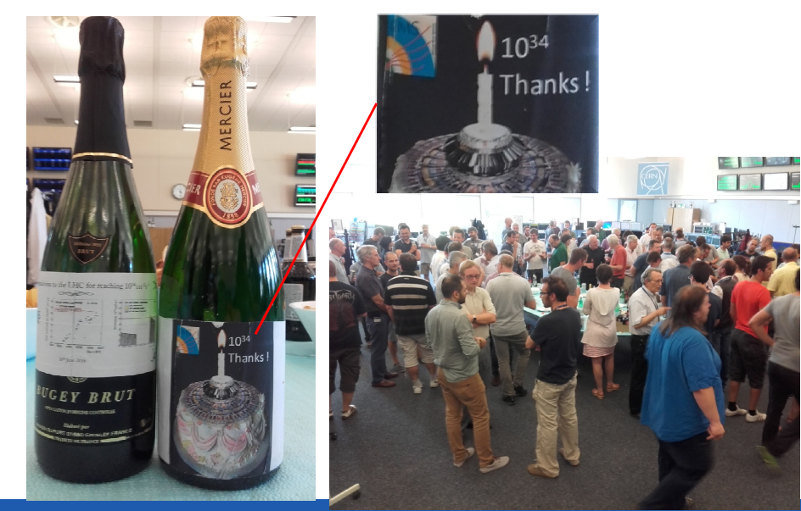
Design luminosity reached
  Reduced beta* and lower transverse beam sizes from the injectors compensating the lower number of bunches

Slide 8
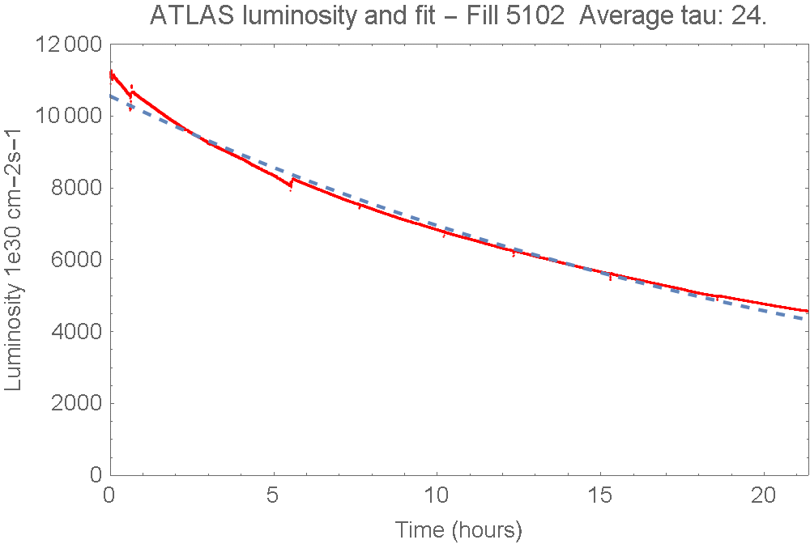
Luminosity lifetime
Excellent luminosity lifetime – main component - proton loss to inelastic collisions in ATLAS, CMS and LHCb

Slide 9
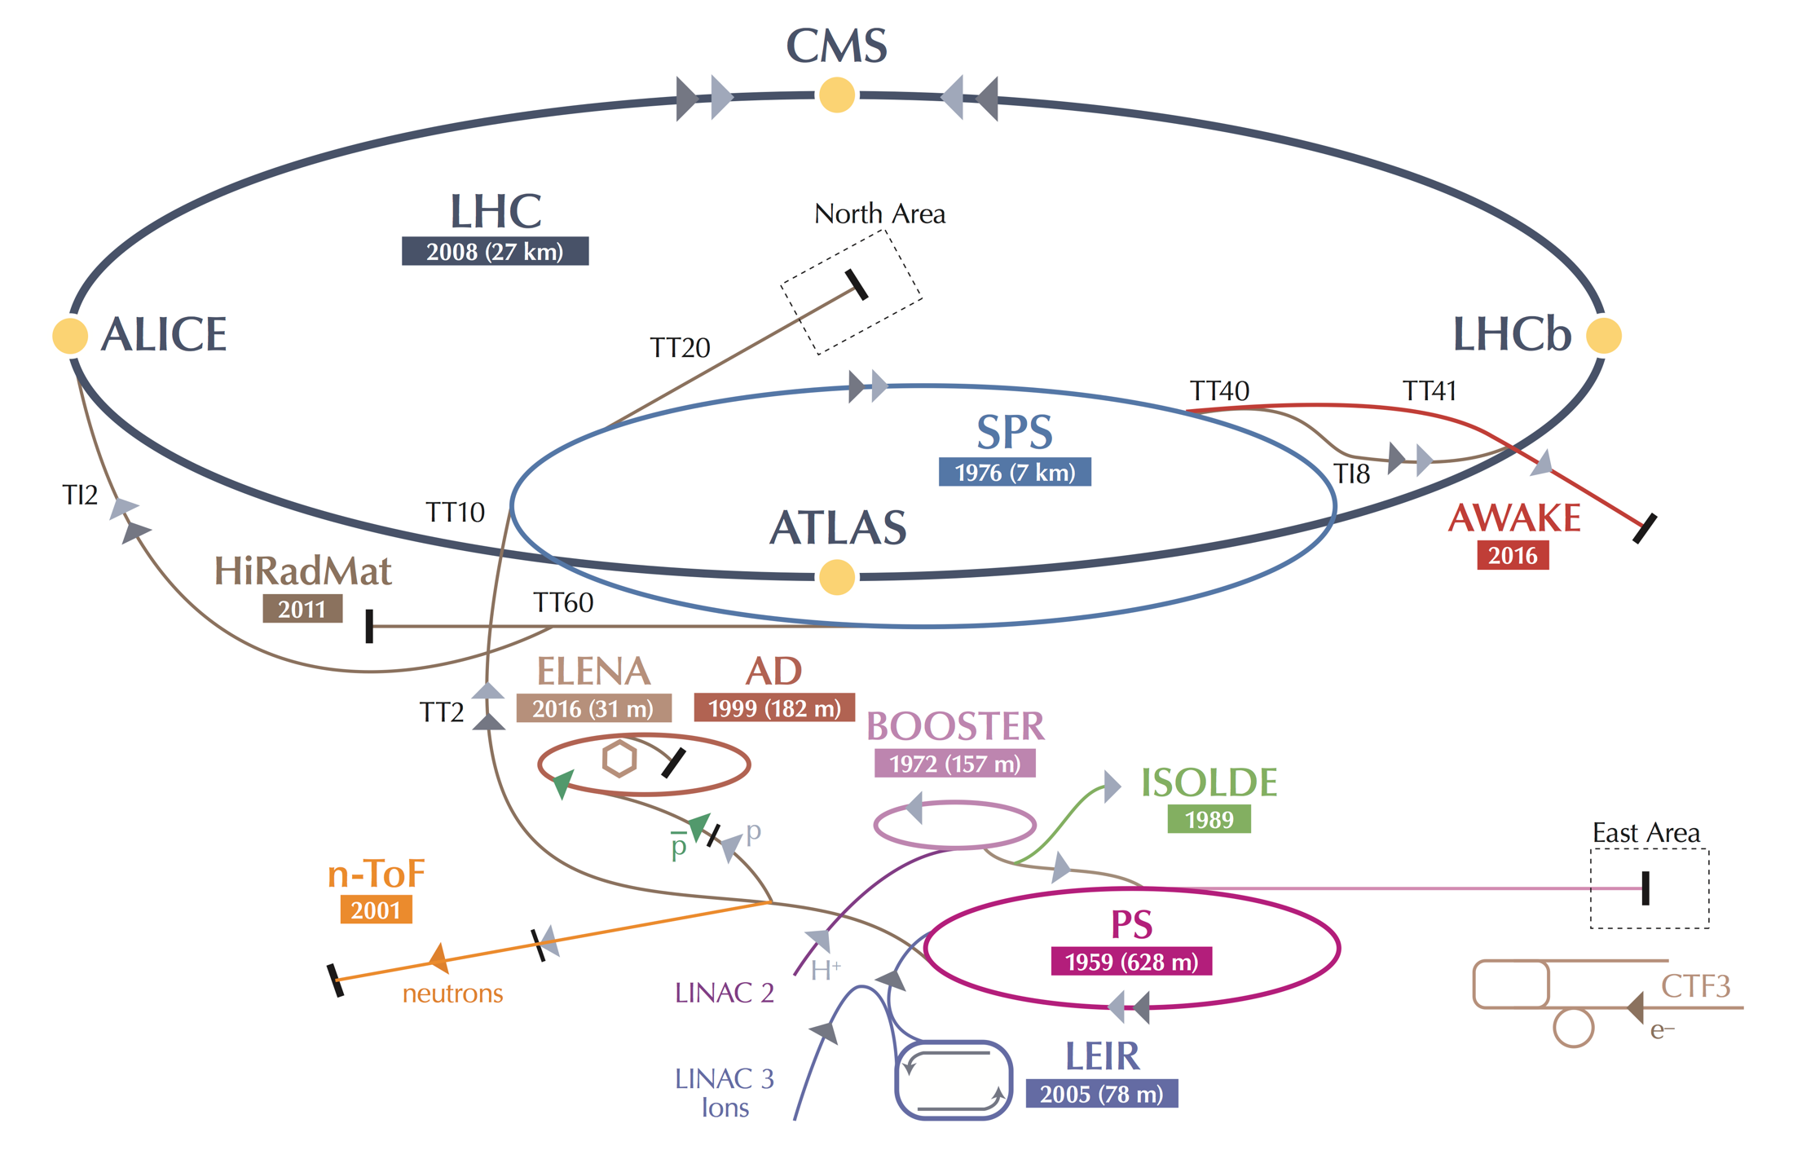
An extra boost from the injectors
The LHC performance fully relies on the performance of its injector complex
By itself one of the largest accelerator facilities in the world with its own diverse and, for many aspects, unique physics program

Slide 10
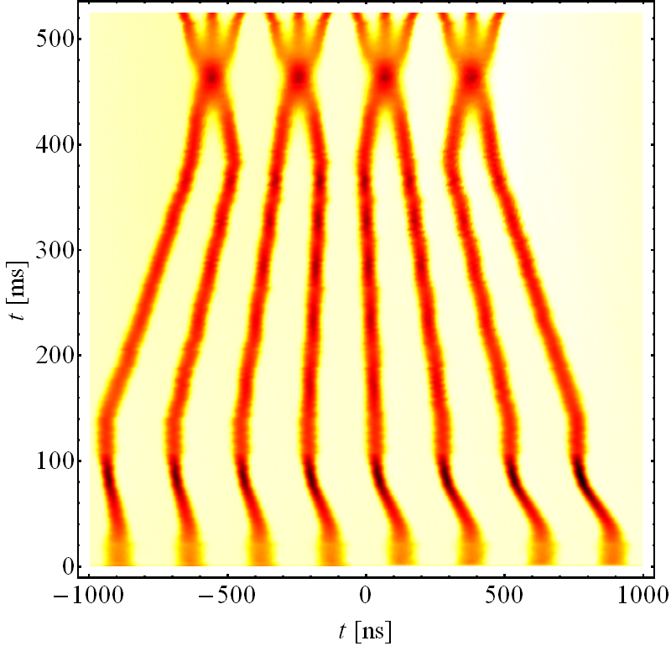
An extra boost from the injectors
An advanced production scheme – the “BCMS” - was put in place in the PS
RF cavities tuned at different frequencies play together to compress, merge and split proton bunches
Beams ~30% brighter than standard scheme
The LHC performance fully relies on the performance of its injector complex
By itself one of the largest accelerator facility in the world with its own diverse and, for many aspects, unique physics program
E_{kin} = 2.5 GeV

Slide 11
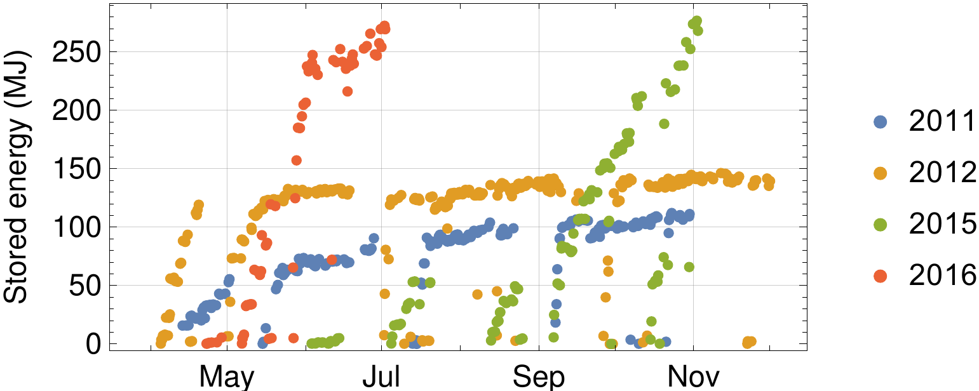
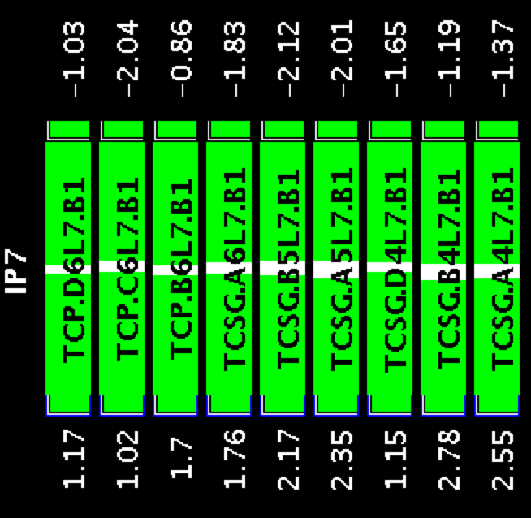
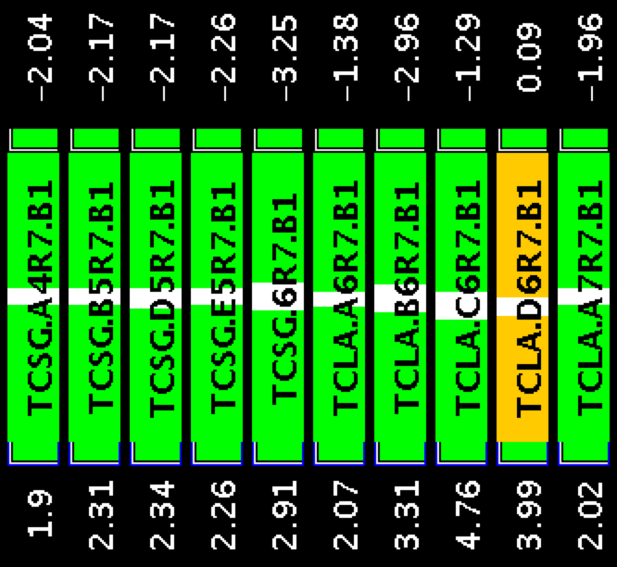
Stored energy per beam
B1 collimators IP7
Beam 1
2.2 mm gap

Slide 12
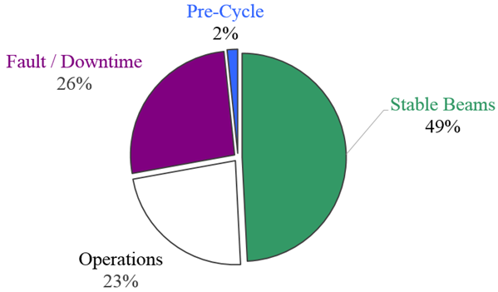
p-p physics – machine availability
2016 was characterized by unprecedented machine availability:
The machine was available for operation 72% of the time scheduled for physics
Overall Stable Beam efficiency of 49% (to be compared to 36% in 2012, and 30% for the short production period in 2015)
Possible thanks to:
Professionalism, commitment and attention to the details from all the different equipment groups
Solid understanding of the machine and beam behaviour
Continuous effort in fault and availability tracking

Slide 13
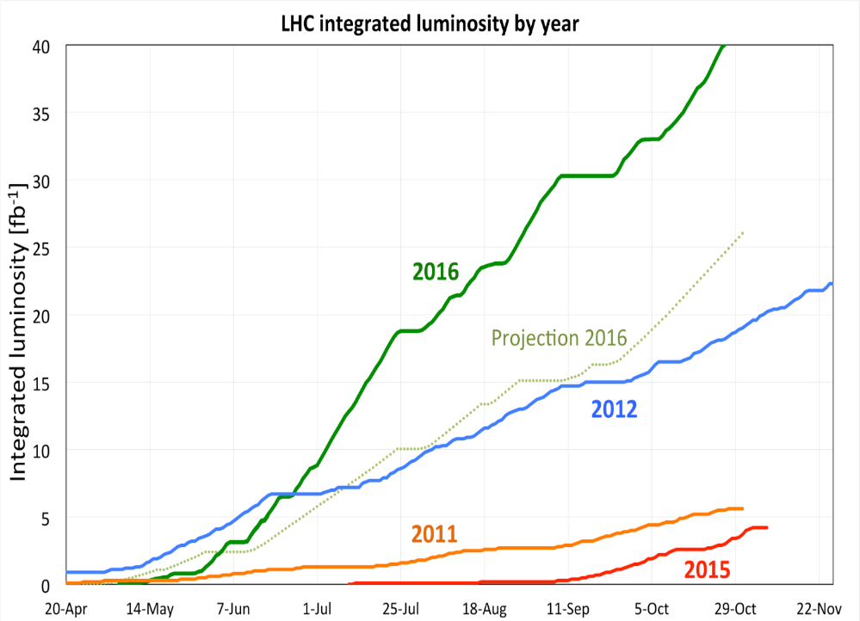
p-p physics – summing all up
Combination of high peak performance and excellent machine availability
→ quite impressive progression of the integrated luminosity
Average between ATLAS and CMS
~40 fb⁻¹
for ATLAS and CMS
(2016 target was 25 fb⁻¹!)

Slide 14
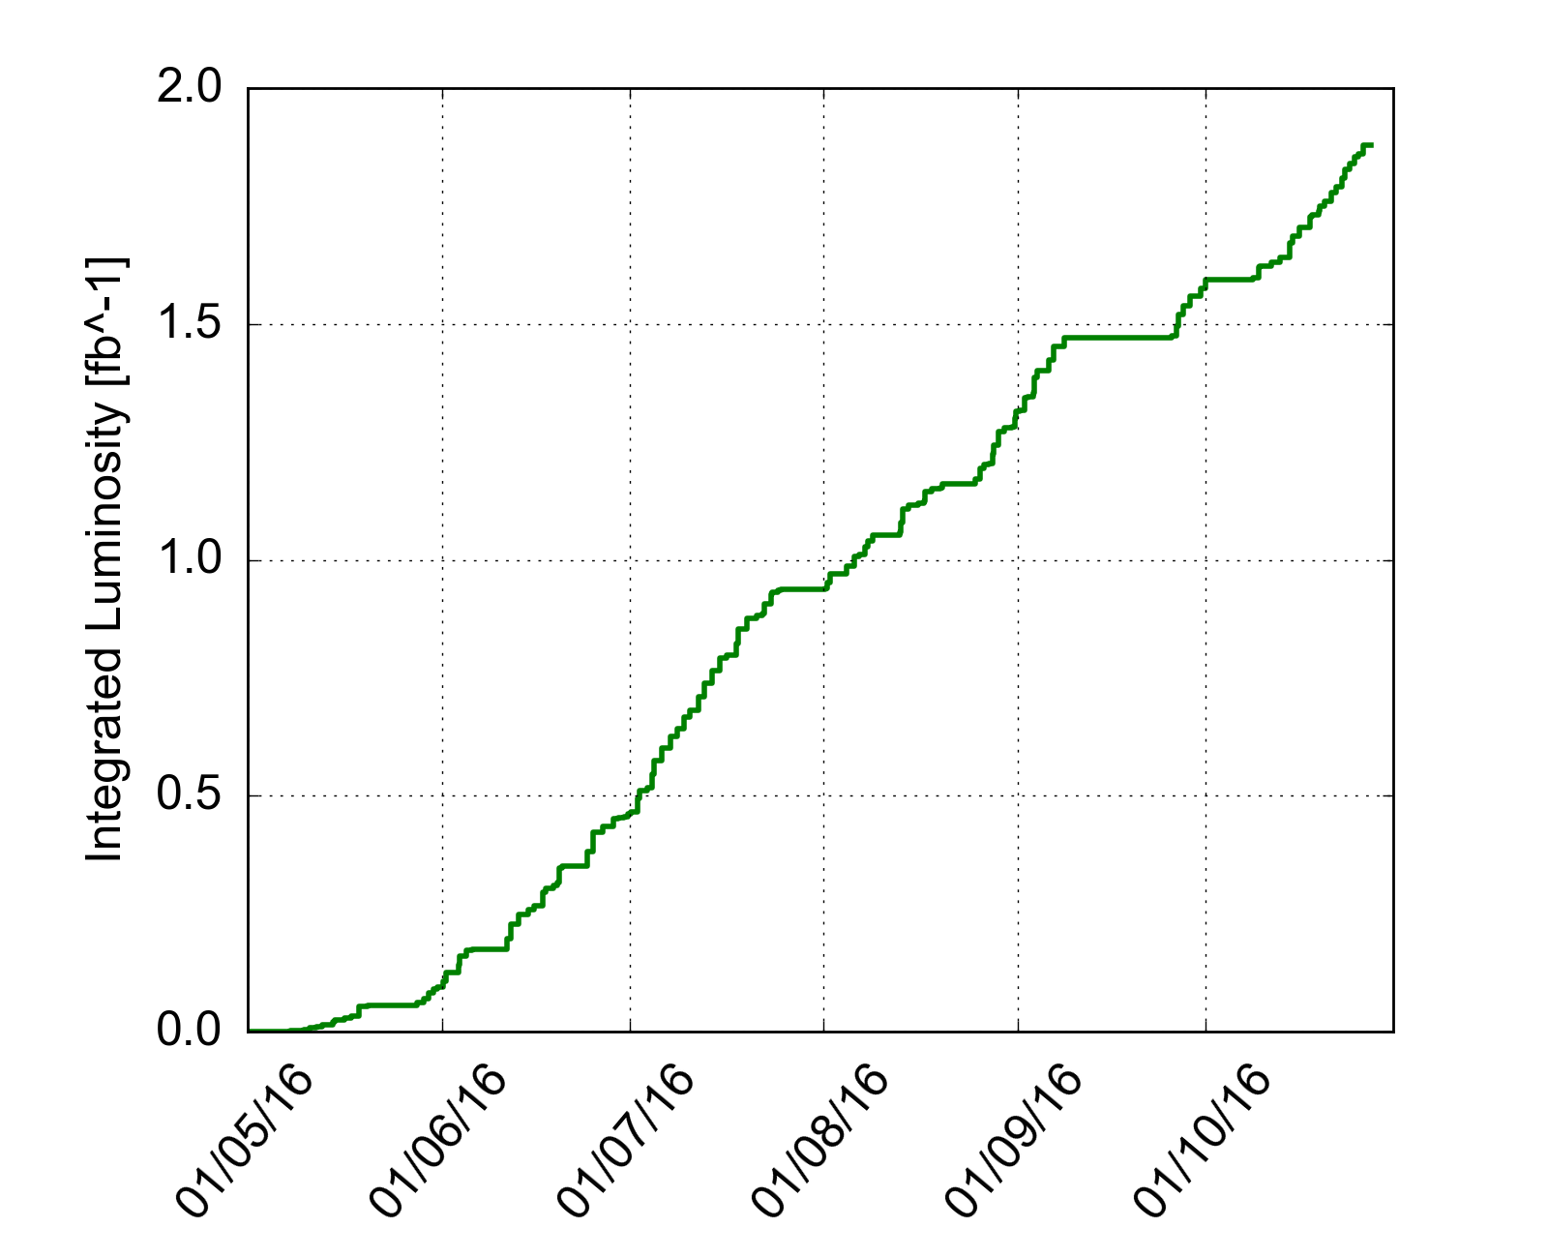
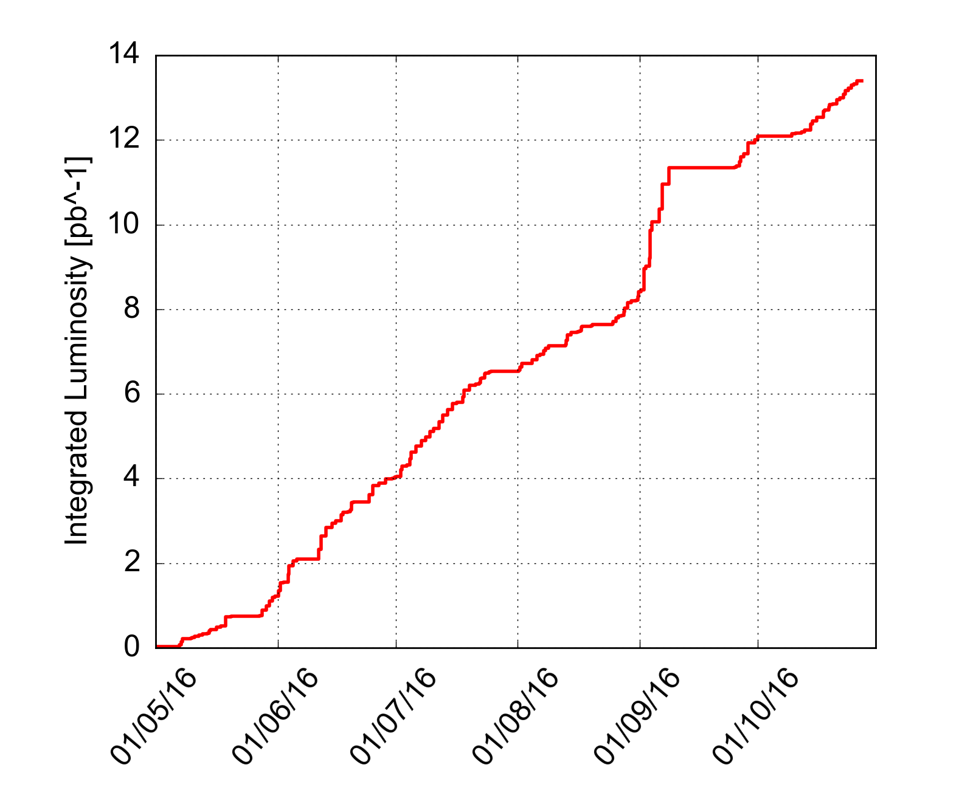
p-p physics – ALICE and LHCb
… acquiring data with luminosity levelled at their desired values all along the p-p fills
LHCb
ALICE
~1.9 fb⁻¹
~13 pb⁻¹

Slide 15
Where are we? 1/2
Mature performance of injectors
Good operational efficiency and flexibility
Remarkable reproducibility
Good beam behaviour (with these intensities)
  Stability
  Transmission through the cycle
  Luminosity lifetime
  Emittance growth
Continue to worry about electron cloud

Slide 16
Where are we? 2/2
Excellent availability in 2016 – it can be done
Mature system performance
  Quench protection, RF, Cryogenics, transverse damper, Power converters, Collimation, instrumentation, Controls, beam dump system, injection….
  Improved functionality, diagnostics, understanding
Premature dumps significantly reduced
  UFOs, Radiation to electronics
Machine protection
  excellent as always

Slide 17
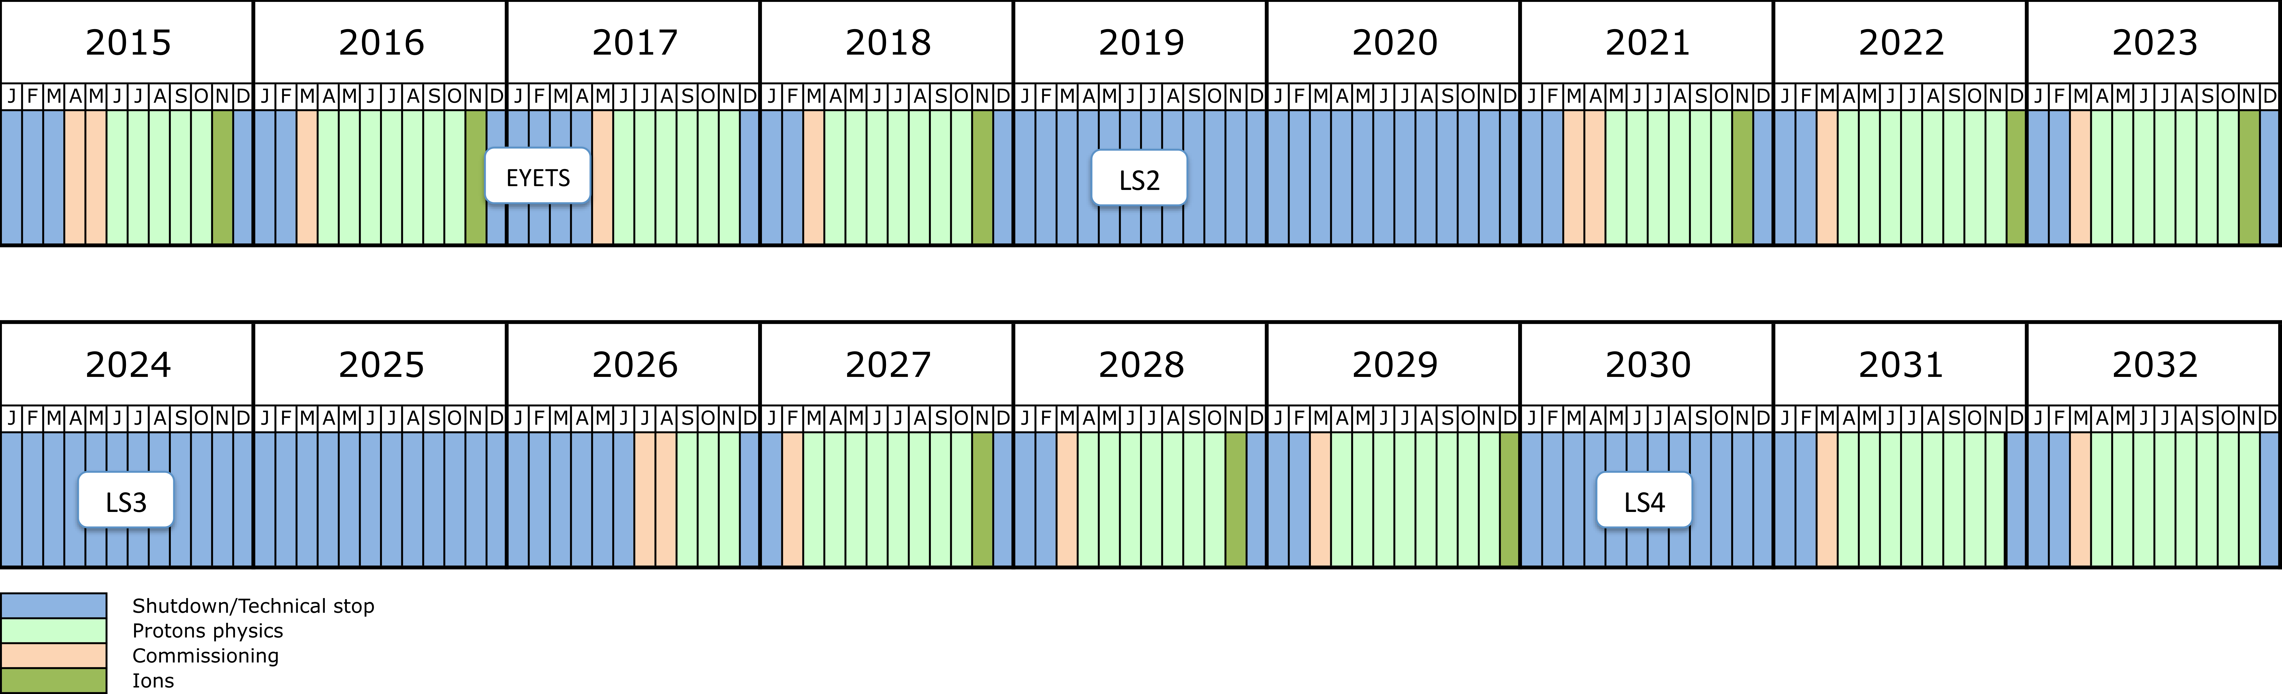
Schedule
Run 2
Run 3
HL-LHC
EYETS – Extended Year End Technical Stop – CMS pixel upgrade
Pb-Pb end 2018
Considerable special physics runs to be slotted in (90 m, 5 TeV pp, low energy high beta*…)

Slide 18
Run 2 - objectives
Deliver 100-120 fb⁻¹ to GPDs, keep ALICE, LHCb, TOTEM, ALFA, AFP happy
Keep pushing performance and availability
Look forward to HL-LHC without compromising present performance:
  Optics (ATS), beta* levelling, LRBB compensation,
  RF full de-tuning, electron cloud…
Look forward to the post-LS2 LIU era and how to exploit the potential
Prepare for 7 TeV operation (but don’t go there)

Slide 19
2017
Another production year
  Late start – no ions
  Target 45 fb⁻¹ to ATLAS & CMS at 6.5 TeV
Machine configuration
  Deploy HL-LHC optics
  Start with beta* = 40 cm, maybe 33 cm later
  25 ns BCMS nominal bunch intensity
  2016 hardware issues resolved
  Max. luminosity ~1.75 x 10³⁴ cm⁻²s⁻¹ – limit cooling capacity of inner triplets
Continue to wrestle with electron cloud

Slide 20
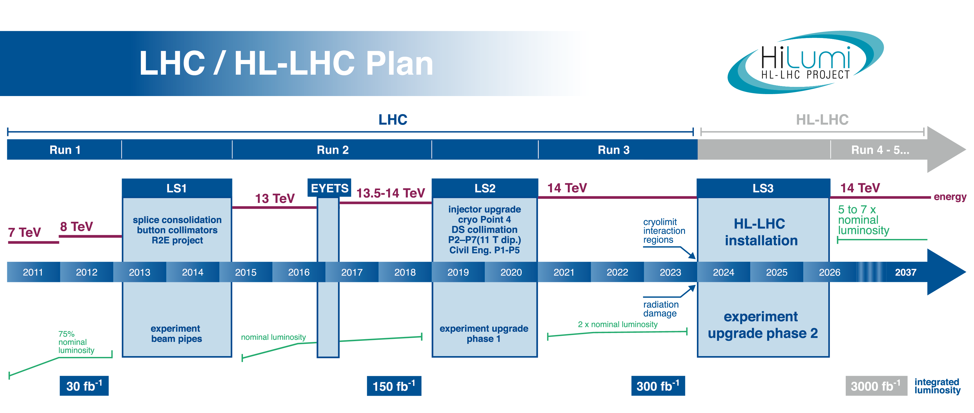
HL-LHC - goals
Prepare machine for operation beyond 2025 and up to ~2035
Operation scenarios for:
  total integrated luminosity of 3000 fb⁻¹ in around 10-12 years
  an integrated luminosity of ~250 fb⁻¹ per year
  mu ≤ 140 (peak luminosity of ~5x10³⁴ cm⁻²s⁻¹)

Slide 21
HL-LHC - how?
Lower beta* (~20 cm)
  New inner triplet magnets - wide aperture Nb₃Sn
  Large aperture NbTi separator magnets
  Novel optics solutions
Crossing angle compensation
  Crab cavities, long-range beam-beam compensation
Dealing with the regime
  Collision debris, high radiation
Beam from injectors
  High bunch population, low emittance, 25 ns beam

Slide 22
HL-LHC: key 25 ns parameters
Protons per bunch | 2.2 x 10¹¹
Number of bunches | 2748
Normalized emittance | 2.5 micron
Beta* | 20 cm
Crossing angle | 510 microrad
Geometric reduction factor | 0.369
Levelled luminosity | 5.32 x 10³⁴ cm⁻²s⁻¹
Levelled <pile-up> | 140
Other variations are considered (BCMS, 8b+4e)

Slide 23
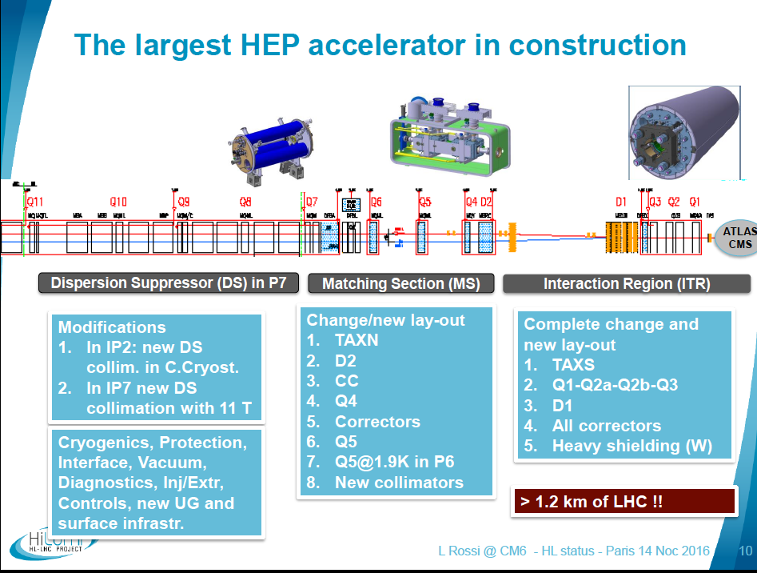

Slide 24
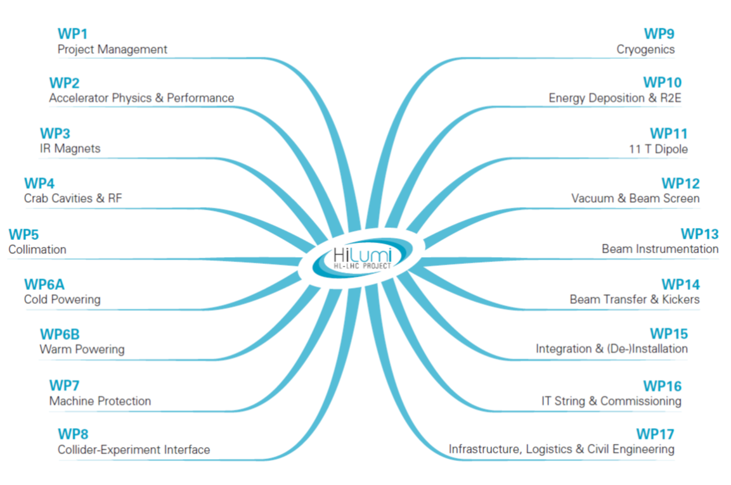
Project structure
Notes:
WP structure: similar but not perfect copy of group: MSC is in 3 WPs; same STI…; Cryo has its own WP but also task in WP3 and WP4 (SPS).
PUT CO as possible new WP

Slide 25
Project status
2016 (June Council): formal approval of the entire HL-LHC project
2016 June-August: re-baseline of the project
2016 2nd Cost & Schedule Review with full endorsement of new baseline cost
Re-baseline:
Identification of the all possible savings, with reasonable impact on performance and availability, reducing the levels of redundancy/mitigations
Keep reversibility (possibility to recovery the missed hardware later on)

Slide 27
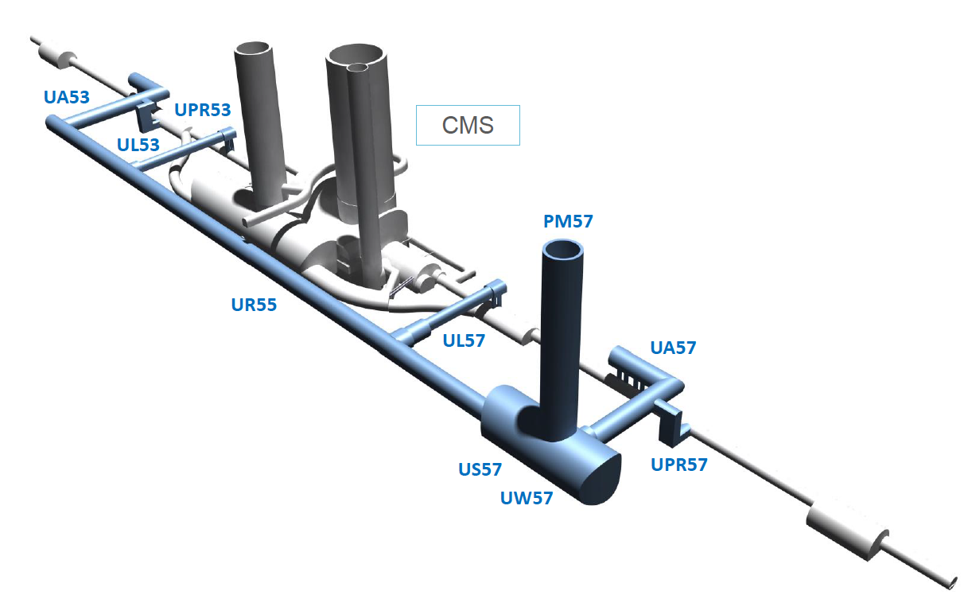
One focus of attention at the moment: civil engineering contract
19 April: Market survey short list
30 June: Issue Invitation to tender
March 2018: Finance committee
Process is being closely monitored!
Plus Point 1 and surface buildings in 1 & 5

Slide 28





The Inner Triplet region with in-kind
Connection to LHC (UL)
Service gallery (UR)
SC Links
Q2a
Q1
TAXS
Q2b
CP
Q3
DFX
D1
DFM

Slide 29


The MS region with in-kinds
UA gallery
Service cavern
(BBLR)
Q4
Crab cavities
D2
Collimators
TAXN

Slide 30
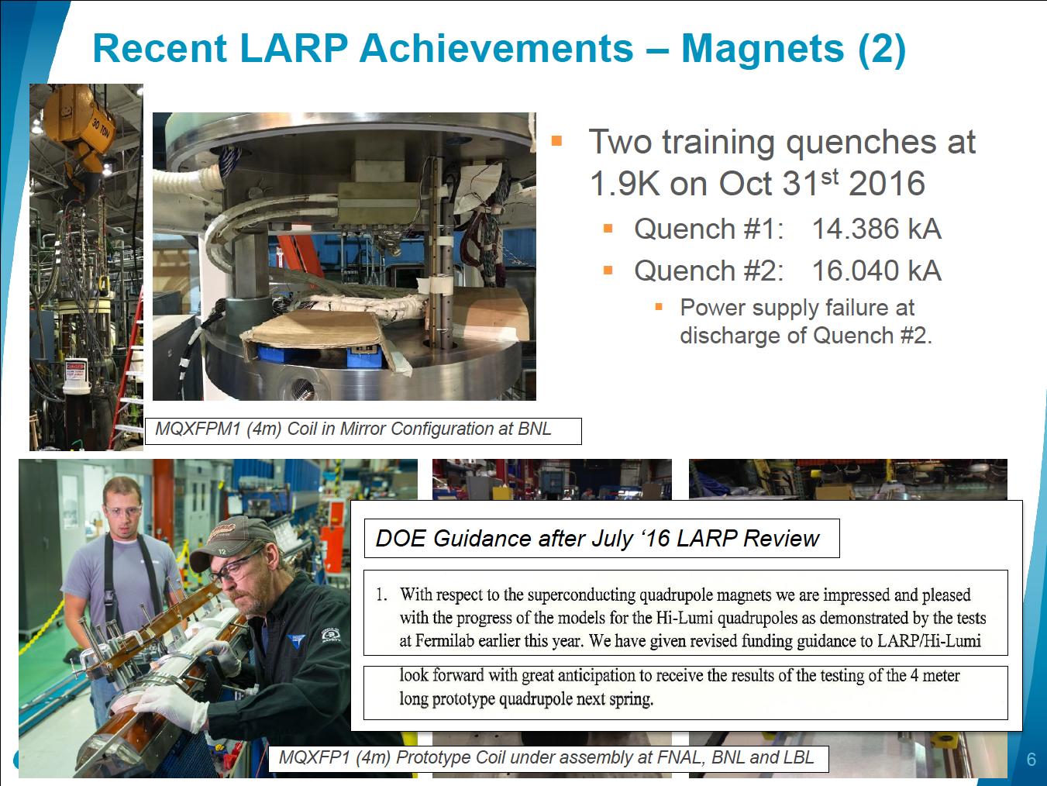

Slide 31
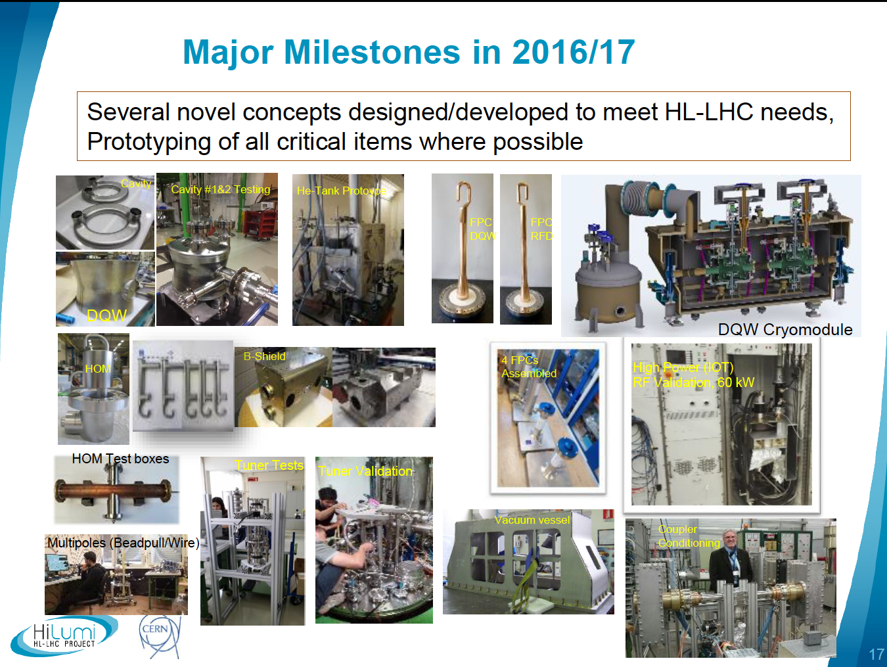
Crab Cavities

Slide 32
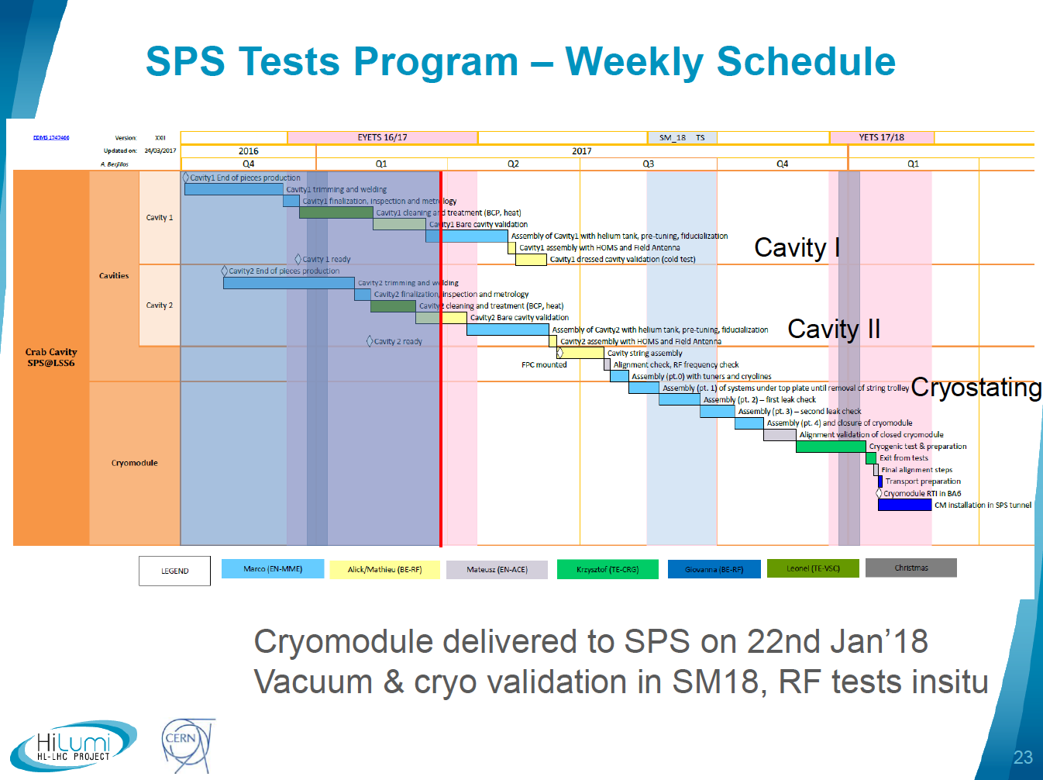

Slide 33
LHC Injector Upgrade (LIU)
Main means to achieve the target HL-LHC proton beam parameters
Linac4 in for Linac2 | H⁻ injection into PSB at 160 MeV Expected double brightness for LHC beams out of the PSB
Booster | Increase energy to 2 GeV New RF system New main power supply
PS | Injection at 2 GeV Beam production schemes Feedback systems: new wide-band longitudinal feedback; transverse feedback against head-tail and e-cloud instabilities
SPS | Power upgrade of the main 200 MHz RF system Electron cloud mitigation through a-C coating (baseline) or beam induced scrubbing
Many other options plus a full ion upgrade program
Deployment: 2019 - 2020

Slide 34
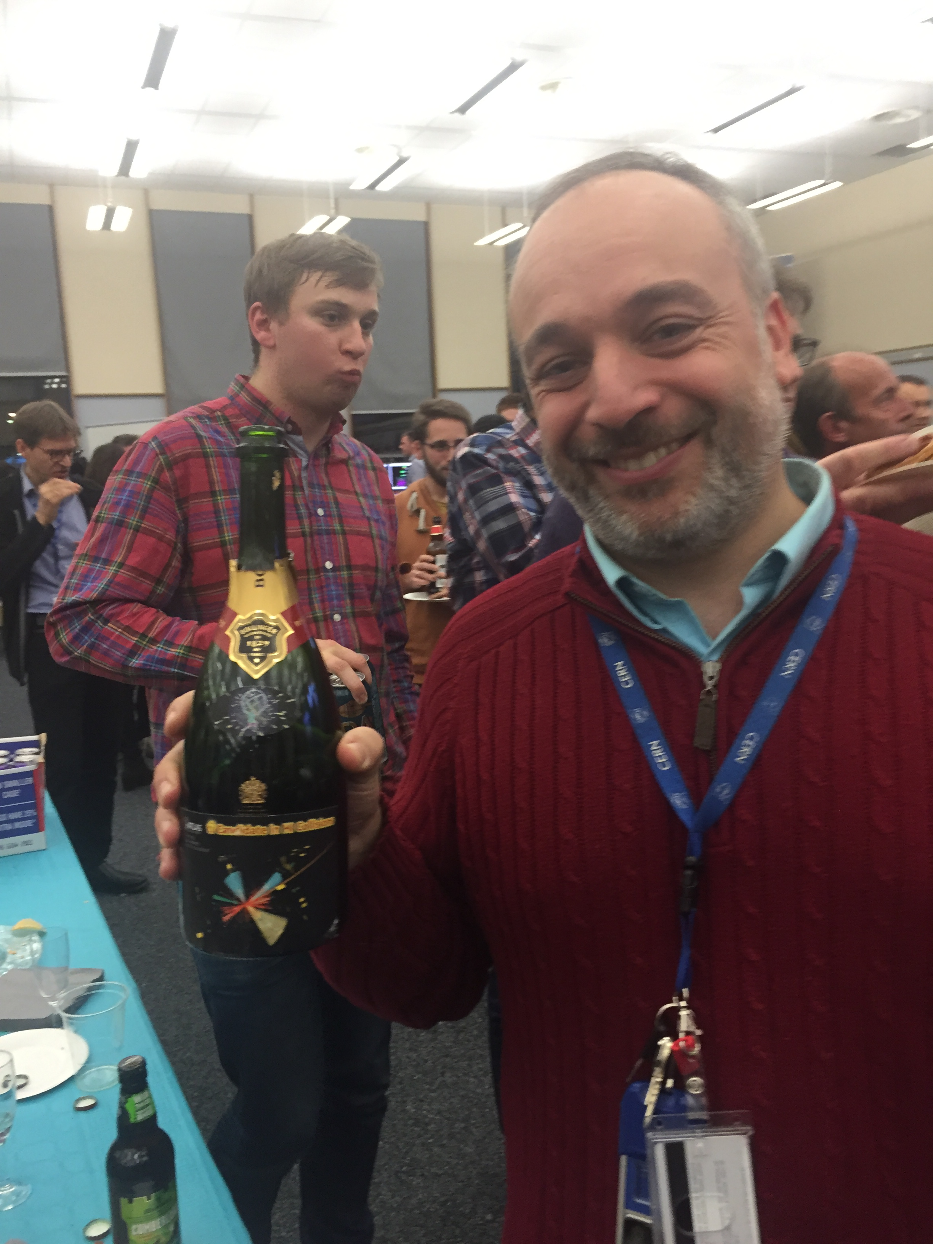
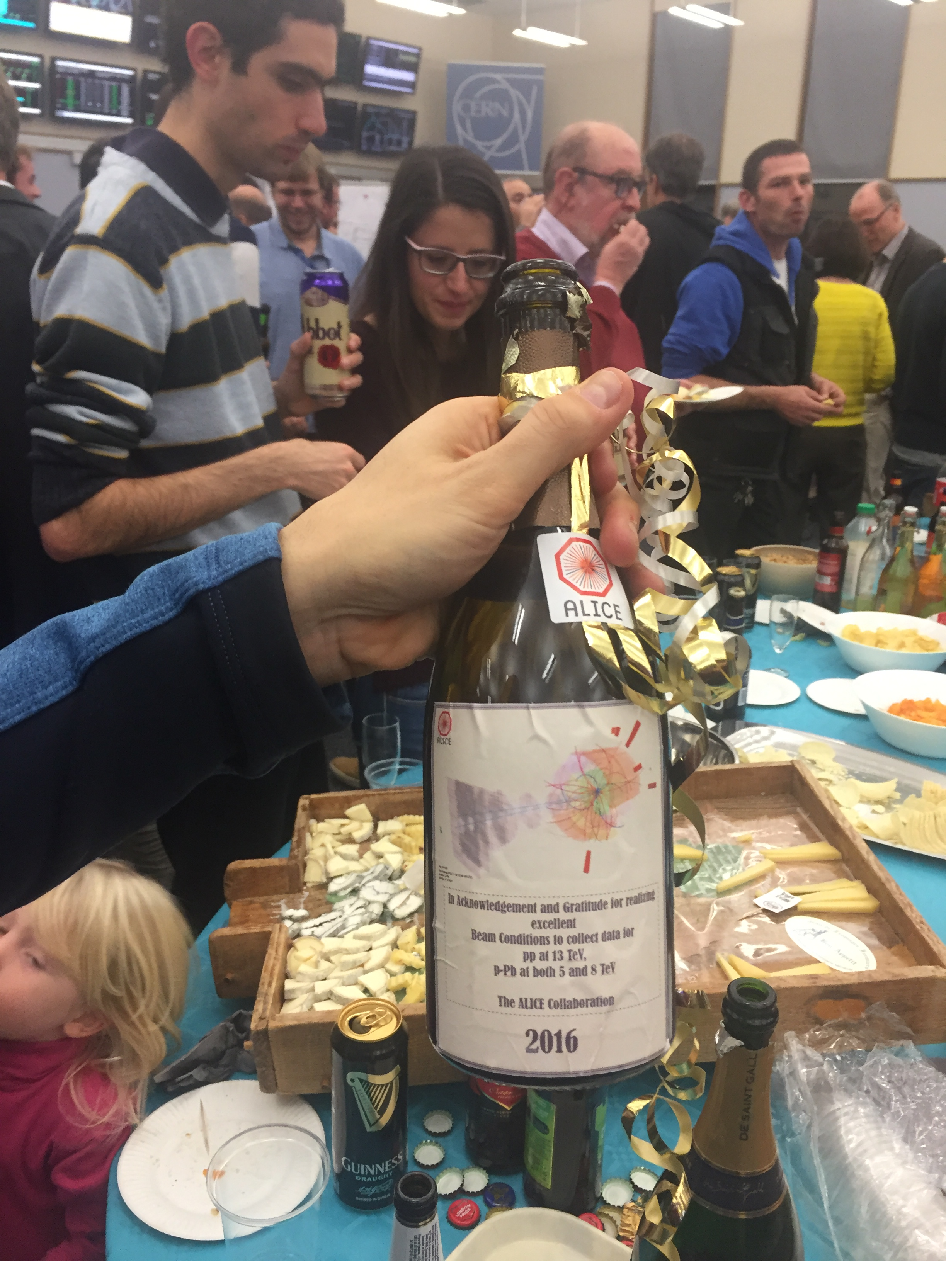
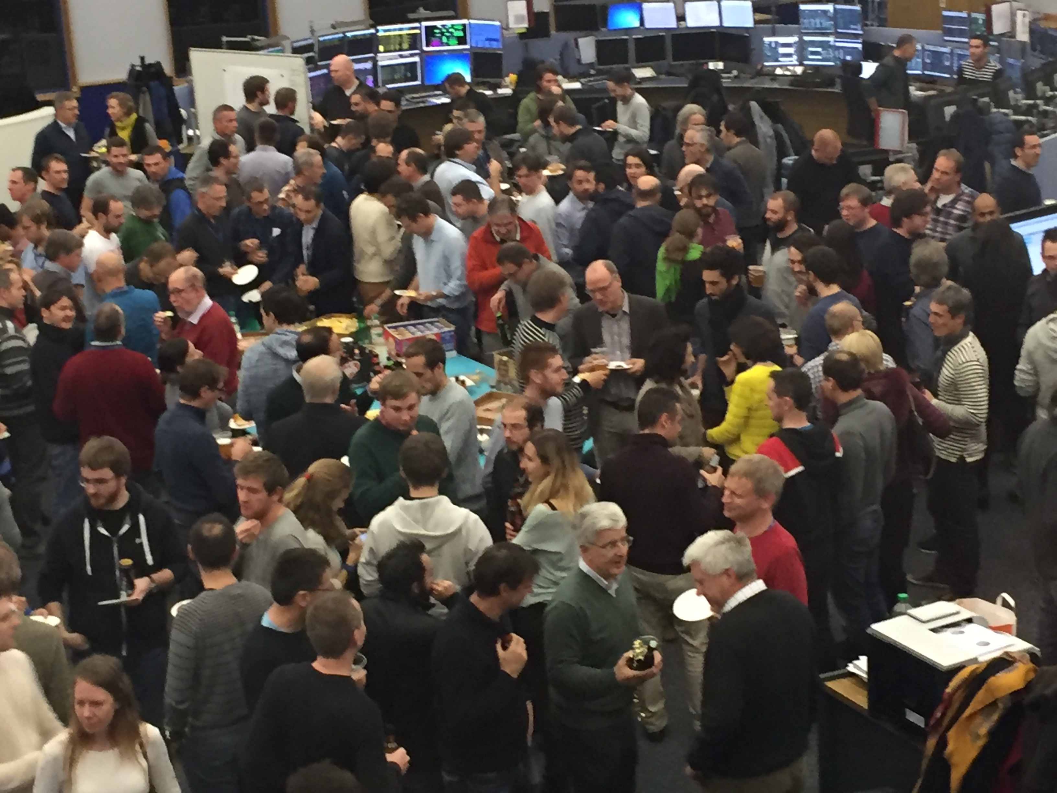
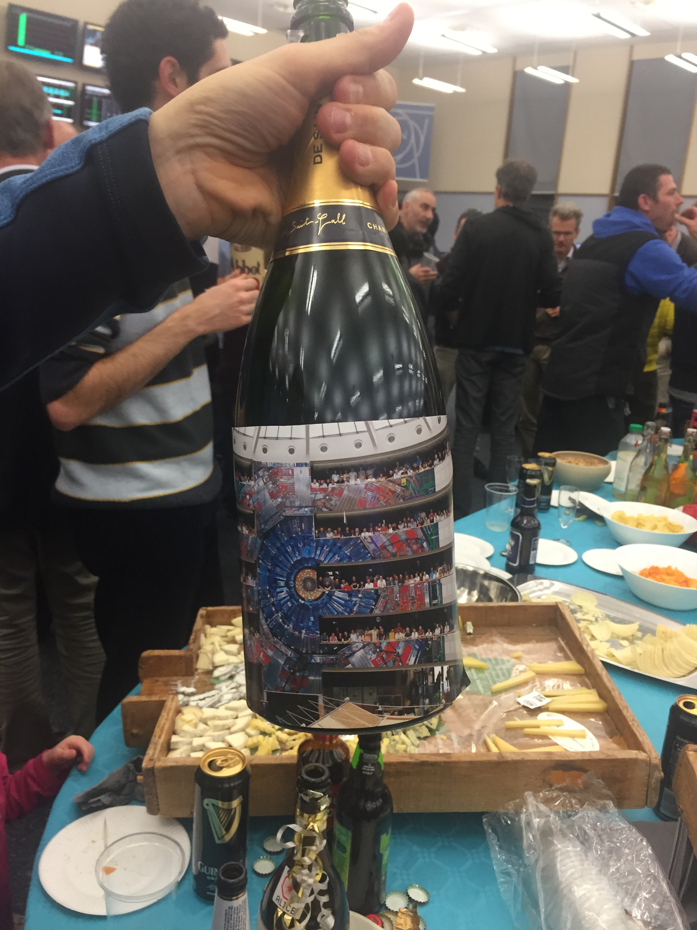
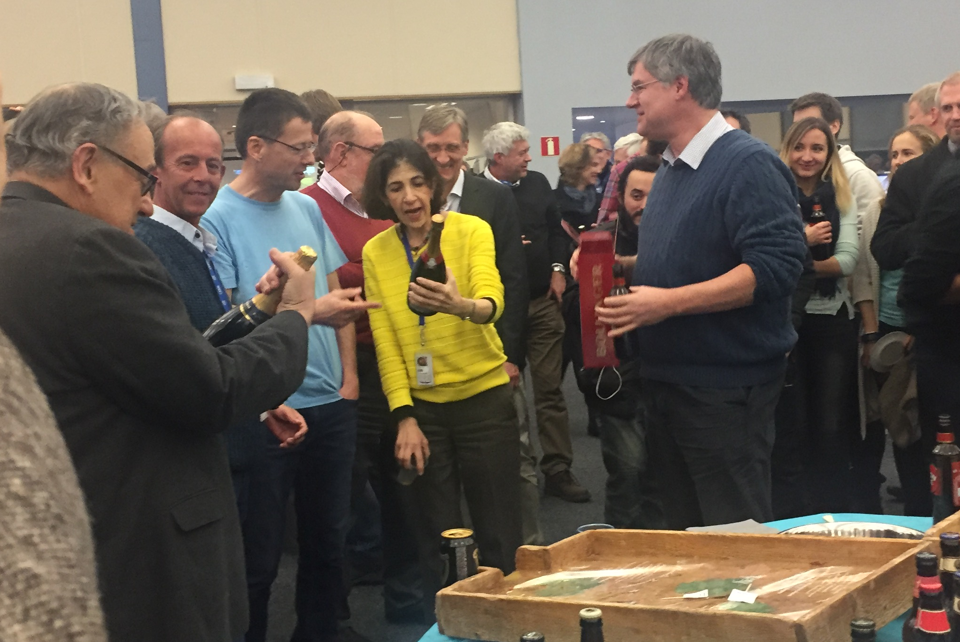
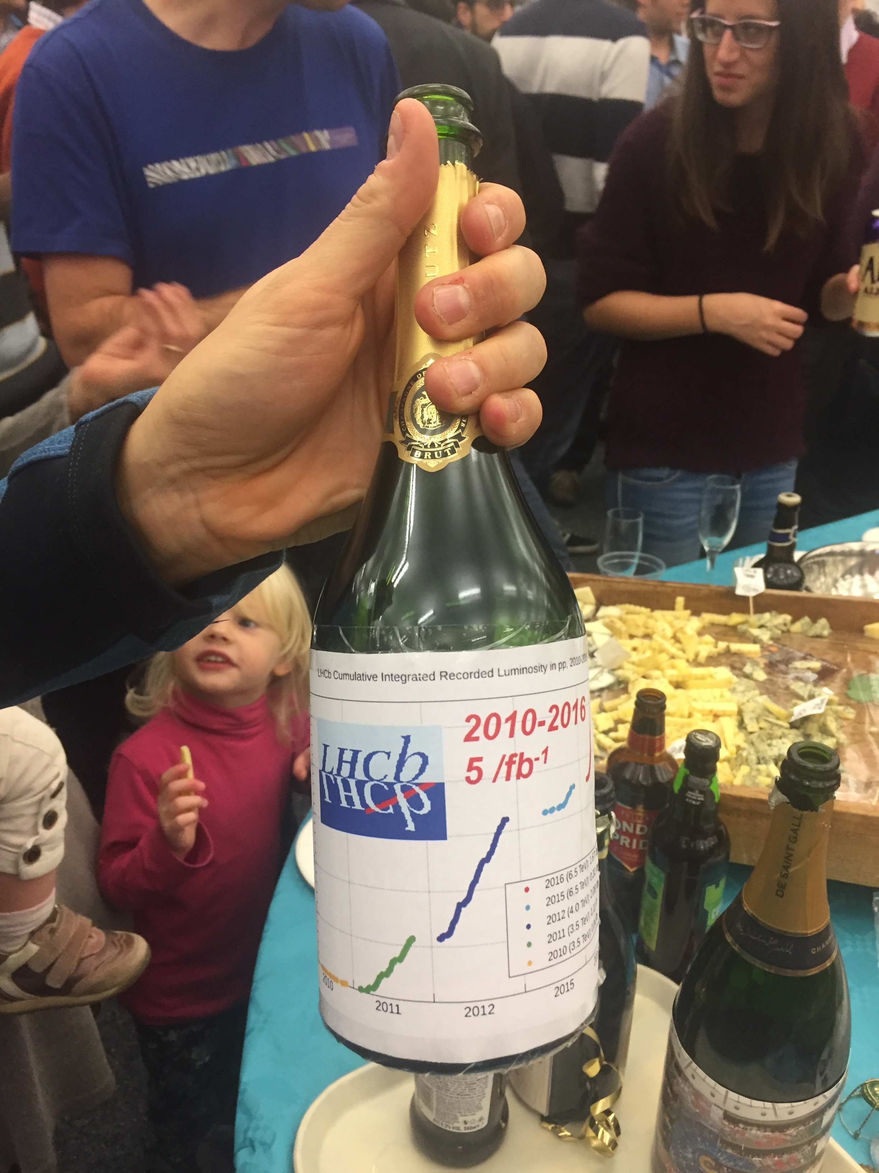
LHC - conclusions
2016 - memorable year for CERN and the LHC
Reached design luminosity and exceeded it by 40%!
While maintaining Stable Beams efficiency of ~50%!
…plus β*=2.5 km, proton-ion, machine developments…
Looking good for the next 2 years
(usual caveats)

Slide 35

HL-LHC Conclusions
Fully approved and re-baselined
Significant international technical effort on all fronts
Critical civil engineering contract process is in progress…

