Slide 1

JAI updates
IOP Particle Accelerators and Beams Group meeting
Royal Holloway, University of London
7 April 2017
Andrei Seryi
John Adams Institute for Accelerator Science

Slide 2
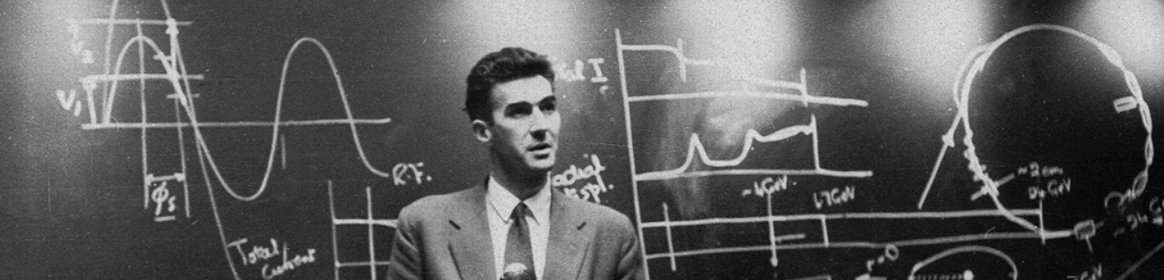
What is JAI
Sir John Adams (24 May 1920 - 3 March 1984) - the 'father' of CERN accelerators.
The John Adams Institute for Accelerator Science is a centre of excellence in the UK for advanced and novel accelerator technology, created in 2004 to foster accelerator R&D in the universities
JAI is based on 3 universities: University of Oxford, Royal Holloway University of London and, since 2011, Imperial College London
http://www.adams-institute.ac.uk

Slide 3
JAI mission
The JAI's mission is to work with other national and international accelerator laboratories and institutes, to promote and develop accelerator science in the UK
The main objectives of the Institute are:
  To develop novel and advanced accelerator technologies for particle physics and other applications
  To train a new generation of accelerator scientists and engineers
  To disseminate knowledge about the benefits of accelerator technology to a wide community through outreach projects
  To make major contributions to the design and development of new particle physics facilities
  To develop new scientific facilities such as new light and neutron sources
  The development and construction of applied accelerator technologies (medical, energy etc.)

Slide 4

Foundation of JAI programme
JAI
programme
Training next generation of scientists
Research at the forefront of accelerator science
Connections with industry and outreach programme

Slide 5
Research program evolution
… -2012
2012 -2017
2017 -2021
Enabling
accelerator
techniques for
scientific, medical
and energy
applications
Advanced
accelerator
Instrumentation
and beam
diagnostics
Enabling
accelerator
techniques for
scientific, medical
and energy
applications
Next generation
compact light
sources and
laser-plasma
acceleration FEL
Advanced
accelerator
Instrumentation
and beam
diagnostics
FEL and novel
light sources
Plasma
acceleration
Future colliders
and particle
physics facilities
Intense hadron
beams
WP2
WP3
WP4
WP5
Training
Training
Training
WP1

Slide 6
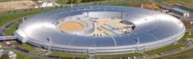
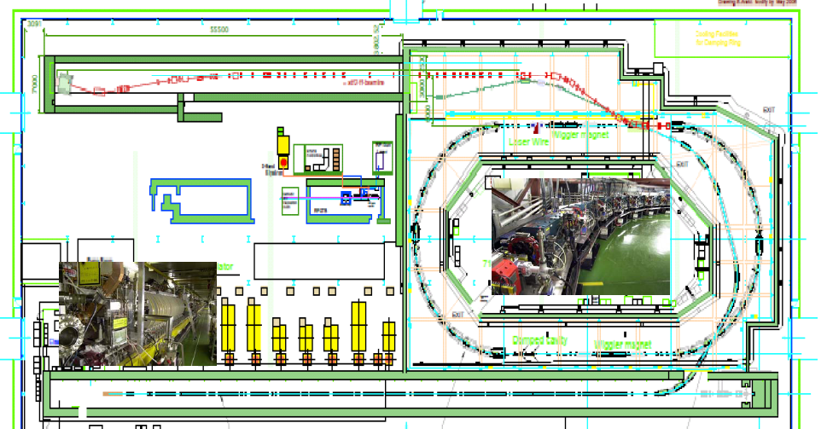
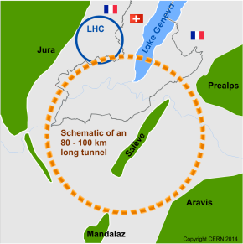
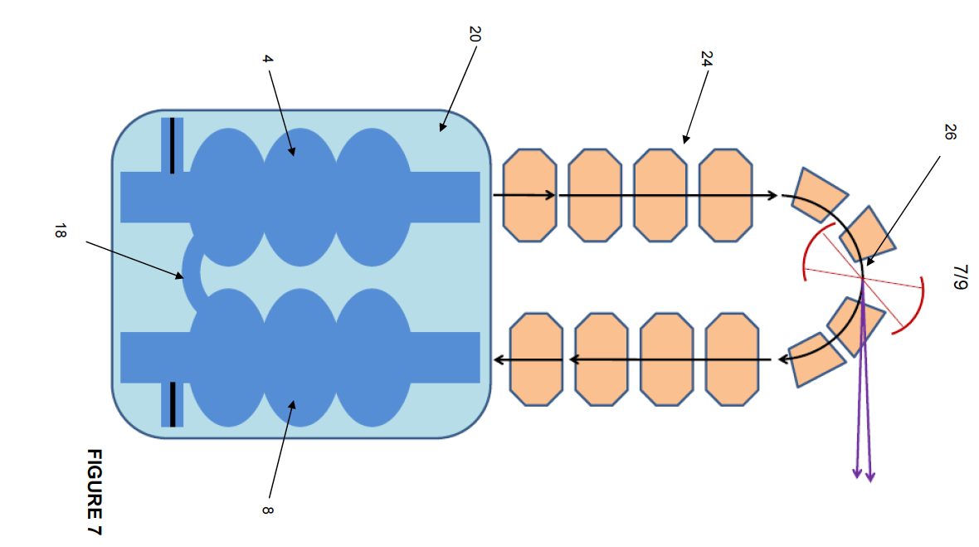

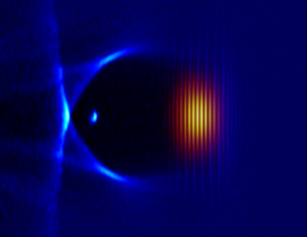
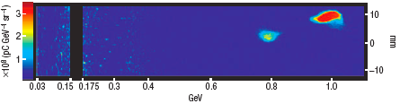
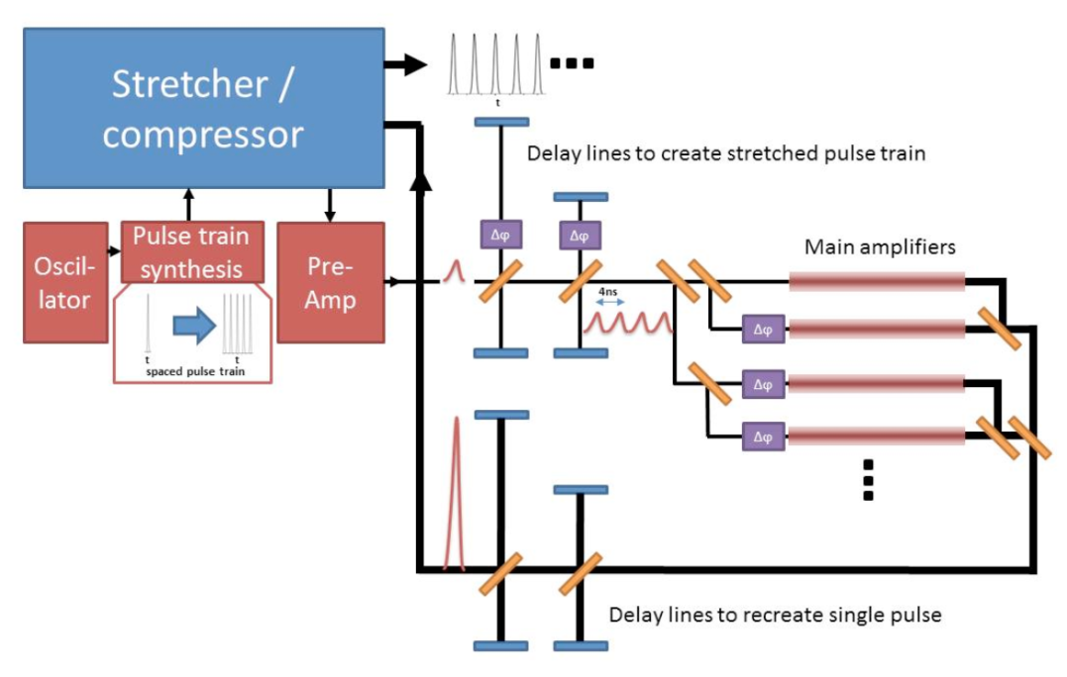
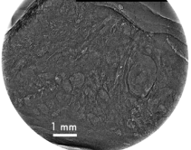
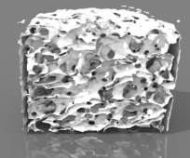
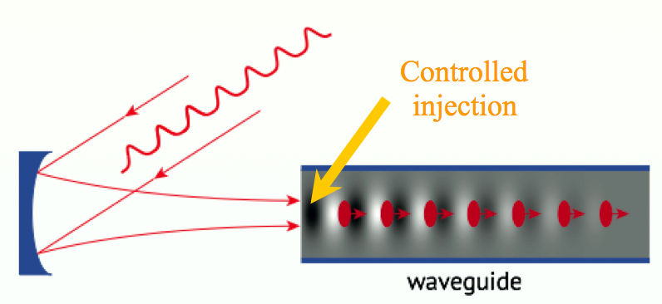
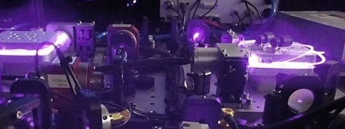
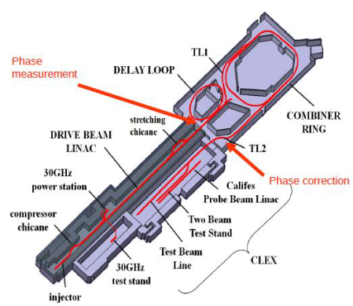
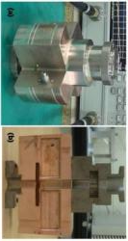
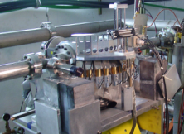
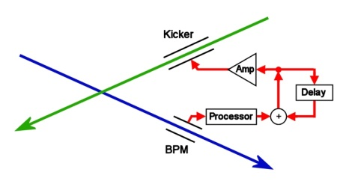
Research Directions (examples)
2012 -2017
Examples of research
Enabling
accelerator
techniques for
scientific, medical
and energy
applications
Next generation
compact light
sources and
laser-plasma
acceleration FEL
Advanced
accelerator
Instrumentation
and beam
diagnostics
Diamond upgrade
LC Final Focus
Novel ERL design of UH-FLUX
ESS
FCC IR & FF
Laser-plasma
acceleration
Feedforward
Laser wire
Training
Beam σ_{z} diagnostics
FONT
BPMs

Slide 7
Research Directions & achievements
2012 -2017
Highlights of achievements
Enabling
accelerator
techniques for
scientific, medical
and energy
applications
Next generation
compact light
sources and
laser-plasma
acceleration FEL
Advanced
accelerator
Instrumentation
and beam
diagnostics
Demonstrating new low ε techniques at Diamond Light Source
Improving HL-LHC collimation system by developing electro-optics BPM embedded into collimators
Validating nm-level beam stabilisation for ATF2 & CLIC IR
Develop drive beam phase feed-forward system
Diamond upgrade
LC Final Focus
Novel ERL design of UH-FLUX
ESS
FCC IR & FF
Laser-plasma acceleration to 2 GeV in a single stage
The first demonstration of multi-pulse plasma-wave excitation
High brightness plasma acc. X-ray sources
Phase-contrast imaging of human tissues and high-resolution bone tomography
Laser-plasma
acceleration
Feedforward
OTR and Smith Purcell diagnostics
Commercialization of cavity BPMs
Commercialization of metrology system.
World-class graduate training: 60 PhD experts graduated from JAI
Laser wire
Training
Beam σ_{z} diagnostics
FONT
BPMs

Slide 8
Many aspirational deliverables or new ideas were realized
2012 -2017
Highlights of over-delivery
Enabling
accelerator
techniques for
scientific, medical
and energy
applications
Next generation
compact light
sources and
laser-plasma
acceleration FEL
Advanced
accelerator
Instrumentation
and beam
diagnostics
Developed optics for Diamond Light Source upgrade which is now being realized in one of the sectors of DLS.
Developed an electro-optics pick-up embedded into collimators – a key device for HL-LHC
Developed a novel design of SCRF compact light source based on coupled asymmetrical cavities
Diamond upgrade
LC Final Focus
Novel ERL design of UH-FLUX
ESS
FCC IR & FF
Developed a new, non-invasive technique for measuring the angularly-resolved spectrum of betatron X-rays.
Developed a proposal for an innovative two-stage laser and beam-driven wakefield accelerator based on self induced microbunching of an external electron beam, which can allow to create X-ray pulses with unique properties.
Laser-plasma
acceleration
Feedforward
Developed further industrial connection for AMULET technology
Teach @ USPAS, JUAS, CAS, AAS
Created a novel textbook
Laser wire
Training
Beam σ_{z} diagnostics
FONT
BPMs

Slide 9
Programme for 2017-2021 - structure
Training
  Undergrad. & grad. training
  Visitor programme
  Advanced courses jointly with CI
FEL and novel light sources
  FEL design
  Diamond upgrade
  FEL-CLF-DLS synergy
  Advanced beam diagnostics for UK FEL
  Compact laser-plasma light sources
  Compact SCRF X-ray and THz sources
Plasma acceleration
  Development of Wakefield acc.
  Laser driven ion beams
  Medical applications
  Contribution to AWAKE
Future colliders & PP facilities
  HL-LHC
  ILC, CLIC and MDI
  FCC and MDI
  MICE science experiment
  A low E gg collider
Intense hadron beams
  Future of FETS
  IBEX Paul trap and IOTA
  FFAG and ISIS-2 design
  ESS linac study & commission.
Industrial and public outreach
Admin and collaboration support

Slide 10
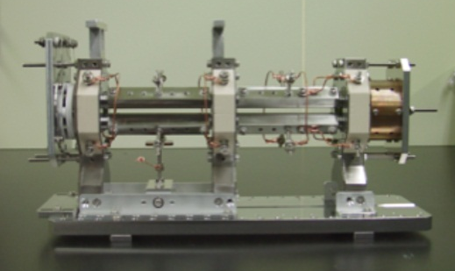
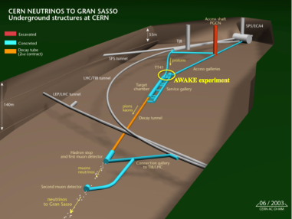
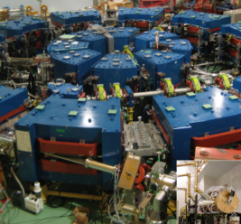
Research directions
2017 -2021
FEL and novel
light sources
Plasma
acceleration
Future colliders
and particle
physics facilities
Intense hadron
beams
UK-FEL
Diamond upgrade
UH-FLUX
MP LWFA
Beam diagnostics
LC FF
FCC IR & FF
IBEX
CLIC R&D
Training
AWAKE

Slide 11

Preliminary calculations on a SwissFEL+
WP2.1: FEL design
e-beam
500 MeV
8.7 GeV
RF-GUN
1.2 GeV
■
S01 S02 S03
X01
50 m UNDULATOR
BC1
S04 S05 S06
BC2
S07 S08 ...
~500 m
tapering to increase pulse power
Energy 8.7 GeV
Repetition rate 100 Hz (each FEL)
Max. photon energy ~ 18.6 keV
Pulse duration 20-30 fs
Photons/pulse (10 keV) ~ 10¹²
No. of FELs up to 4 (?)
Possible FELs SXR (0.1 – 2 keV)
MXR (1.5 – 6 keV)
HXR (5 – 15 keV)
Experimental stations 3 per FEL
Facility length ~ 850 m
Power consumption ~ 7MW
self-seeding to increase coherence

Slide 12
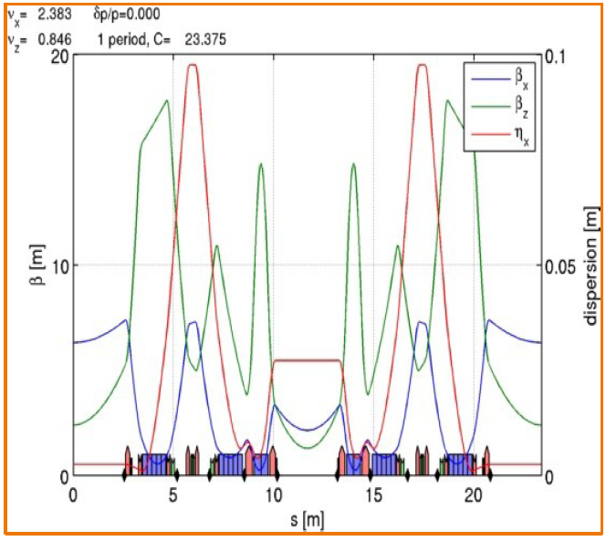
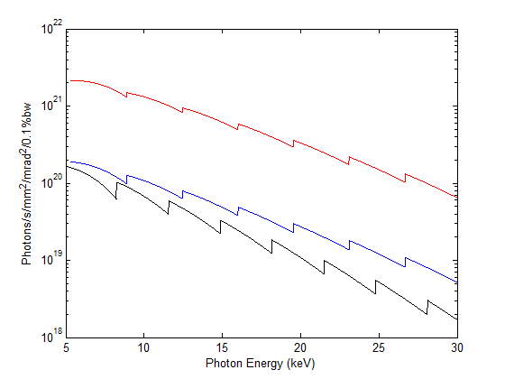
WP2.2: Diamond upgrade
The novel optics will allow an order of magnitude higher brightness

Slide 13
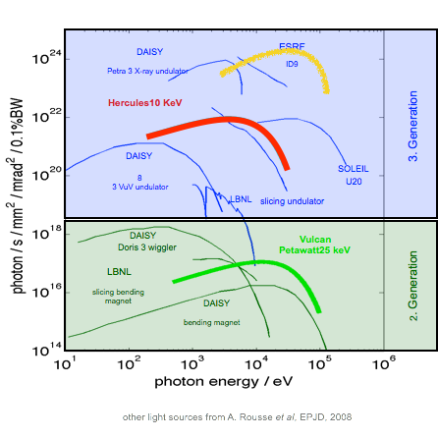
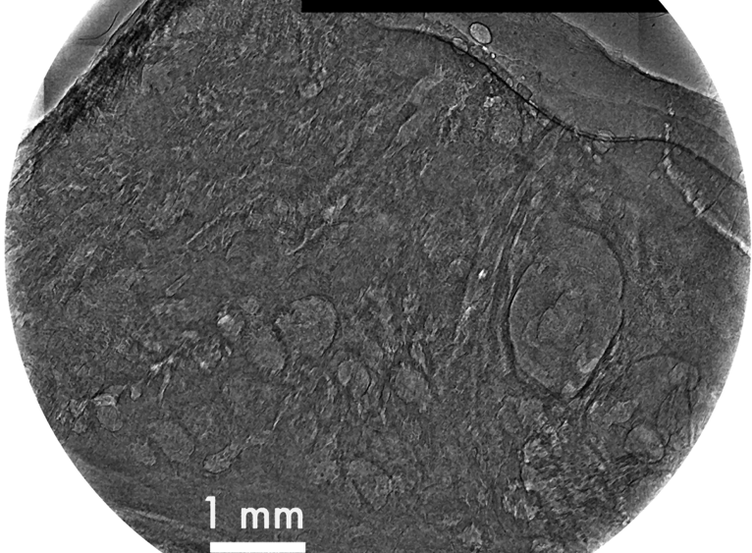
WP2.5: Compact laser plasma radiation sources
Used for imaging fast phenomena; e.g. shock propagation in dense material.
Gemini betatron x-ray source now > 10²⁴ photons per (mm² mrad² sec 0.1%BW)
Gemini 2015
medically relevant material; e.g. phase contrast imaging of prostate sample

Slide 14
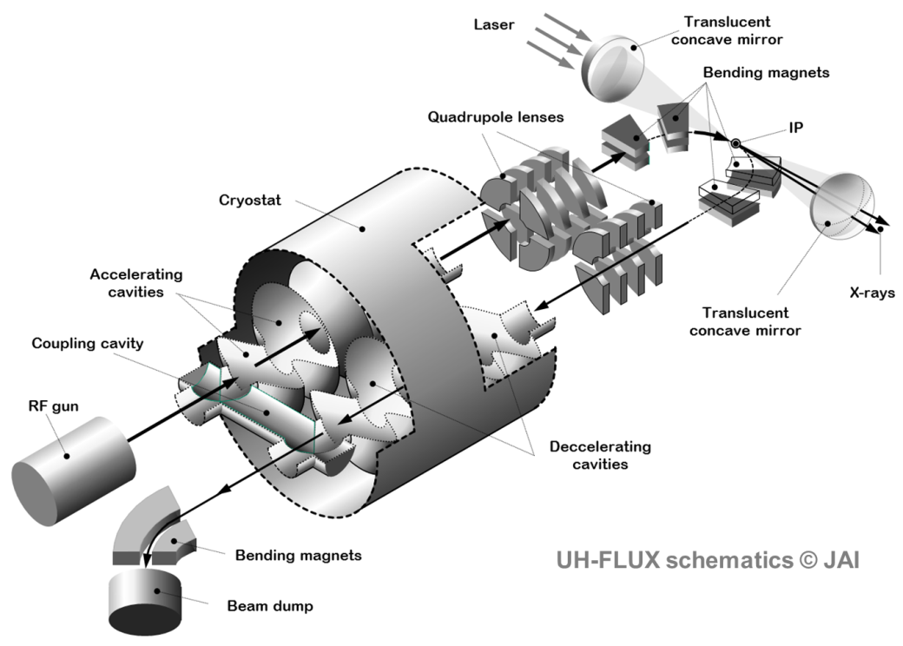
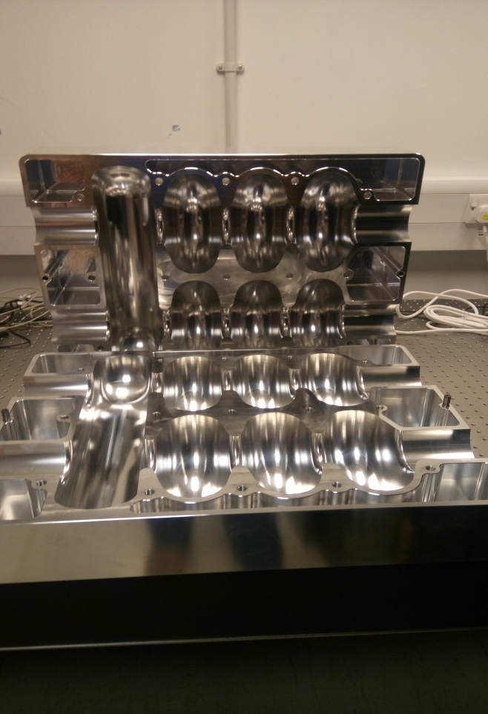
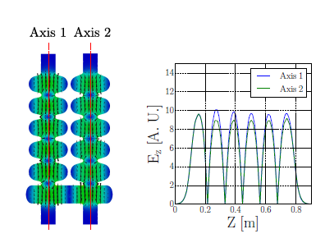
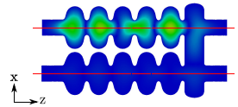
WP2.6: Compact SCRF X-ray and THz light source
Asymmetric Energy Recovery Linac
Advantages:
a) capability to drive 1As level electron beam
average current
b) independent tuning of IP point and
accelerator if phase shifter is introduced
in the coupling cell
c) field tuning to account
for beam change at
interaction point
Operating field flatness @1.3GHz
Electric field contour plot of dipole partial eigenmode at 1.73GHz
Axis 2
Al prototype for low-level RF measurements
Axis 1
Electric field contour plot of operating eigenmode at 1.3GHz

Slide 15
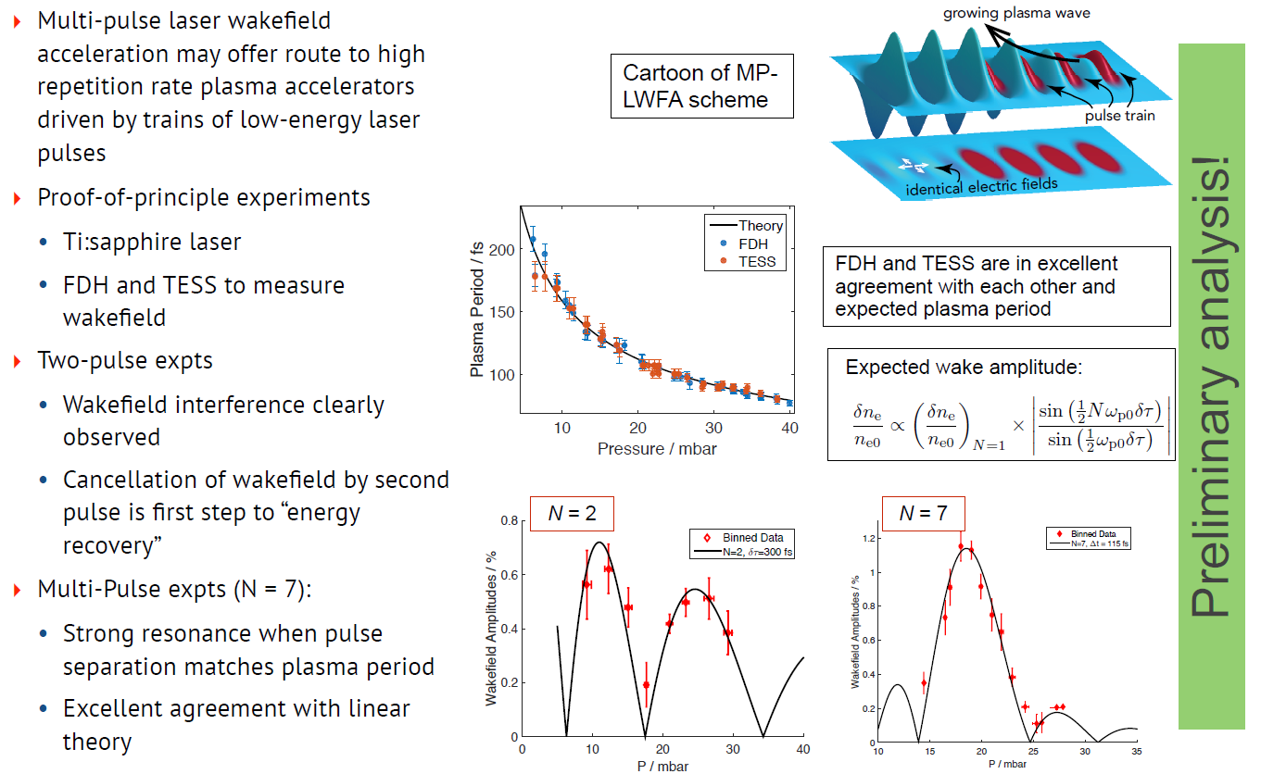
WP3.1: Development of wakefield accelerators
WP3.1.2: Development of efficient high rep-rate LWFA
Simon Hooker at al

Slide 16
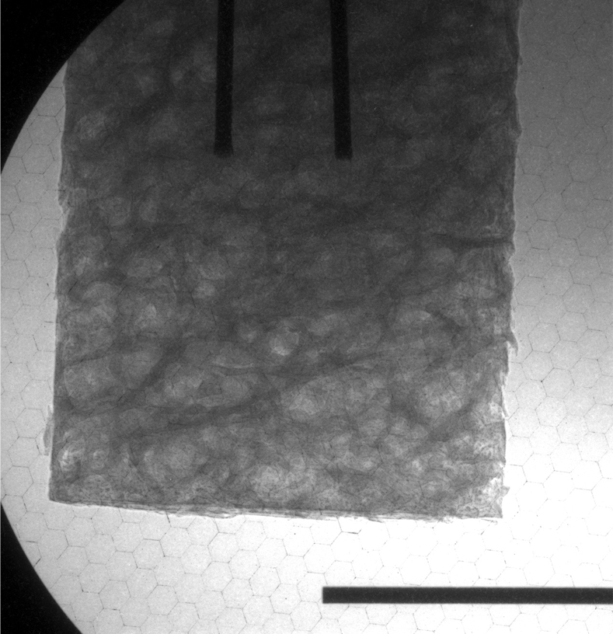
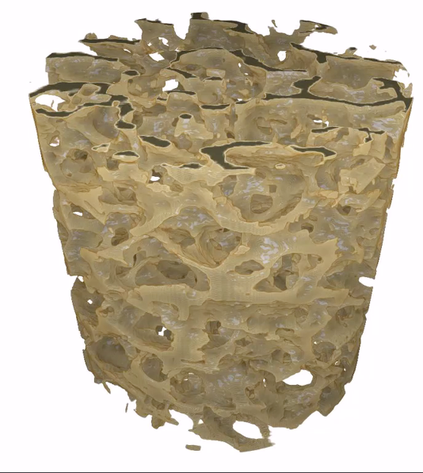
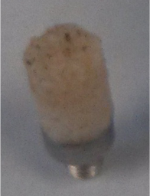
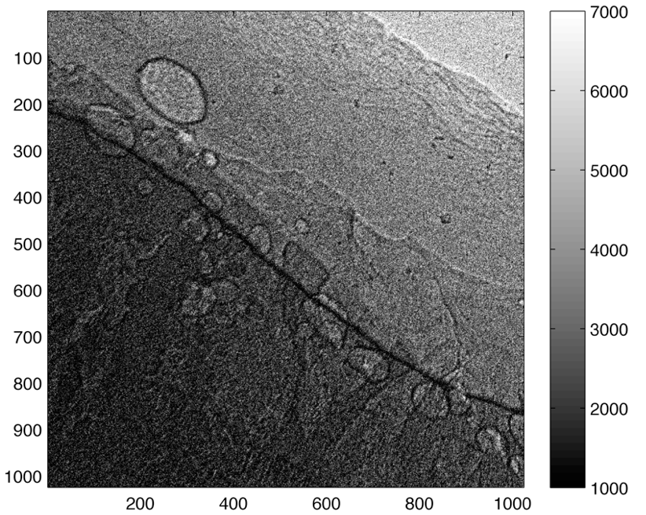
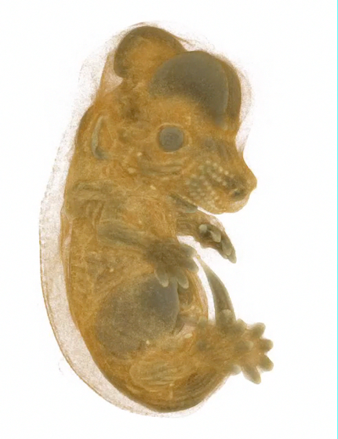
WP3.3: Medical application of laser-acc. particles
Betatron radiation could prove to be an interesting source for medical radiography
  Small source size and collimated beam allows for high resolution phase contrast imaging of soft tissue, e.g. breast, prostate…
  Hard photon energy with small source size allows for high resolution imaging of bone, biological samples
X-ray radiograph of femural bone sample (left, and photo inset) tomographically reconstructed (right)
Phase-contrast imaging of prostate (left) and tomograph of pre-natal mouse (right)

Slide 17

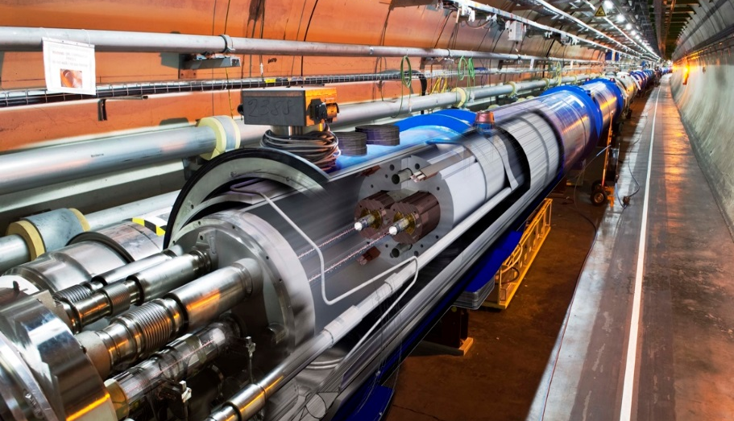
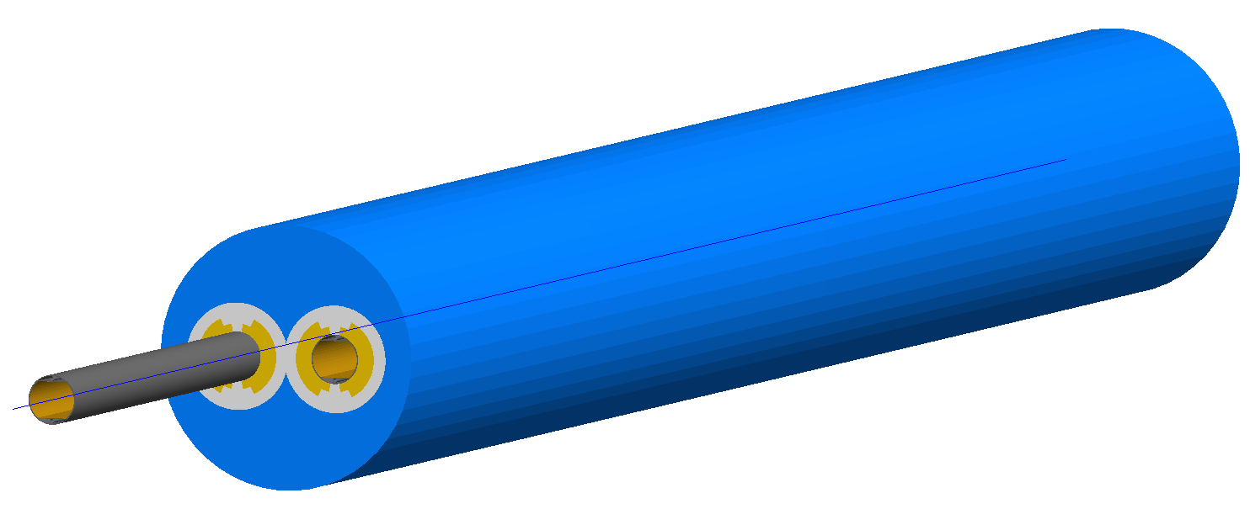
WP4.1: High Luminosity LHC
Collimation challenge:
to efficiently clean the LHC beam, while…
protecting cryogenic magnets from huge stored beam energy (doubles at HL-LHC!)
mitigating beam backgrounds that reach the experiments!
Collimation challenge
Superconducting coil:
T = 1.9 K, quench limit
~15 mJ cm⁻³
Factor 9.7 x 10⁹
Proton beam: 145 MJ
LHC design: 362 MJ
HL-LHC: 678 MJ!
LHC dipole
JAI-RHUL experts already integrated in team at CERN. Main contributions:
  Off-momentum loss maps: new model recently validated with energy deposition measurements at LHC.
  Advanced simulations of beam dynamics to design the new triplet layout for HL-LHC.
  RHUL-developed tool (BDSIM) to model LHC beam backgrounds measured at ATLAS.
in BDSIM
Off-momentum loss maps:
Model
Beam background simulation
LHC data

Slide 18
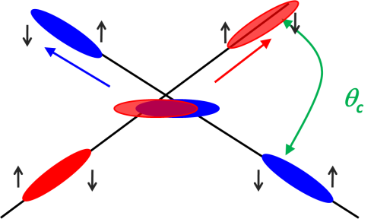
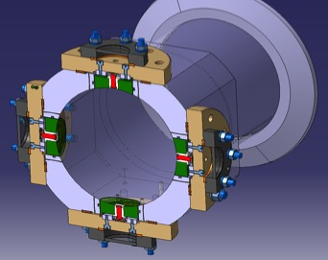
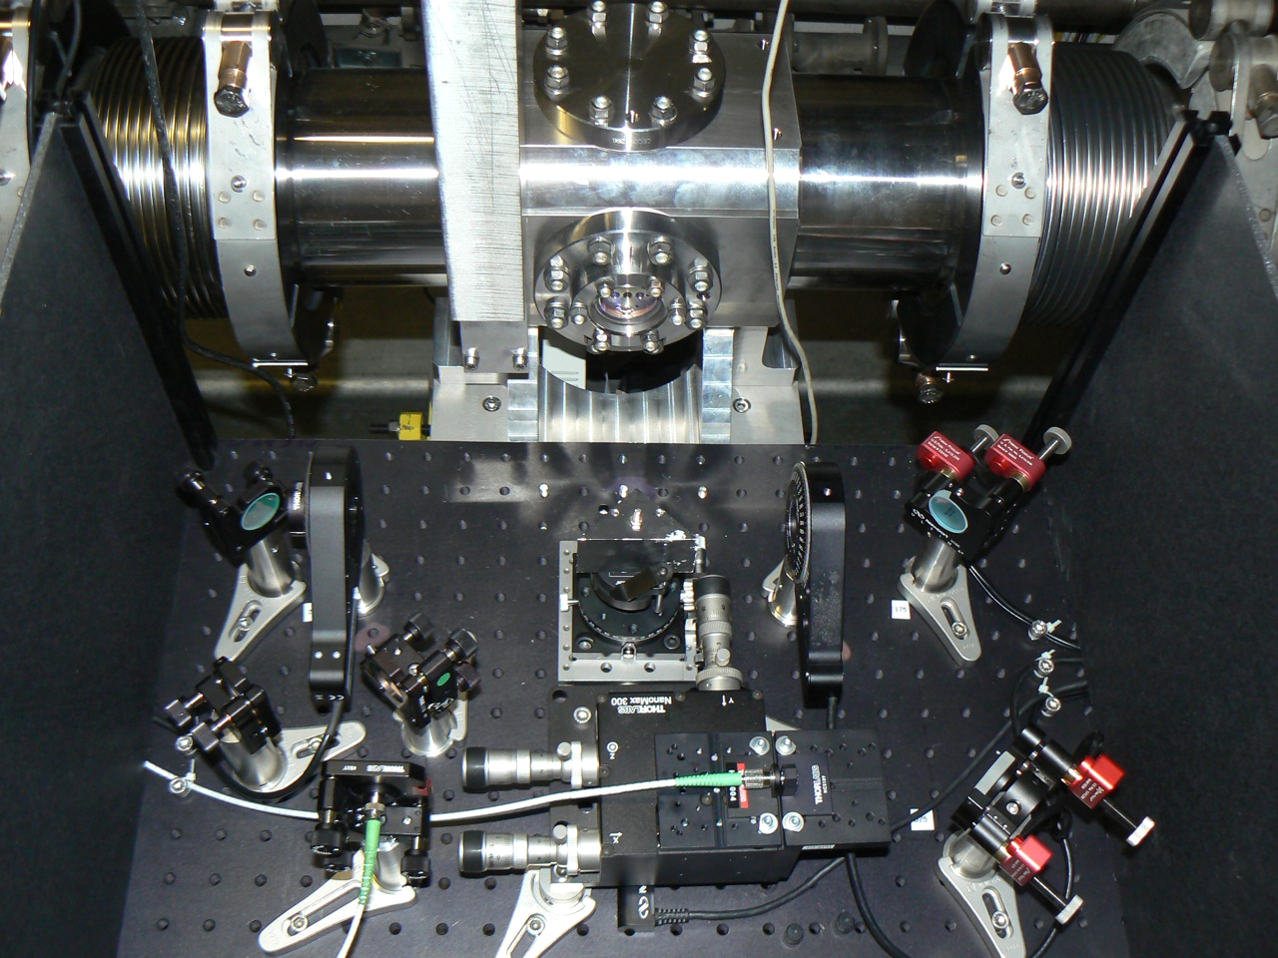
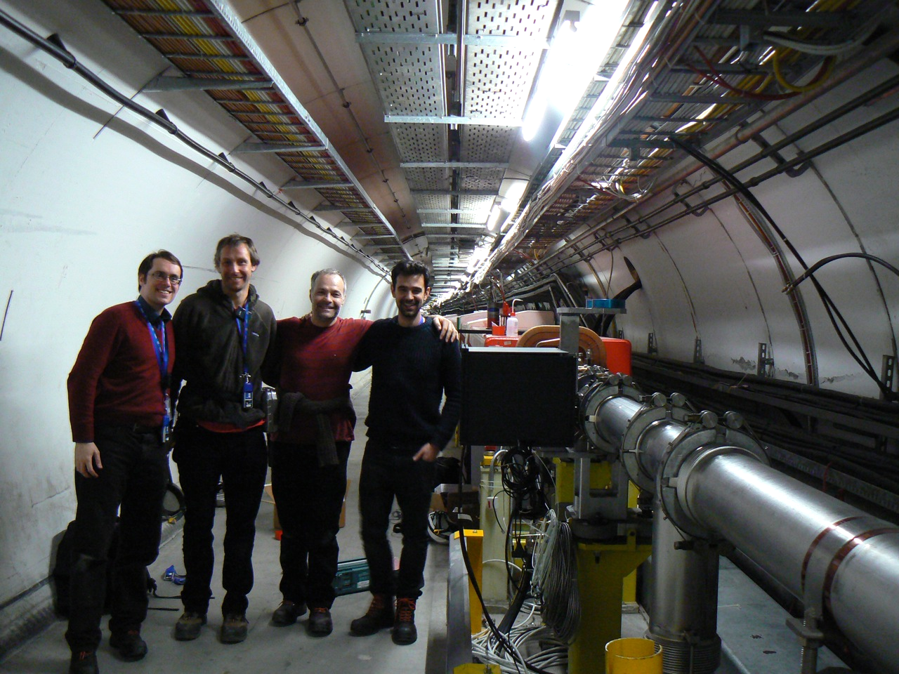
WP4.1: High Luminosity LHC
Diagnostics: Electro-optic Beam Position Monitors
HL-LHC crab cavities require new instrumentation to monitor bunch rotation and optimize performance.
High bandwidth electro-optical pick-ups enable intra-bunch measurements of transverse position.
JAI built prototype installed in 2016 at CERN SPS for proof of principle tests, in collaboration with CERN BI group.
JAI built prototype already installed for tests at CERN SPS
Second prototype planned for LHC, before deployment at HL-LHC

Slide 19
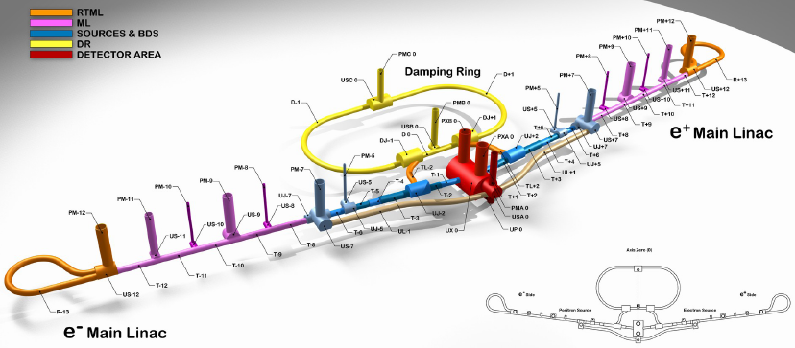
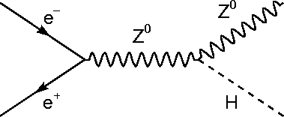

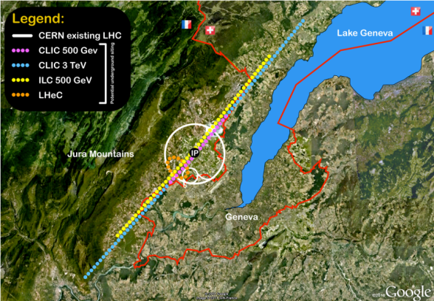
WP4.2: ILC, CLIC and MDI
More detail in talk of Phil B.
Accelerator R&D for electron-positron Linear Collider
‘Higgs Factory’
Selected site
Japan
CERN →
International Linear Collider: awaiting decision from Japan (~2018)
CLIC: preparing input for European Strategy update (~2019)

Slide 20
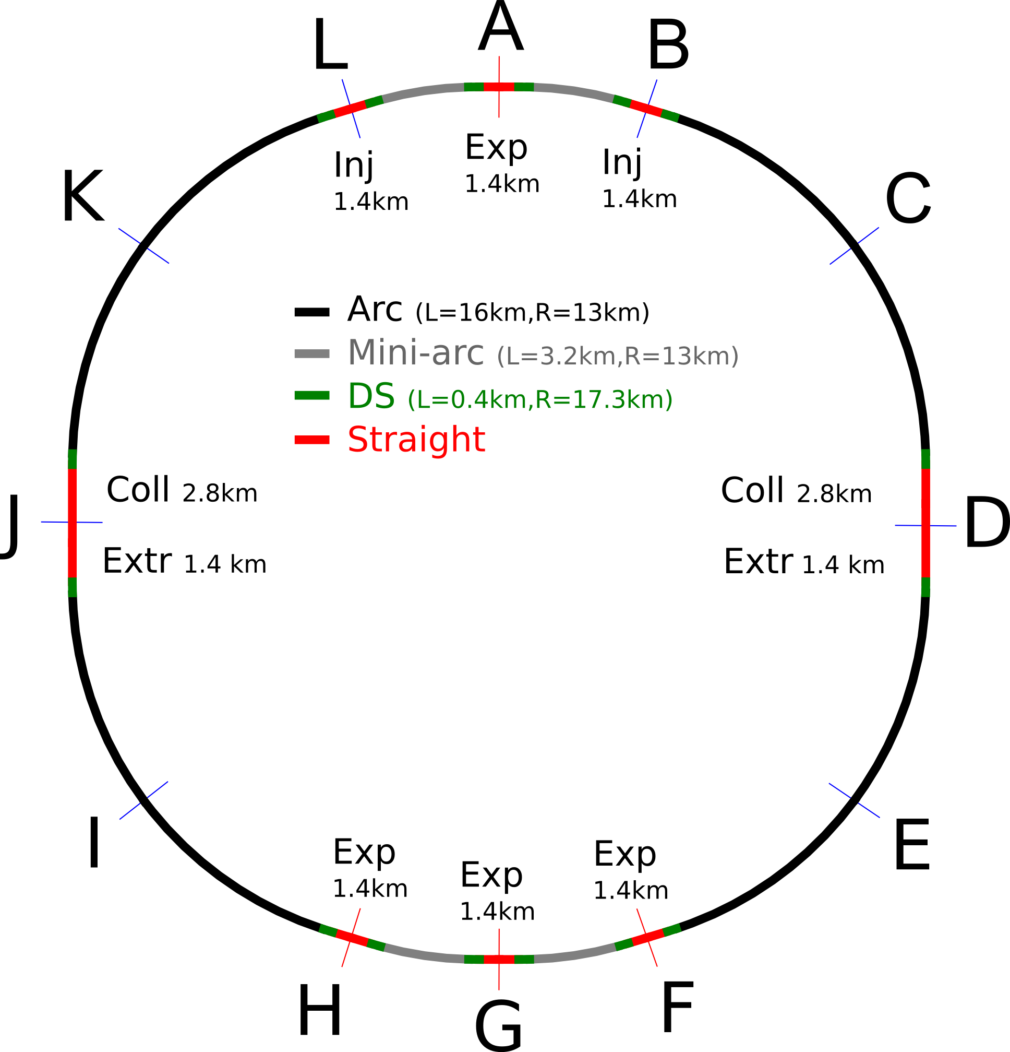
WP4.3: FCC-hh and MDI
Experimental Interaction Region
  One of critical areas defining FCC-hh (HE-LHC) performance
Design tasks of EuroCirCol IR Work Package
  Coordination
    JAI/Oxford (lead), CERN, task 3.1
  Development of the interaction region lattice
    JAI/Oxford (lead), CERN, task 3.2
  Design of machine detector interface
    CI/Manchester (lead), INFN, CERN, task 3.3
  Study of beam-beam interaction
    EPFL (lead), CERN, task 3.4
Responsibility of JAI

Slide 21
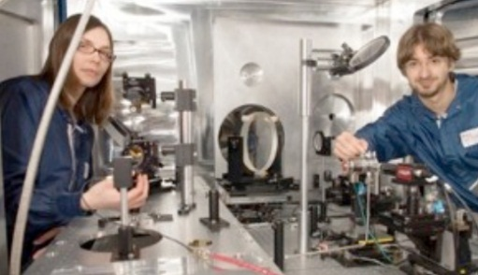
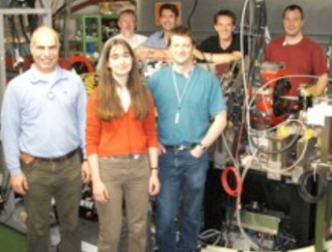
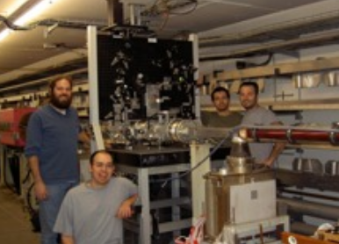
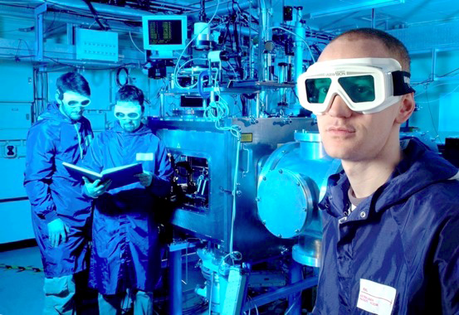
JAI graduate training
  PhD based on state-of-the-art studies in accelerator science
  Excellent record – majority graduates in 4 years
  Total number of PhD graduates is about 60 (20% women)
    Majority of theses (91%) combine experimental research with theoretical/simulation investigations
  Excellent post-PhD employment opportunities
    Our graduates have excellent career prospects in fields of science & technology – they now work at RAL, ASTeC, Oxford, NPL London, CERN, SLAC, BNL, DESY, LLNL, LBNL, etc.
    15% of our alumni work in industry

Slide 22
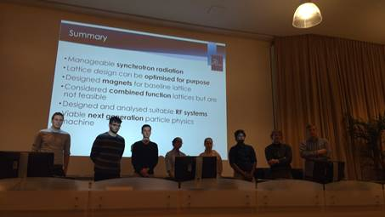

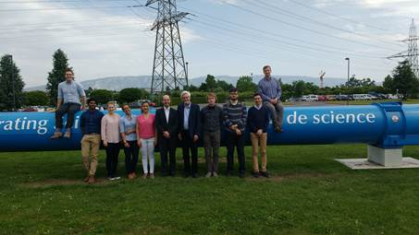
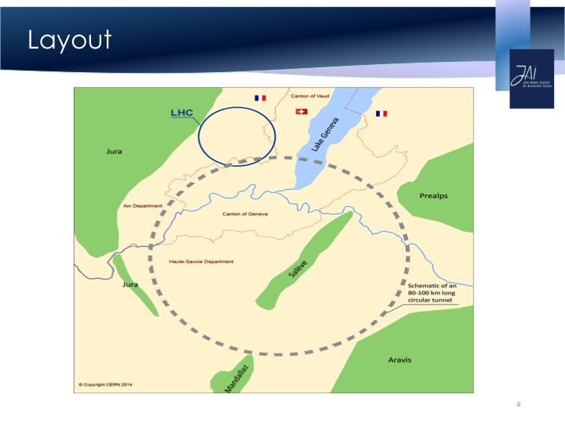
Post-graduate training - students’ project
Every year students work on a design project, that allows them to put their skills into practice
Students present results of design project first to JAI staff, then to Advisory Board, and then to CERN colleagues
Presentation at CERN Council Chamber May 2016
Group Photo at CERN May 2016

Slide 23

JAI post-graduate training
JAI method of post-graduate training spreads around the world
The students’ design project has been applied this year, for the first time, at USPAS class, taught by JAI’s A.S. and Aakash Sahai
JAI taught USPAS class, following 1-week course, wrote a paper and got an oral talk at North American Particle Accelerator conference!

Slide 24

CAS at RHUL

Slide 25
JAI and UK facilities
Contributed strongly to existing UK facilities and their possible upgrades
  The first version of optics for Diamond Light Source upgrade originated from JAI graduate student – it now being realized in part of the ring
  Joint Diamond-JAI senior academic and junior researchers
  Joint ISIS-JAI researcher enhance our impact on developments of ISIS upgrade and future of FETS facility
  Made key contribution to development of Central Laser Facility upgrade plan
  Contributed to Technical Design Reports for the 20PW upgrade for the Vulcan Laser facility and to the high rep-rate upgrade/replacement to Astra Gemini (Pulsar)

Slide 26
JAI future goals
  aim to excel in our training program
  aim to contribute strongly to UK facilities and their upgrades, Diamond Light Source, ISIS neutron source, Central Laser Facility
  aim to play a key role in evolution of UK-FEL from R&D into the project phase
  will strongly engage in and lead ILC and CLIC, if hosting/construction decisions will be taken
  will strive to make practical use of our SCRF compact source (in industry) as well as plasma acceleration source (in medicine)
  will lead the key technical areas of FCC and possibly HE-LHC project into the next project stages
  will aim to realise the high power proton beam facilities based on concepts we helped to develop

