Slide 1
Report by Brian McNeil, Hon. Treasurer to the AGM of the PAB Group,
8 April, 2016

Slide 2
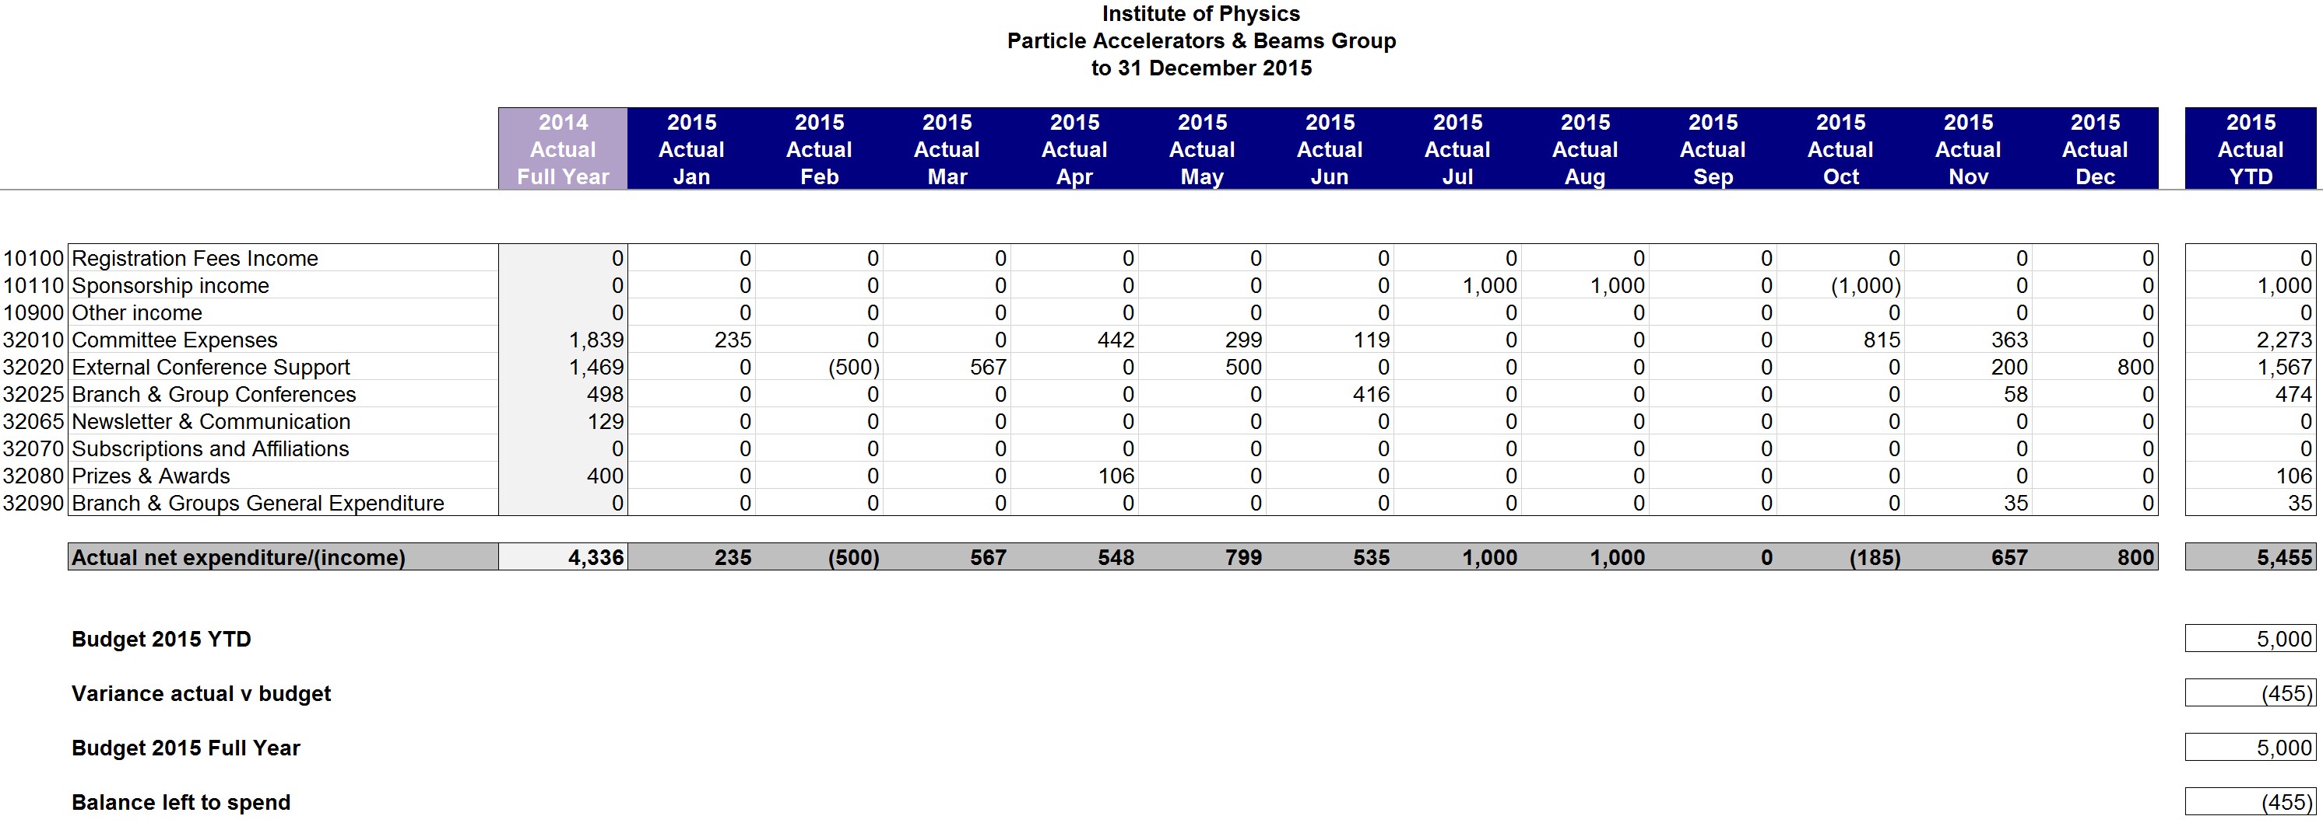
Accounts Jan.-Dec. 2015
Summary (All figures Exclude VAT):
Budget 2014 YTD £5000
Actual net expenditure/(income) £5455
Balance -£ 455
STFC say they had “major issues with our invoicing system prior to year end (due to system issues and lack of staff)” – caused some problems.
An erroneous expenses charge of £119.09 in 2015 accounts should have been charged to the Polymer Physics Group - Cannot be corrected now.

Slide 3
Current year 2016
Total budget for year 2016 increased from £5000 to £5500. Following some corrections we have £5633
Future meetings/events planned and supported:
£500 Electron- Ion Collider meeting;
£500 Designing Future X-Ray FELs workshop.
These, and others with planning in-progress, indicate that in 2016 PABG will again be on target to spend the budget effectively and efficiently.

