Slide 1
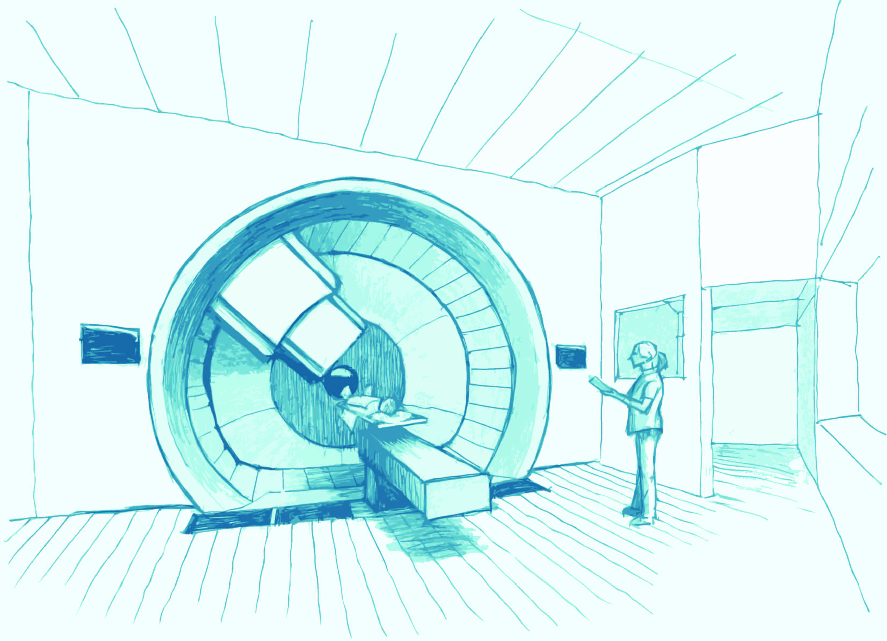
Developing proton therapy
Dr R I MacKay
The Christie NHS Foundation Trust

Slide 2
Radiotherapy News
Testing underway for UK proton beam cancer treatment
Advanced Oncotherapy has begun testing its groundbreaking Light machine for the UK’s first proton beam therapy centre, in what is expected to be a cancer treatment milestone when it opens by the end of next year.
The Telegraph - Comment on this story
Will the UK become the proton therapy centre of Europe?
Several companies are opening proton beam therapy centres across the UK as the treatment becomes more popular. Recent independent medical research suggests that proton beam cancer therapy treatment is far less harmful and traumatic to cancer patients than chemotherapy. Proton Partners International will bring the world’s first digital PET CT system to Wales. The equipment fitted at the UK’s first proton beam therapy centre will provide cancer patients with the most advanced cancer technology available.

Slide 3
Radiotherapy
After surgery, it is the next most important method of curing cancer.
40% of all patients cured of cancer are cured by radiotherapy.
50% of all cancer patients will benefit from receiving radiotherapy as part of their cancer management.
Its use is continuing to expand. This is due to better patient pathways, the role of multi-disciplinary team meetings and more integrated treatments.

Slide 4
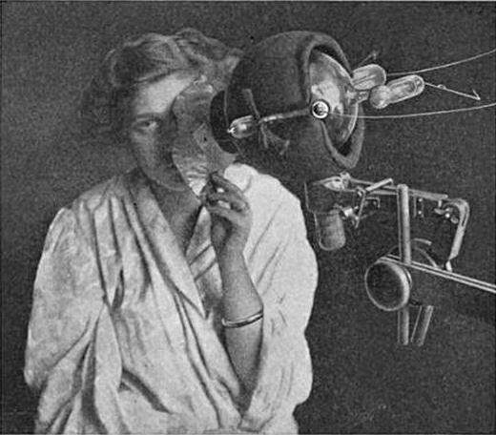
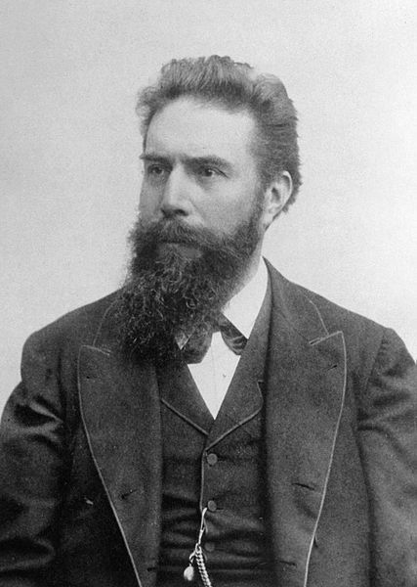
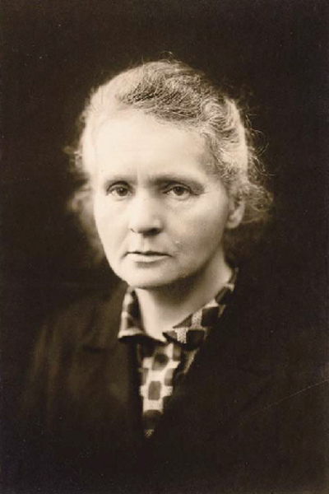
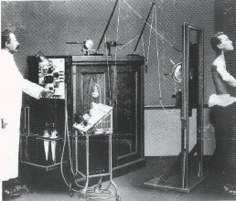
A little history…
Very quickly after Roentgen’s discovery of X-rays and Marie Curie’s discovery of radioactivity, they were both being used to treat disease, including cancer
Freund/Schiff 1896 – skin treatments
Emil Grubbe 1897 – cancer treatment
Herbert Jackson 1896 – use of electron focusing

Slide 5
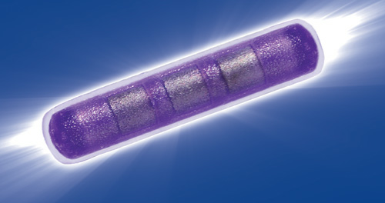
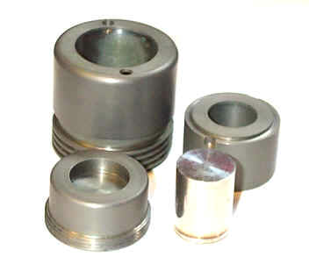
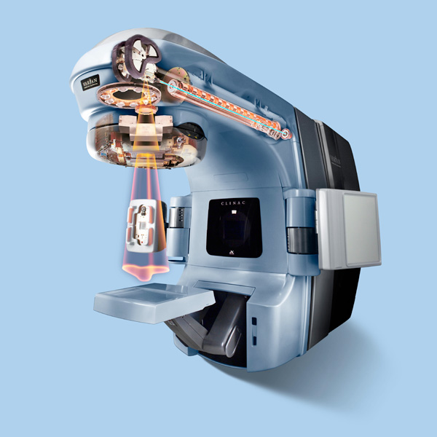
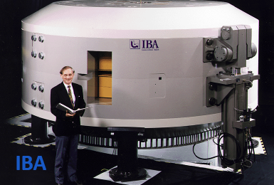
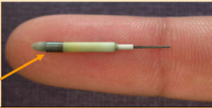
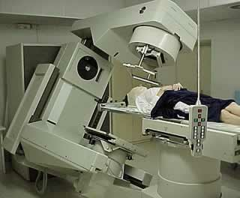
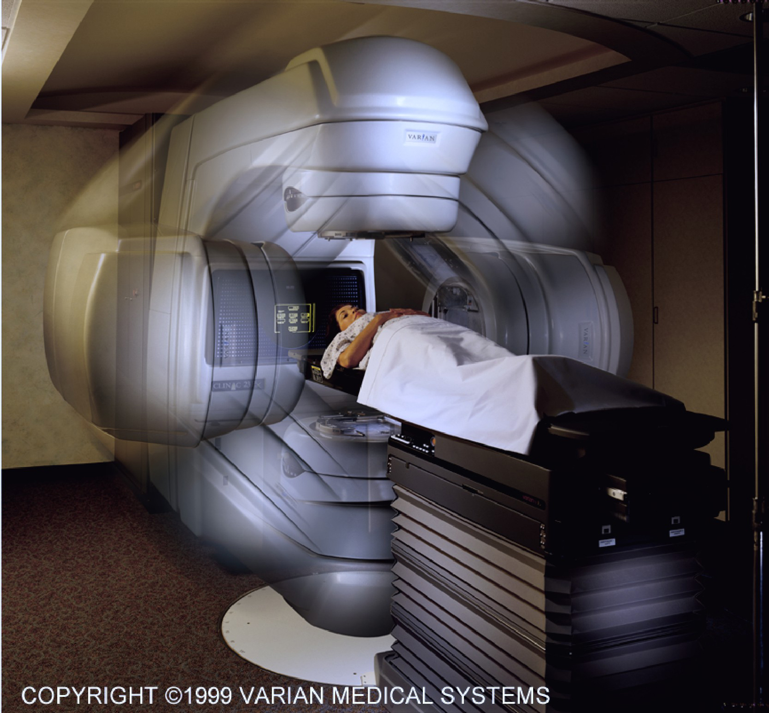
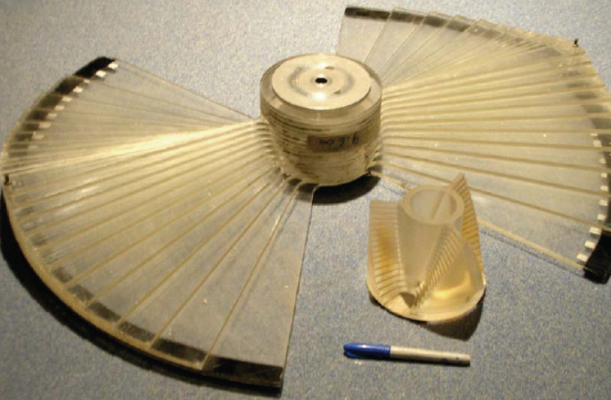
A smorgasbord of radiotherapy
Brachytherapy:
X, γ, β
Ir-192, Co-60, Cs-137, Au-198
I-125, Ra-226
Teletherapy
γ
Co-60, Cs-137
X-ray radiotherapy
X
6-40 MeV electrons onto W target
Particle therapy
p, C, etc.
Cyclotrons, synchrotrons etc.

Slide 6
Radiotherapy Linear Accelerator
Electron
Standing or travelling wave
4- 20 MV but most commonly 6 -10MV
Dose rate for photons ~ 5Gy a minute
Field size 30x40cm – 5mm MLC
Electrons impact on a tungsten transmission target to produce x-ray beam
Beam flattened and shaped

Slide 7
External Beam Radiotherapy

Slide 8
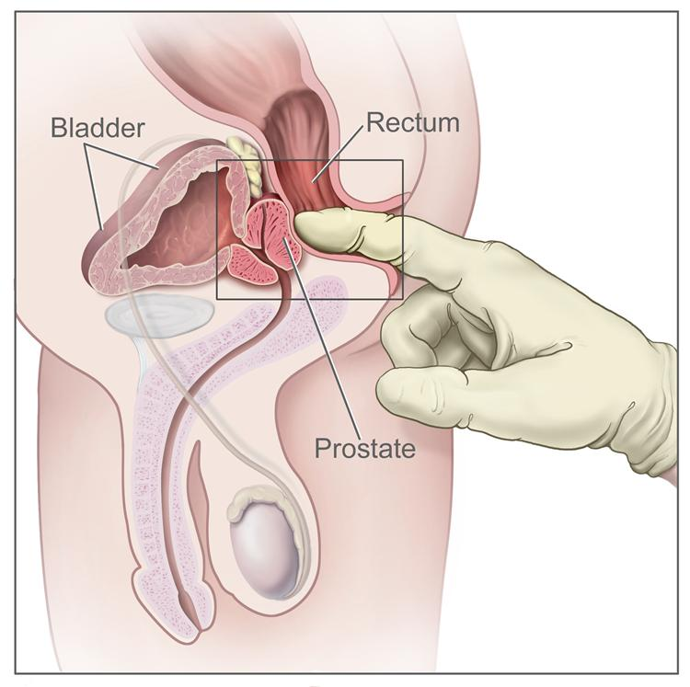
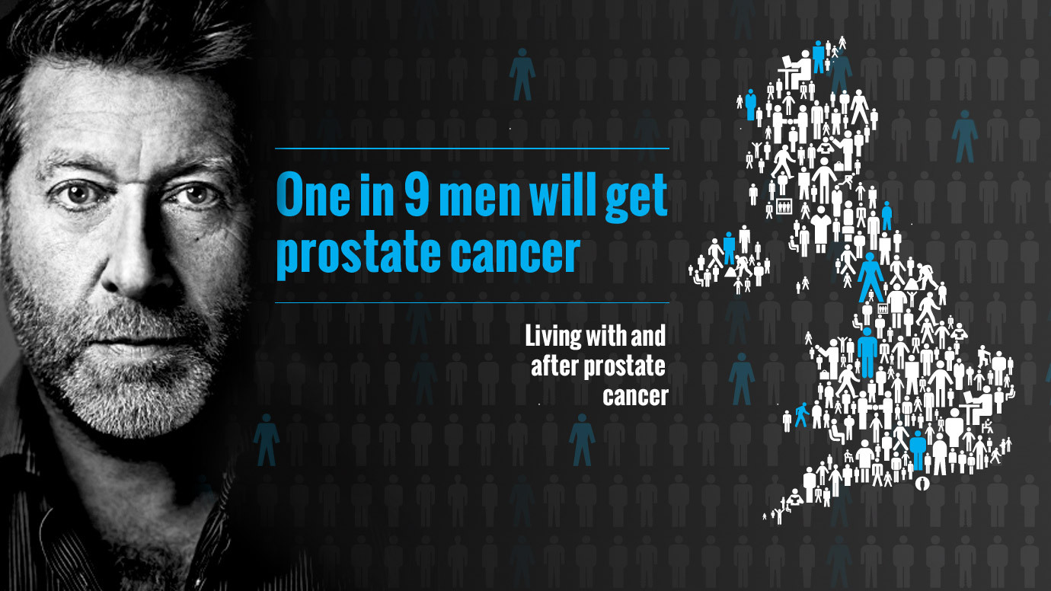
Prostate

Slide 9
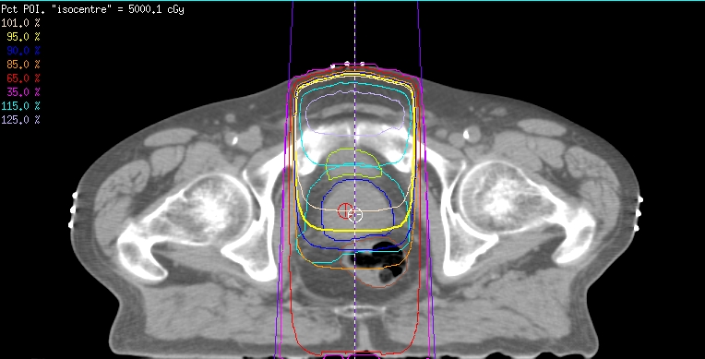
Single beam isodose plot

Slide 10
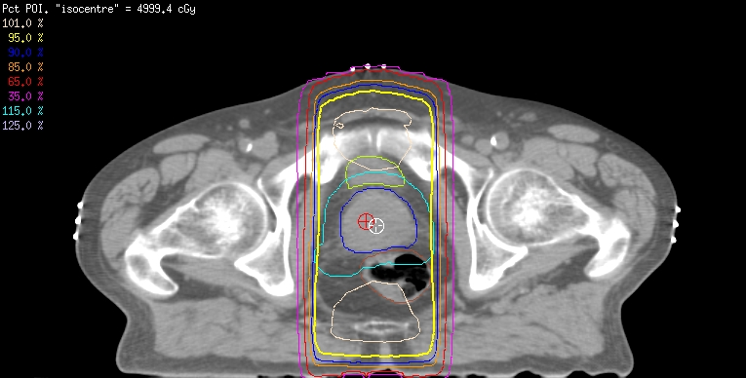
Parallel opposed pair

Slide 11
Parallel opposed pair
Reduced the area of high dose
Still treating a large volume of normal tissue (in particular the rectum in this case)
CAX plot:

Slide 12
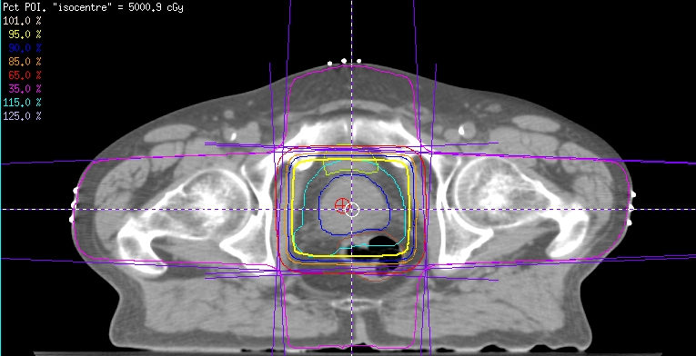
Four field brick

Slide 13
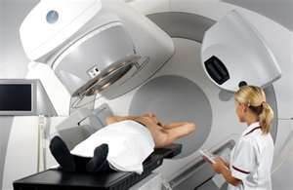
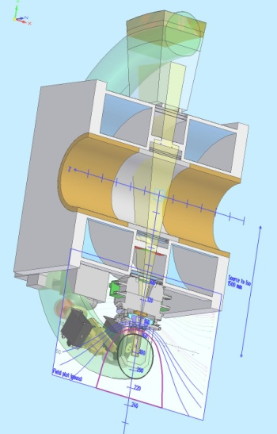

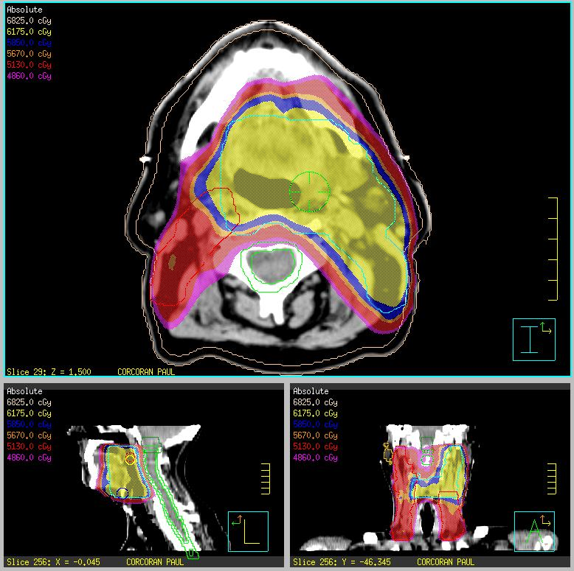
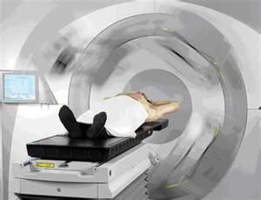
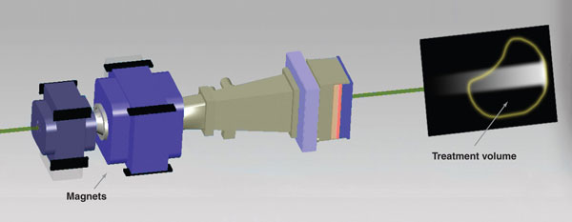
Radiotherapy Development Timeline
IGRT
MR Linac
1990
MLC
2000
2010
VMAT
Proton therapy
IMRT

Slide 14

The Christie Advanced Radiotherapy
Summer School (11th - 14th July 2016)
The Christie, Manchester, UK, M20 4BX
Further info: http//adv-radiotherapy.eventbrite.co.uk

Slide 15
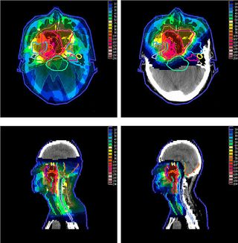
X-ray - Proton Therapy
X-ray
Proton

Slide 16
Benefits of protons
  Superior dose distribution
Notes:
Ed

Slide 17
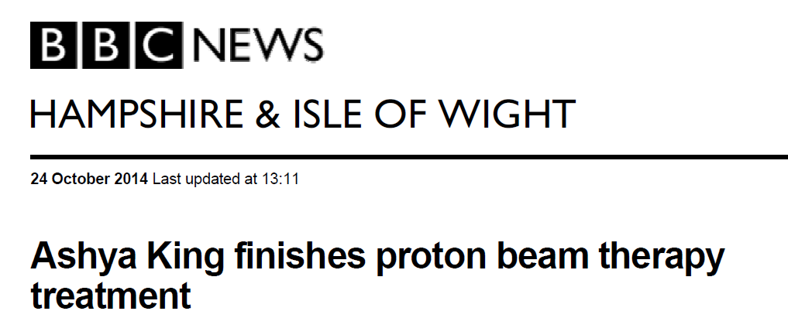
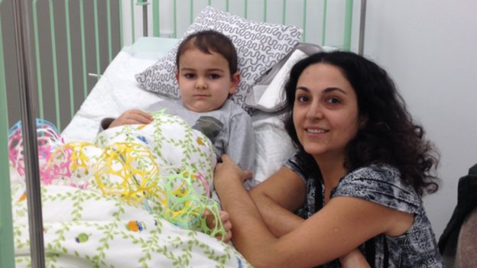
Notes:
Ed

Slide 18







Slide 19
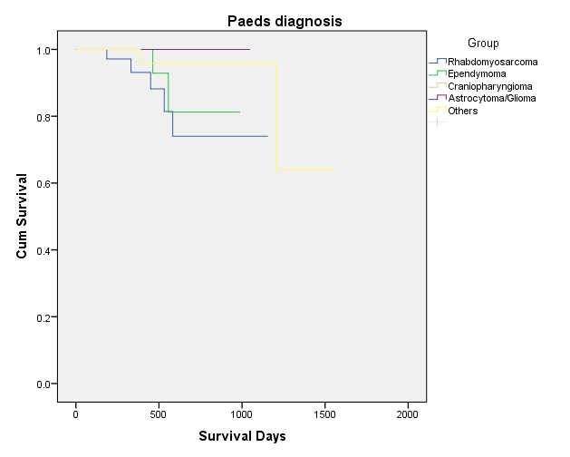

NHS Proton Overseas Programme
 | Approved | Treated
Paediatric | 483 | 429
Adult | 197 | 145
Total | 680 | 574
Total Referred | 861
Structured Approach
Curative Intent
Clinical Policies and Defined Criteria
All Cases Reviewed by National Panel
Equity of Access
2 Centres USA,
  Jacksonville and Oklahoma
  PSI Villigen
Outcomes Tracking
High patient satisfaction
Growth in Approvals since 2008

Slide 20
Capacity - Patient Groups
1% all RT Capacity
NHS England Service Review Radiotherapy
Business as usual
Highly Specialised Commissioning
Categories | 1500
Paediatric | 278
TYA | 185
Adult Core | 314
Devolved Administrations | 147
Total | 924
Remaining Capacity | 576
Clinical Trials
  Breast
  Lymphoma
  Brain and Spinal Cord
Evaluative Commissioning (CtE)
‘Enhanced Commissioning Research’

Slide 21
Country | Population | Rooms | % of all RT
Sweden | 9.5M | 2 | 14%
Denmark | 5.6M | 3 | 7%
Holland | 17M | 7 | 10%
Norway | 5.1M | 6
England | 56M | 6 | 1%

Slide 22
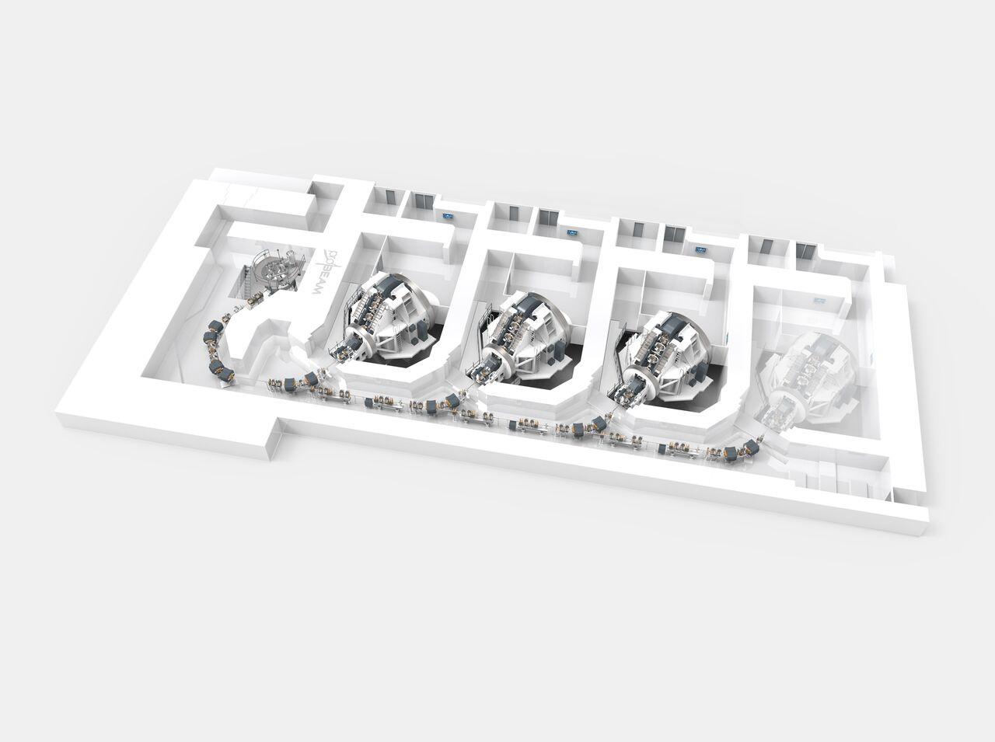

Slide 23
Beam Parameters
Beam energy ~ 60- 240MeV
Spot size at max beam energy in air ~ 3.5mm
Dose rate 2Gy to one litre in 1min
Field size 30x40cm

Slide 24
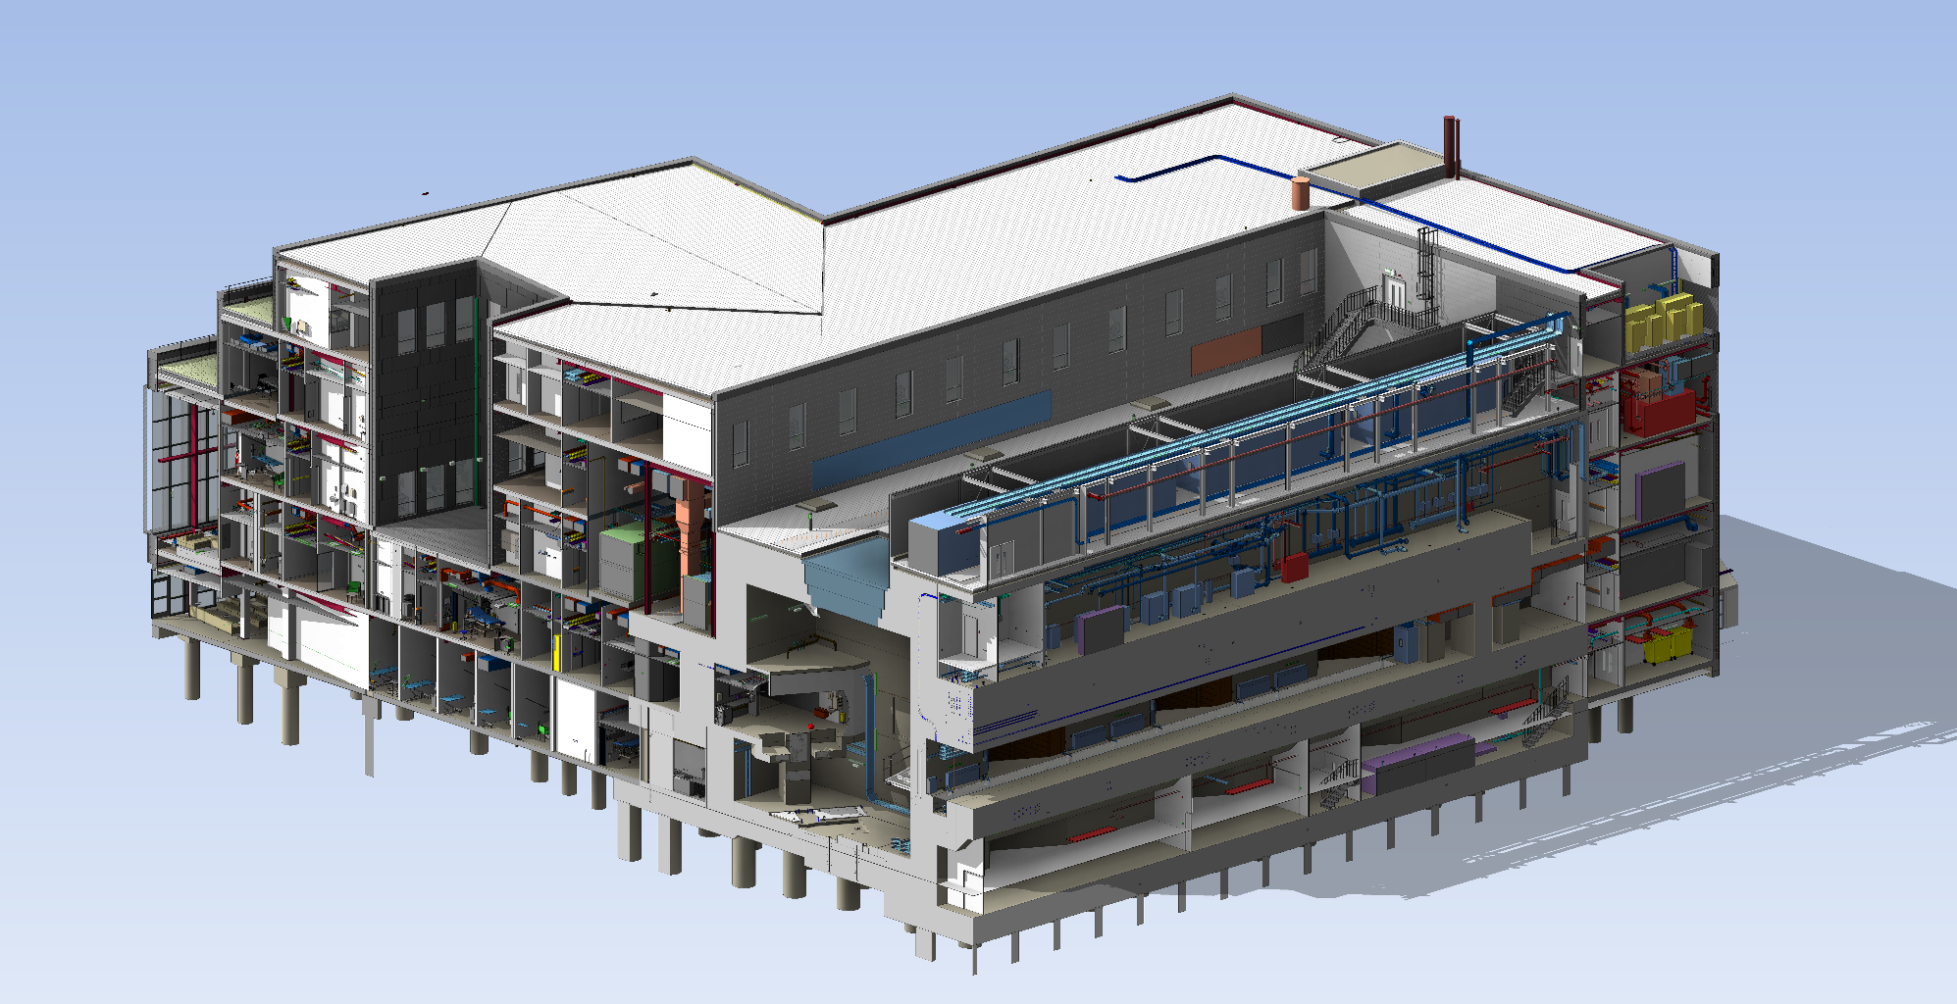

Slide 25
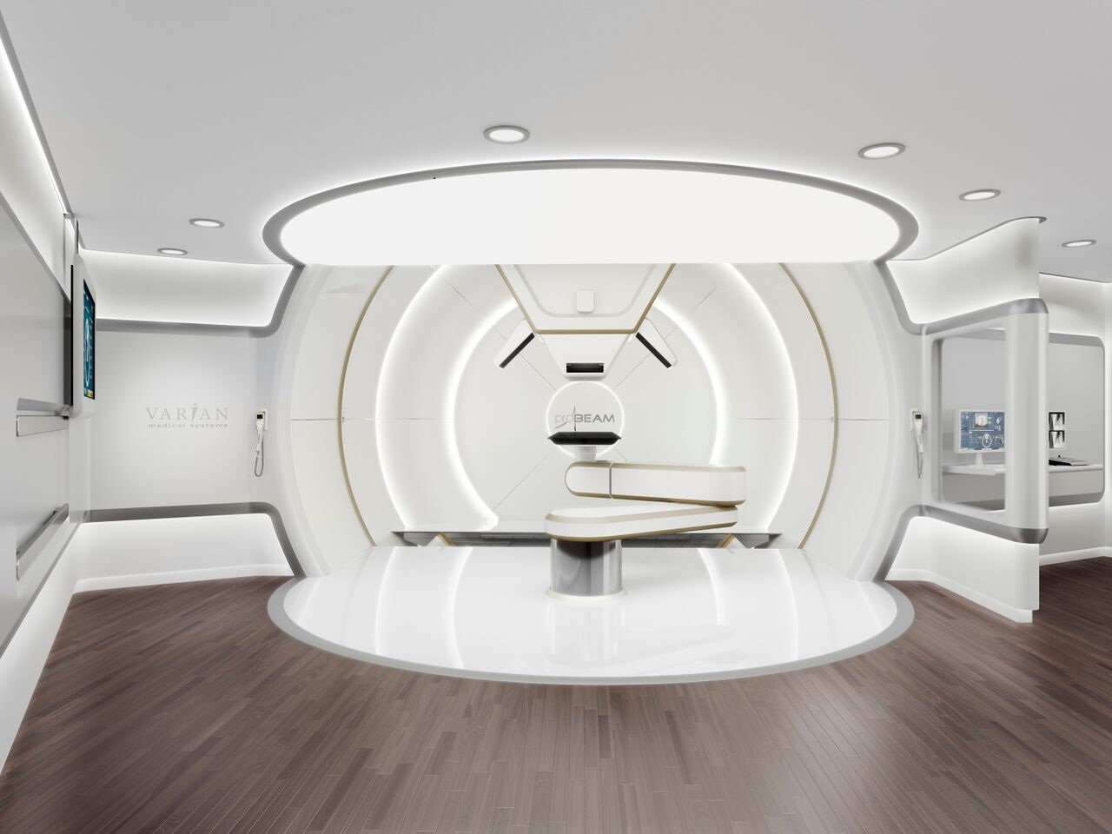

Slide 26
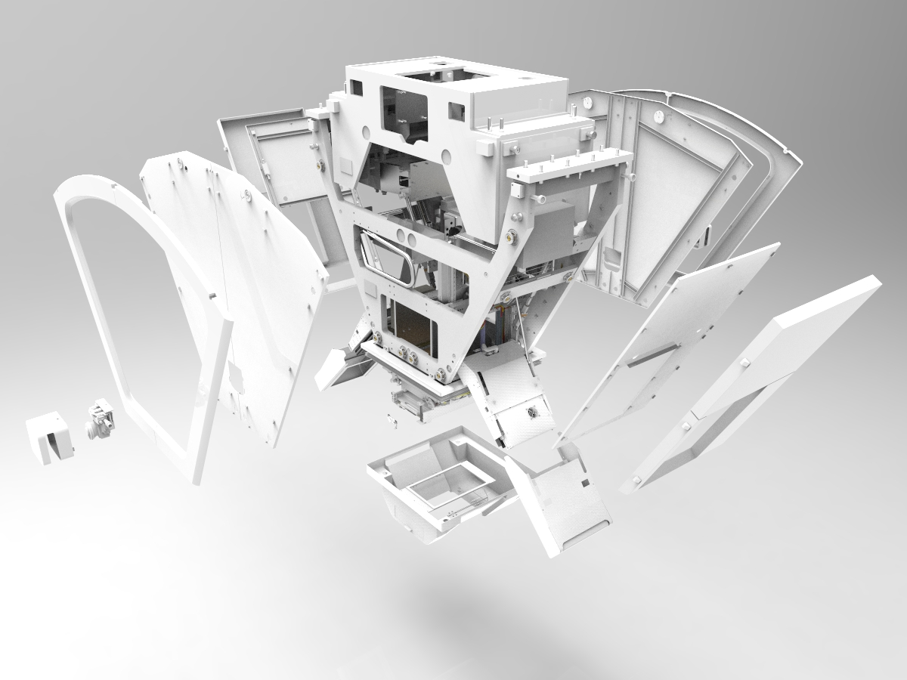

Slide 27
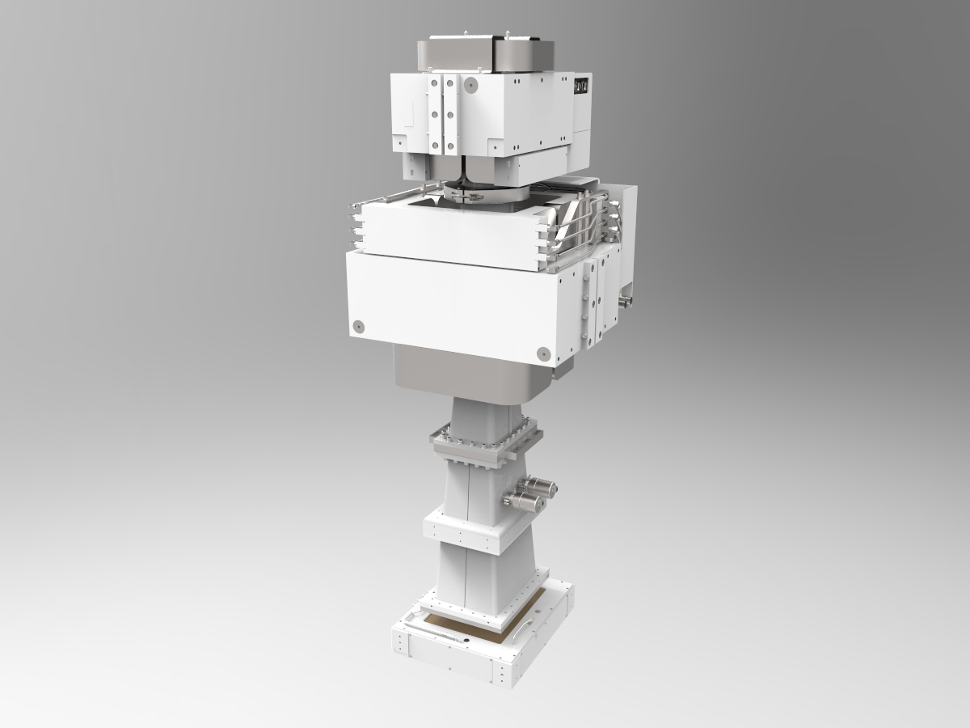
1st scanner magnet Y
2560 mm
2nd scanner magnet X
2000 mm
vacuum drift tube
dose and position monitor
895 mm

Slide 28
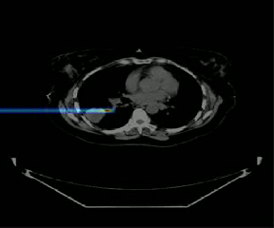
Scanning Beams

Slide 29
PBS IMRT
Notes:
Ed

Slide 30
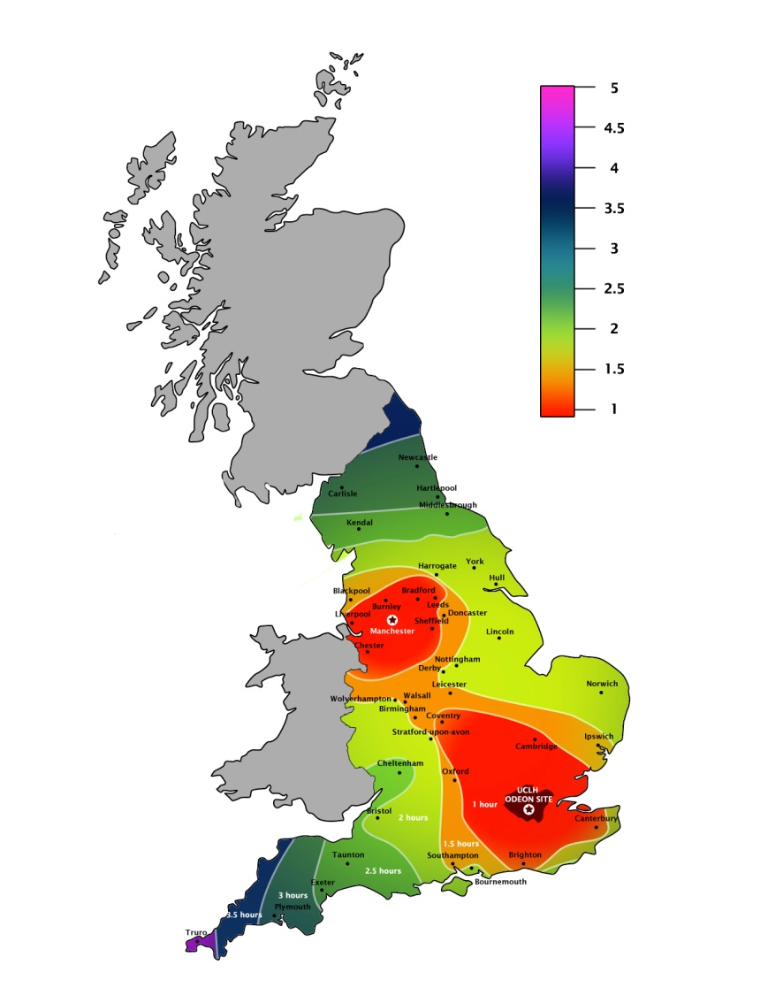
NHSe commissioned provision
  Care within a wider NHS setting
    Mostly rare tumours/inidications
    Complex pathway management
    Comprehensive outcomes analysis
      Core and evaluative indications
    Established research environment
  Care within established Cancer Centres
    Protons - 3 Gantries, 360º
    Advanced photon capacity
    Comprehensive support services
      Paediatric/TYA/Adult
      Acute care
      Diagnostics
      Chemotherapy
      Patient Support
      Academic/Research environment
      Accommodation

Slide 31
Key issues
Complexity
  It shall deliver proton radiotherapy for the prescribed Indication List
  Complex indication list with high proportion of paediatrics
Dose
  Improved dose distributions compared to photon radiotherapy
Throughput
  It shall deliver the improved dose distribution to as many patients as possible
Value for money

Slide 32
Indicative timeline
Notes:
Ran

Slide 33
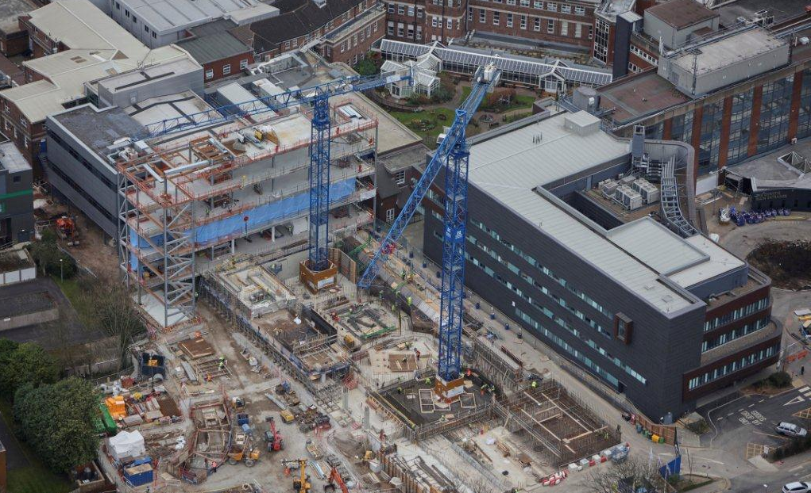

Slide 34
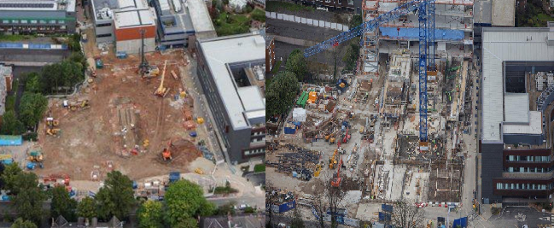

Slide 35


Slide 36
Summarise
Radiotherapy is an effective treatment of cancer and has advanced considerably over the last 20 years
Proton therapy is one development of radiotherapy that improves dose distribution and enhances outcome for patients
The national facilities at the Christie and UCLH UK will offer a limited provision for patients that currently have to go abroad for treatment
Research into the technology and benefits of proton therapy is an important part of proton therapy developments in the UK

