Slide 1
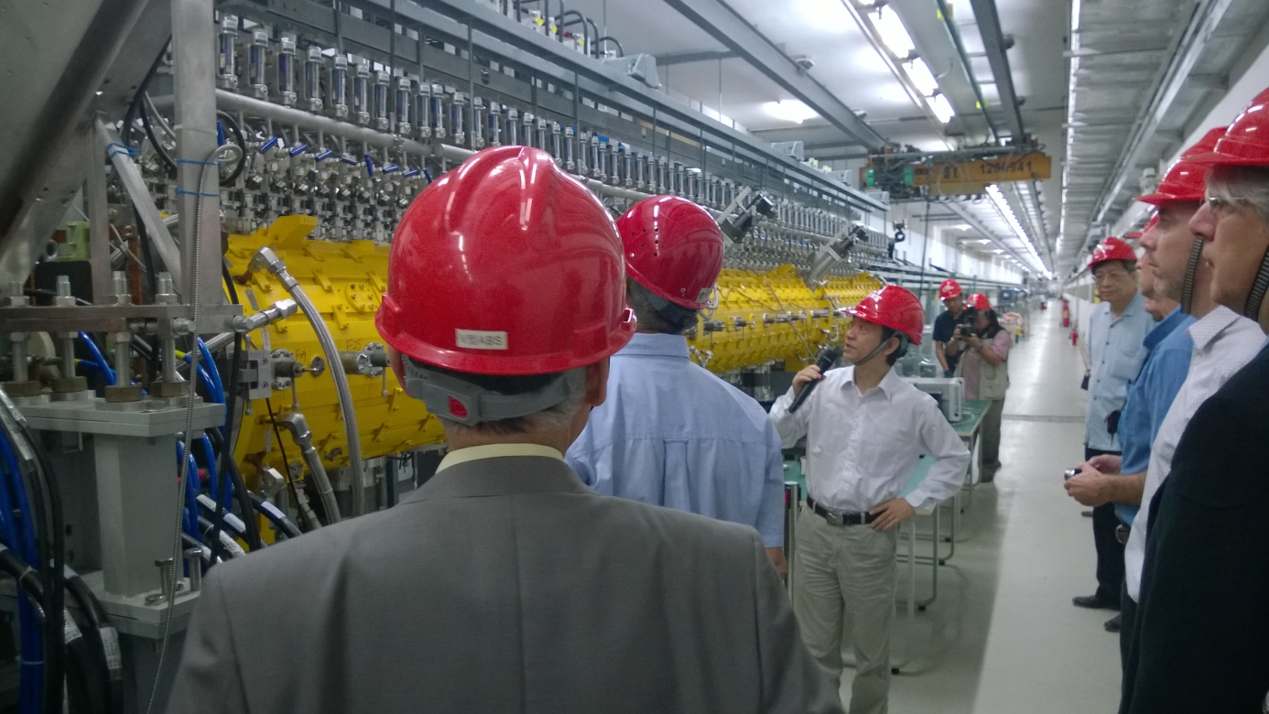
The Chinese Spallation
Neutron Source
John Thomason & Shinian Fu

Slide 2

ATAC
Yoshi Yamazaki – MSU (chair)
Massimo Giovannozzi – CERN
Mike Plum – ORNL
Kazuo Hasegawa – JAEA
Mike Seidel – PSI
John Thomason – STFC
Takeshi Toyama – J-PARC
(David Findlay was former
Chair of the CSNS ATAC)
NTAC
Andrew Taylor – STFC (chair)
Carla Andreani – University of Rome
John Galambos – ORNL
C K Loong – ANL
Rob McQueeny – ORNL
Rob Robinson – ANSTO

Slide 3
Contents
Design Overview of the Accelerator
Beam Commissioning
Mass Production Progress
Measurement and Test Results
Installation Status
Project Management
Interaction with ISIS
Notes:
1, The physics design has no obvious variation but some optimization according to the suggestion from the last review meet. This section will outline the major change points.
2, We have conducted more than 20 prototype items. The section will outline the completion status and major result as well as the remaining problems. Some results gave a feedback to the physics design.
3, This section will briefly introduce present manpower status and our project mile stone.

Slide 4
Design Overview of the Accelerator

Slide 5
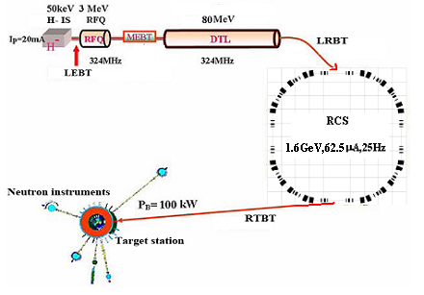
Accelerator major design parameters
Project Phase | I | II
Beam Power on target [kW] | 100 | 500
Proton energy [GeV] | 1.6 | 1.6
Average beam current [μA] | 62.5 | 312.5
Pulse repetition rate [Hz] | 25 | 25
Linac energy [MeV] | 80 | 250
Linac type | DTL | +Spoke
Linac RF frequency [MHz] | 324 | 324
Macropulse. ave current [mA] | 15 | 40
Macropulse duty factor | 1.0 | 1.7
RCS circumference [m] | 228 | 228
RCS harmonic number | 2 | 2
RCS Acceptance [πmm-mrad] | 540 | 540
Linac

Slide 6
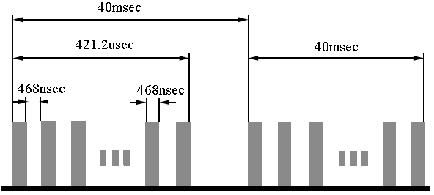
Linac Design
EMQ option in FFDD lattice for DTL
Electrostatic chopper in LEBT
 | Ion Source | RFQ | DTL
Input Energy（MeV) |  | 0.05 | 3.0
Output Energy(MeV) | 0.05 | 3.0 | 80
Pulse Current (mA) | 20/40 | 20/40 | 15/30
RF frequency (MHz) |  | 324 | 324
Chop rate (%) |  | 50 | 50
Duty factor (%) | 1.3 | 1.05 | 1.05
Repetition rate (Hz) | 25 | 25 | 25

Slide 7
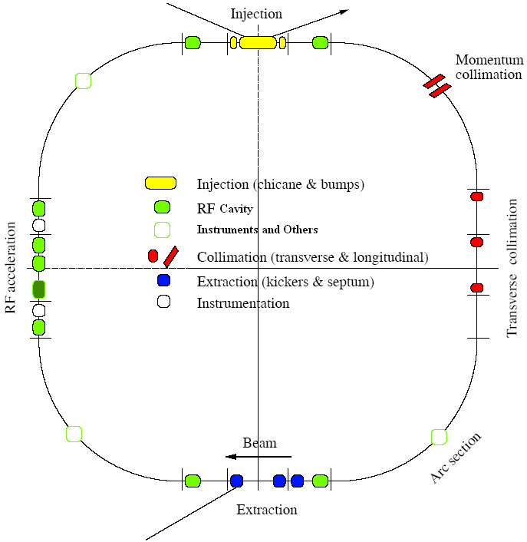
RCS Design
Lattice of 4-fold symmetry, triplet.
227.92m circumference.
Four long straight sections for injection, acceleration, collimation and extraction.
24 main dipoles with one power supply.
48 main quadrupoles with 5 power supplies.
Ceramic vacuum chambers for the AC & pulsed magnets.
8 RF ferrite loaded cavities to provide 165 kV.

Slide 8
Beam Commissioning

Slide 9
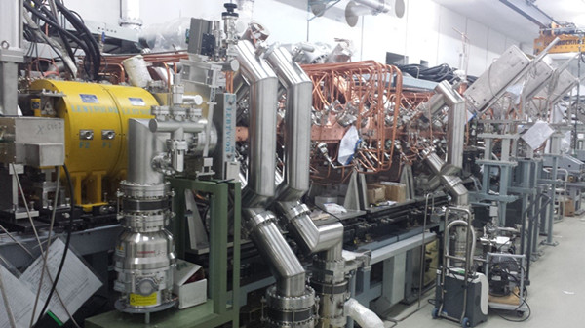
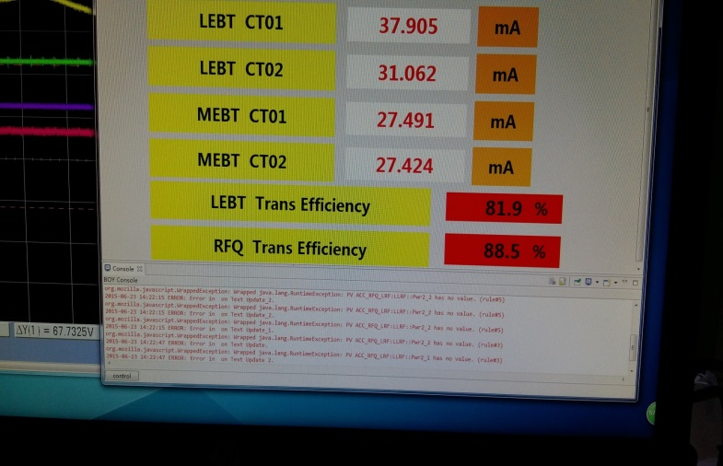
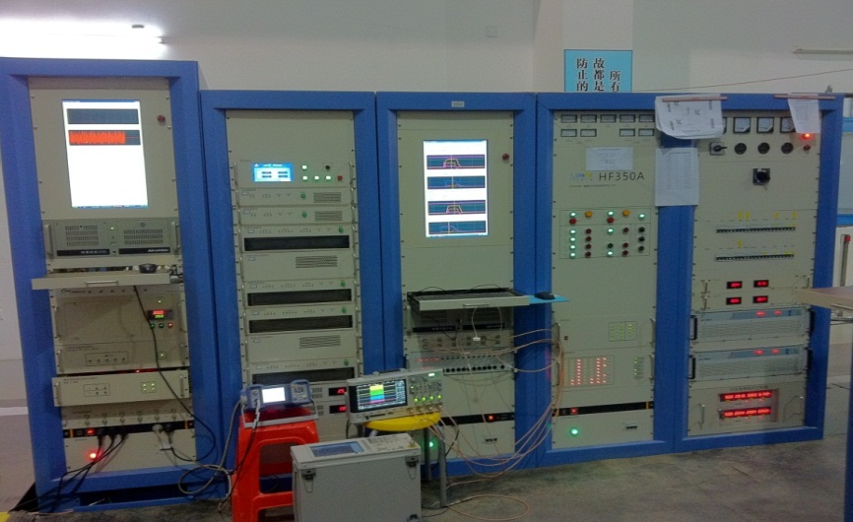
Front End Commissioning Run
Low to high duty factor (April →July 2015):
50 → 500 μs, 1 → 25 Hz (chop rate: 0 → 50%).
Then 90 hours continuous operation at the design specification.
Limited by the beam dump, can run 250 μs unchopped beam or 500 μs beam at 50% chop rate.
Beam diagnostics commissioning of hardware and software went in parallel with beam commissioning.
RFQ highest transmission rate reached 88%.
RFQ tetrode power source worked stably with field amplitude and phase < ±0.5% / ±0.5 º respectively.
38% machine fault time mainly from ion source high voltage and RF system.

Slide 10
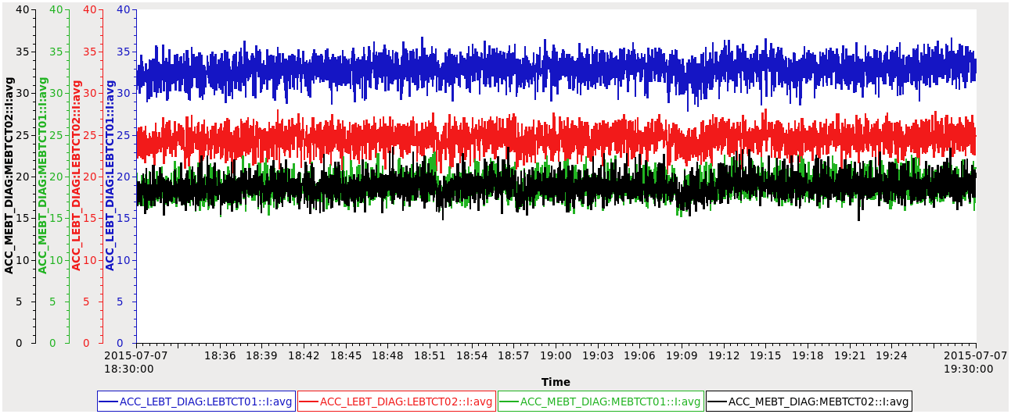
Front End Commissioning Results
 | Design | Measured
Ion source current [mA] | 20 | 31
MEBT Peak current [mA] | 15 | 17
MEBT Beam energy[MeV] | 3.0258 | 3.02±0.015
Chopping rate [%] | 50 | 50
Pulse width [μs] | 420 | 500
Pulse repetition rate [Hz] | 25 | 25
Emittance (π mm mrad ) | 0.22 | 0.26

Slide 11
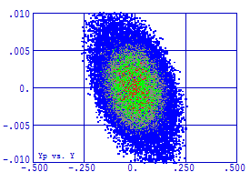
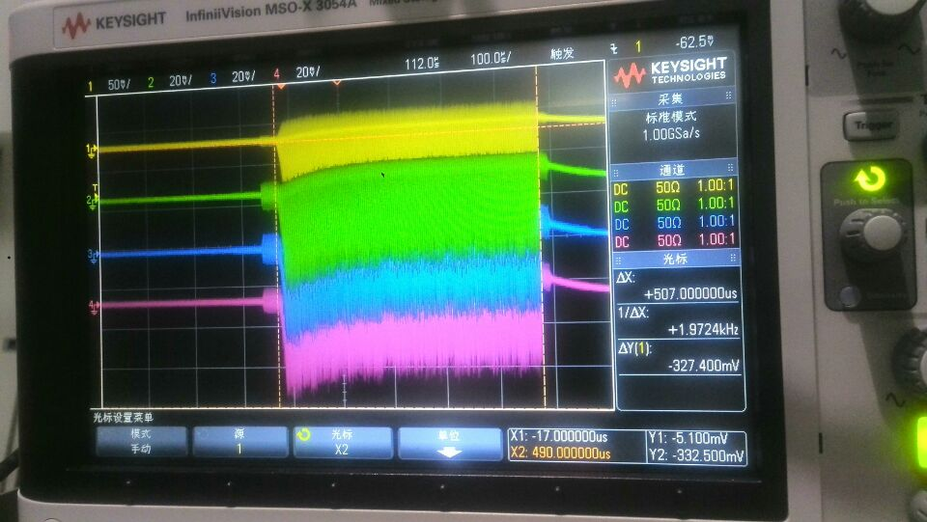
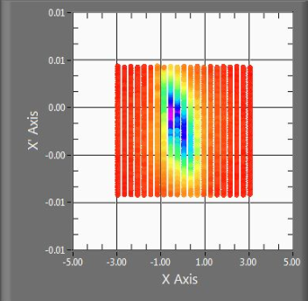
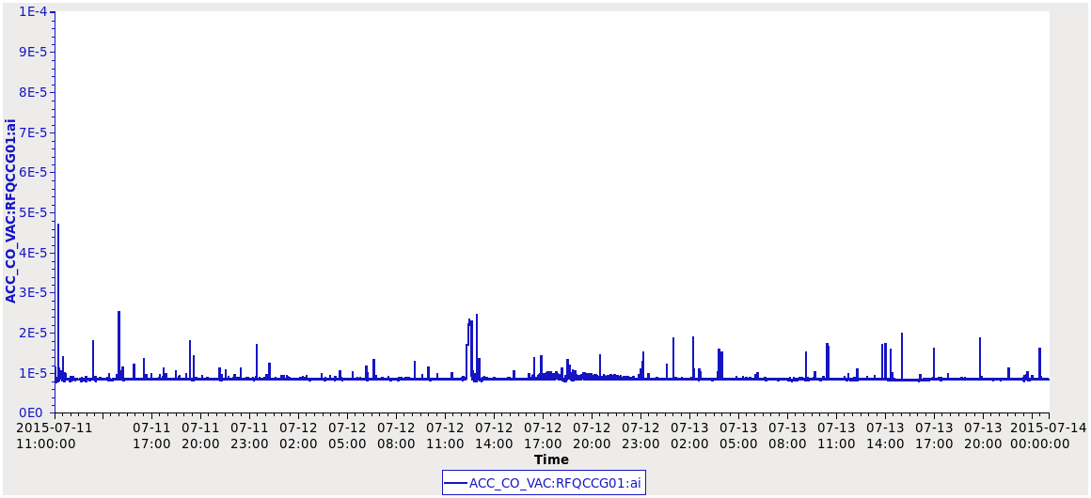
Front End Commissioning Results
500 μs
Beam pulse of 500 μs measured with 4 FCT in MEBT
Y’(mrad)
Y (mm)
Emmitance:
(π mm mrad)
simulated=0.22
measured=0.27
Vacuum in RFQ cavity

Slide 12
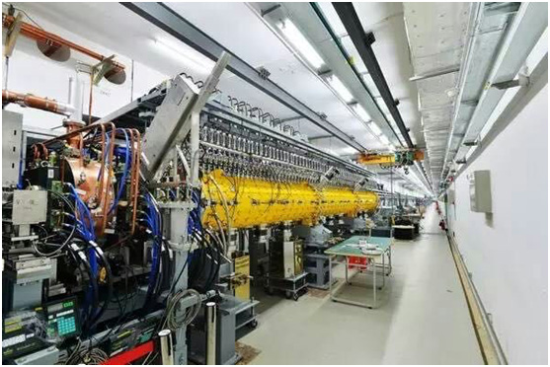
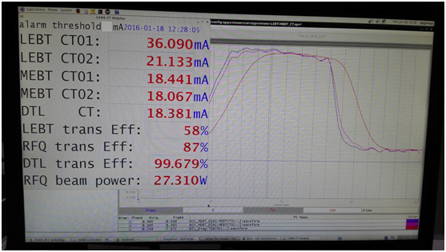
DTL-1 Commissioning Results
In January 2016 a negative hydrogen ion beam was successfully accelerated to the design energy of 21.6MeV with the first Drift Tube Linac.
The peak pulsed current reached 18mA, higher than the design value of 15mA.
Almost all the beam went through the linac with 99.7% beam transmission rate.
This is an important milestone for the CSNS project. Beam commissioning took only 10 days to hit the major design target. This speed is rather faster than most of the other DTL linacs in the world, owing to good preparation.

Slide 13
Mass Production Progress

Slide 14
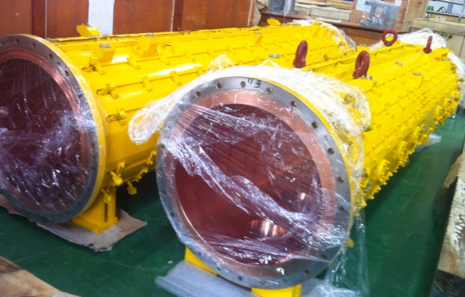
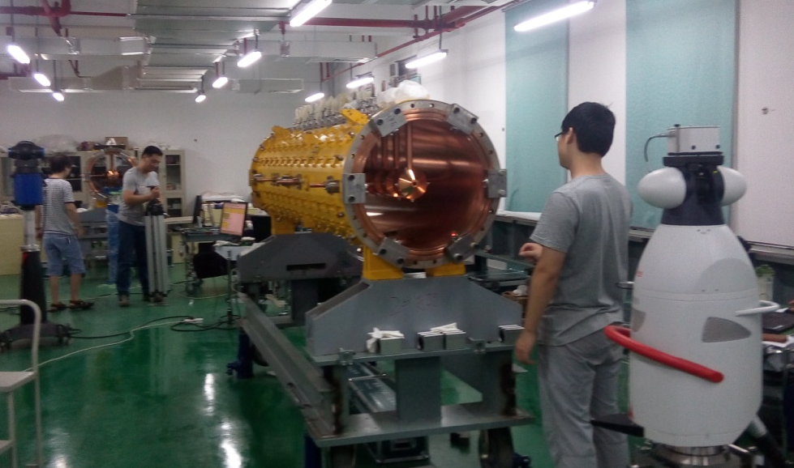
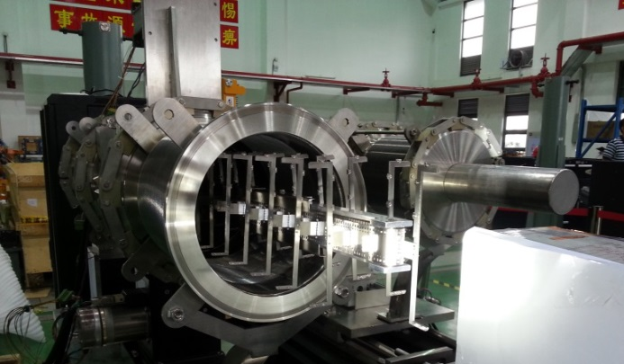
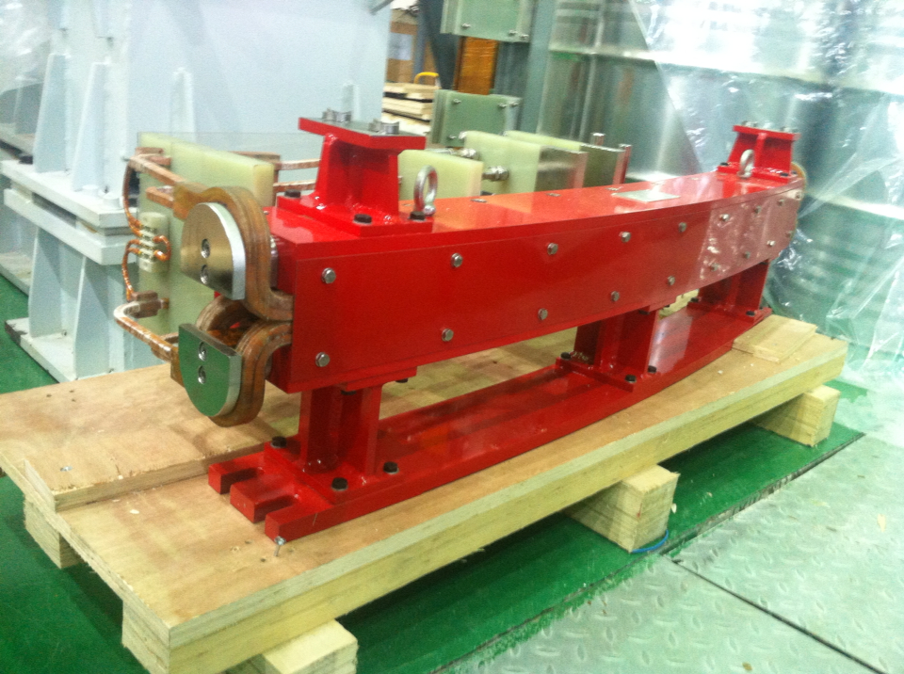
All 12 DTL unit tanks with copper plating inside have been fabricated and are waiting for assembly with drift tubes.
All 156 drift tubes have been fabricated.
To speed up the drift tube assembly work, two groups worked on two tanks in parallel.
All 8 bump pulse magnets, 2 septum magnets and two stripping foil assemblies are ready. Installation of the injection area will soon start.

Slide 15
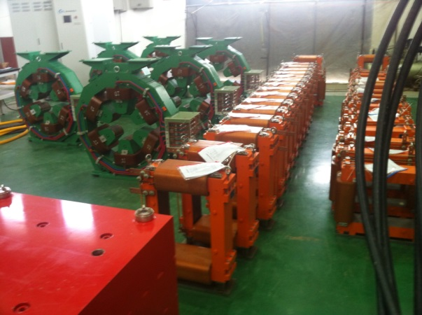
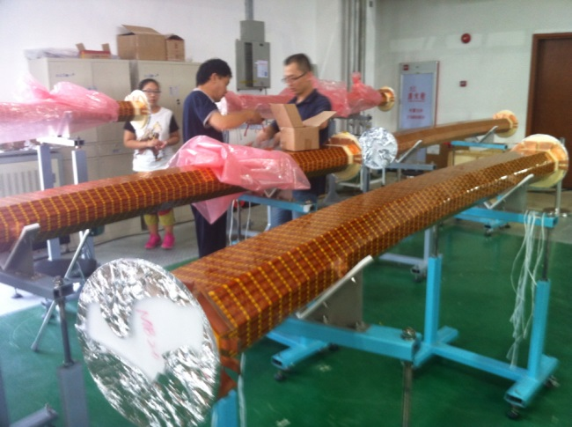
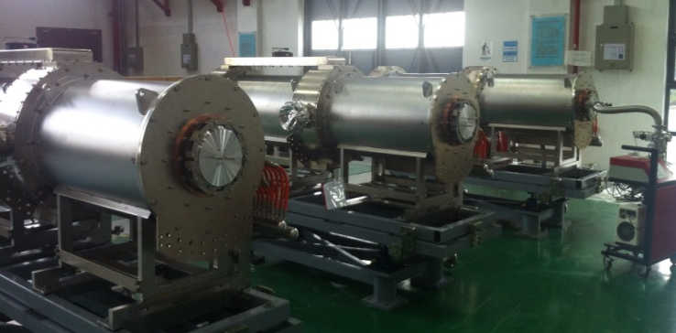
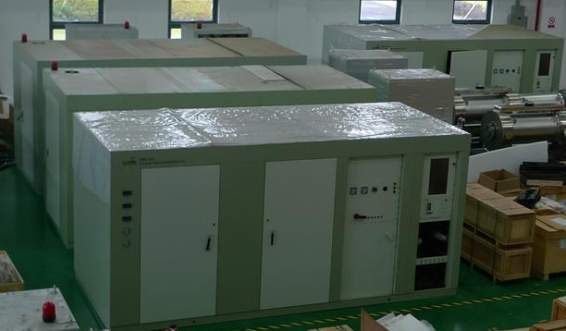
All ring magnets, including 24 dipole, 48 quadrupole, 16 sextupole and 36 correctors have been fabricated.
All 26 dipole ceramic chambers have been coated with TiN inside and some of them are dressed with an external RF screen.
All 8 ferrite-loaded RF cavities and their tetrode RF power sources with bias power supplies are almost manufactured.

Slide 16
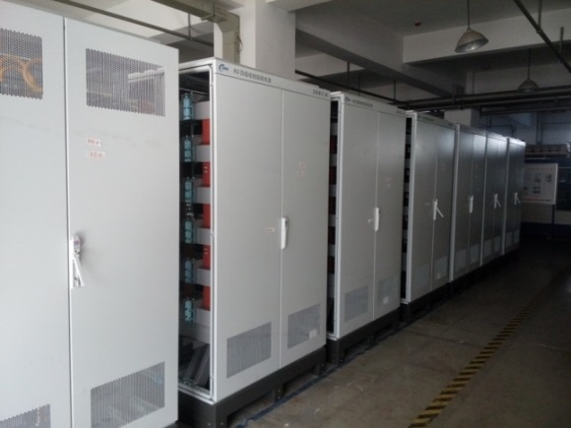
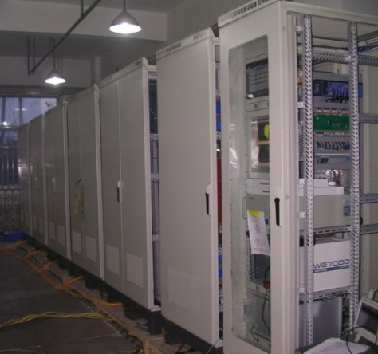
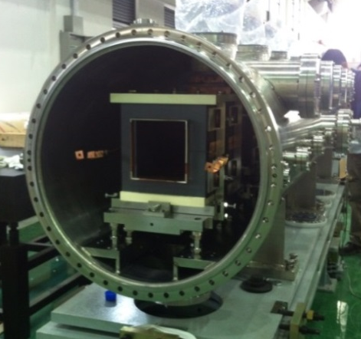
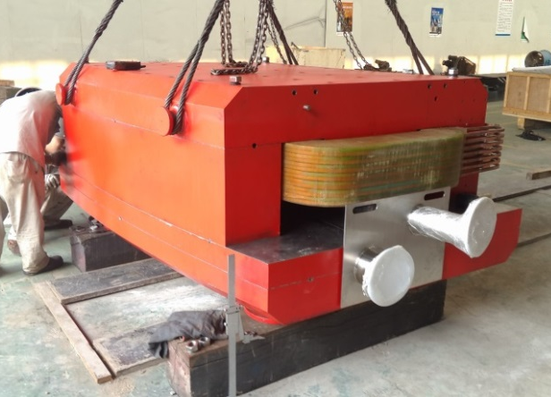
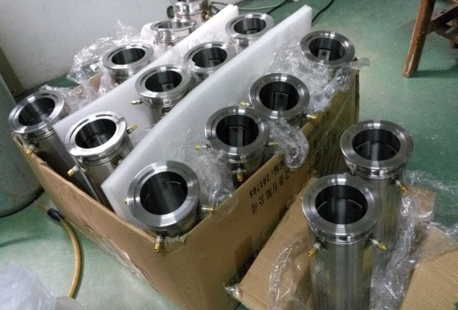
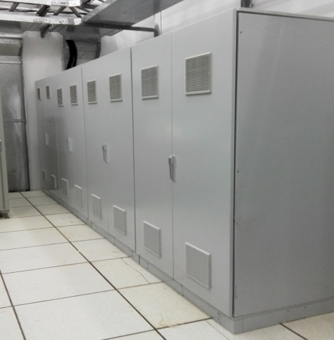
1+5 sets of magnet power supplies have been manufactured.
8 Extraction kickers & their pulsed power supplies and a Lambertson magnet are under final fabrication.
Magnets for the RTBT are under mass production as planned.
Beam window and primary collimator have been manufactured.
Beam diagnostics are now under mass production. LRBT BPMs are almost completed.
Most of the control system is ready.

Slide 17
Measurement and Test

Slide 18
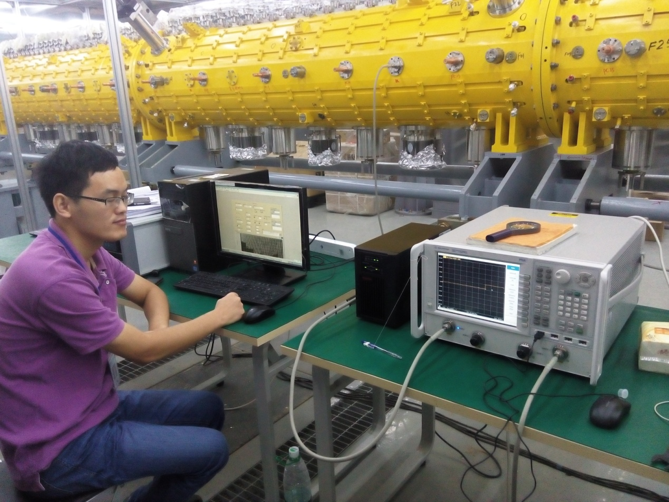
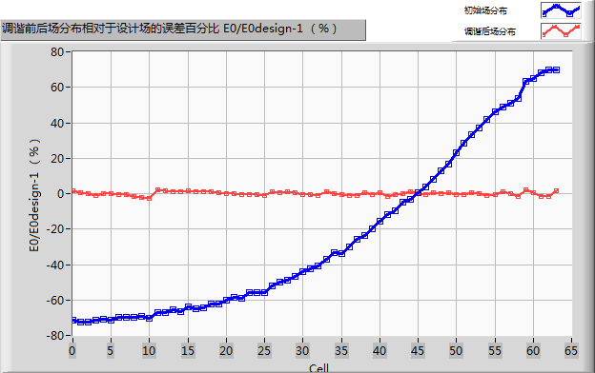
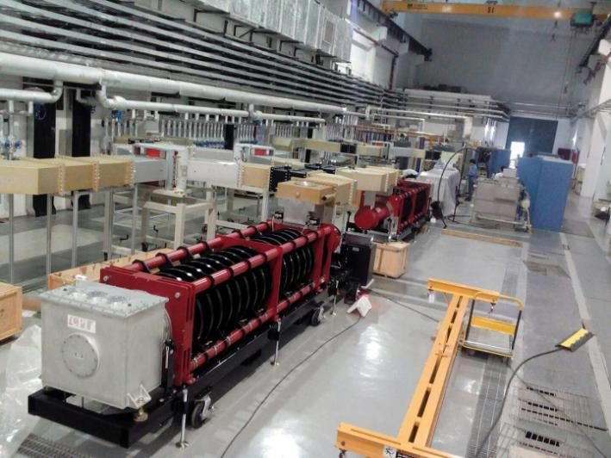
Bead-pull measurement of the field in the first 9 m long DTL tank has been completed. The field flatness and stability were tuned to the design values.
All 4 klystrons for the DTL have suffered from vacuum leakage when powered-on for the first time after arrival at the CSNS site. The first one has been fixed by the manufacturer and will be delivered to CSNS imminently. The others will be returned to the manufacturer for maintenance.
Two sets of resonant high voltage power supplies, crowbar and modulator have passed high voltage testing.

Slide 19
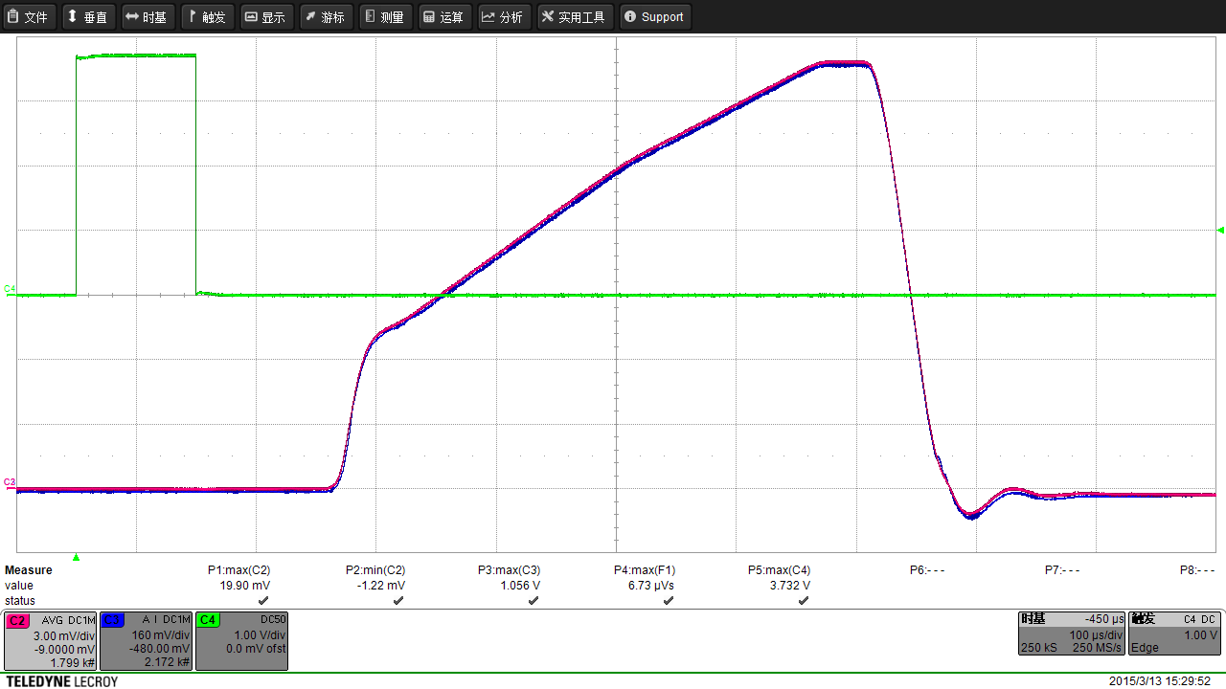
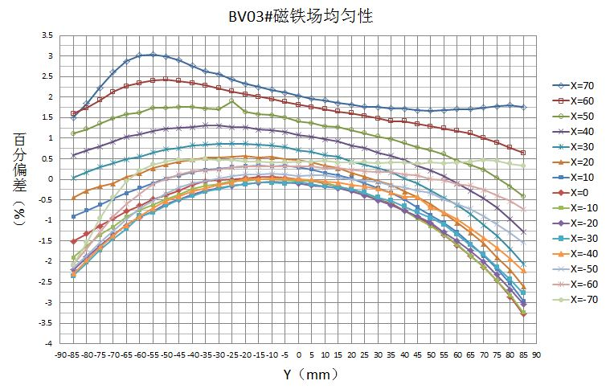
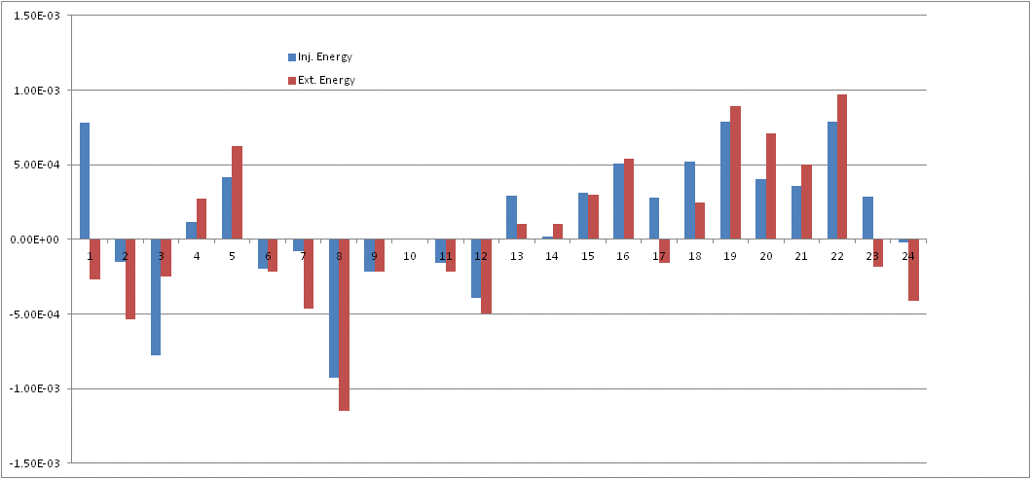
8 Injection painting magnets were measured with short and long coils. Their field and vibration meet the requirement.
4 injection bump magnets and 2 septum magnets were measured with a Hall probe and the field quality is satisfactory.
24 ring dipole magnets have all been measured with a field quality better than the requirement. The uniformity is nice with integral field difference among them less than ±0.1%. Sorting has then been determined. With harmonic injection the time-harmonic error is reduced to <0.01%.

Slide 20
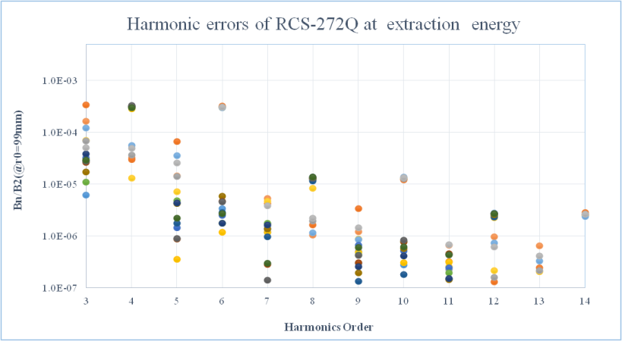
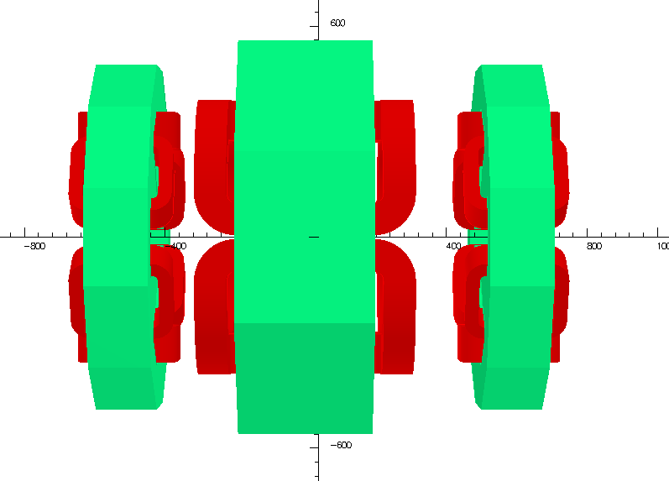
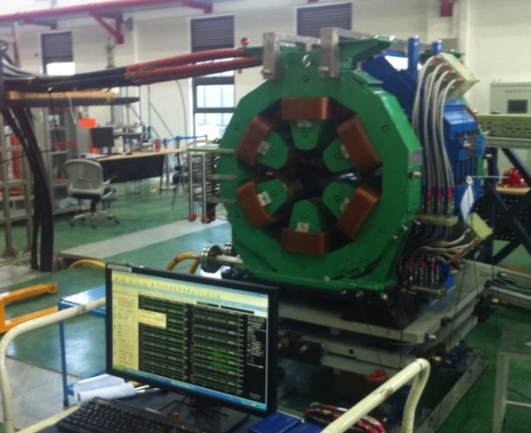
40 ring quadrupoles have been measured and the remaining 8 will soon be completed. Family uniformity is good (±0.2%), except for one 206Q family. Space-harmonic error is less than 0.06% and time-harmonic error is suppressed to 0.1%.
A small flip-flop coil measurement system has been set up for AC fringe field measurement of the RCS main quads.
The fringe field interference and interaction between main dipole /quadrupole and nearby sextupole /corrector magnets has been measured and the compensation current increase has been determined.

Slide 21
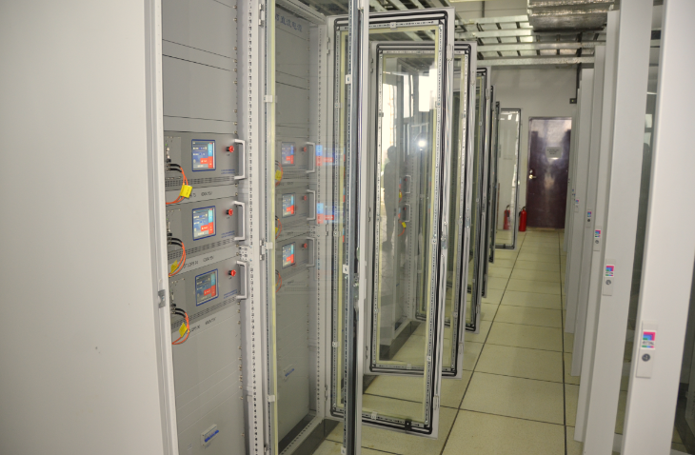
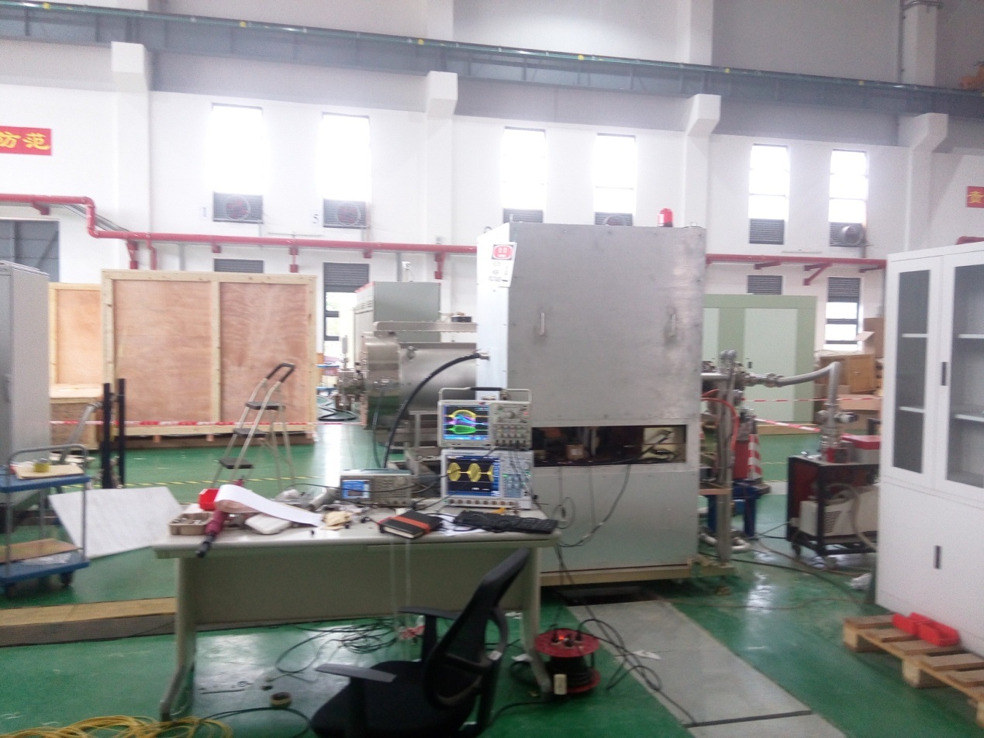
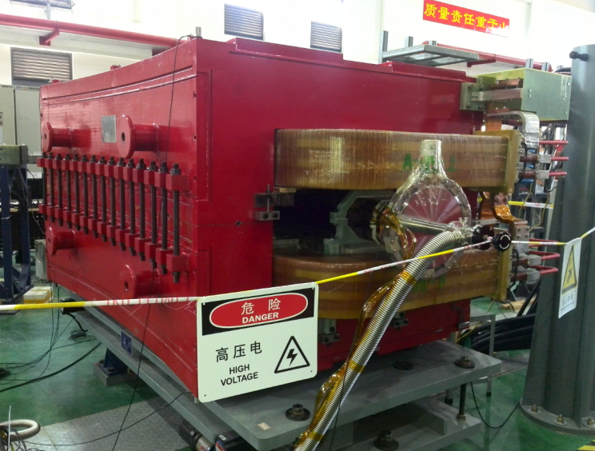
All sextupoles and dipole correctors have been measured as good quality.
The first White cirucuit power supply will be tested with a real load of 8 quadrupoles in the next month.
Integrated testing of DTL power supplies with the control system has been conducted.
4 RF power systems for the ring cavities have been high-power tested for 7 days’ continuous operation, with amplitude error <±0.5% and phase error <±0.5º.
The effect of AC dipole vibration on a ceramic chamber was tested for 3 days’ operation .

Slide 22
Installation Status

Slide 23
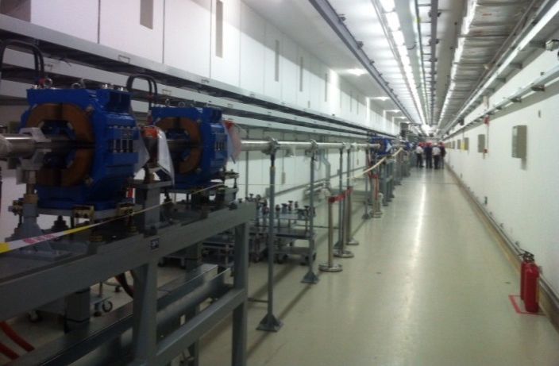
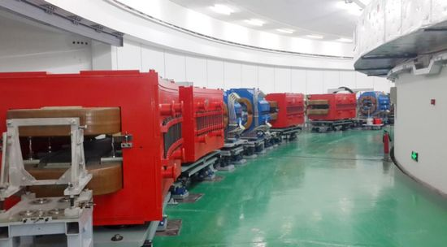
DTL waveguide system has been installed in the klystron gallery.
All DTL-Q power supply are all installed.
Installation of the linac control system is going well.
LRBT has been installed in the linac tunnel, and full connection will soon complete. Power supply will start installation next month.
Injection system will start installation this month.
23 dipole and 30 quadrupole magnets have been placed in the RCS tunnel.
4 chokes and 5 capacitors for the resonant power supply have been installed ready for testing.
A new ion source test facility has been constructed for improving the operation quality of the ion source on line.

Slide 24
Project Management

Slide 25
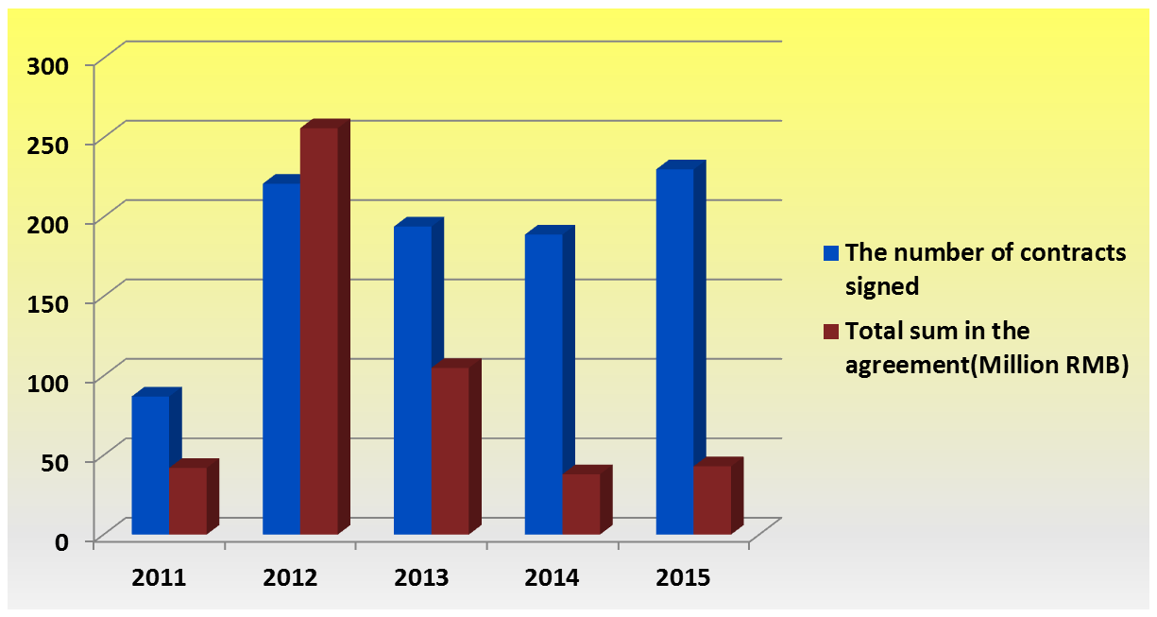
Budget Management (within budget)
256
221
230
194
189
105
87
42
38
43

Slide 26
Manpower Management (stable)
98
99
91
79
79
79
79
74
Staff Number
52
37
40
38
Progress of Staffing

Slide 27
Staffing
TOTAL:137
13
12
11
11
10
10
10
9
9
9
8
7
7
4
4
3

Slide 28
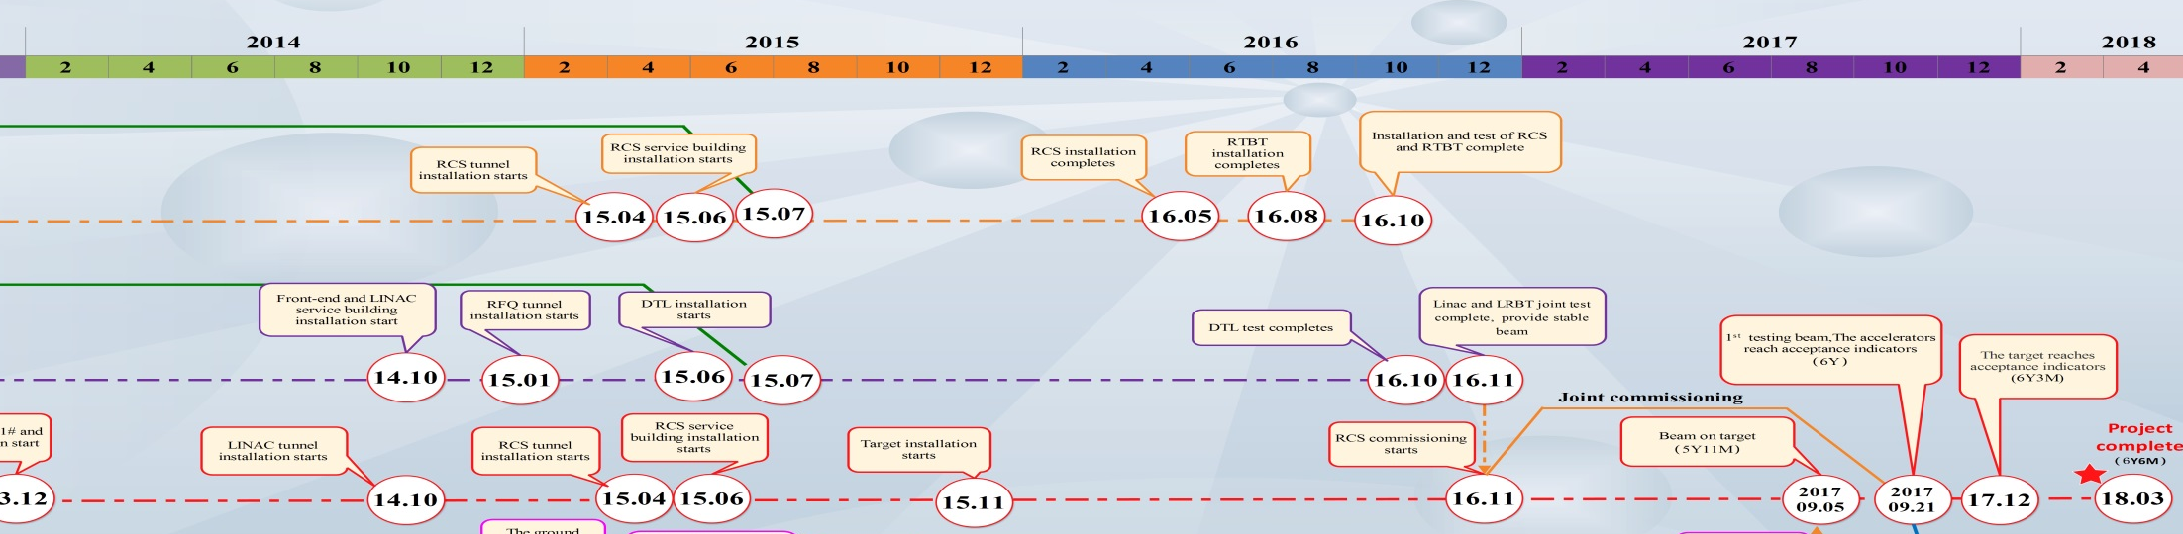
Plan (on time)
2015.06 DTL installation
2015.1. DTL-1 beam commission
2016.08. RCS installed
2016.09. Linac beam operation
2017.01. RCS beam commission
2017.09. Beam on target

Slide 29
Interaction with ISIS

Slide 30

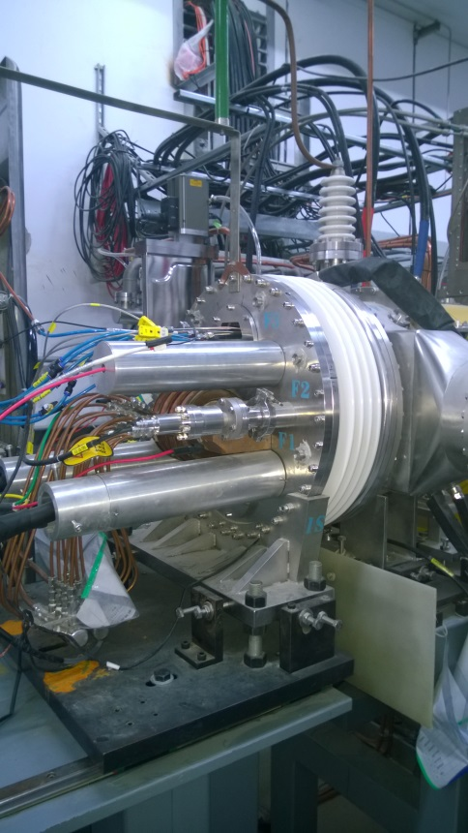
Ion Source
The CSNS ion source is a surface plasma Penning source based directly on the ISIS ion source. Collaboration began in 2006, with tests of Chinese manufactured components at ISIS.
An ion source test rig was run at the Technical University of Dongguan, and then installed at CSNS.
Successful beam tests (along with the RFQ and MEBT) were carried out on CSNS during 2015.

Slide 31
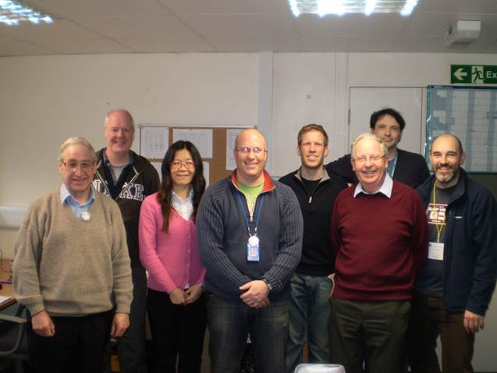
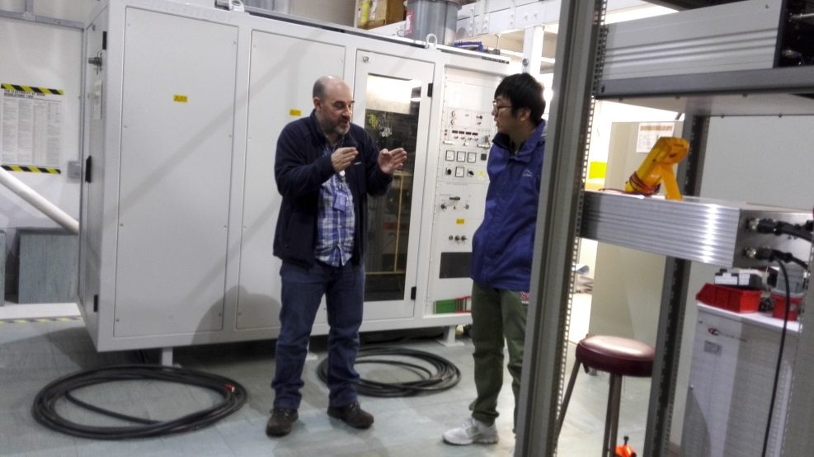
Swept-frequency RF
Collaborations with CSNS on synchrotron radio frequency (RF) studies span a decade, with ISIS providing technical advice on the set-up of the RF system, including work on the digital Low Power RF system and the high power components used to drive the RF cavity.
This has allowed CSNS to advance rapidly in synchrotron studies, subsequently promoting the manufacture of synchrotron components within China, and thus diversifying the supply chain and driving innovation in the field.
Dr Weiling Huang visited ISIS from October 2012 to April 2013 and used her expertise in computer simulation to help develop a finite-element model of the ISIS RF cavities, and took the opportunity to learn some of the practicalities of the operation of RF systems on a large particle accelerator.
Dr Li Xiao and Ms Sun Hong visited ISIS in March 2015 to observe RF and general machine set-up, discuss the system architecture for the ISIS and CSNS digital LPRF systems, and see development work on a TH558 based high power drive amplifier.

Slide 32
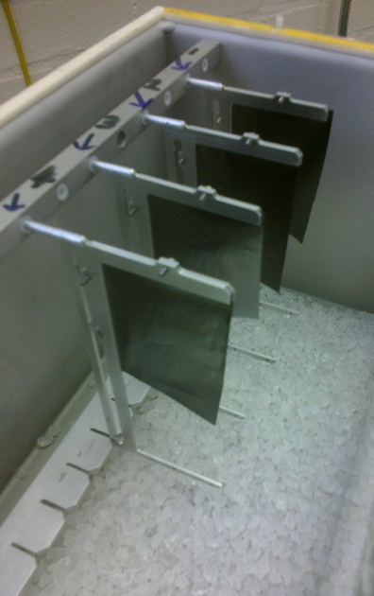
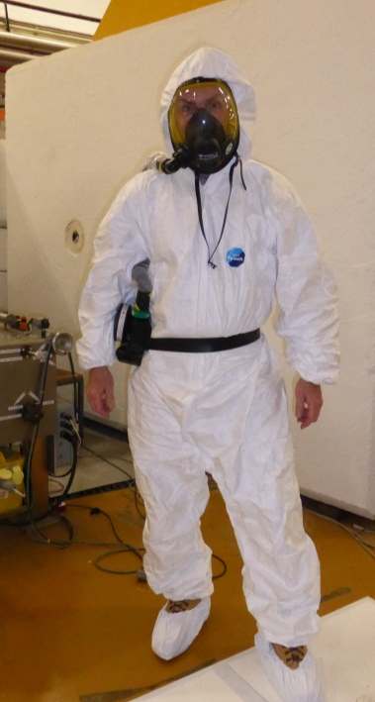
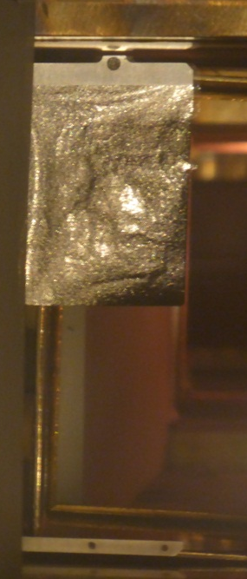

Stripping Foils
Injection Dipoles
Circulating p+
0.5 µm foils strip H– to p⁺ at injection.
New commercial carbon foils tested:
  Much more robust.
  Simplified installation.
  Reduced staff effort, downtime, dose and potential contamination.
  Suitable for future injection energy increase.
Septum
Foil
Injected H⁻
Sweeper
Similar foil to that which will be used at CSNS.
CSNS team will visit May 2016 to take part in foil tests and investigate foil change methodology.
200
100
Beam Current (µA)
04:00 5th Feb -> 07:00 7th Feb
Notes:
The H- beam is stripped to protons as it is injected into the synchrotron.
Currently this is done with a 0.5 micron thick aluminium-oxide foil produced in-house by the Vacuum Section.
Recently we have tested some commercially available carbon foils.
These foils are much more robust than the present foils making installation and removal much easier and safer.
They have the potential save many staff hours in foil preparation and reduce downtime and staff dose for a foil change.
Initial tests have been positive, the foils are easy to handle and injection efficiency is good.
However, foil deformation has been seen after several hours of 50Hz beam and improvement of the mechanical support of the foil is being investigated.
Contributors:
Bryan Jones, Hayley Smith – Beam Physics
Theo Rutter – Mechanical Design
Geoff Matthews, Mark Waite – Foil Preparation
Ops Crew and Health Physics – Foil Installation

Slide 33




ICFA Mini-workshop on Beam Commissioning for High Intensity Accelerators, June 2015, Dongguan
More than 40 participants from CERN, ESS, SLAC, FNAL, MSU, SNS, ISIS, ASTeC, J-PARC, KEK, PKU, IMP, SIAP,IHEP attended the workshop.

Slide 34

Neutron Science
ISIS has been awarded funds as part of the UK Government’s Newton Fund to support researchers from China, India and South Africa to use ISIS.
ISIS is able to support a limited number of experiments each round from users from these three countries.
In advance of the Chinese National neutron scattering conference a delegation of ISIS staff visited Beijing to participate in the first ISIS-China workshop on neutron scattering on the 7th November 2015.
The workshop covered many aspects of neutron scattering and its application to a wide range of basic and applied science. The topics covered generated a large amount of discussion around future scientific projects between ISIS and Chinese researchers.

Slide 35

The workshop also provided an opportunity to sign a formal agreement between the Institute of High Energy Physics (IHEP) and STFC under the framework of the UK-China Research and Innovation partnership fund.
Robert McGreevy, ISIS Director: “Building an expert user community takes many years – this will help our Chinese colleagues to accelerate that process and to better exploit CSNS, and the CARR and CMRR research reactors”

