Slide 1
Towards a UK X-FEL
Jim Clarke
STFC Daresbury Laboratory & The Cockcroft Institute
IoP PAB Group Annual Conference
8th April 2016

Slide 2
Contents
UK X-FEL?
CLARA
FEL R&D Planning & Goals
Summary

Slide 3
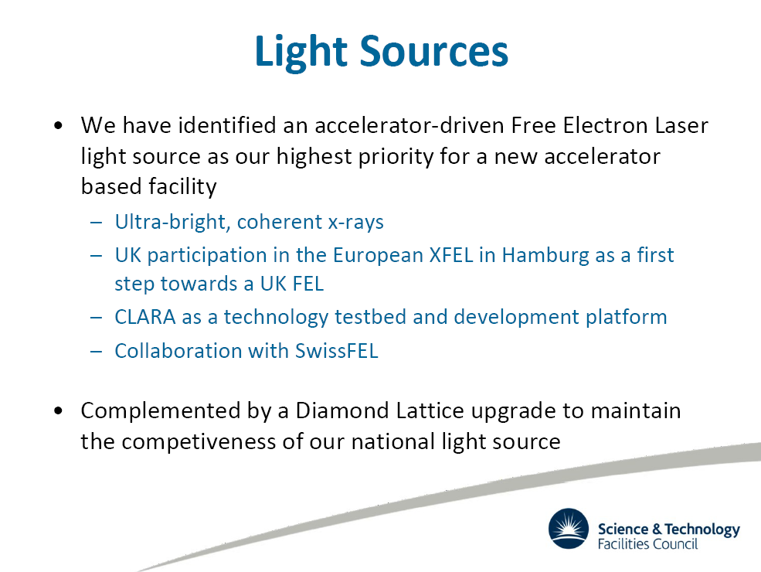
John Womersley, CEO, STFC, Particle Accelerator Engineering Network meeting, Oct 2015

Slide 4
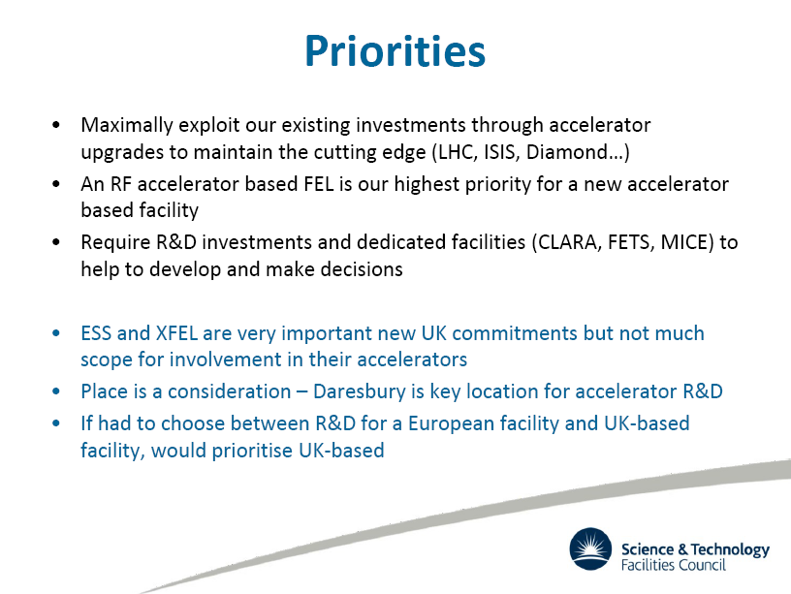
John Womersley, CEO, STFC, Particle Accelerator Engineering Network meeting, Oct 2015

Slide 5
CLARA
CLARA will be a purpose built dedicated flexible FEL Test Facility
  Capable of testing the most promising new schemes
We have strategically decided to focus on stability, synchronisation, and new FEL capabilities
  We are focussing on the longer term capabilities of FELs, not just short term incremental improvements
  Taking FELs into a new regime
  By demonstrating these goals we will have to tackle all the challenges currently faced by state of the art FELs so we will be very well placed to meet the needs of the UK users when we design and build a national X-ray FEL

Slide 6





















CLARA
Compact Linear Accelerator for Research and Applications
An upgrade of the existing VELA Photoinjector Facility at Daresbury Laboratory to a 250MeV Free-Electron Laser Test Facility
Proof-of-principle demonstrations of novel FEL concepts and development of future accelerator technologies
Emphasis on Stability, Synchronisation and new FEL capabilities

Slide 7
Do any other countries build test facilities?
Japan built SCSS then SACLA
Germany built FLASH then European XFEL
Italy built SPARC then FERMI
Switzerland built SwissFEL Injector then SwissFEL
China has built SDUV-FEL and are planning SXFEL test facility
SCSS & FLASH have now transitioned to user facilities, SwissFEL Injector has been decommissioned
SPARC and SDUV-FEL are still running as test facilities
NLCTA in the USA is a test facility that runs alongside LCLS and is informing the design of LCLS-2

Slide 8
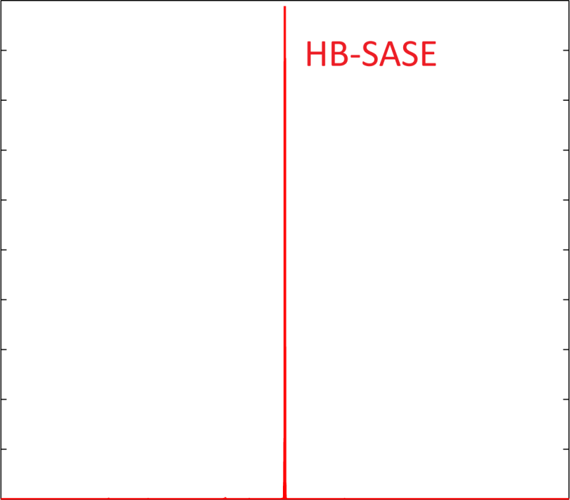
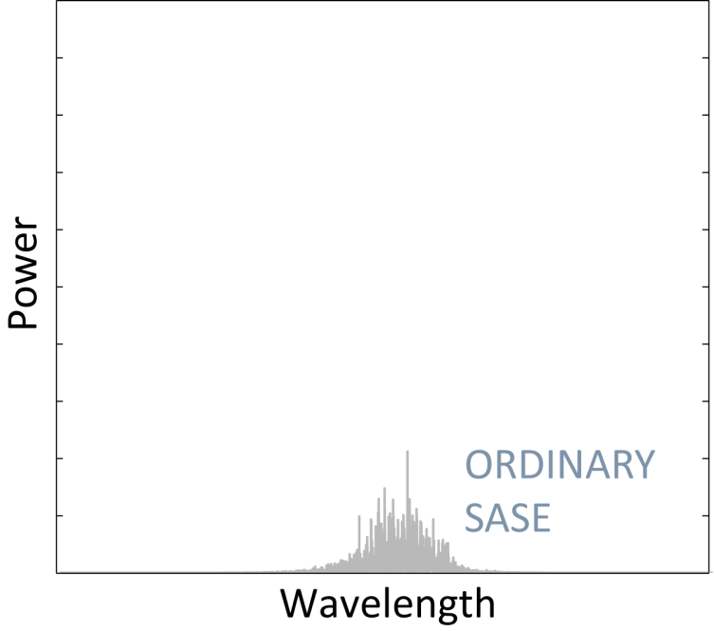
What will CLARA be able to do?
Example: Reducing the spread of wavelengths
Prove that a new idea called HB-SASE actually works
  Could then build it in from the start of the UK FEL
Will work at any wavelength and any repetition rate, no fancy optics required!
NORMAL FEL
B.W.J. McNeil, N.R. Thompson & D.J. Dunning, PRL 110, 134802 (2013)

Slide 9
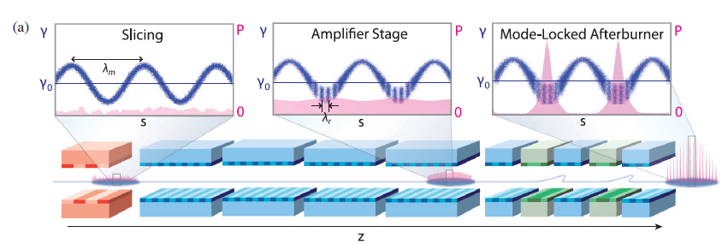
What will CLARA be able to do?
Example: Generate few cycle pulses
Prove that a new idea called Mode-locked afterburner actually works
  Could then build it in from the start of the UK FEL
  Able to probe ever faster processes (sub-attosecond)
D.J. Dunning, B.W.J. McNeil, & N.R. Thompson PRL 110, 104801 (2013)

Slide 10
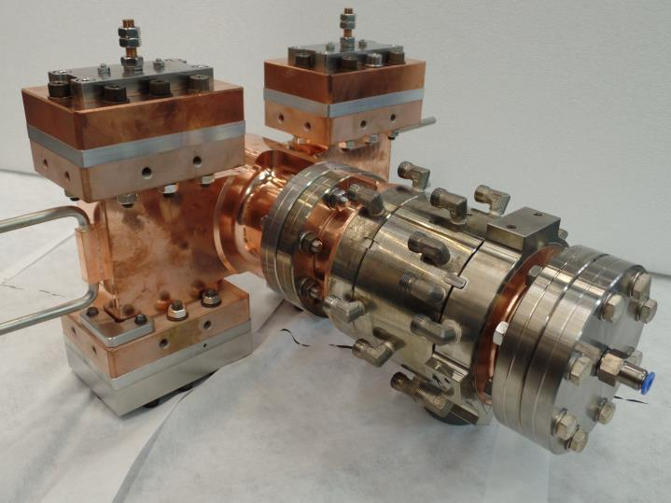
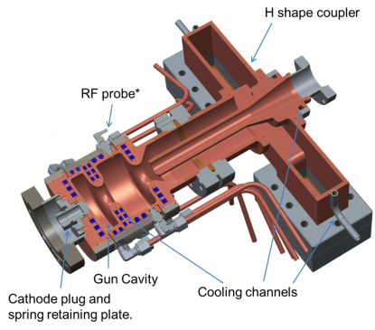
What will CLARA be able to do?
Example: Prove performance of 400 Hz Photoinjector Prototype
1.5 cell S-band gun with RF probe designed and fabricated
Maximum gradient of 120 MV/m @100 Hz, or 100 MV/m @400 Hz (10kW cooling capacity)
Vacuum load lock system for easy replacement of cathode
Will be installed April 2016

Slide 11
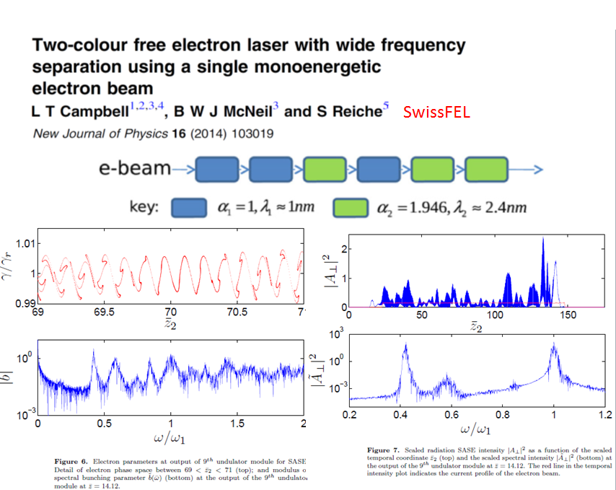
Brian McNeil, STFC/IoP Towards a UK XFEL Workshop, Feb 2016

Slide 12
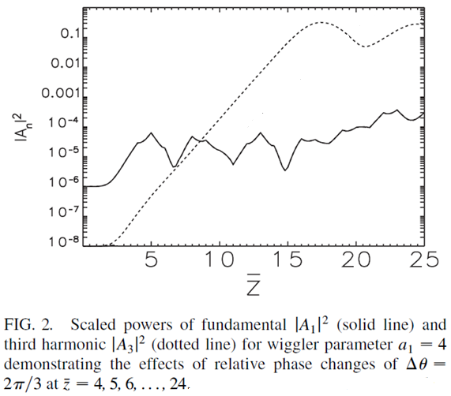
Harmonic Lasing in a FEL
Seeded at fundamental
*McNeil, Robb, Poole & Thompson, PRL 96, 084801 (2006)
Schneidmiller & Yurkov, PRST-AB 15, 080702 (2012)
Penn, PRST-AB 18, 060703 (2015)
DESY
LBNL
Brian McNeil, STFC/IoP Towards a UK XFEL Workshop, Feb 2016

Slide 13
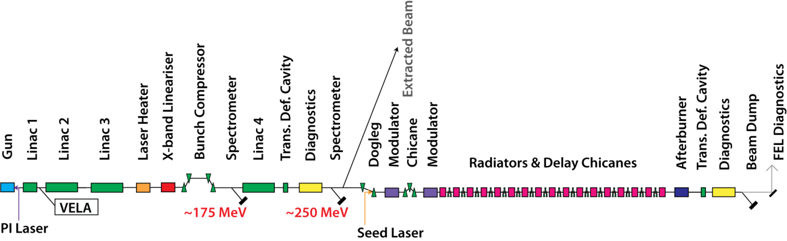
CLARA Schematic & Project Phases
Phase 1, 50 MeV, 2016
Phase 2, 250 MeV, 2018
Phase 3, 100nm SASE, 2020

Slide 14
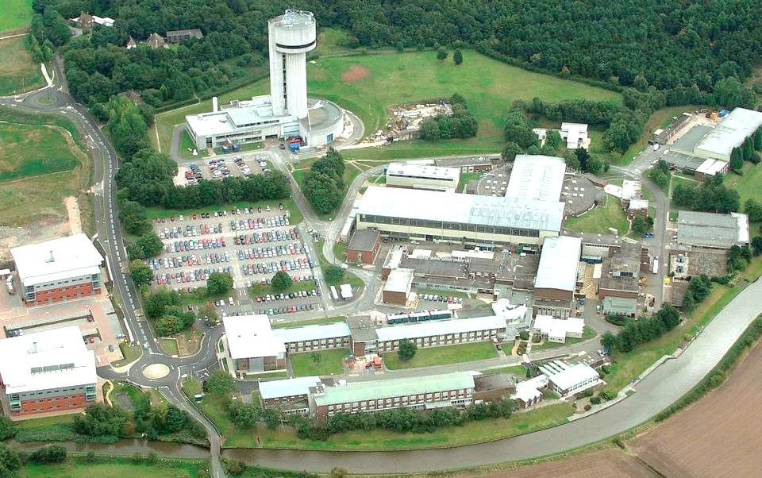
Where is CLARA being built?
~100m
CLARA

Slide 15
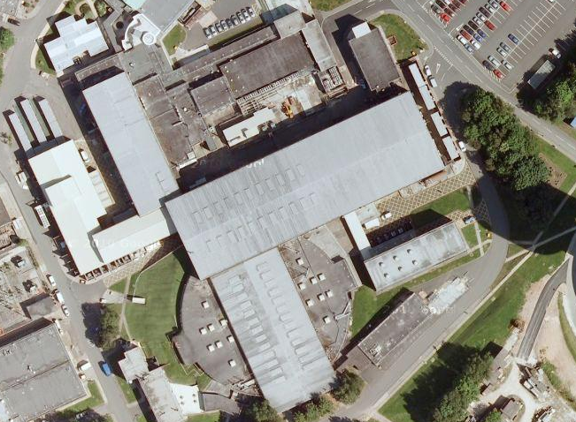
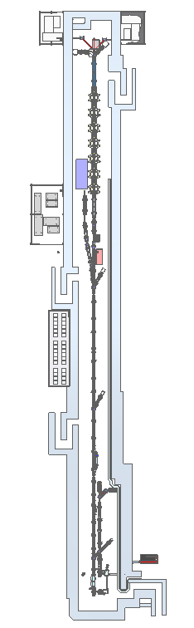
CLARA in the Electron Hall

Slide 16
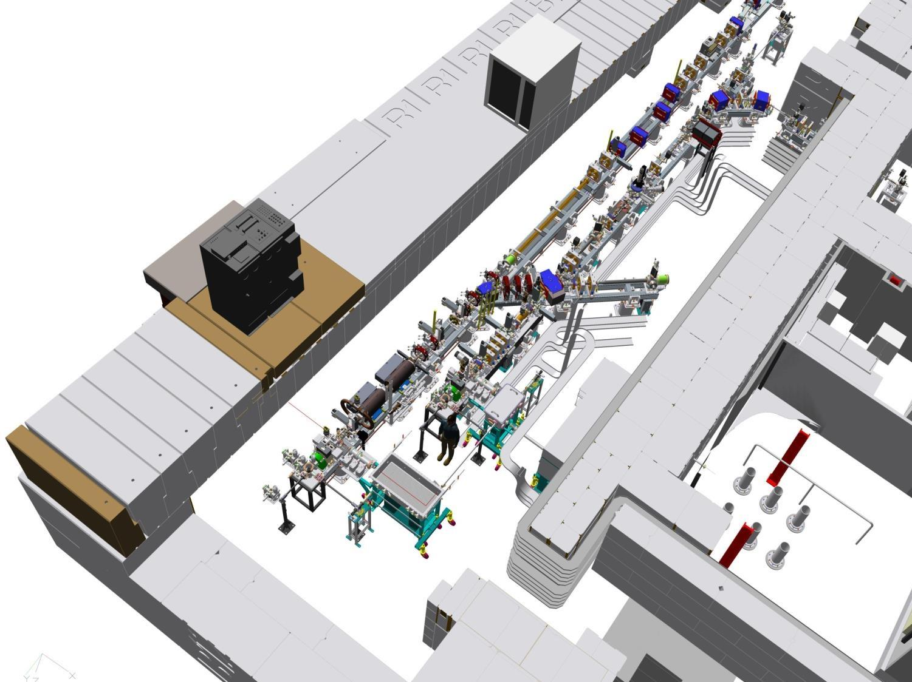


Variable Bunch Compressor (VBC)
CLARA build phase 1
2015/16
Installation started November 2015
Engineering Technology Centre
Laser Heater Stage
Accelerating Linac2 S-Band 70MeV
Dump
VELA
Collimator & YAG diagnostics
Accelerating Linac1 S-Band 35MeV
High Rep Rate Gun
CLARA
Photocathode loadlock
Engineering Technology Centre

Slide 17
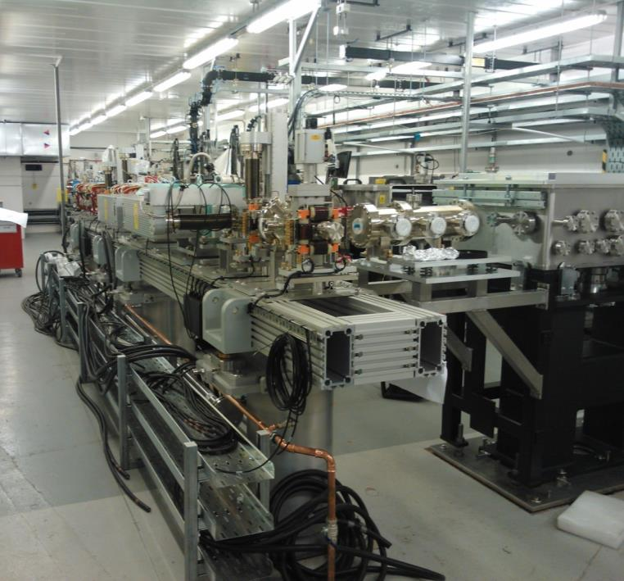
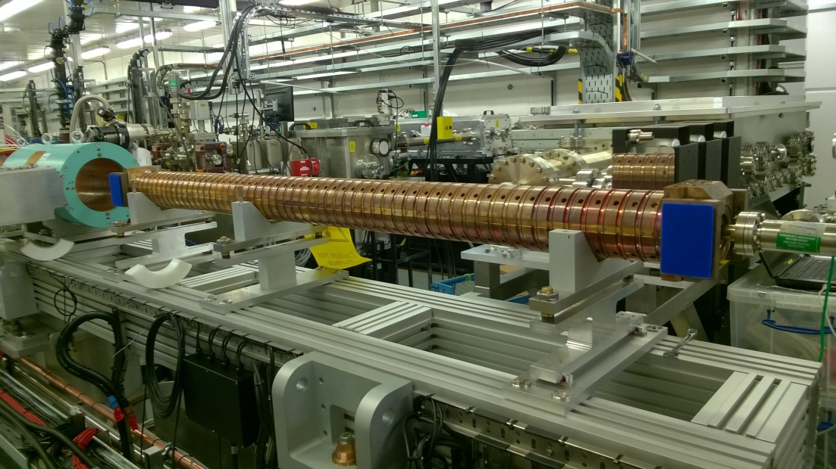
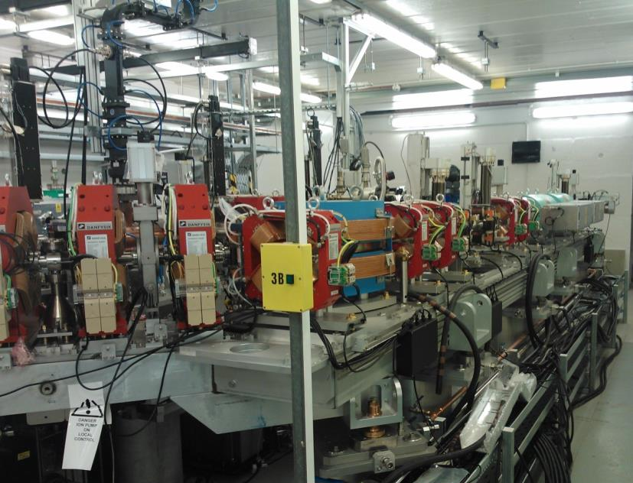
CLARA Phase 1
400Hz RF Photoinjector
Commissioning starts June 2016

Slide 18
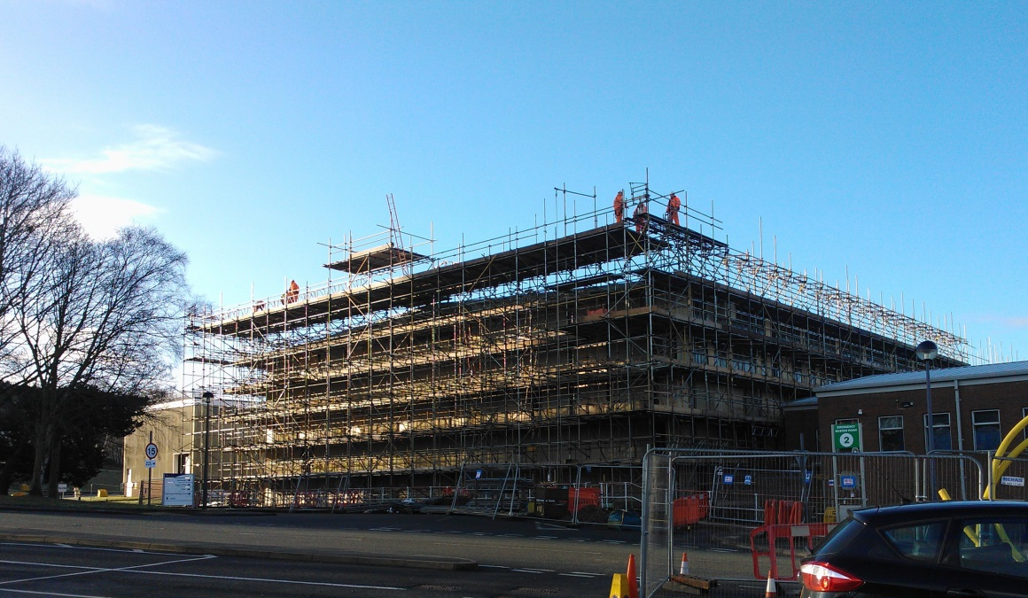
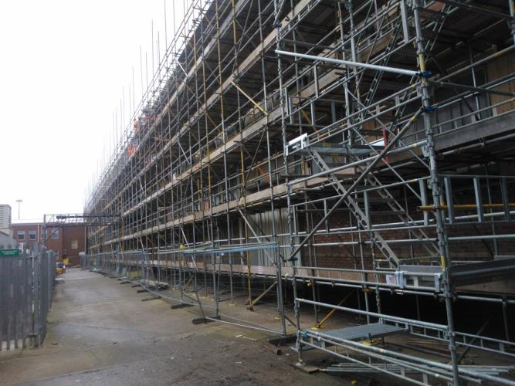
The Electron Hall
CLARA is currently being installed in the Electron Hall
The Electron Hall is not fit for purpose so is being upgraded
  Since we want to build a very stable FEL, we need the temperature of the facility to also be very stable
  Currently the temperature within the building varies by at least 15 °C over the year
  Refurbishment will reduce this to only ±1 °C within the building
  Within the shielded enclosure it will be ±0.05 °C

Slide 19
UK X-FEL R&D Planning
The accelerator community is generating a UK FEL R&D programme to develop the skills and technology required so that when we get the green light for the UK X-ray FEL facility we are ready to make well informed decisions on layout and have solutions to all major technical issues
The plan has received input from ASTeC, CI, DLS, & JAI
The six goals identified will need to be confirmed after the STFC FEL strategy is published and digested
The heart of the R&D programme will be the detailed design, assembly, commissioning, development, and exploitation of the CLARA FEL Test Facility
A very important aspect of the overall programme will be strong connections to the potential FEL user community.

Slide 20
Agreed FEL R&D Goals
Colour coded to highlight where CLARA is impacting on achieving these goals
#1: Gun development
Optimised electron source:
- designs for minimum emittance at low charge, minimum emittance at high charge etc.
#2: RF
- RF frequency choice
- Low level and high level RF control and stability
- RF structure design & optimisation
- Economic optimisation of accelerating gradient
Multibunch operation
#3: Electron Beam Transport Simulation and Optimization
Delivering appropriate quality electron bunches at the entrance to the FEL and transporting through the FEL:
- Start to end simulations from cathode to FEL, optimizing performance and stability
- Understanding and mitigating (or potentially exploiting) collective effects such as space charge, wakefields, and CSR
- Alignment and tuning strategies within the FEL
- Beam switching between FELs (slow and fast)

Slide 21
Agreed FEL R&D Goals
#4: FEL Output Simulation and Optimization
Critically examine potential FEL output performance enhancements over current generation of X-ray FELs:
- Achieving the best FEL output stability shot to shot (intensity and wavelength).
- Generation of flexible FEL output pulse structures (eg two colour, two pulse, …).
- Generating ultra-short photon pulses (sub fs).
- Generating transform limited FEL output (time-bandwidth product).
Other potential enhancements (higher peak power, generating useful high harmonics of fundamental, polarisation control, …)
#5: Electron & Photon Diagnostics
- Bunch (slice) measurements at all charge levels
- Transverse and longitudinal profiles (e.g. cSPR, …)
- Diagnostic for ultra-low charge operation, (cavity BPM)
- Feedback systems (trajectory, optics, energy, charge, …)
FEL pulse wavelength, pulse length, profile, etc.
#6: Synchronisation
Achieving sub-10 fs synchronisation between the FEL output and an external laser:
- Timing distribution and synchronisation of essential systems.
- Measuring synchronisation level between FEL output and external laser.
- Measuring electron bunch arrival time.
- Minimising electron bunch jitter through passive or active schemes.

Slide 22
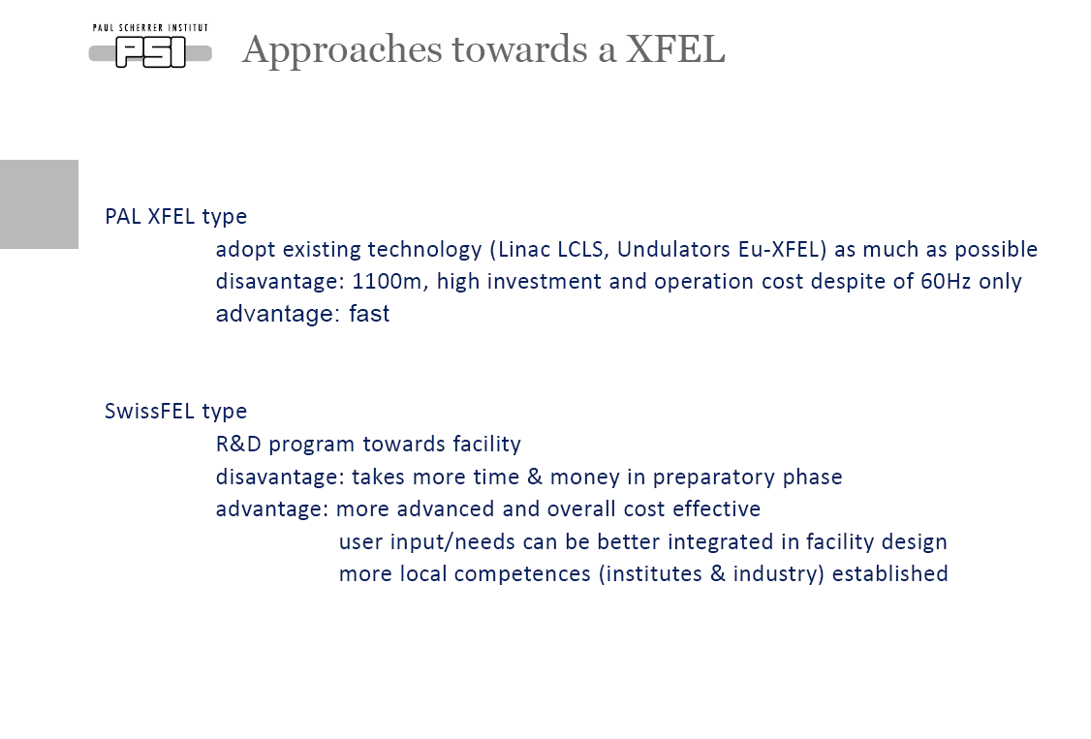
Hans Braun (PSI), STFC/IoP Towards a UK XFEL Workshop, Feb 2016

Slide 23
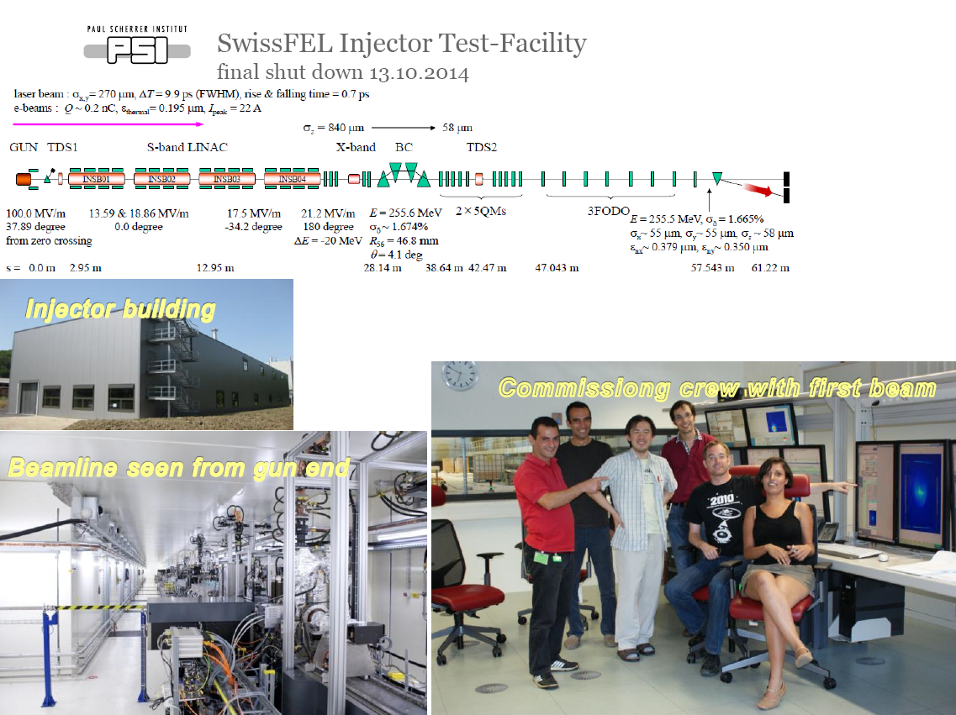
Hans Braun (PSI), STFC/IoP Towards a UK XFEL Workshop, Feb 2016

Slide 24
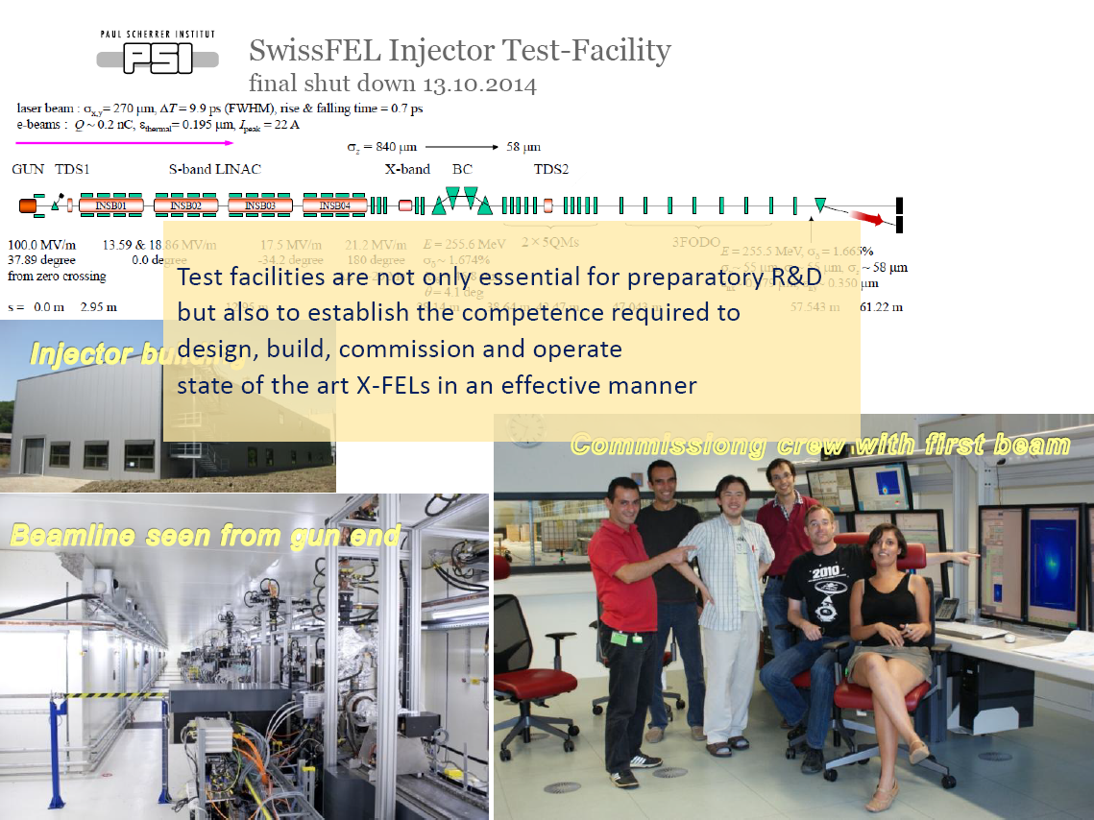
Hans Braun (PSI), STFC/IoP Towards a UK XFEL Workshop, Feb 2016

Slide 25
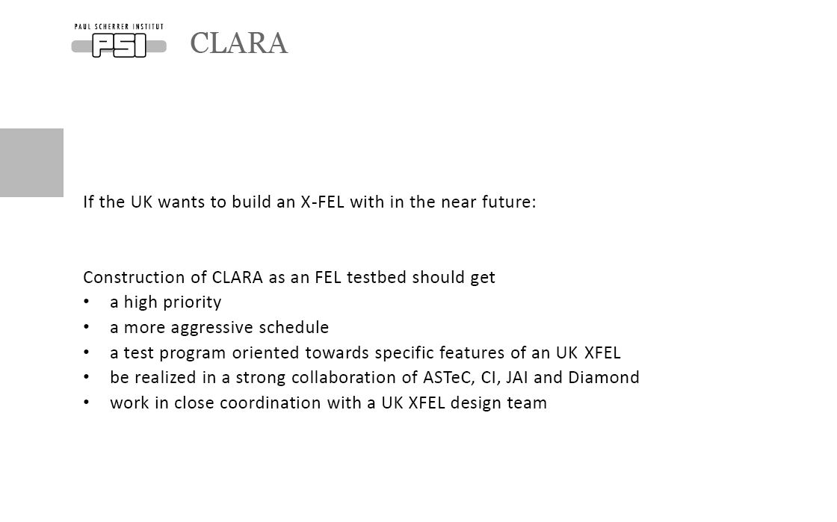
Hans Braun (PSI), STFC/IoP Towards a UK XFEL Workshop, Feb 2016

Slide 26
Goals for FEL related R&D
Support an UK XFEL Collaborative Programme Aimed at Delivering World-class FEL Science within the Next Decade
  UK-XFEL Facility Specification
  Critical FEL R&D Challenges
    CLARA FEL test facility
  UK XFEL Design, Prototyping and Delivery
World-class Facility
UK “FEL” Science Community
National Labs
Accelerator Institutes/Uni
Industry
Susan Smith, STFC/IoP Towards a UK XFEL Workshop, Feb 2016

Slide 27
Summary
The STFC aspiration for a UK X-FEL is clear
The accelerator and FEL community has agreed a number of FEL R&D goals
  Gun development
  RF Issues
  Electron Beam Transport Simulation and Optimization
  FEL Output Simulation and Optimization
  Electron & Photon Diagnostics
  Synchronisation
CLARA will be at the heart of the FEL R&D programme
  Front End installation has started
  Procurement of remaining items for CLARA is ongoing
  Electron Hall refurbishment is well underway
  First lasing in 2020
There is an opportunity for all members of our community to contribute to this exciting application of particle accelerators

