Slide 1
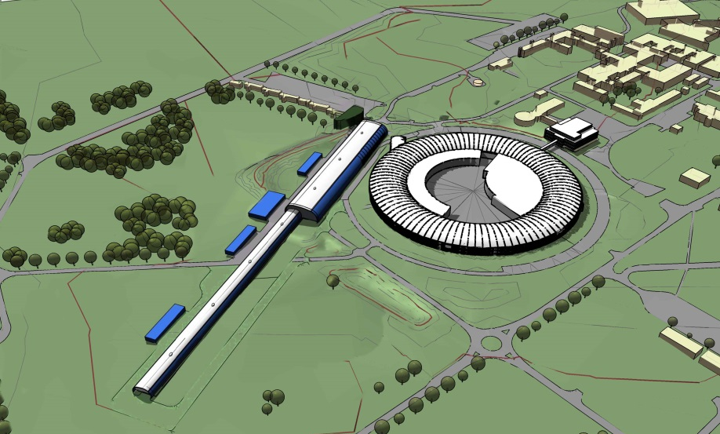
The FEL Review ... and Beyond
R.P. Walker, Diamond Light Source
IoP Particle Accelerators & Beams Group
Annual Conference
University of Huddersfield, 8th April 2016

Slide 2
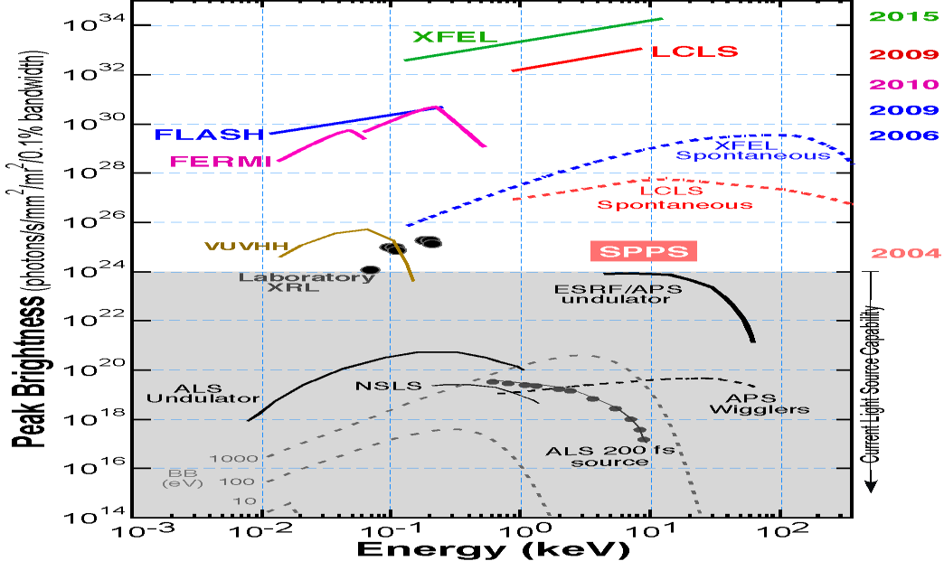
Hard X-ray FELs provide photon characteristics that enable transformative science
exceptional peak brightness
wide tuning range to > 10 keV
fs, to sub-fs, pulses
high degree of spatial and temporal coherence
two pulse, two colour operation
fs synchronisation to external lasers
x10⁹

Slide 3
Current X-ray FEL Science Highlights
Current X-ray FEL Science Highlights
Structural dynamics of physical, chemical and biological processes at the atomic scale (“molecular movies”)
Matter at extreme conditions
Nanostructure imaging
Serial nano-crystallography
courtesy of Jon Marangos

Slide 4
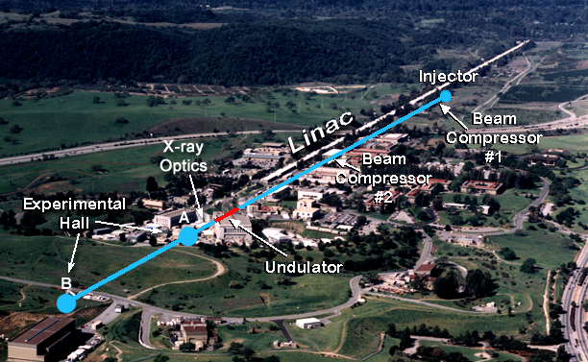
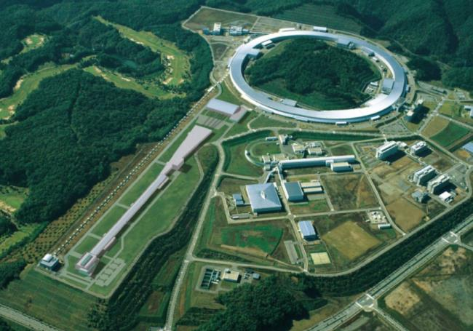
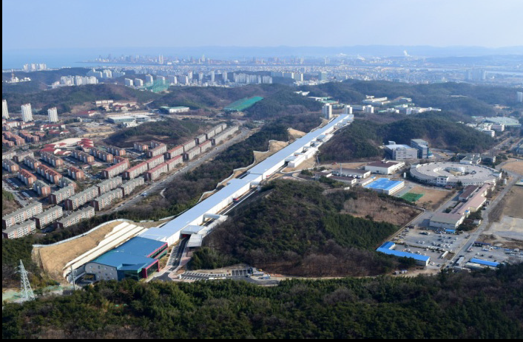
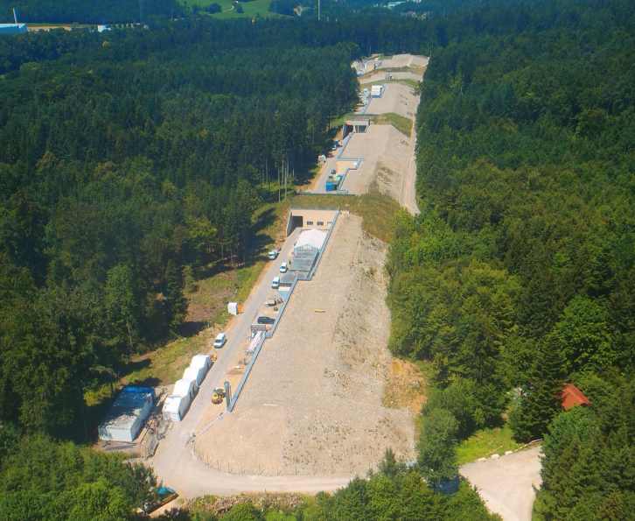
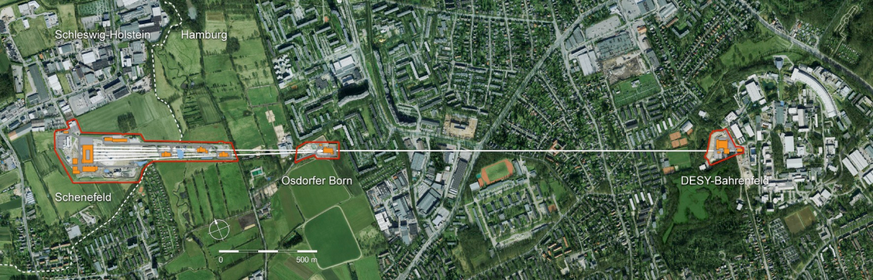
Hard X-ray FELs
LCLS, USA – 2009
SACLA, Japan – 2011
PAL XFEL, Korea – 2016/17
SwissFEL – 2016/17
European XFEL, Germany – 2016/17

Slide 5
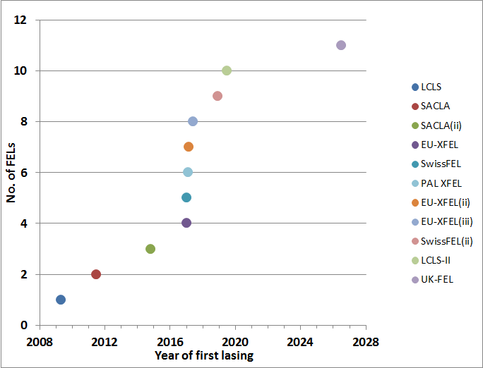
UK-FEL ?

Slide 6
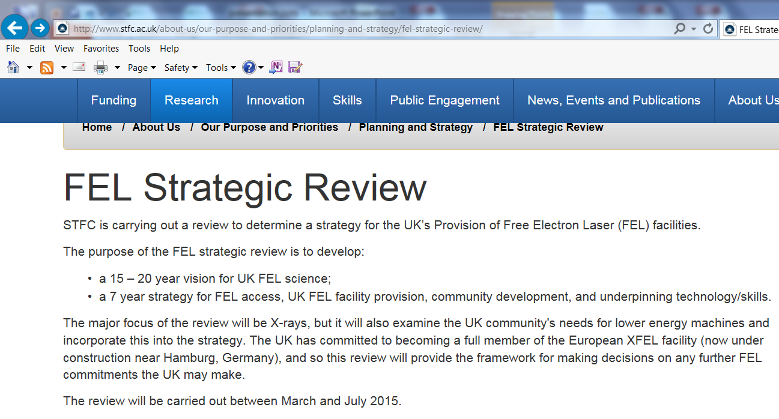
http://www.stfc.ac.uk/about-us/our-purpose-and-priorities/planning-and-strategy/fel-strategic-review/

Slide 7
The Panel:
Tony Ryan (Chair) | U. Sheffield
Gabriel Aeppli | PSI
Massimo Altarelli | EU-XFEL
David Brown | U. Kent
Richard Catlow | UCL
Elspeth Garman | U. Oxford
Peter Henderson | U. Leeds
Malcolm McMahon | U. Edinburgh
Jon Marangos | Imperial
Jim Naismith | U. St. Andrews
Richard Walker | Diamond Light Source

Slide 8
as presented to STFC Science Board 11.02.16
Executive Summary
“The UK needs to increase its investment in XFEL.EU …. recognising that there will be the need for a UK FEL facility in the future ”
“To better equip the UK to exploit FELs, the user community of UK scientists should be developed …. Coordinated measures to boost and strengthen the UK scientific community in XFEL science are essential ”
“Capability in key areas of underpinning technology will also be further developed ”
“In the long term, the UK’s capacity requirements will be best served by constructing a UK FEL facility,”
“Doing nothing is not an option. FEL science is advancing rapidly: the UK has a competitive position based on facility use elsewhere, and must invest in this area in order to exploit science opportunities and take a key role in the international community in this exciting field.”

Slide 9
Type of Machine:
“In order to address the majority of the key science challenges, a UK facility would need to deliver hard X-rays. To further broaden the range of science which could be tackled, the ideal machine would also have a high repetition rate. However, this is likely to be unaffordable as a national facility, so a best compromise specification will need to be defined to fit UK science. This is expected to be an enhanced SwissFEL like facility: a high-energy non-superconducting X-ray FEL.”
“The UK has a unique opportunity to co-locate an X-ray FEL with the state-of-the-art ultrafast, high-energy and high-powered auxiliary laser sources currently located at the Harwell Campus. This would equip the UK with world-leading facilities for creating and probing matter at extreme conditions, unmatched by any equivalent facility in the foreseeable future.”

Slide 10
Timescales:
“STFC should be in a position to take the final decision on whether to build an X-ray FEL in the UK, and what kind of machine to build, in five years”
“The time taken from fully committing to the construction of a UK FEL facility to it being operational is likely to be at least six years. The final decision on whether to build an X-ray FEL in the UK and to what specification to build could be taken in five years, around 2020.”

Slide 11
.. so in the meanwhile ...
“To prepare for this decision in five years’ time the following actions are recommended in parallel with the development of the community:
initiate a programme to define the specification that is required and prepare preliminary costings;
develop a fully coordinated FEL R&D programme, building upon existing expertise in the following areas:
  accelerators;
  detectors;
  lasers and auxiliary light sources;
  diagnostics;
  sample environment and target delivery;
  simulation, control, data acquisition, data analysis, and storage.
strategically plan the development of the skills base required to deliver the necessary technologies.”

Slide 12
Feedback from STFC Science Board: (extracts relevant to machine design)
2.15.3 Science Board requested that the specification for the optimum UK FEL facility be provided as part of the context. This could then be compared with the suggested “Swiss-FEL plus” facility. Science Board suggested that the report should not be too prescriptive about the specification for the facility, given that technology would continue to develop…
2.15.4 Science Board requested that a decision point in ~2020 should be explicit in the text and in all diagrams. It should be articulated clearly that further assessment was required before any decision, for example, to evaluate that a sufficiently large FEL community had emerged, that the science case was sufficiently strong and the costing was robust; (my emphasis)
2.15.8 Science Board asked that the evidence for co-location of the UK facility with CLF at RAL be more explicit and further aligned with the indicative design characteristics of the machine…

Slide 13
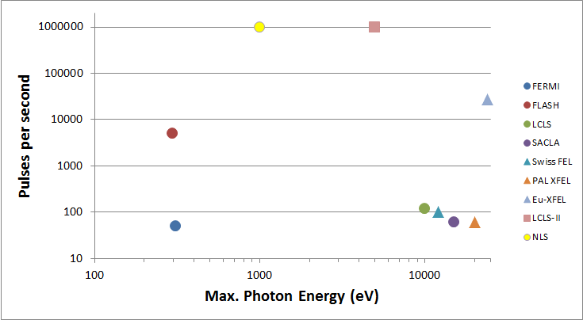
Three basic accelerator technologies:
cw superconducting RF
(equi-spaced pulses)
pulsed superconducting RF
(non equi-spaced pulses, “burst mode”)
normal conducting RF
(equi-spaced pulses)

Slide 14
With a strong influence on cost…
“Not affordable” †
“Affordable”†
† “affordable”, according to earlier indications, means ≤ ~ £500m (incl. VAT)

Slide 15
Possible Options
Soft X-rays at high rep. rate or Hard X-rays at low rep. rate ?
~2-3 keV at 1 MHz … “updatedNLS” ?
~5 keV at 27 kHz … “superFLASH” / “miniXFEL” ?
(burst mode - same time structure as FLASH/XFEL)
~10-15 keV at 100 Hz … like SwissFEL/SACLA/PAL-XFEL
Or possibly a combination ?
~350 eV at 1 MHz (“cw FLASH/FERMI”) + ~10 keV at 100 Hz (“SwissFEL”)

Slide 16
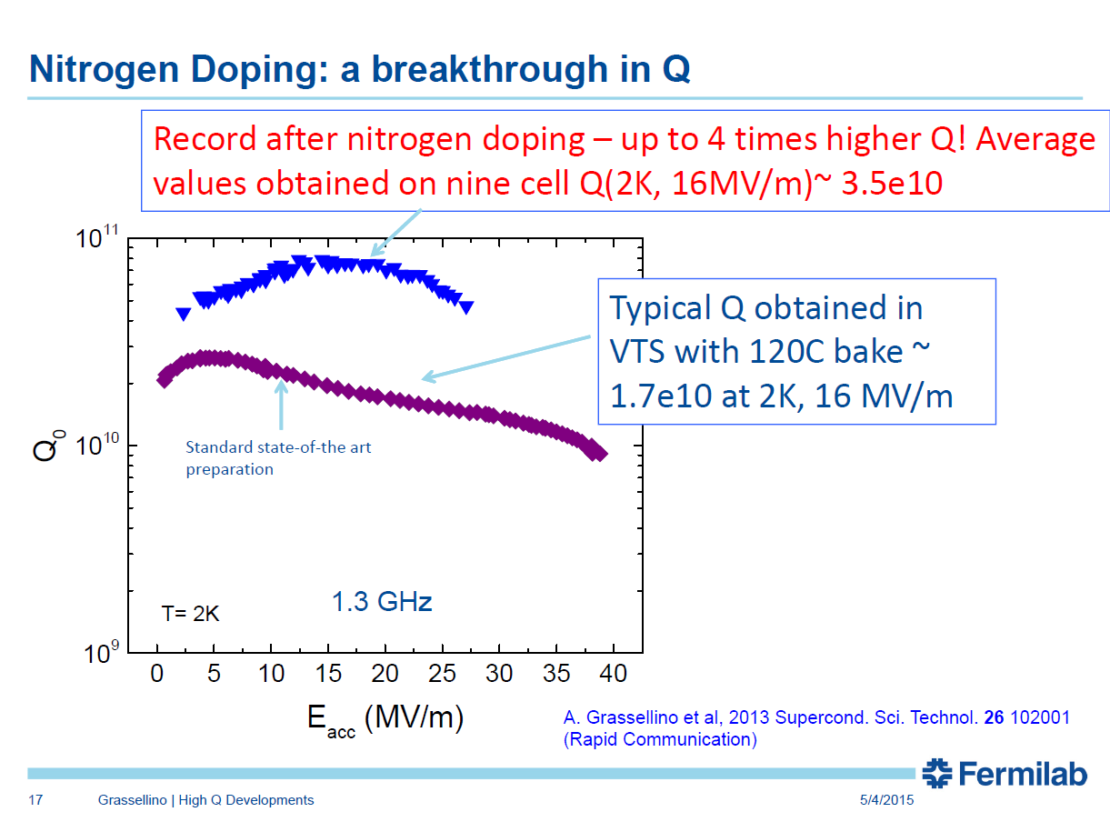
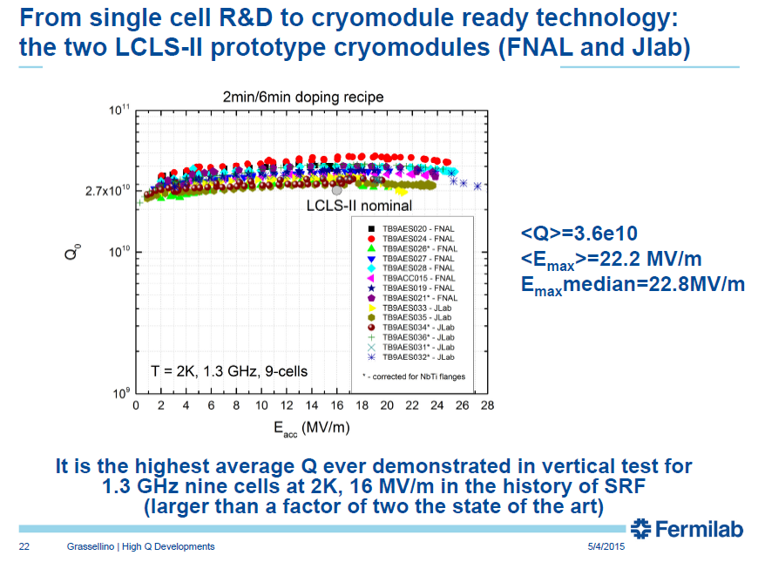
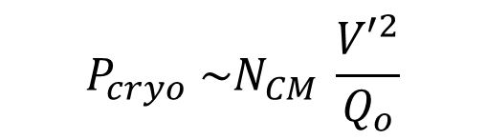
But hasn’t superconducting technology improved since NLS …?
Yes it has …
see for example,
A. Grassellino, IPAC 2015
$$P_{cryo} \sim N_{CM} \frac{{V′}^{2}}{Q_{o}}$$

Slide 17
.. but not that much …
- that’s why LCLS-II is limited to 4 GeV and 5 keV photon energy,
(and why they are going for a massive 2 x 4 kW @2K cryoplant)
Cryo- Module | T (K) | Q_{o} (10¹⁰) | N_{CM} | V’ (MV/m) | E (GeV) | e (keV)
NLS | 1.8 | 2.0 | 18 | 15 | 2.25 | 1
LCLS-II | 2 | 2.7 | 18 | 18.3 | 2.73 | 1.5
LCLS-II | 1.8 | 4.0 | 19 | 20 | 3.19 | 2.0
LCLS-II + | 1.8 | 5.1 | 21 | 20 | 3.43 | 2.3
LCLS-II s/c technology, for approx. the same total cost, would bring NLS to ~ 3.2-3.4 GeV and hence increase peak fundamental photon energy from 1 keV to 2.0-2.3 keV.

Slide 18
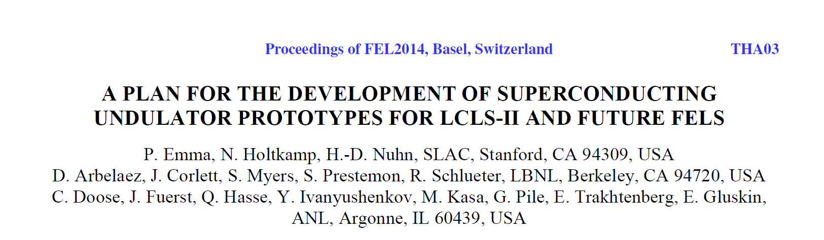
And what about undulators ?
SwissFEL has chosen in-vacuum undulators with an “aggressive” 4.7 mm minimum gap (and very limited tunability).
LCLS-II has chosen a conventional undulator with 7.2 mm gap,
… but is still supporting R&D on superconducing undulators:

Slide 19
What would these do for NLS?
Take these designs, adjust period length to get K=2 - to give x2 tunability in photon energy - and determine maximum photon energy (at K=1);
compared to 1 keV maximum in NLS
Undulator type | period (mm) | min. gap (mm) | Kmax | max. photon energy (keV) @ 2.25 GeV
LCLS-II | 23.5 | 7.2 | 2.0 | 1.36
SwissFEL in-vacuum | 19.8 | 4.7 | 2.0 | 1.61
LCLS-II SCU NbTi | 16.4 | 5.7 | 2.0 | 1.94
LCLS-II SCU Nb₃Sn | 15.0 | 5.7 | 2.0 | 2.14

Slide 20
What would these do for NLS?
Take these designs, adjust period length to get K=2 - to give x2 tunability in photon energy - and determine maximum photon energy (at K=1);
compared to 1 keV maximum in NLS
Undulator type | period (mm) | min. gap (mm) | Kmax | max. photon energy (keV) @ 2.25 GeV | max. photon energy (keV) @ 3.19 GeV
LCLS-II | 23.5 | 7.2 | 2.0 | 1.36 | 2.73
SwissFEL in-vacuum | 19.8 | 4.7 | 2.0 | 1.61 | 3.25
LCLS-II SCU NbTi | 16.4 | 5.7 | 2.0 | 1.94 | 3.92
LCLS-II SCU Nb₃Sn | 15.0 | 5.7 | 2.0 | 2.14 | 4.29

Slide 21
What would these do for NLS?
Take these designs, adjust period length to get K=2 - to give x2 tunability in photon energy - and determine maximum photon energy (at K=1);
compared to 1 keV maximum in NLS
Undulator type | period (mm) | min. gap (mm) | Kmax | max. photon energy (keV) @ 2.25 GeV | max. photon energy (keV) @ 3.19 GeV | max. photon energy (keV) @ 3.43 GeV
LCLS-II | 23.5 | 7.2 | 2.0 | 1.36 | 2.73 | 3.16
SwissFEL in-vacuum | 19.8 | 4.7 | 2.0 | 1.61 | 3.25 | 3.76
LCLS-II SCU NbTi | 16.4 | 5.7 | 2.0 | 1.94 | 3.92 | 4.53
LCLS-II SCU Nb₃Sn | 15.0 | 5.7 | 2.0 | 2.14 | 4.29 | 4.97

Slide 22
Conclusion:
Even with the most advanced superconducting RF and the most advanced superconducting undulator, using Nb₃Sn technology, an “affordable” cw machine will still only reach ~ 5 keV in the fundamental.

Slide 23
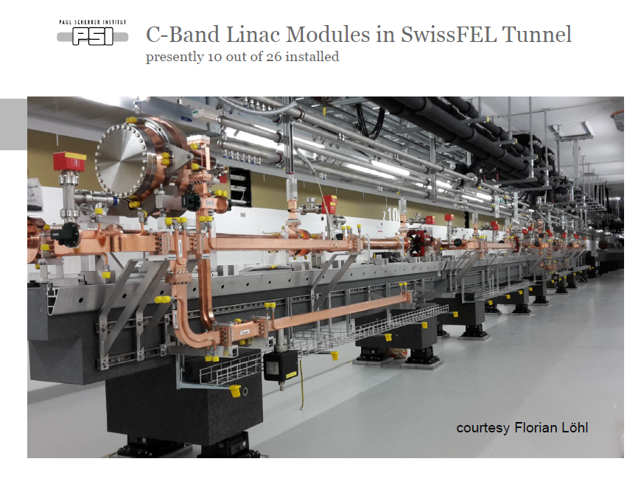

So what’s the alternative ? – Normal Conducting RF
$$P_{av.} \sim \frac{E^{2} f}{R^{′} L }$$
where, :
P_{av.} = power consumption (MW)
E = linac energy (GeV)
f = repetition frequency (Hz)
L = active length (m)
R’ = effective impedance (MΩ/m)
Effective Impedance
SwissFEL 168 MΩ/m
SACLA 125 MΩ/m
LCLS 56 MΩ/m
C-band (SACLA, SwissFEL) is 2-3 times more efficient than S-band (LCLS, PAL)
courtesy of H.Braun, PSI

Slide 24
What improvements can be made with respect to SwissFEL ?
SwissFEL CDR:
“The tuning is primarily done by the electron beam energy. However, this implies the possibility of only a single hard X-ray beamline in any future extension of the facility, due to the coupling of the FELs through the electron beam energy.”
⇒ increase beam energy to gain tuneability through undulator gap variation to allow multiple high energy FELs
Increased beam energy also helps improve peak power and no. of photons per pulse.

Slide 25
Possible parameters for UK-FEL
e-beam
500 MeV
8.7 GeV
RF-GUN
1.2 GeV
■
S01 S02 S03
X01
50 m UNDULATOR
BC1
S04 S05 S06
BC2
S07 S08 ...
~500 m
Energy 8.7 GeV
Repetition rate 100 Hz (each FEL)
Max. photon energy ~ 18.6 keV
Pulse duration 20-30 fs
Photons/pulse (10 keV) ~ 10¹²
No. of FELs up to 4 (?)
Possible FELs SXR (0.1 – 2 keV)
MXR (1.5 – 6 keV)
HXR (5 – 15 keV)
Experimental stations 3 per FEL
Facility length ~ 850 m
Power consumption ~ 7MW
tapering to increase pulse power
self-seeding to increase conherence
preliminary calculations by R. Bartolini, I. Martin, DLS

Slide 26
Many concepts have already been proposed/tested (at LCLS)
- tapering, self-seeding + tapering …
- seeding & harmonic schemes, self-seeding, single spike, pSASE, iSASE, HB-SASE …
- slotted foil, laser slicing schemes, various combinations of chirping, laser modulation and self seeding, mode-locked pulse train schemes etc. etc.
double laser pulse, double-slotted foil, double undulator schemes etc.
RF stability improvements, better diagnostics, stabilisation schemes etc.
Other desired enhancements
increased peak power (~TW) and photons/pulse (~10¹³)
improve temporal coherence and pulse shape uniformity
sub-fs / attosecond pulses
two-pulse and two-colour operation
reduce timing and wavelength jitter; improve laser & FEL synchronisation
New ideas are continually emerging and we need to be ready to study, and if possible, test them to assess the benefits and implications of including them in UK-FEL.

Slide 27
Conclusion
A normal-conducting “SwissFEL+” type facility looks the best overall match to the UK’s science needs, taking into account technology & cost constraints.
Timescales suggested by the FEL Review, with a decision in 2020, would lead to a facility being operational in mid 2026.
To be ready for a decision in 2020, with a robust costing, needs action to be taken soon:
- STFC to publish the FEL Review and its response
- Steering Committee to be established to oversee facility design, R&D programme, development of the science case as well as efforts to grow the UK community
- UK-FEL Design Team to be established
- R&D programme to be established
- CLARA to be developed as a UK-FEL test facility
with “a more aggressive schedule”, “in a strong collaboration of ASTeC, CI, JAI and Diamond”, “in close coordination with a UK XFEL design team” and “oriented towards specific features of a UK XFEL” †
(†H. Braun, SwissFEL Project Leader, IoP/ASB meeting, London, 16th Feb. 2016)
aiming to make UK-FEL as unique, advanced and future-proof as possible

Slide 28
FEL R&D Goals
Outcome of the meeting of accelerator experts 28 Jan 2016
#1: Gun development
Optimised electron source:
- designs for minimum emittance at low charge, minimum emittance at high charge etc.
#2: RF
- RF frequency choice
- Low level and high level RF control and stability
- RF structure design & optimisation
- Economic optimisation of accelerating gradient
Multibunch operation
#3: Electron Beam Transport Simulation and Optimization
Delivering appropriate quality electron bunches at the entrance to the FEL and transporting through the FEL:
- Start to end simulations from cathode to FEL, optimizing performance and stability
- Understanding and mitigating (or potentially exploiting) collective effects such as space charge, wakefields, and CSR
- Alignment and tuning strategies within the FEL
- Beam switching between FELs (slow and fast)

Slide 29
#4: FEL Output Simulation and Optimization
Critically examine potential FEL output performance enhancements over current generation of X-ray FELs:
- Achieving the best FEL output stability shot to shot (intensity and wavelength).
- Generation of flexible FEL output pulse structures (eg two colour, two pulse, …).
- Generating ultra-short photon pulses (sub fs).
- Generating transform limited FEL output (time-bandwidth product).
Other potential enhancements (higher peak power, generating useful high harmonics of fundamental, polarisation control, …)
#5: Electron & Photon Diagnostics
- Bunch (slice) measurements at all charge levels
- Transverse and longitudinal profiles (e.g. cSPR, …)
- Diagnostic for ultra-low charge operation, (cavity BPM)
- Feedback systems (trajectory, optics, energy, charge, …)
- FEL pulse wavelength, pulse length, profile, etc.
#6: Synchronisation
Achieving sub-10 fs synchronisation between the FEL output and an external laser:
- Timing distribution and synchronisation of essential systems.
- Measuring synchronisation level between FEL output and external laser.
- Measuring electron bunch arrival time.
- Minimising electron bunch jitter through passive or active schemes.

